Slide 1

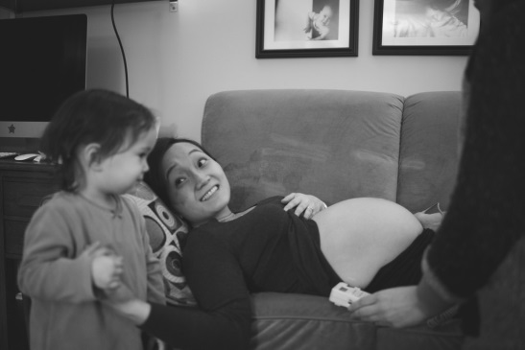

Making choice a reality: a co-designed intervention package to support
midwives in their place of birth discussions with women
Dr Beck Taylor
CLAHRC West Midlands

Slide 2
Today’s presentation
Work with Birmingham Women’s NHS Foundation Trust
  Intervention to enhance place of birth discussions
  Evaluation of intervention
  Future plans

Slide 3
Our team at University of Birmingham
Sara Kenyon
Beck Taylor
Cathy Shneerson
Laura Goodwin
Albert Farre
Ellie Jones
Jo Naylor-Smith

Slide 4
BWNFT team
Claire Cheetham, Community Matron
Place of Birth Lead Midwives
  Bubby Nagra
  Charlotte Davies
  Debbie Mawby
  Helen Hands
  Jane Duggan

Slide 5
Choice of birth place – the problem
Midwives’ role is to provide women with an informed choice of where to give birth
NICE, Intrapartum Care: care of healthy women and their babies during childbirth, National Institute for Health and Care Excellence, Editor. 2014: London.
National Maternity Review, Better births: improving outcomes of maternity services in England. A five year forward view for maternity care. 2016: UK.
BUT…
Women often don’t know the full range of birth place options
Many women consider hospital birth the “default option”
Some women (especially migrant communities) are unaware that homebirth is an option
Media presentation of childbirth/birthplace focuses on hospital and obsetric-led settings
Coxon K, Sandall J, and Fulop N.J, To what extent are women free to choose where to give birth? How discourses of risk, blame and responsibility influence birth place decisions. Health, Risk & Society 2014. 16(1): p. 52-67.
Naylor-Smith, J., What are women’s views on homebirth? A study to inform the development of practical strategies that will promote birth at home as a choice for low-risk, multiparous women. 2014, University of Birmingham: Birmingham.

Slide 6
Why aren’t all women offered choice?
Our systematic review suggests variation in what midwives told women about their place of birth options
  Due to:
  Organisational pressures
  Professional norms
  Inadequate knowledge
  Lack of confidence
  Influence of colleagues
  Personal beliefs and experiences
  Variation in service availability
  Medical or sociological outlook
Henshall, C., B. Taylor, and S. Kenyon, A Systematic Review to examine the Evidence regarding Discussions by Midwives, with Women, around their options for where to give Birth. BMC Pregnancy and Childbirth, 2016. 16(53).

Slide 7
Our Mission
To promote a genuine choice of birth setting for women
(NB not just promoting homebirth)

Slide 8
Place of Birth Study
Study Aim:
To design an intervention package to improve the quality of the discussion between midwives and women around place of birth options.
Methods:
Six focus groups with midwives, covering all community and home birth teams
- Explored the barriers to carrying out place of birth discussions with women.
- Used COM-B theory to understand influences on midwives’ behaviour.
Three workshops with midwives and women
- Agreed priority areas for change
- Created an intervention package to standardise the quality of these discussions, incorporating theory-based techniques.

Slide 9
Place of Birth Study
Results:
Study participants (n=63) agreed that standardised information on the safety, intervention and transfer rates was required.
We assessed midwife knowledge of safety and intervention rates in different settings for low risk women. Average score was on this test were 5.4/10, with self-rated midwife confidence 7.2/10.
An intervention package was co-produced by midwives at BWNFT and researchers – it had to be short, focused, and do-able.
This package included
    A training update session for midwives on place of birth
    A place of birth leaflet and script to support conversations with women
    Leadership and ongoing support through regular team meetings and appointment of a Place of Birth Lead

Slide 10
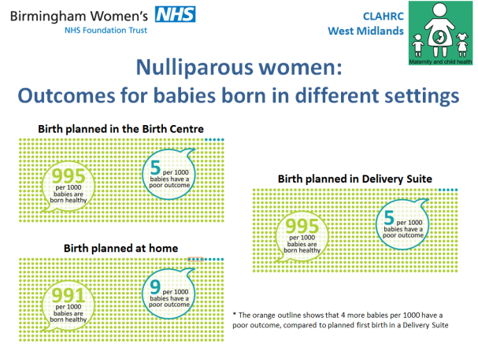
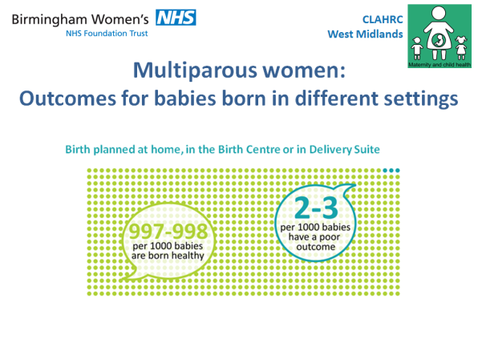
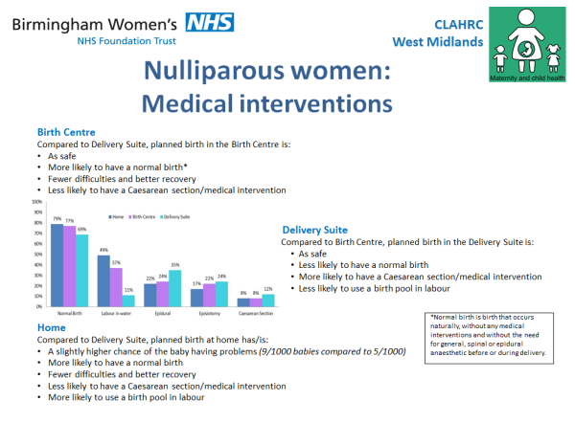
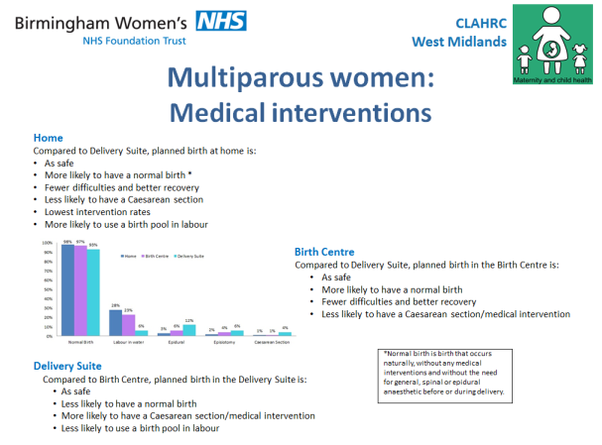
PoB Package 1) Update Session (not training!)
Session length 45mins to an hour
Delivered by midwives
Key safety and intervention facts and figures
Video examples of place of birth discussions
Uses techniques based on behaviour change theory

Slide 11
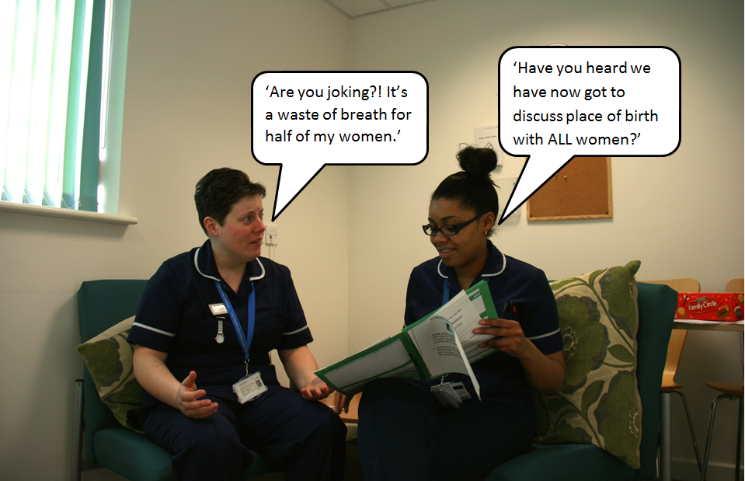
Example from the update slides…

Slide 12
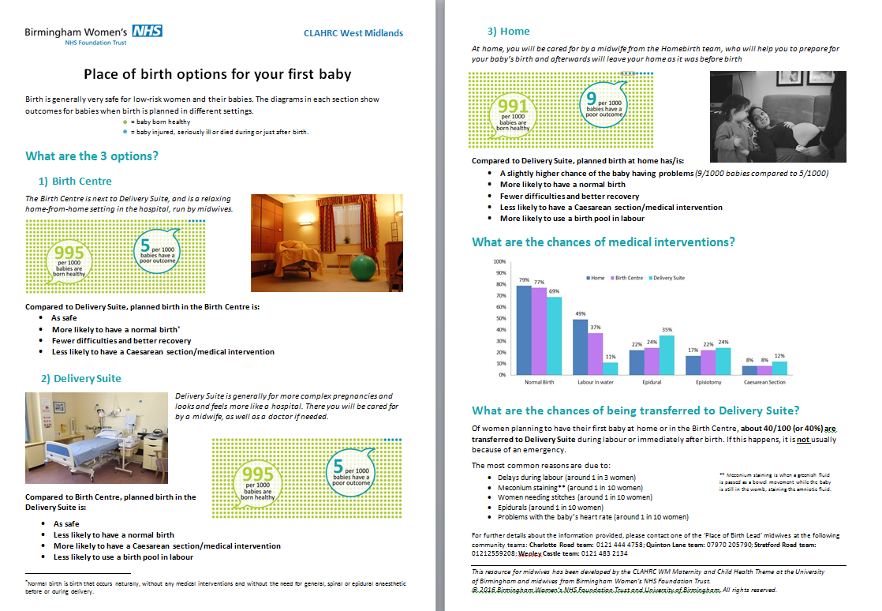
PoB Package 2) Leaflets (nullip)

Slide 13
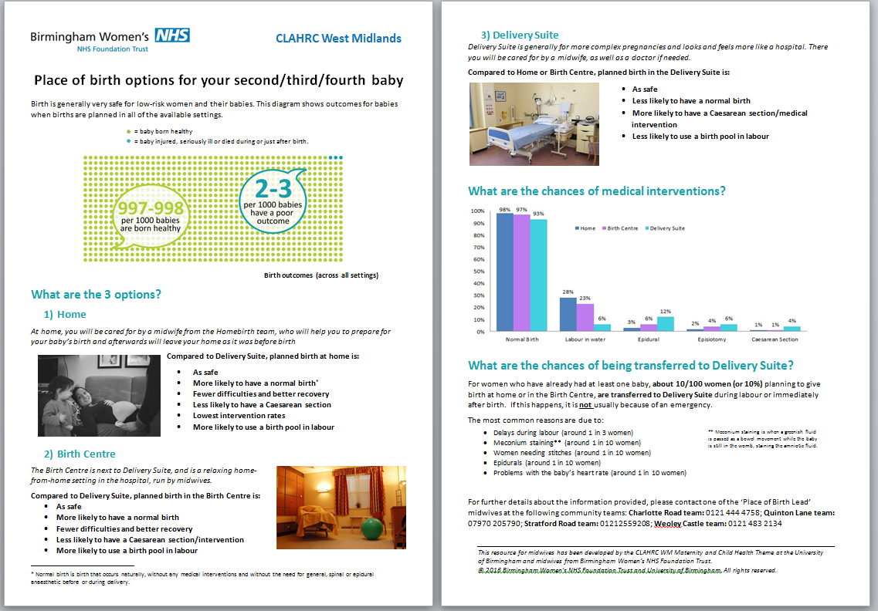
PoB Package 2) Leaflets (multip)

Slide 14
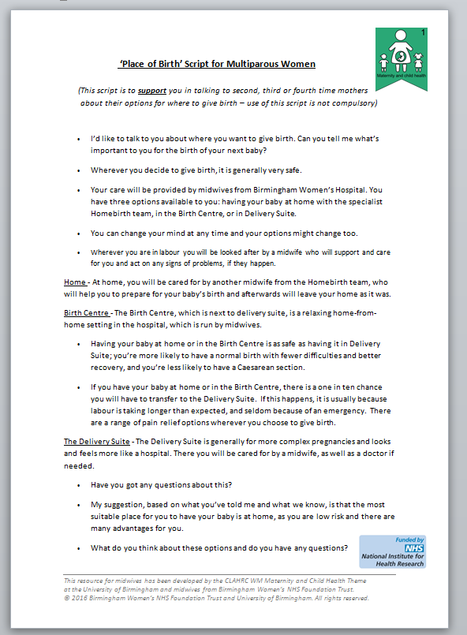
PoB Package – 2) Script
Support tool rather than prescriptive

Slide 15
PoB Package 3) Leadership and support
PoB Leads within each community midwifery team, deliver update session, plus ongoing support and monthly meetings
Some volunteers, some nominated
Trained and supported by our research team
Regular meetings and support for Leads from researchers
  Theory-informed tools including quizzes, story sharing, praise and troubleshooting

Slide 16
Evaluation at BWFNT
METHODS
Implemented in April 2016. Evaluation of this package occurred between April and September 2016 (3 months after implementation). The evaluation involved:
Questionnaires from midwives (before initial update, after initial update, and 3-4 months after initial update)
Focus groups with midwives (3-4 months after package introduced)
Interviews with Place of Birth Leads (ad hoc basis after package implementation)
Telephone surveys with women (3-4 months after package introduced)
Focus groups with women and their families (3-4 months after package introduced)

Slide 17
Evaluation findings
Midwives appreciated being involved and consulted in the research and implementation process.
Overall, the PoB package was seen as fit for purpose, with a few minor modifications.
The initial update session improved midwives’ knowledge on safety issues relating to each place of birth. Average (mean) scores:
  Pre-implementation 3.7/6
  Immediately after training 4.8/6
  3-4 months post-training 4.7/6
Self-reported confidence increased from 3/5 to 5/5 following the update session, and self-reported knowledge increased from 3/5 to 5/5.

Slide 18
Evaluation findings cont’d
Some confusion as to the intervention’s objective; whether it was to promote informed choice or to promote home birth. This tension between choice and recommendation was seen to hamper package implementation.
The PoB leaflet was seen as useful in prompting discussion and aiding communication about place of birth, and was described as user-friendly and satisfying to work with.
Midwives suggested that they would like a way to provide the information in the leaflet to women who do not speak or read English.

Slide 19
Evaluation cont’d
The script was often seen as unnecessary.
Place of birth discussions were not always happening at 16 week appointments. Midwives felt that it was important to tailor this.
Place of Birth Leads were seen as key to sustaining implementation.
Some challenges were time (most common), language barriers, women having already made up their mind about place of birth, cultural differences, and partners.
Manager buy-in was seen as important for continuation of the implementation.
Poor response rate from women – more work needed.

Slide 20
Further roll-out
Refine package
Test in other locations, prove concept
Explore long term impact and sustainability
Reduce researcher involvement – cutting apron strings
Moving beyond trust boundaries to present choice across whole health economy
Tailoring to reflect local options
Linking with wider activity on increasing choice

Slide 21
QUESTIONS

Slide 22
Contact us
  Theme Lead - Dr Sara Kenyon
    S.Kenyon@bham.ac.uk
  Clinical Research Fellow – Dr Beck Taylor
    R.Taylor.3@bham.ac.uk
  Research Fellow - Dr Laura Goodwin
    L.Goodwin@bham.ac.uk

