Slide 1
Sharing lessons learned from UKMidSS
The practicalities

Slide 2

Staying in touch…Twitter
@Berks Maternity
tweeting with
@NPEU_UKMidSS

Slide 3
Sharing learning: step 1…5-8 mins
Top 3 things that have worked well
1
2
3
Top 3 things that have not worked so well (qus & suggestions for improvement)
1
2
3

Slide 4
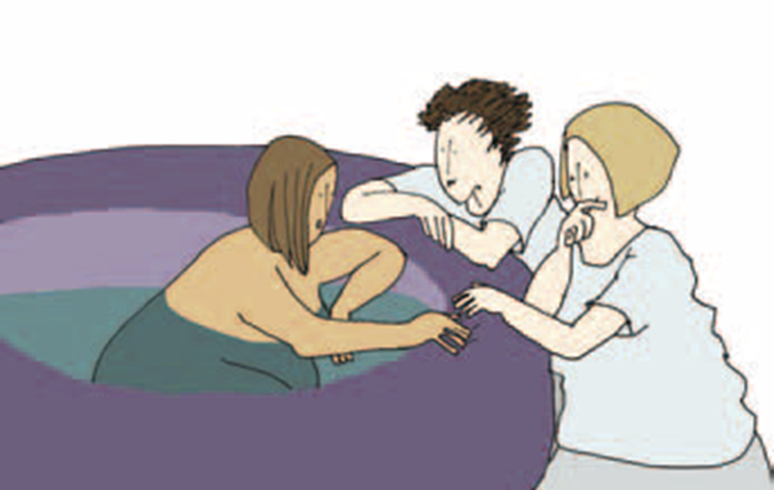

Let’s talk about it…UKMidSS practicalities
Themes
Ideas
Questions

