Slide 1


Slide 2
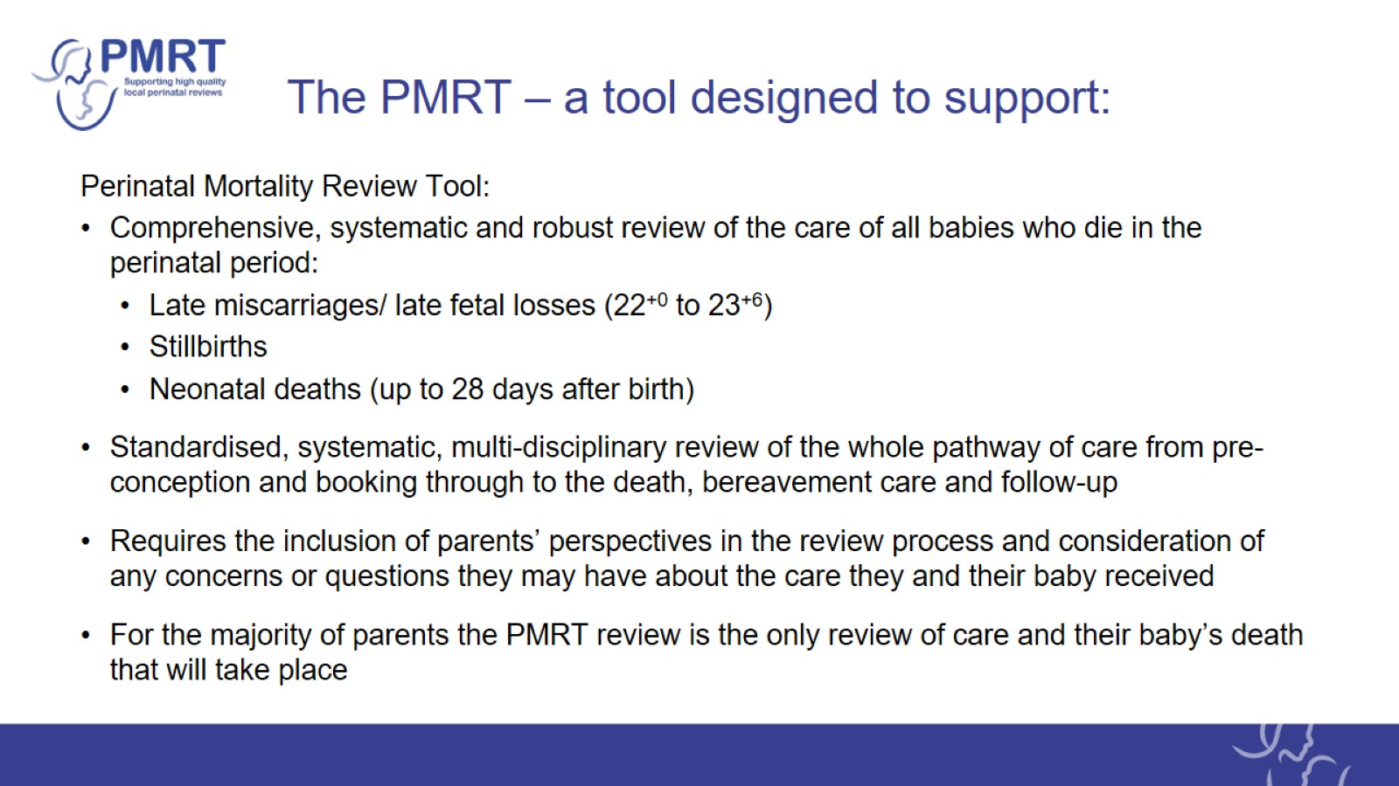
The PMRT – a tool designed to support:

Slide 3

Annual report – reviews in 2023

Slide 4
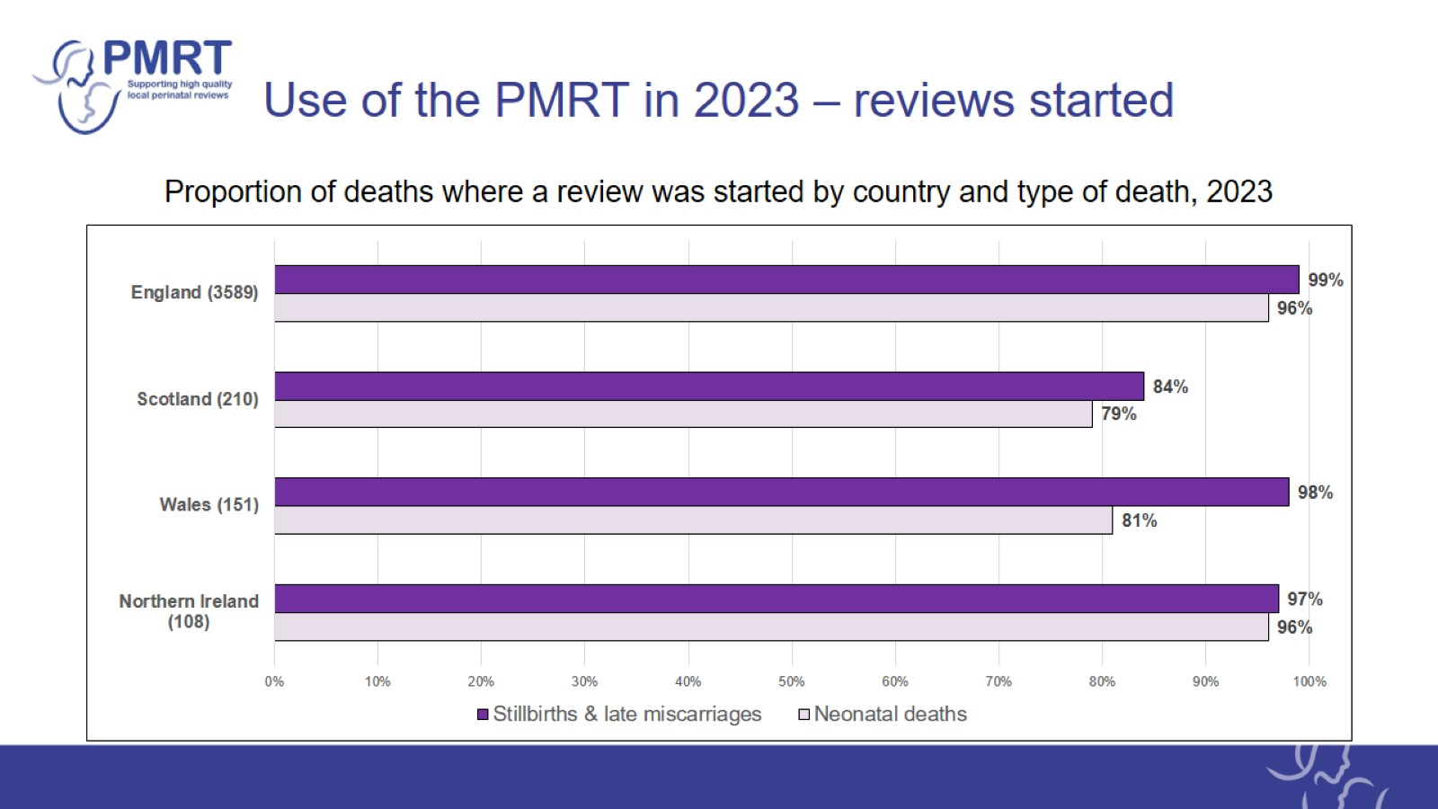
Use of the PMRT in 2023 – reviews started

Slide 5
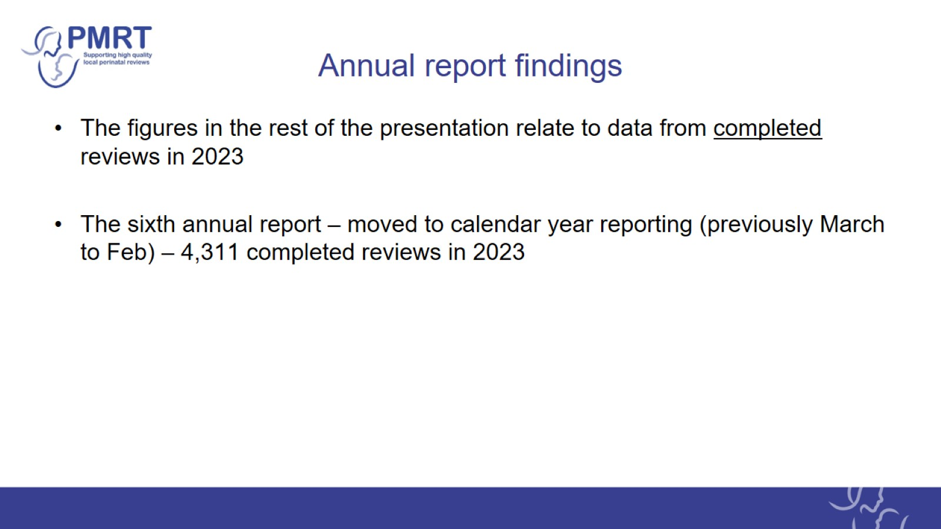
Annual report findings

Slide 6
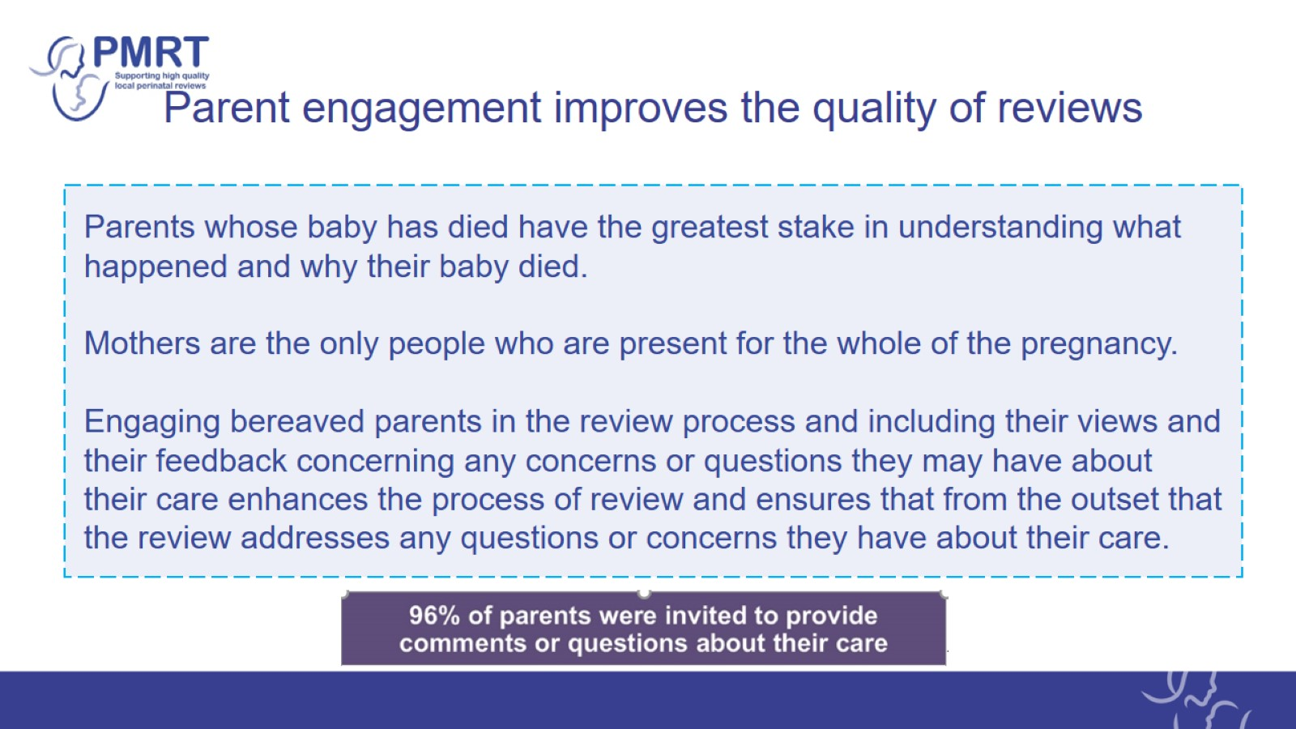
Parent engagement improves the quality of reviews

Slide 7


Slide 8
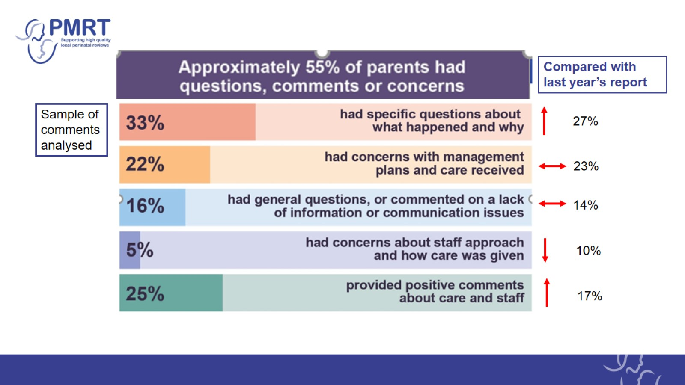

Slide 9
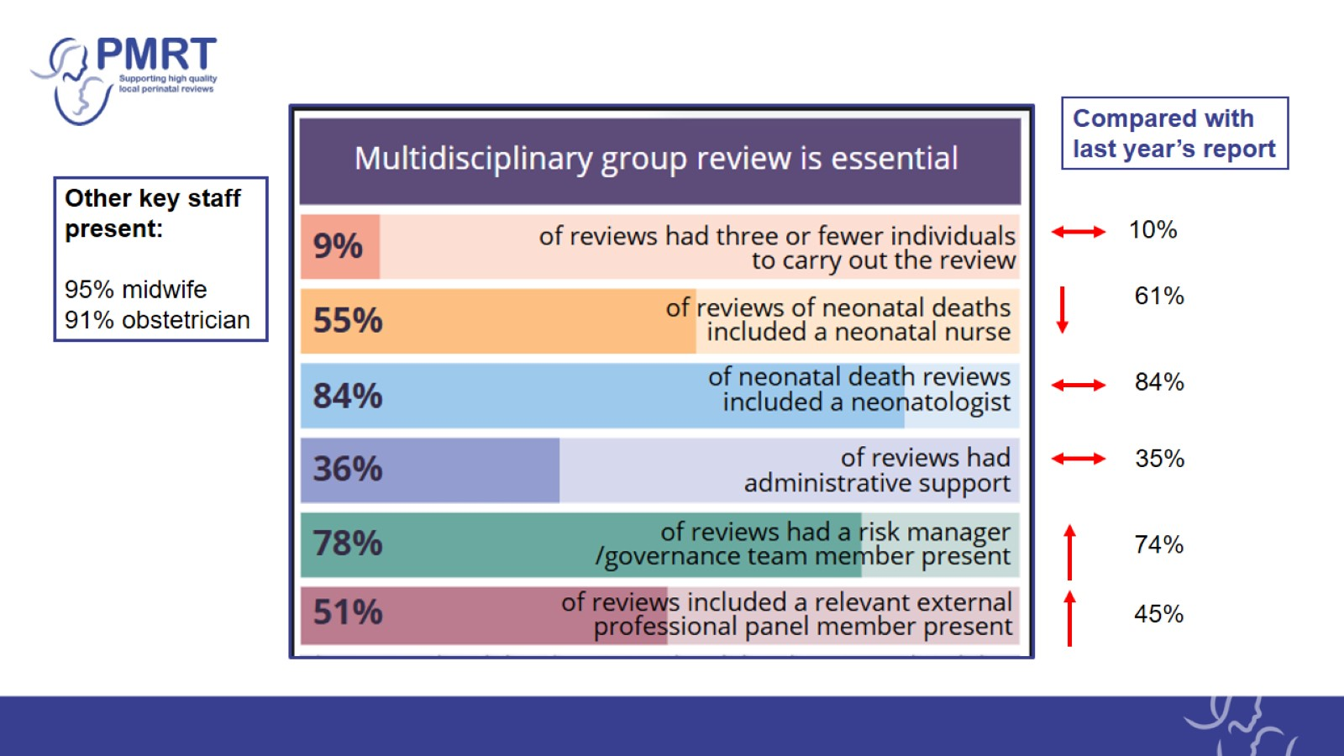

Slide 10
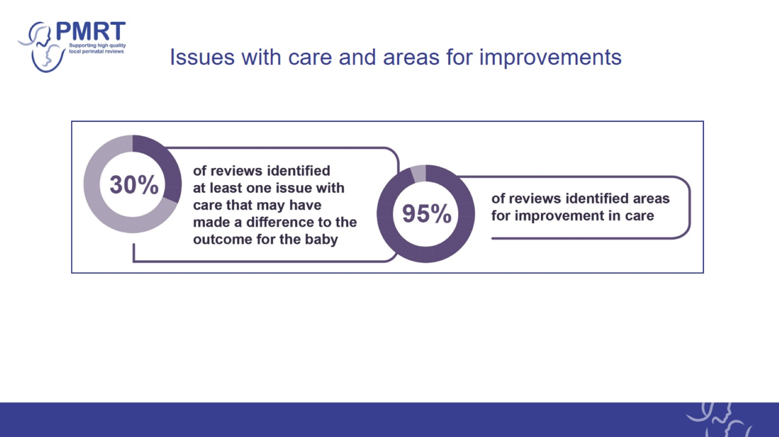
Issues with care and areas for improvements

Slide 11
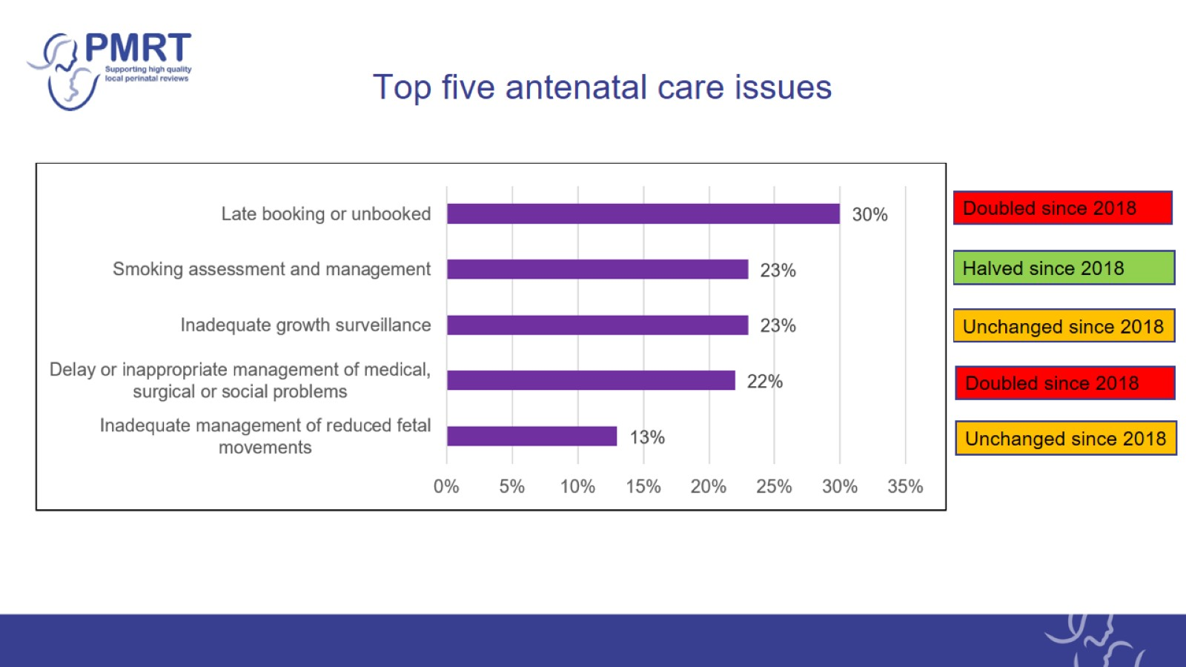
Top five antenatal care issues

Slide 12
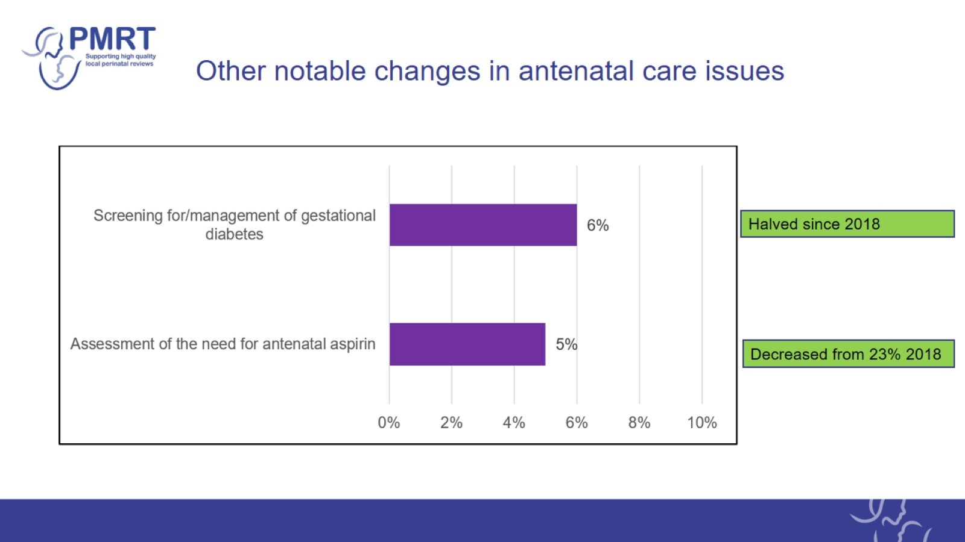
Other notable changes in antenatal care issues

Slide 13
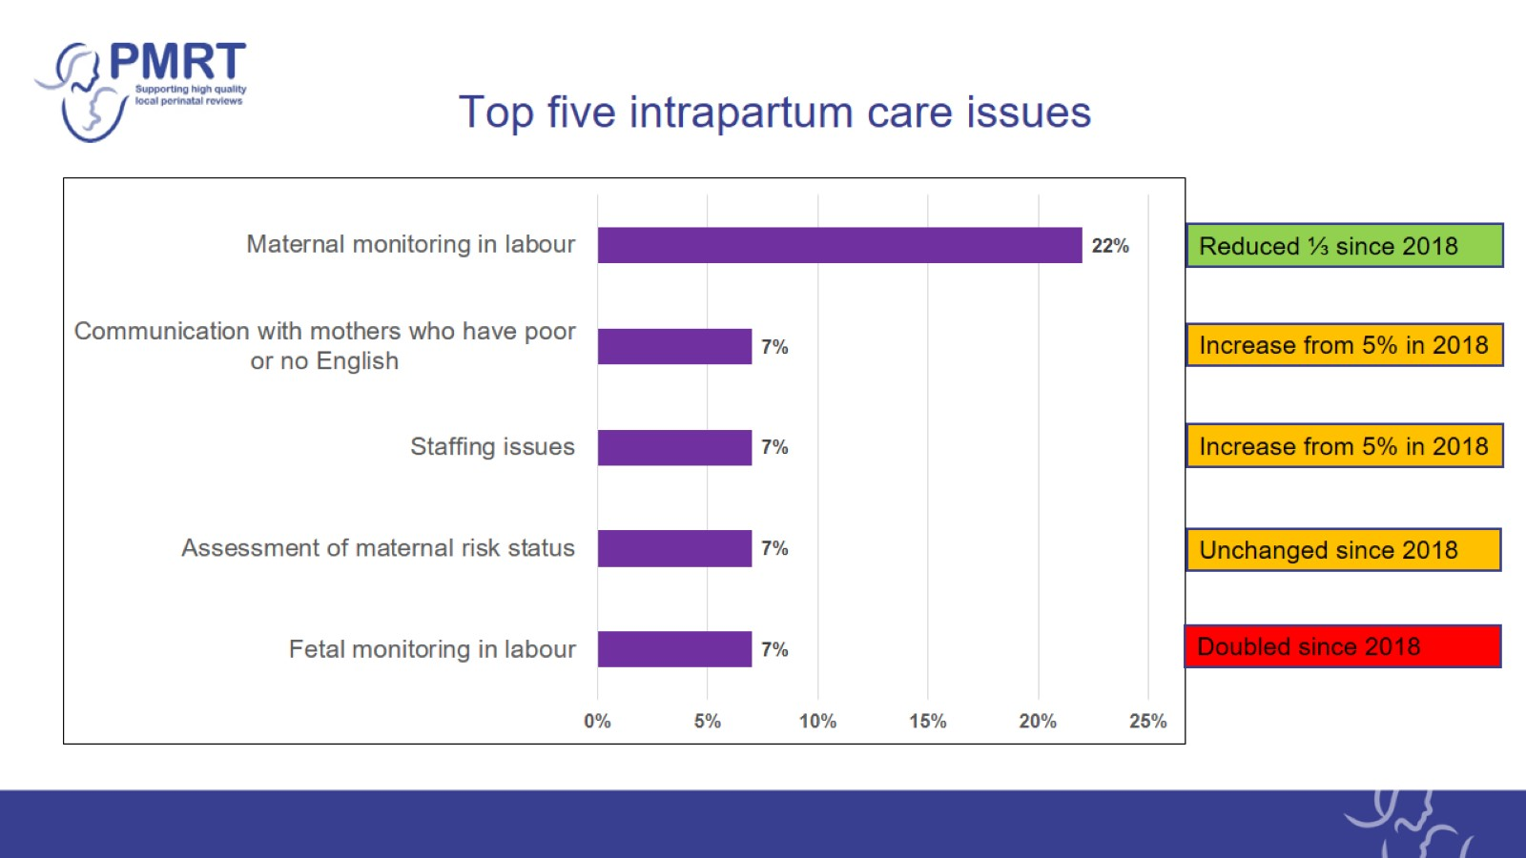
Top five intrapartum care issues

Slide 14
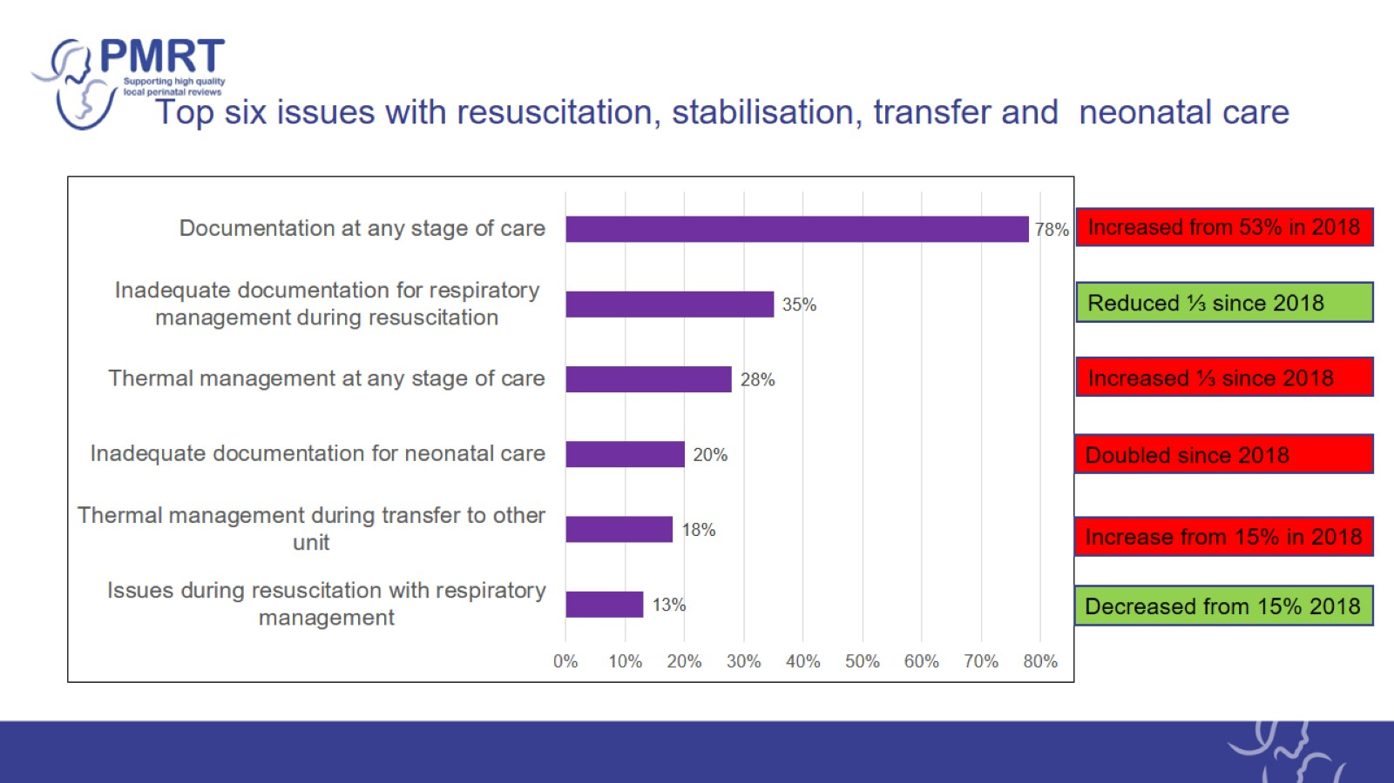
Top six issues with resuscitation, stabilisation, transfer and neonatal care

Slide 15
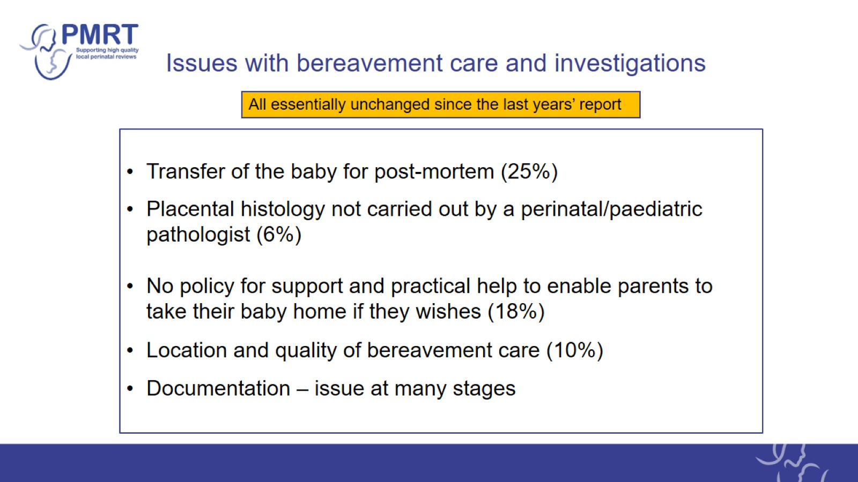
Issues with bereavement care and investigations

Slide 16
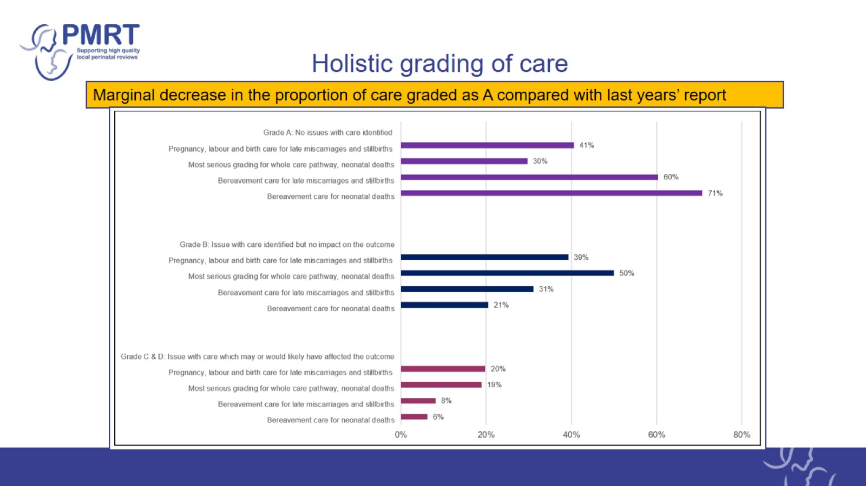
Holistic grading of care

Slide 17
Issues with care and areas for improvements

Slide 18
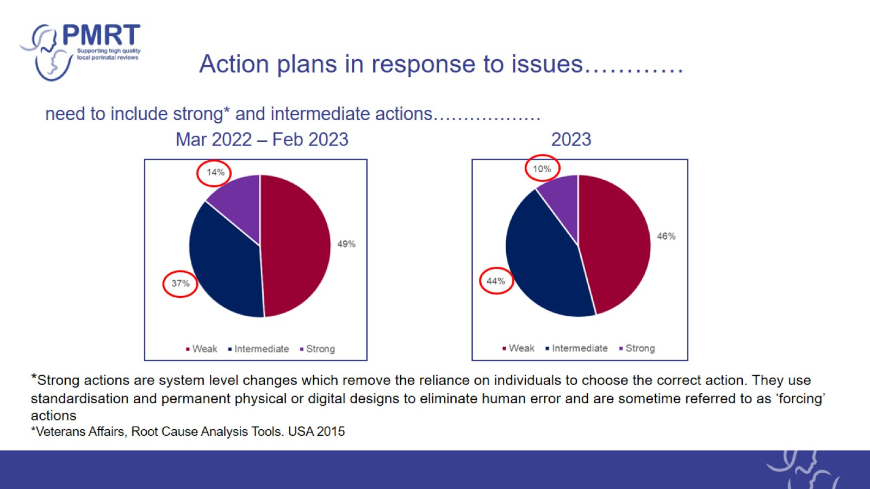
Action plans in response to issues…………

Slide 19
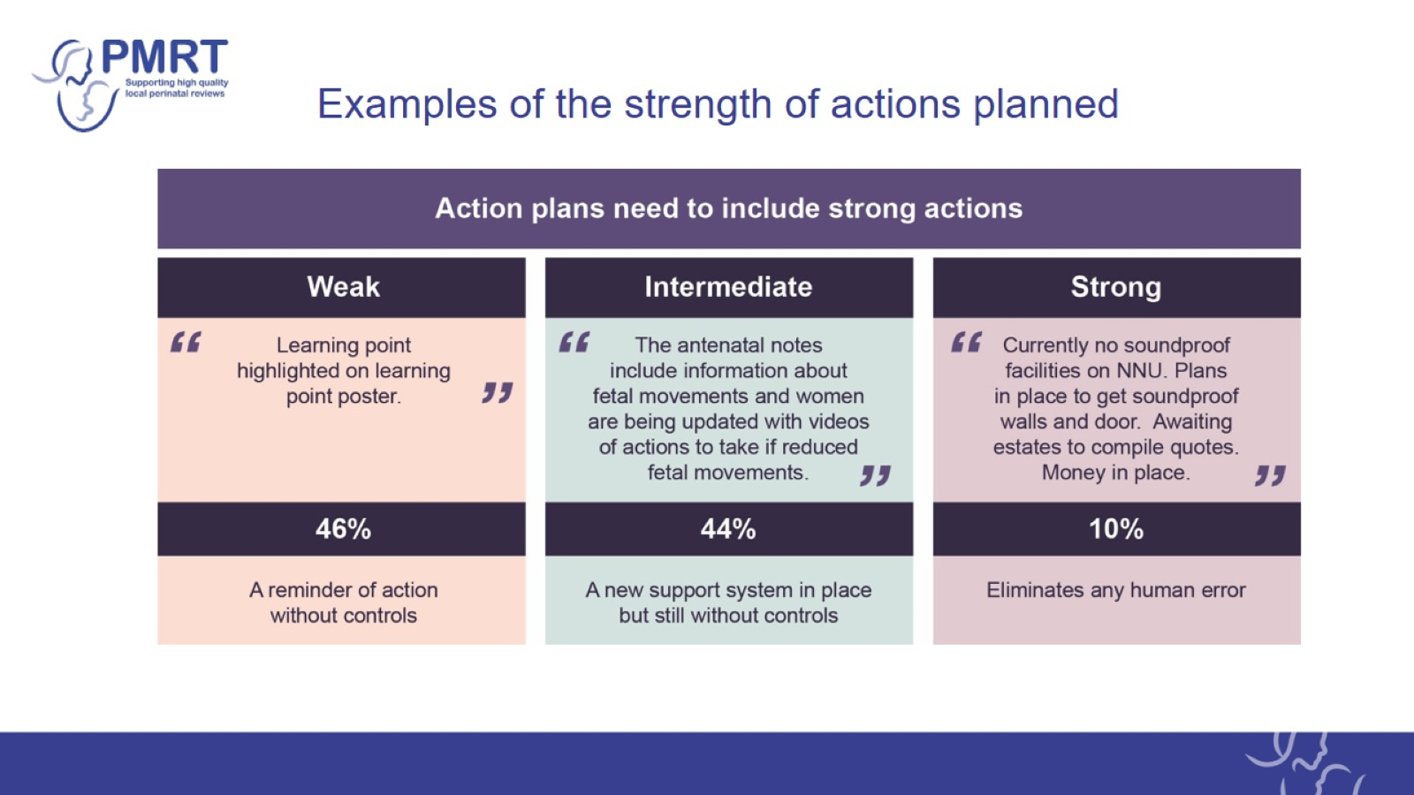
Examples of the strength of actions planned

Slide 20
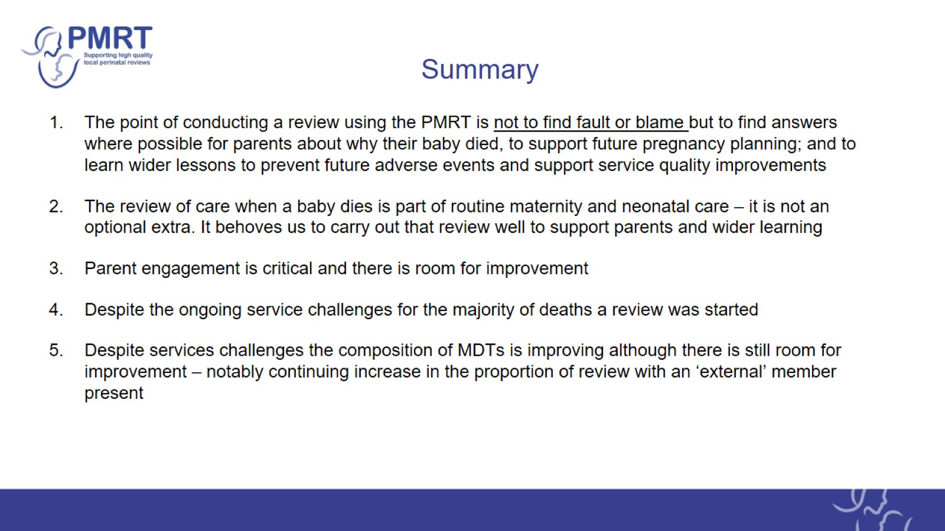
Summary

Slide 21

Summary

Slide 22
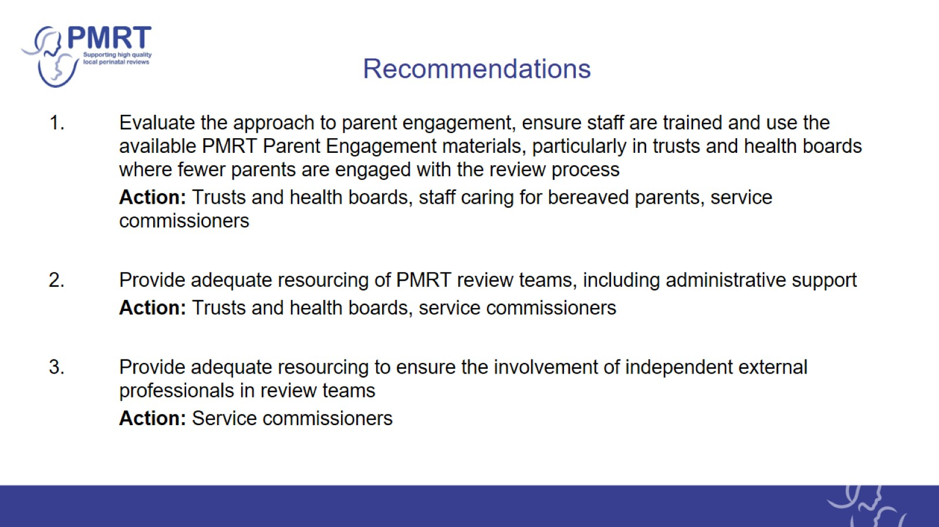
Recommendations

Slide 23
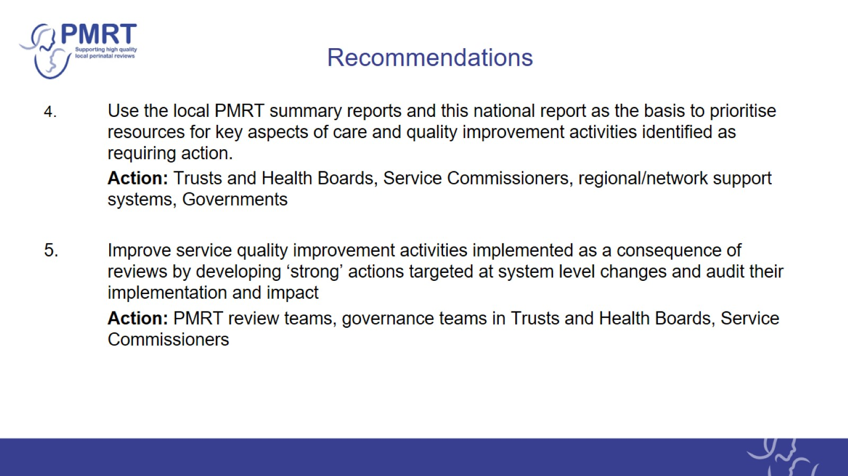
Recommendations

Slide 24
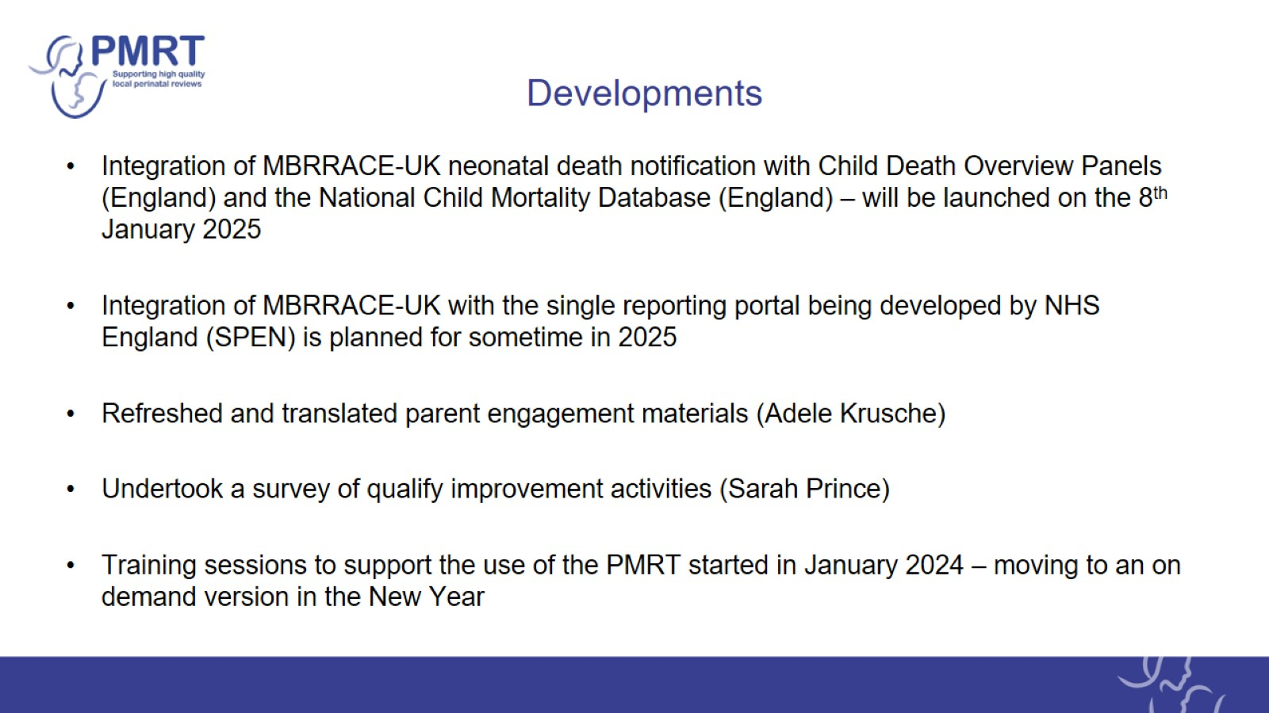
Developments

Slide 25

Acknowledgements

Slide 26

MBRRACE-UK/PMRT collaboration

Slide 27
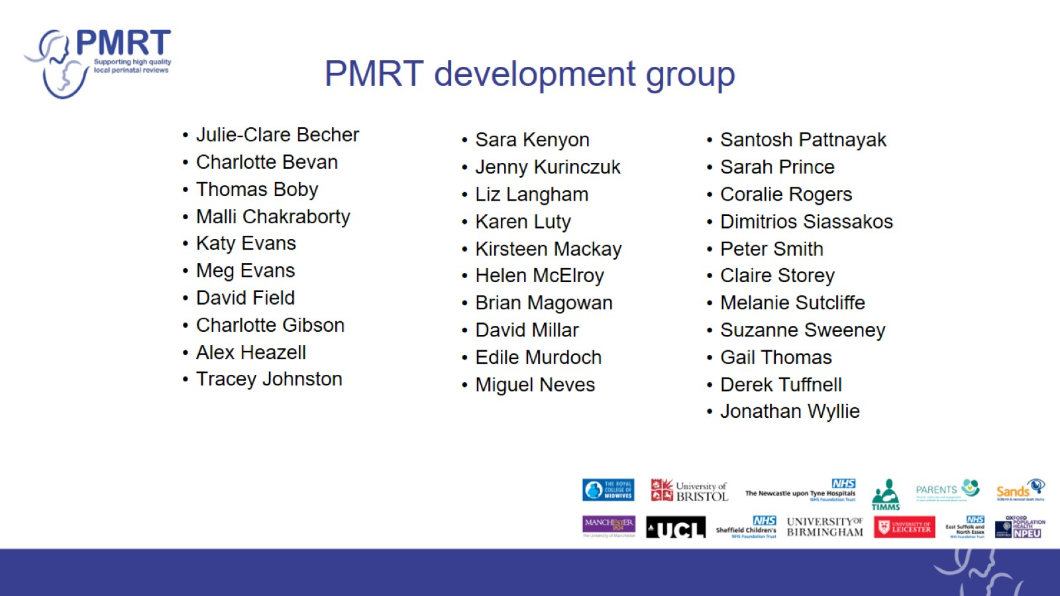
PMRT development group

