Slide 1


Slide 2
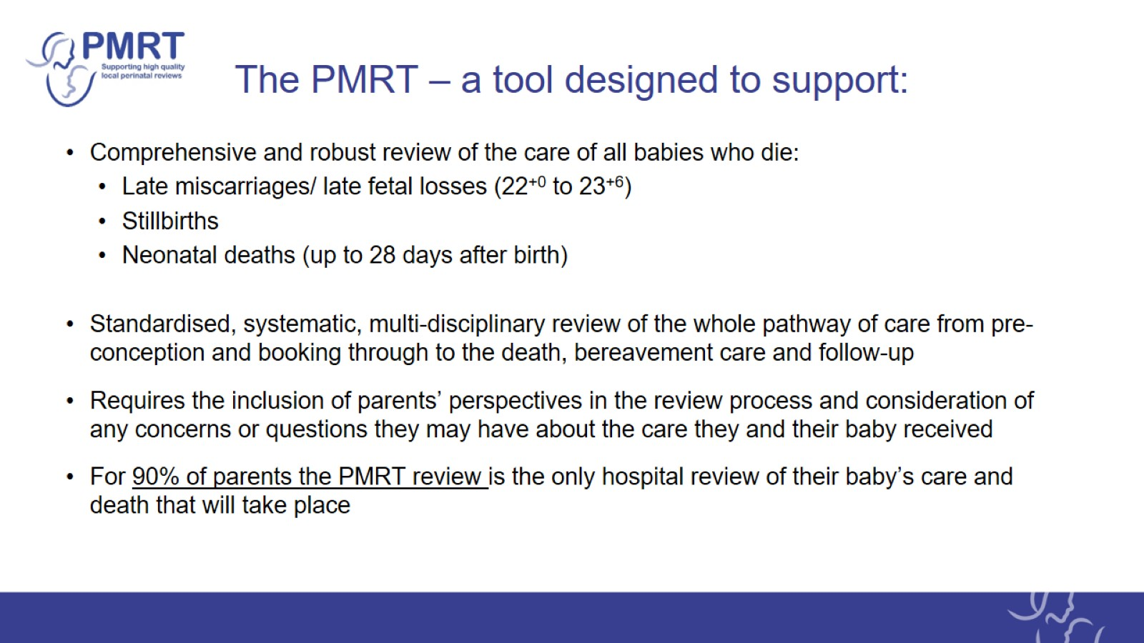
The PMRT – a tool designed to support:

Slide 3

Annual reports

Slide 4
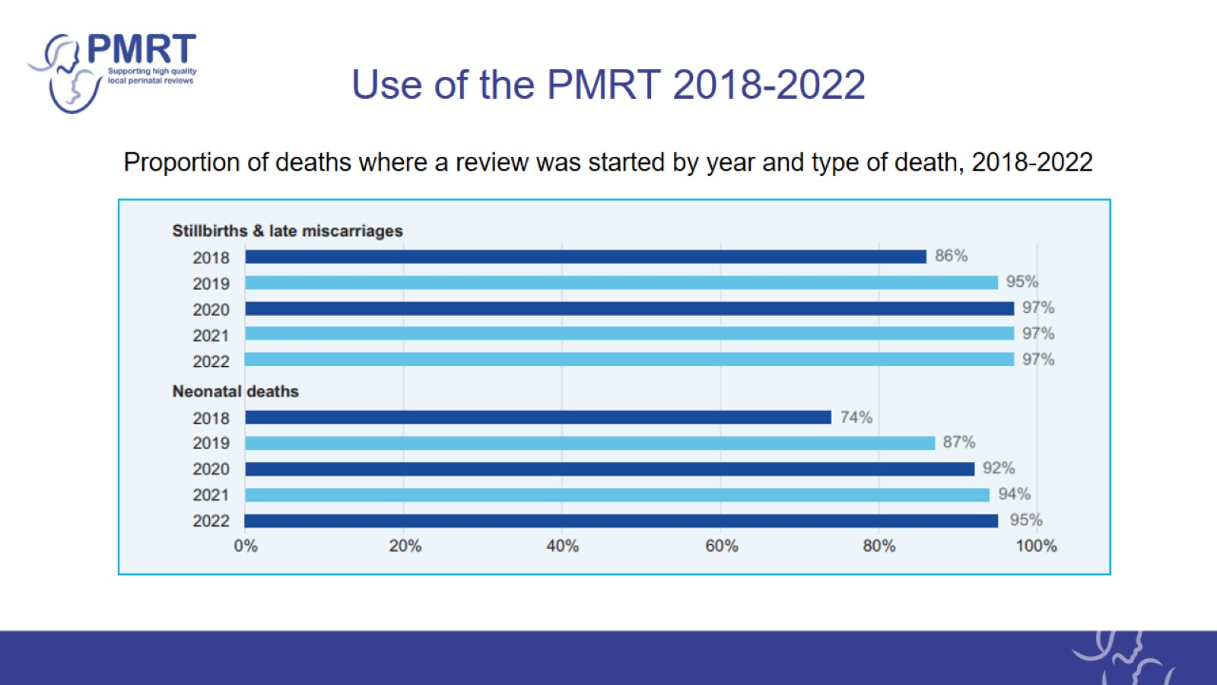
Use of the PMRT 2018-2022

Slide 5
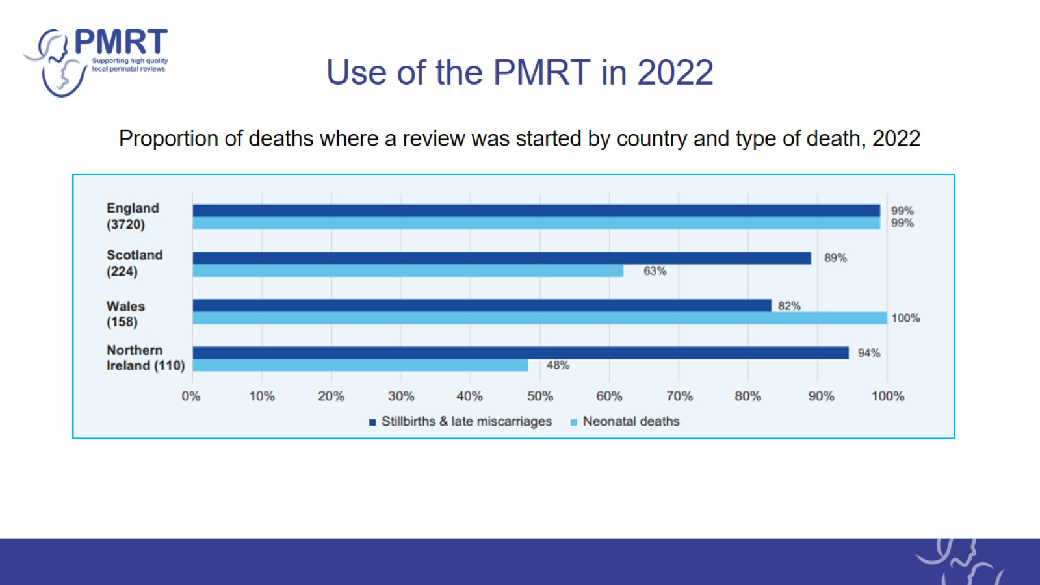
Use of the PMRT in 2022

Slide 6
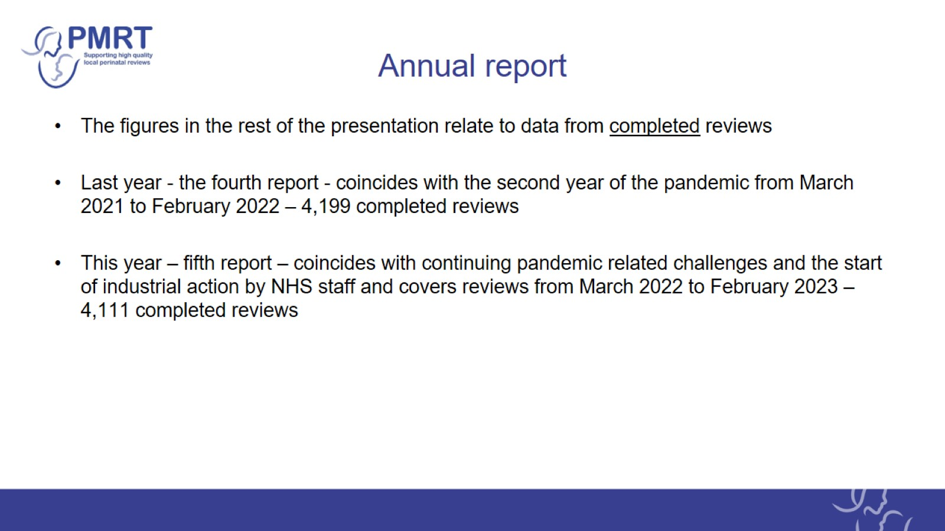
Annual report

Slide 7
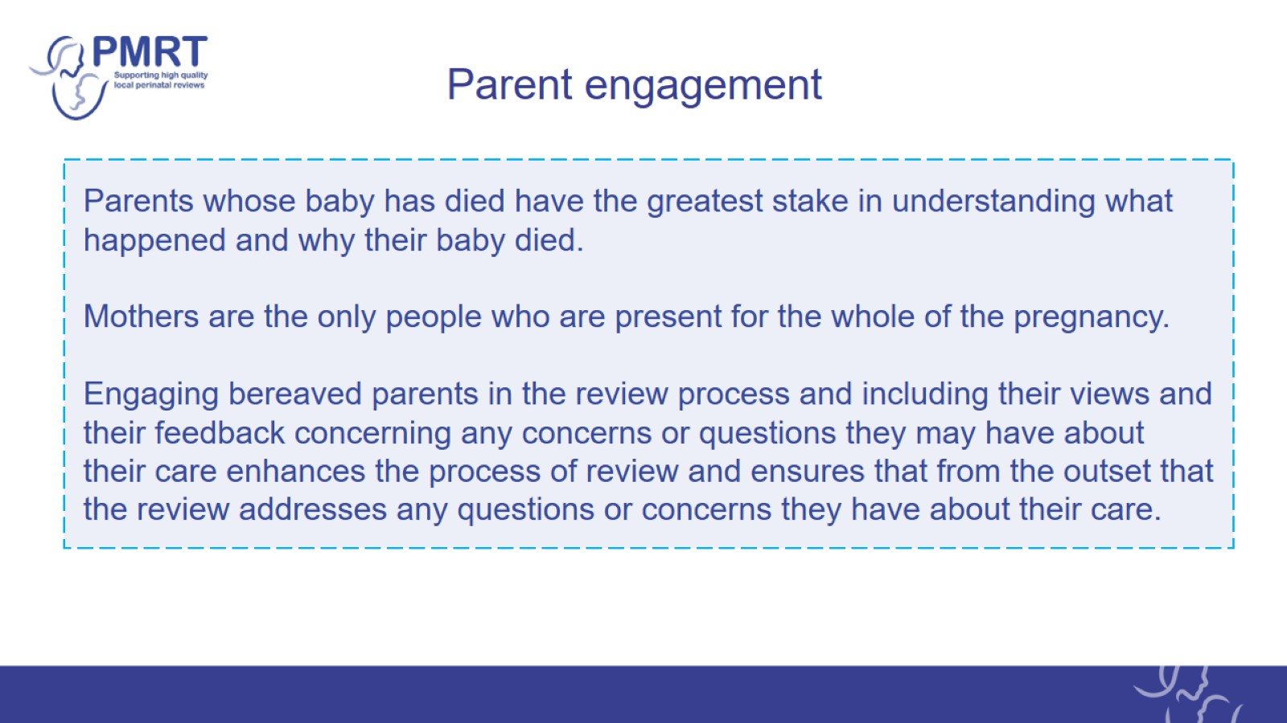
Parent engagement

Slide 8
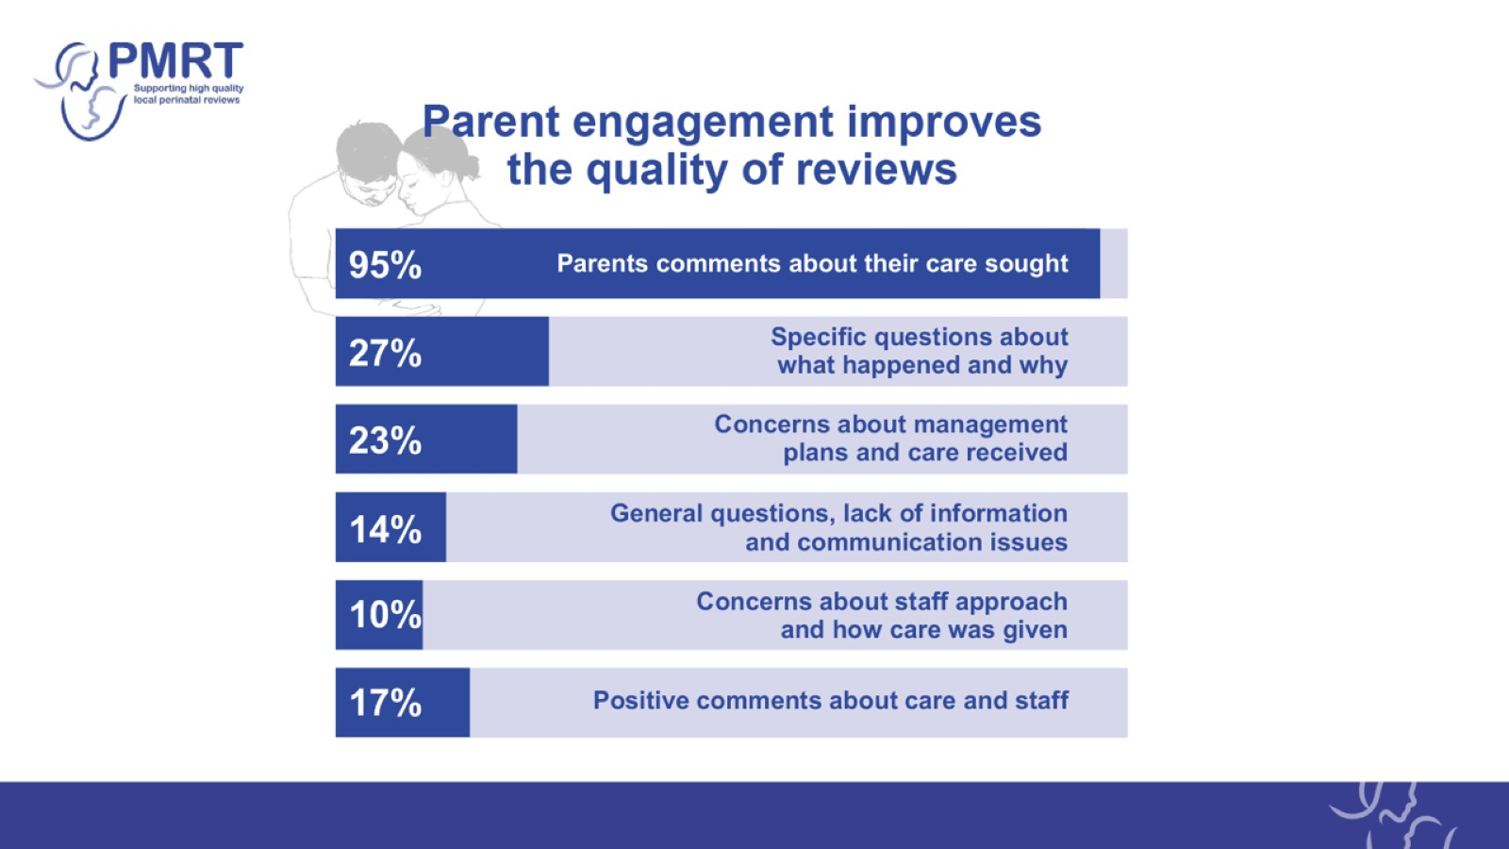

Slide 9


Slide 10
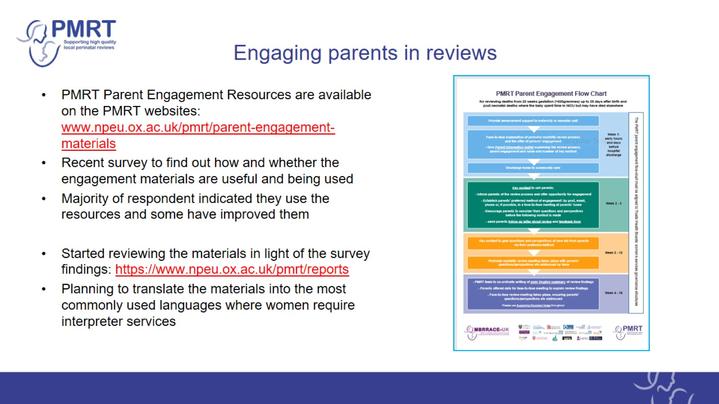
Engaging parents in reviews

Slide 11
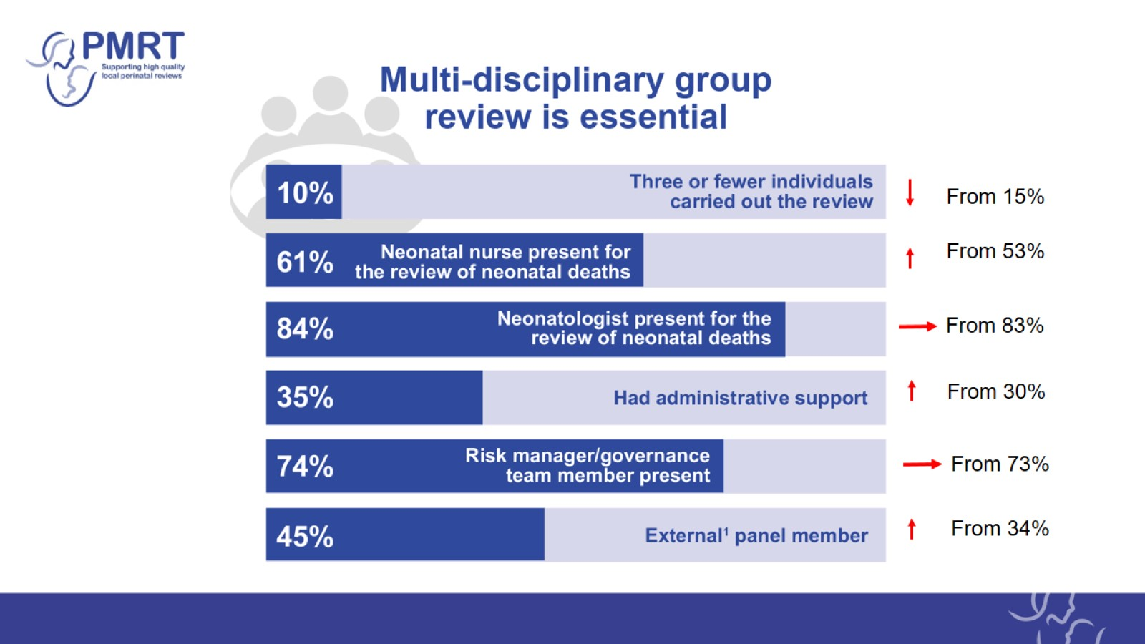

Slide 12


Slide 13
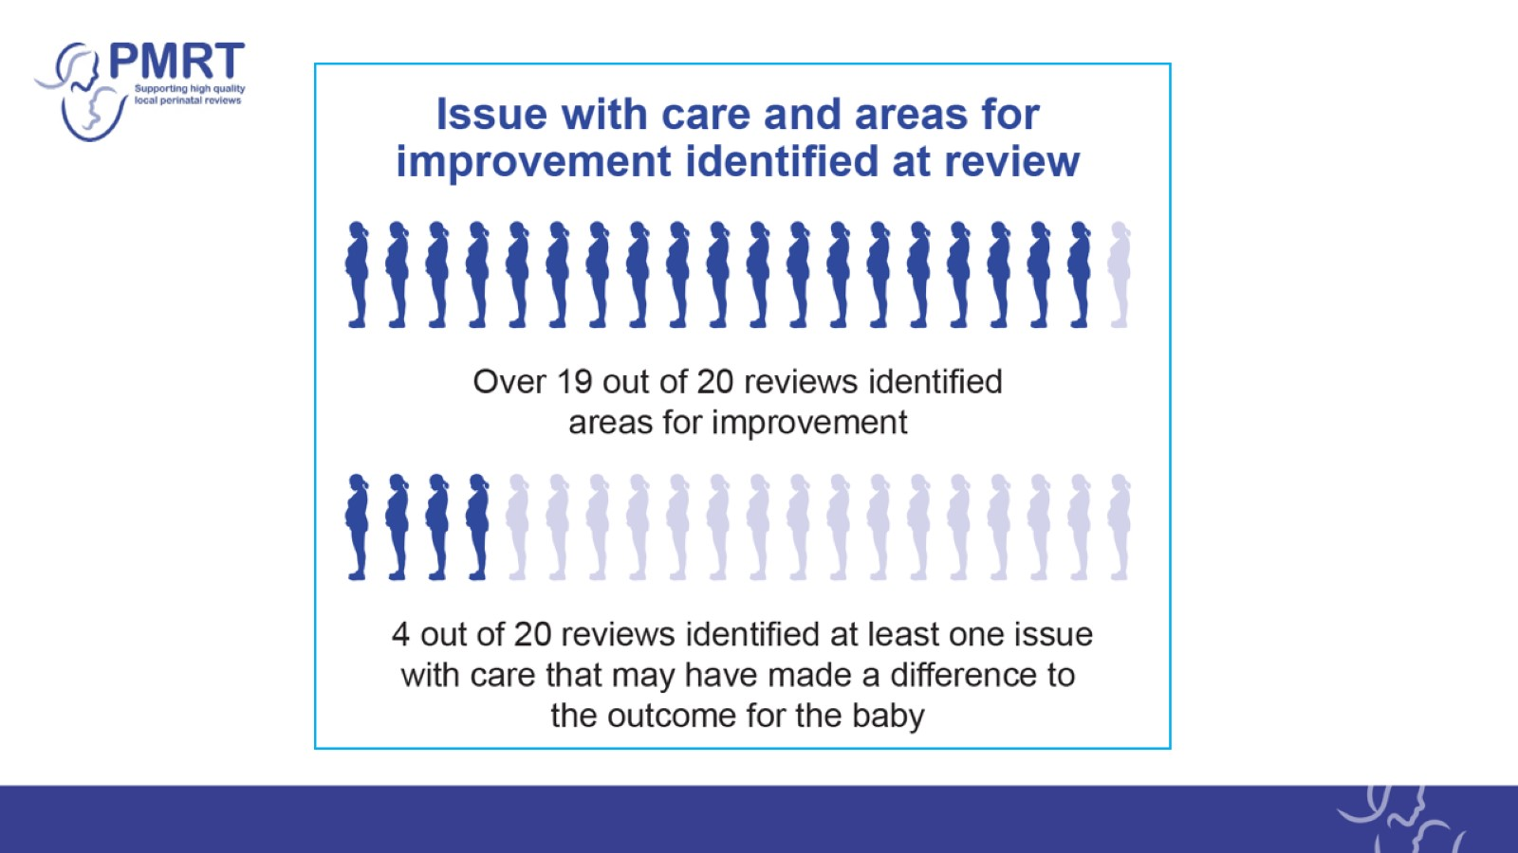

Slide 14
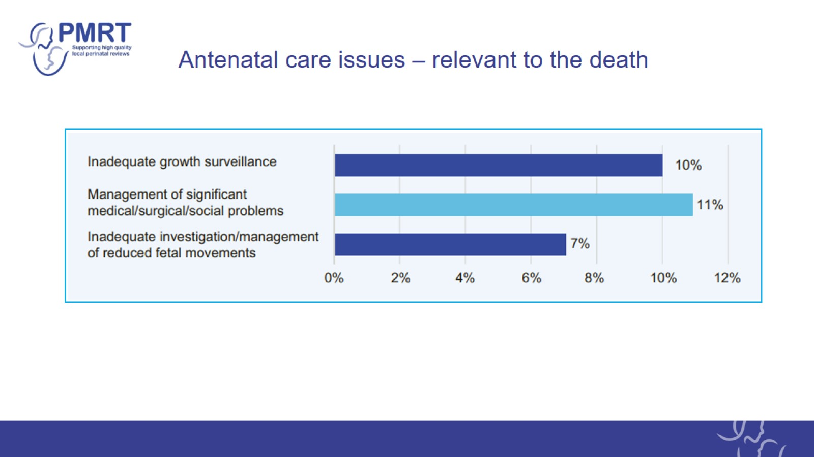
Antenatal care issues – relevant to the death

Slide 15
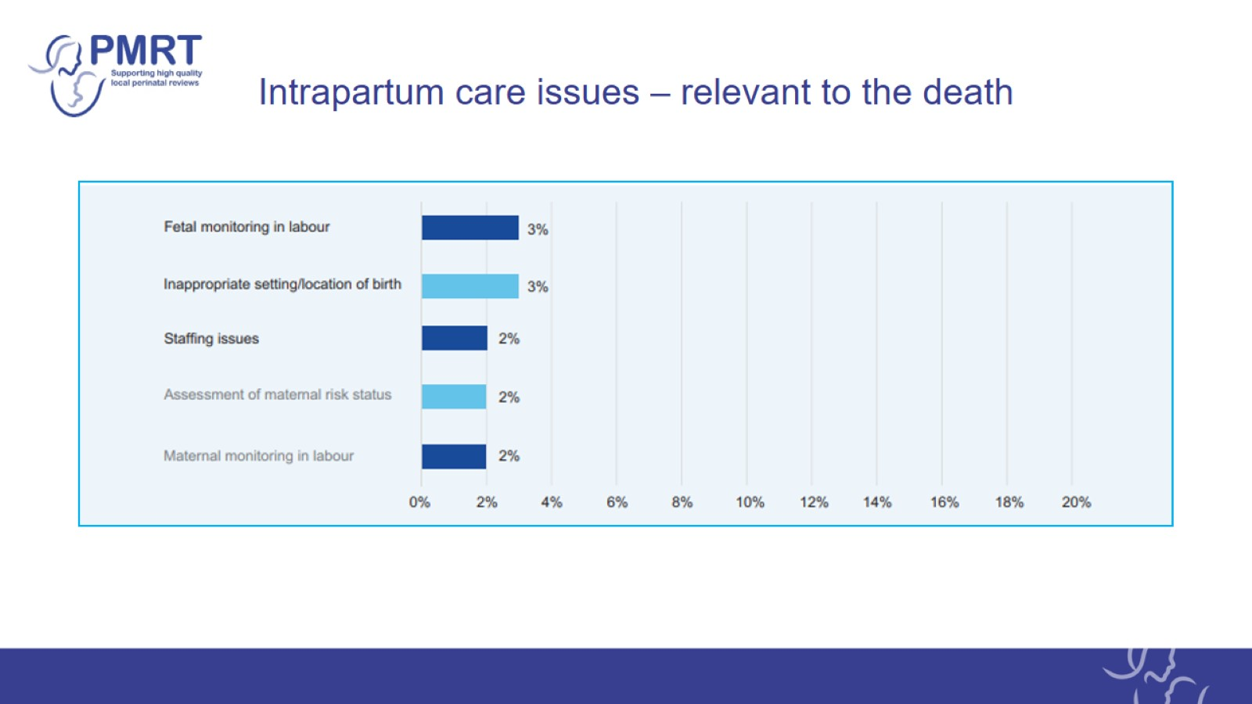
Intrapartum care issues – relevant to the death

Slide 16
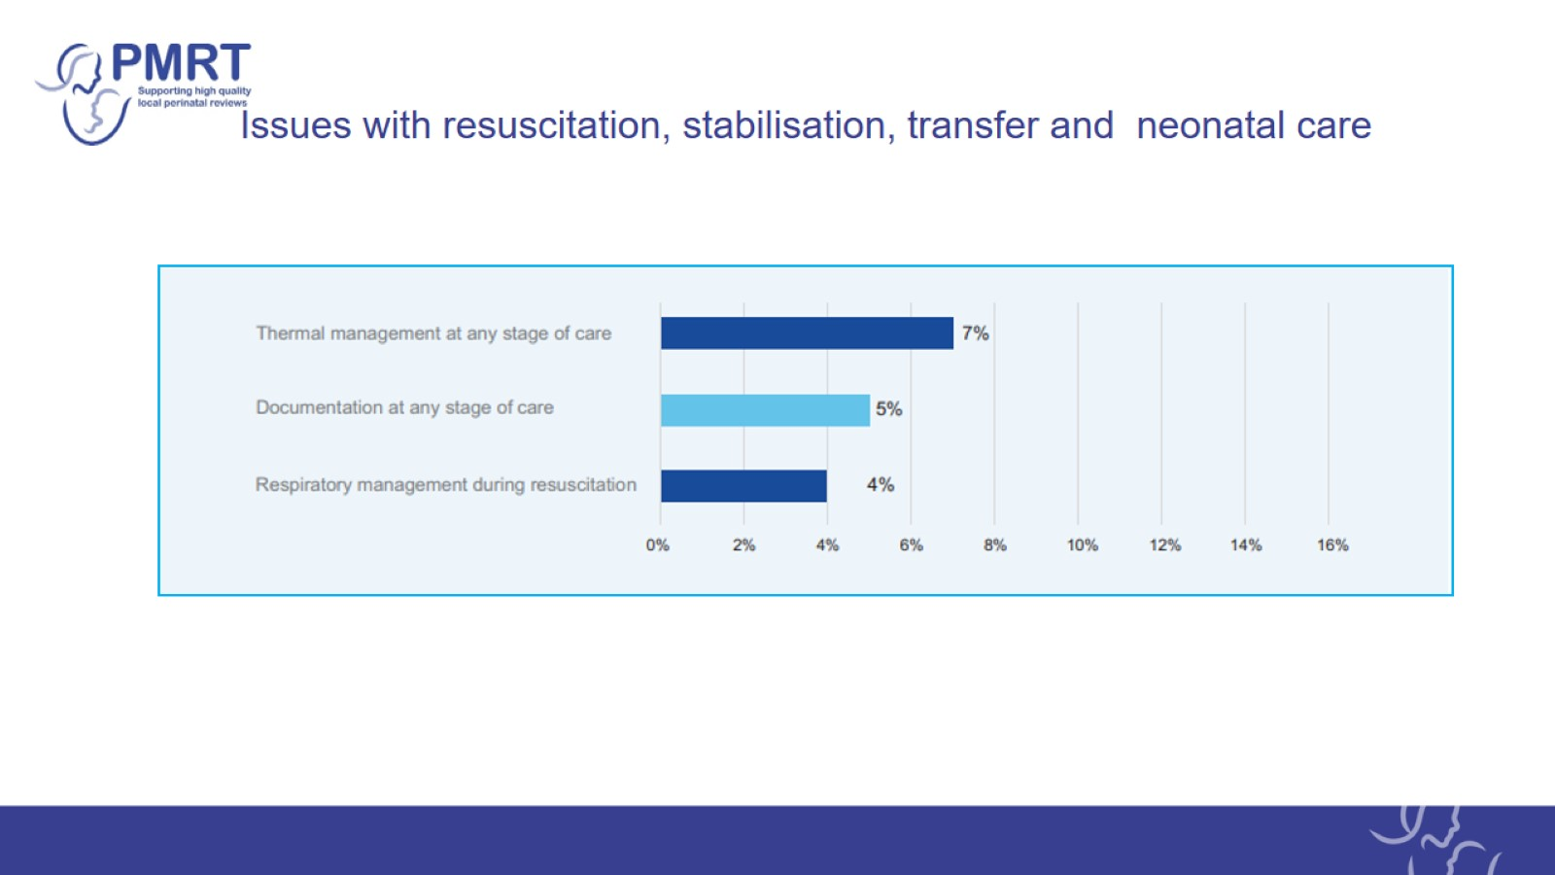
Issues with resuscitation, stabilisation, transfer and neonatal care

Slide 17
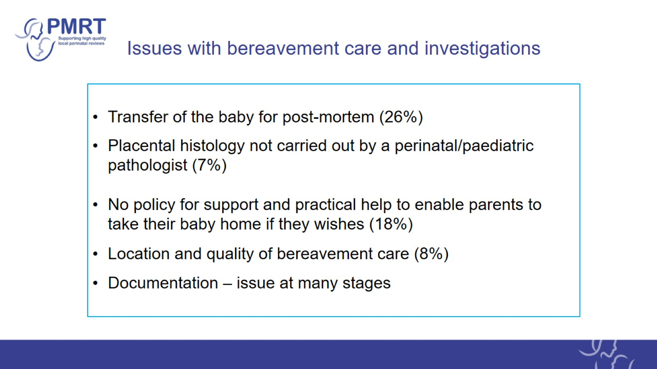
Issues with bereavement care and investigations

Slide 18
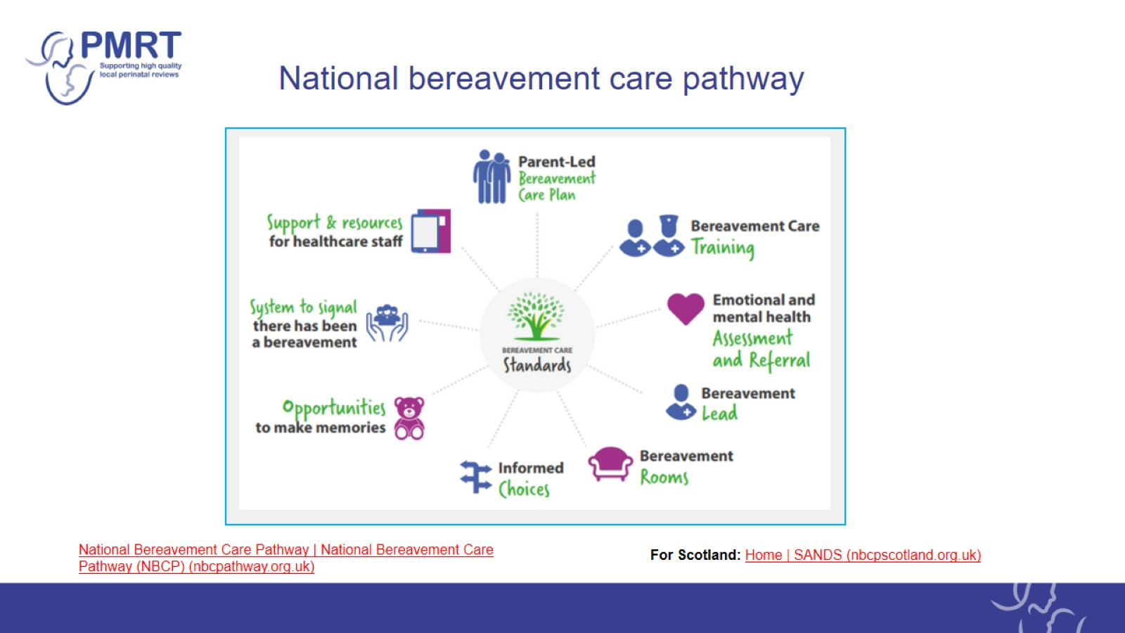
National bereavement care pathway

Slide 19
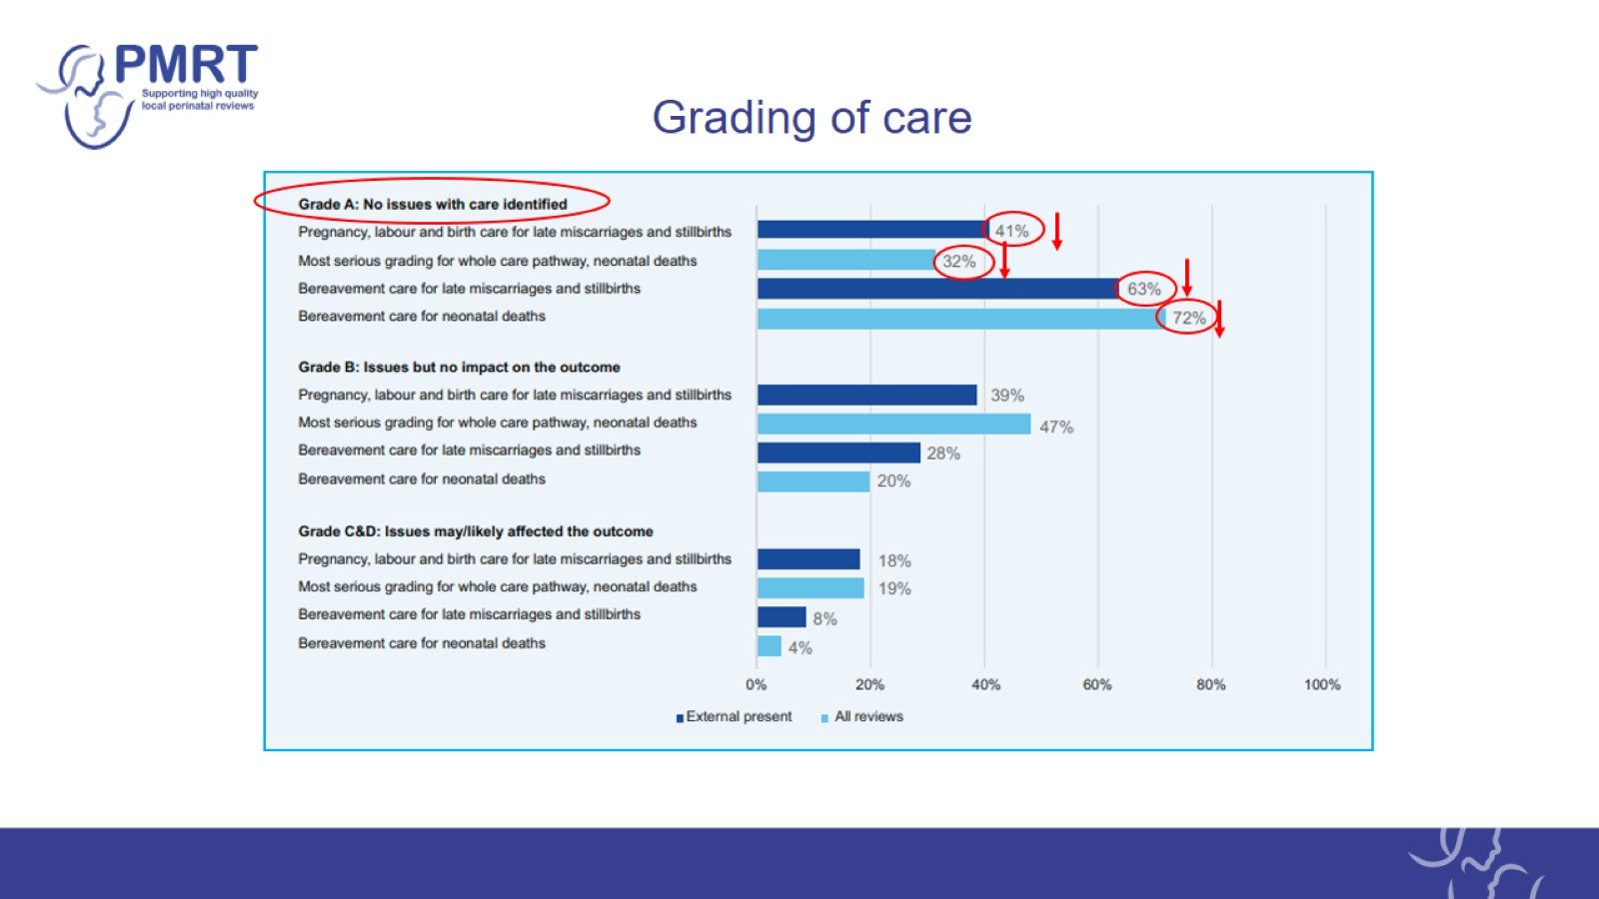
Grading of care

Slide 20
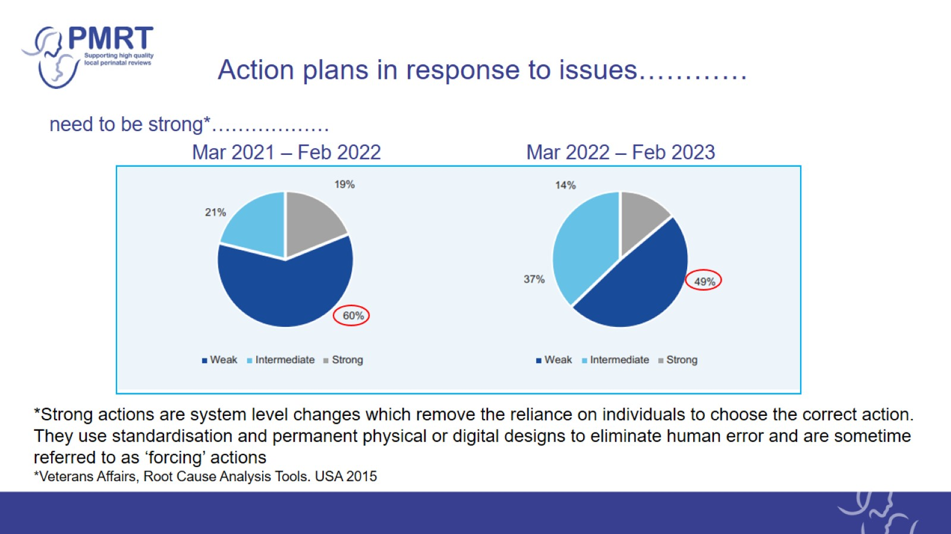
Action plans in response to issues…………

Slide 21
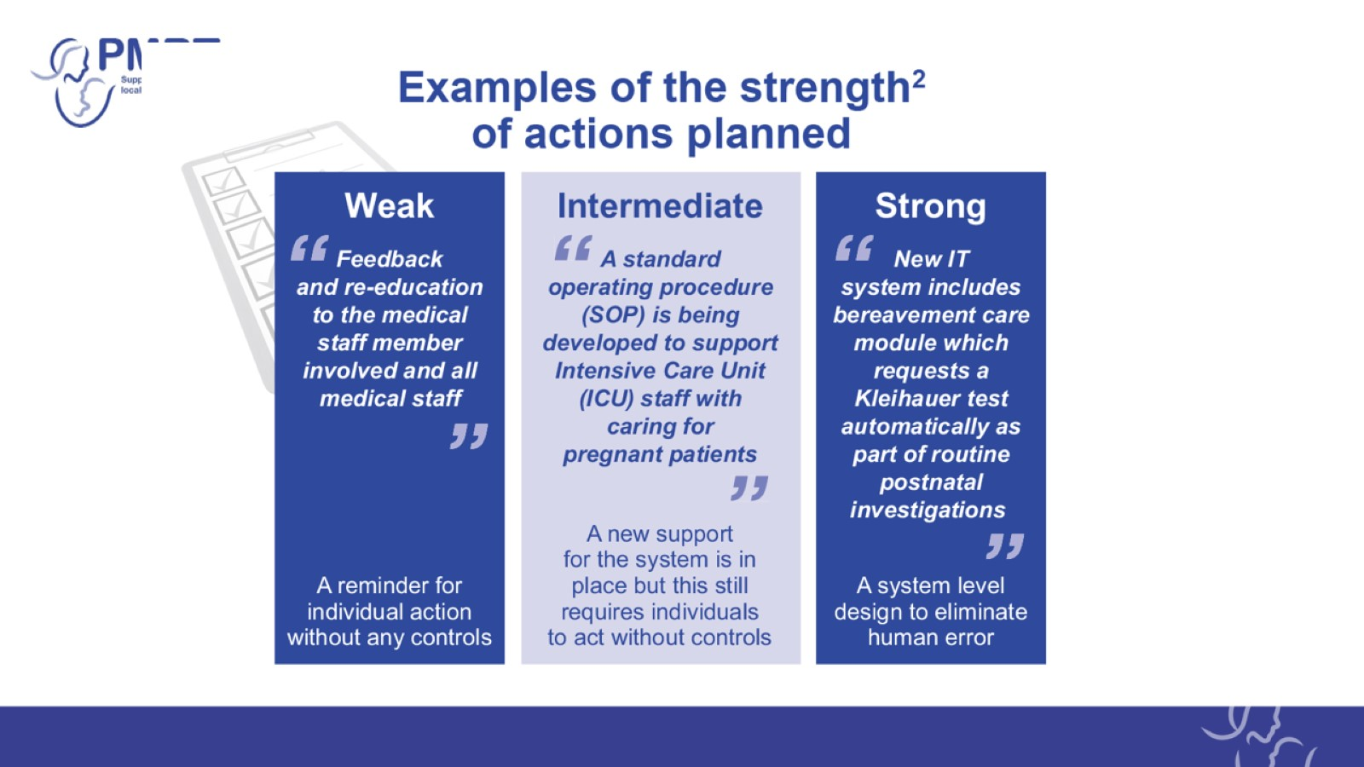

Slide 22
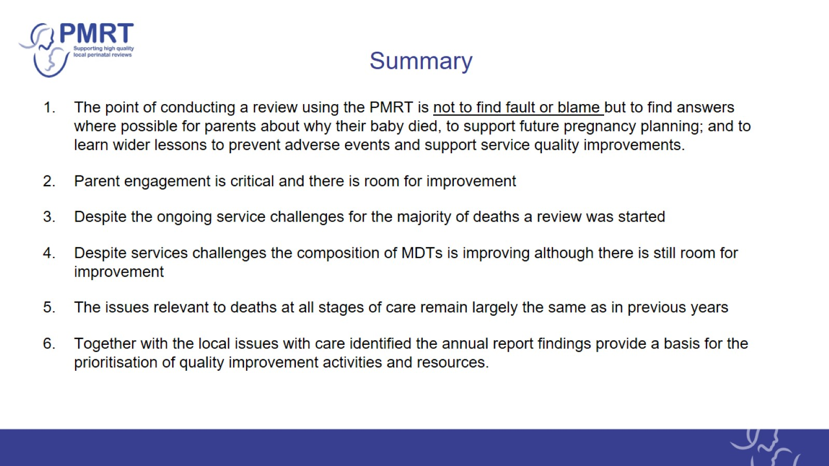
Summary

Slide 23
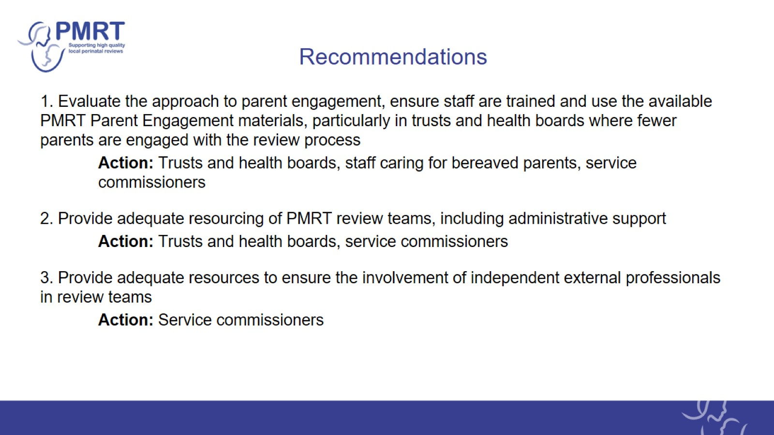
Recommendations

Slide 24
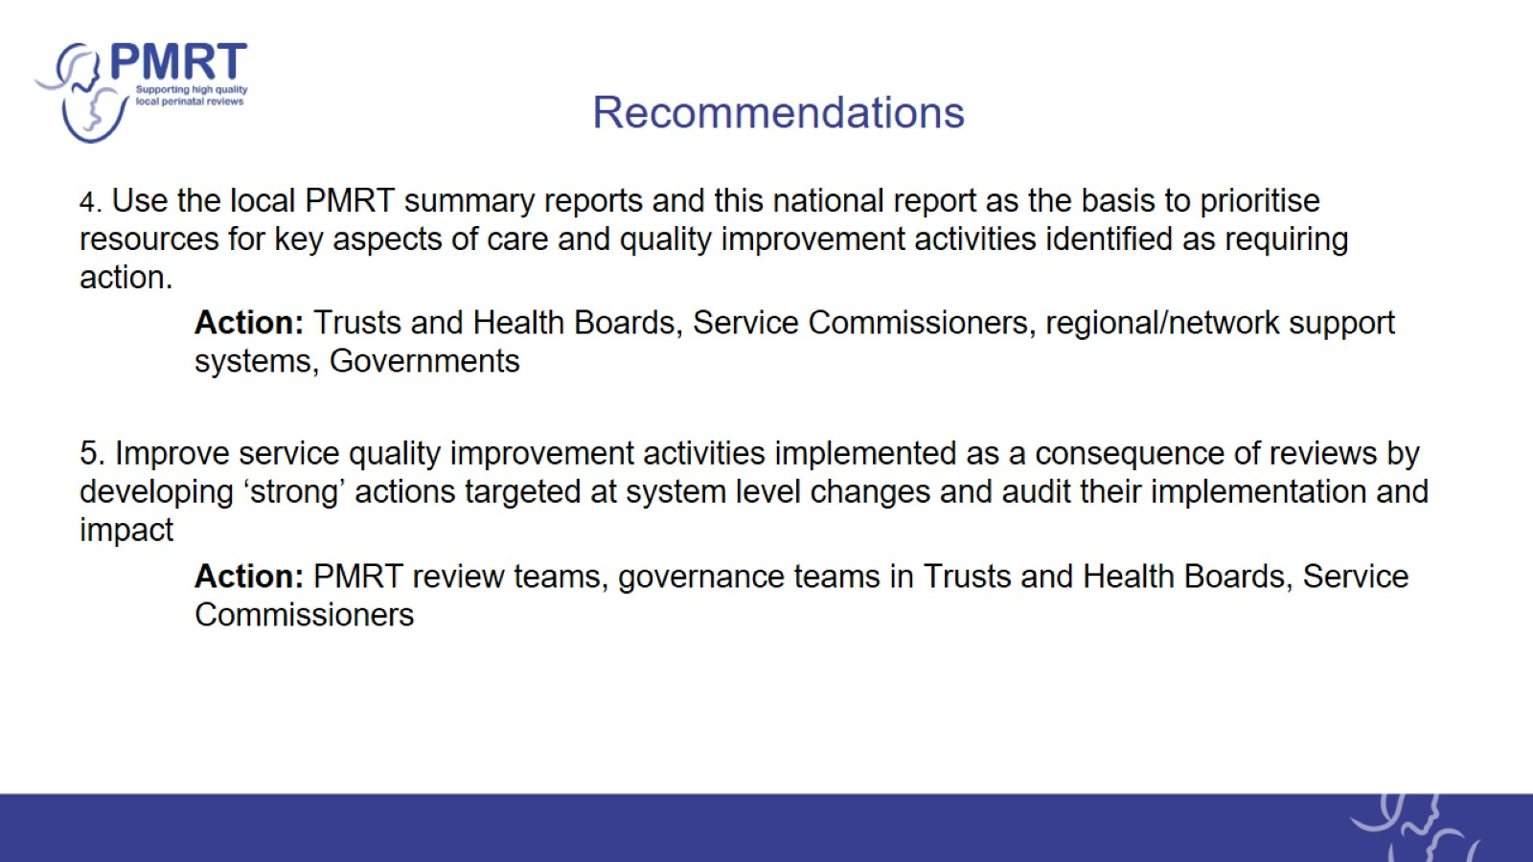
Recommendations

Slide 25
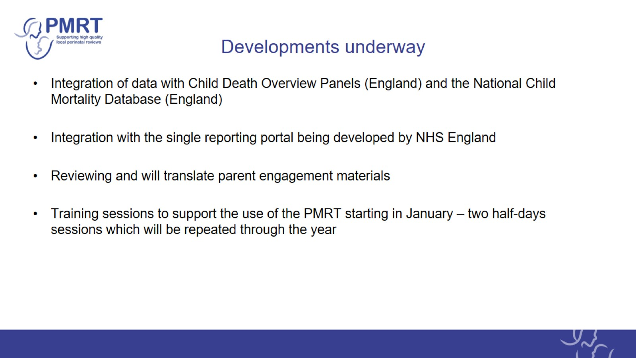
Developments underway

Slide 26

Acknowledgements

Slide 27

MBRRACE-UK/PMRT collaboration

Slide 28

PMRT development group

