Slide 1

Action Plans &
Sustained Improvement

Slide 2
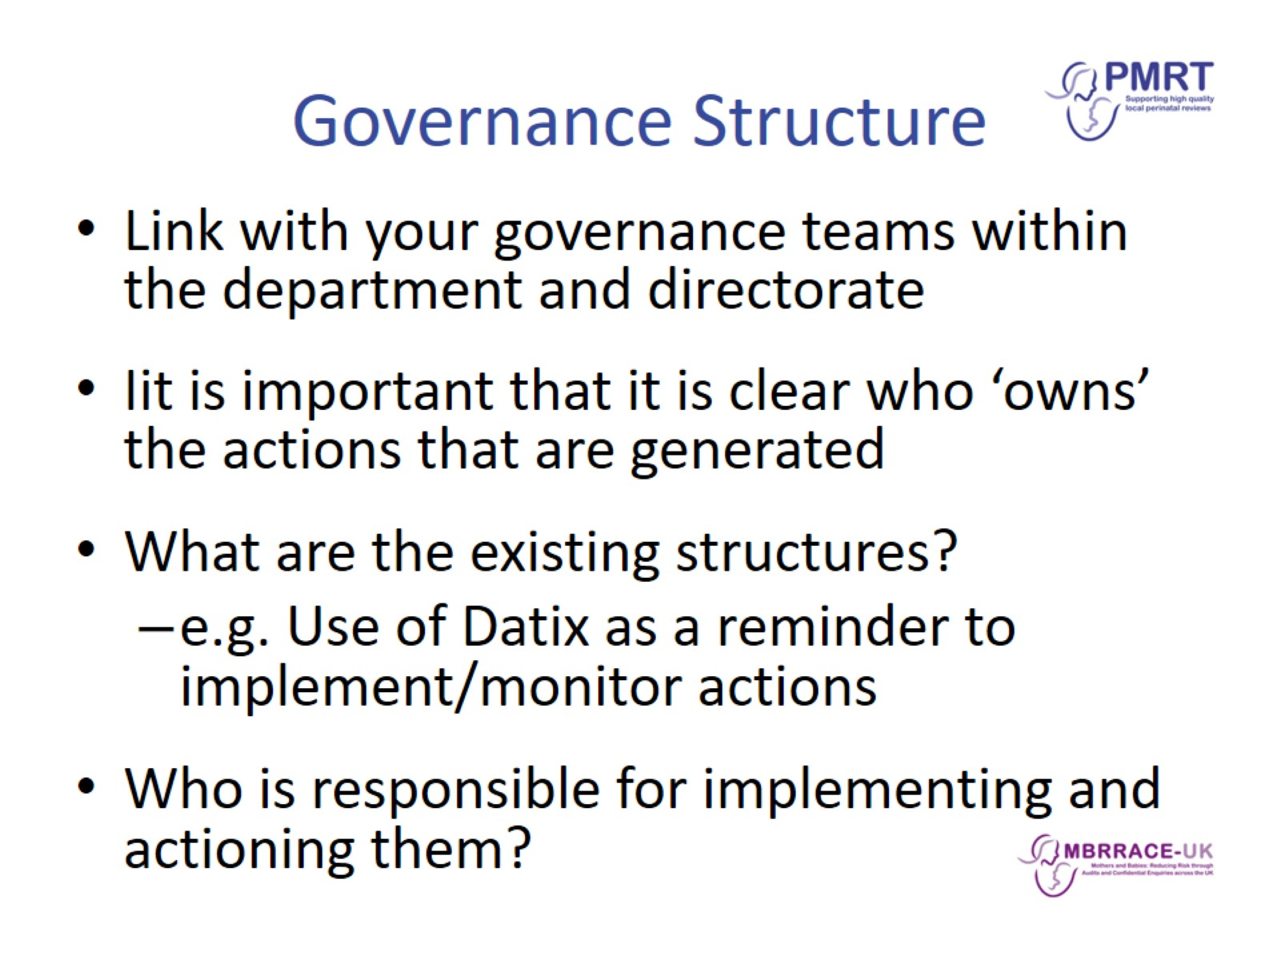
Governance Structure

Slide 3
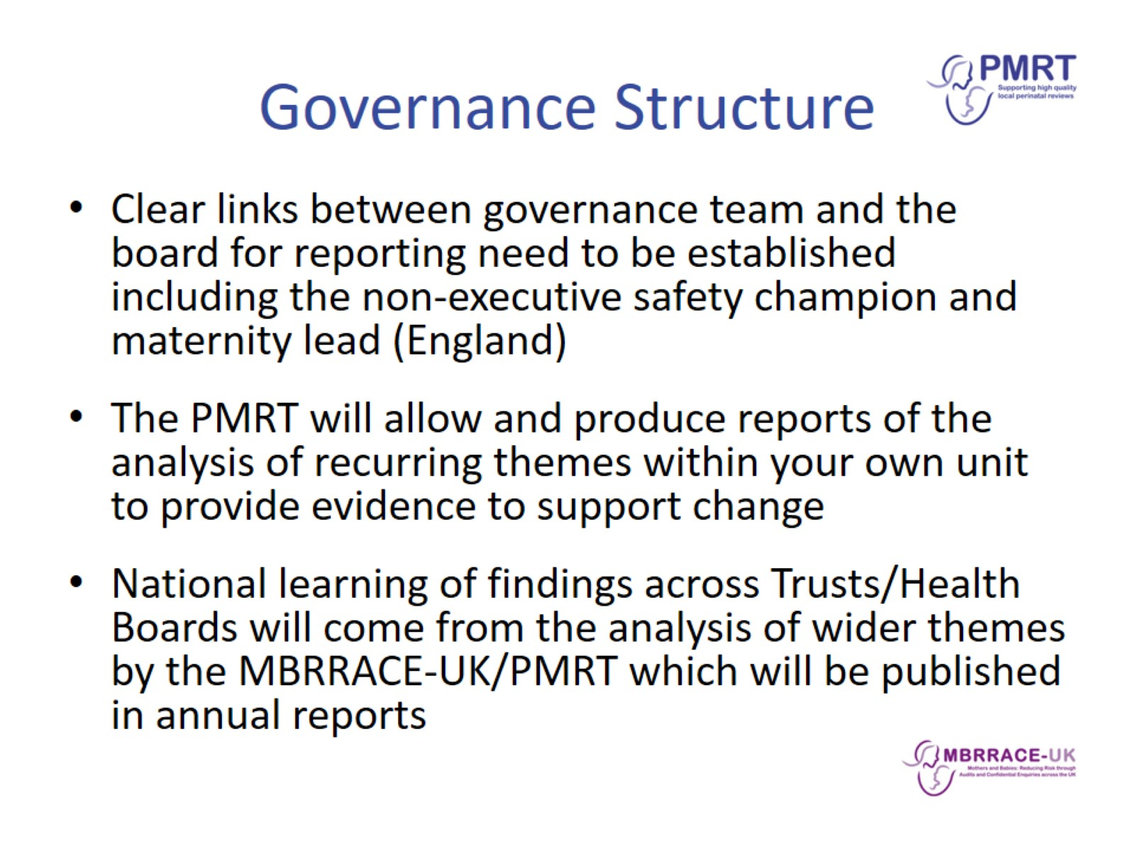
Governance Structure

Slide 4
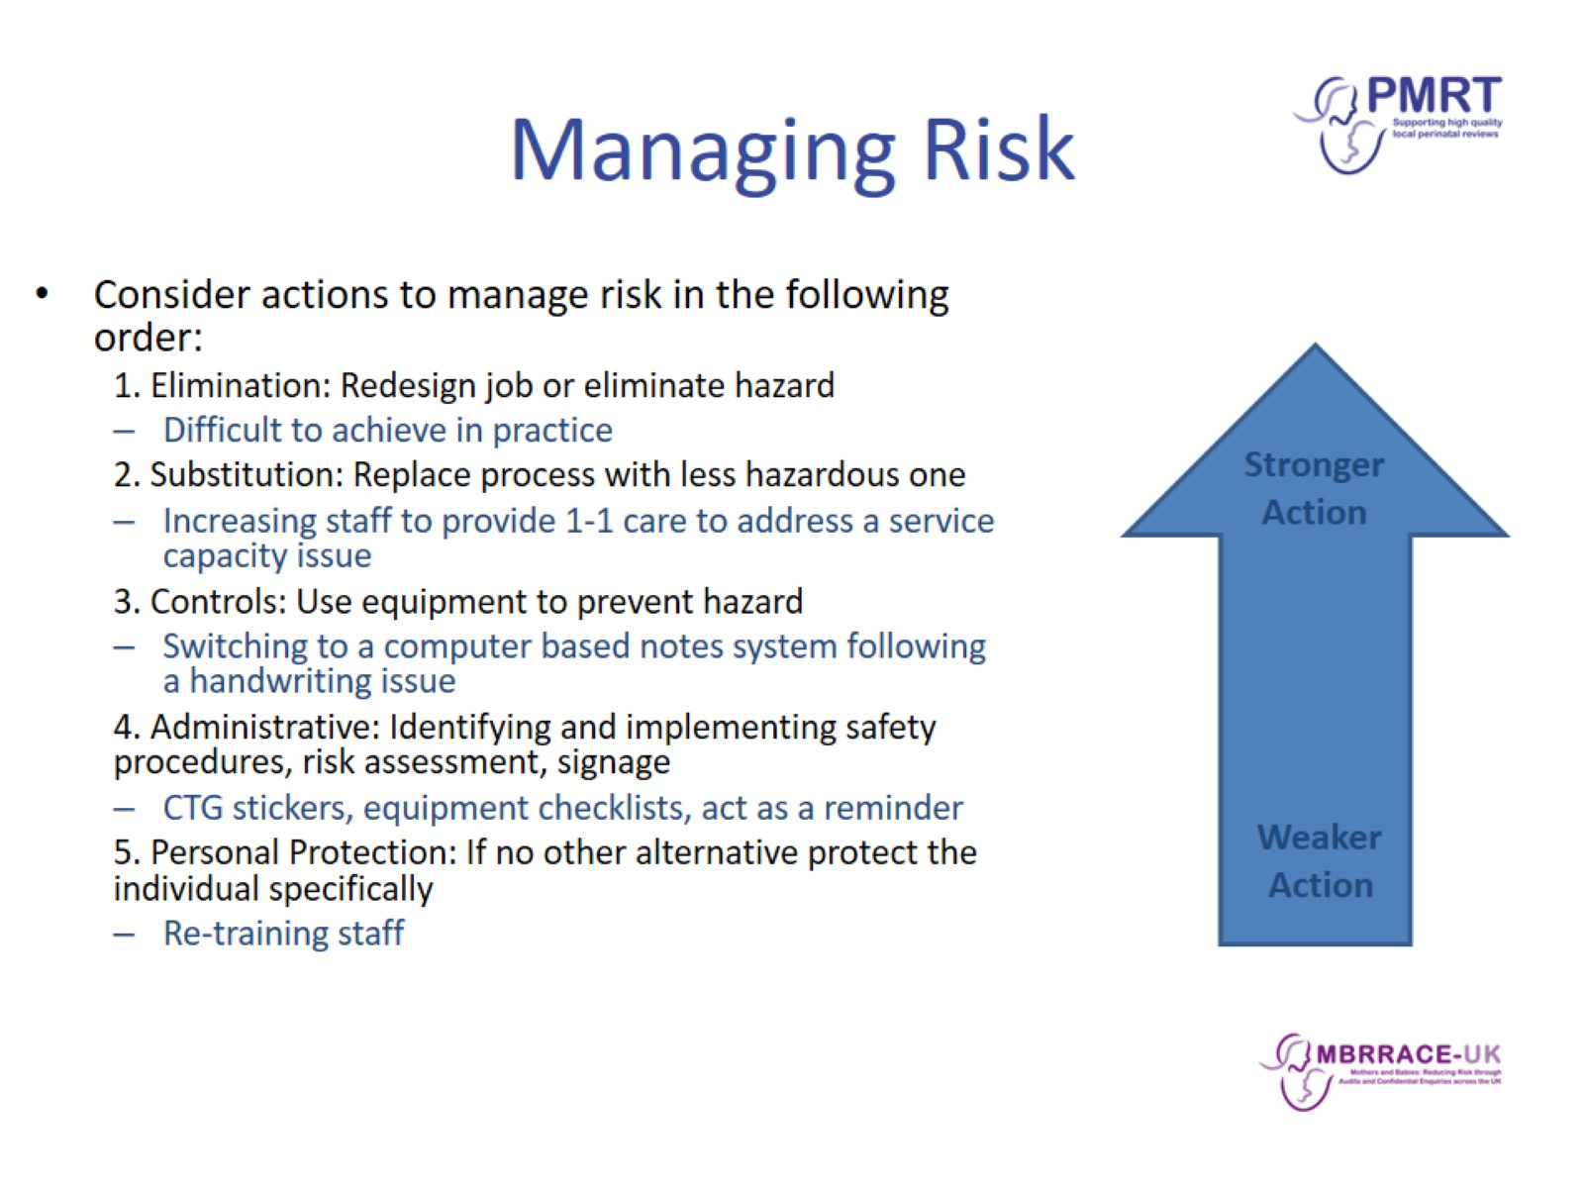
Managing Risk

Slide 5
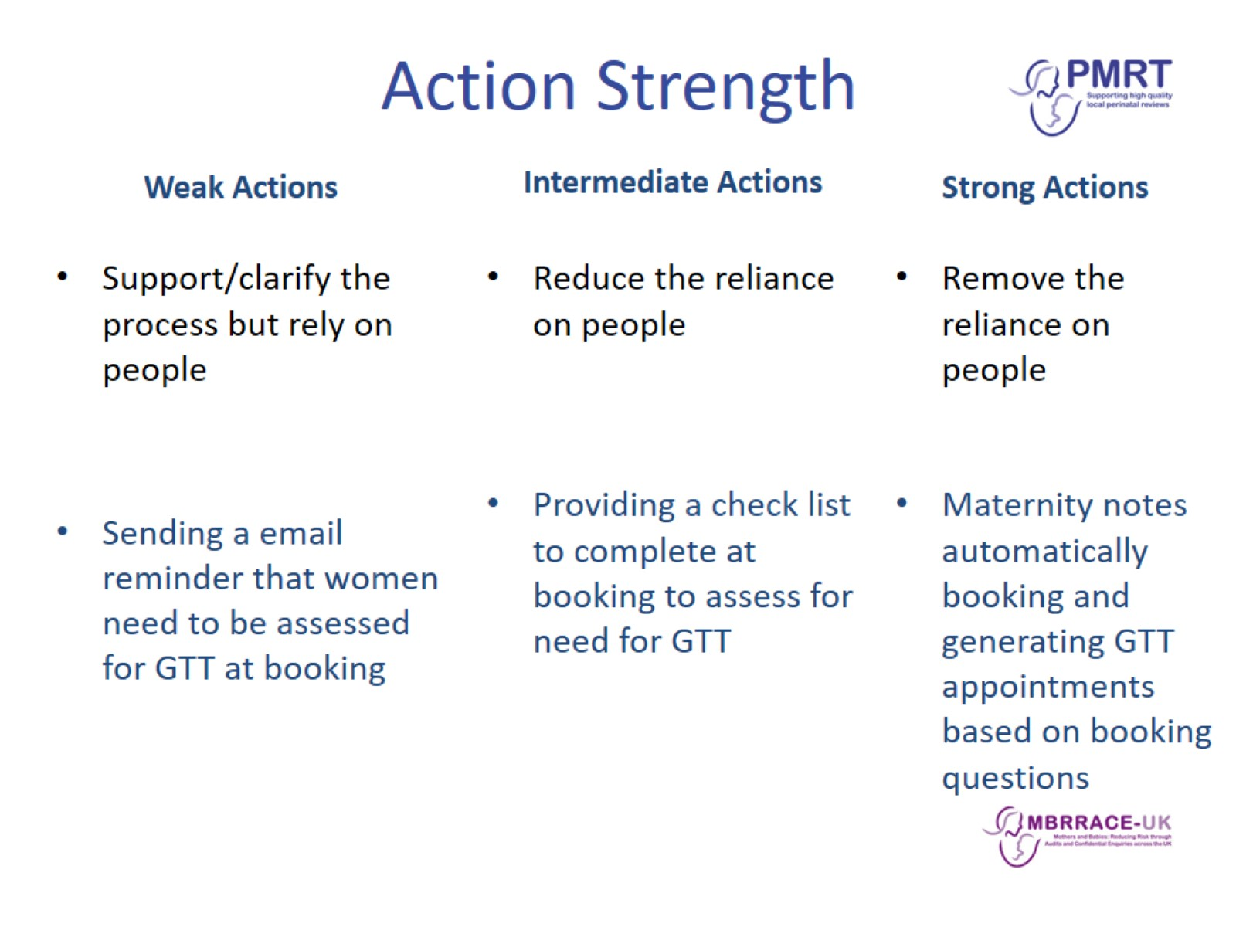
Action Strength

Slide 6
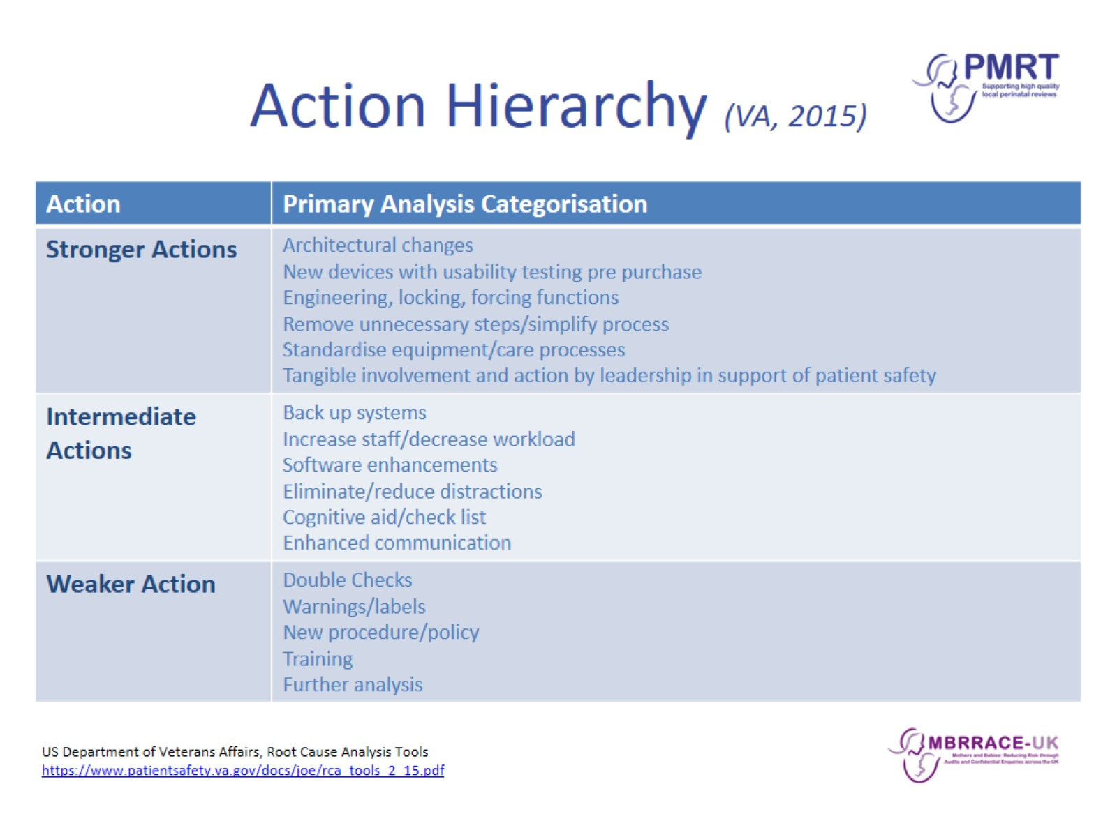
Action Hierarchy (VA, 2015)

Slide 7
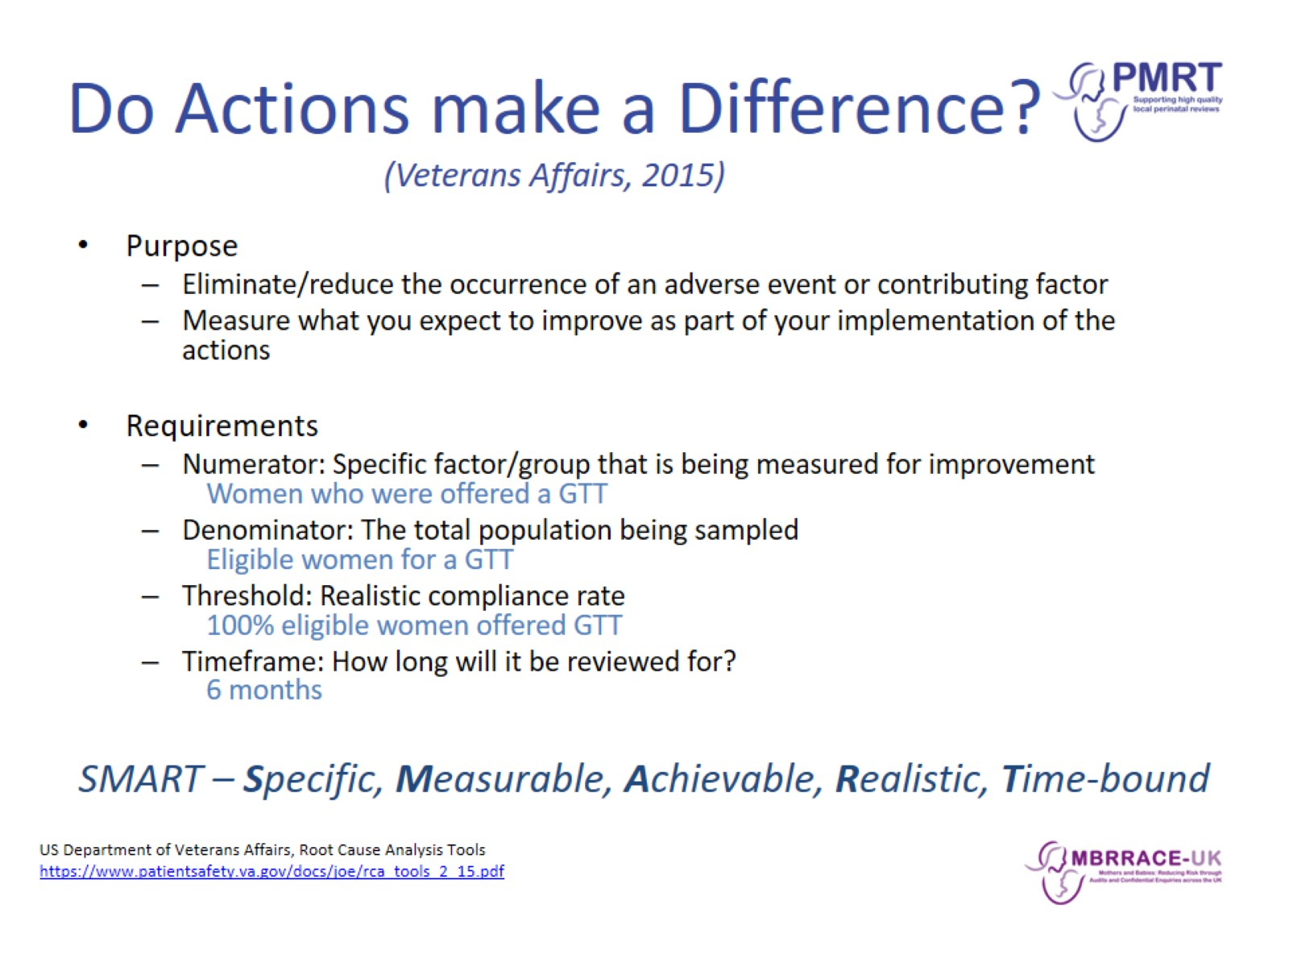
Do Actions make a Difference?
(Veterans Affairs, 2015)

Slide 8
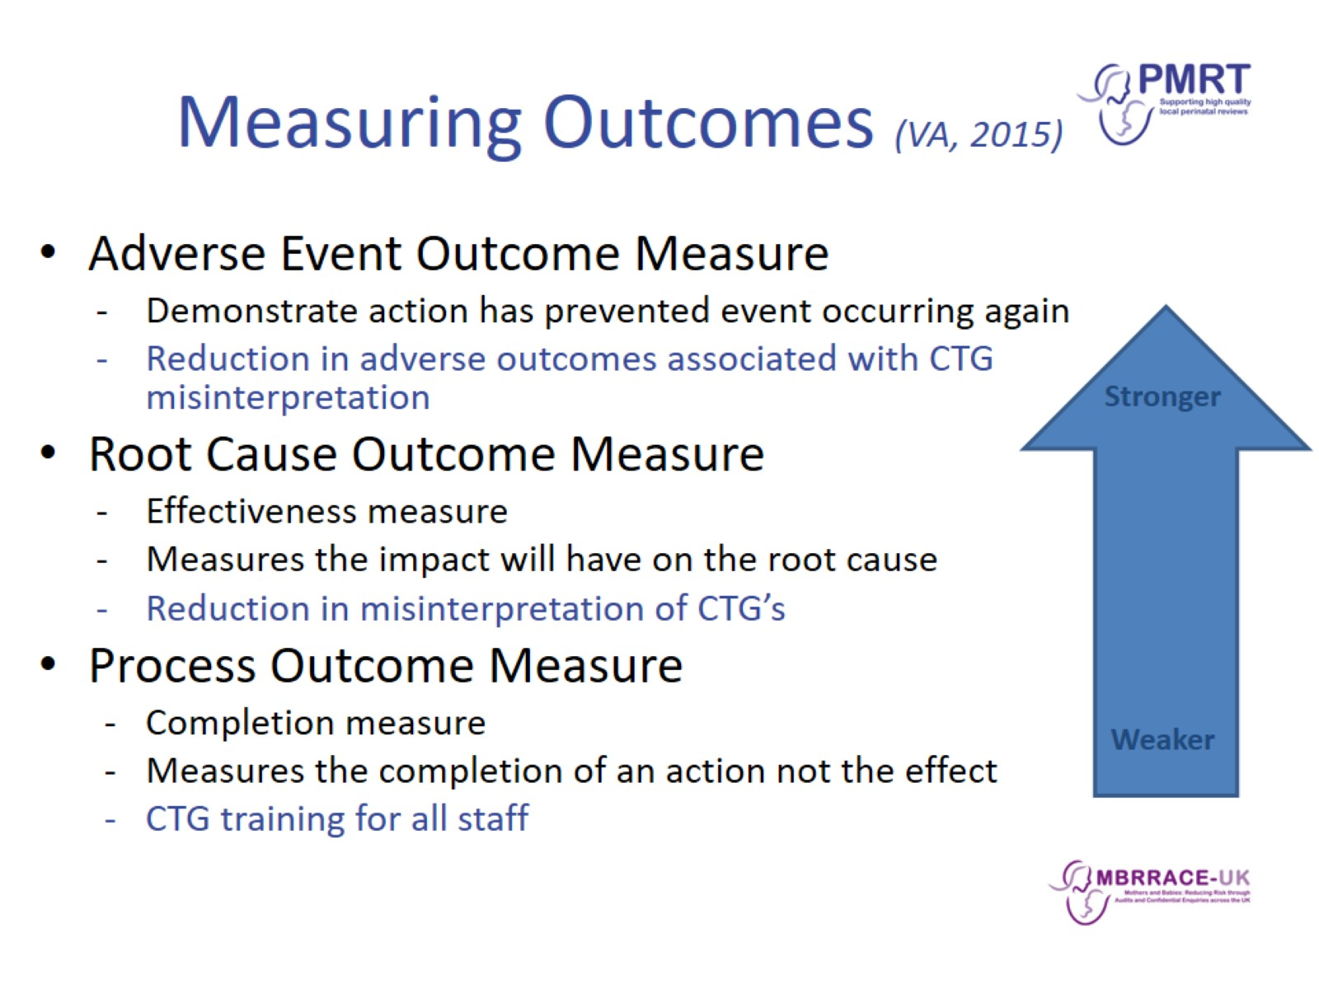
Measuring Outcomes (VA, 2015)

Slide 9
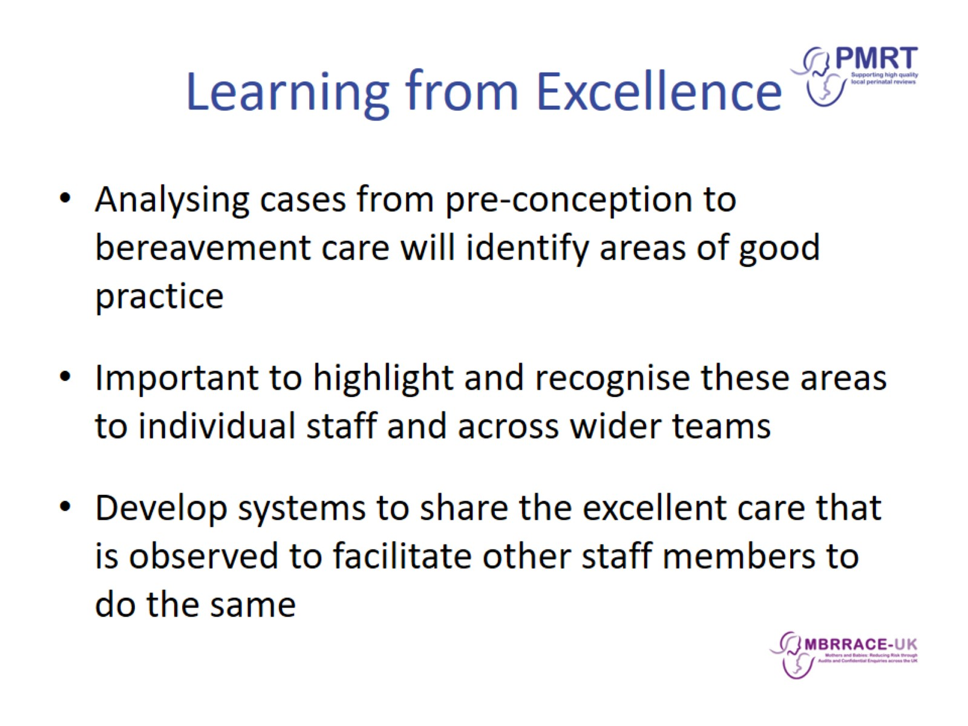
Learning from Excellence

Slide 10
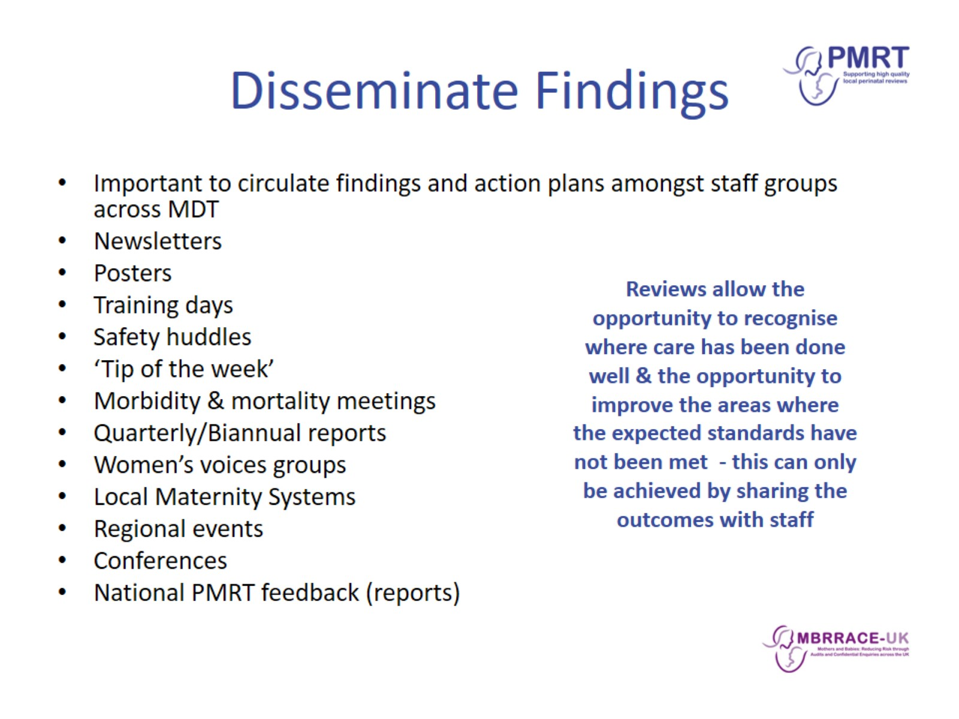
Disseminate Findings

Slide 11
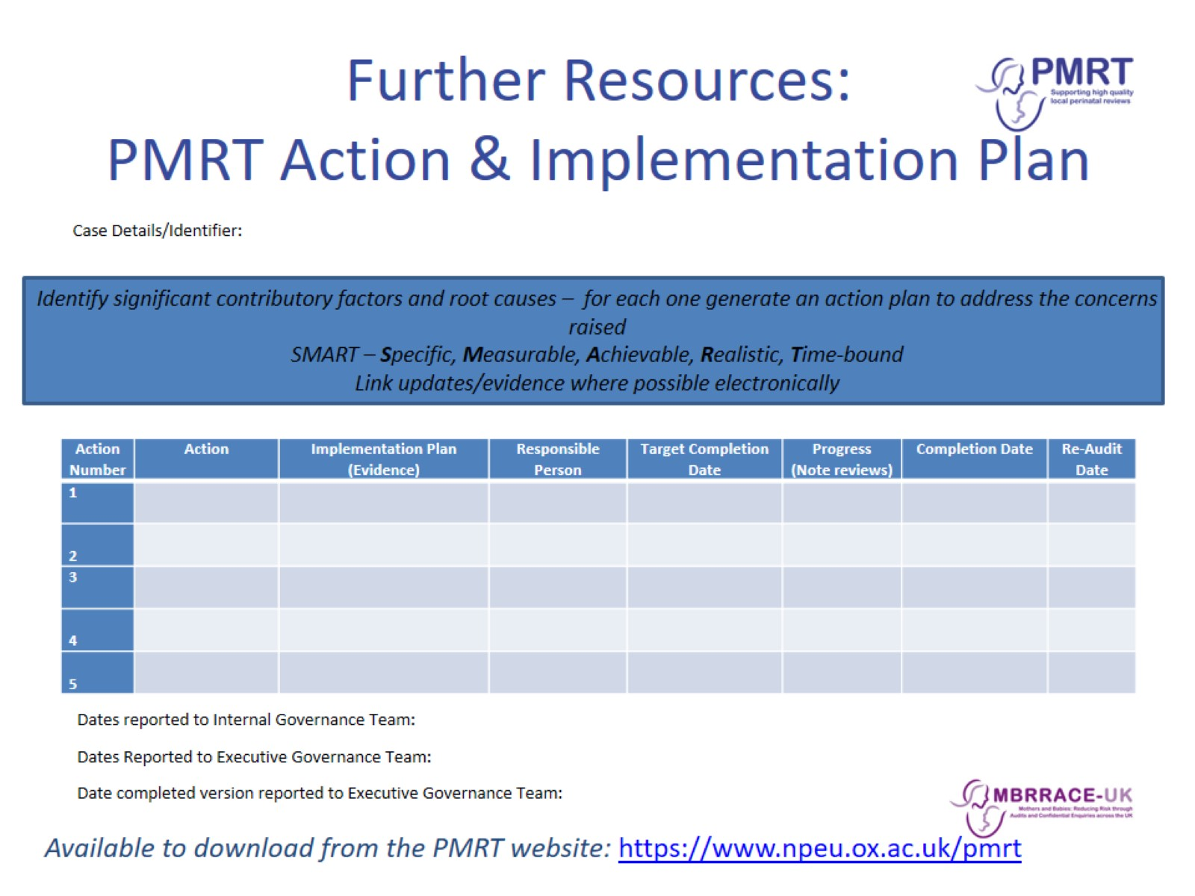
Further Resources:
PMRT Action & Implementation Plan

Slide 12
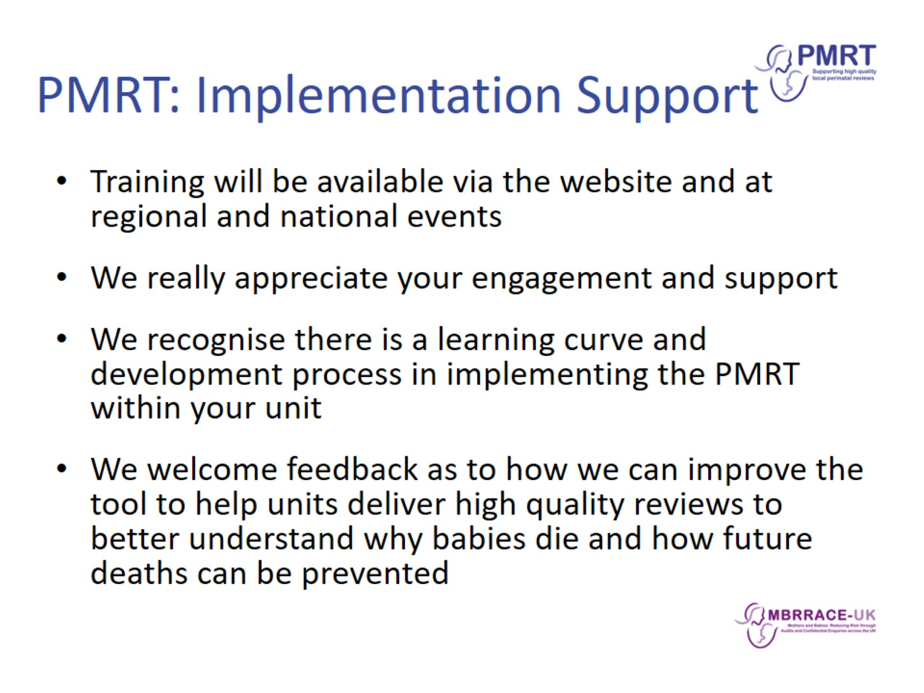
PMRT: Implementation Support

Slide 13
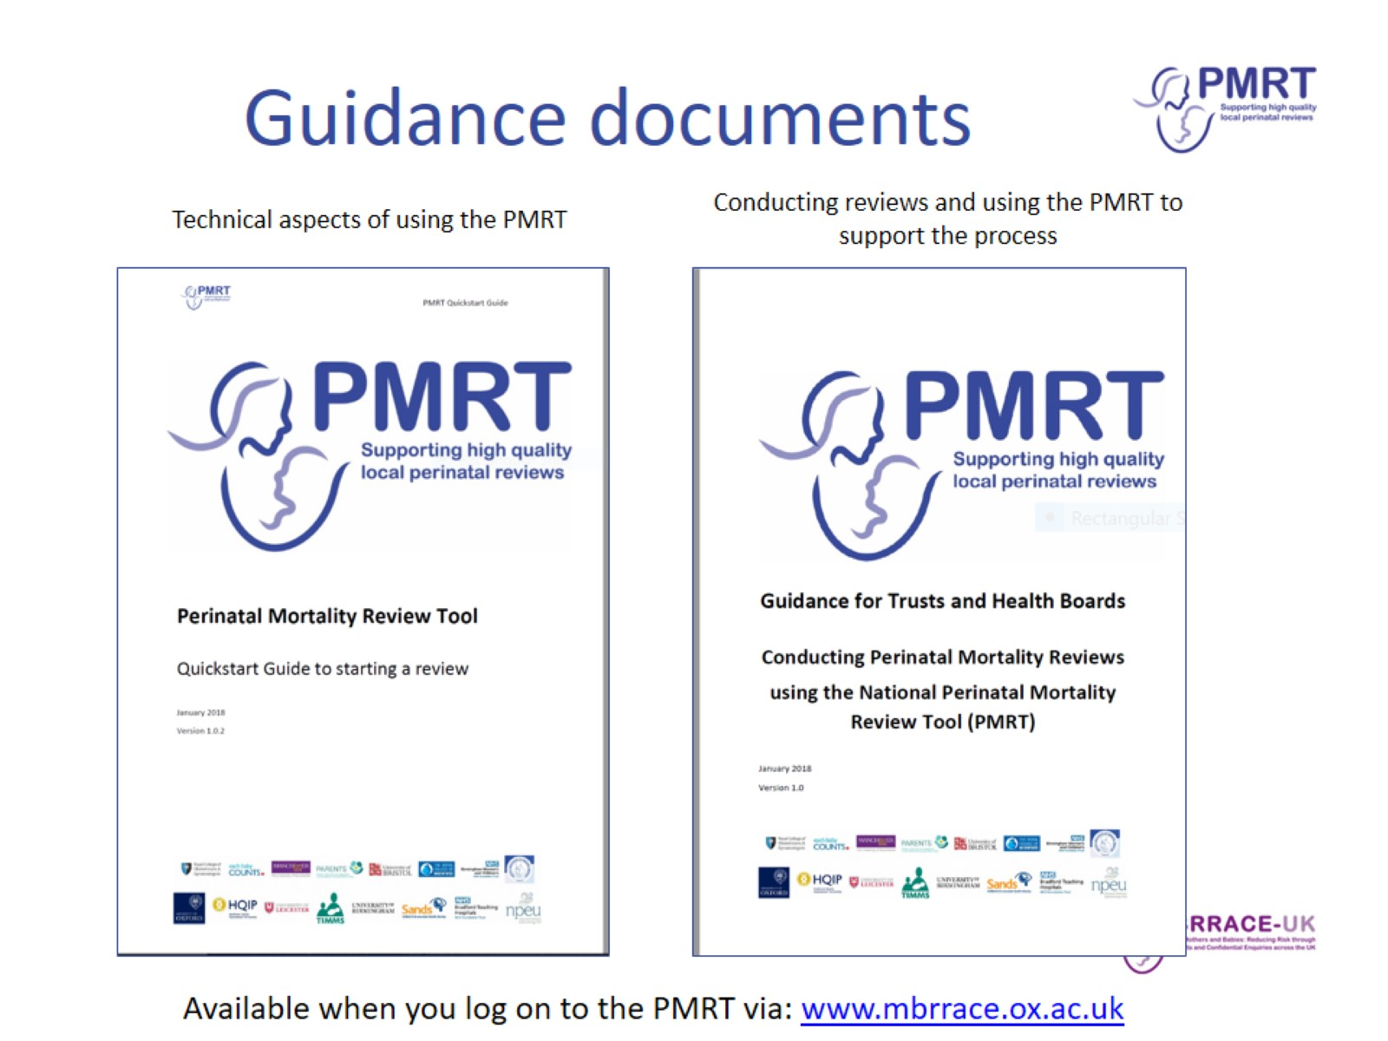
Guidance documents

Slide 14
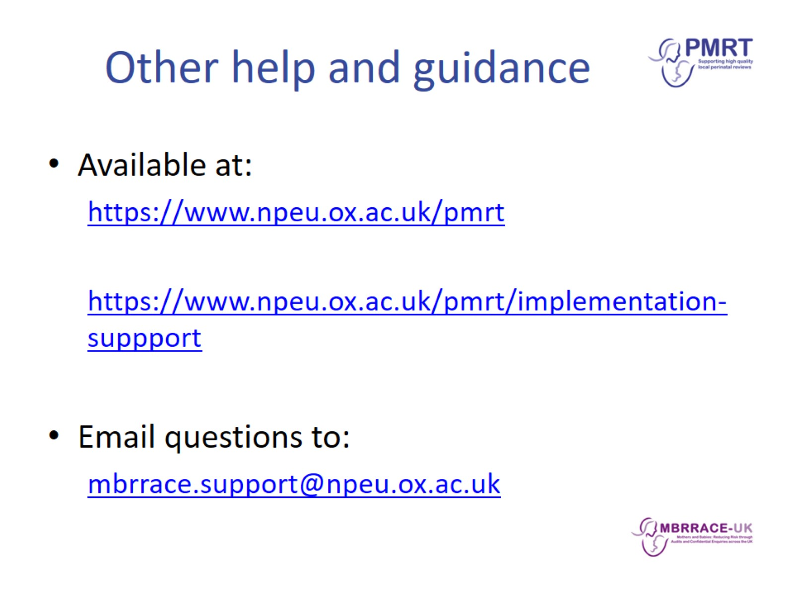
Other help and guidance

