Slide 1

Introducing the Perinatal Mortality Review Tool

Slide 2
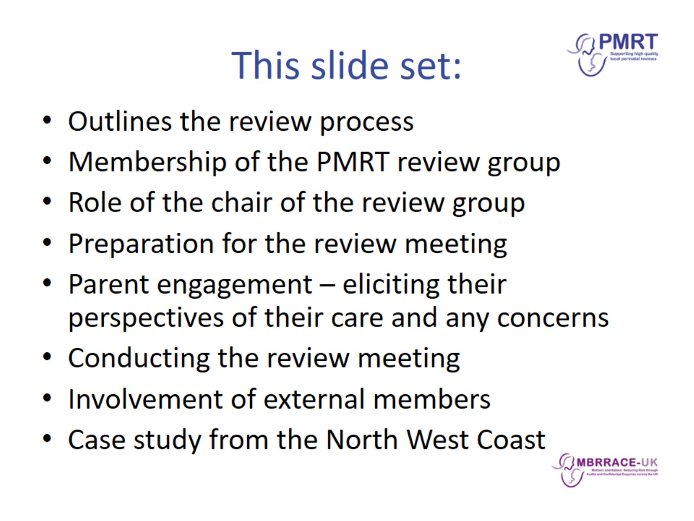
This slide set:

Slide 3
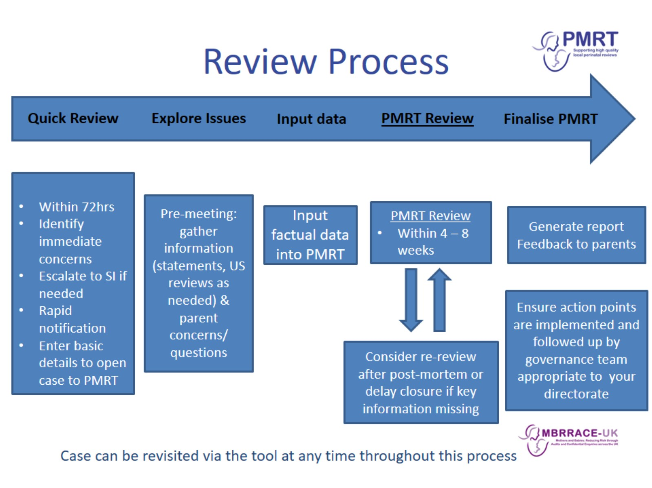
Review Process

Slide 4
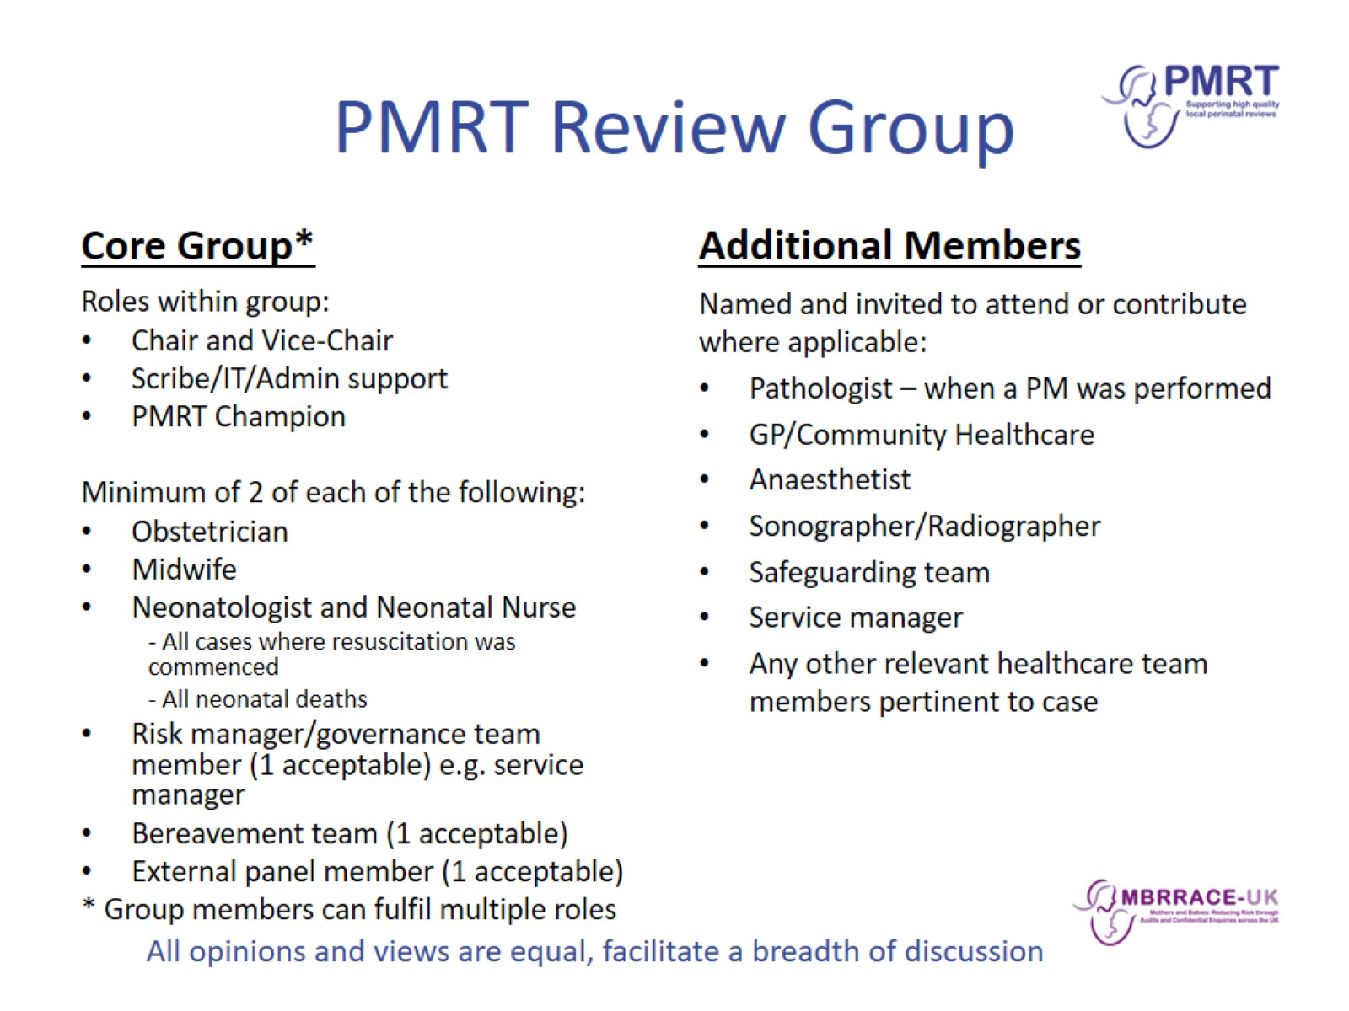
PMRT Review Group

Slide 5
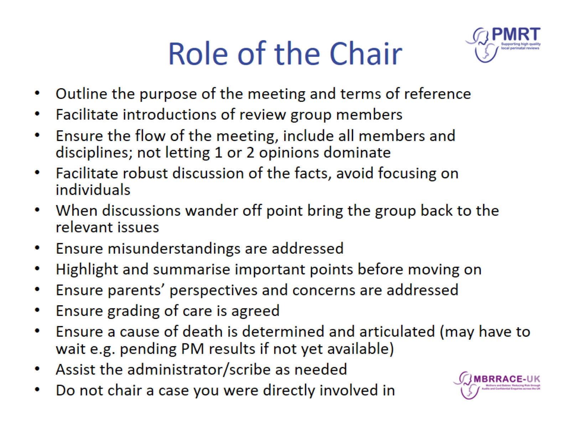
Role of the Chair

Slide 6
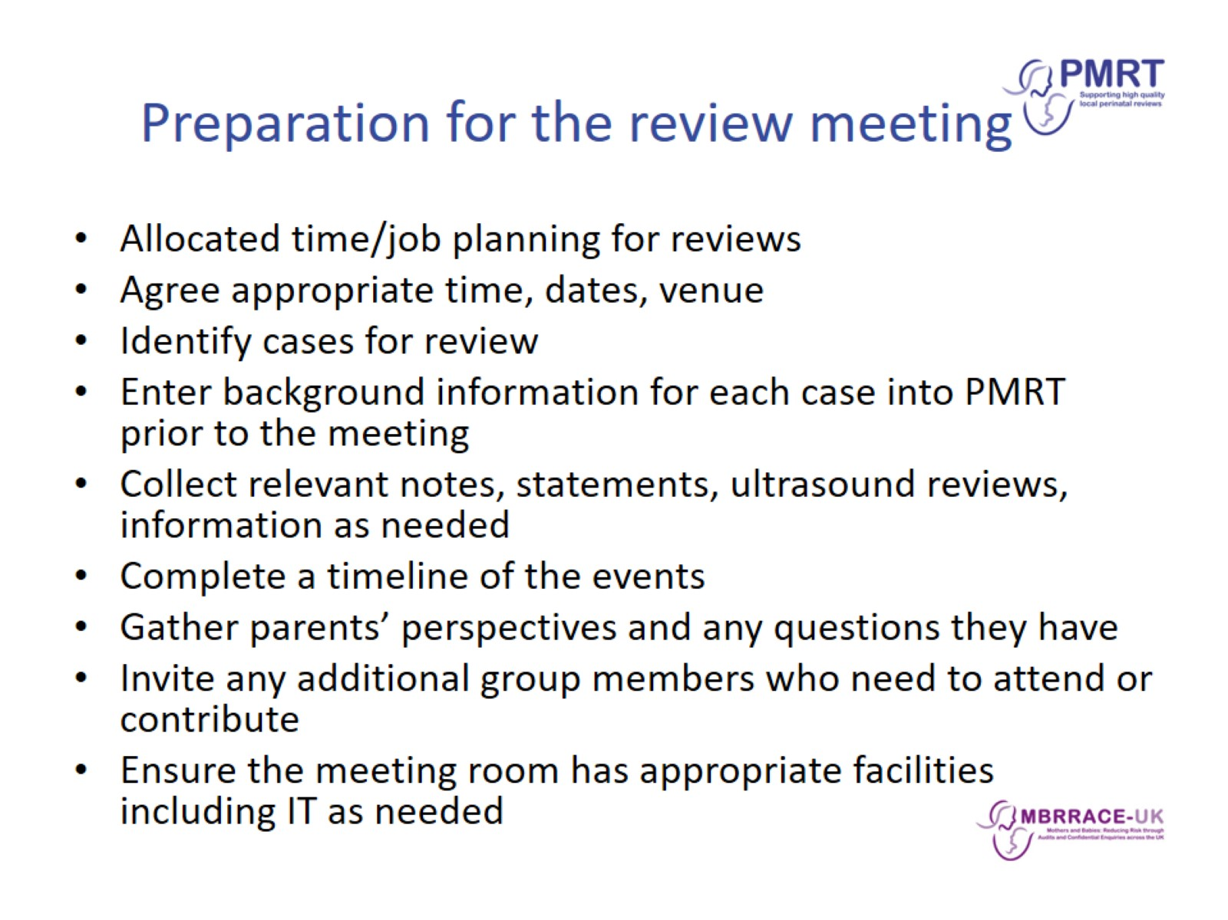
Preparation for the review meeting

Slide 7
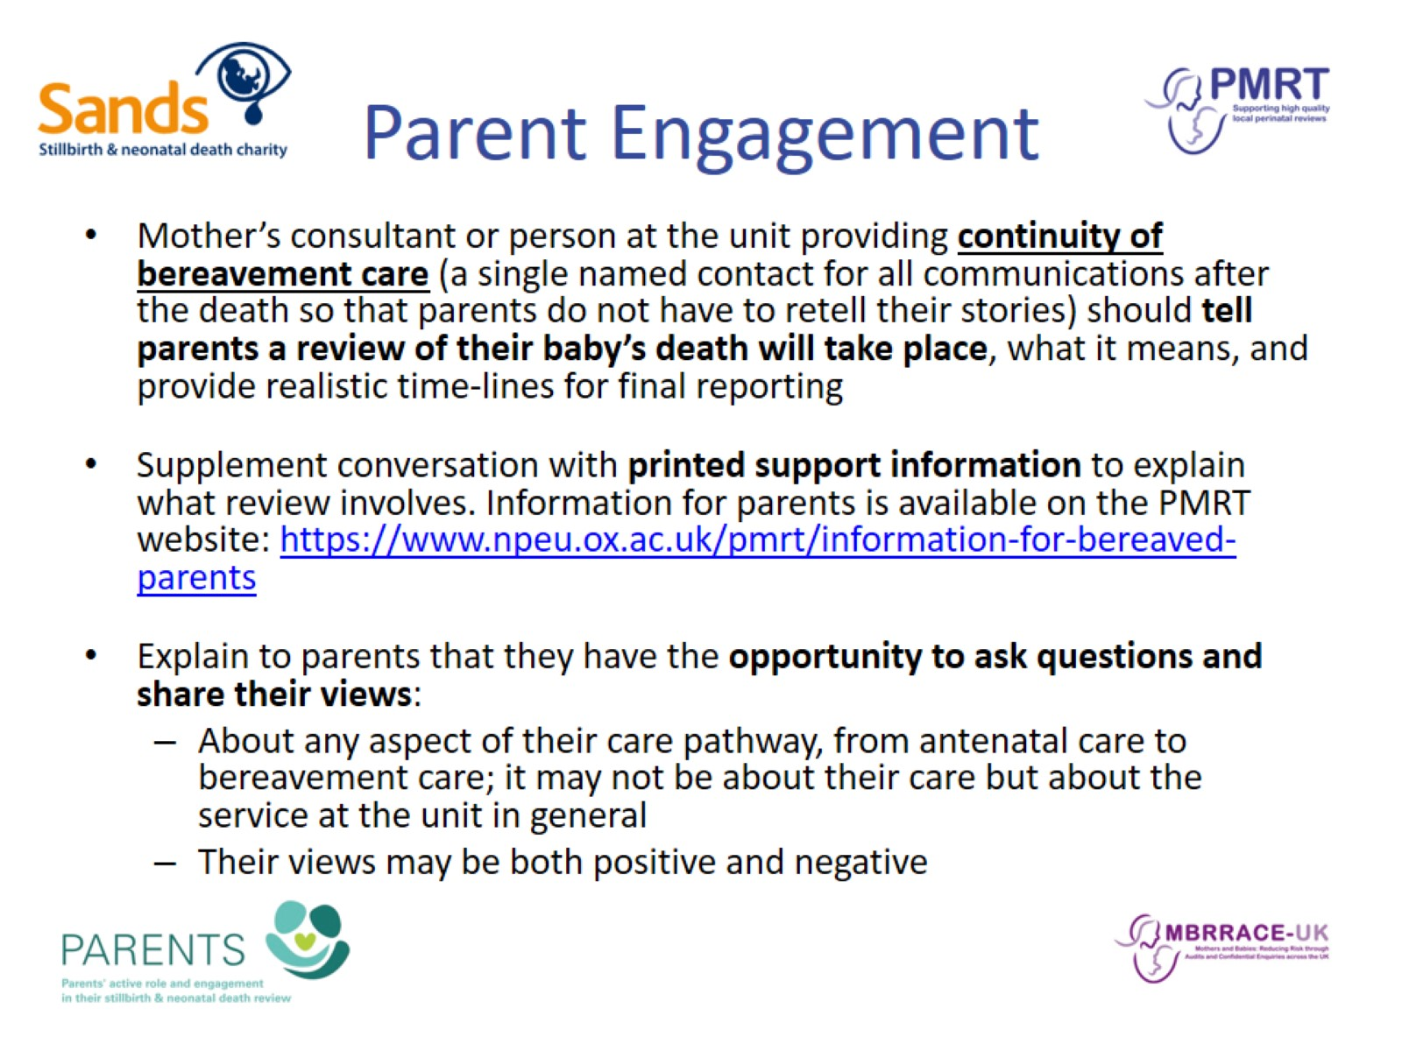
Parent Engagement

Slide 8
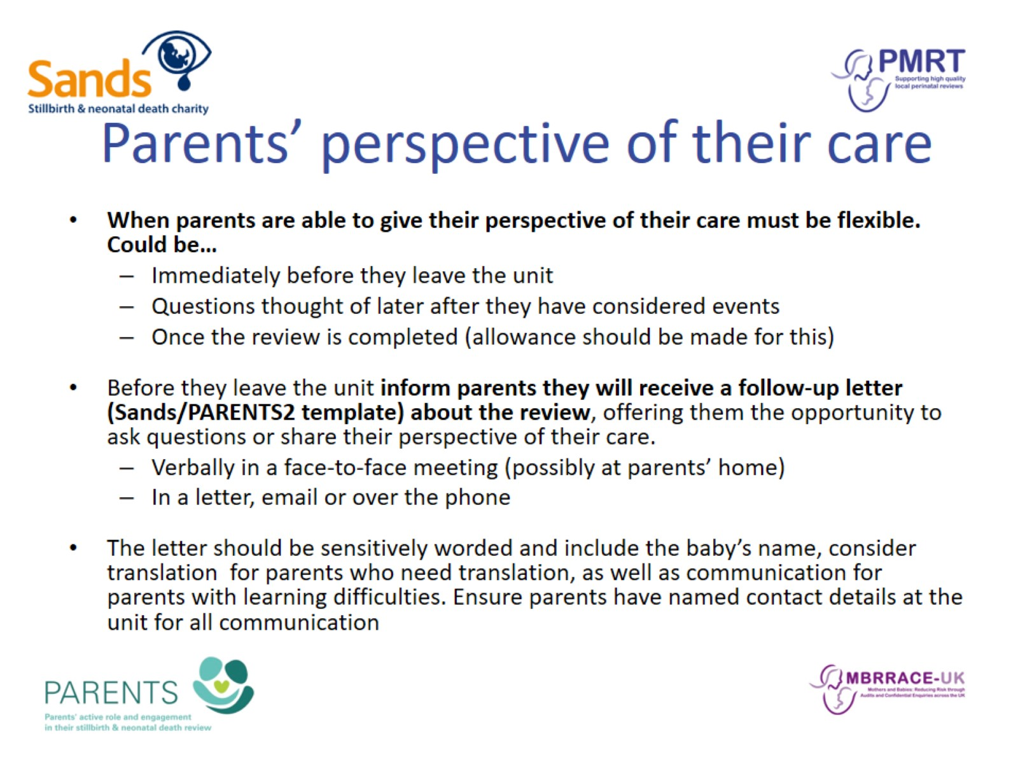
Parents’ perspective of their care

Slide 9
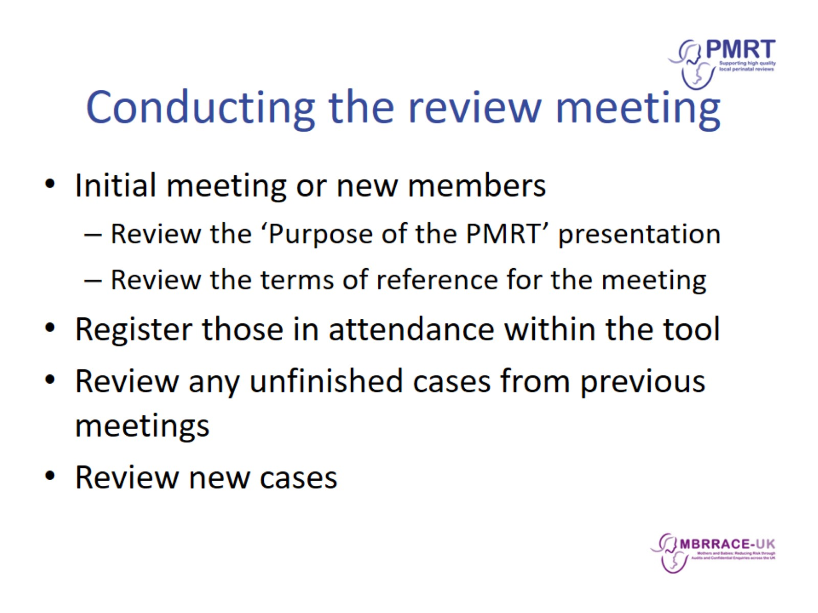
Conducting the review meeting

Slide 10
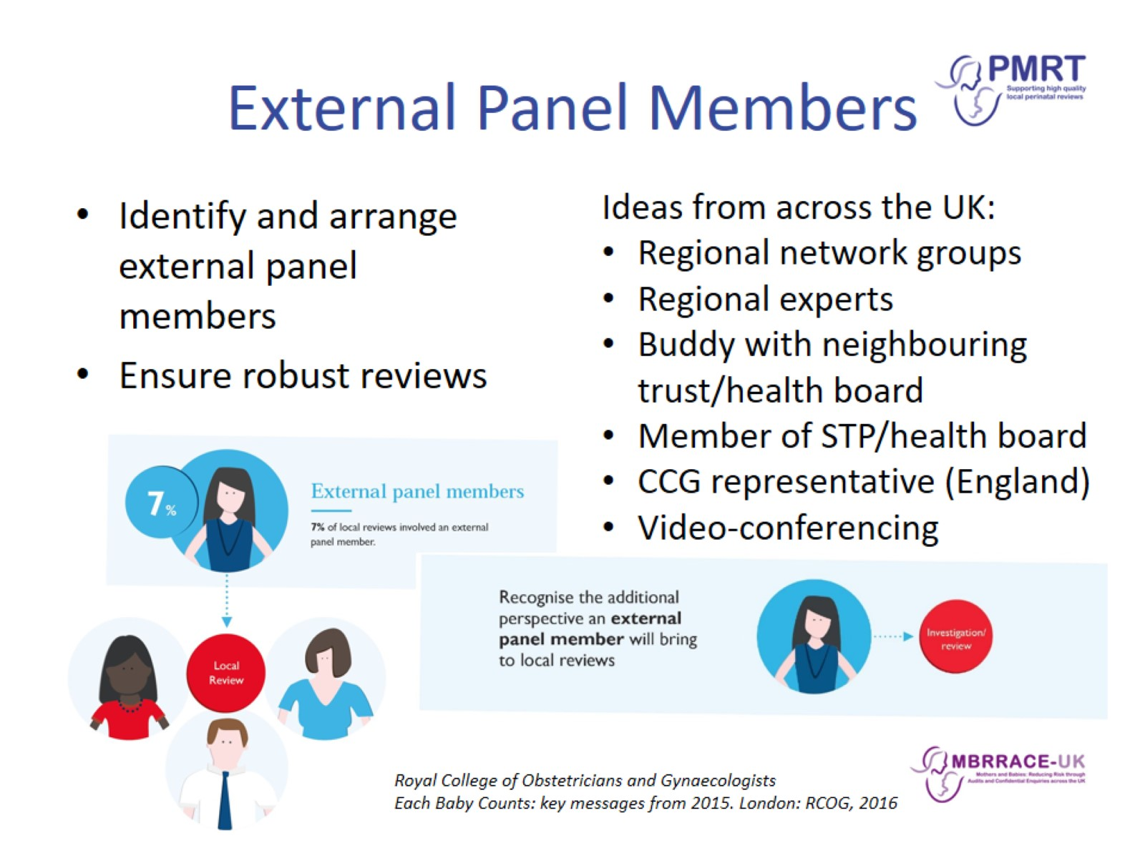
External Panel Members

Slide 11
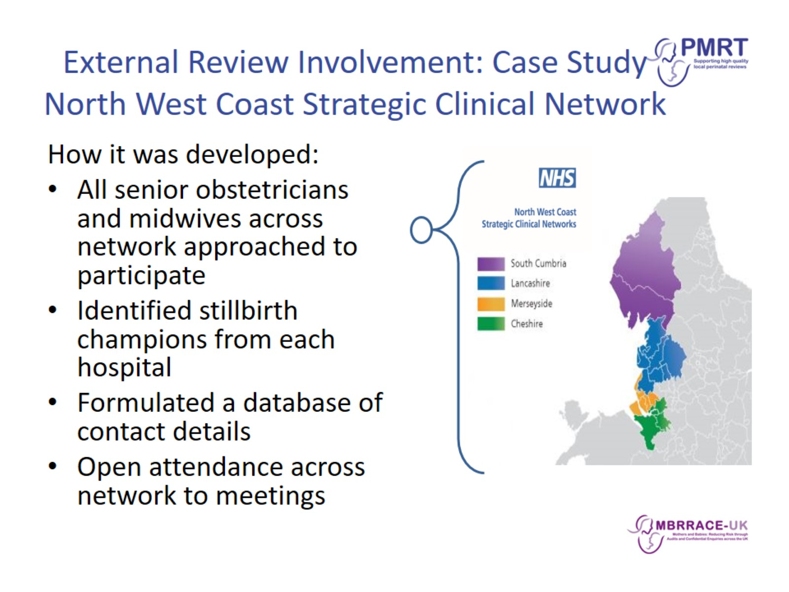
External Review Involvement: Case Study
North West Coast Strategic Clinical Network

Slide 12
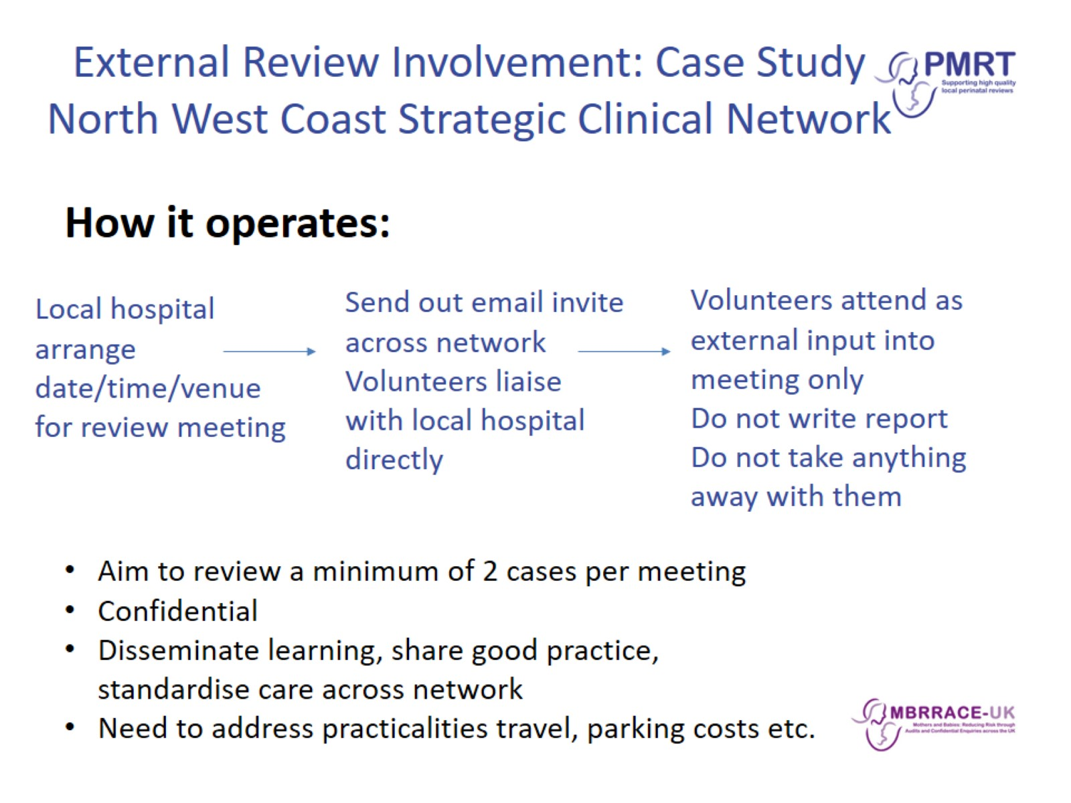
External Review Involvement: Case Study
North West Coast Strategic Clinical Network

Slide 13
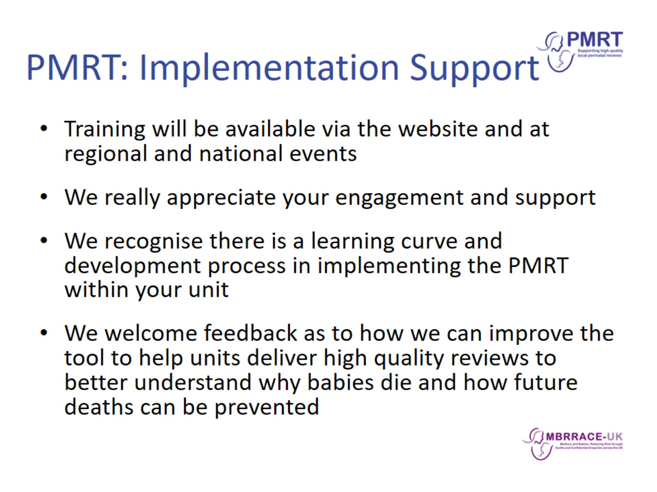
PMRT: Implementation Support

Slide 14
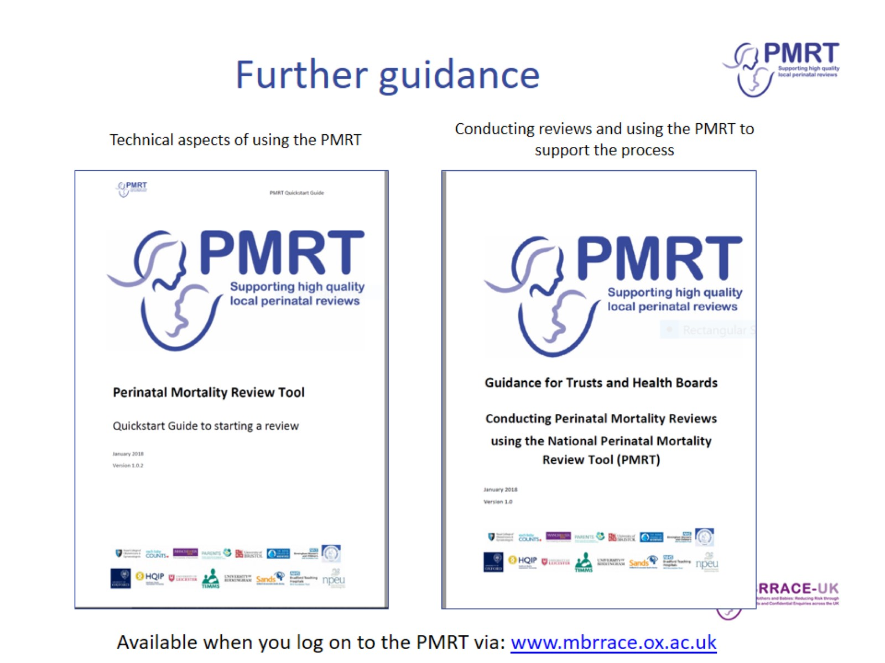
Further guidance

Slide 15
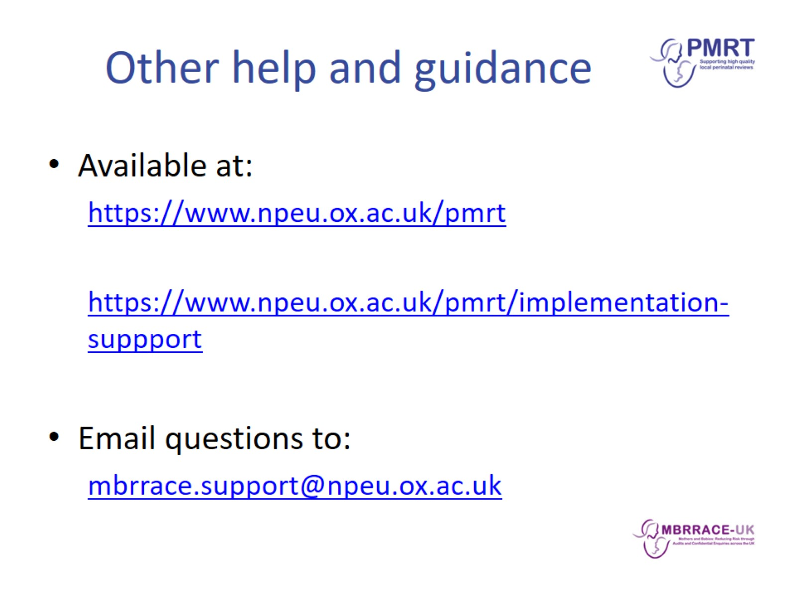
Other help and guidance

