Slide 1
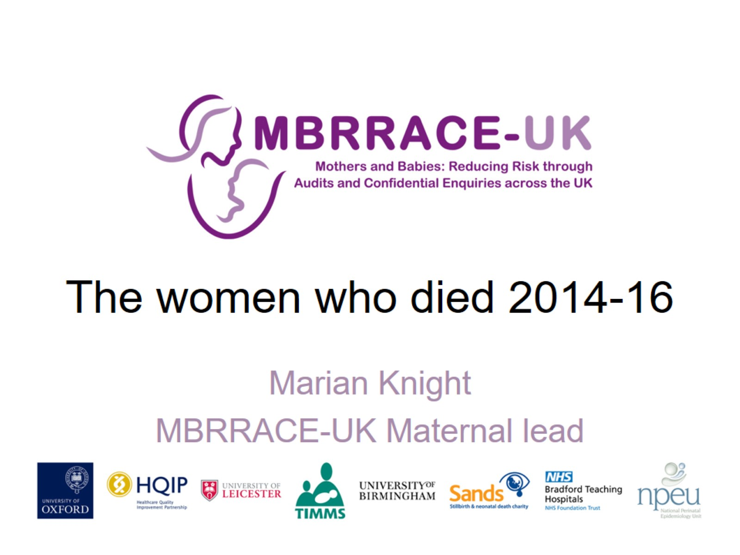
The women who died 2014-16

Slide 2
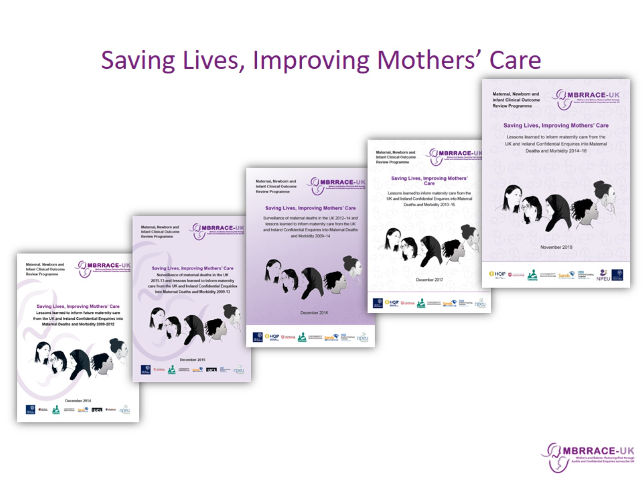
Saving Lives, Improving Mothers’ Care

Slide 3
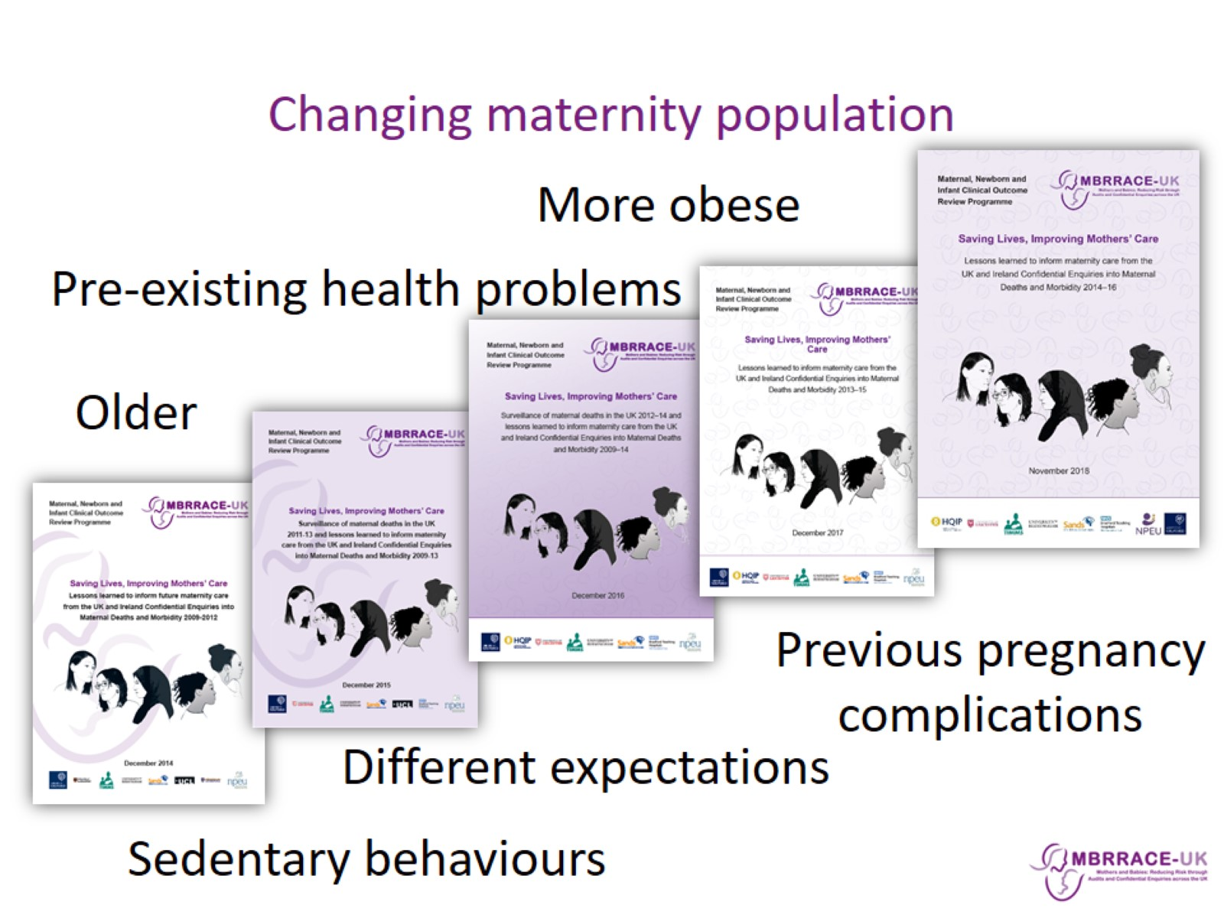
Changing maternity population

Slide 4
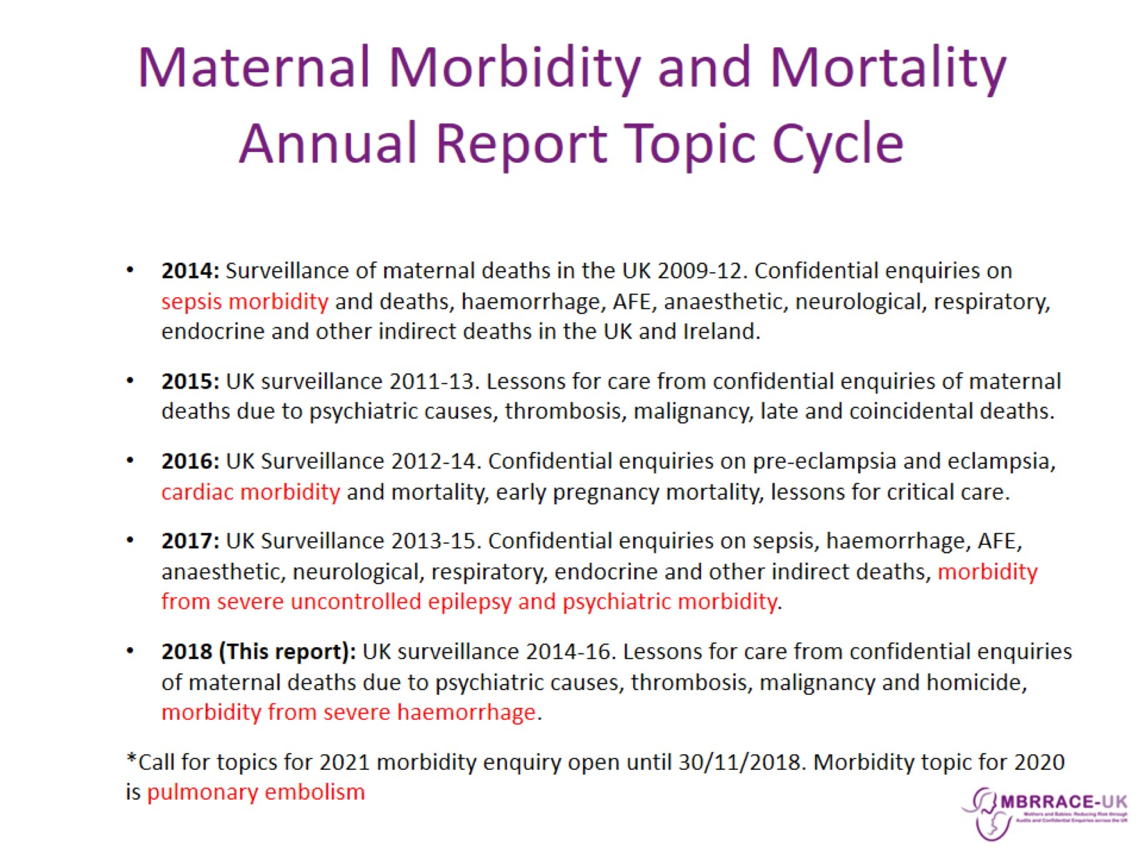
Maternal Morbidity and Mortality
Annual Report Topic Cycle

Slide 5
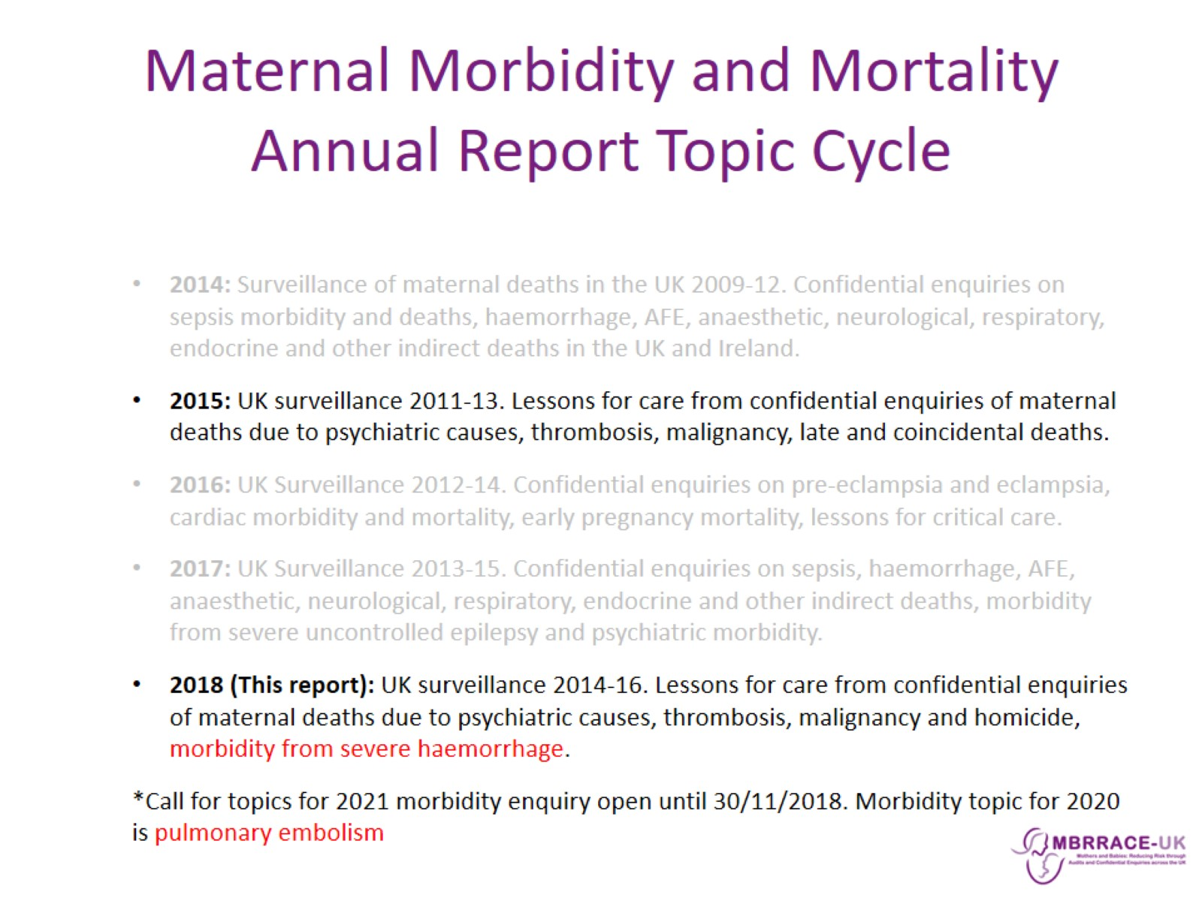
Maternal Morbidity and Mortality
Annual Report Topic Cycle

Slide 6

MBRRACE-UK: Methods

Slide 7
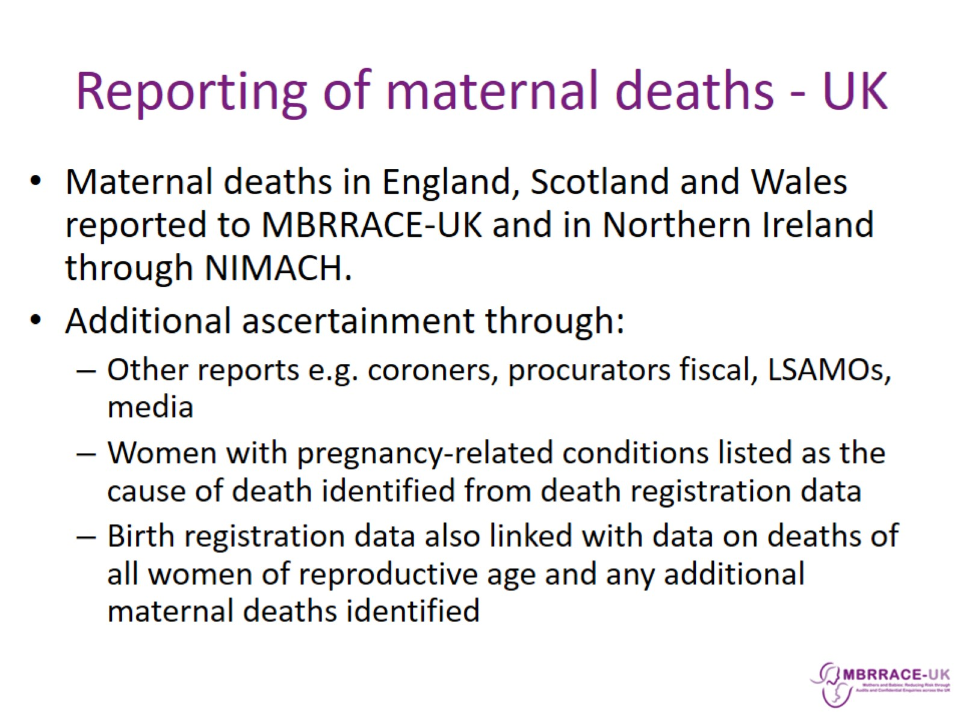
Reporting of maternal deaths - UK

Slide 8
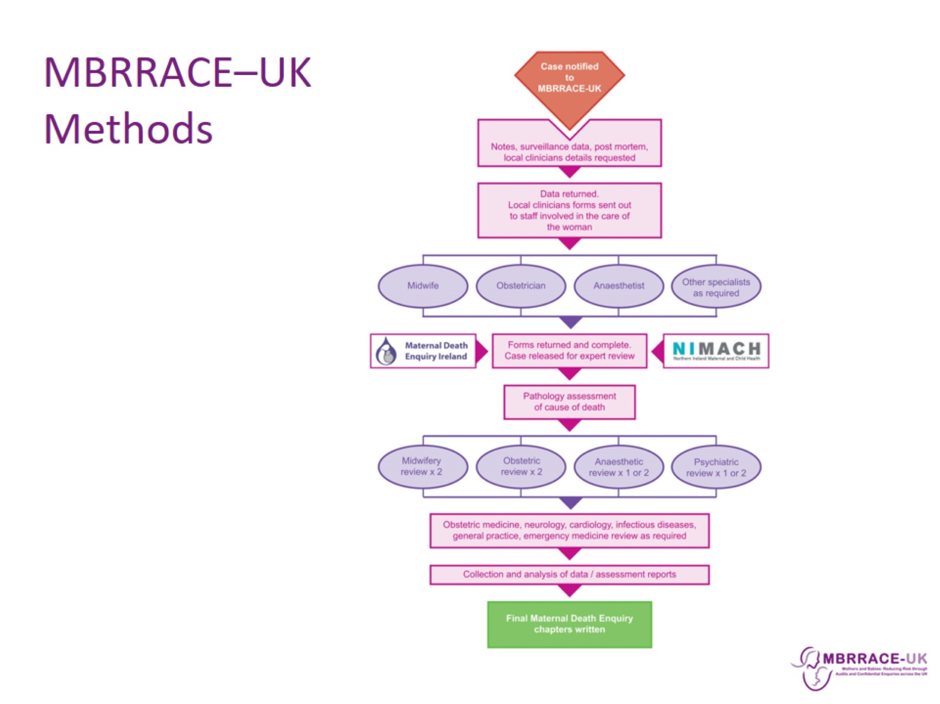
MBRRACE–UK Methods

Slide 9
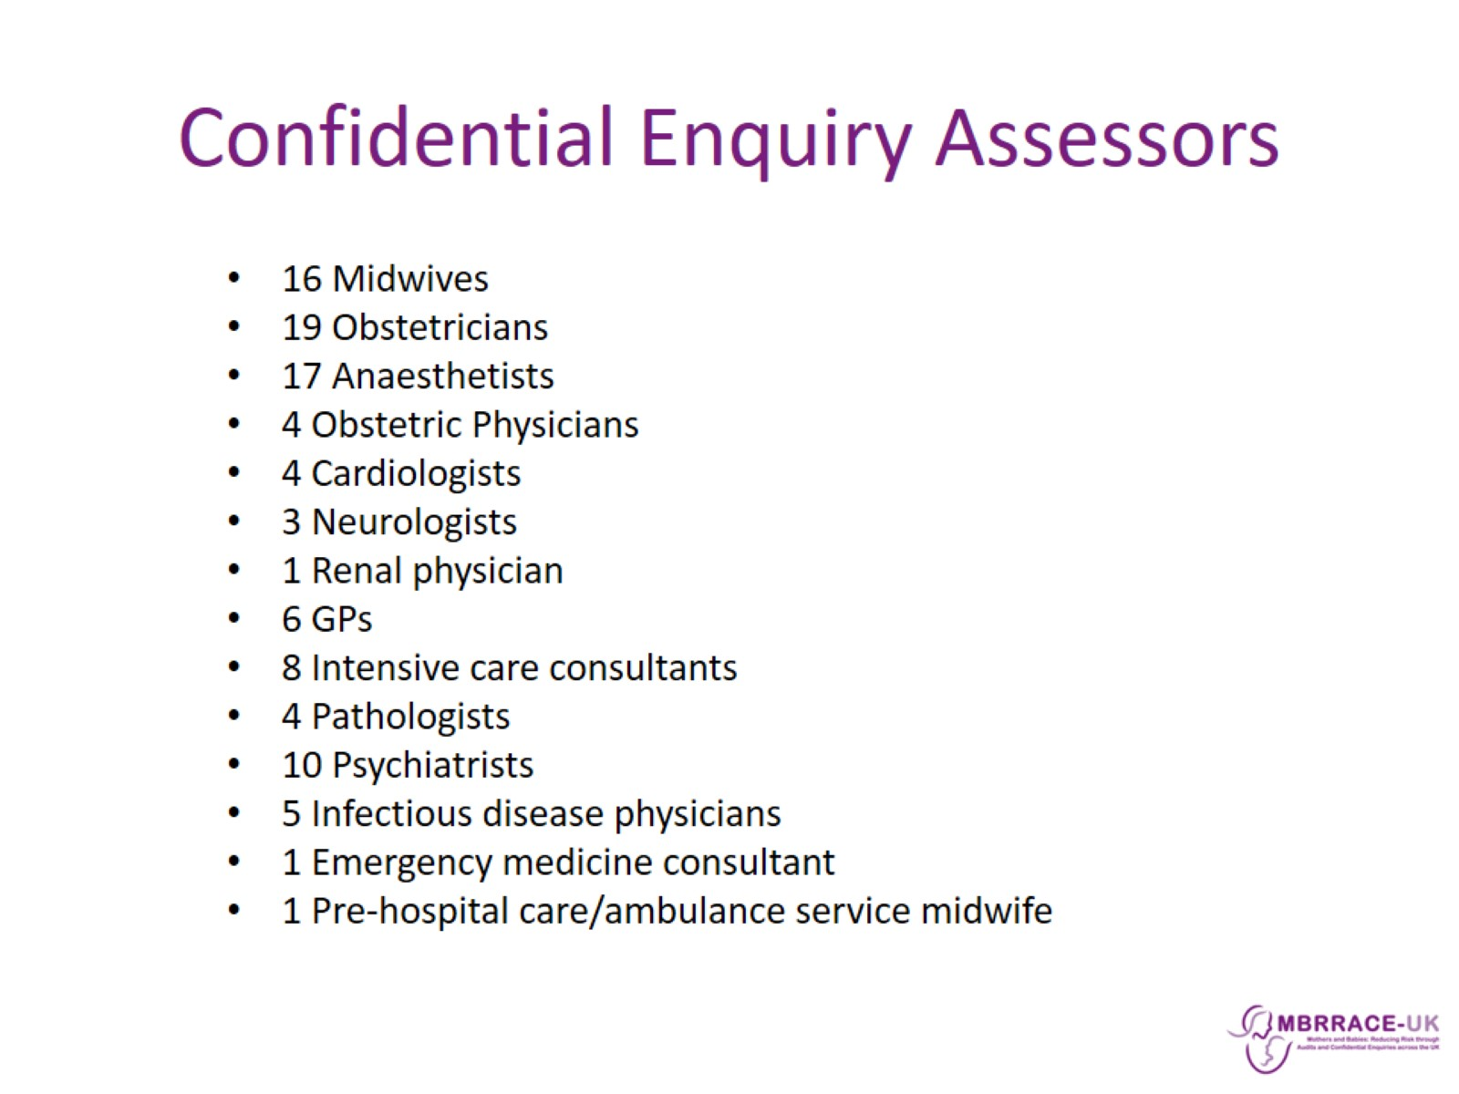
Confidential Enquiry Assessors

Slide 10
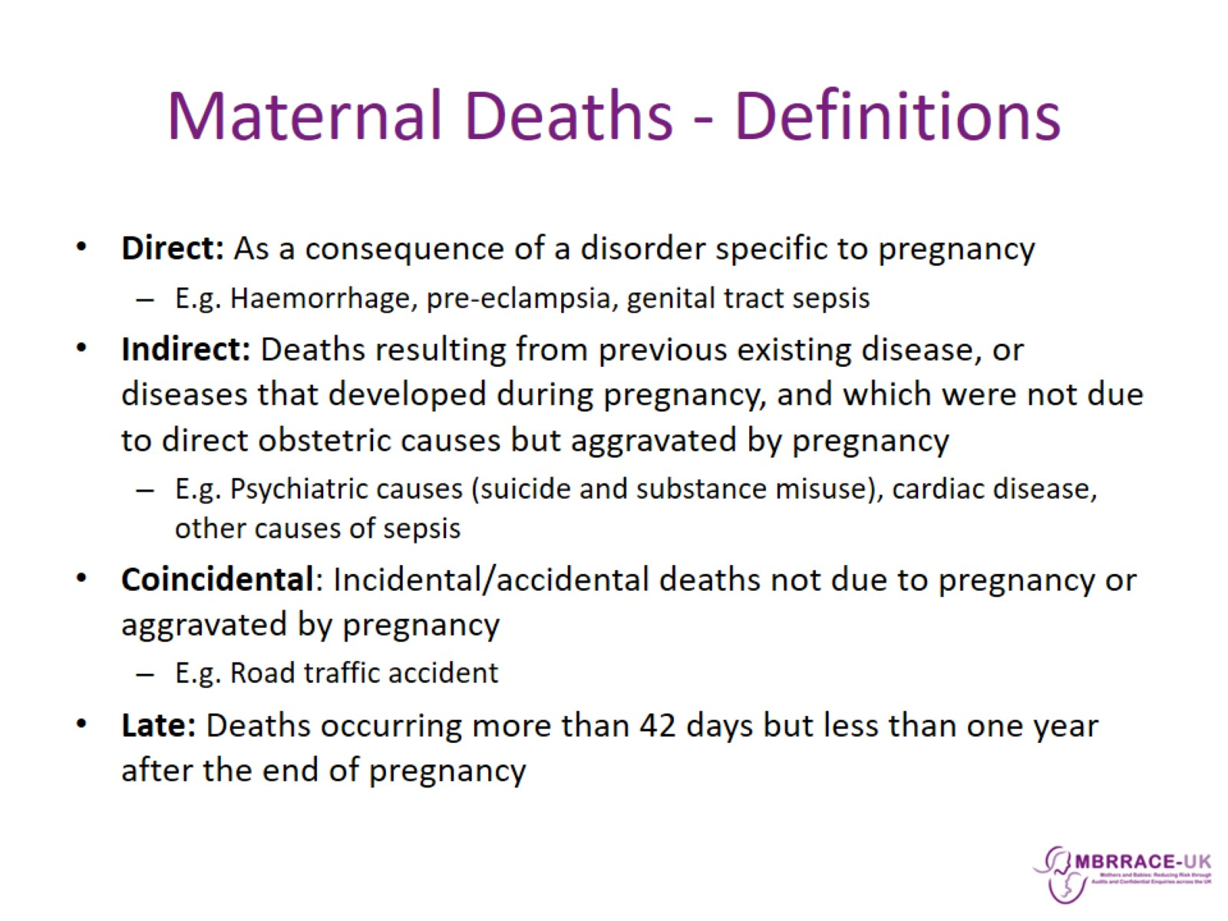
Maternal Deaths - Definitions

Slide 11
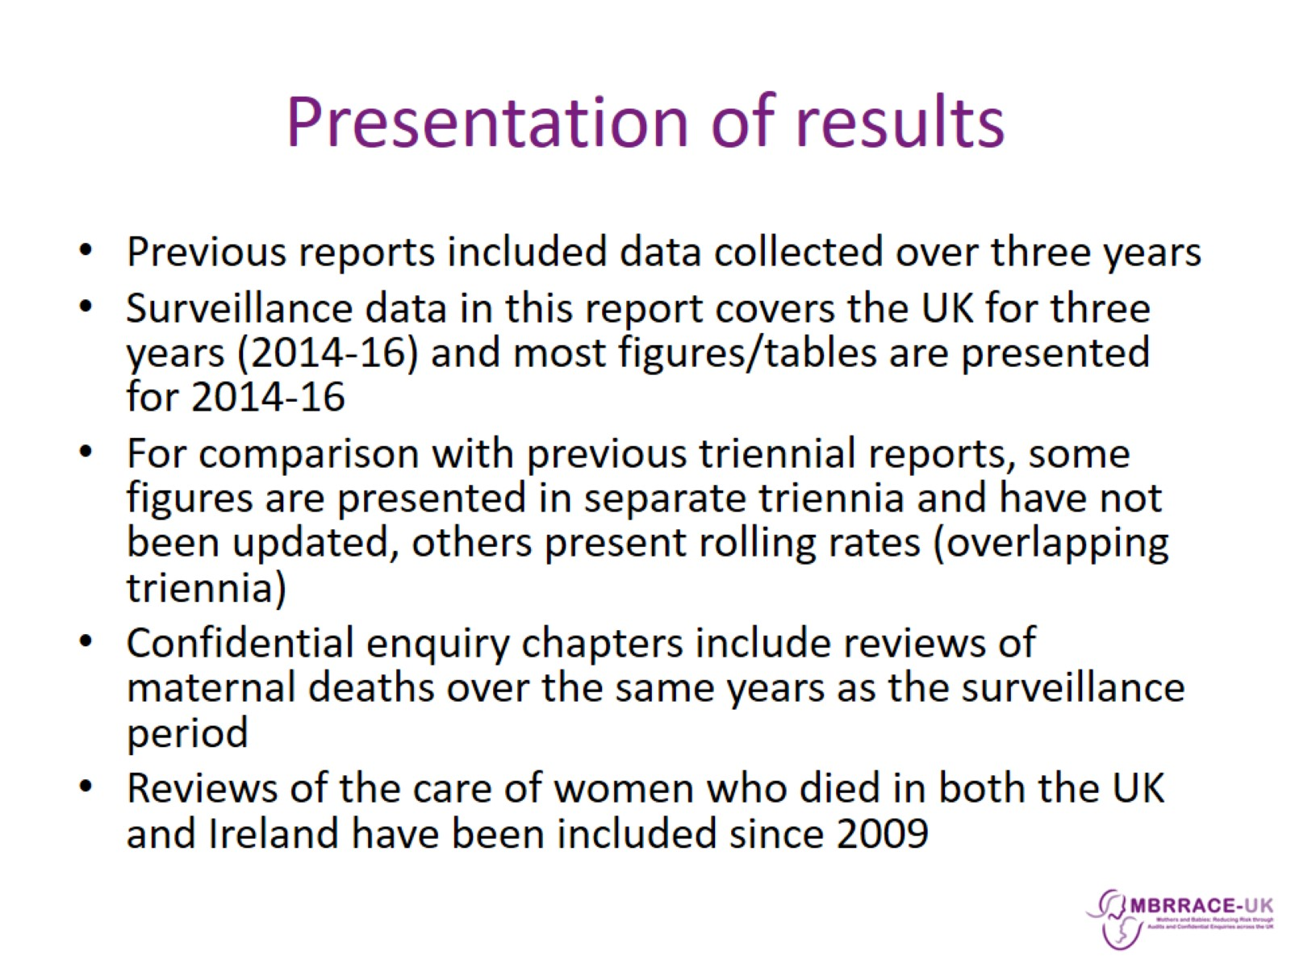
Presentation of results

Slide 12
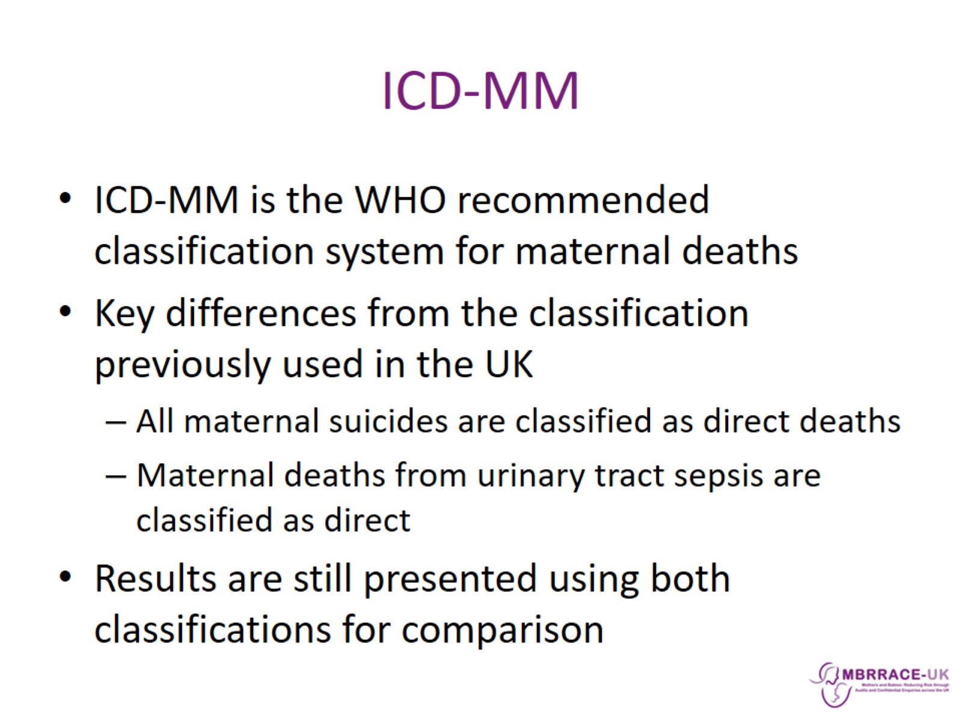
ICD-MM

Slide 13

MBRRACE-UK: Surveillance results

Slide 14
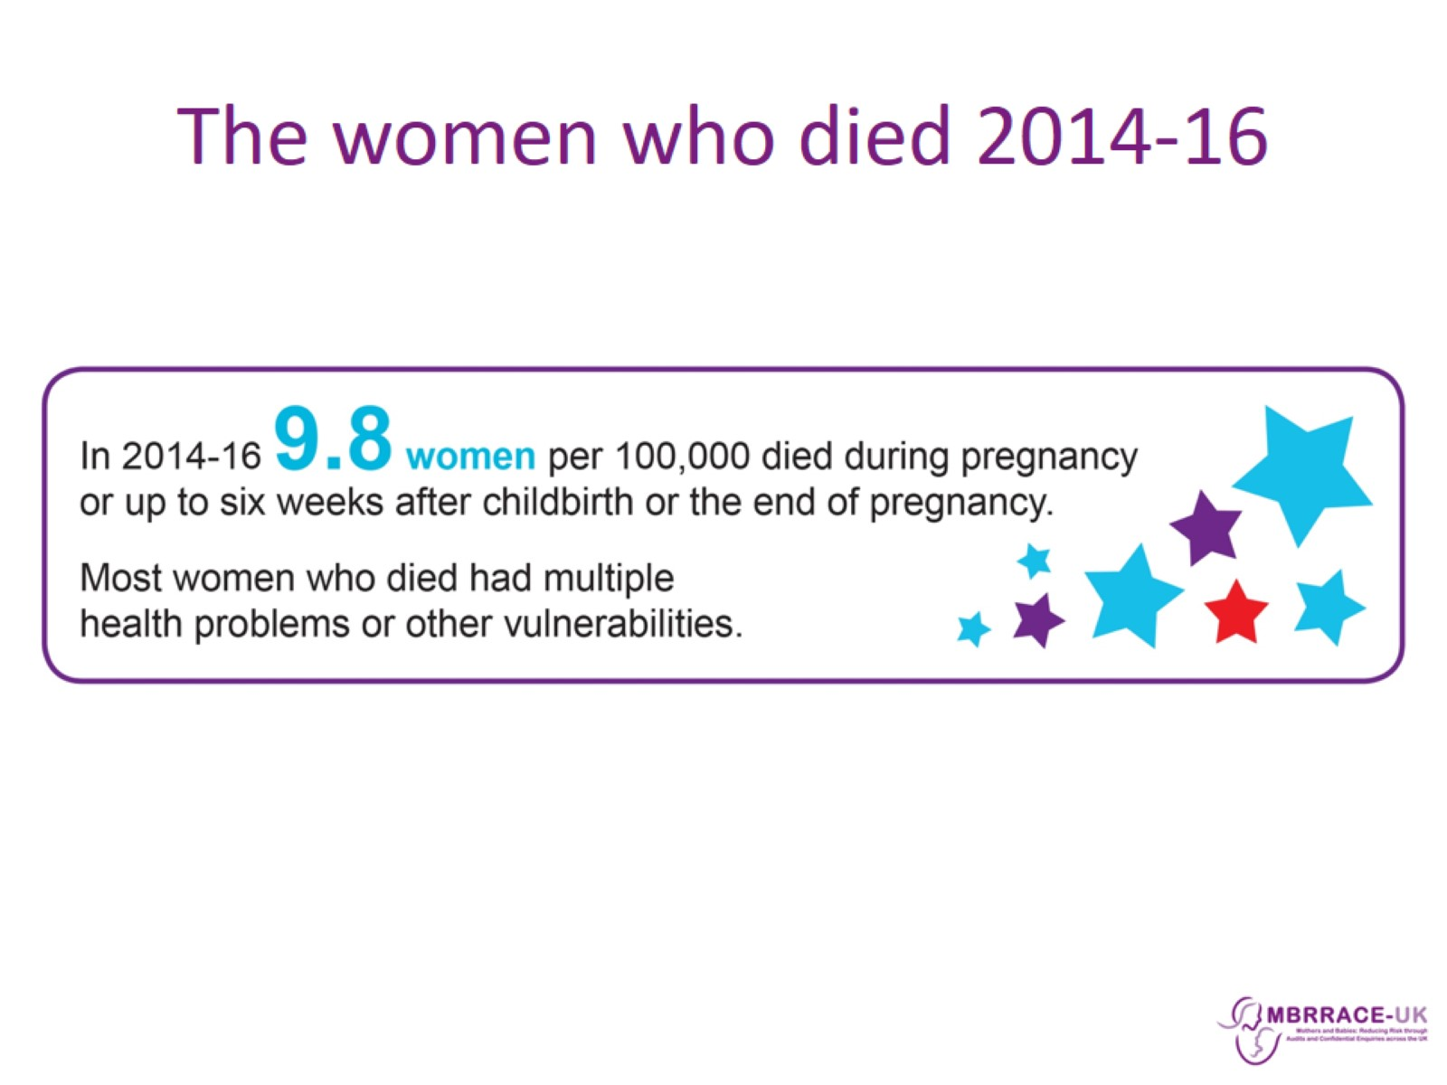
The women who died 2014-16

Slide 15
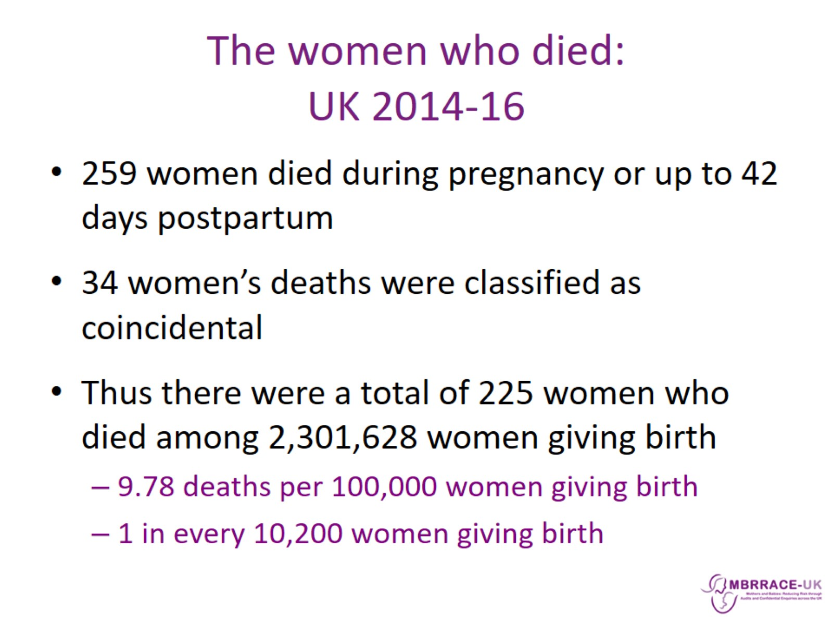
The women who died:
UK 2014-16

Slide 16
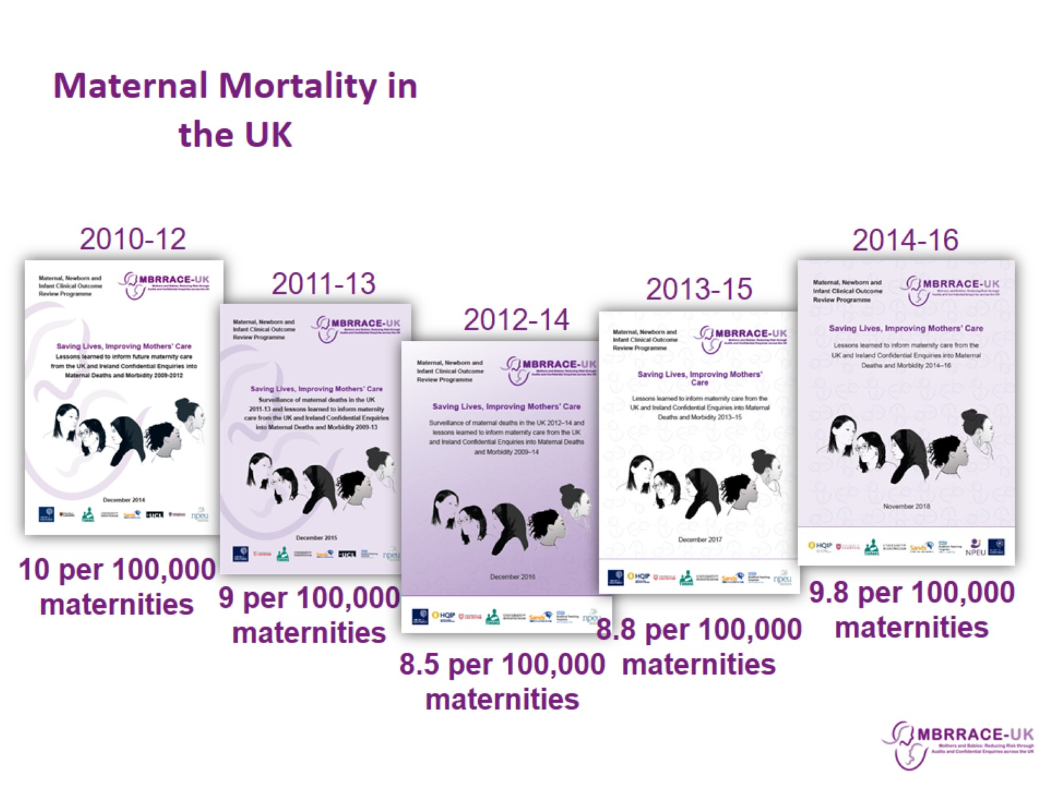
Maternal Mortality in the UK

Slide 17
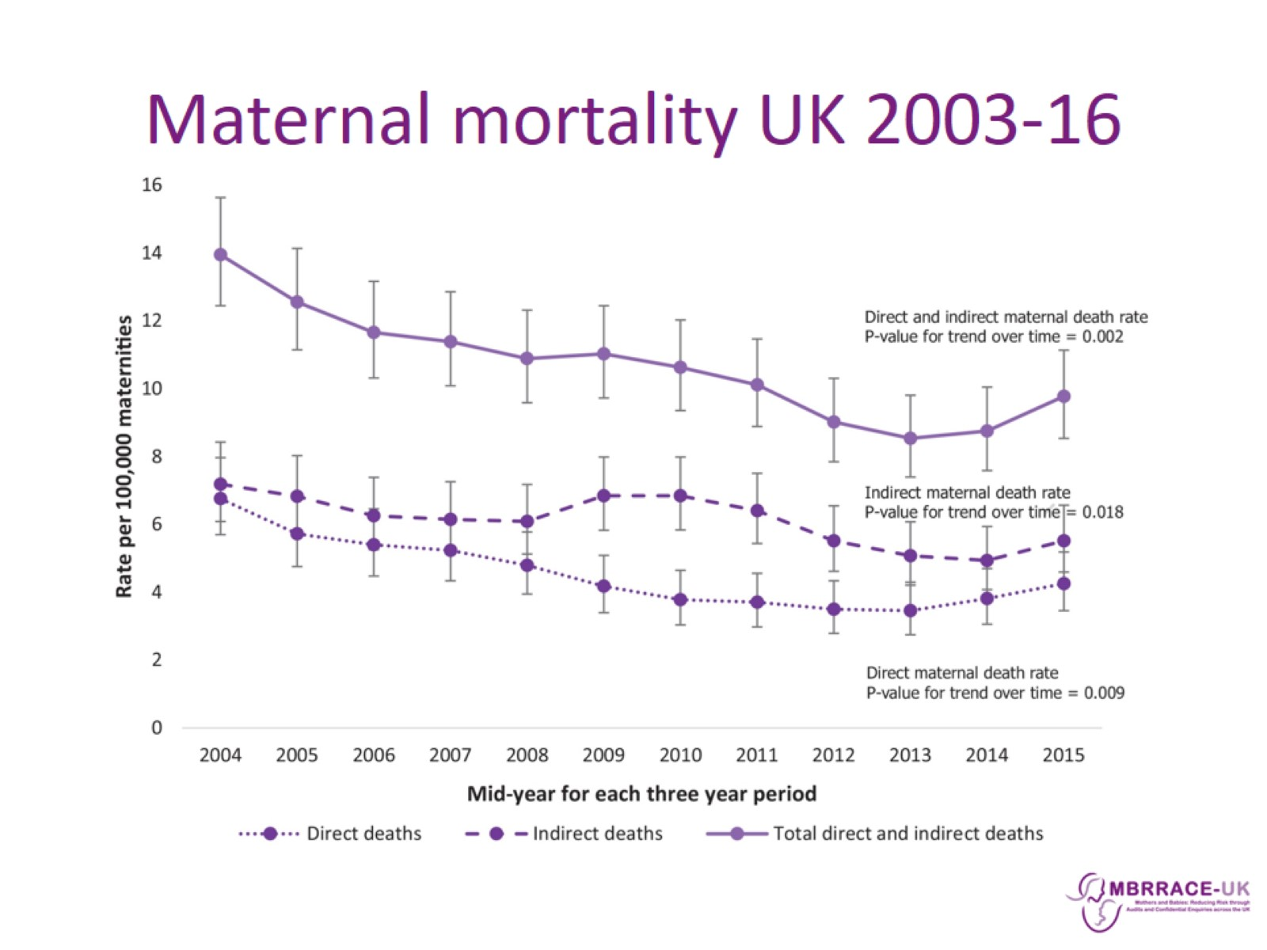
Maternal mortality UK 2003-16

Slide 18
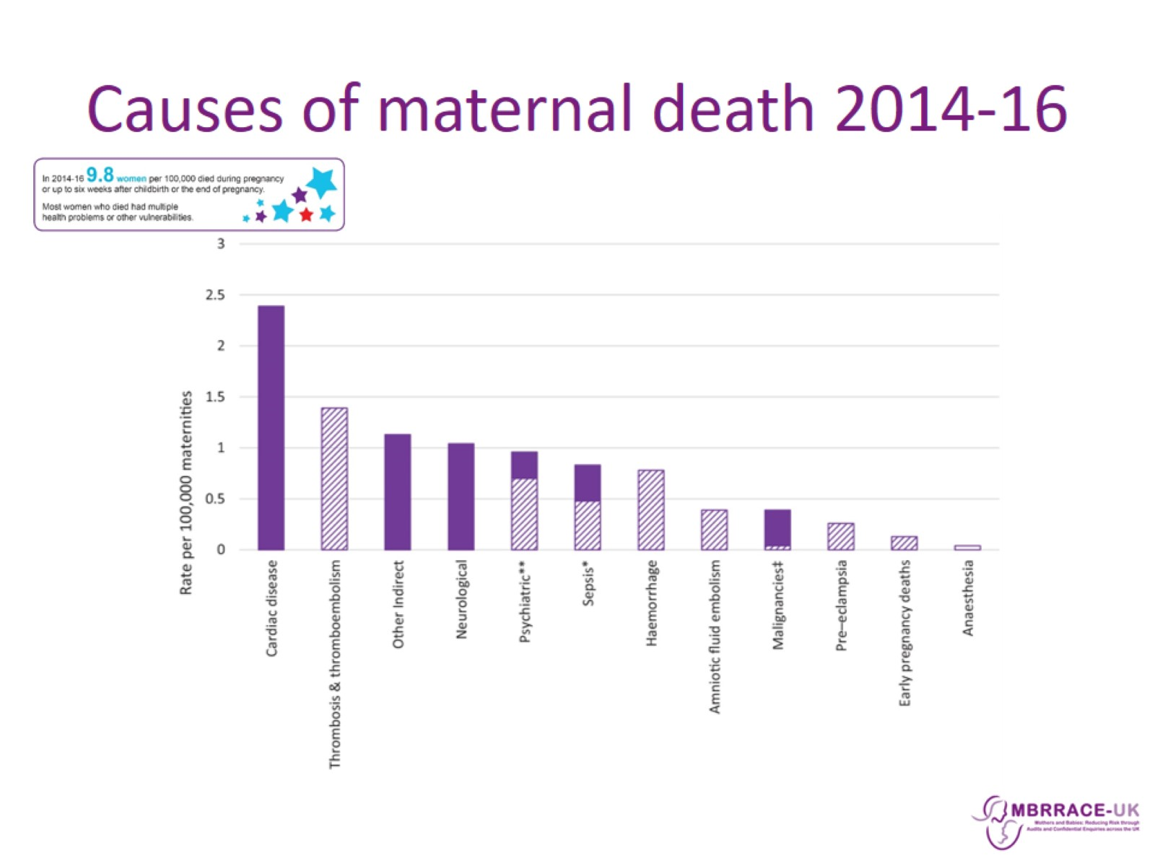
Causes of maternal death 2014-16

Slide 19
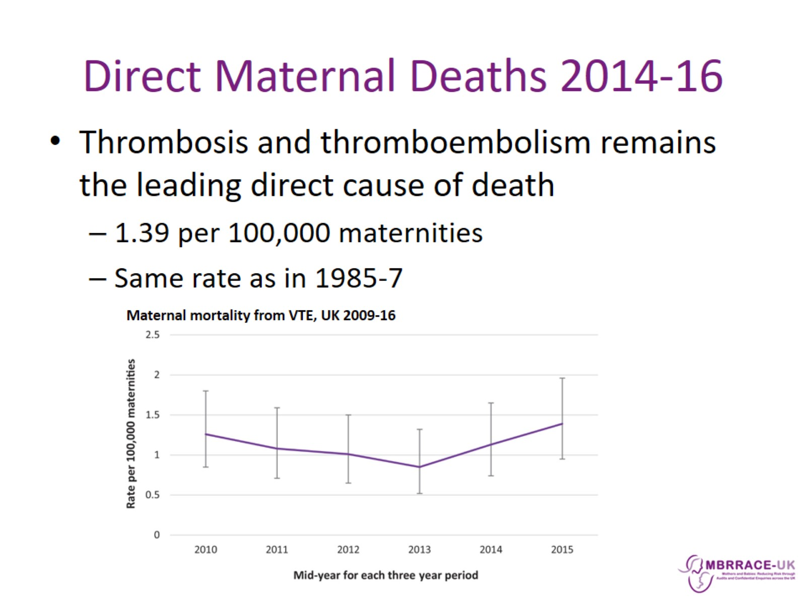
Direct Maternal Deaths 2014-16

Slide 20
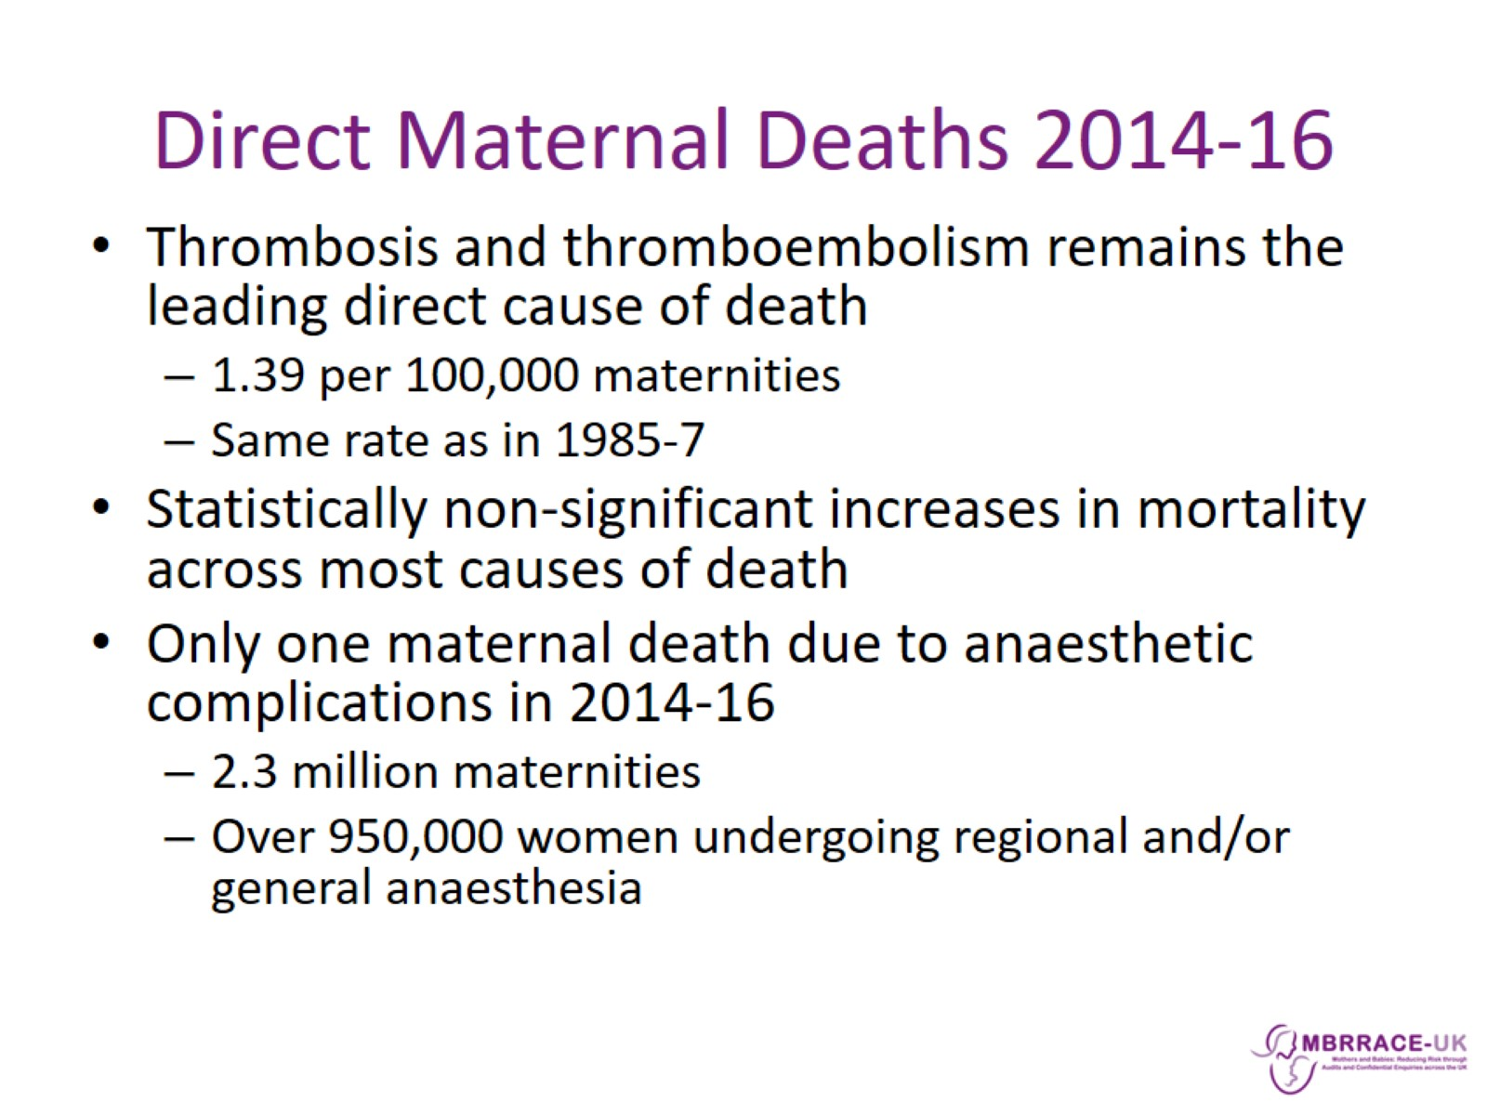
Direct Maternal Deaths 2014-16

Slide 21
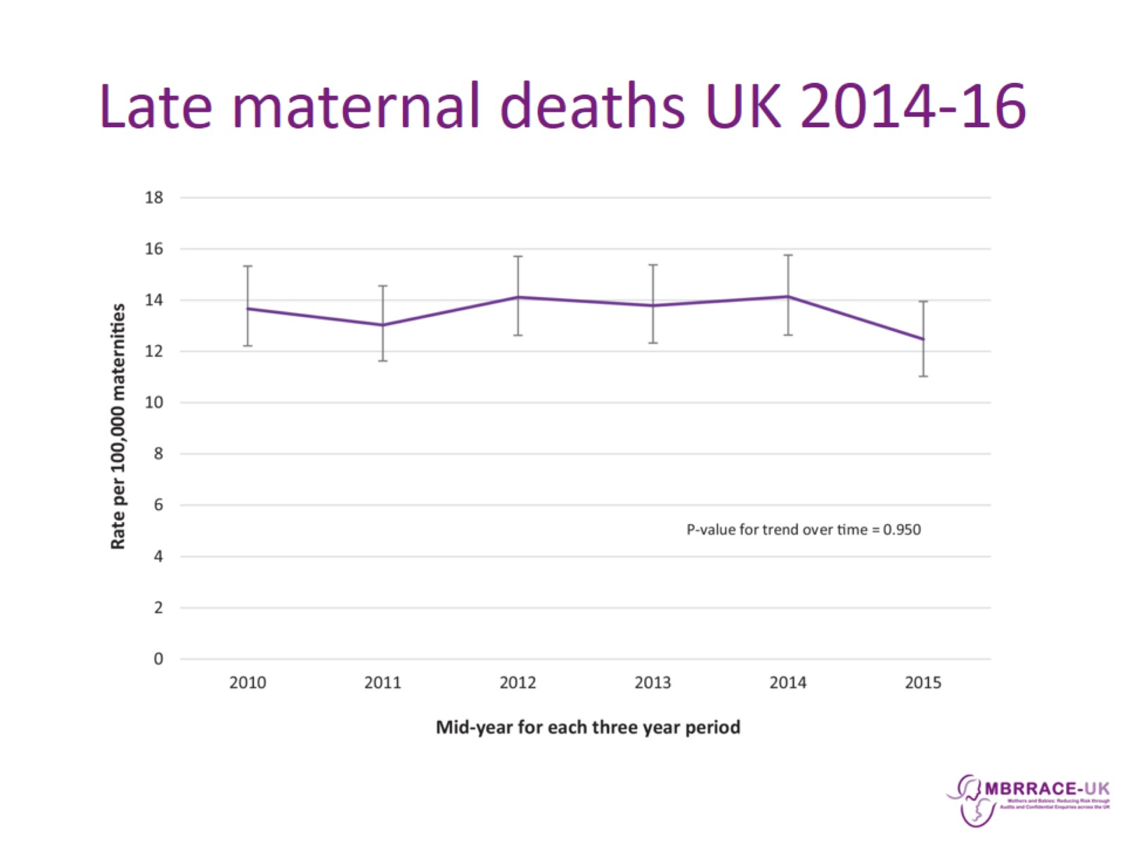
Late maternal deaths UK 2014-16

Slide 22
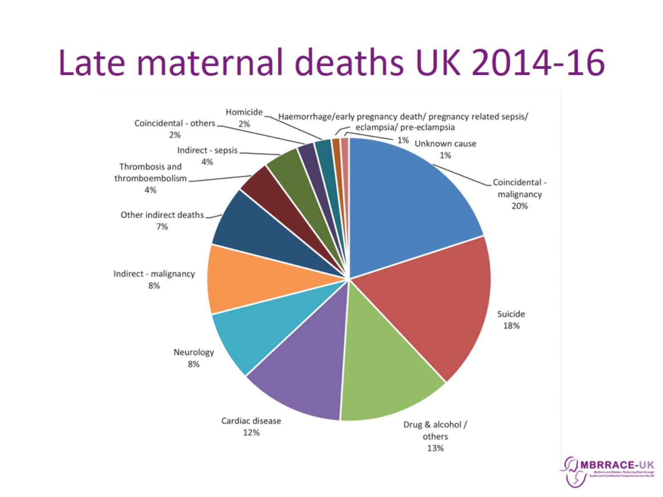
Late maternal deaths UK 2014-16

Slide 23
Late maternal deaths UK 2014-16

Slide 24
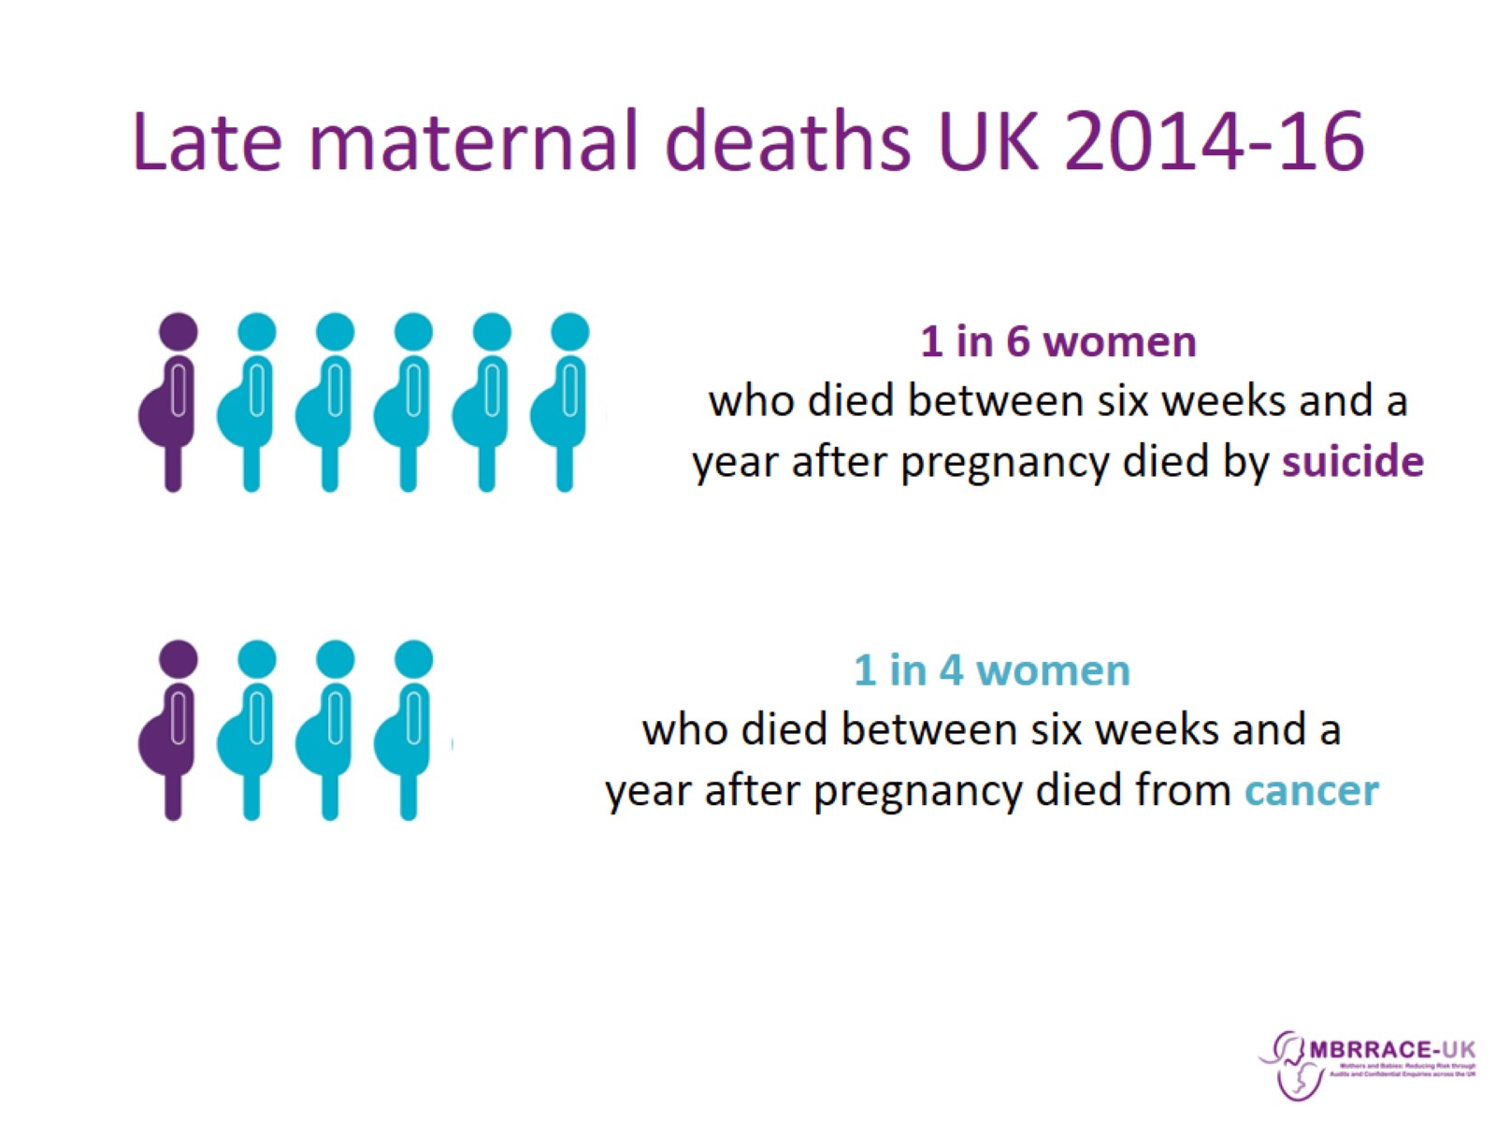
Late maternal deaths UK 2014-16

Slide 25
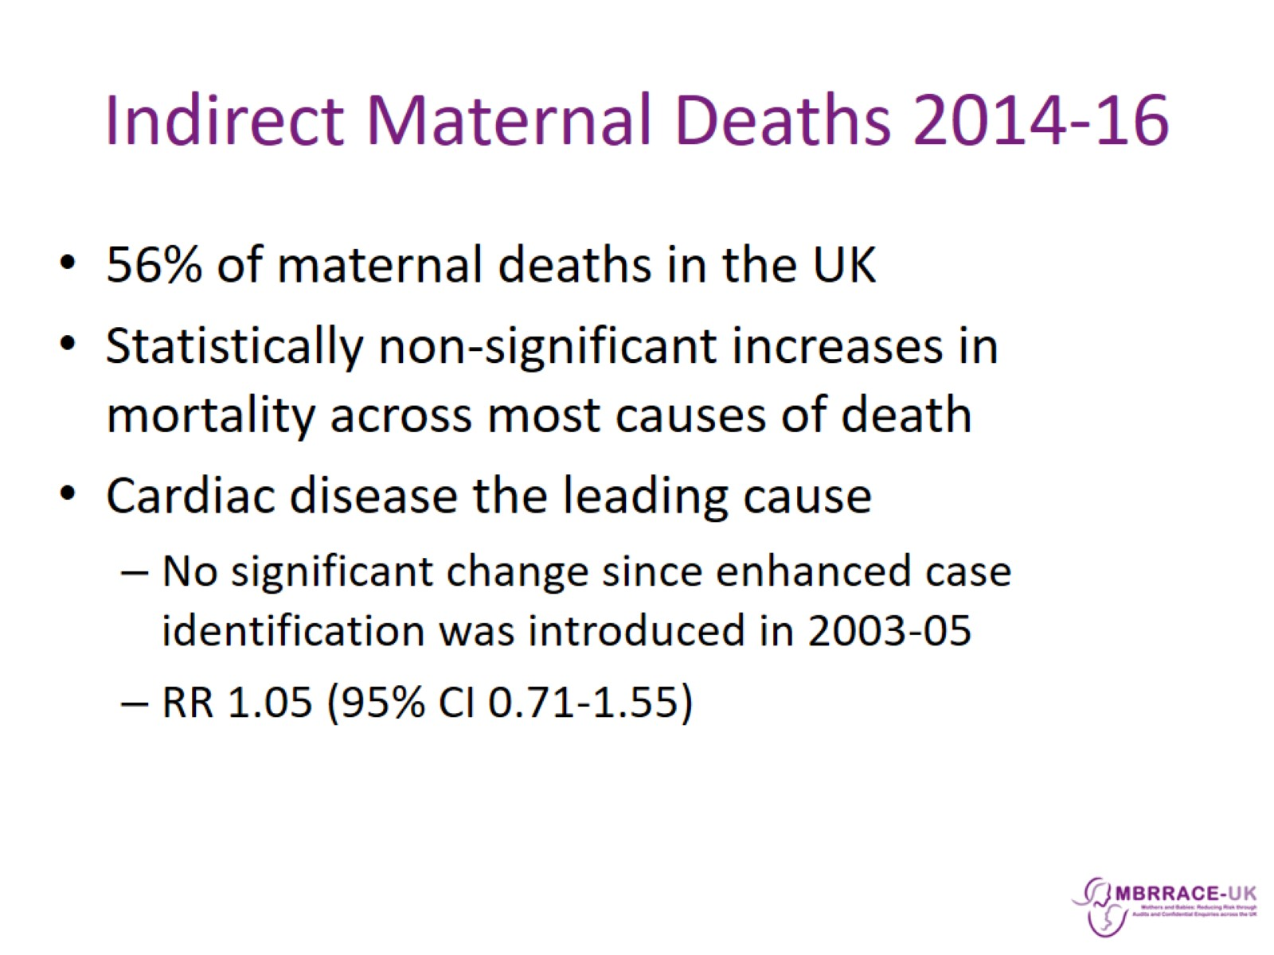
Indirect Maternal Deaths 2014-16

Slide 26
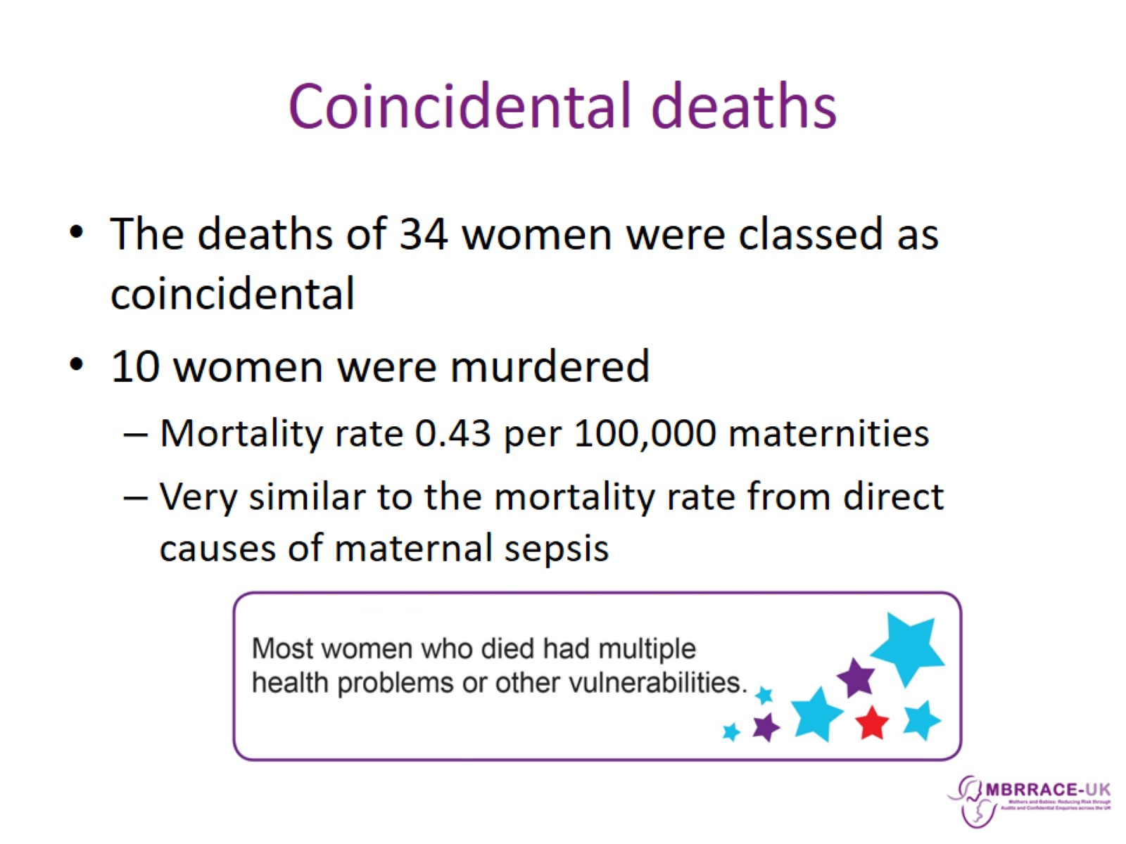
Coincidental deaths

Slide 27
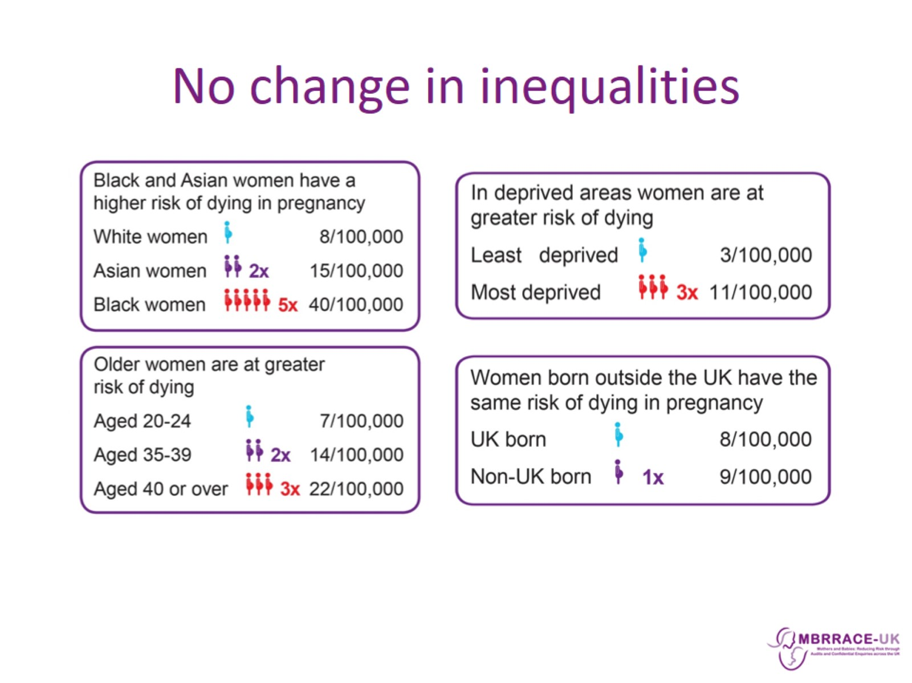
No change in inequalities

Slide 28
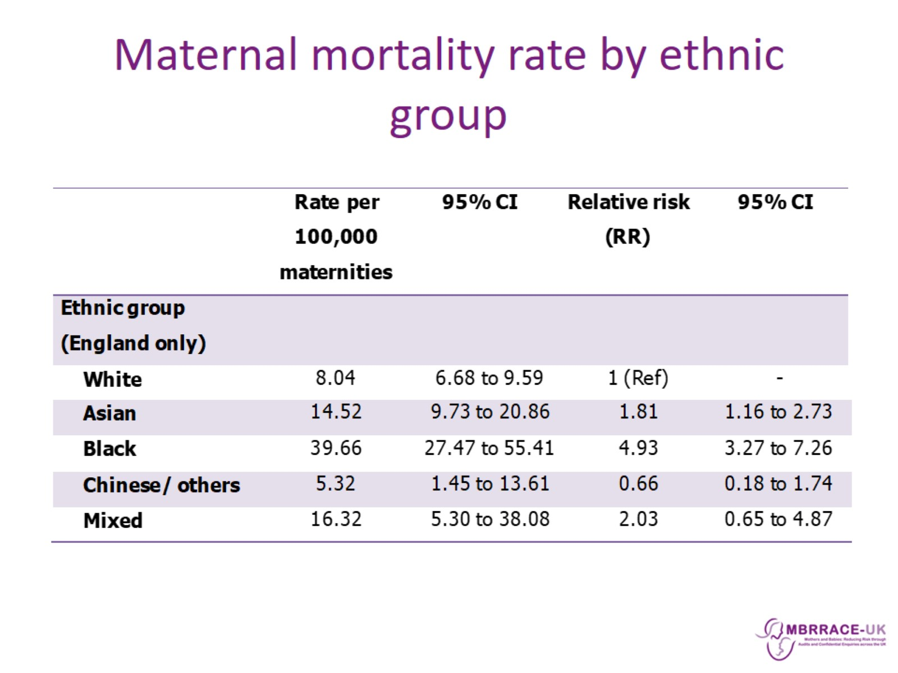
Maternal mortality rate by ethnic group

Slide 29
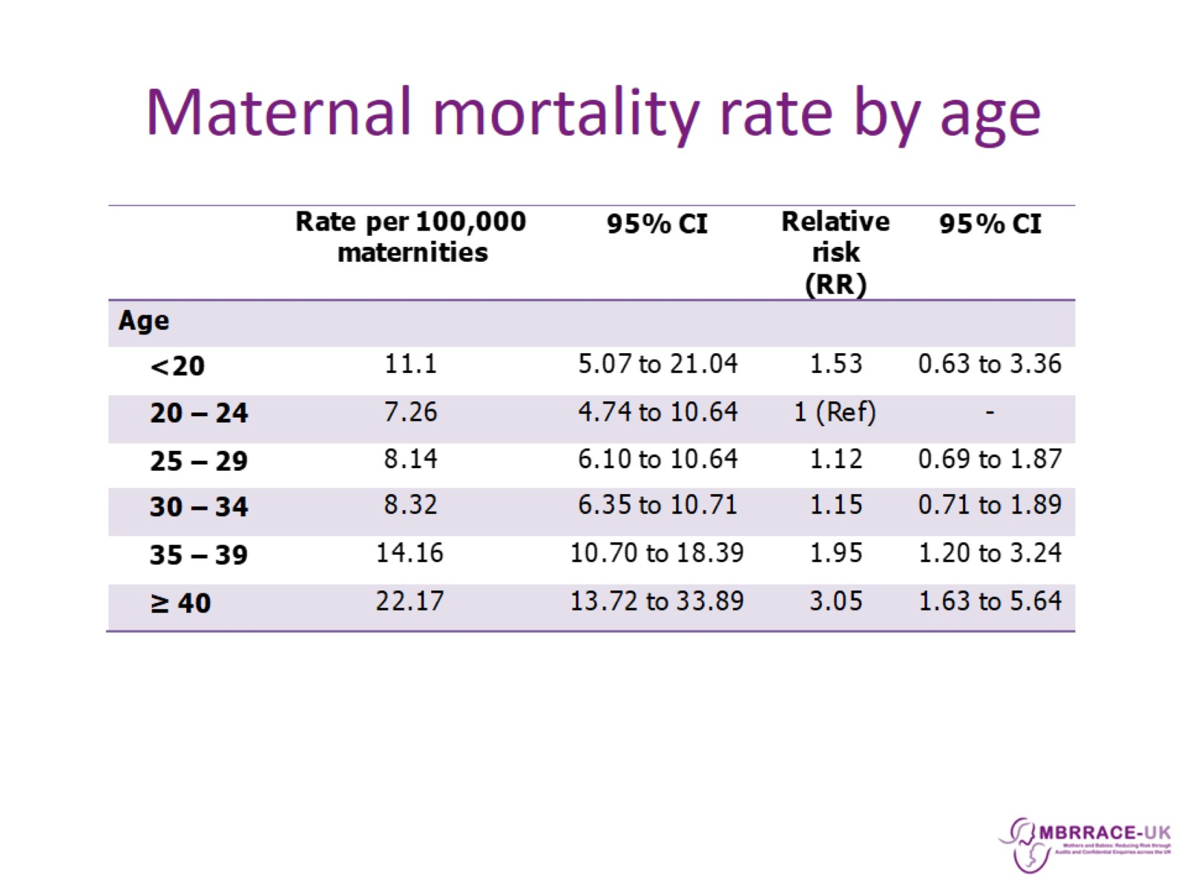
Maternal mortality rate by age

Slide 30
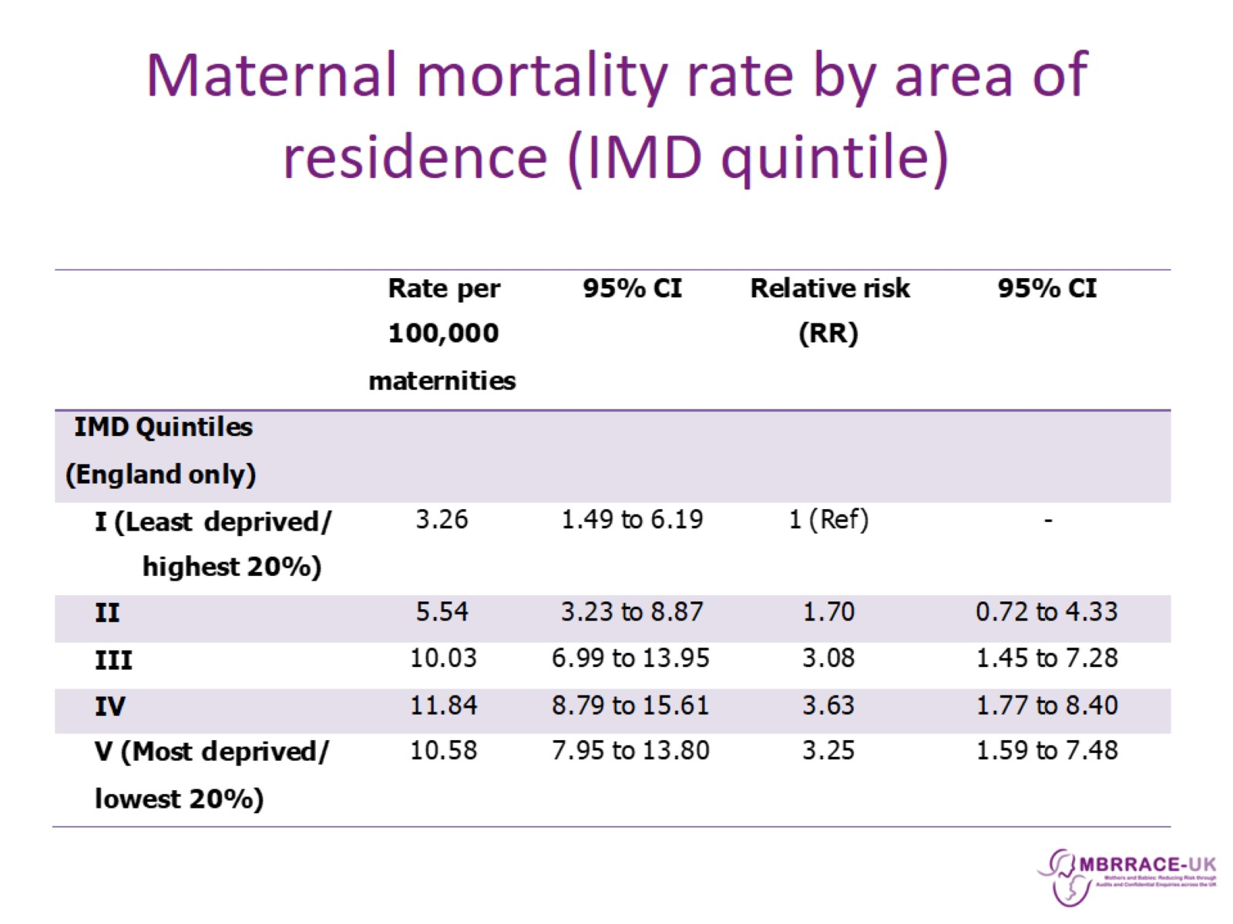
Maternal mortality rate by area of residence (IMD quintile)

Slide 31
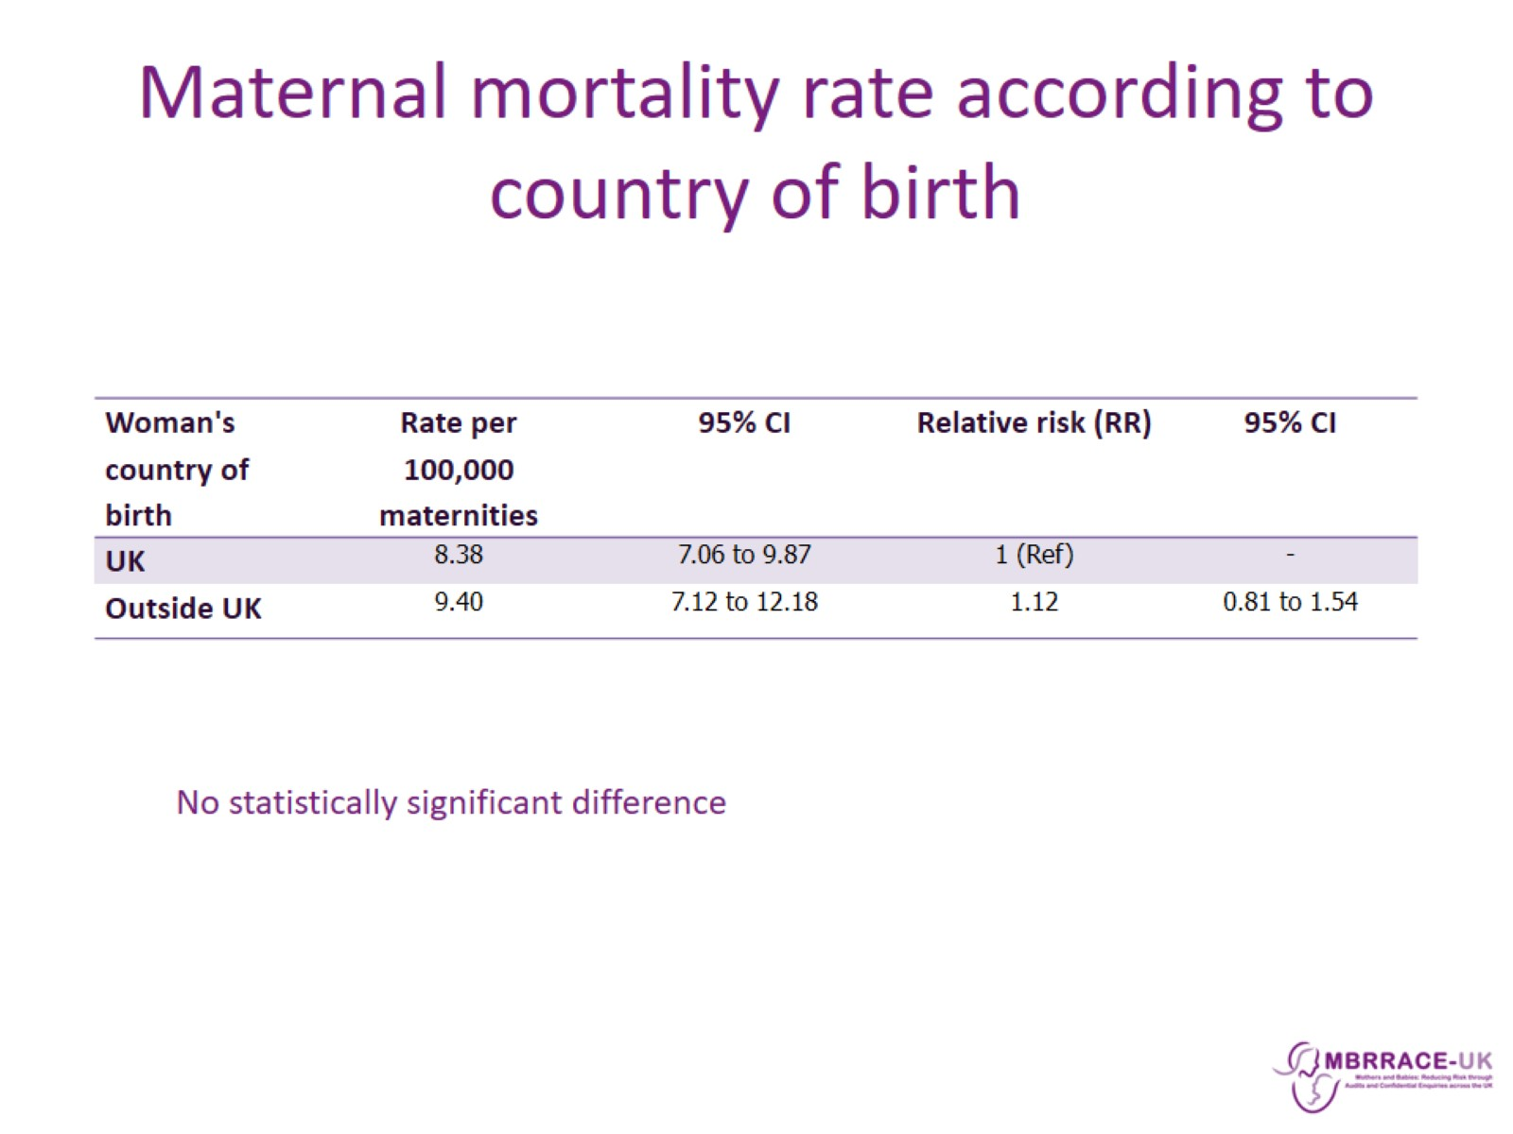
Maternal mortality rate according to country of birth

Slide 32
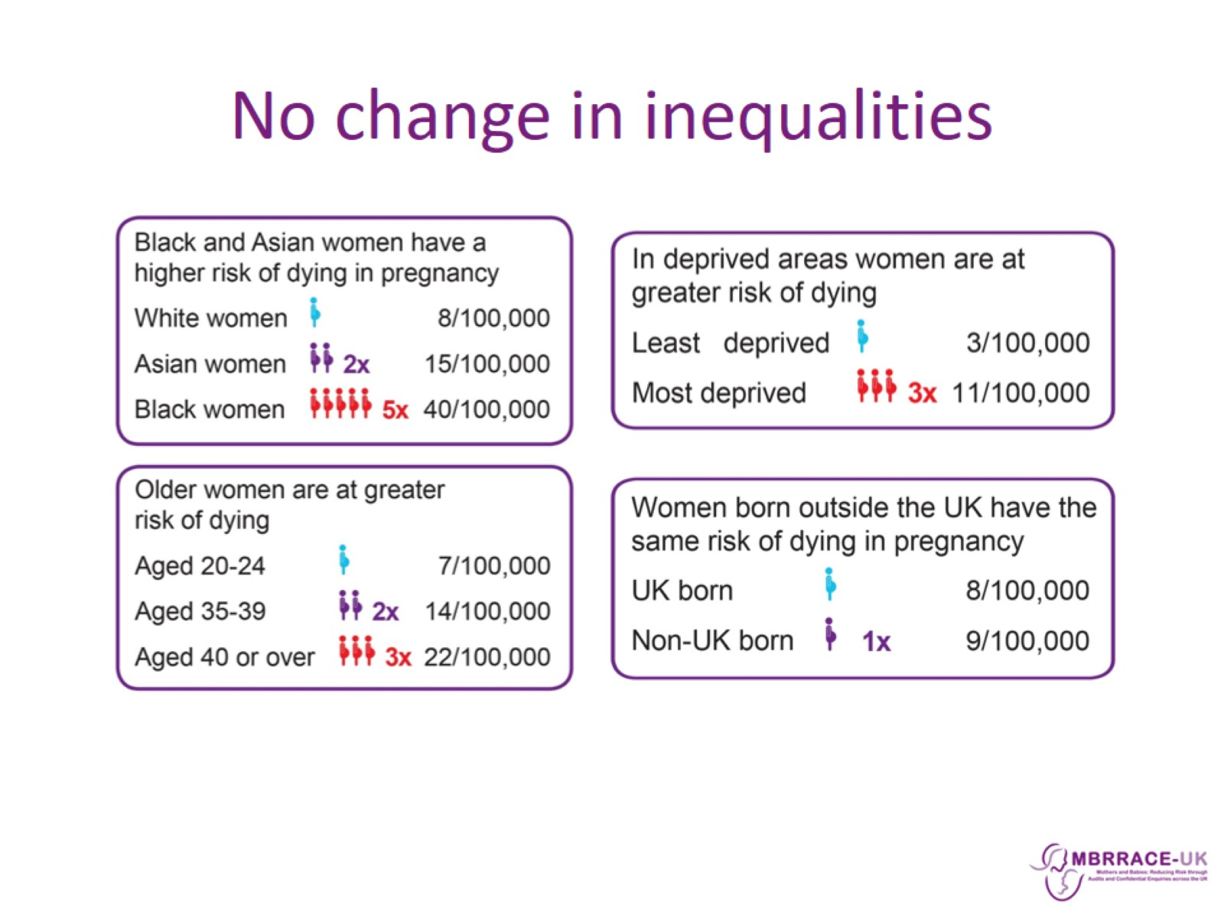
No change in inequalities

Slide 33
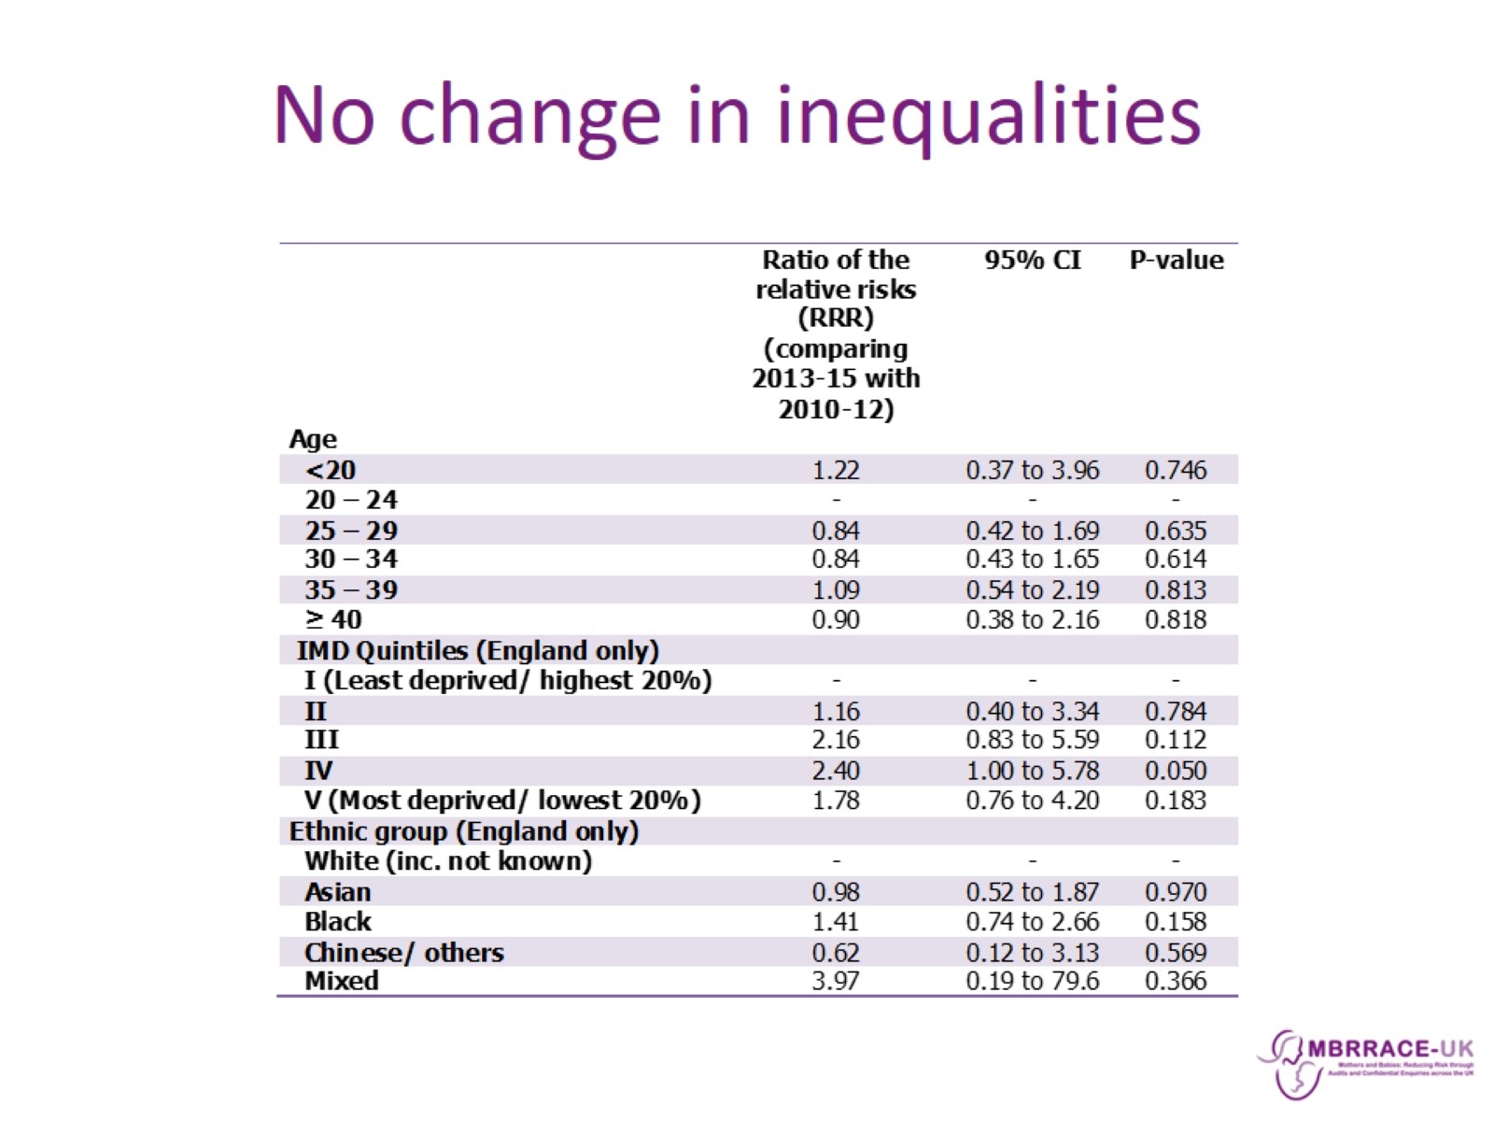
No change in inequalities

Slide 34
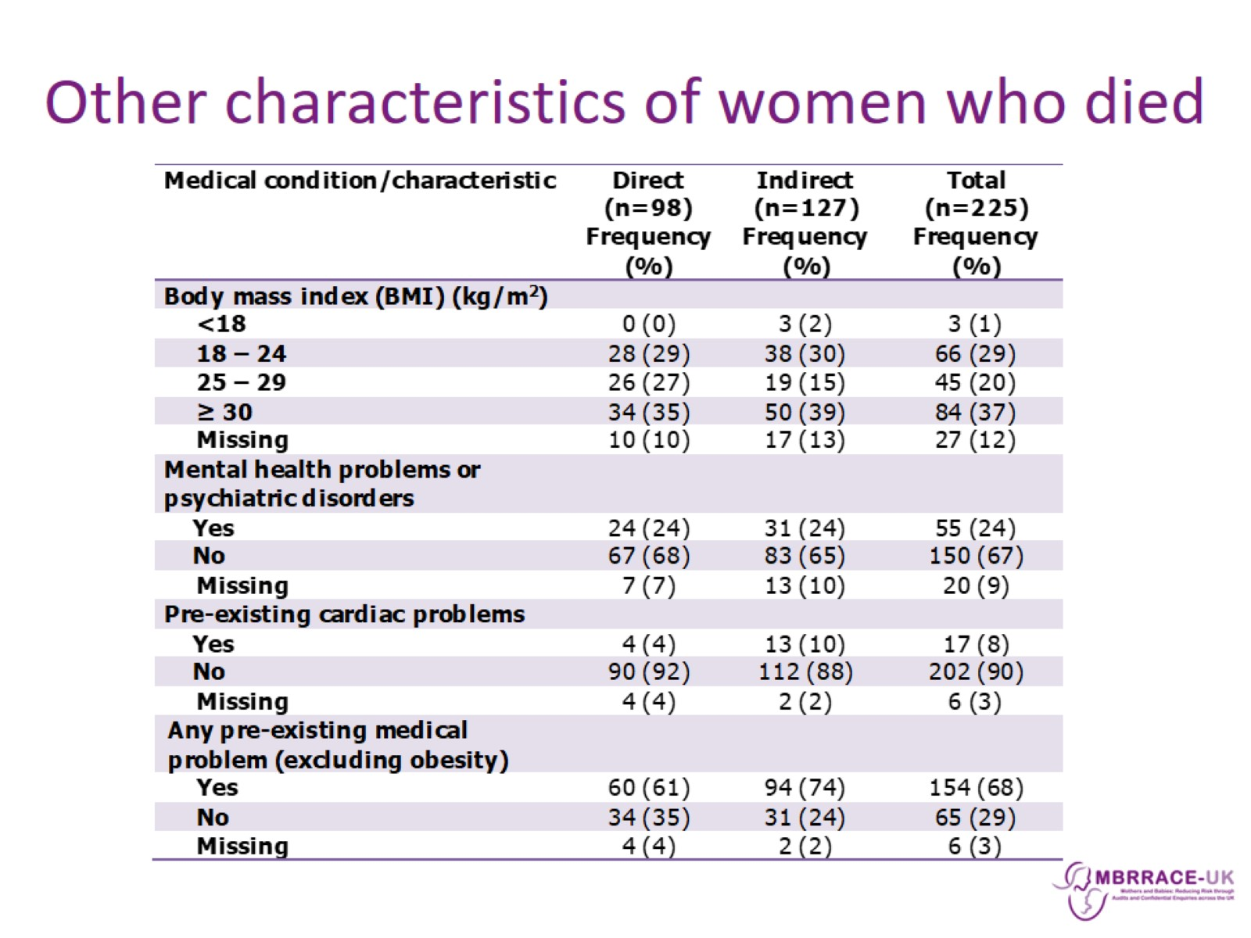
Other characteristics of women who died

Slide 35
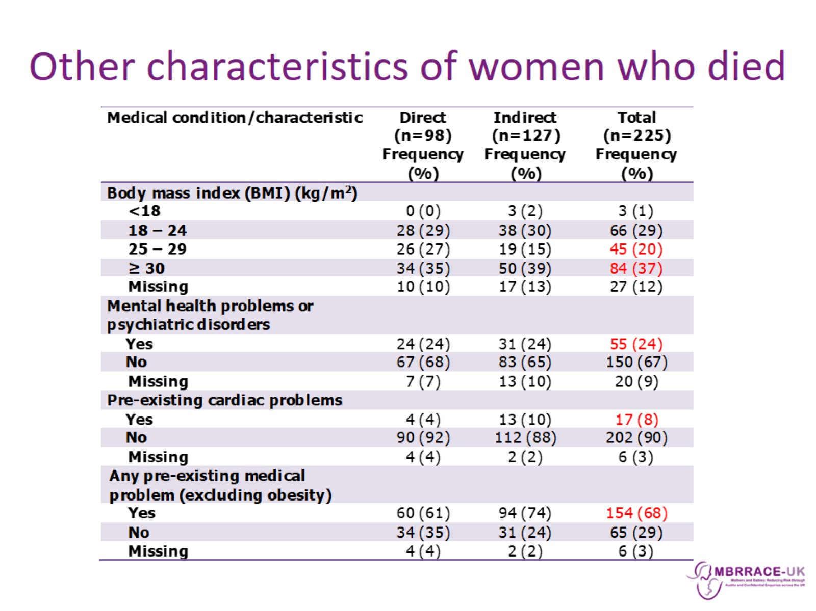
Other characteristics of women who died

Slide 36
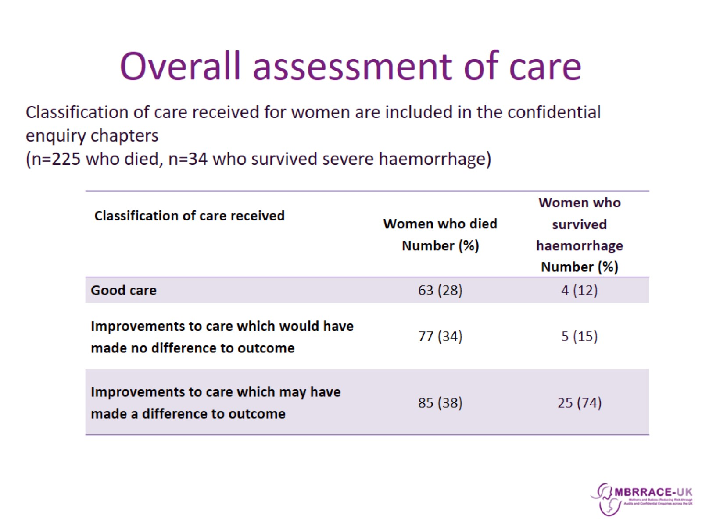
Overall assessment of care

Slide 37
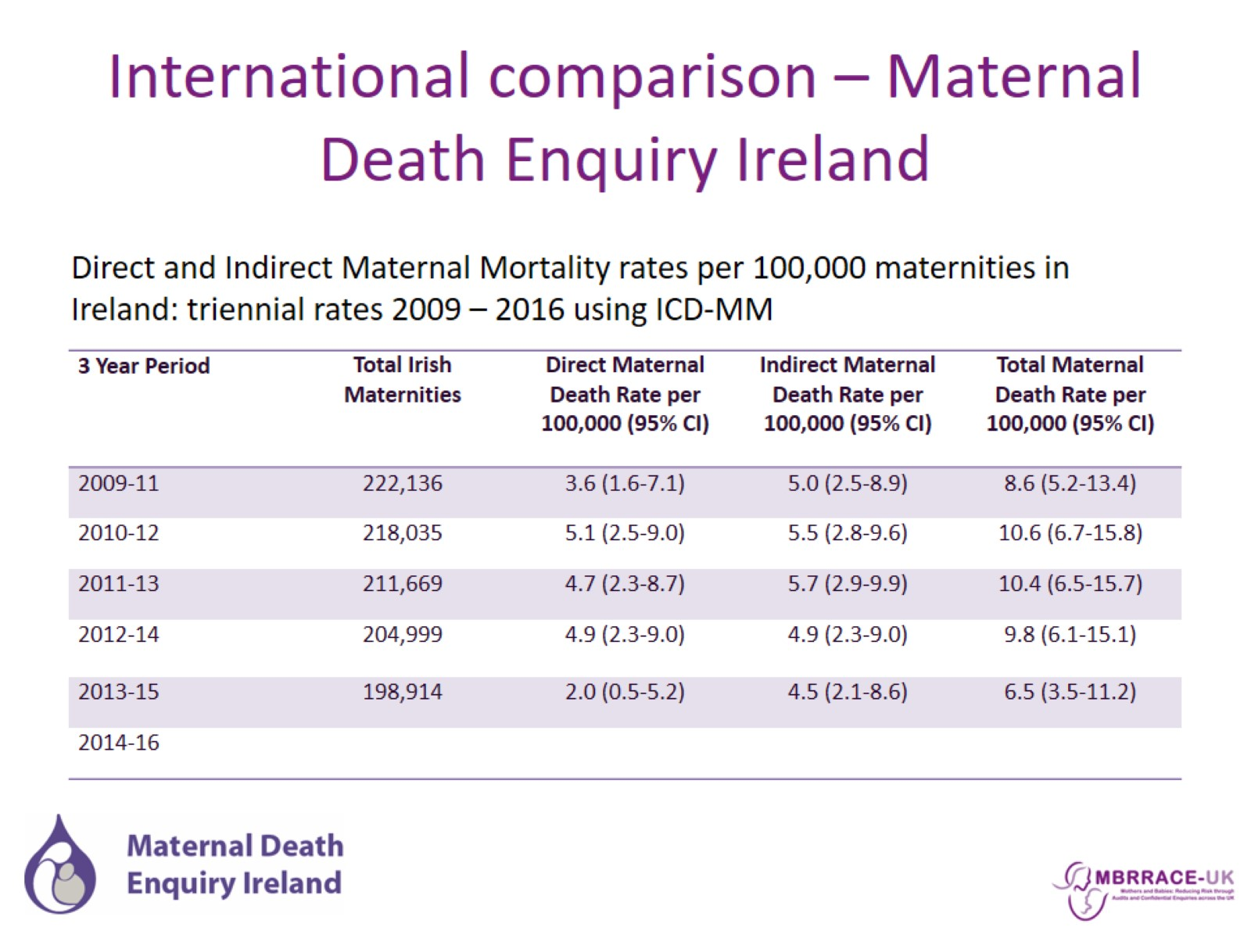
International comparison – Maternal Death Enquiry Ireland

Slide 38
Maternal Mortality in the UK

Slide 39

Actions following previous reports

Slide 40

Actions following previous reports

Slide 41

Summary

Slide 42
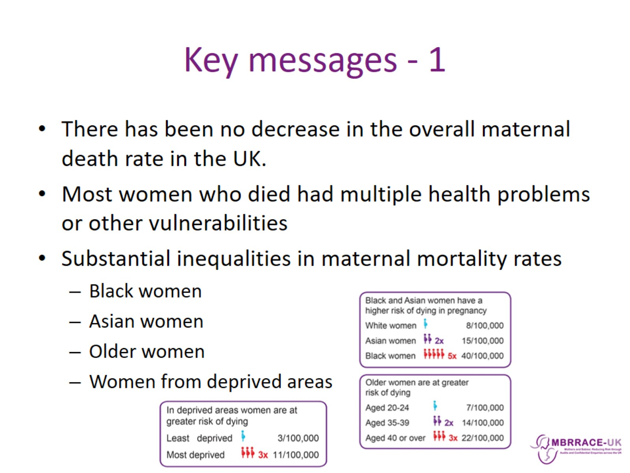
Key messages - 1

Slide 43
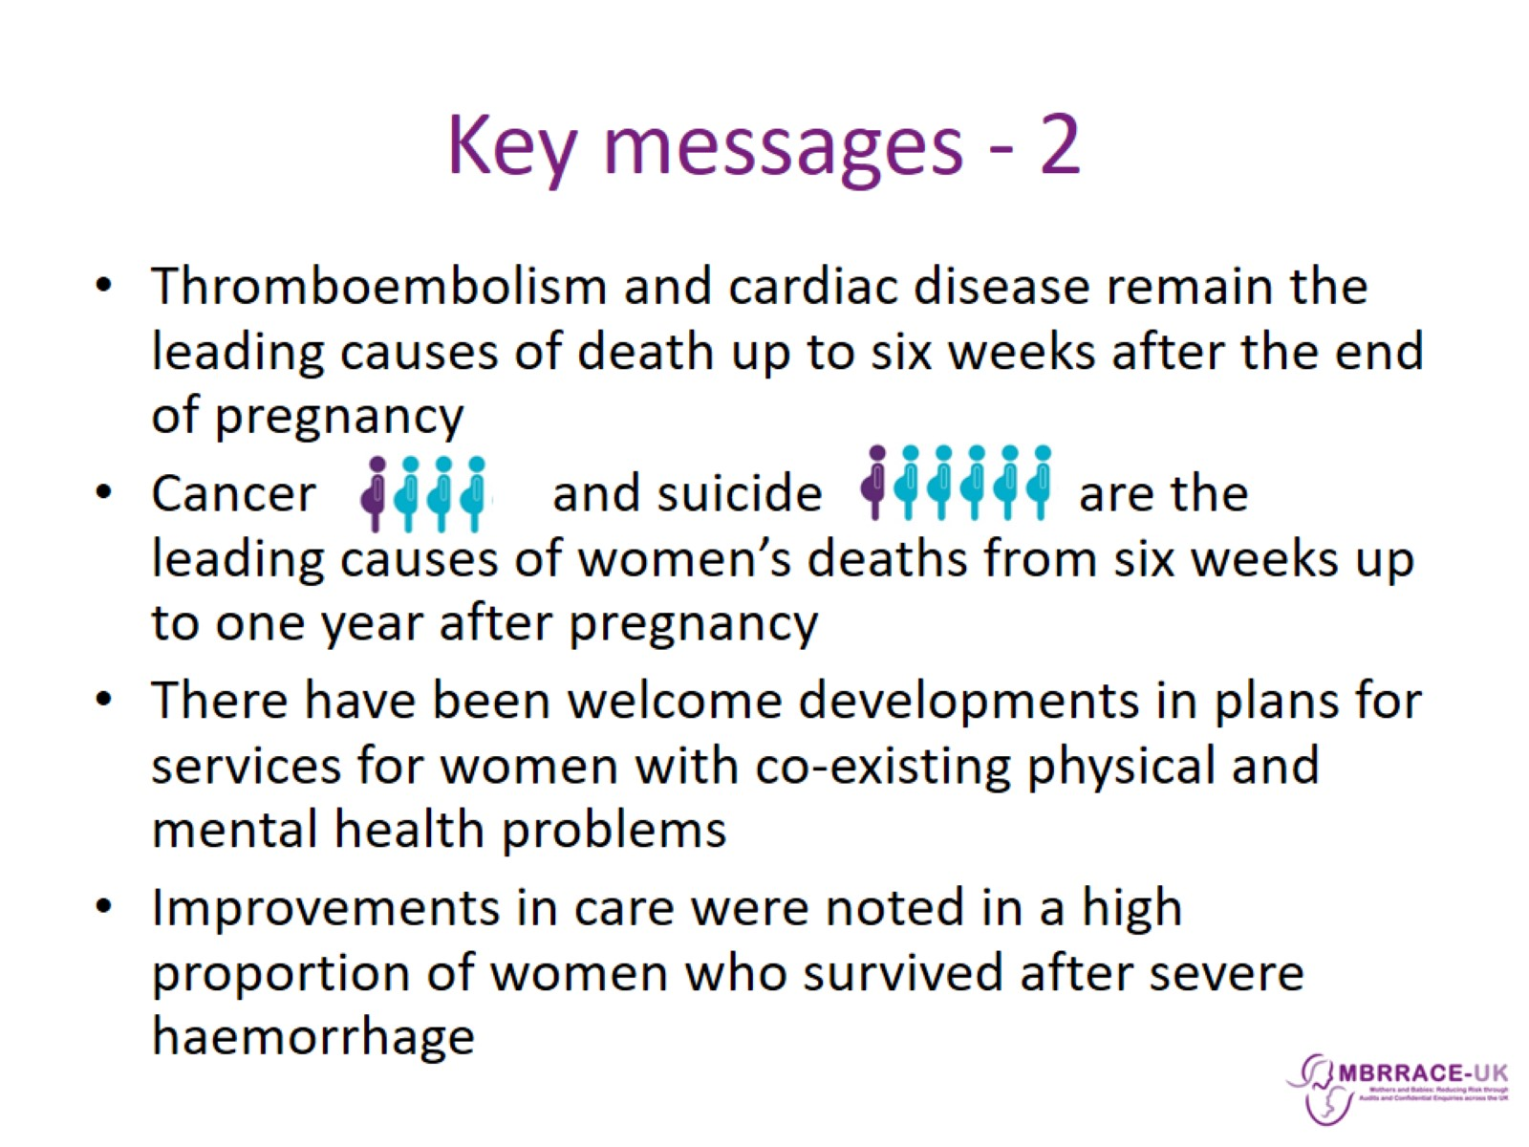
Key messages - 2

Slide 44
