Slide 1

Update: on the MBRRACE-UK programme
November 2015

Slide 2
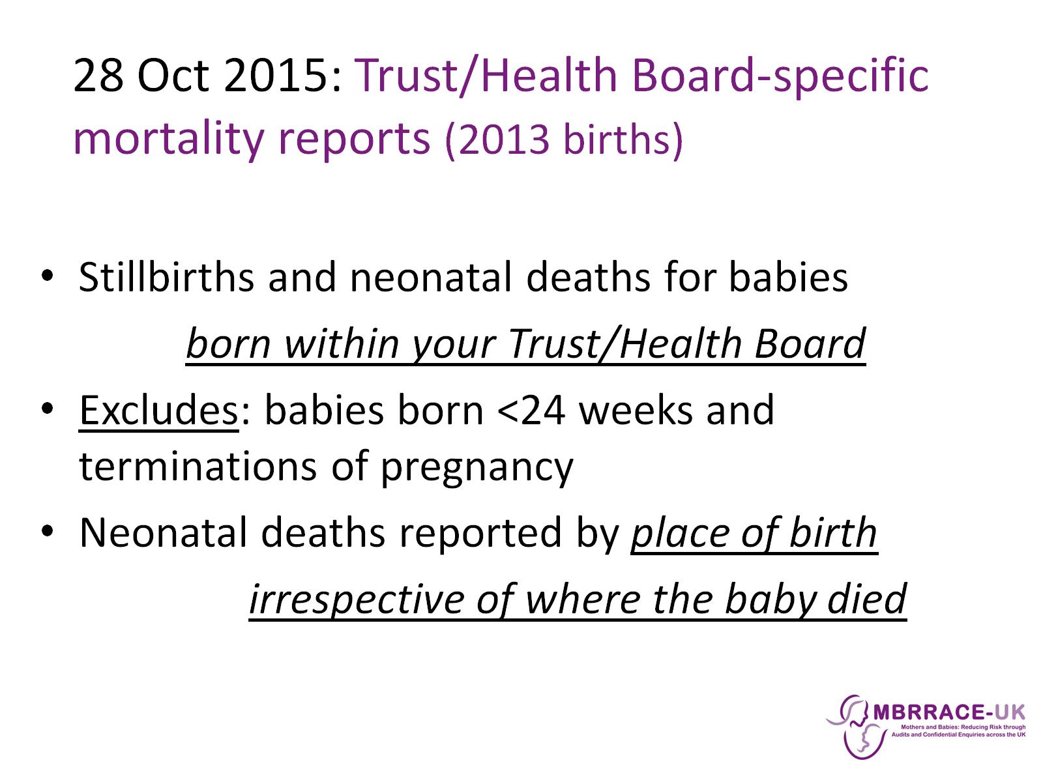
28 Oct 2015: Trust/Health Board-specific mortality reports (2013 births)

Slide 3
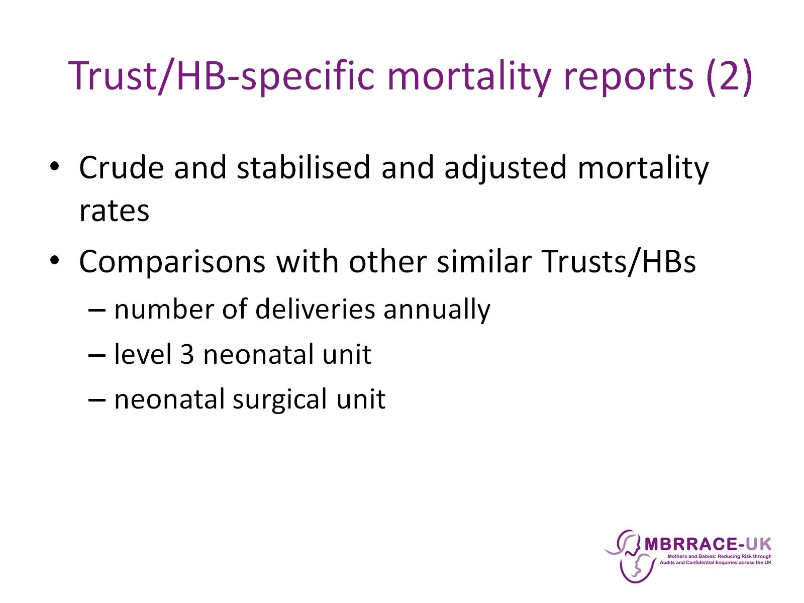
Trust/HB-specific mortality reports (2)

Slide 4
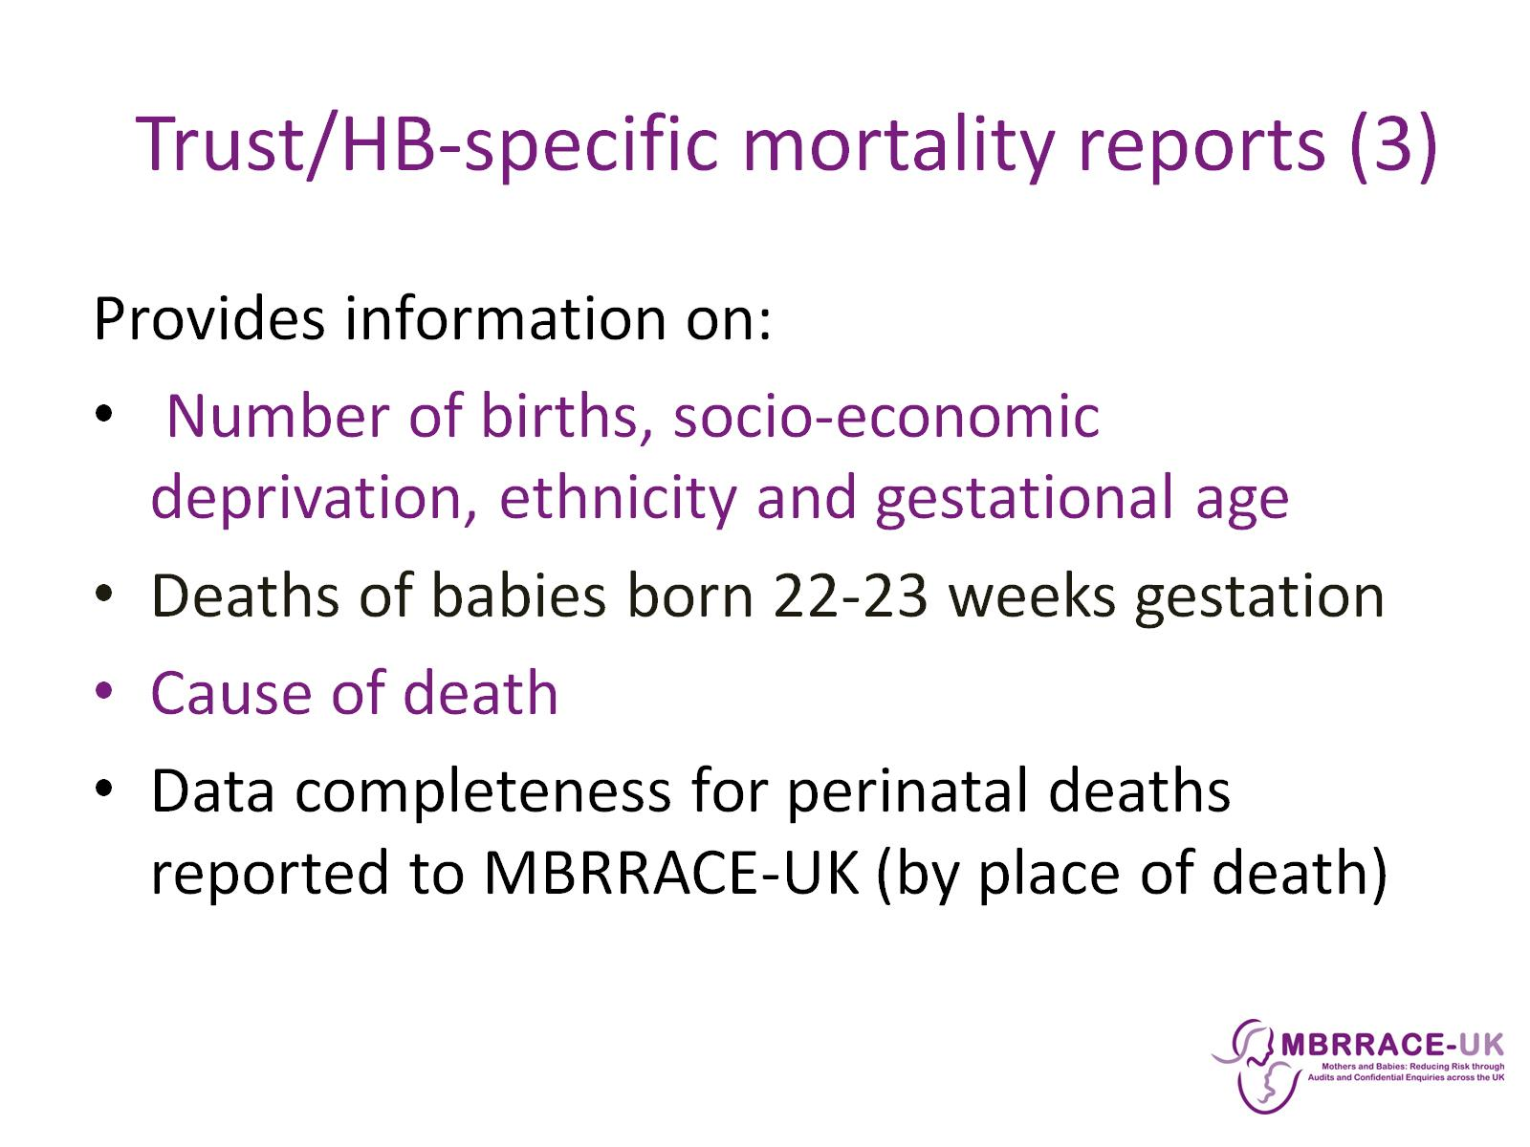
Trust/HB-specific mortality reports (3)

Slide 5
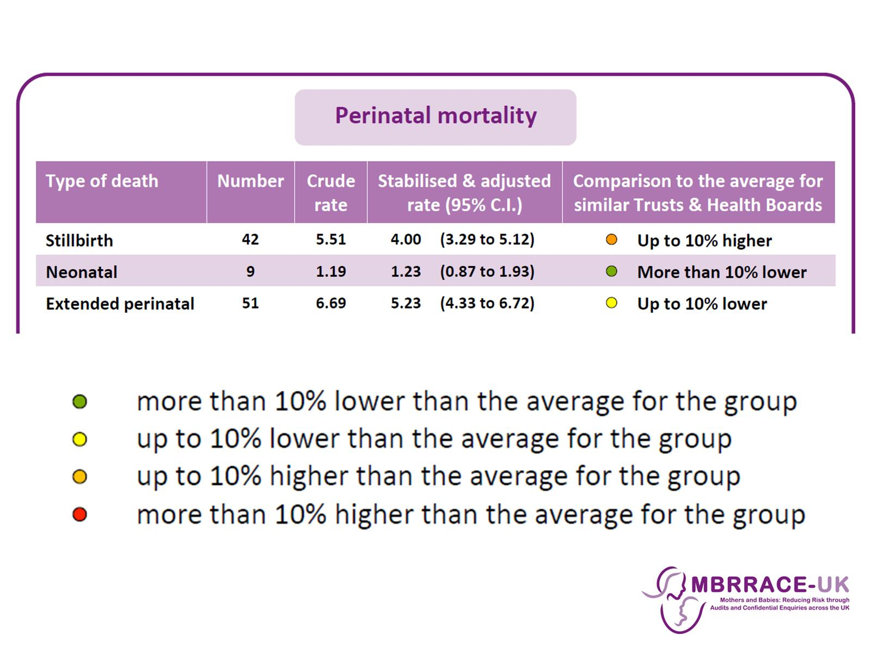

Slide 6
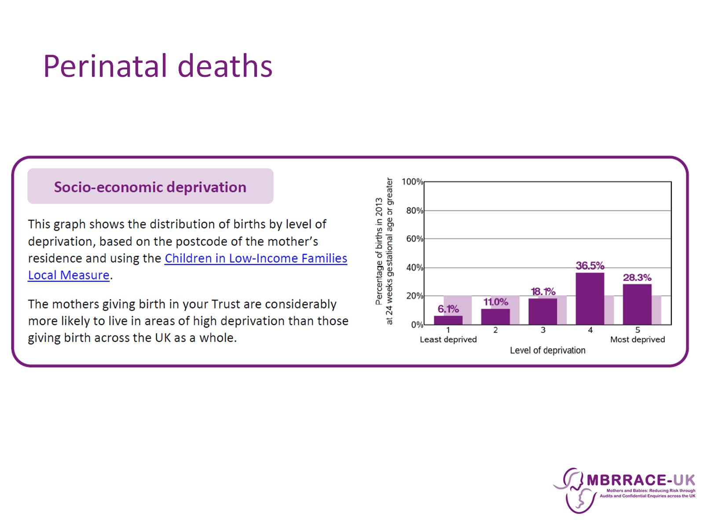
Perinatal deaths

Slide 7
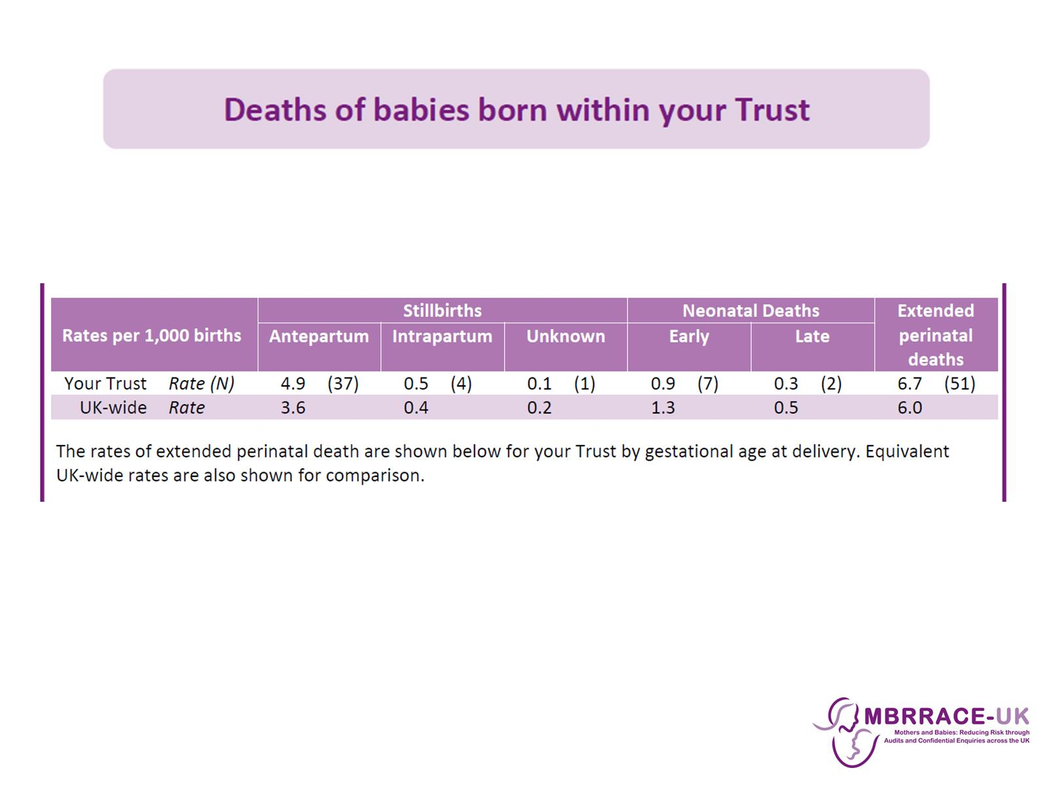

Slide 8
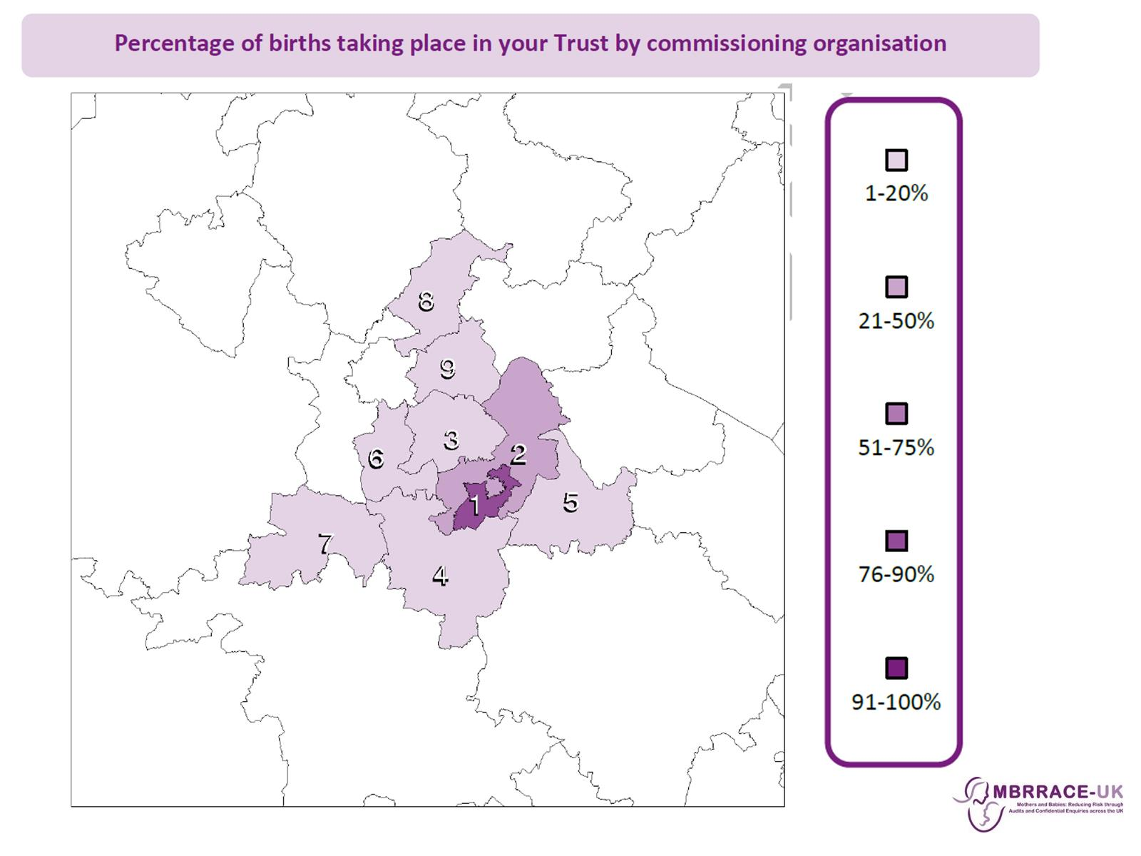

Slide 9
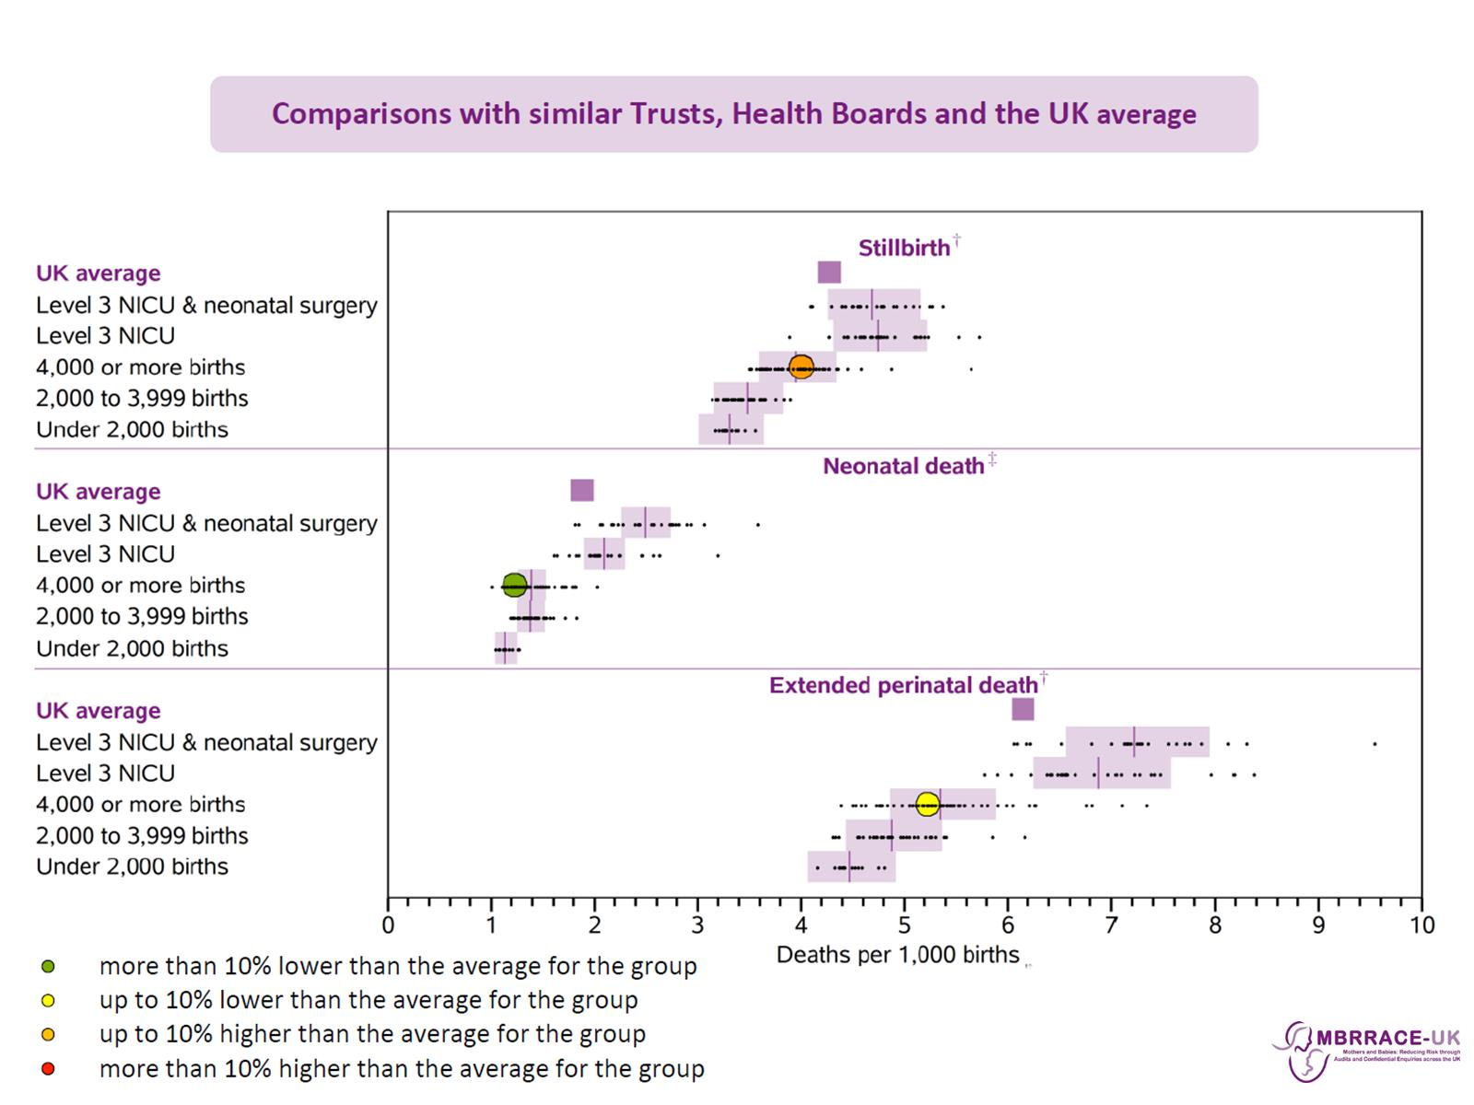

Slide 10
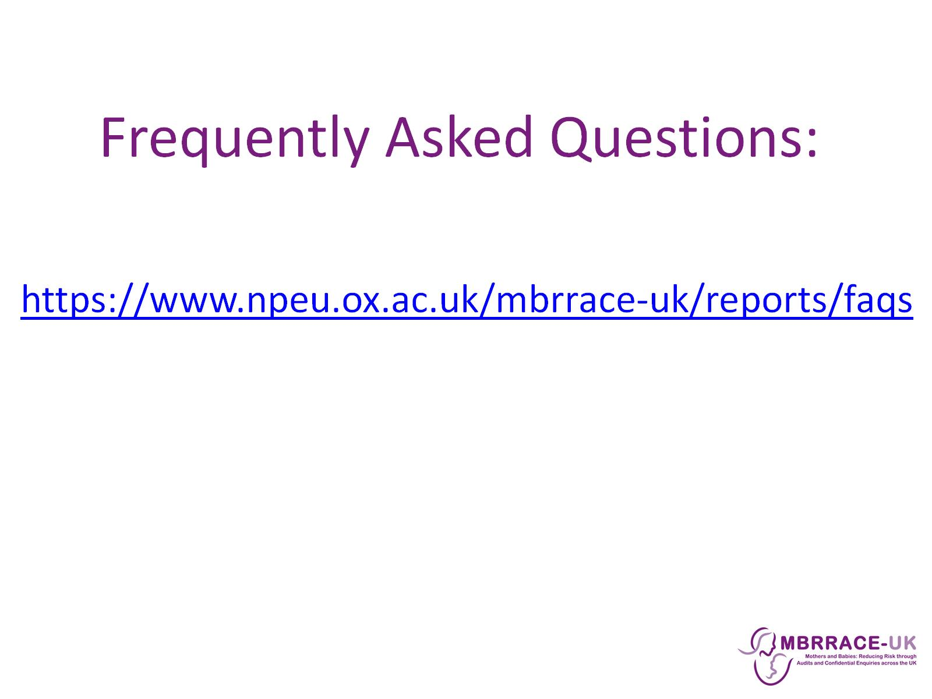
Frequently Asked Questions:

Slide 11
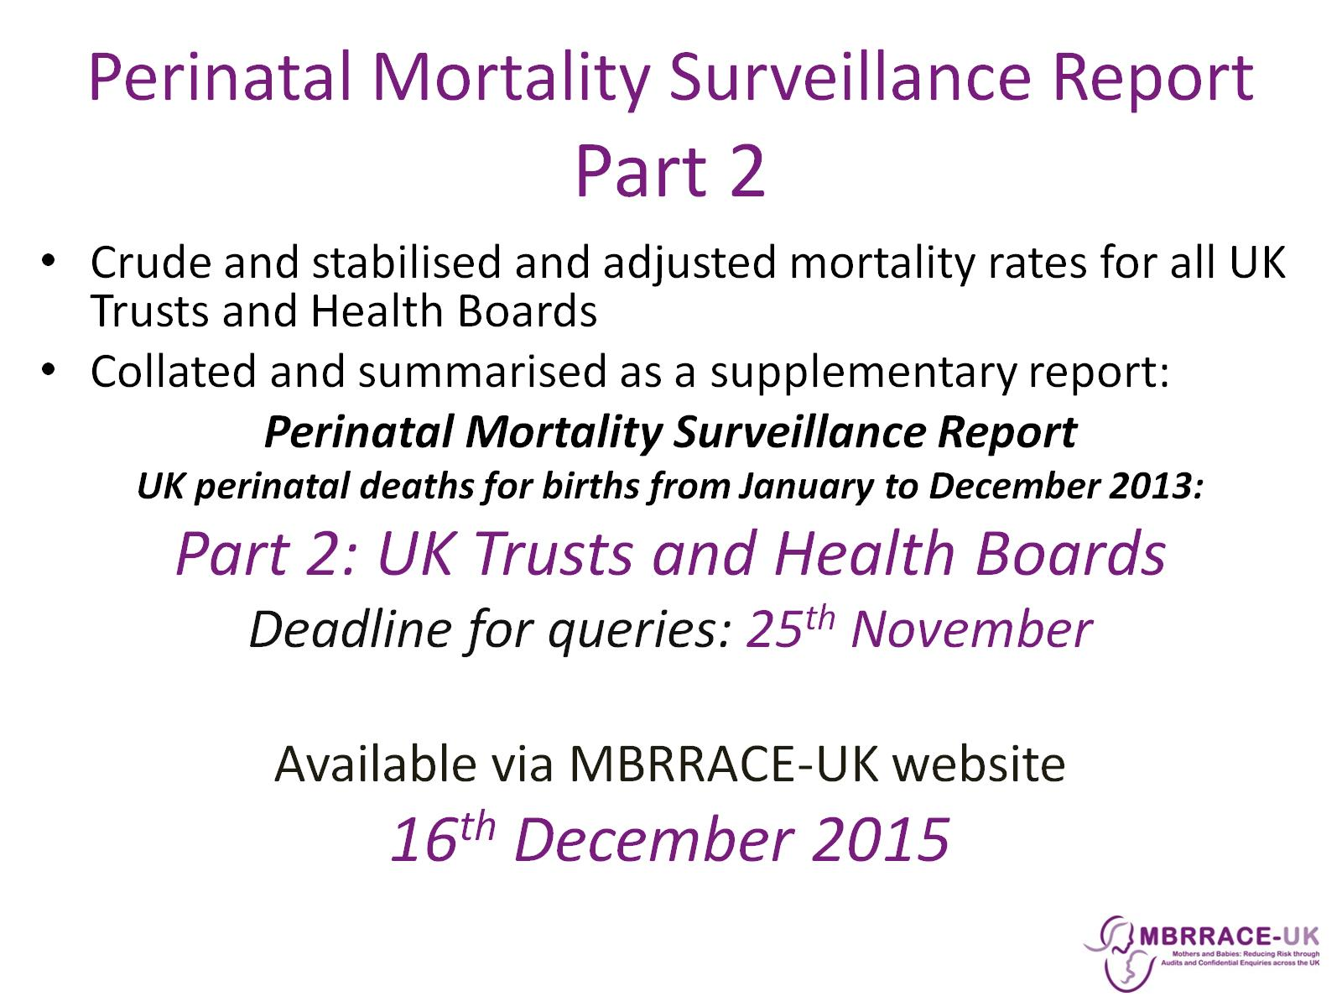
Perinatal Mortality Surveillance Report Part 2

Slide 12
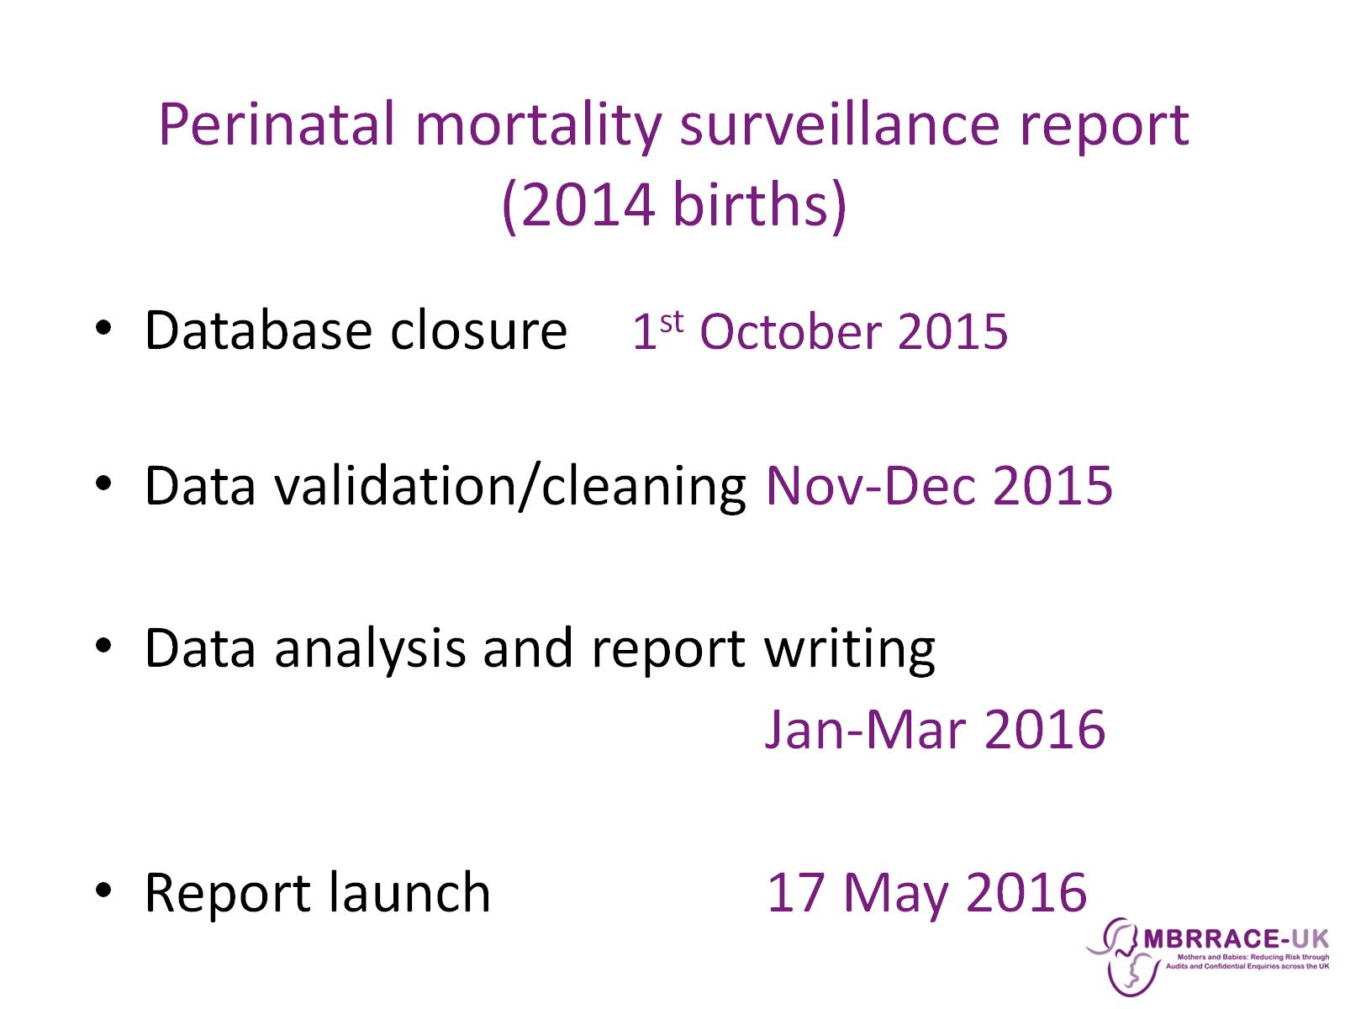
Perinatal mortality surveillance report (2014 births)

Slide 13
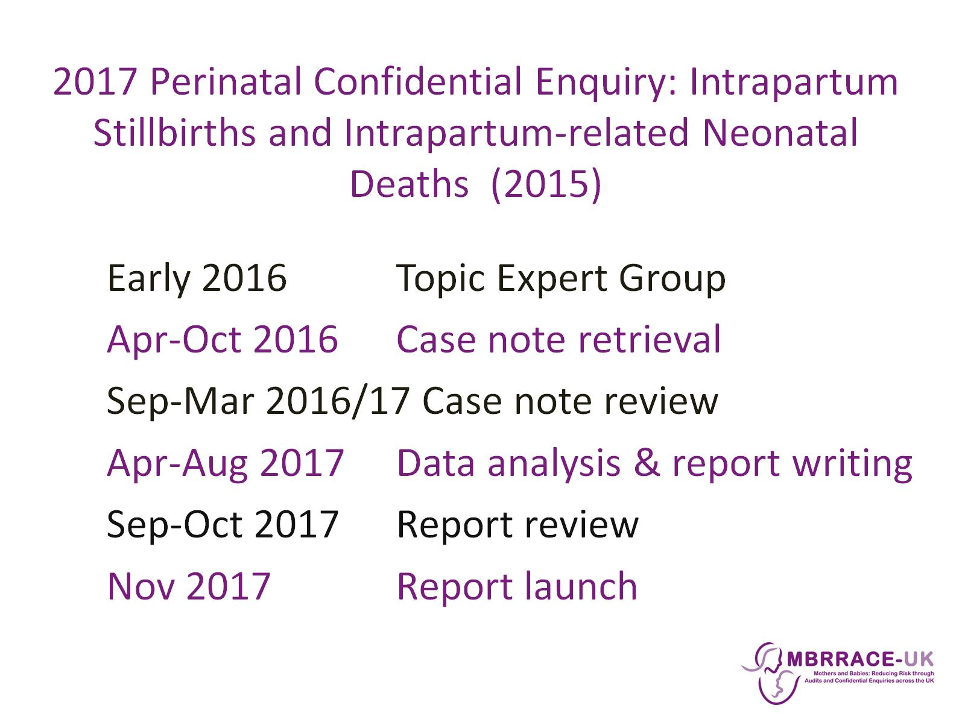
2017 Perinatal Confidential Enquiry: Intrapartum Stillbirths and Intrapartum-related Neonatal Deaths (2015)

Slide 14
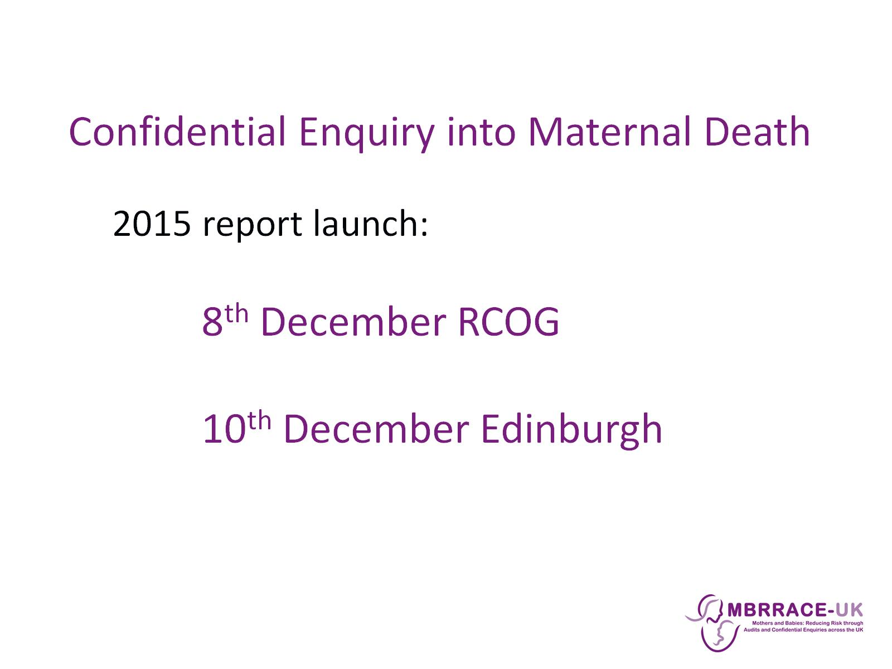
Confidential Enquiry into Maternal Death

Slide 15
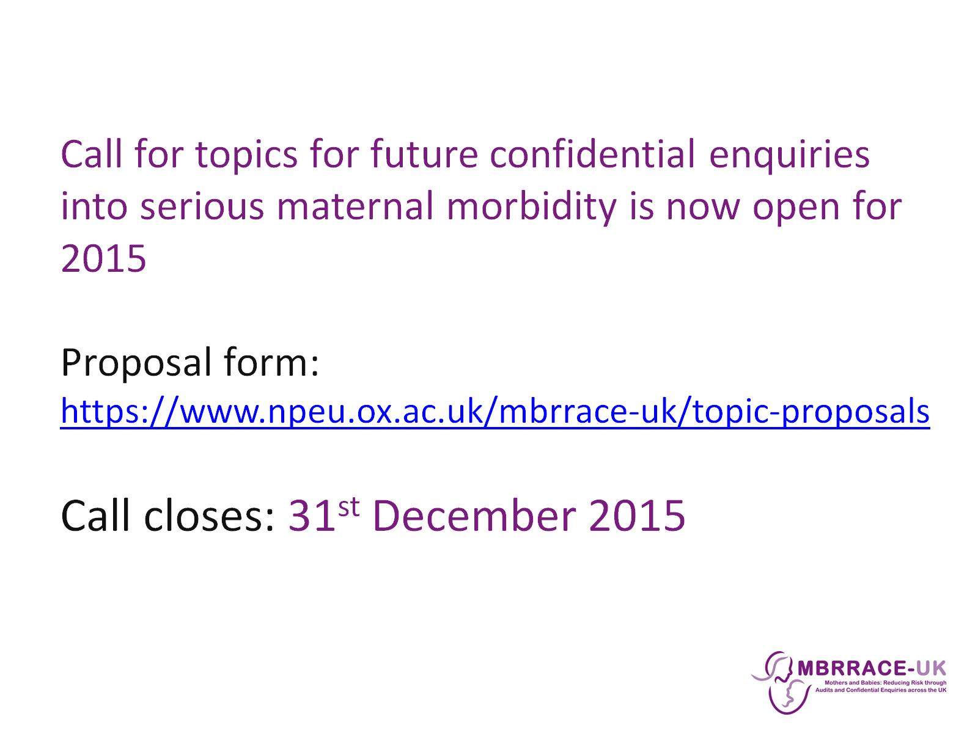
Call for topics for future confidential enquiries into serious maternal morbidity is now open for 2015
Proposal form: https://www.npeu.ox.ac.uk/mbrrace-uk/topic-proposals
Call closes: 31st December 2015

Slide 16


