Slide 1

Follow-up care and local review
Tracey Johnston
Authors: Sara Kenyon, Coralie Rogers & Tracey Johnston

Slide 2

Local Review

Slide 3
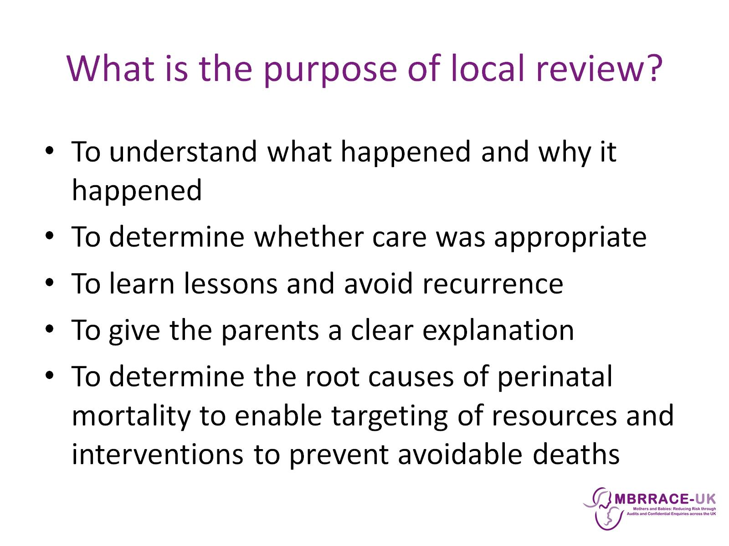
What is the purpose of local review?

Slide 4
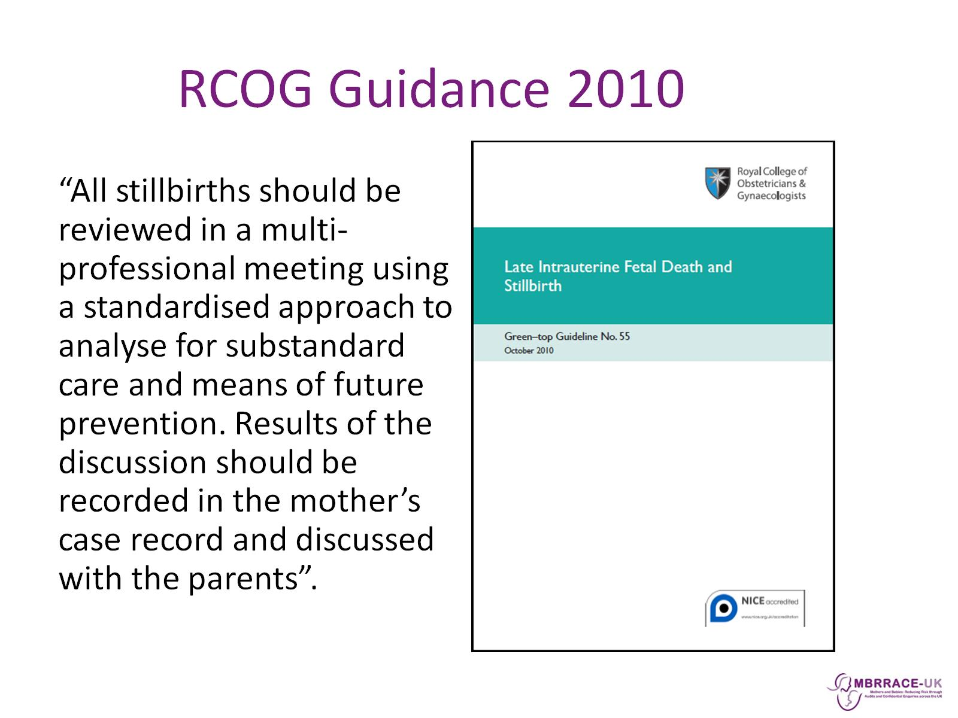
RCOG Guidance 2010

Slide 5
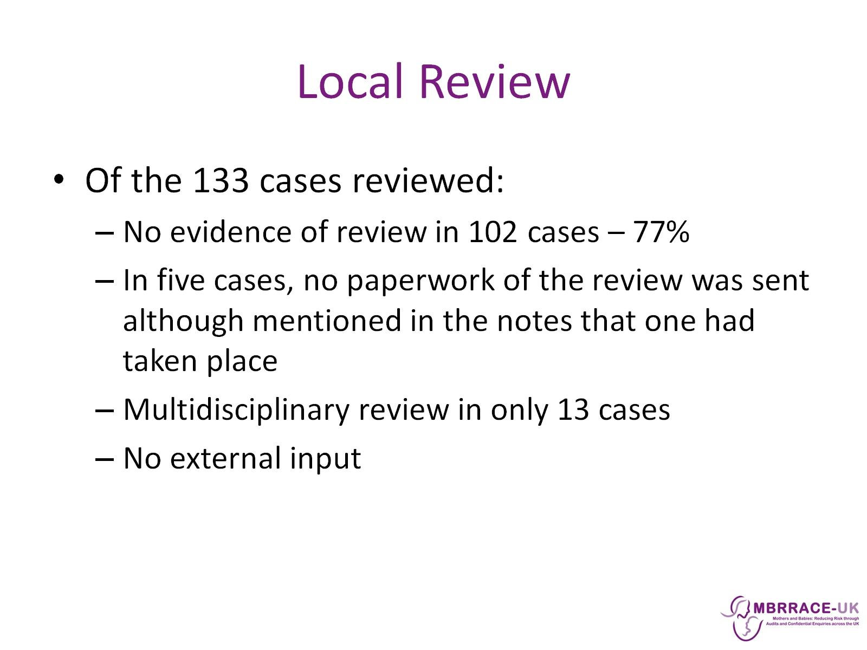
Local Review

Slide 6
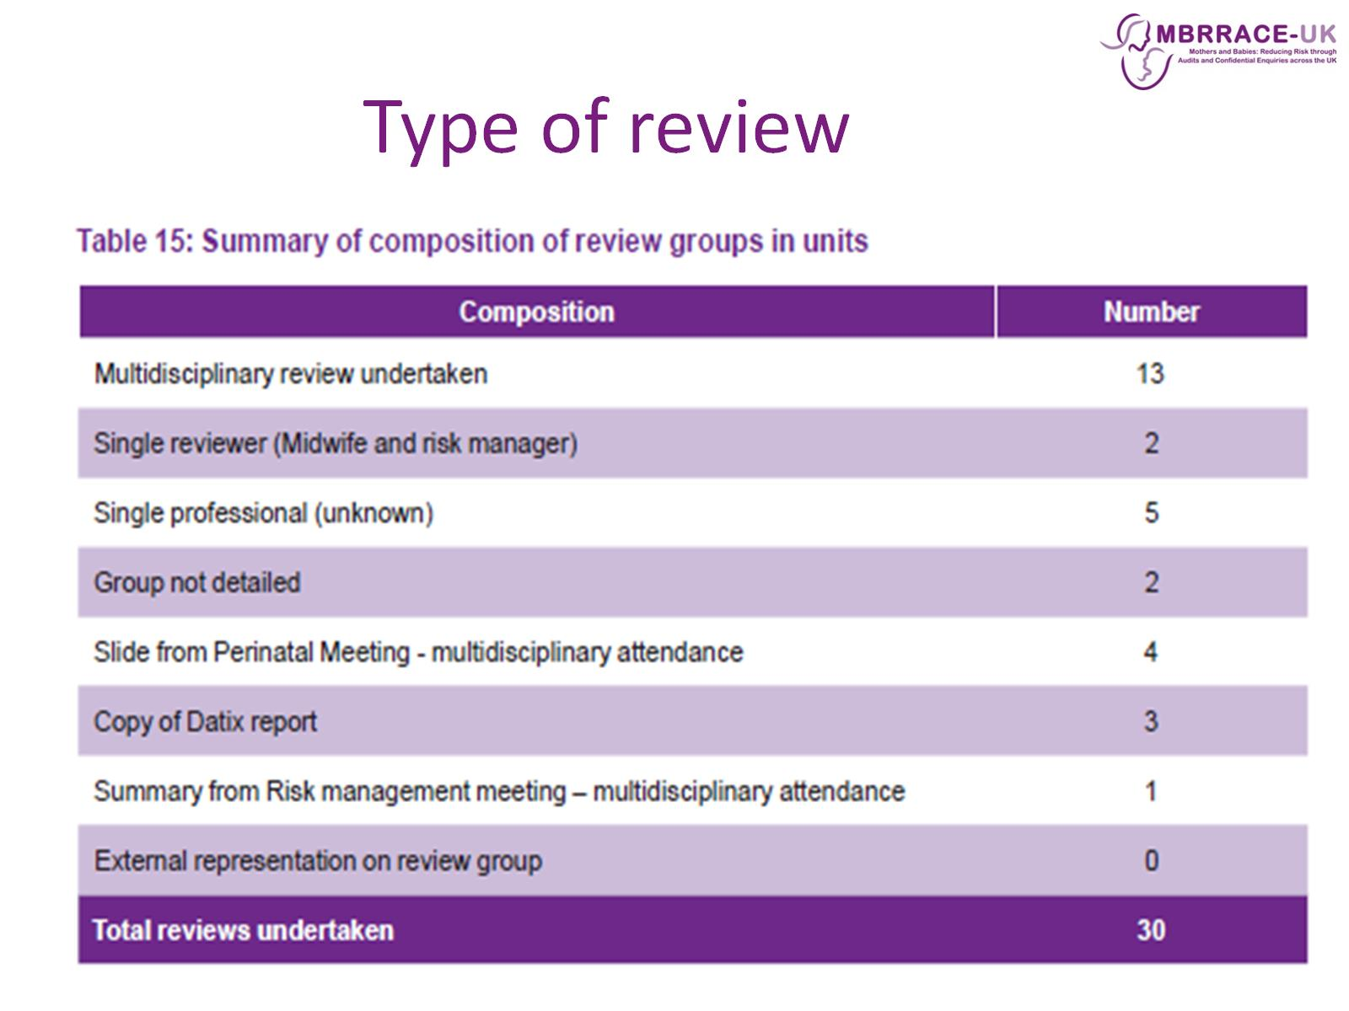
Type of review

Slide 7
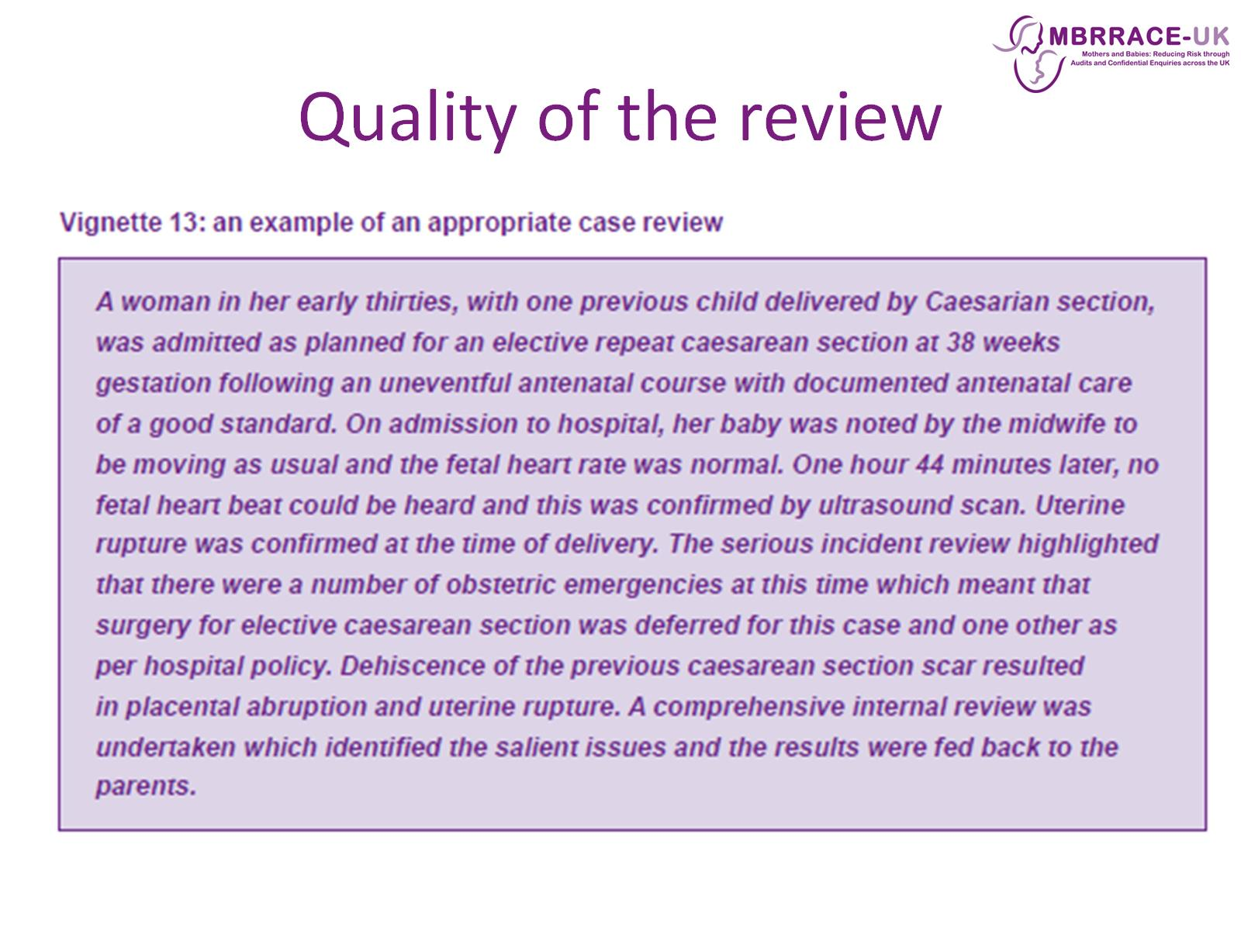
Quality of the review

Slide 8
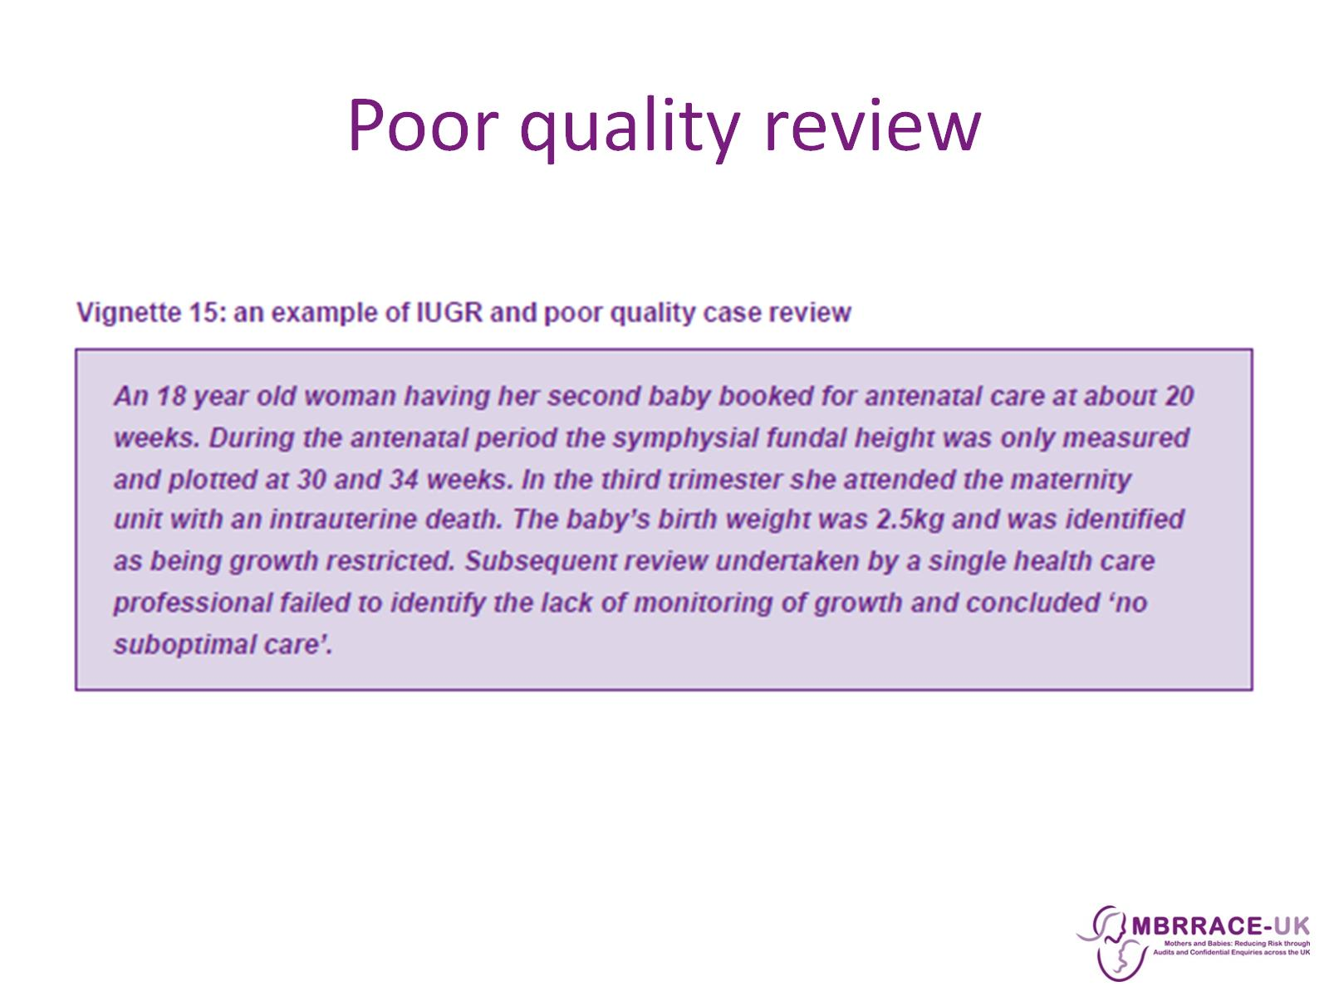
Poor quality review

Slide 9
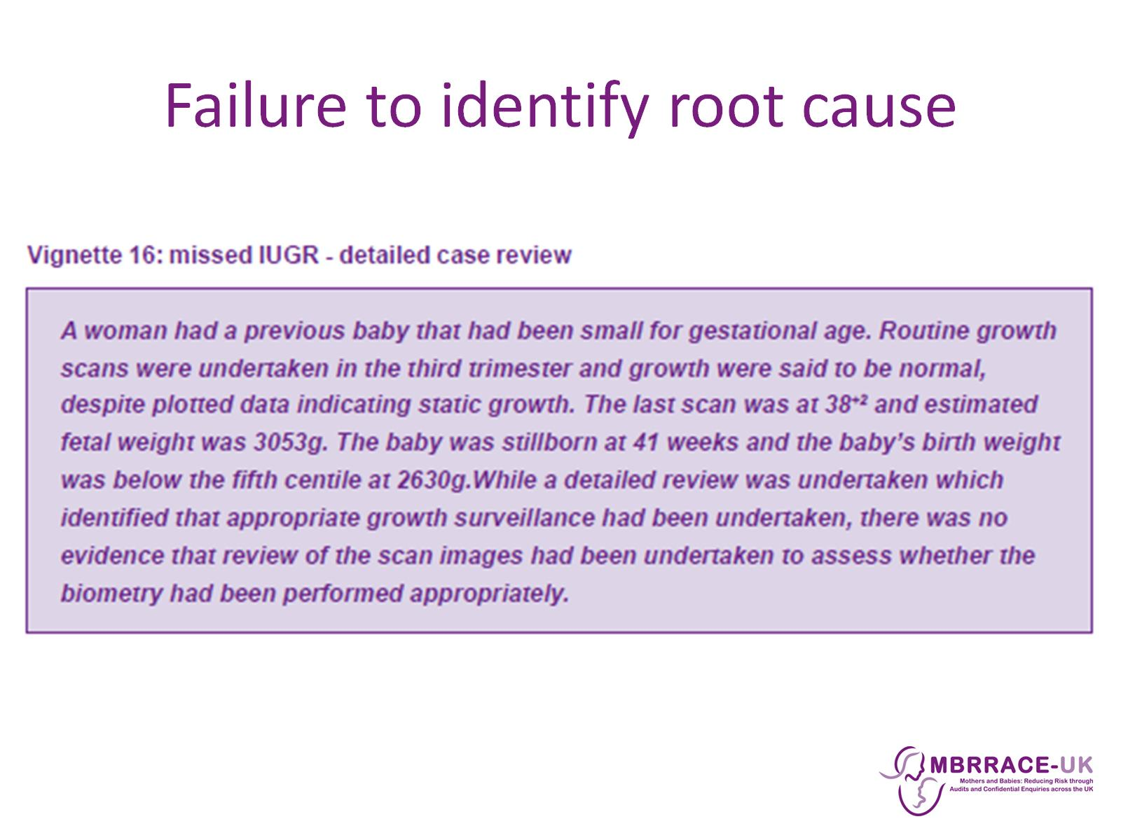
Failure to identify root cause

Slide 10
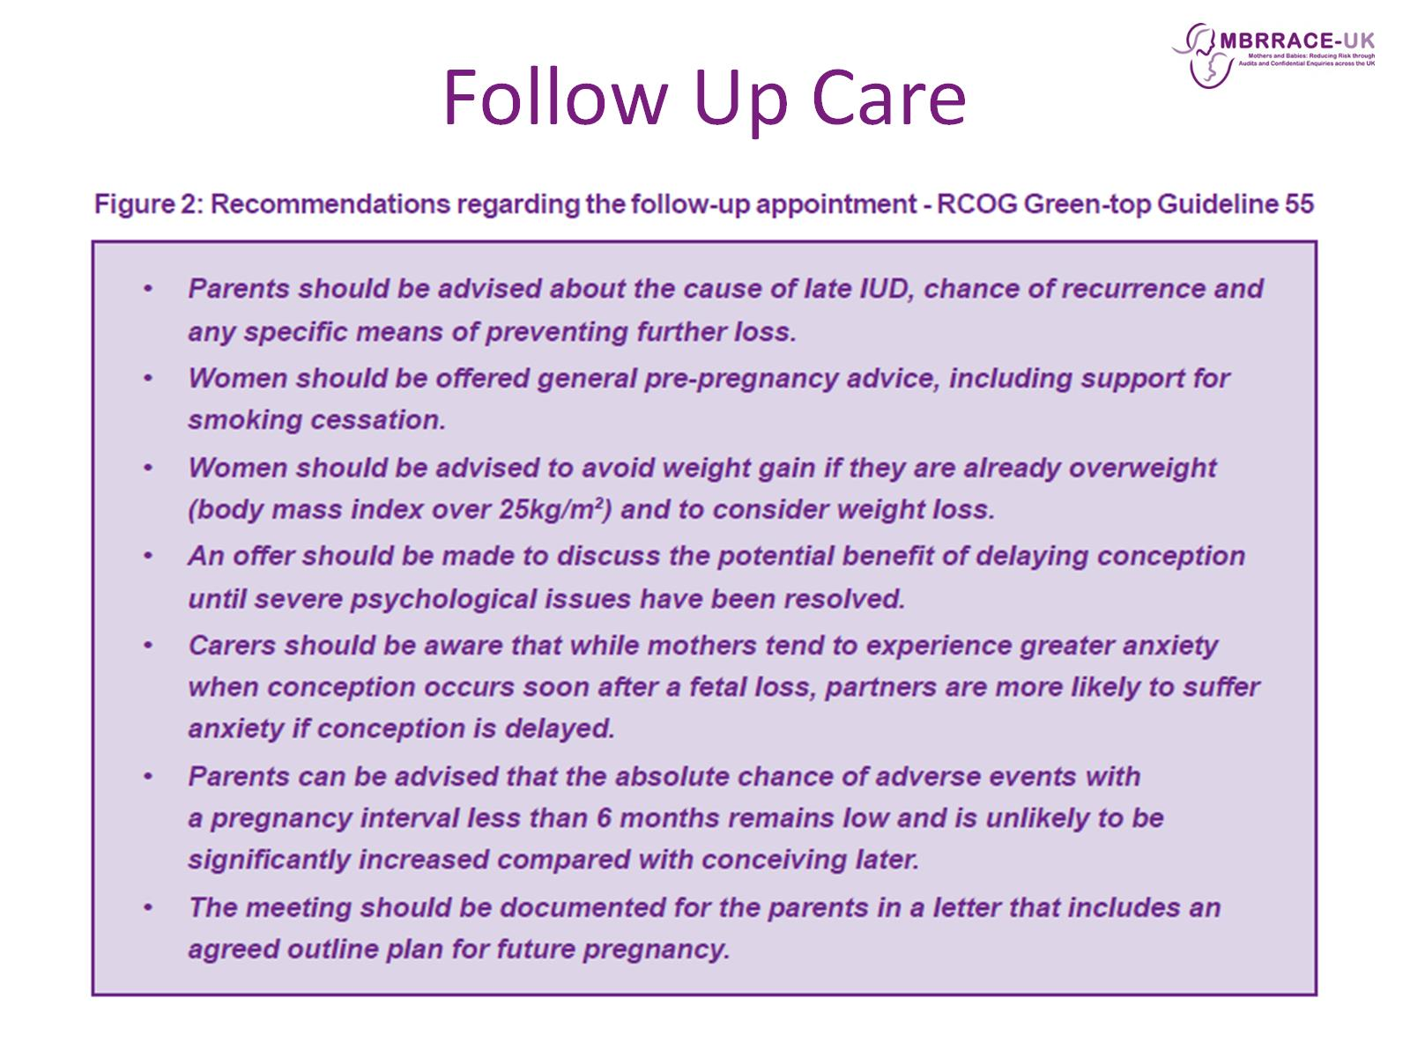
Follow Up Care

Slide 11
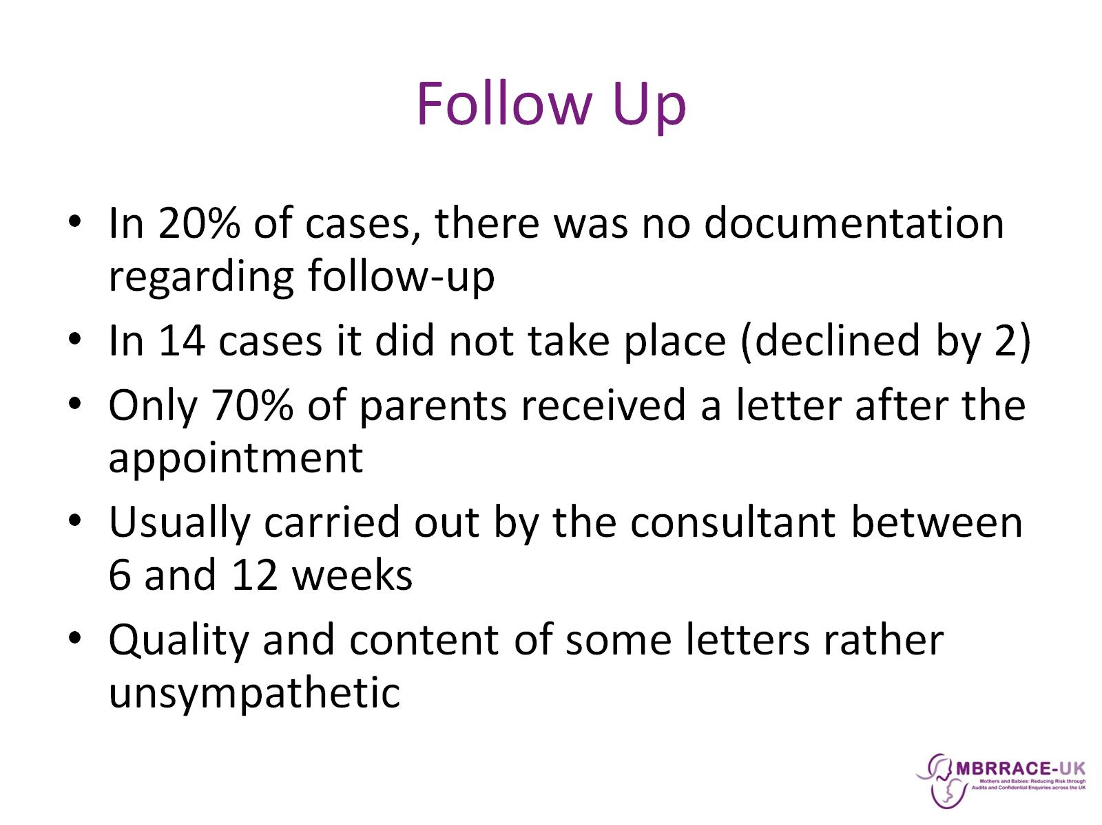
Follow Up

Slide 12
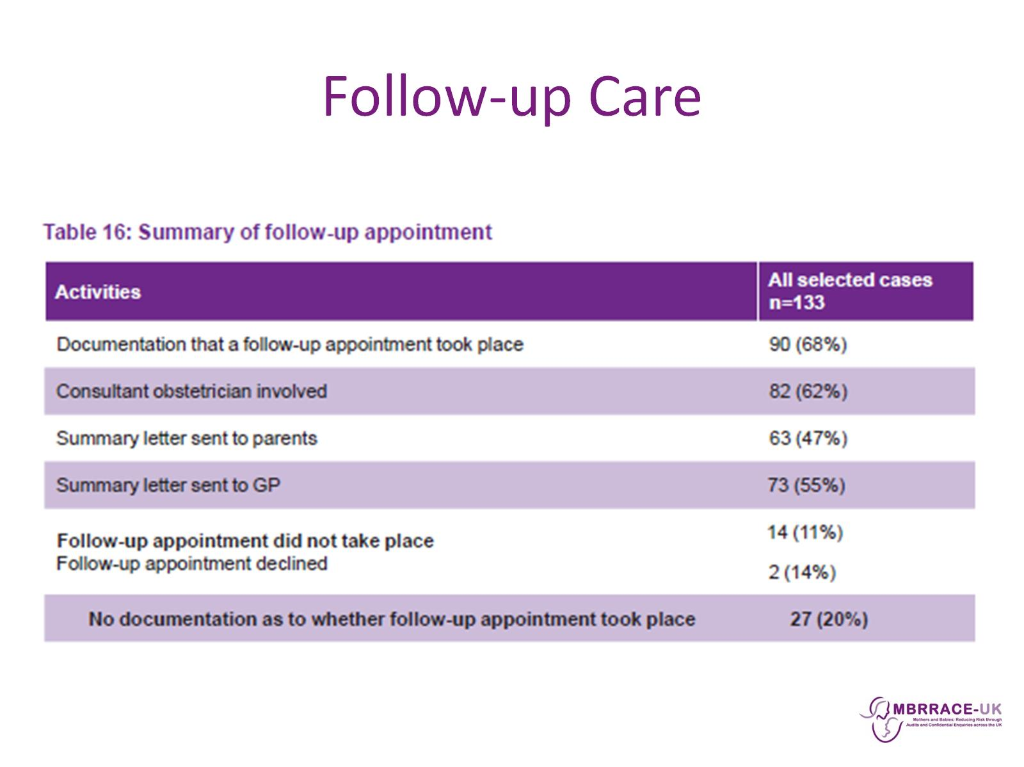
Follow-up Care

Slide 13
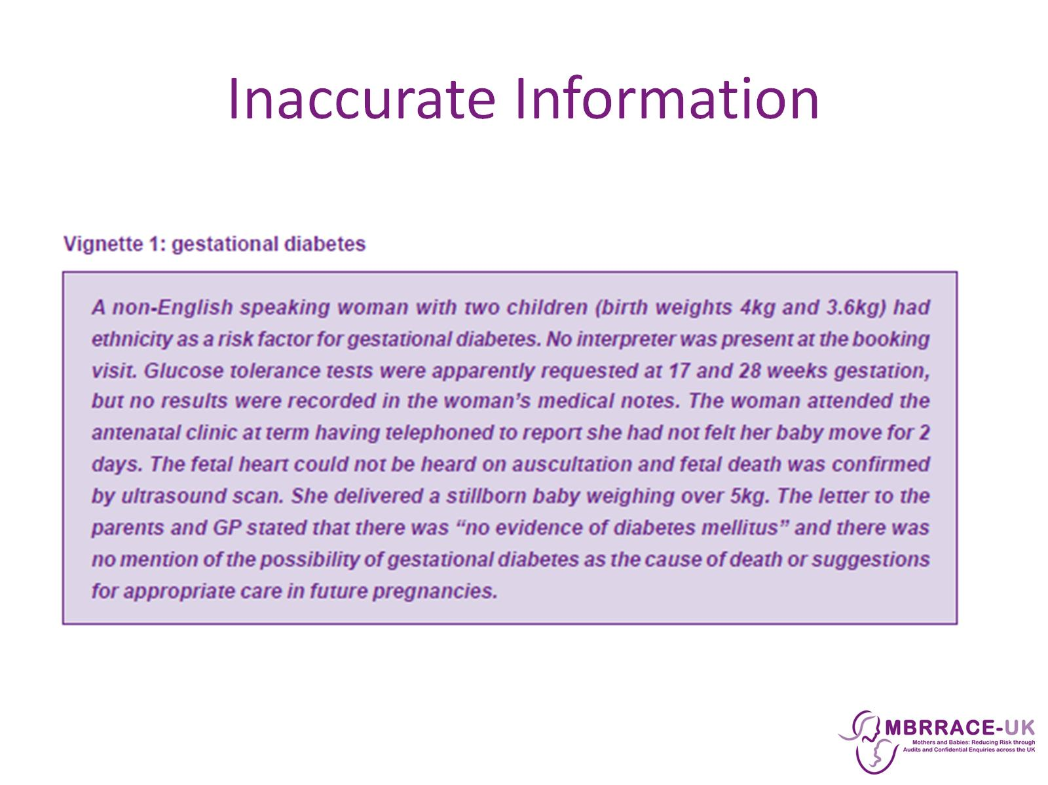
Inaccurate Information

Slide 14
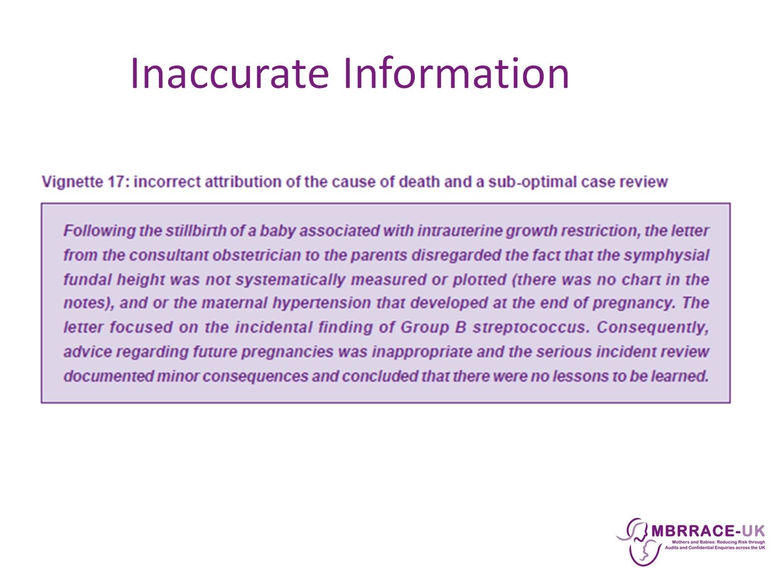
Inaccurate Information

Slide 15
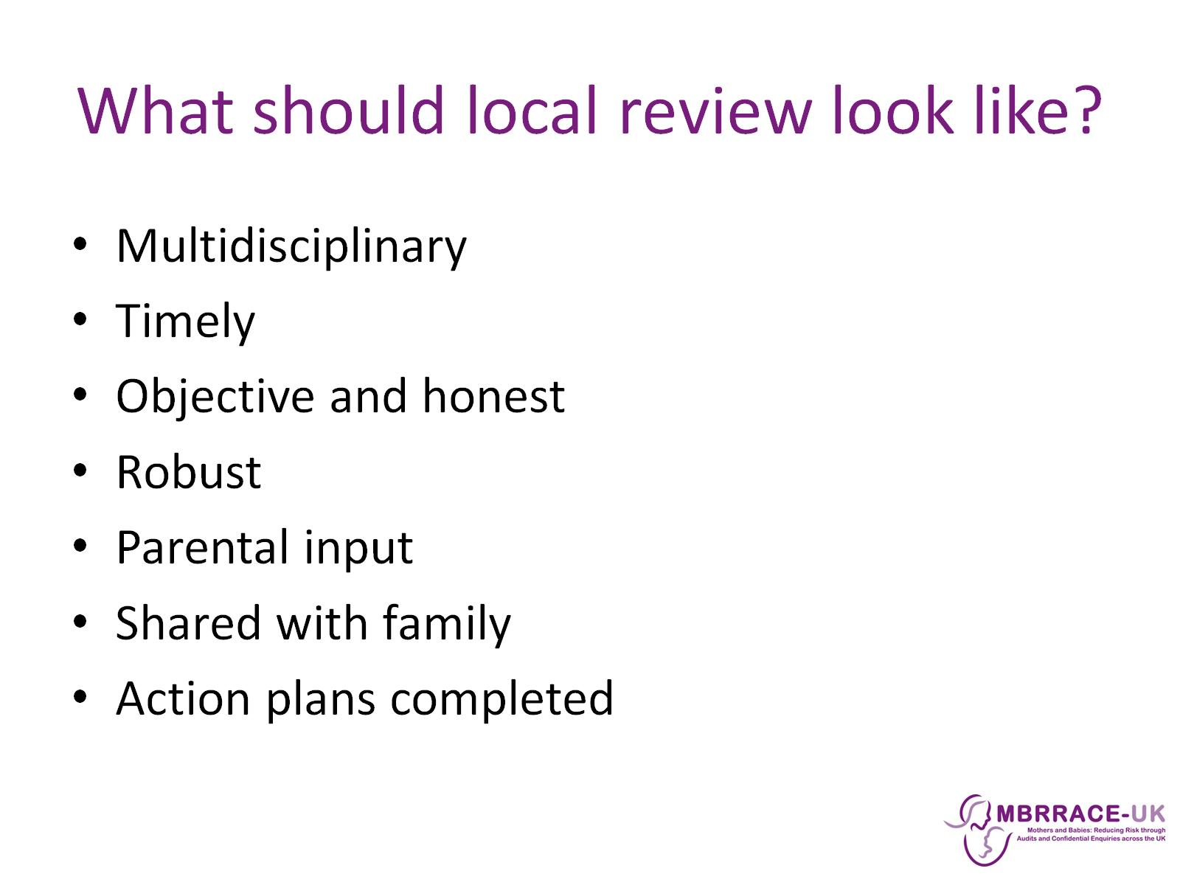
What should local review look like?

Slide 16
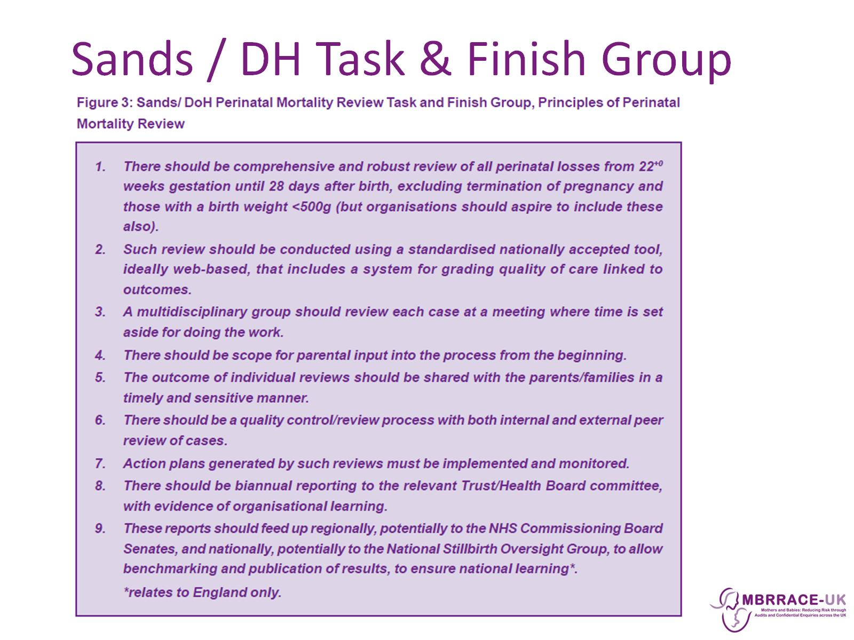
Sands / DH Task & Finish Group

Slide 17
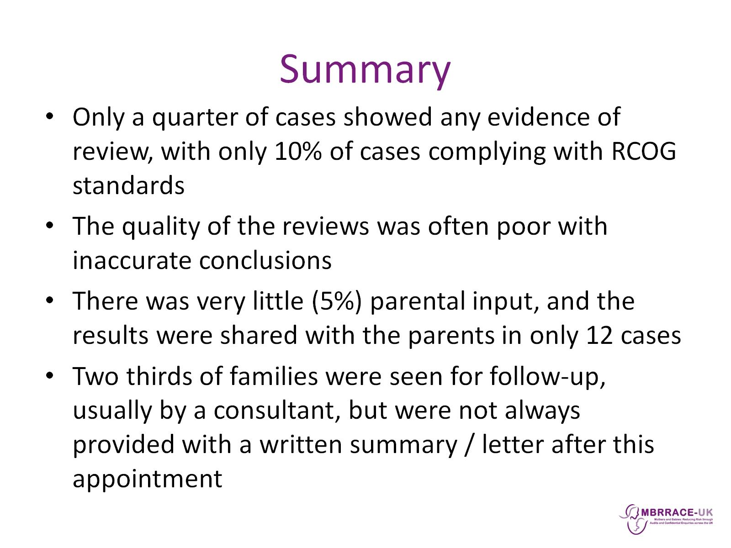
Summary

Slide 18
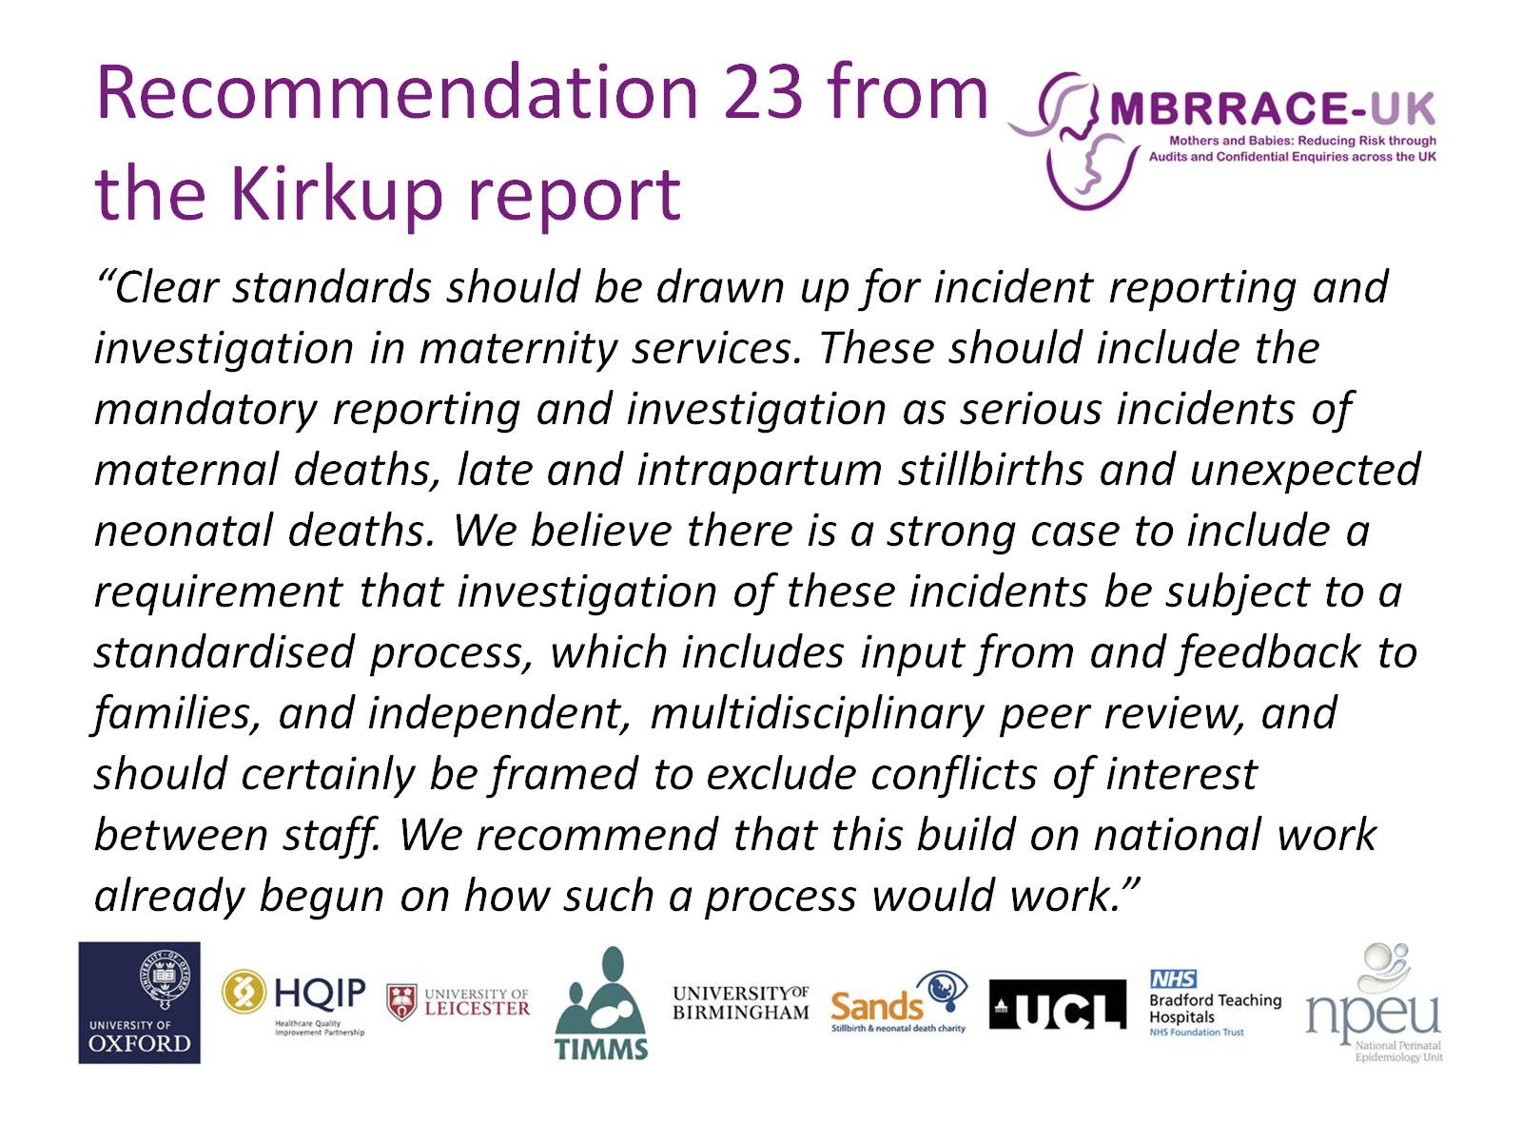
Recommendation 23 from the Kirkup report

