Slide 1

Women with multiple psycho-social problems including substance misuse

Slide 2
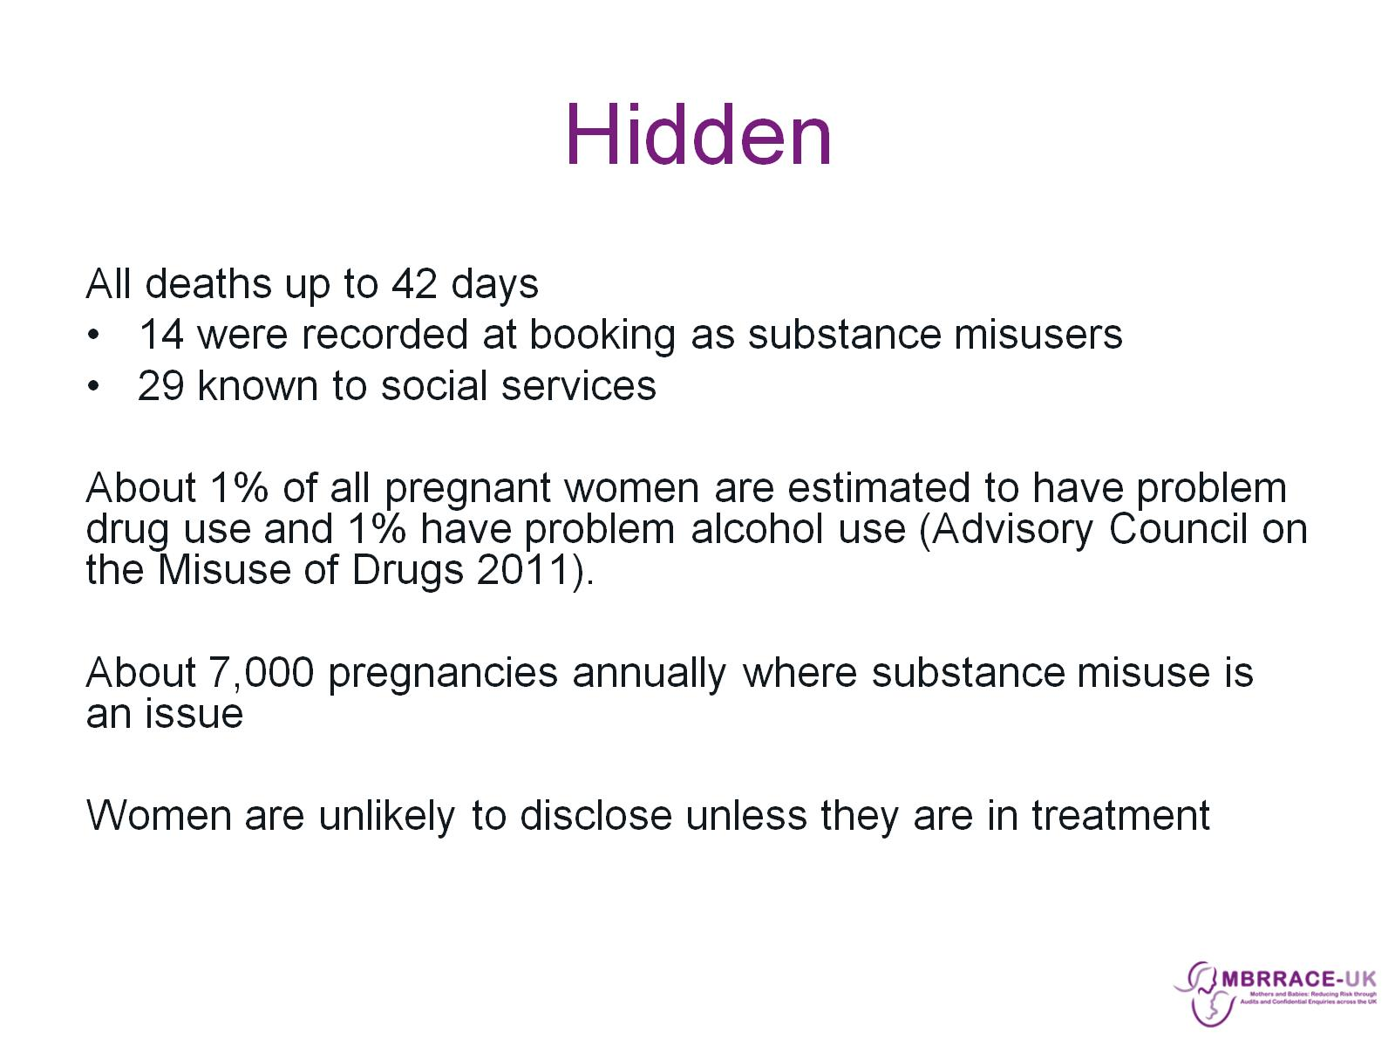
Hidden

Slide 3
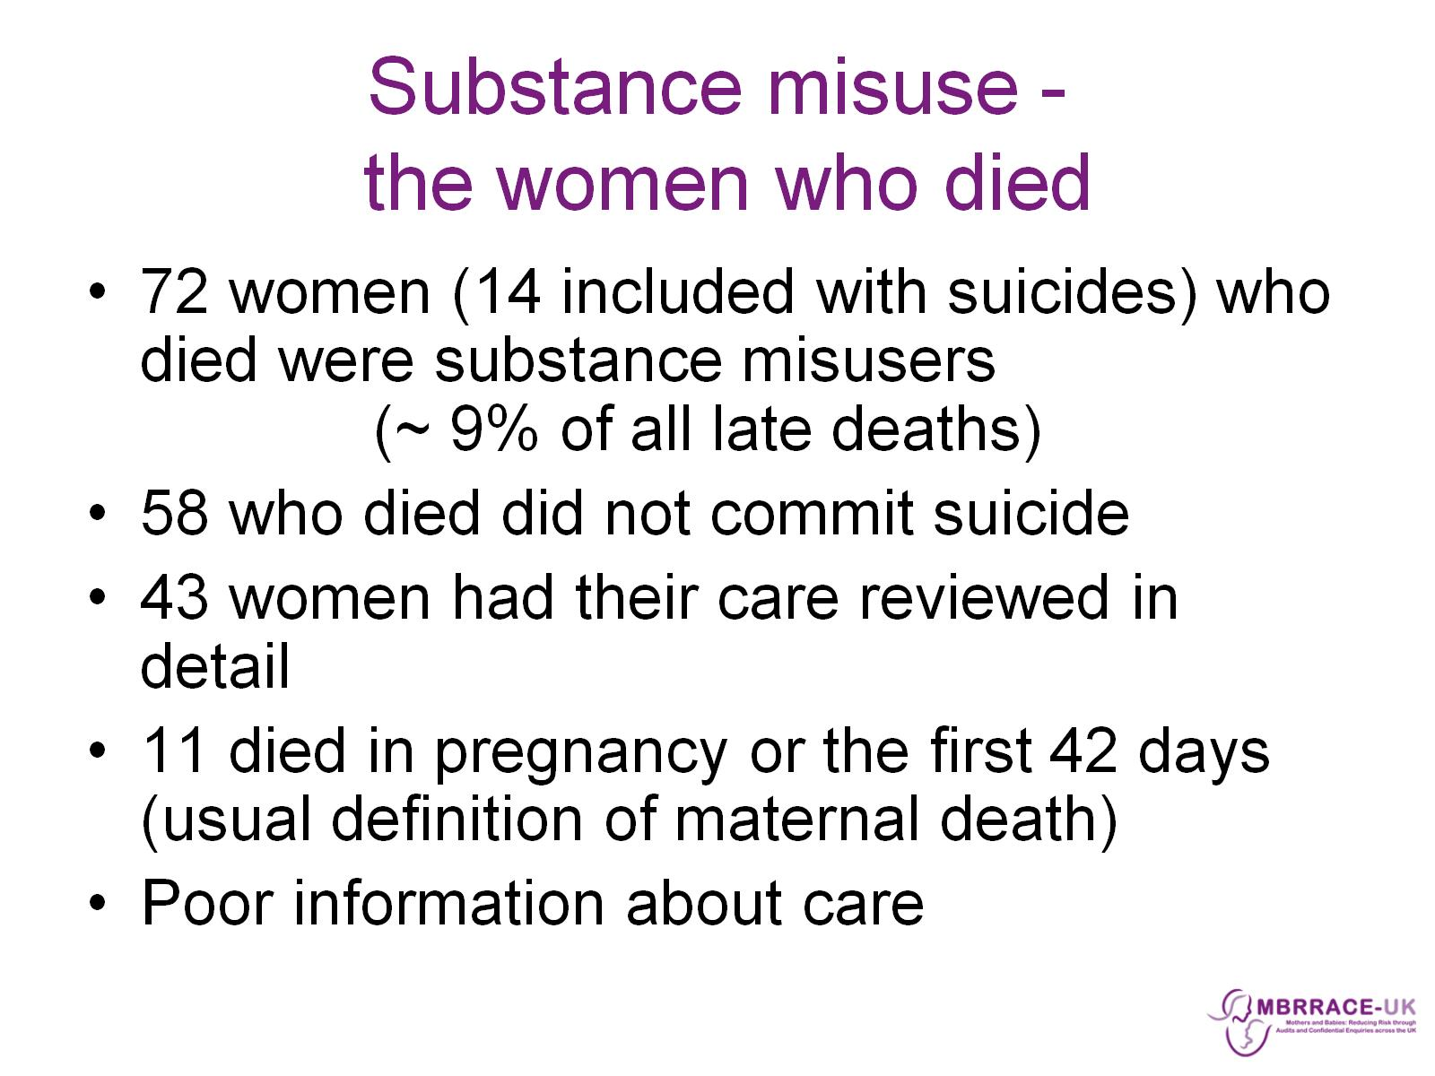
Substance misuse - the women who died

Slide 4
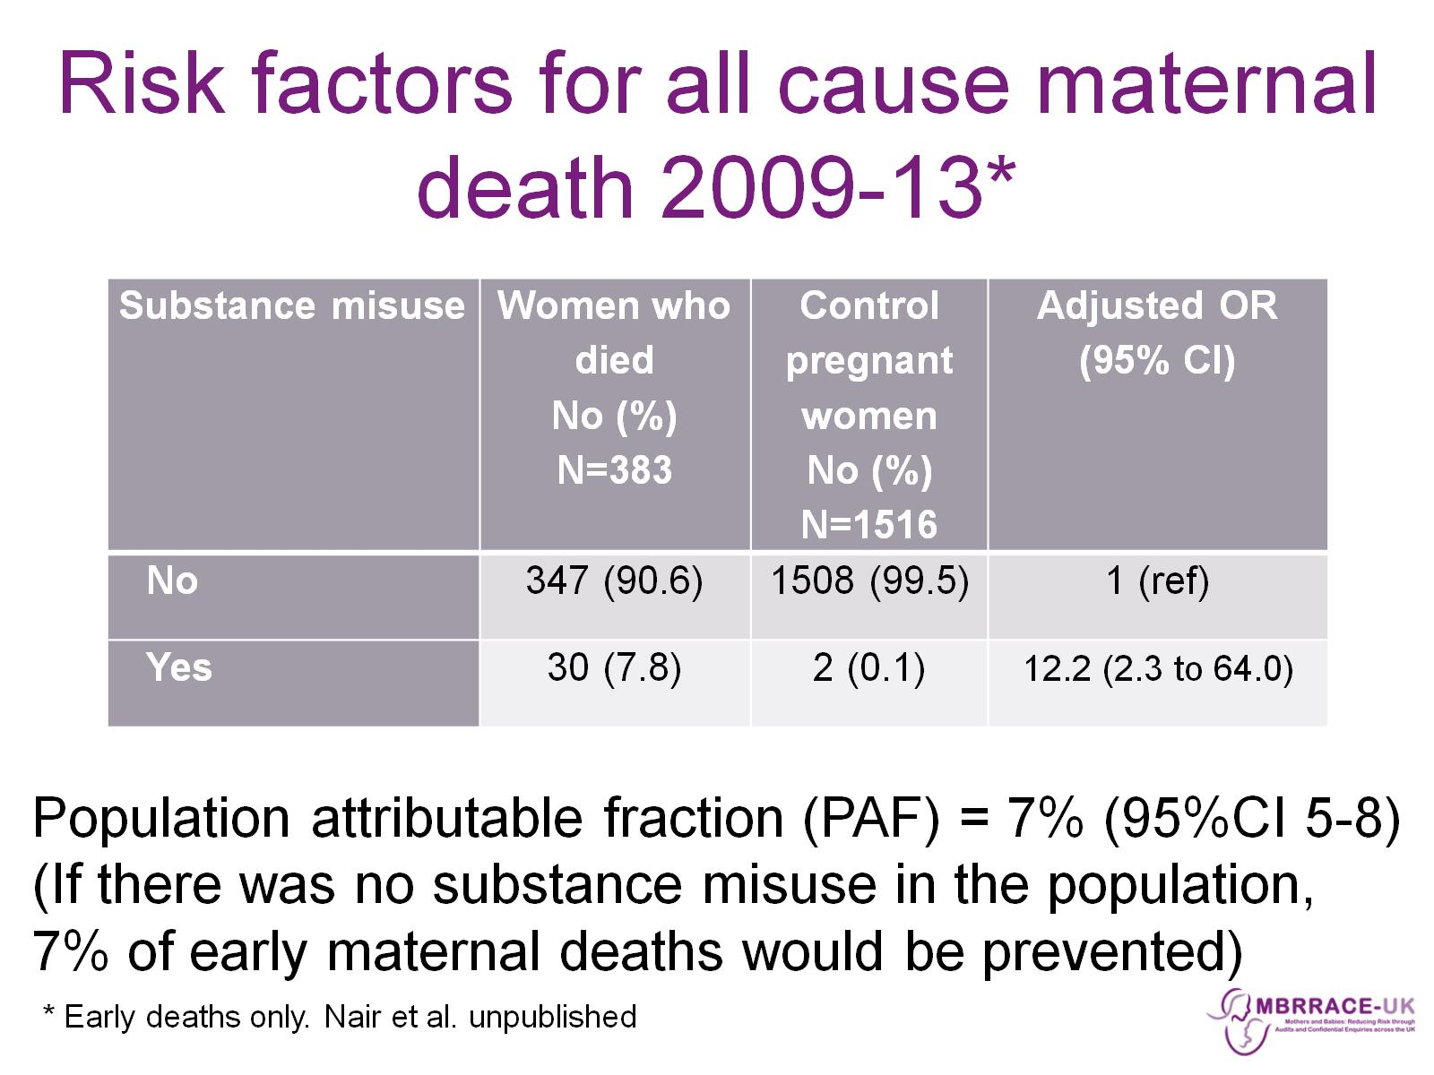
Risk factors for all cause maternal death 2009-13*

Slide 5
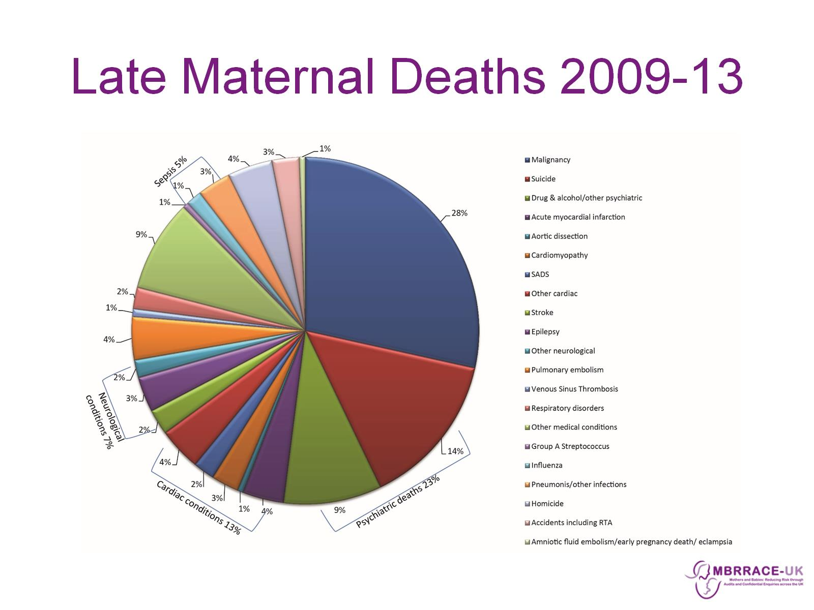
Late Maternal Deaths 2009-13

Slide 6
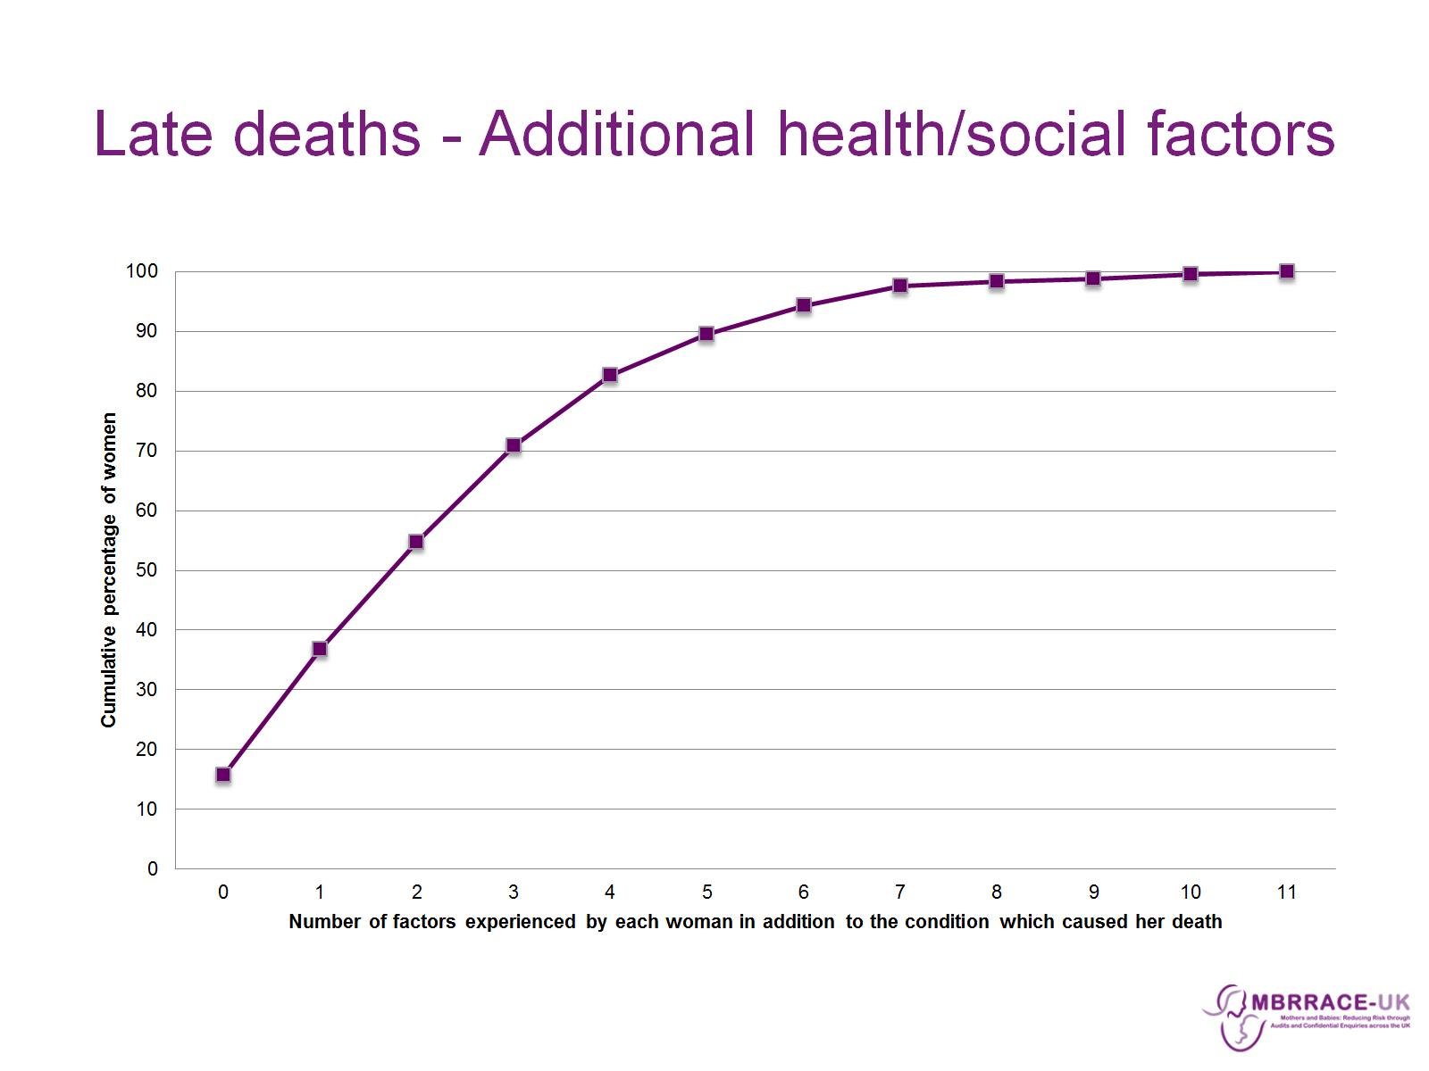
Late deaths - Additional health/social factors

Slide 7
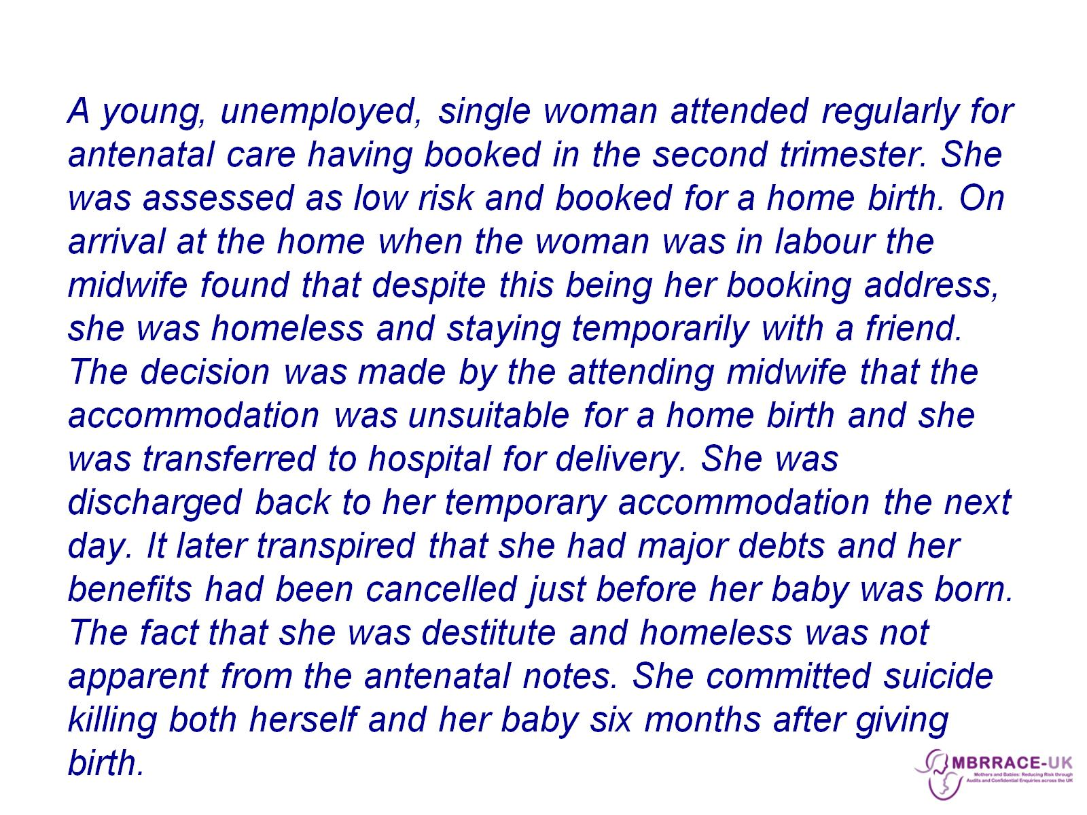

Slide 8
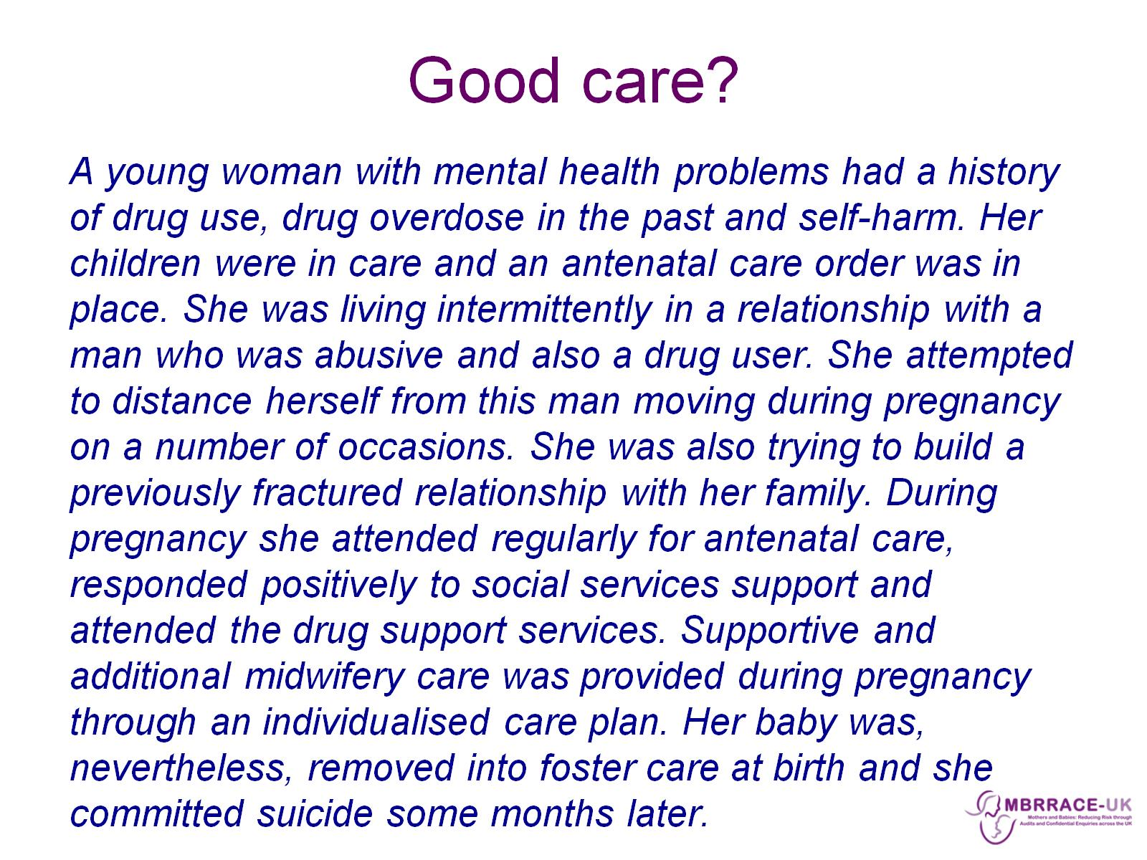
Good care?

Slide 9
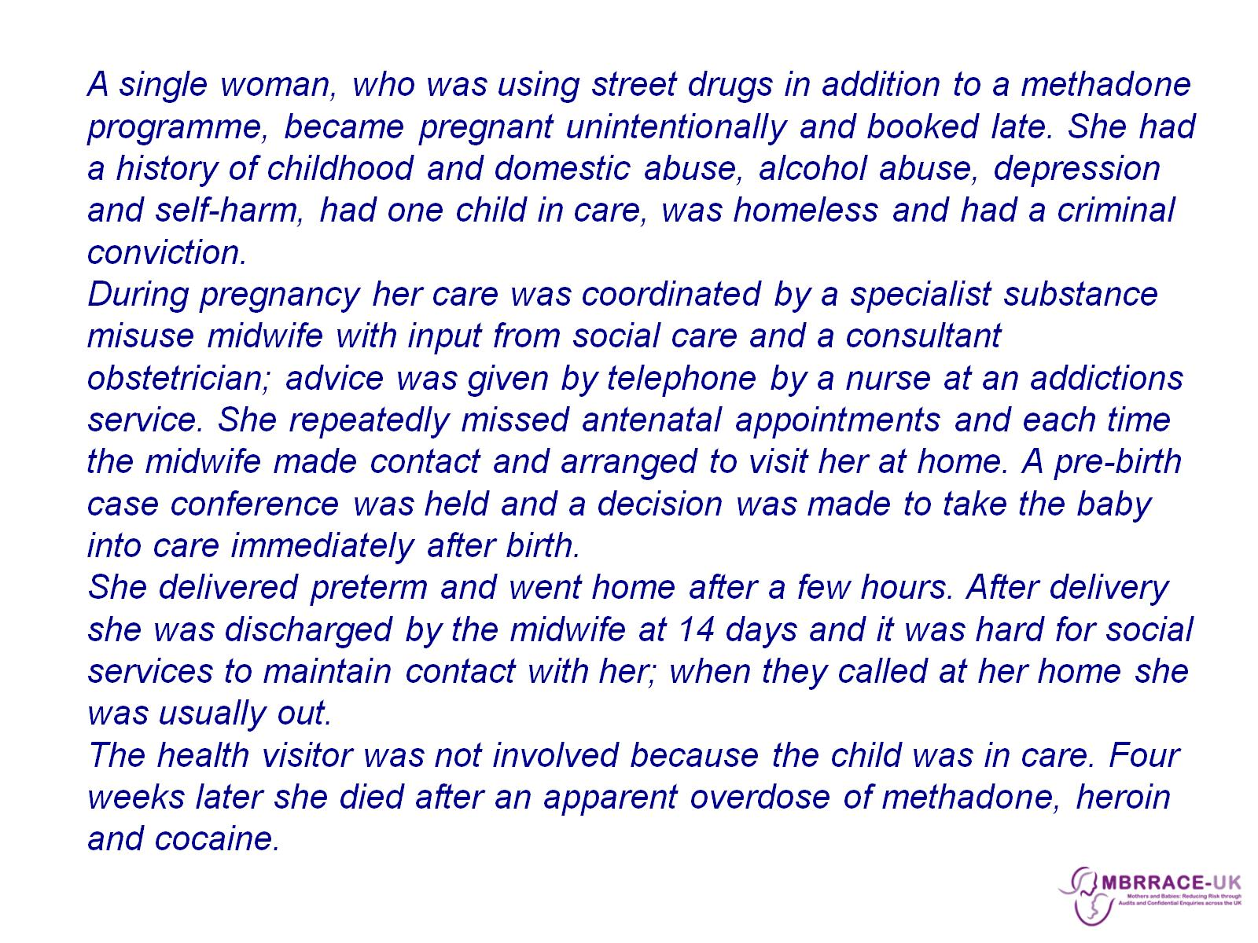

Slide 10
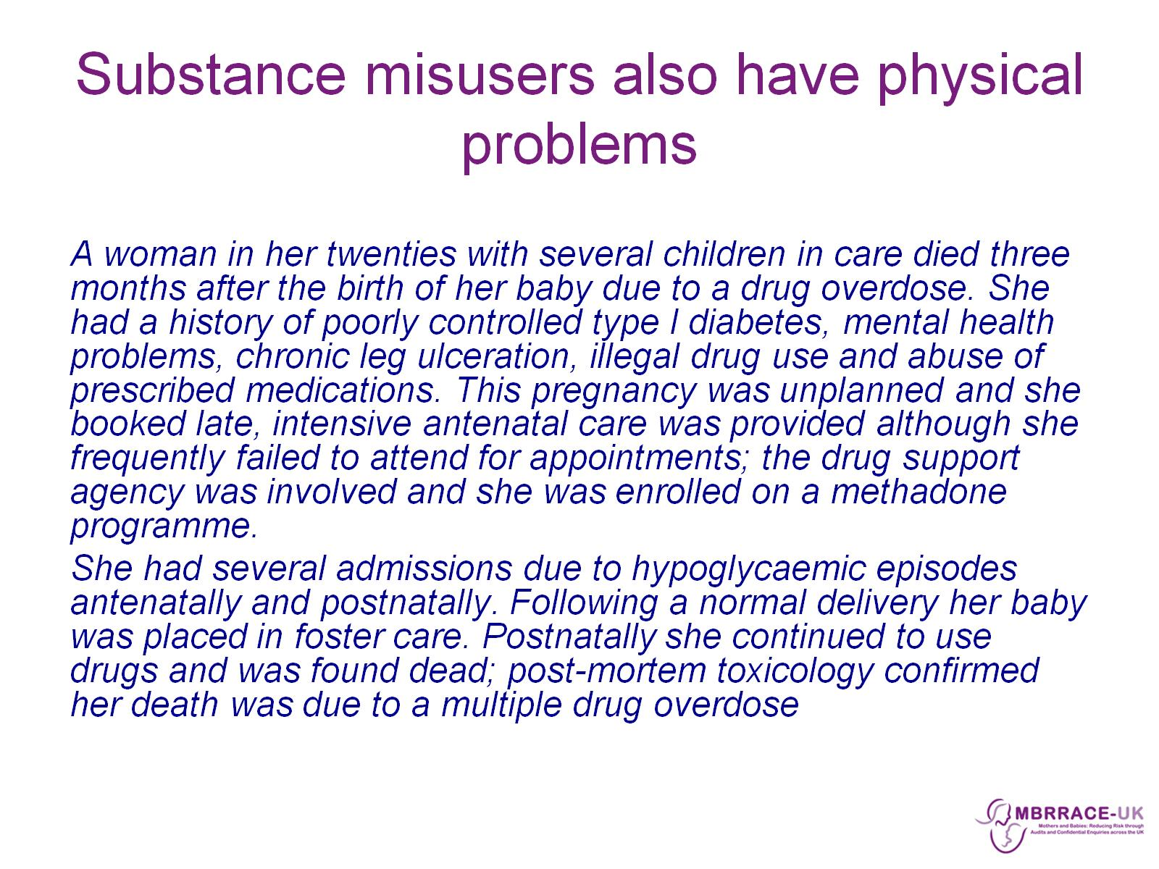
Substance misusers also have physical problems

Slide 11
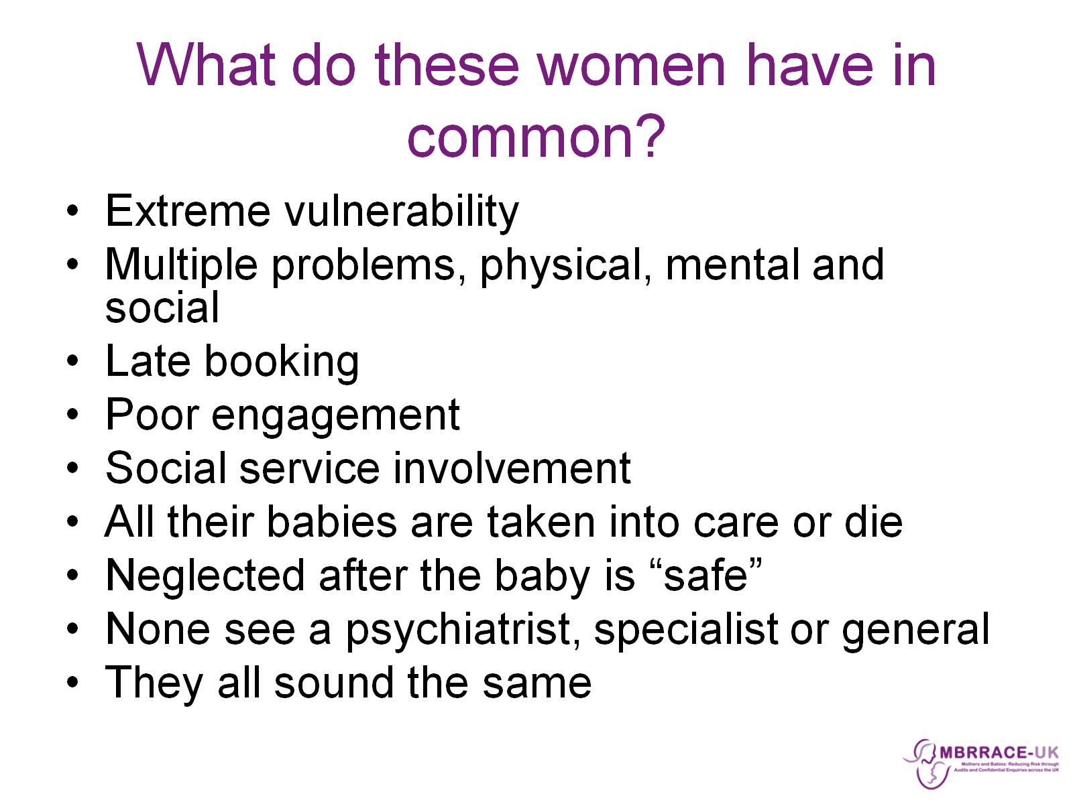
What do these women have in common?

Slide 12
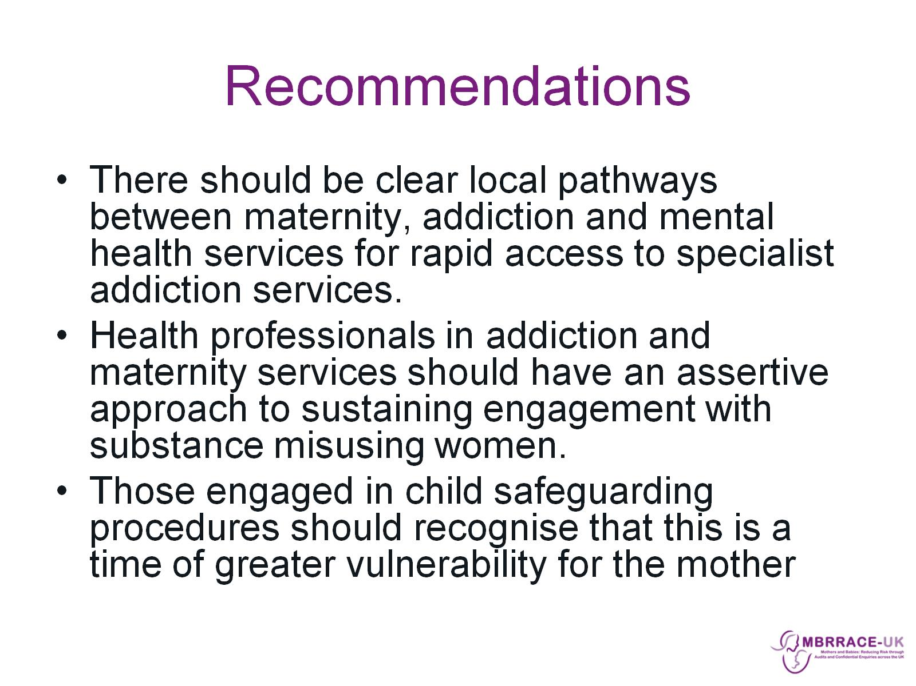
Recommendations

Slide 13
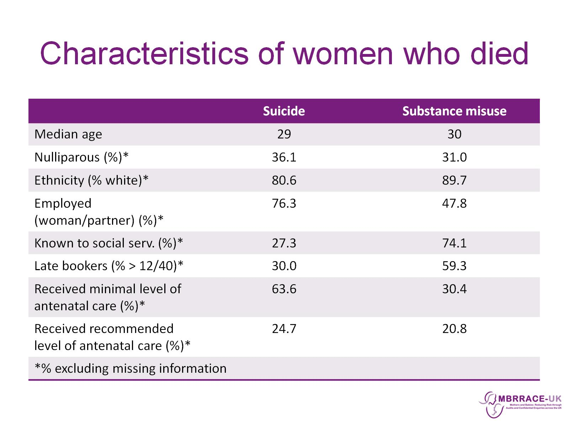
Characteristics of women who died

Slide 14
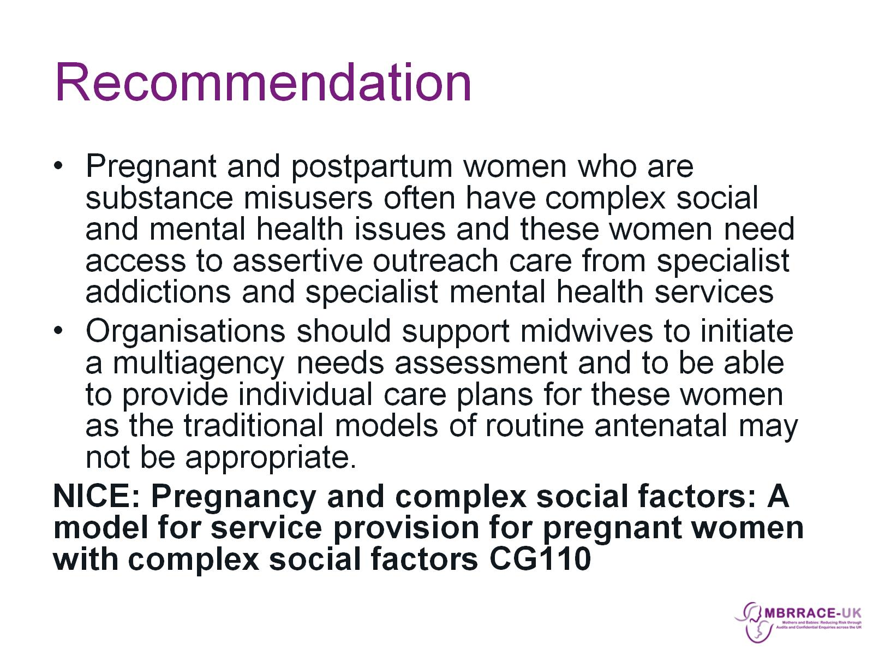
Recommendation

Slide 15
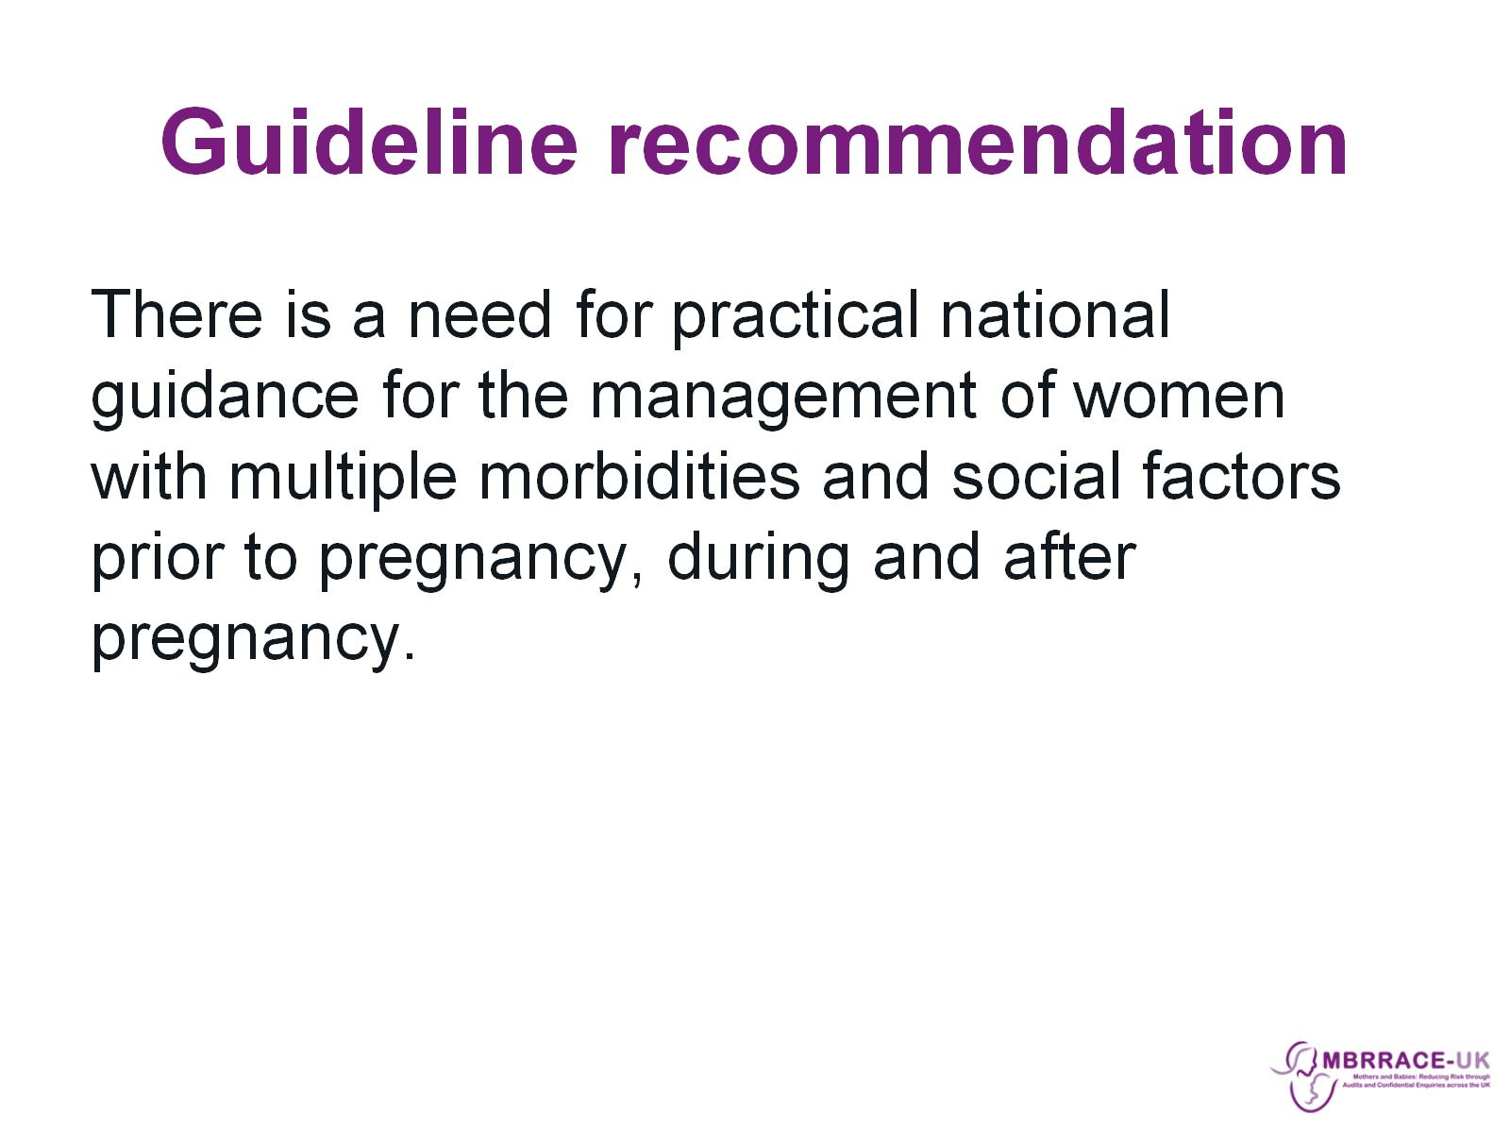
Guideline recommendation

Slide 16
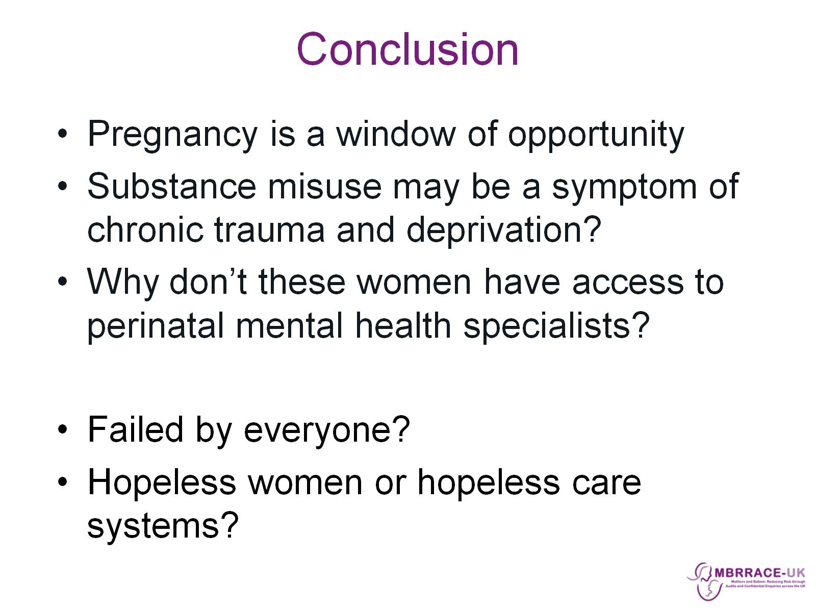
Conclusion

