Slide 1

The women who died 2011-13

Slide 2
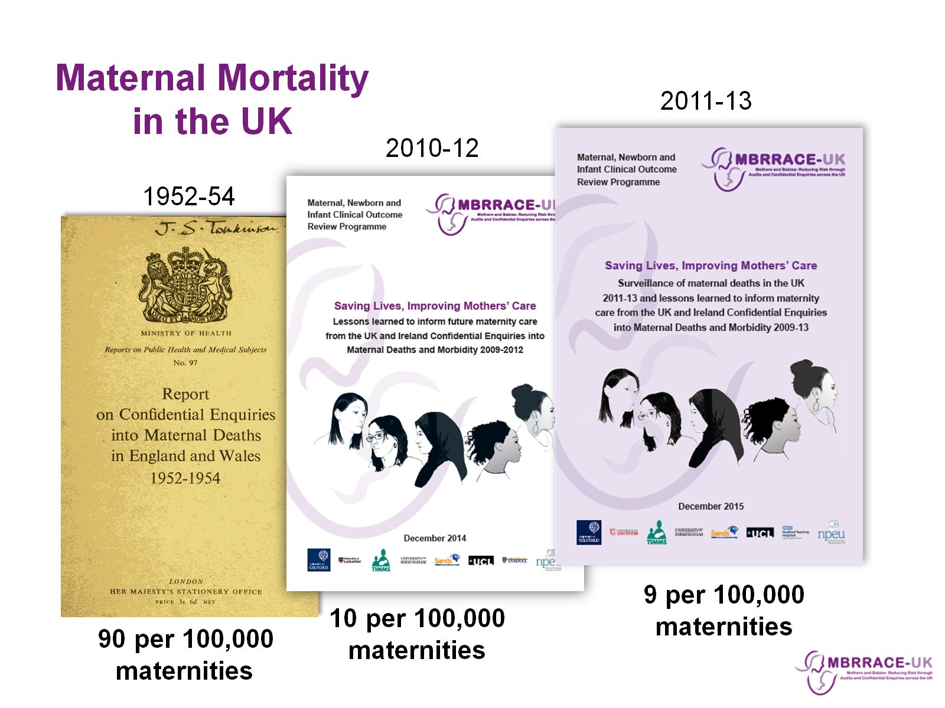
Maternal Mortality in the UK

Slide 3
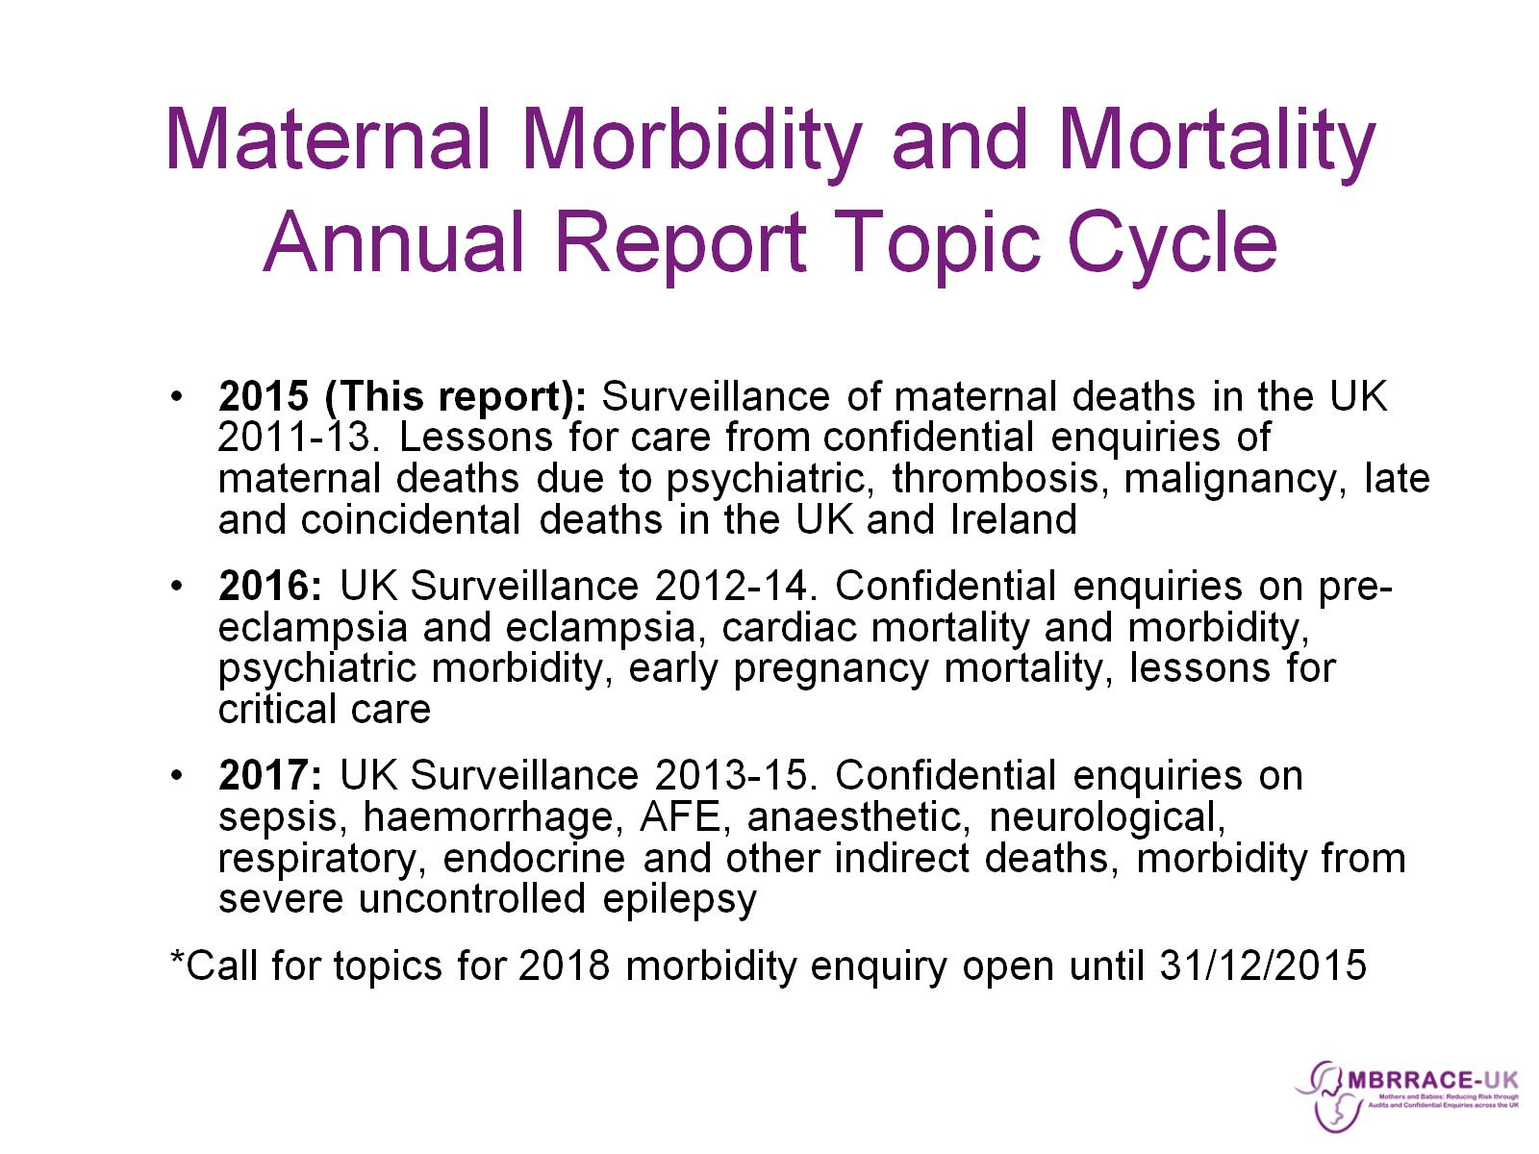
Maternal Morbidity and Mortality
Annual Report Topic Cycle

Slide 4

MBRRACE-UK: Methods

Slide 5
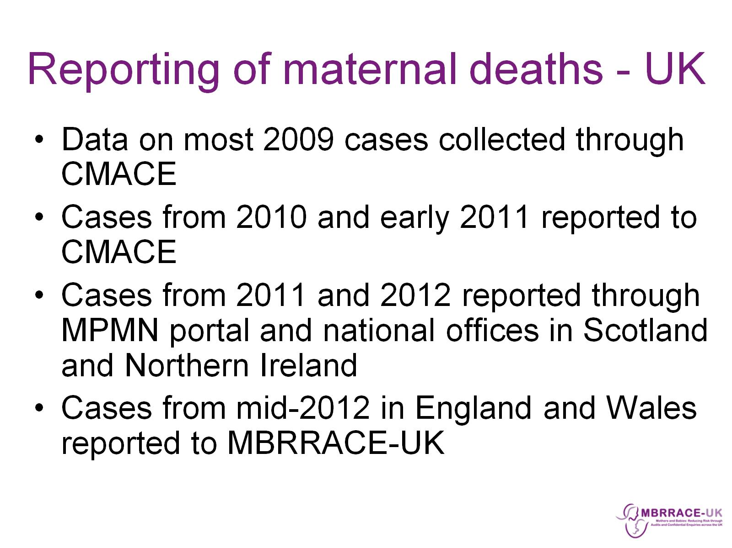
Reporting of maternal deaths - UK

Slide 6
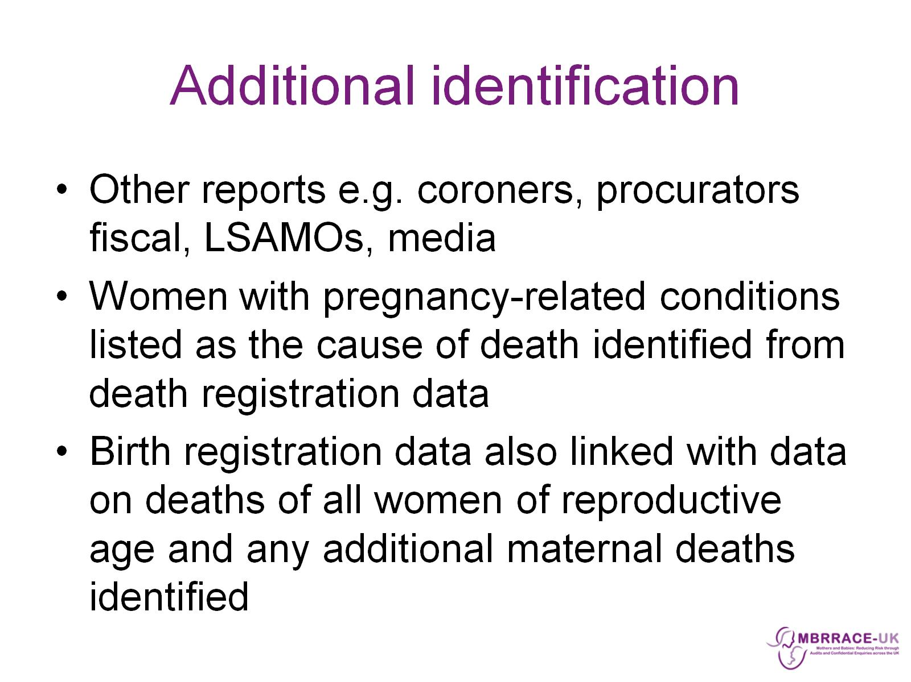
Additional identification

Slide 7
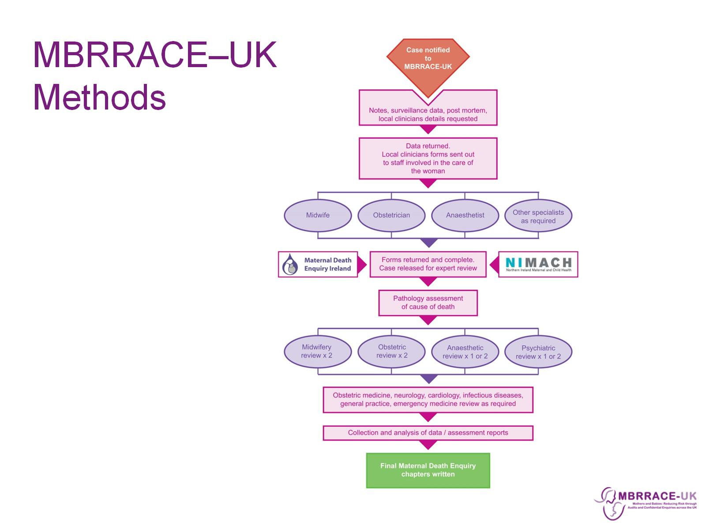
MBRRACE–UK Methods

Slide 8
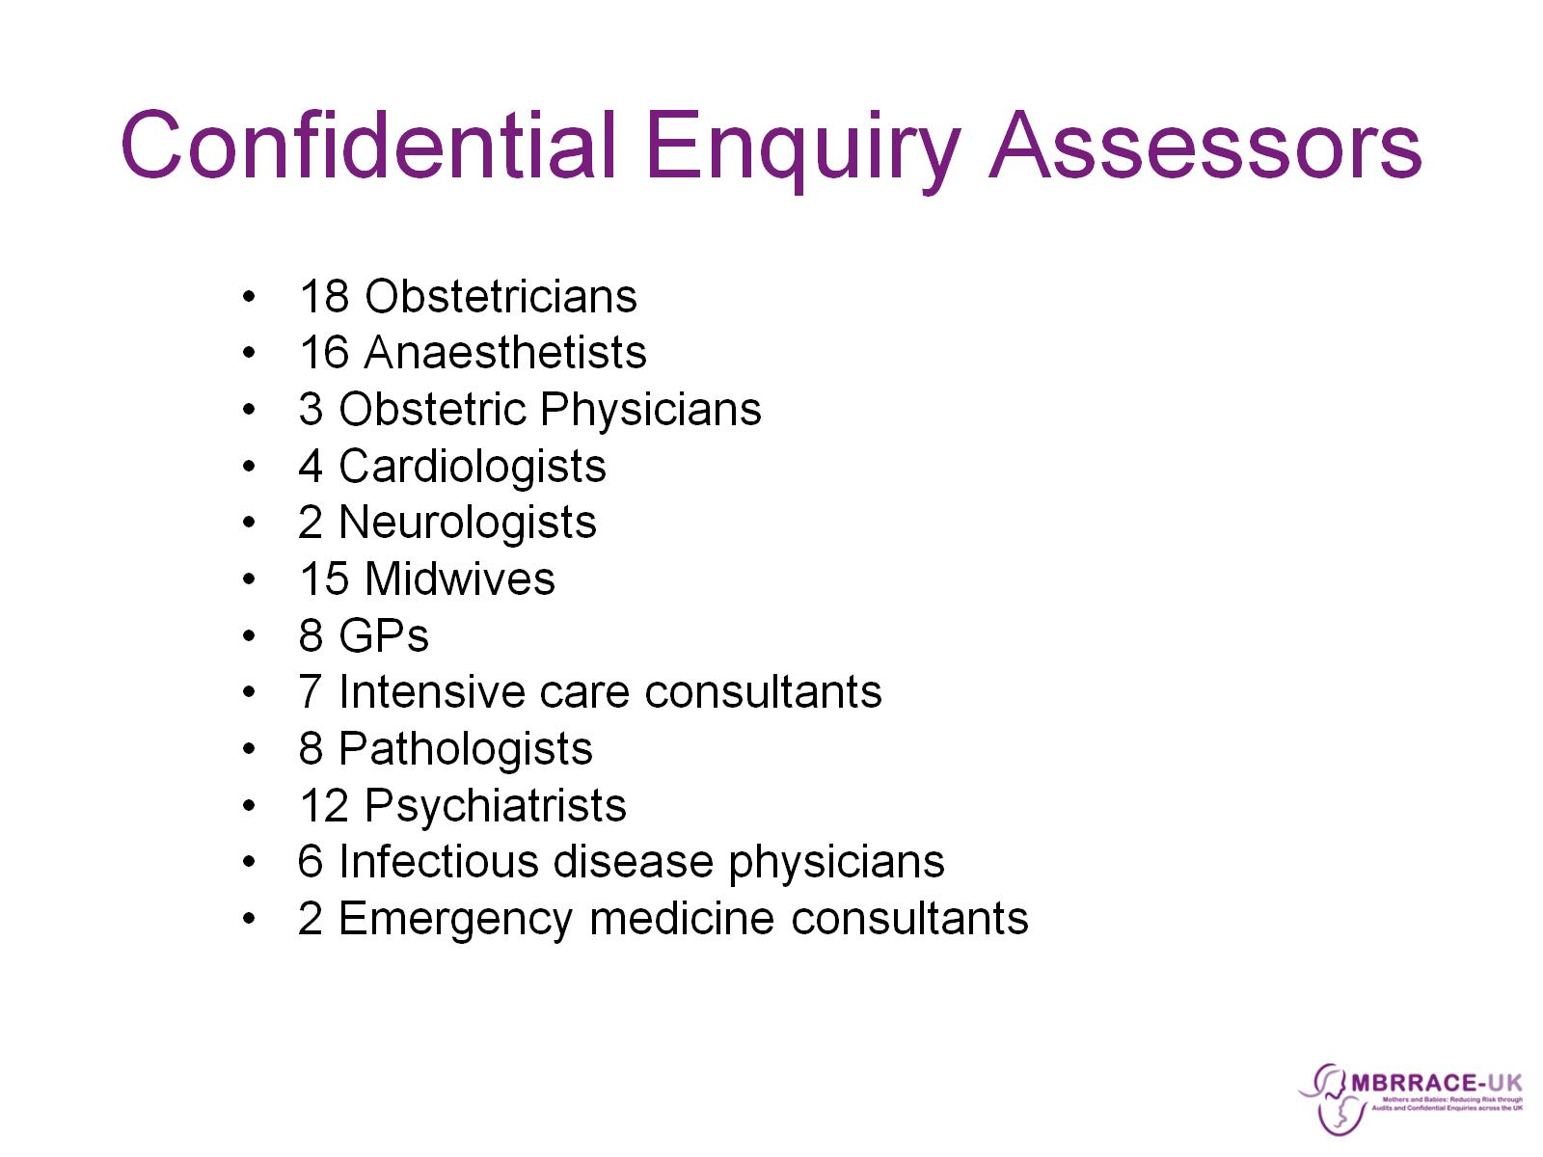
Confidential Enquiry Assessors

Slide 9
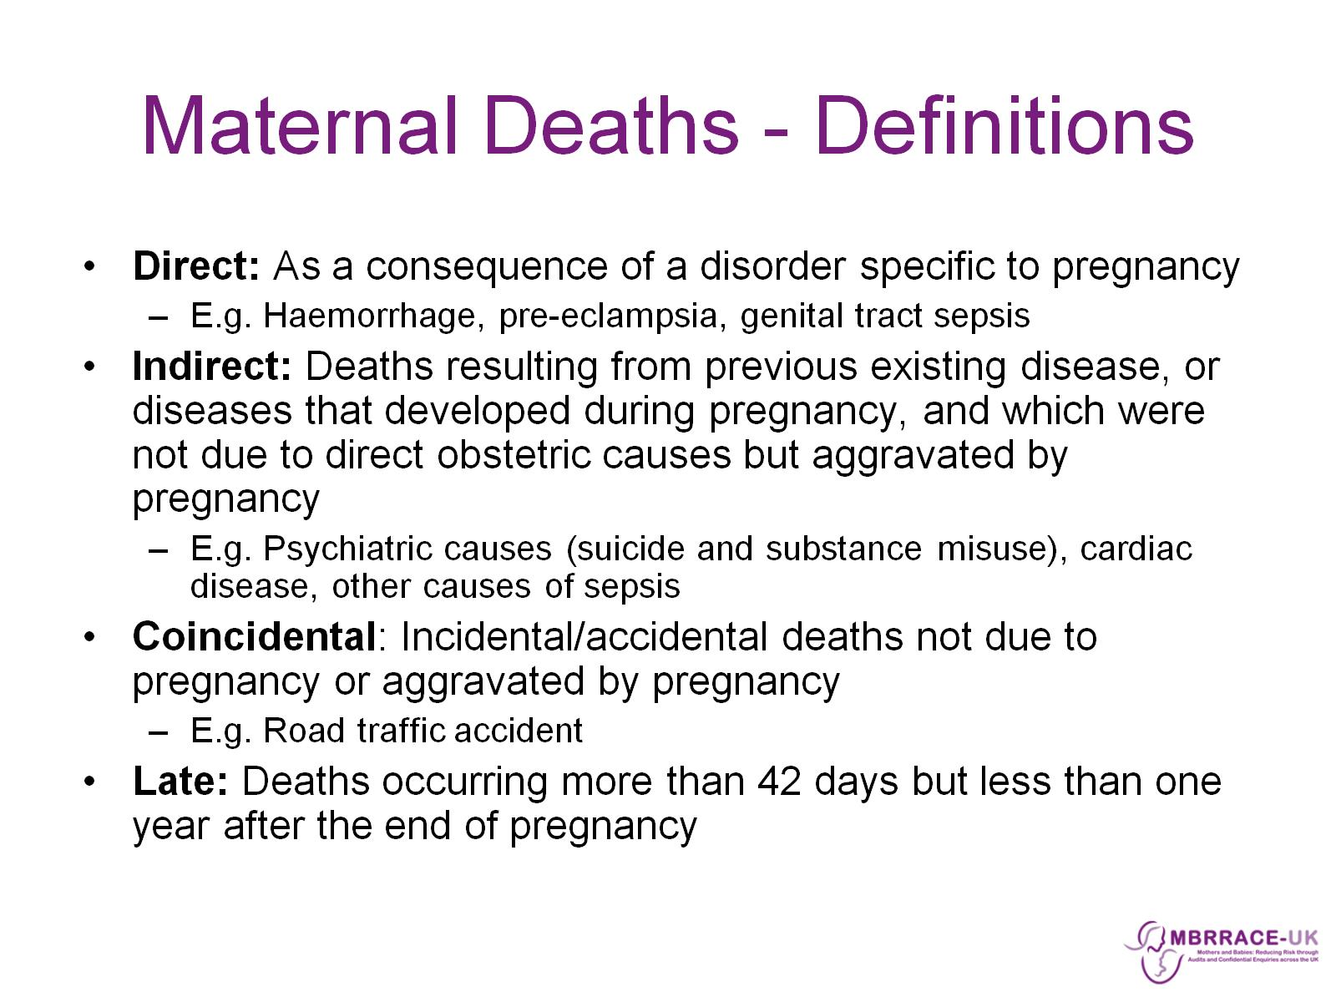
Maternal Deaths - Definitions

Slide 10
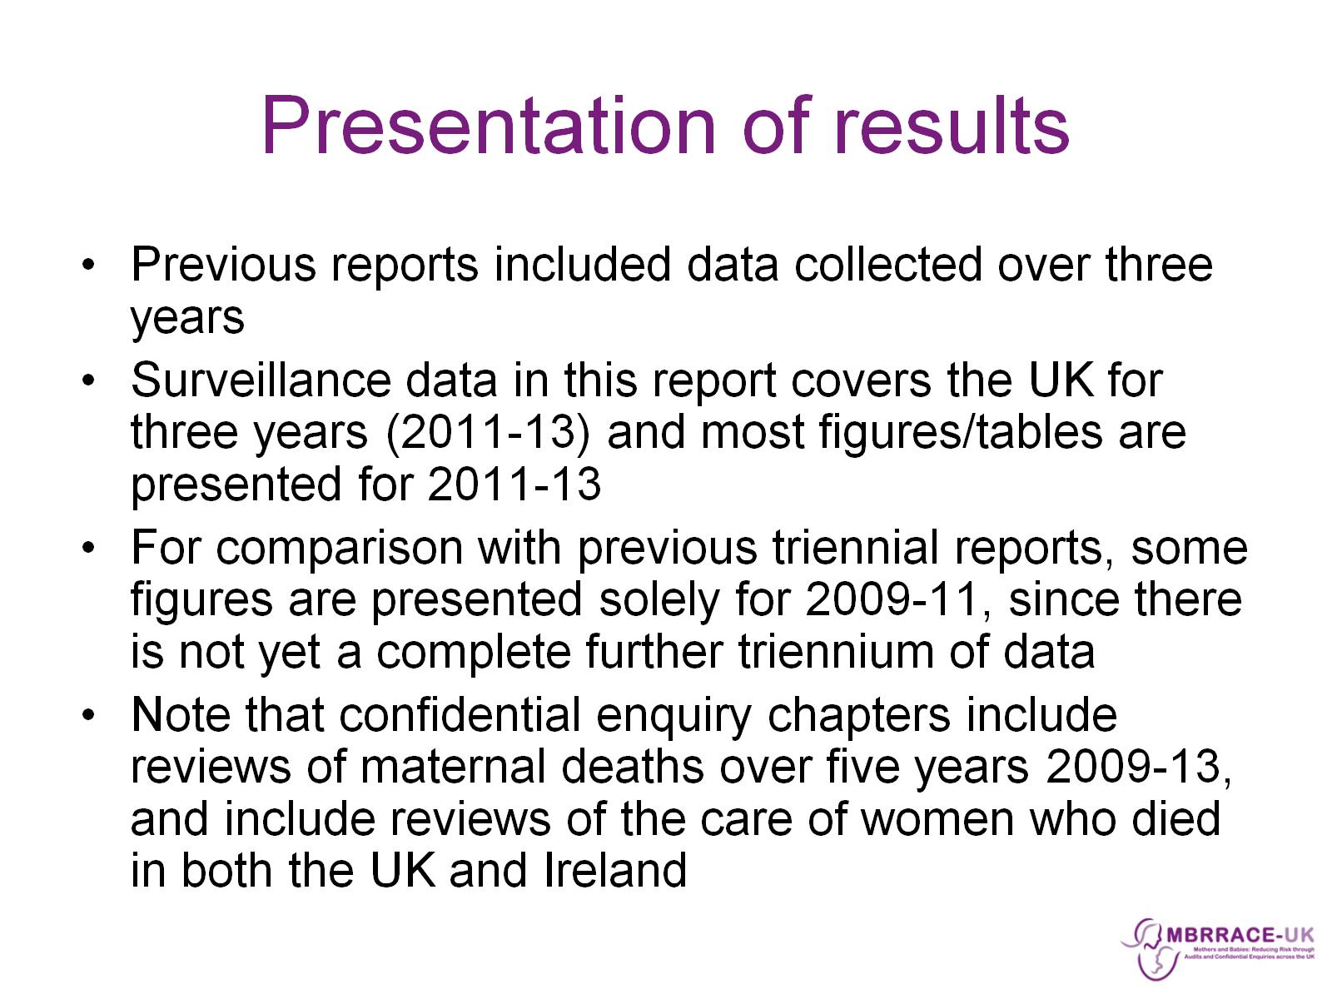
Presentation of results

Slide 11

MBRRACE-UK: Surveillance results

Slide 12
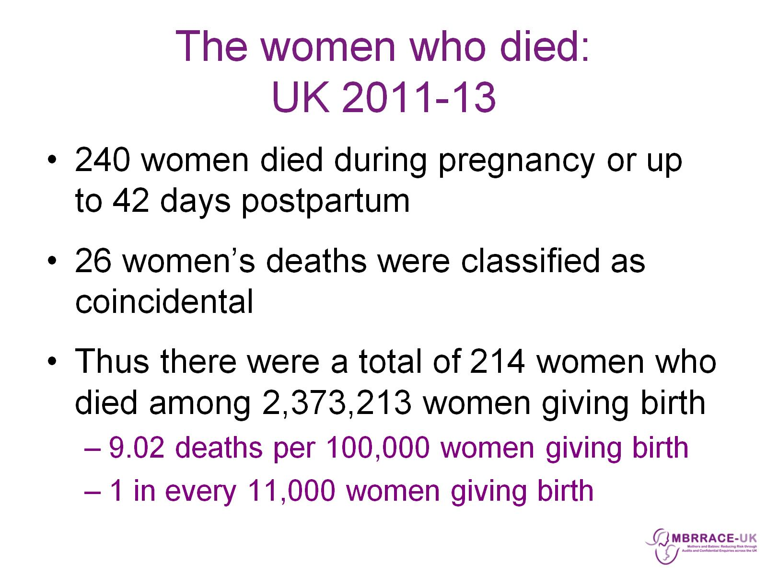
The women who died:
UK 2011-13

Slide 13
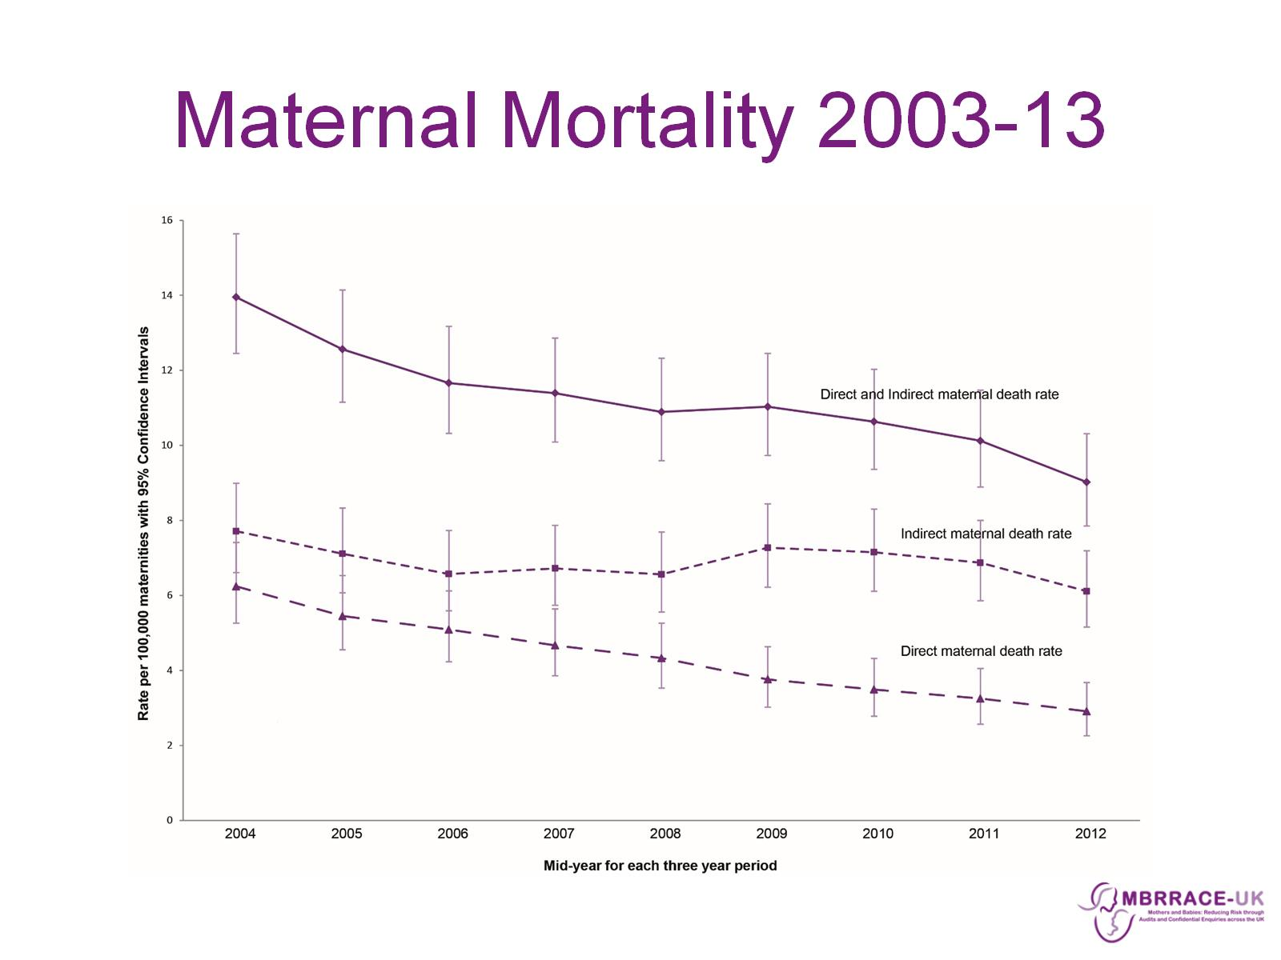
Maternal Mortality 2003-13

Slide 14
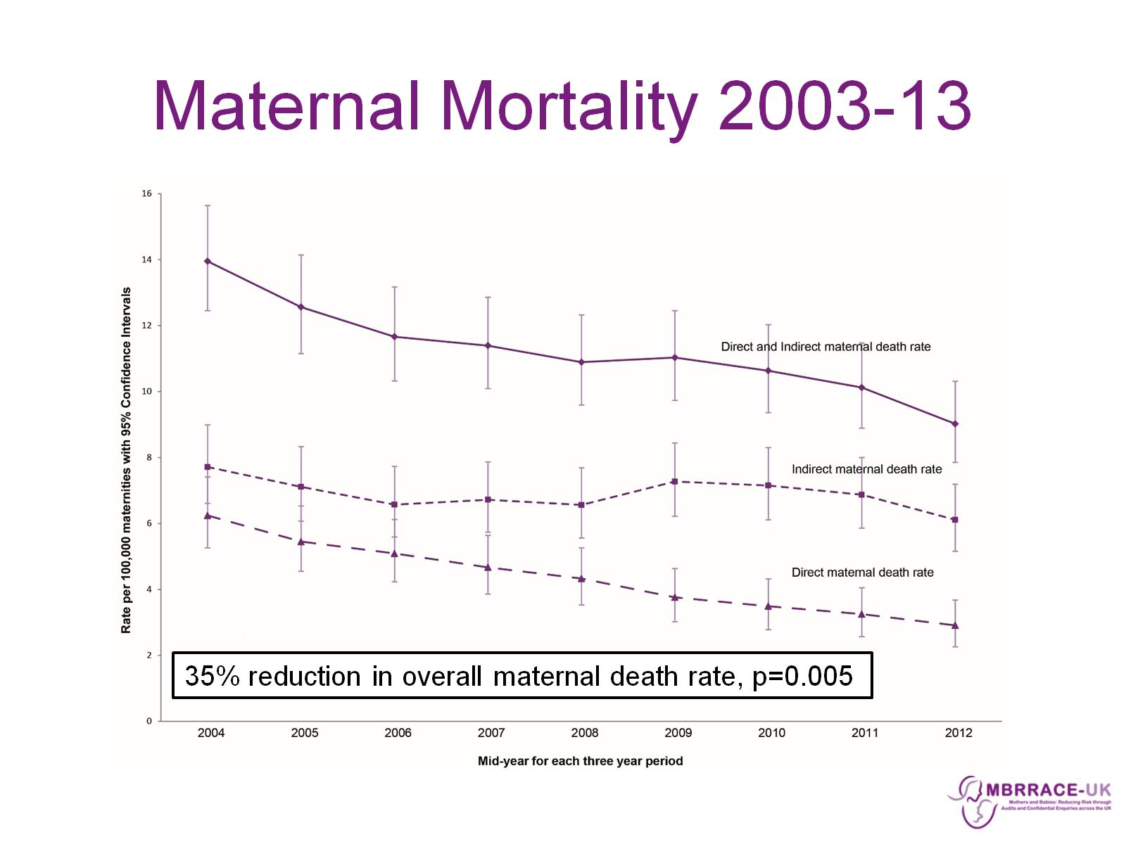
Maternal Mortality 2003-13

Slide 15

Maternal Mortality 2003-13

Slide 16
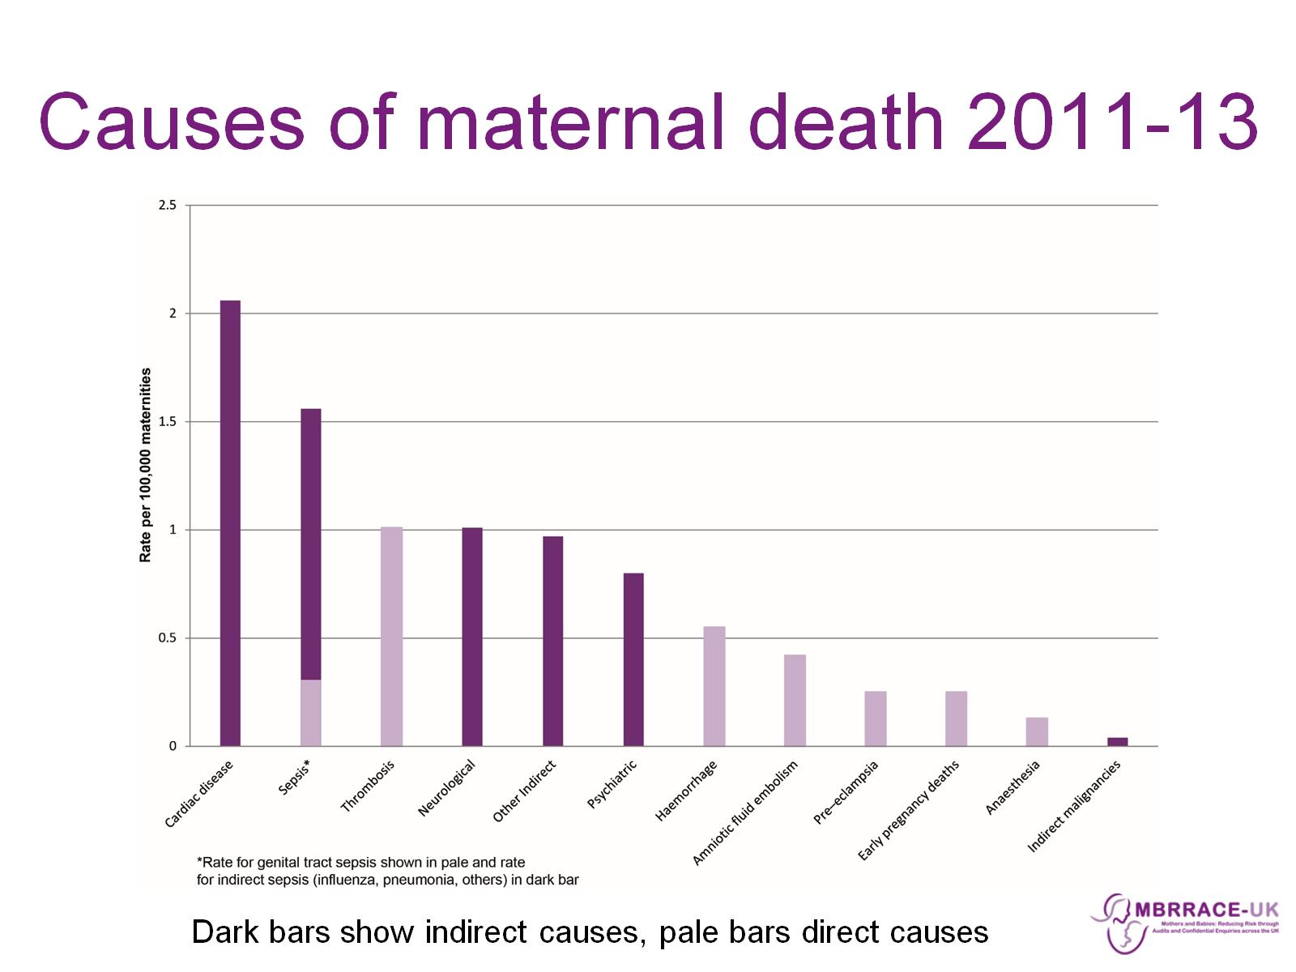
Causes of maternal death 2011-13

Slide 17
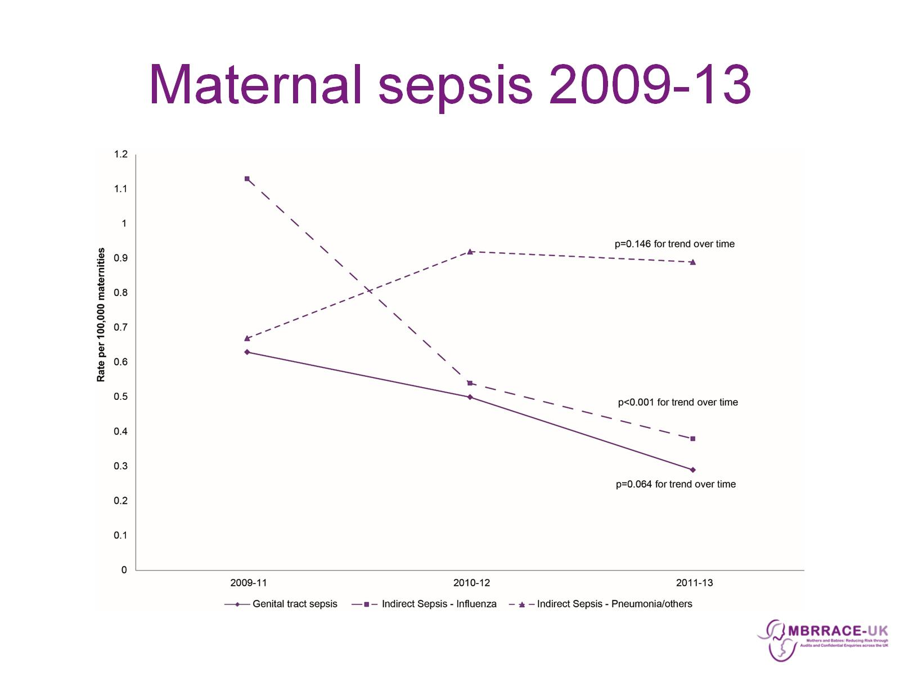
Maternal sepsis 2009-13

Slide 18
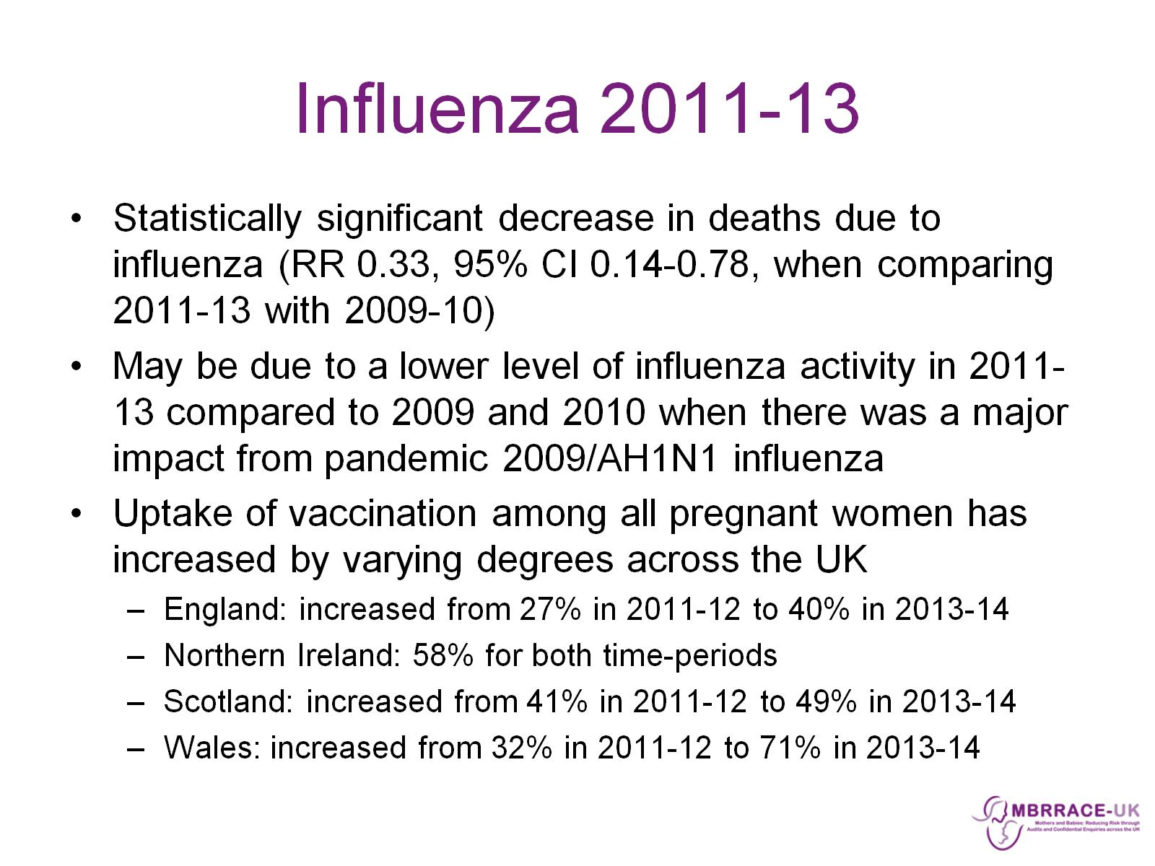
Influenza 2011-13

Slide 19
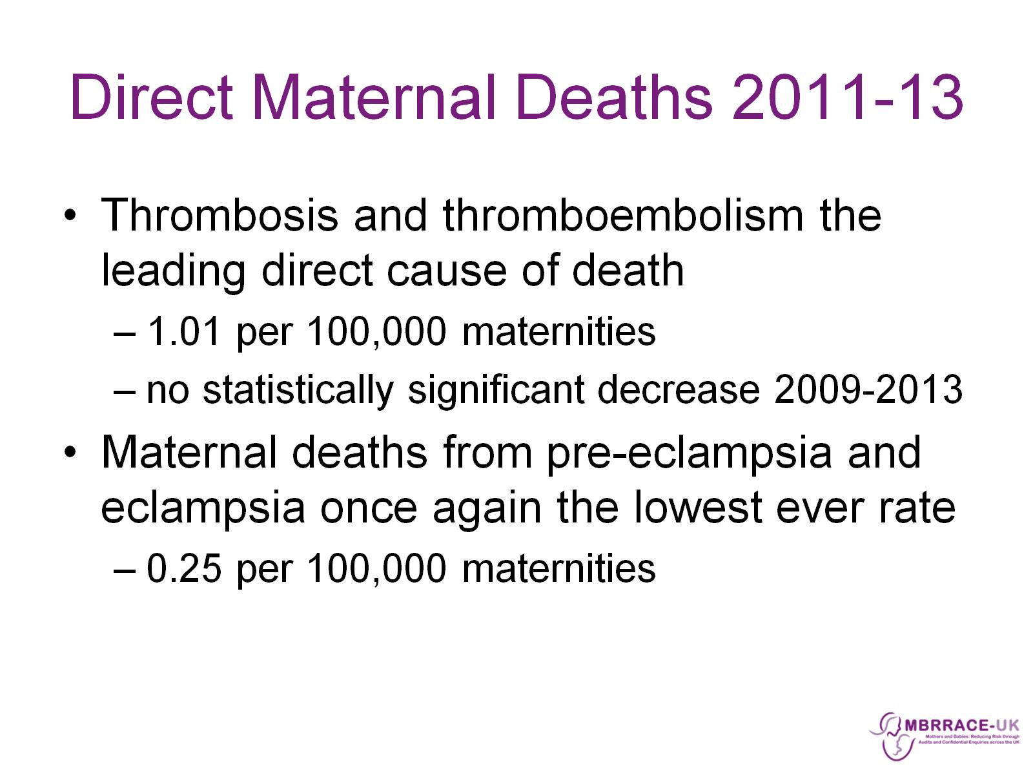
Direct Maternal Deaths 2011-13

Slide 20
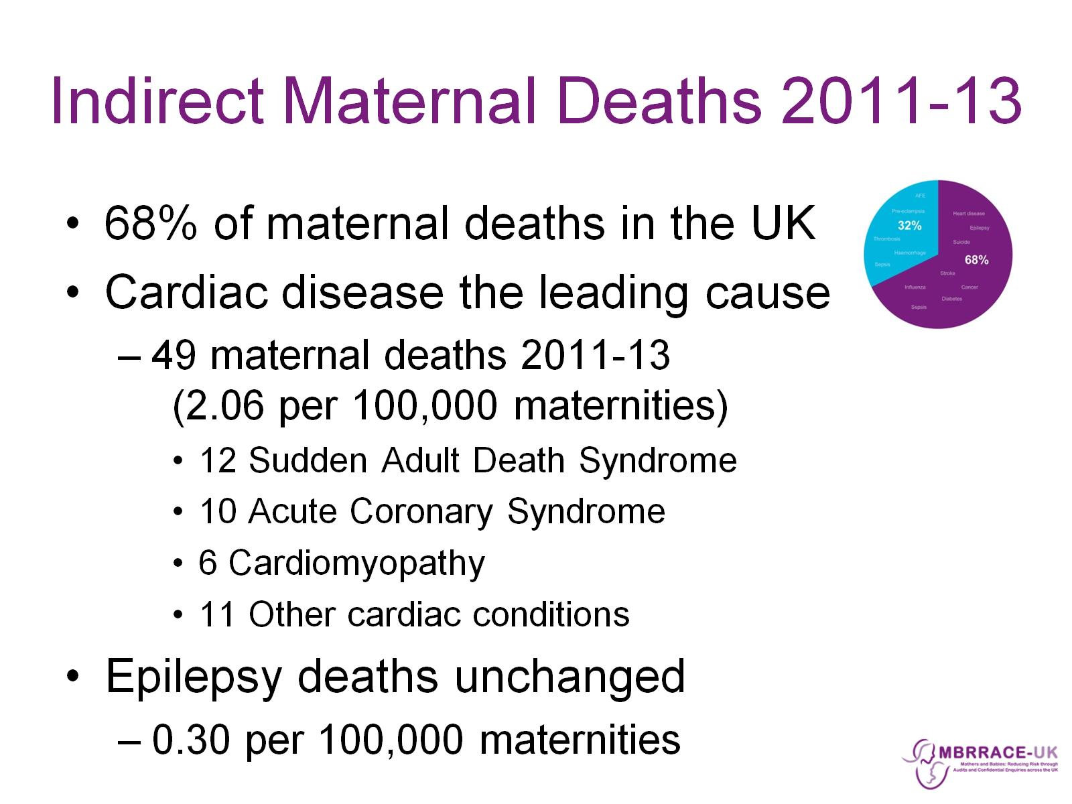
Indirect Maternal Deaths 2011-13

Slide 21
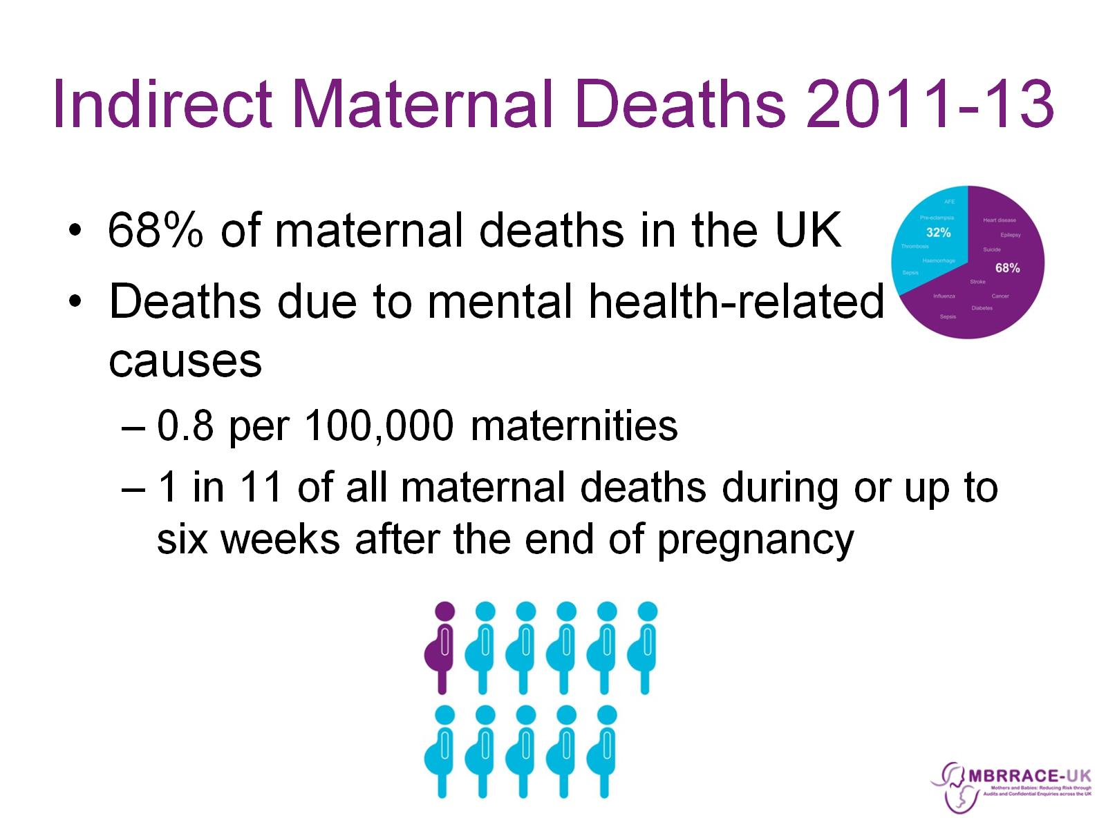
Indirect Maternal Deaths 2011-13

Slide 22
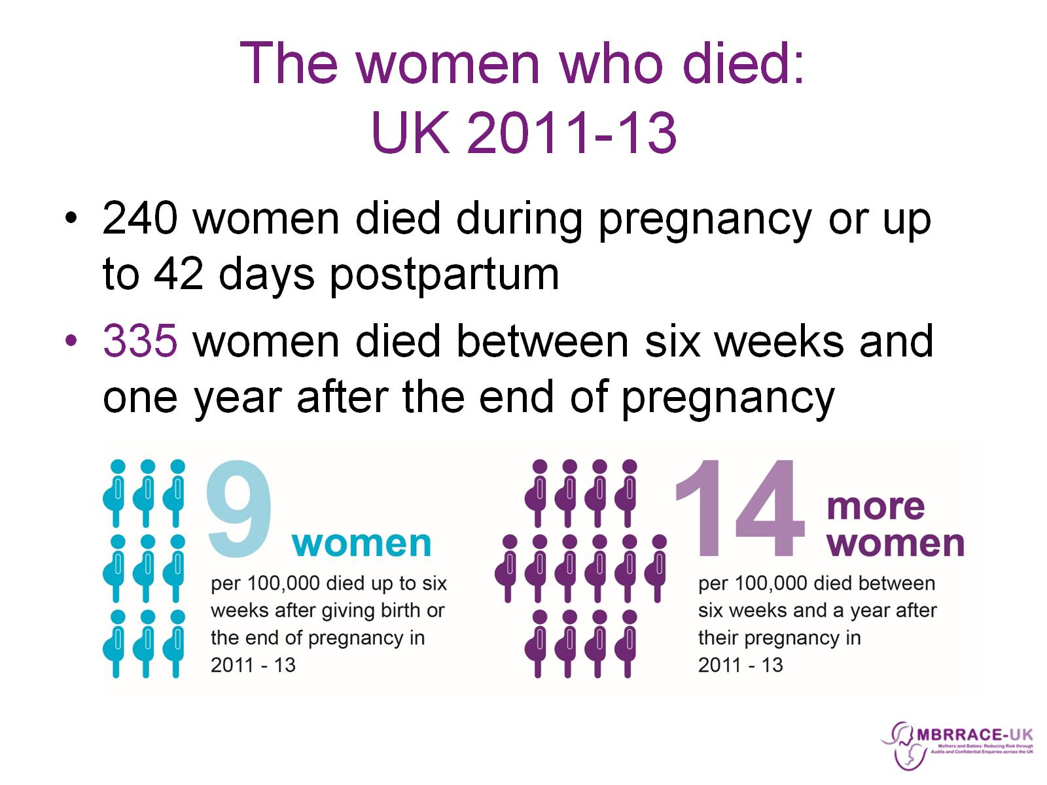
The women who died:
UK 2011-13

Slide 23
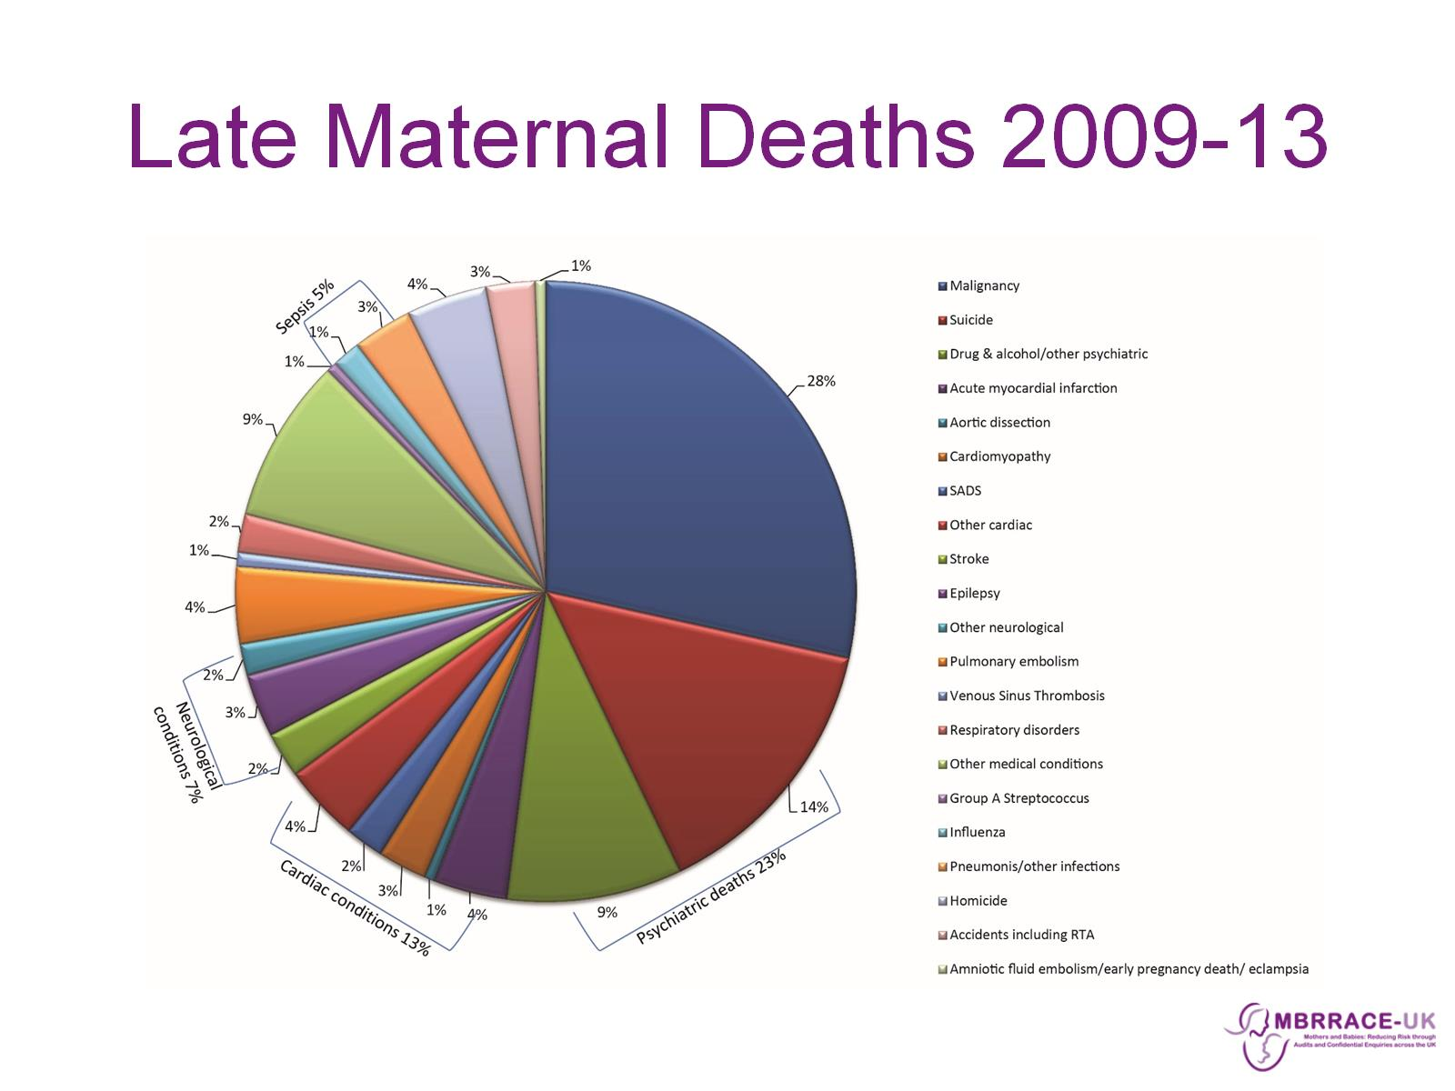
Late Maternal Deaths 2009-13

Slide 24
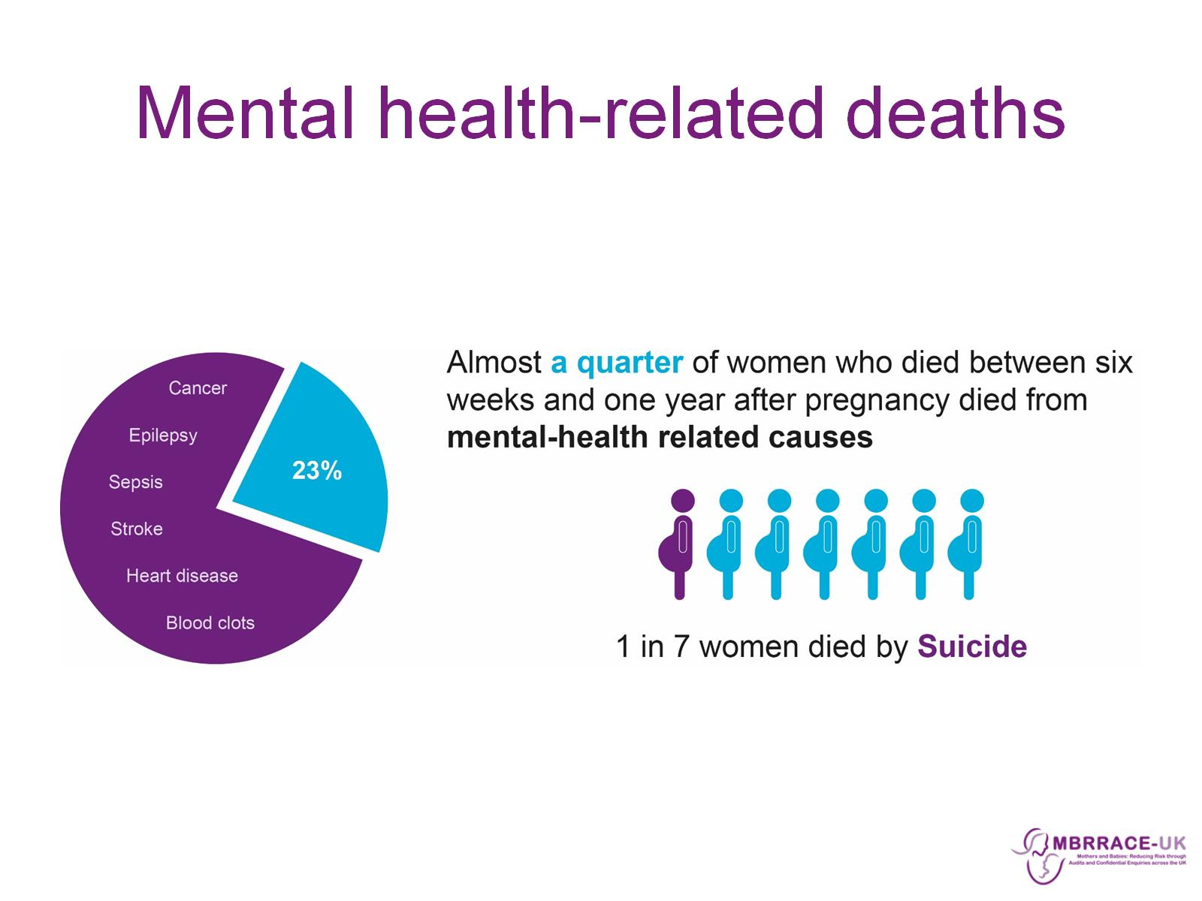
Mental health-related deaths

Slide 25
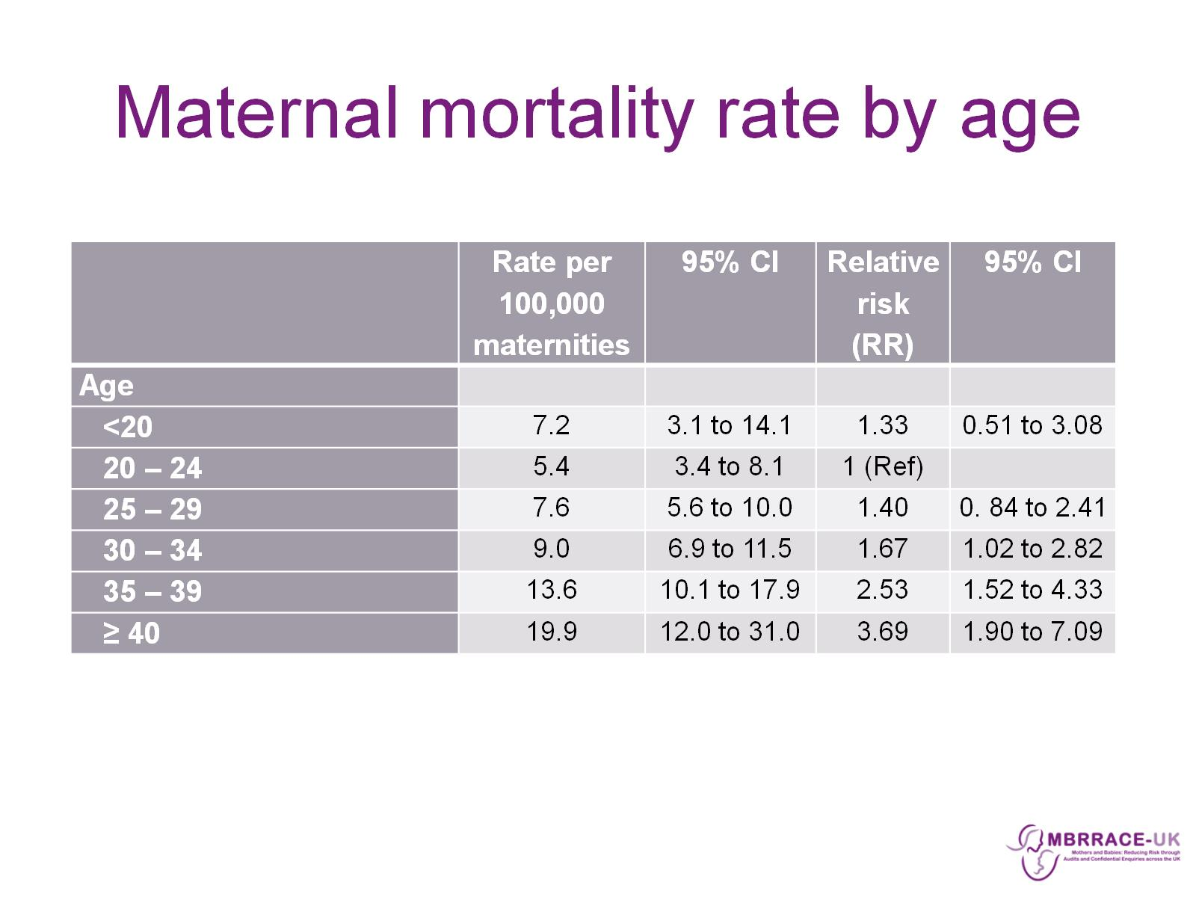
Maternal mortality rate by age

Slide 26
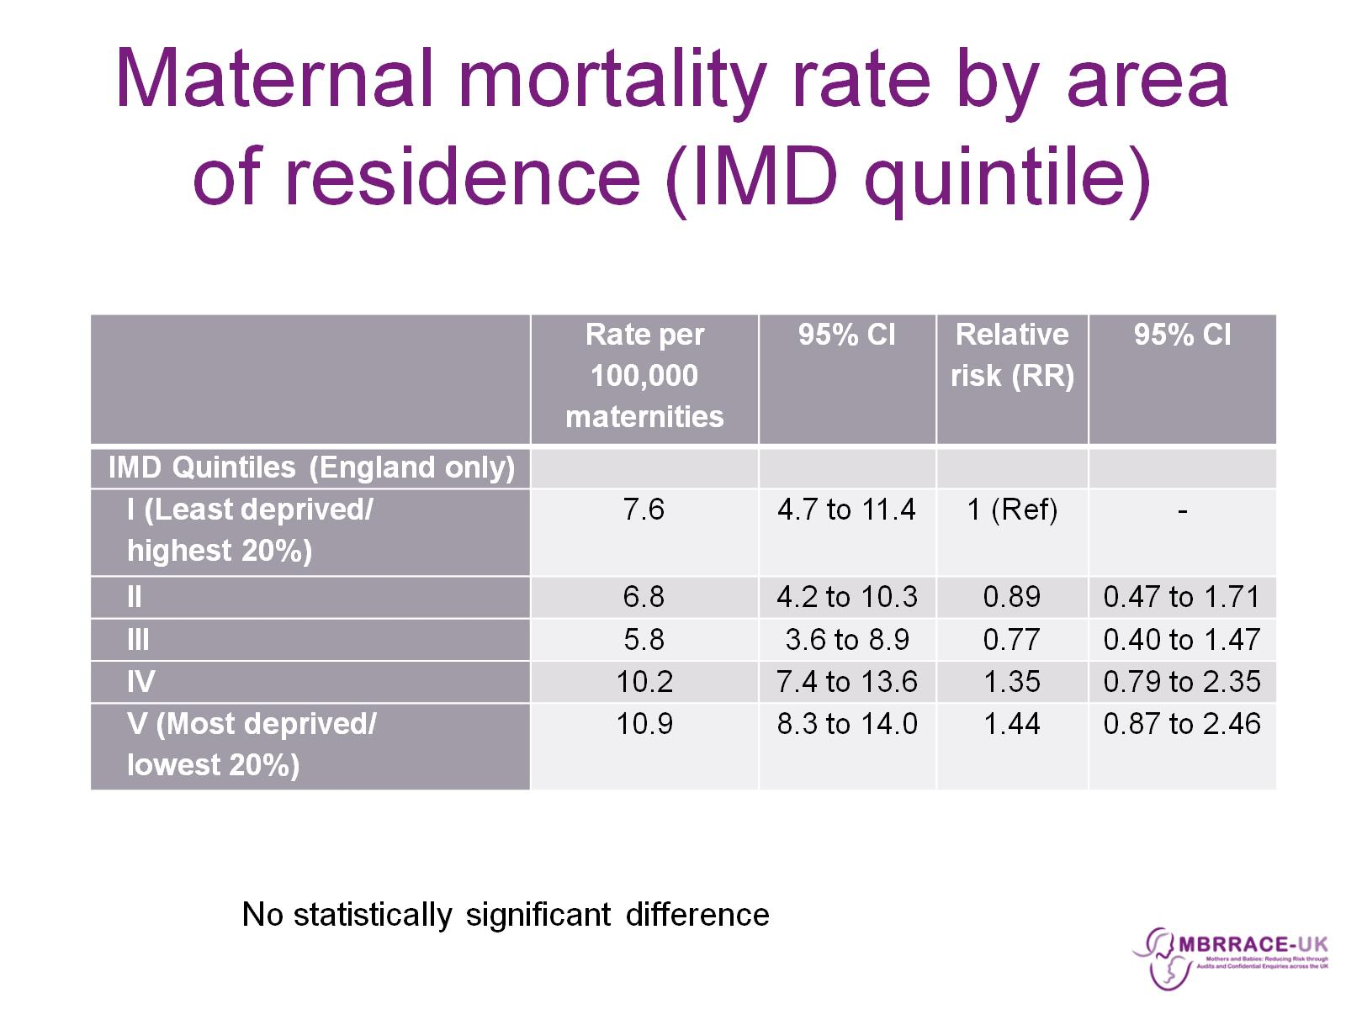
Maternal mortality rate by area of residence (IMD quintile)

Slide 27
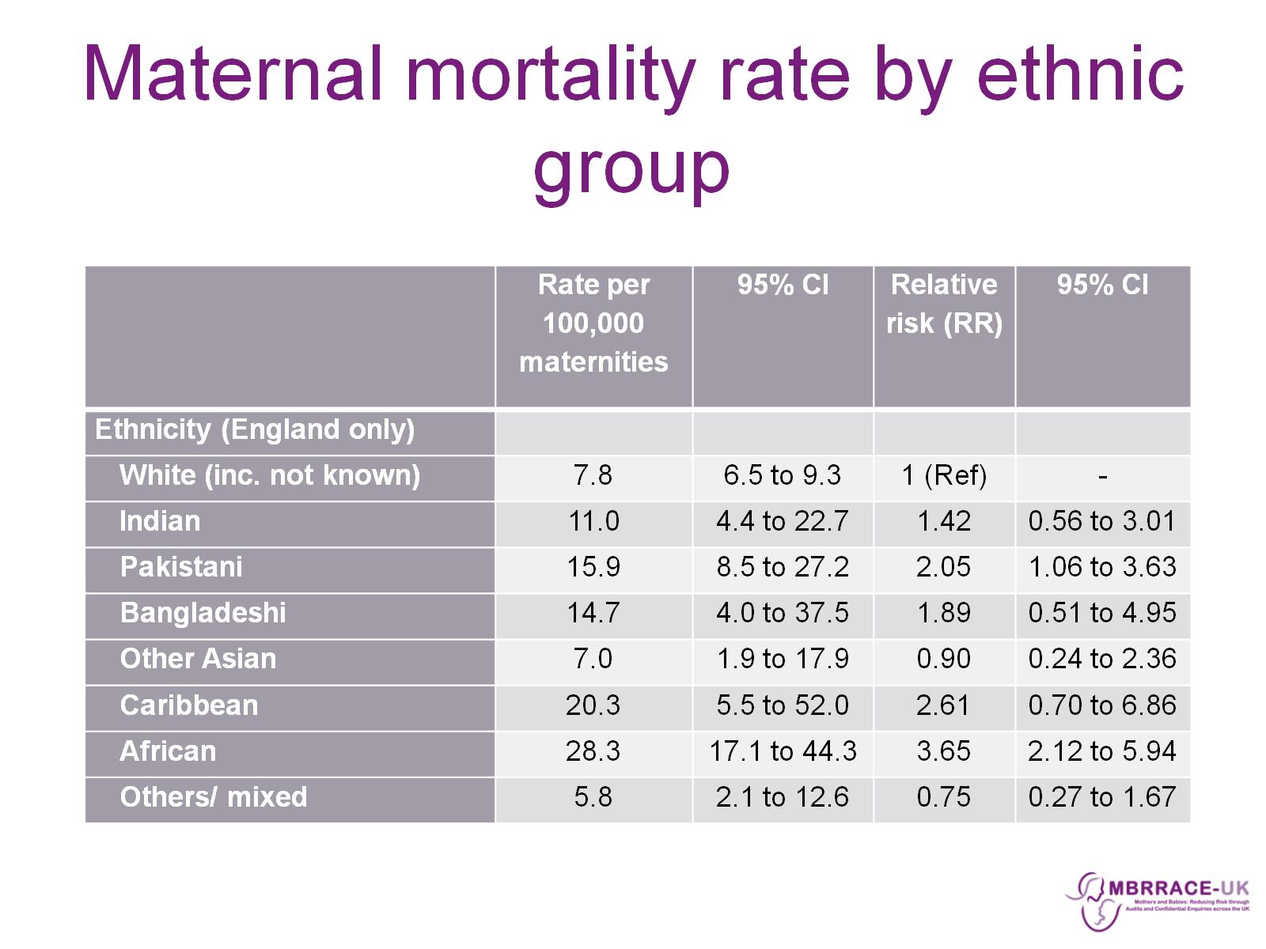
Maternal mortality rate by ethnic group

Slide 28
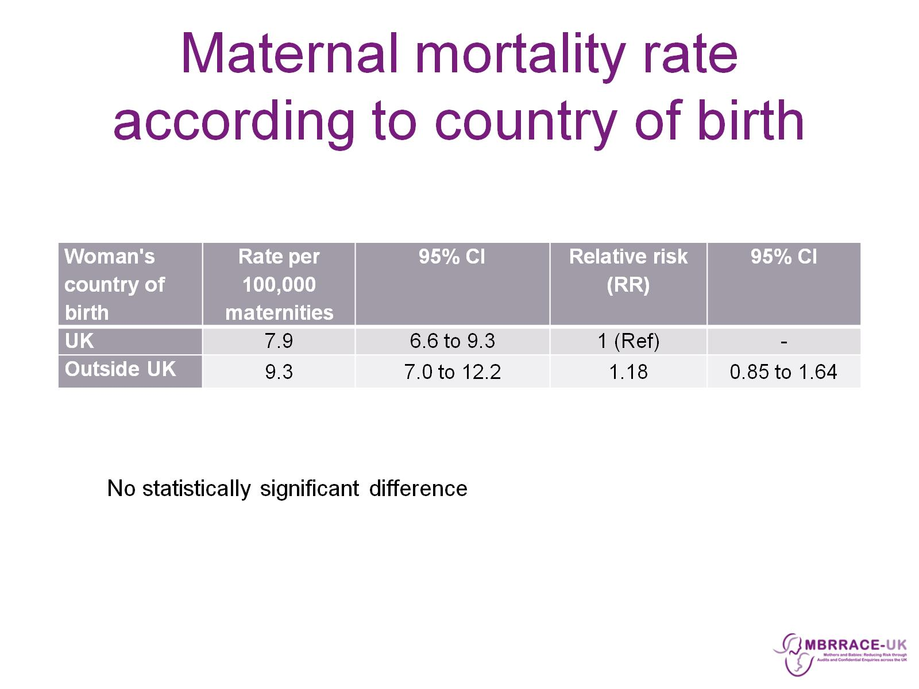
Maternal mortality rate according to country of birth

Slide 29
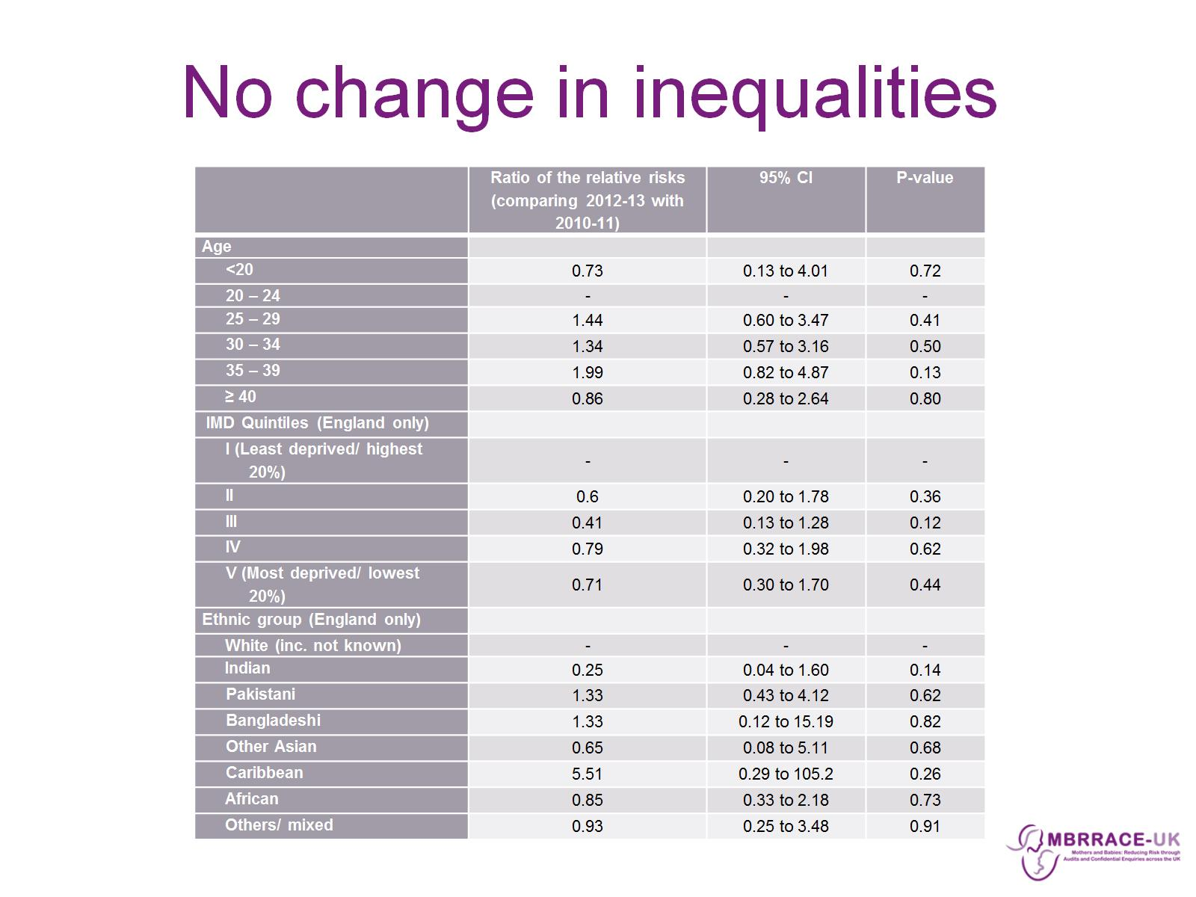
No change in inequalities

Slide 30
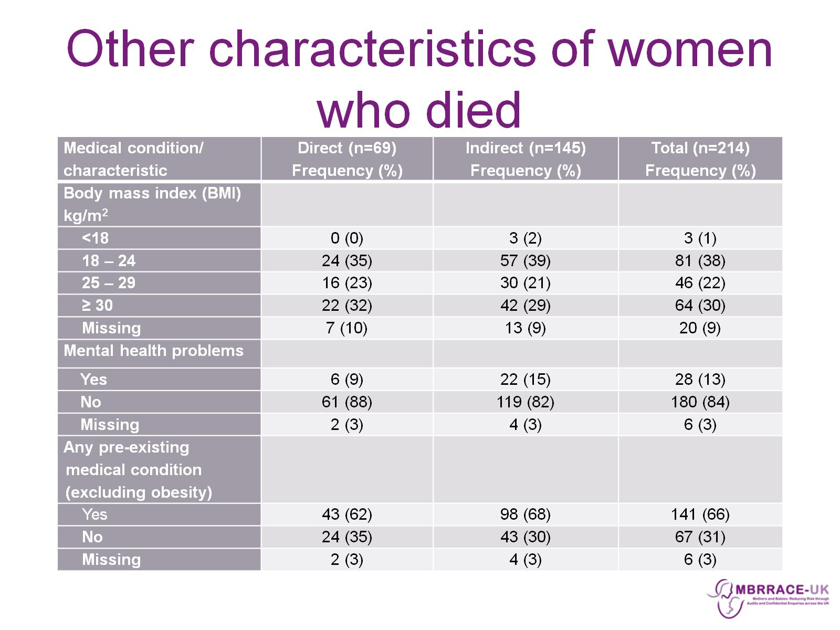
Other characteristics of women who died

Slide 31
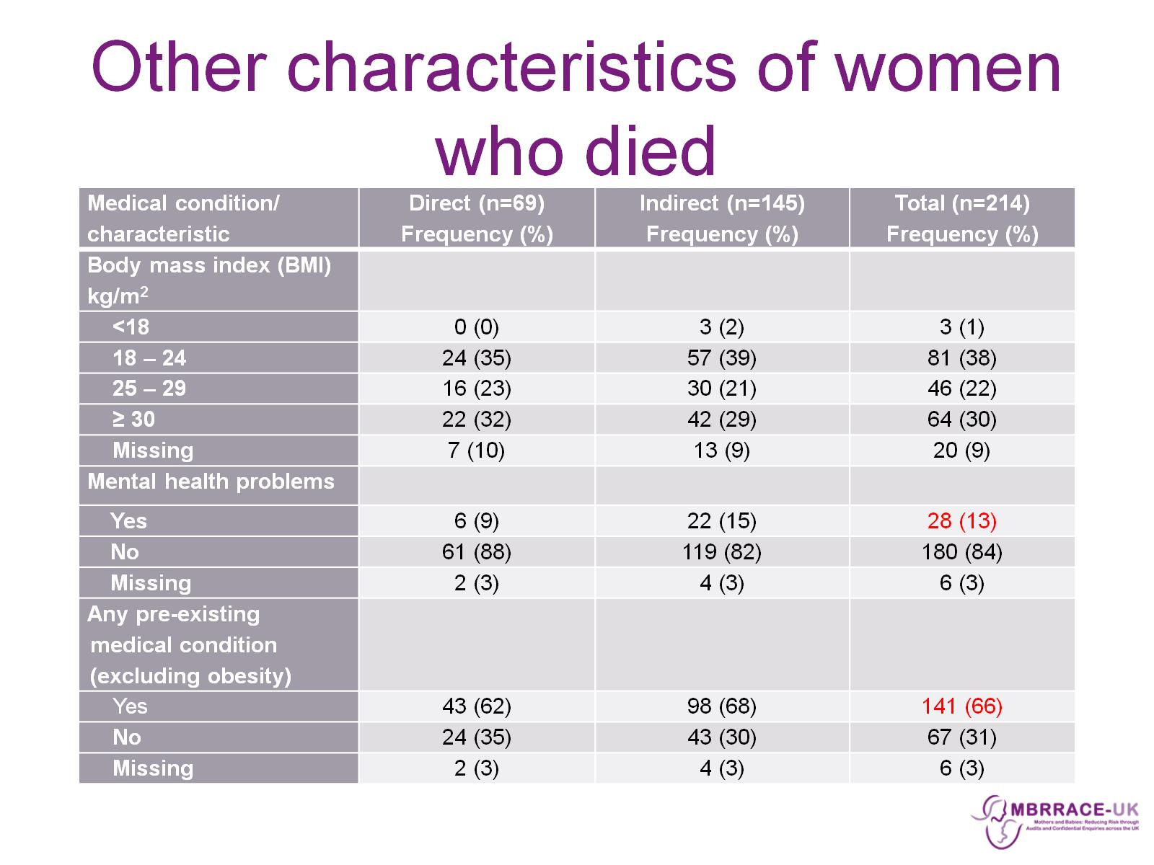
Other characteristics of women who died

Slide 32
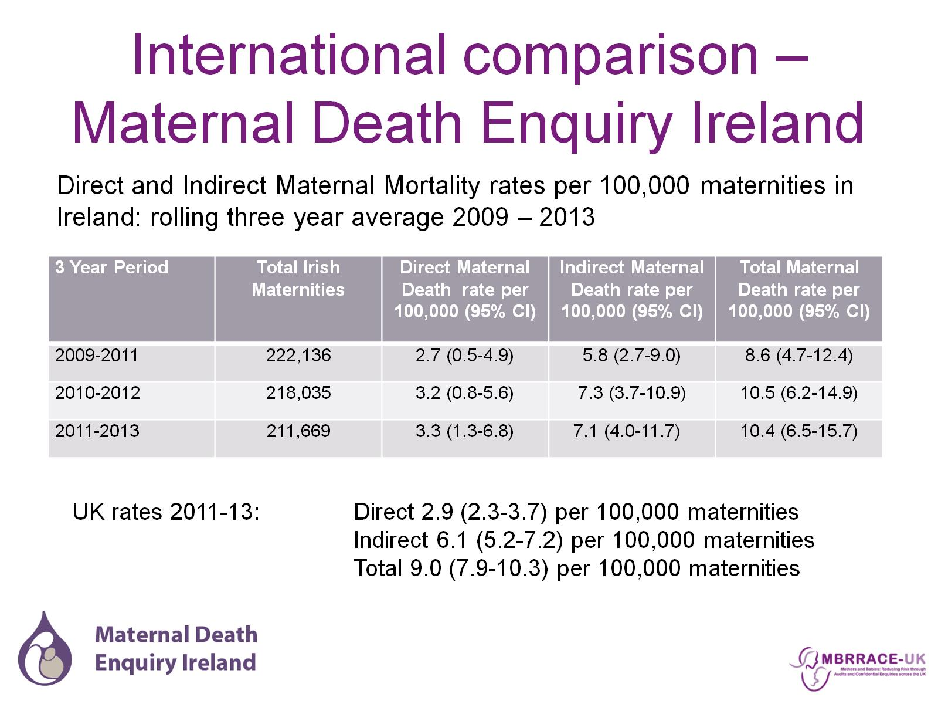
International comparison – Maternal Death Enquiry Ireland

Slide 33
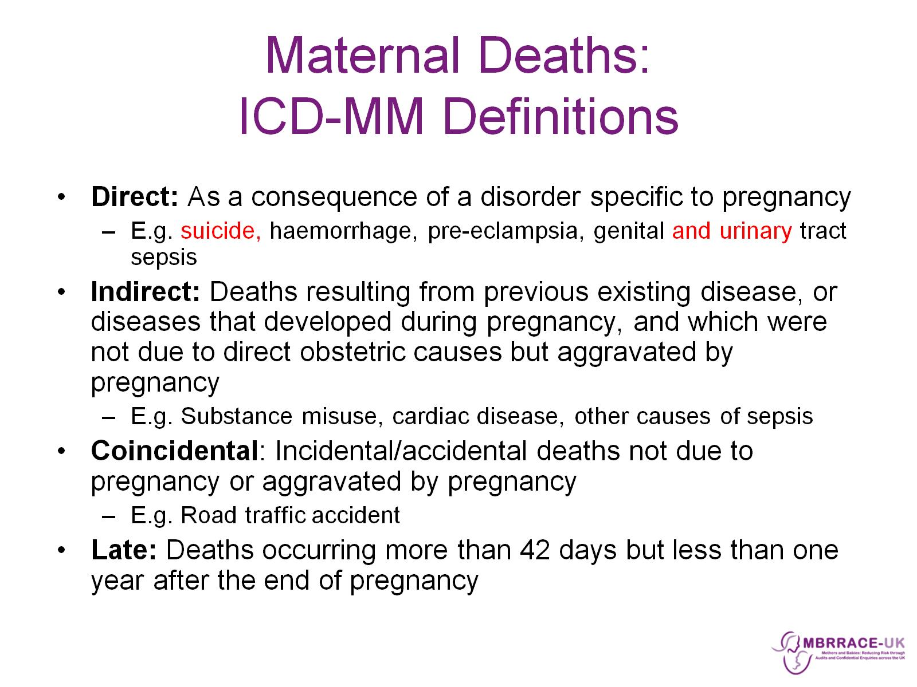
Maternal Deaths:
ICD-MM Definitions

Slide 34
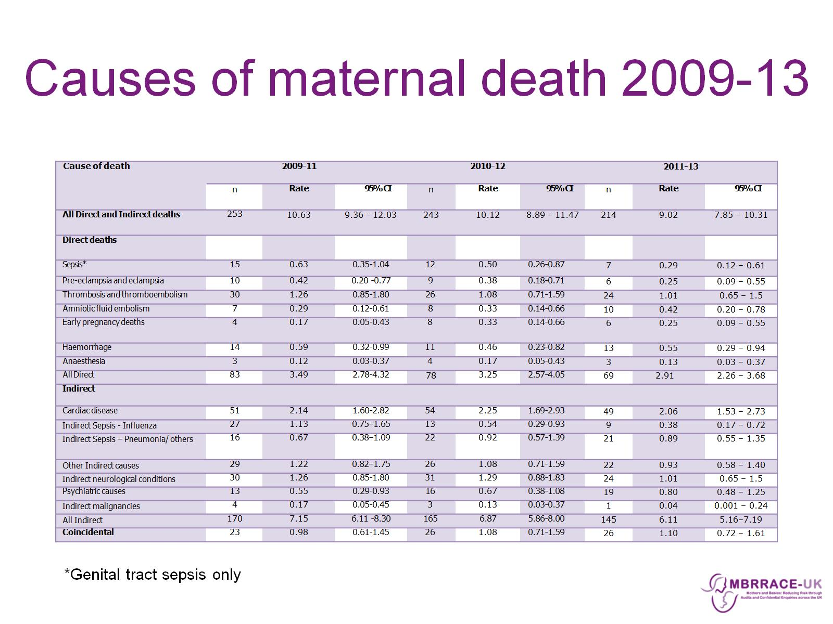
Causes of maternal death 2009-13

Slide 35
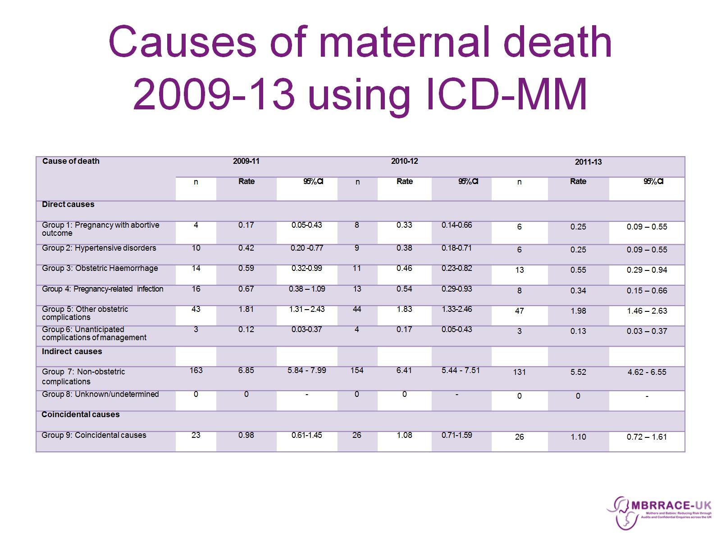
Causes of maternal death
2009-13 using ICD-MM

Slide 36
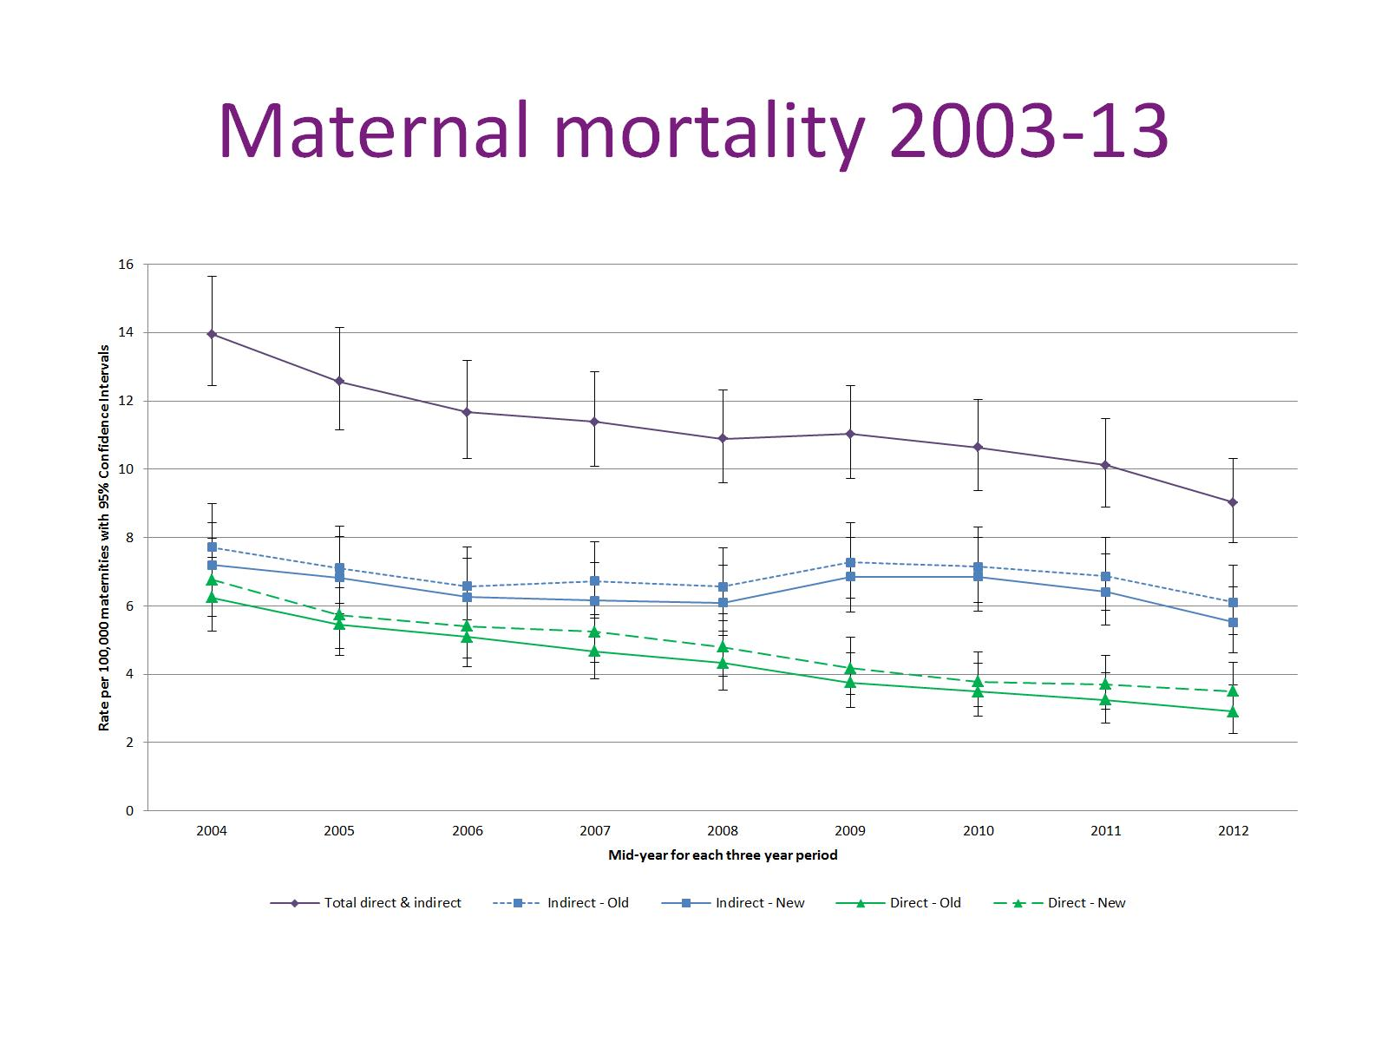
Maternal mortality 2003-13

Slide 37
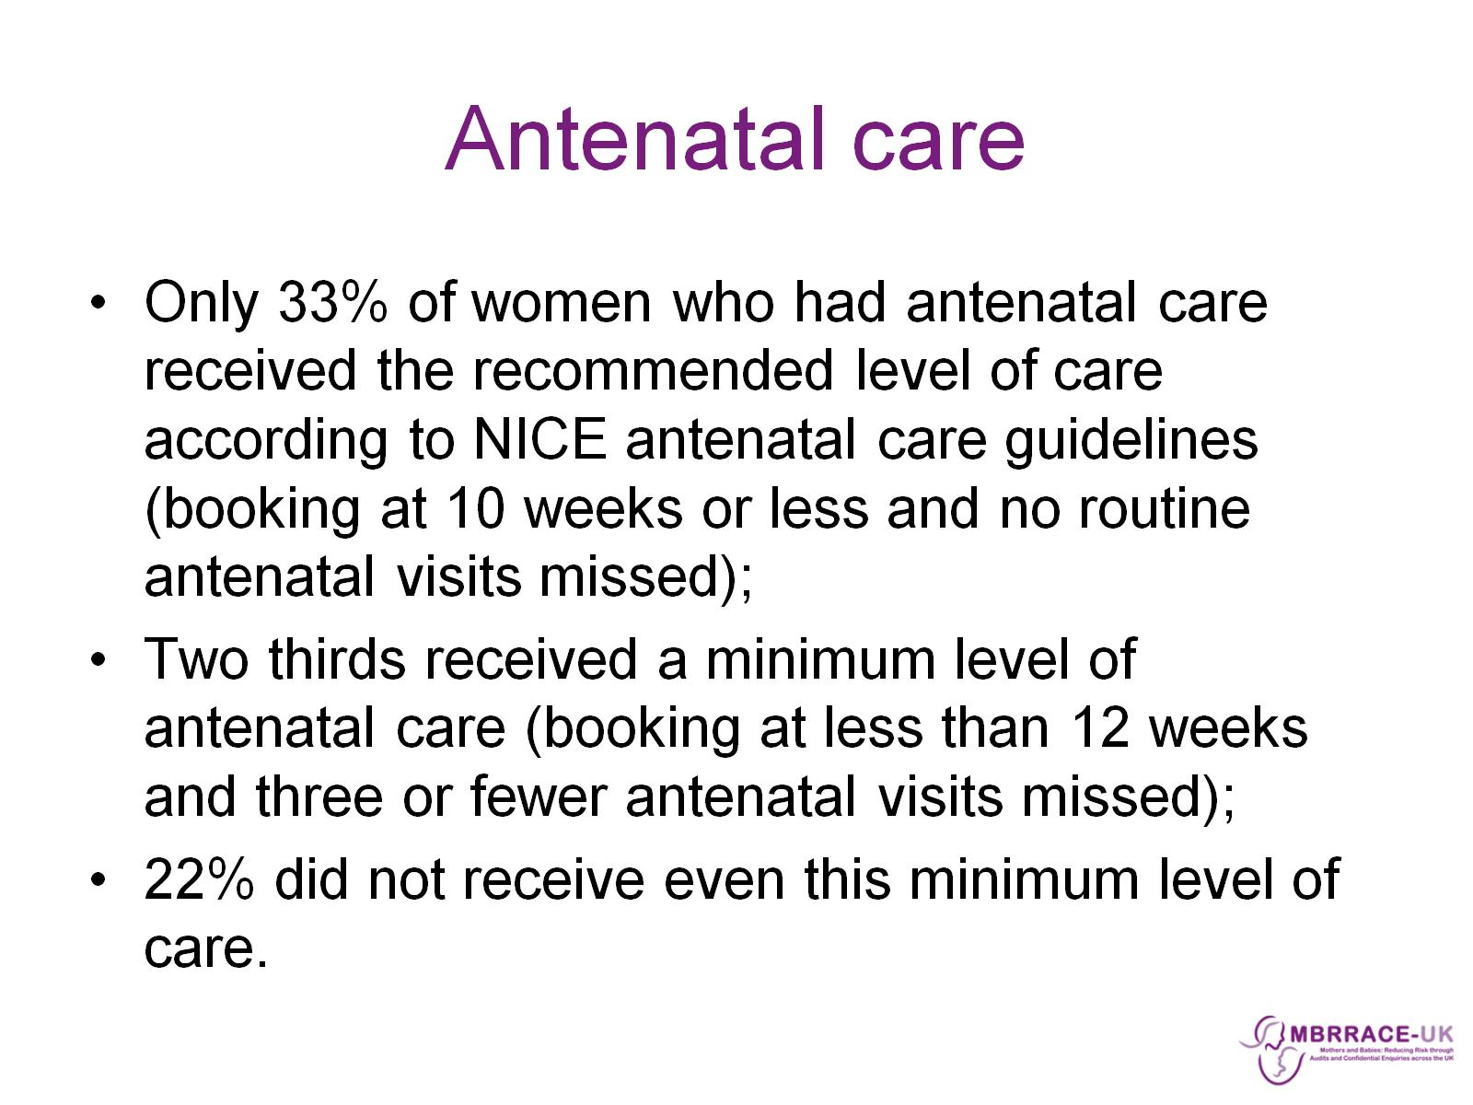
Antenatal care

Slide 38
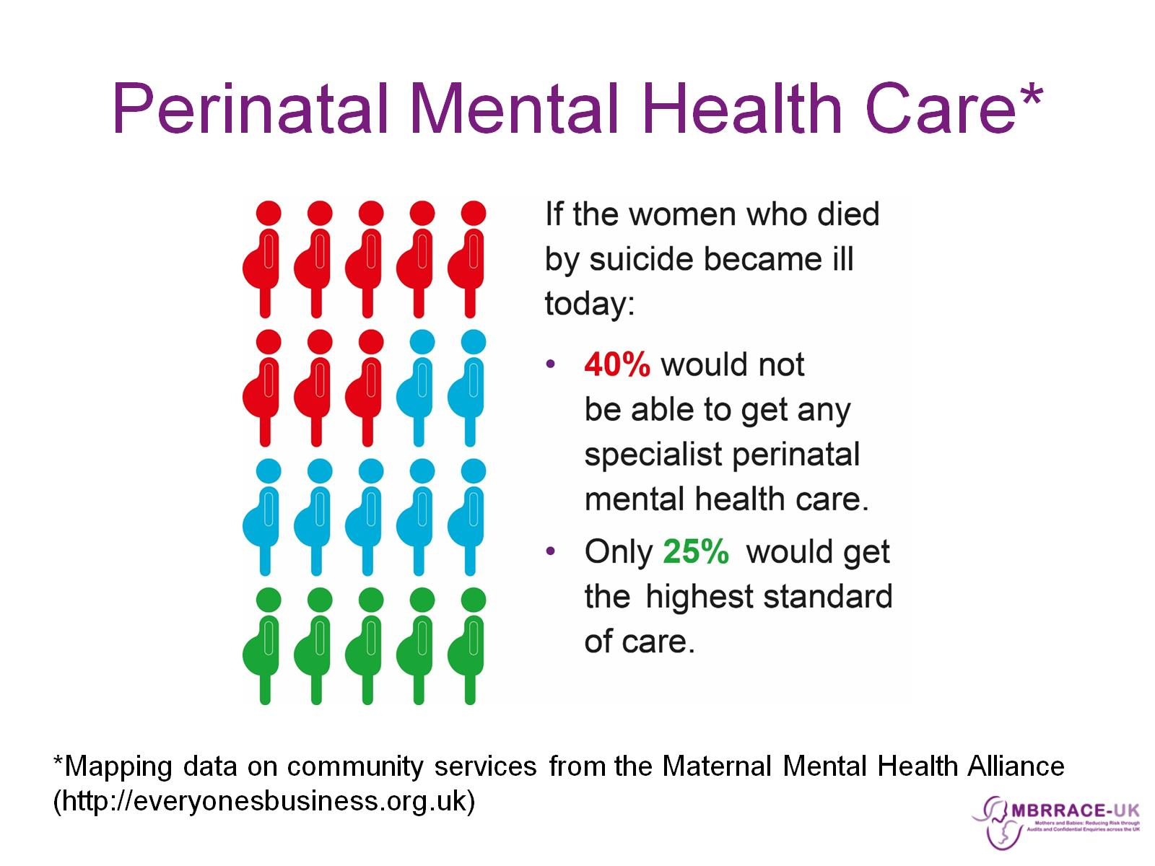
Perinatal Mental Health Care*

Slide 39
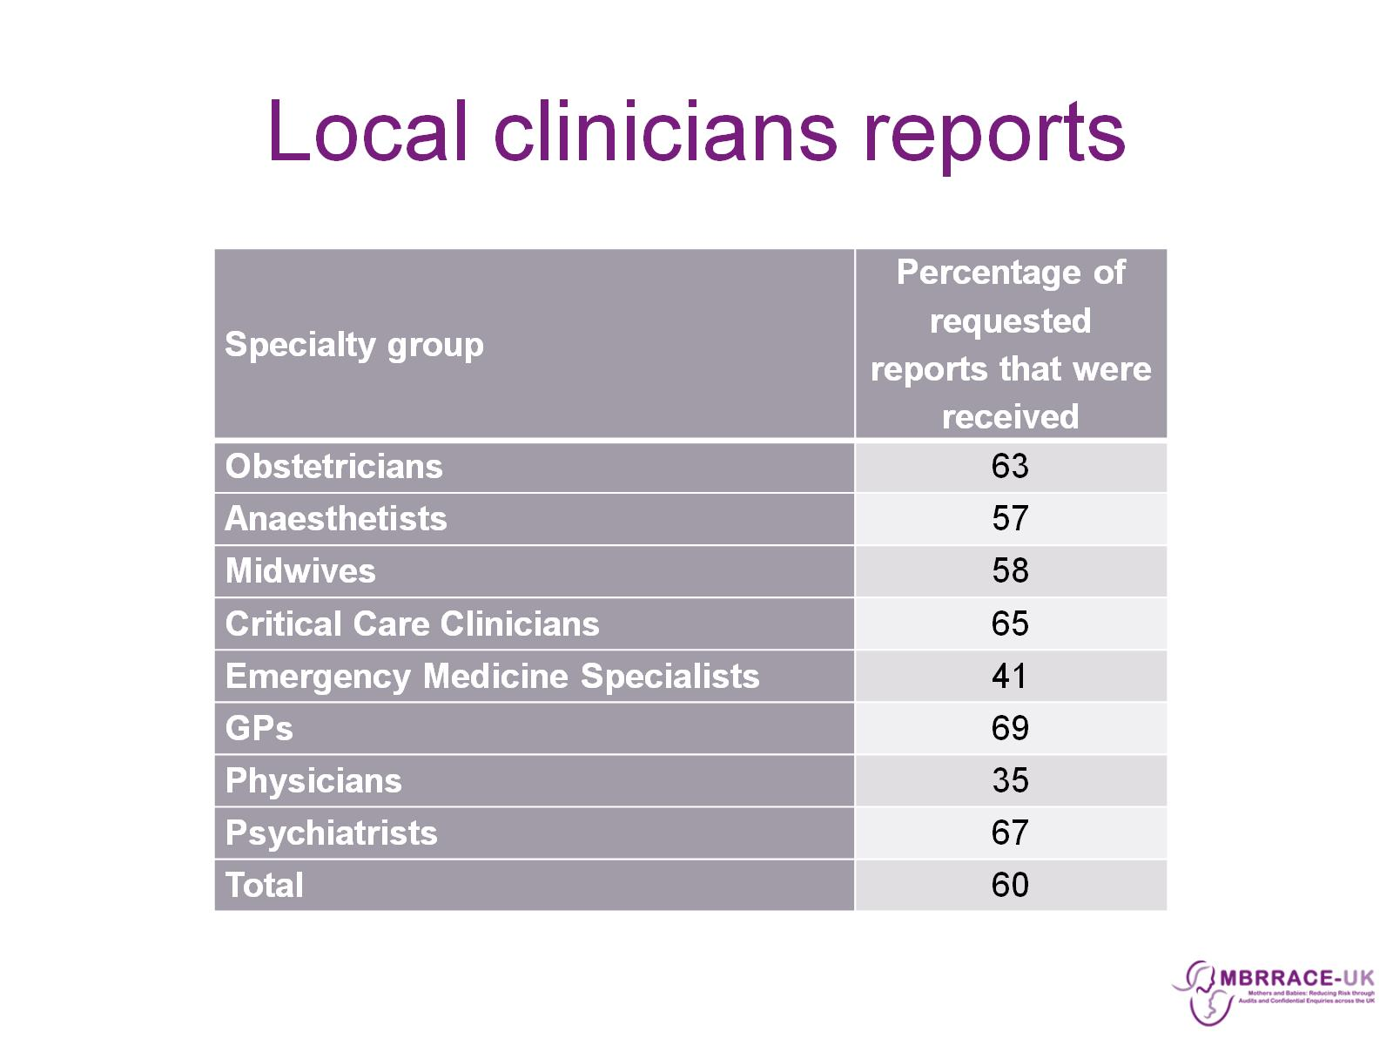
Local clinicians reports

Slide 40
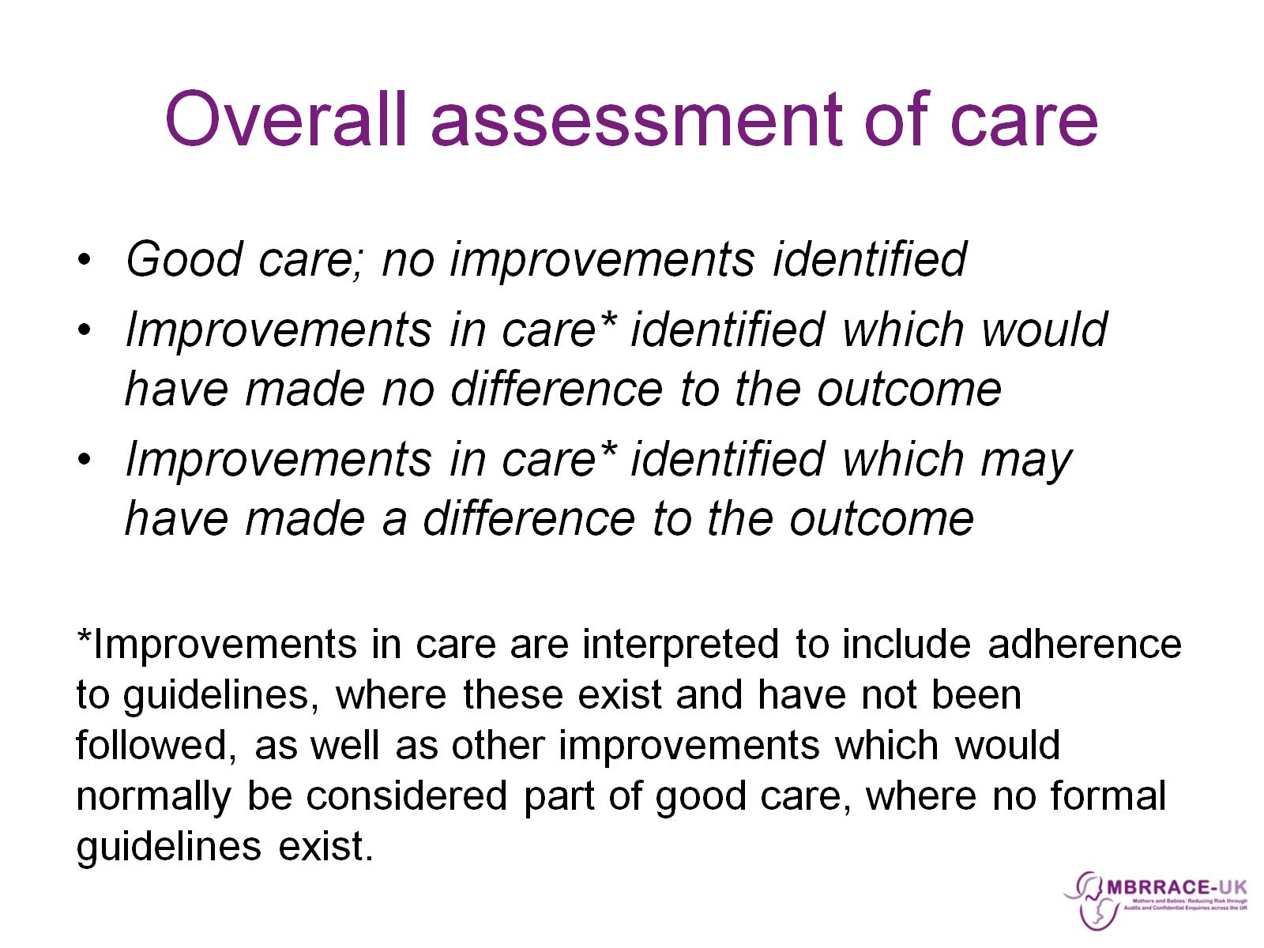
Overall assessment of care

Slide 41
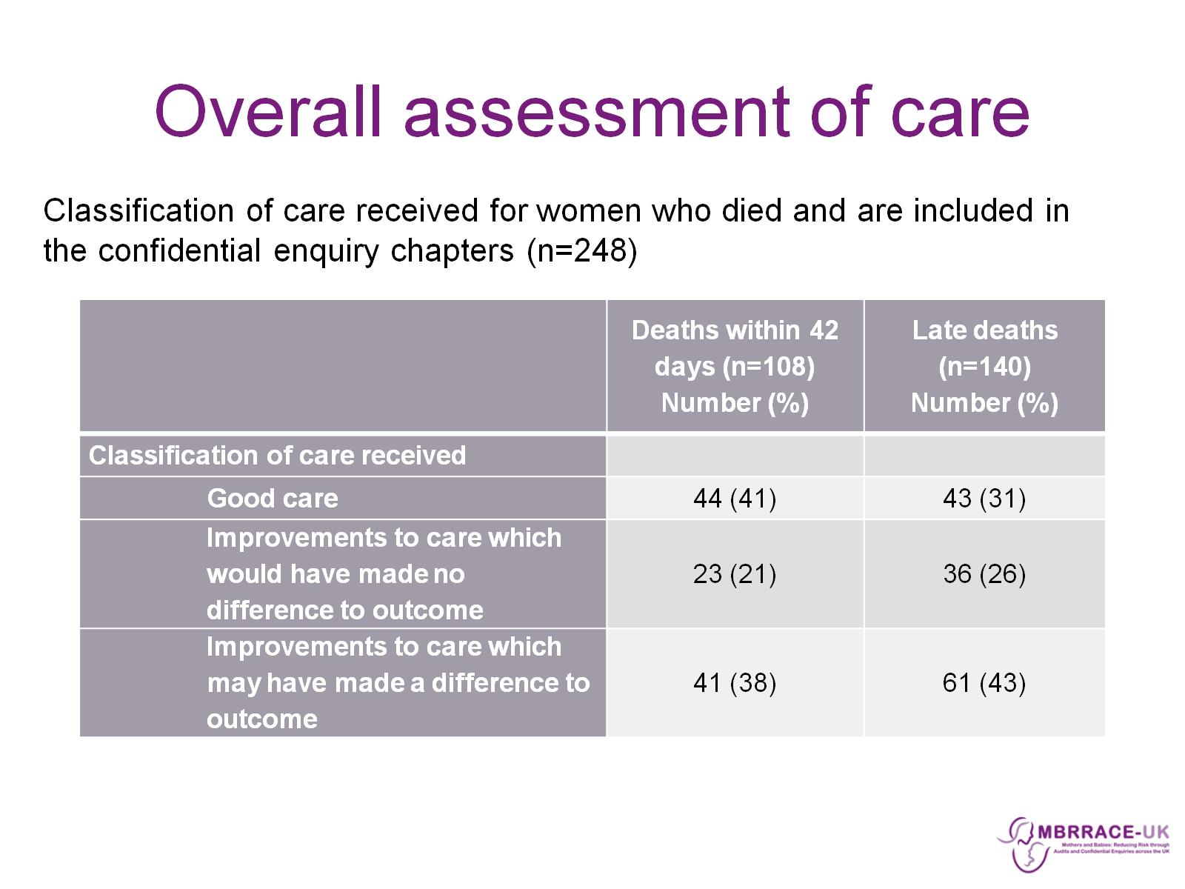
Overall assessment of care

Slide 42

Summary

Slide 43
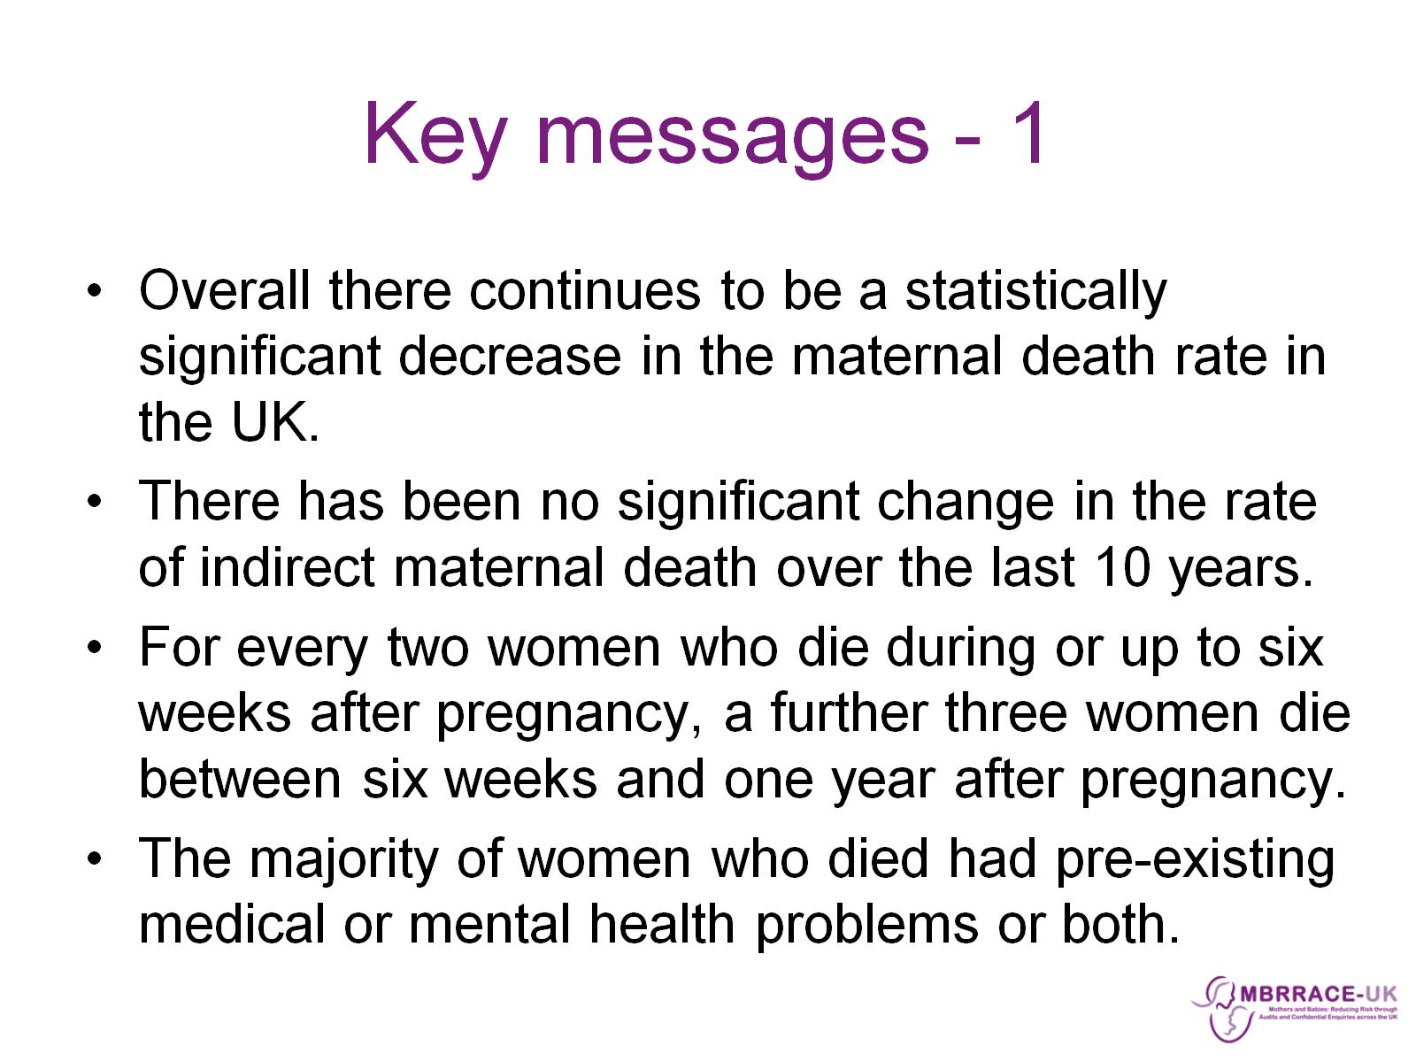
Key messages - 1

Slide 44
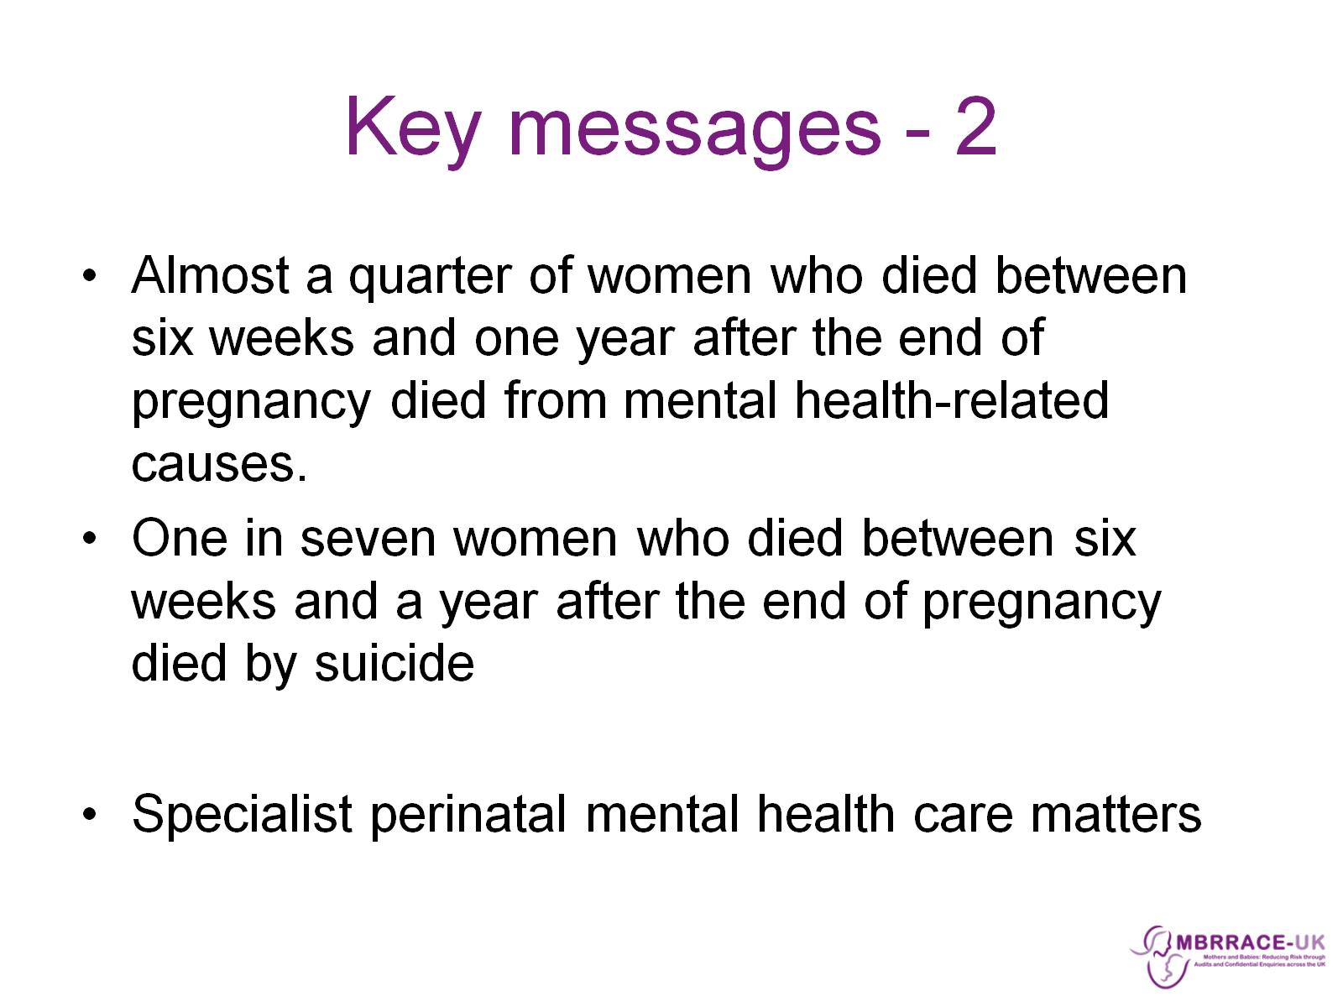
Key messages - 2

Slide 45


