Slide 1
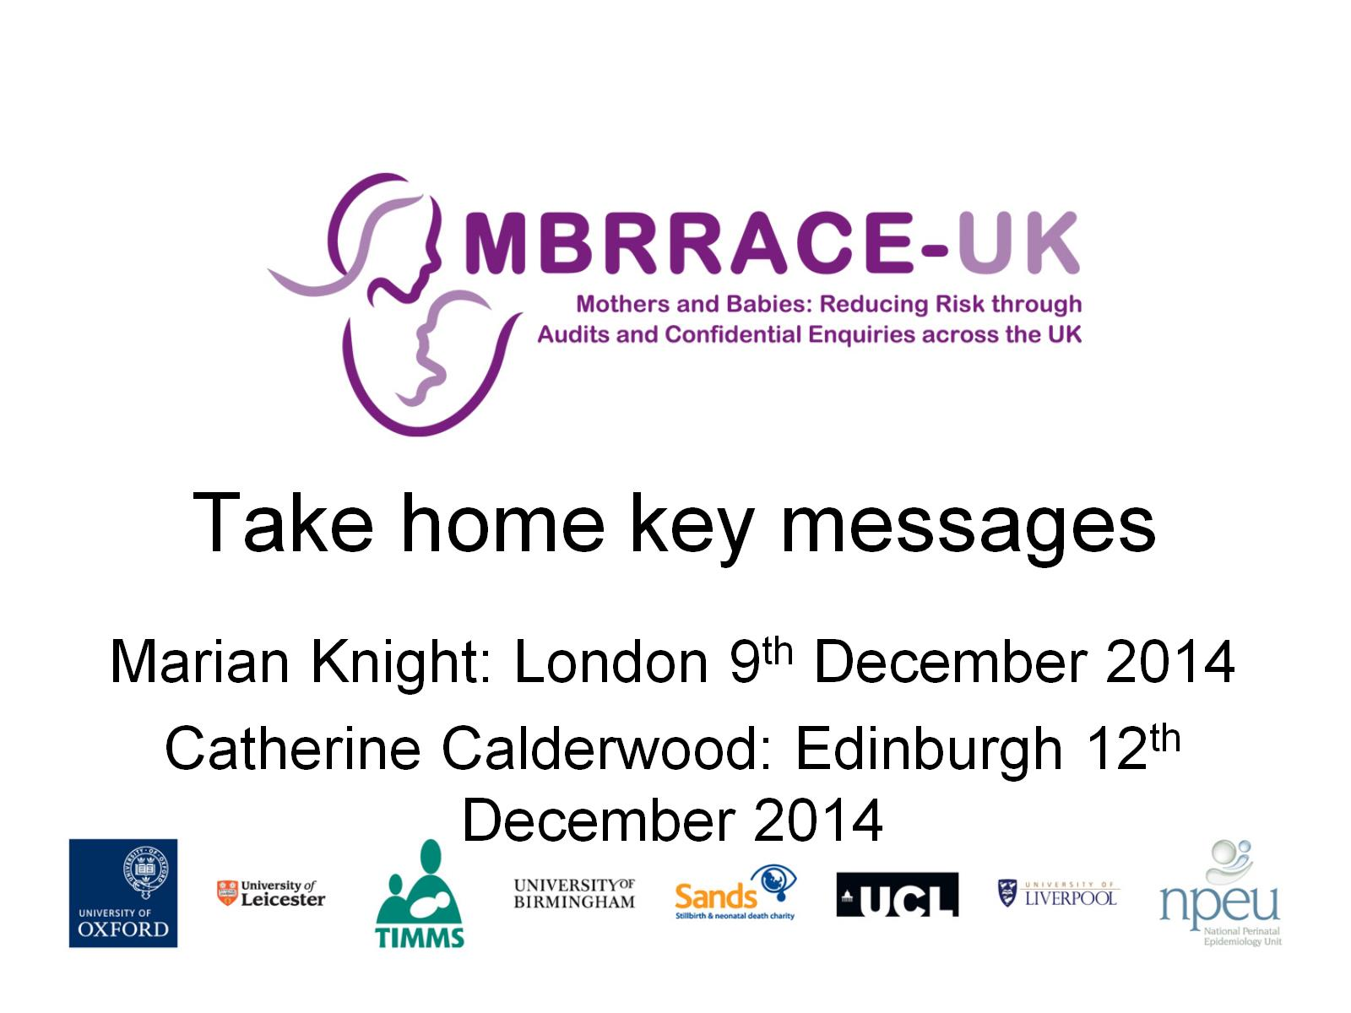
Take home key messages

Slide 2

Actions for Doctors, Midwives and Allied Health Professionals

Slide 3
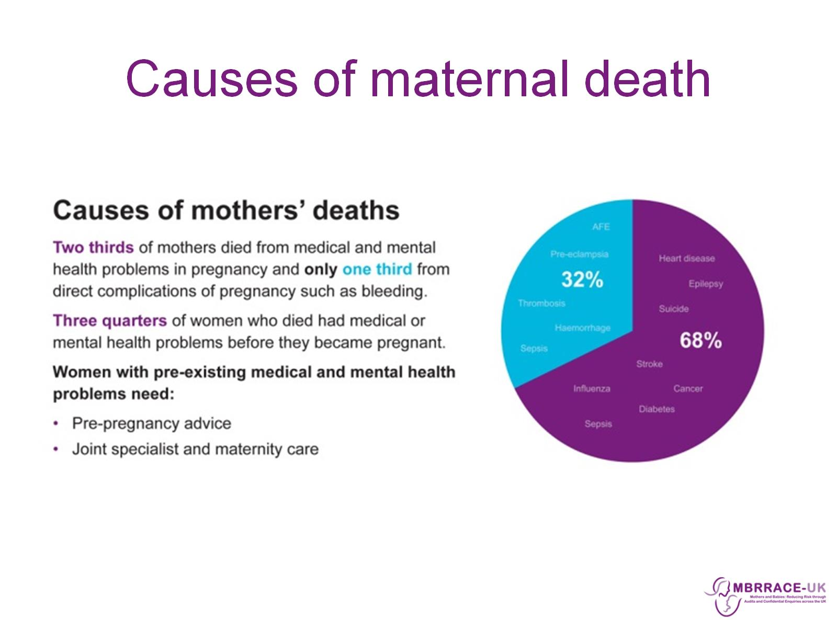
Causes of maternal death

Slide 4
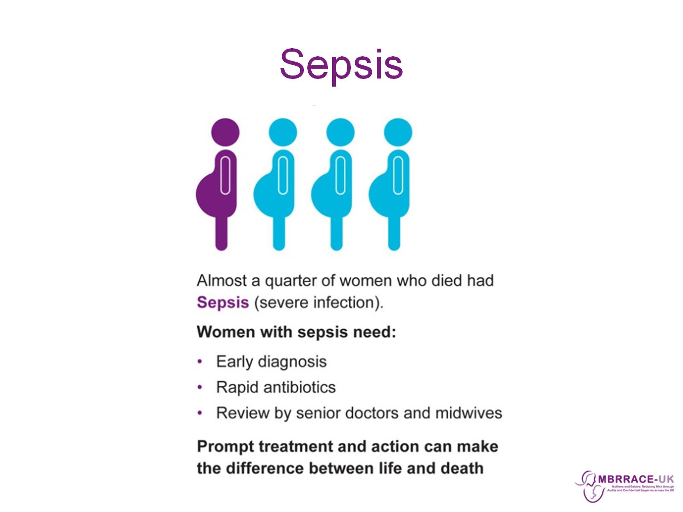
Sepsis

Slide 5
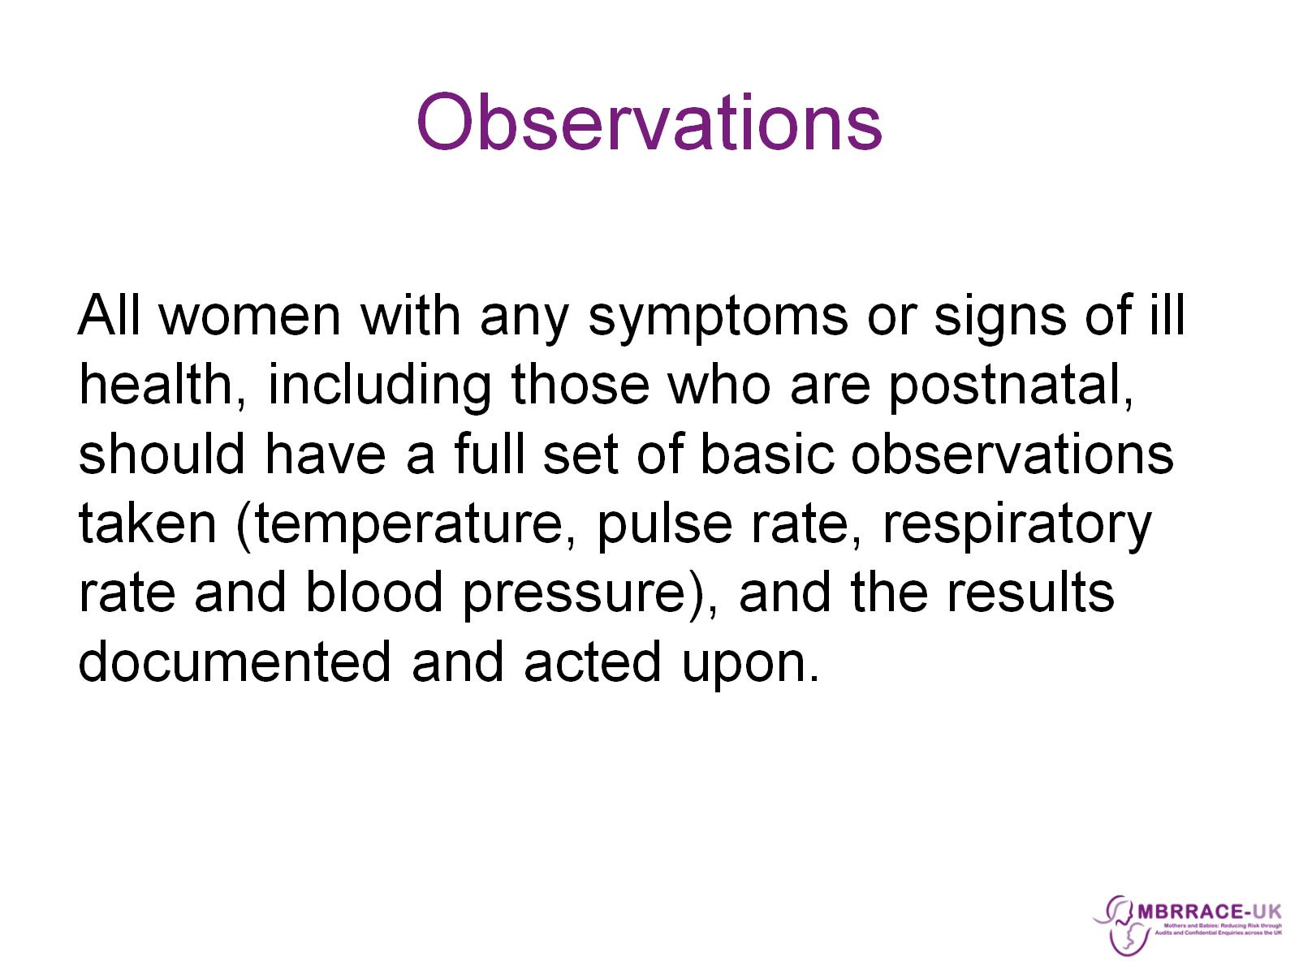
Observations

Slide 6
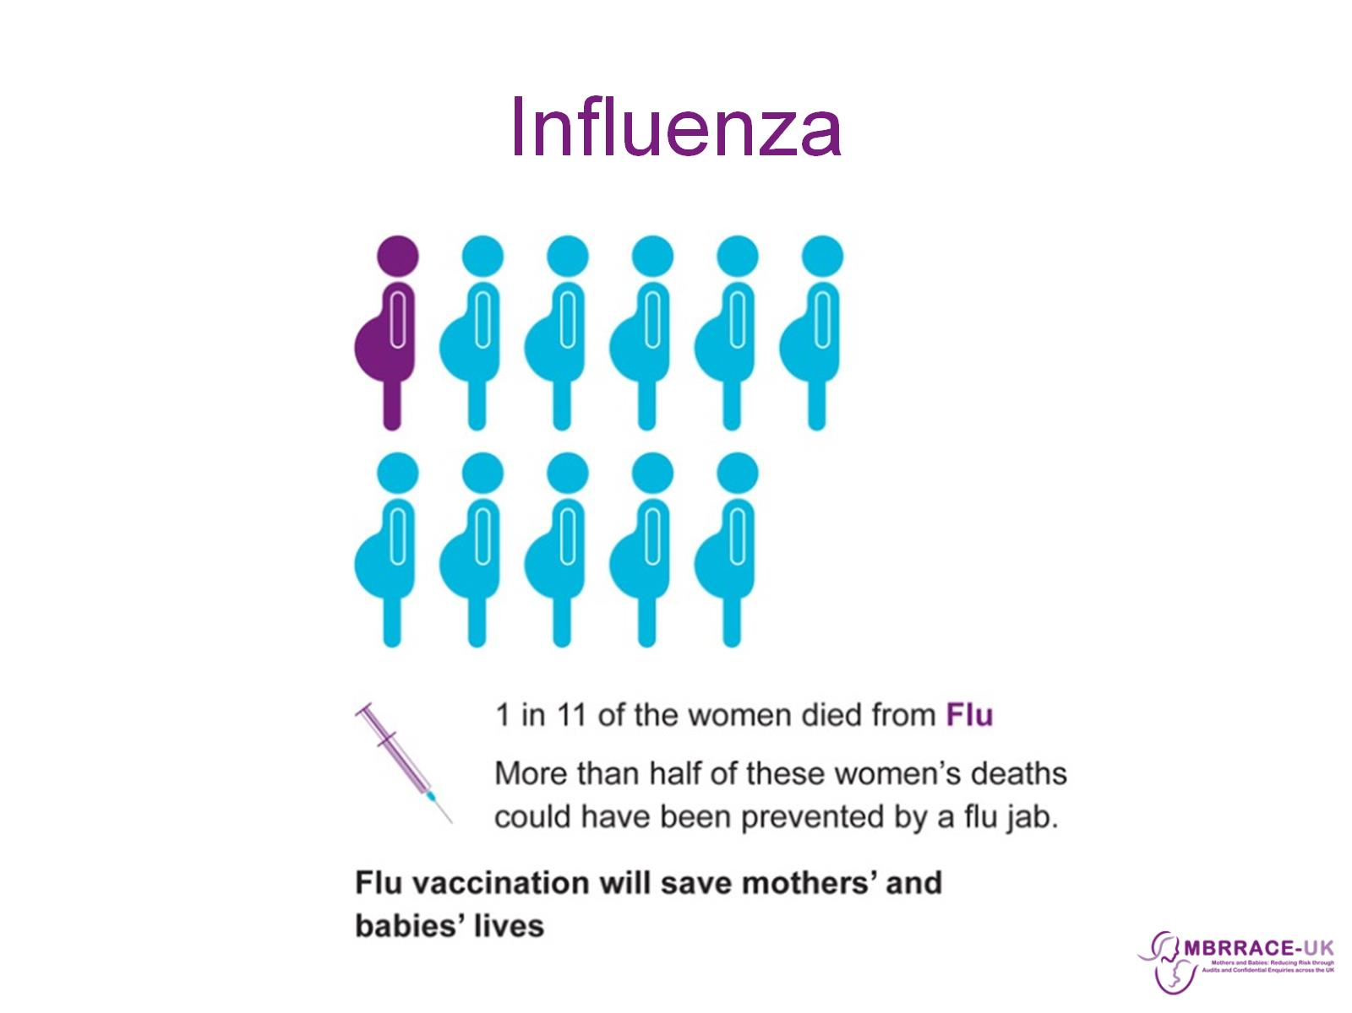
Influenza

Slide 7
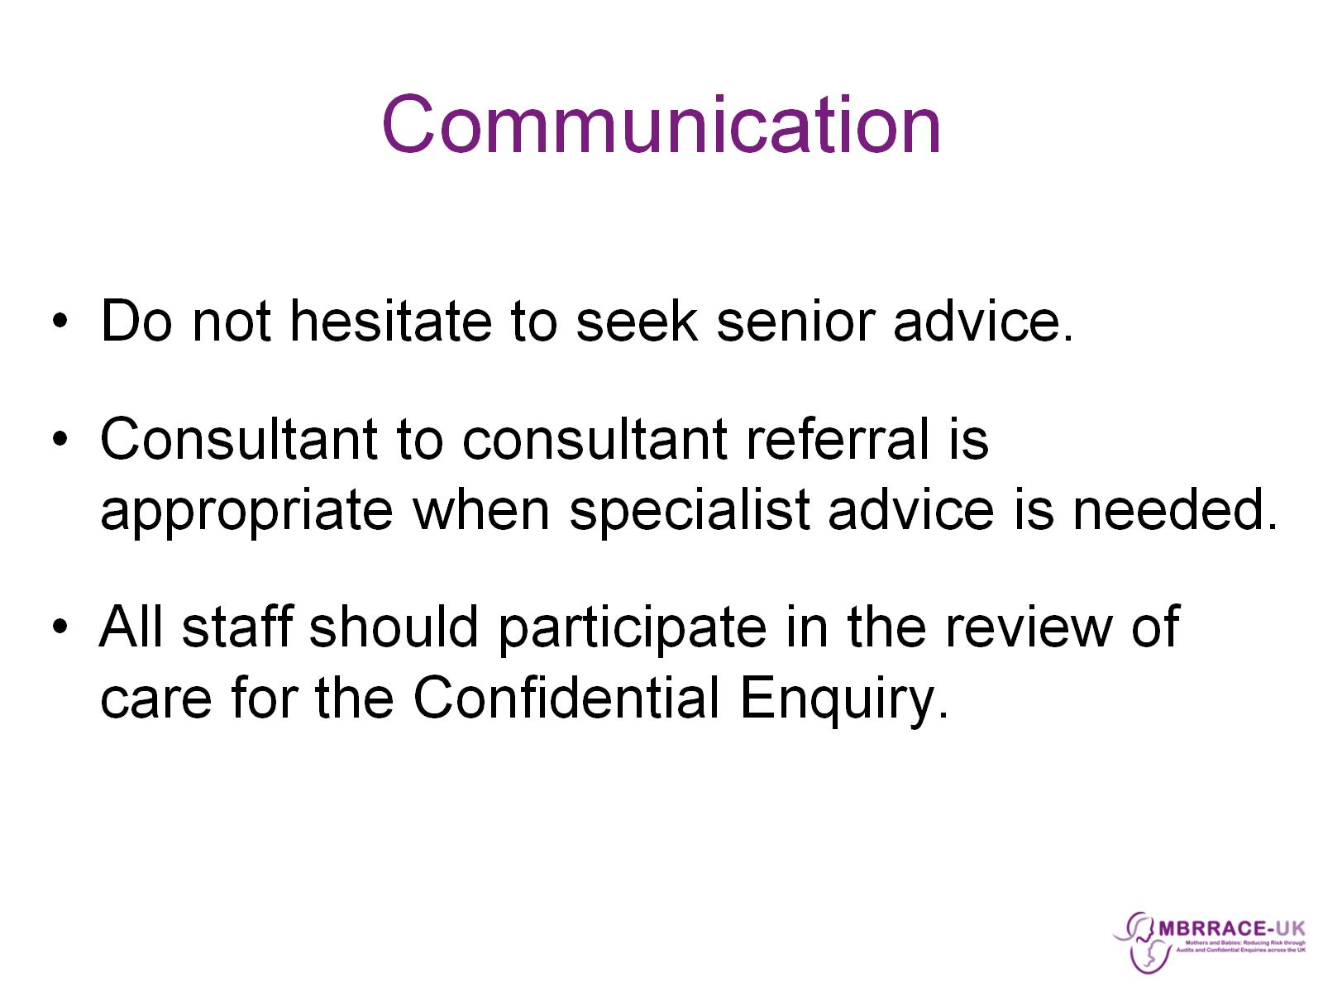
Communication

Slide 8
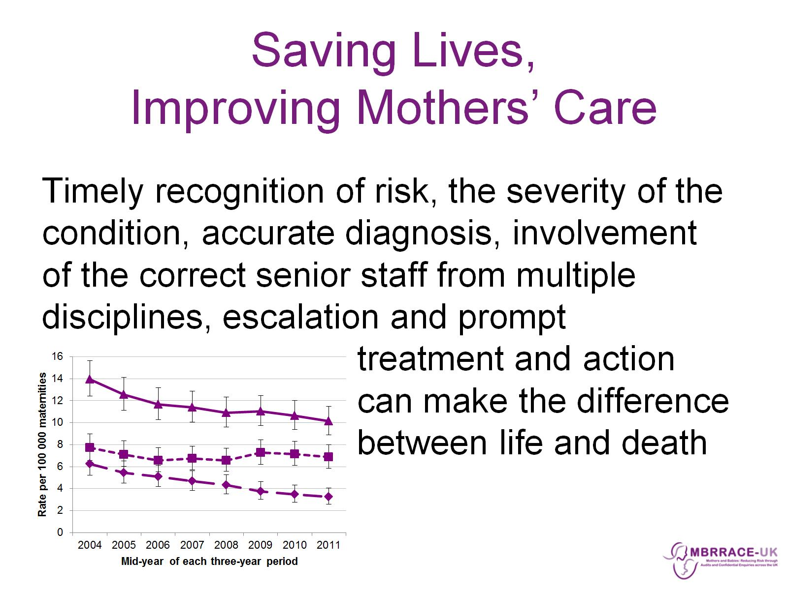
Saving Lives,
Improving Mothers’ Care

Slide 9


