Slide 1
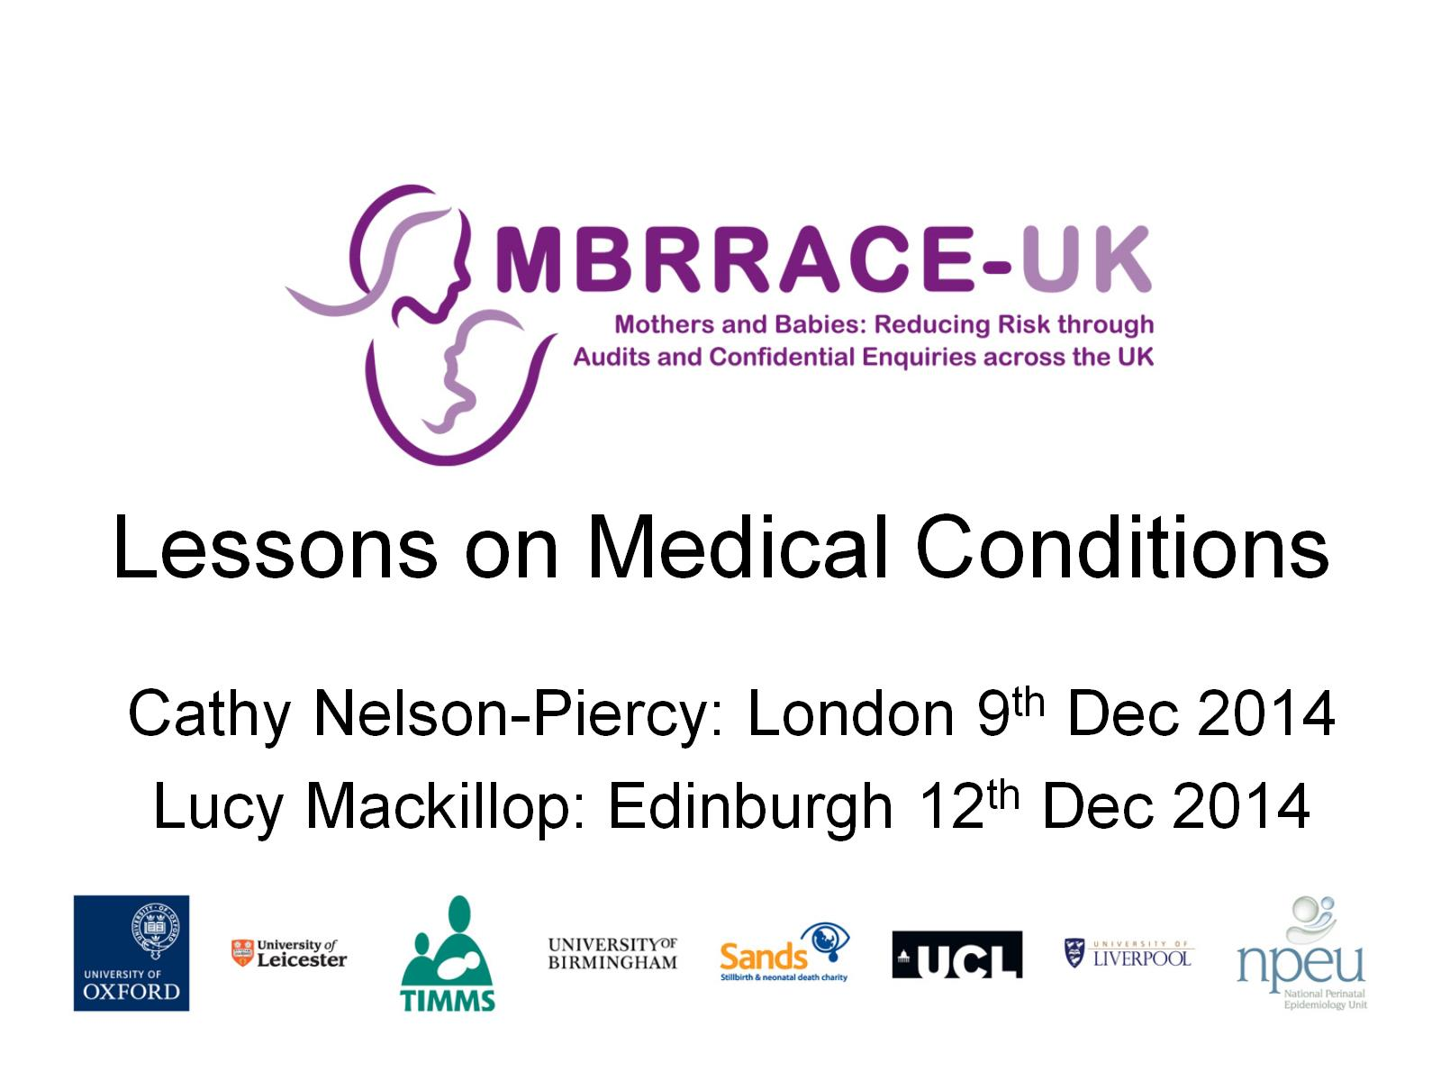
Lessons on Medical Conditions

Slide 2
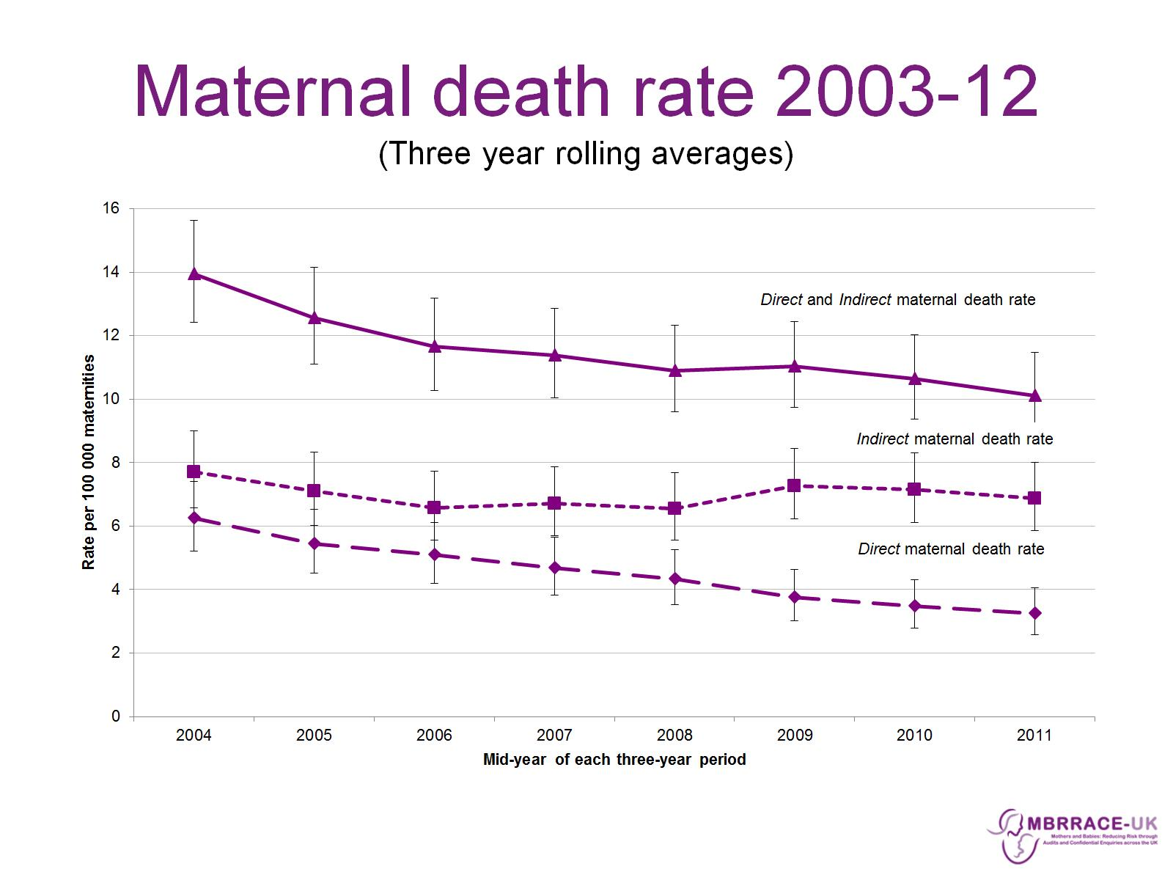
Maternal death rate 2003-12
(Three year rolling averages)

Slide 3
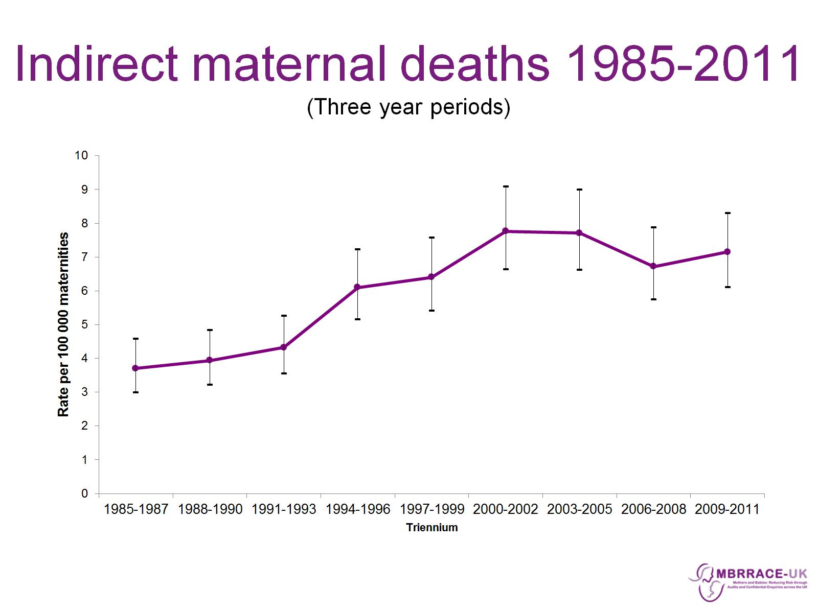
Indirect maternal deaths 1985-2011
(Three year periods)

Slide 4
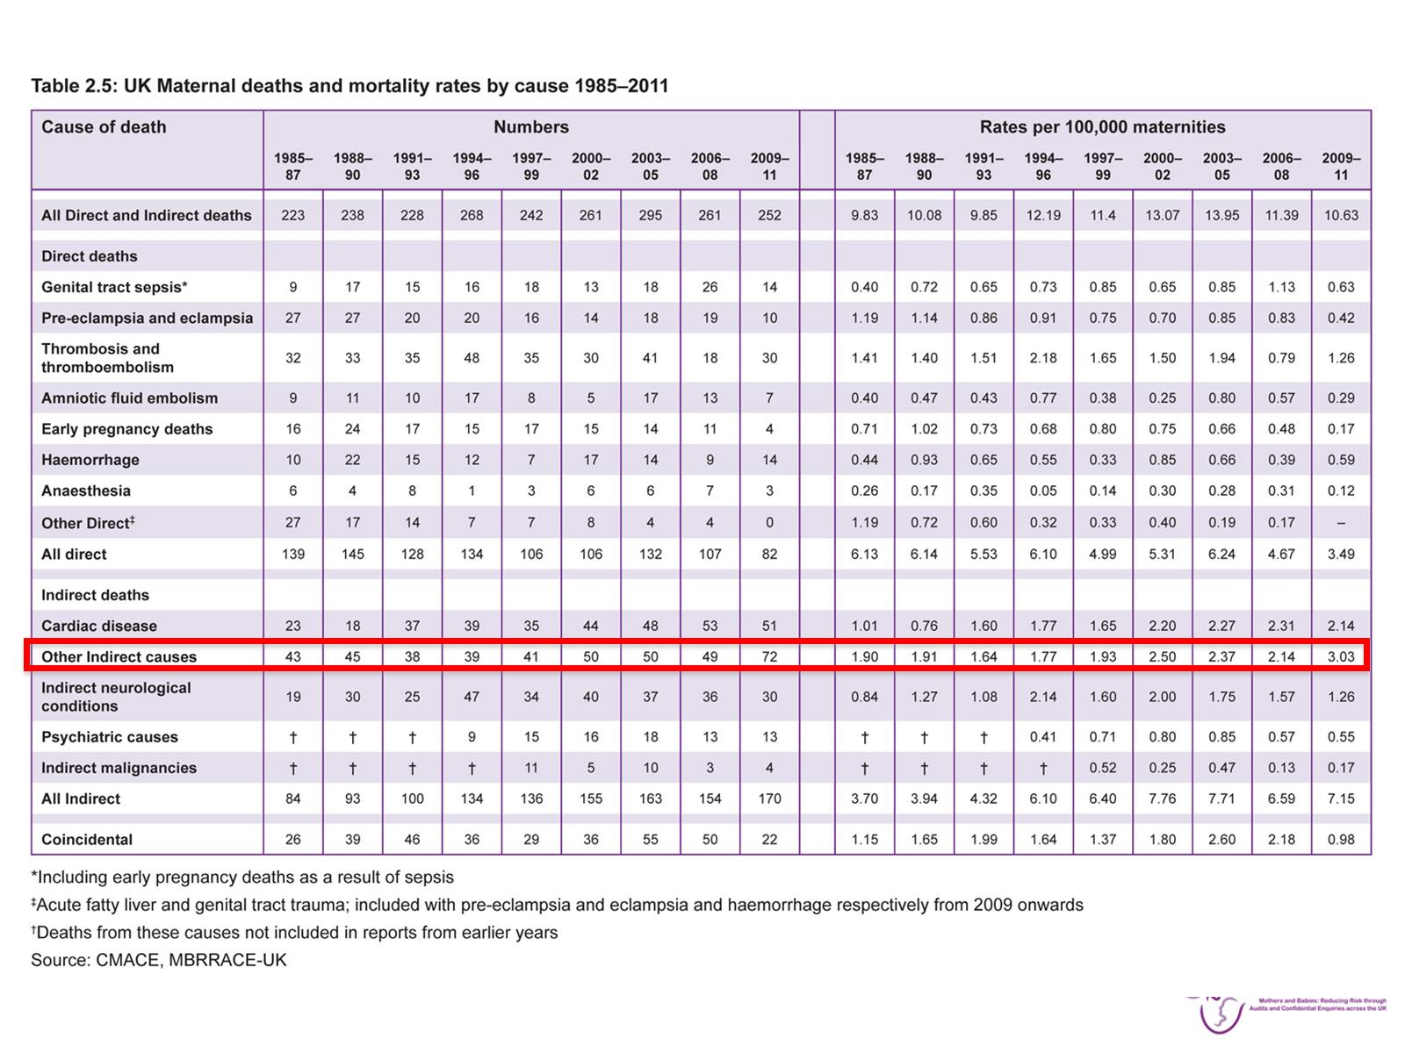

Slide 5
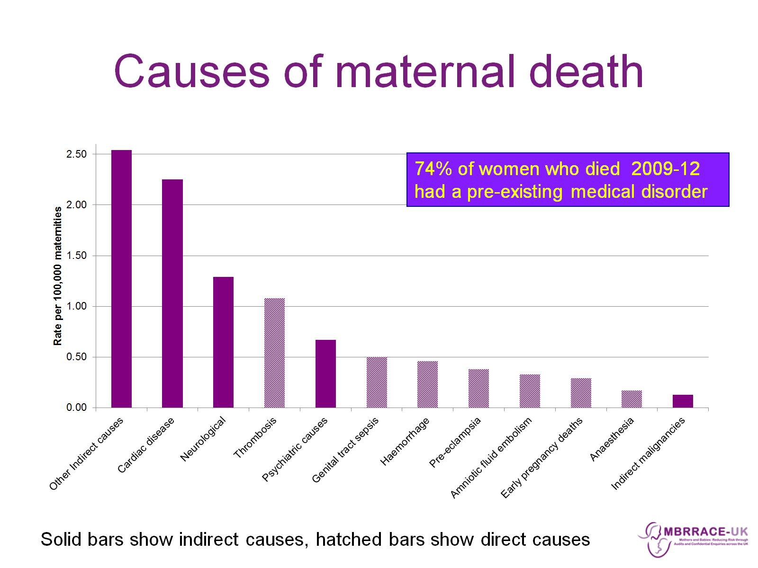
Causes of maternal death

Slide 6
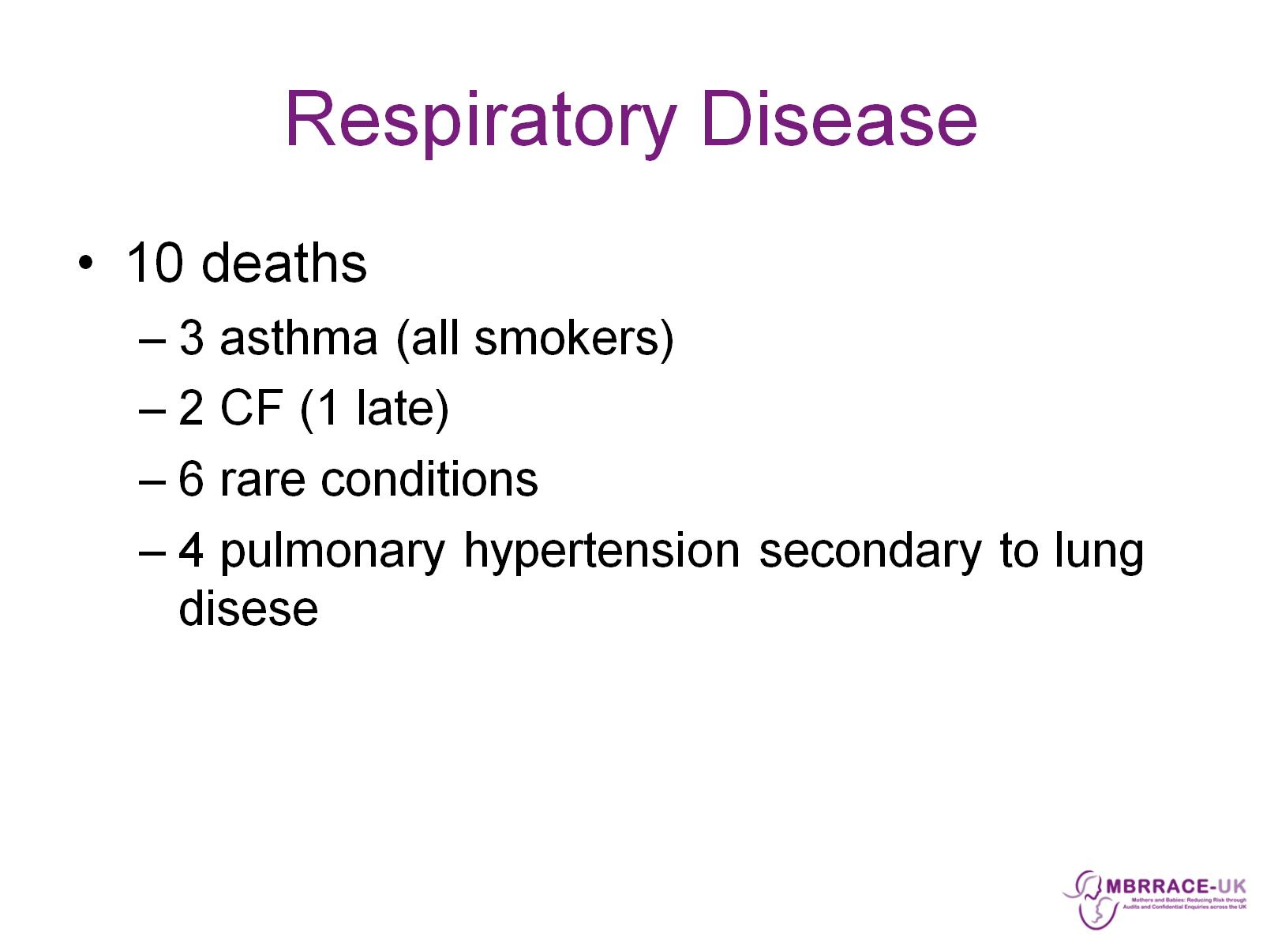
Respiratory Disease

Slide 7
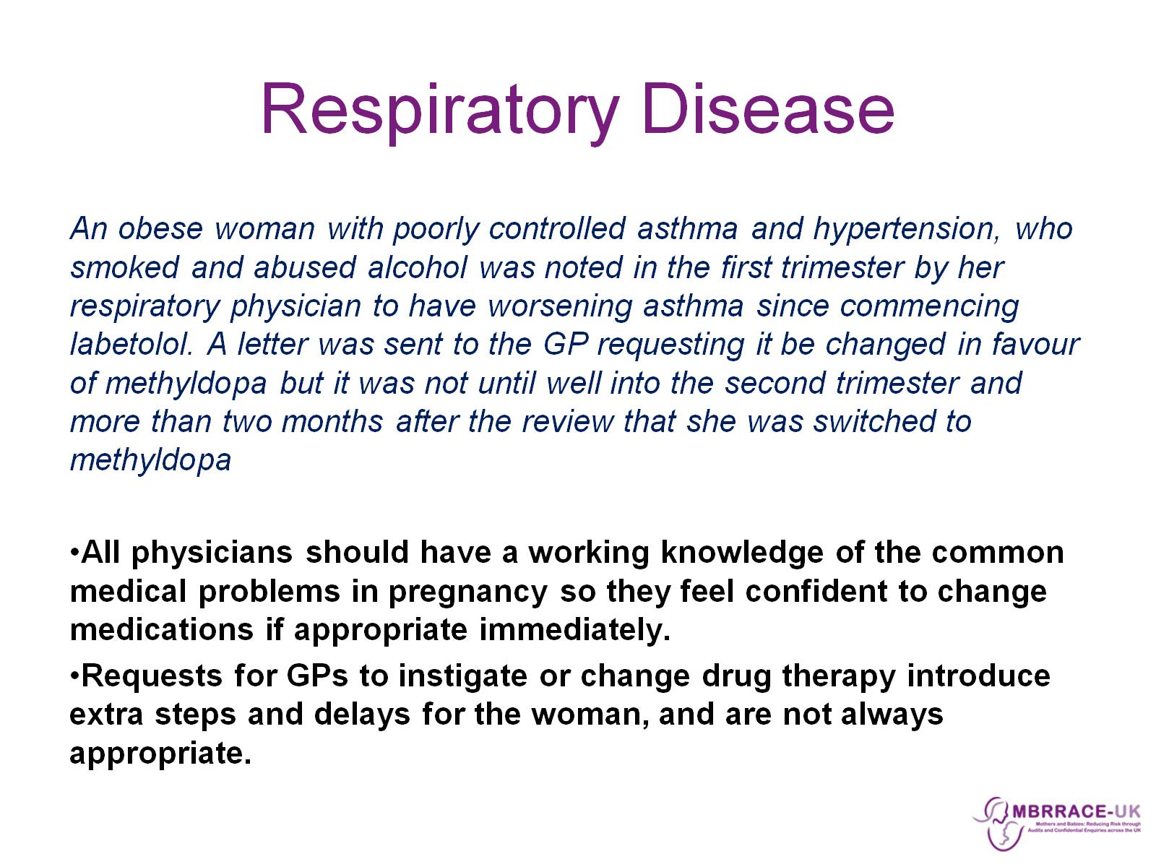
Respiratory Disease

Slide 8
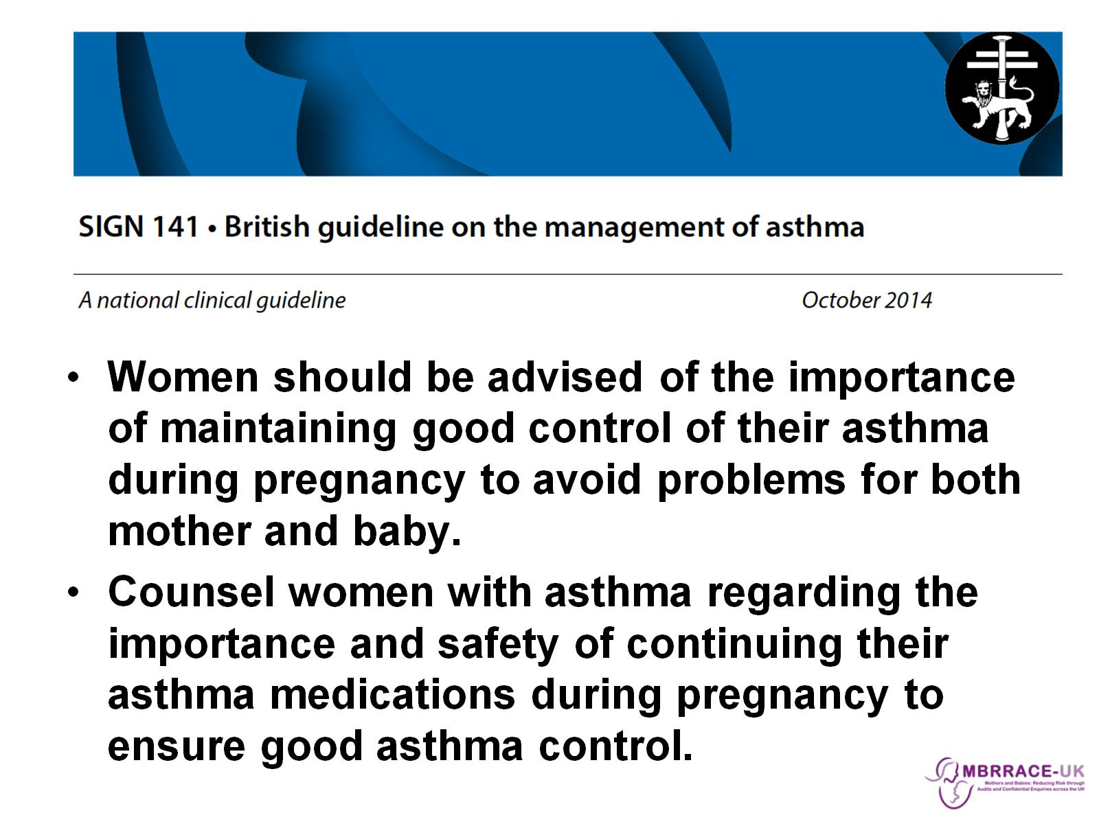
SIGN/BTS Asthma Guideline 101

Slide 9
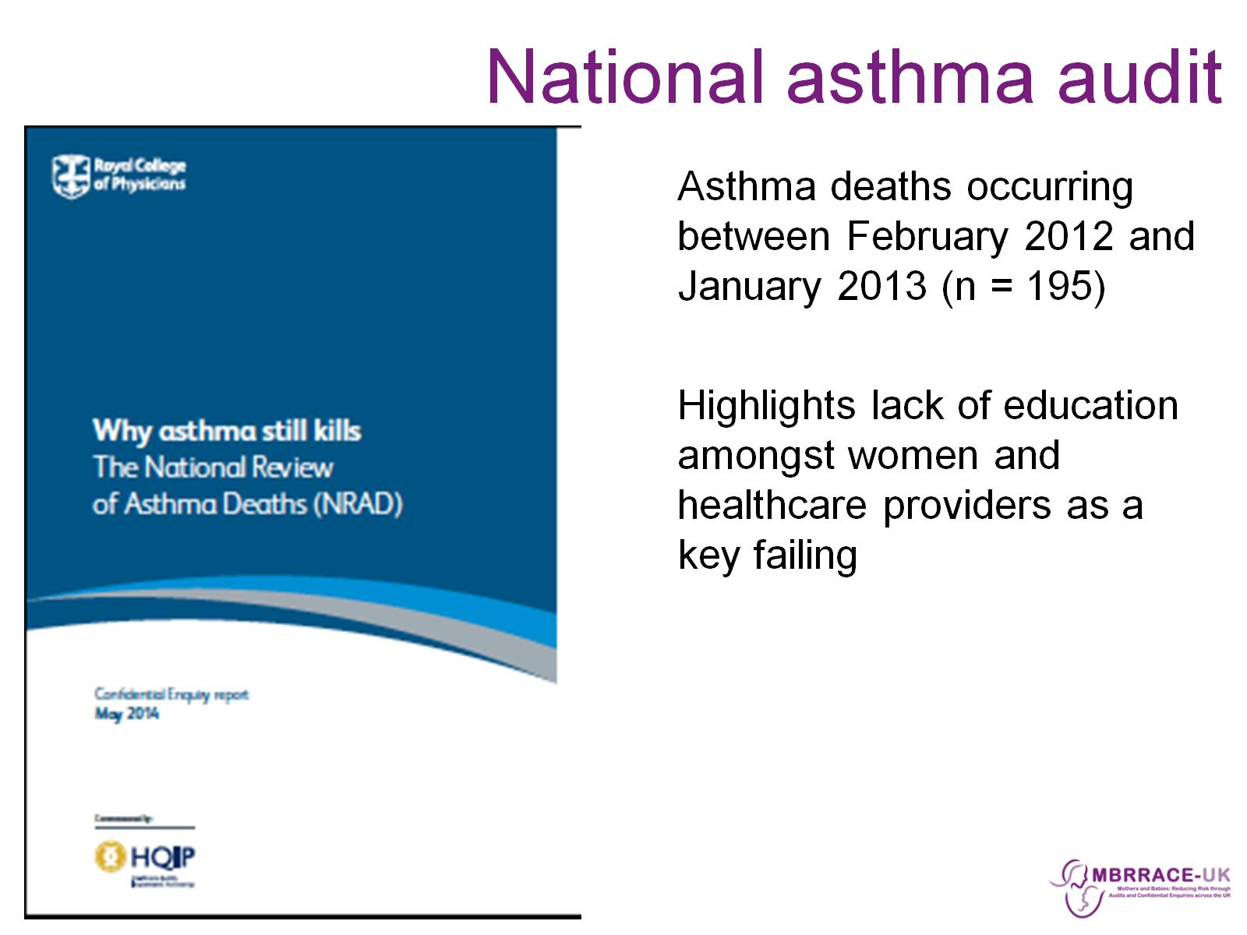
National asthma audit

Slide 10
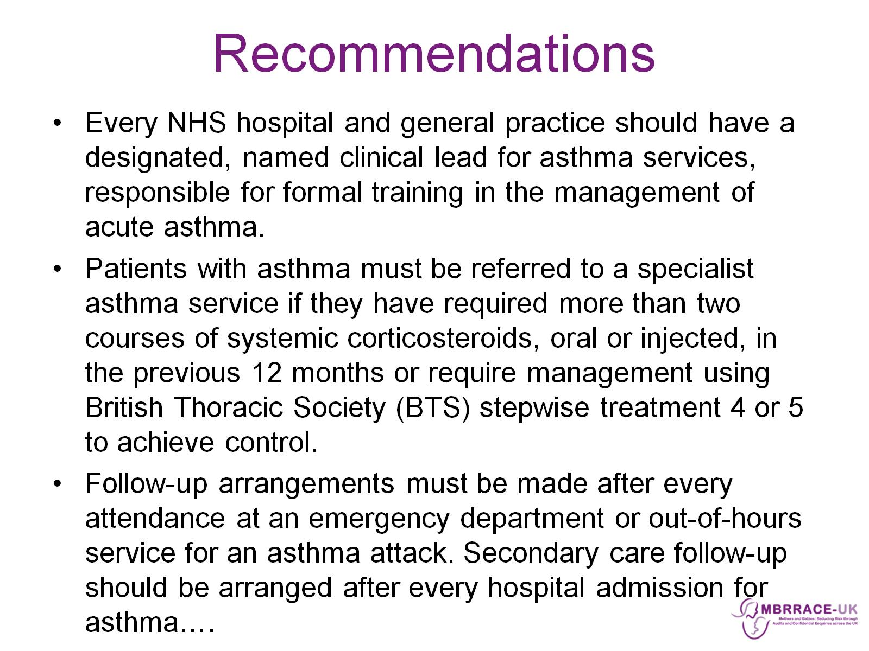
Recommendations

Slide 11
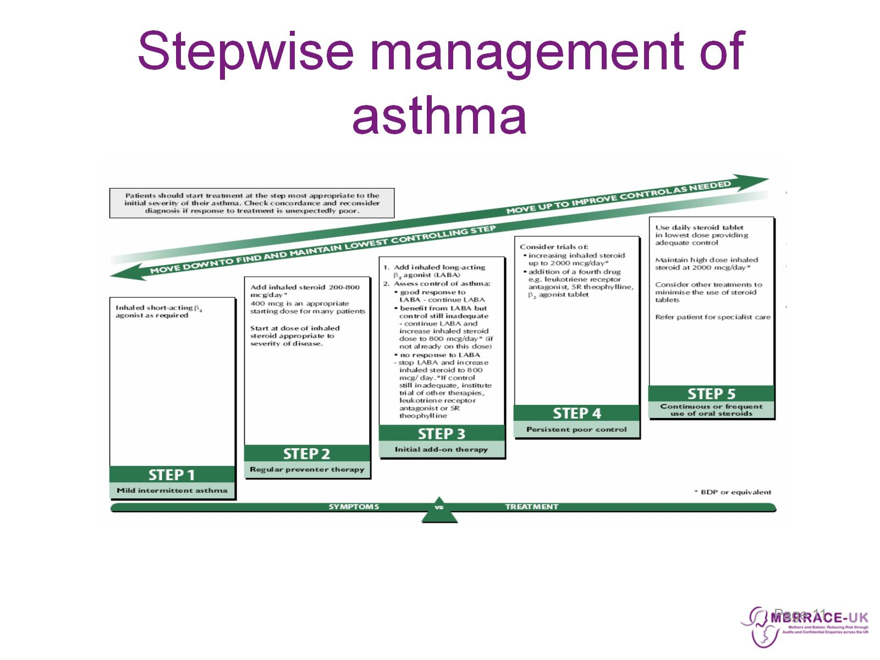
Stepwise management of asthma

Slide 12
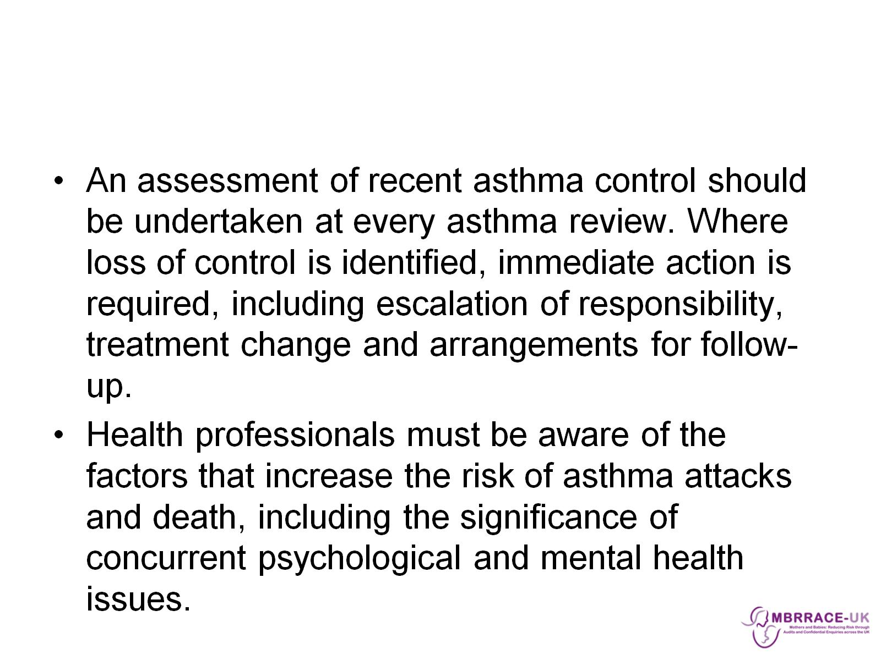

Slide 13
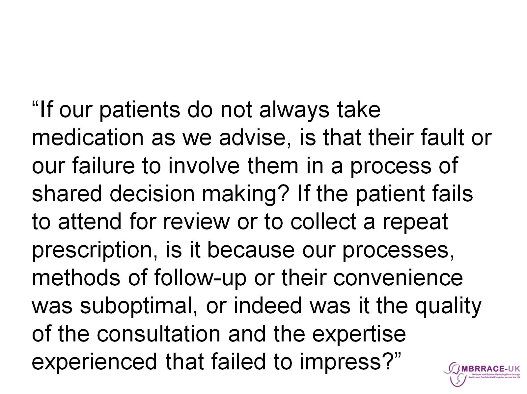

Slide 14
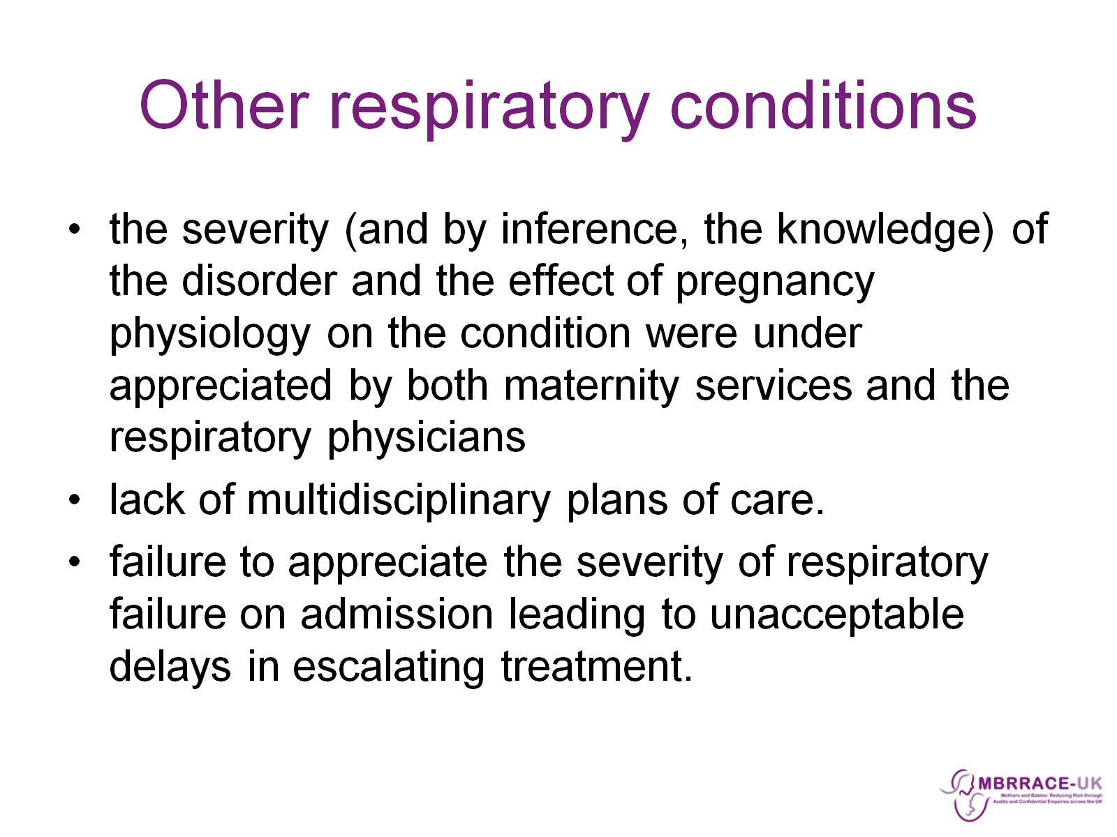
Other respiratory conditions

Slide 15
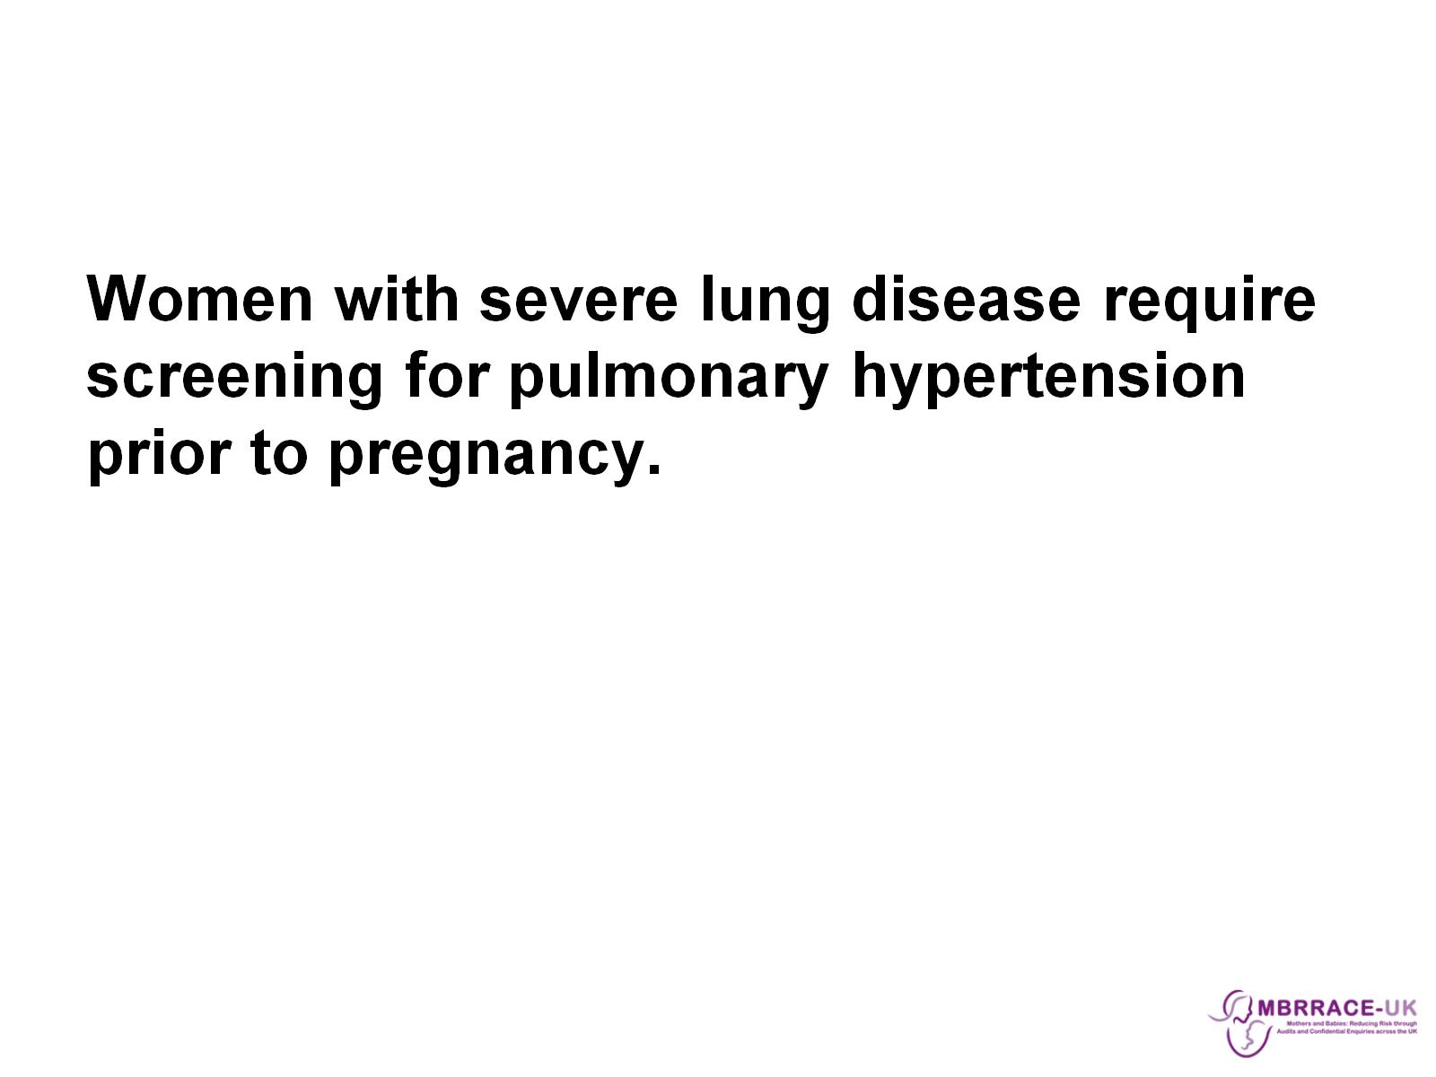

Slide 16
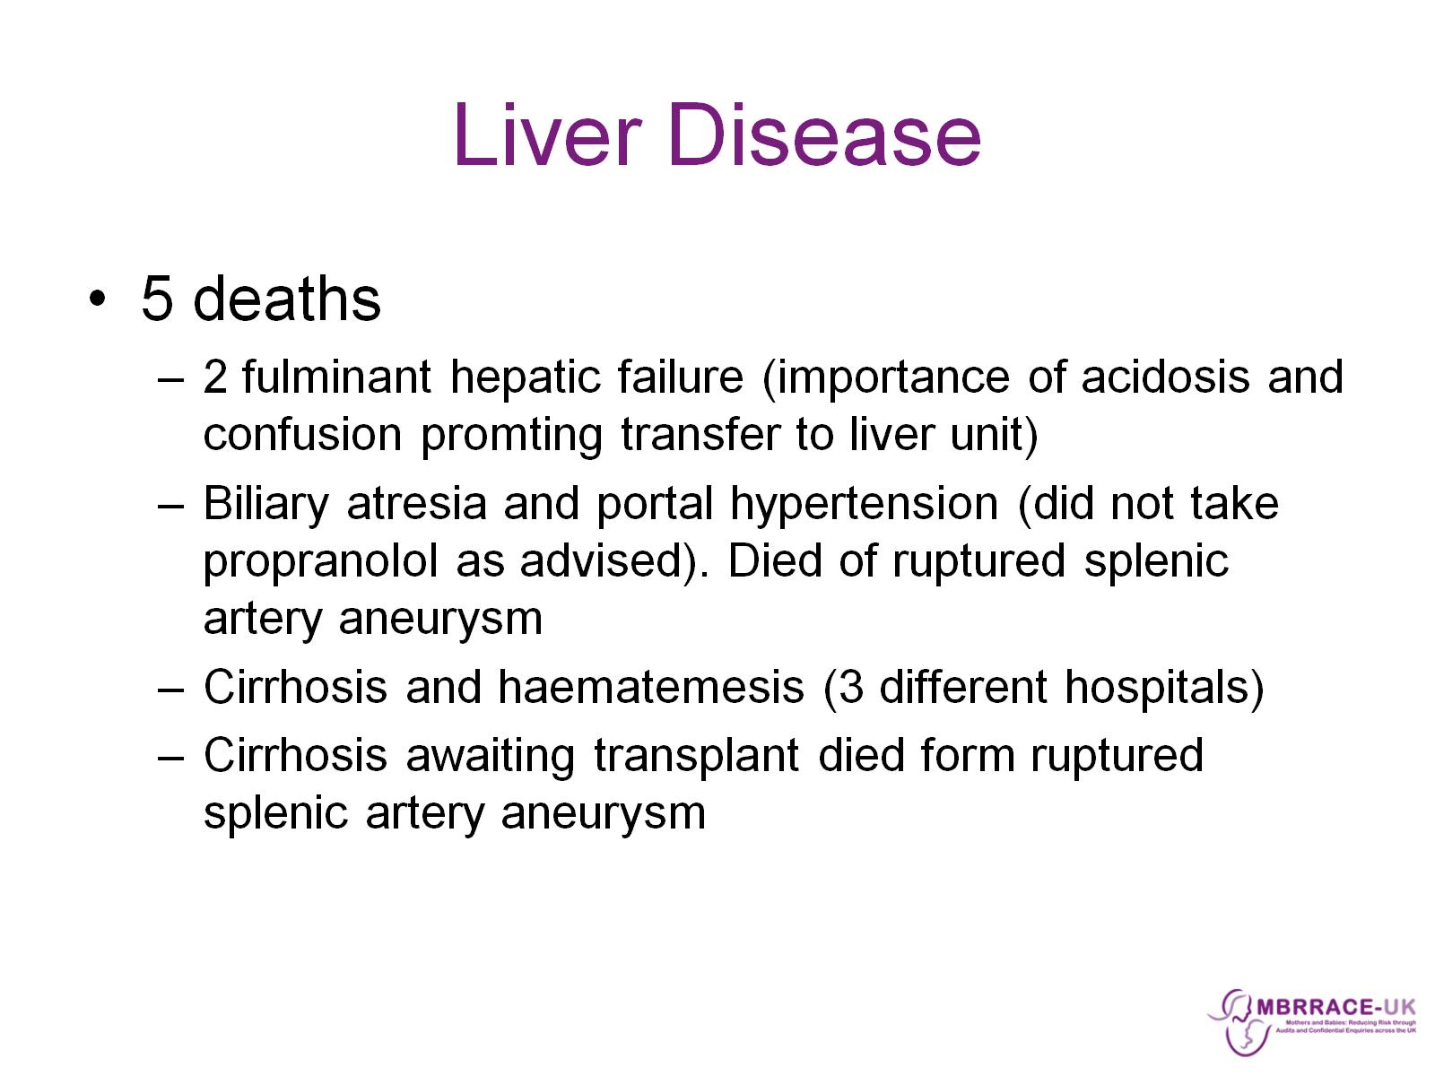
Liver Disease

Slide 17
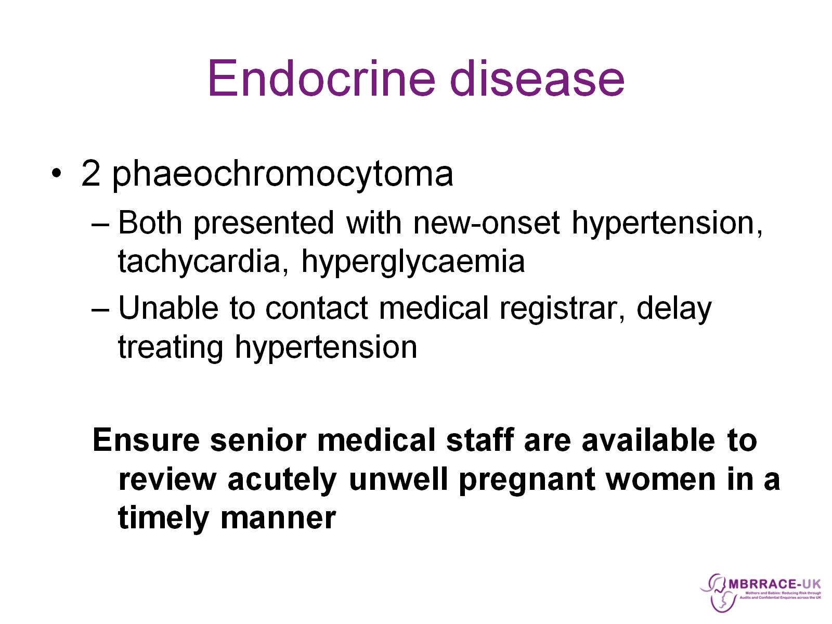
Endocrine disease

Slide 18
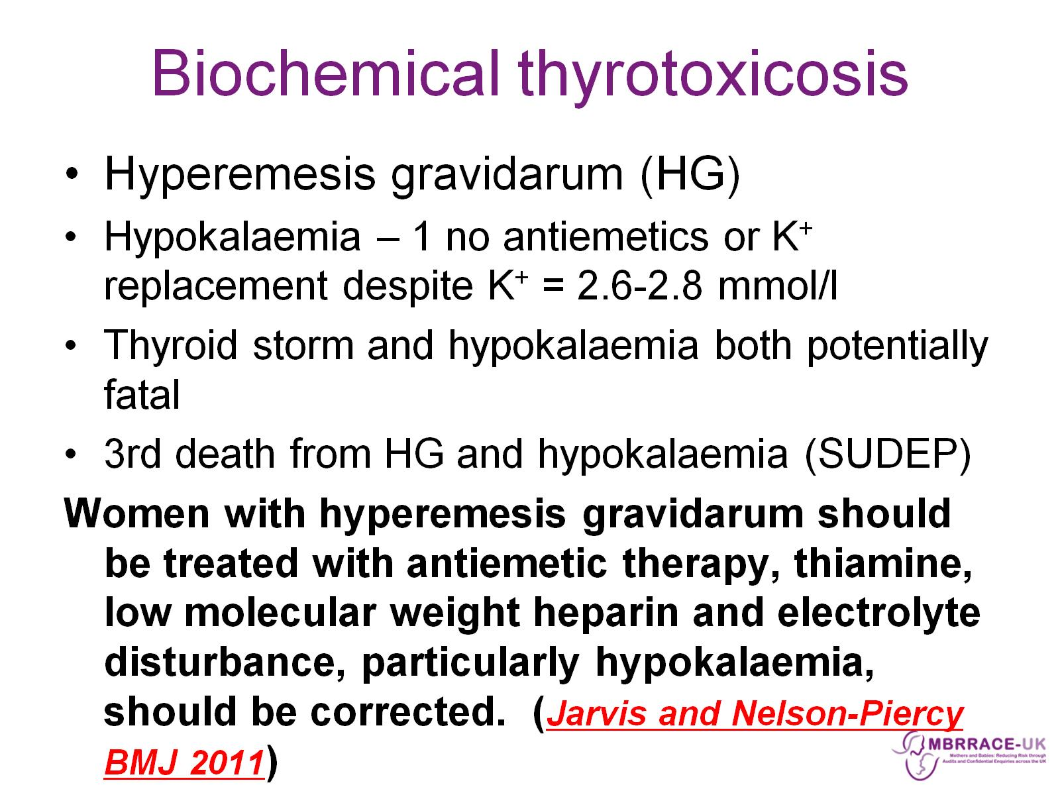
Biochemical thyrotoxicosis

Slide 19
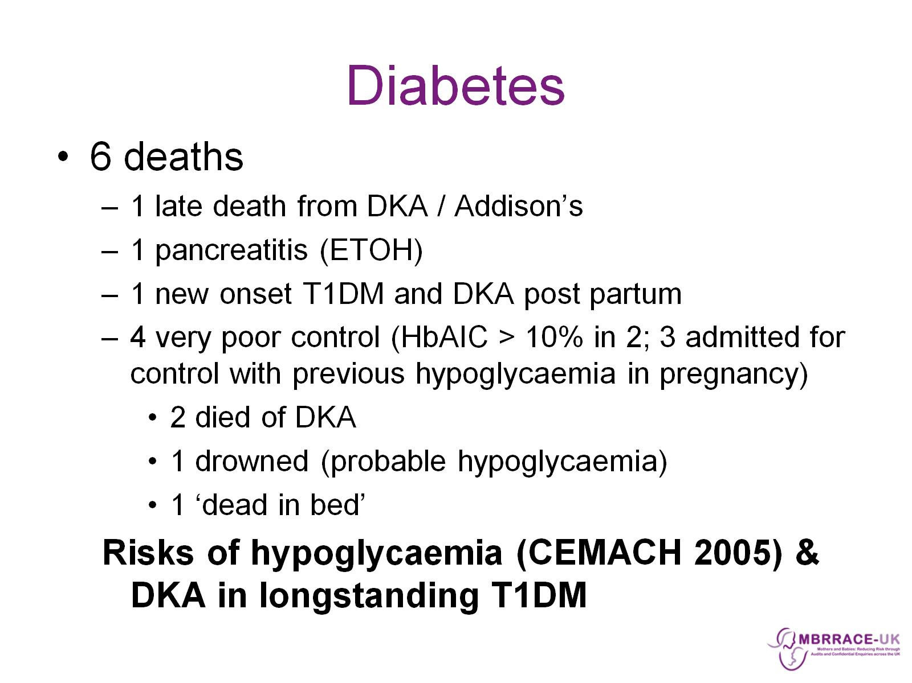
Diabetes

Slide 20
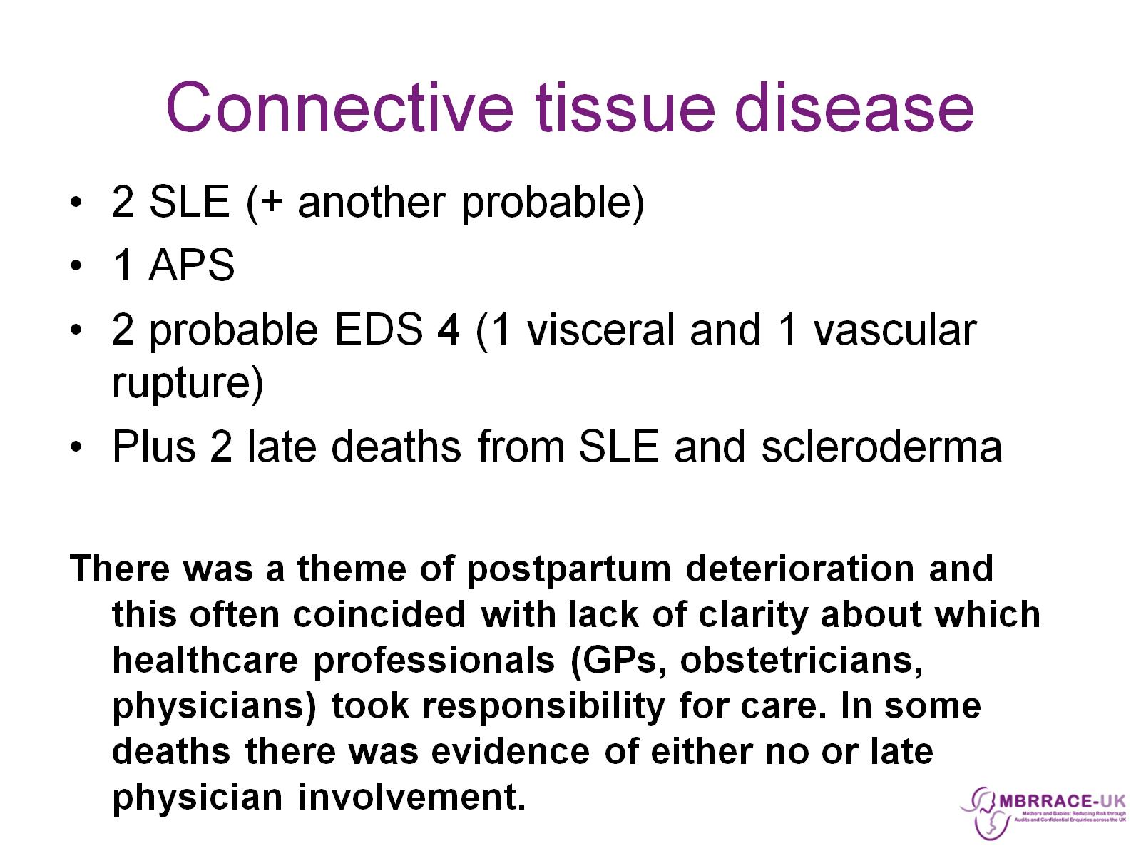
Connective tissue disease

Slide 21
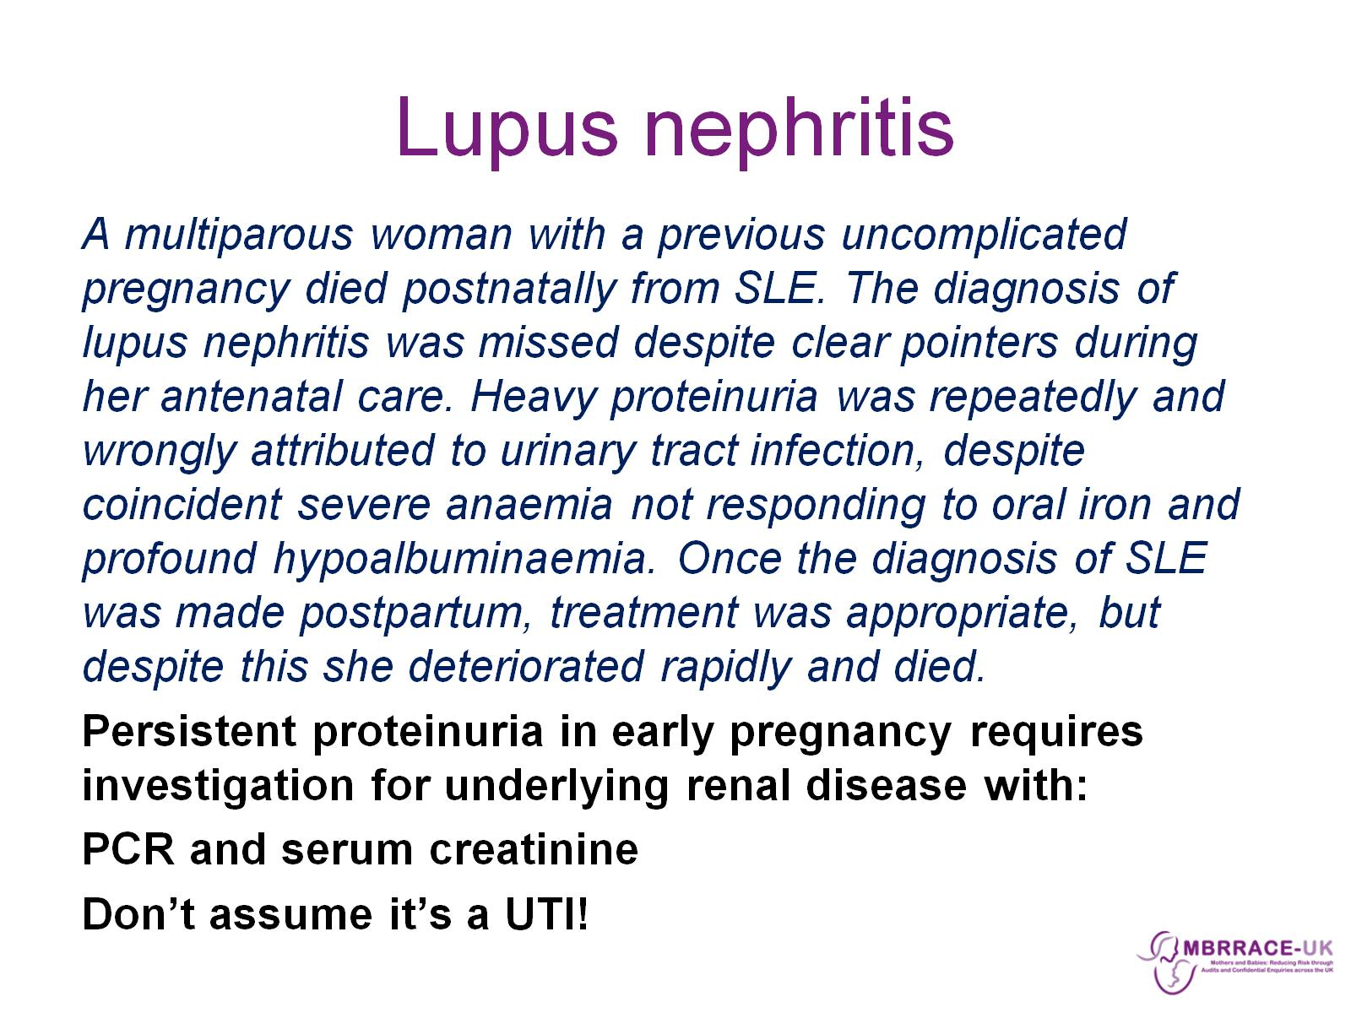
Lupus nephritis

Slide 22
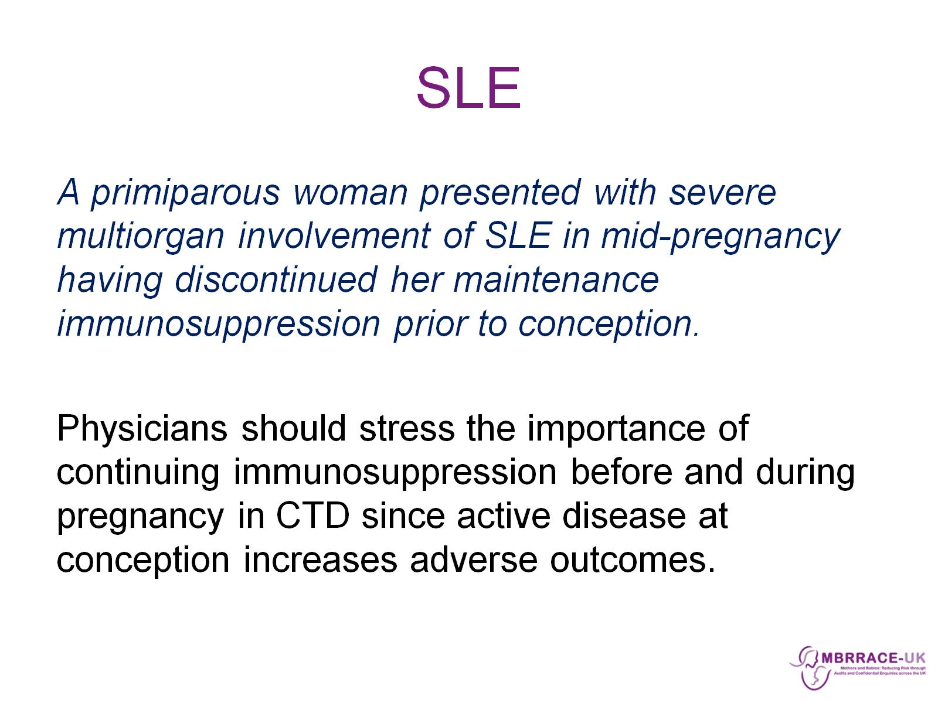
SLE

Slide 23
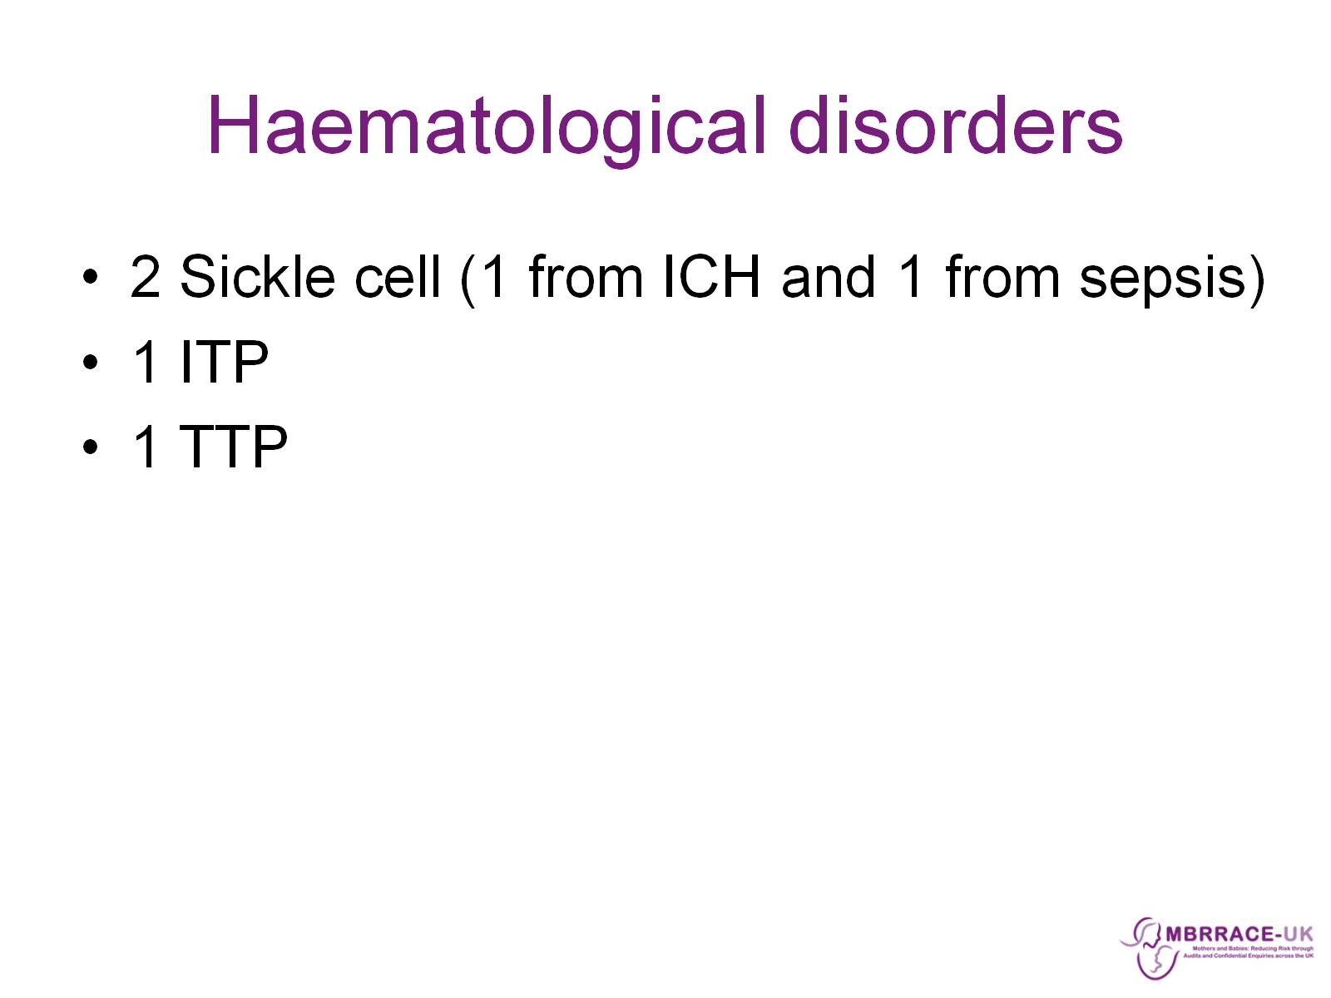
Haematological disorders

Slide 24
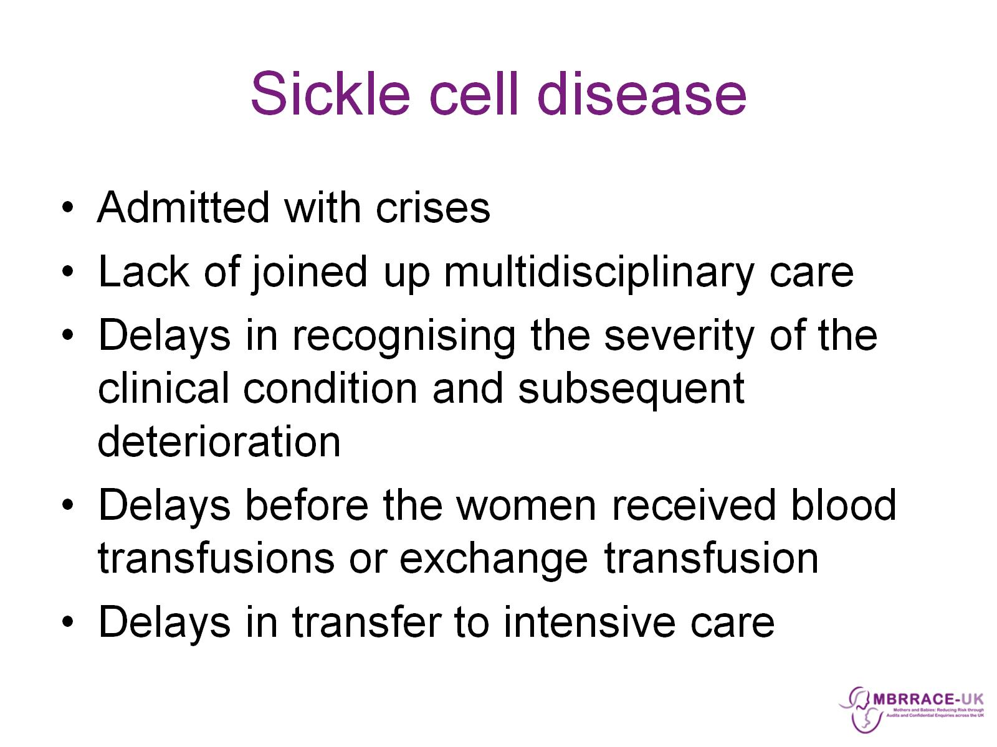
Sickle cell disease

Slide 25
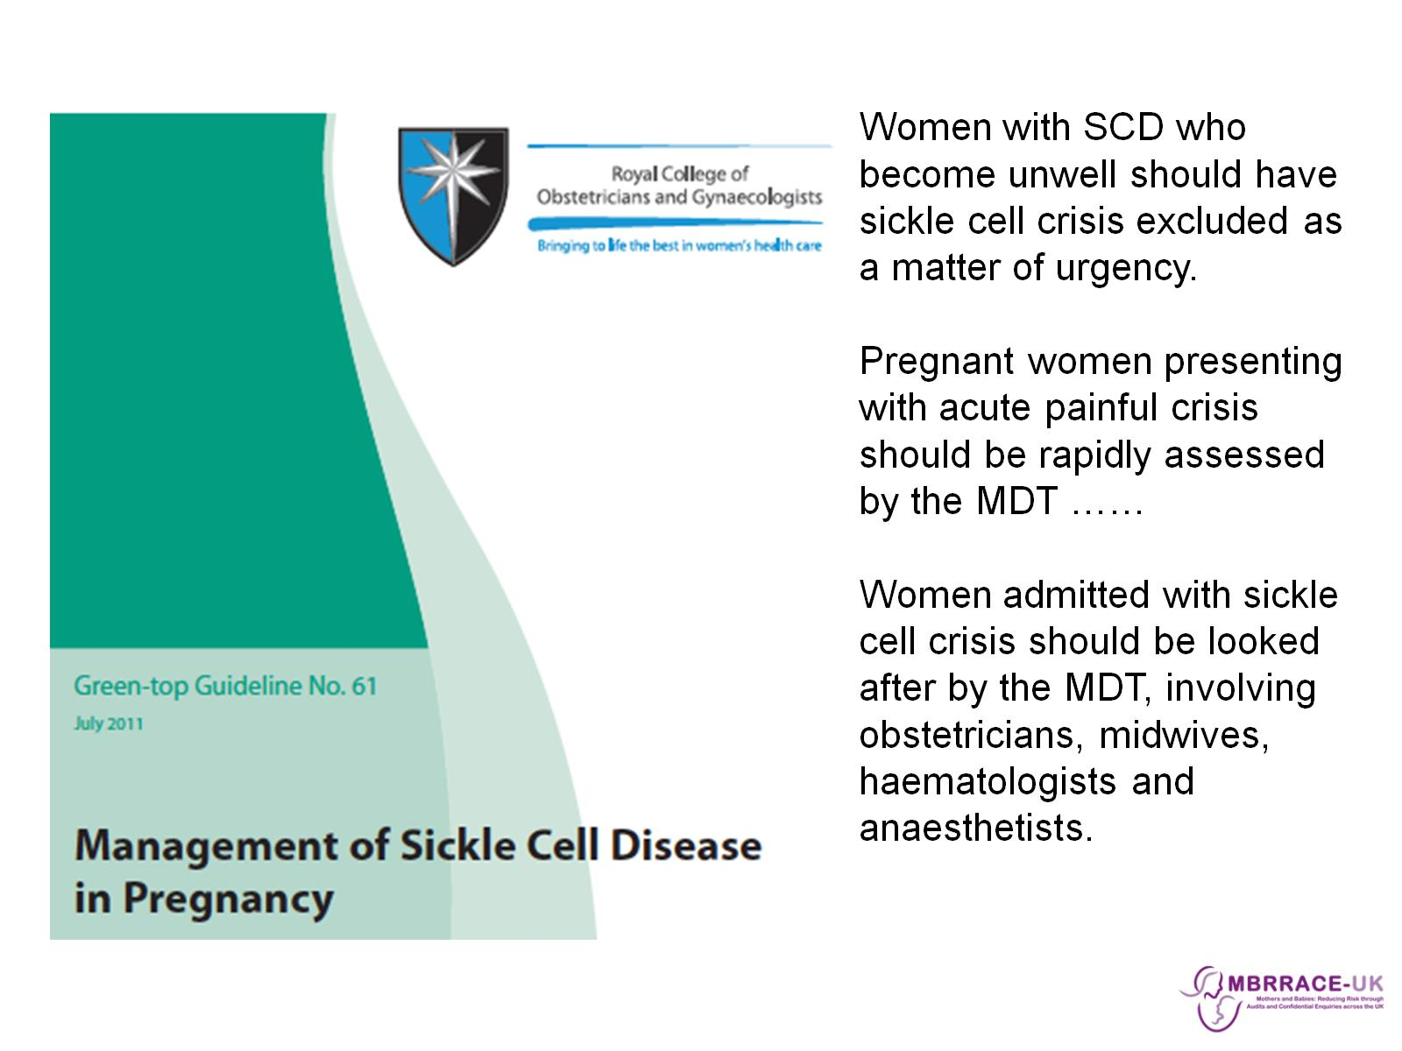

Slide 26
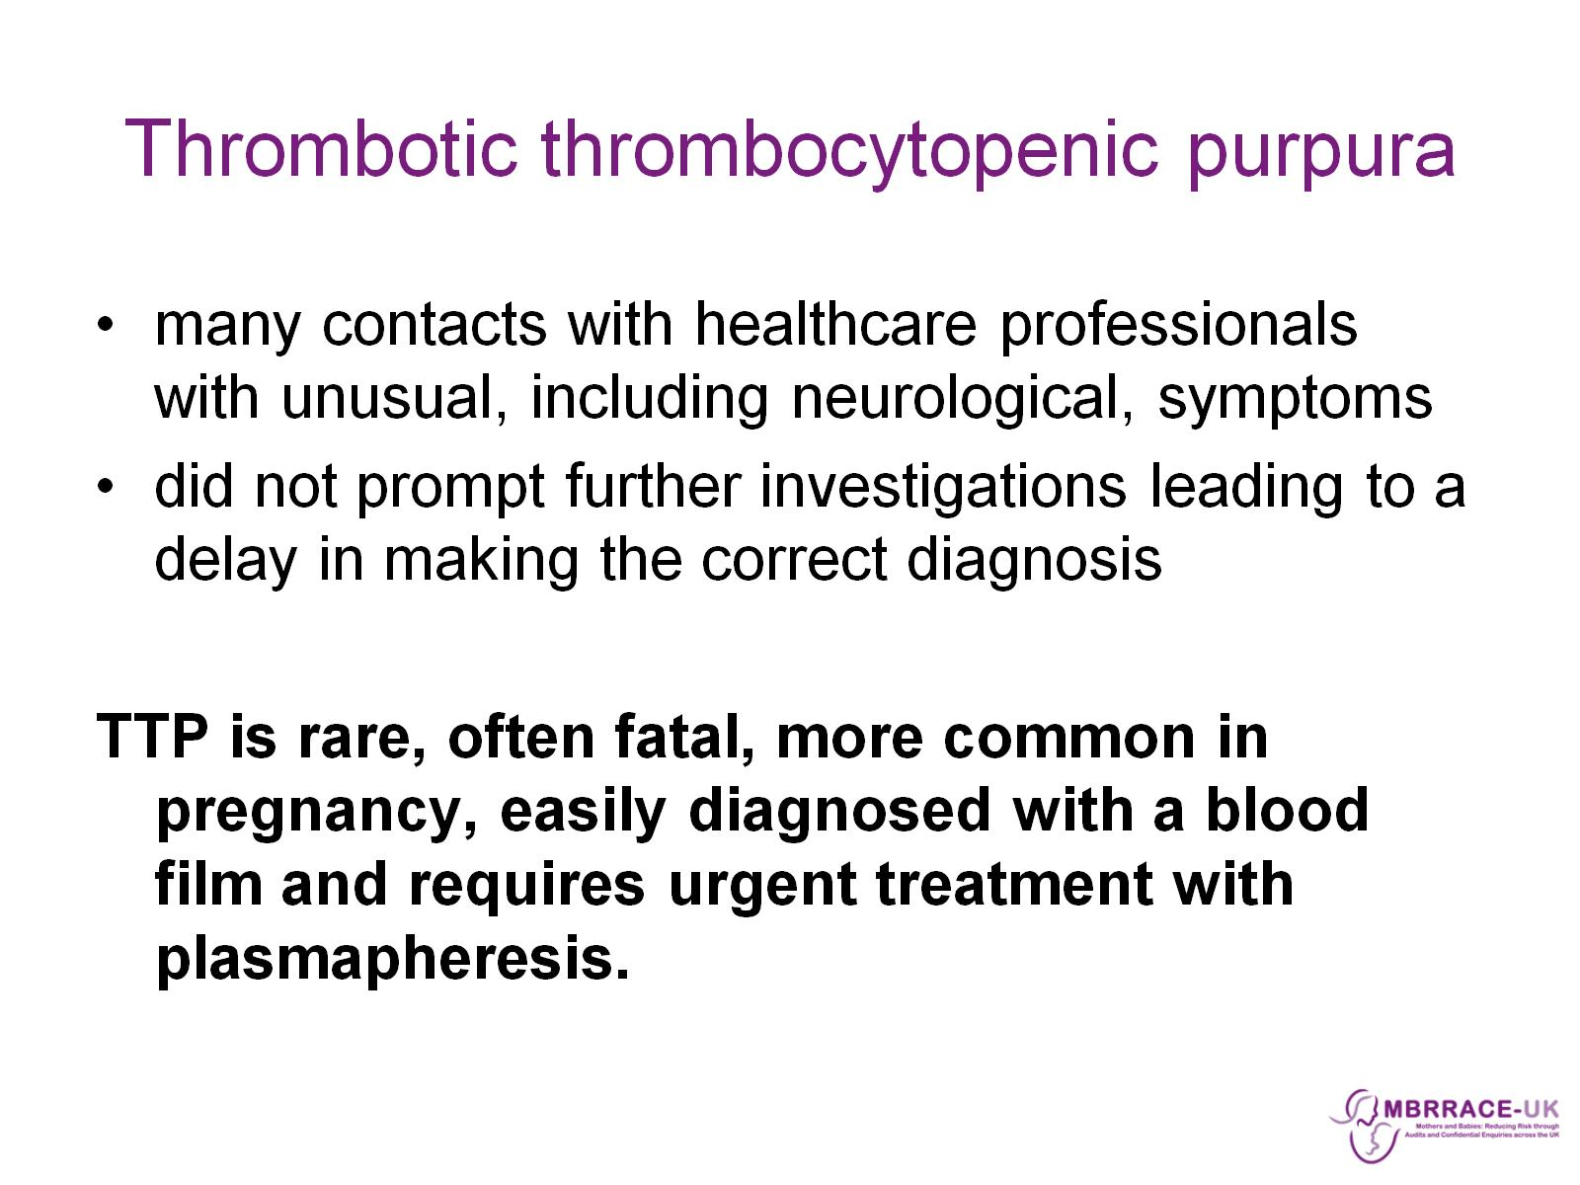
Thrombotic thrombocytopenic purpura

Slide 27
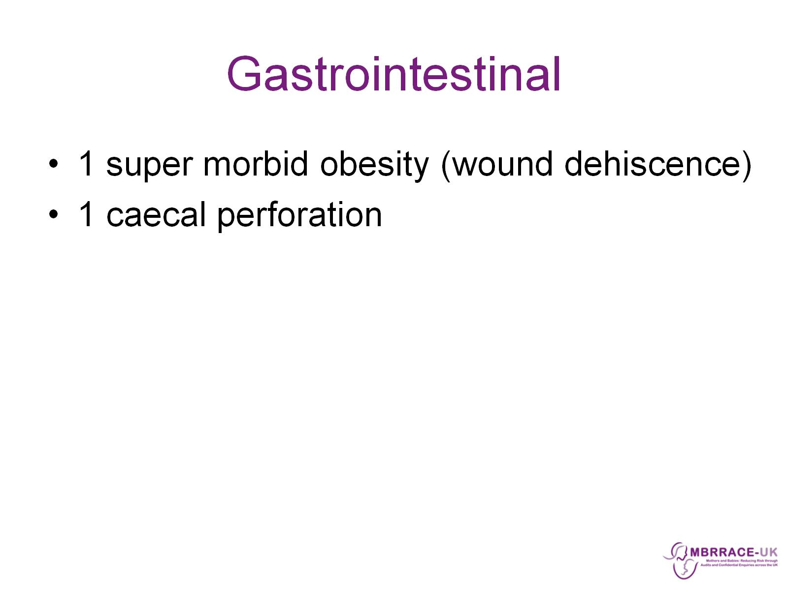
Gastrointestinal

Slide 28
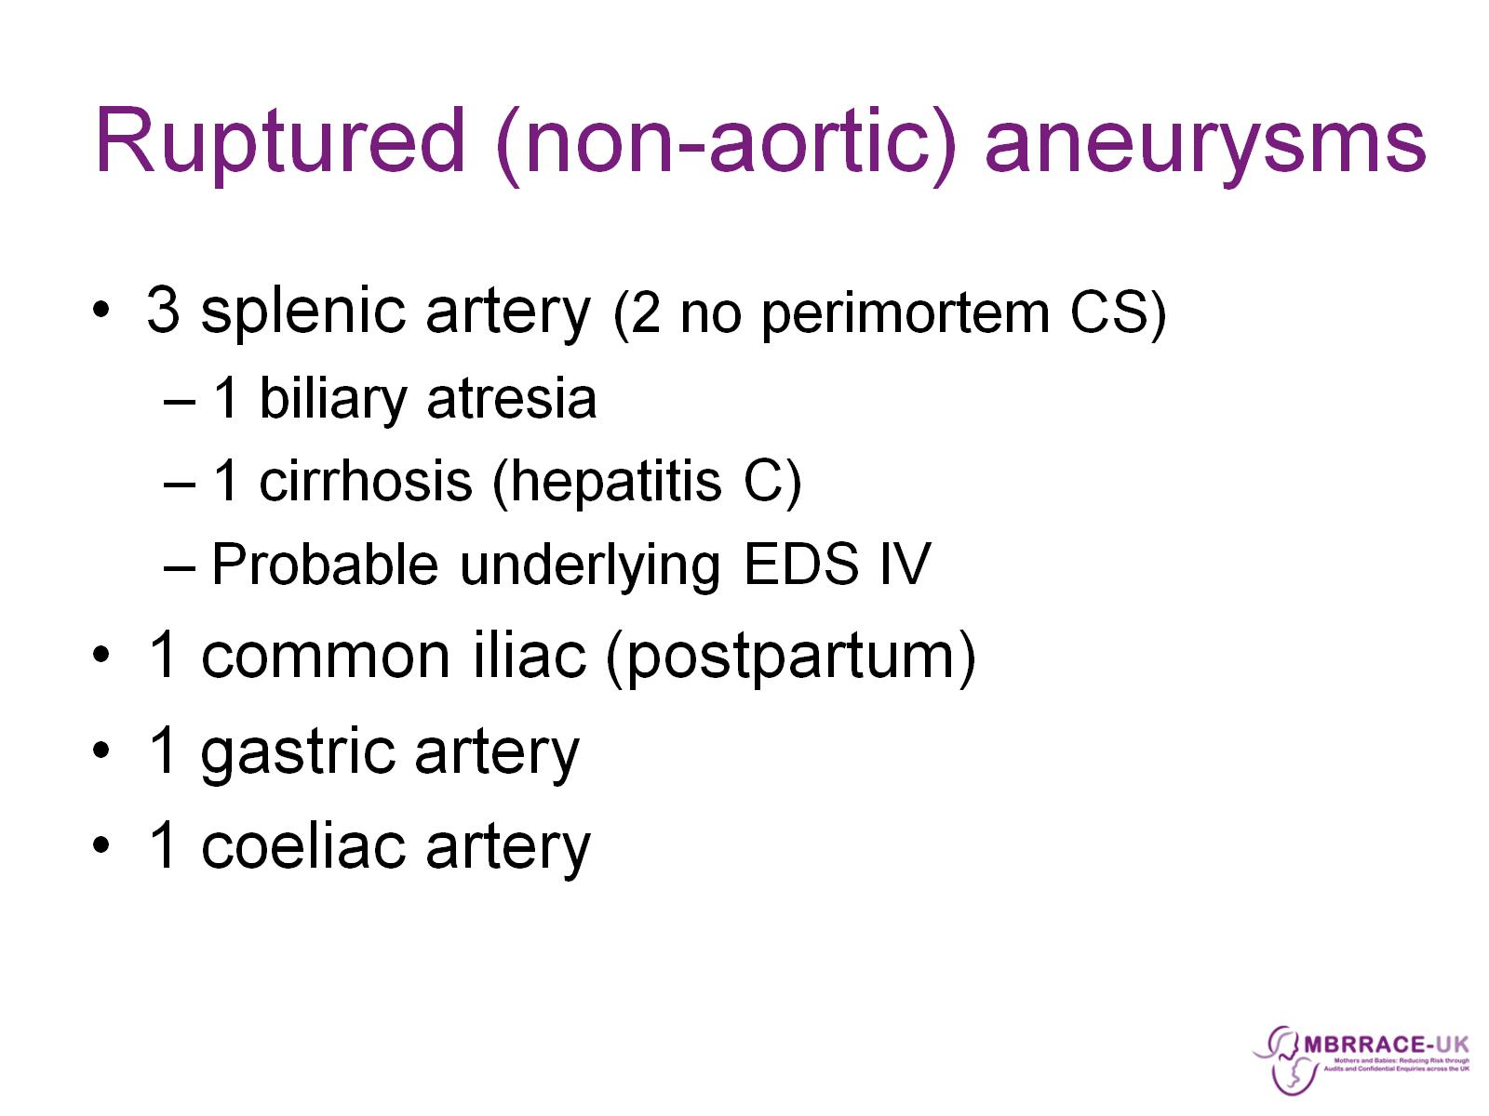
Ruptured (non-aortic) aneurysms

Slide 29
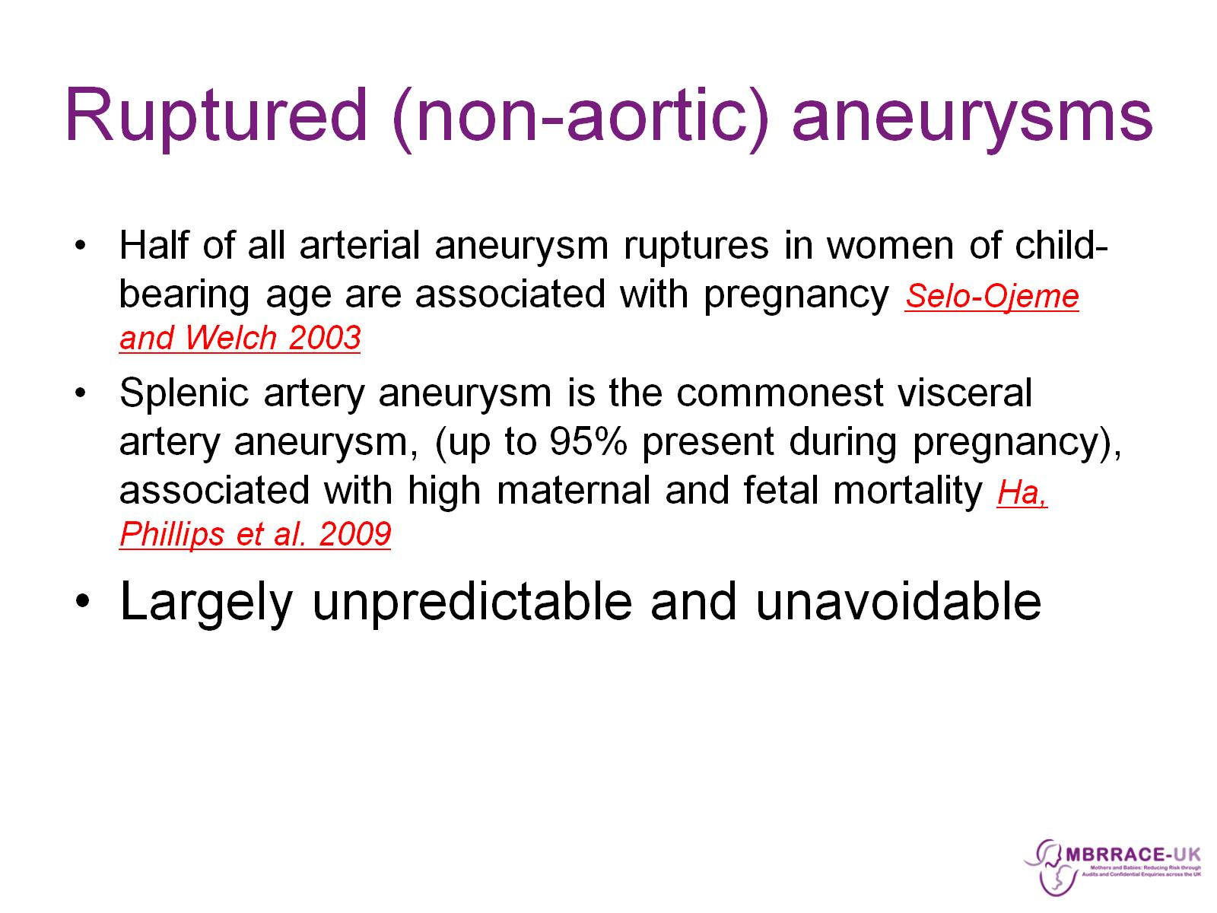
Ruptured (non-aortic) aneurysms

Slide 30
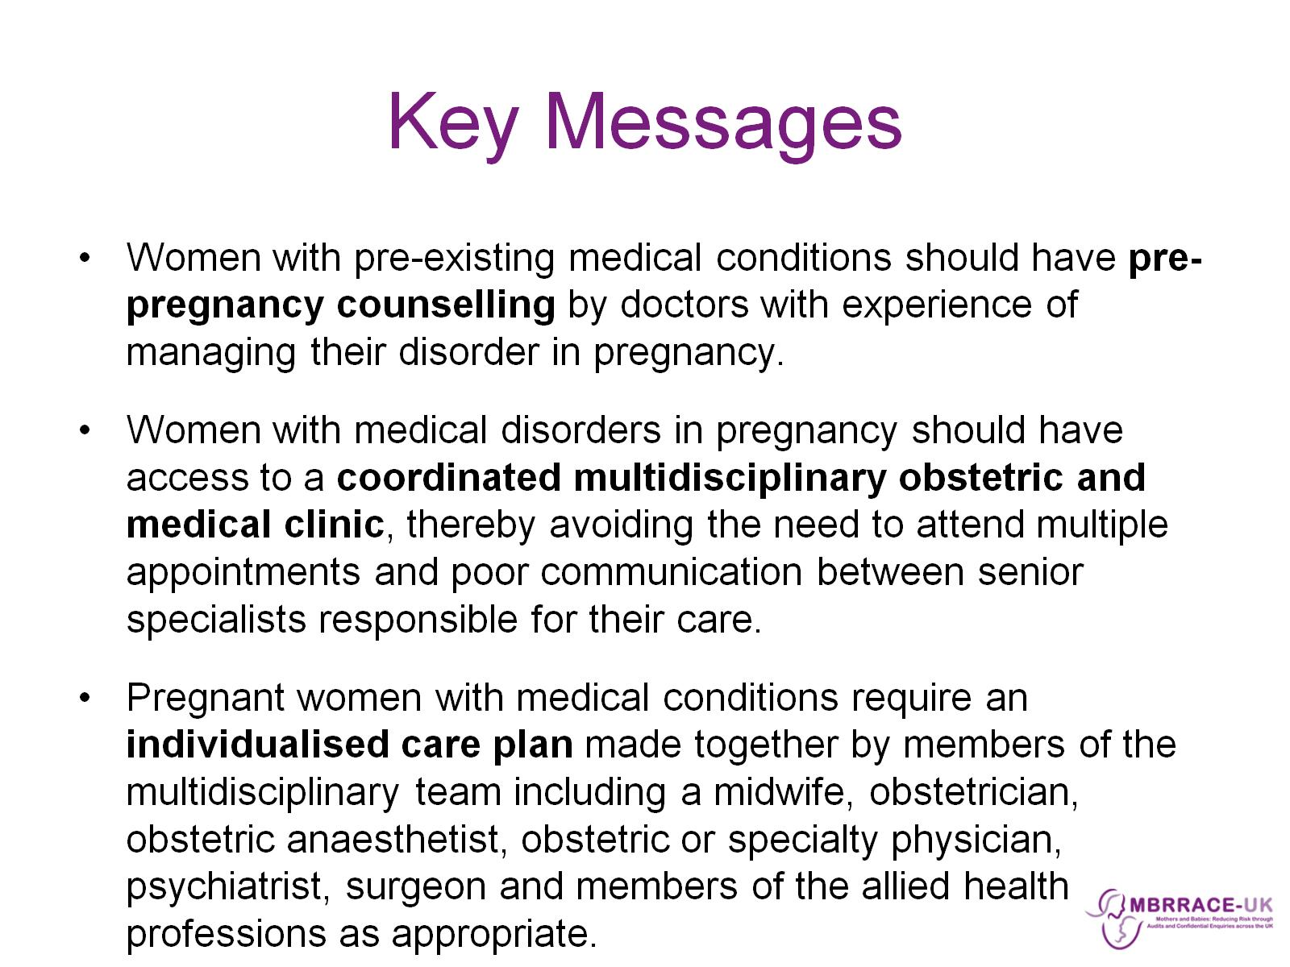
Key Messages

Slide 31
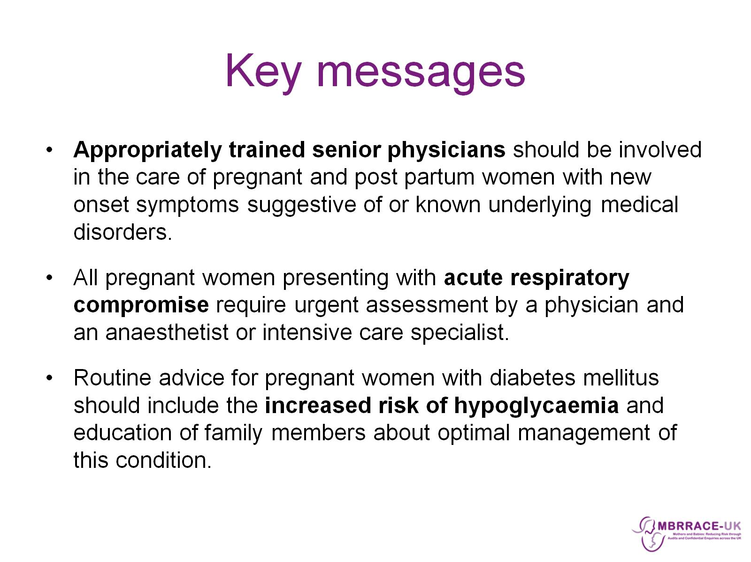
Key messages

Slide 32
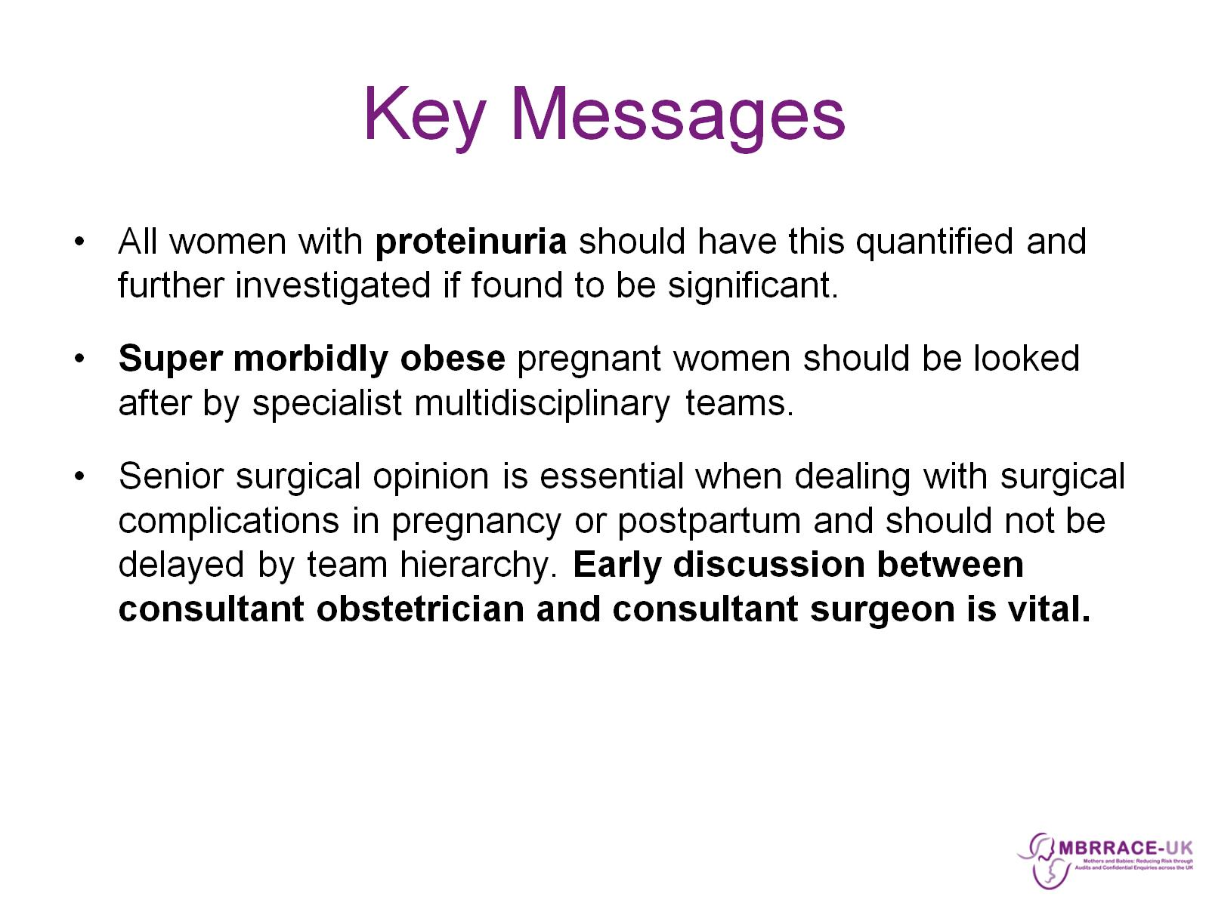
Key Messages

Slide 33
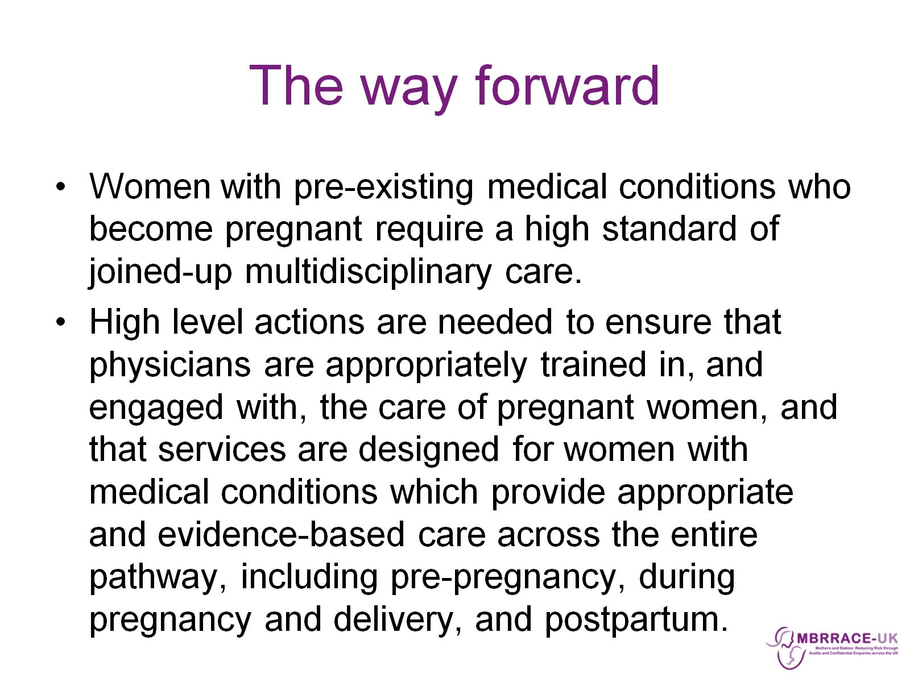
The way forward

Slide 34

http://www.e-lfh.org.uk/programmes/medical-problems-in-pregnancy/

Slide 35

Acknowledgements

Slide 36


