Slide 1
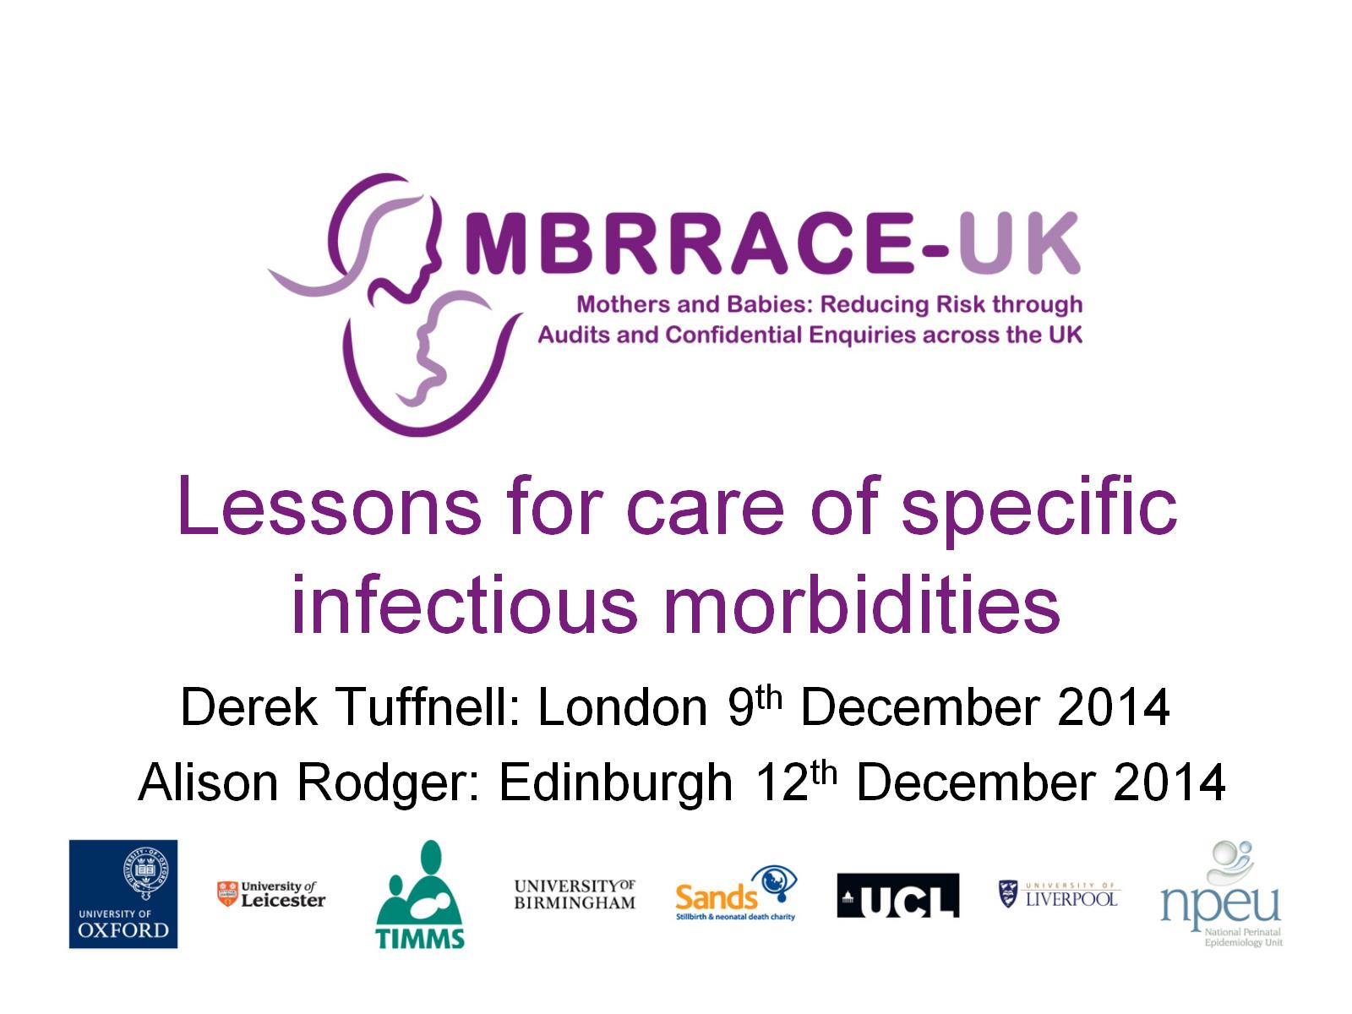
  Lessons for care of specific infectious morbidities

Slide 2
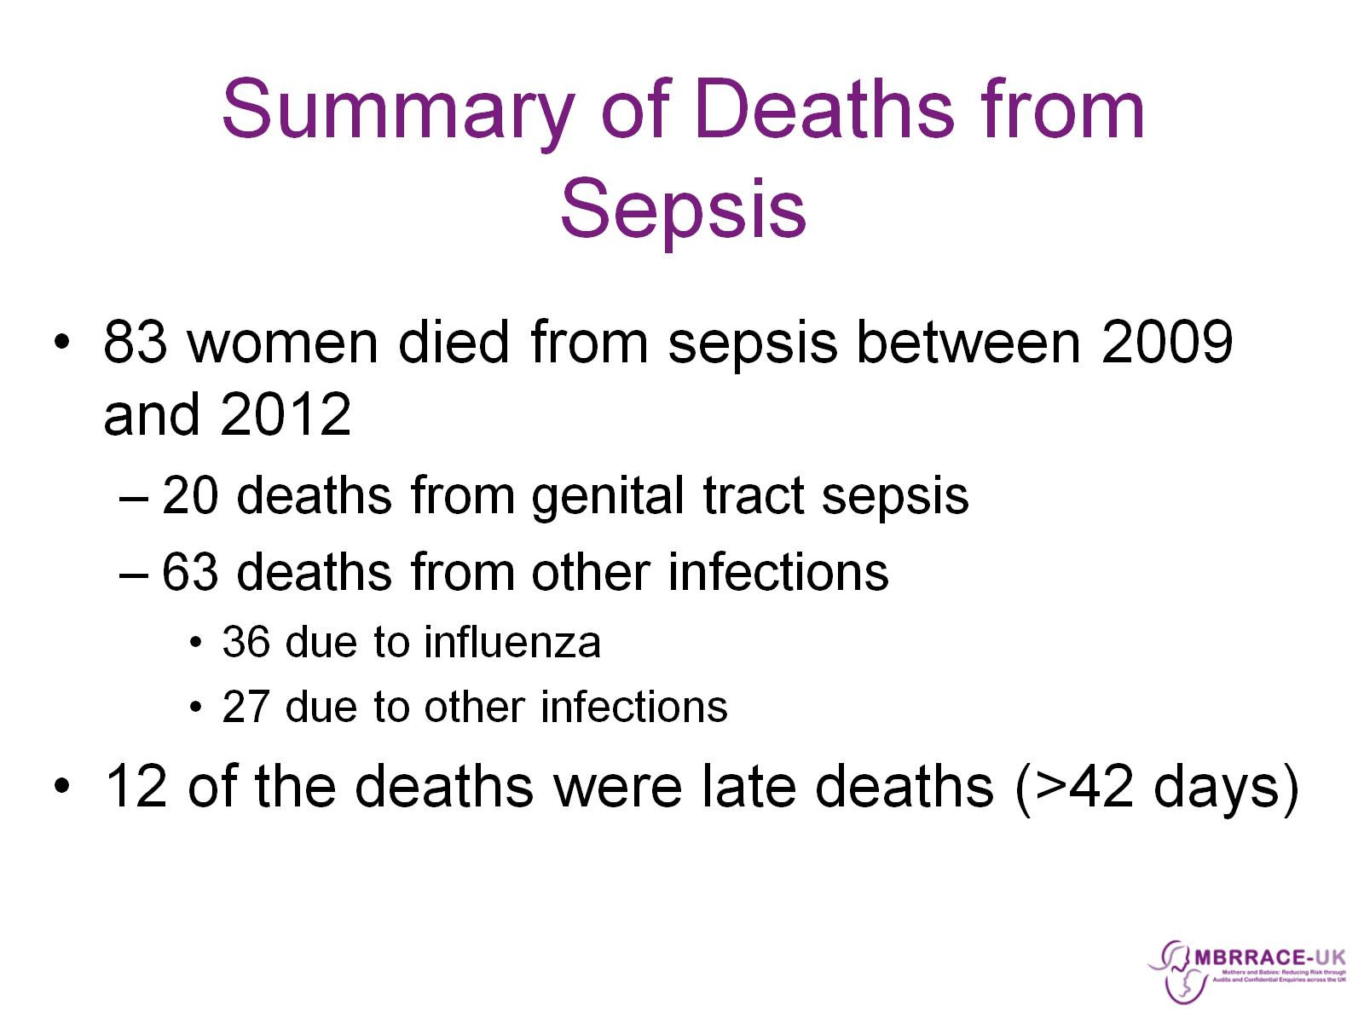

Slide 3
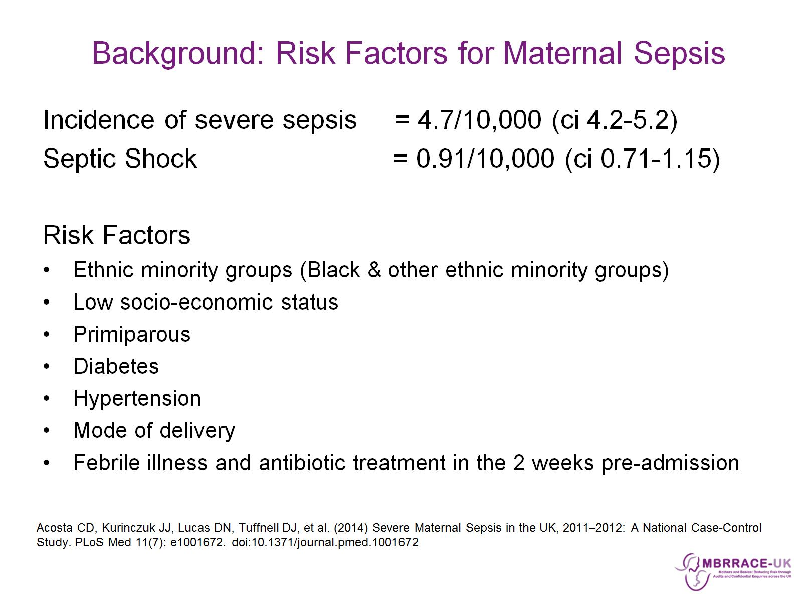

Slide 4
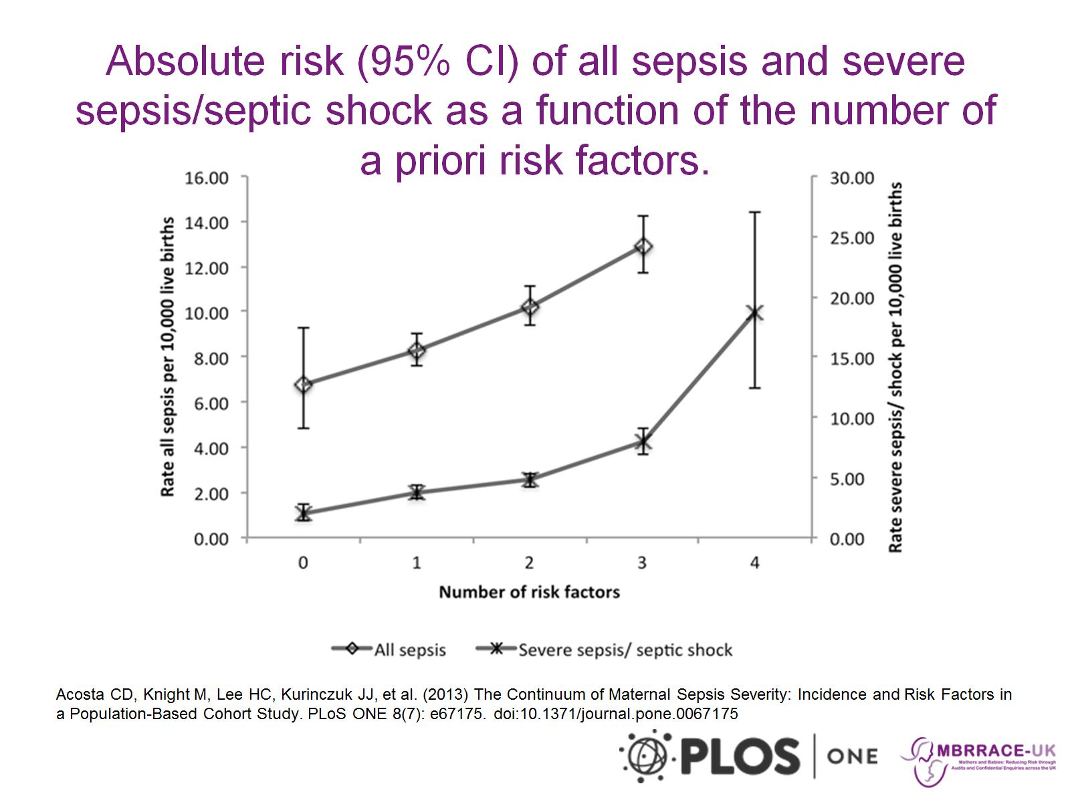

Slide 5
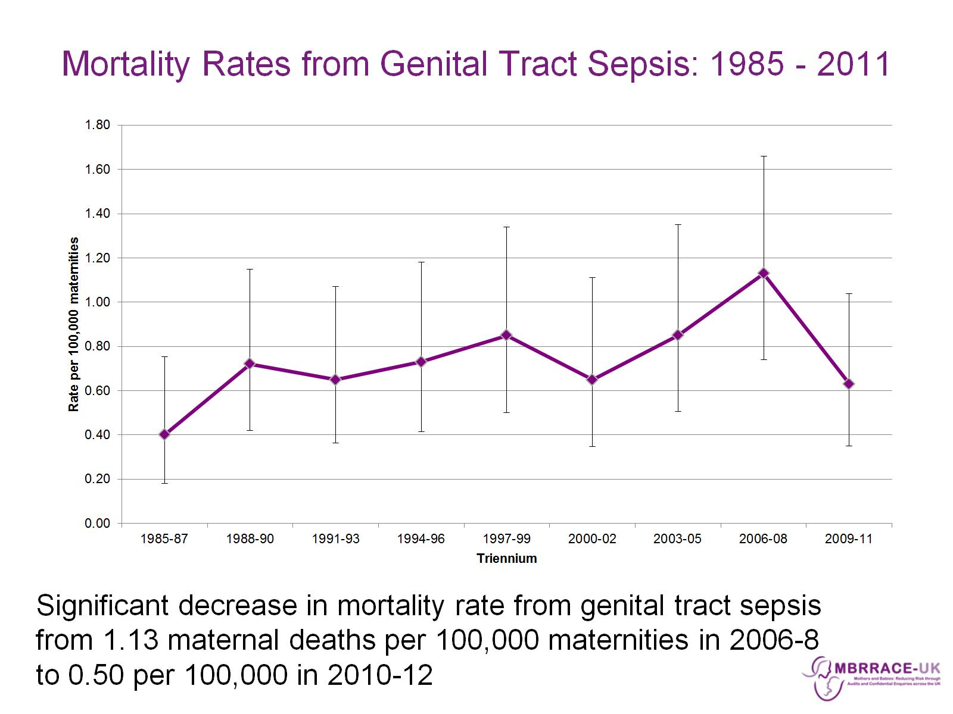
Mortality Rates from Genital Tract Sepsis: 1985 - 2011

Slide 6
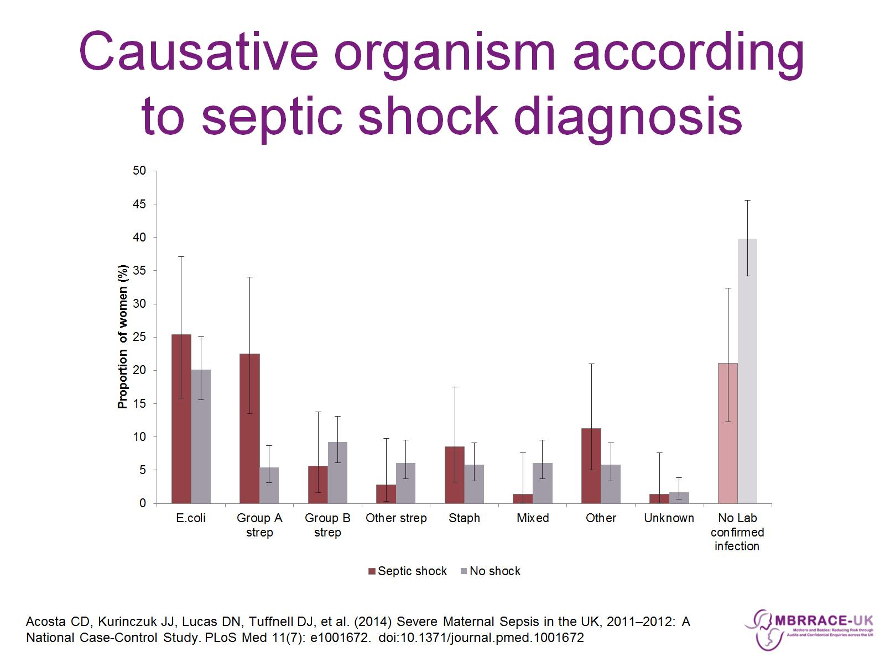
Causative organism according to septic shock diagnosis

Slide 7
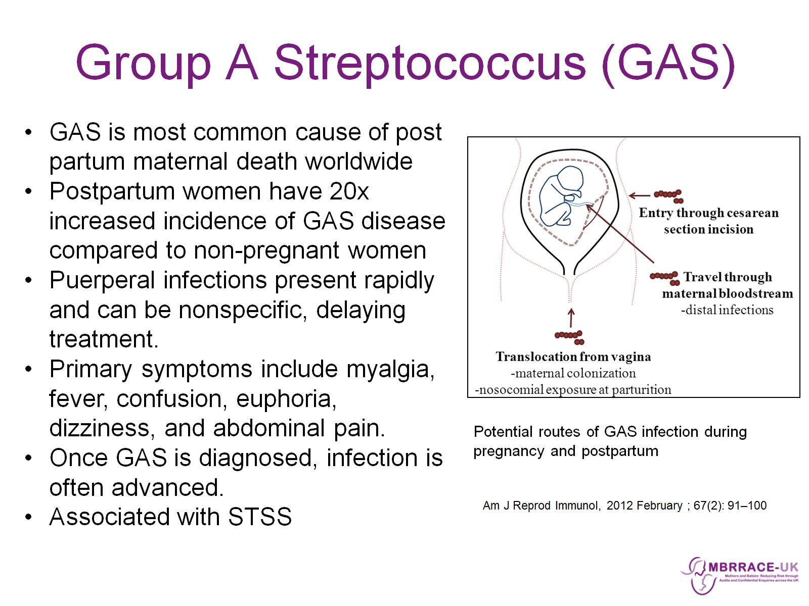
Group A Streptococcus (GAS)

Slide 8
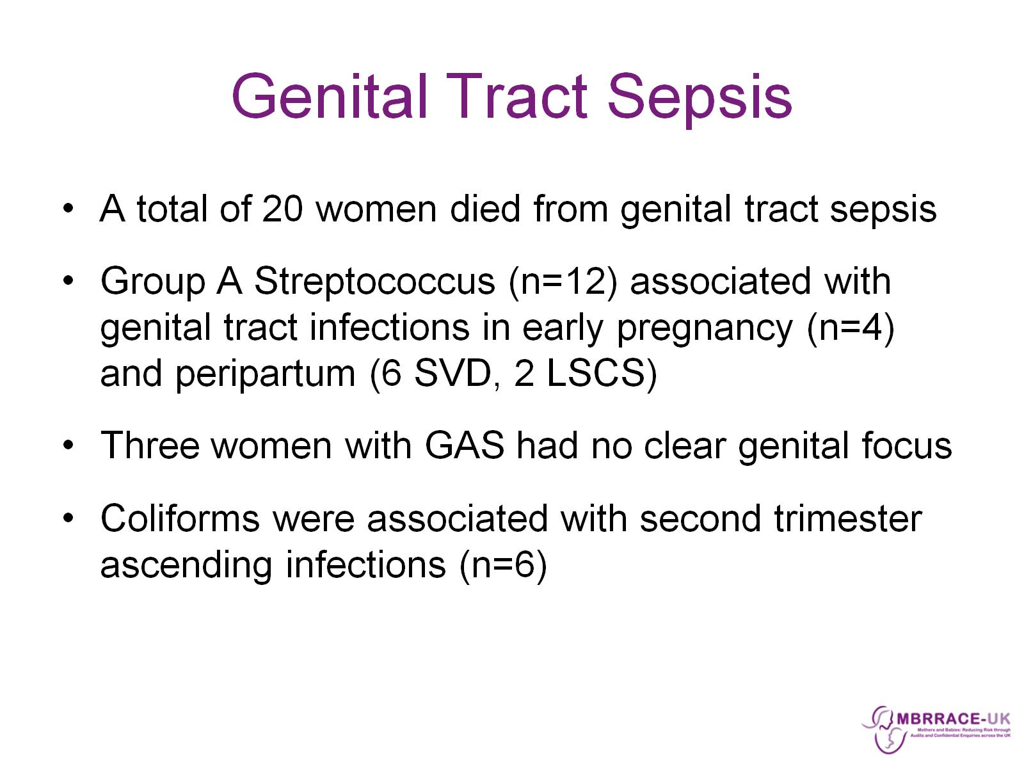
Genital Tract Sepsis

Slide 9
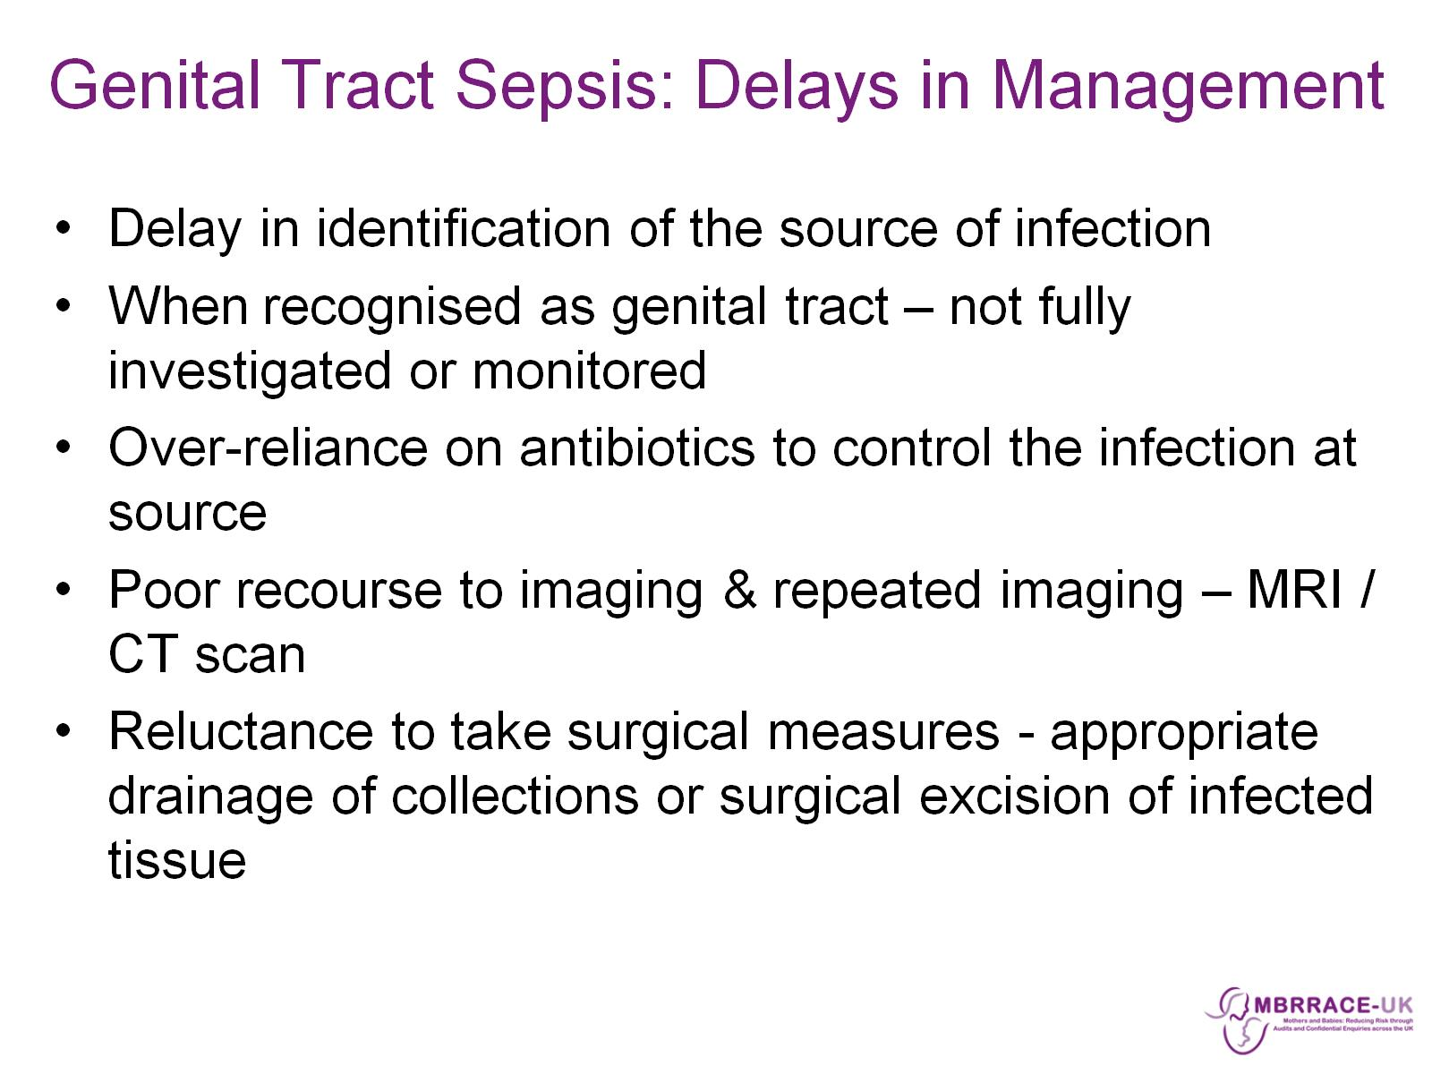
Genital Tract Sepsis: Delays in Management

Slide 10
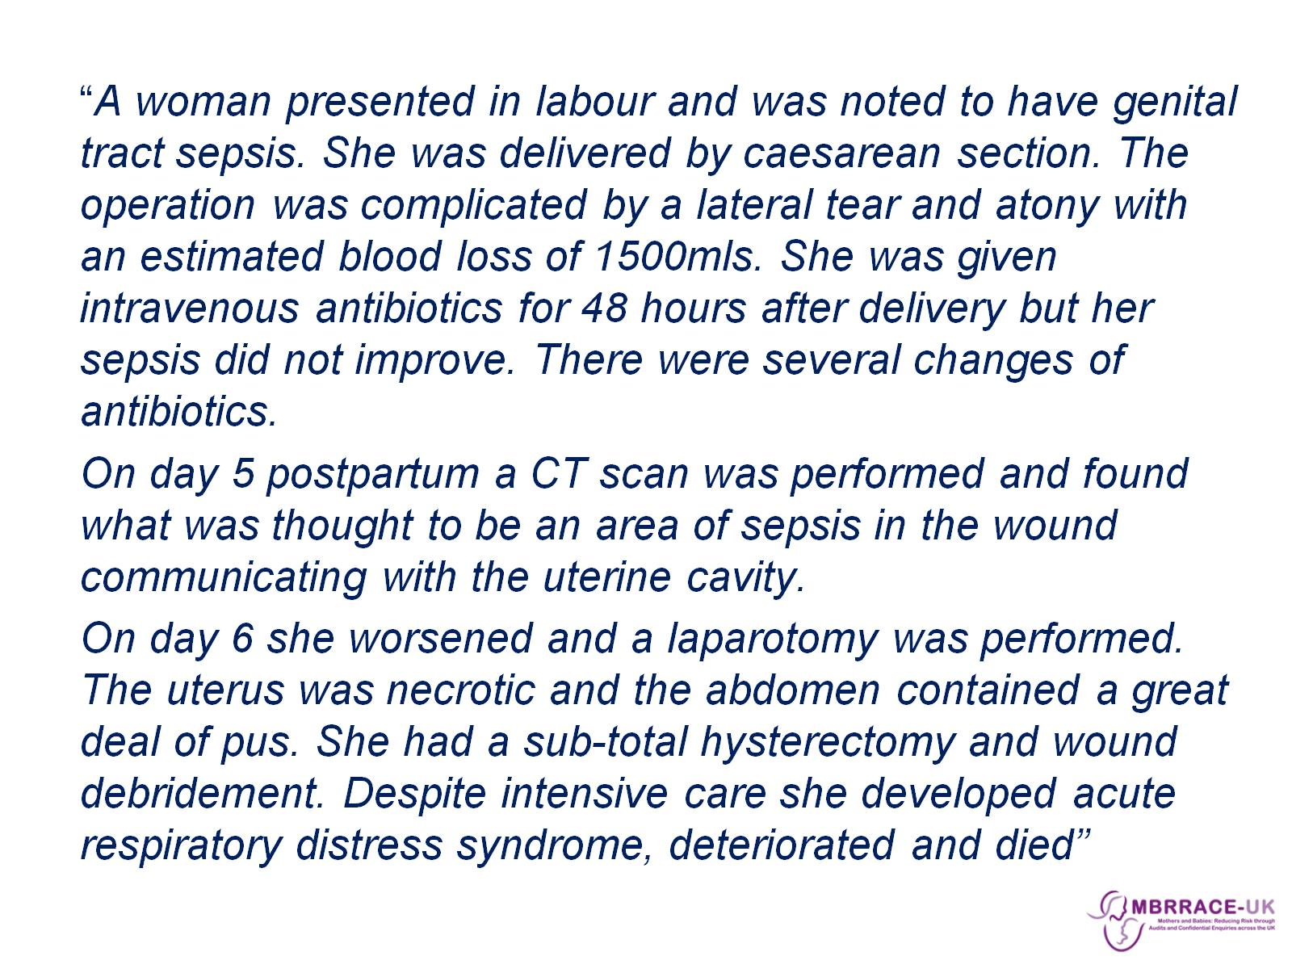

Slide 11
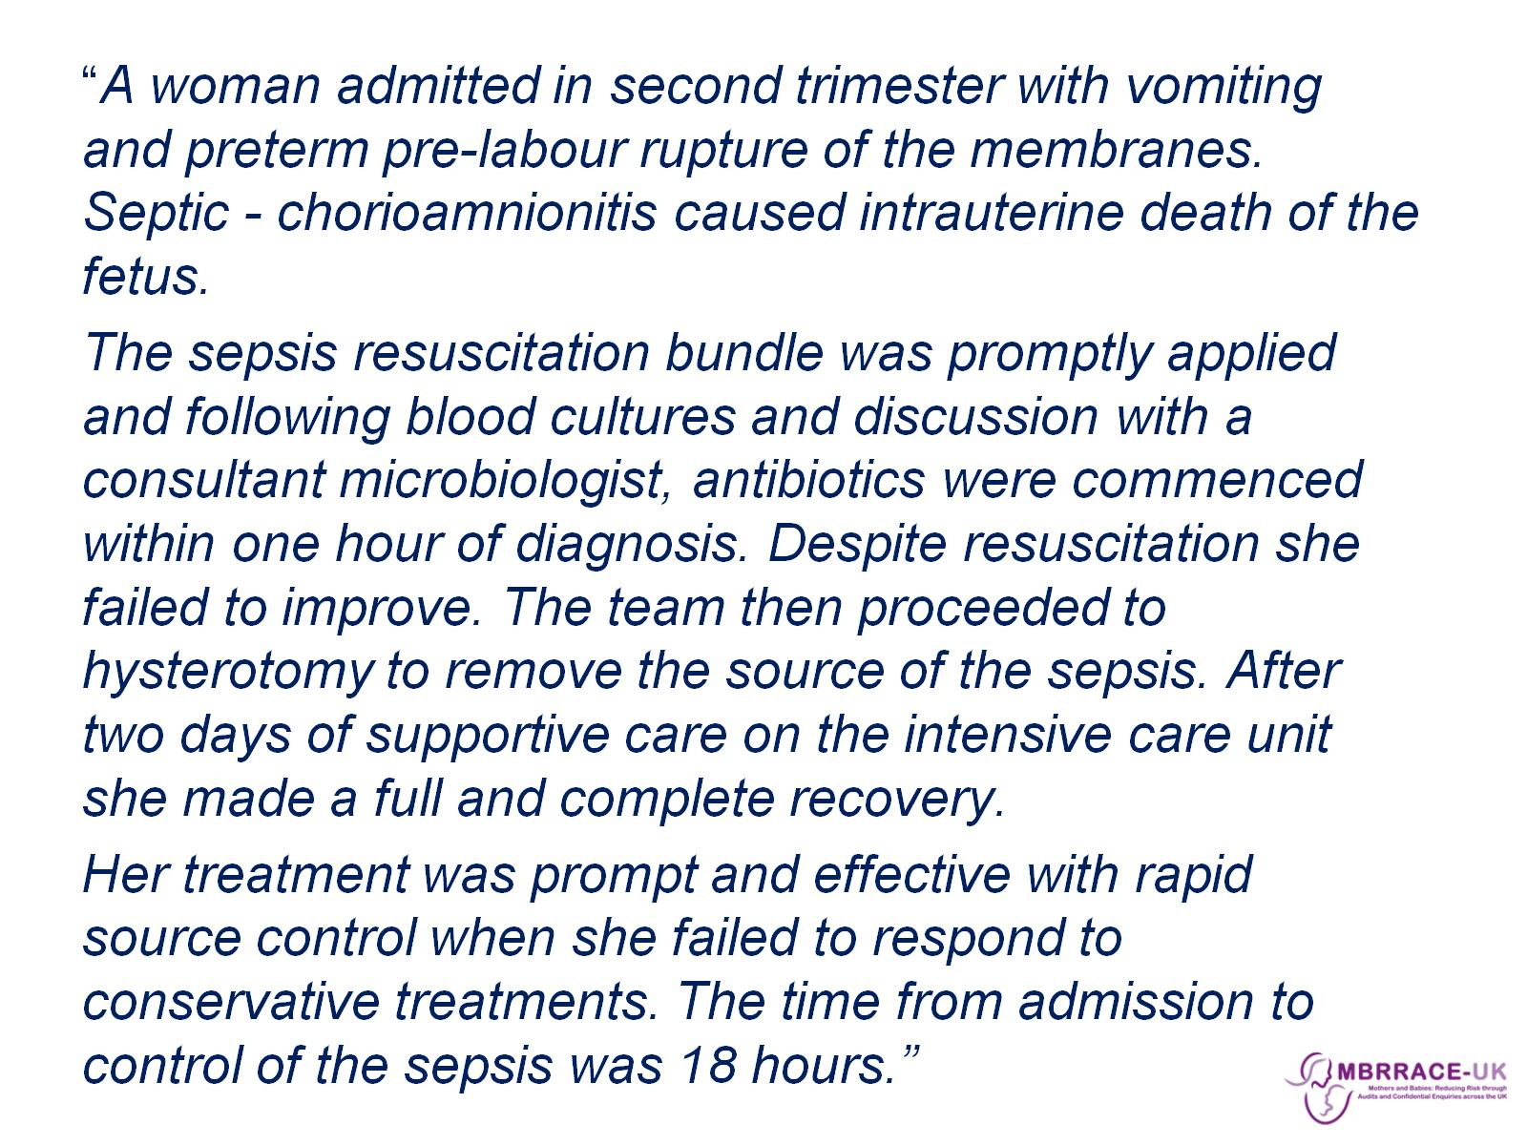

Slide 12
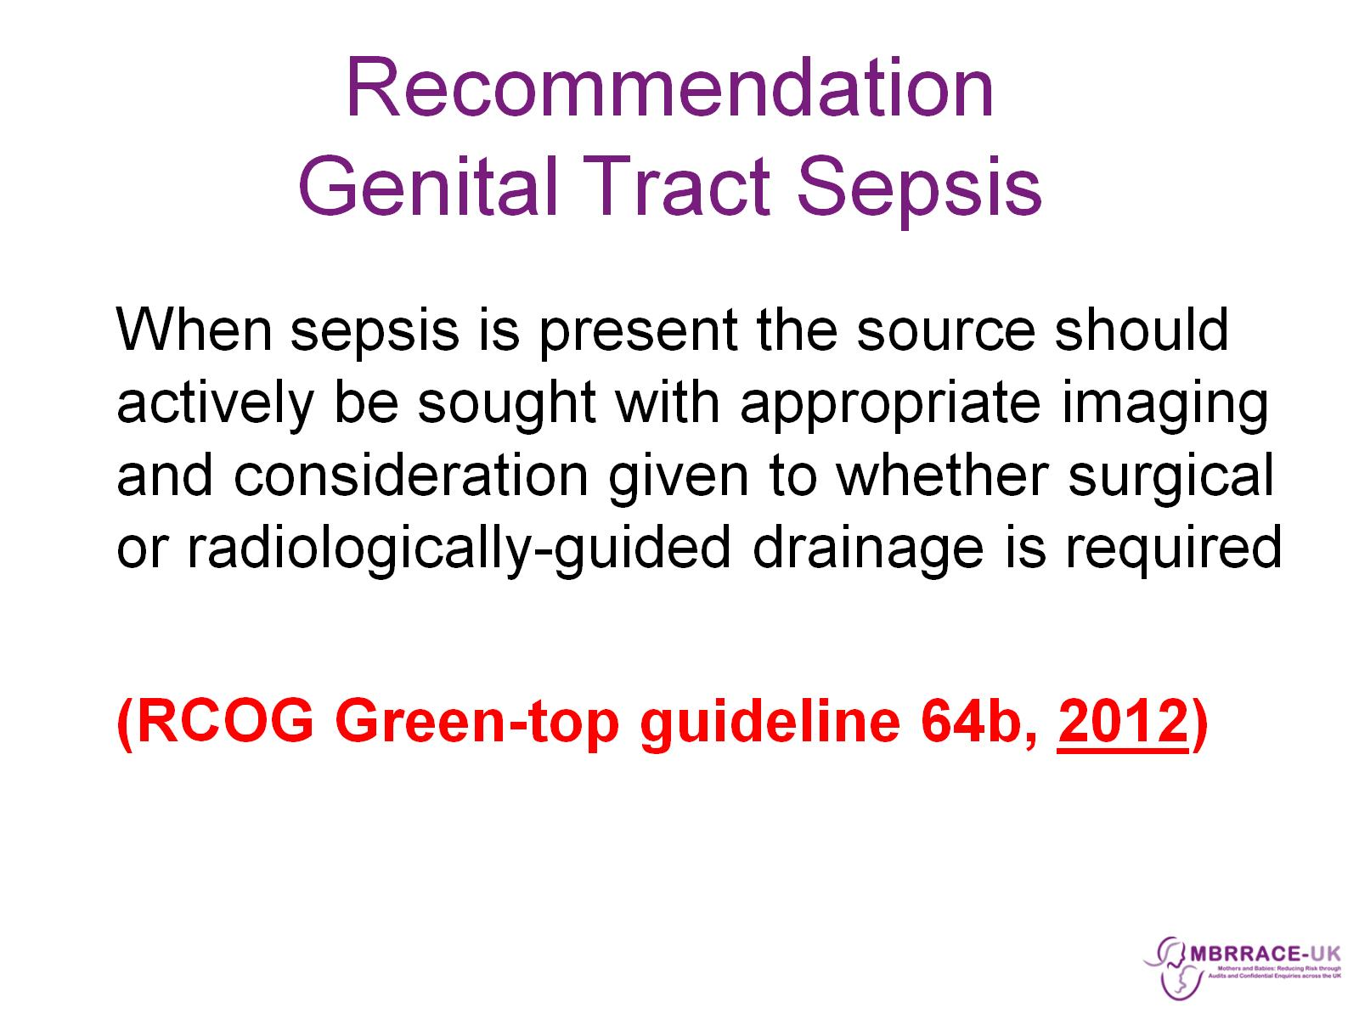
Recommendation
Genital Tract Sepsis

Slide 13
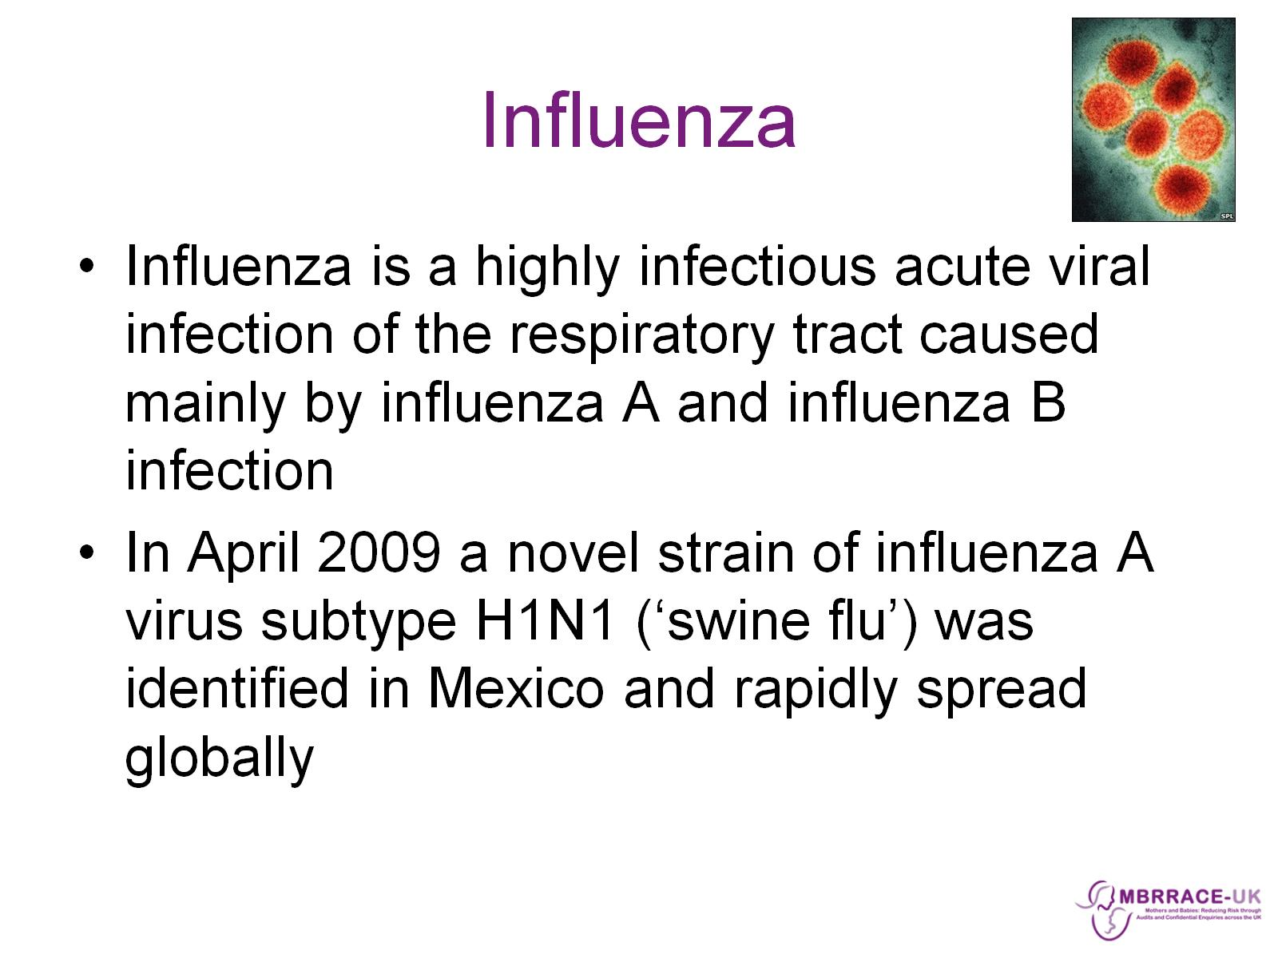
Influenza

Slide 14
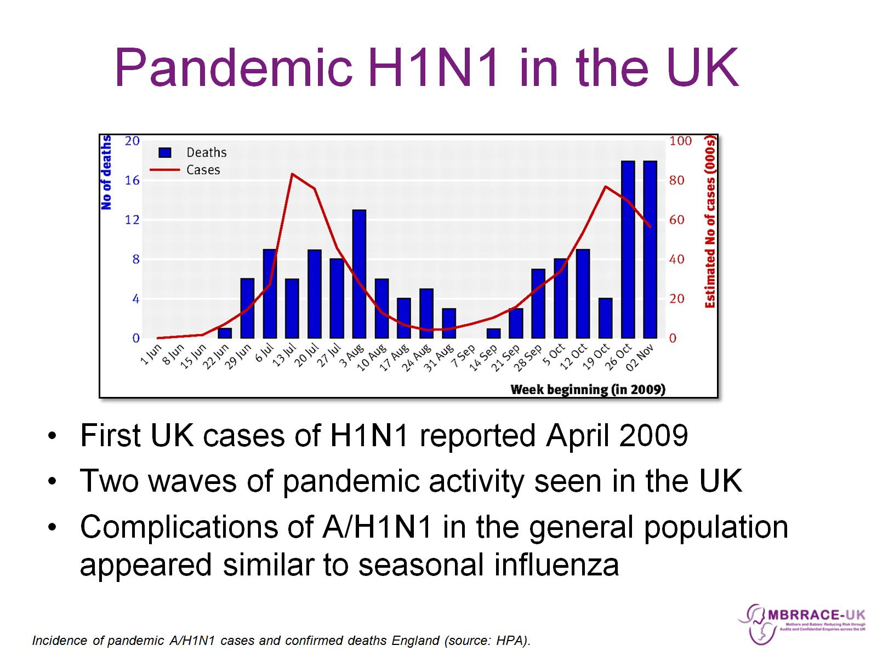
Pandemic H1N1 in the UK

Slide 15
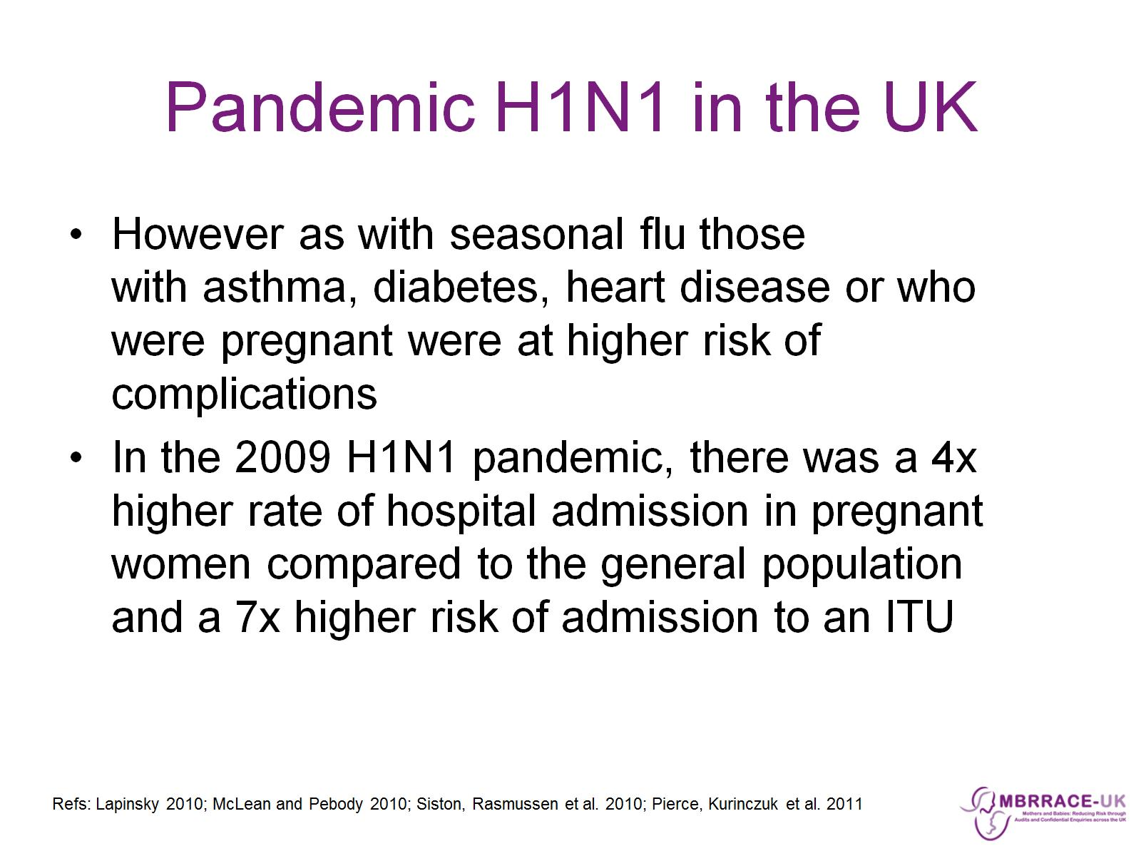
Pandemic H1N1 in the UK

Slide 16
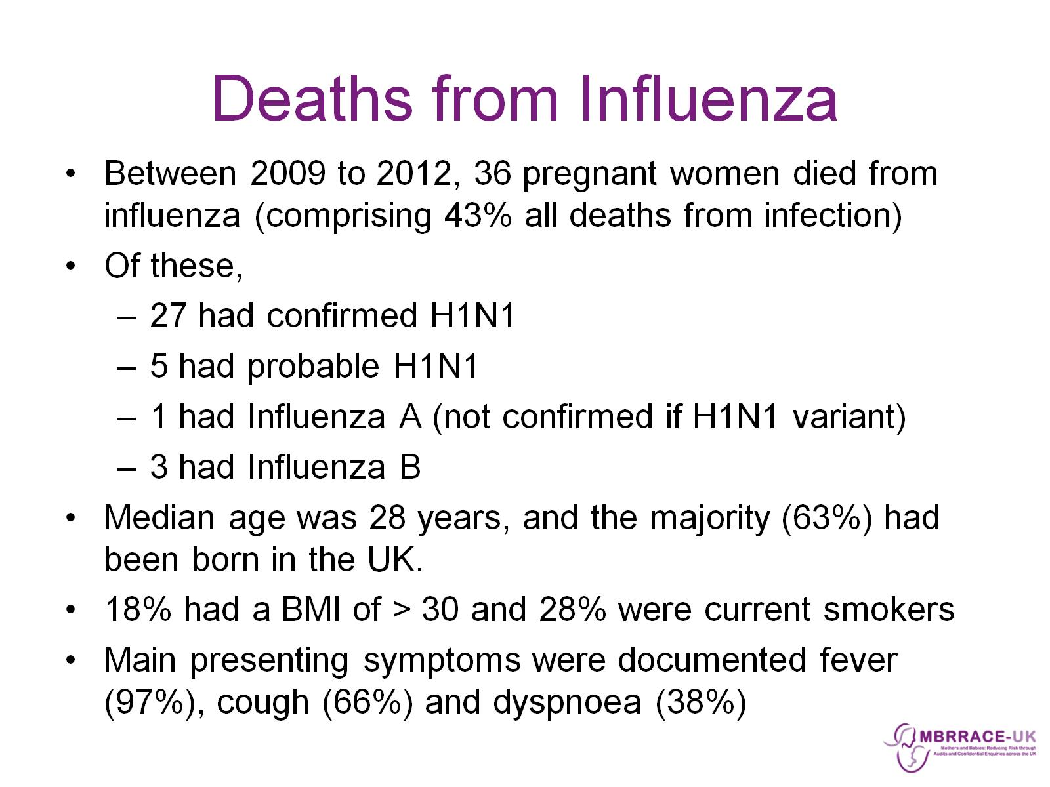
Deaths from Influenza

Slide 17
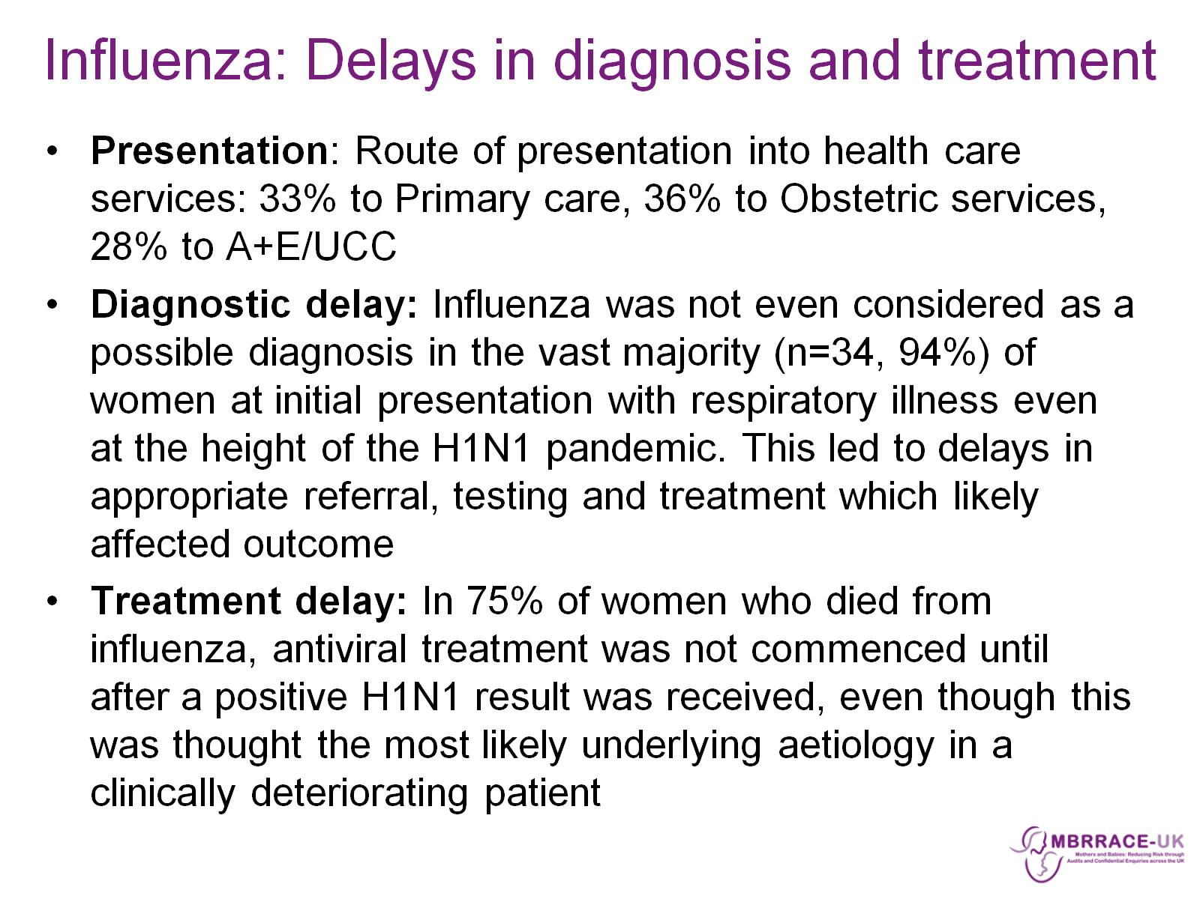
Influenza: Delays in diagnosis and treatment

Slide 18
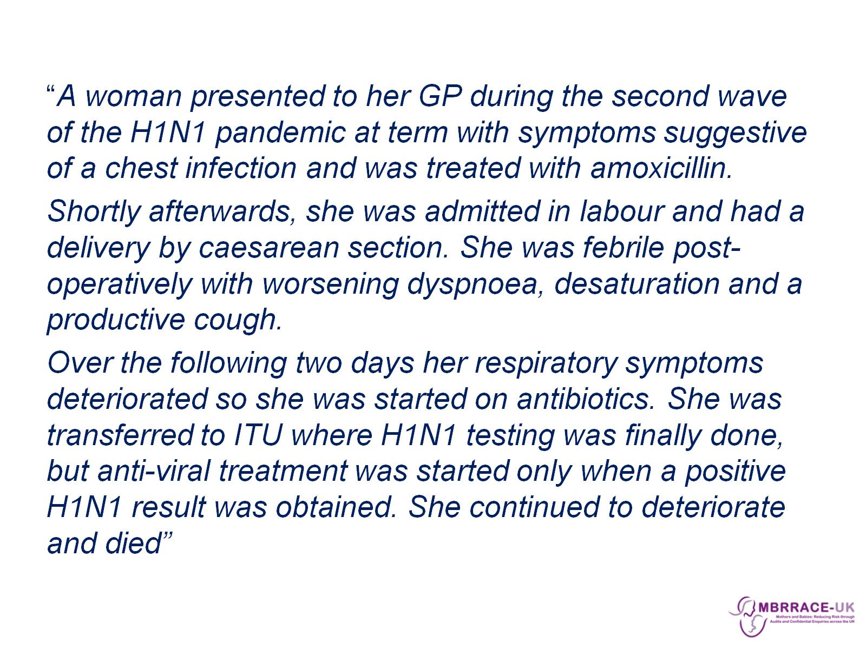

Slide 19
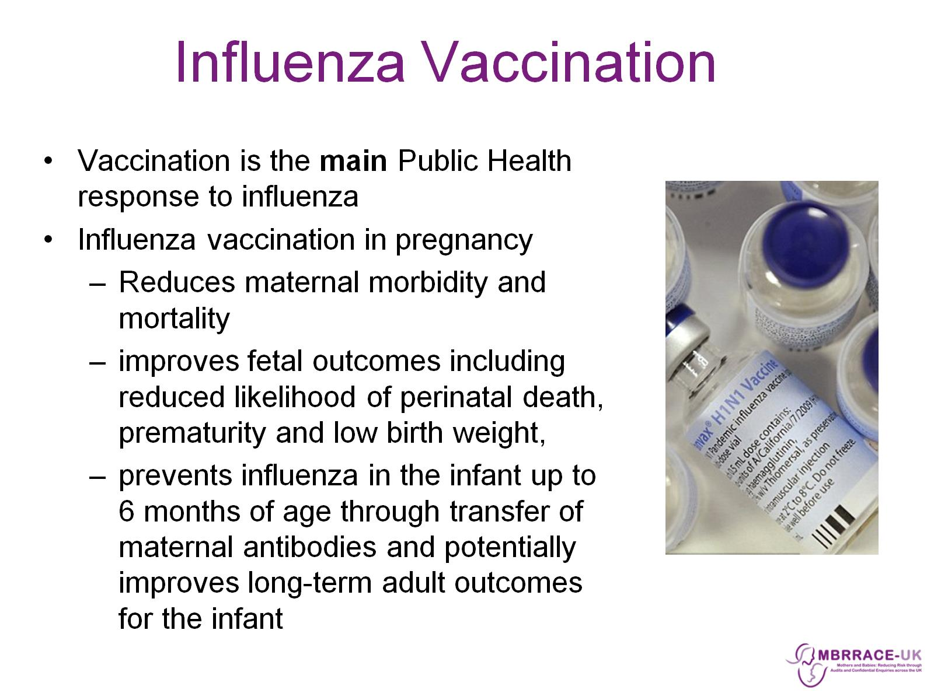
Influenza Vaccination

Slide 20
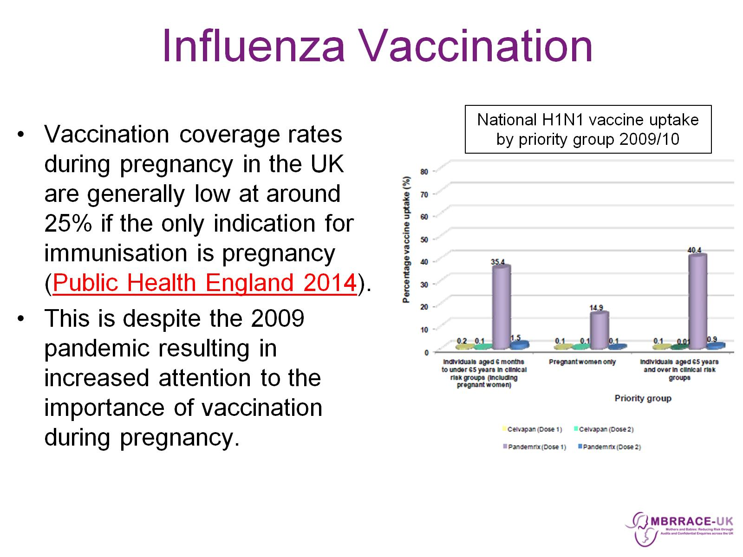
Influenza Vaccination

Slide 21
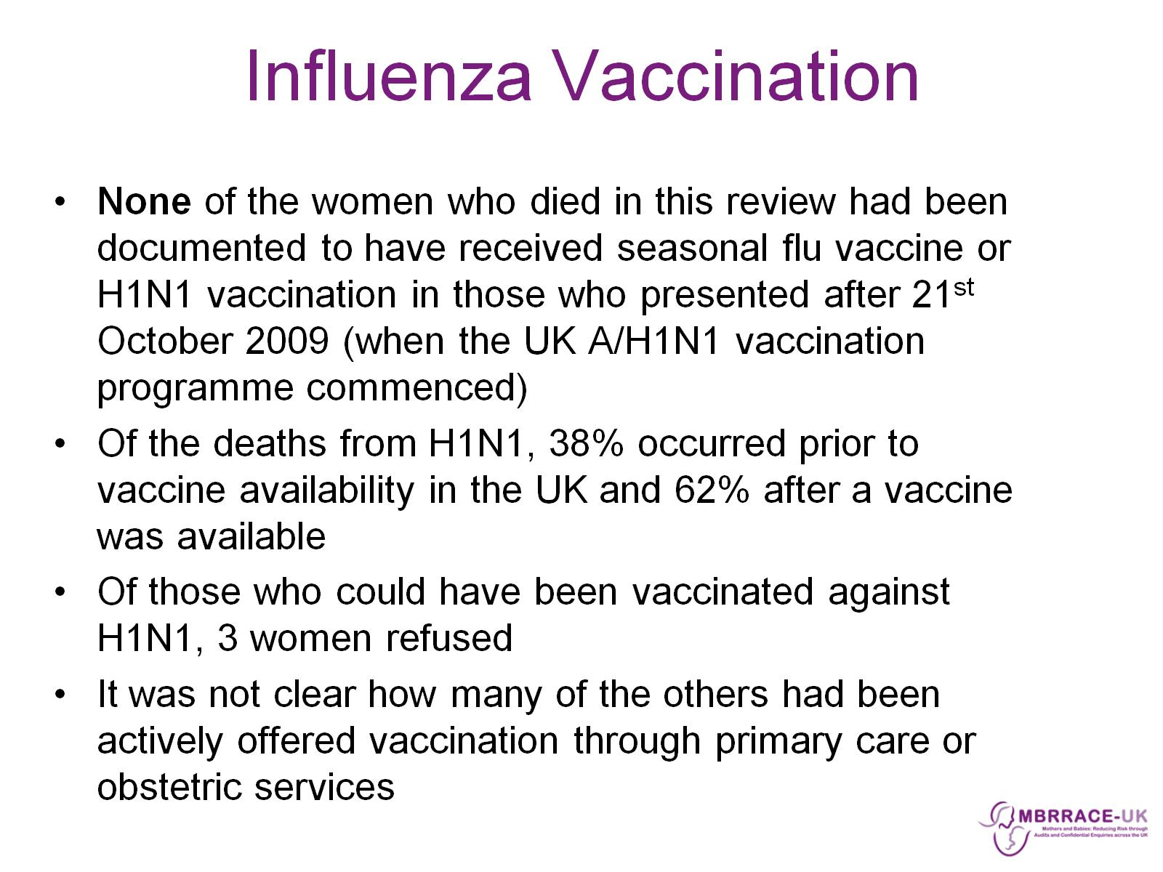
Influenza Vaccination

Slide 22
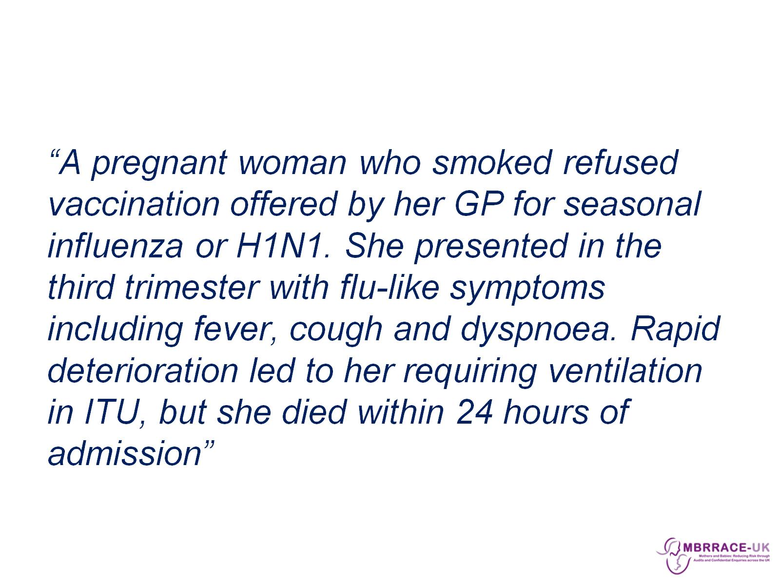

Slide 23
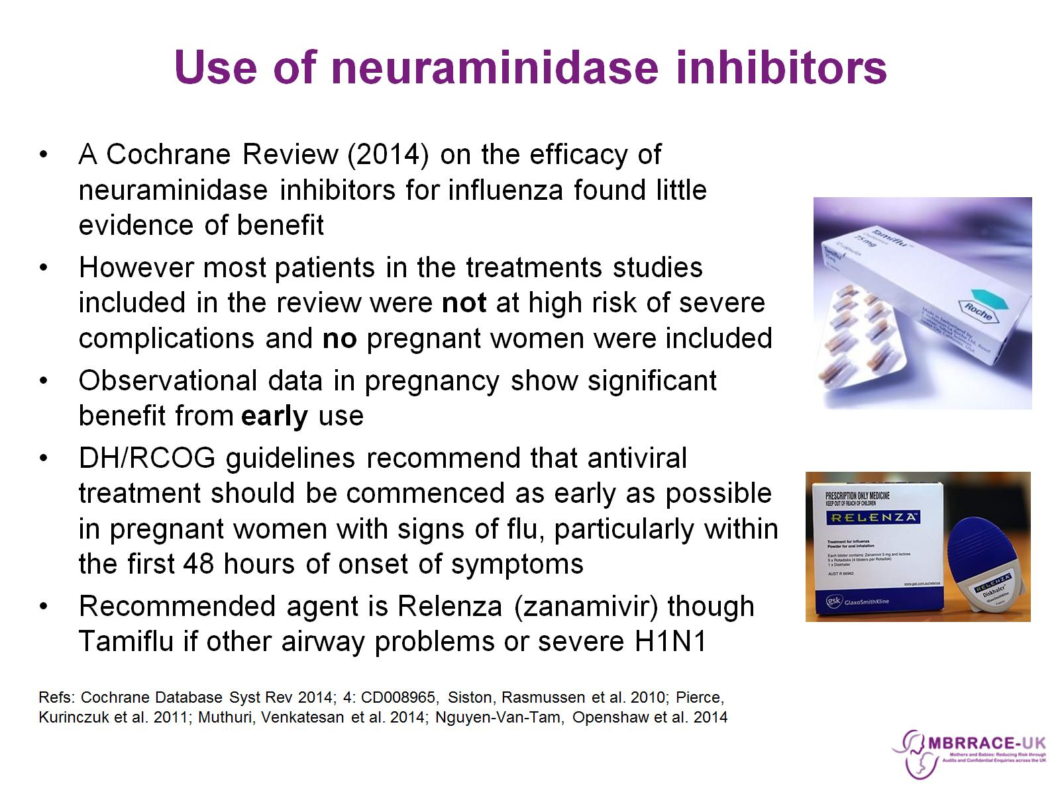
Use of neuraminidase inhibitors

Slide 24
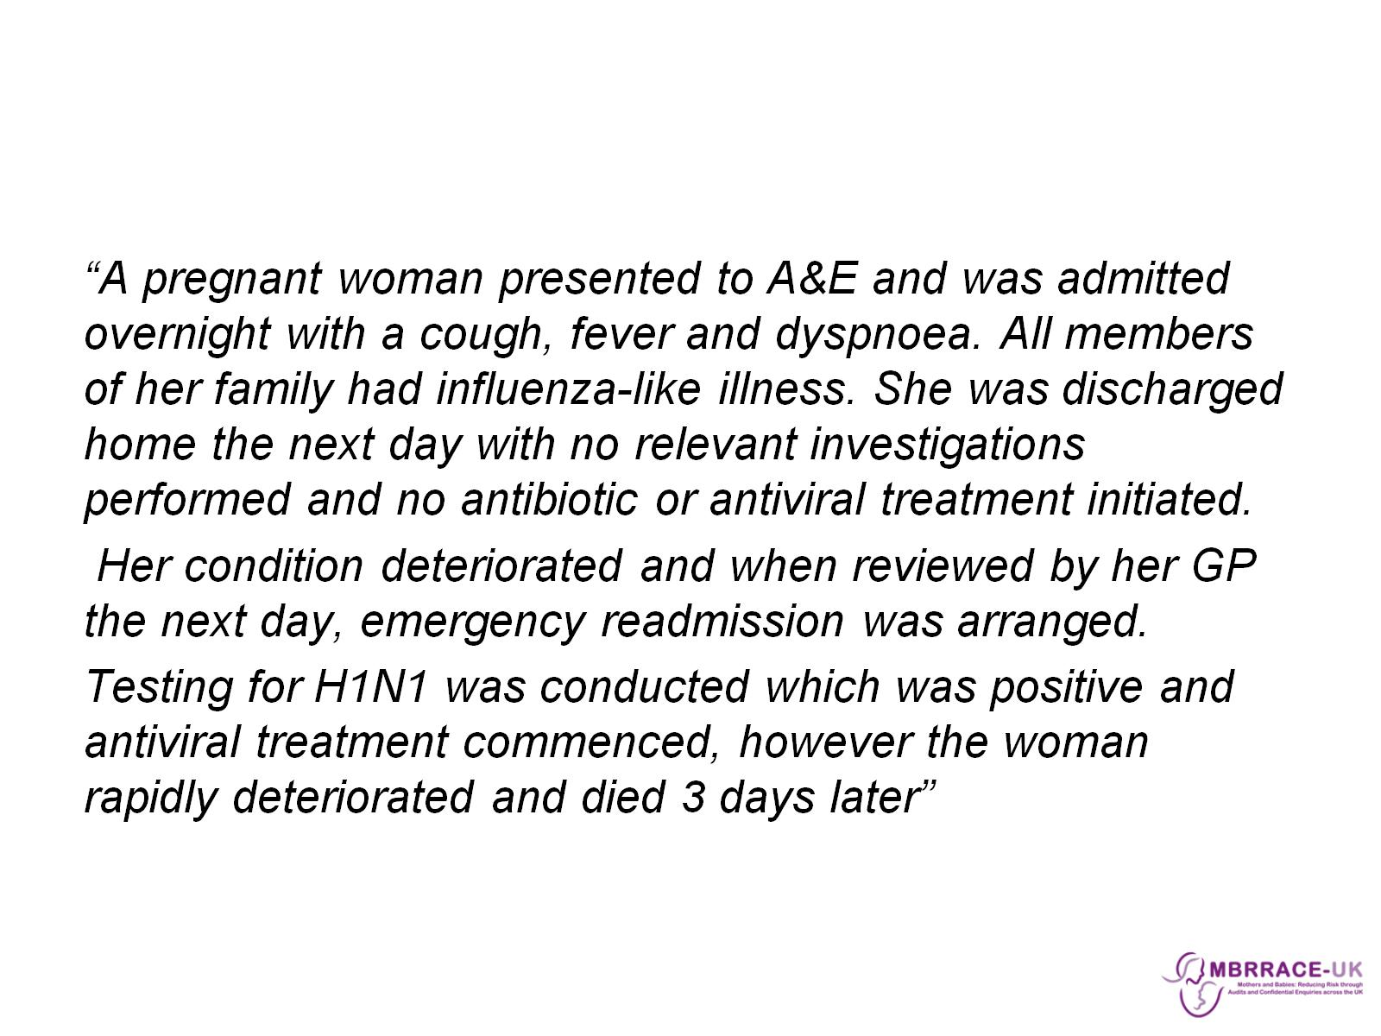

Slide 25
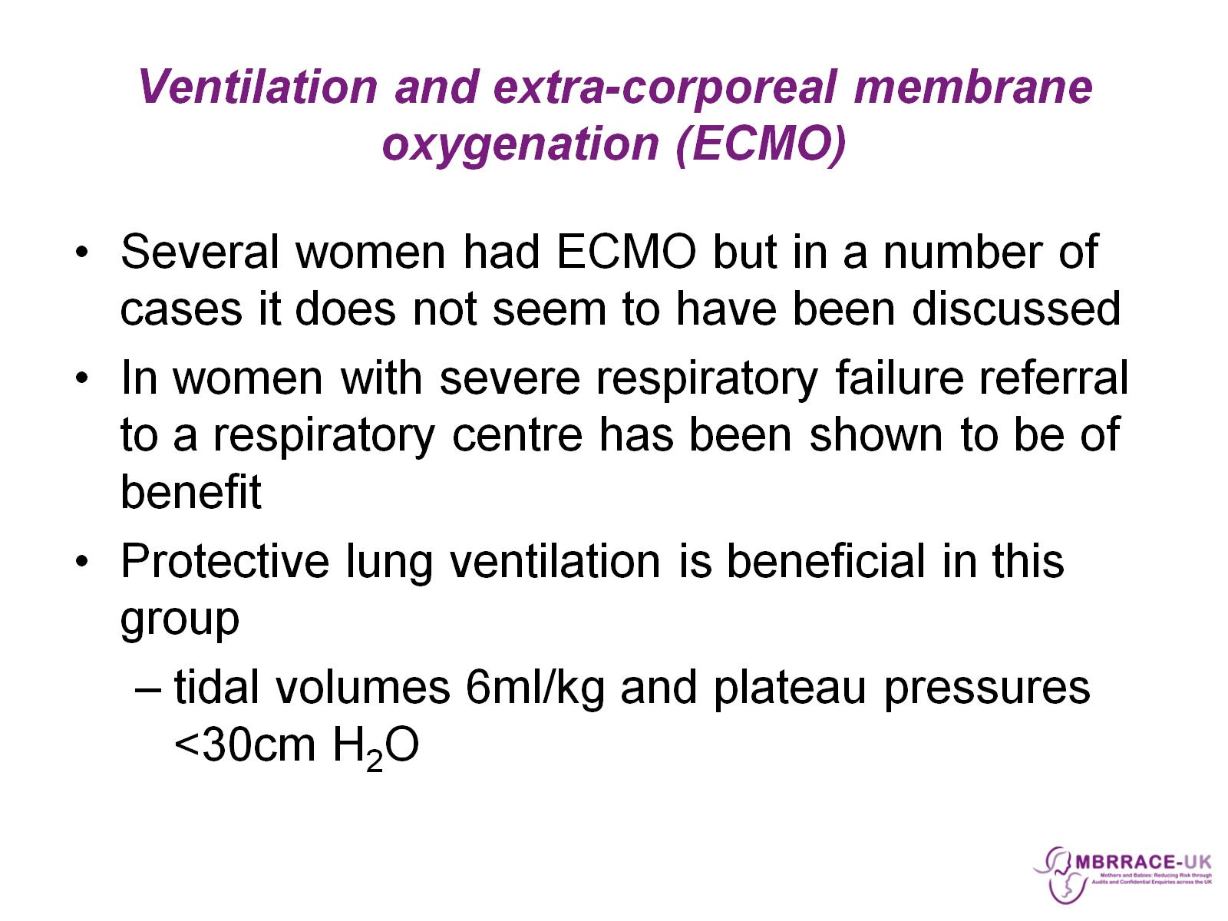
Ventilation and extra-corporeal membrane oxygenation (ECMO)

Slide 26
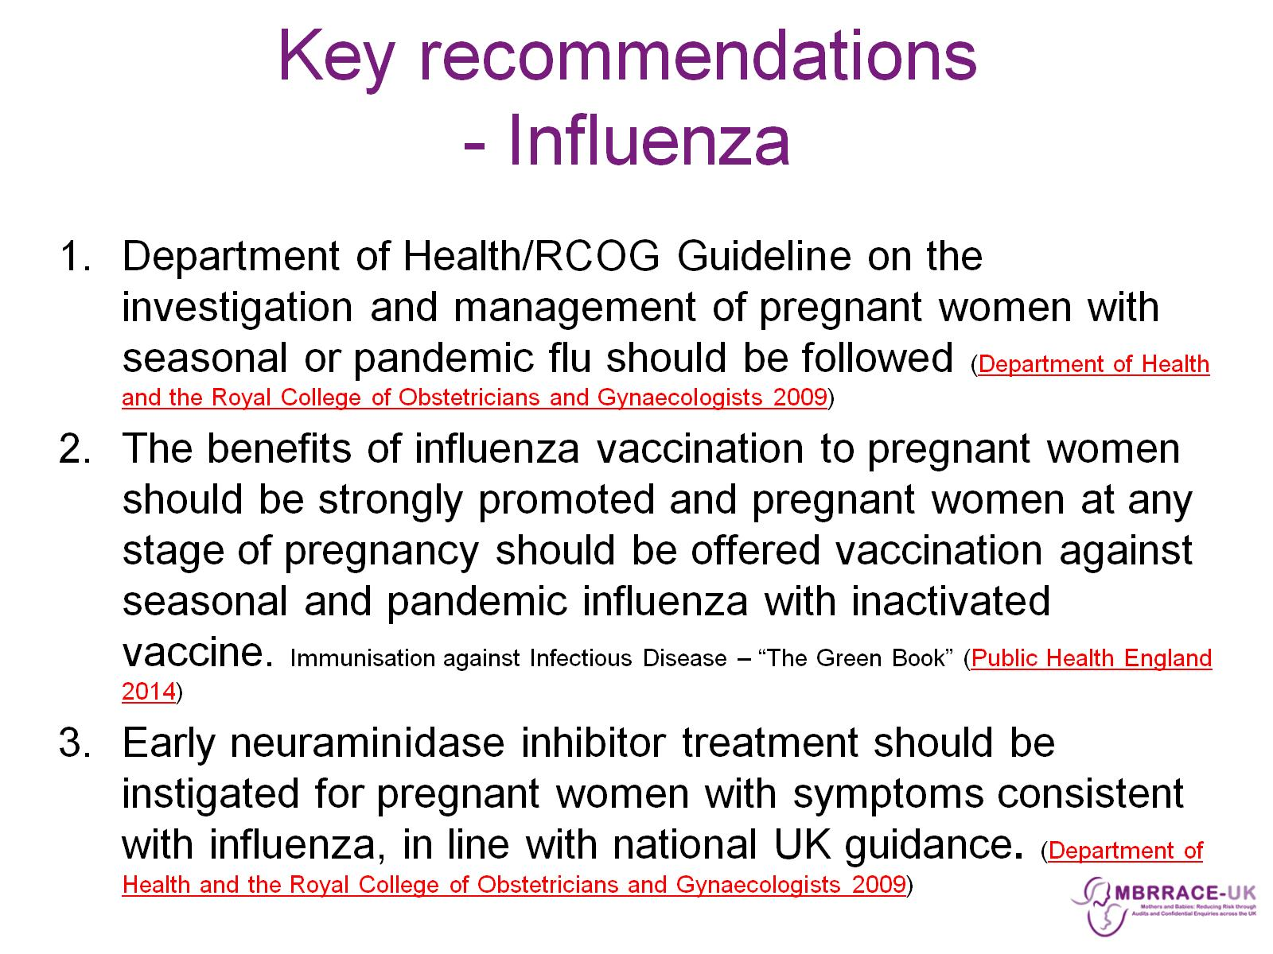
Key recommendations
- Influenza

Slide 27
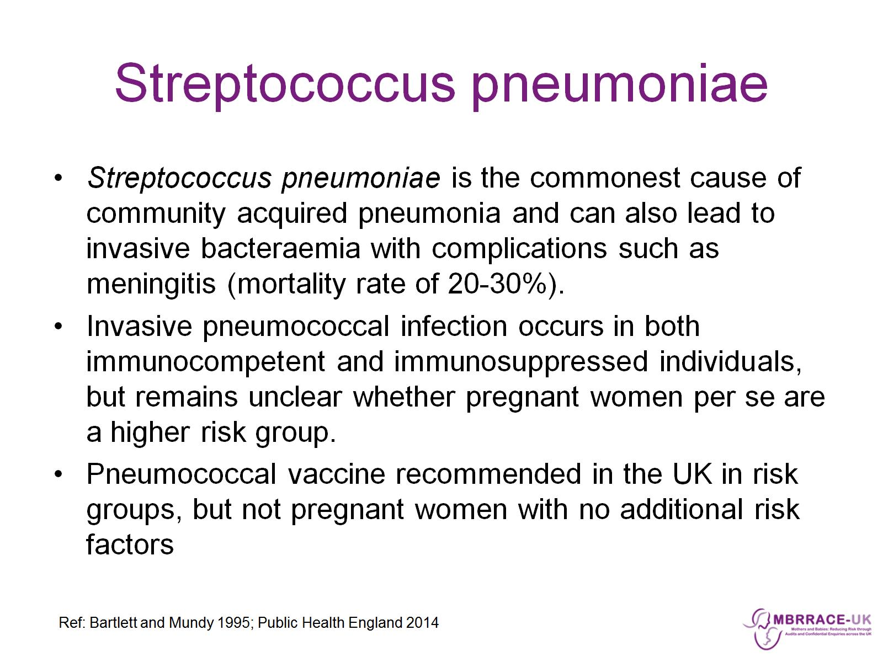
Streptococcus pneumoniae

Slide 28
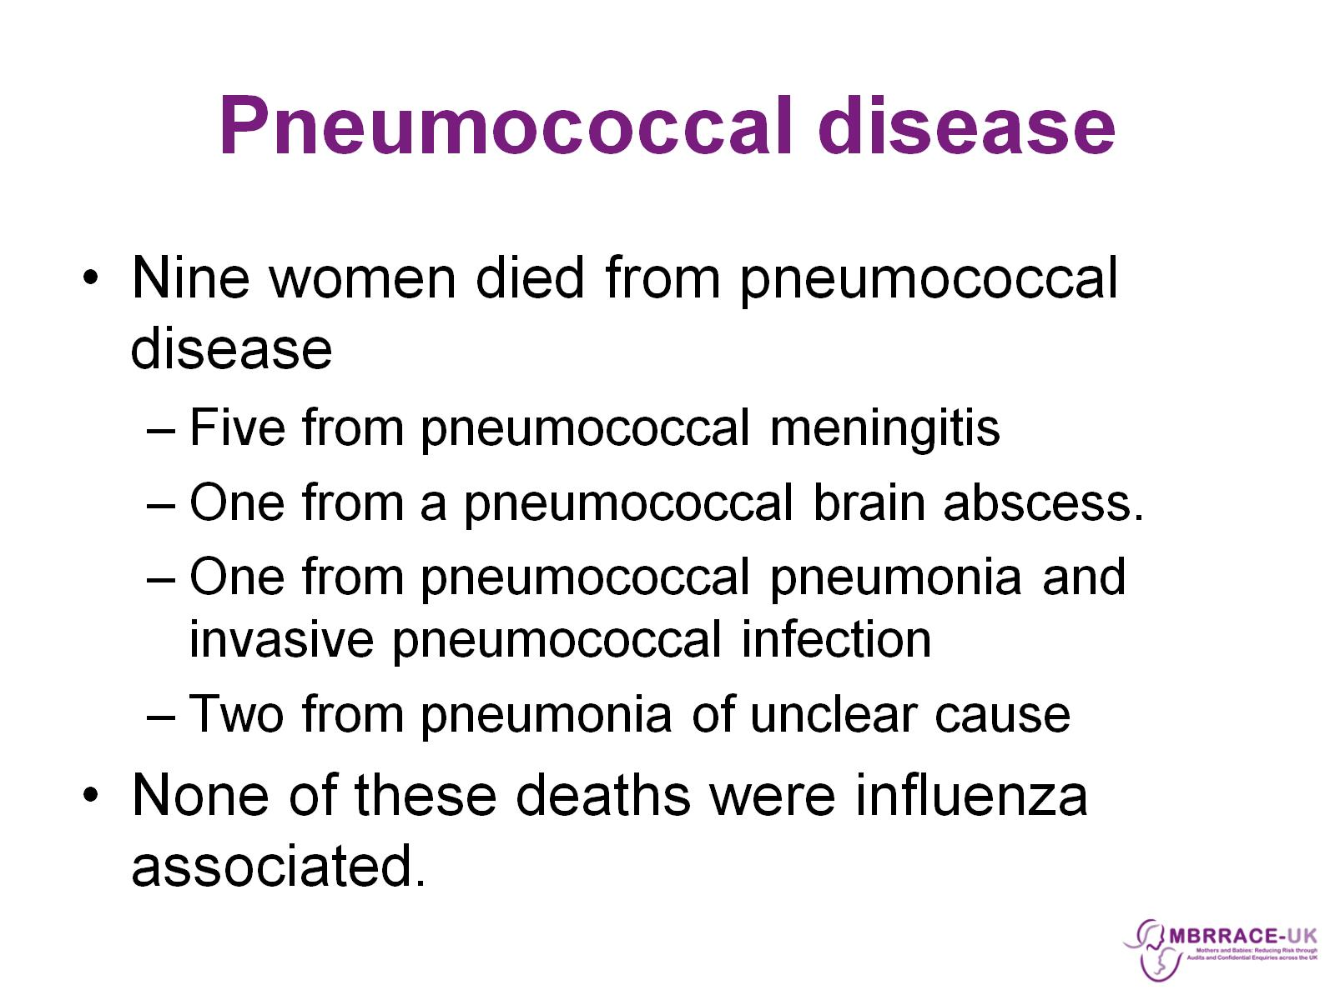
Pneumococcal disease

Slide 29
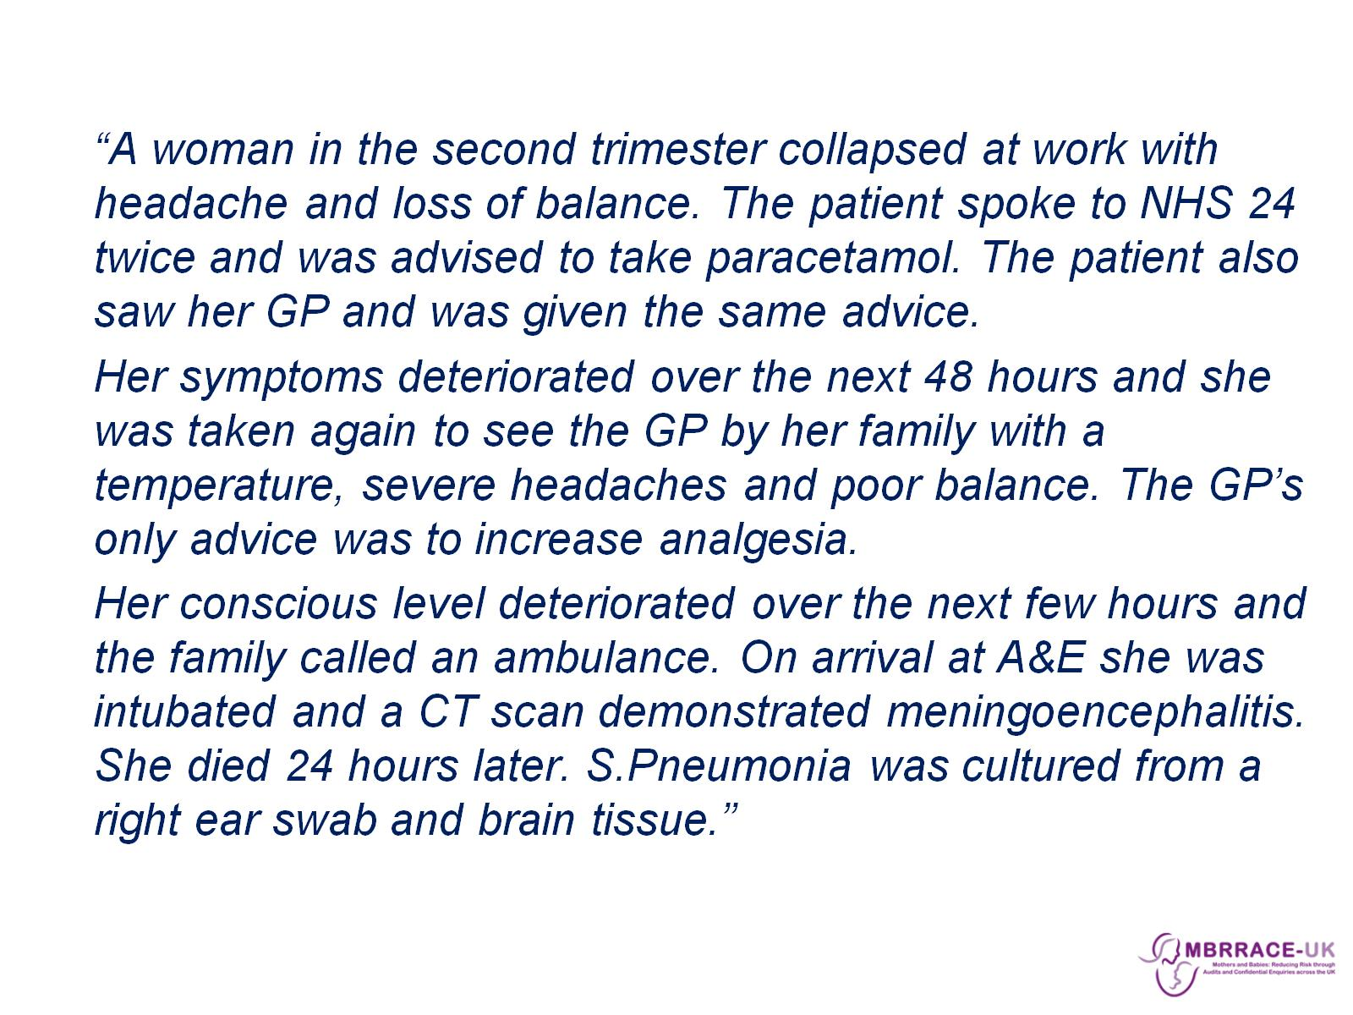

Slide 30
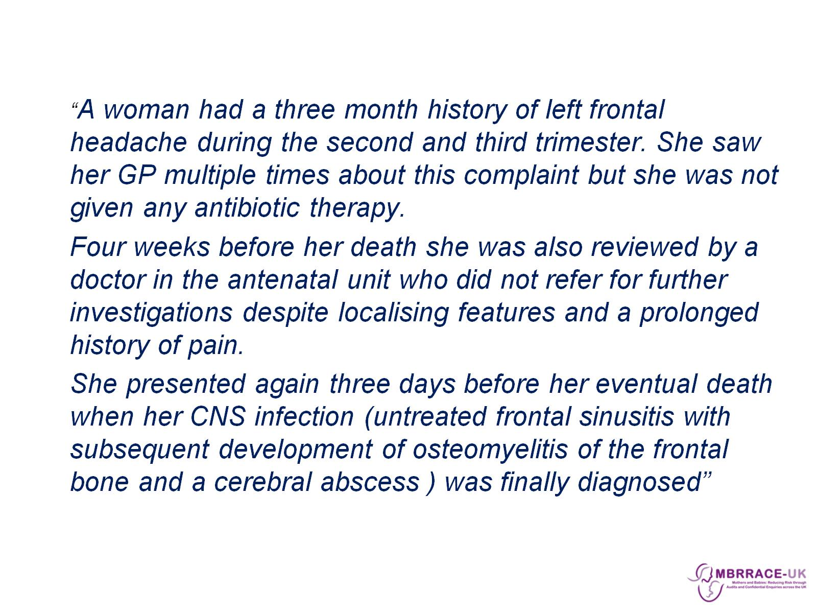

Slide 31
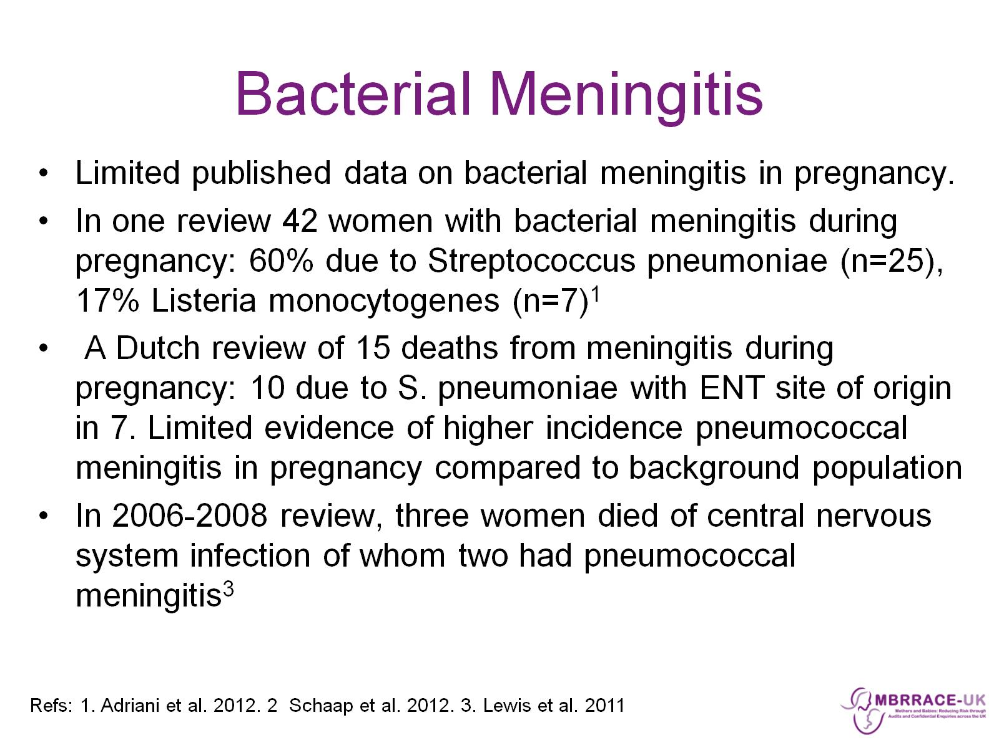
Bacterial Meningitis

Slide 32
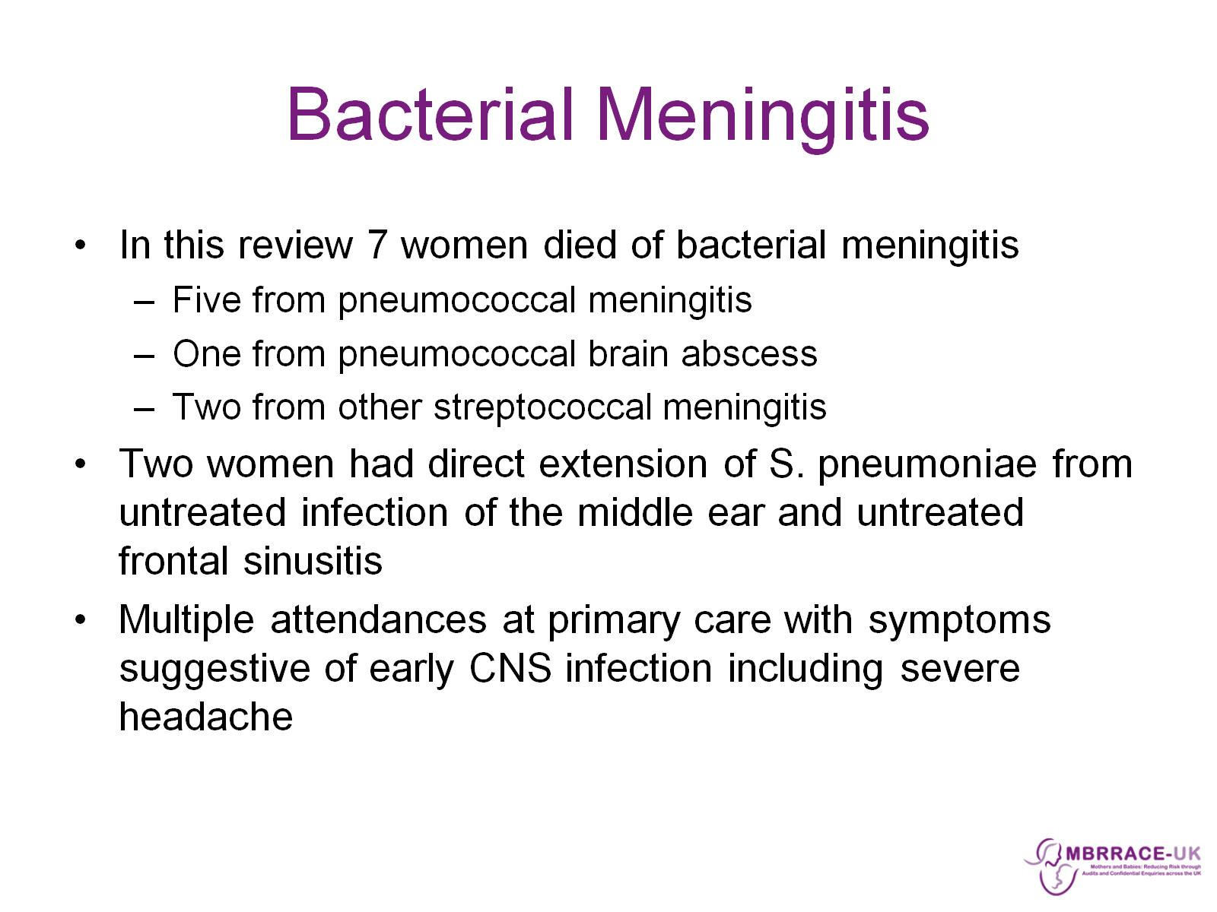
Bacterial Meningitis

Slide 33
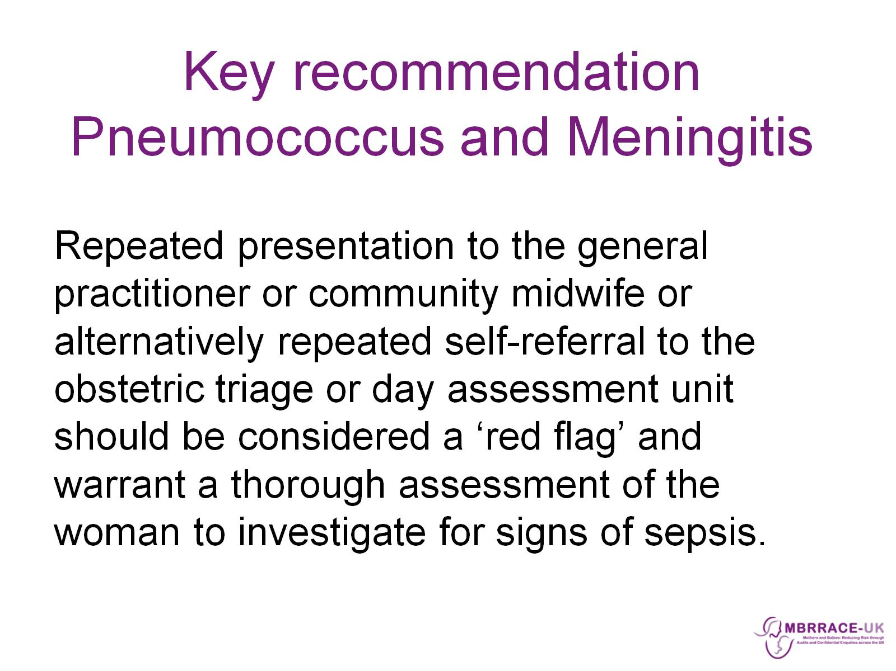
Key recommendation
Pneumococcus and Meningitis

Slide 34
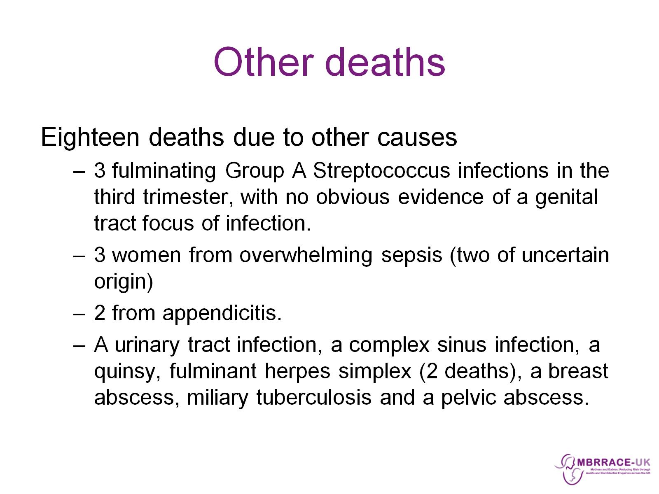
Other deaths

Slide 35
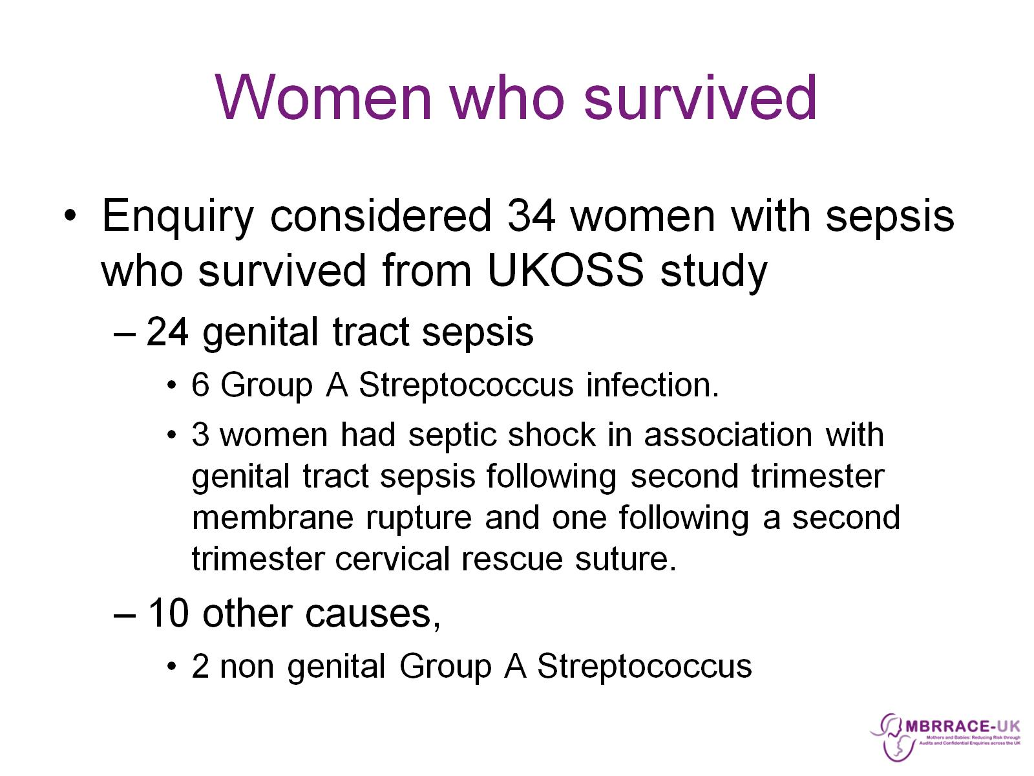
Women who survived

Slide 36
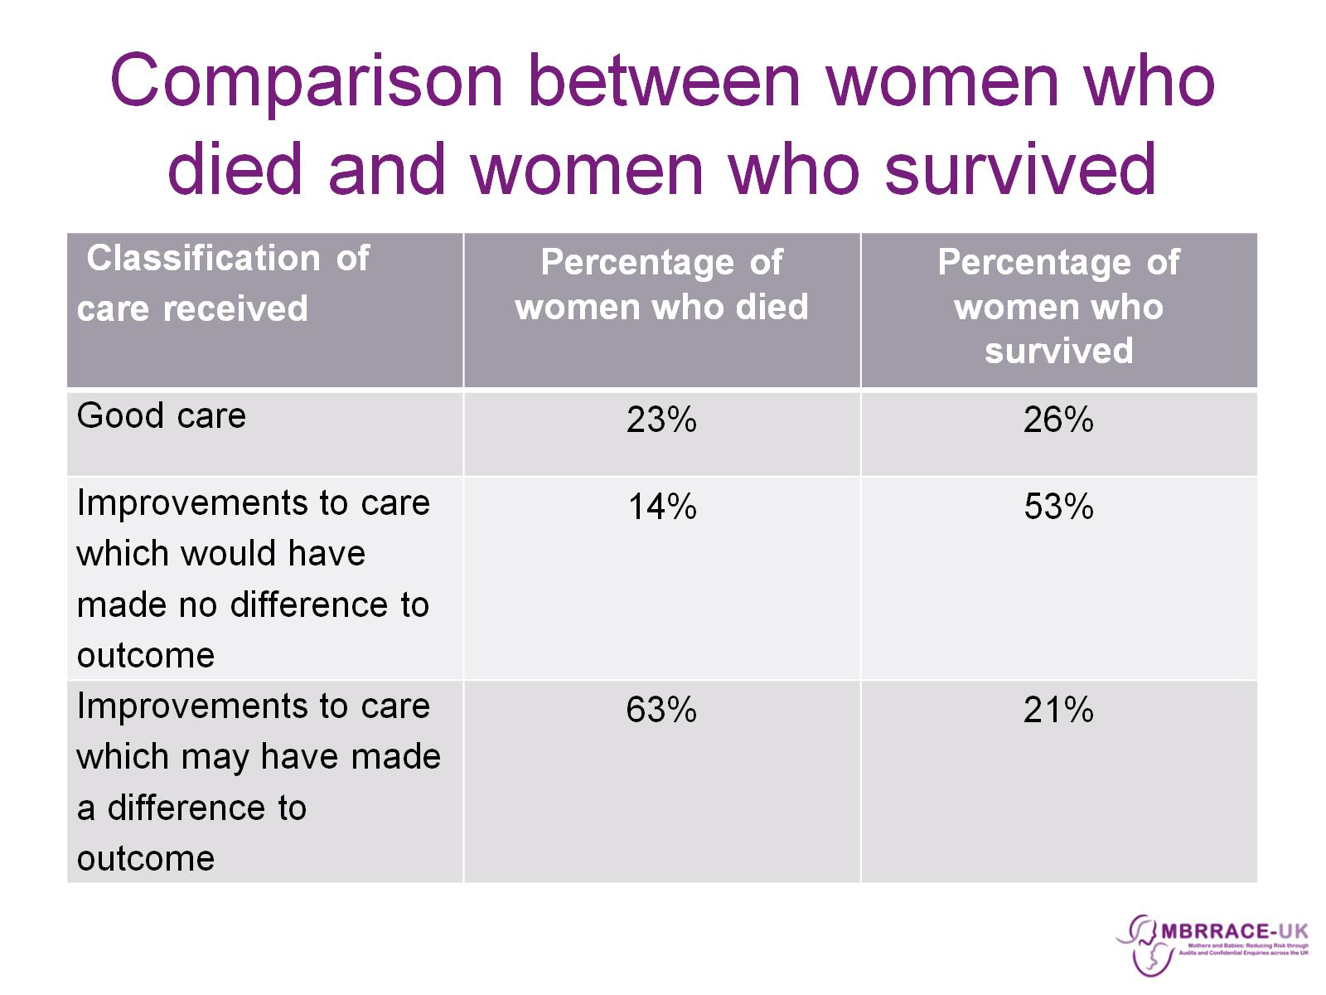
Comparison between women who died and women who survived

Slide 37
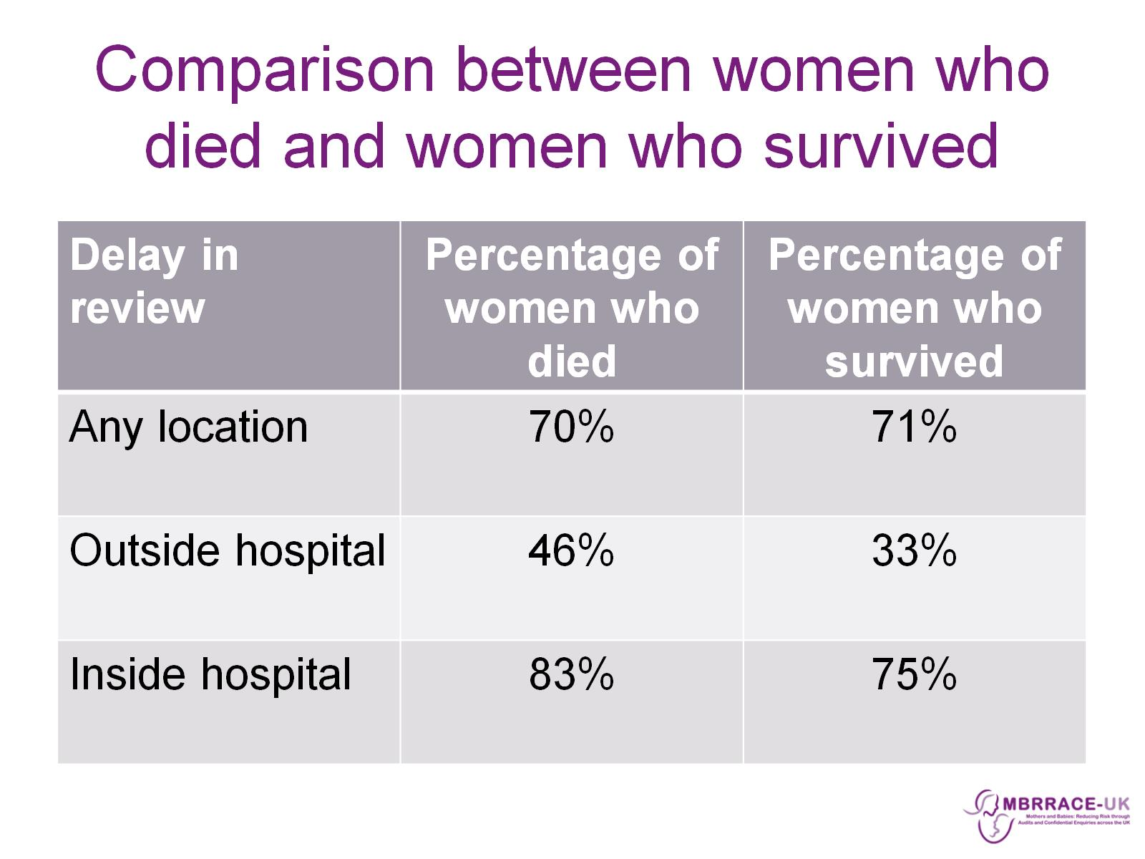
Comparison between women who died and women who survived

Slide 38
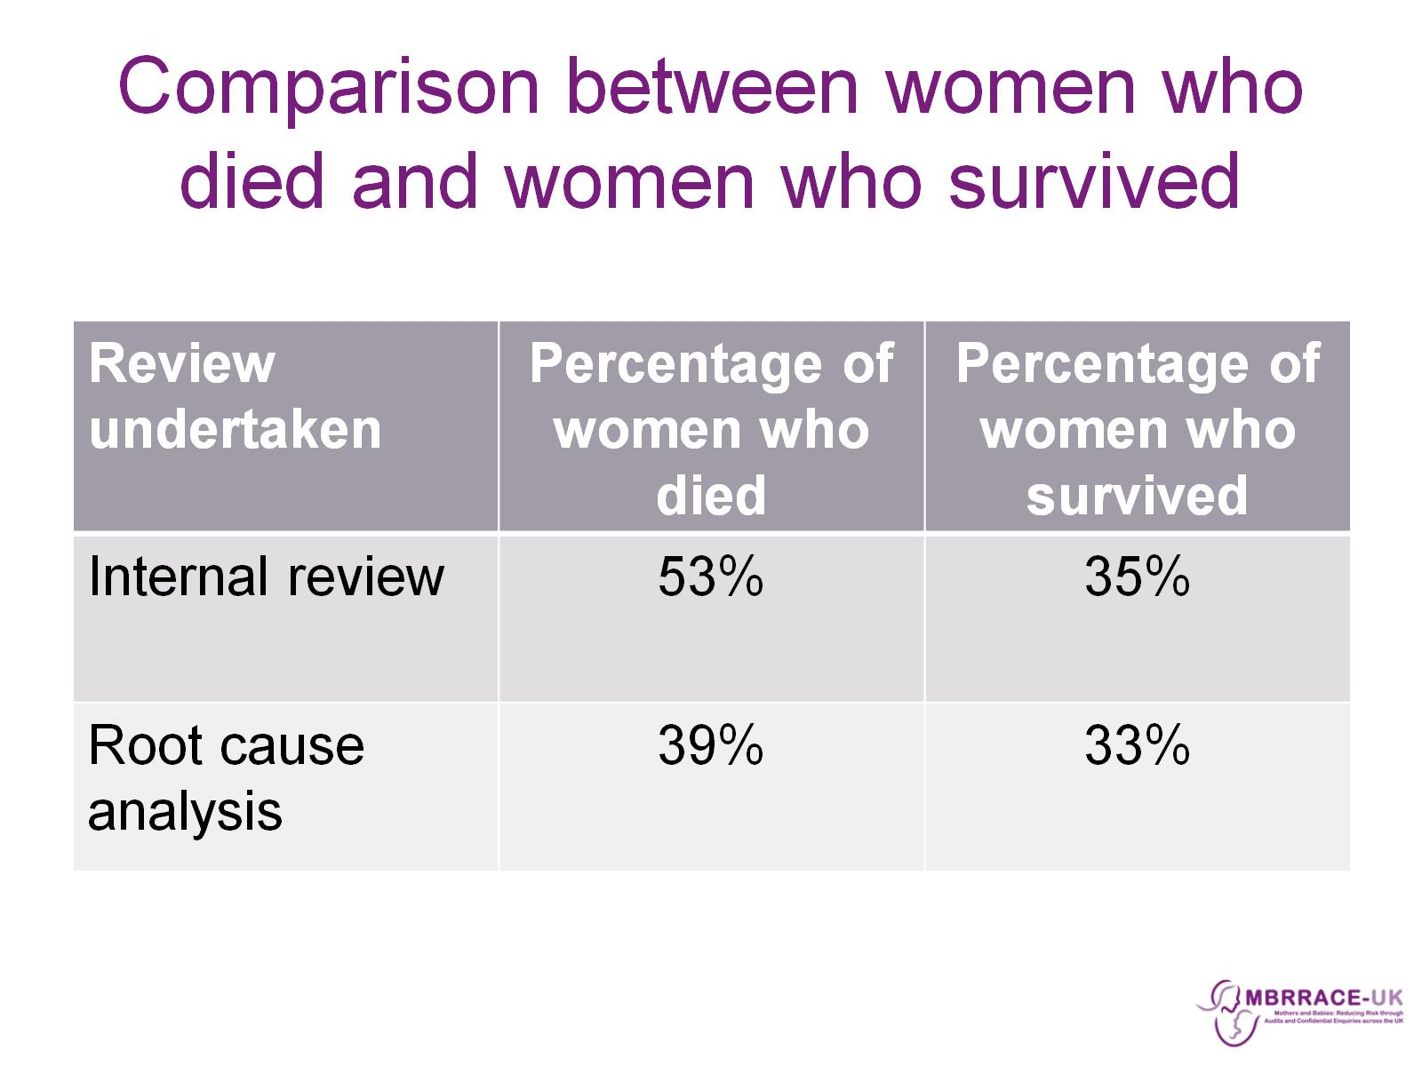
Comparison between women who died and women who survived

Slide 39
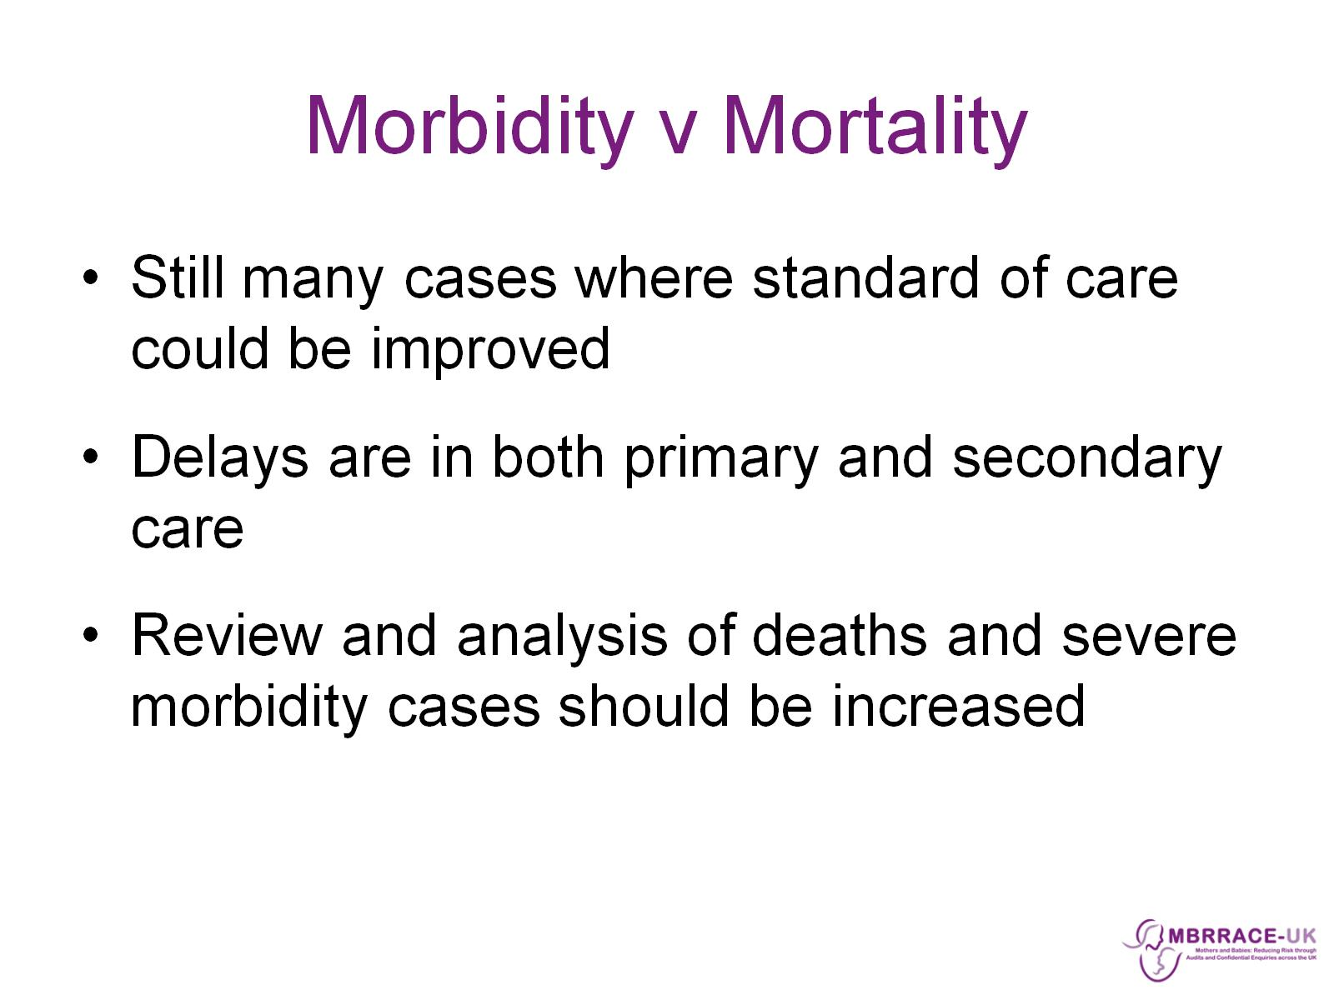
Morbidity v Mortality

Slide 40
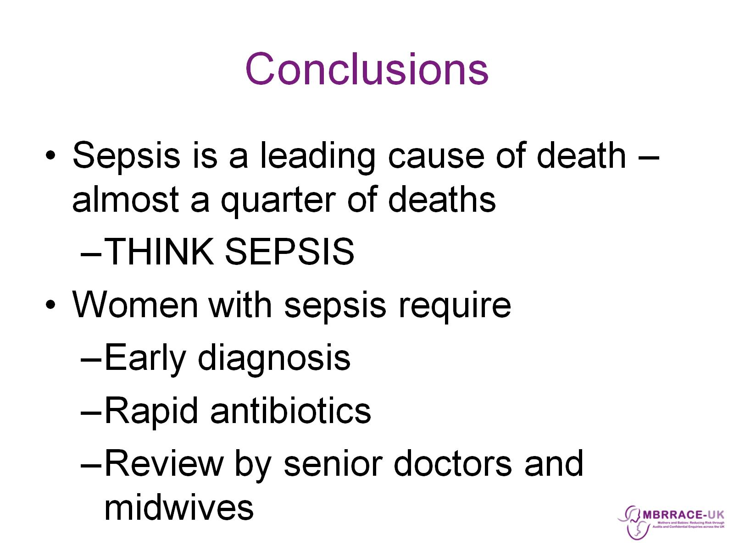
Conclusions

Slide 41
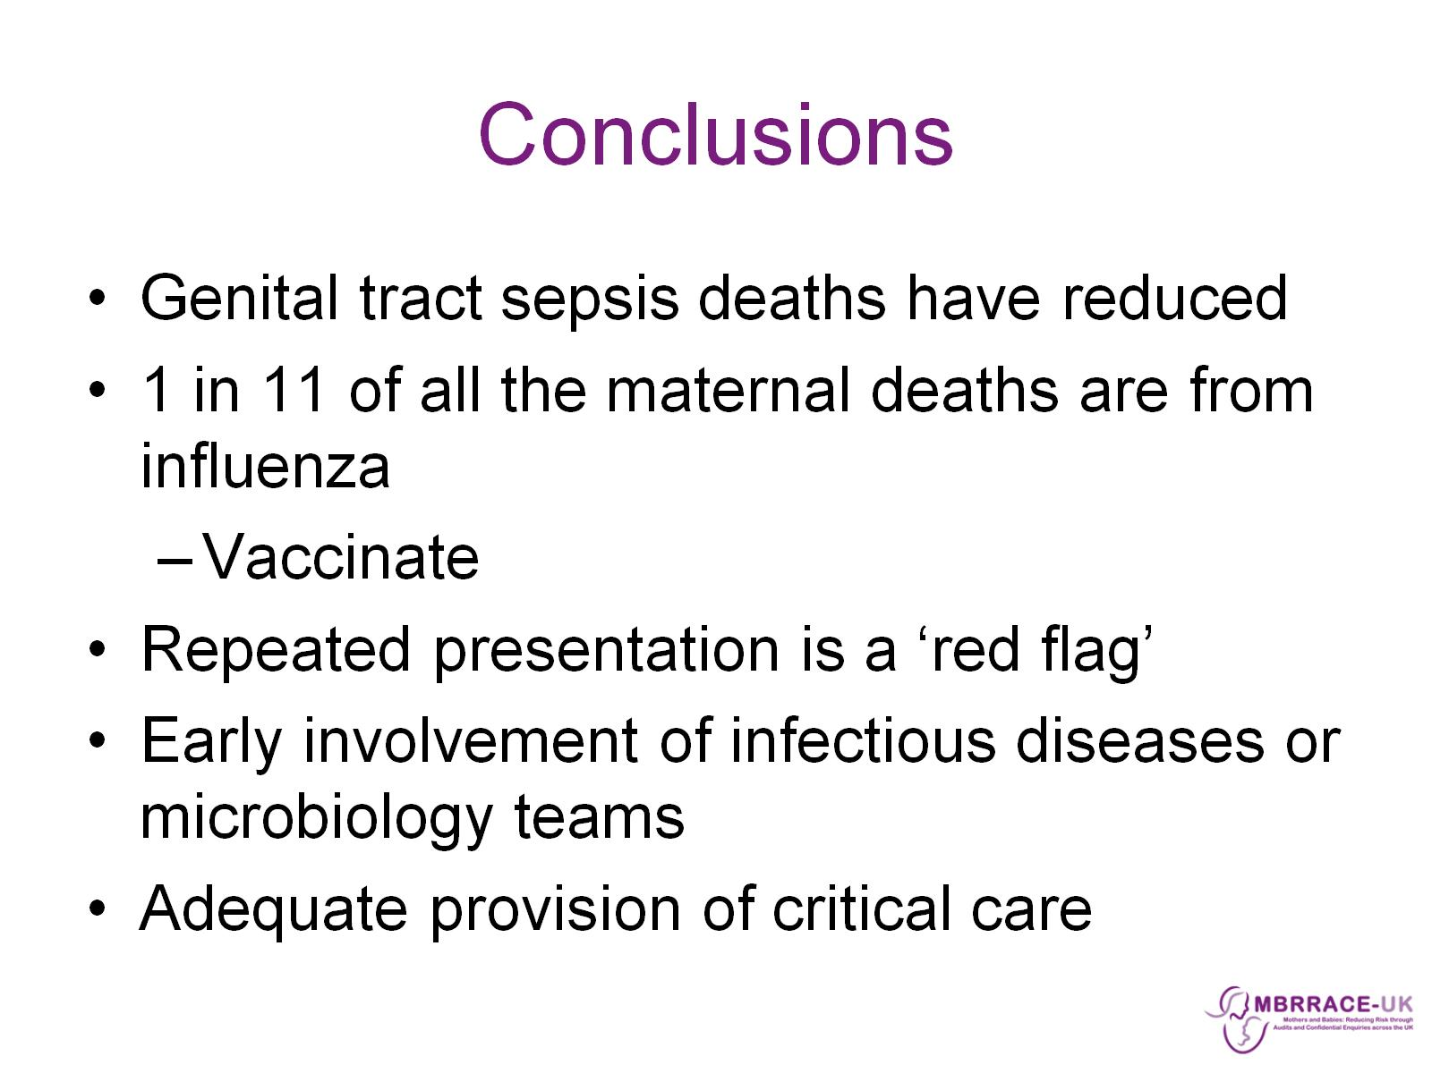
Conclusions

