Slide 1

The women who died 2009-12

Slide 2
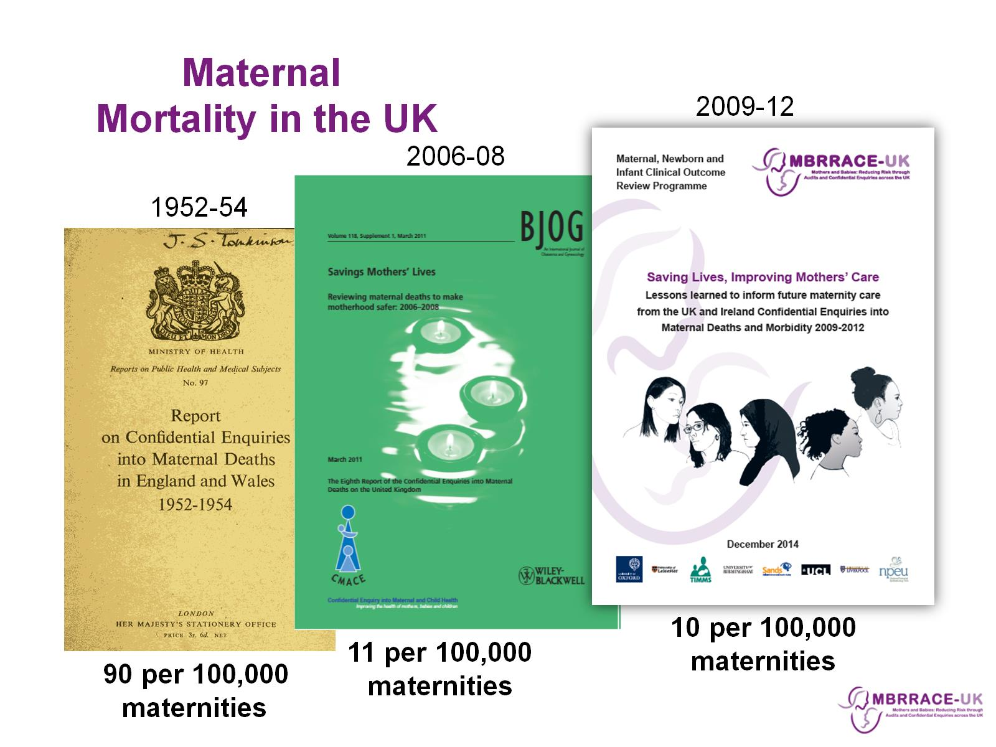

Slide 3
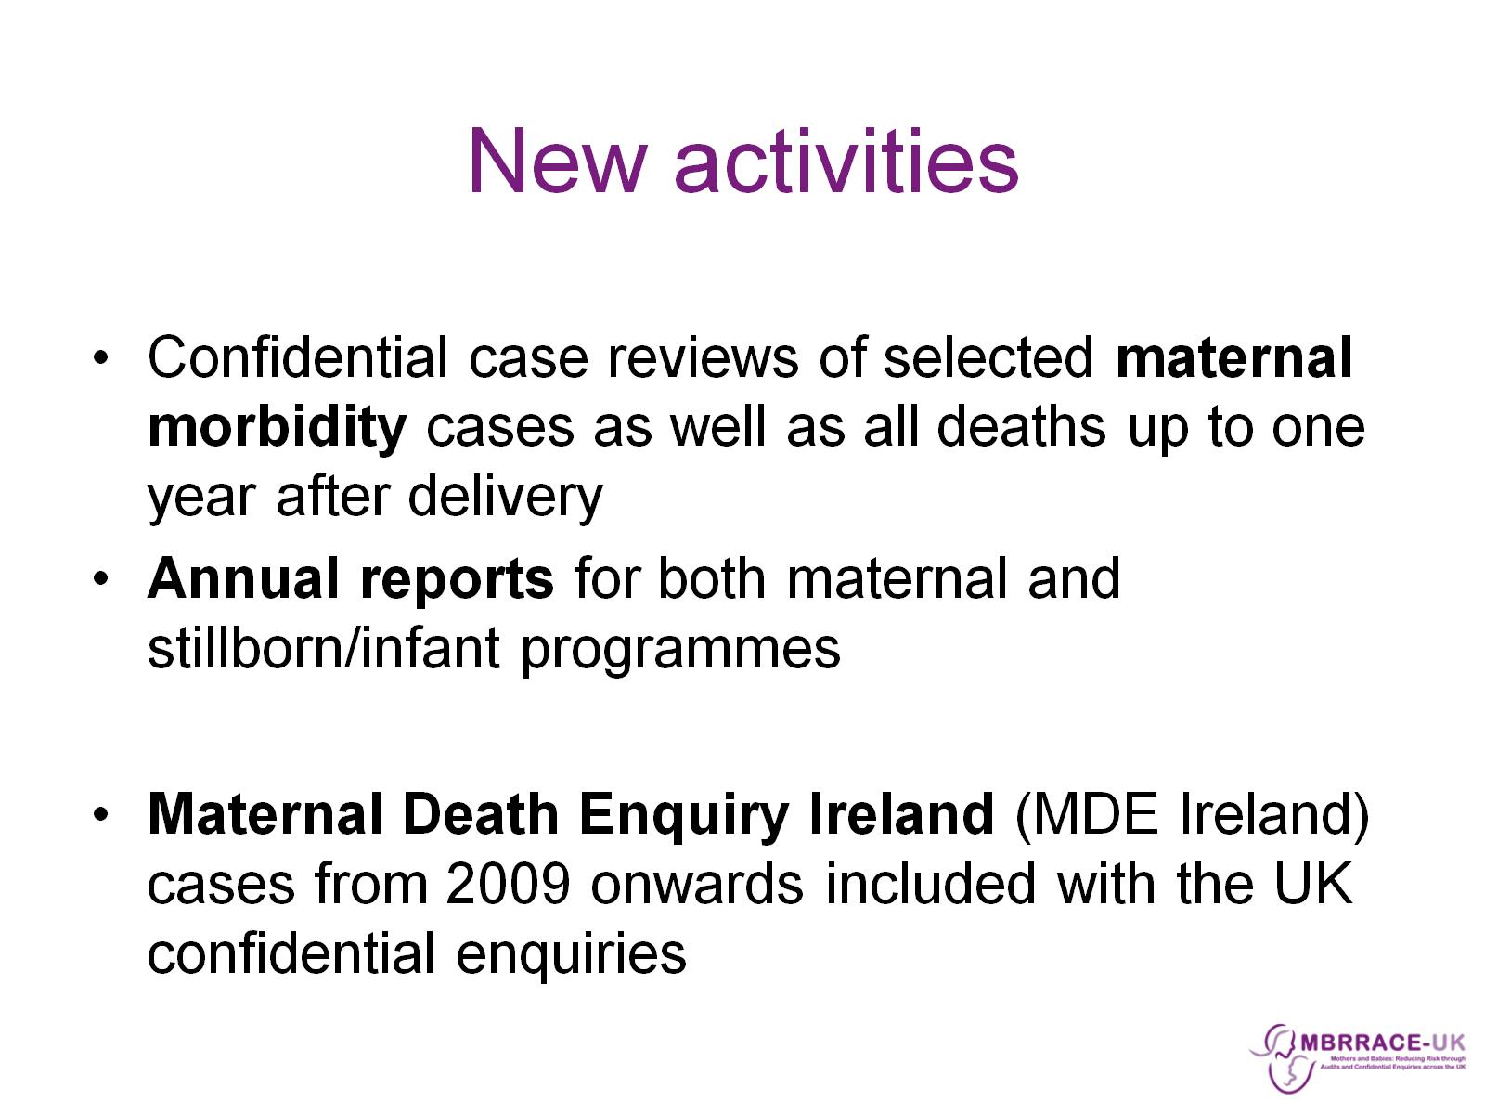
New activities

Slide 4
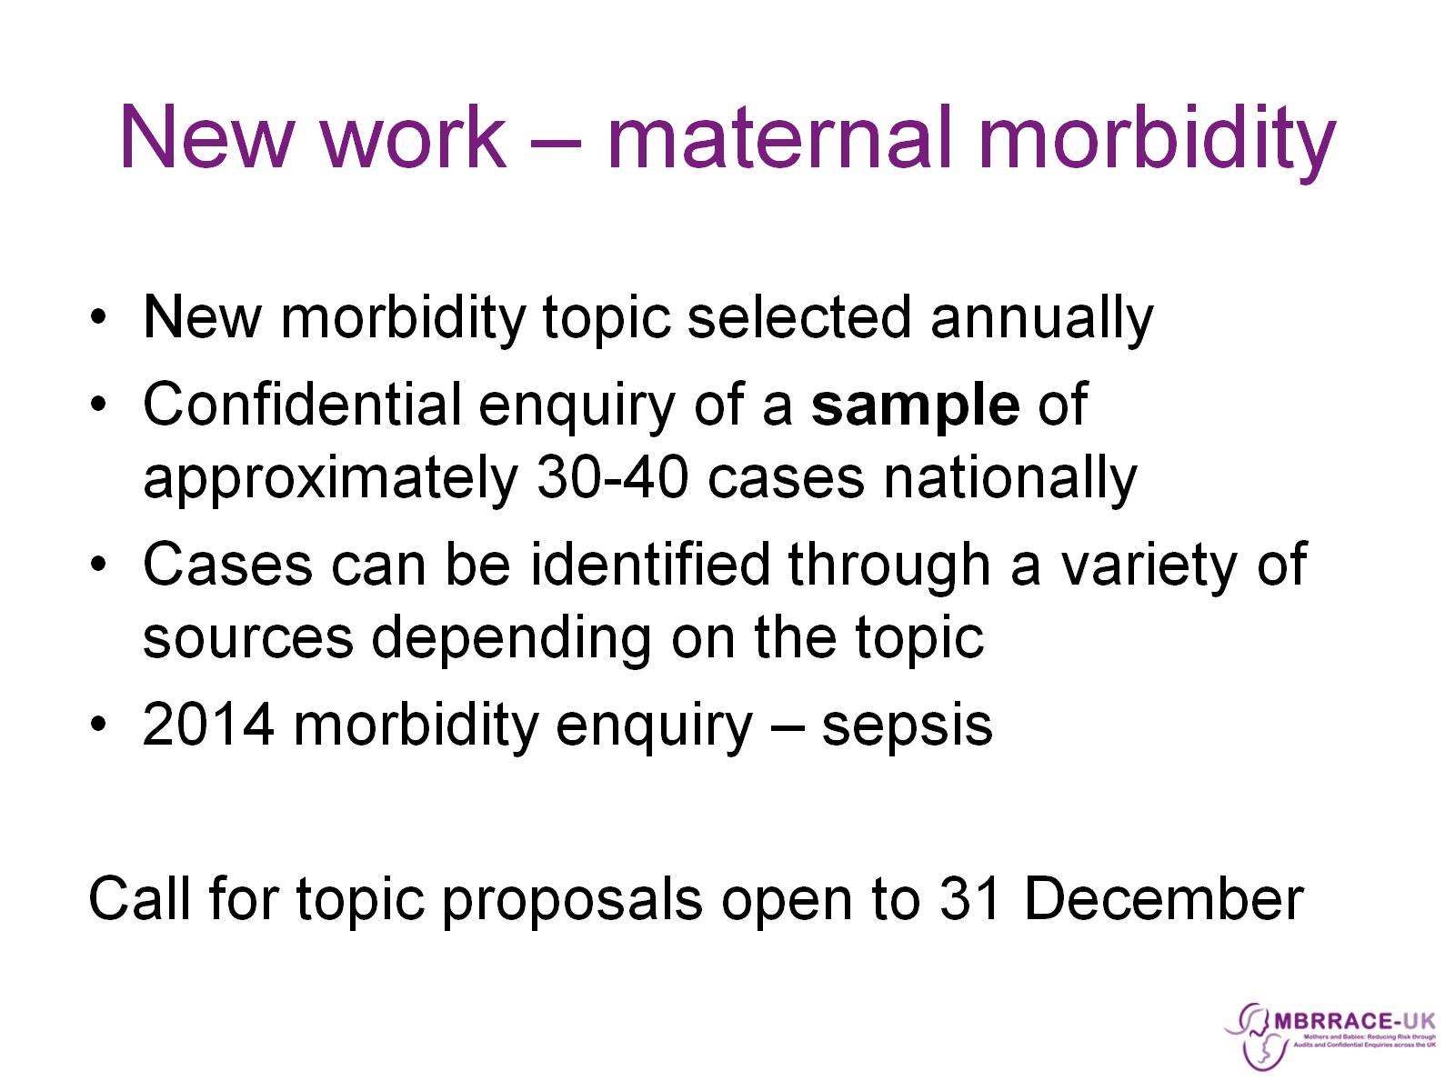
New work – maternal morbidity

Slide 5
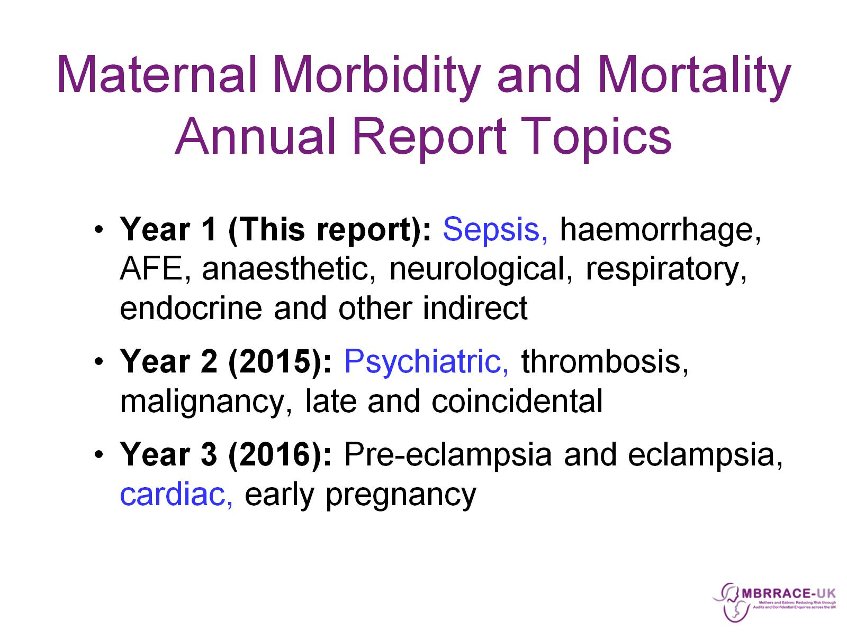
Maternal Morbidity and Mortality
Annual Report Topics

Slide 6

MBRRACE-UK: Methods

Slide 7
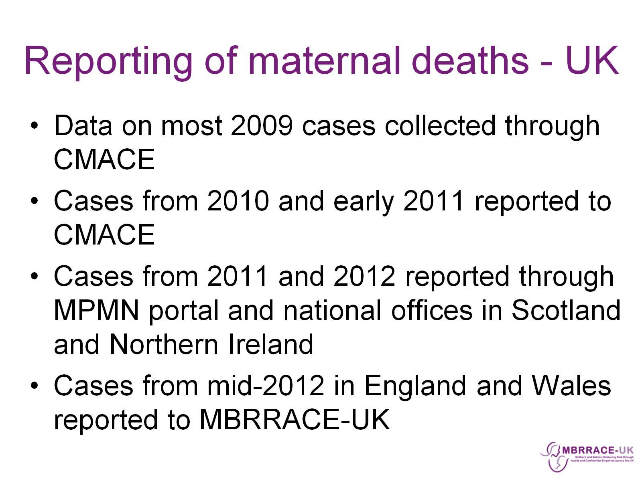
Reporting of maternal deaths - UK

Slide 8
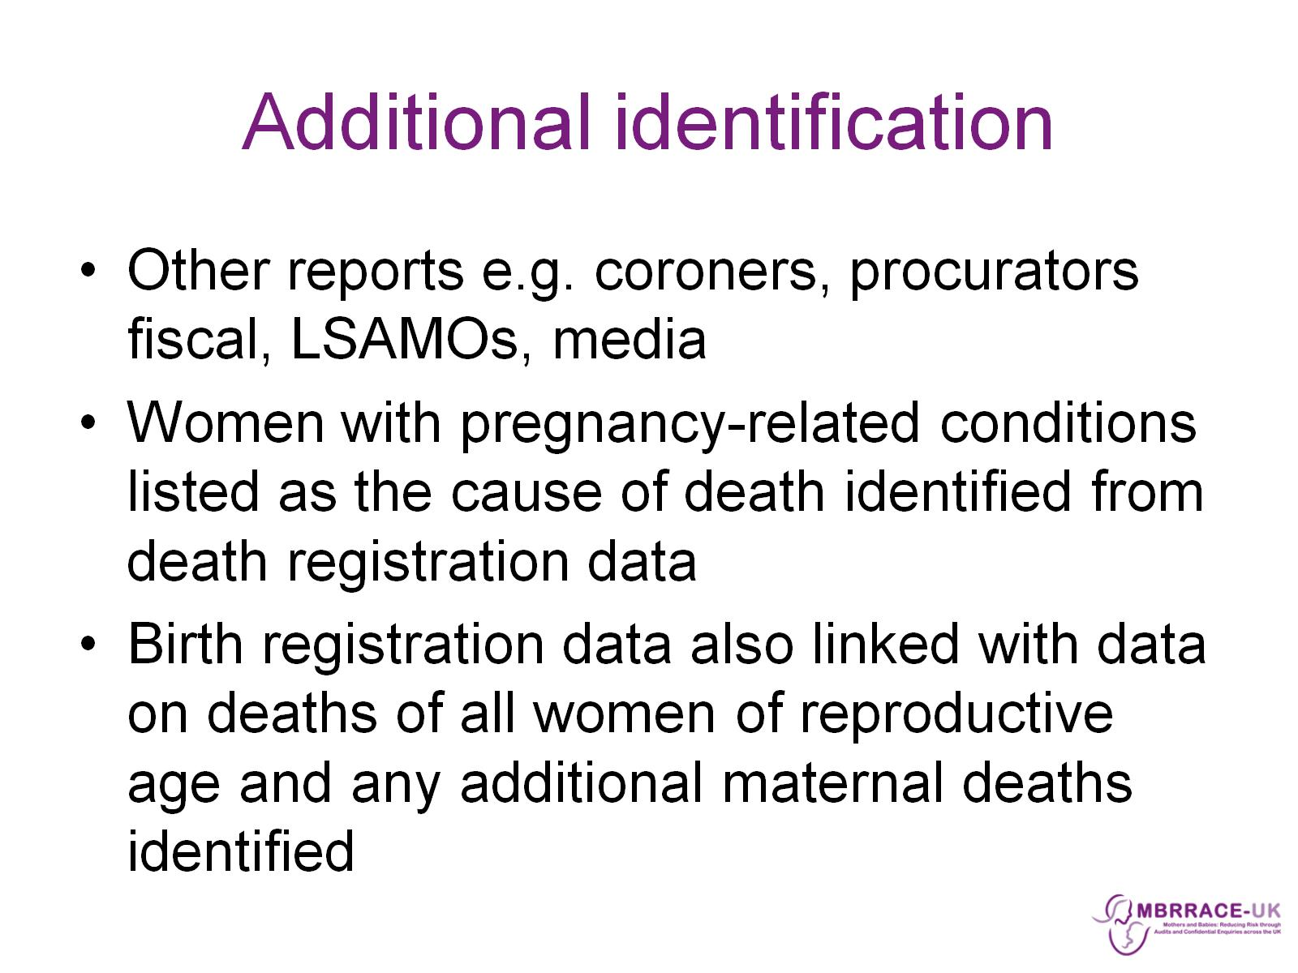
Additional identification

Slide 9
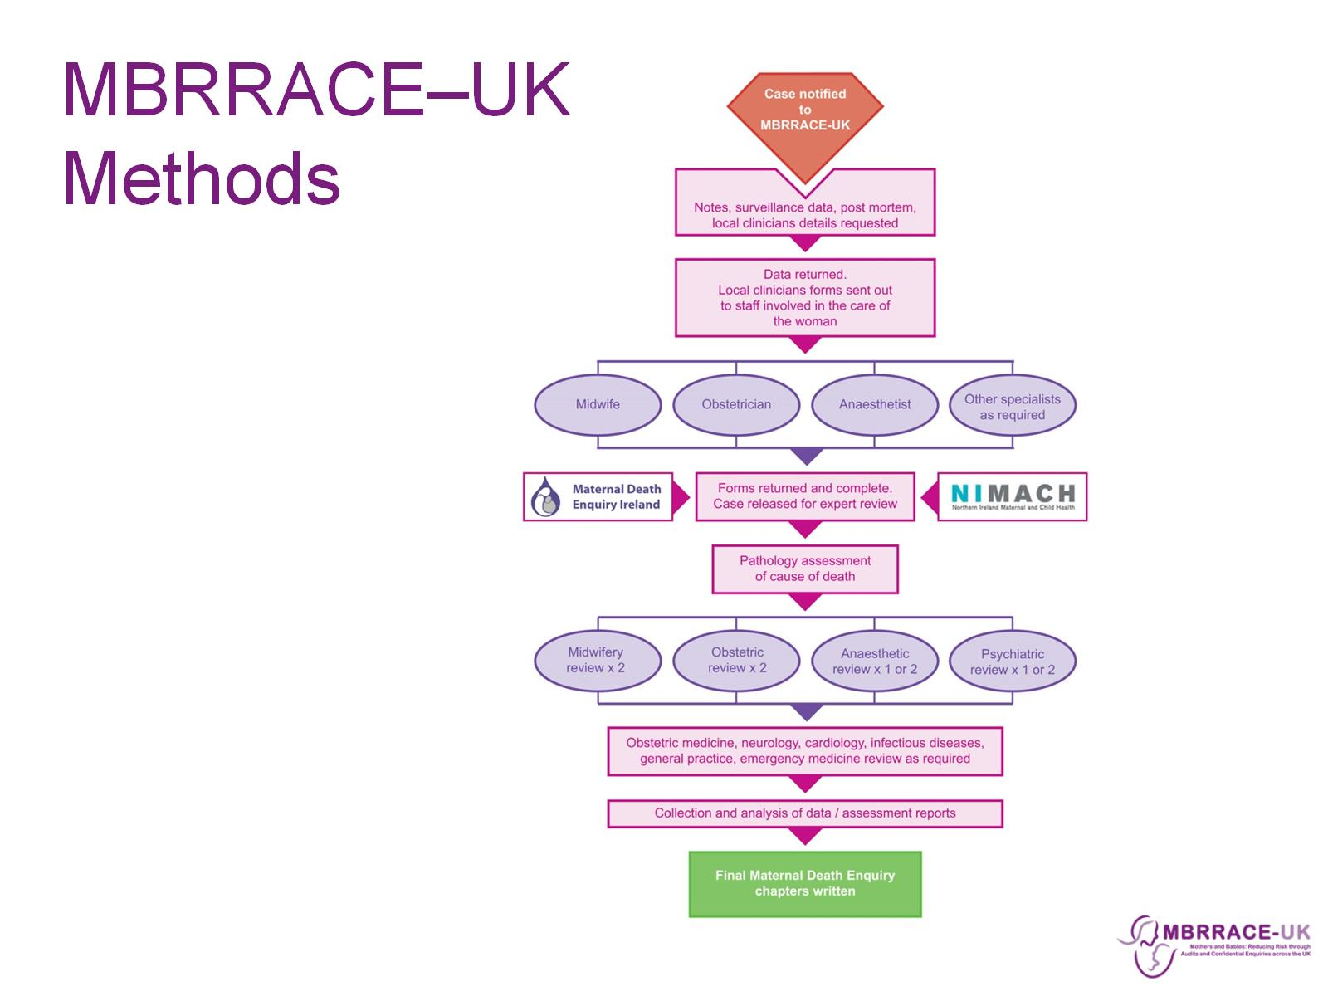
MBRRACE–UK Methods

Slide 10
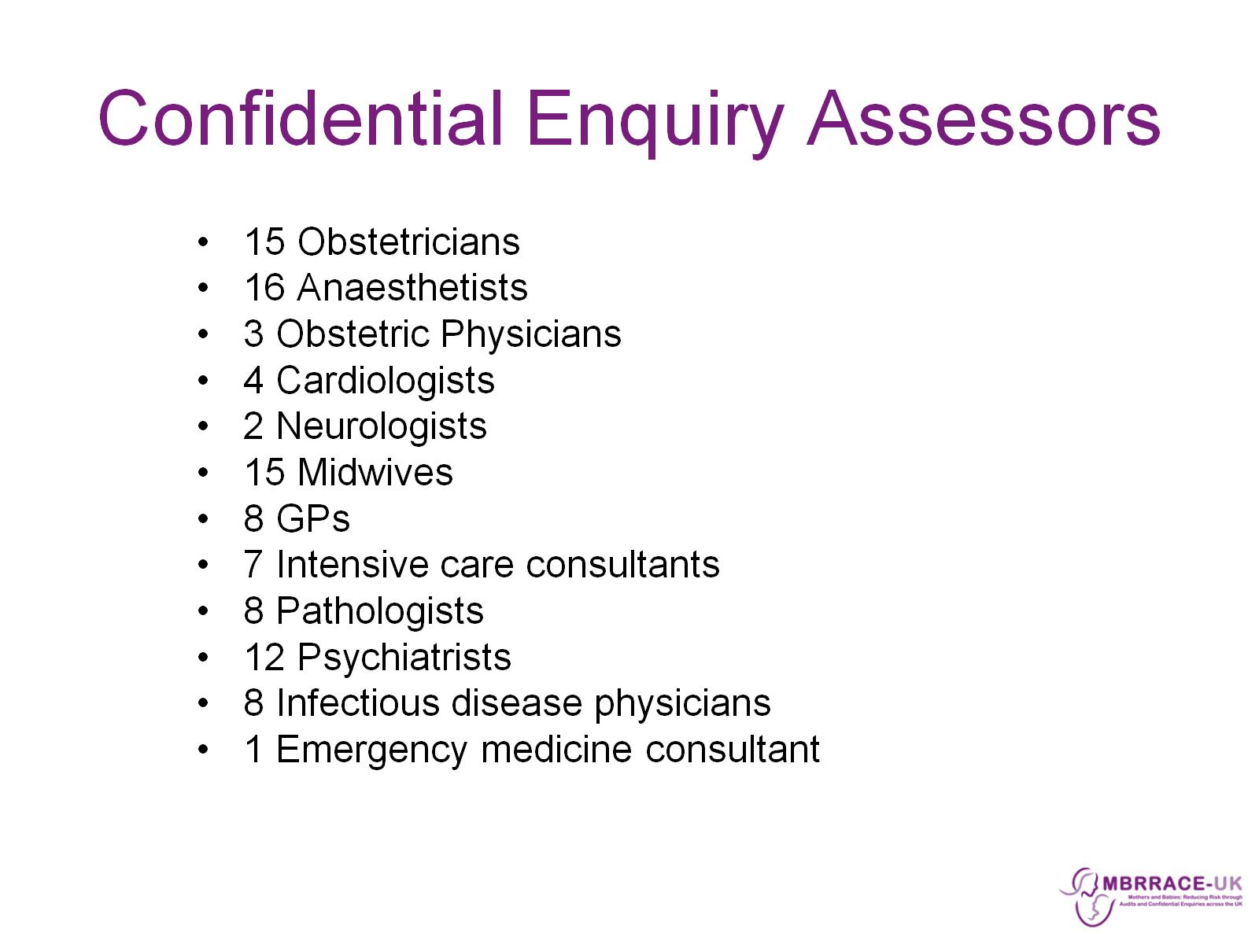
Confidential Enquiry Assessors

Slide 11
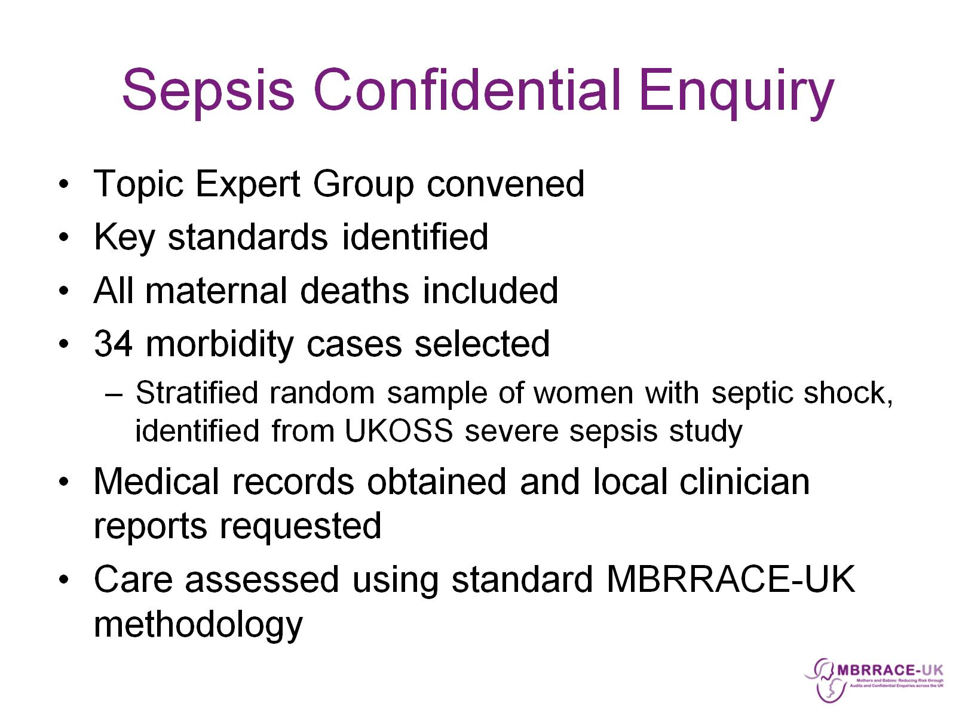
Sepsis Confidential Enquiry

Slide 12
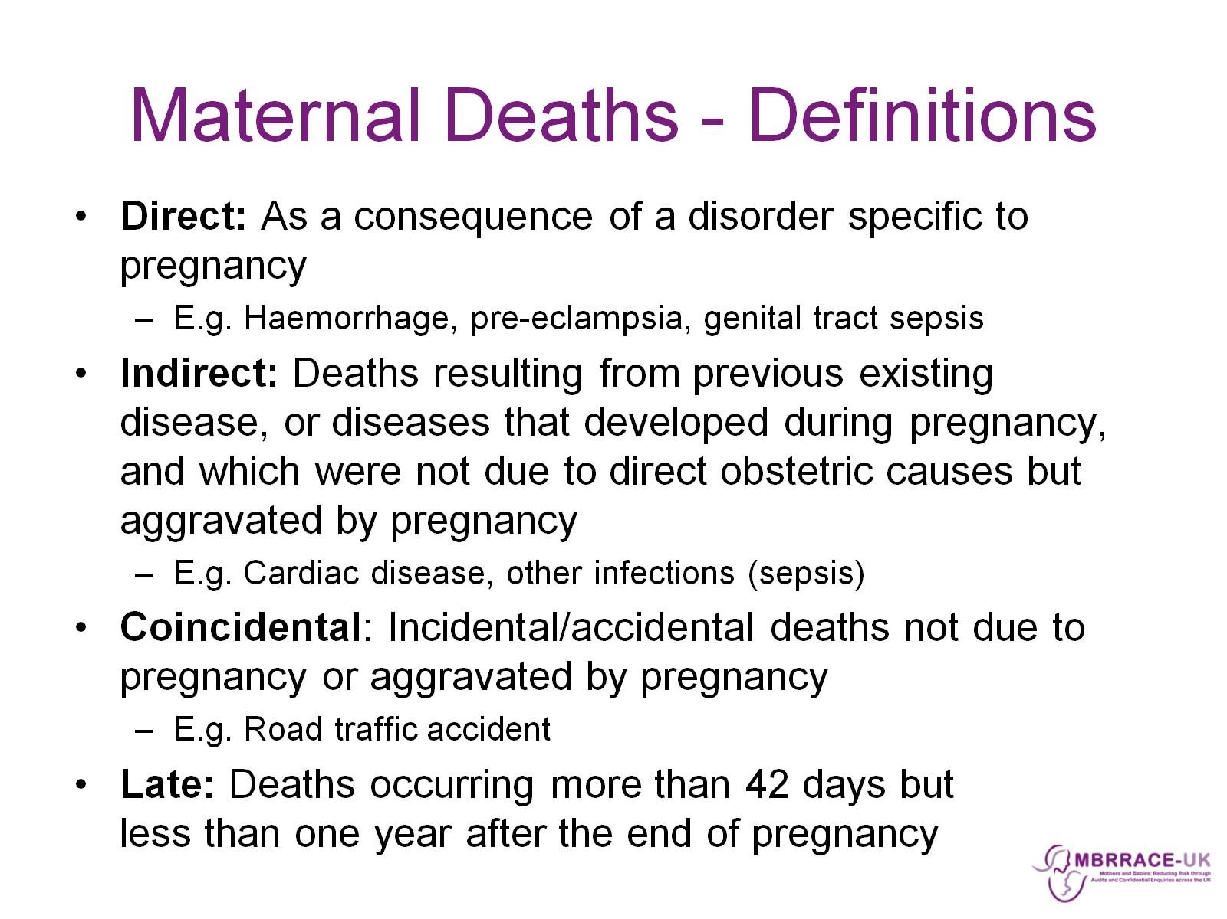
Maternal Deaths - Definitions

Slide 13
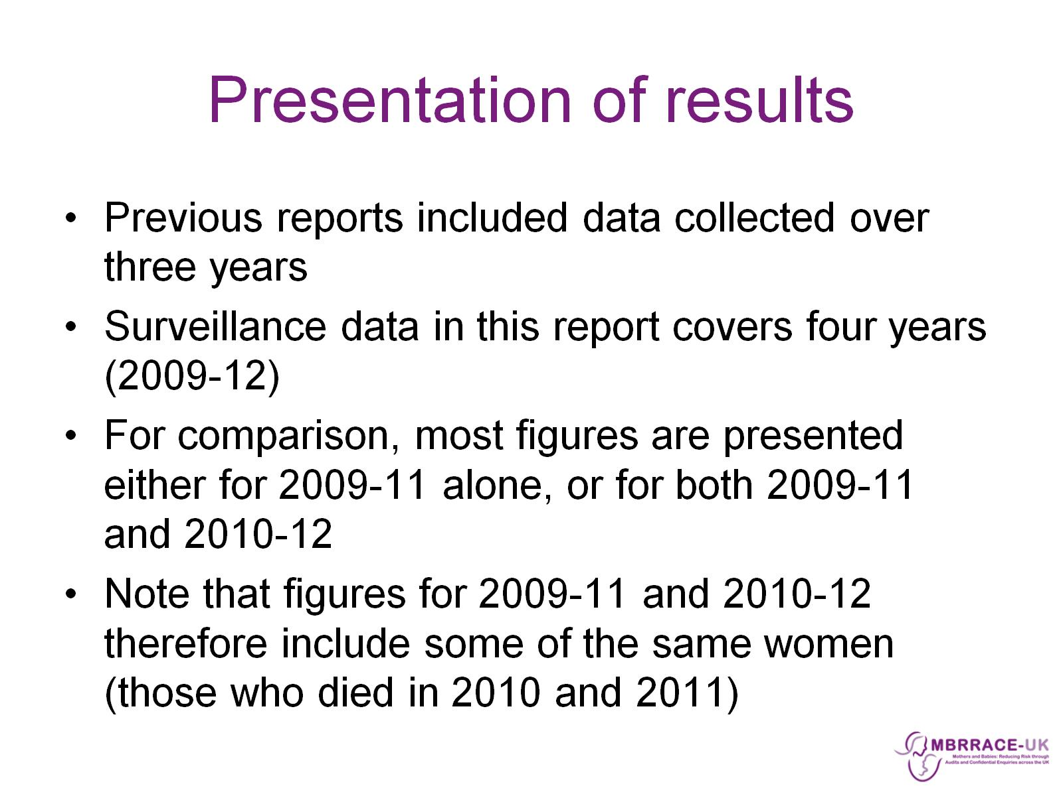
Presentation of results

Slide 14

MBRRACE-UK: Surveillance results

Slide 15
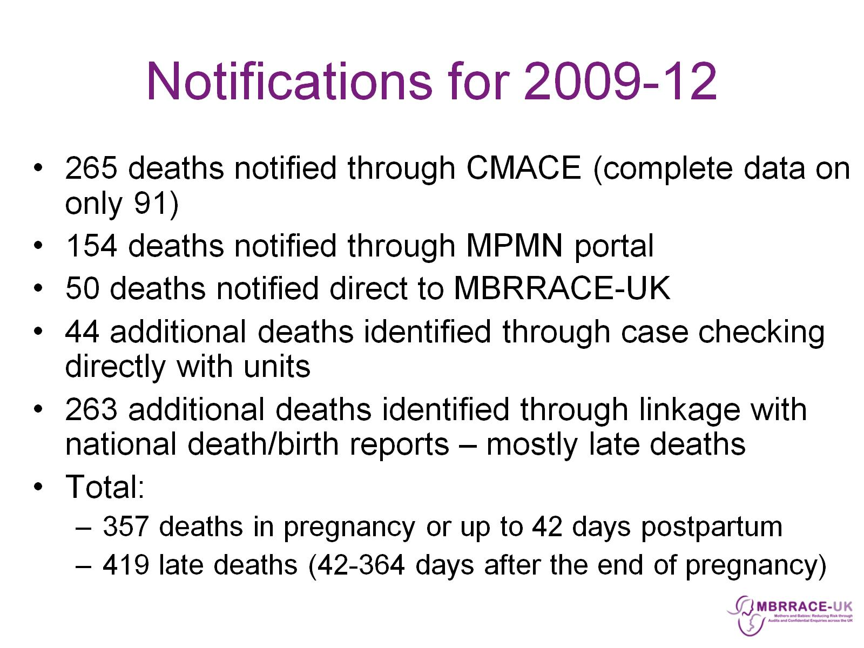
Notifications for 2009-12

Slide 16
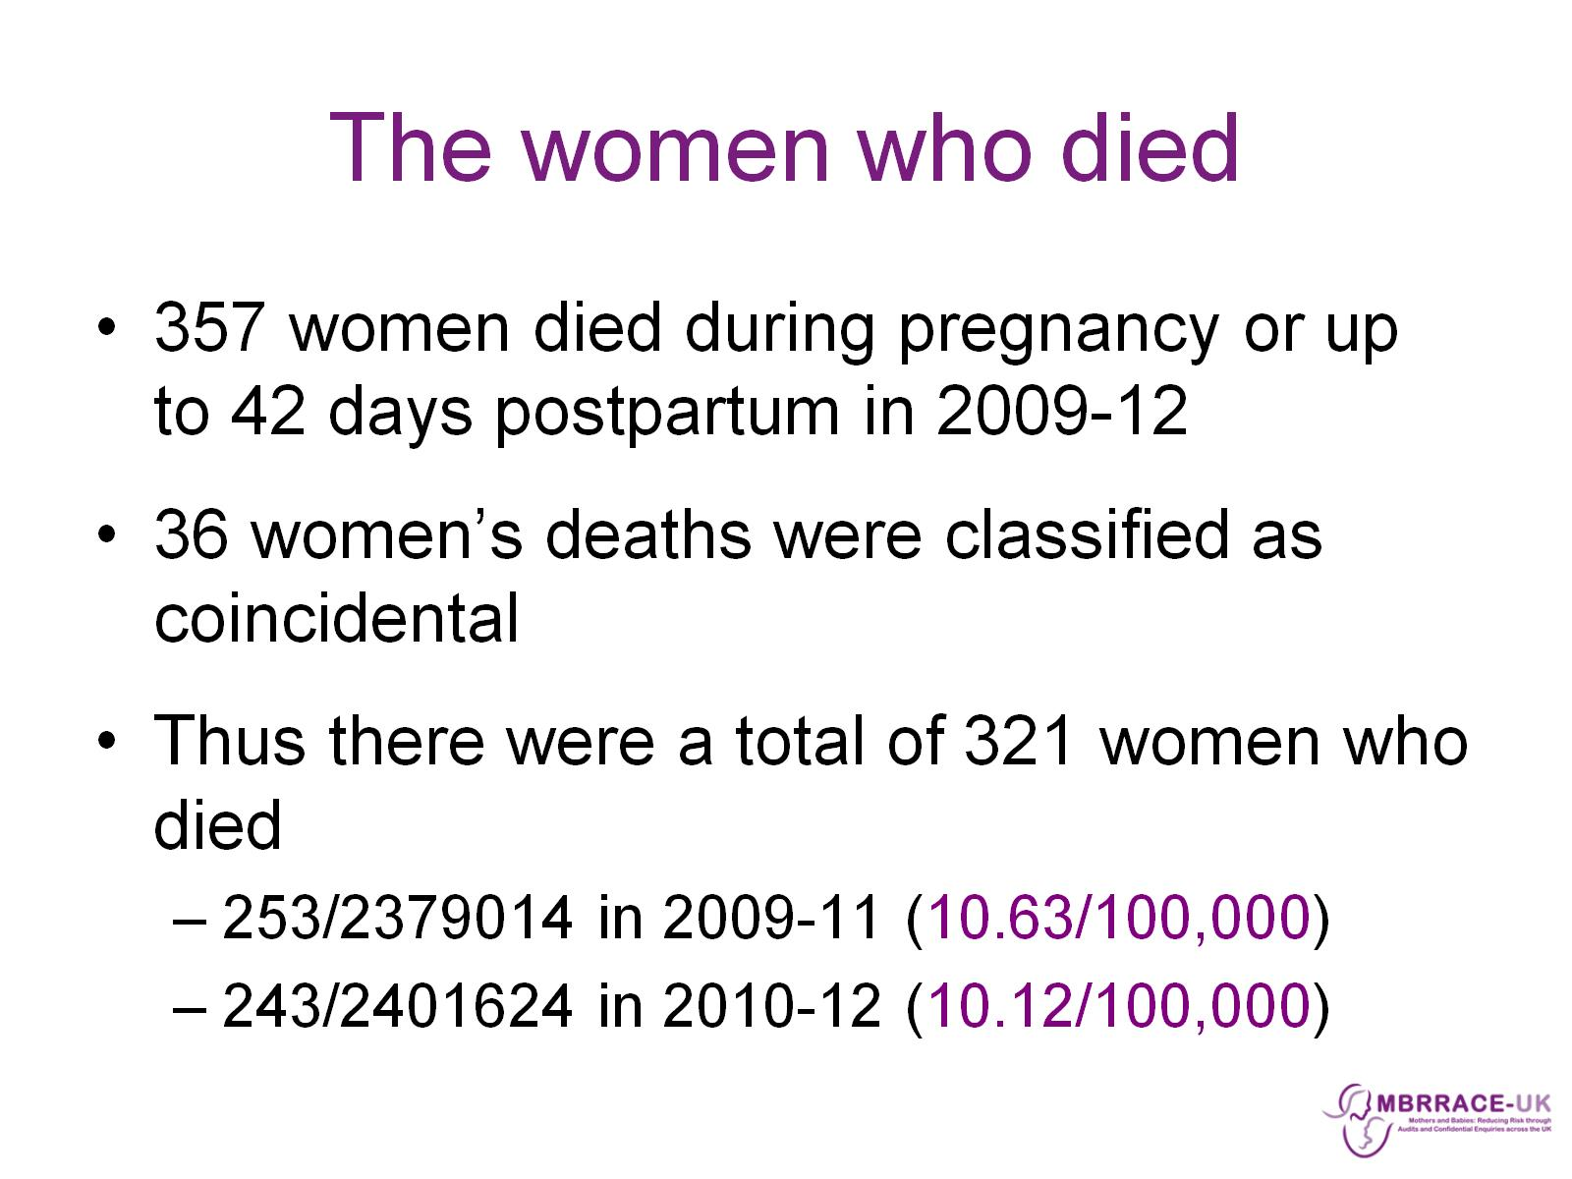
The women who died

Slide 17
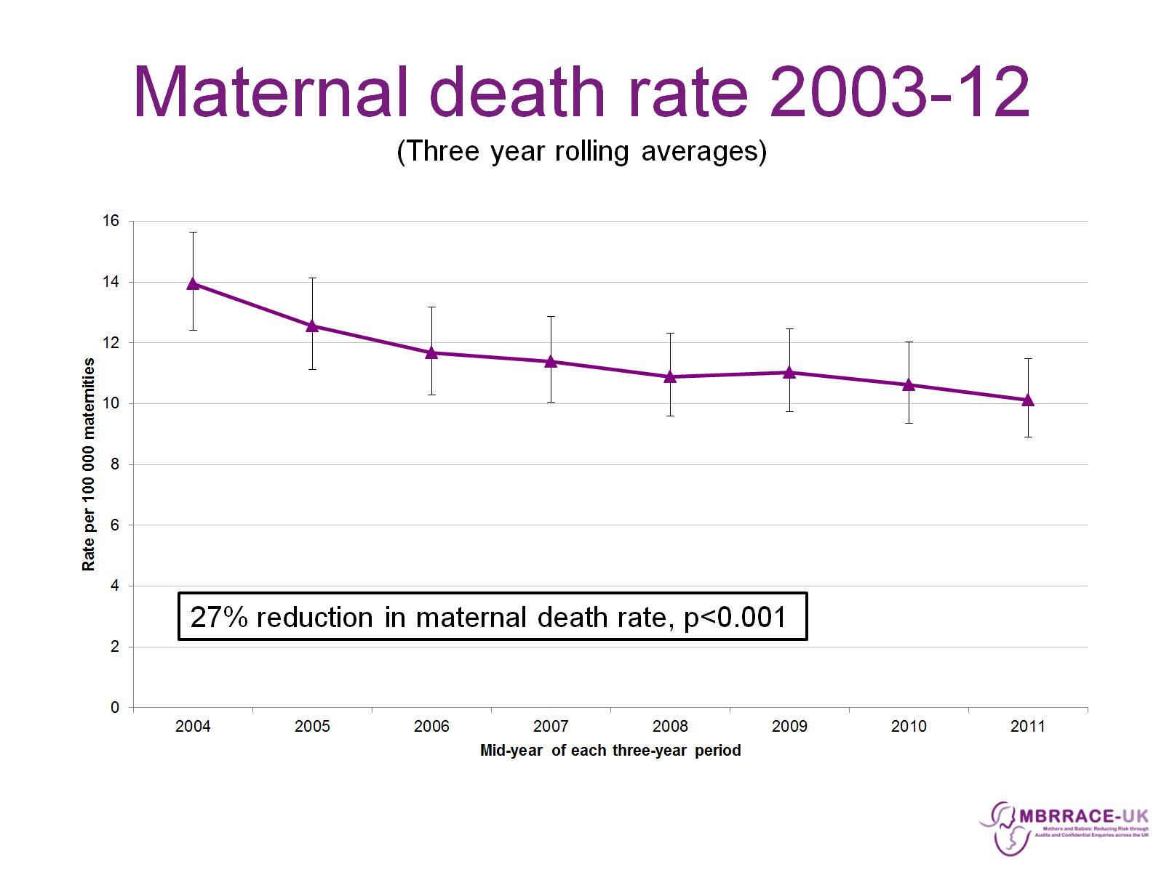
Maternal death rate 2003-12
(Three year rolling averages)

Slide 18
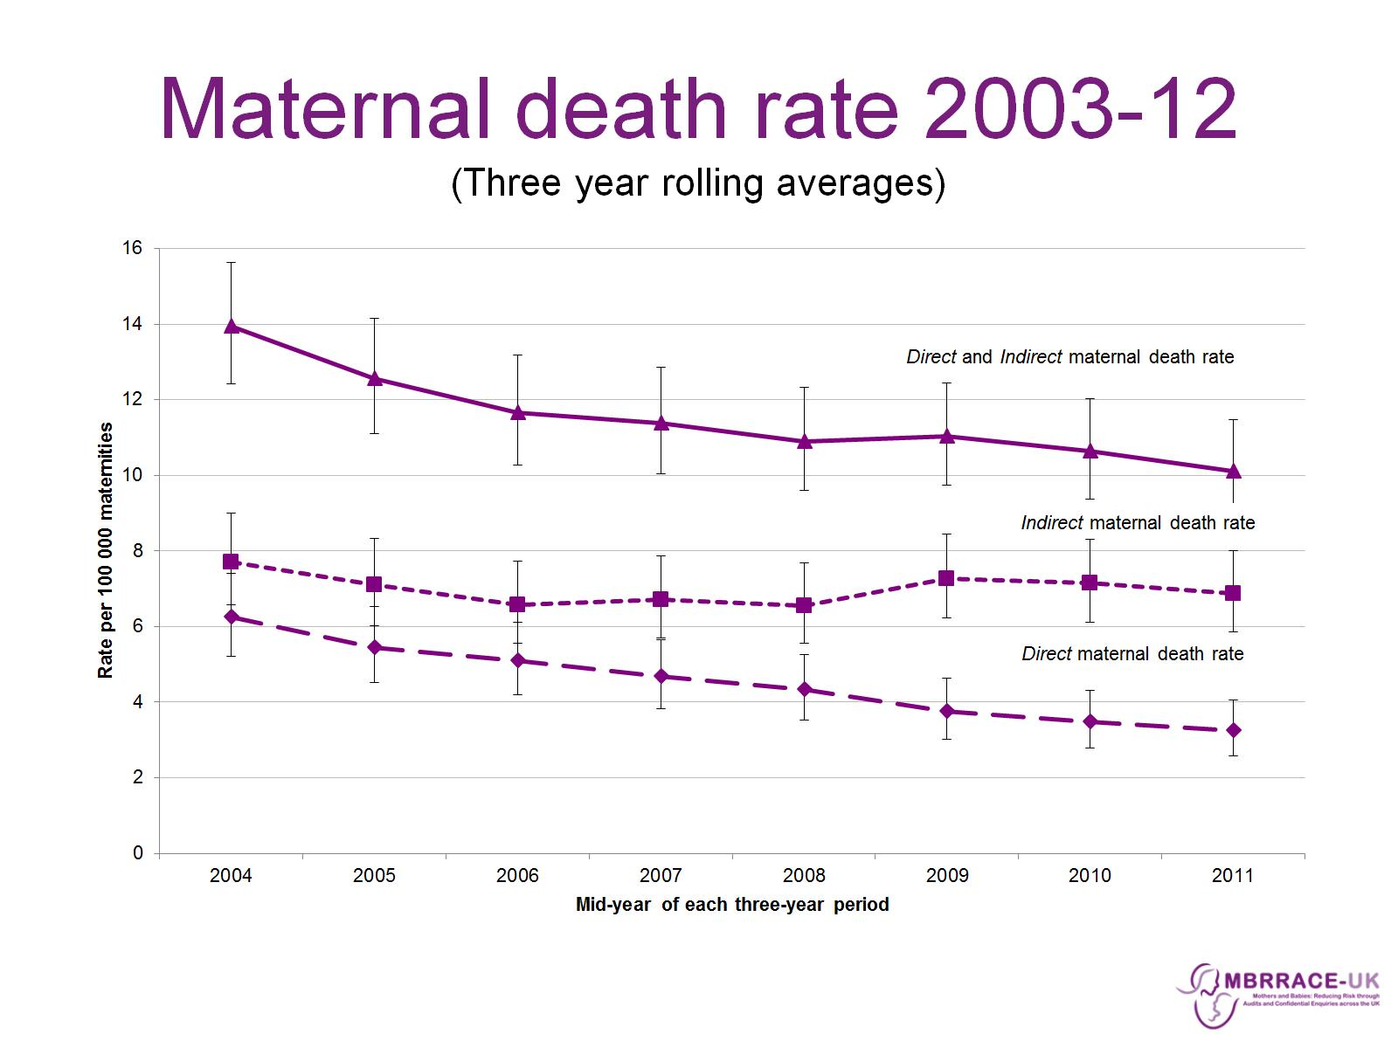
Maternal death rate 2003-12
(Three year rolling averages)

Slide 19
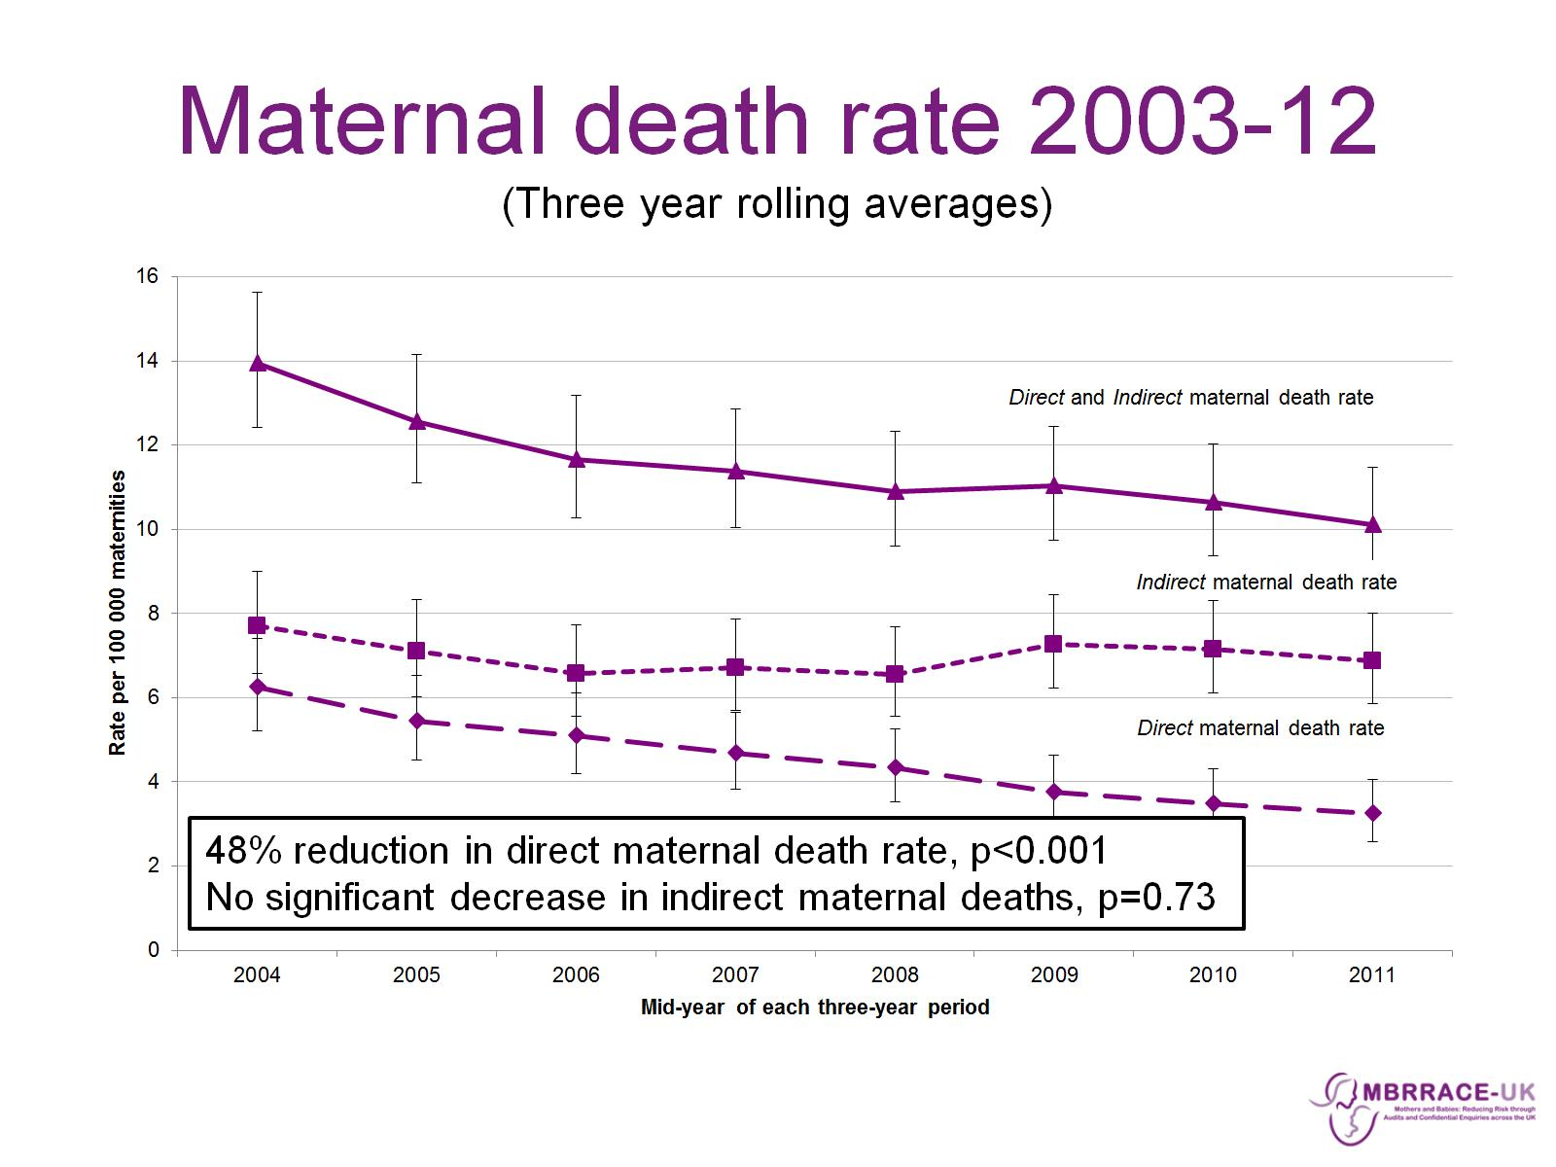
Maternal death rate 2003-12
(Three year rolling averages)

Slide 20
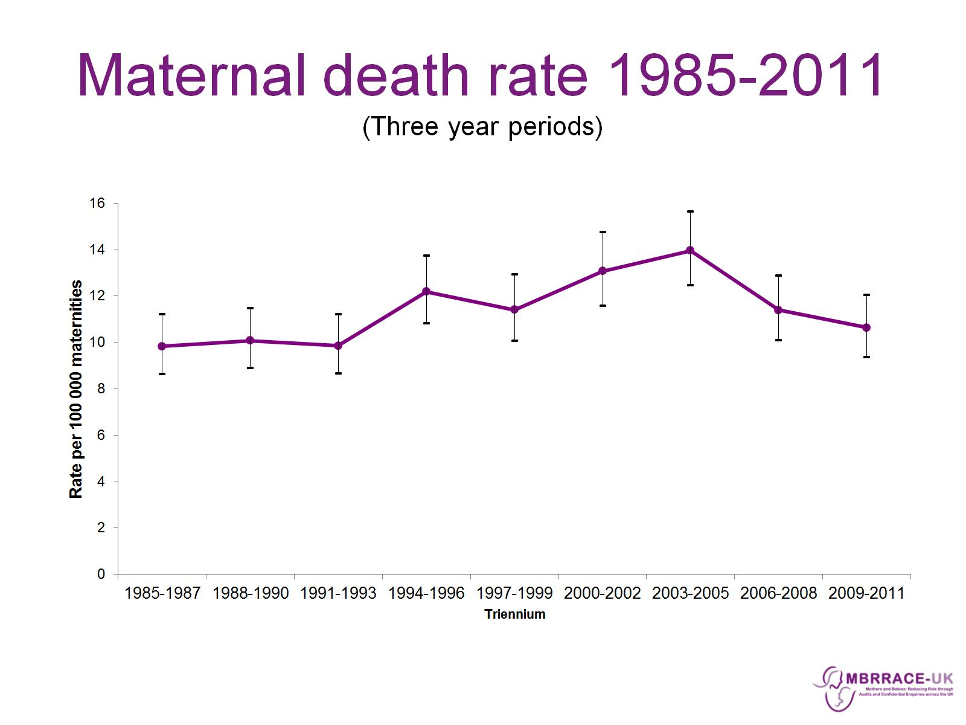
Maternal death rate 1985-2011
(Three year periods)

Slide 21
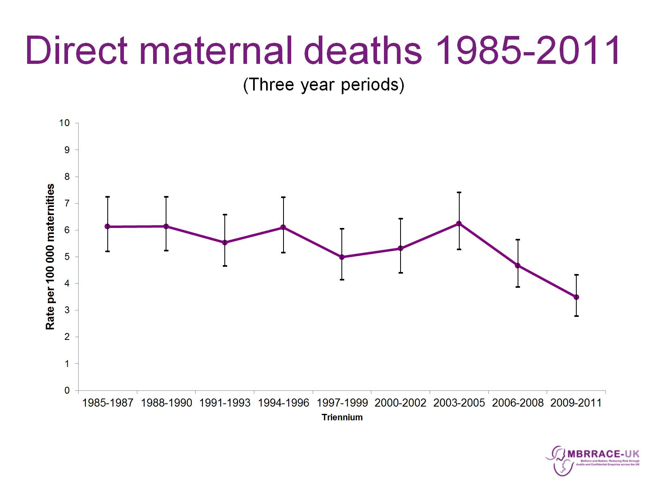
Direct maternal deaths 1985-2011
(Three year periods)

Slide 22
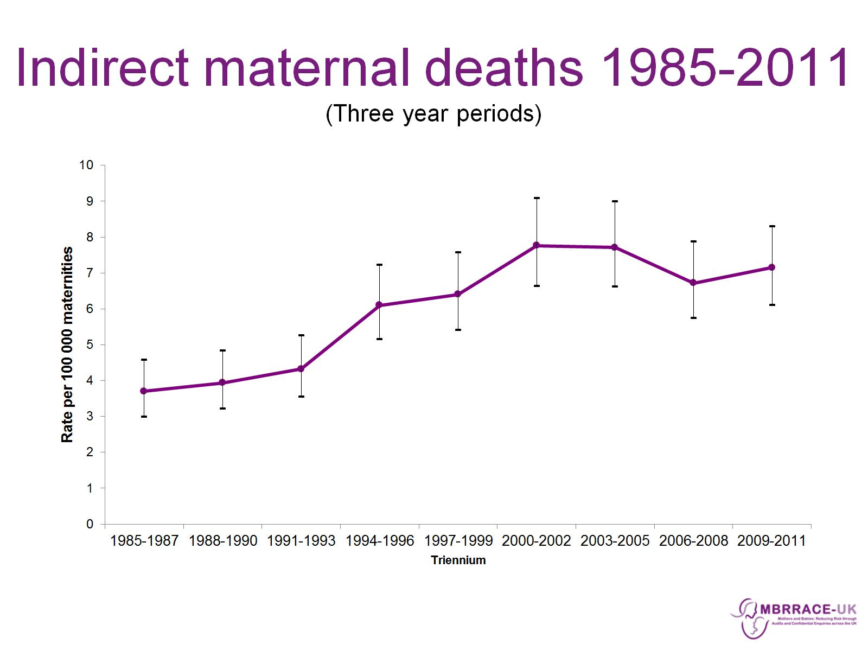
Indirect maternal deaths 1985-2011
(Three year periods)

Slide 23
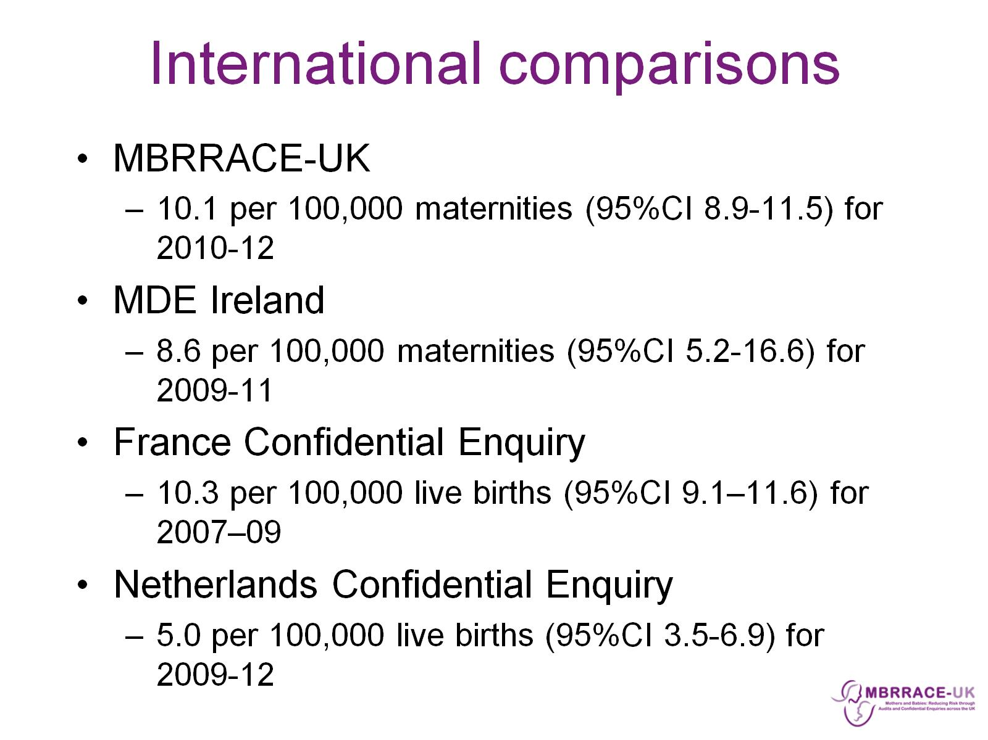
International comparisons

Slide 24
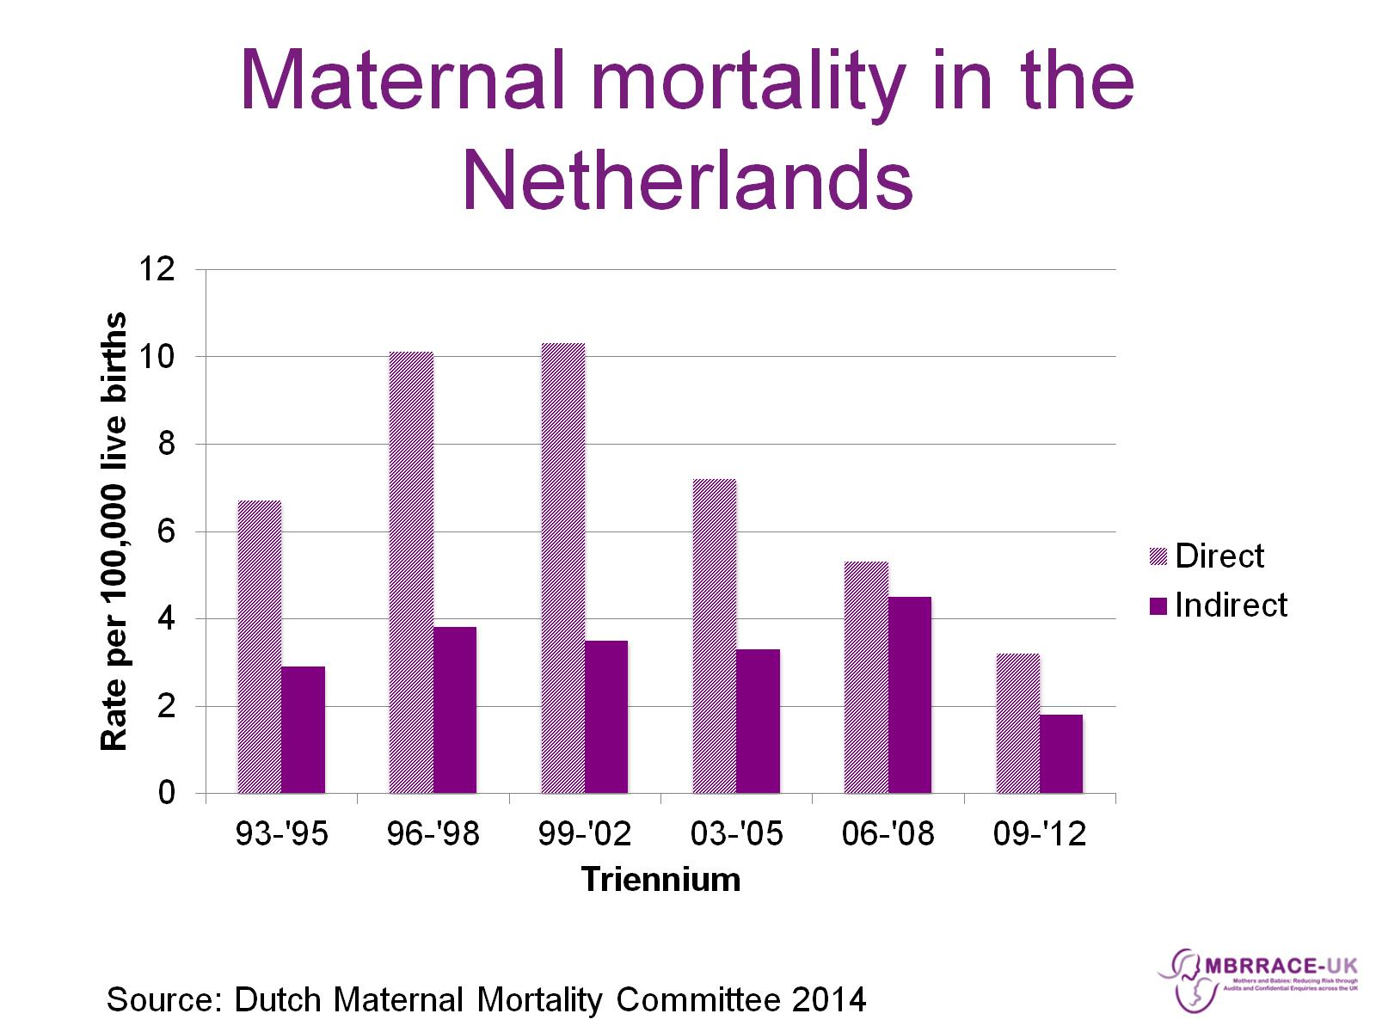
Maternal mortality in the Netherlands

Slide 25
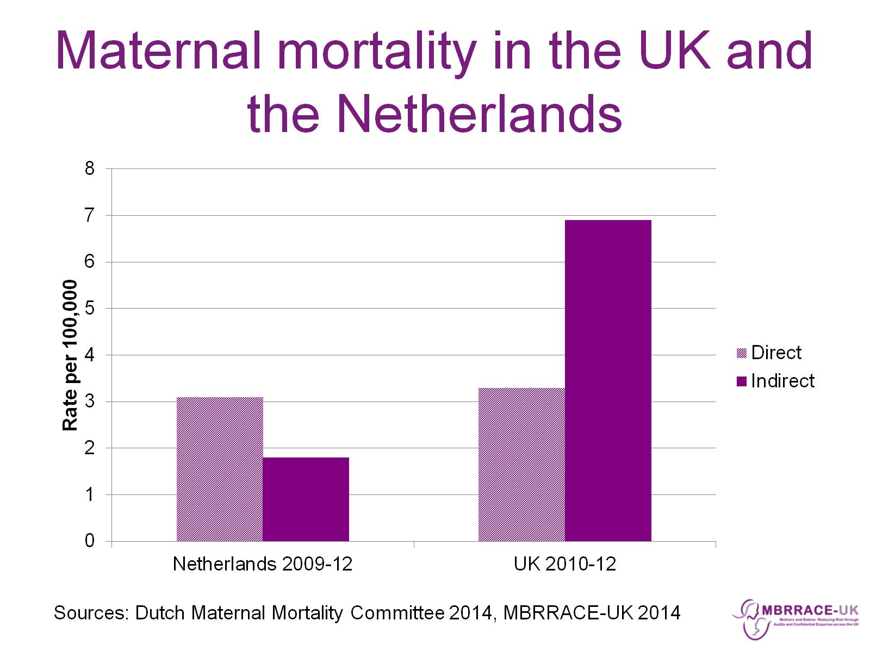
Maternal mortality in the UK and the Netherlands

Slide 26
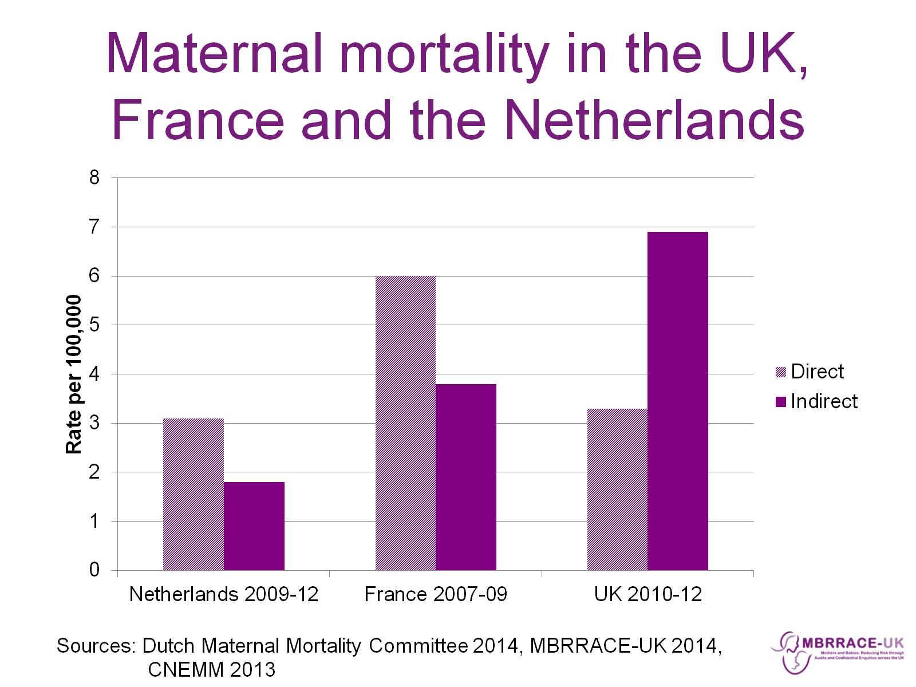
Maternal mortality in the UK, France and the Netherlands

Slide 27
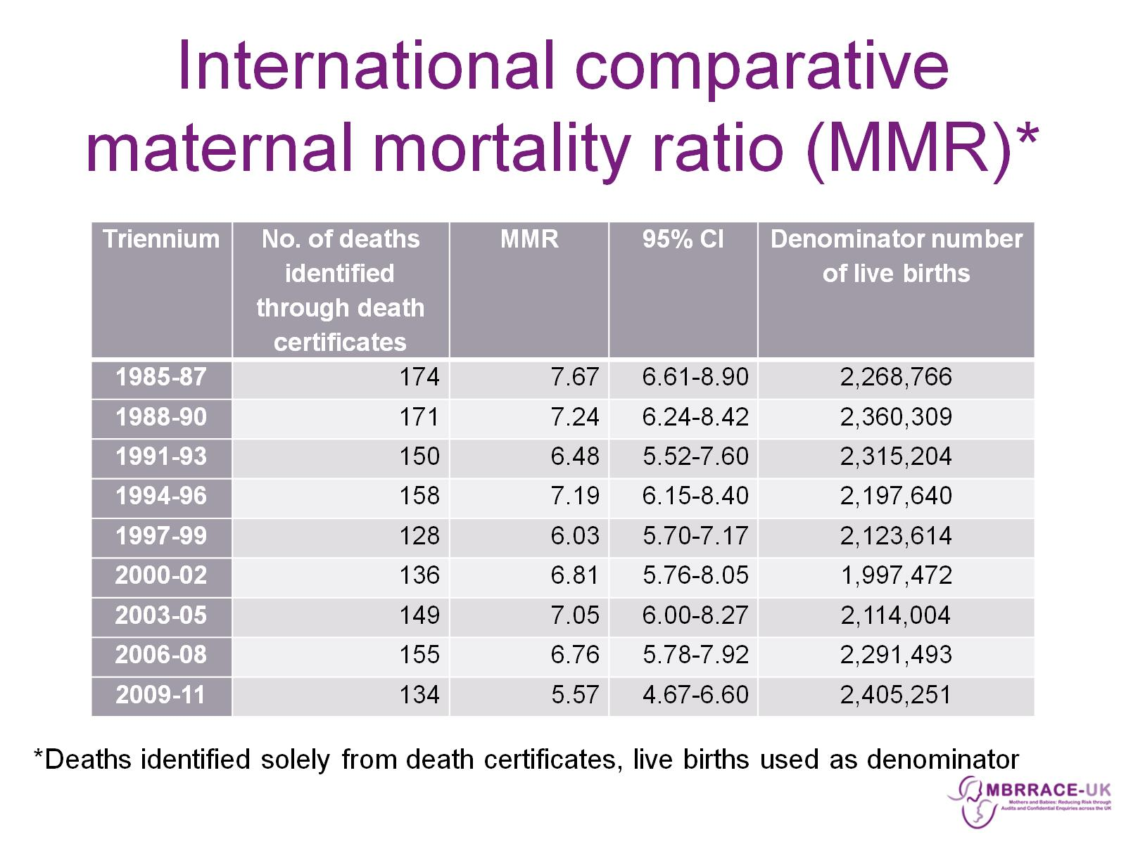
International comparative maternal mortality ratio (MMR)*

Slide 28
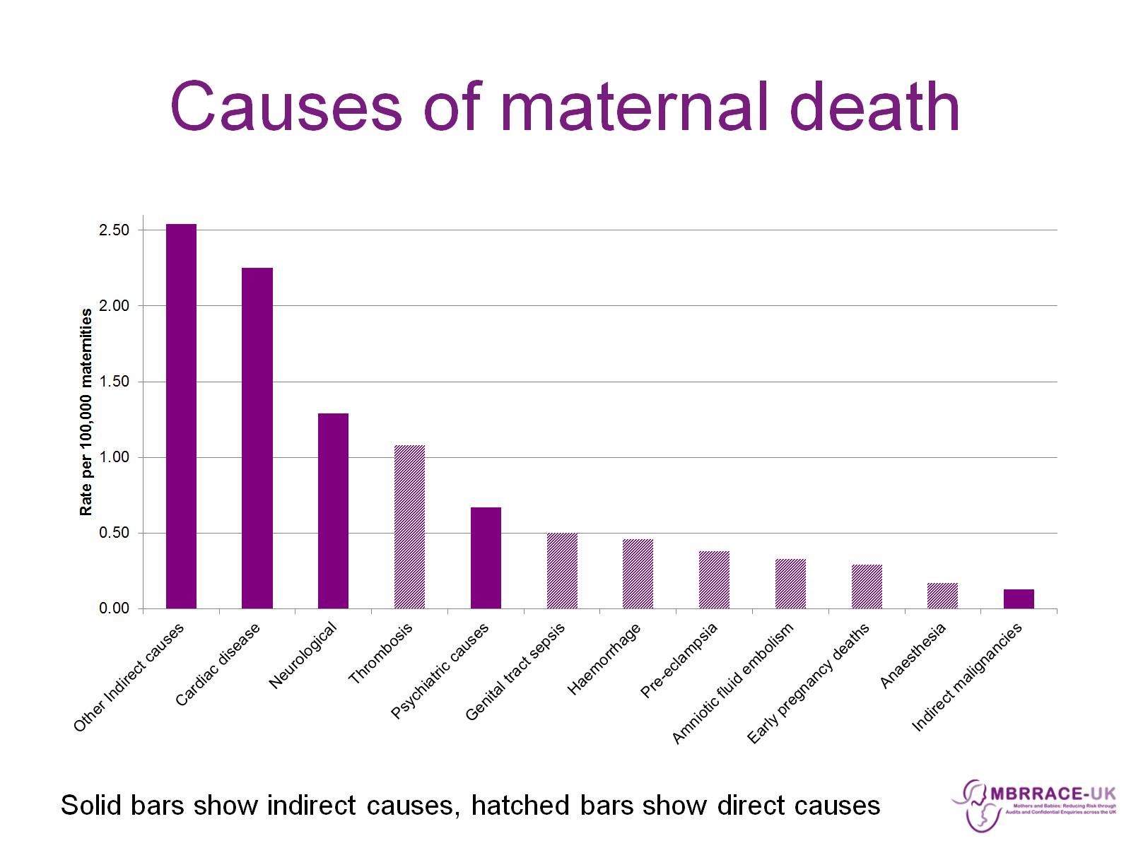
Causes of maternal death

Slide 29
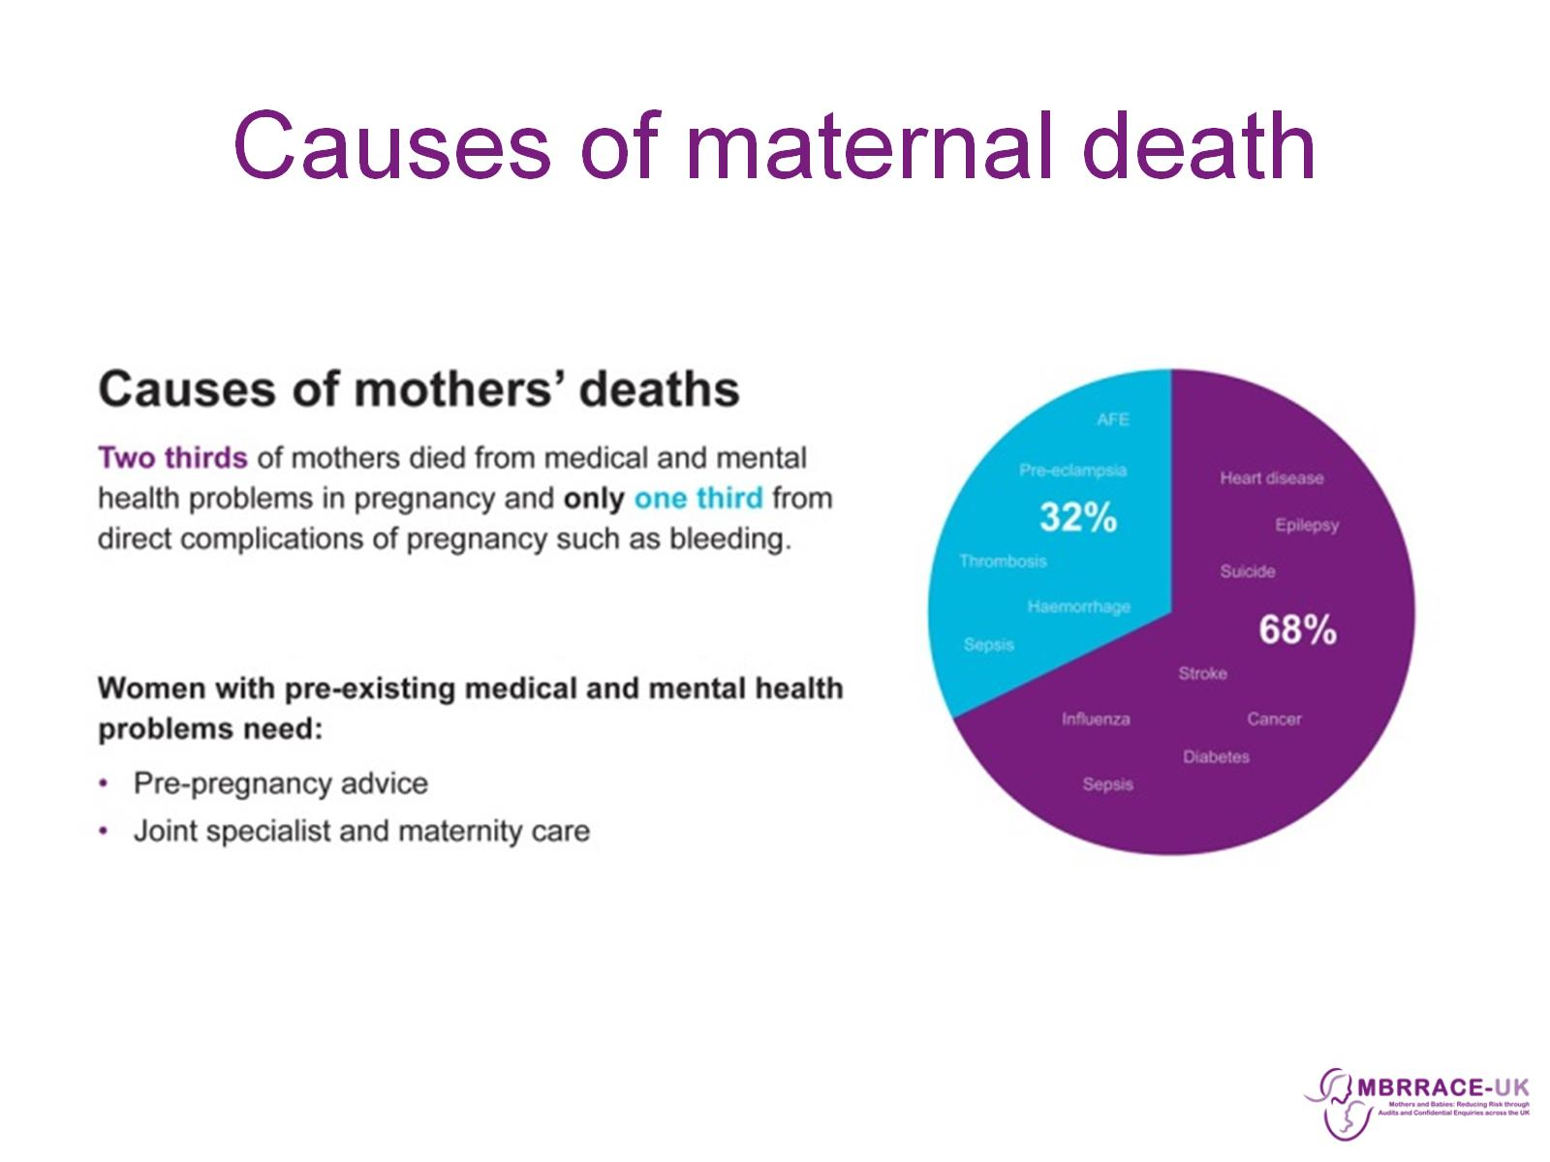
Causes of maternal death

Slide 30
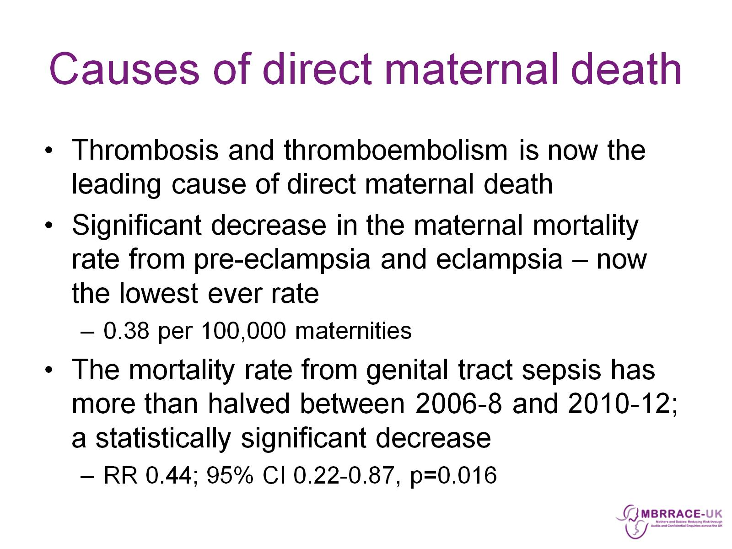
Causes of direct maternal death

Slide 31
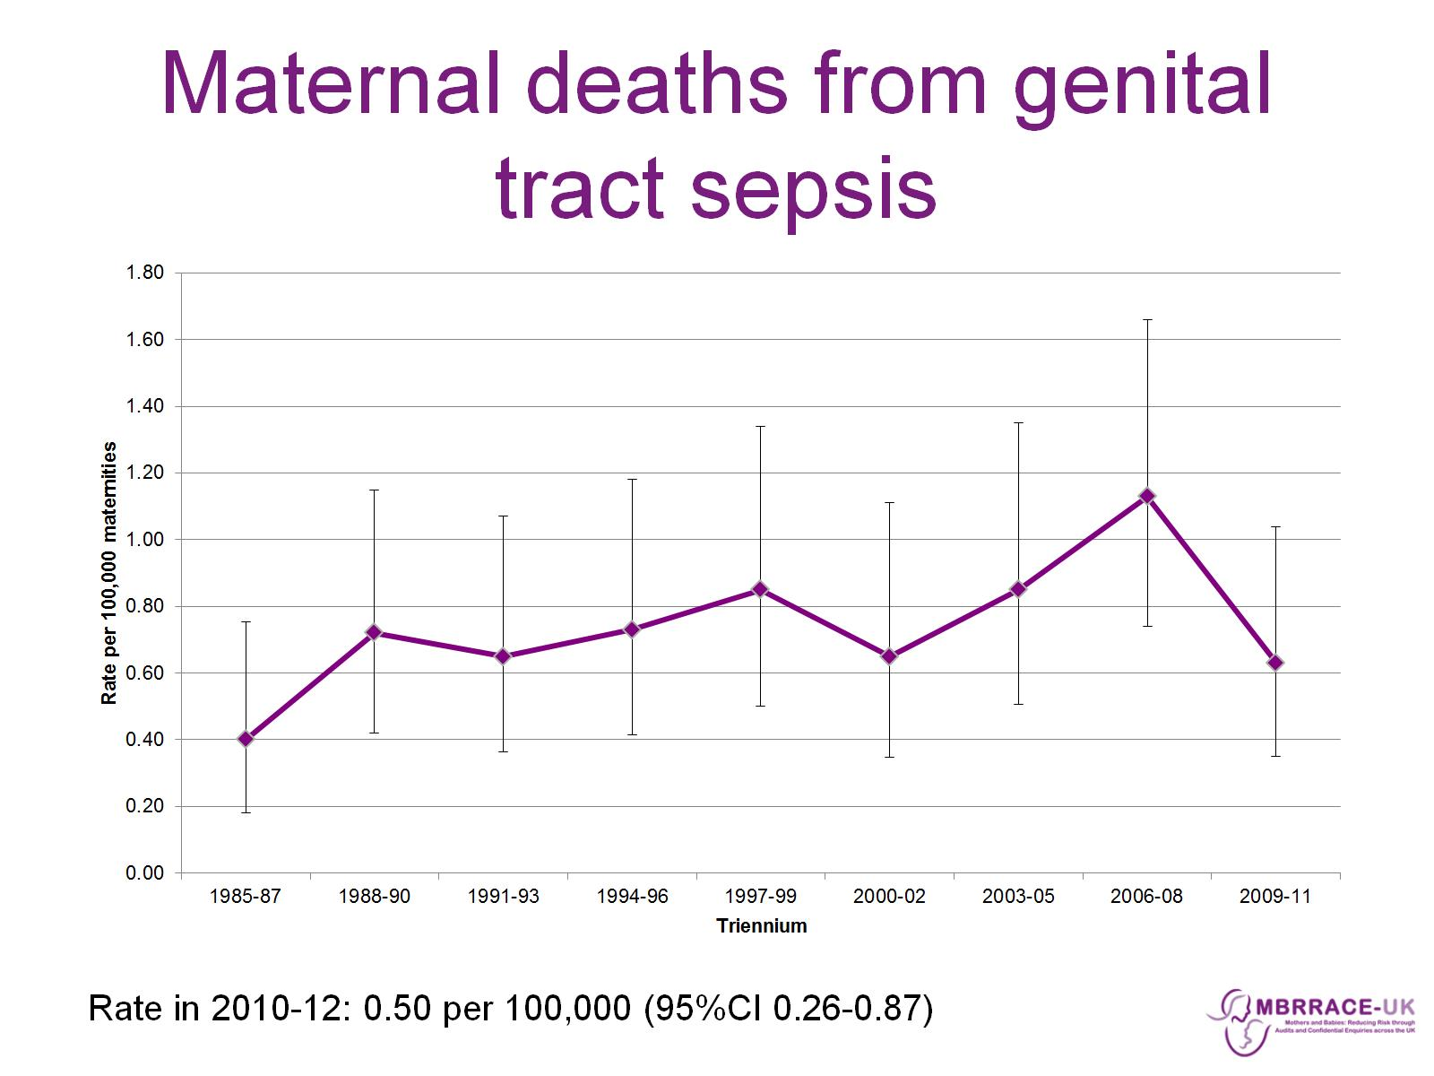
Maternal deaths from genital tract sepsis

Slide 32
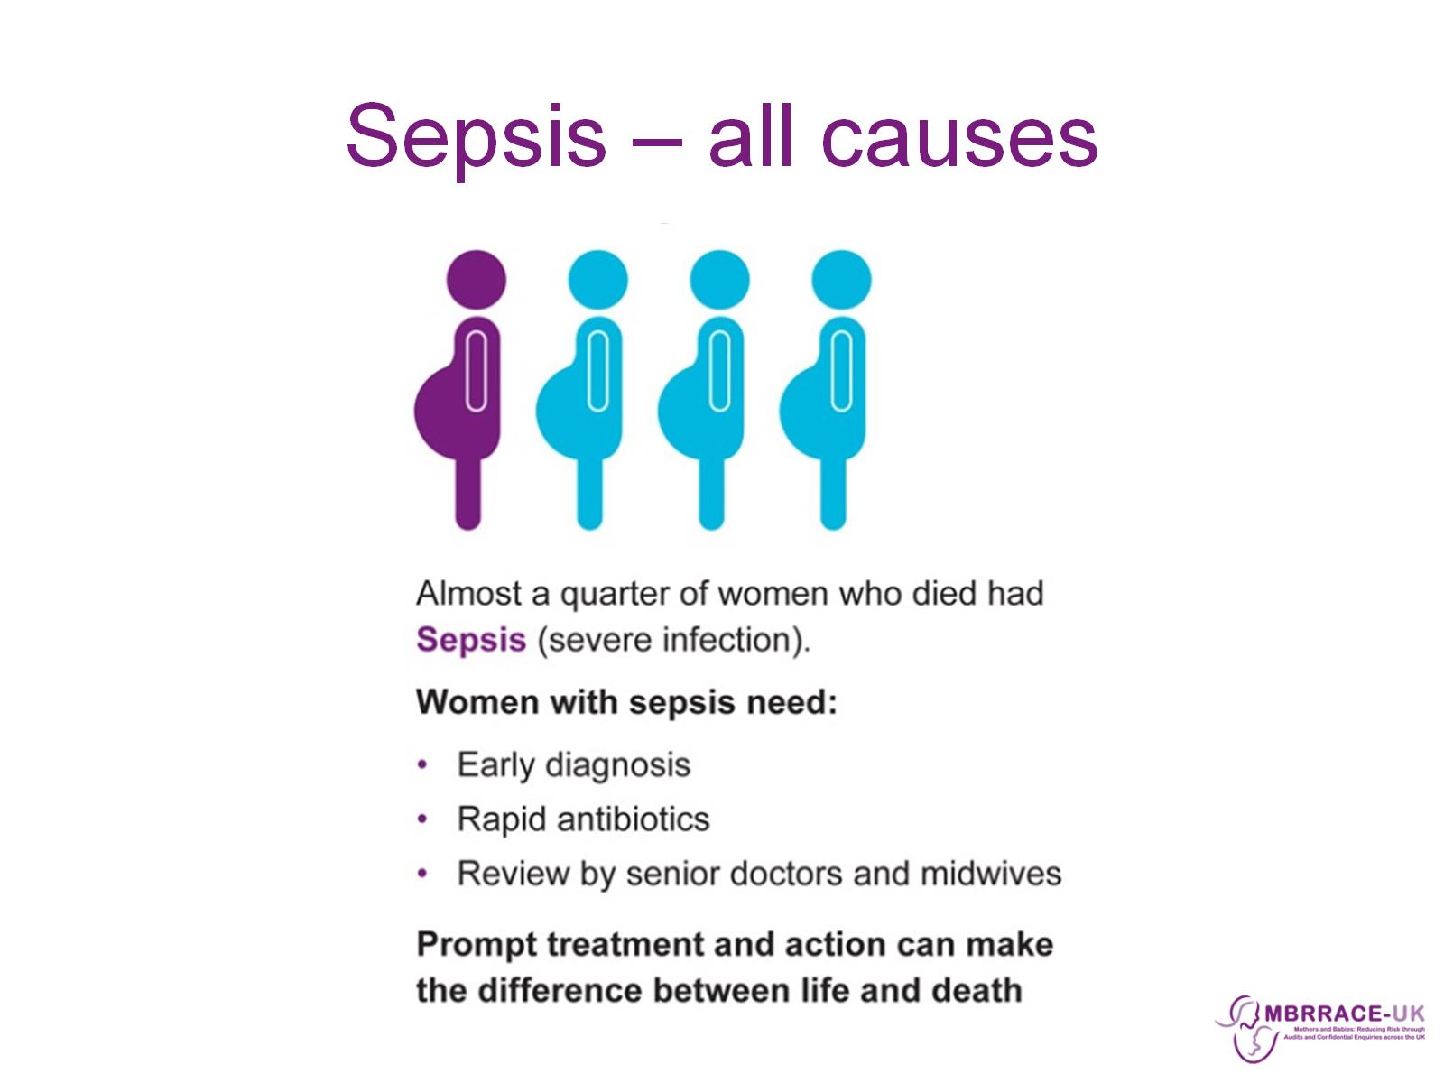
Sepsis – all causes

Slide 33
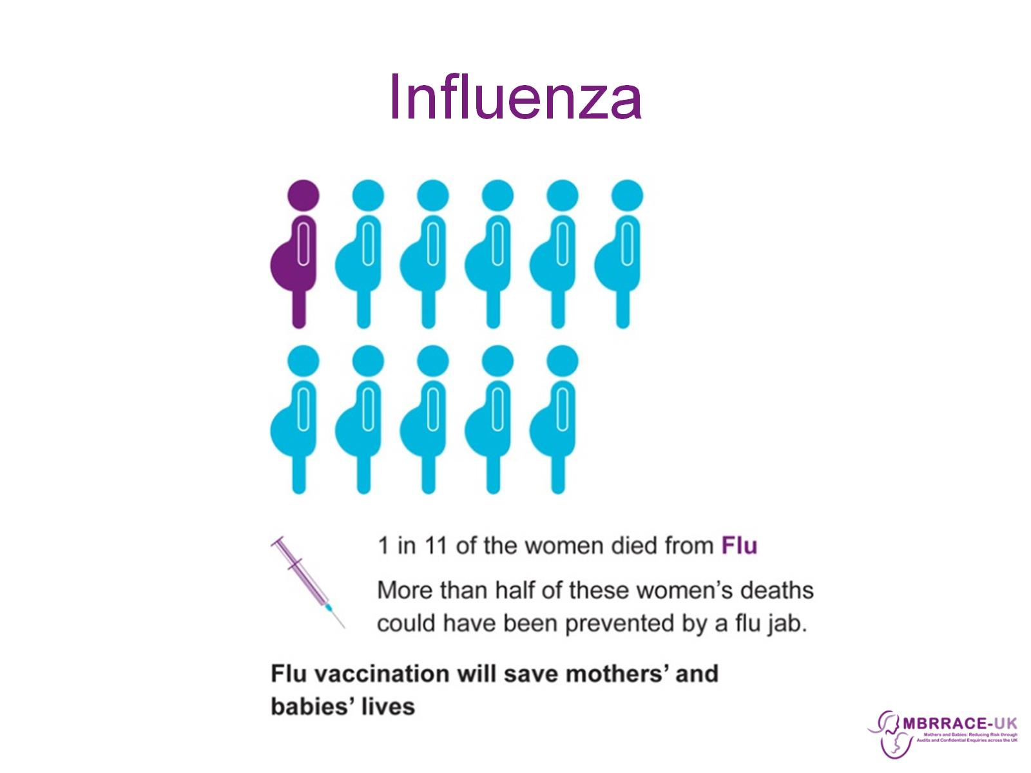
Influenza

Slide 34
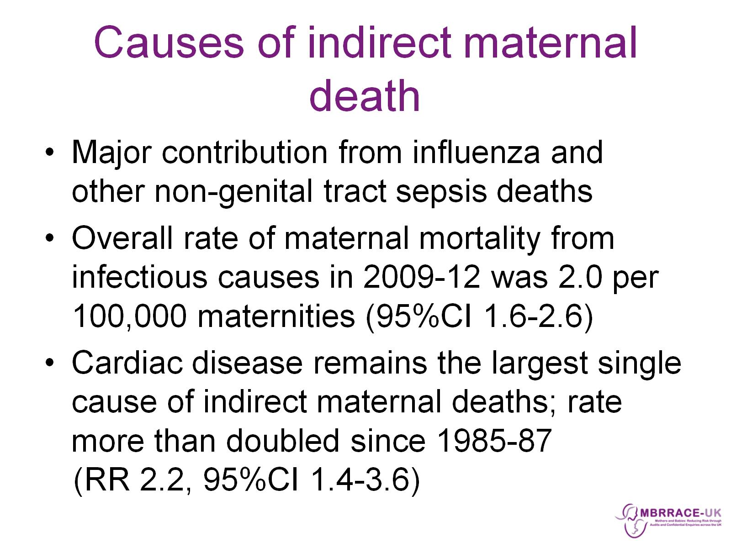
Causes of indirect maternal death

Slide 35
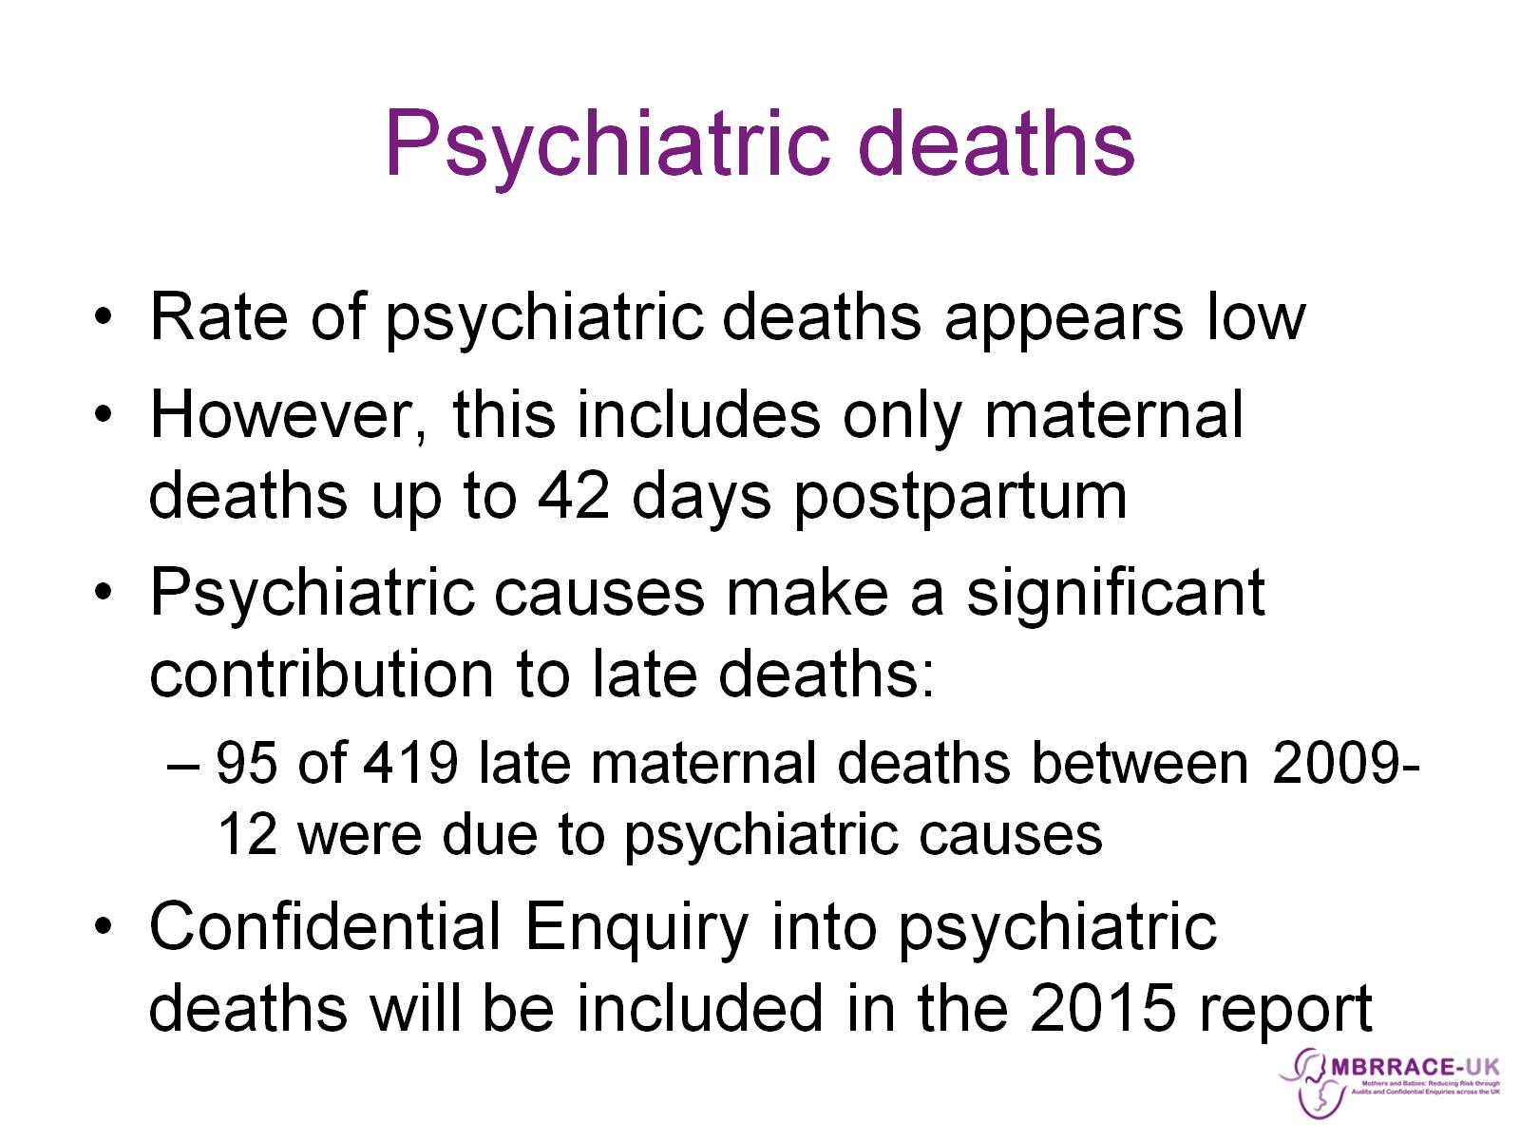
Psychiatric deaths

Slide 36
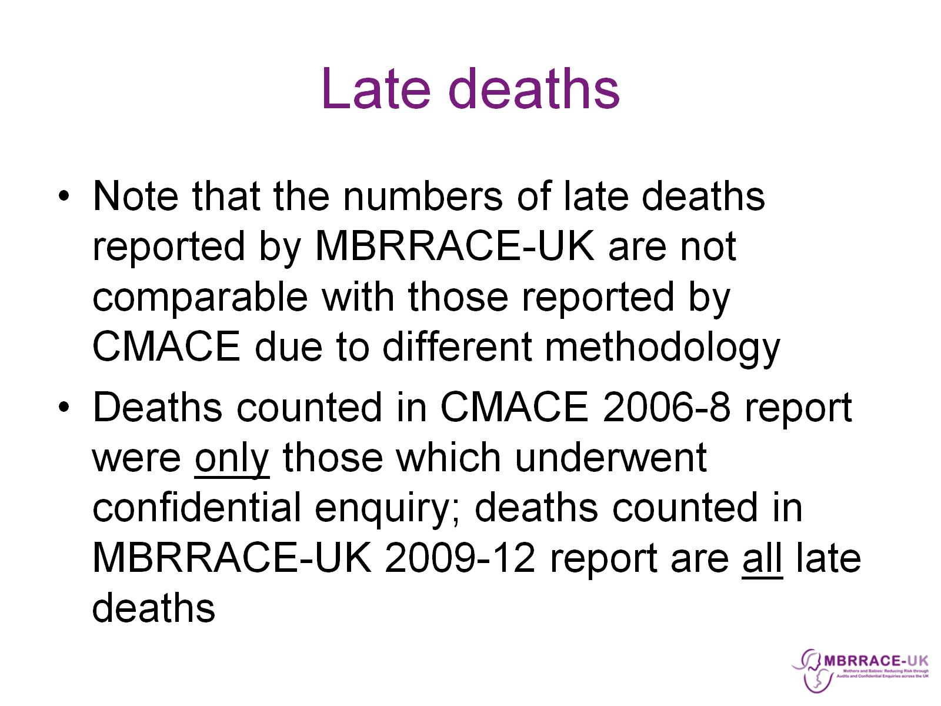
Late deaths

Slide 37
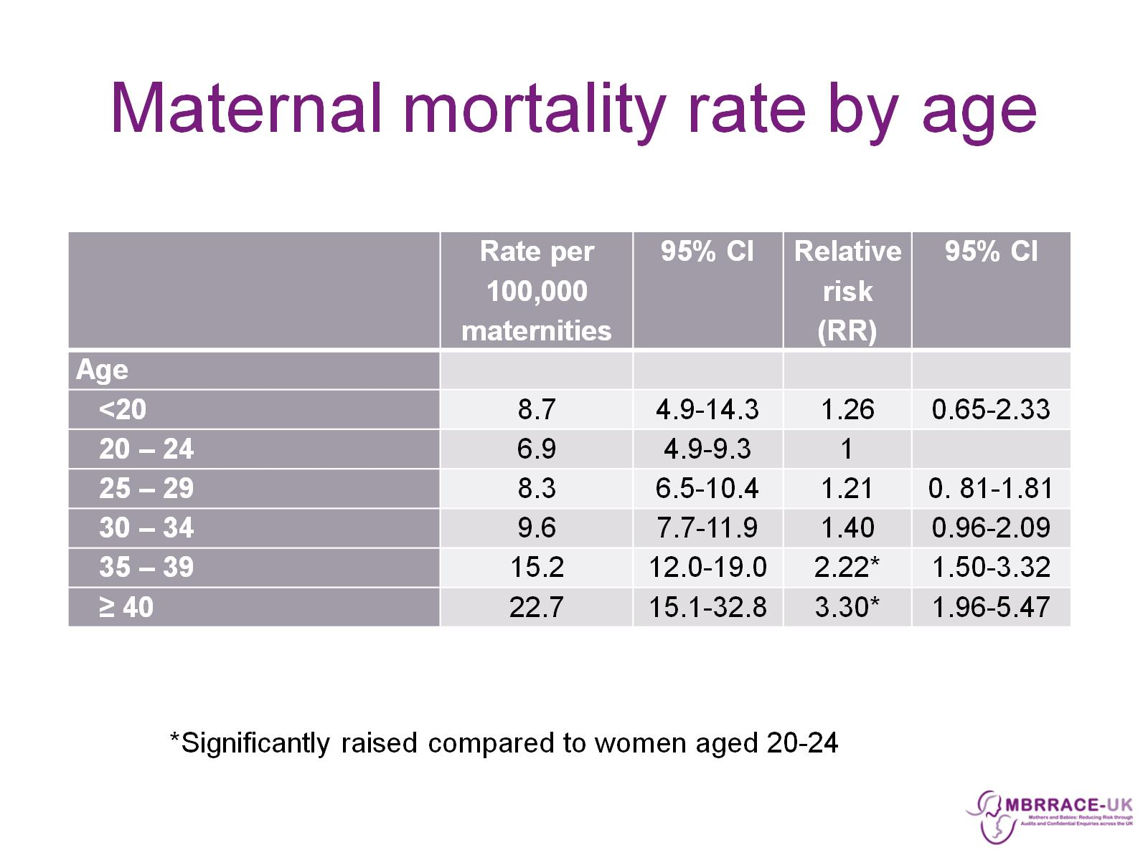
Maternal mortality rate by age

Slide 38
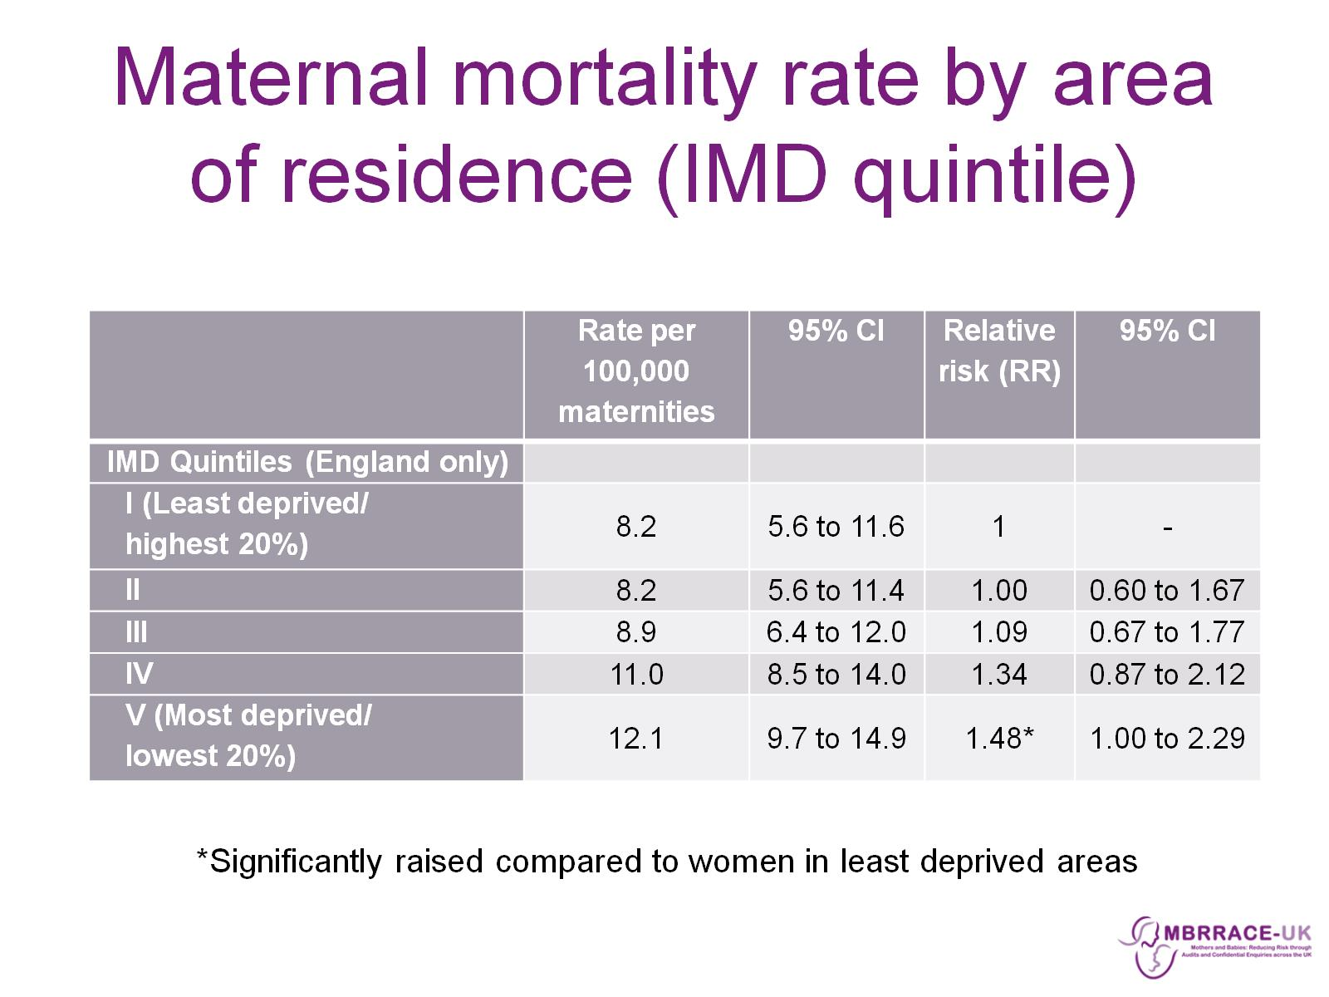
Maternal mortality rate by area of residence (IMD quintile)

Slide 39
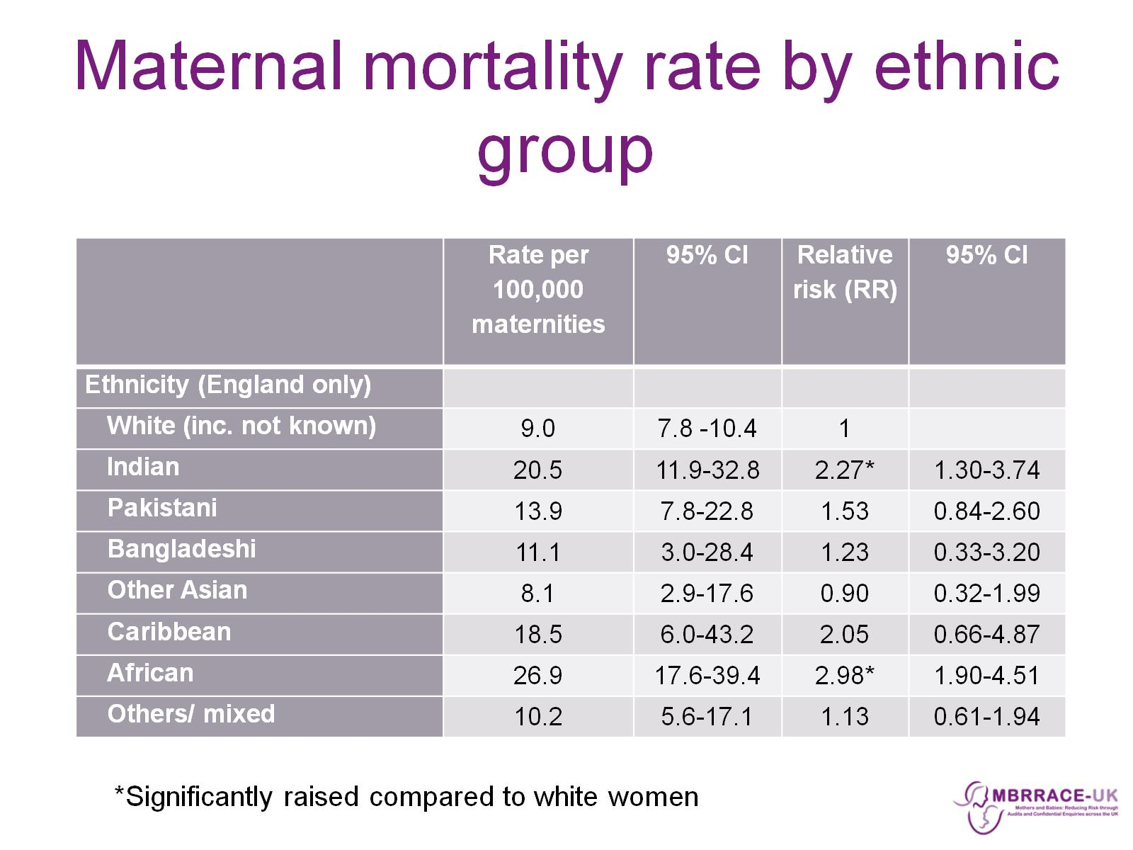
Maternal mortality rate by ethnic group

Slide 40
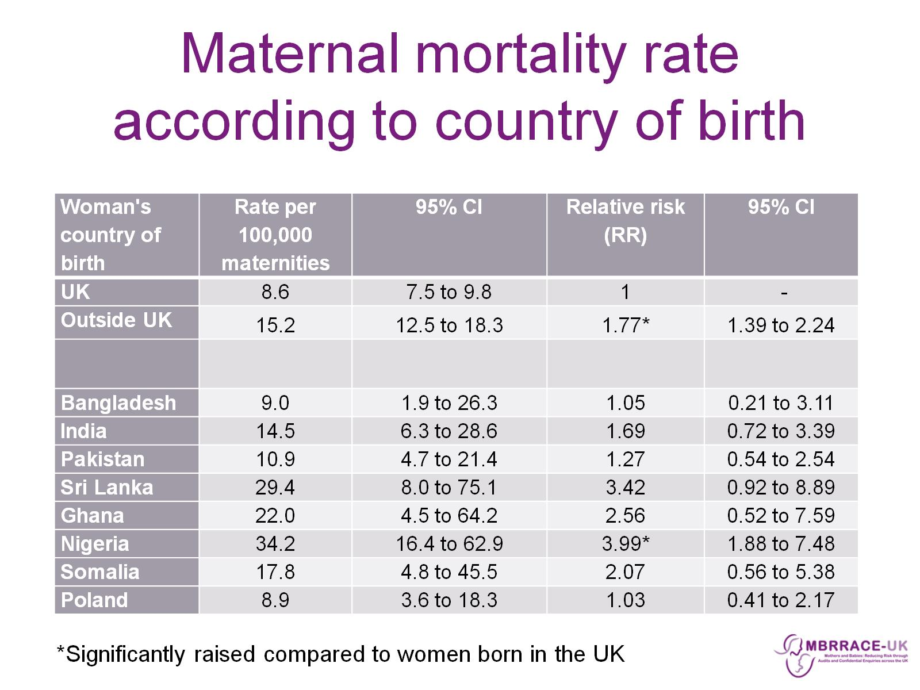
Maternal mortality rate according to country of birth

Slide 41
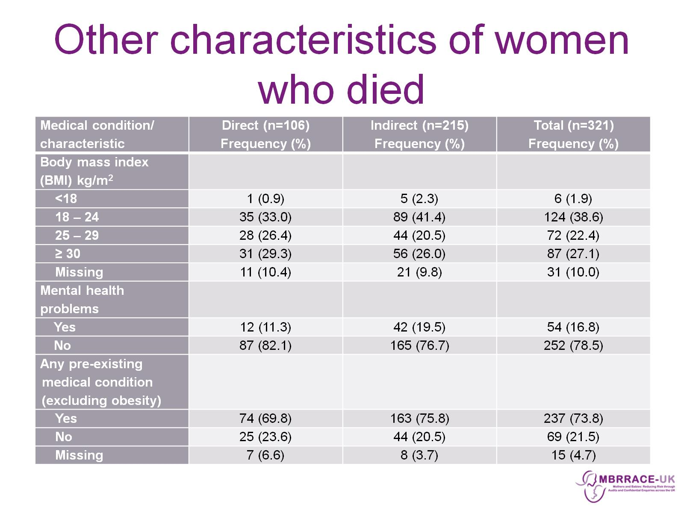
Other characteristics of women who died

Slide 42
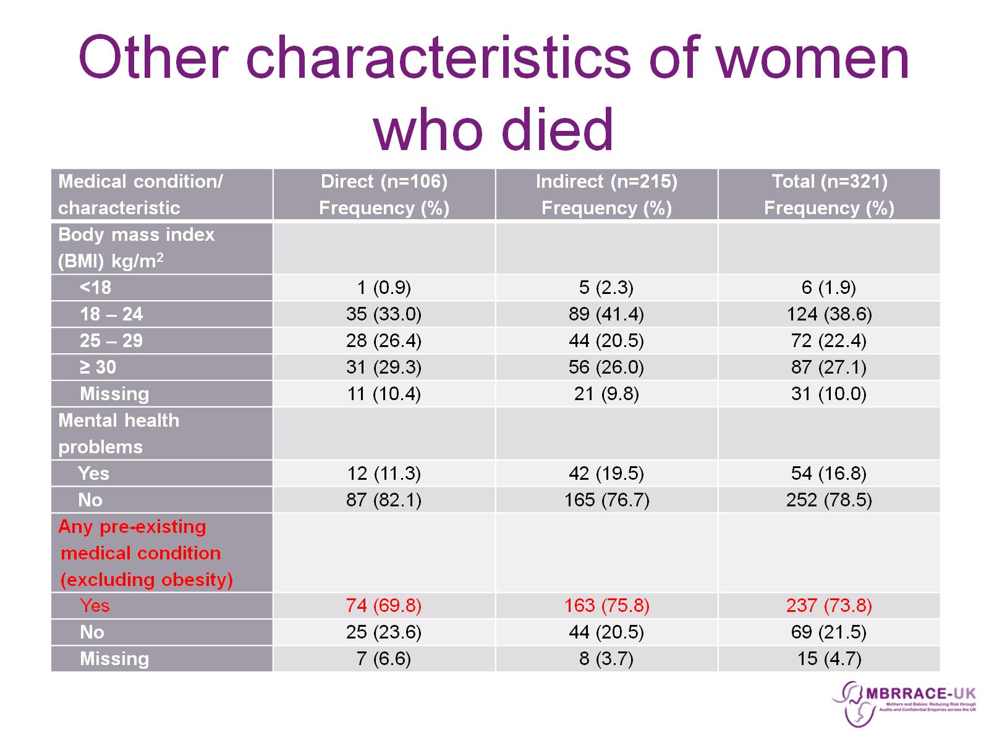
Other characteristics of women who died

Slide 43
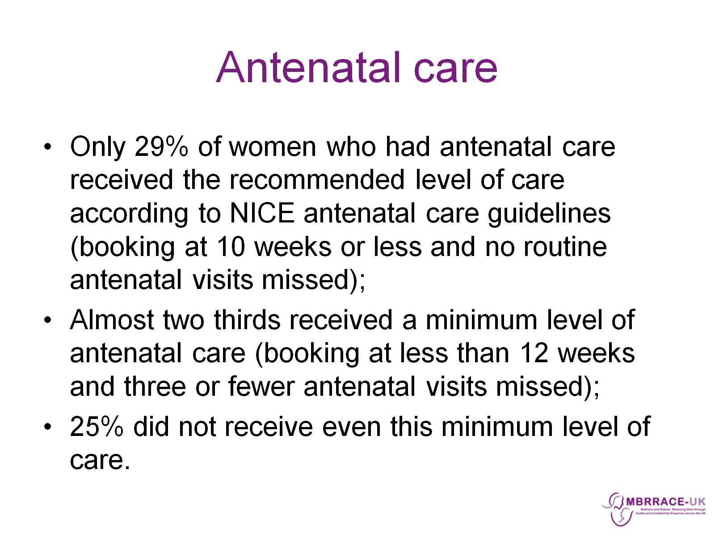
Antenatal care

Slide 44
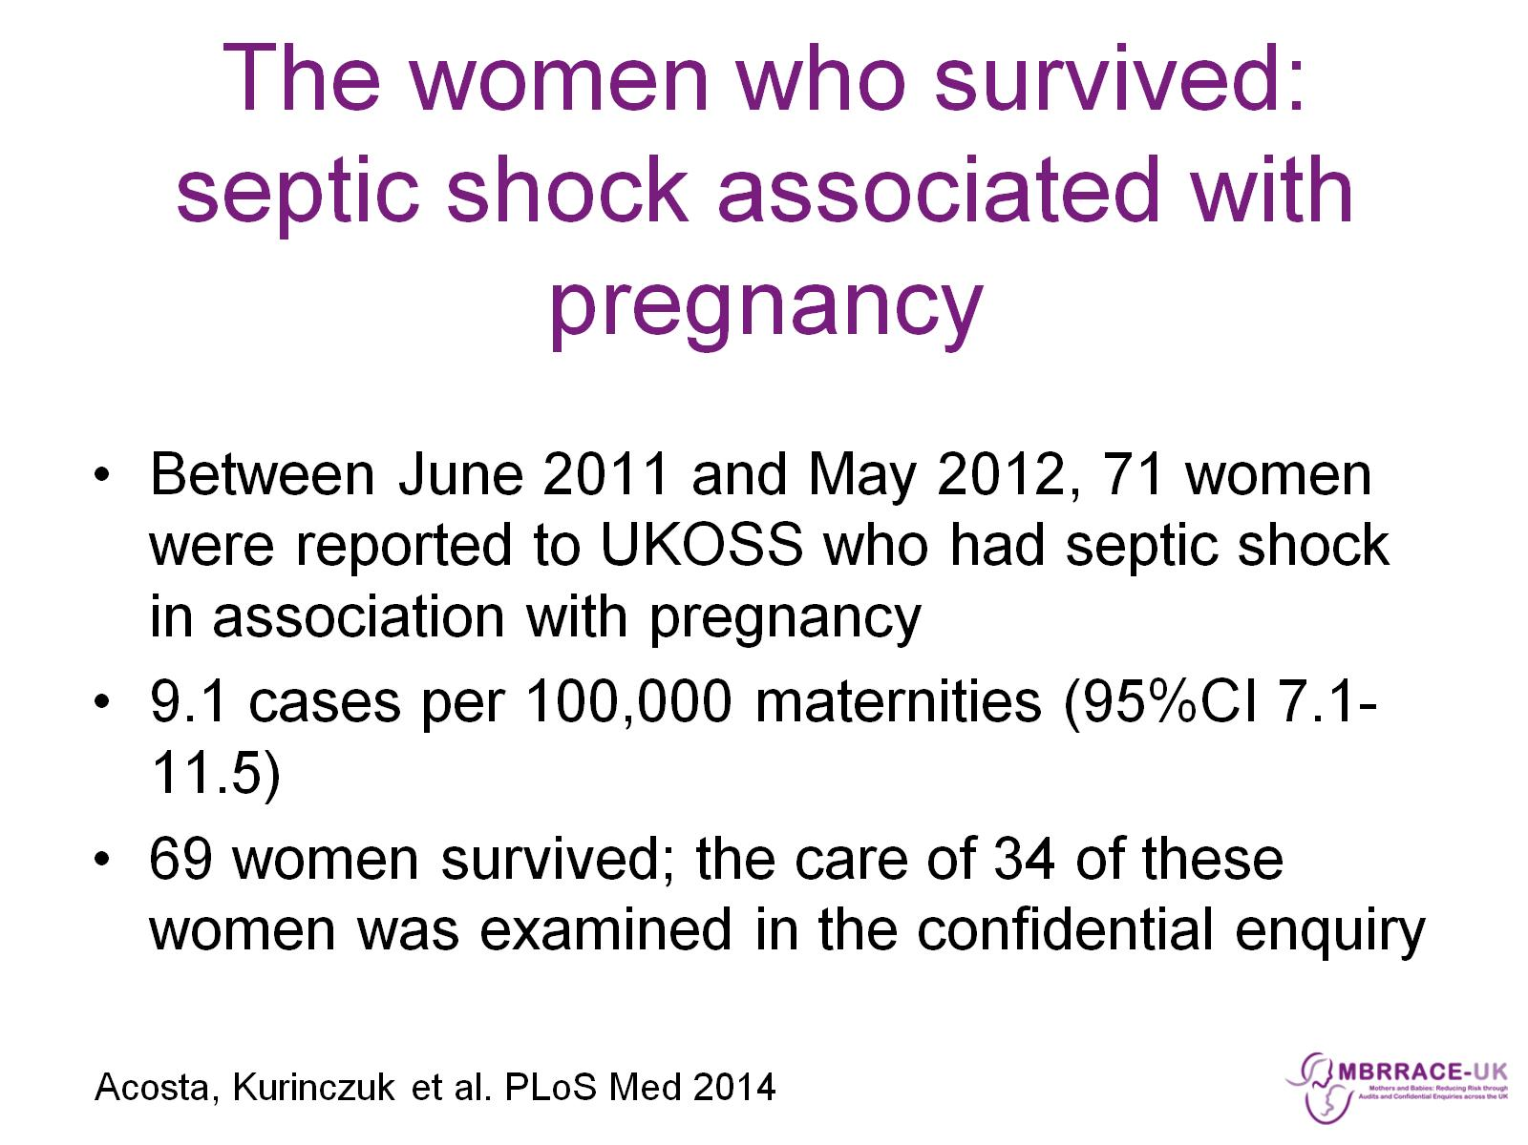
The women who survived: septic shock associated with pregnancy

Slide 45
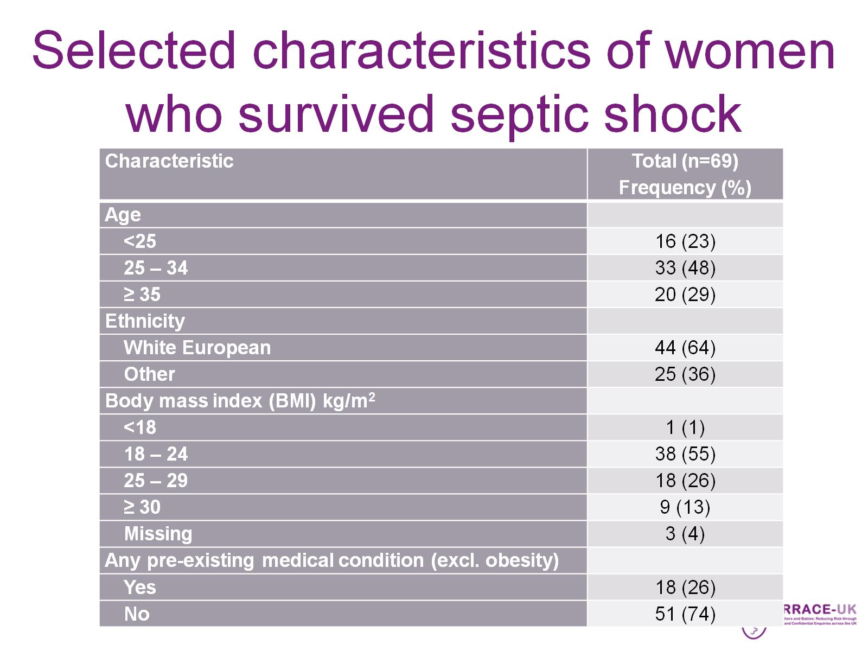
Selected characteristics of women who survived septic shock

Slide 46

Results: Confidential enquiries

Slide 47
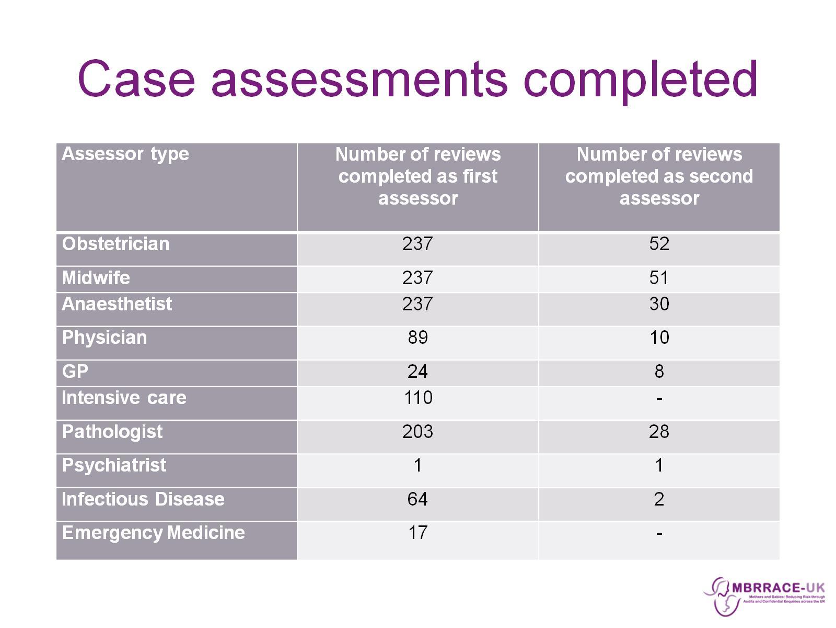
Case assessments completed

Slide 48
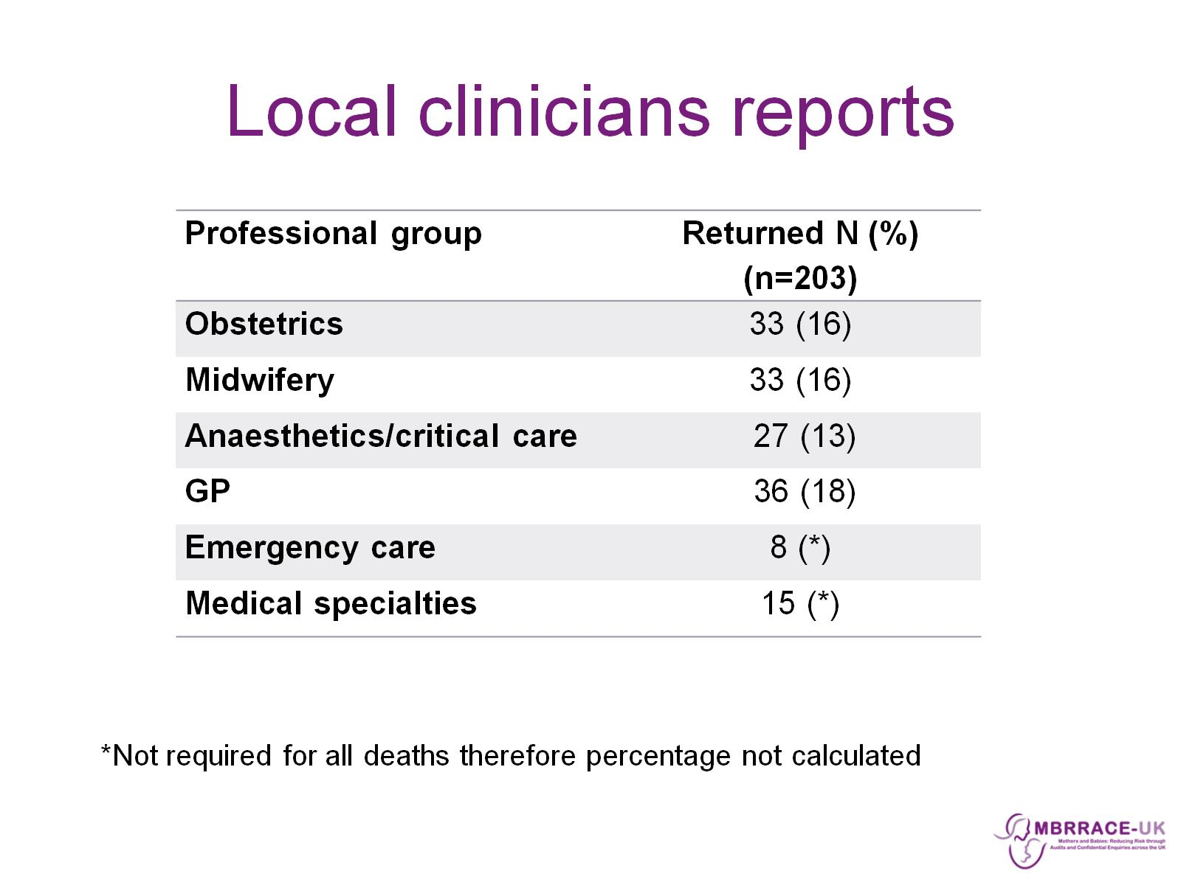
Local clinicians reports

Slide 49
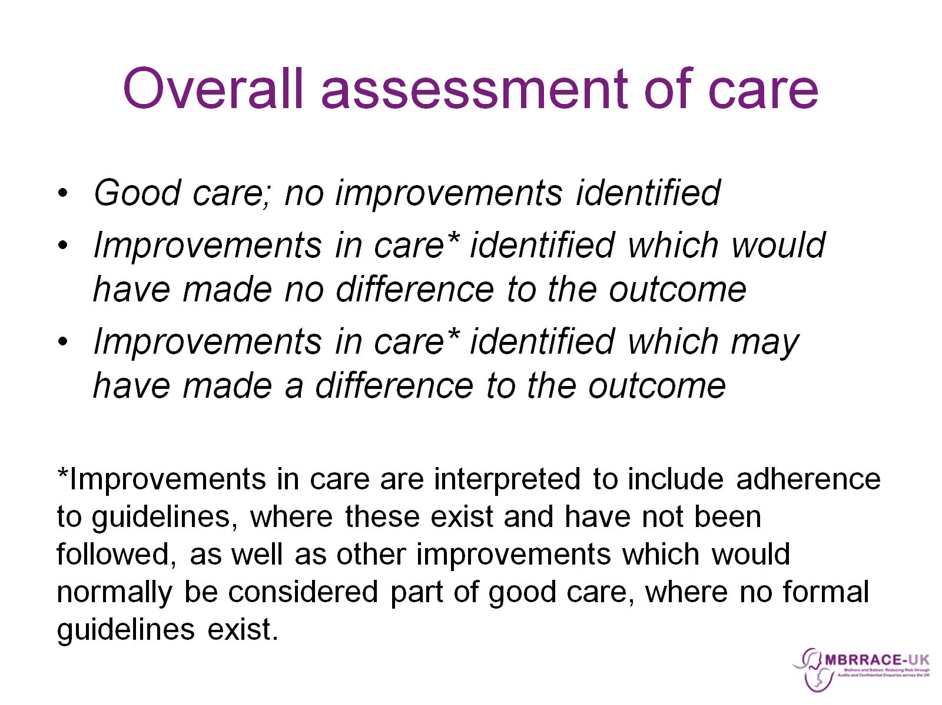
Overall assessment of care

Slide 50
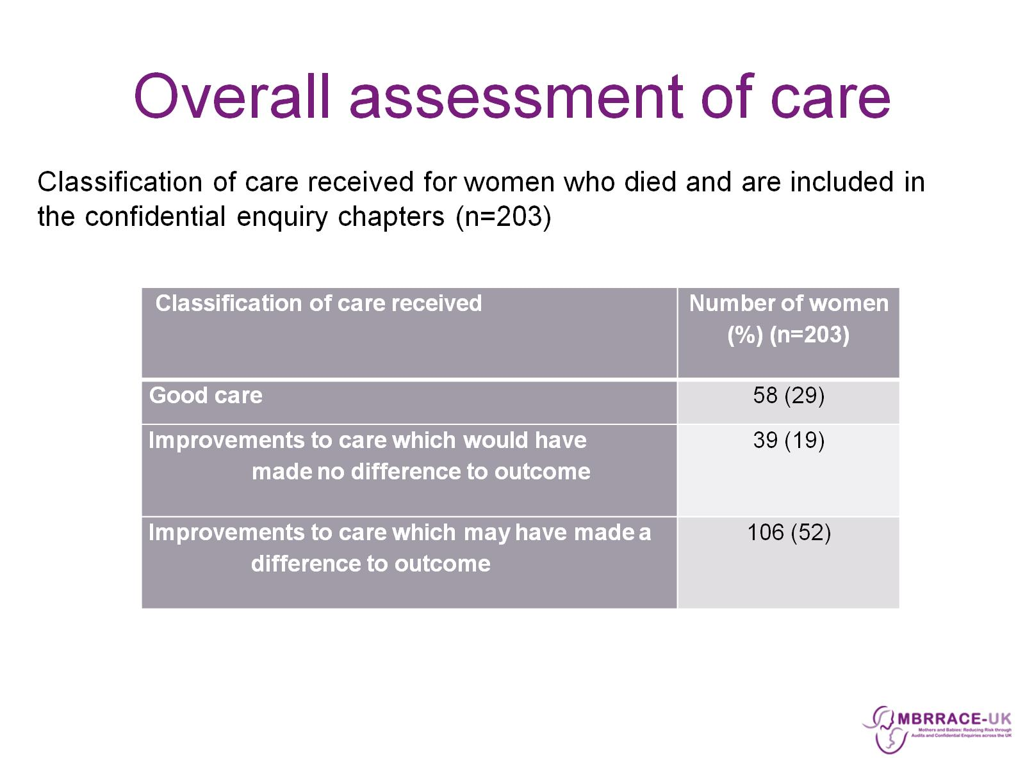
Overall assessment of care

Slide 51
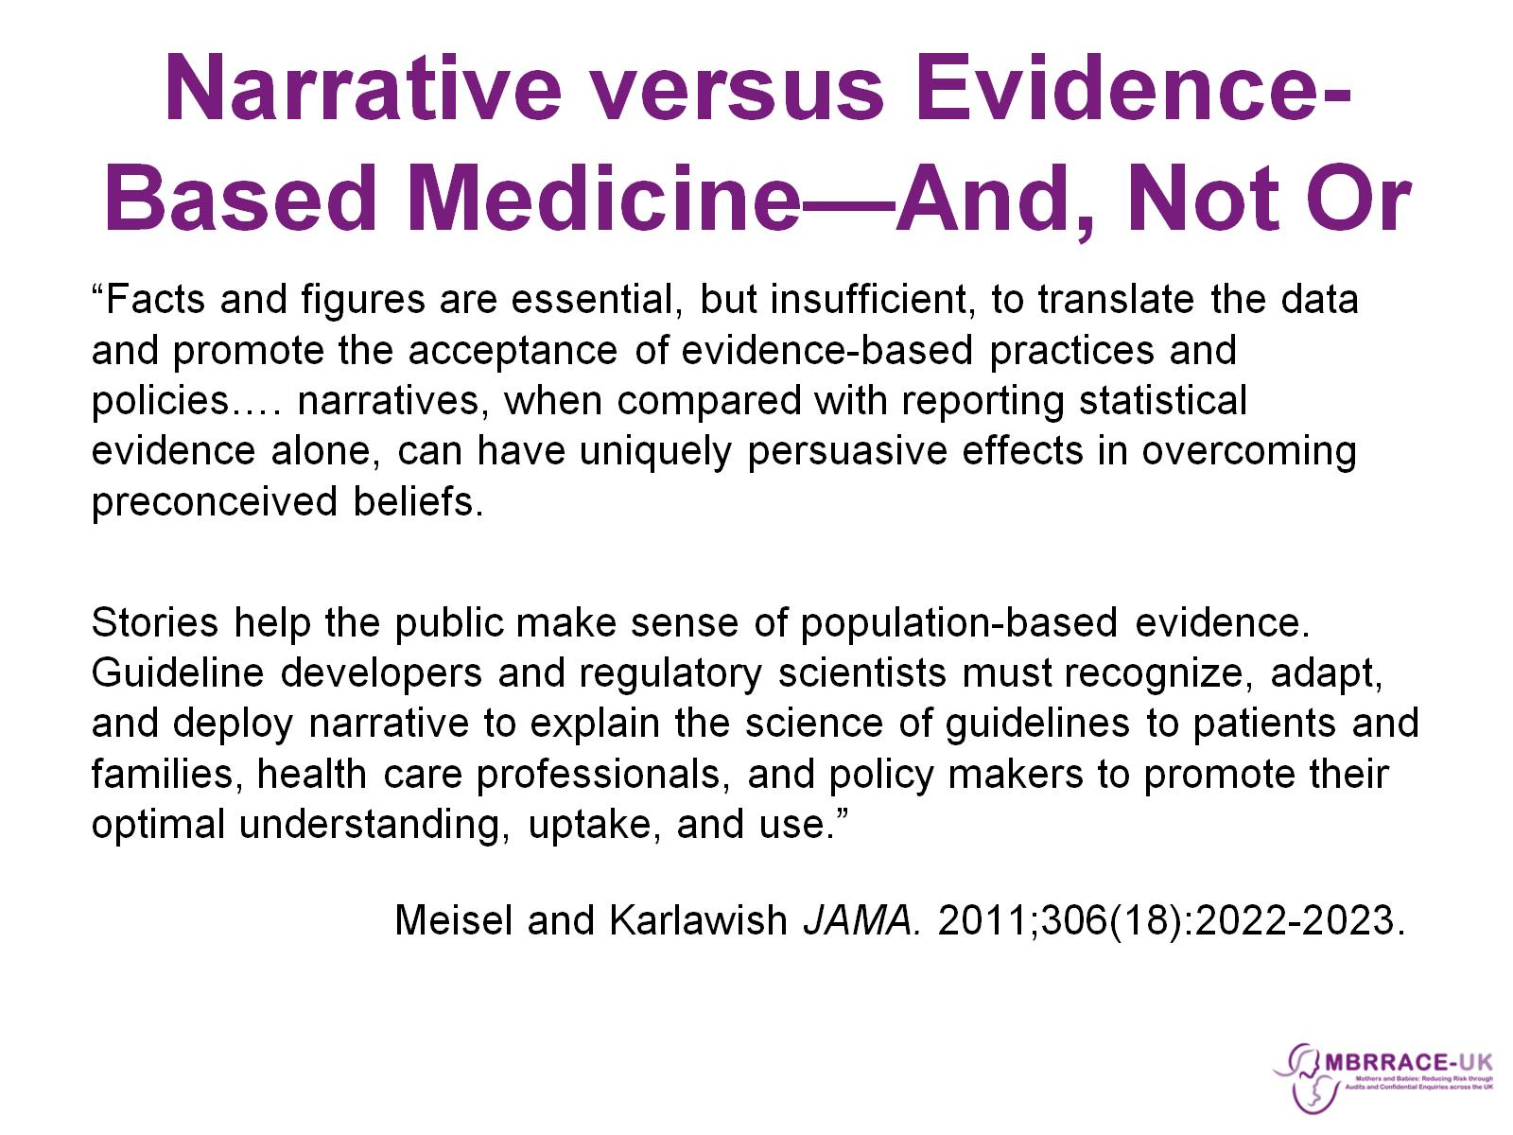
Narrative versus Evidence-Based Medicine—And, Not Or

Slide 52

Summary

Slide 53
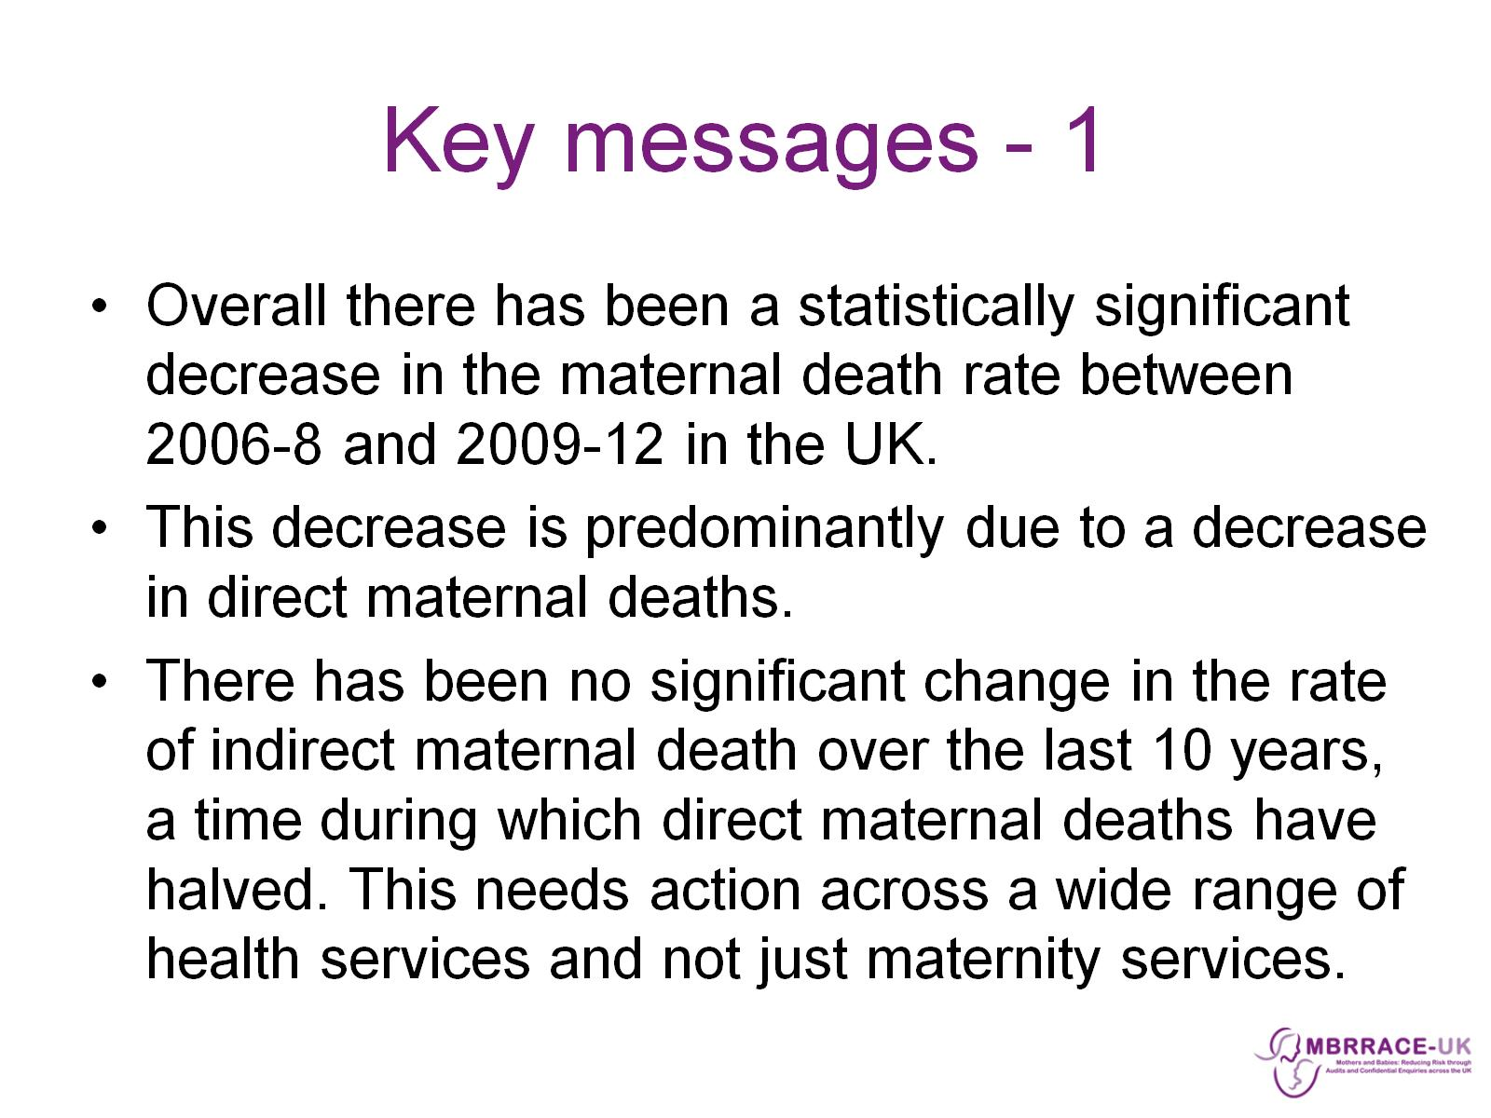
Key messages - 1

Slide 54
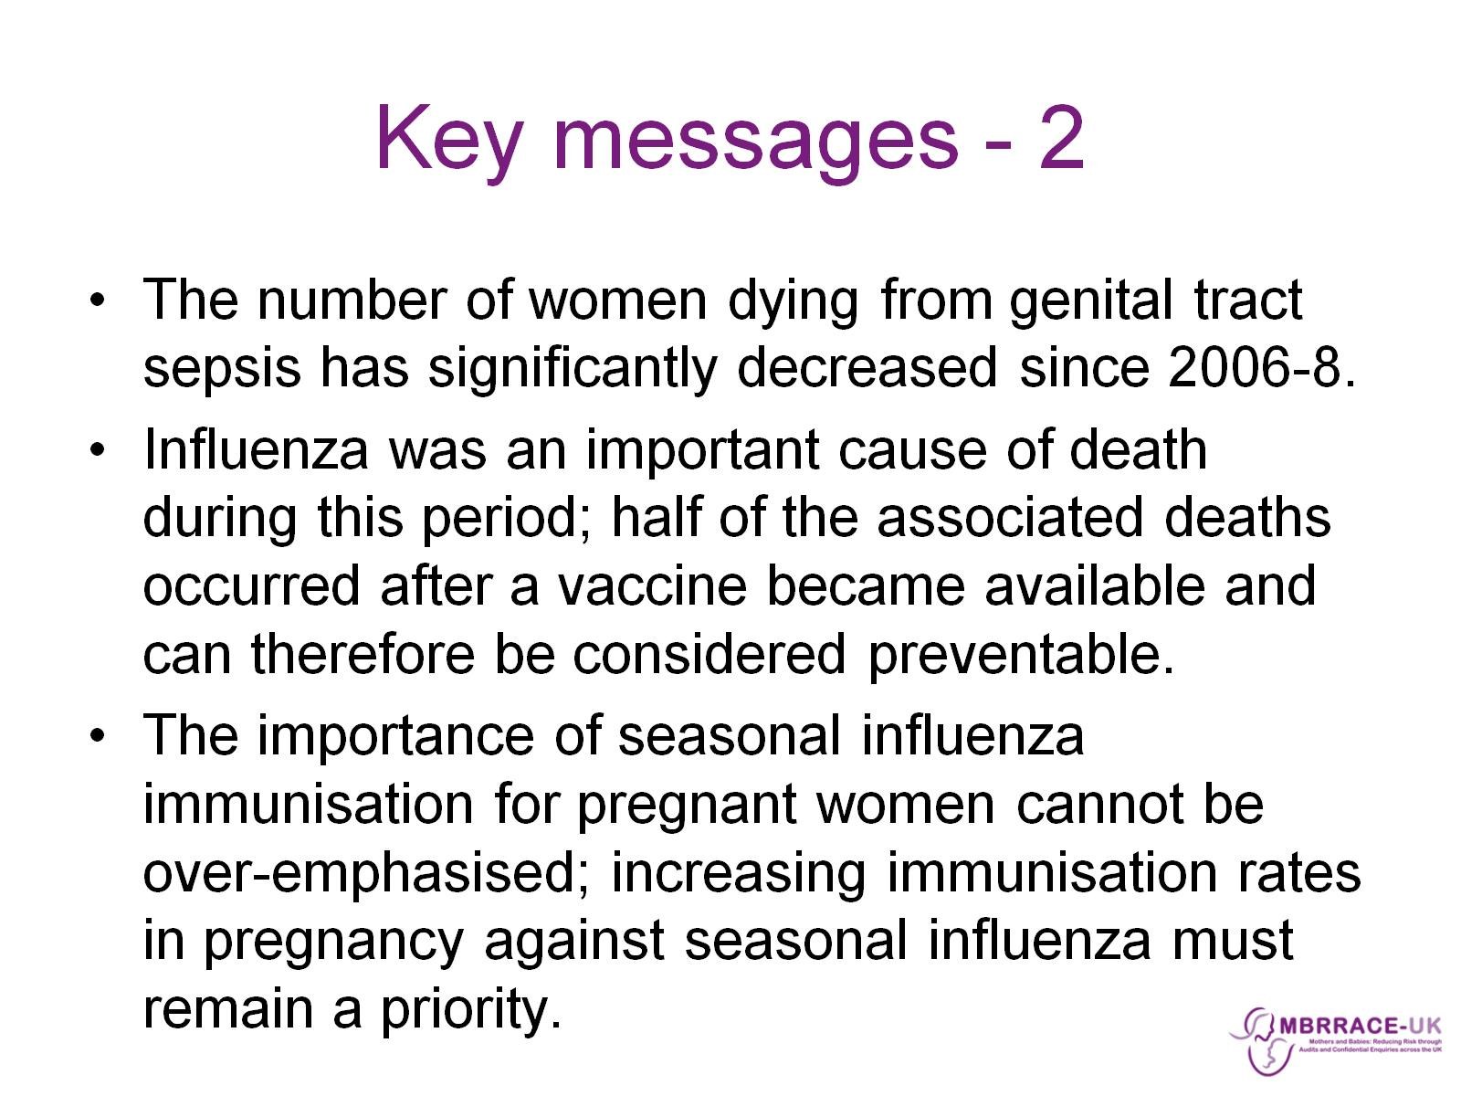
Key messages - 2

