Slide 1

Caring for women with severe mental illness – morbidity confidential enquiry

Slide 2
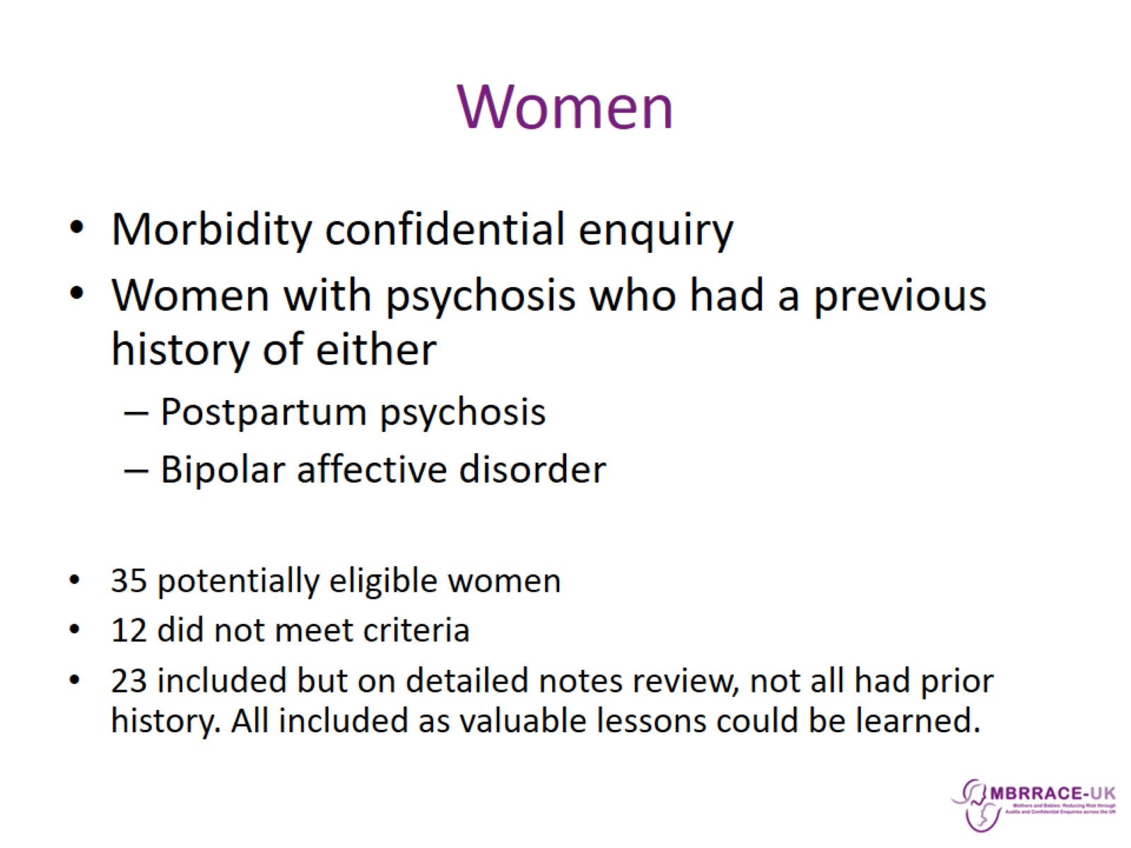
Women

Slide 3
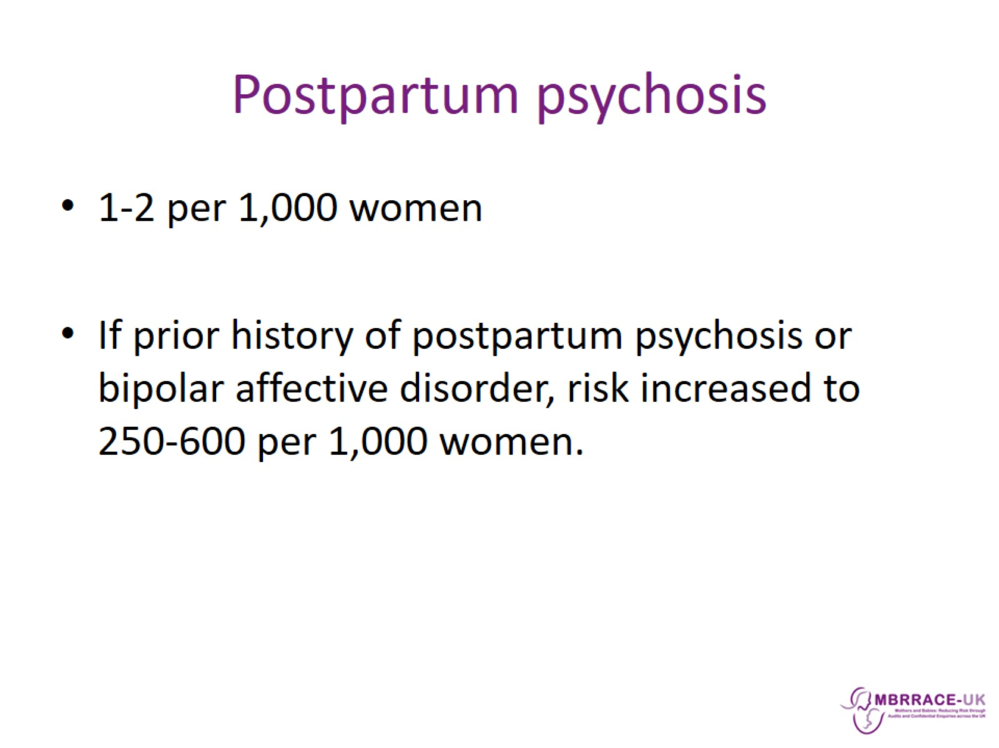
Postpartum psychosis

Slide 4
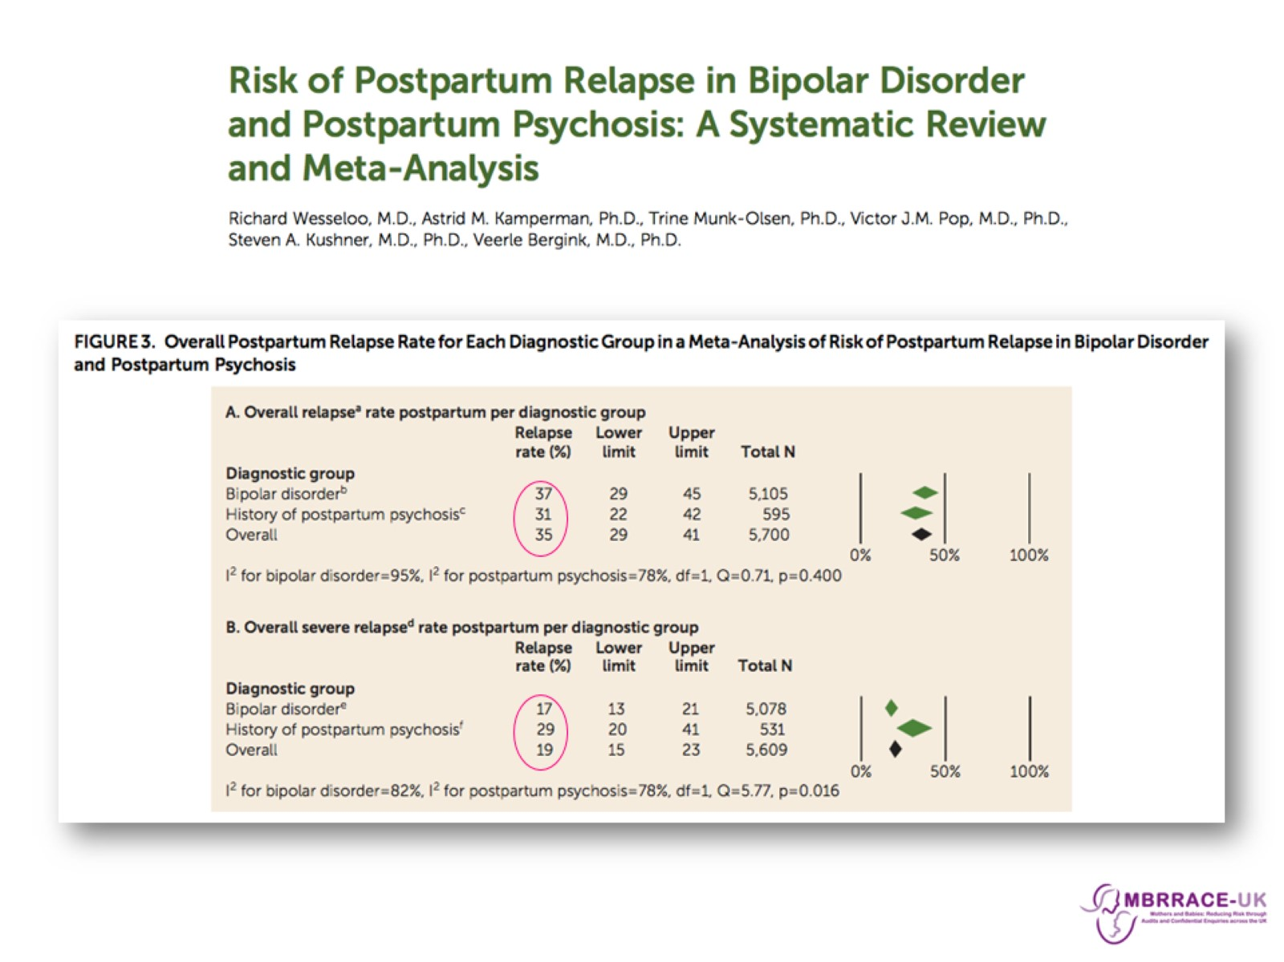

Slide 5
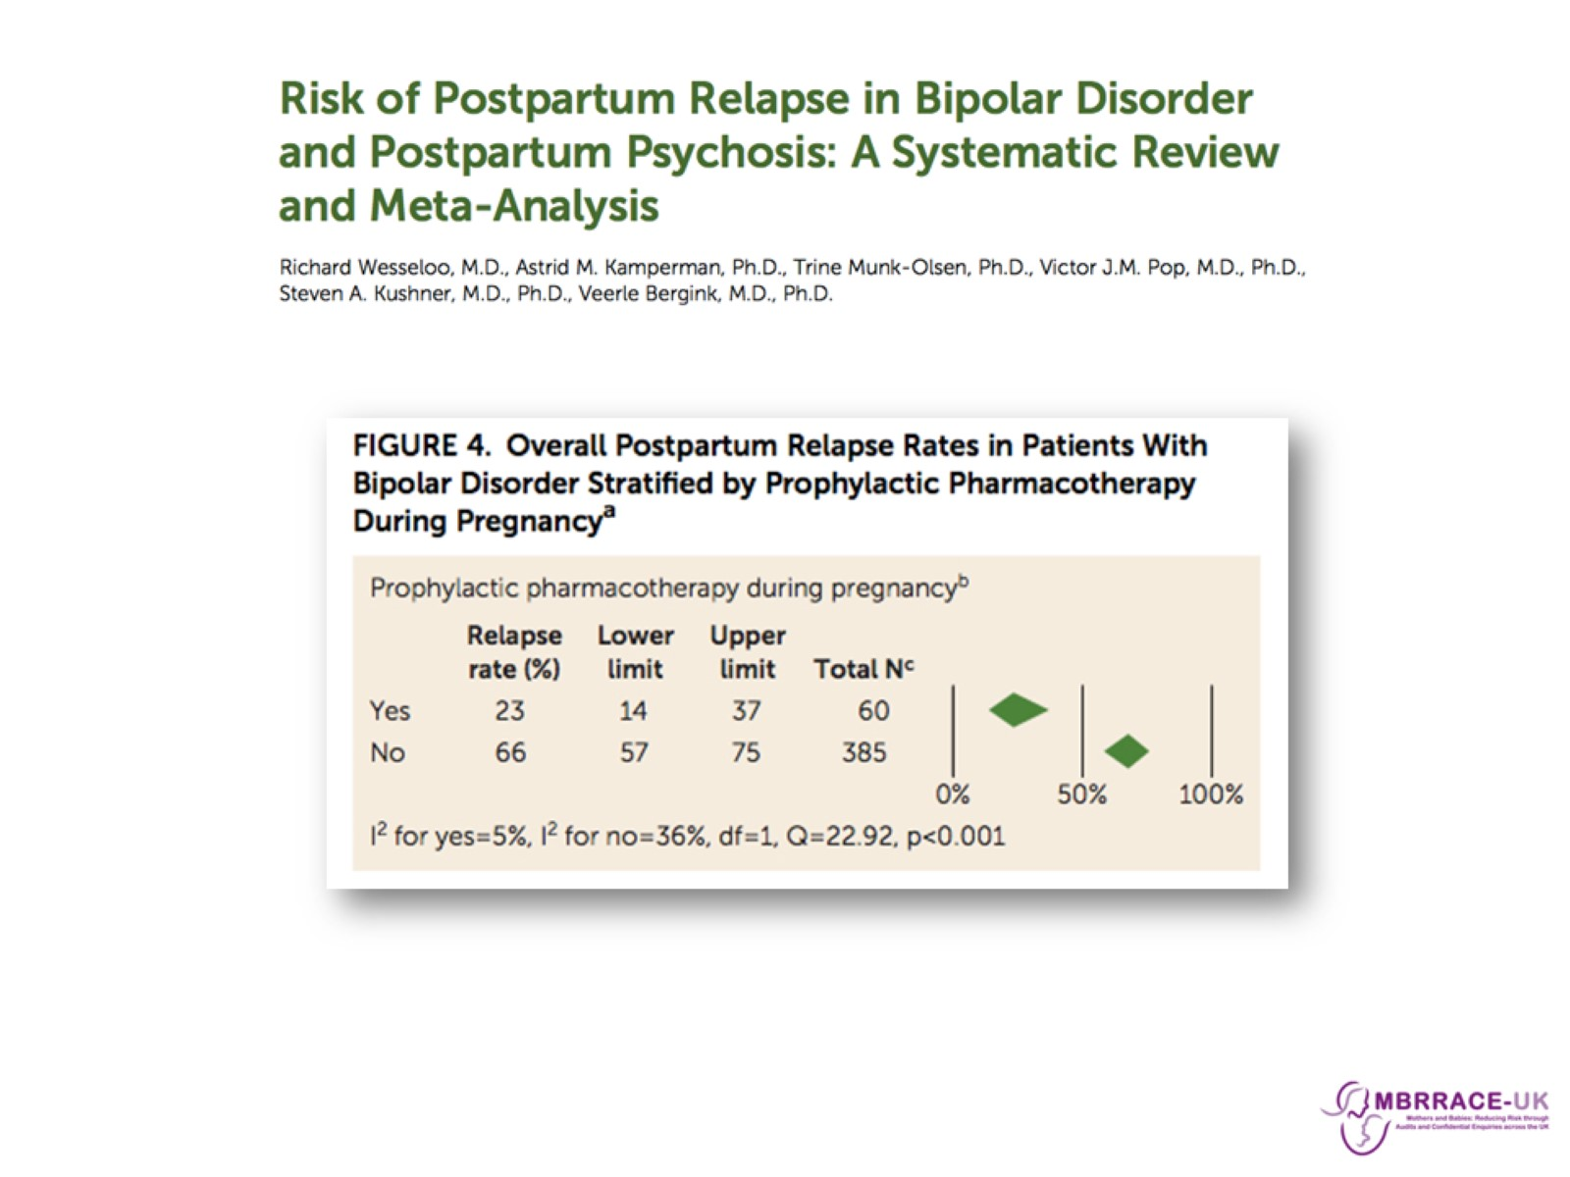

Slide 6
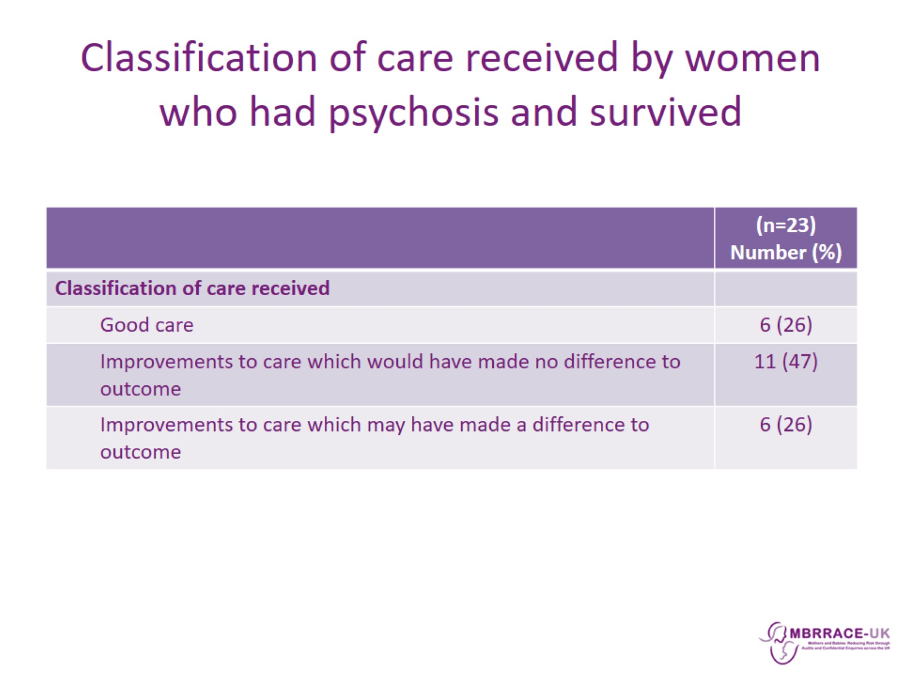
Classification of care received by women who had psychosis and survived

Slide 7
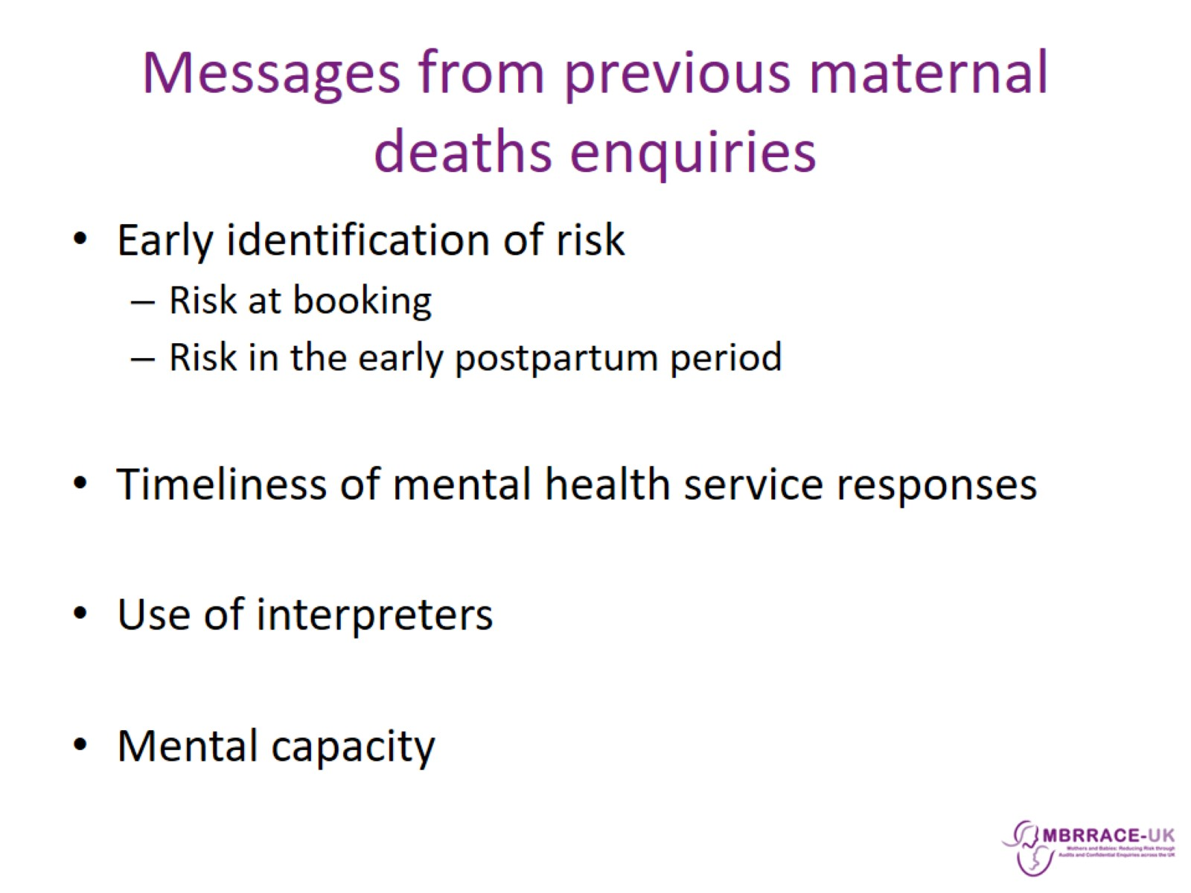
Messages from previous maternal deaths enquiries

Slide 8
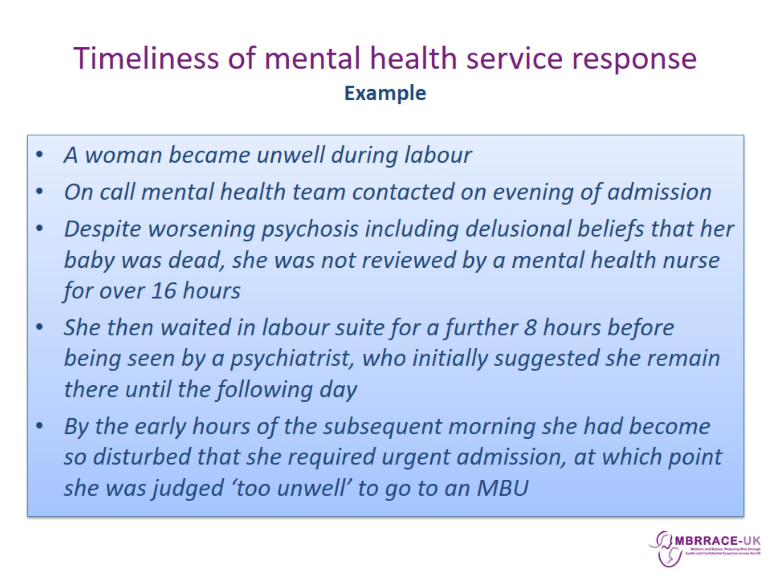
Timeliness of mental health service response
Example

Slide 9
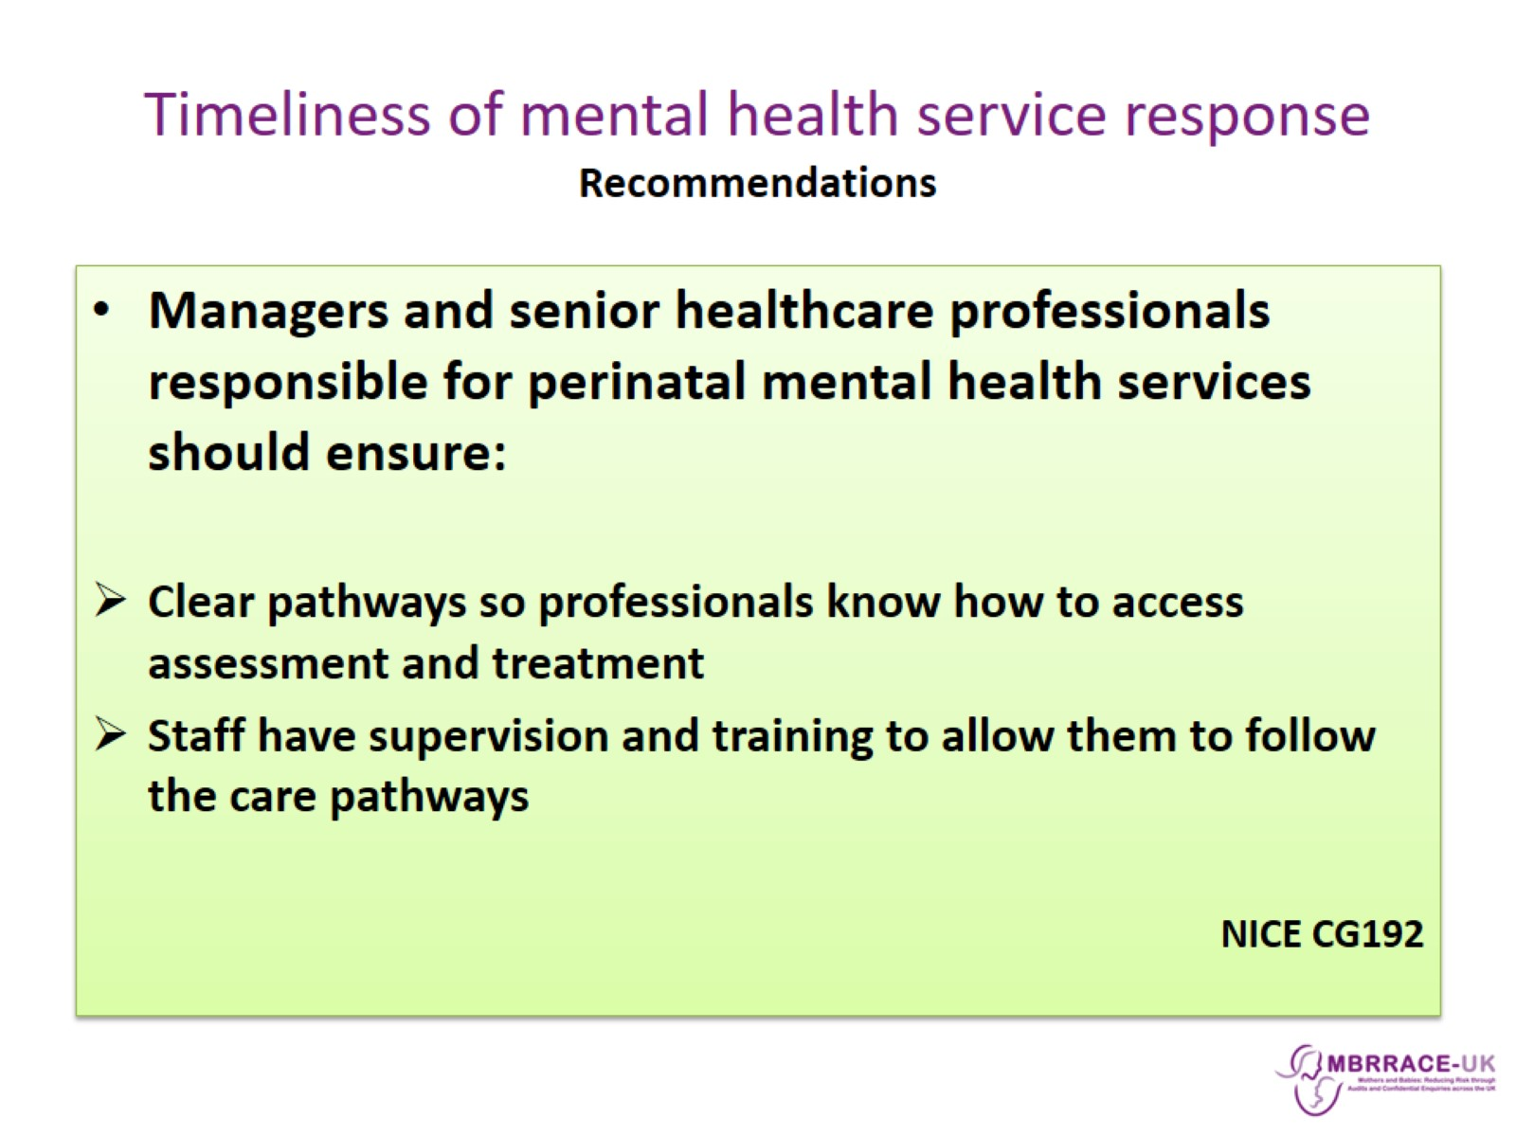
Timeliness of mental health service response
Recommendations

Slide 10
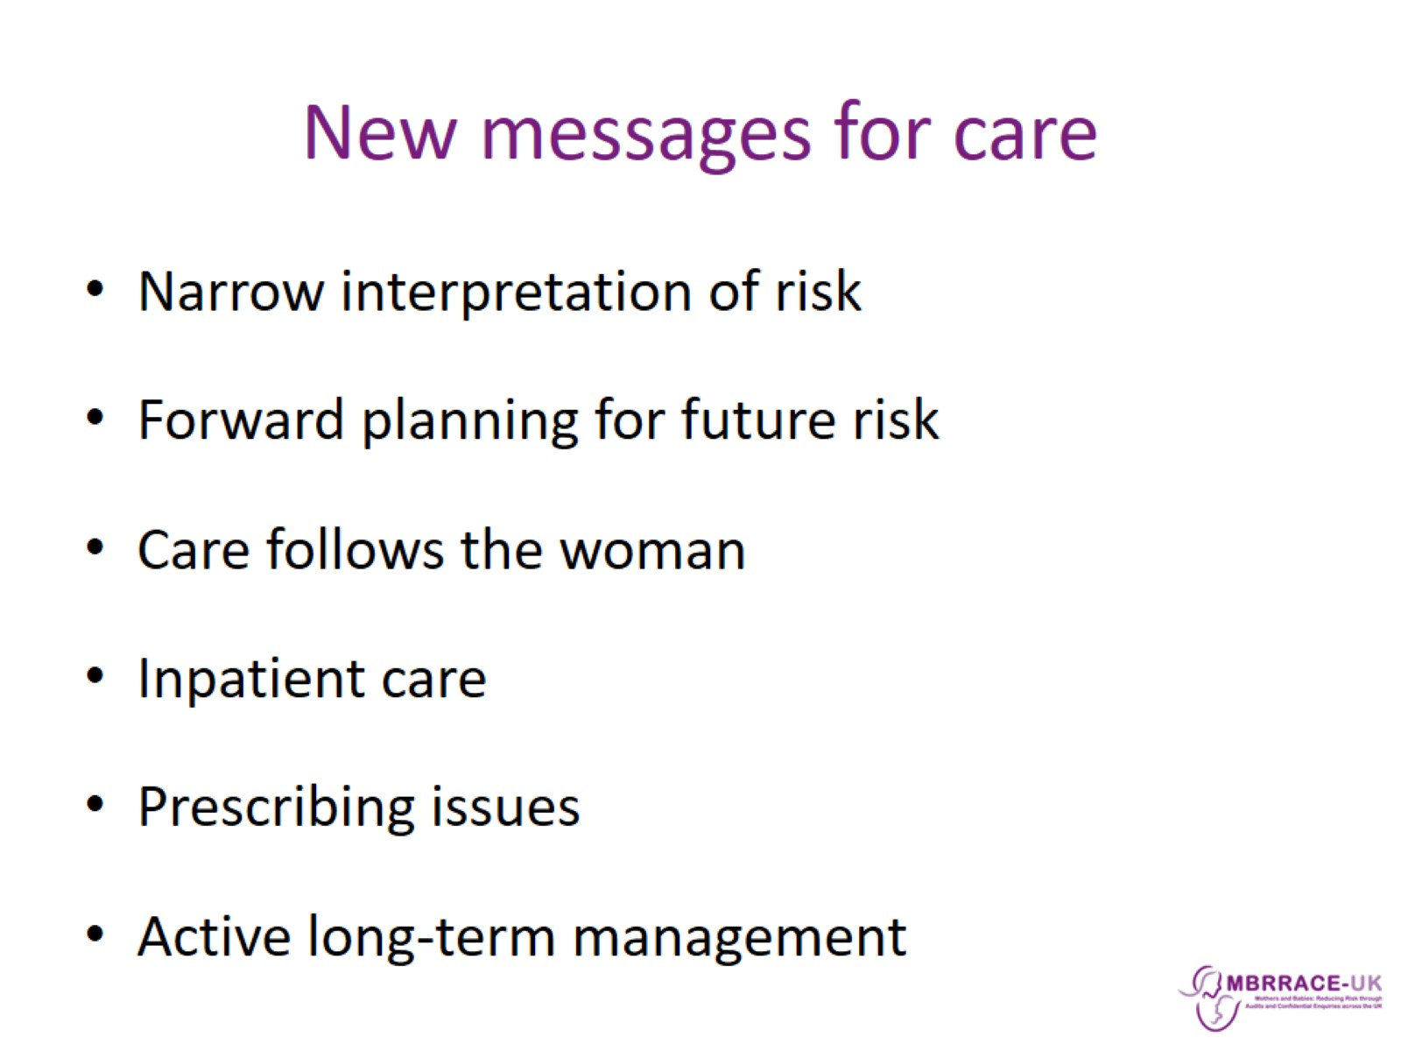
New messages for care

Slide 11
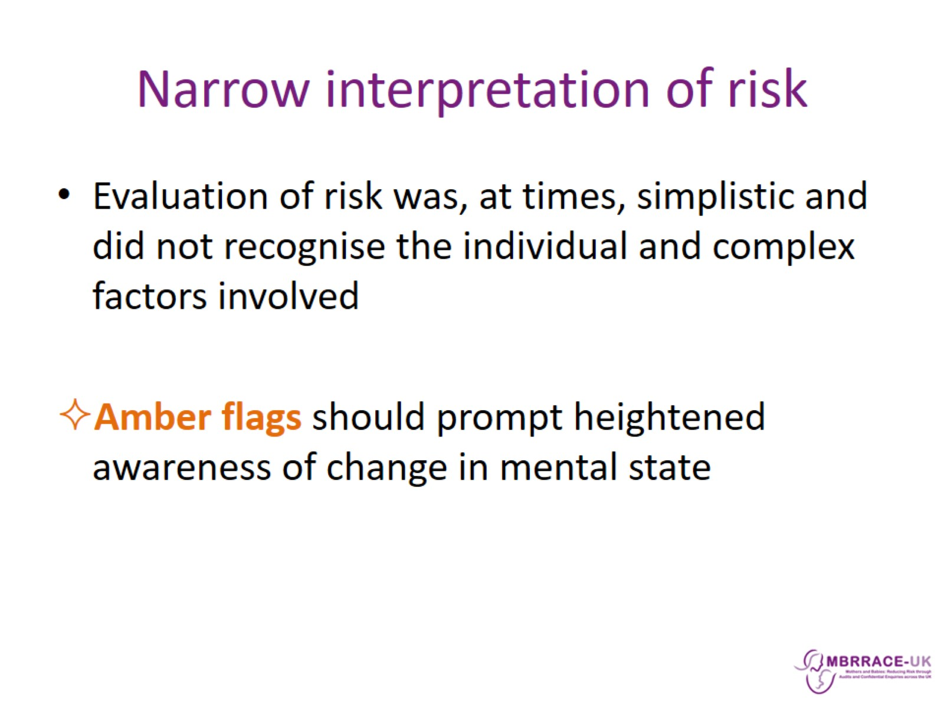
Narrow interpretation of risk

Slide 12
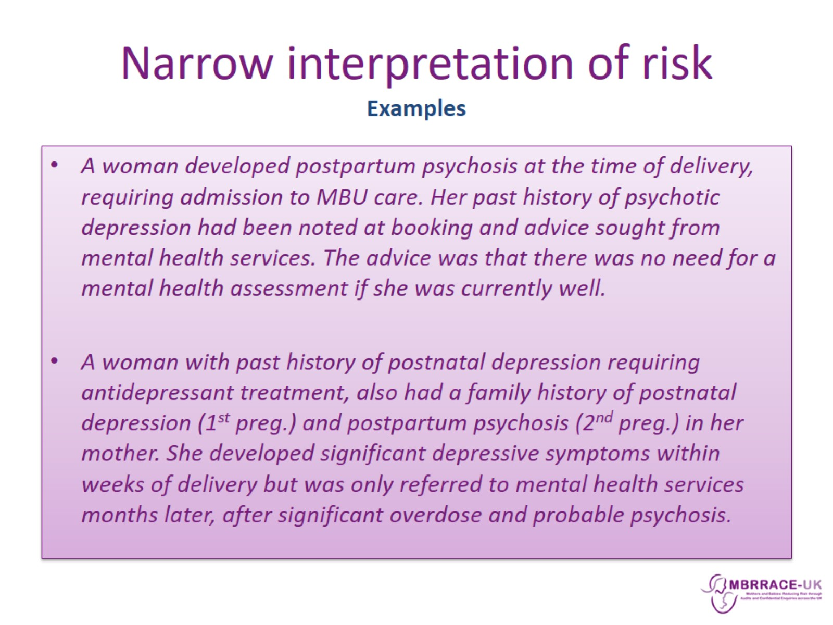
Narrow interpretation of risk
Examples

Slide 13
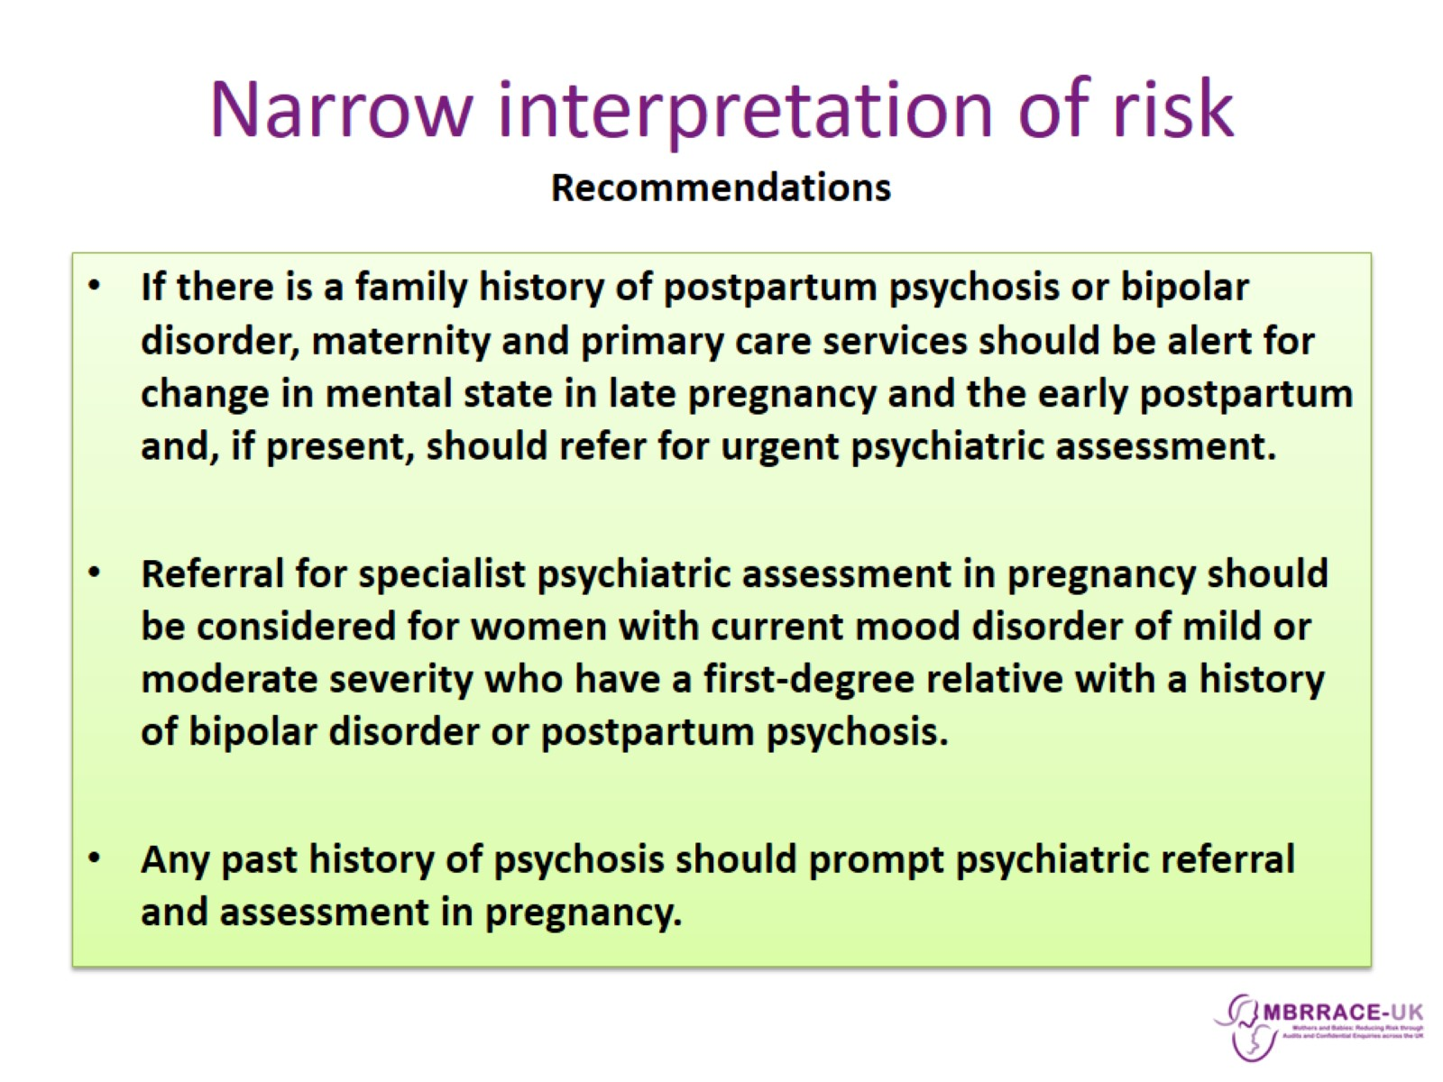
Narrow interpretation of risk
Recommendations

Slide 14
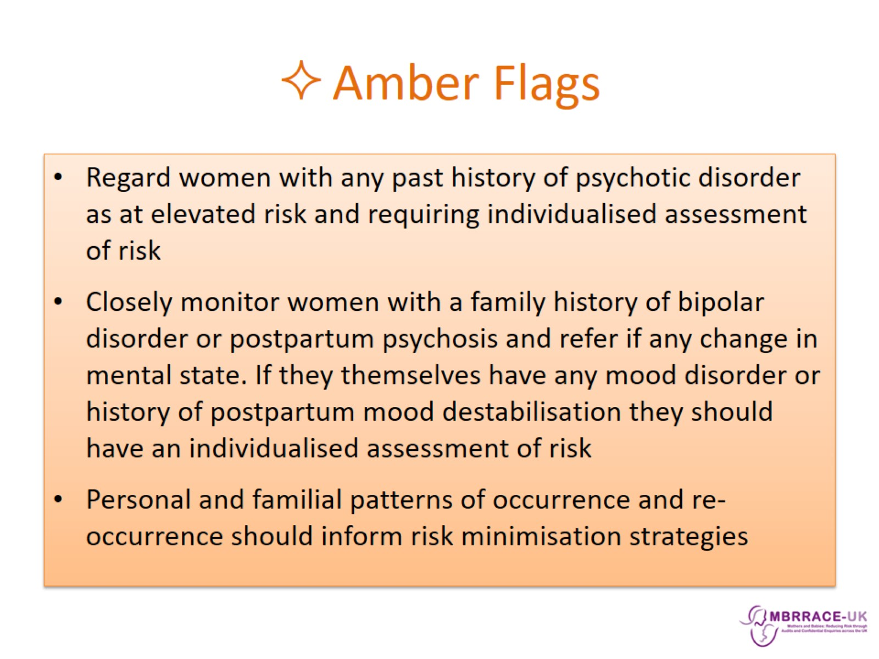
Amber Flags

Slide 15
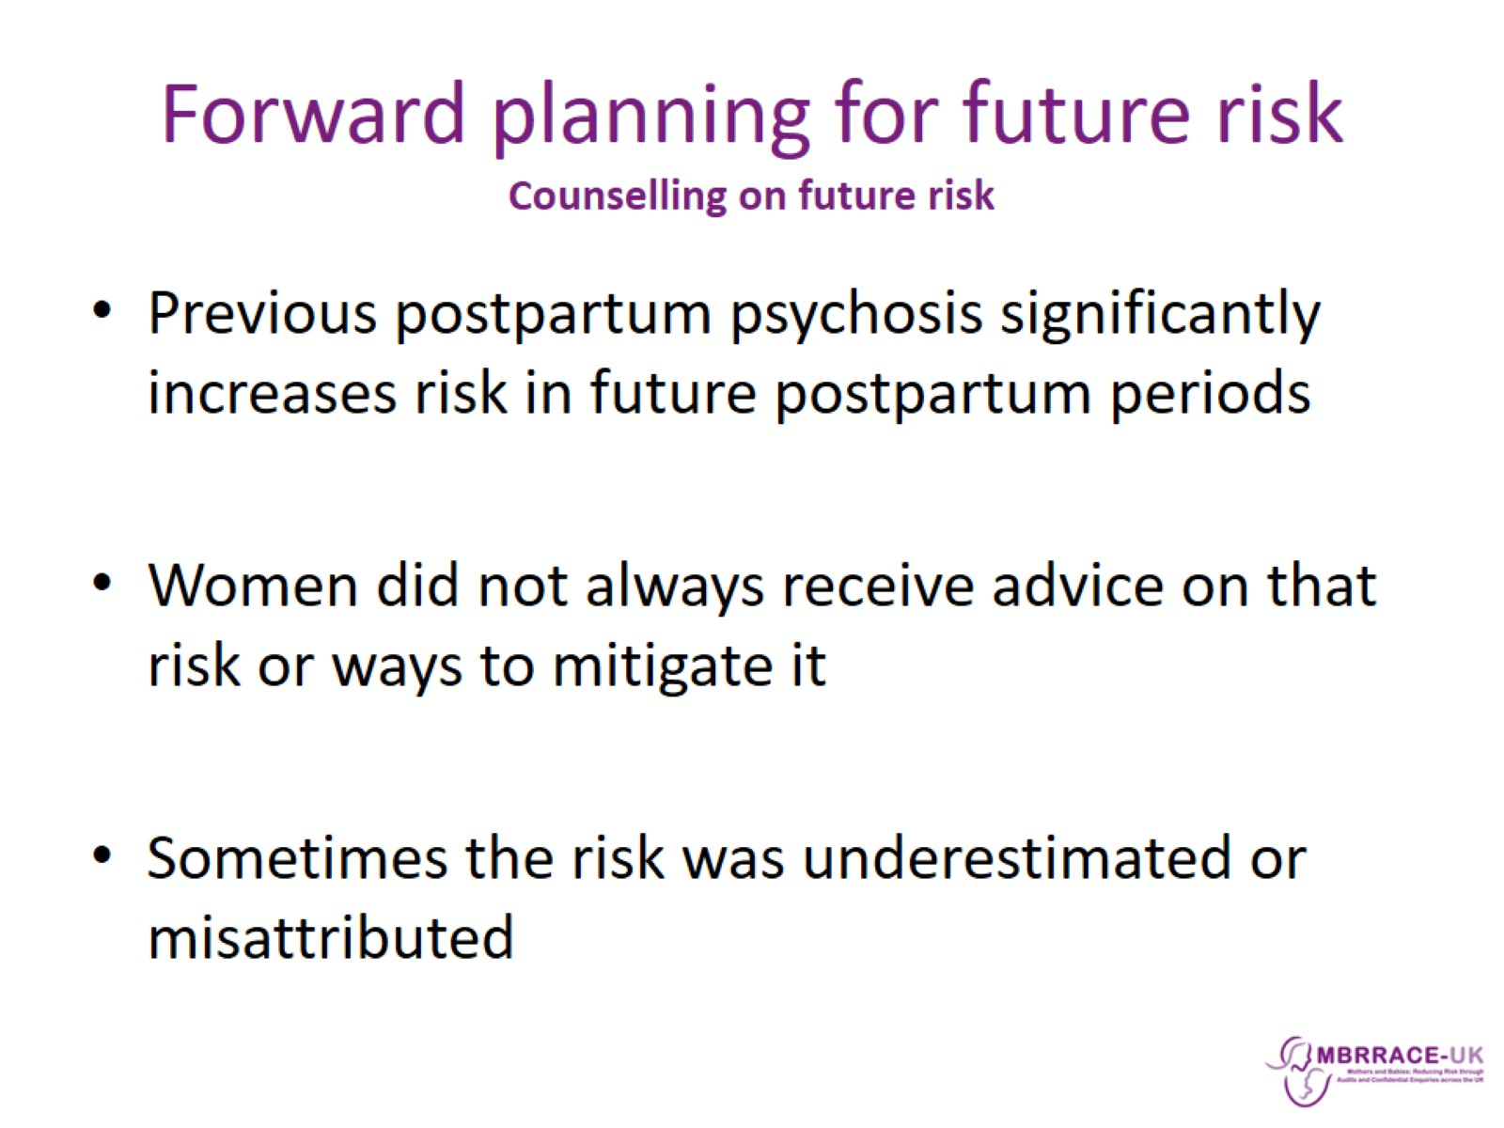
Forward planning for future risk
Counselling on future risk

Slide 16
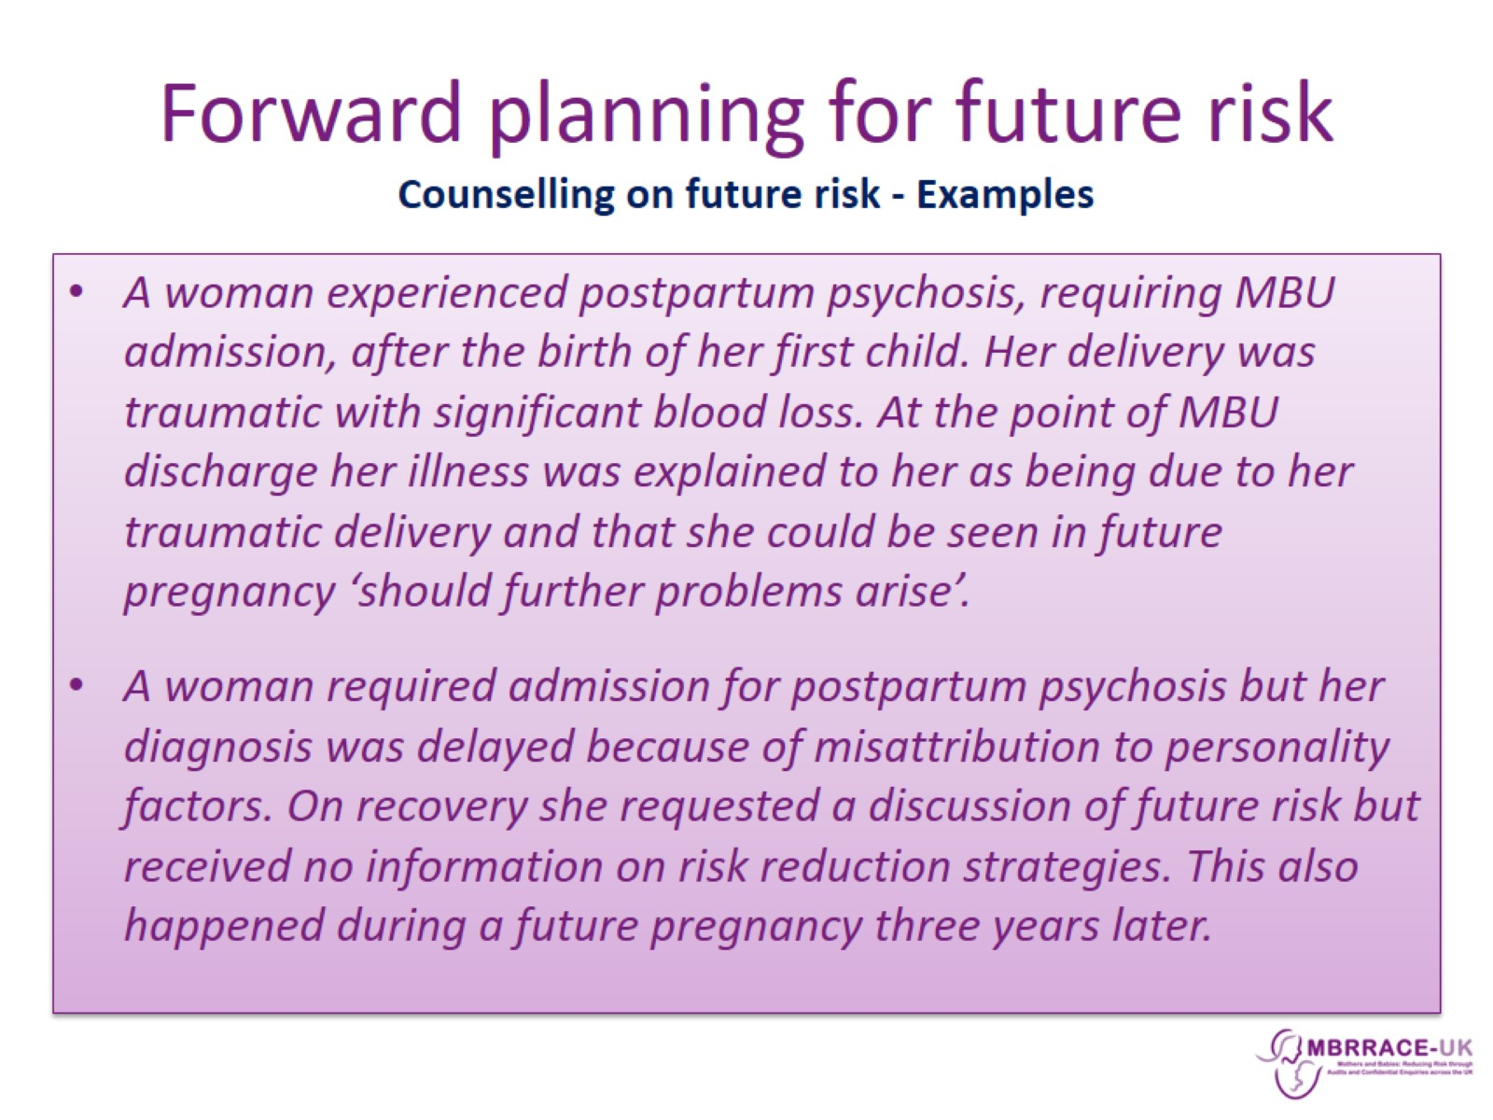
Forward planning for future risk
Counselling on future risk - Examples

Slide 17
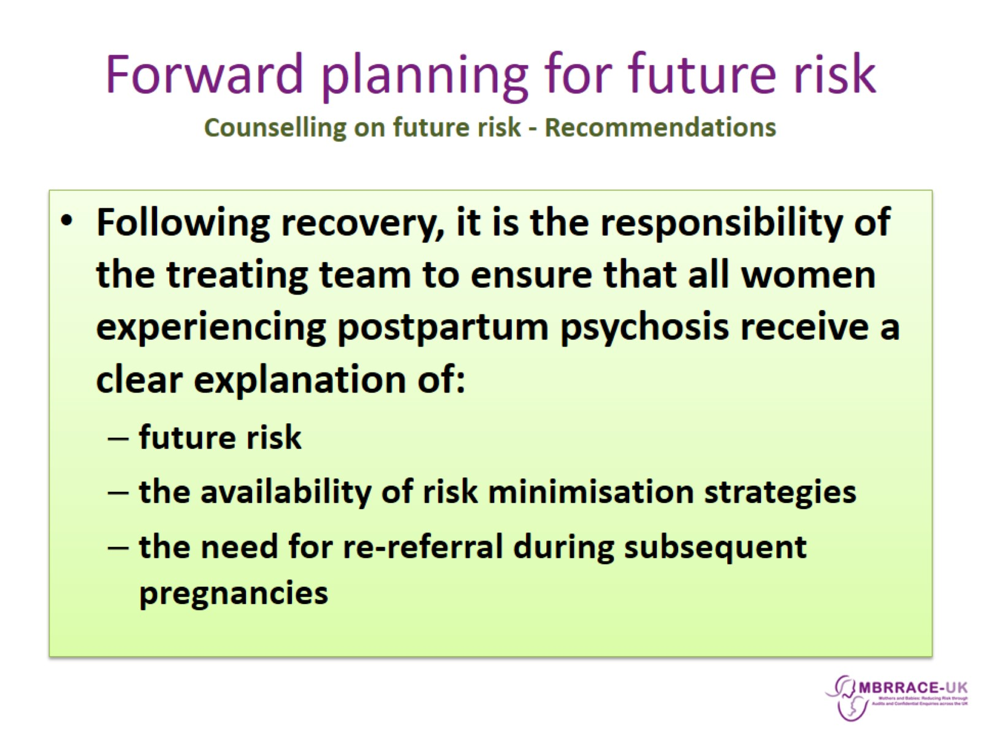
Forward planning for future risk
Counselling on future risk - Recommendations

Slide 18
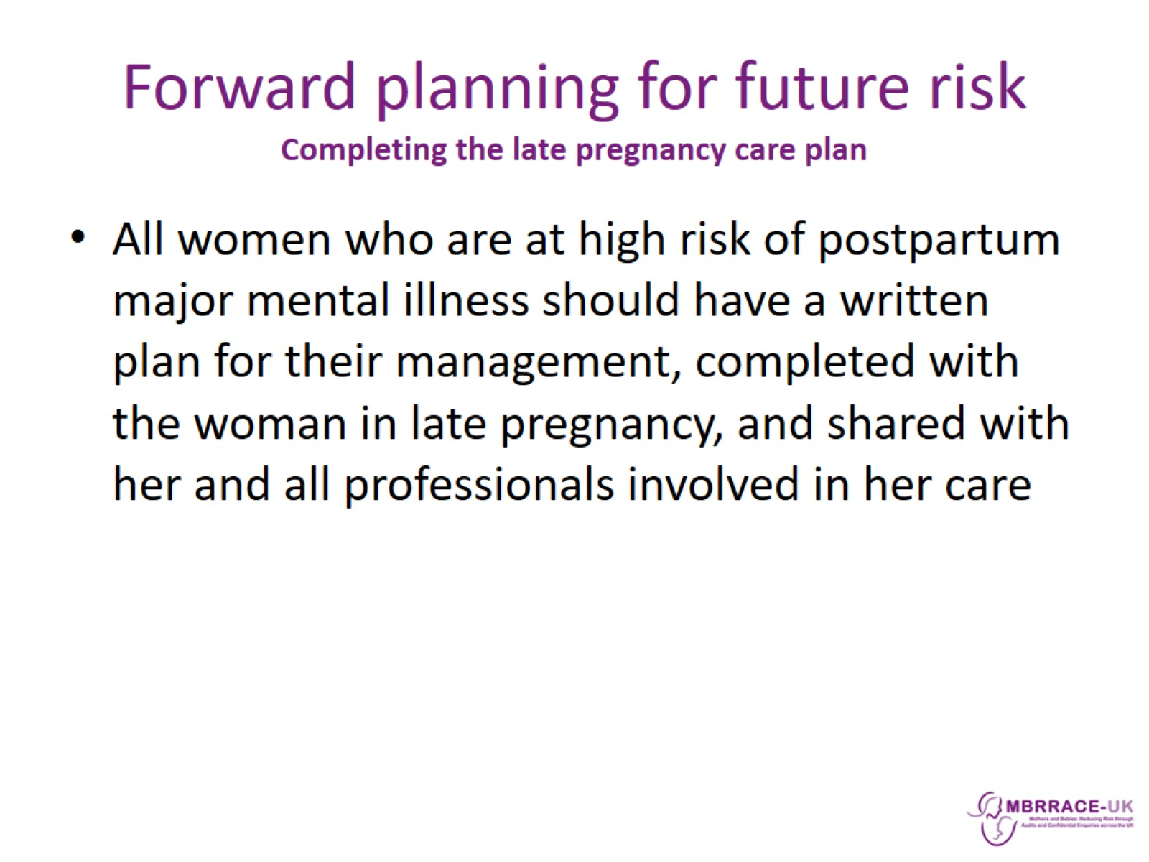
Forward planning for future risk
Completing the late pregnancy care plan

Slide 19
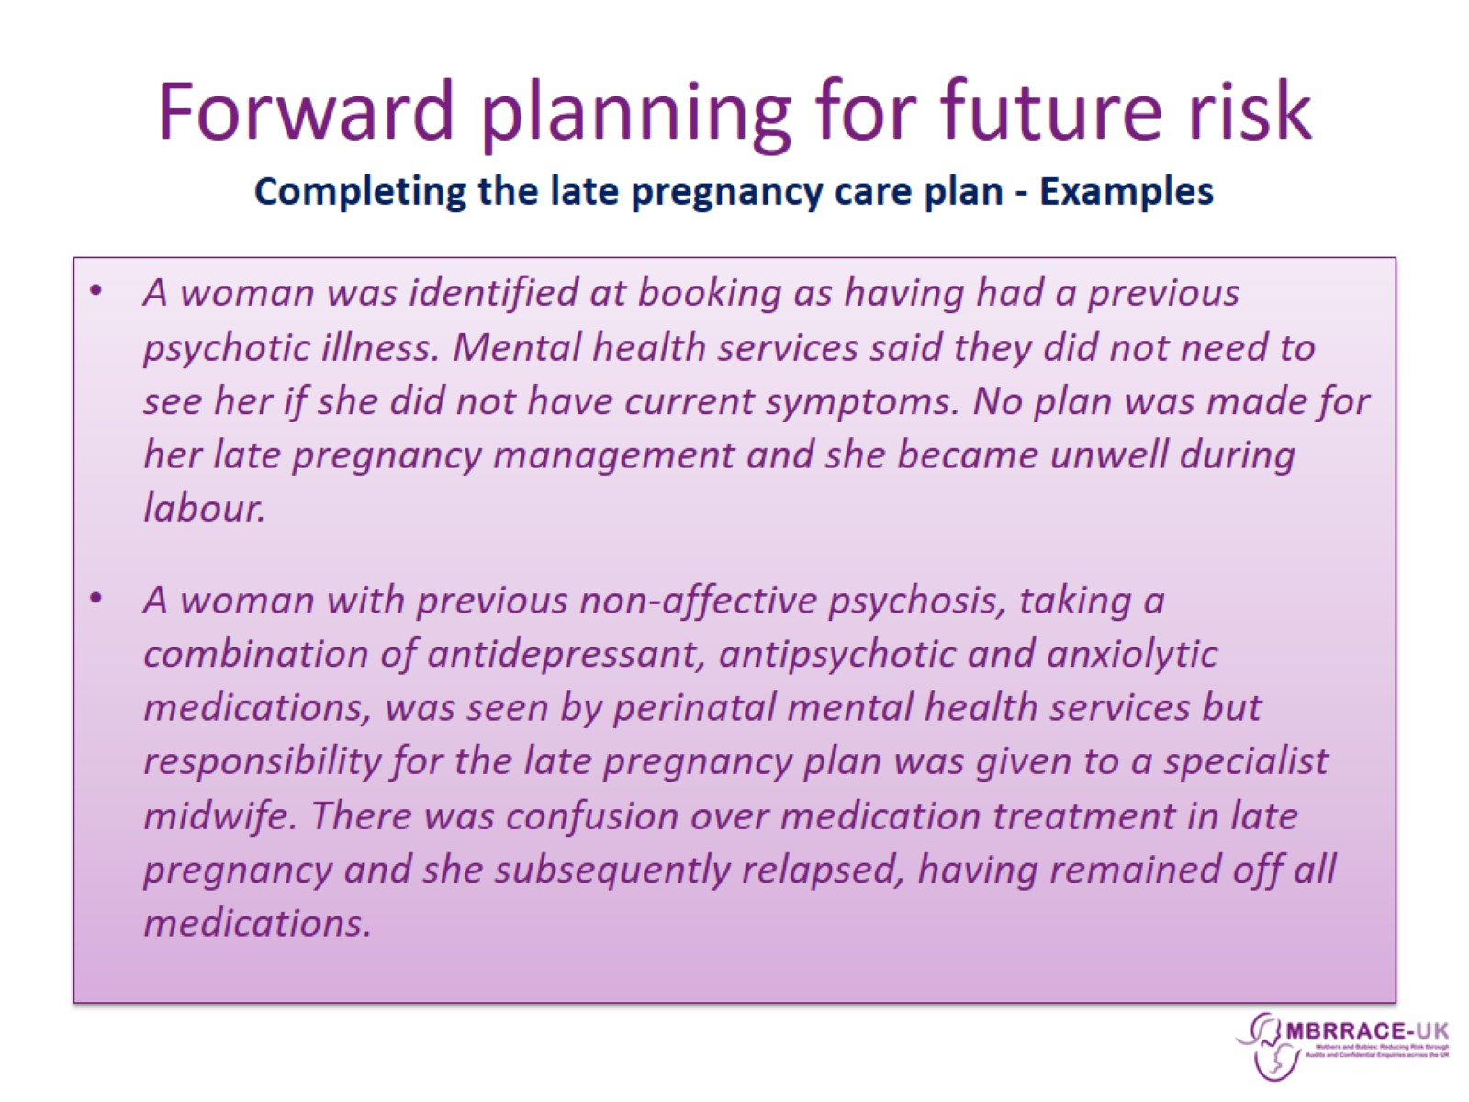
Forward planning for future risk
Completing the late pregnancy care plan - Examples

Slide 20
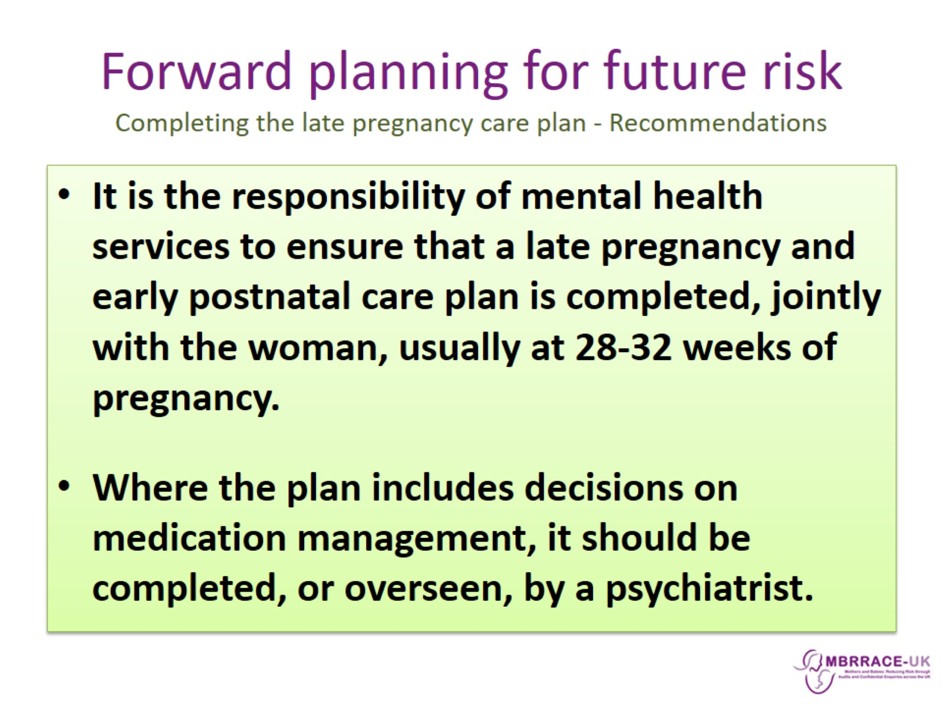
Forward planning for future risk
Completing the late pregnancy care plan - Recommendations

Slide 21
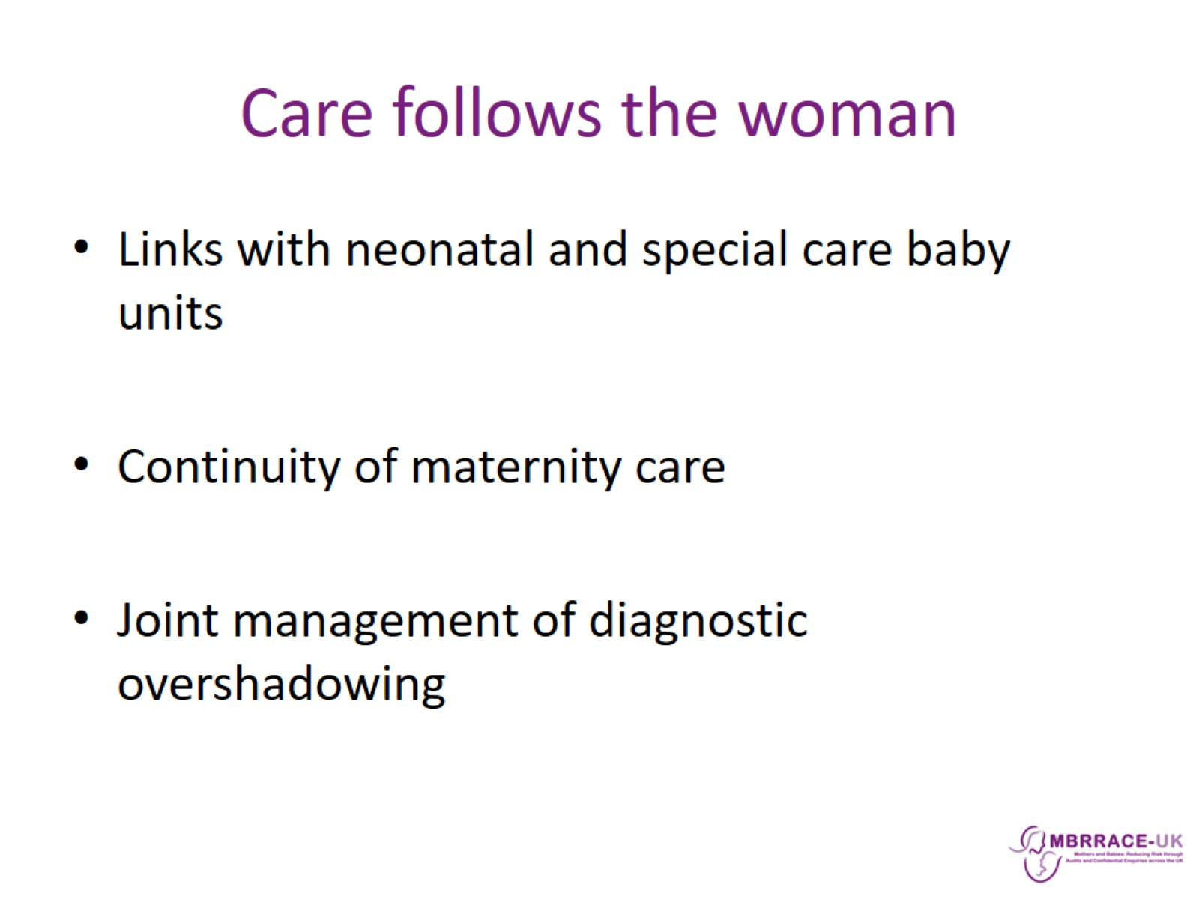
Care follows the woman

Slide 22
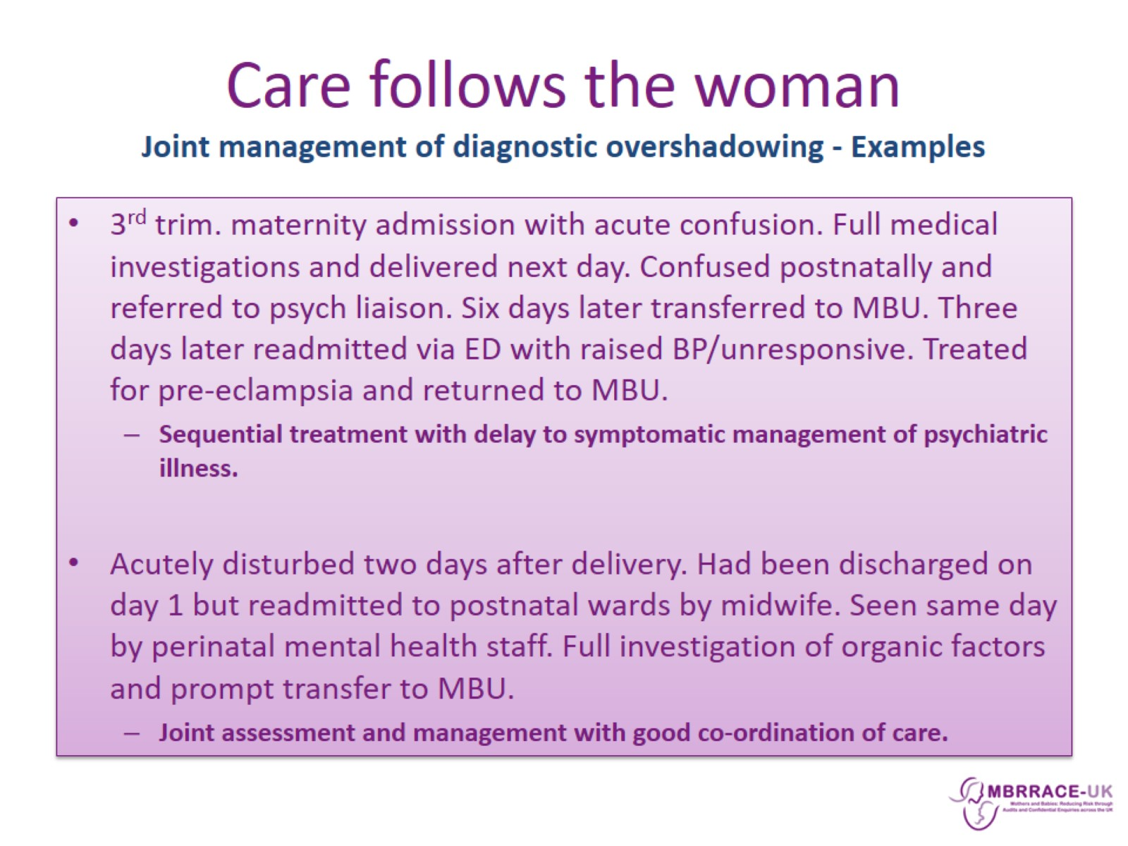
Care follows the woman
Joint management of diagnostic overshadowing - Examples

Slide 23
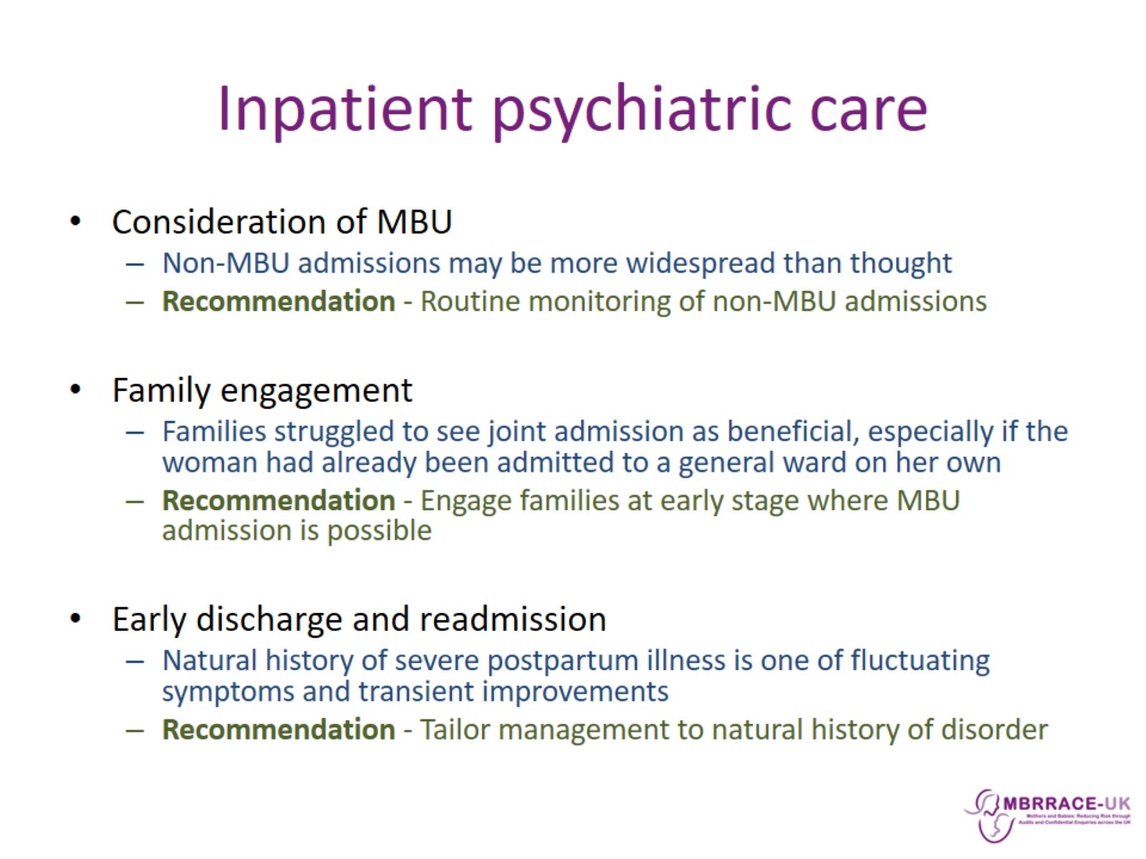
Inpatient psychiatric care

Slide 24
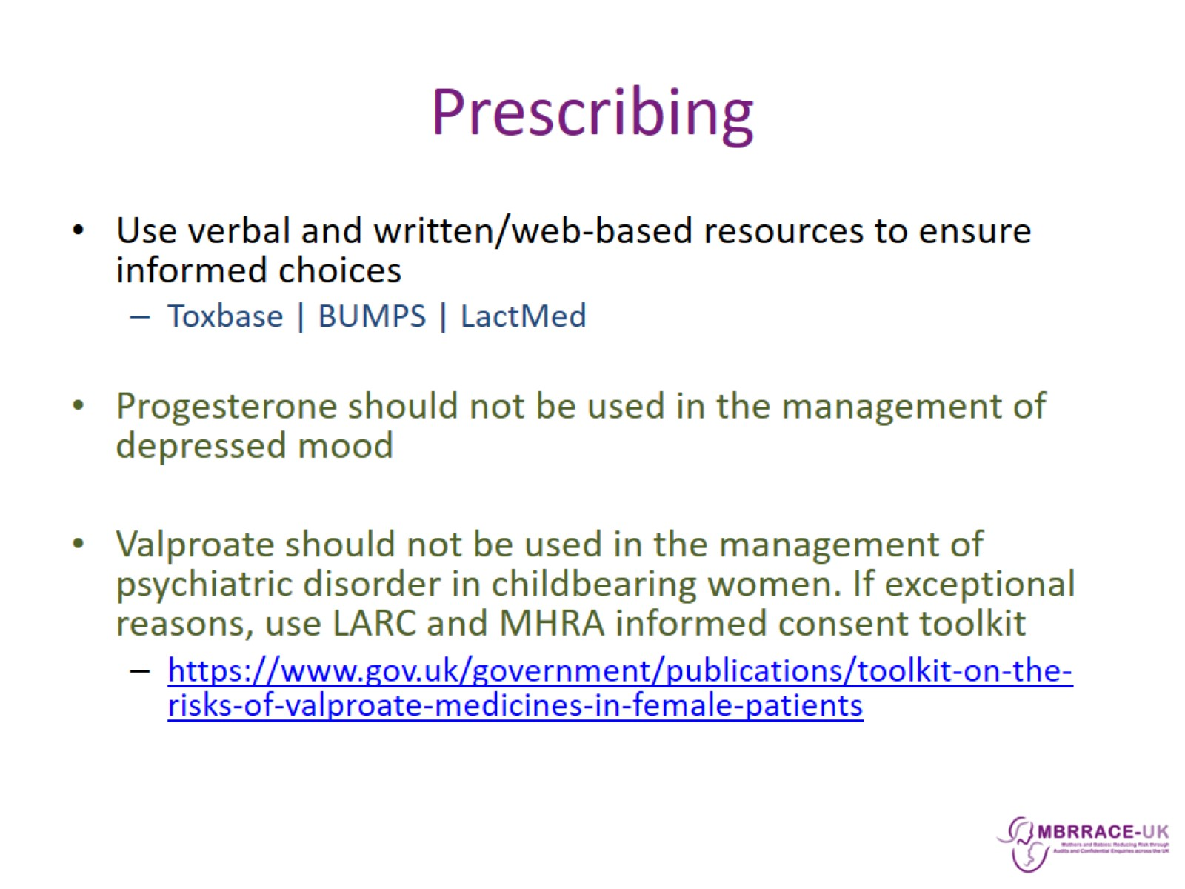
Prescribing

Slide 25
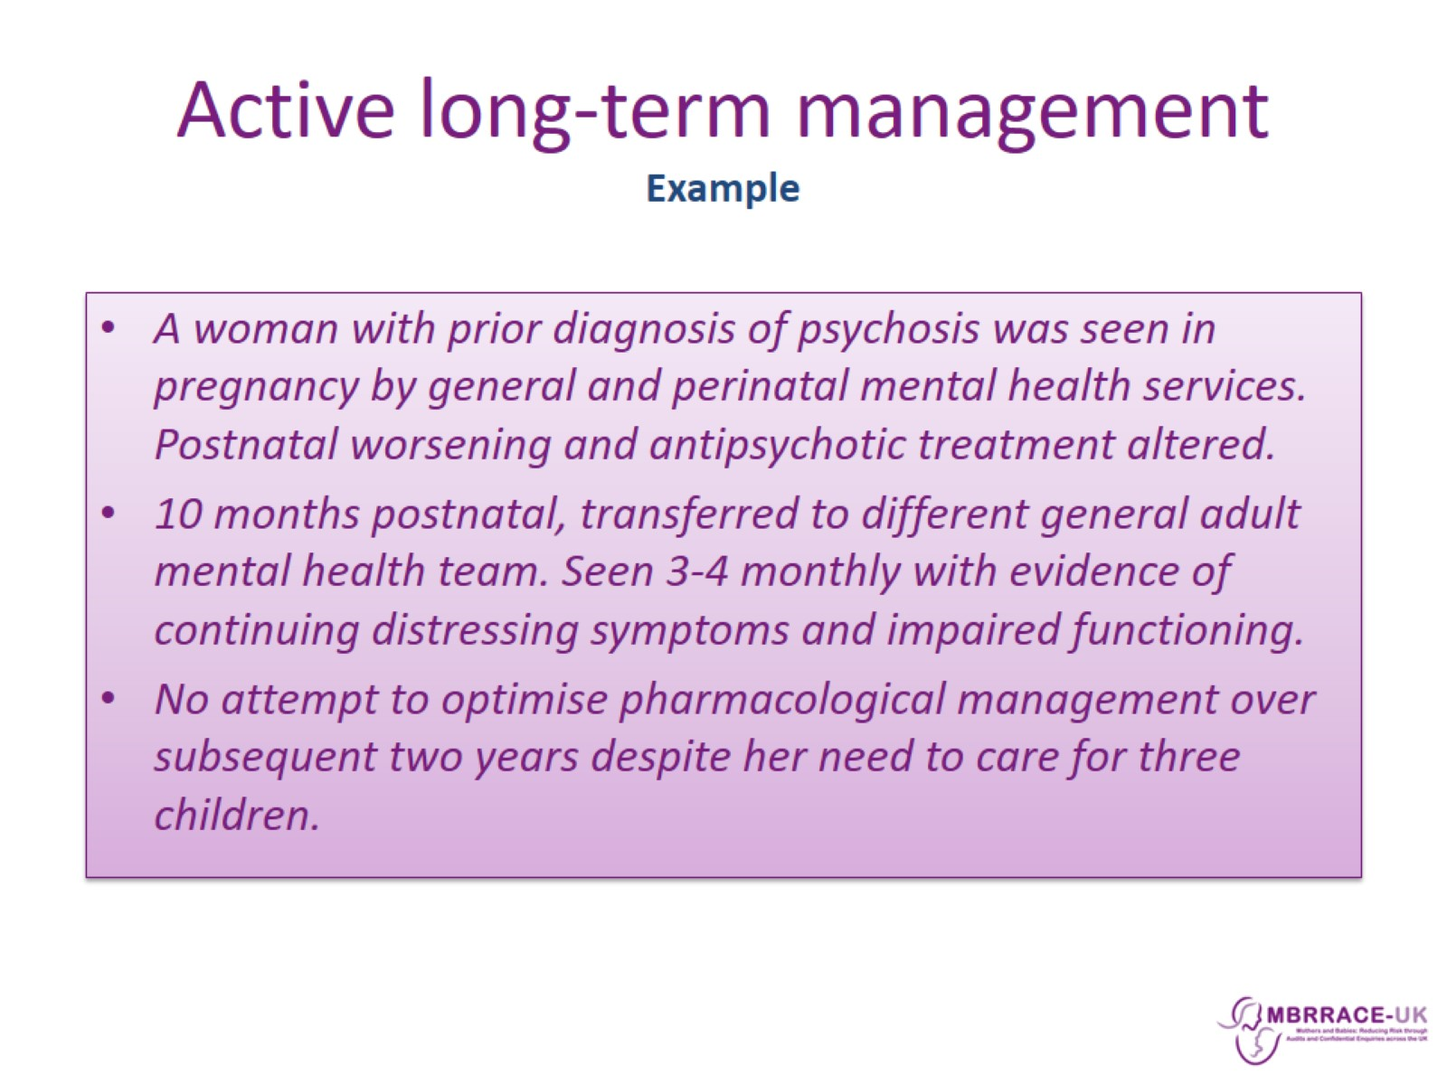
Active long-term management
Example

Slide 26
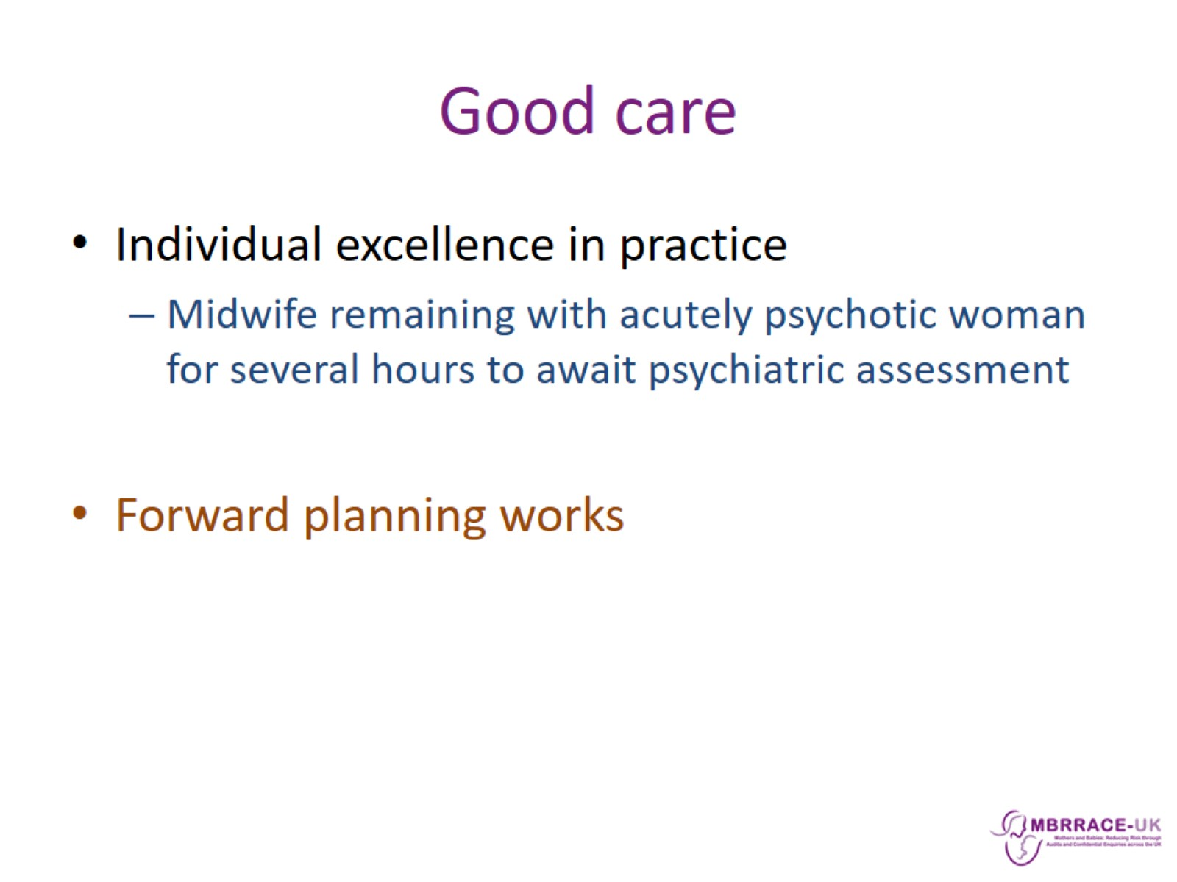
Good care

Slide 27
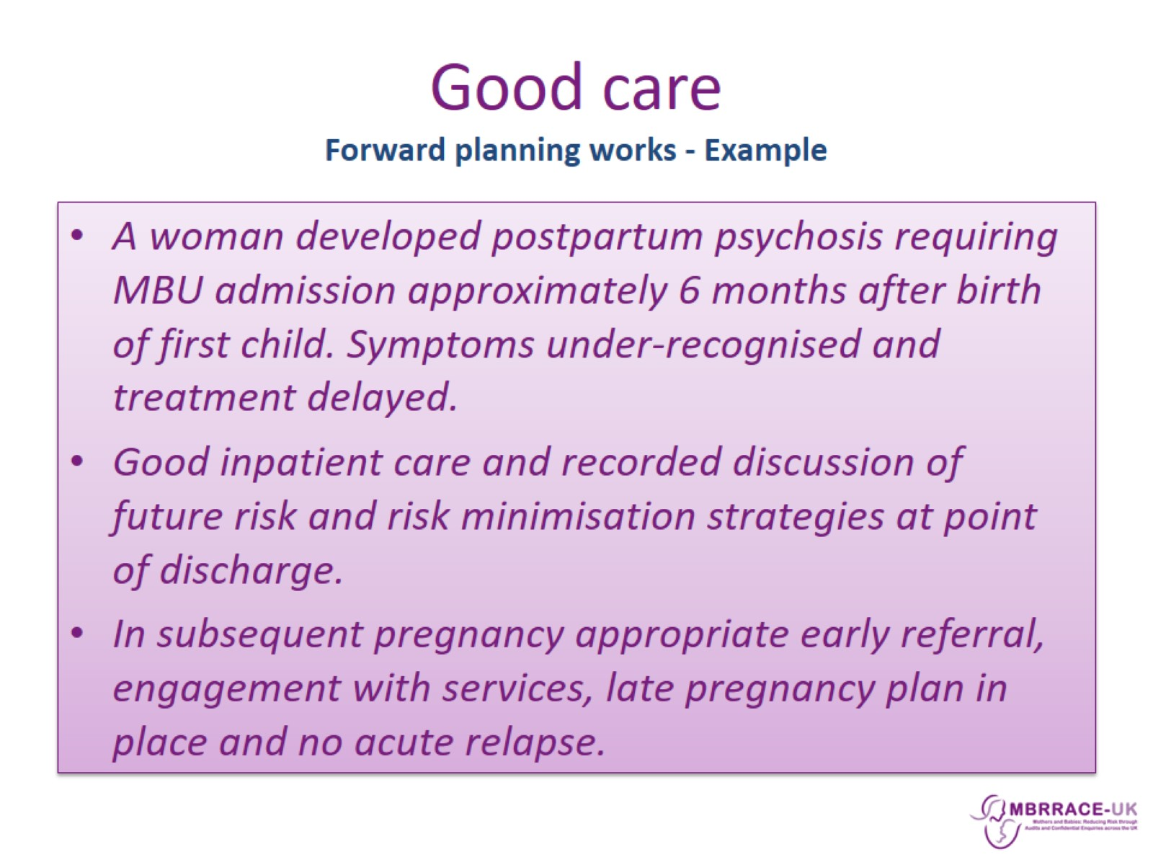
Good care
Forward planning works - Example

Slide 28
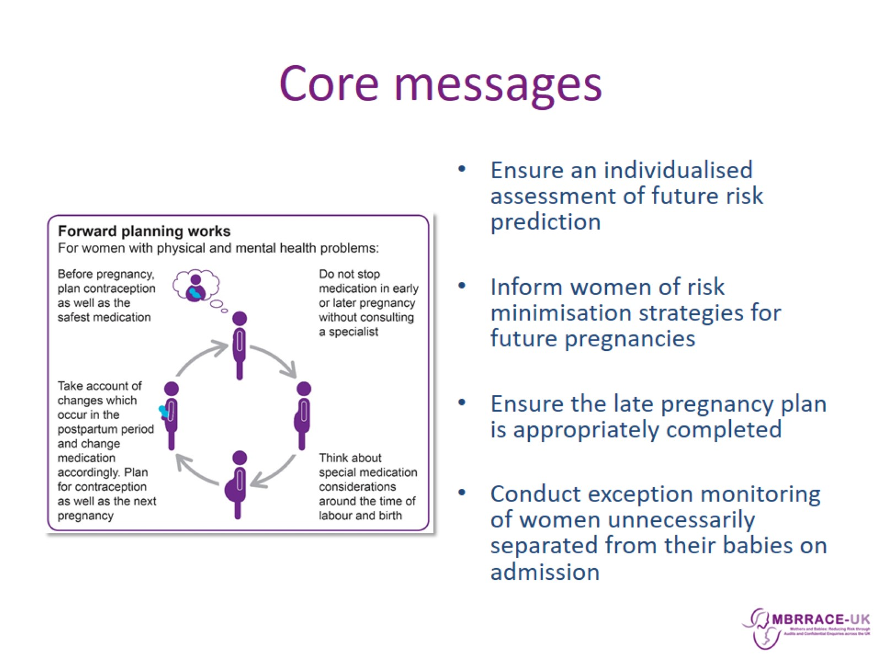
Core messages

