Slide 1
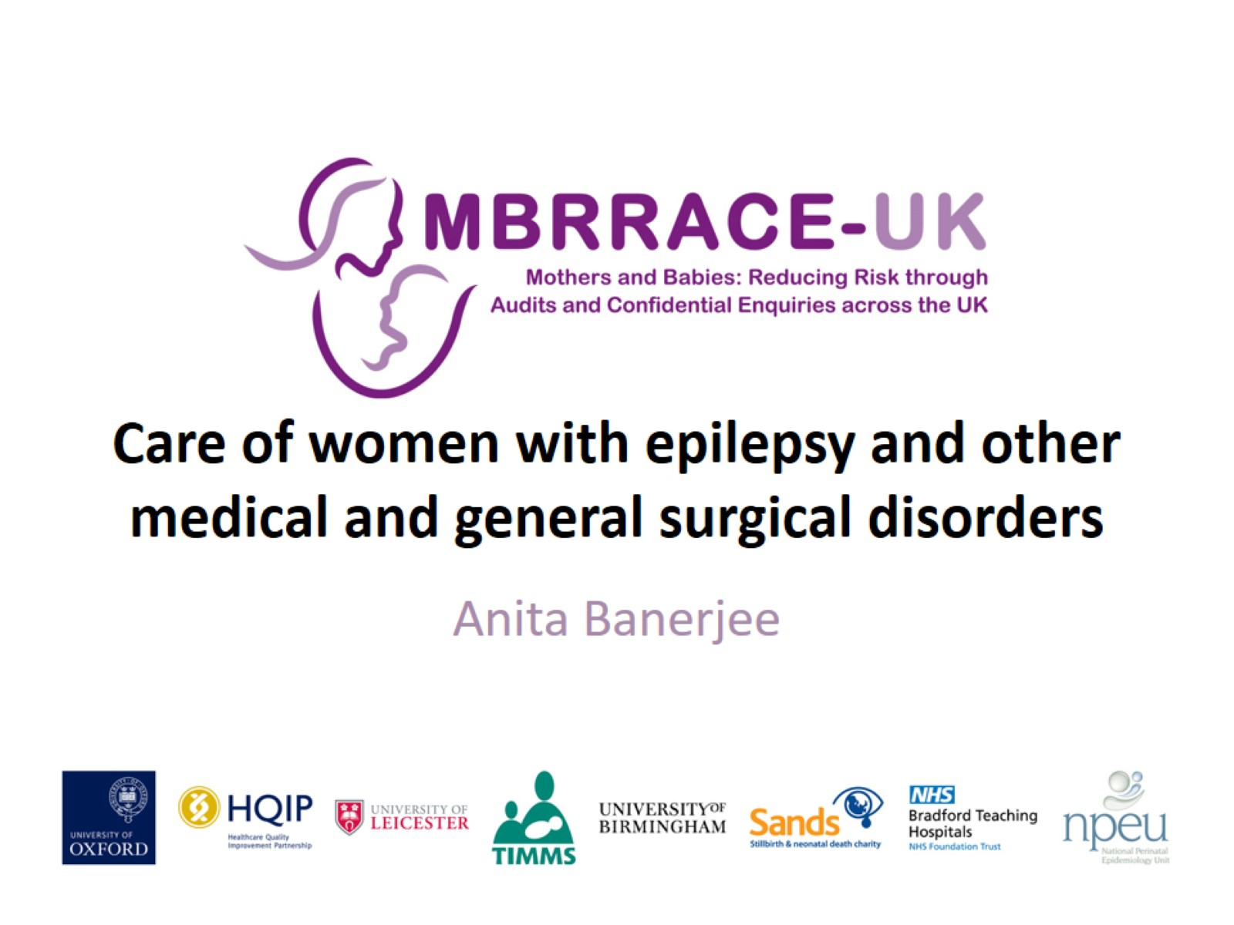
Care of women with epilepsy and other medical and general surgical disorders

Slide 2
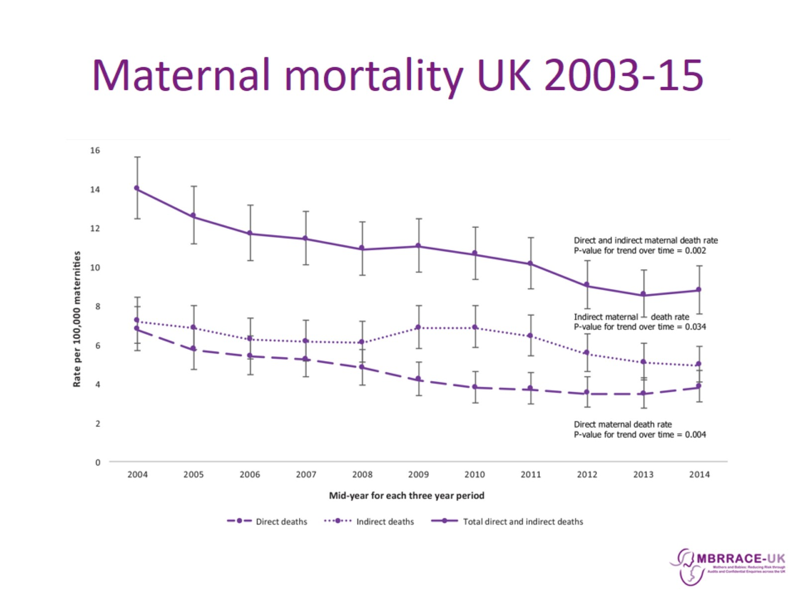
Maternal mortality UK 2003-15

Slide 3
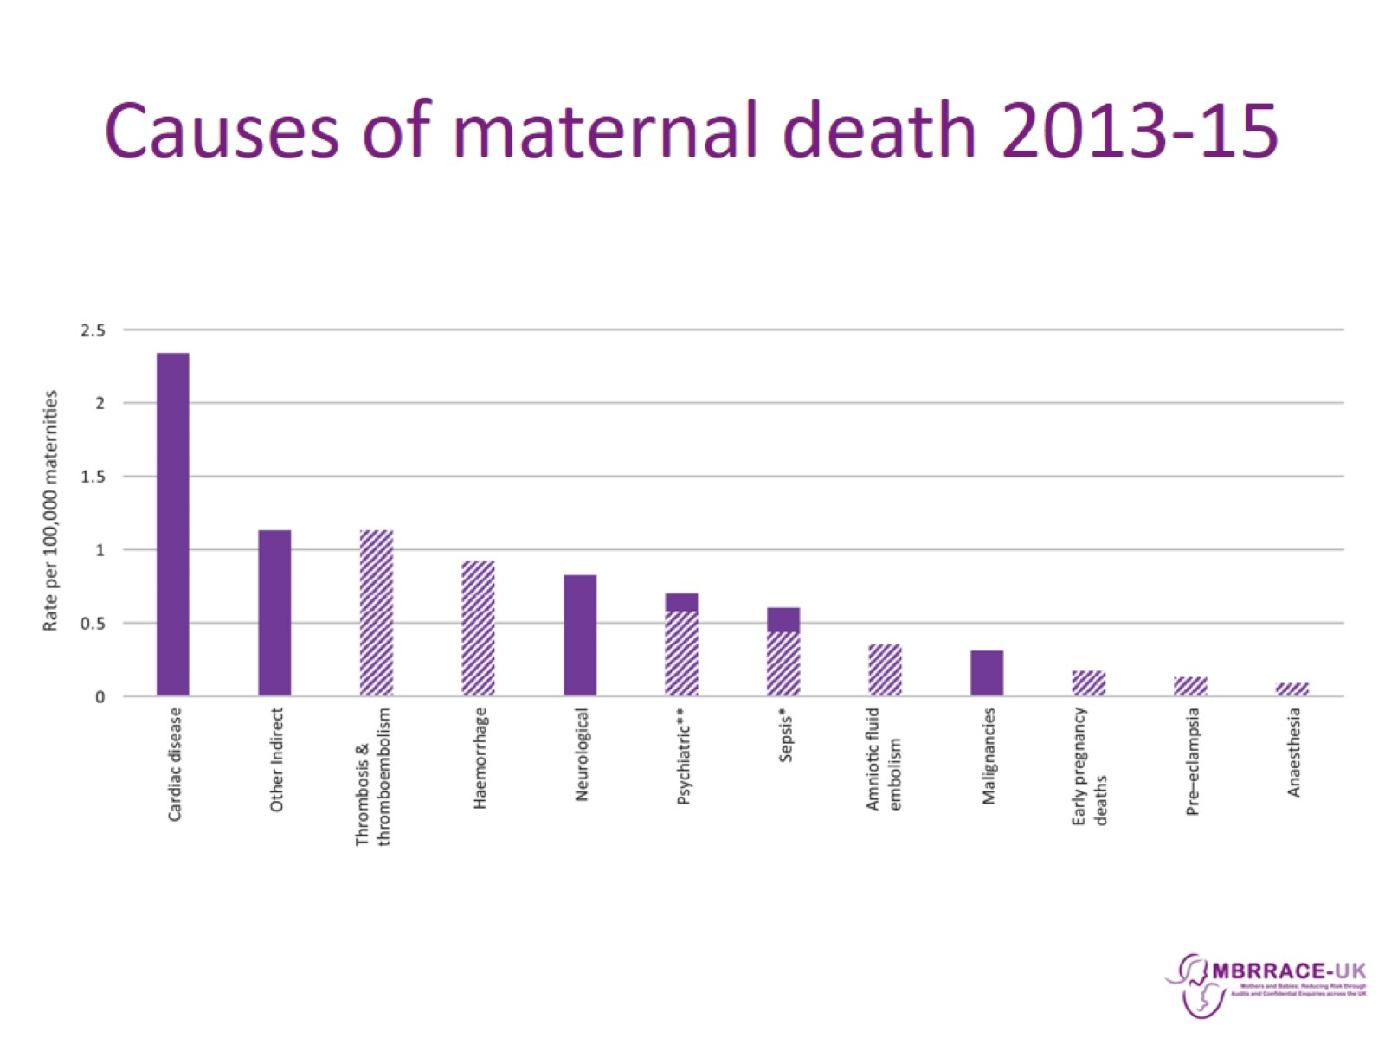
Causes of maternal death 2013-15

Slide 4
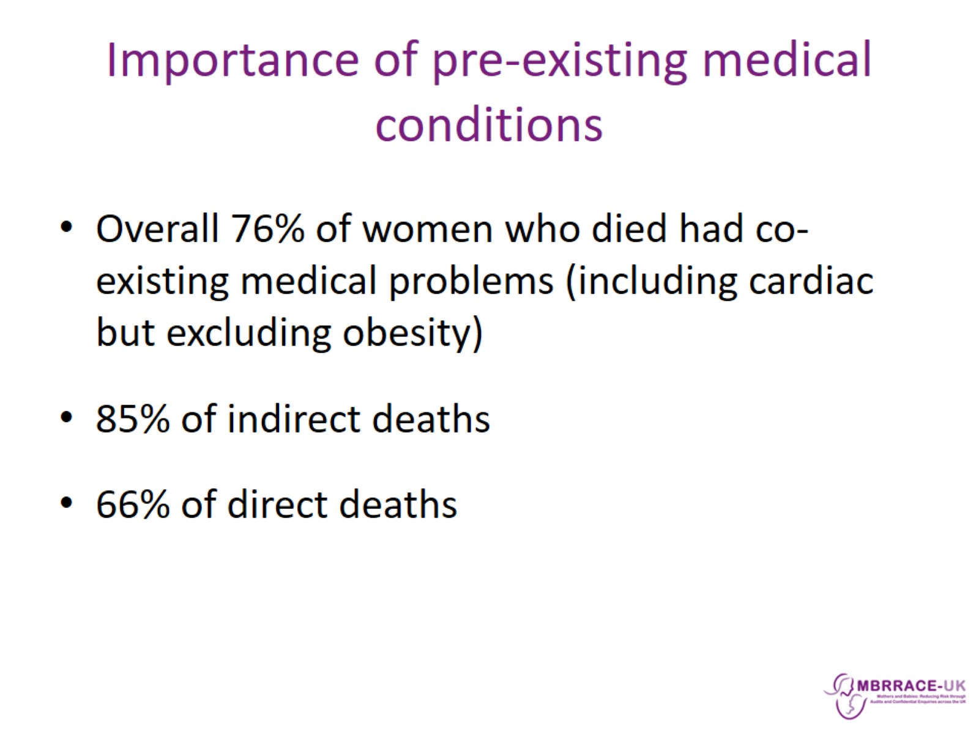
Importance of pre-existing medical conditions

Slide 5
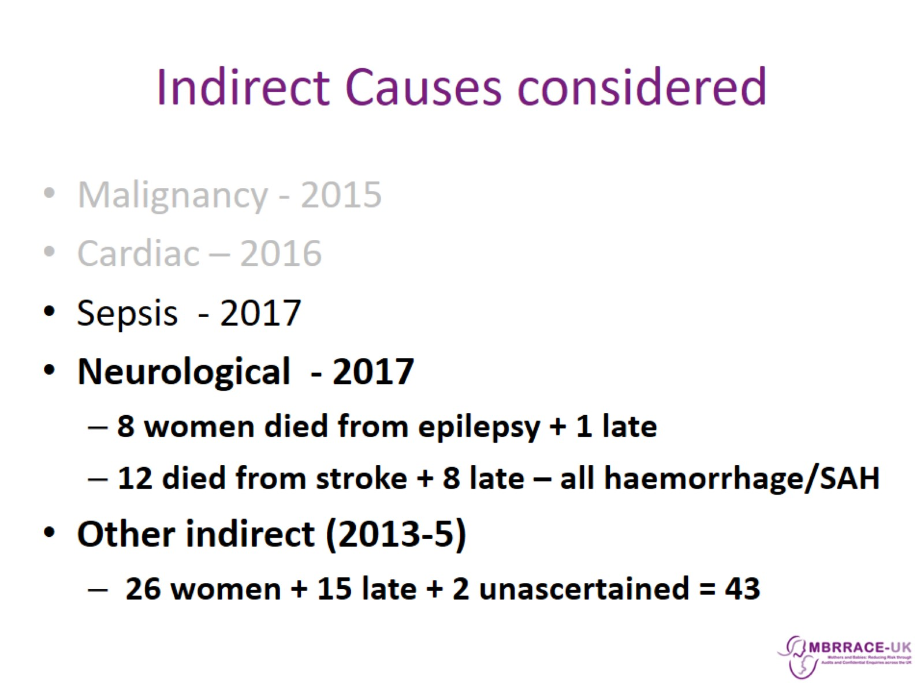
Indirect Causes considered

Slide 6
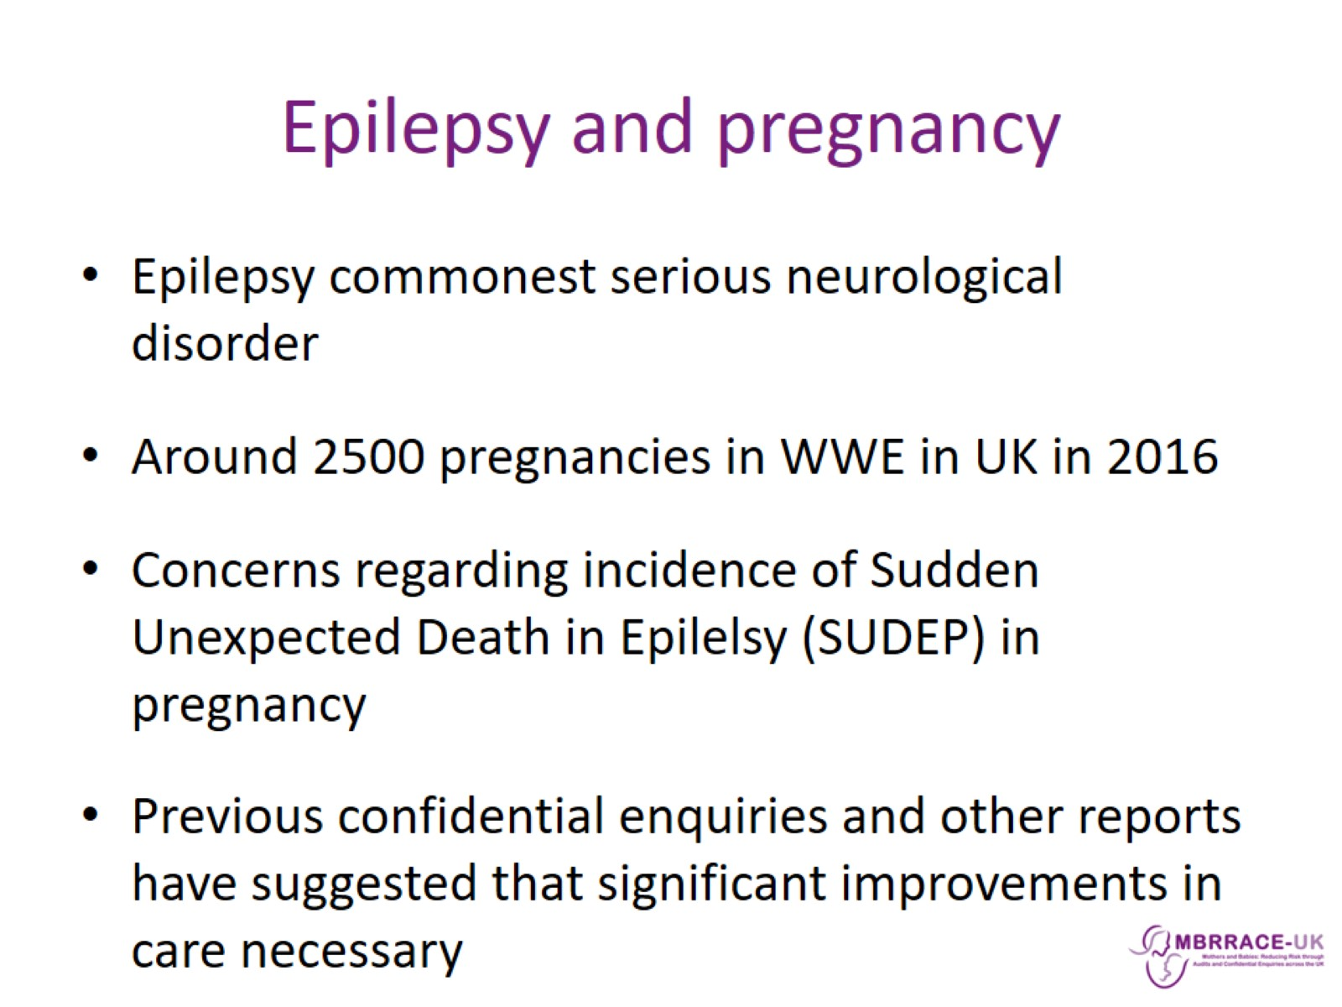
Epilepsy and pregnancy

Slide 7
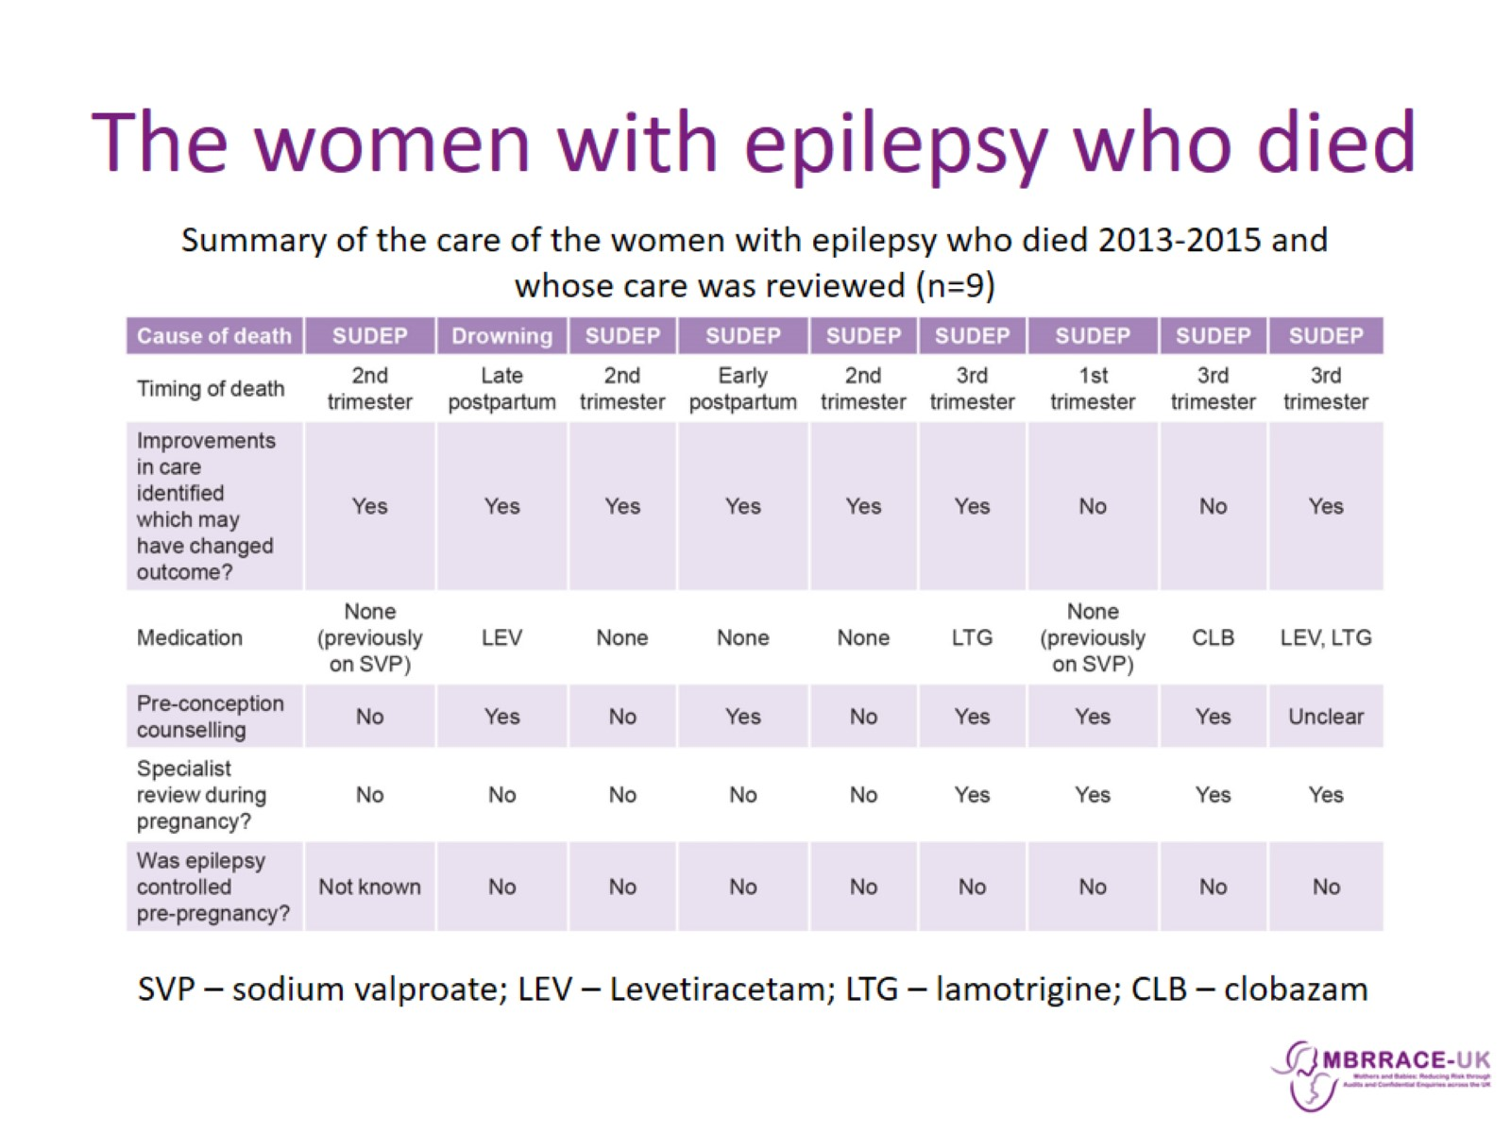
The women with epilepsy who died

Slide 8
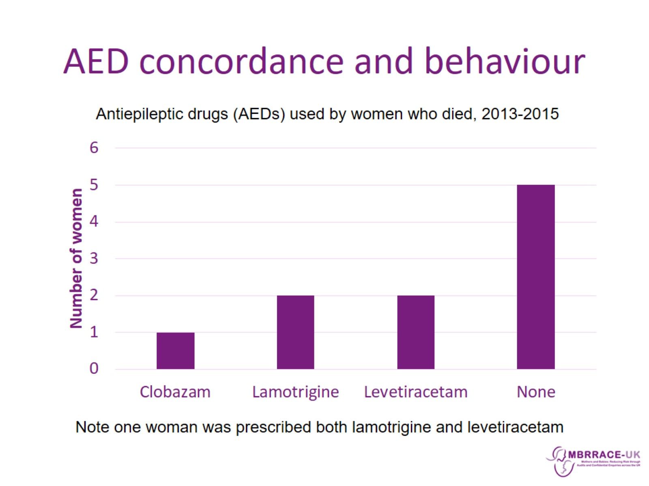
AED concordance and behaviour

Slide 9
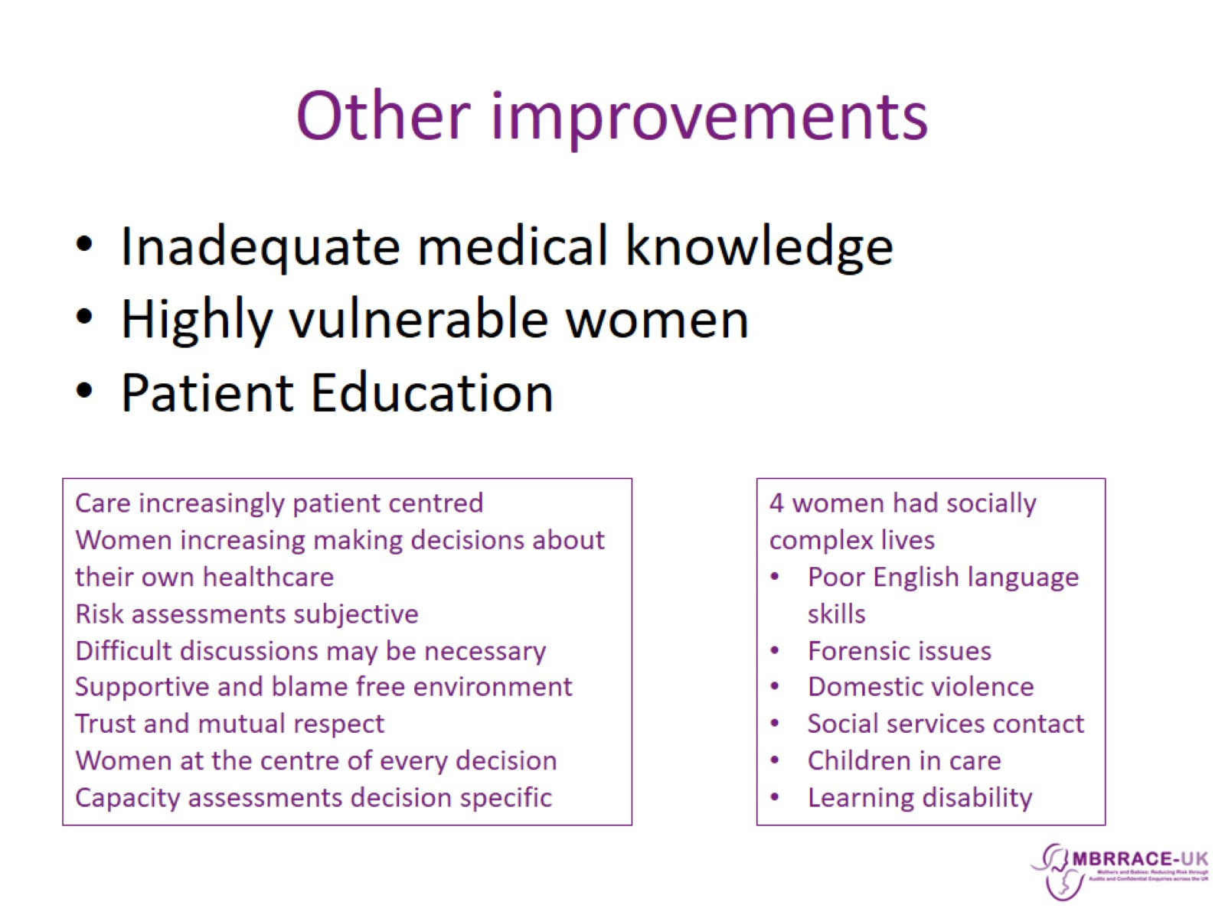
Other improvements

Slide 10
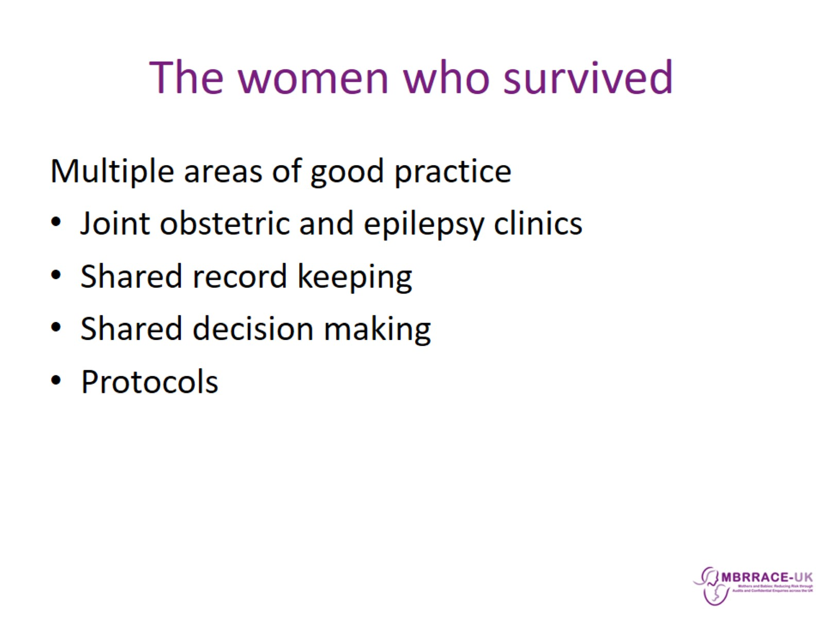
The women who survived

Slide 11
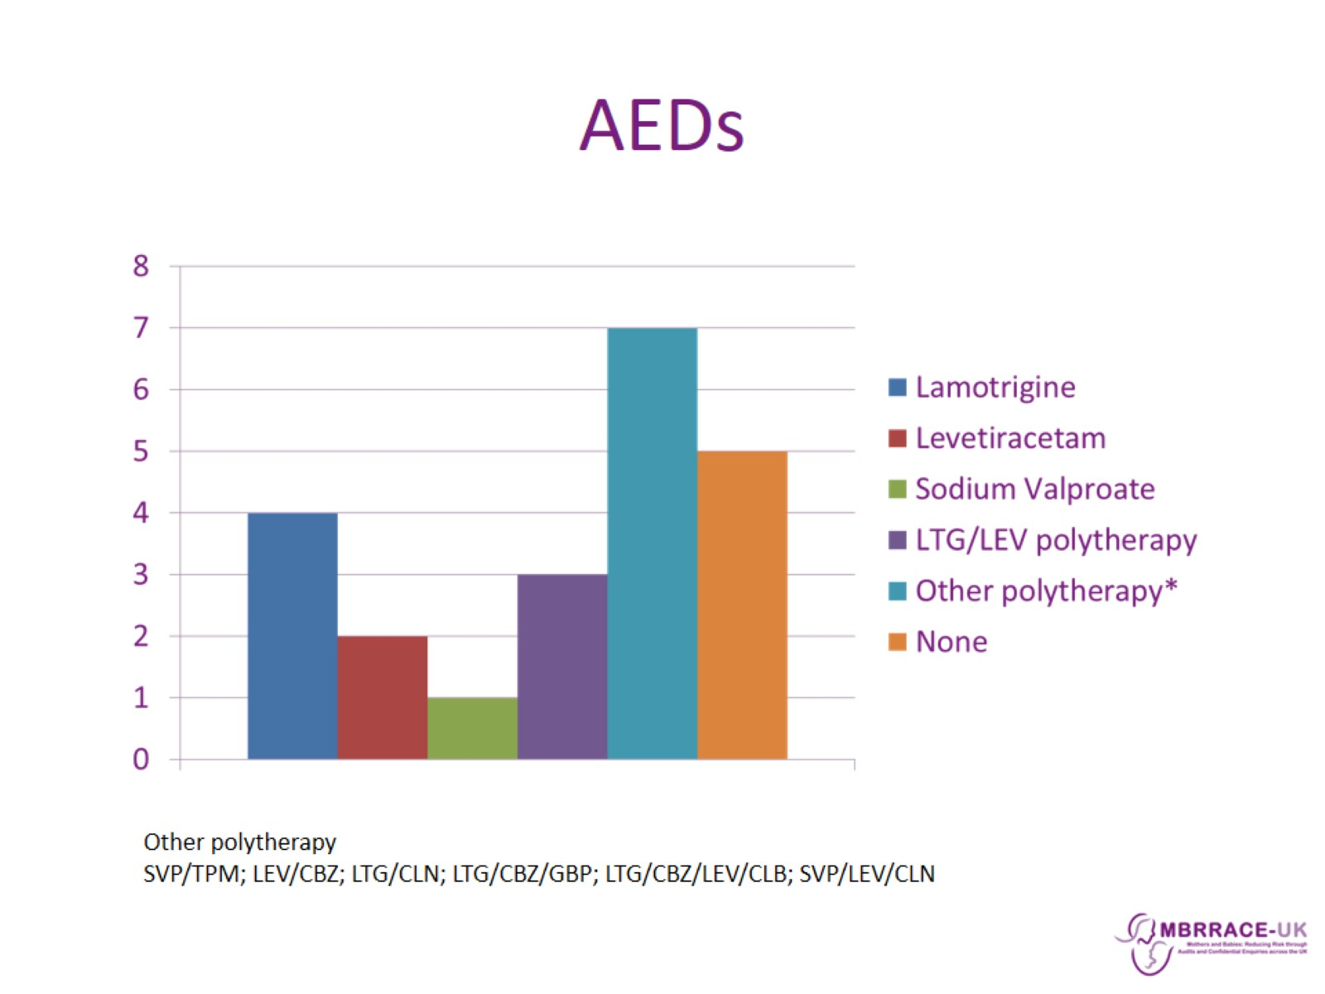
AEDs

Slide 12
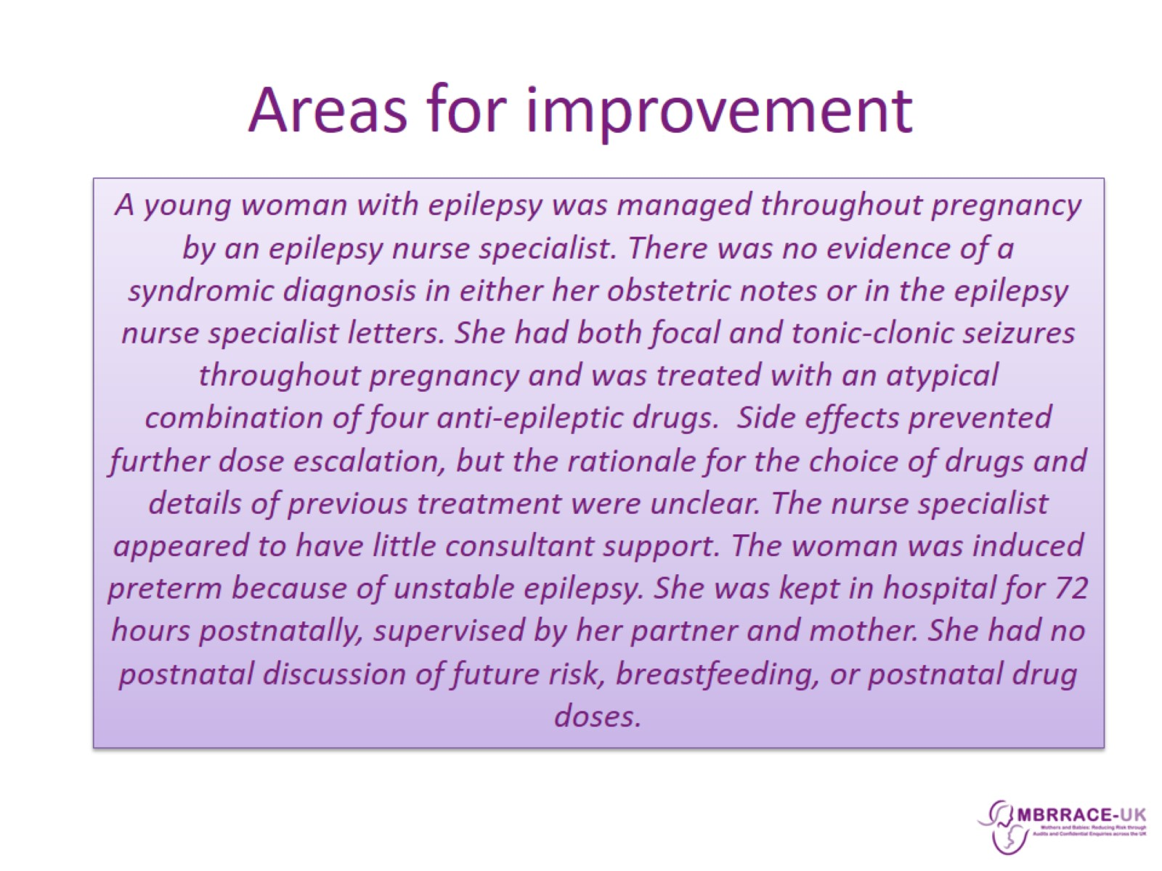
Areas for improvement

Slide 13
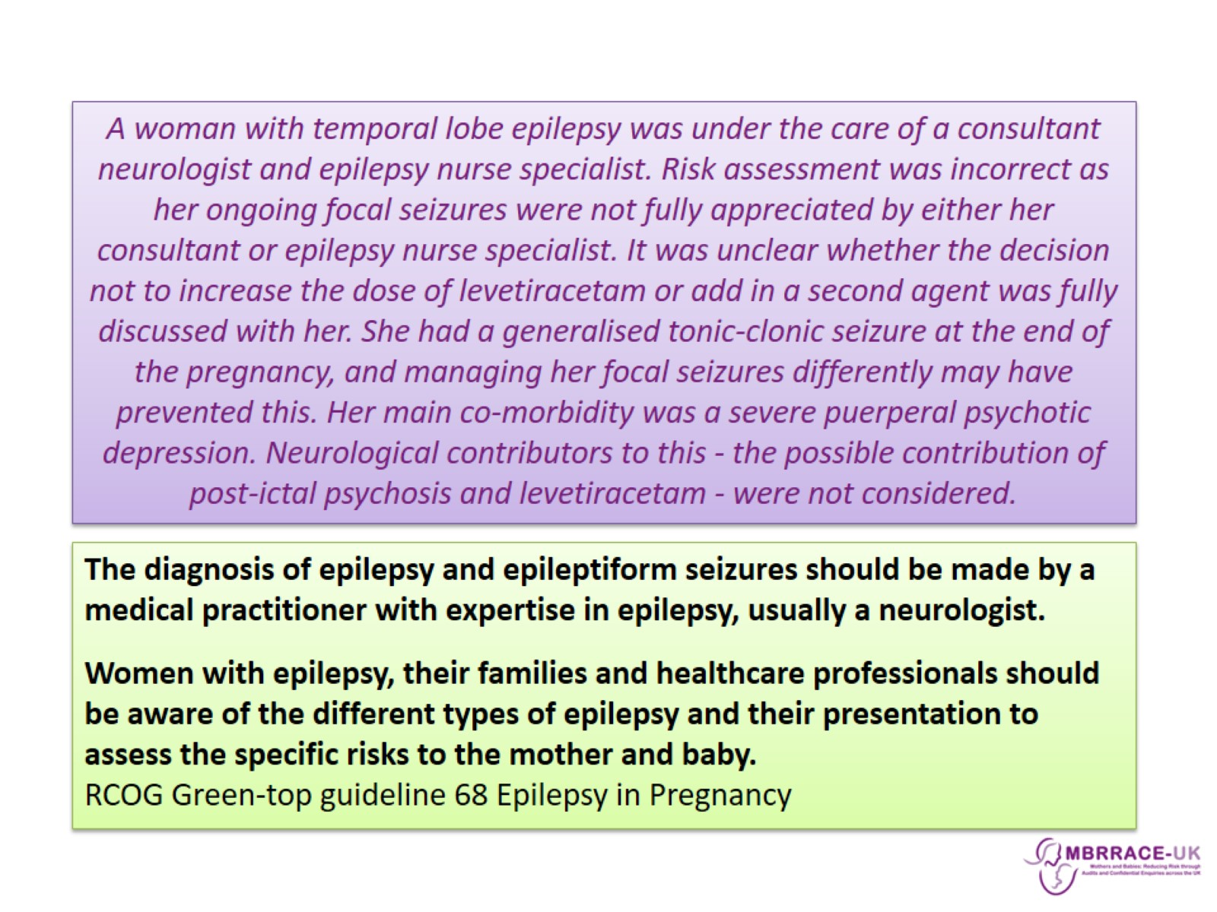

Slide 14
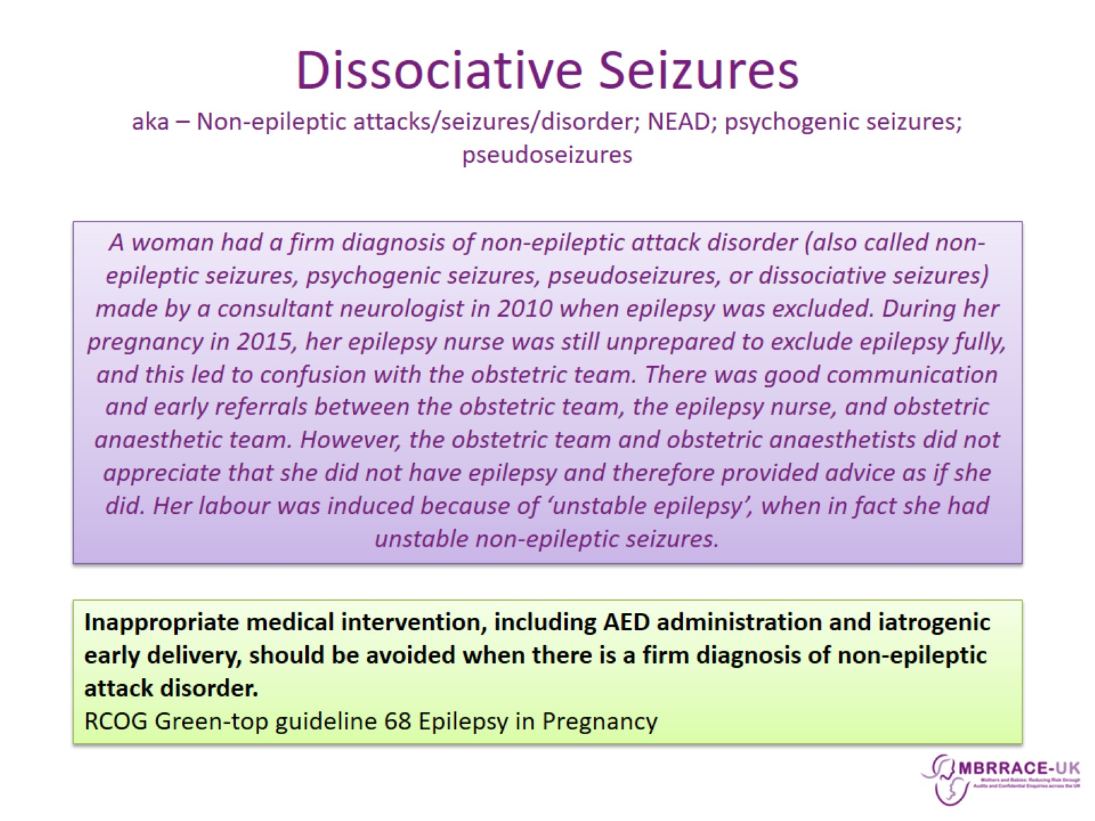
Dissociative Seizures aka – Non-epileptic attacks/seizures/disorder; NEAD; psychogenic seizures; pseudoseizures

Slide 15
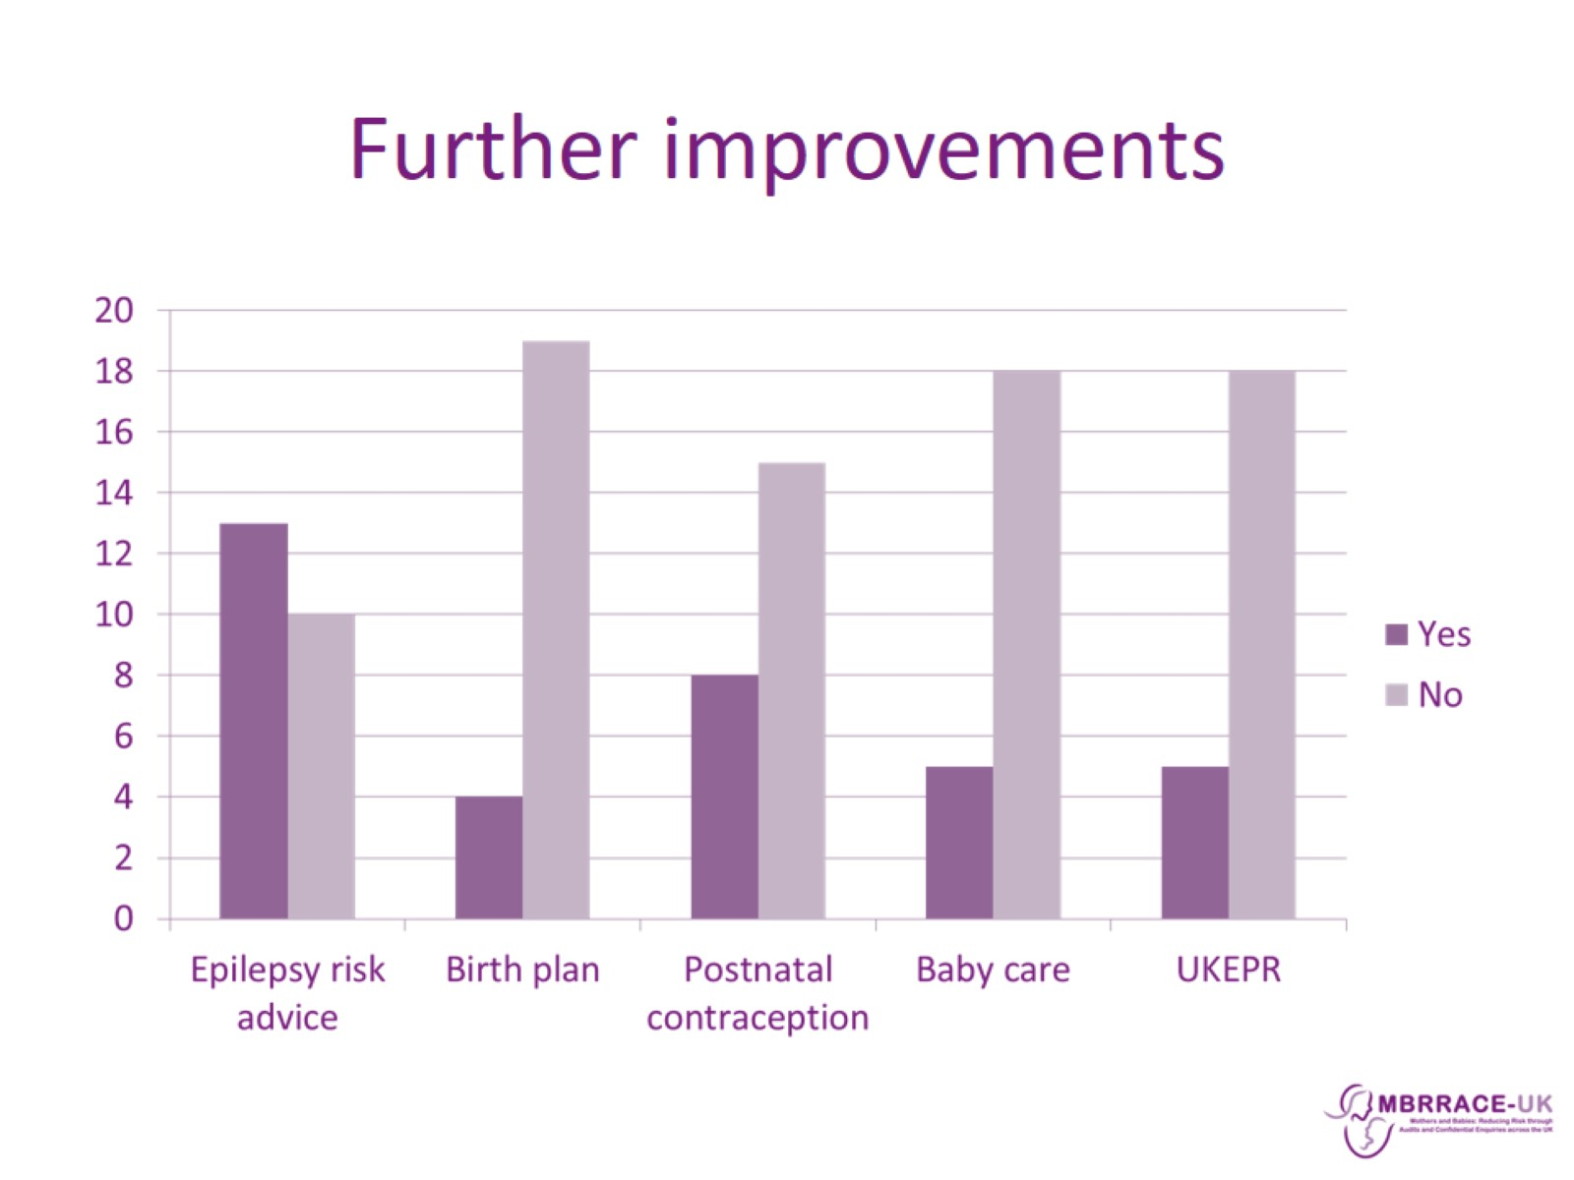
Further improvements

Slide 16
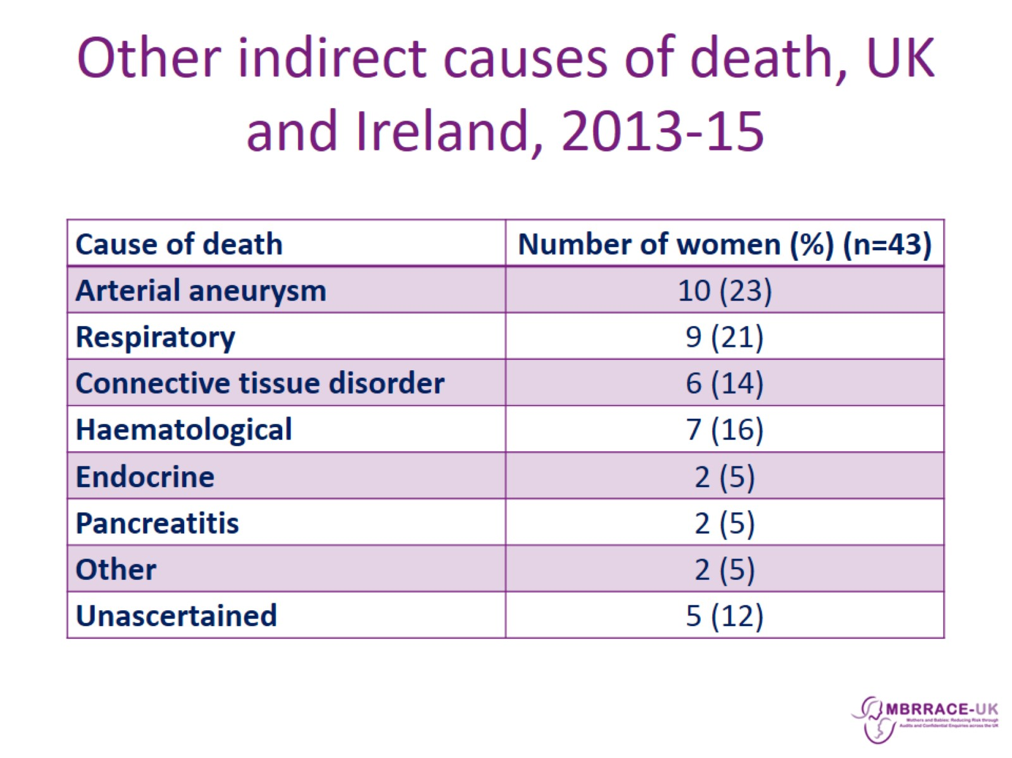
Other indirect causes of death, UK and Ireland, 2013-15

Slide 17
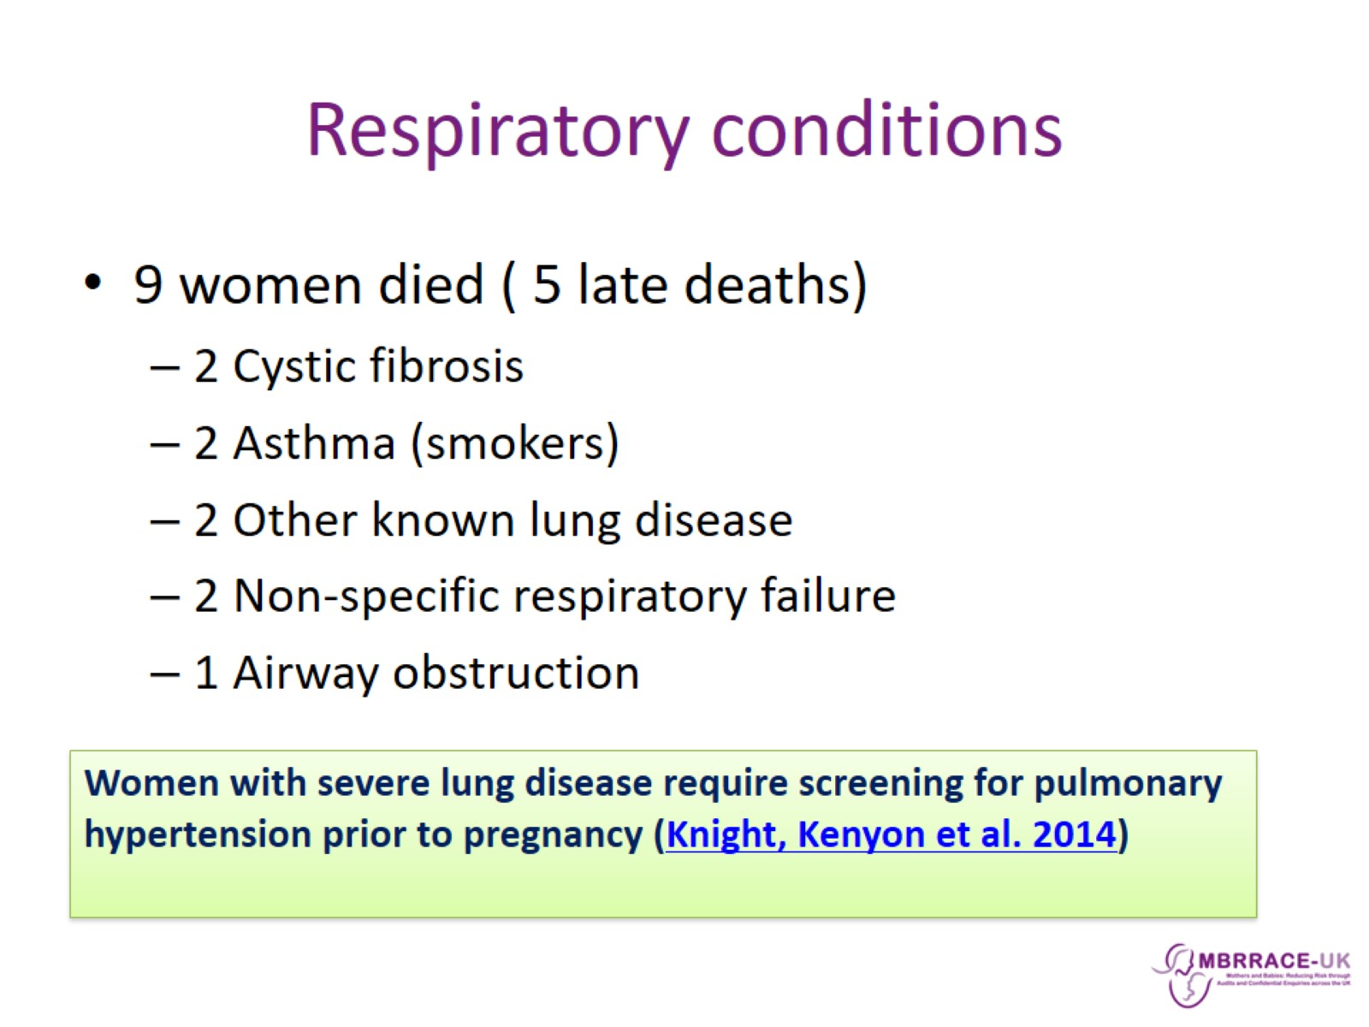
Respiratory conditions

Slide 18
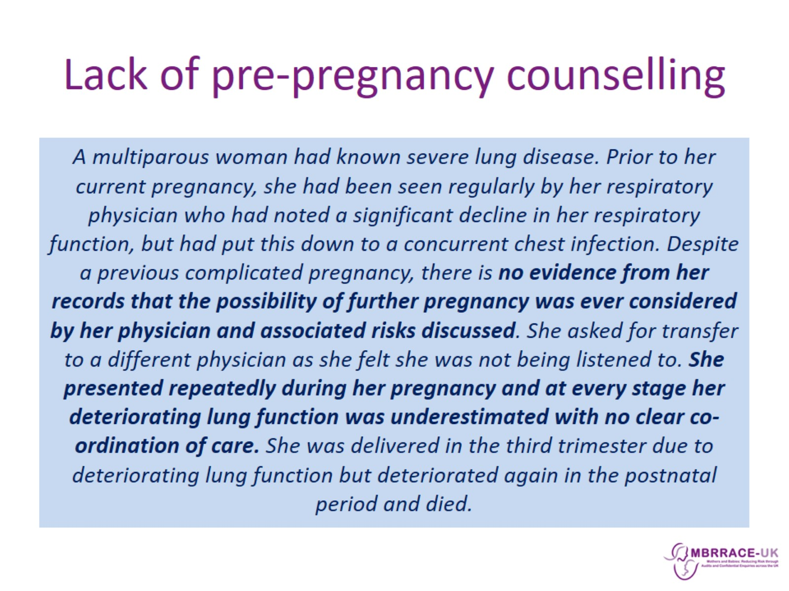
Lack of pre-pregnancy counselling

Slide 19
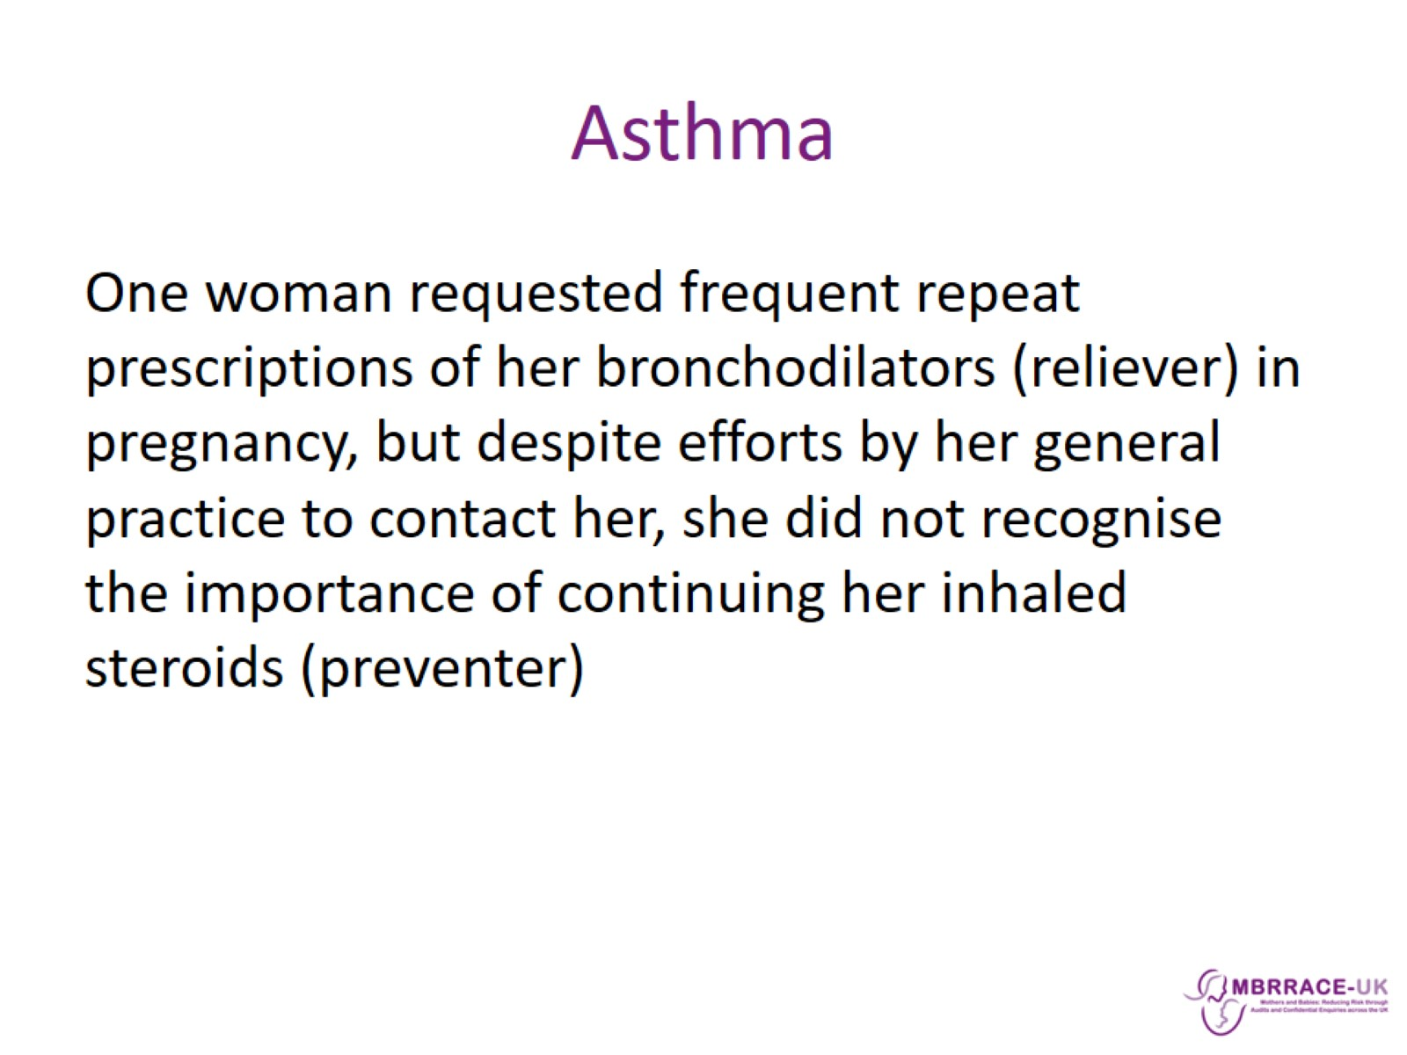
Asthma

Slide 20
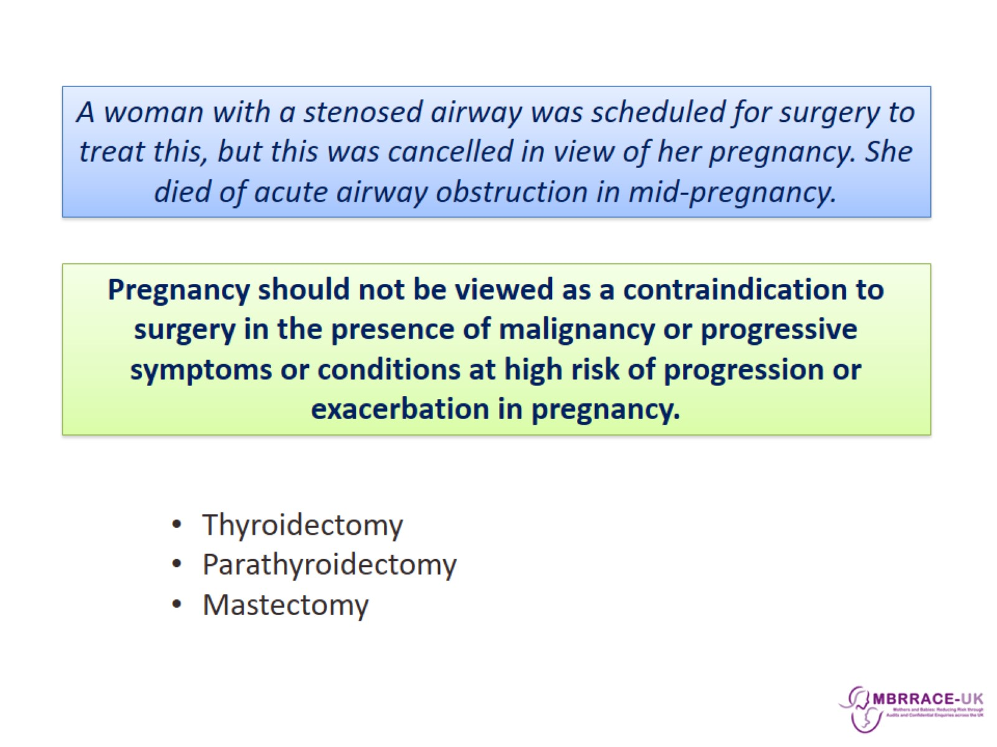

Slide 21
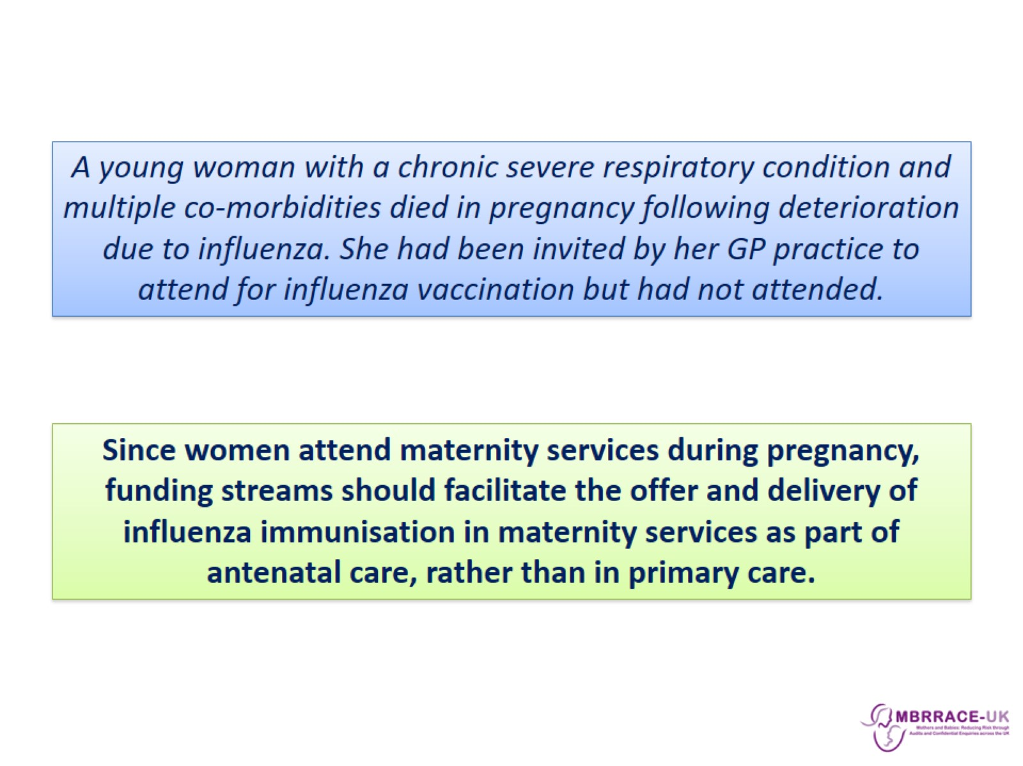

Slide 22
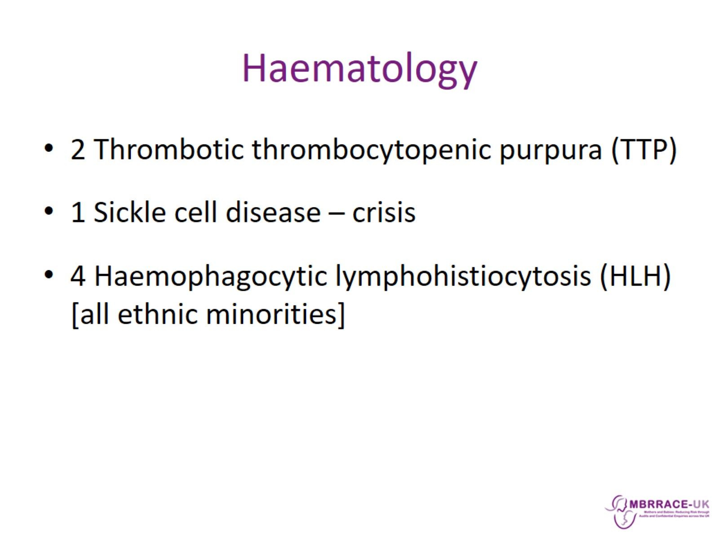
Haematology

Slide 23
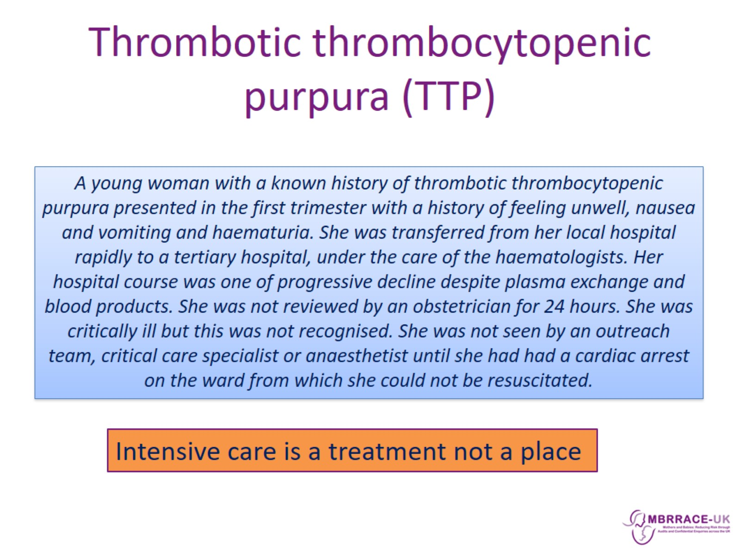
Thrombotic thrombocytopenic purpura (TTP)

Slide 24
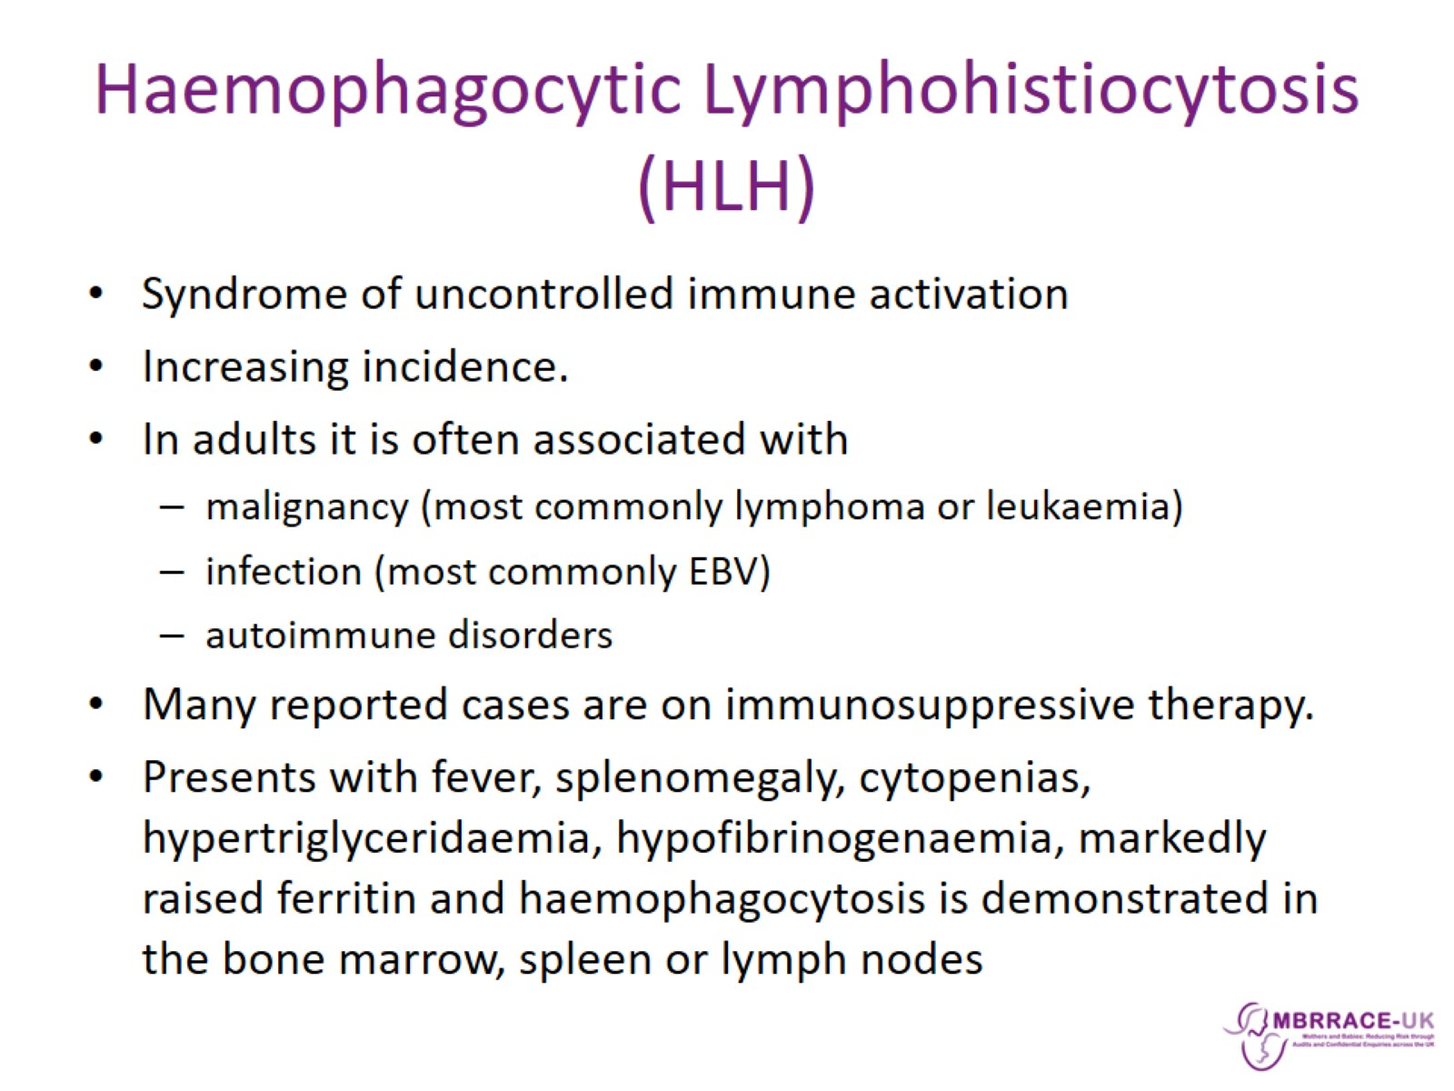
Haemophagocytic Lymphohistiocytosis (HLH)

Slide 25
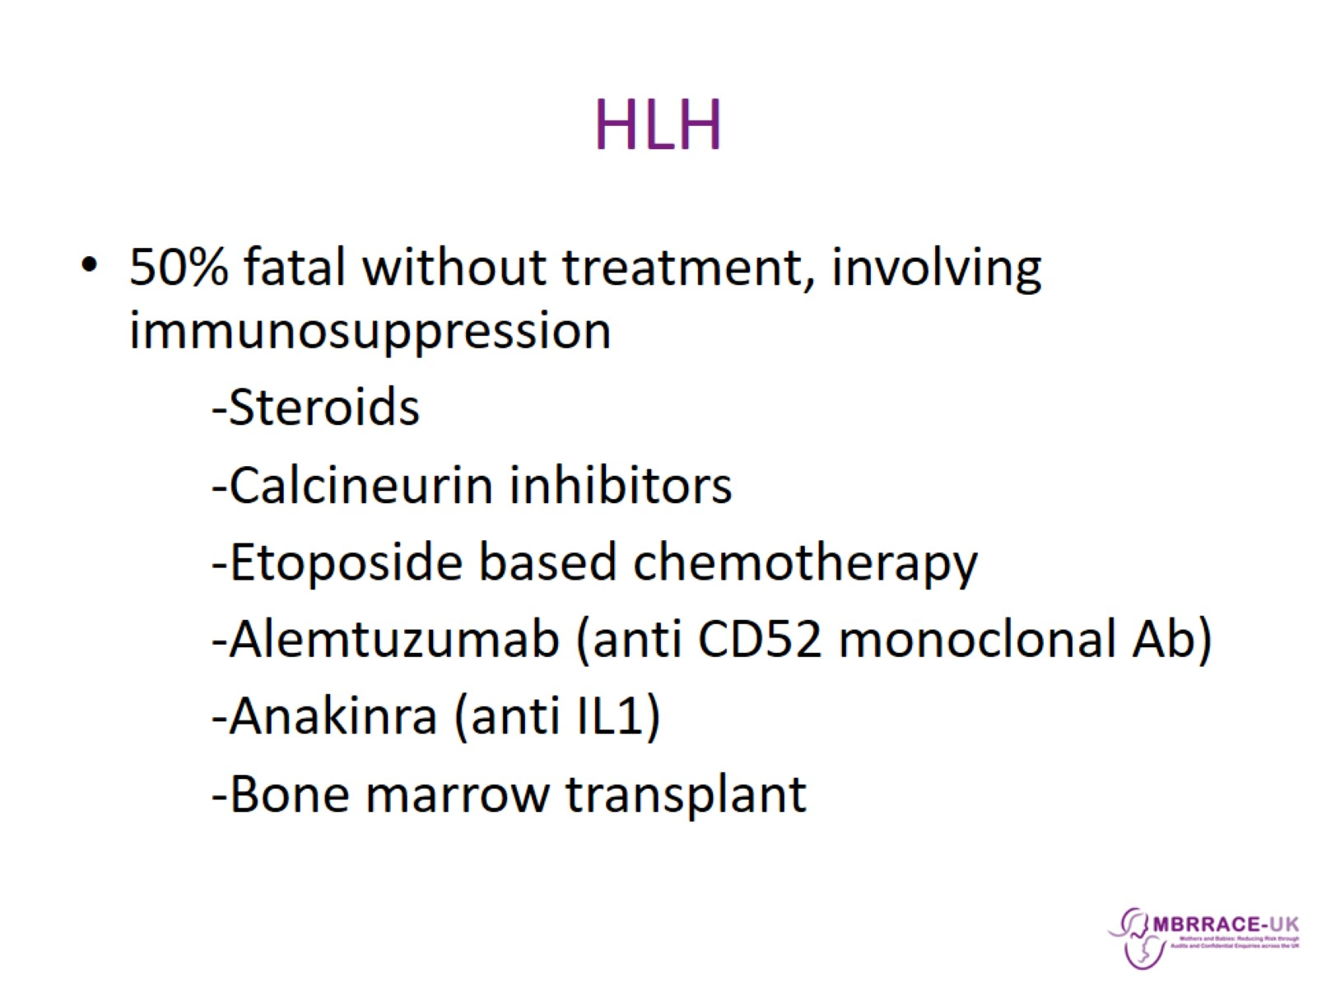
HLH

Slide 26
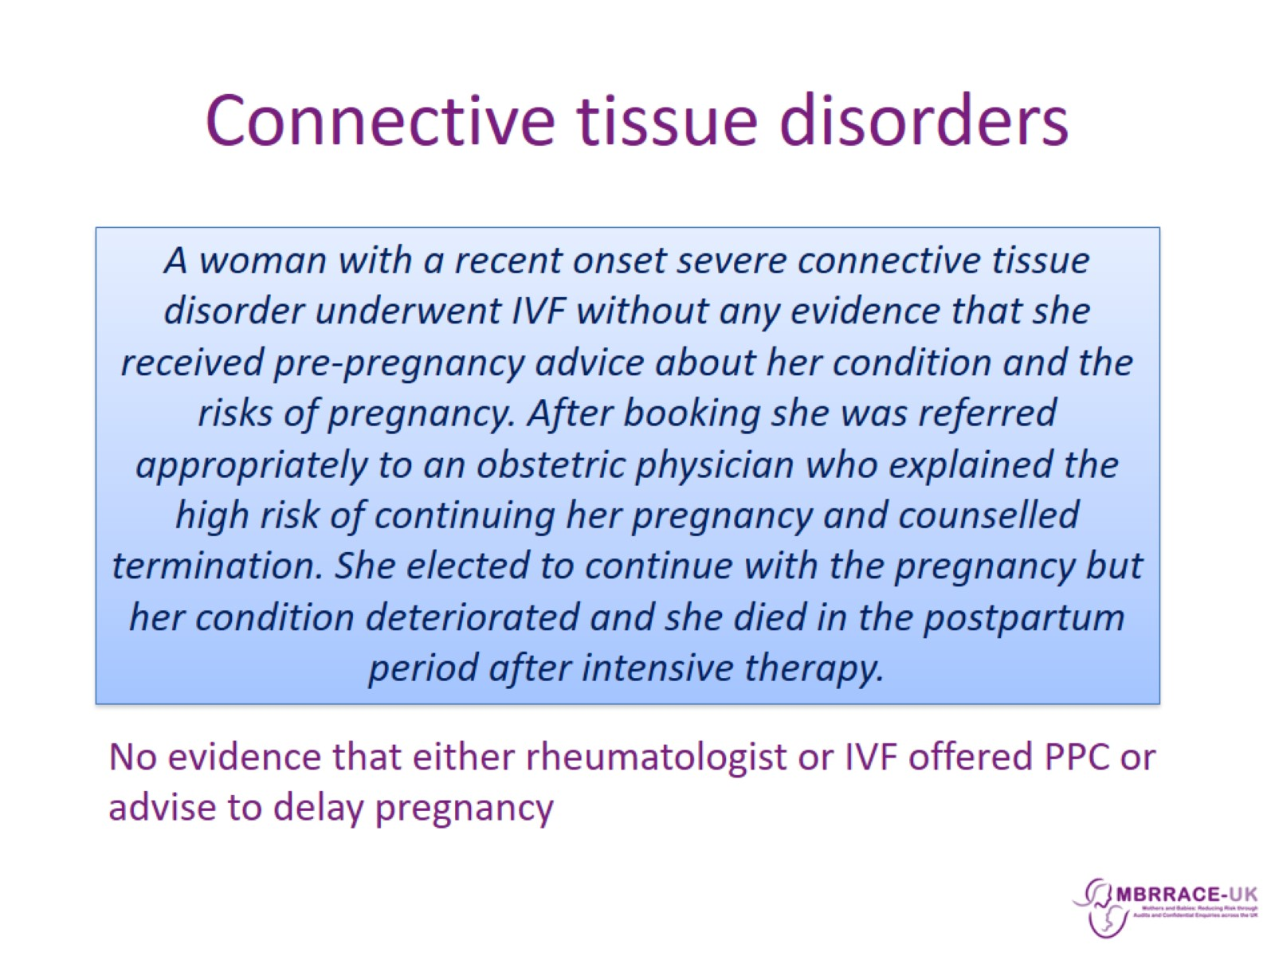
Connective tissue disorders

Slide 27
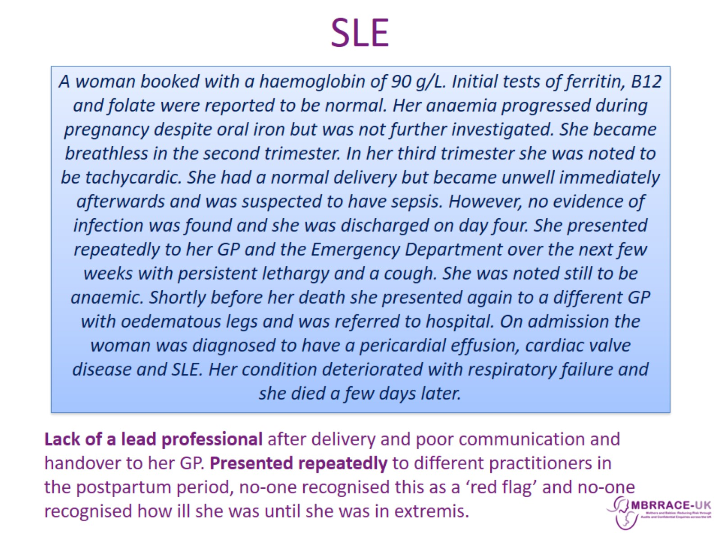
SLE

Slide 28
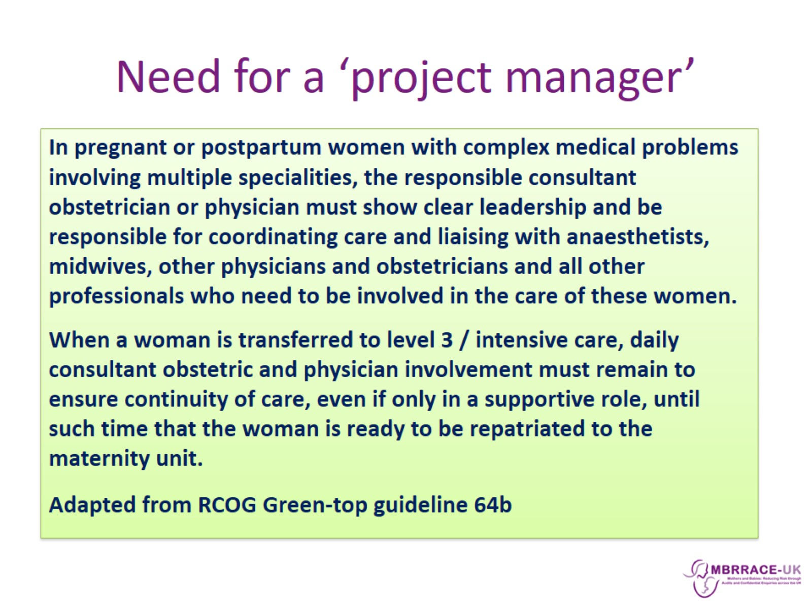
Need for a ‘project manager’

Slide 29
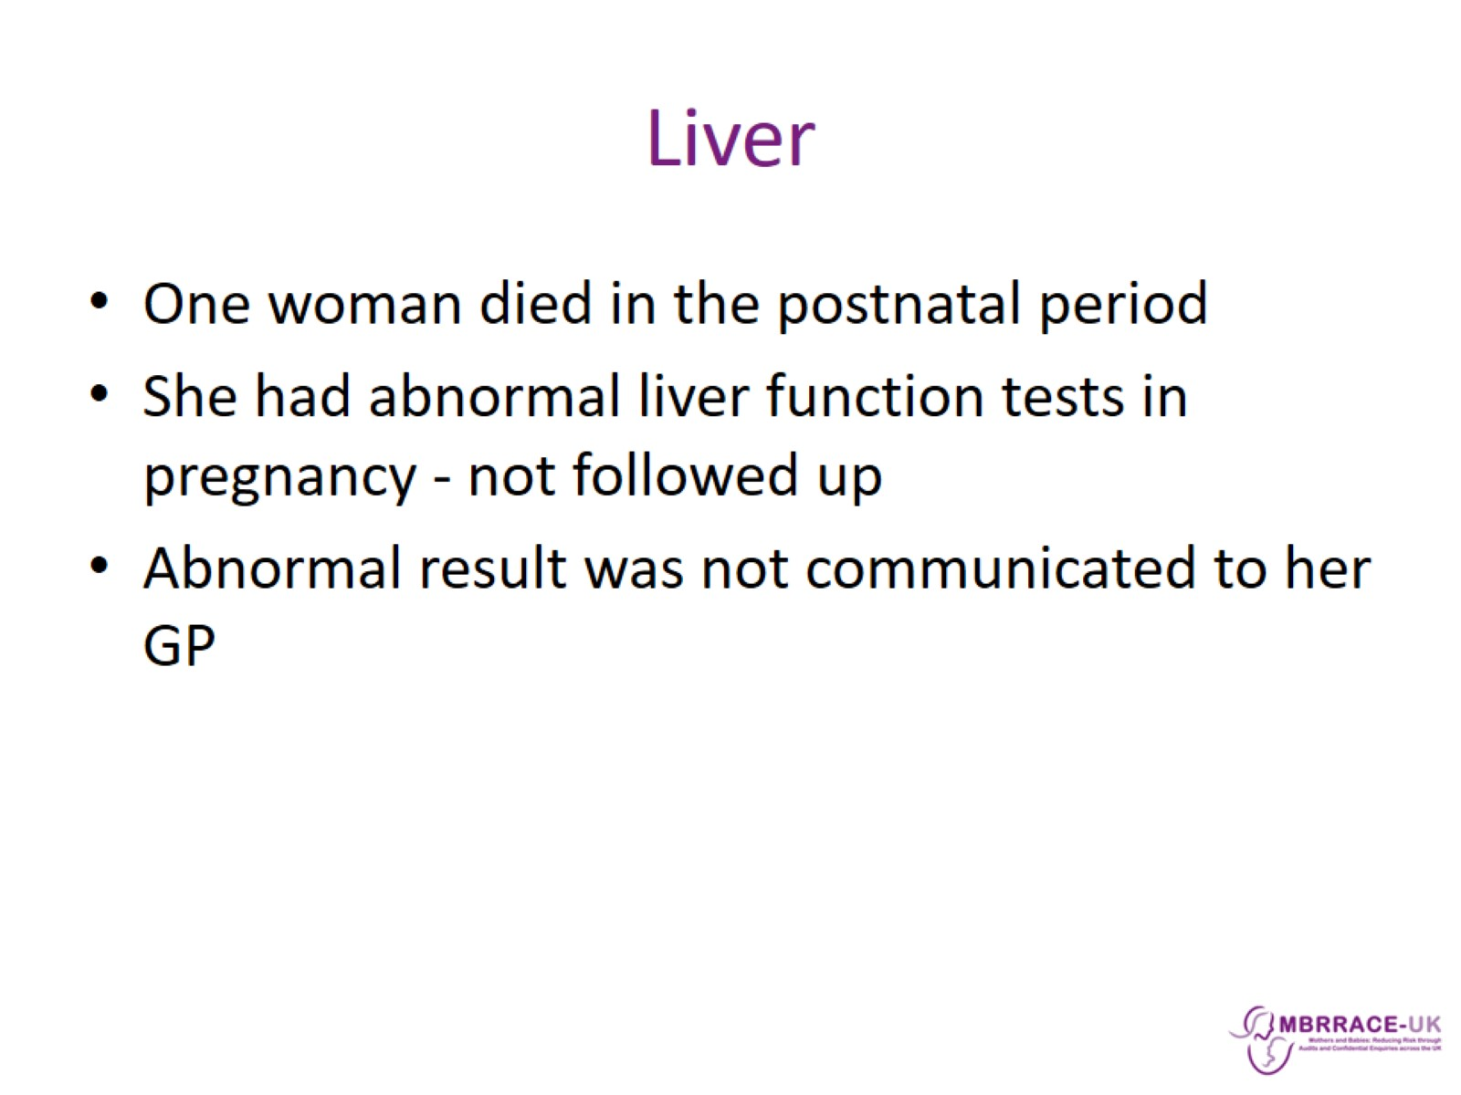
Liver

Slide 30
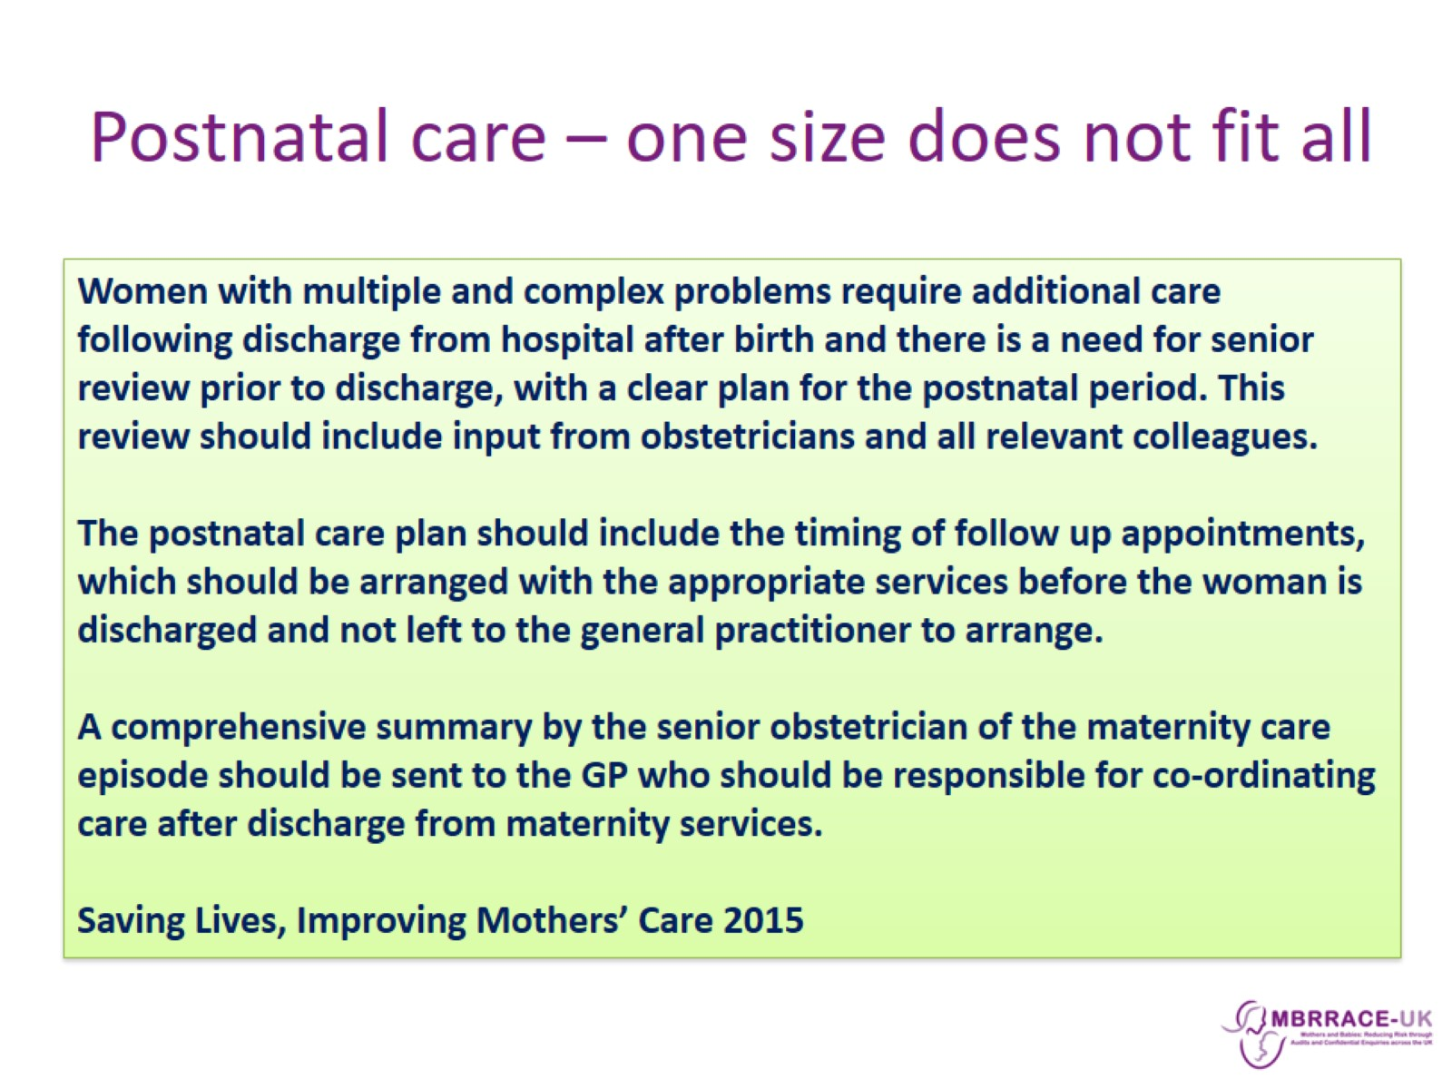
Postnatal care – one size does not fit all

Slide 31
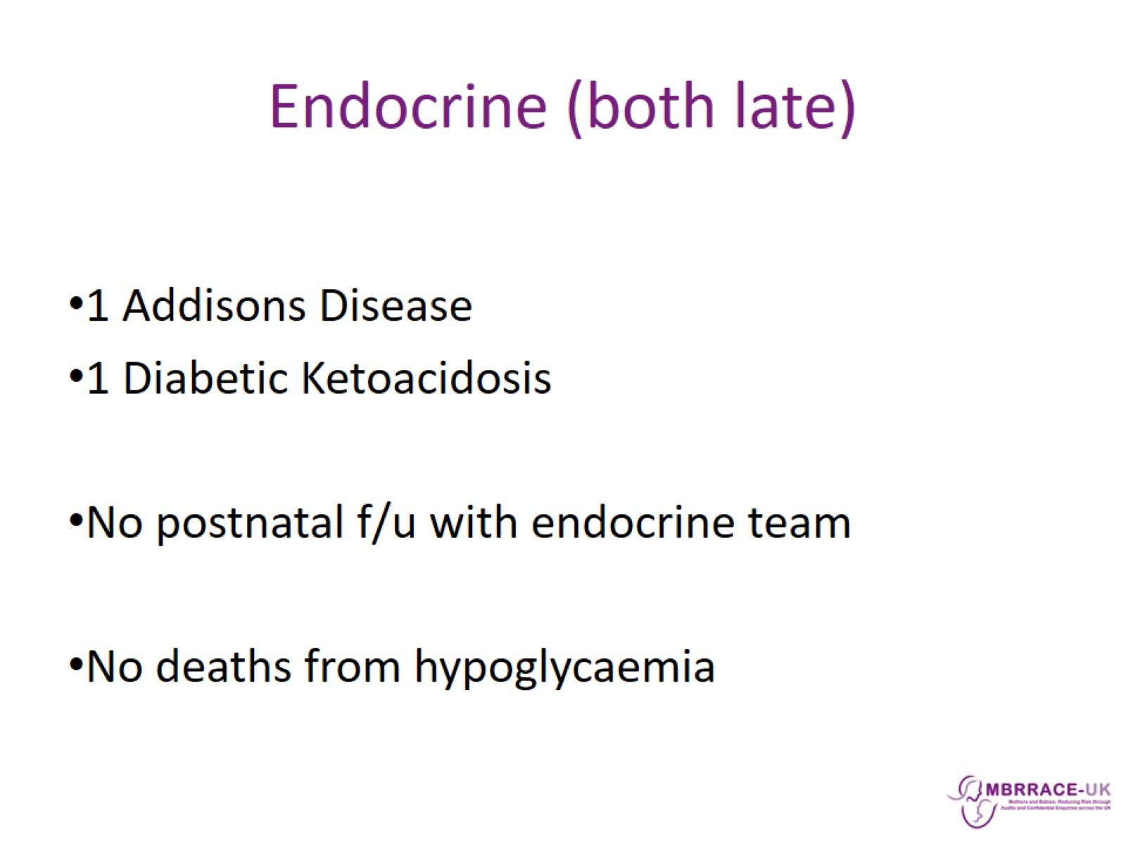
Endocrine (both late)

Slide 32
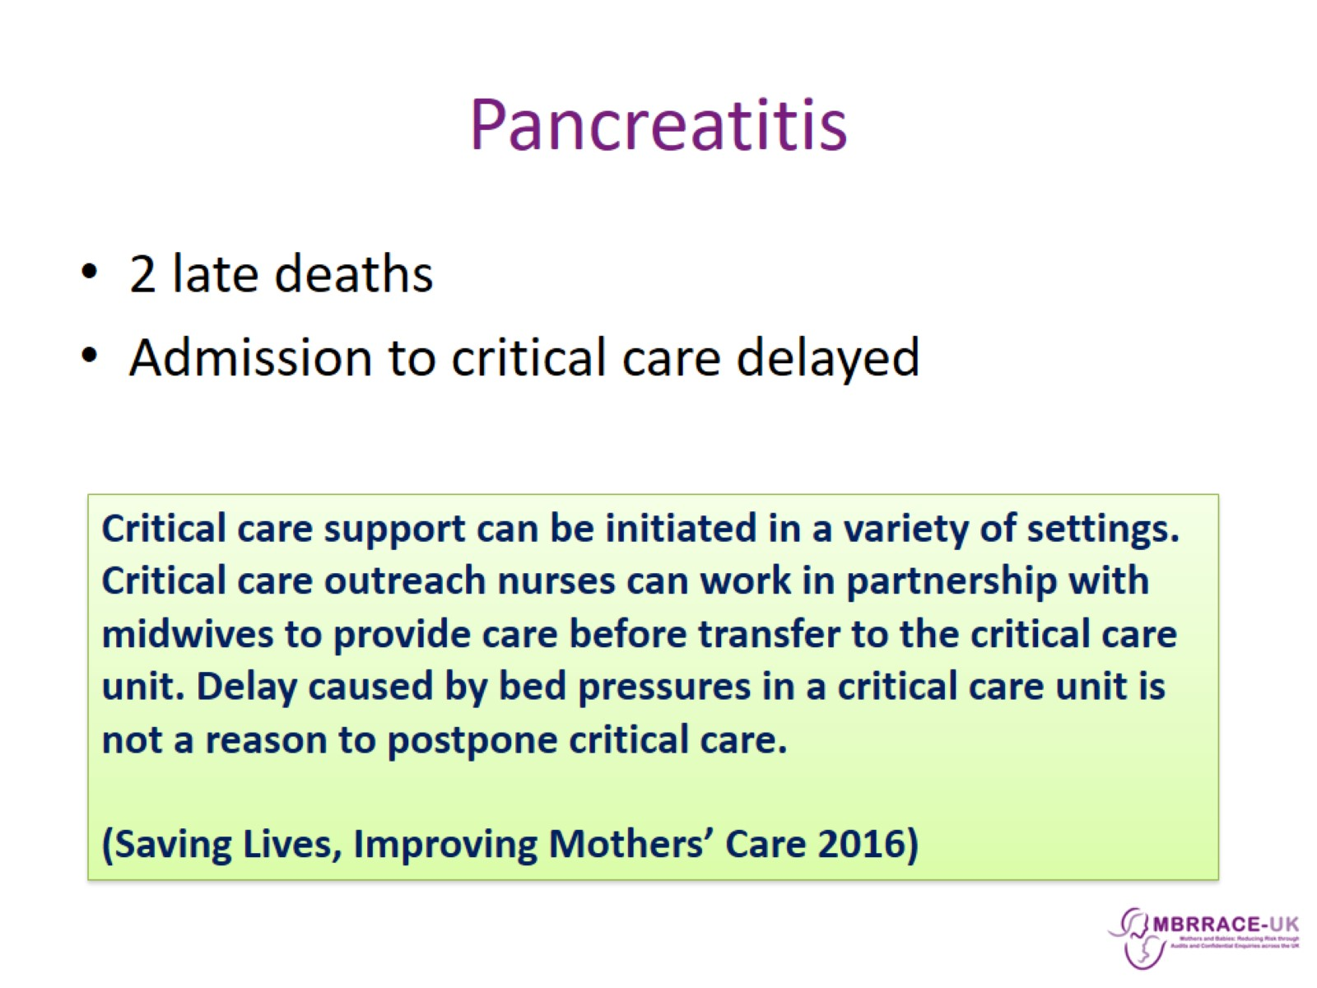
Pancreatitis

Slide 33
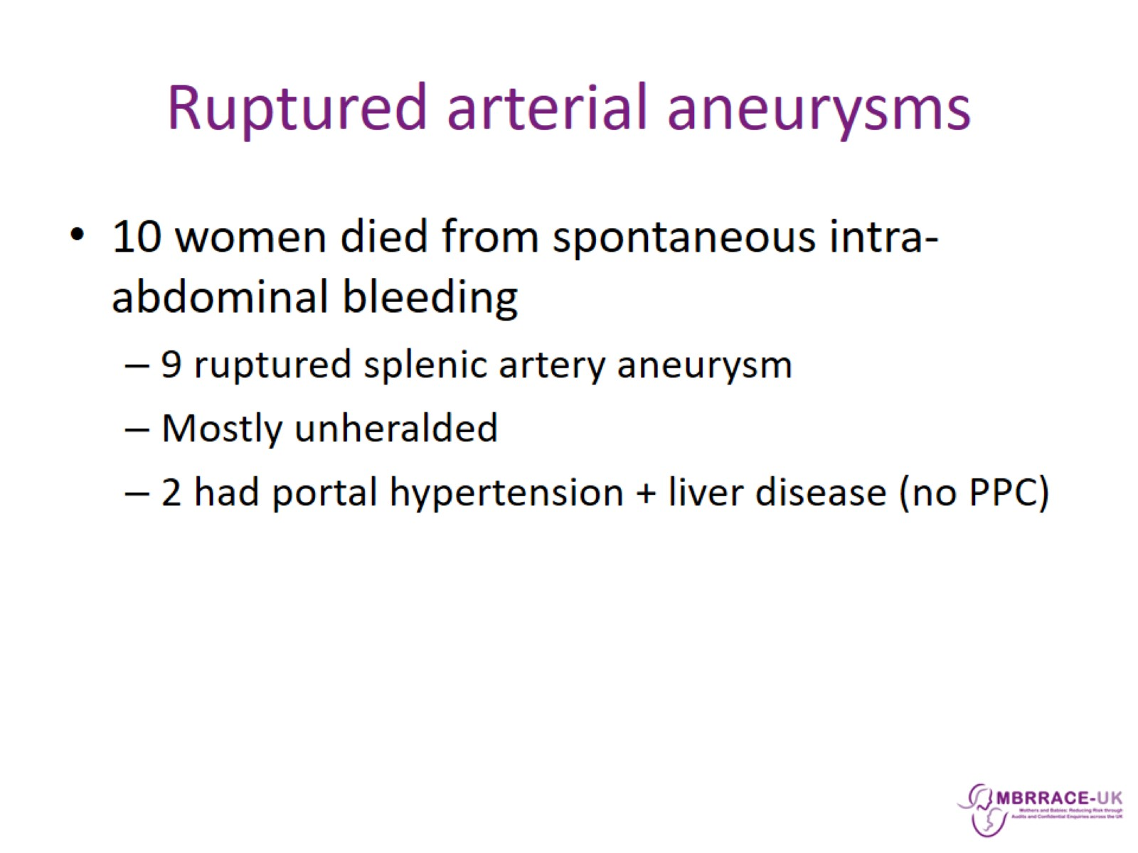
Ruptured arterial aneurysms

Slide 34
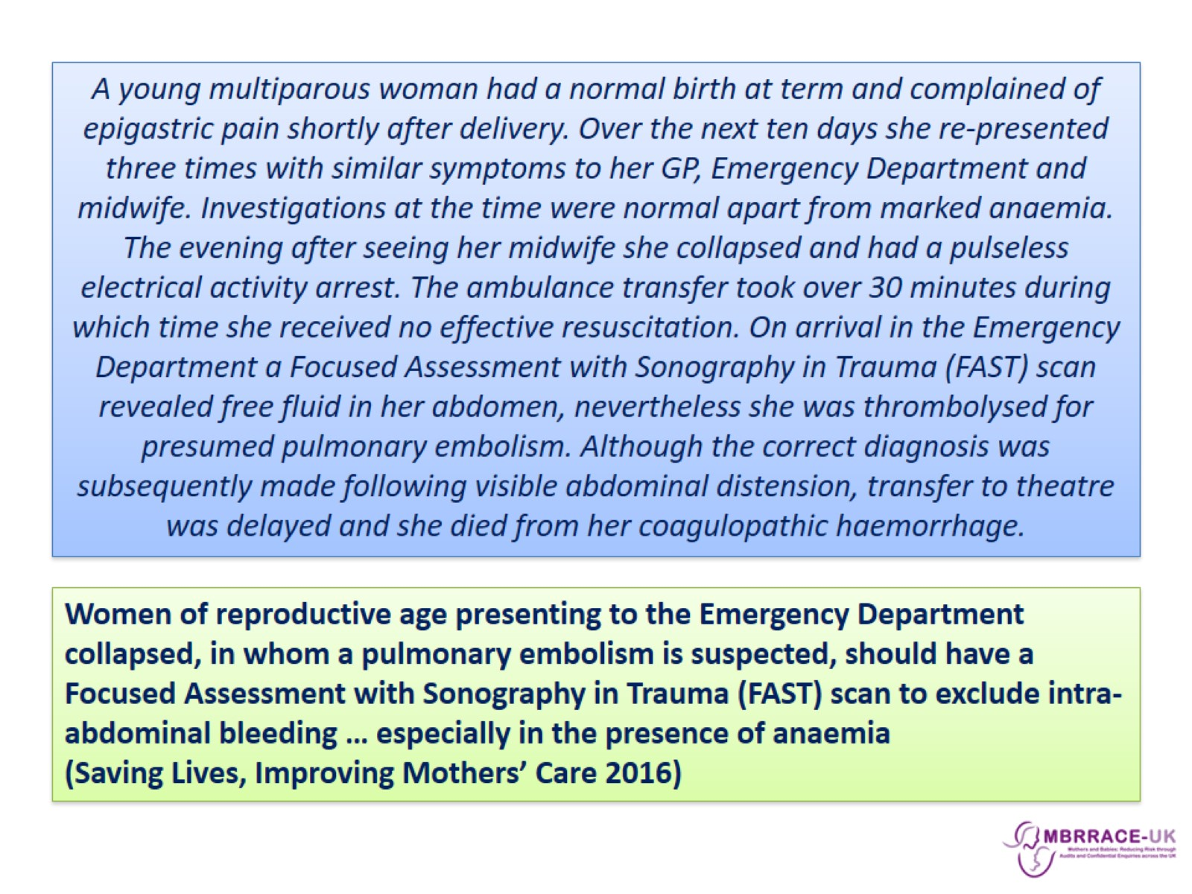

Slide 35
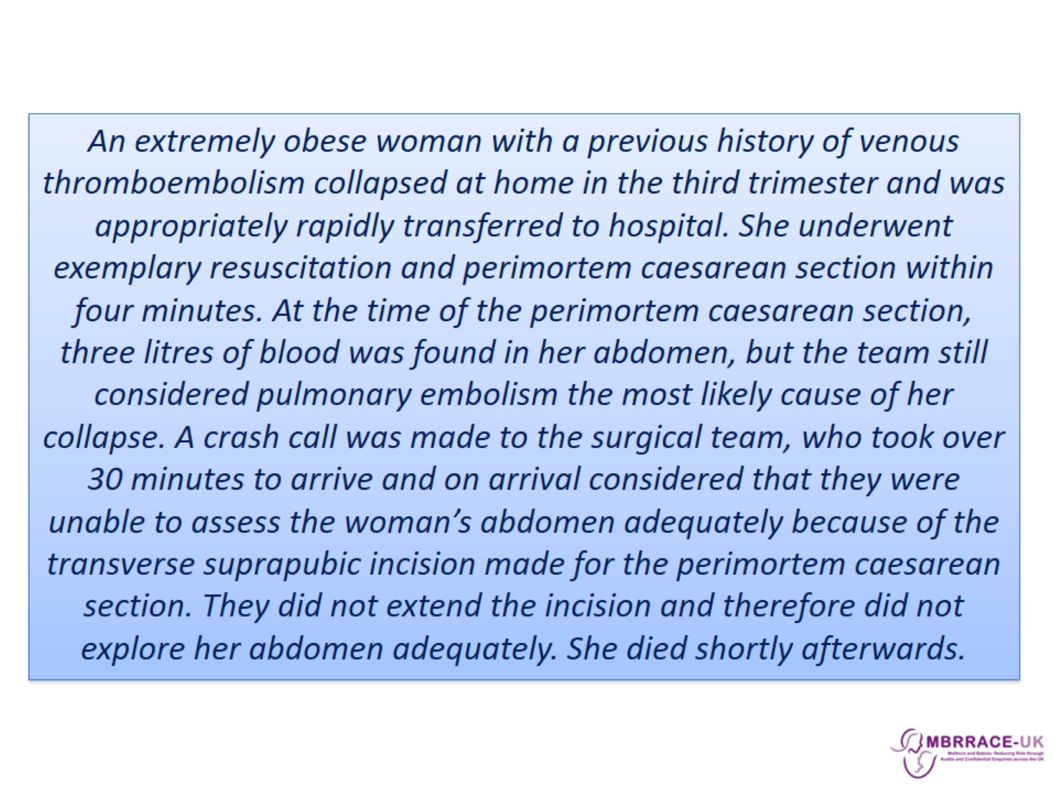

Slide 36
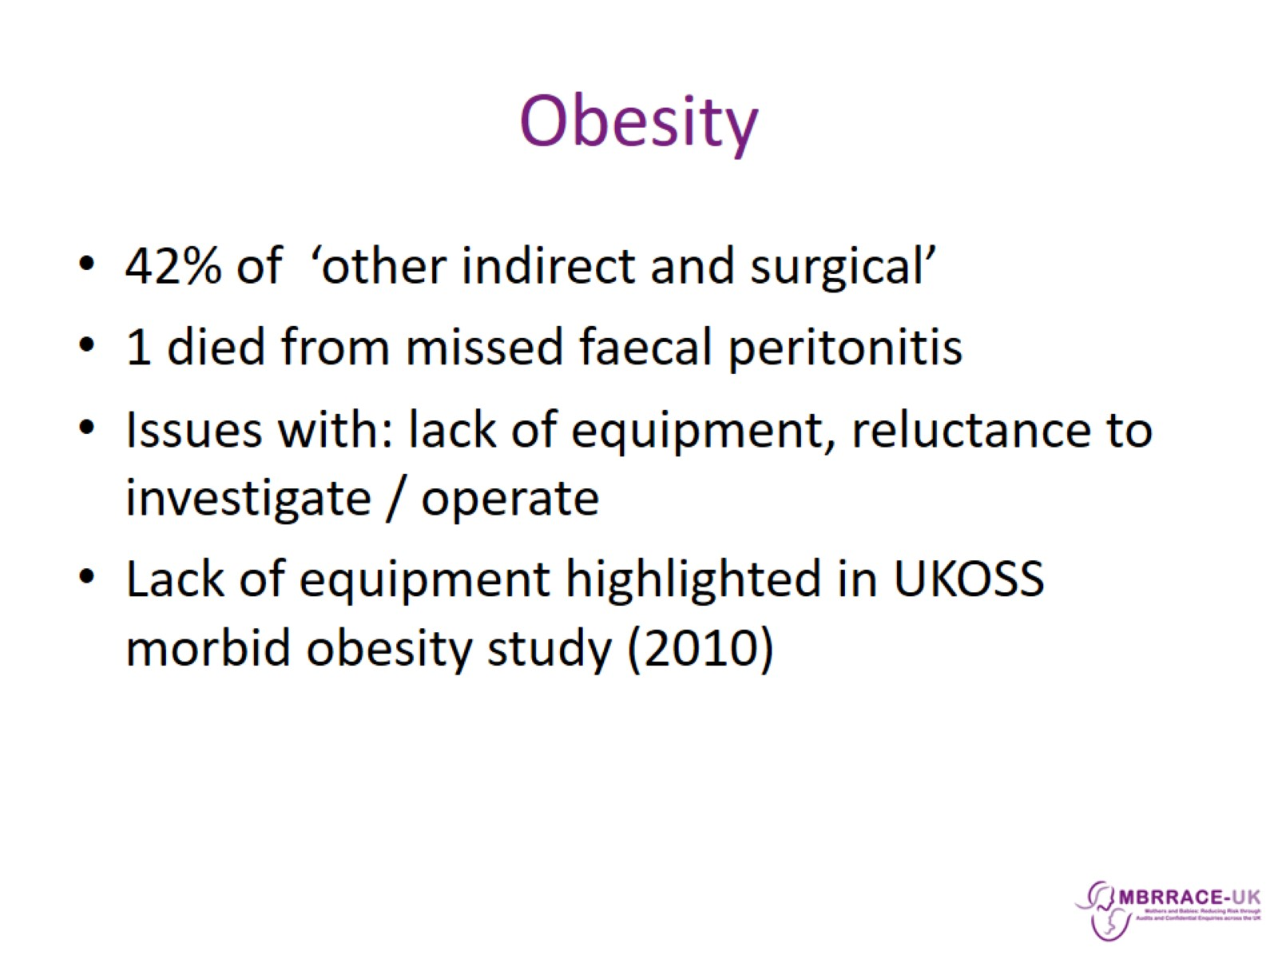
Obesity

Slide 37
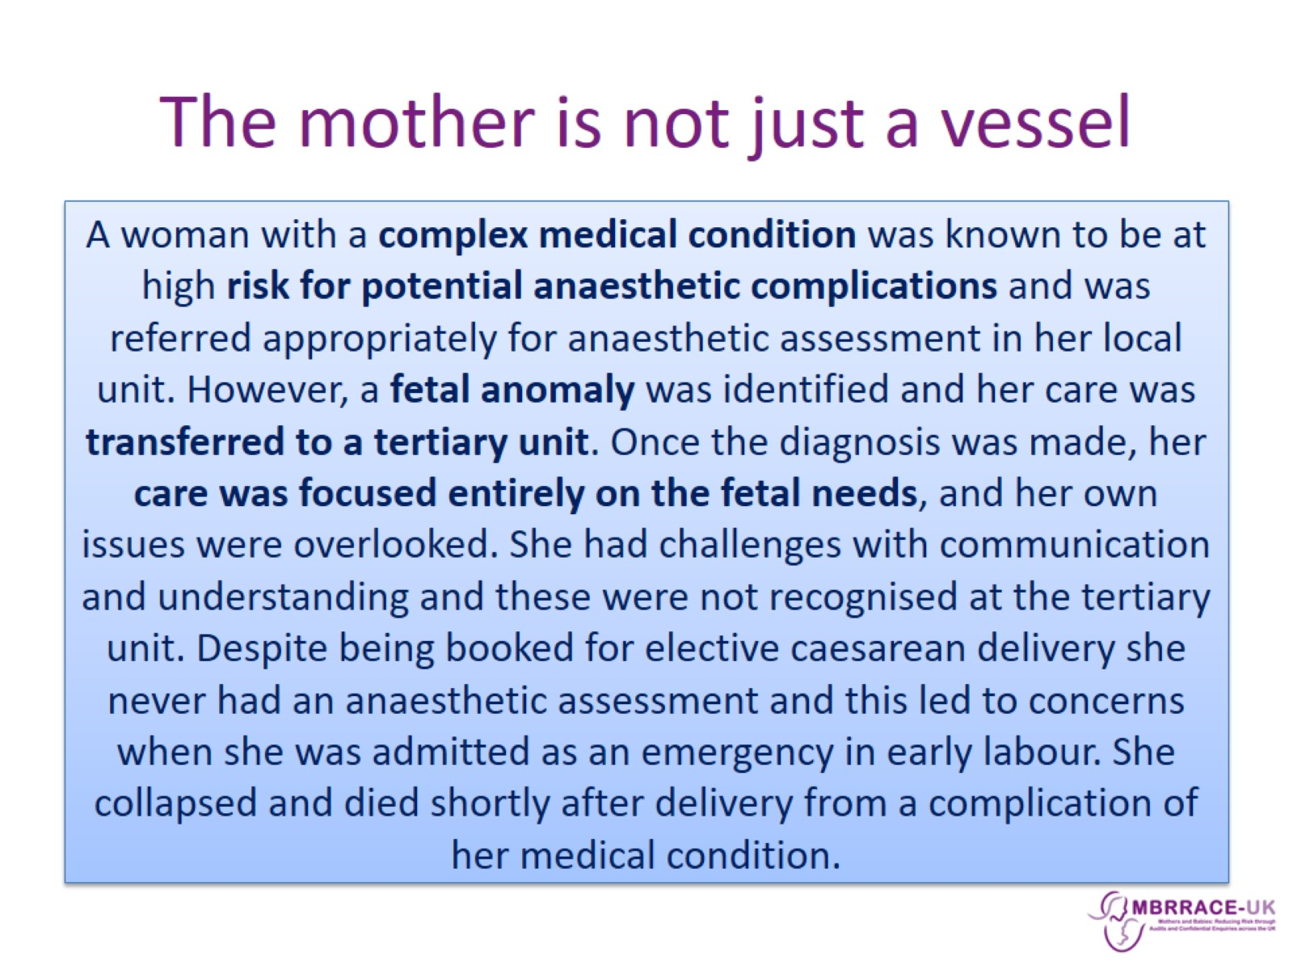
The mother is not just a vessel

Slide 38
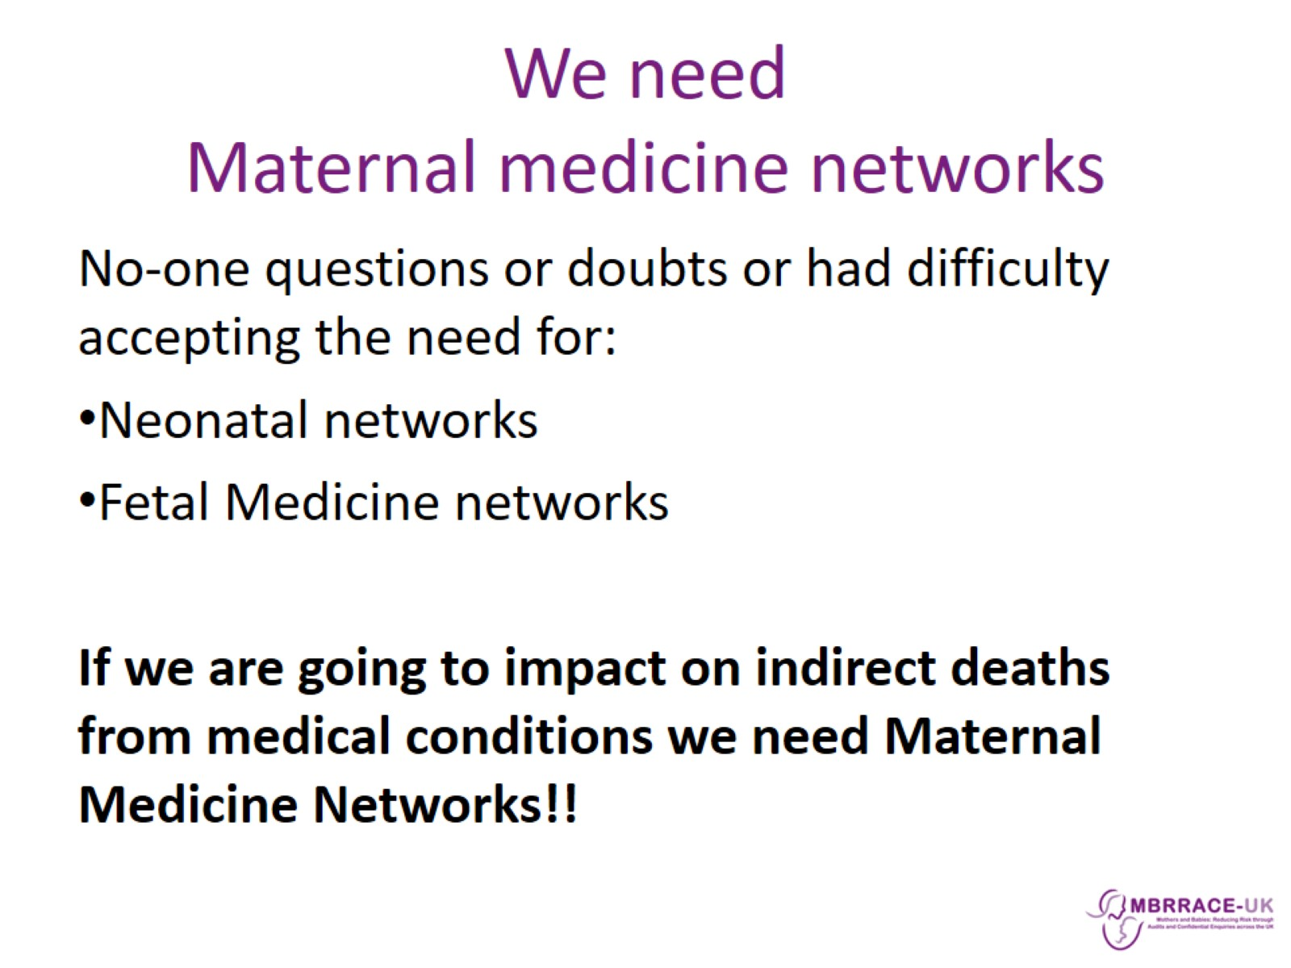
We need
Maternal medicine networks

Slide 39
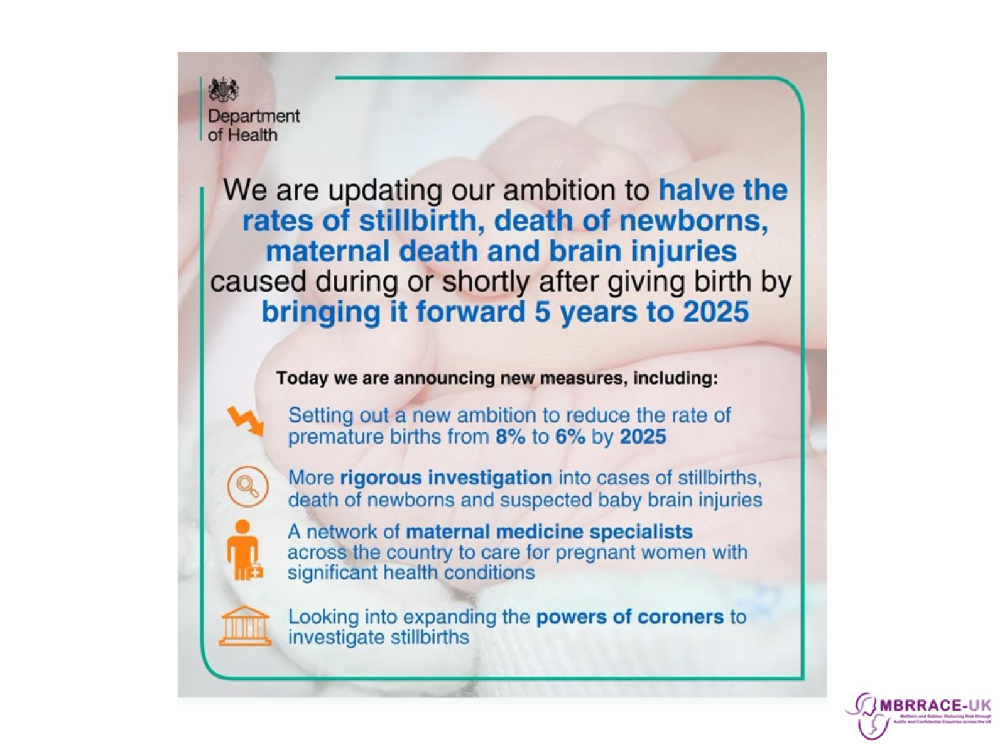

Slide 40
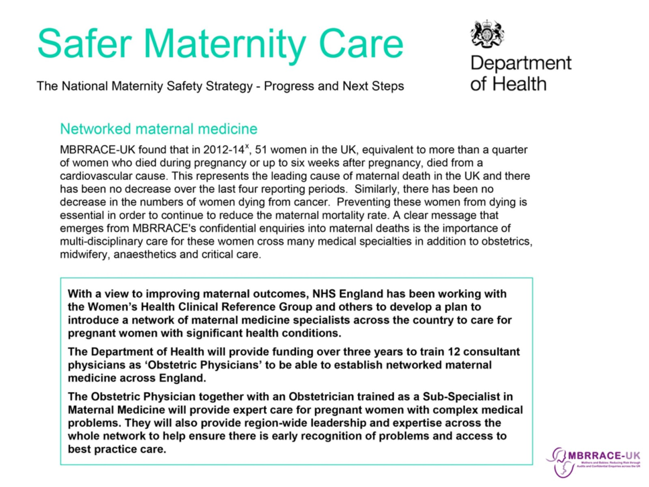

Slide 41
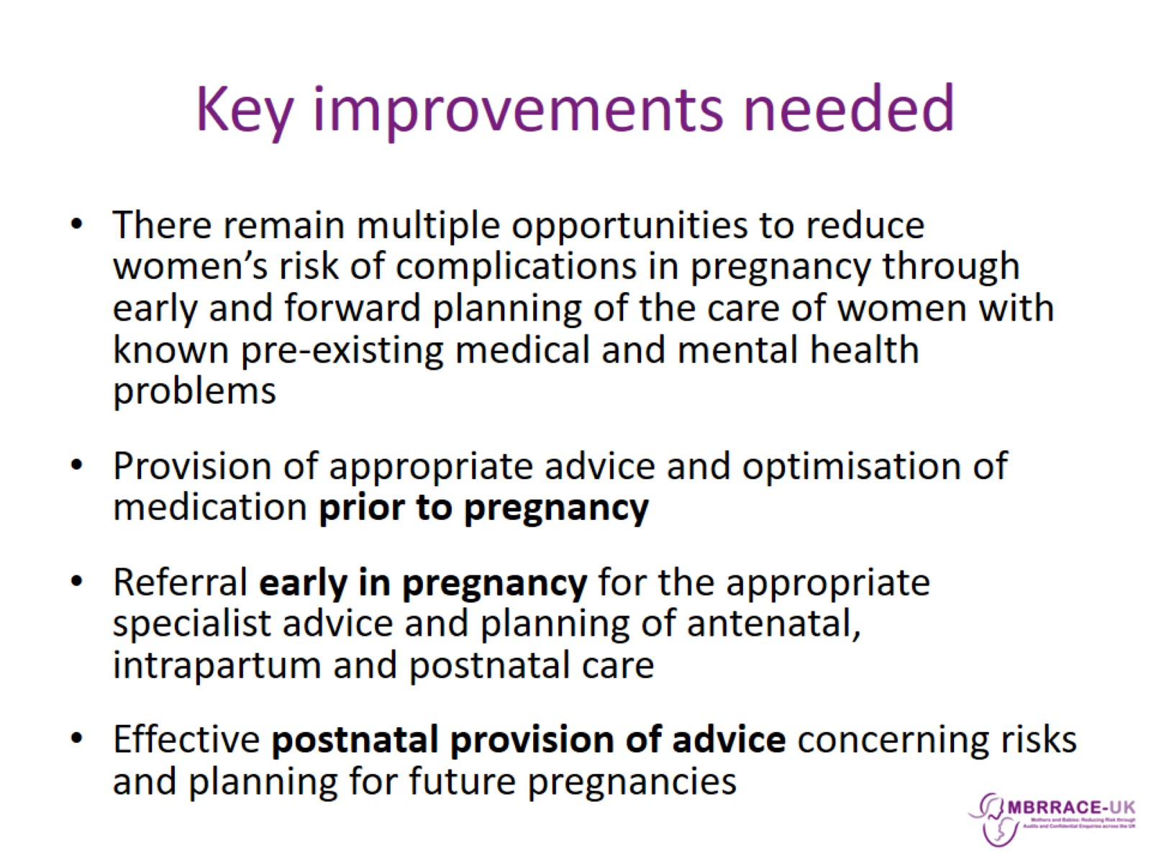
Key improvements needed

Slide 42
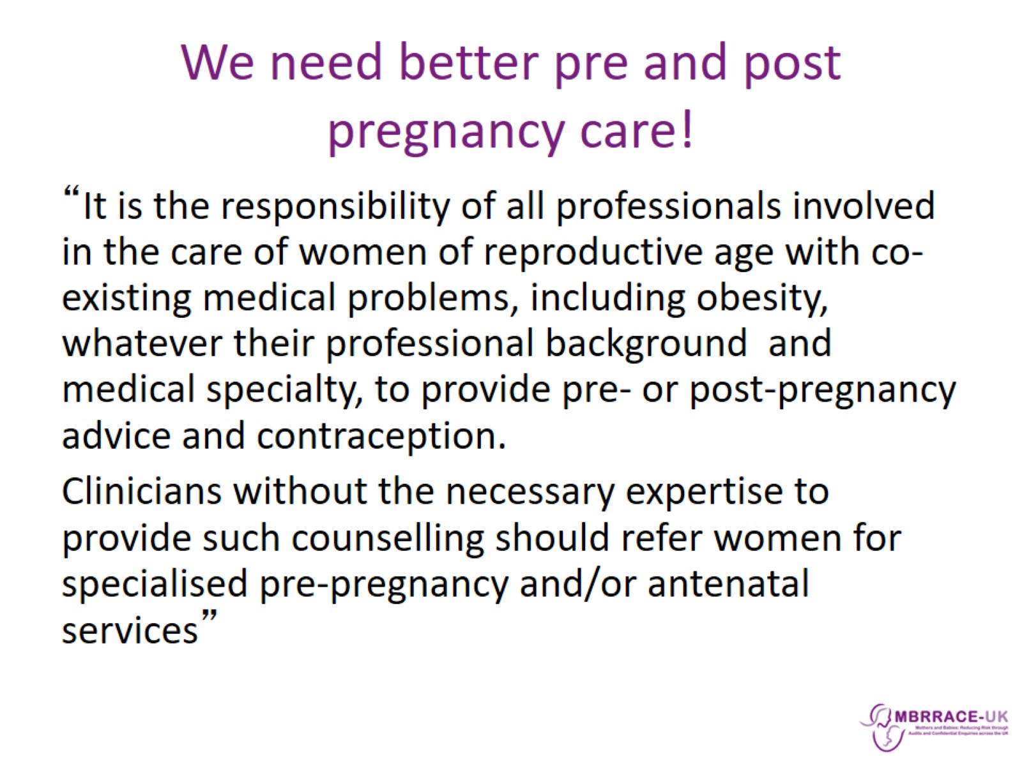
We need better pre and post pregnancy care!

Slide 43
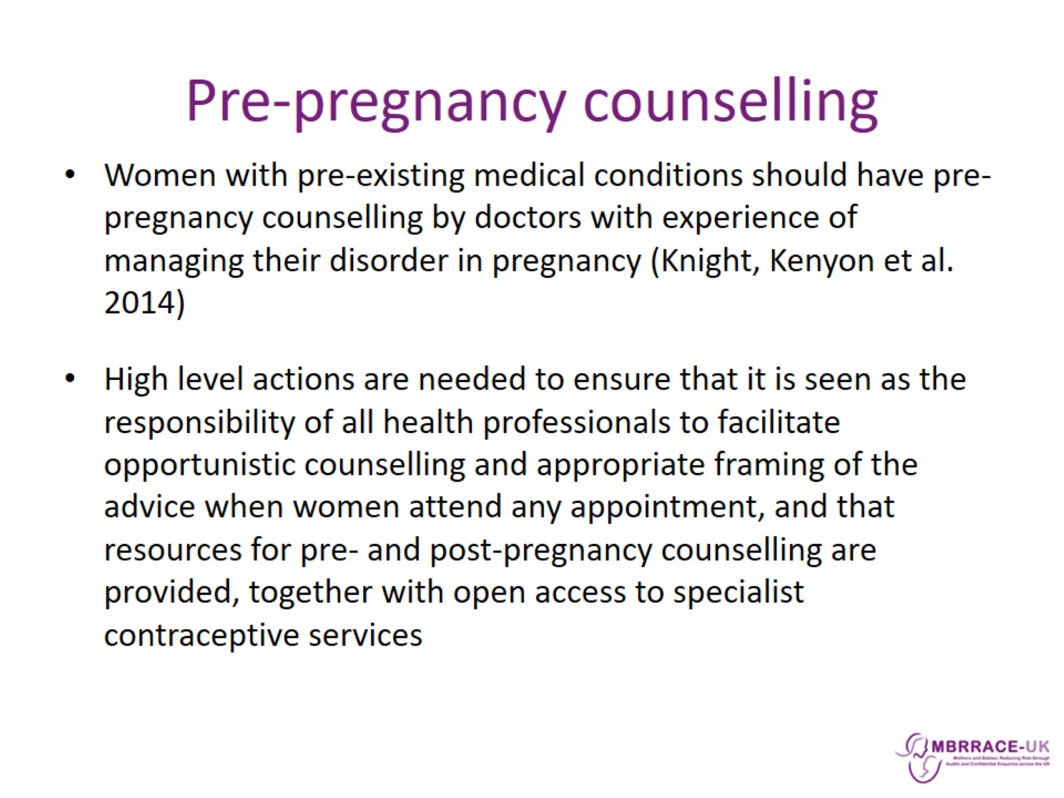
Pre-pregnancy counselling

Slide 44
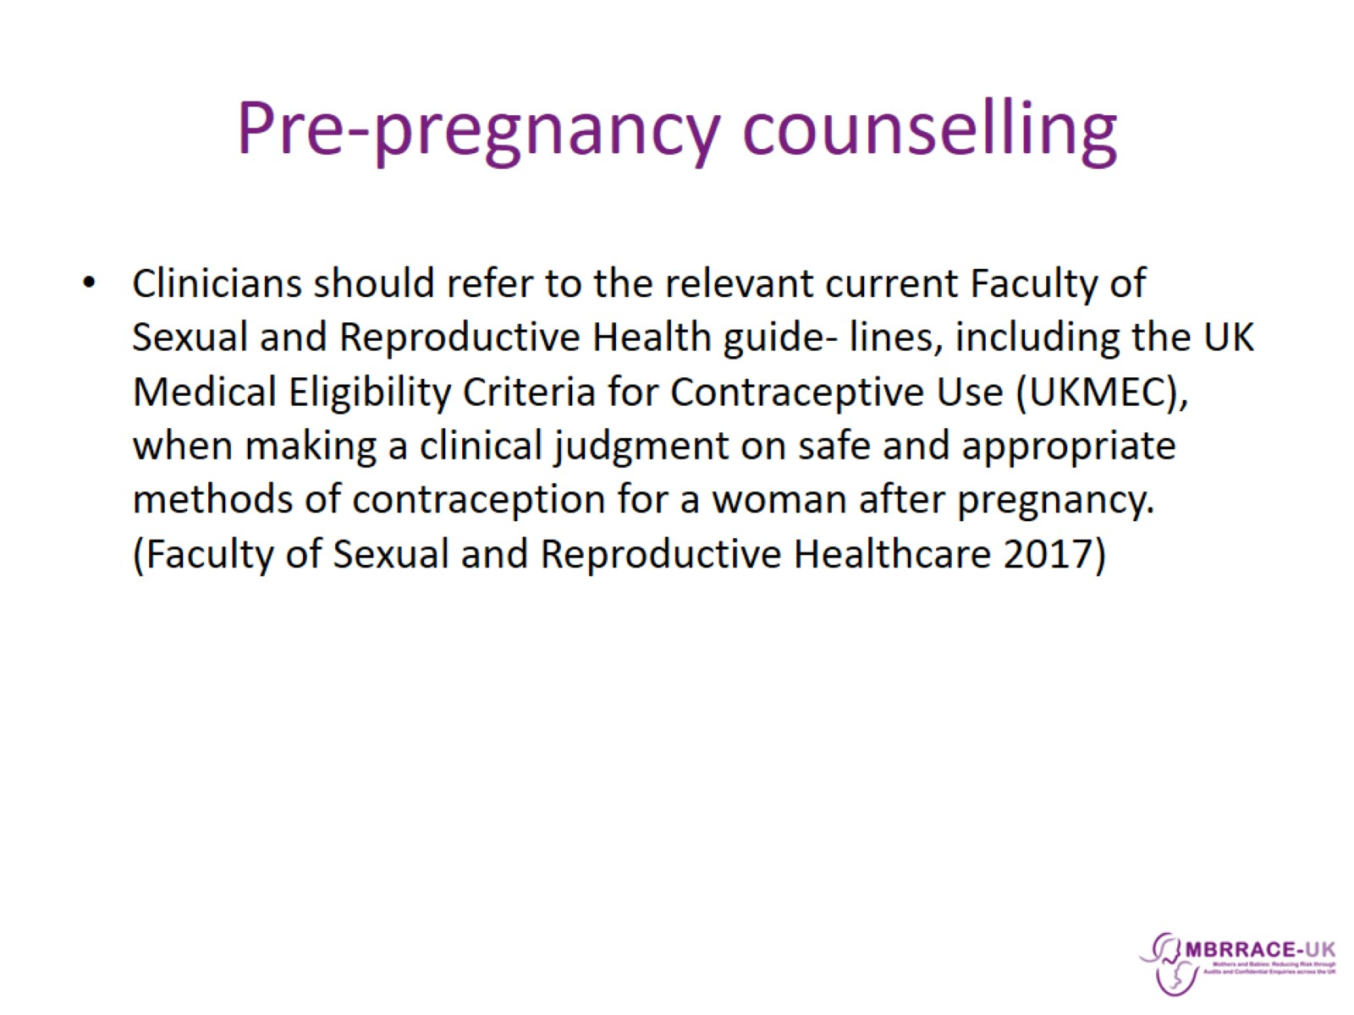
Pre-pregnancy counselling

Slide 45
