Slide 1

The women who died 2013-15

Slide 2
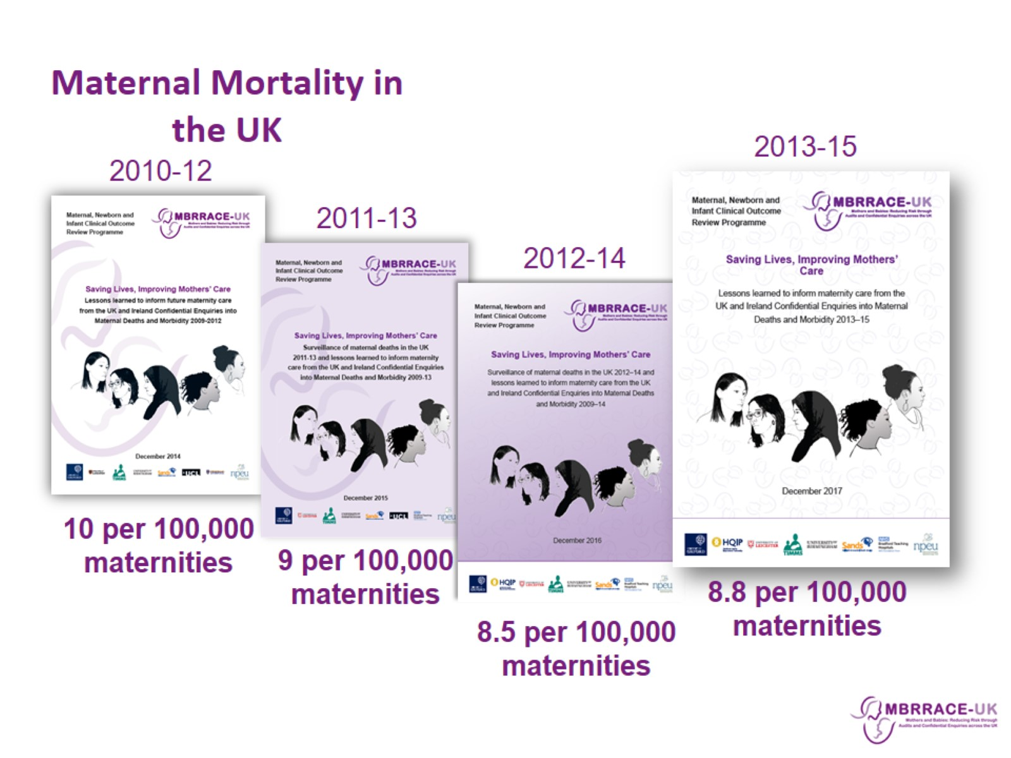
Maternal Mortality in the UK

Slide 3
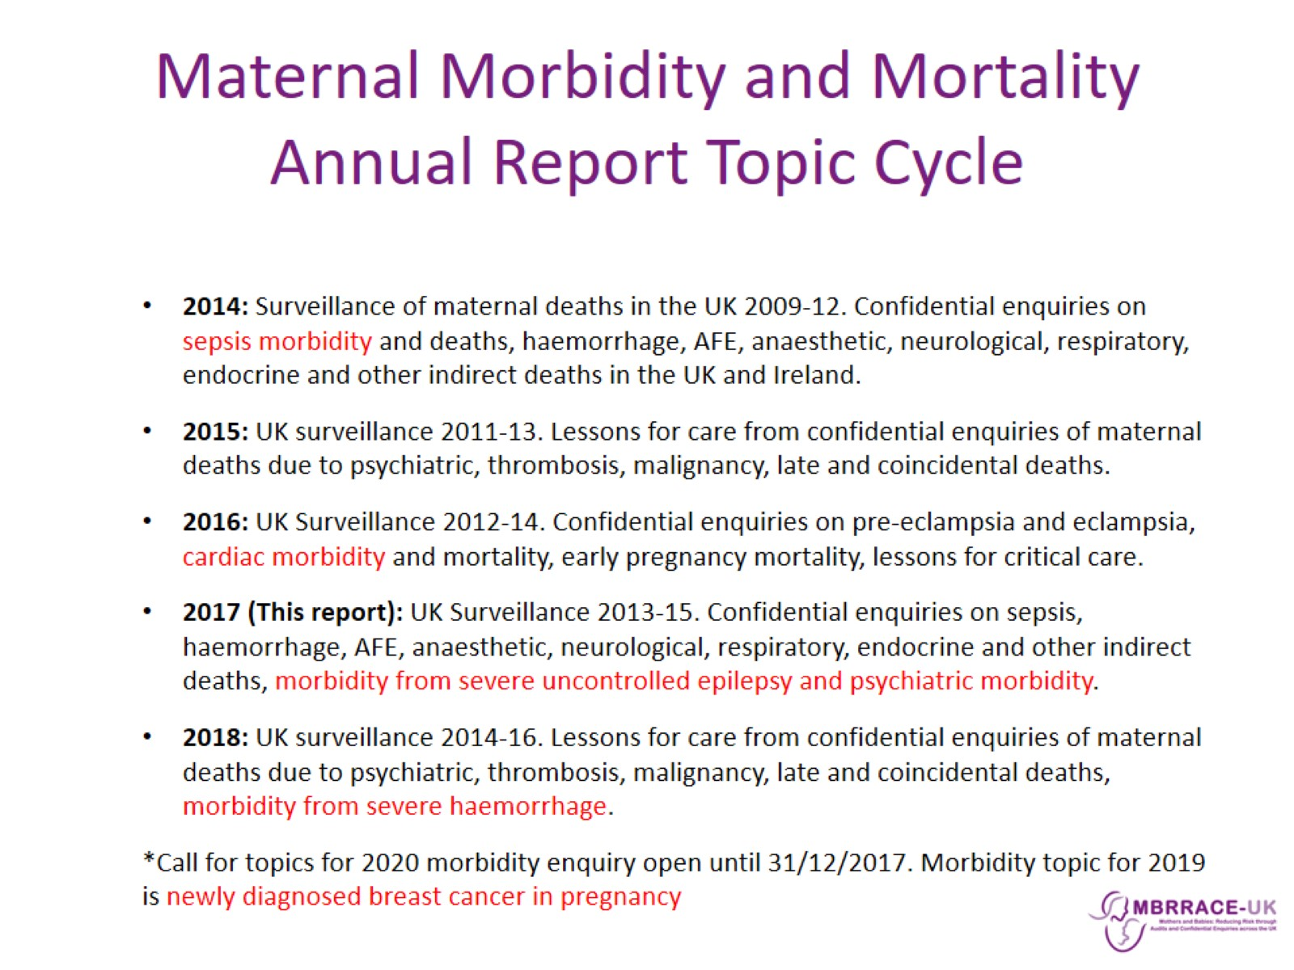
Maternal Morbidity and Mortality
Annual Report Topic Cycle

Slide 4
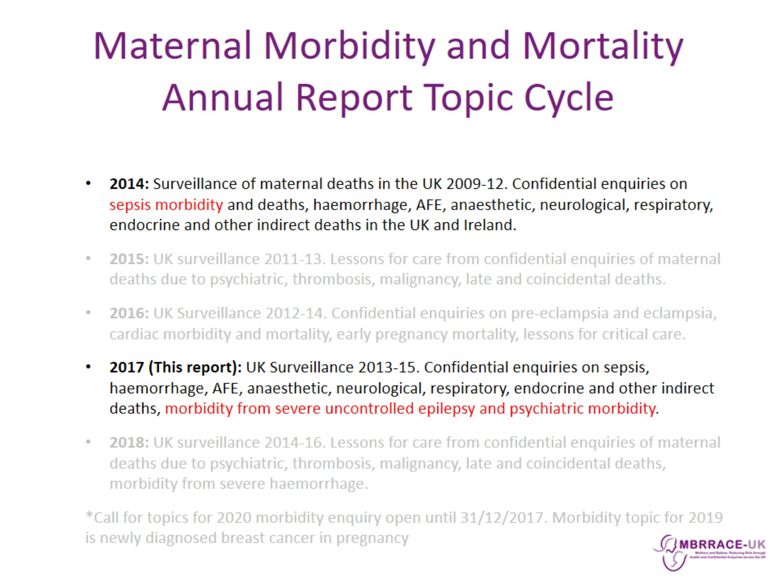
Maternal Morbidity and Mortality
Annual Report Topic Cycle

Slide 5

MBRRACE-UK: Methods

Slide 6
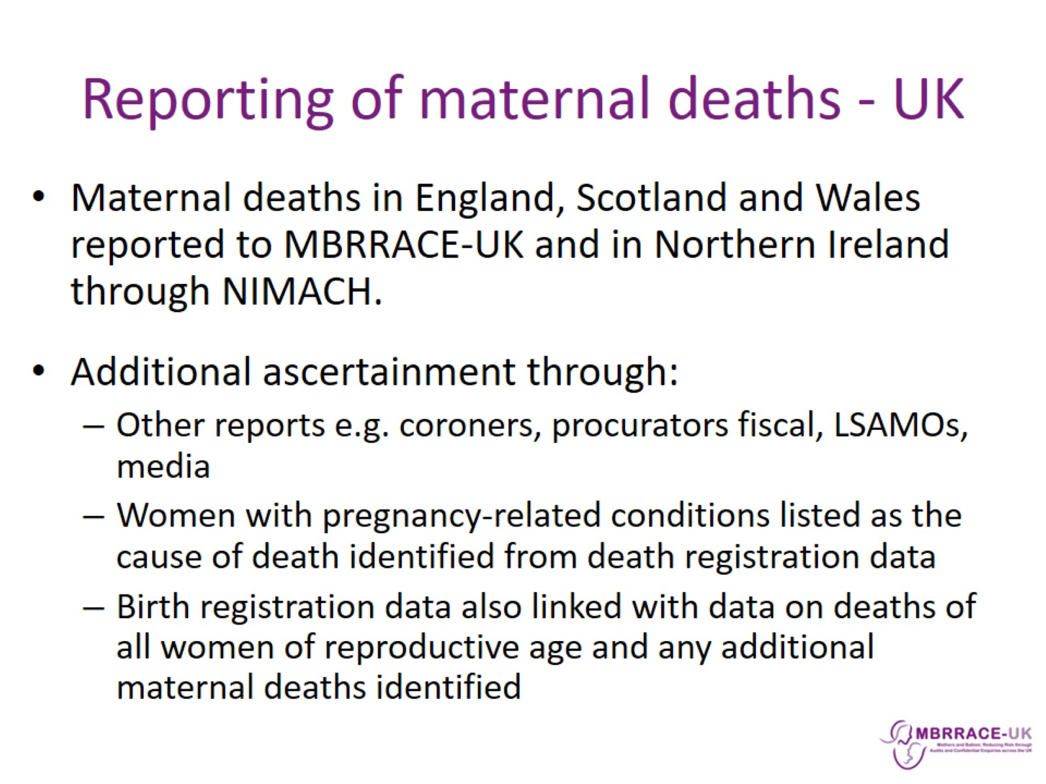
Reporting of maternal deaths - UK

Slide 7
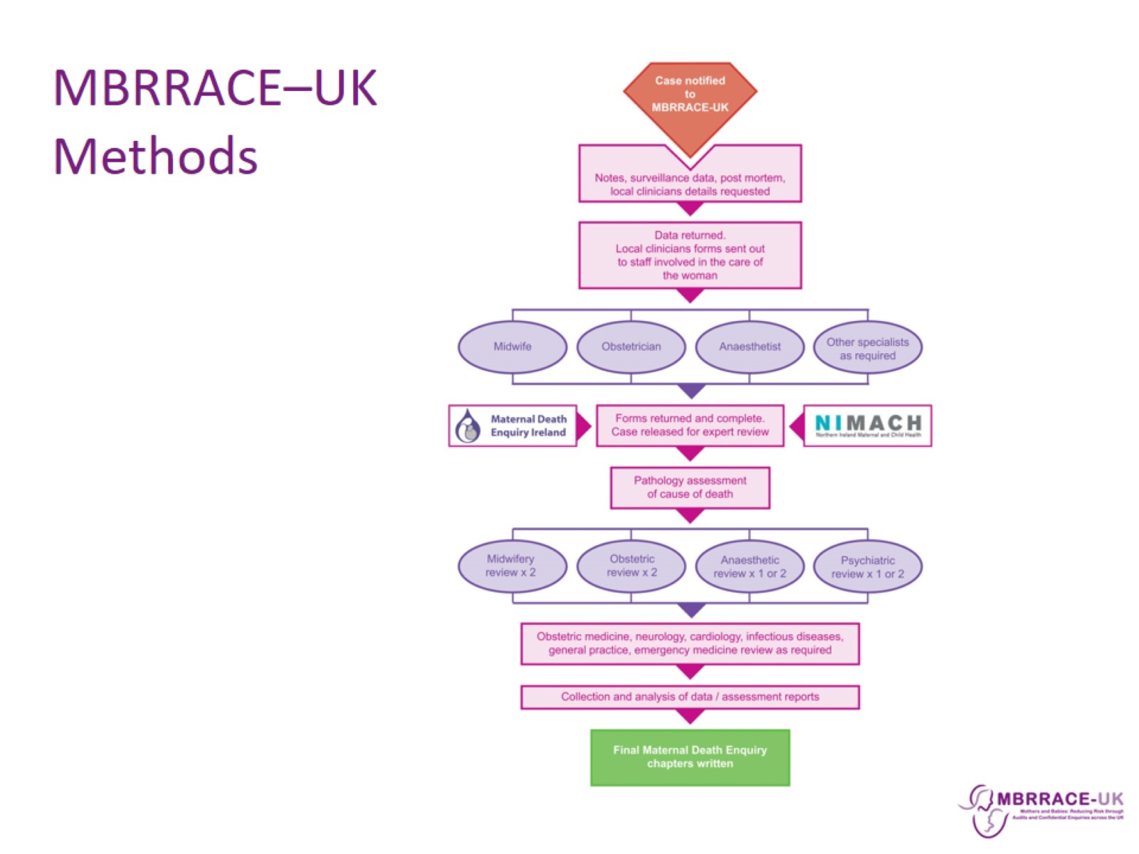
MBRRACE–UK Methods

Slide 8
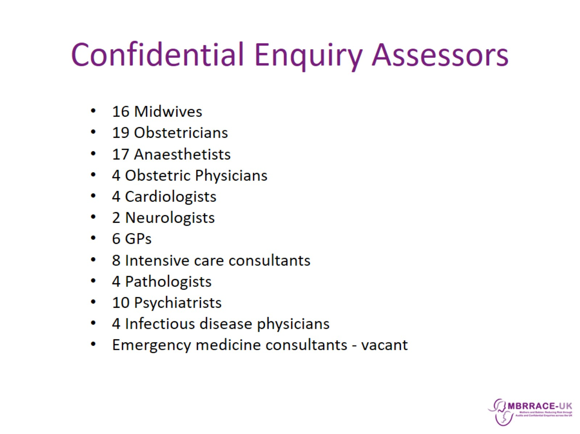
Confidential Enquiry Assessors

Slide 9
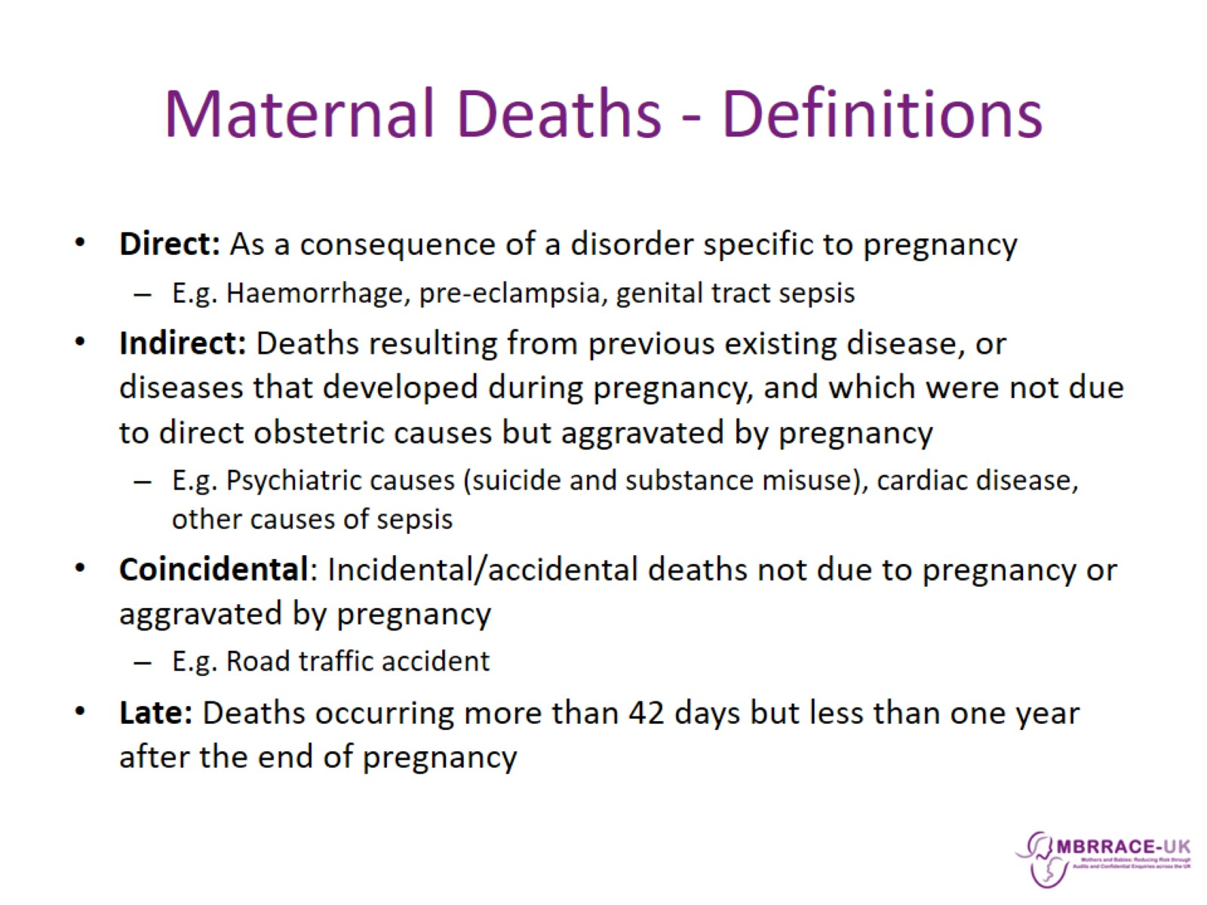
Maternal Deaths - Definitions

Slide 10
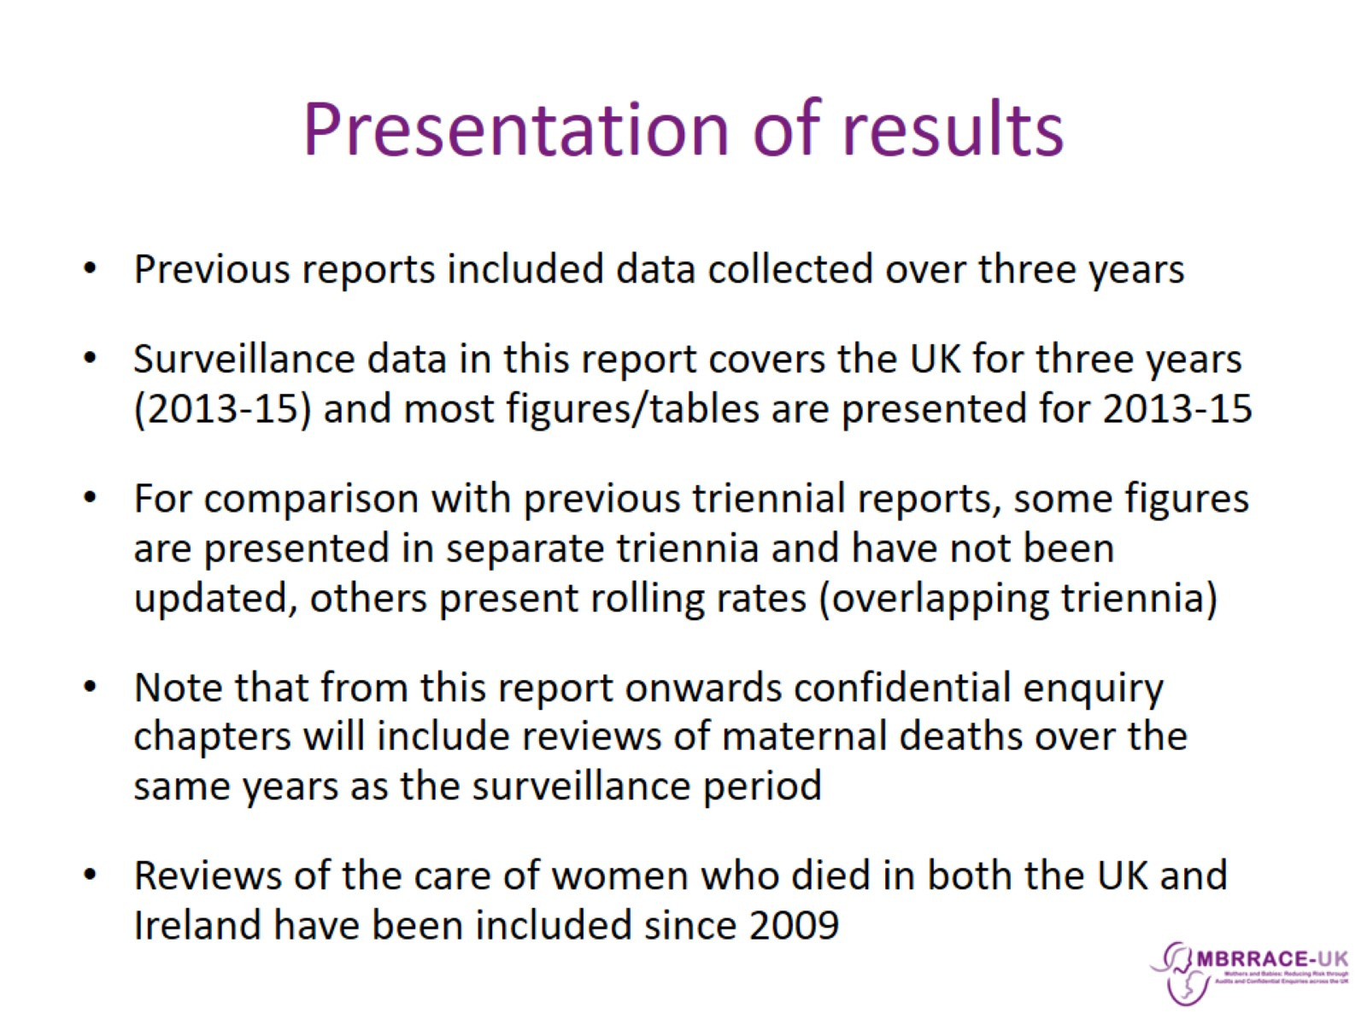
Presentation of results

Slide 11
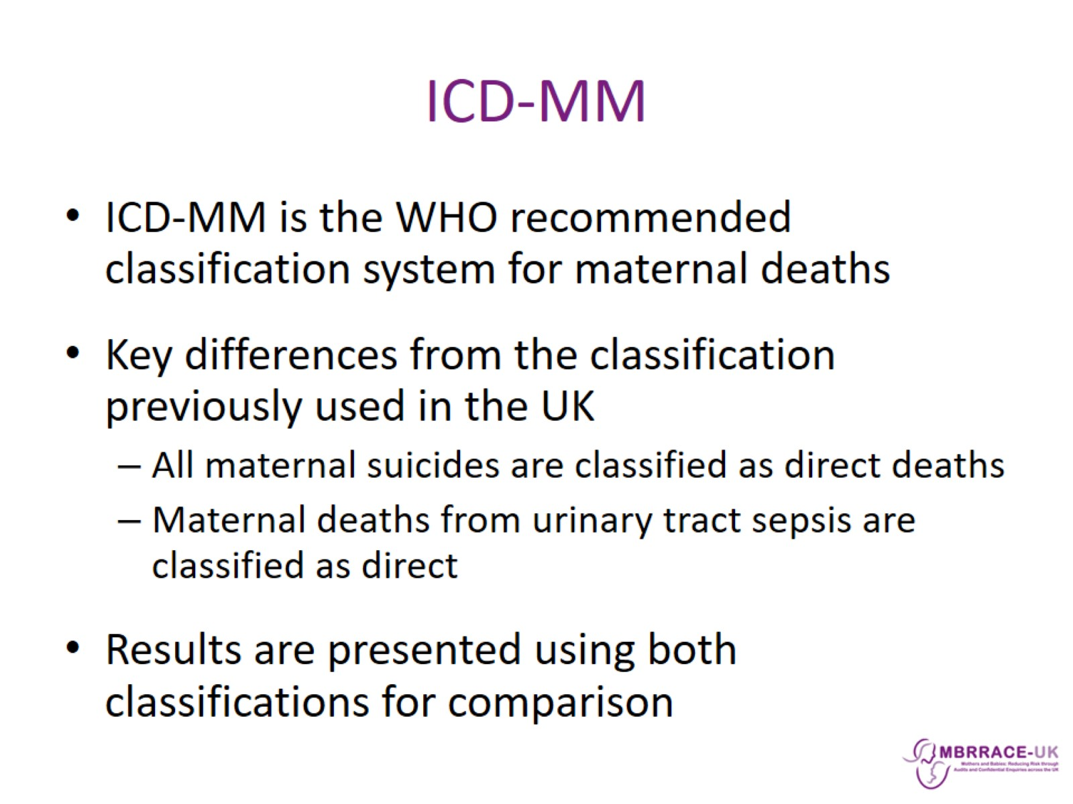
ICD-MM

Slide 12

MBRRACE-UK: Surveillance results

Slide 13
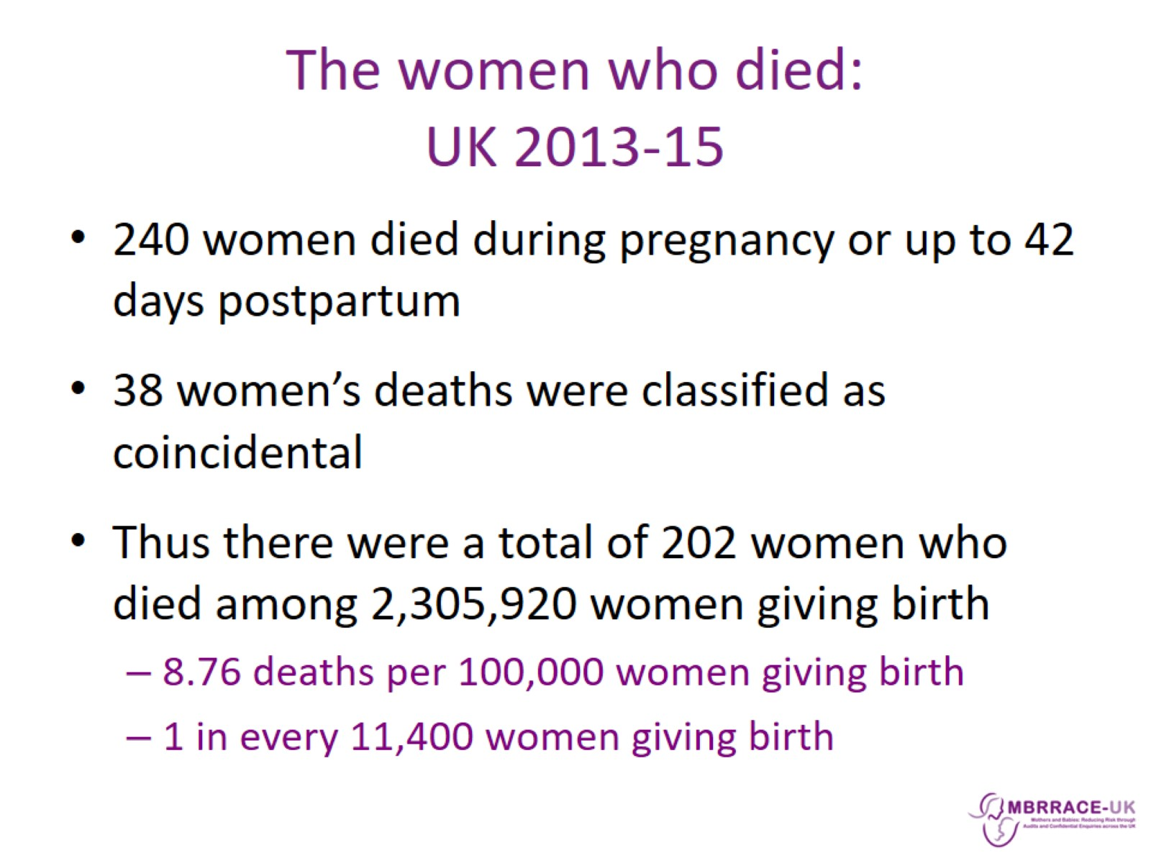
The women who died:
UK 2013-15

Slide 14
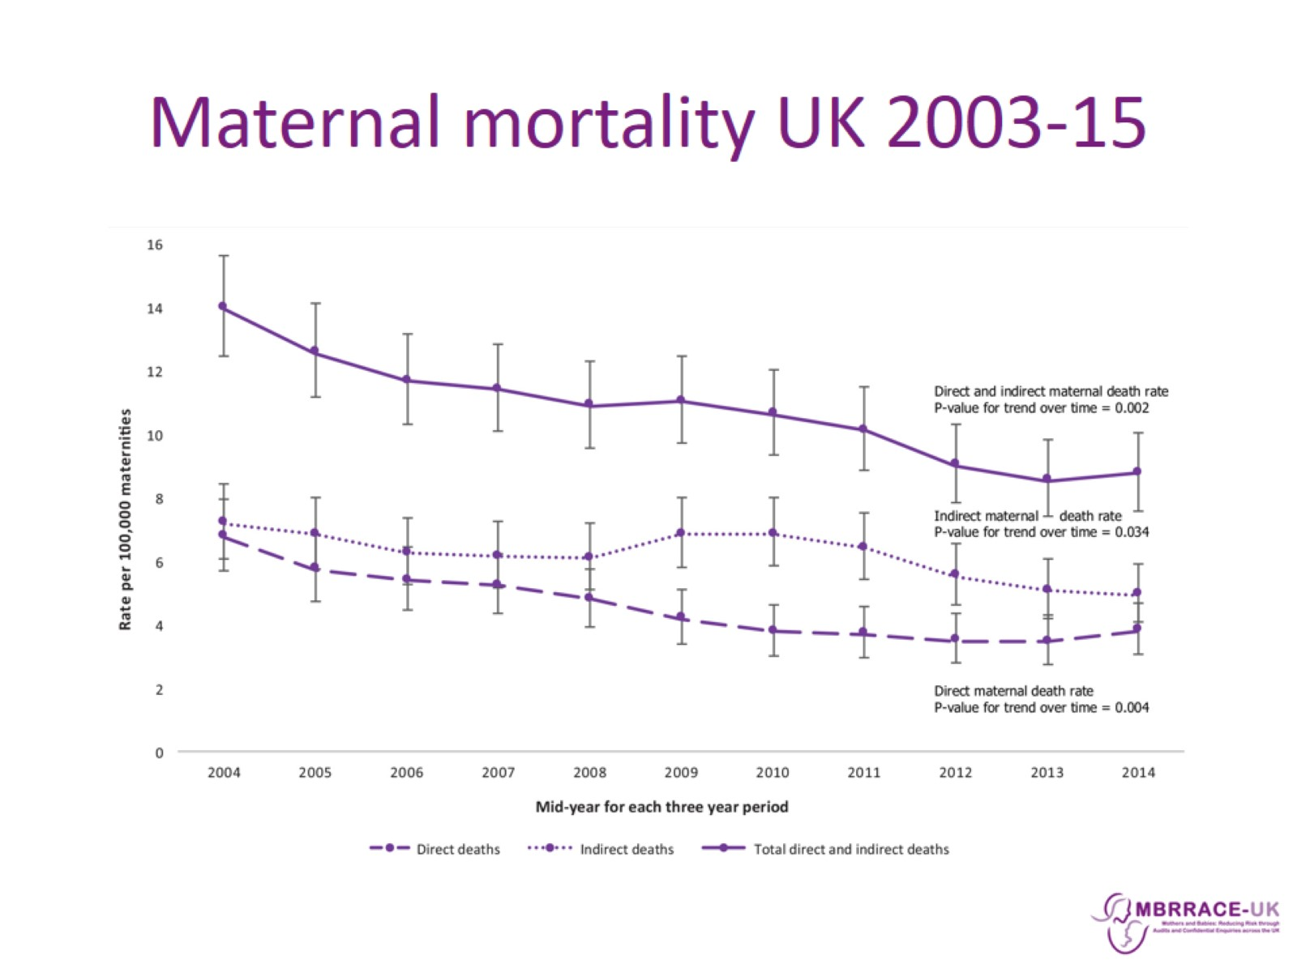
Maternal mortality UK 2003-15

Slide 15
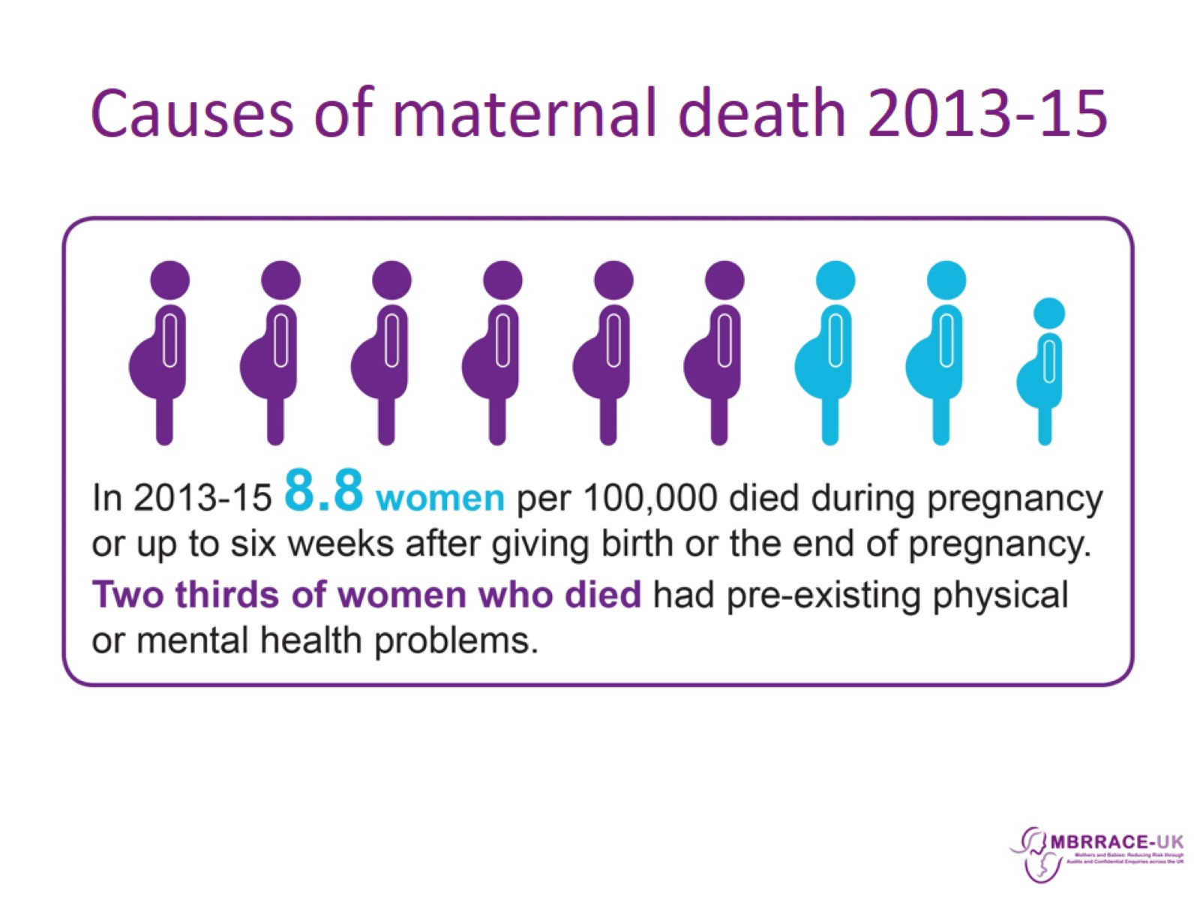
Causes of maternal death 2013-15

Slide 16
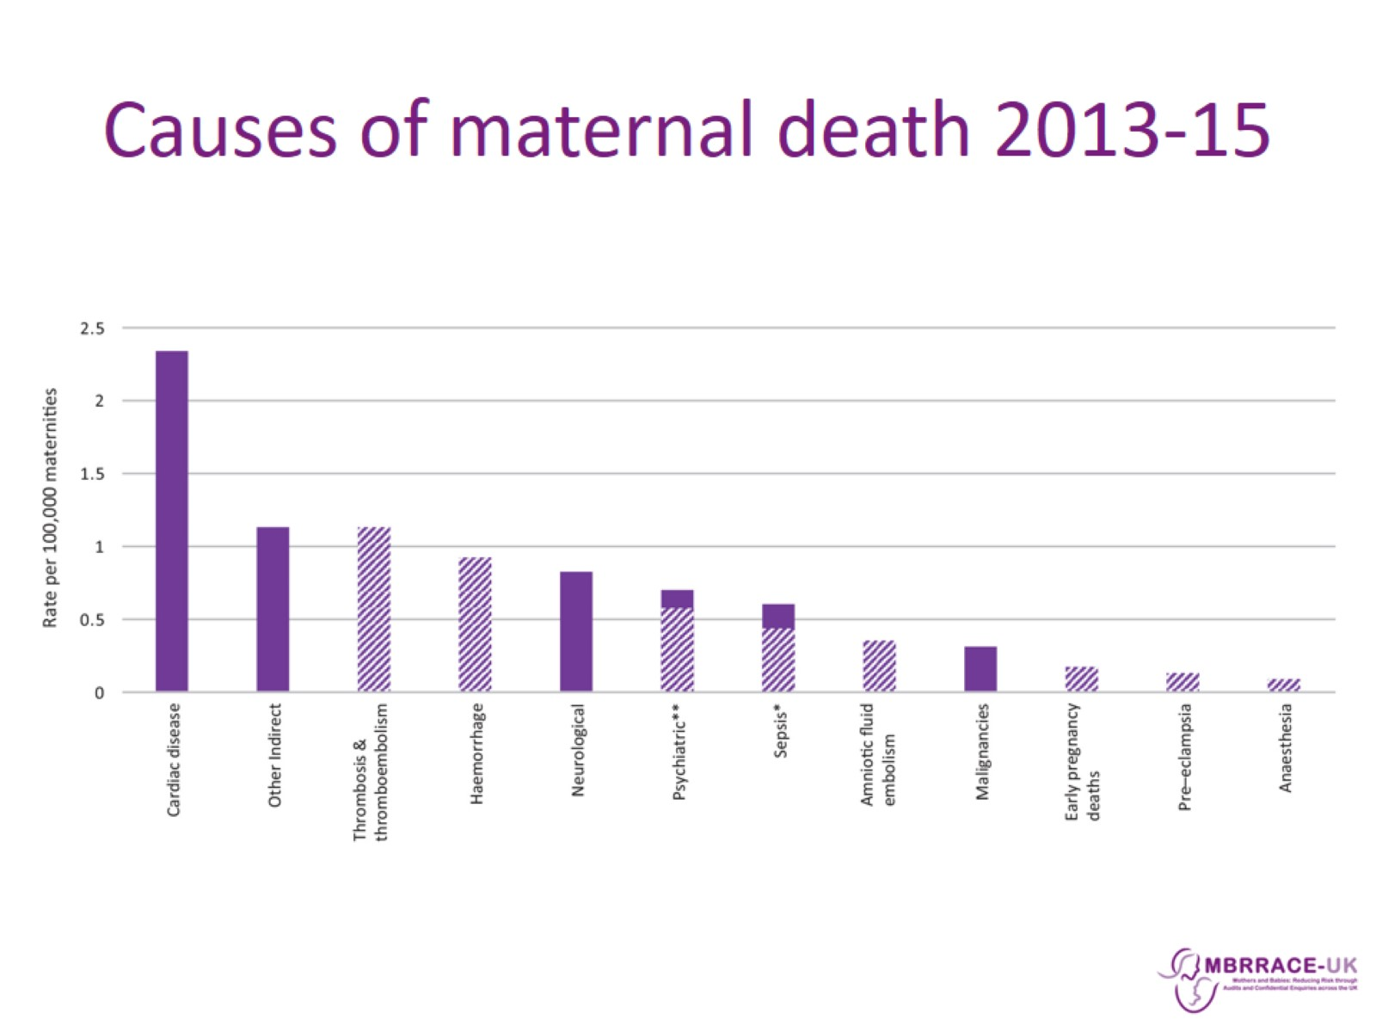
Causes of maternal death 2013-15

Slide 17
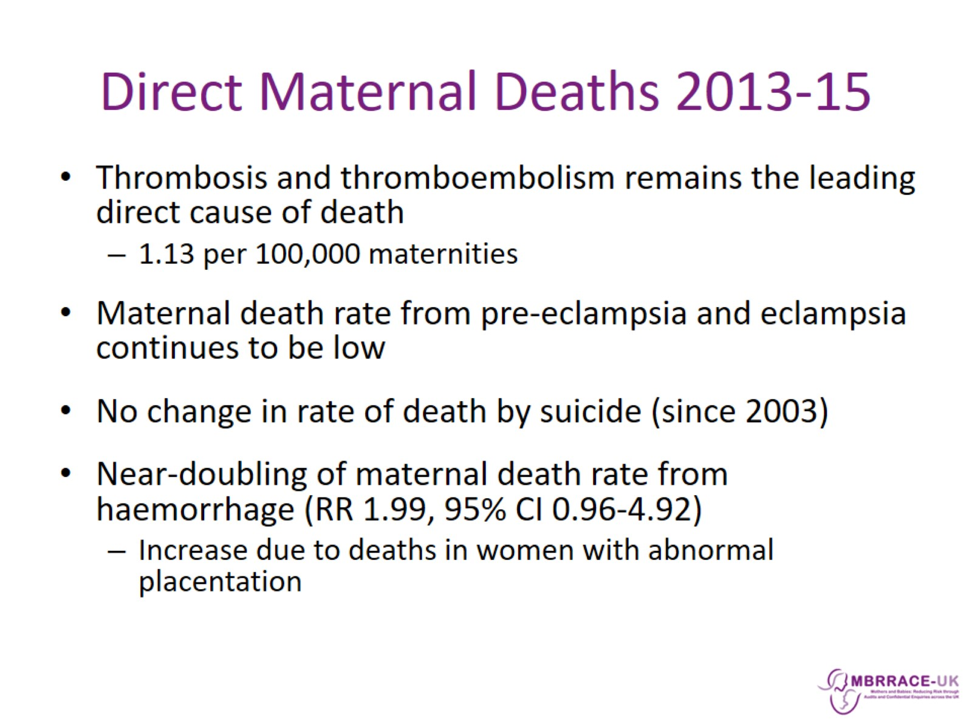
Direct Maternal Deaths 2013-15

Slide 18
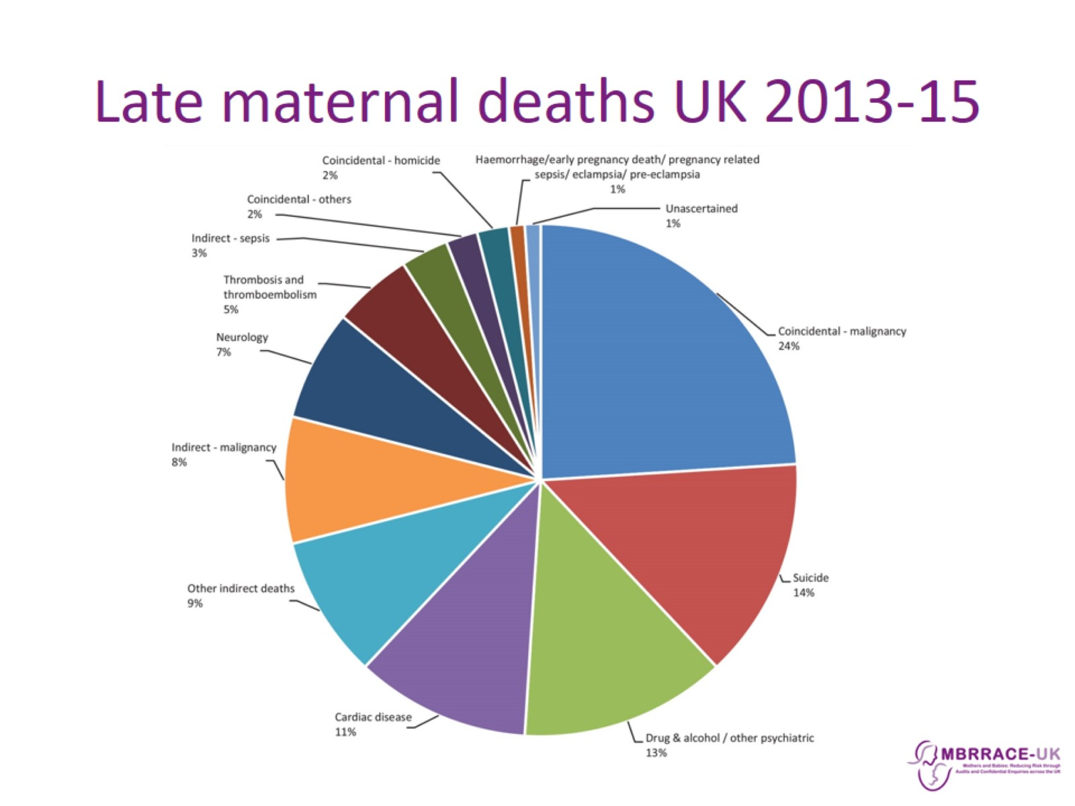
Late maternal deaths UK 2013-15

Slide 19
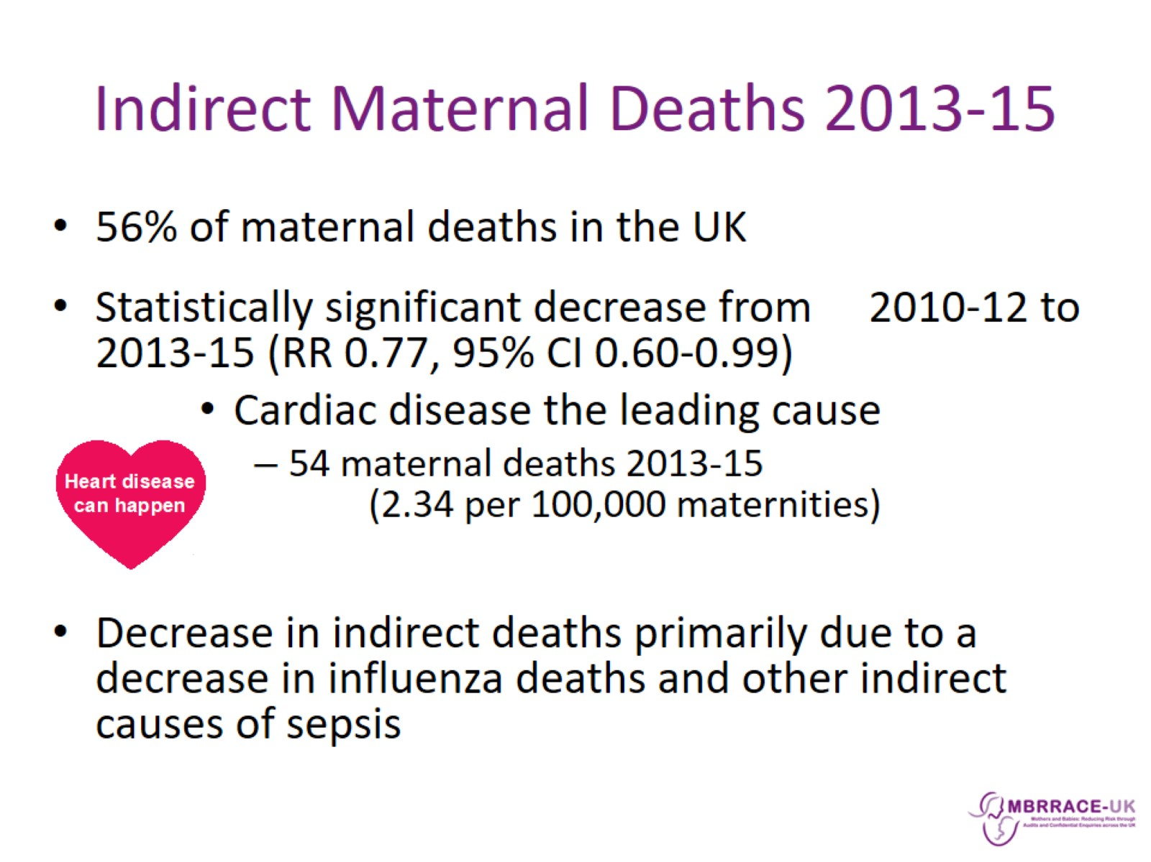
Indirect Maternal Deaths 2013-15

Slide 20
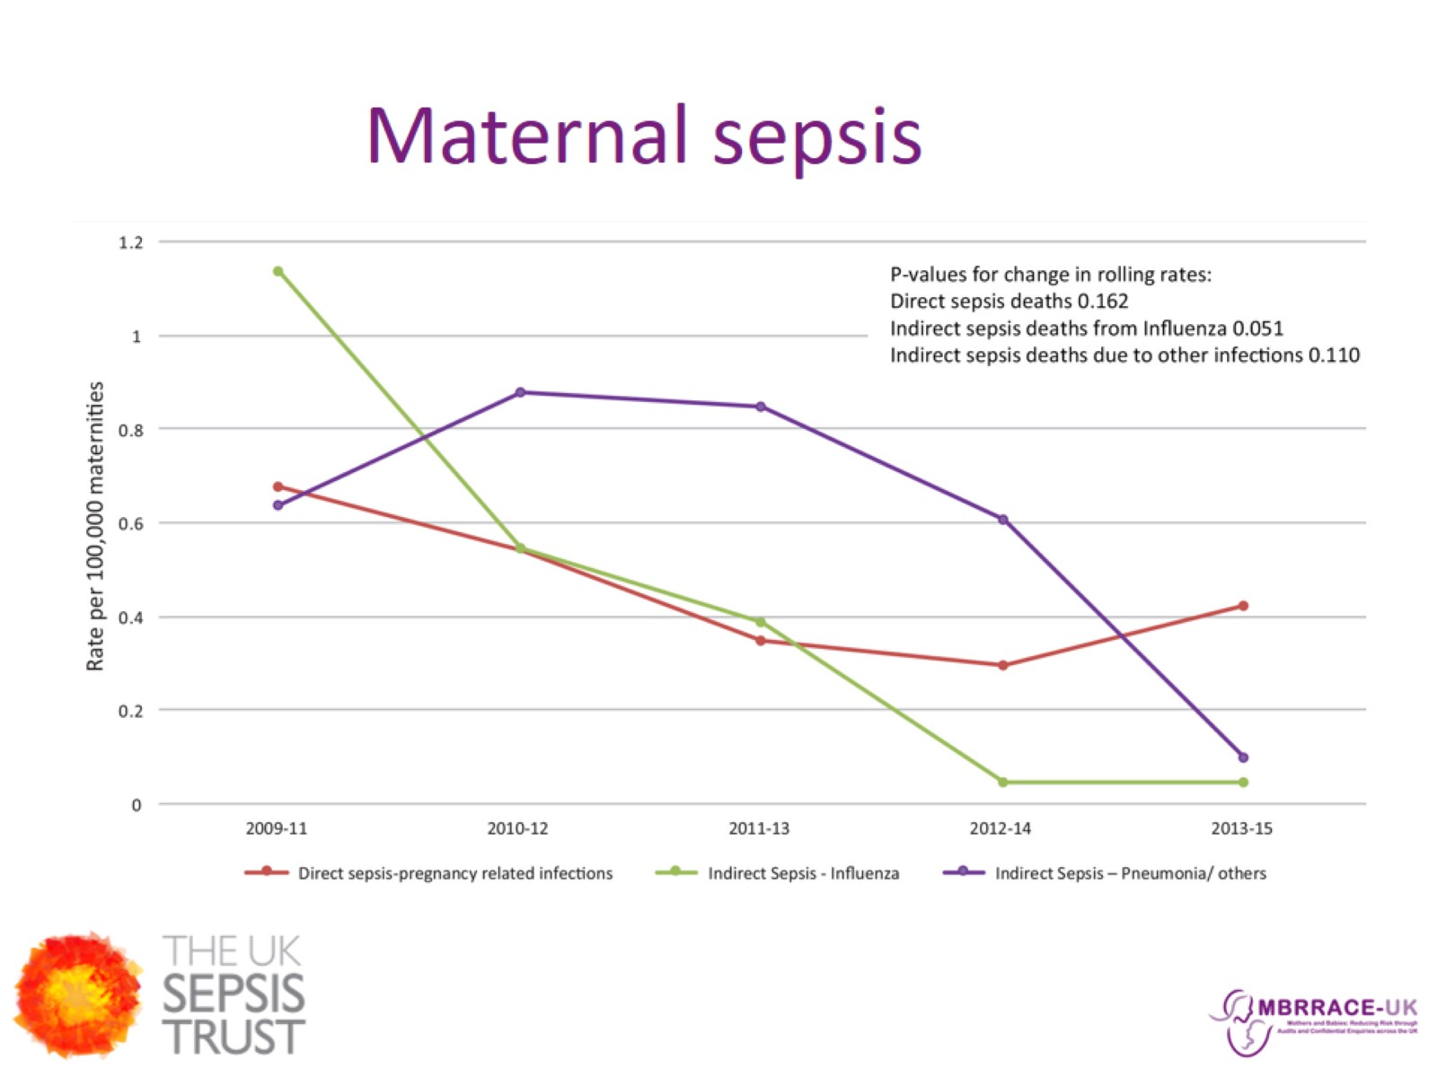
Maternal sepsis

Slide 21
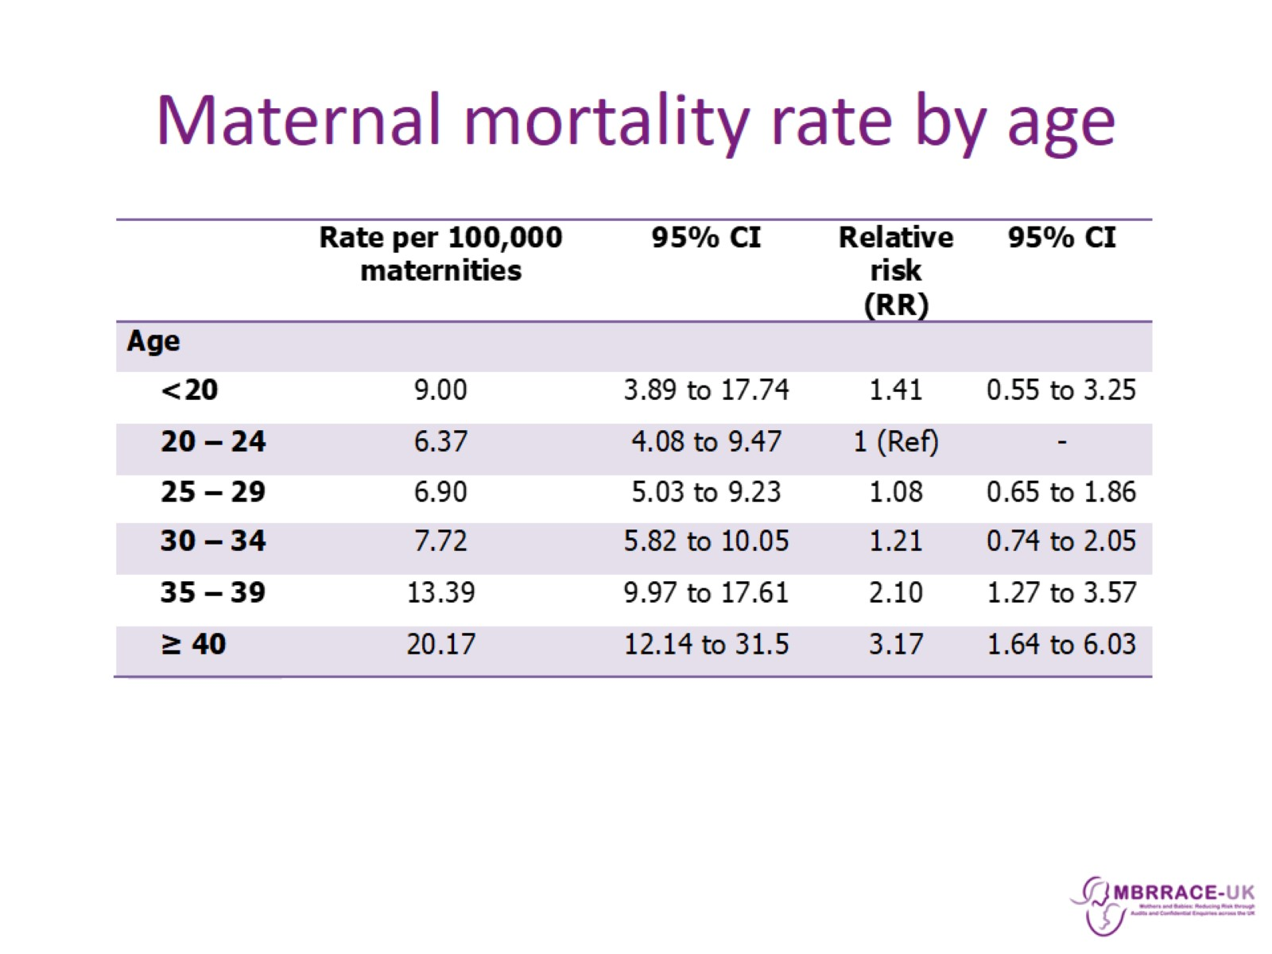
Maternal mortality rate by age

Slide 22
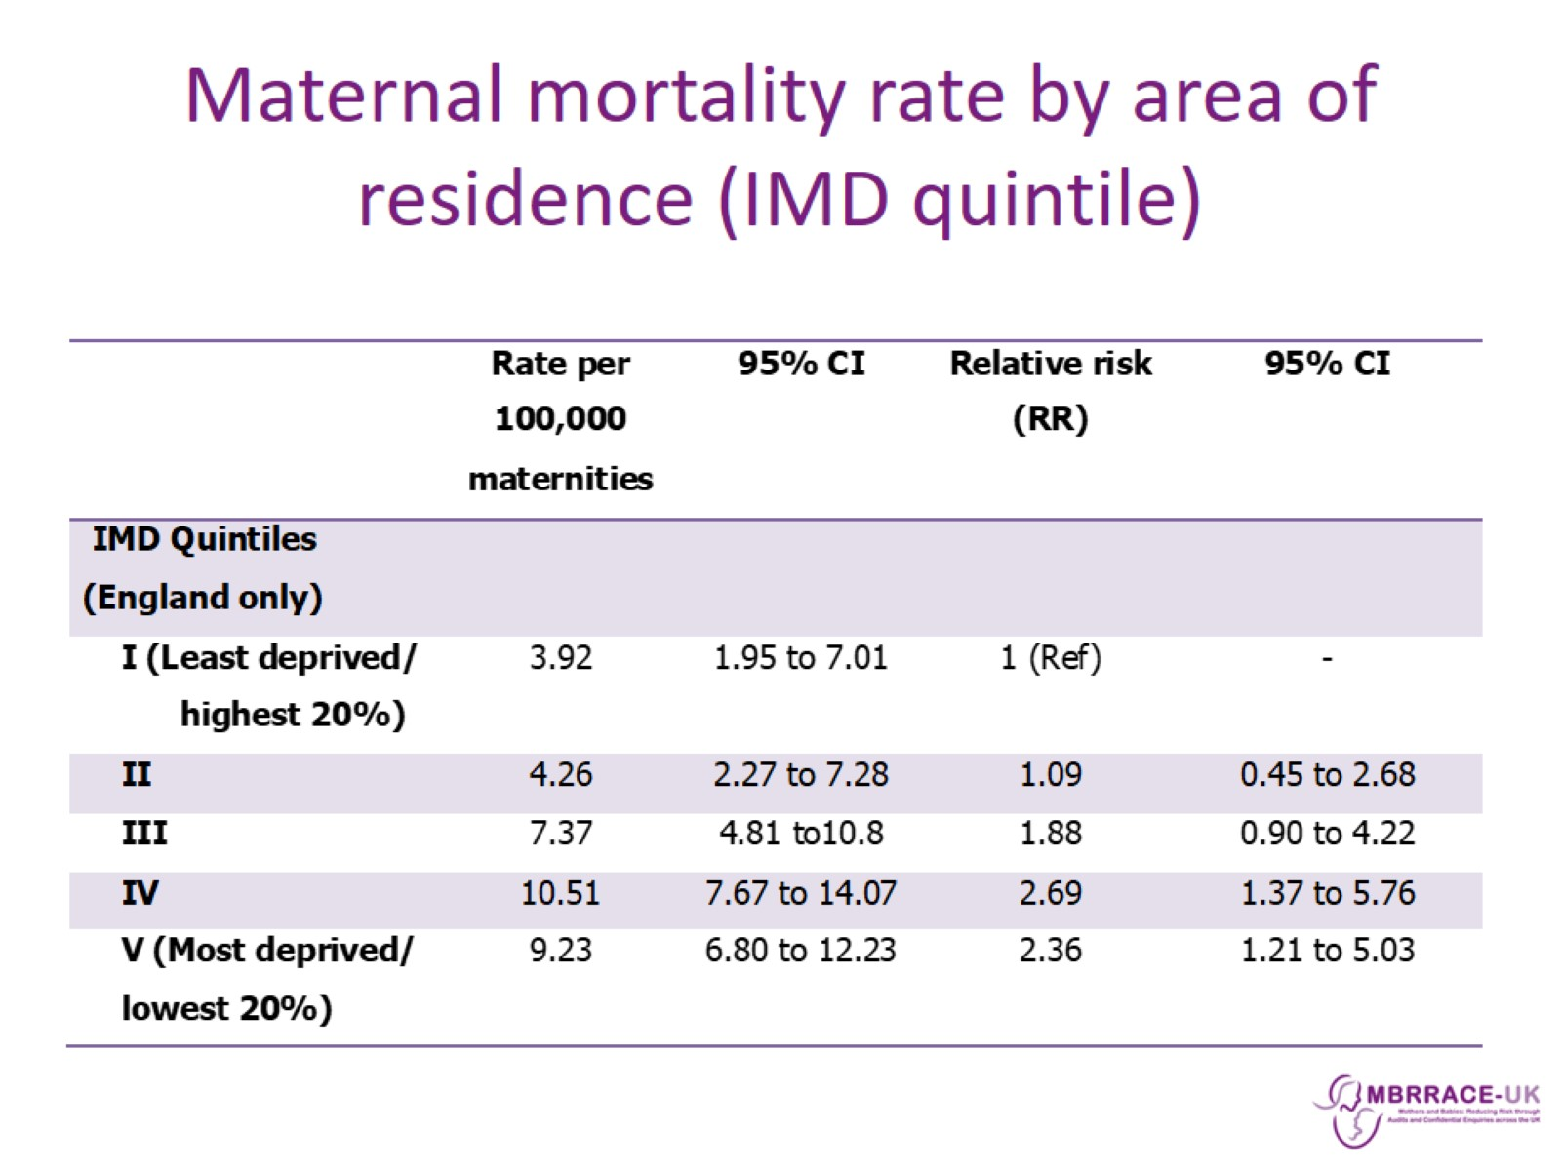
Maternal mortality rate by area of residence (IMD quintile)

Slide 23
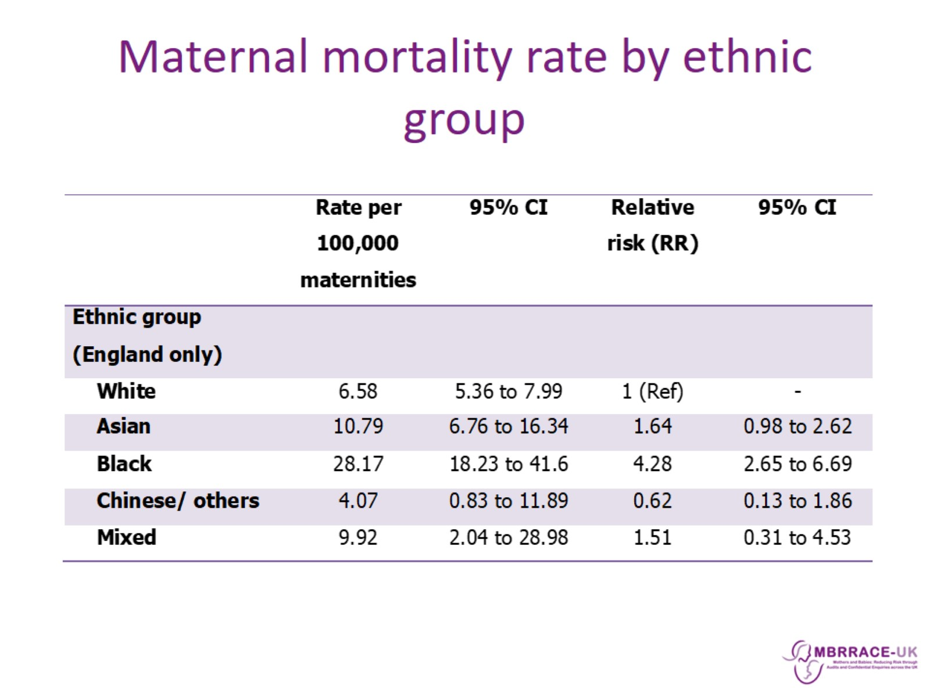
Maternal mortality rate by ethnic group

Slide 24
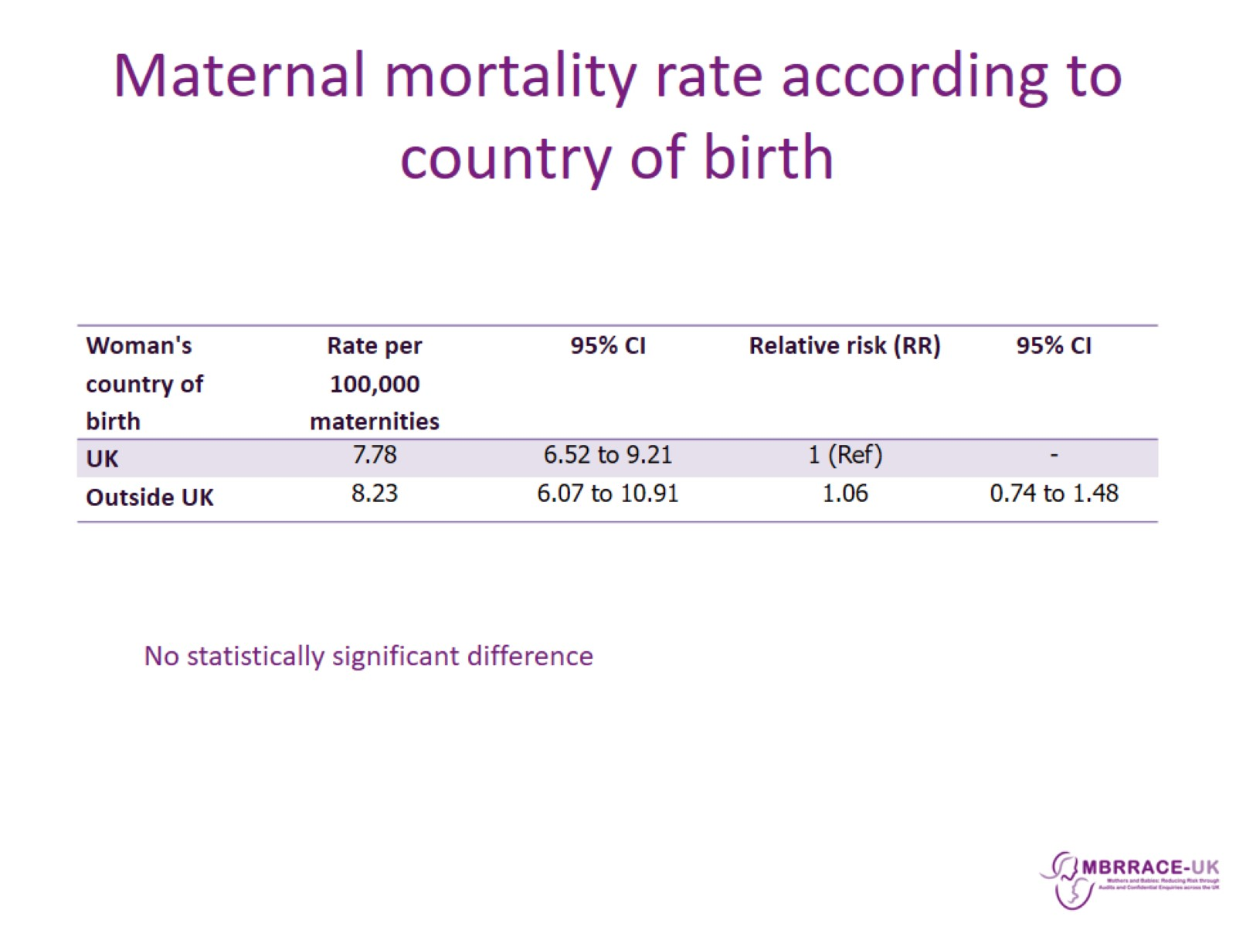
Maternal mortality rate according to country of birth

Slide 25
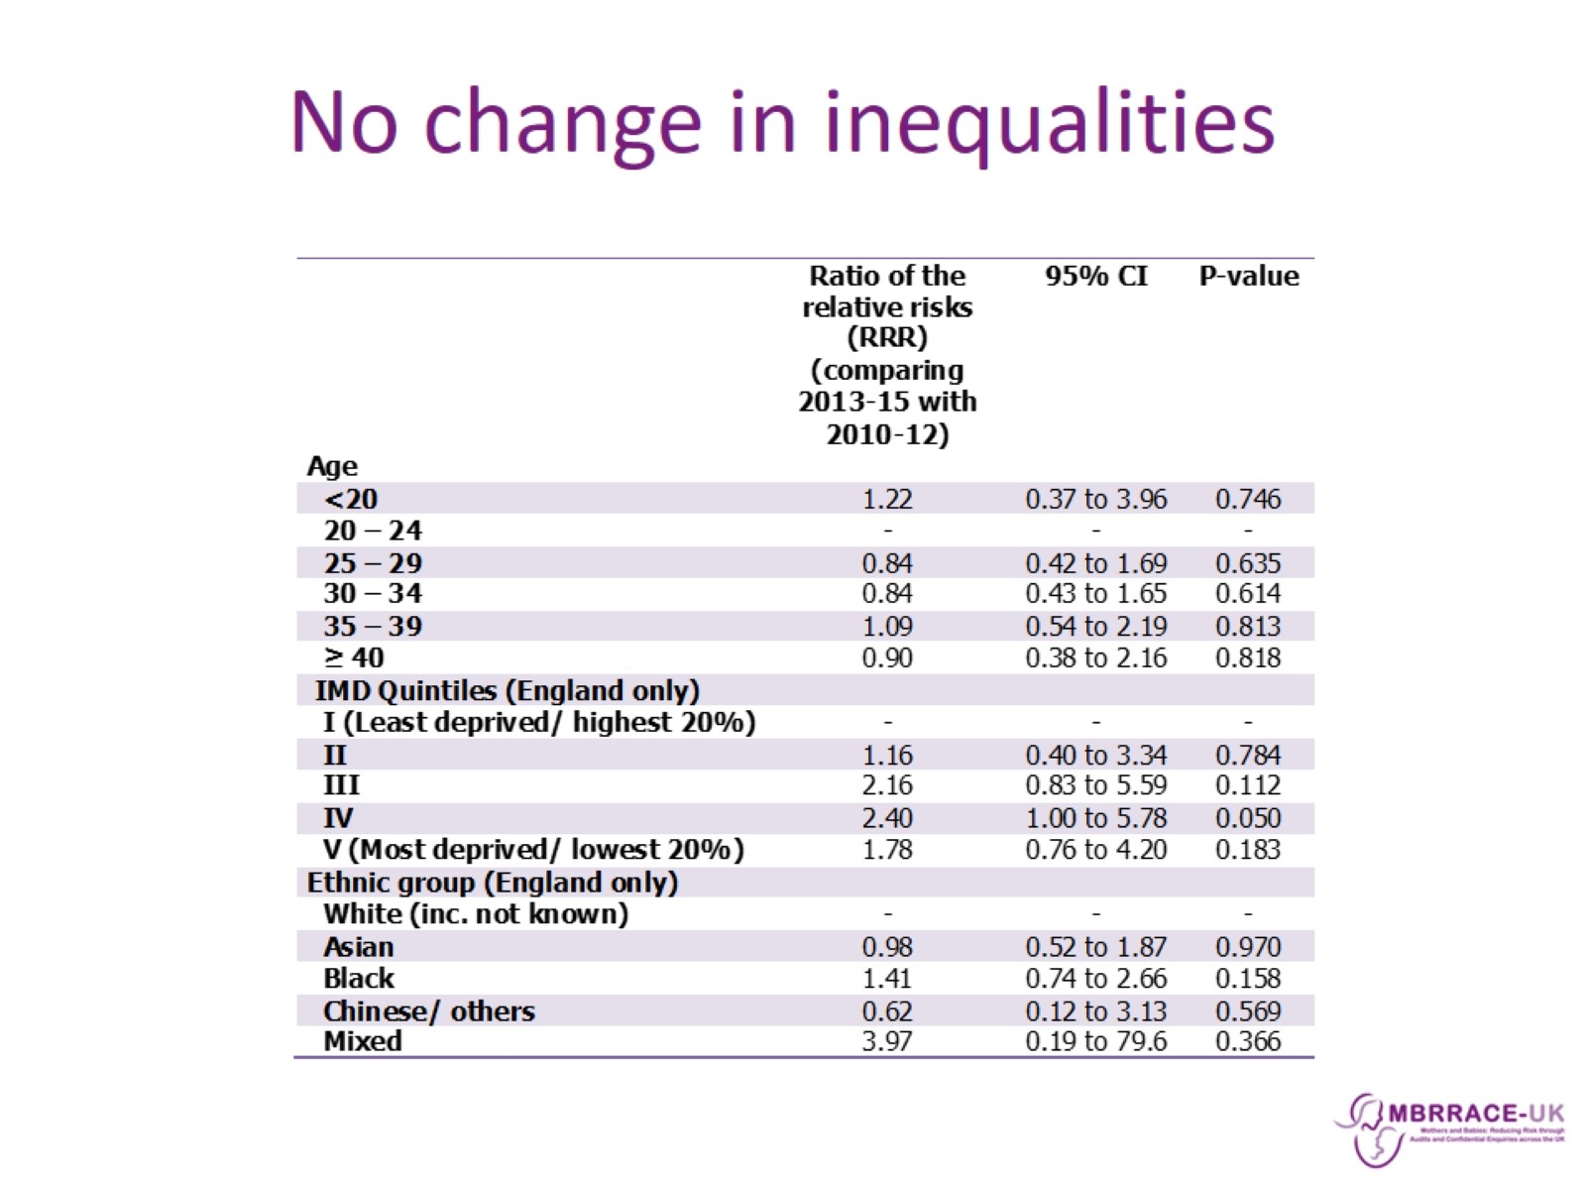
No change in inequalities

Slide 26
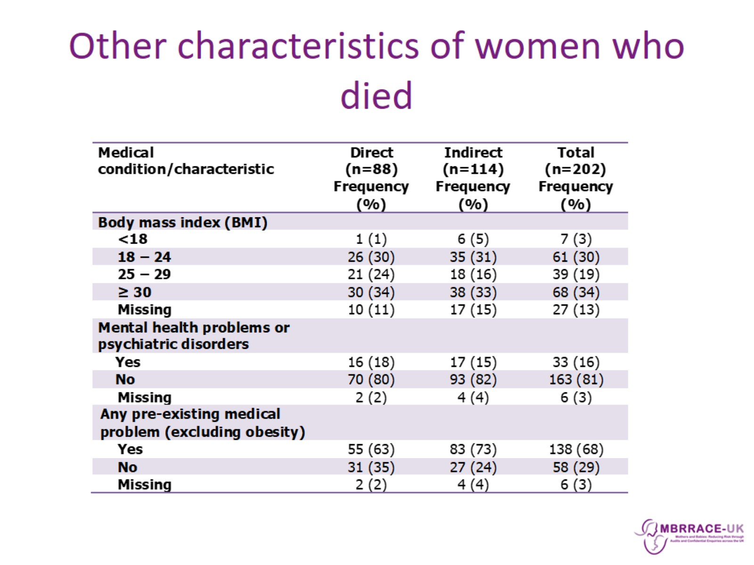
Other characteristics of women who died

Slide 27
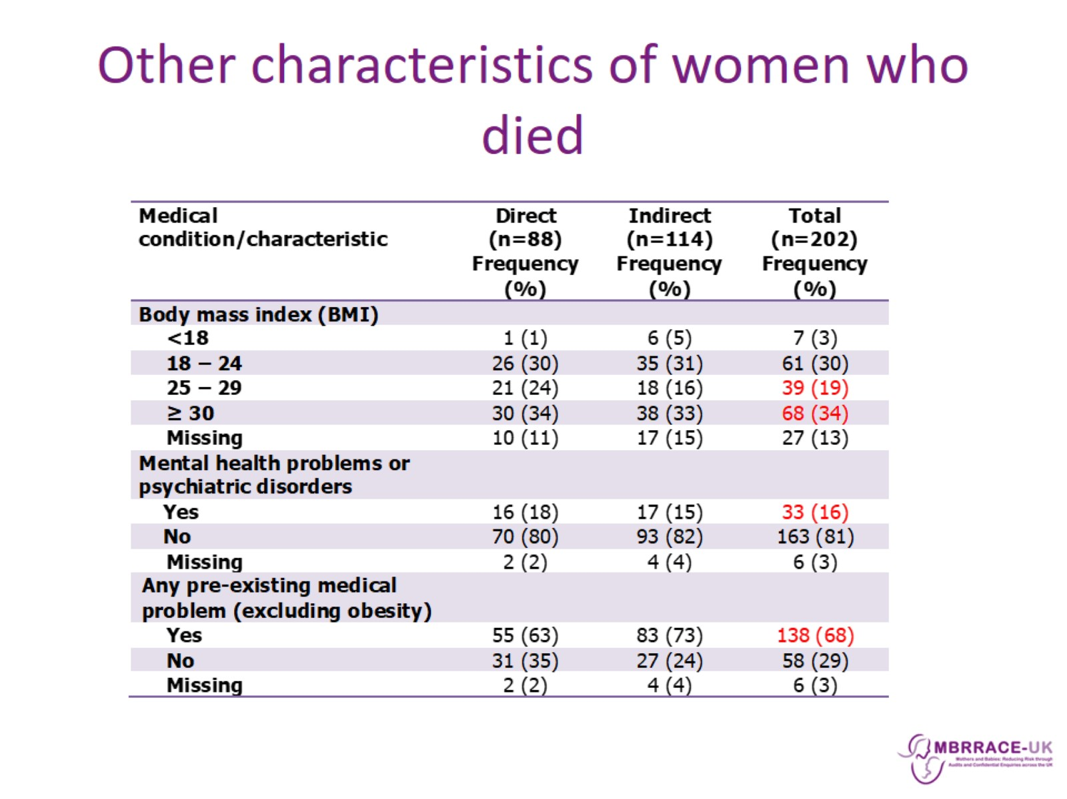
Other characteristics of women who died

Slide 28
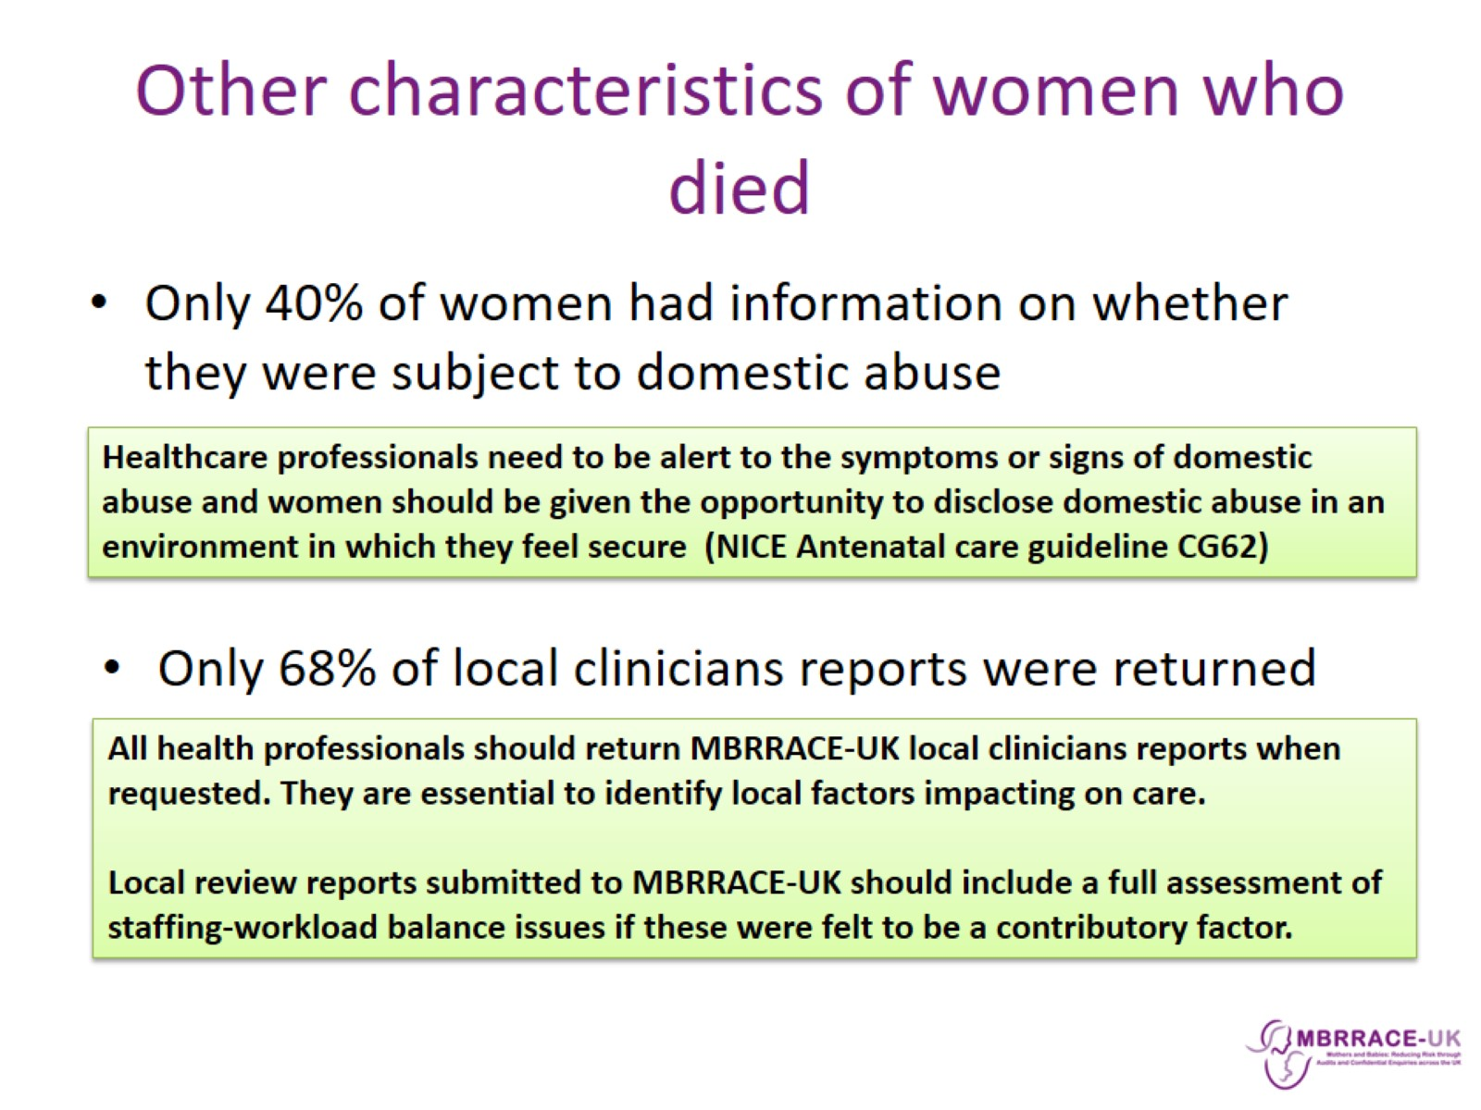
Other characteristics of women who died

Slide 29
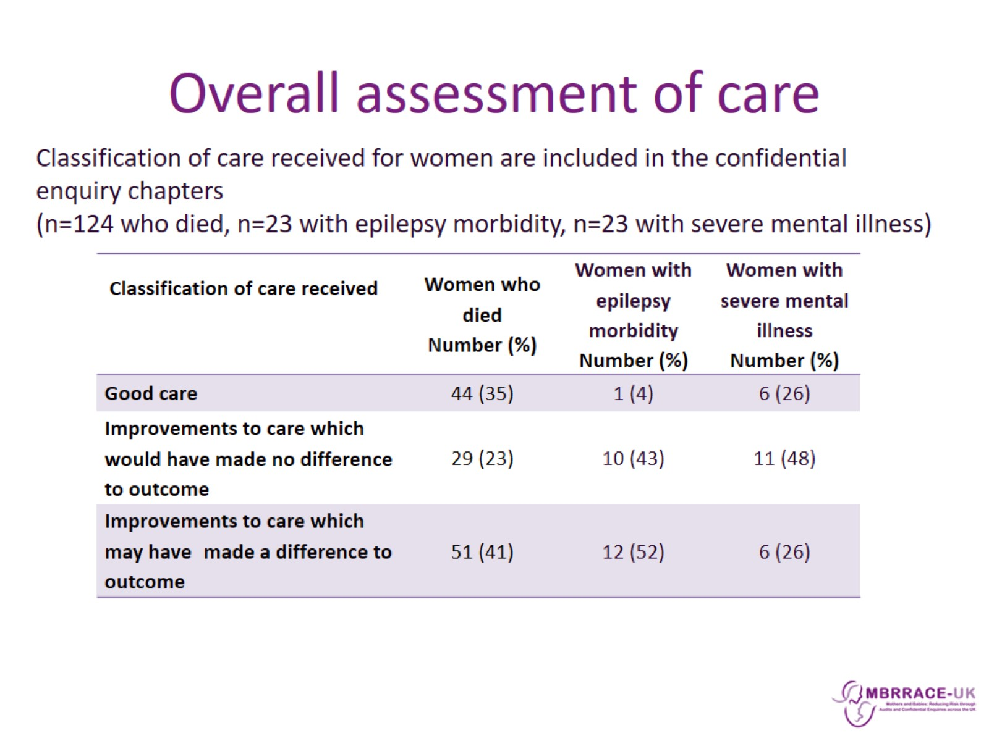
Overall assessment of care

Slide 30

Summary

Slide 31
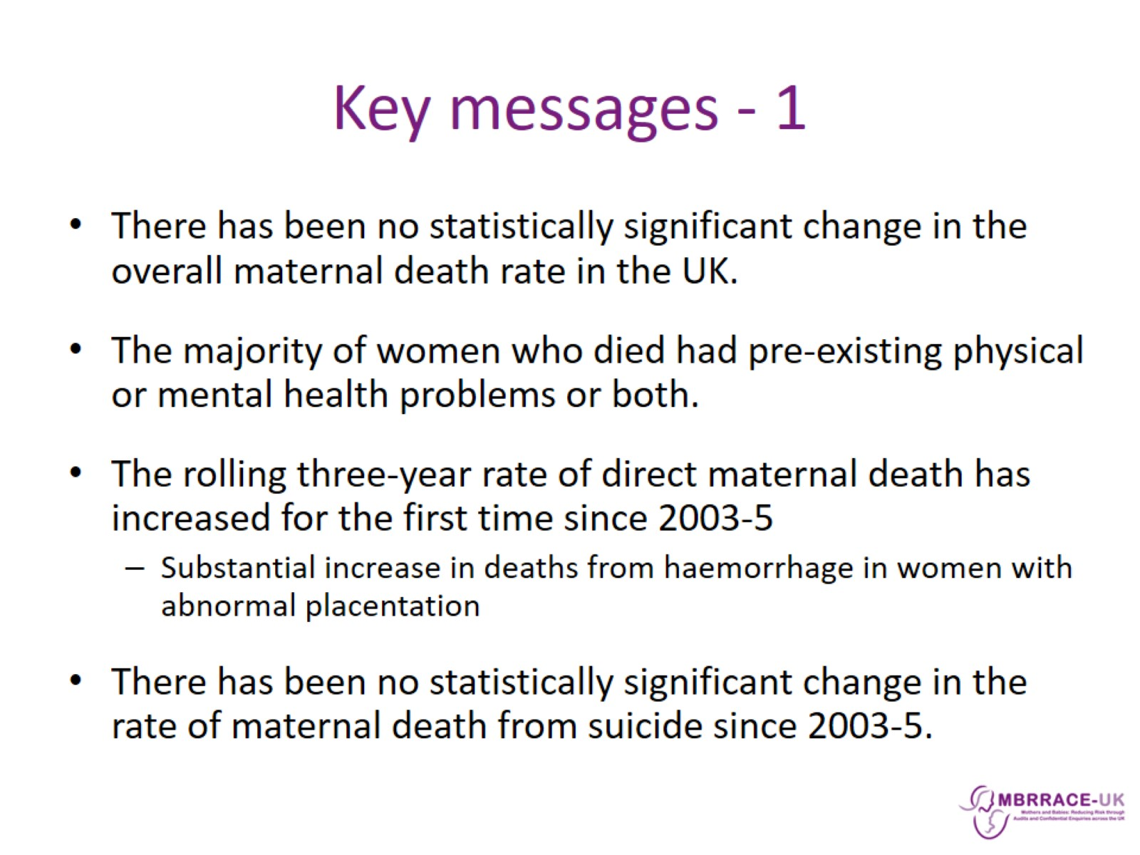
Key messages - 1

Slide 32
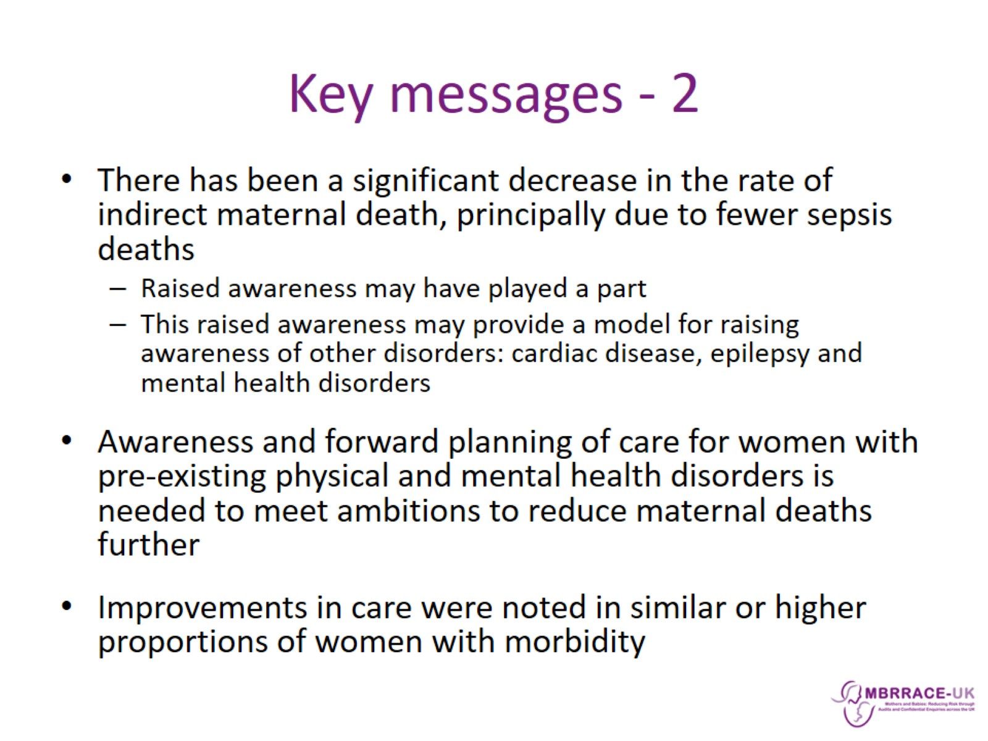
Key messages - 2

Slide 33
