Slide 1
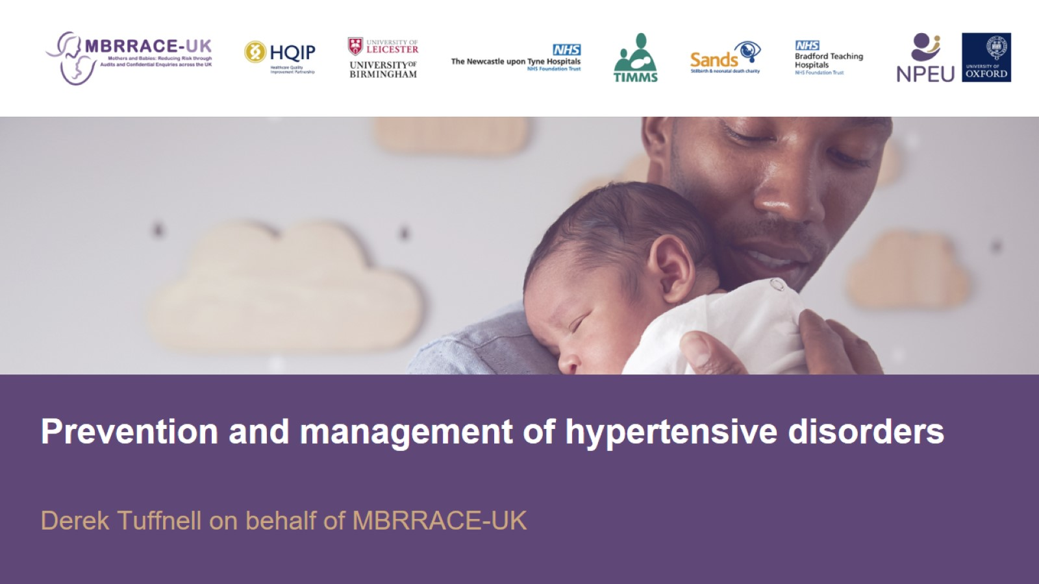

Slide 2
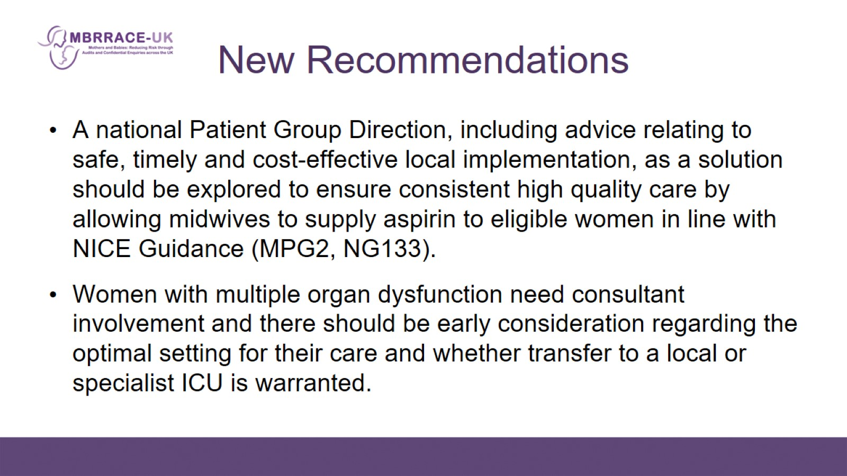
New Recommendations

Slide 3
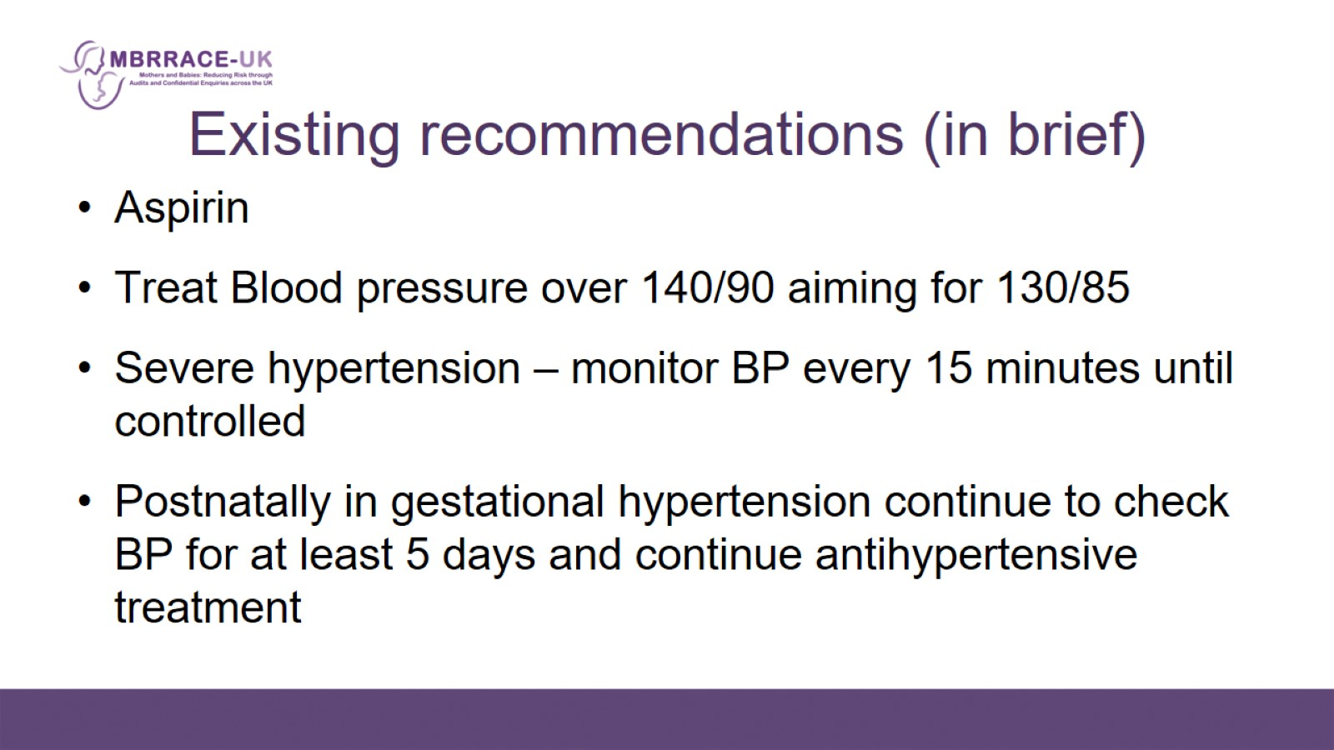
Existing recommendations (in brief)

Slide 4
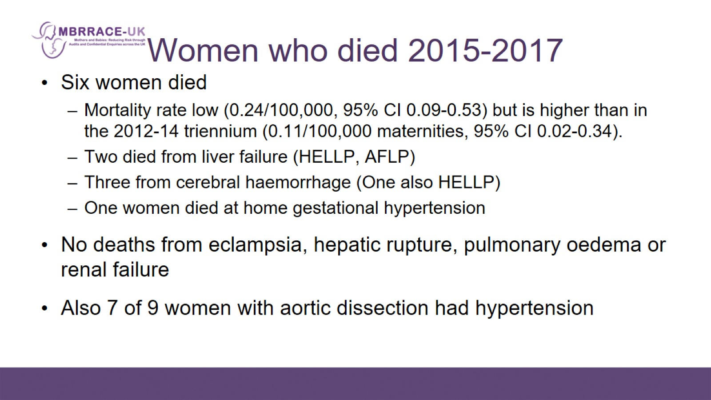
Women who died 2015-2017

Slide 5
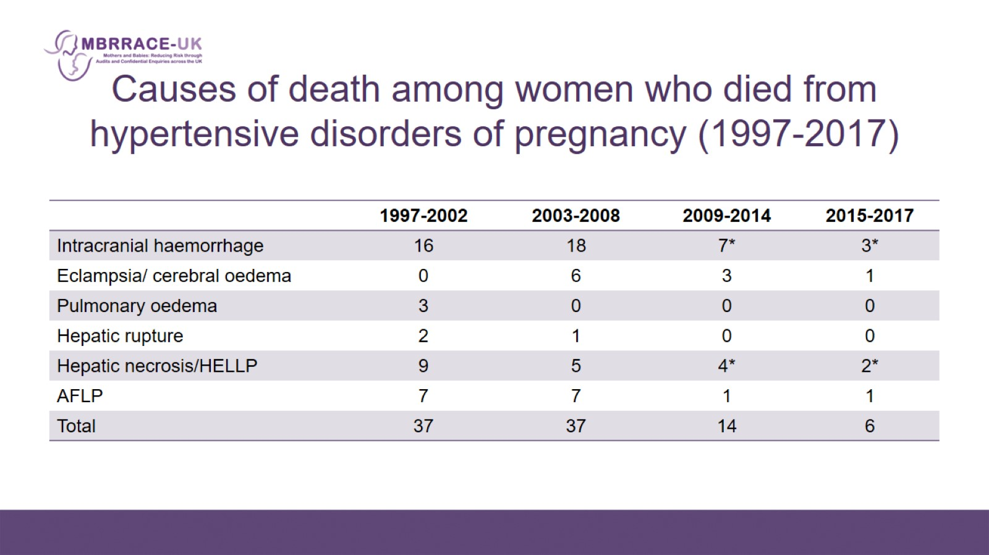
Causes of death among women who died from hypertensive disorders of pregnancy (1997-2017)

Slide 6
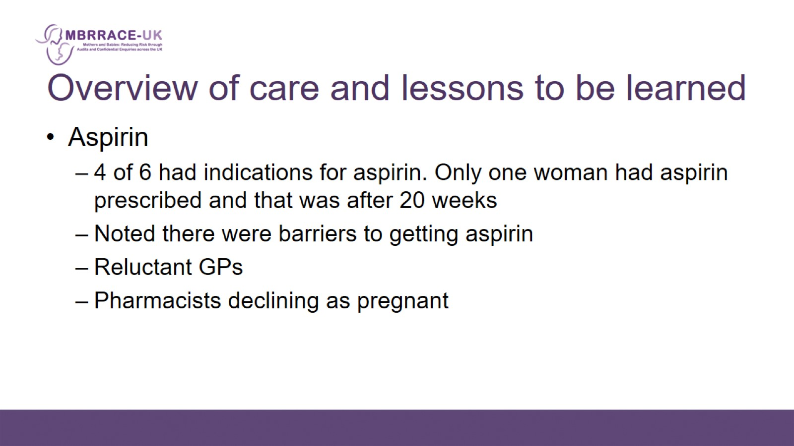
Overview of care and lessons to be learned

Slide 7
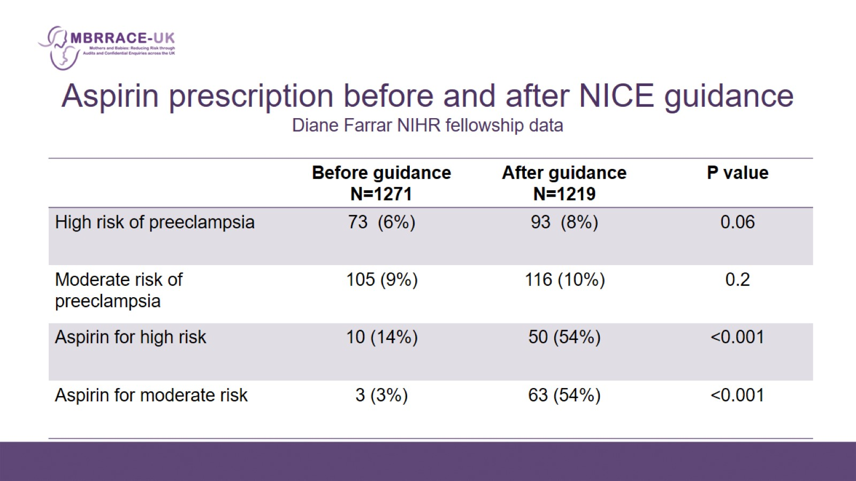
Aspirin prescription before and after NICE guidance
Diane Farrar NIHR fellowship data

Slide 8
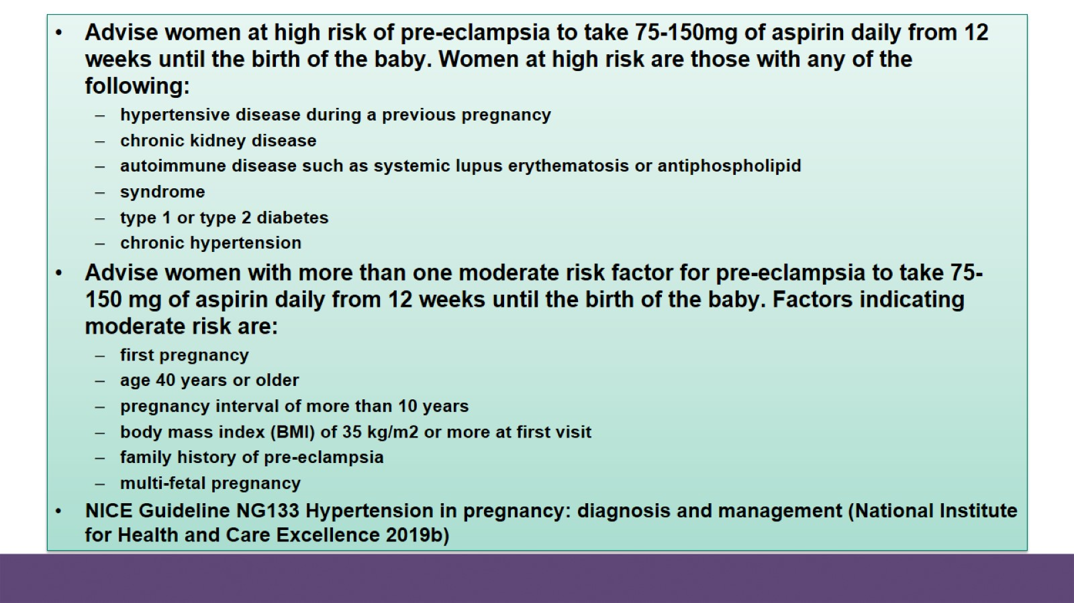

Slide 9
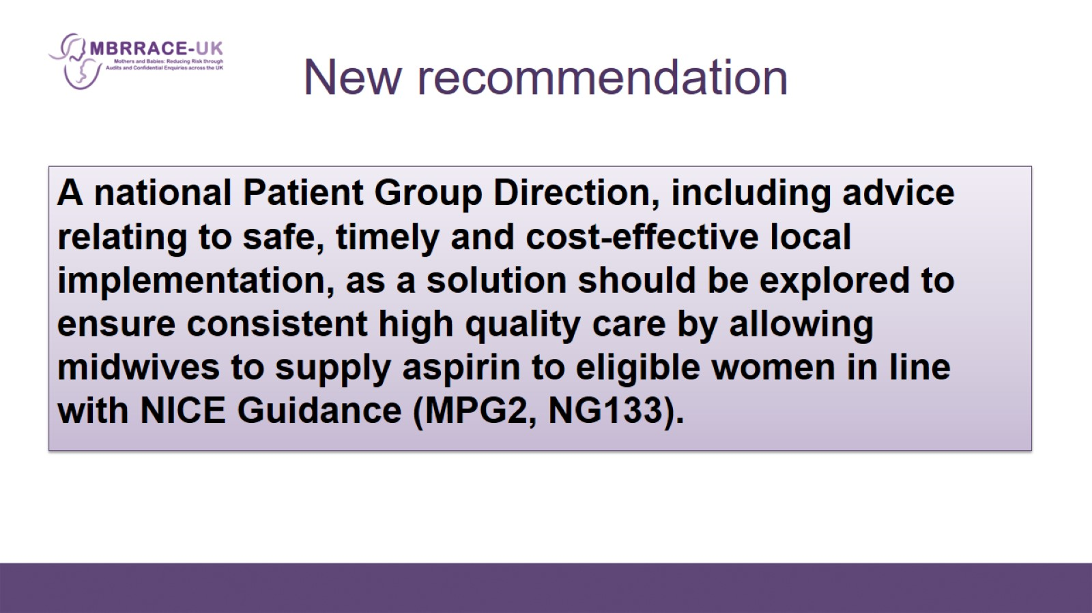
New recommendation

Slide 10
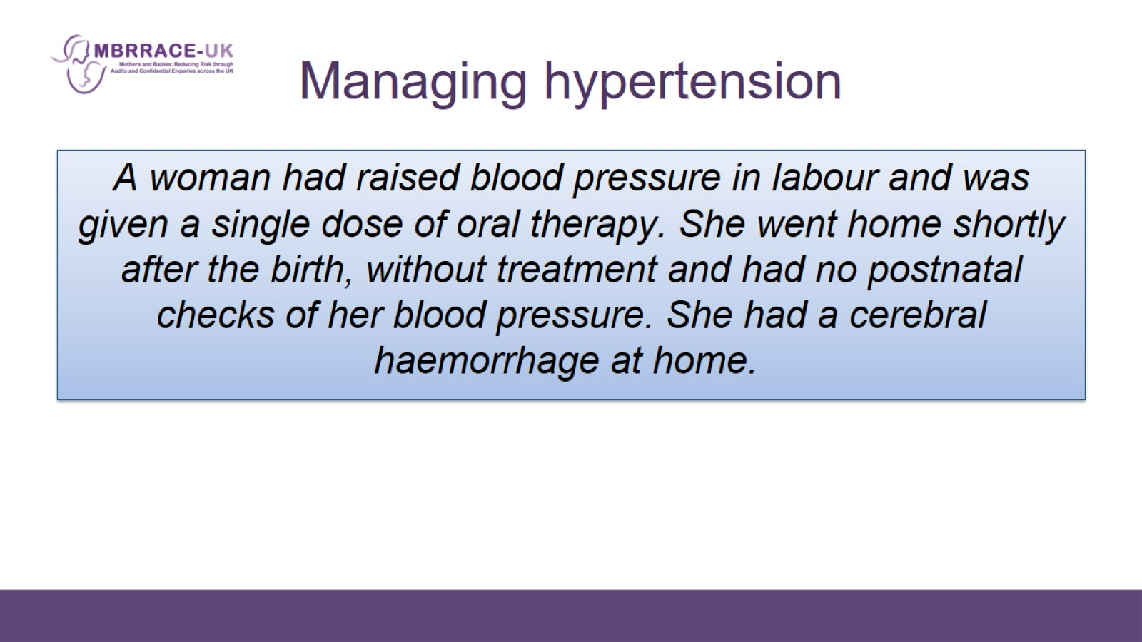
Managing hypertension

Slide 11
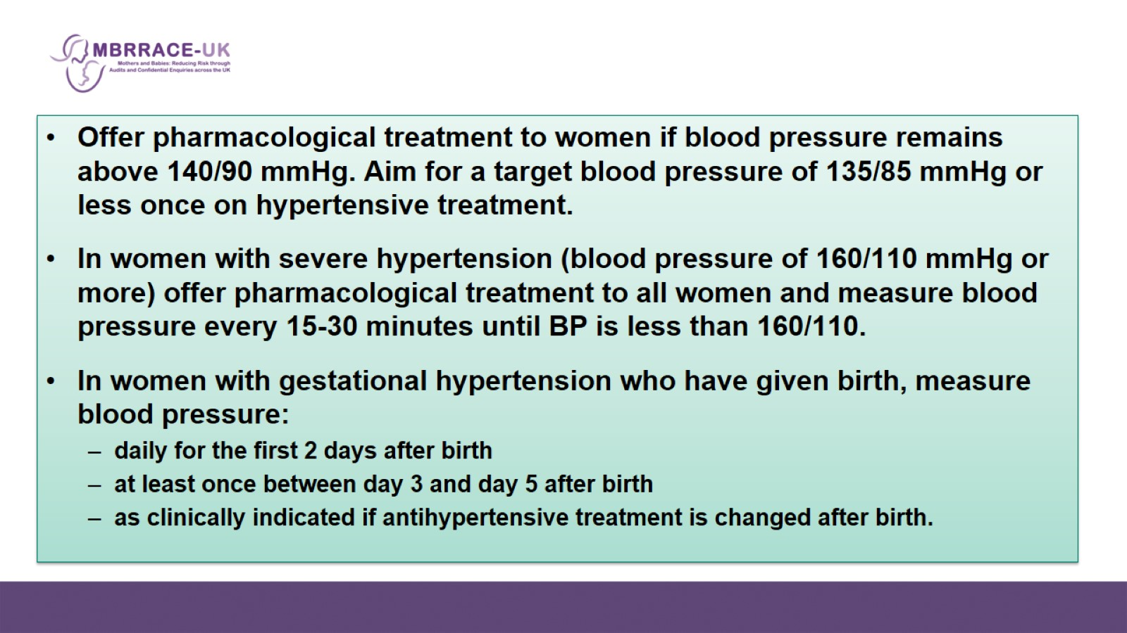

Slide 12
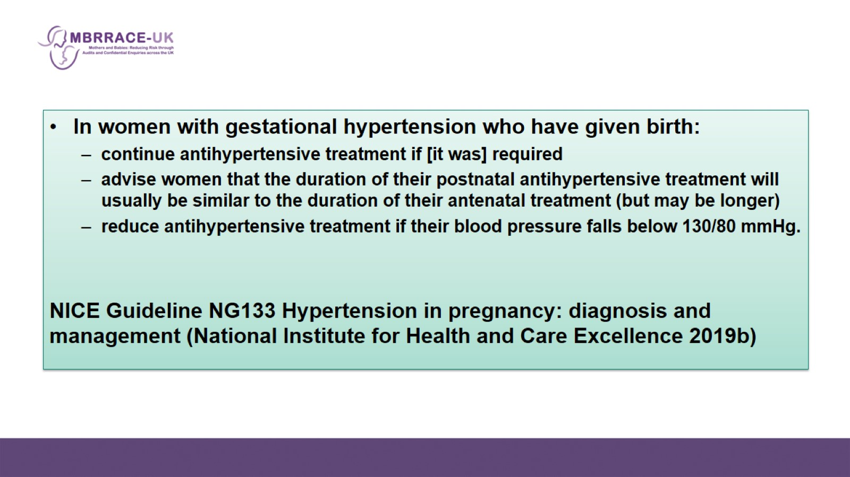

Slide 13
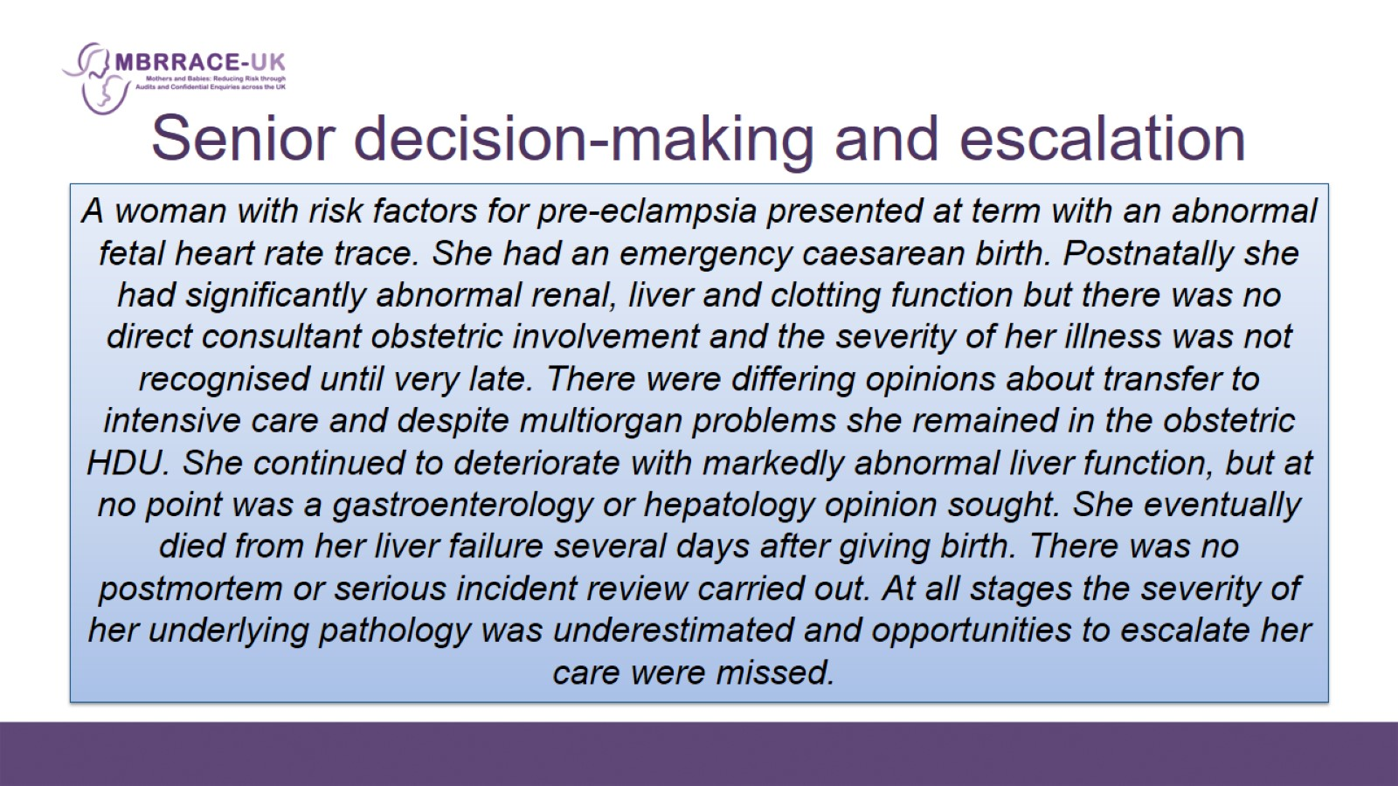
Senior decision-making and escalation

Slide 14
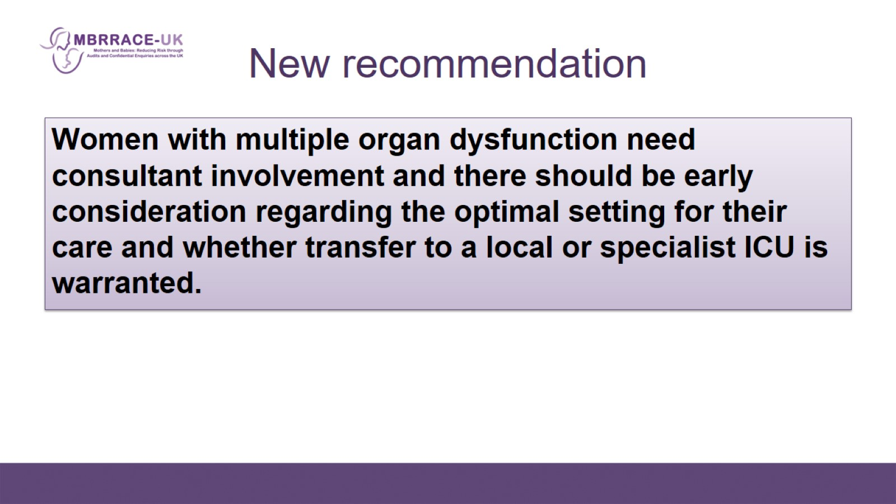
New recommendation

Slide 15
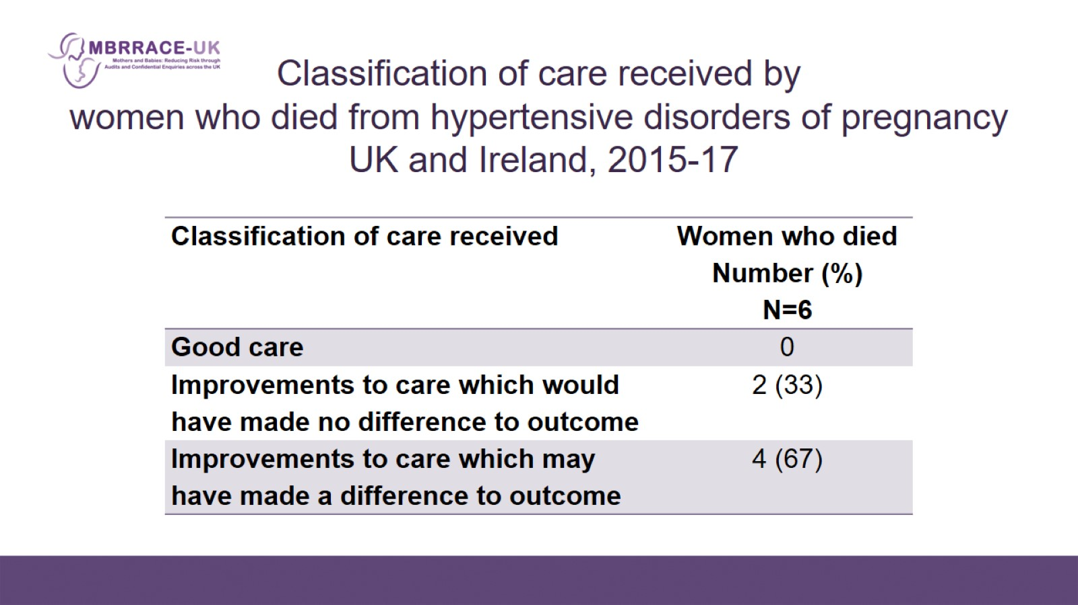
Classification of care received by women who died from hypertensive disorders of pregnancy
UK and Ireland, 2015-17

Slide 16
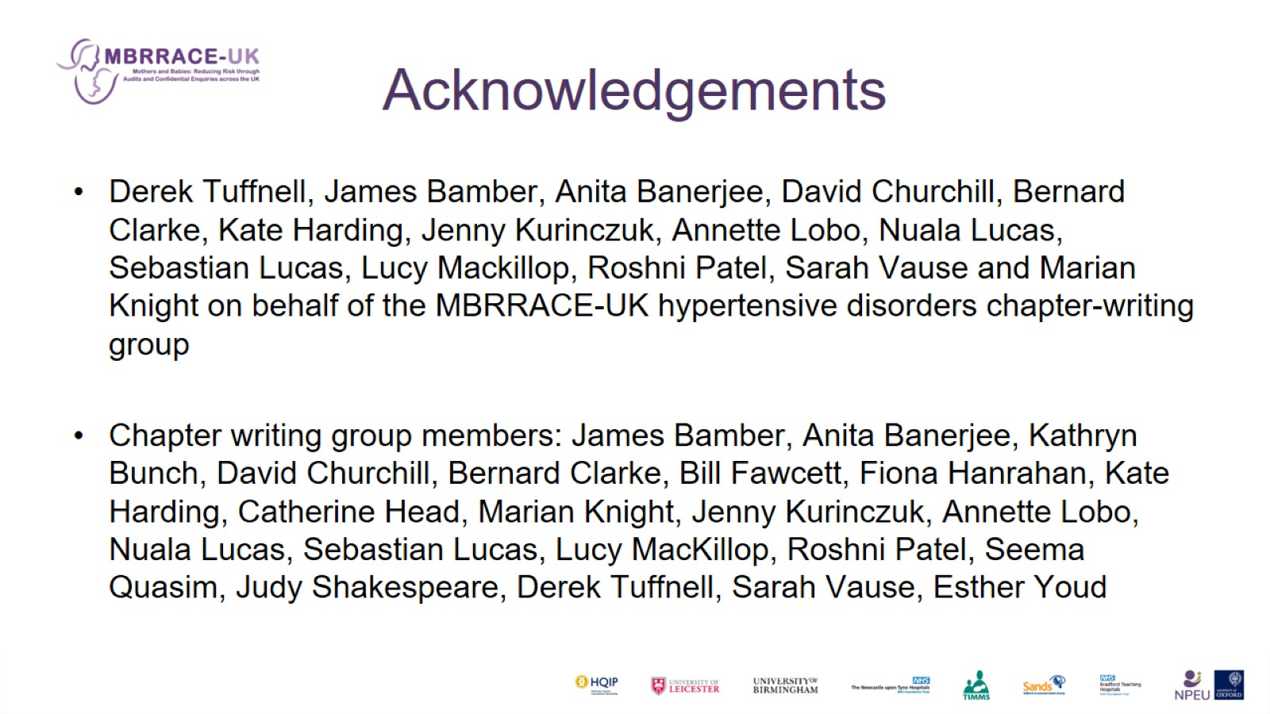
Acknowledgements

