Slide 1


Slide 2
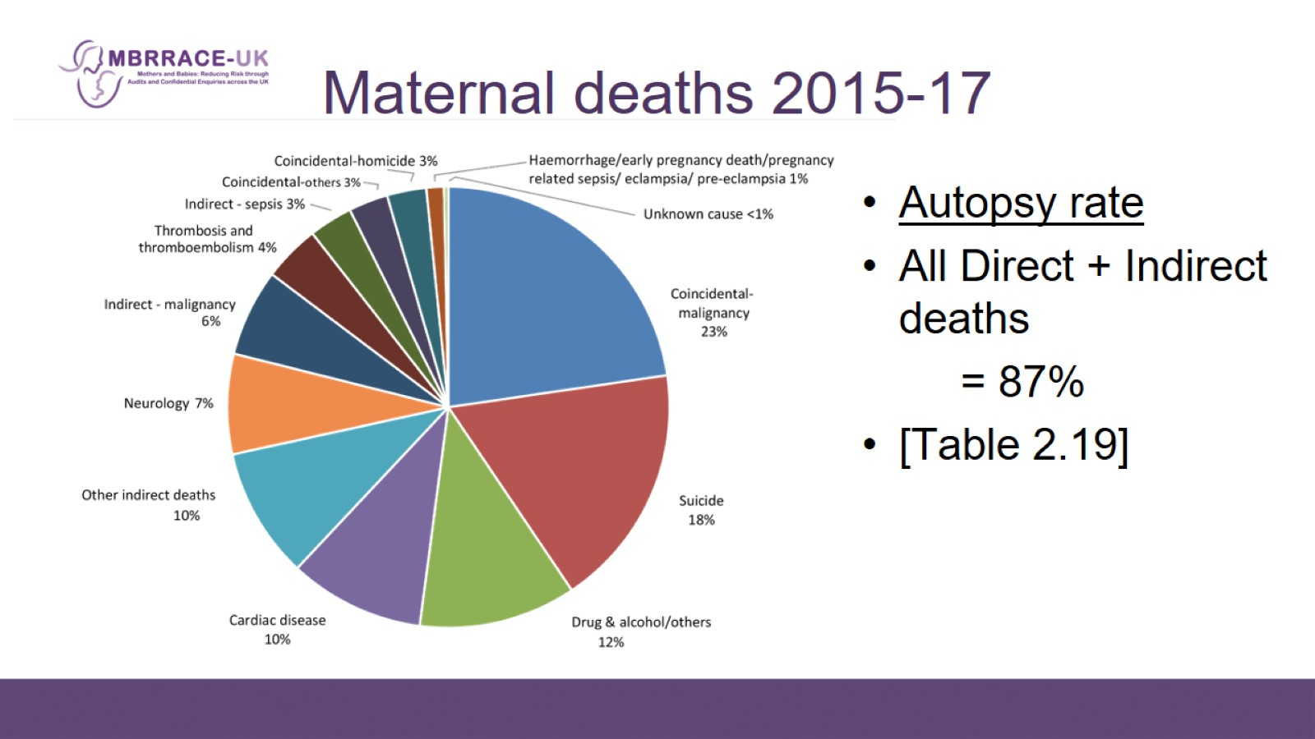
Maternal deaths 2015-17

Slide 3
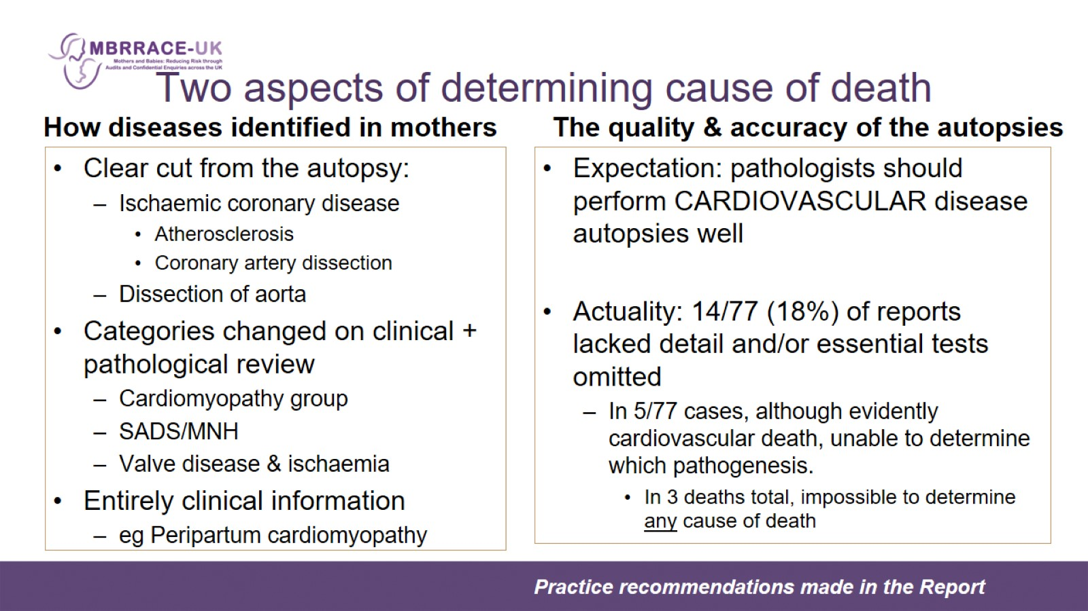
Two aspects of determining cause of death

Slide 4
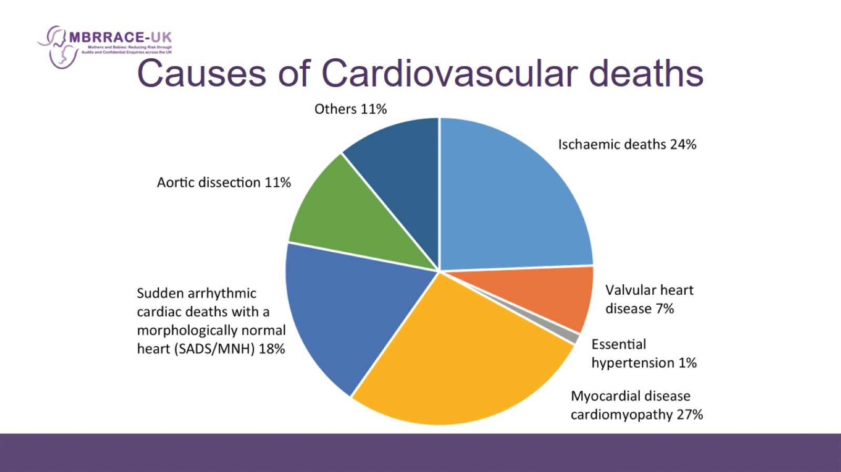
Causes of Cardiovascular deaths

Slide 5
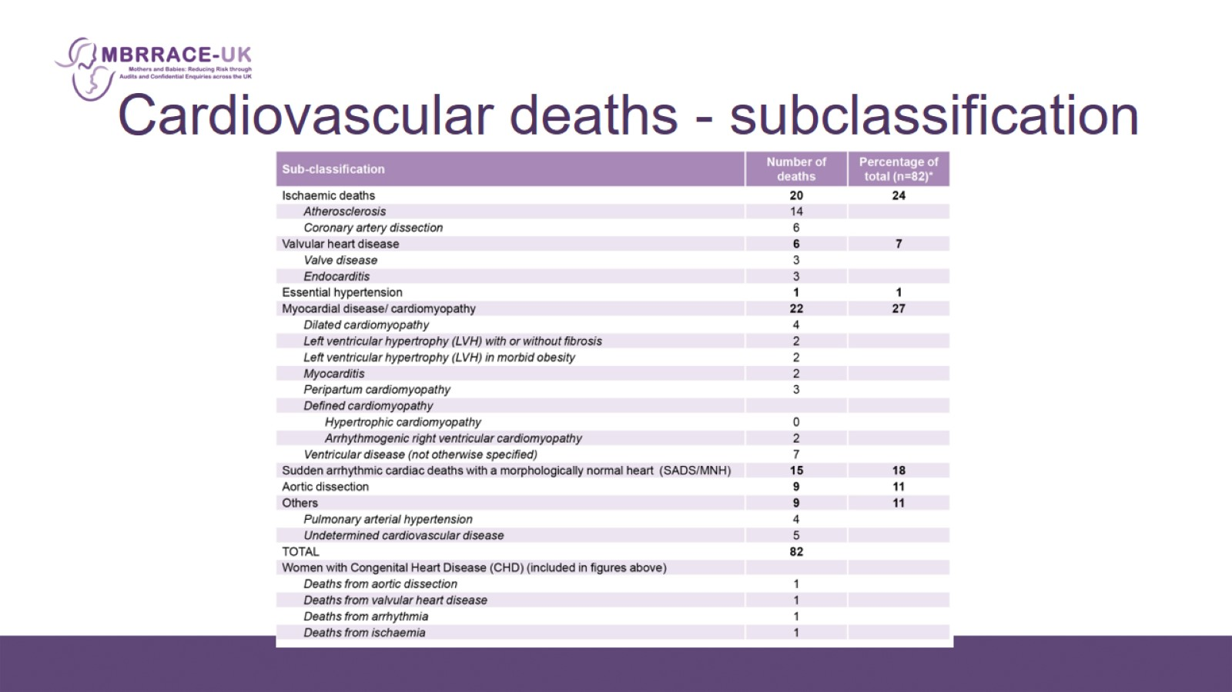
Cardiovascular deaths - subclassification

Slide 6
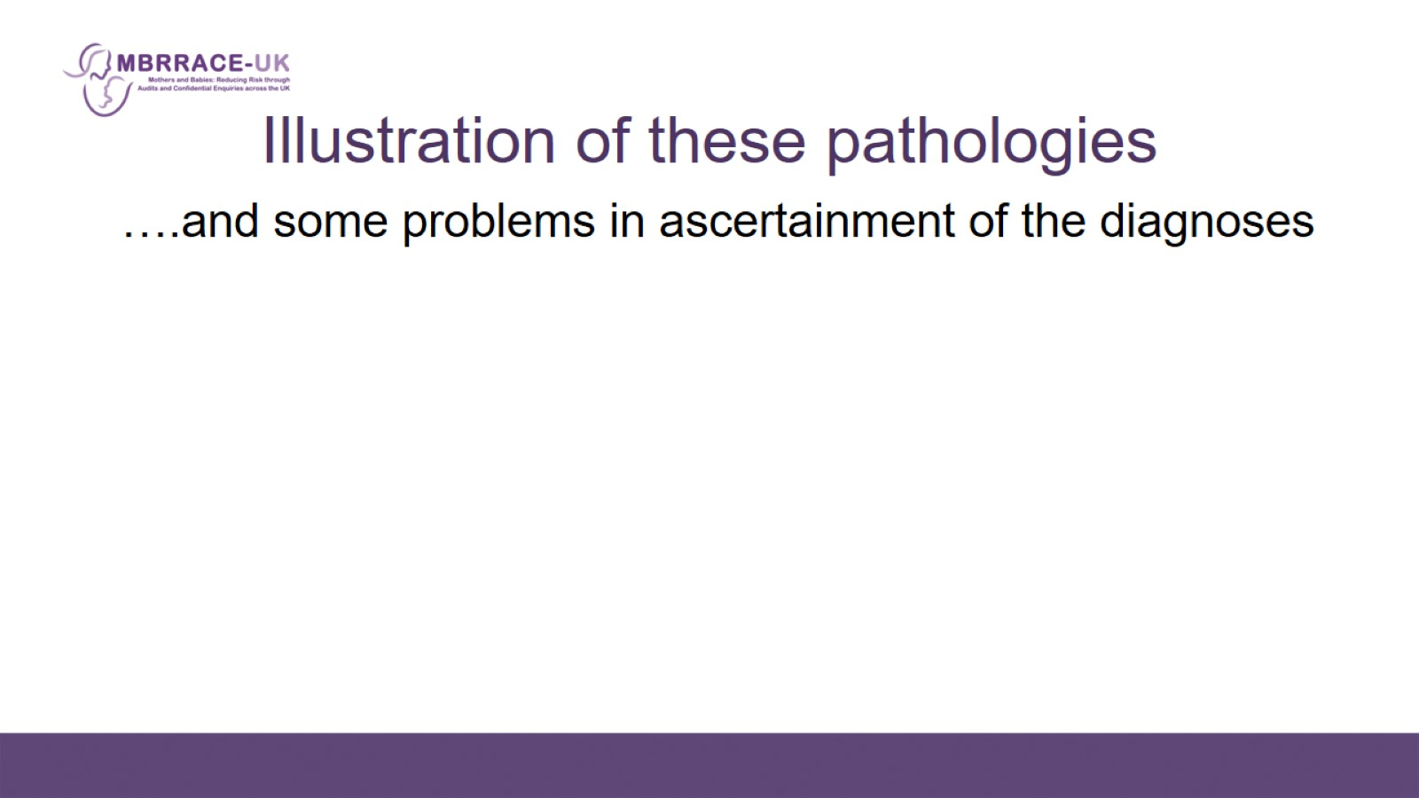
Illustration of these pathologies

Slide 7
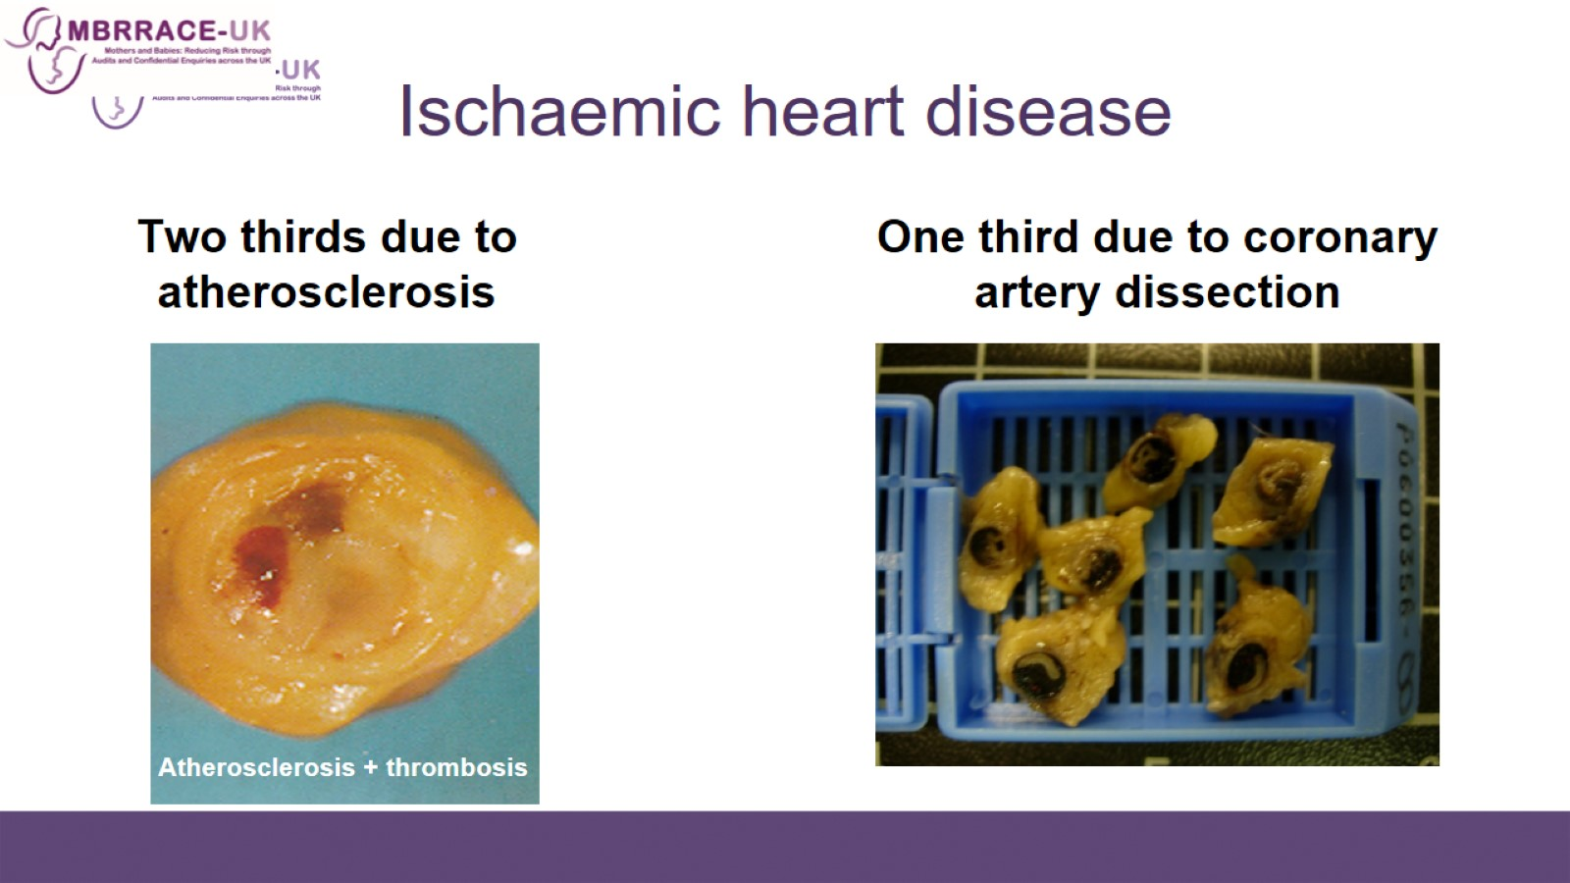
Ischaemic heart disease

Slide 8
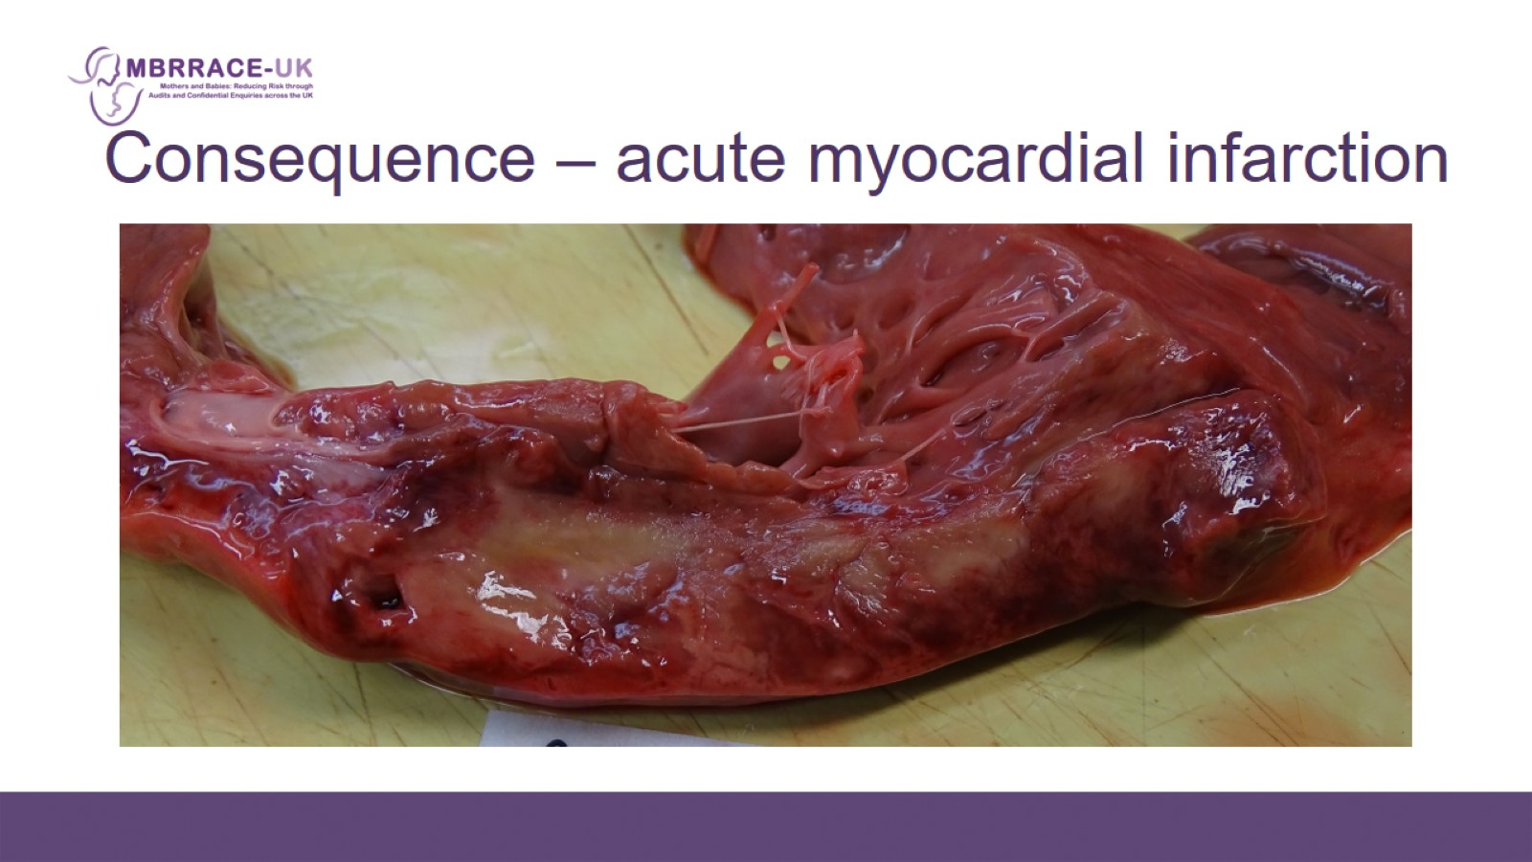
Consequence – acute myocardial infarction

Slide 9
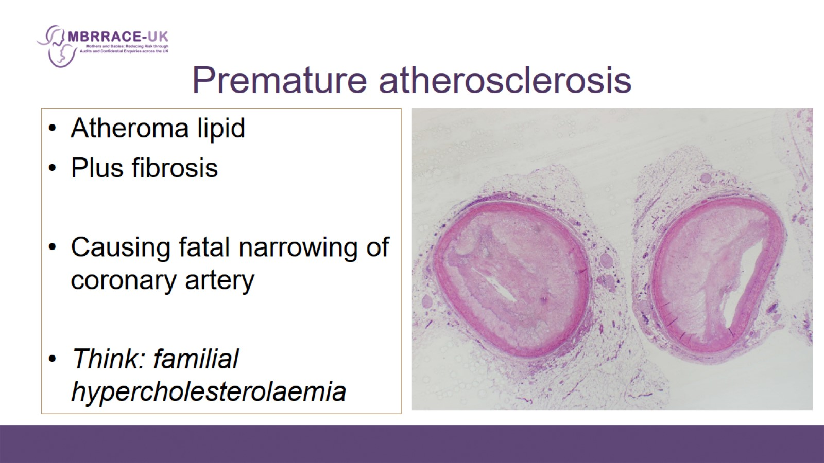
Premature atherosclerosis

Slide 10
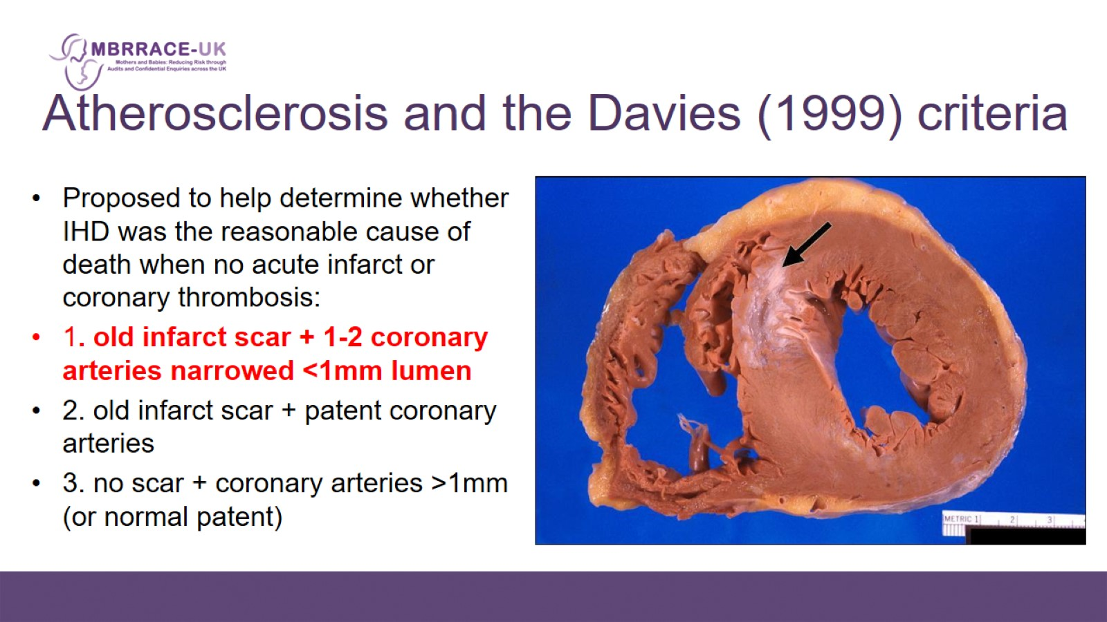
Atherosclerosis and the Davies (1999) criteria

Slide 11
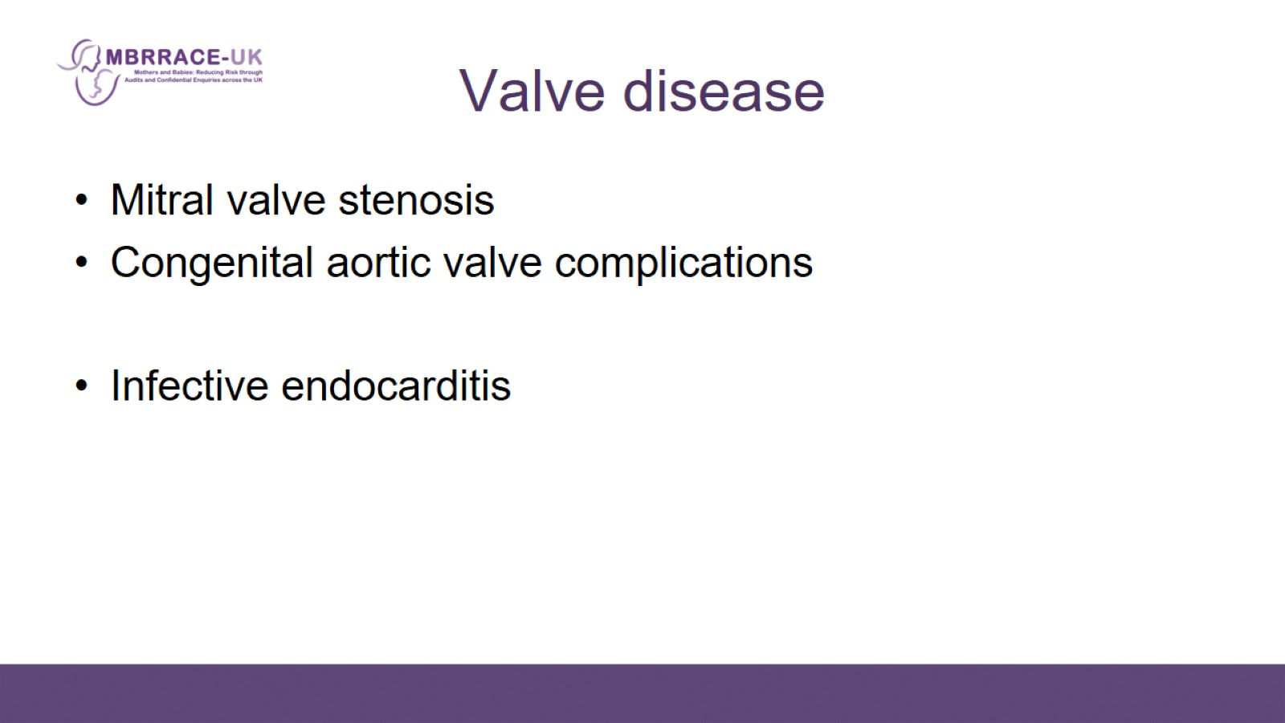
Valve disease

Slide 12
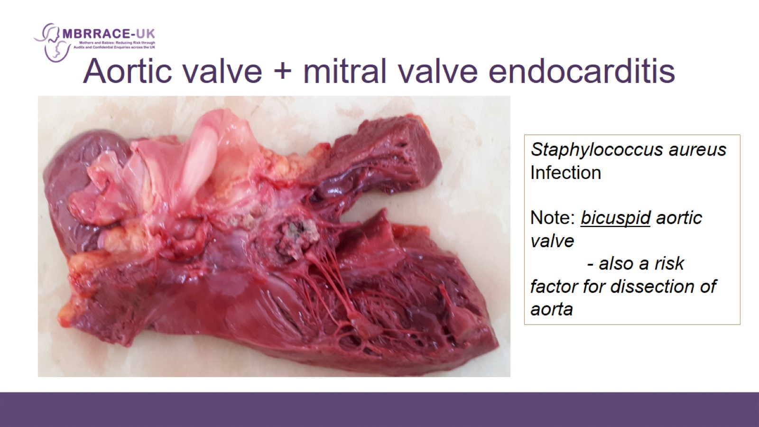
Aortic valve + mitral valve endocarditis

Slide 13
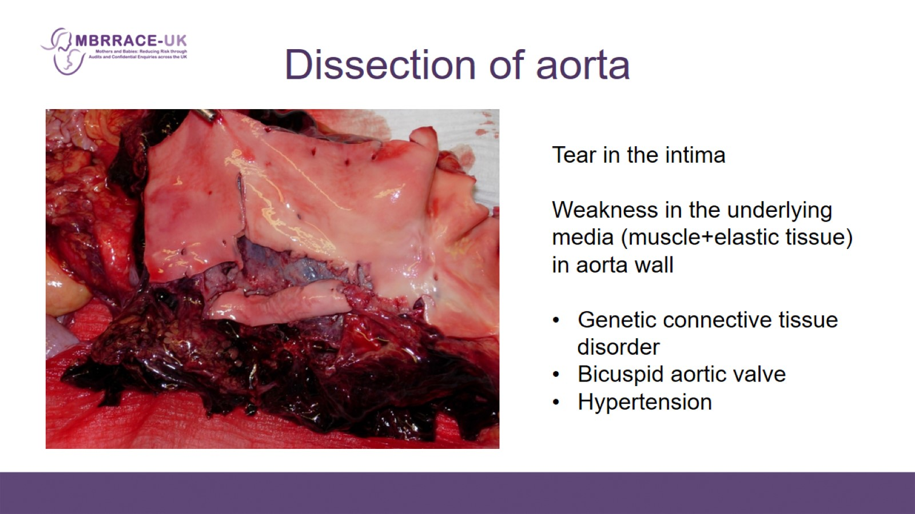
Dissection of aorta

Slide 14
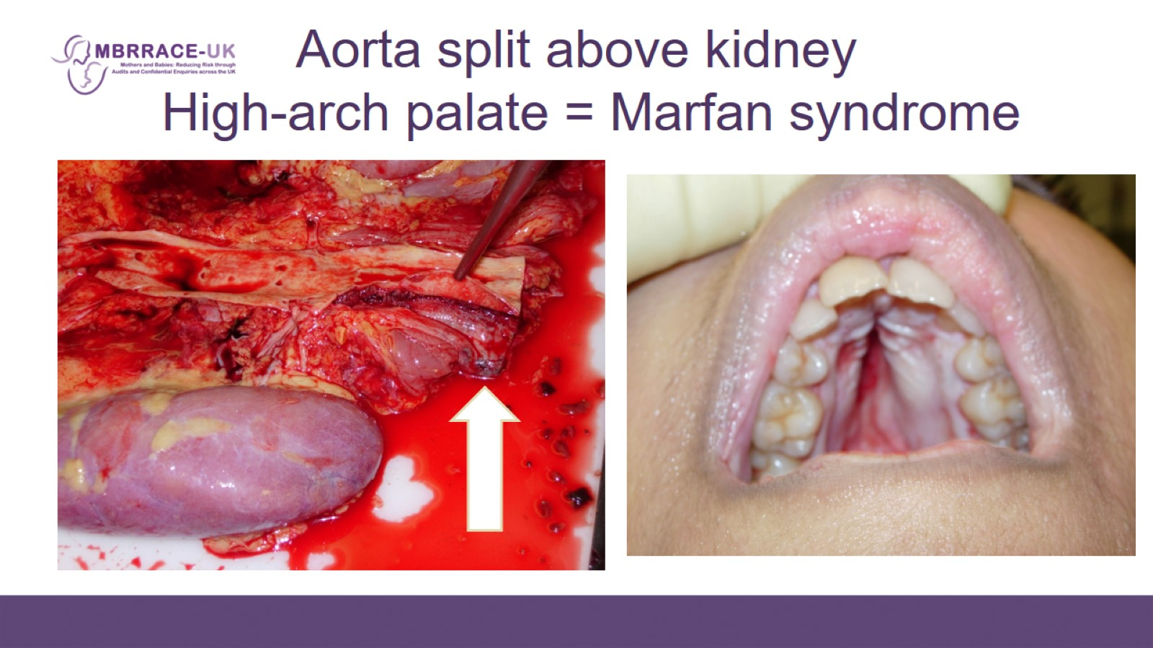
Aorta split above kidney
High-arch palate = Marfan syndrome

Slide 15
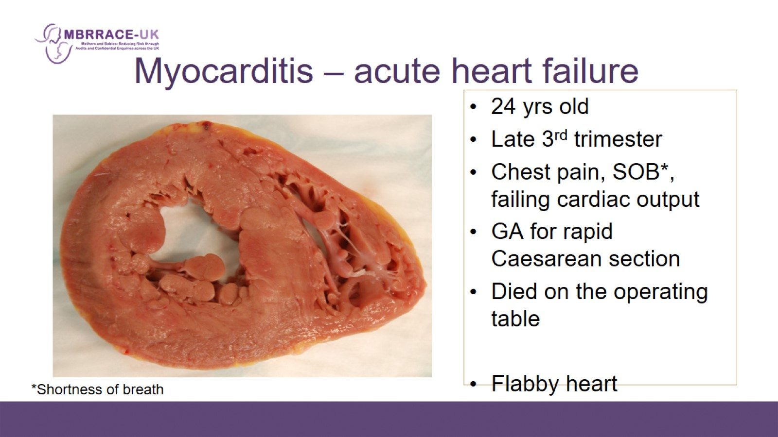
Myocarditis – acute heart failure

Slide 16
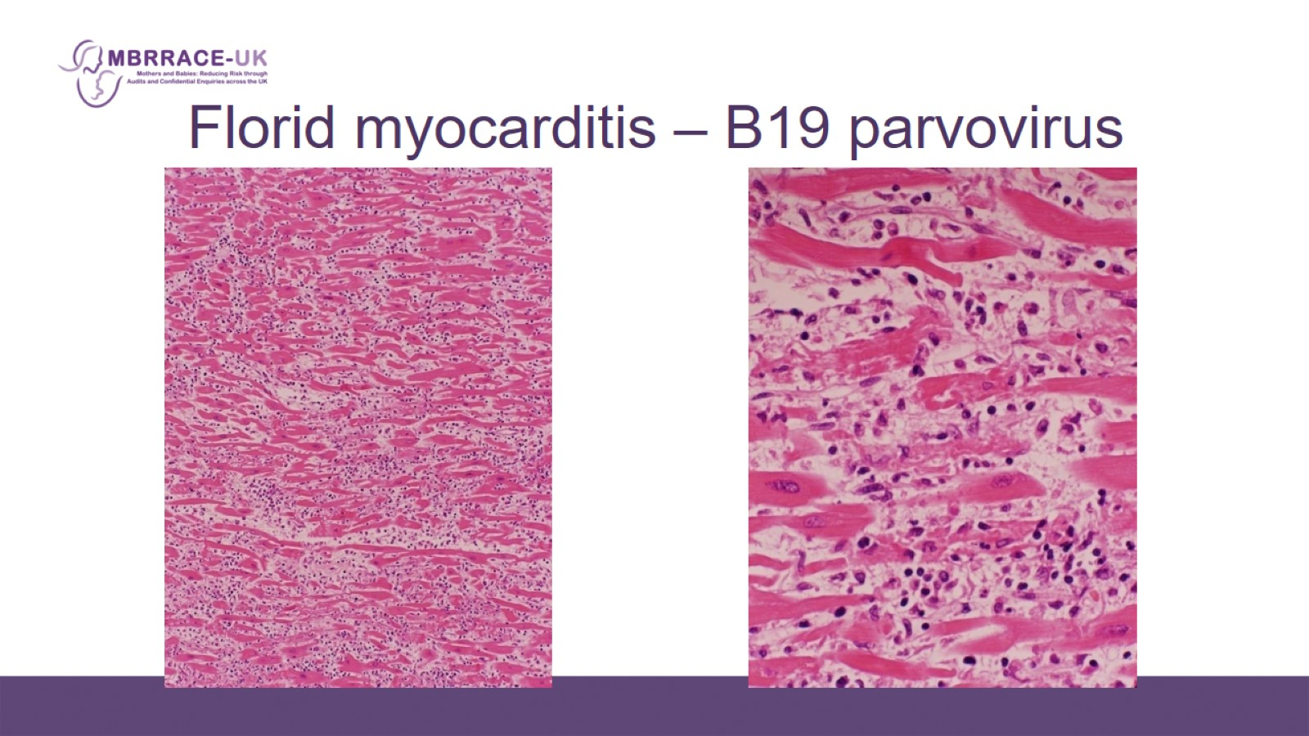
Florid myocarditis – B19 parvovirus

Slide 17
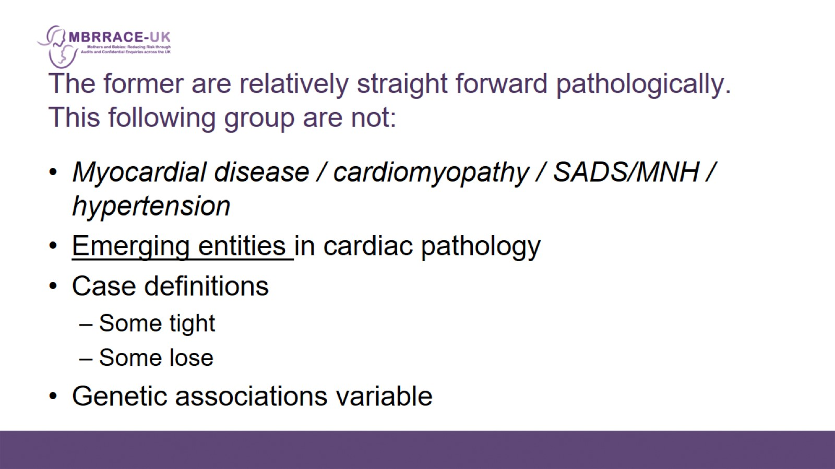
The former are relatively straight forward pathologically. This following group are not:

Slide 18
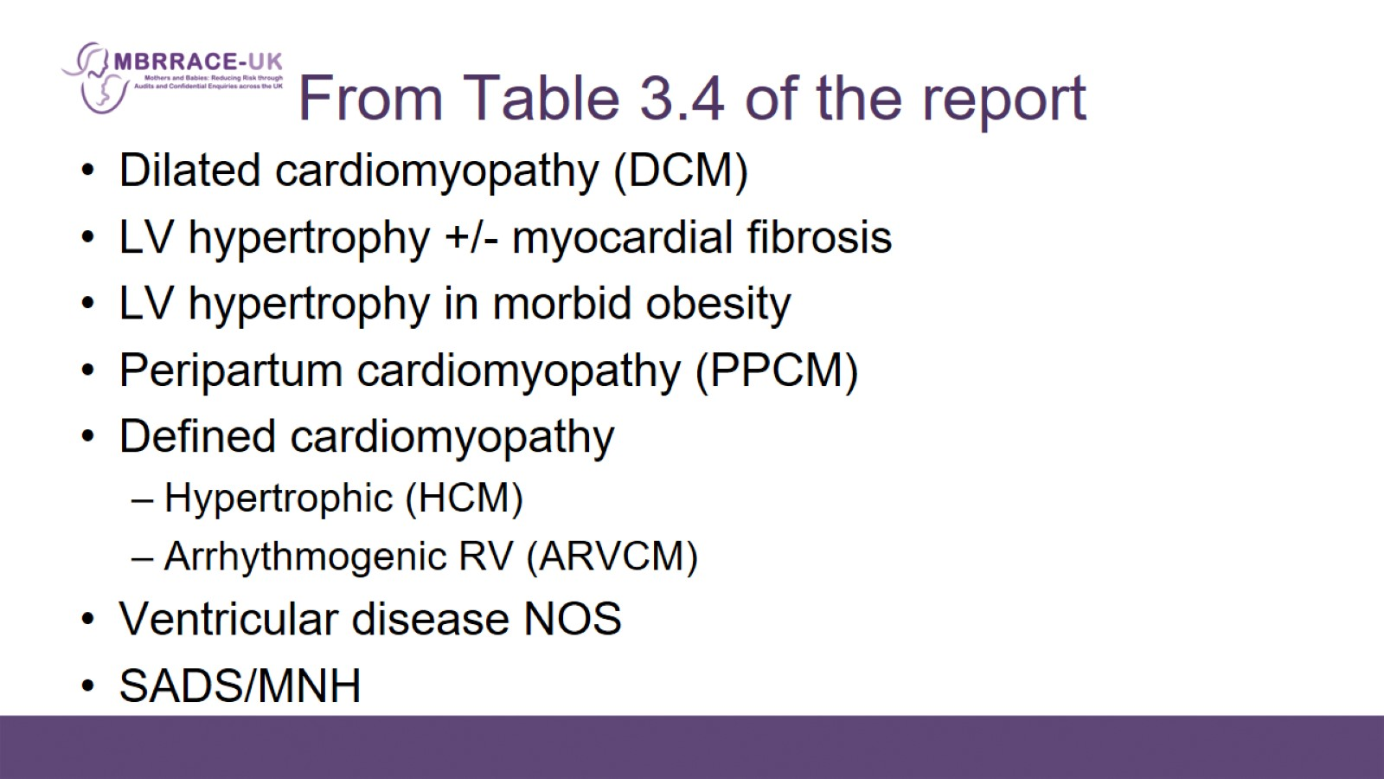
From Table 3.4 of the report

Slide 19
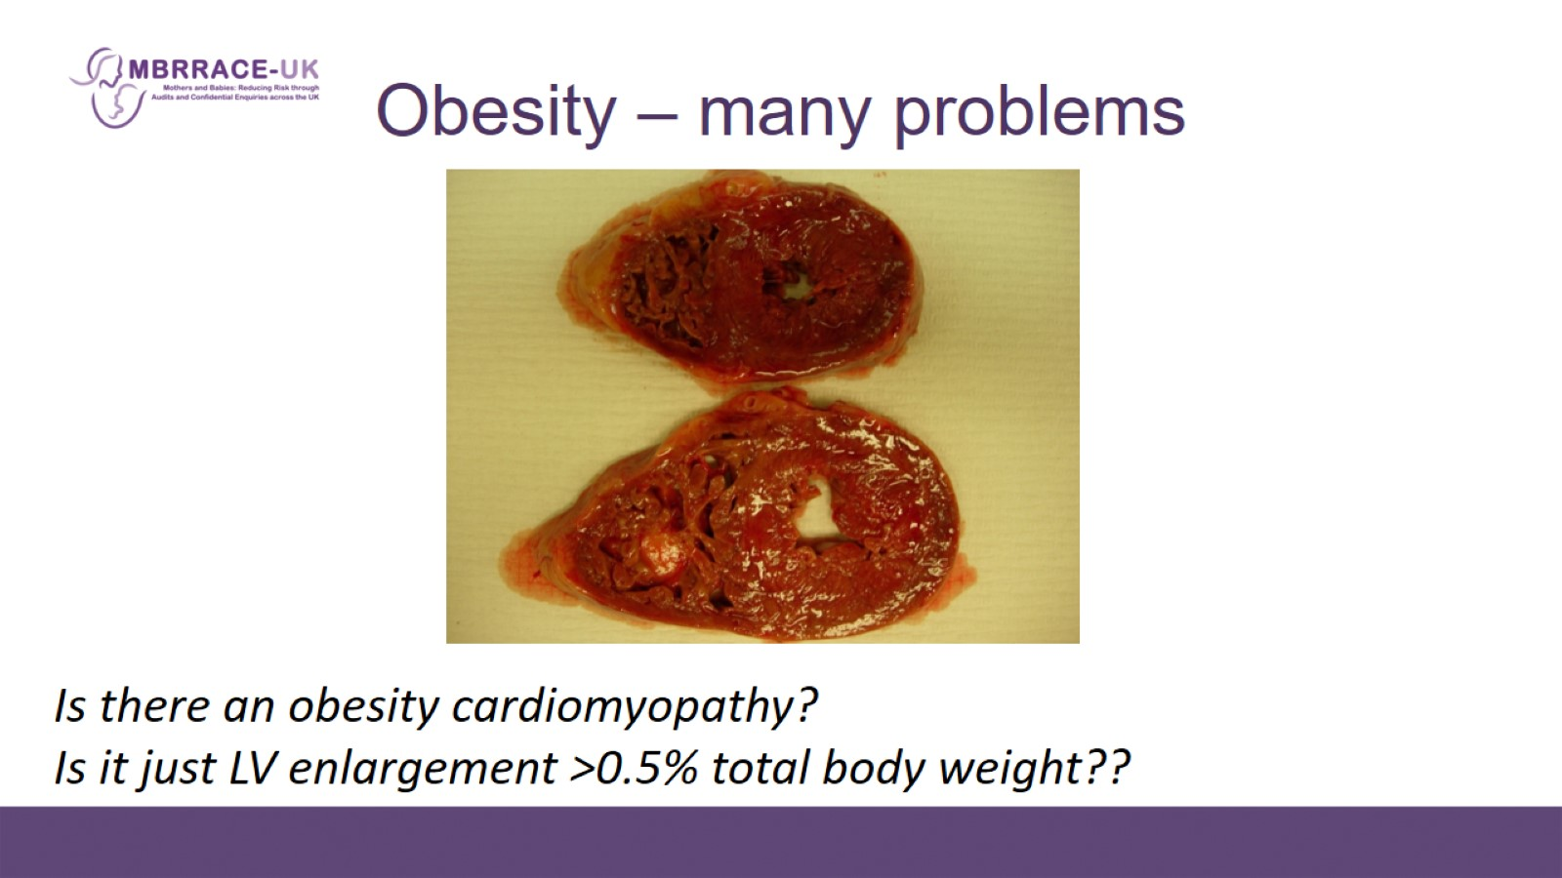
Obesity – many problems

Slide 20
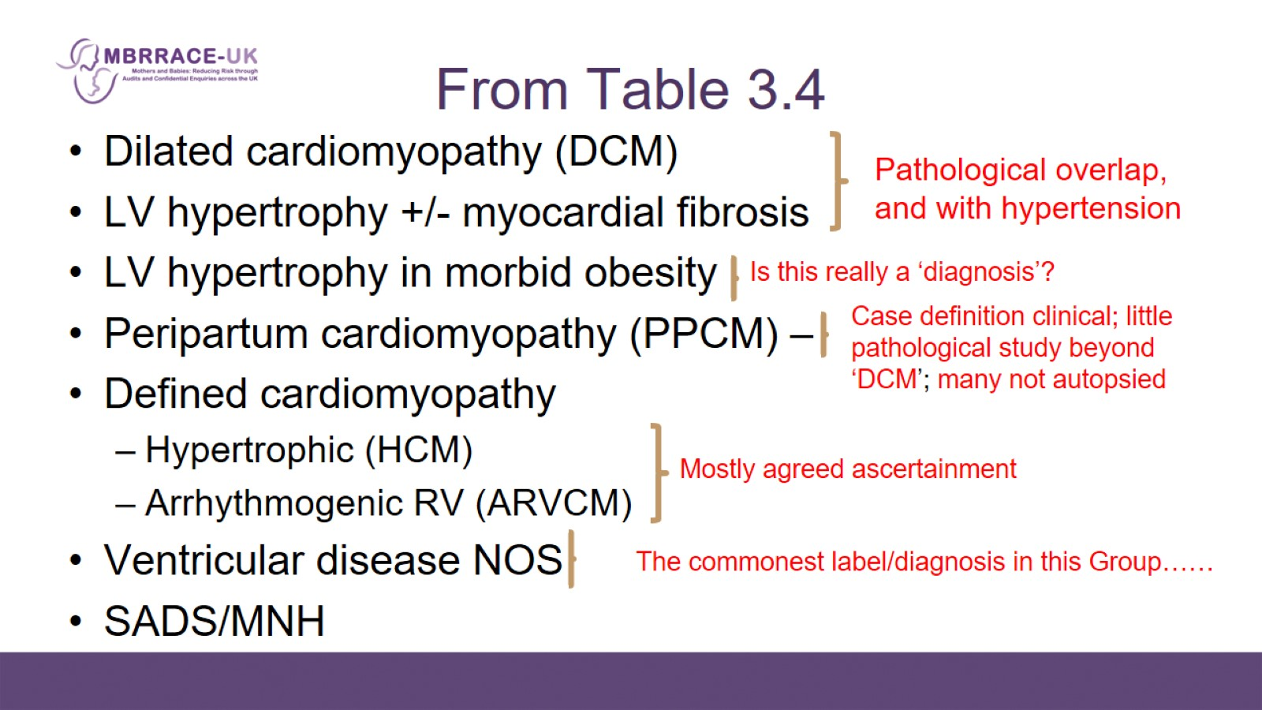
From Table 3.4

Slide 21
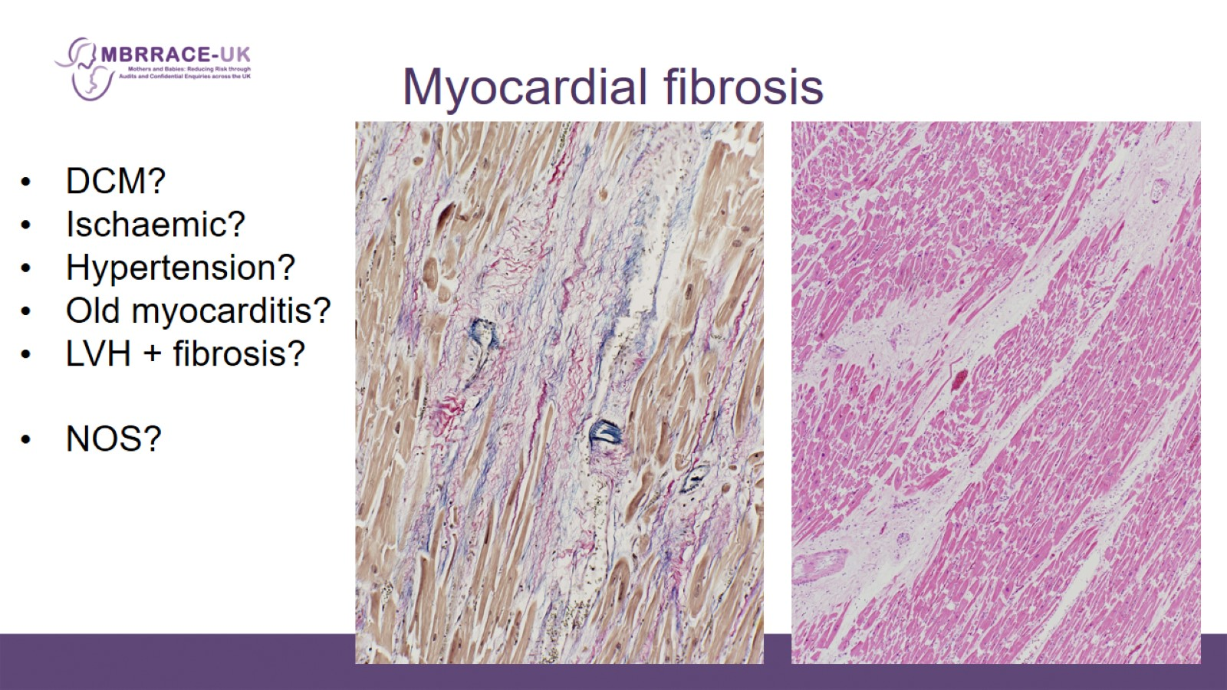
Myocardial fibrosis

Slide 22
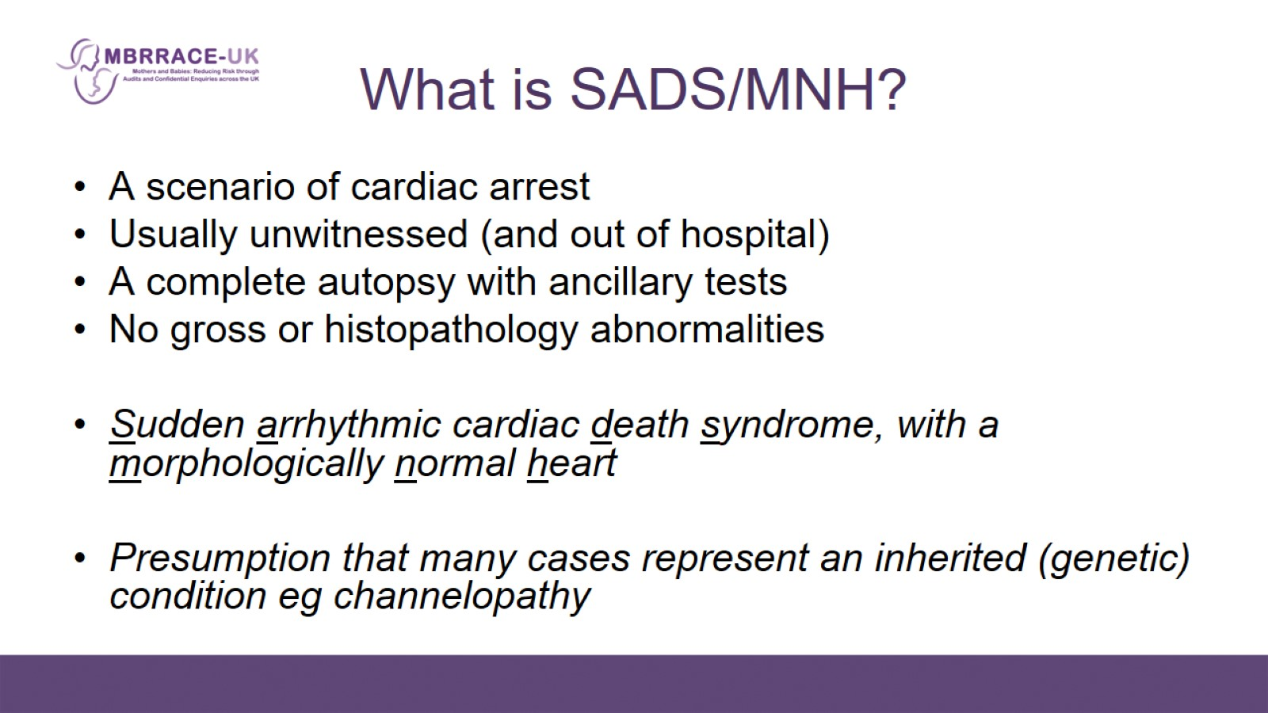
What is SADS/MNH?

Slide 23
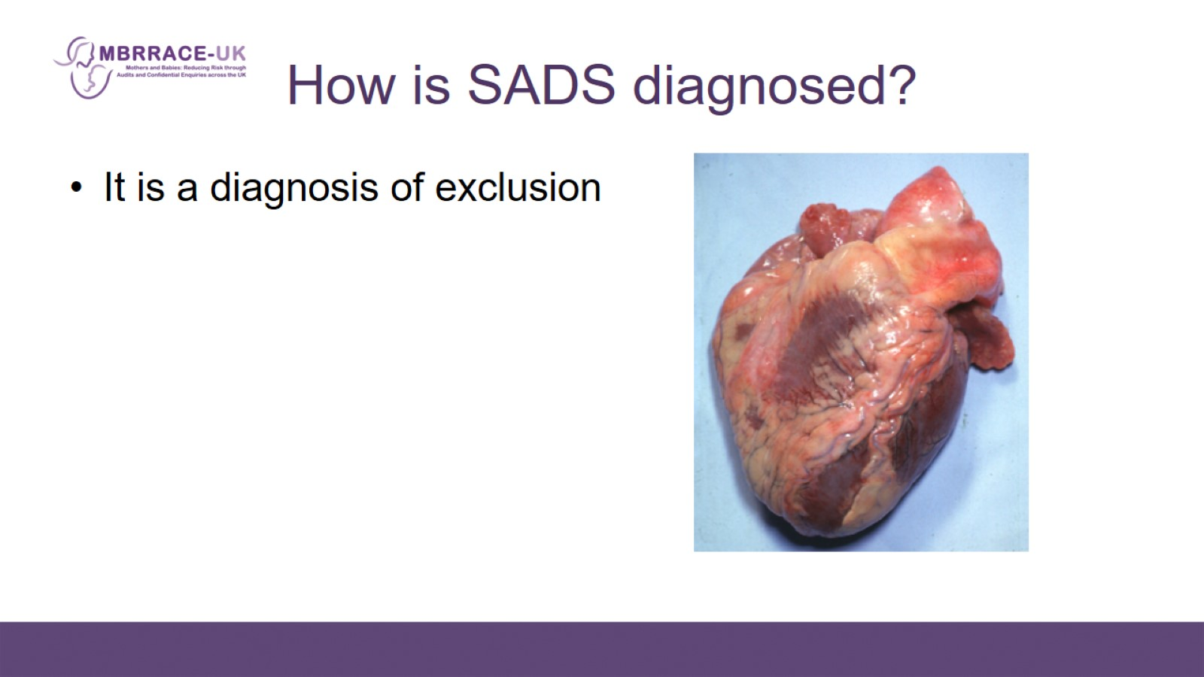
How is SADS diagnosed?

Slide 24
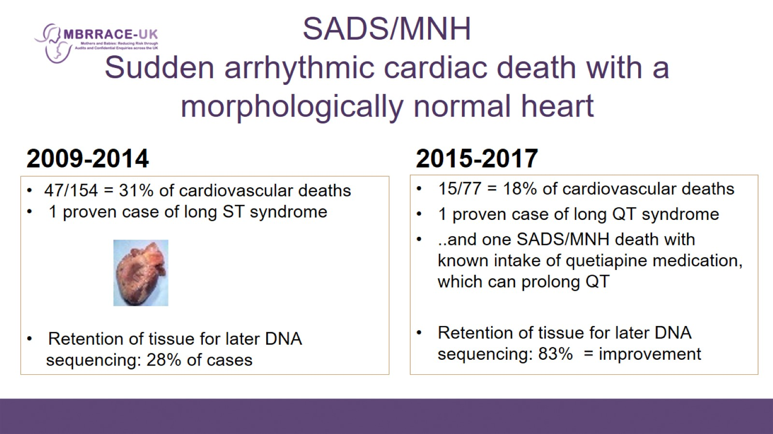
SADS/MNH
Sudden arrhythmic cardiac death with a morphologically normal heart

Slide 25
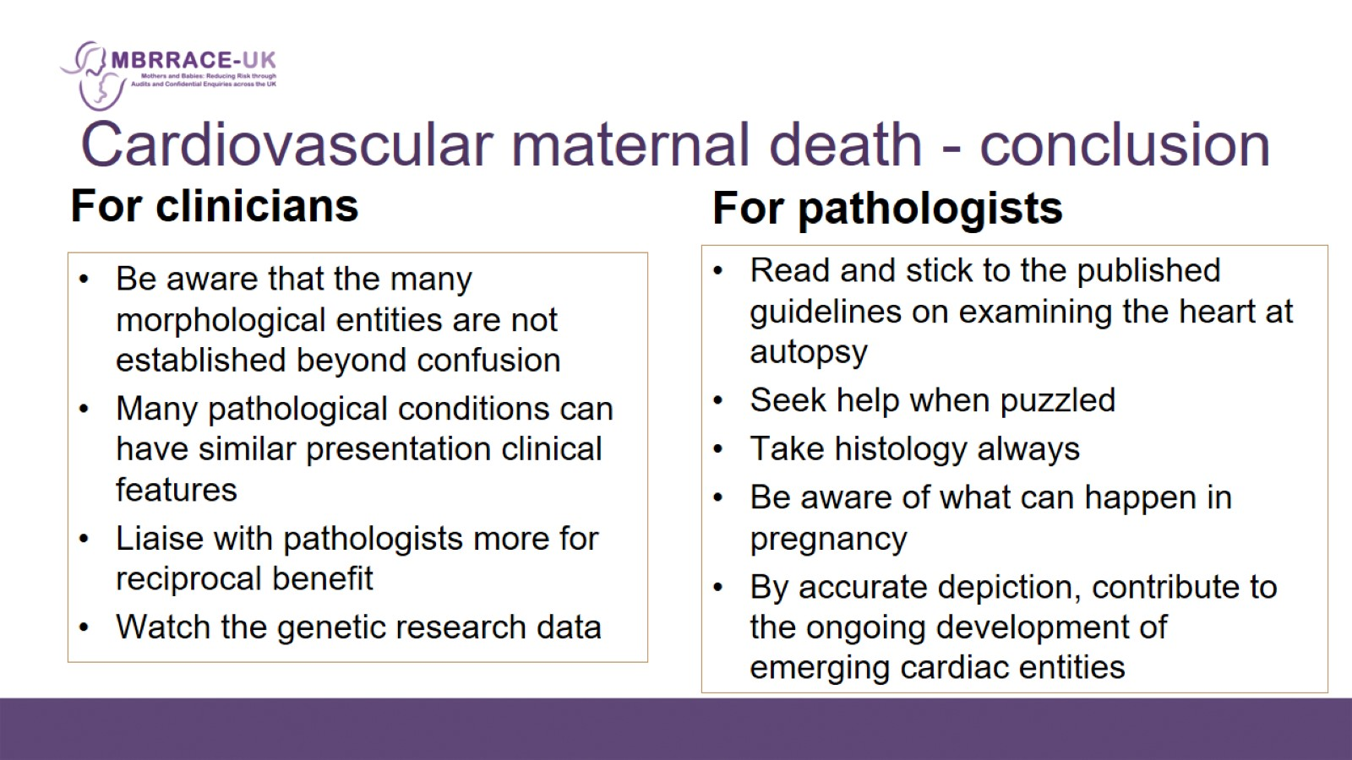
Cardiovascular maternal death - conclusion

