Slide 1
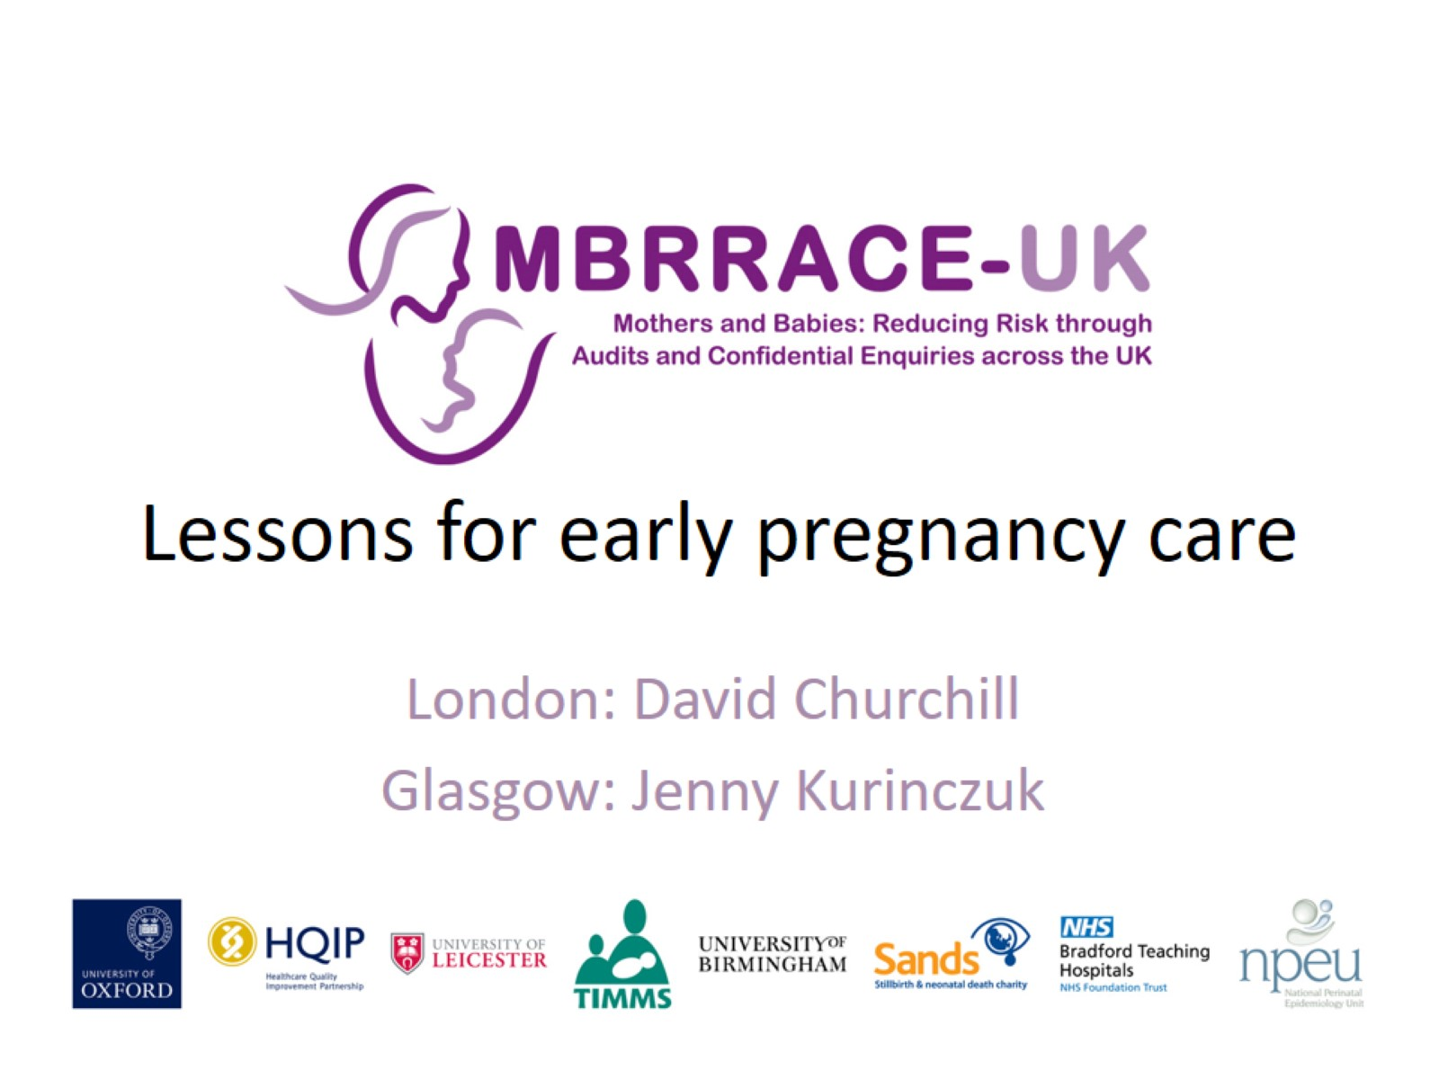
Lessons for early pregnancy care

Slide 2
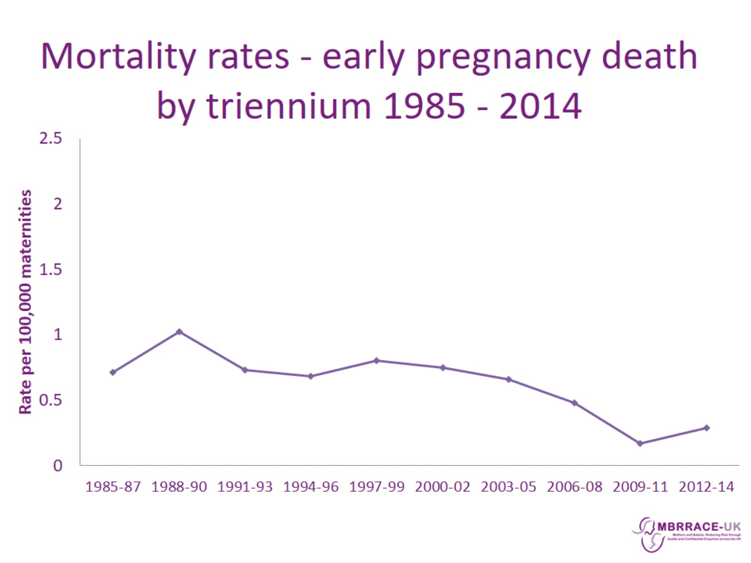
Mortality rates - early pregnancy death by triennium 1985 - 2014

Slide 3
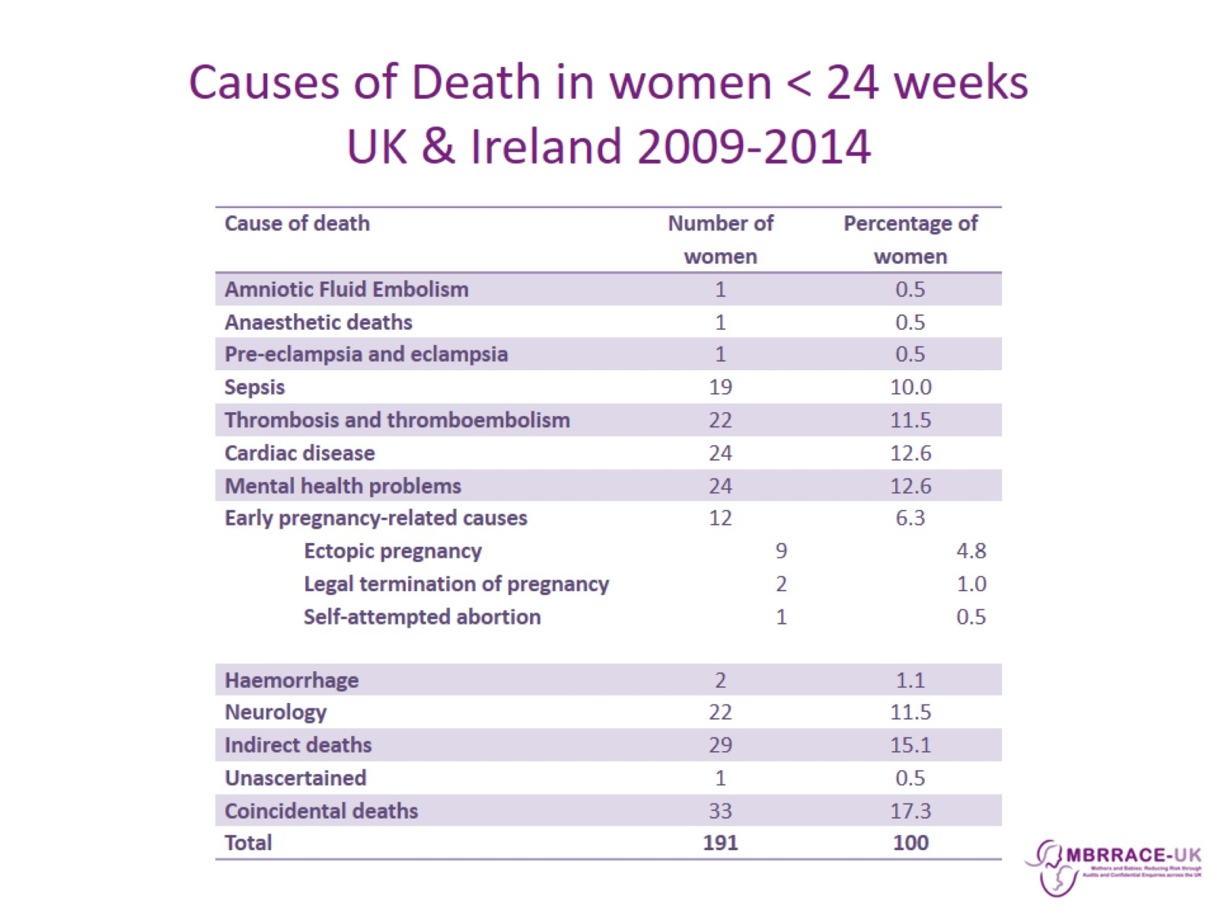
Causes of Death in women < 24 weeks
UK & Ireland 2009-2014

Slide 4
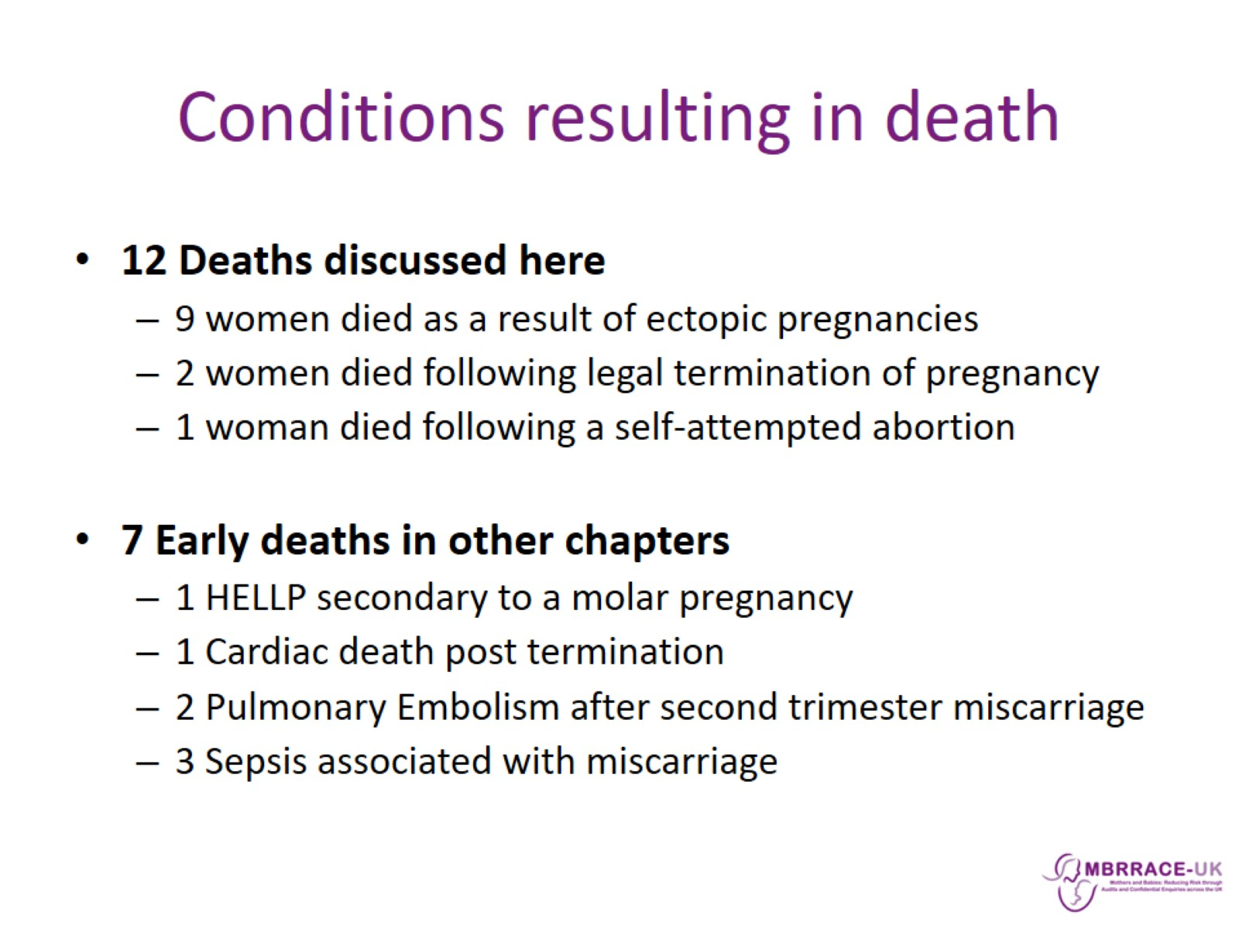
Conditions resulting in death

Slide 5
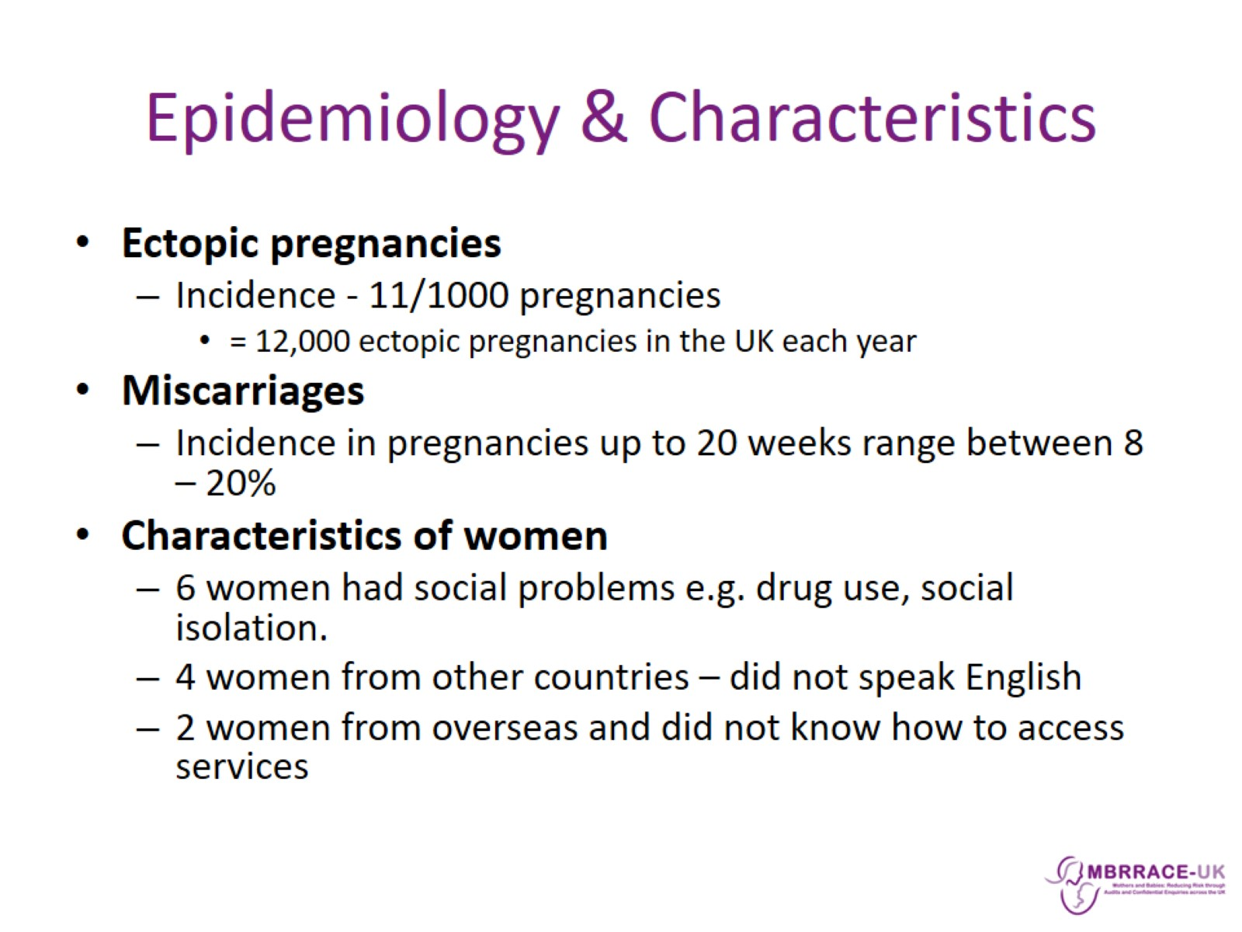
Epidemiology & Characteristics

Slide 6
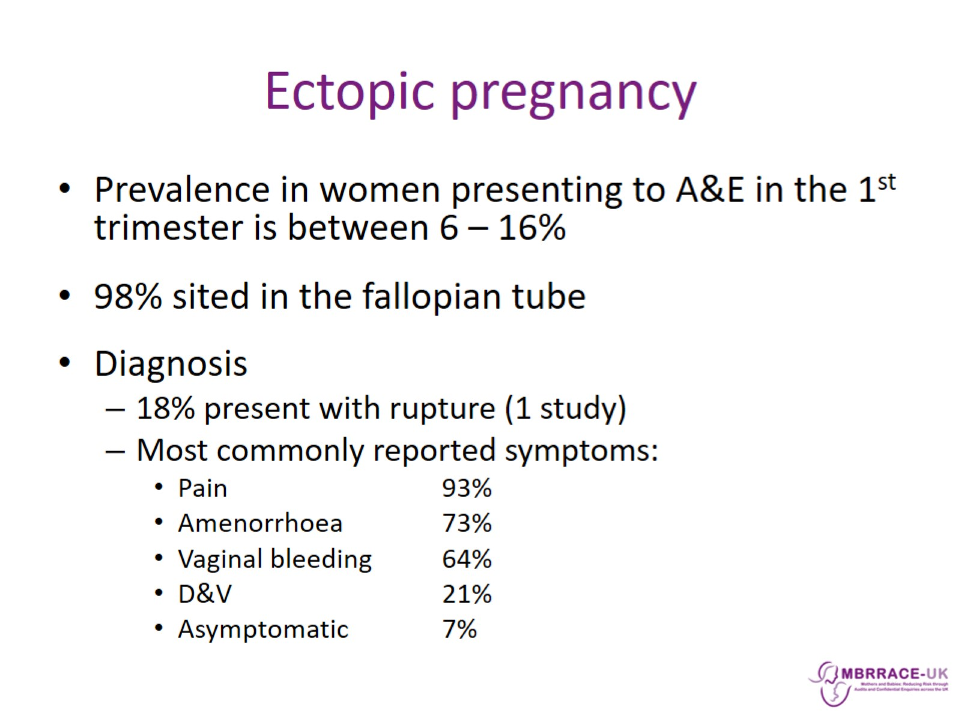
Ectopic pregnancy

Slide 7
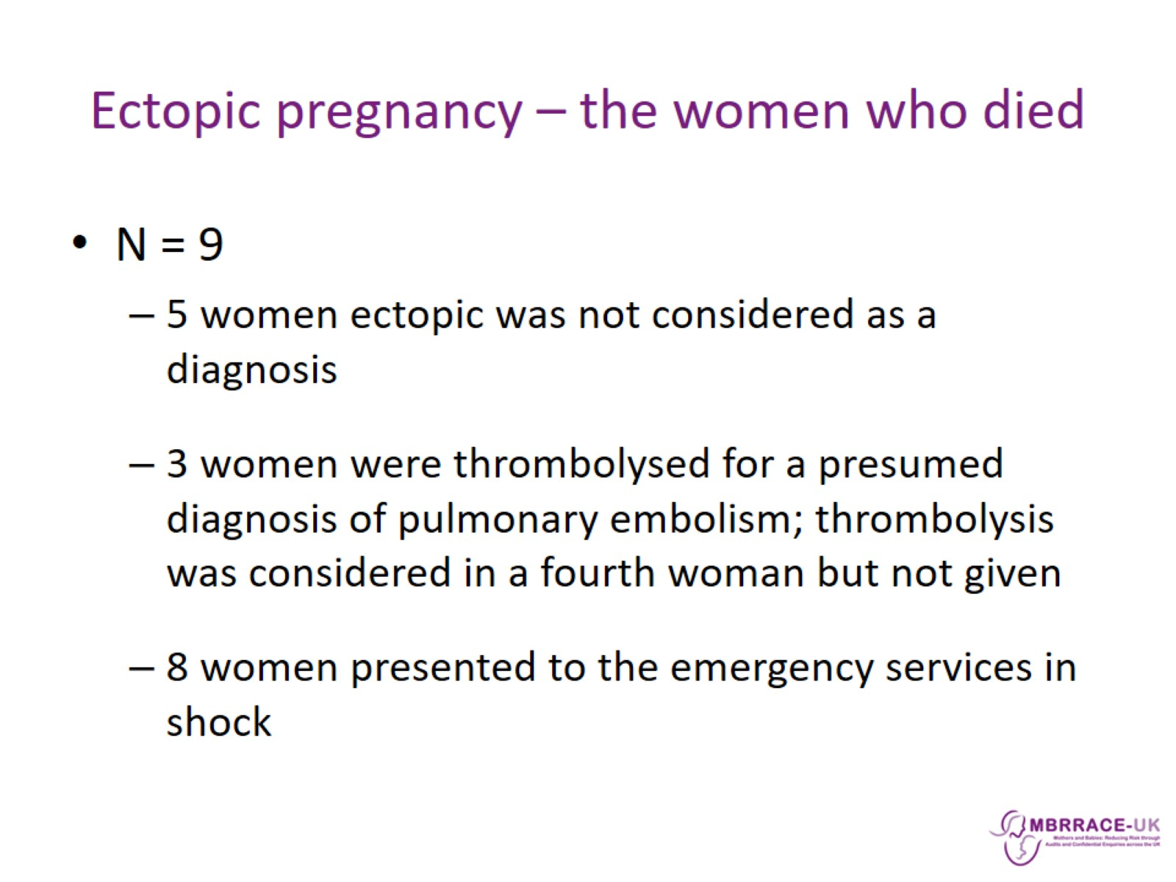
Ectopic pregnancy – the women who died

Slide 8
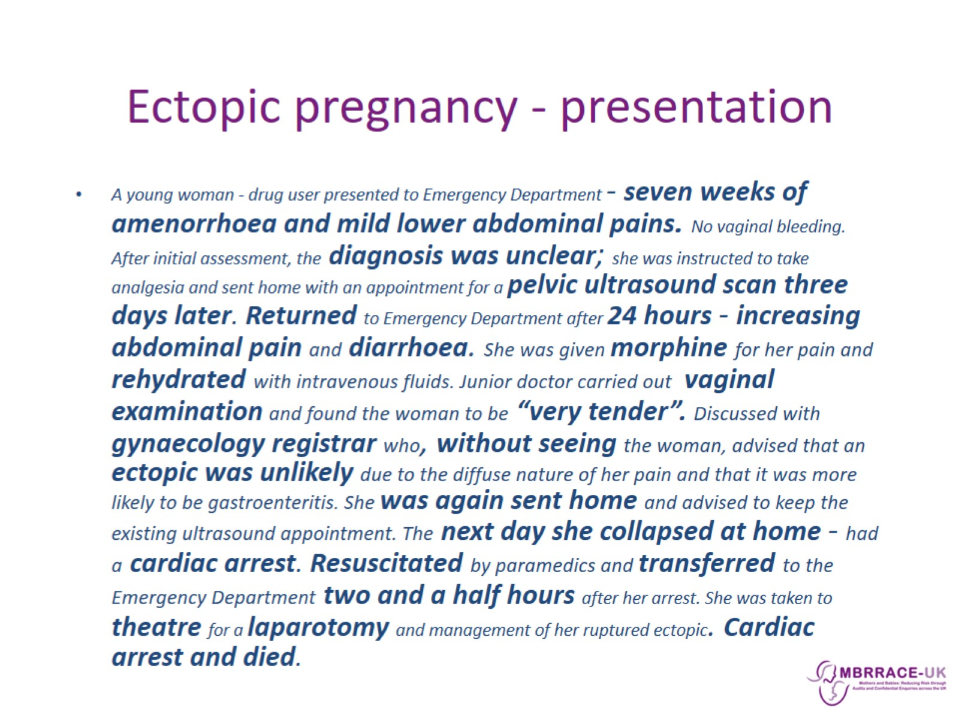
Ectopic pregnancy - presentation

Slide 9
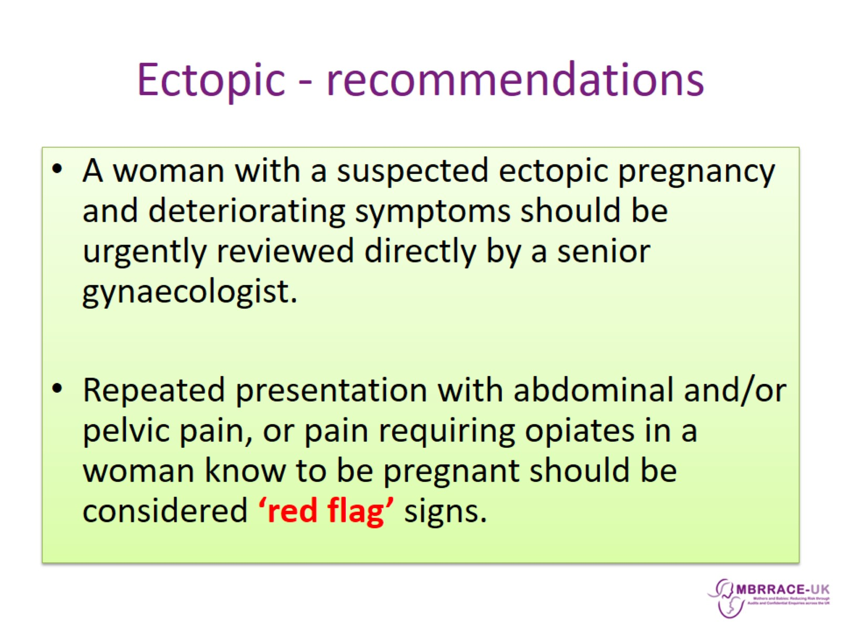
Ectopic - recommendations

Slide 10
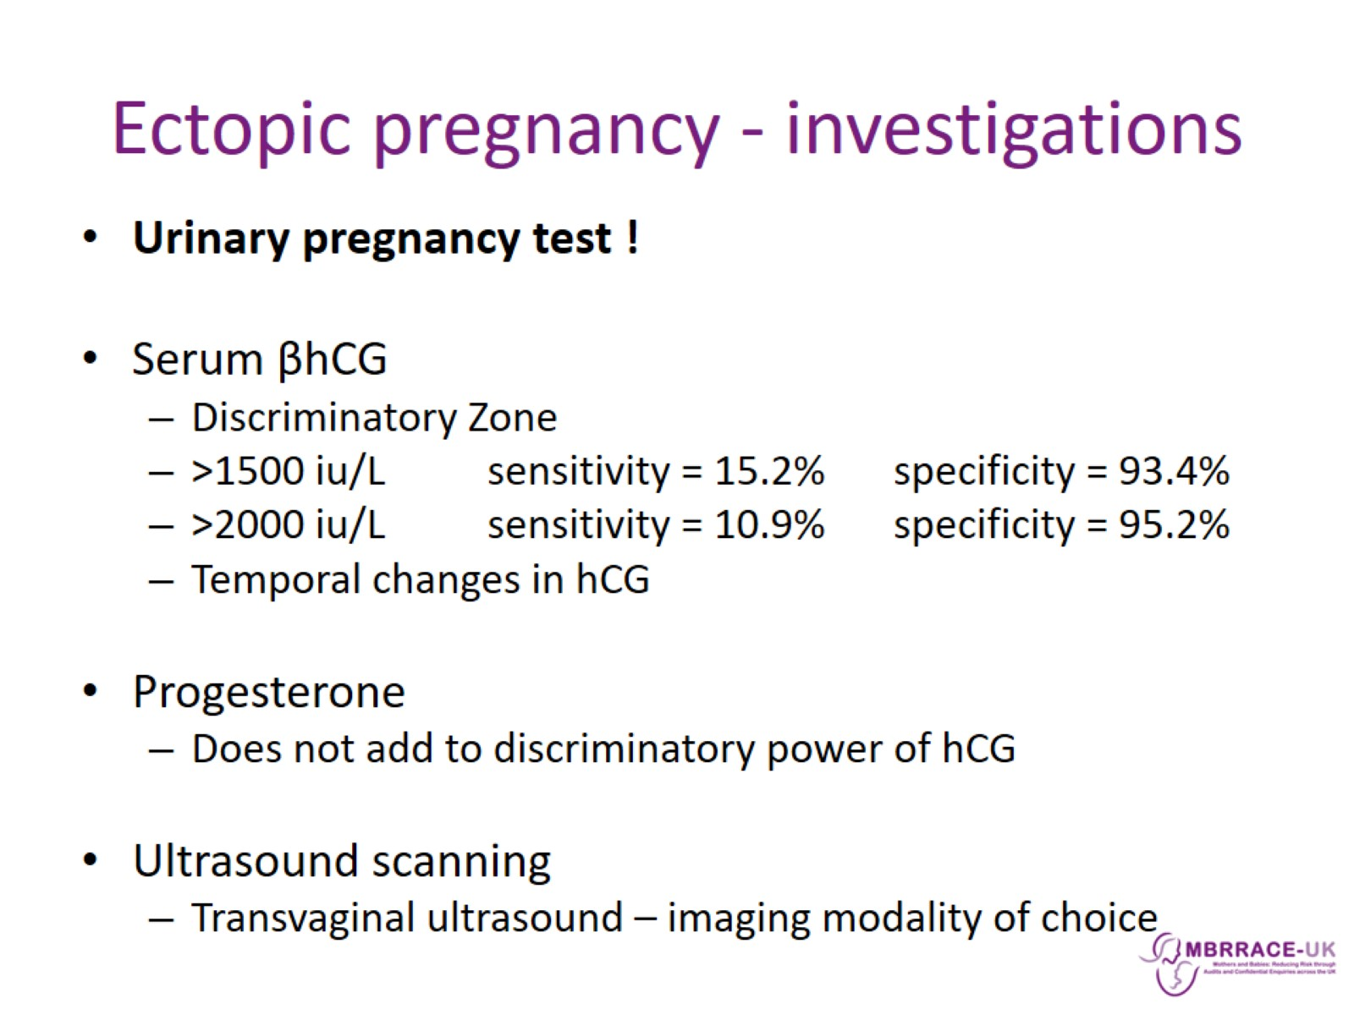
Ectopic pregnancy - investigations

Slide 11
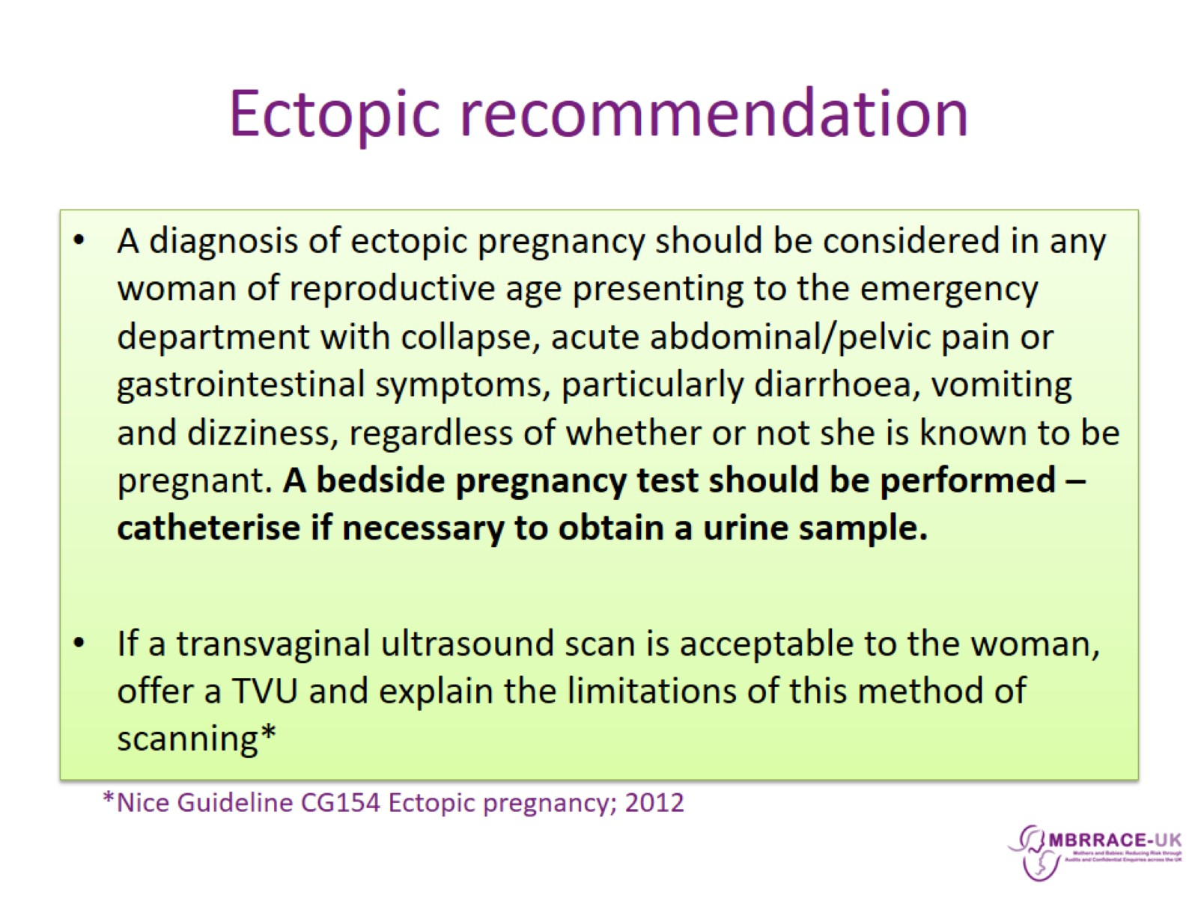
Ectopic recommendation

Slide 12
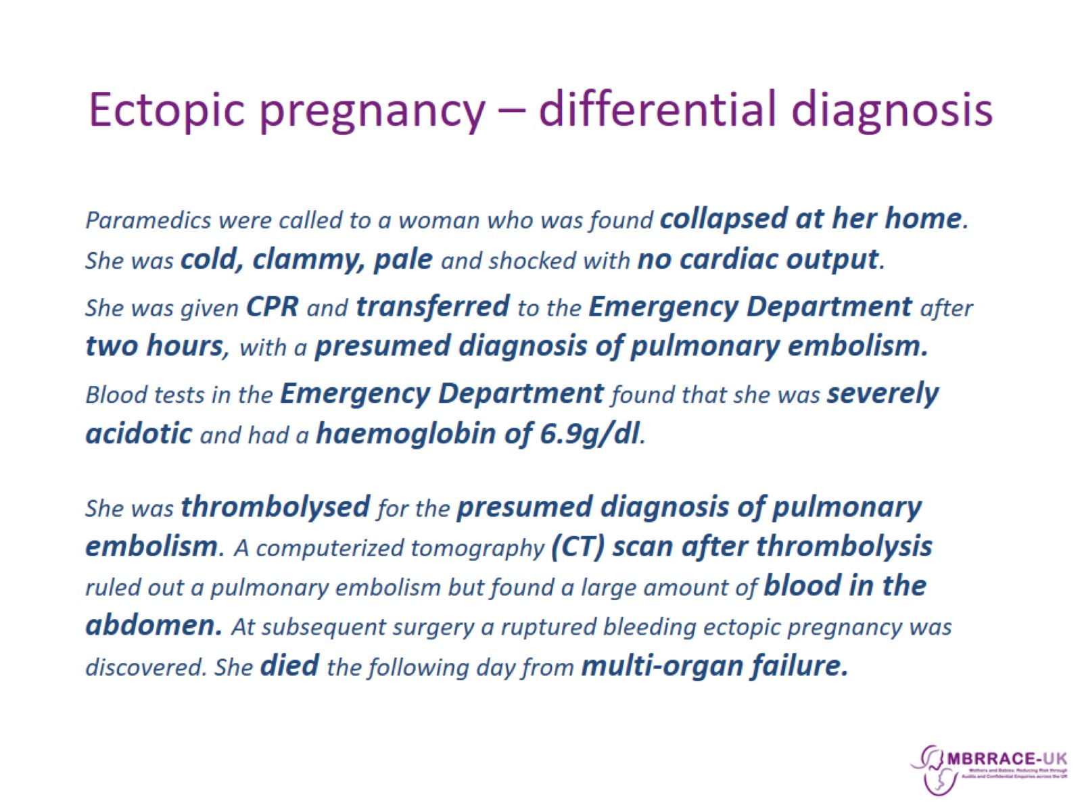
Ectopic pregnancy – differential diagnosis

Slide 13
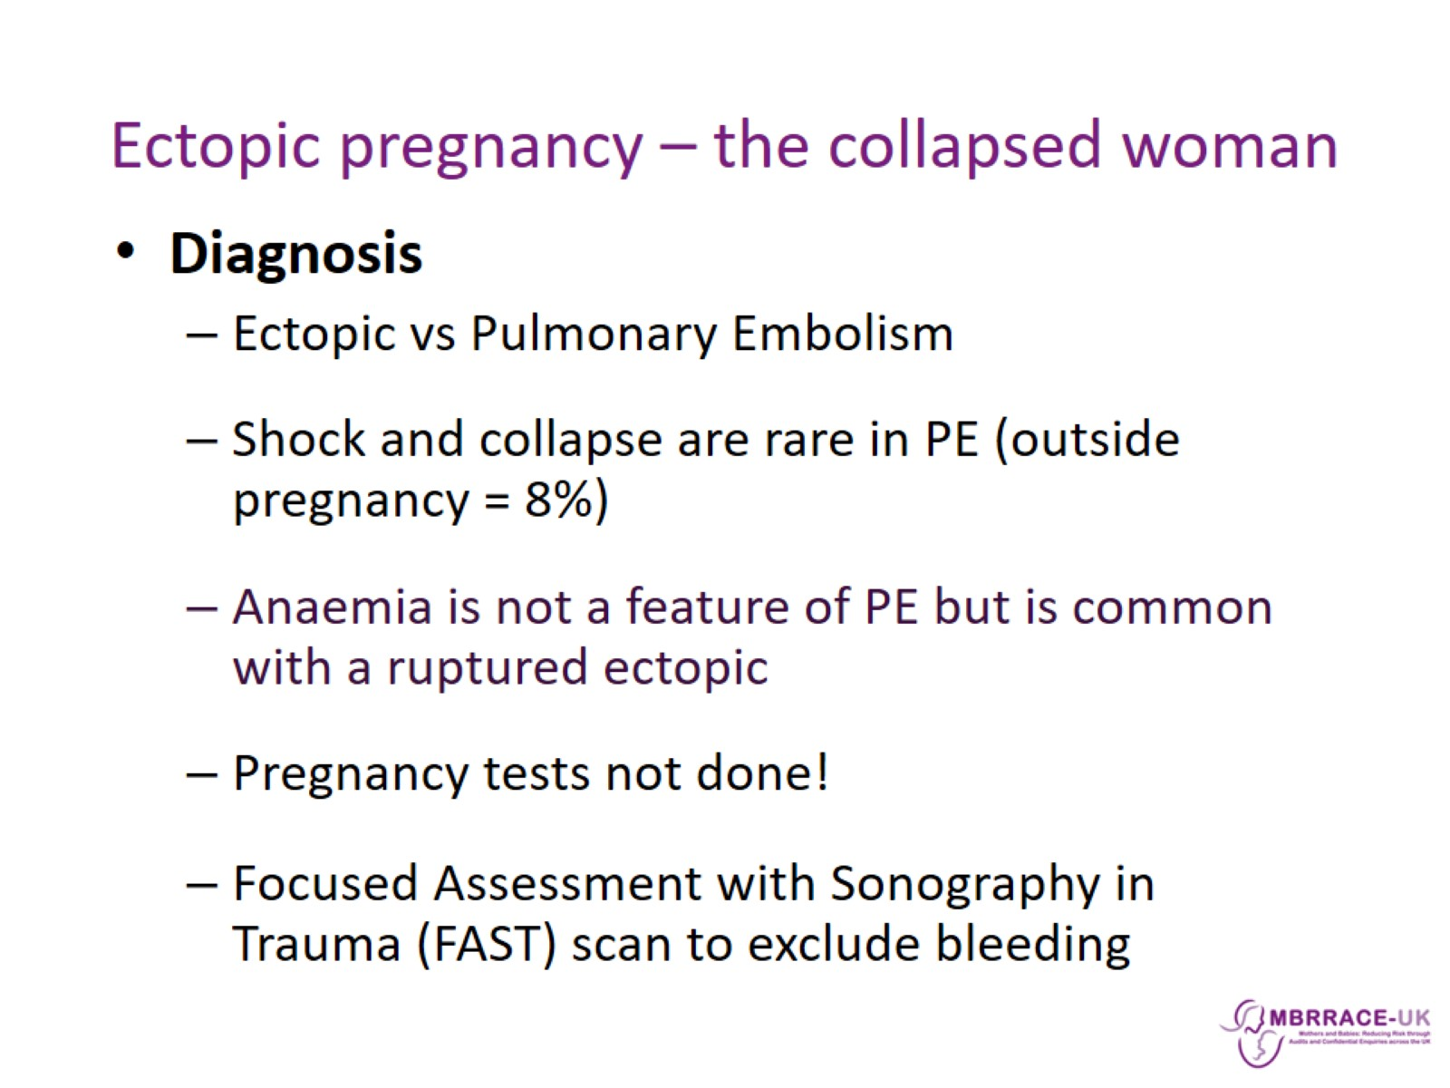
Ectopic pregnancy – the collapsed woman

Slide 14
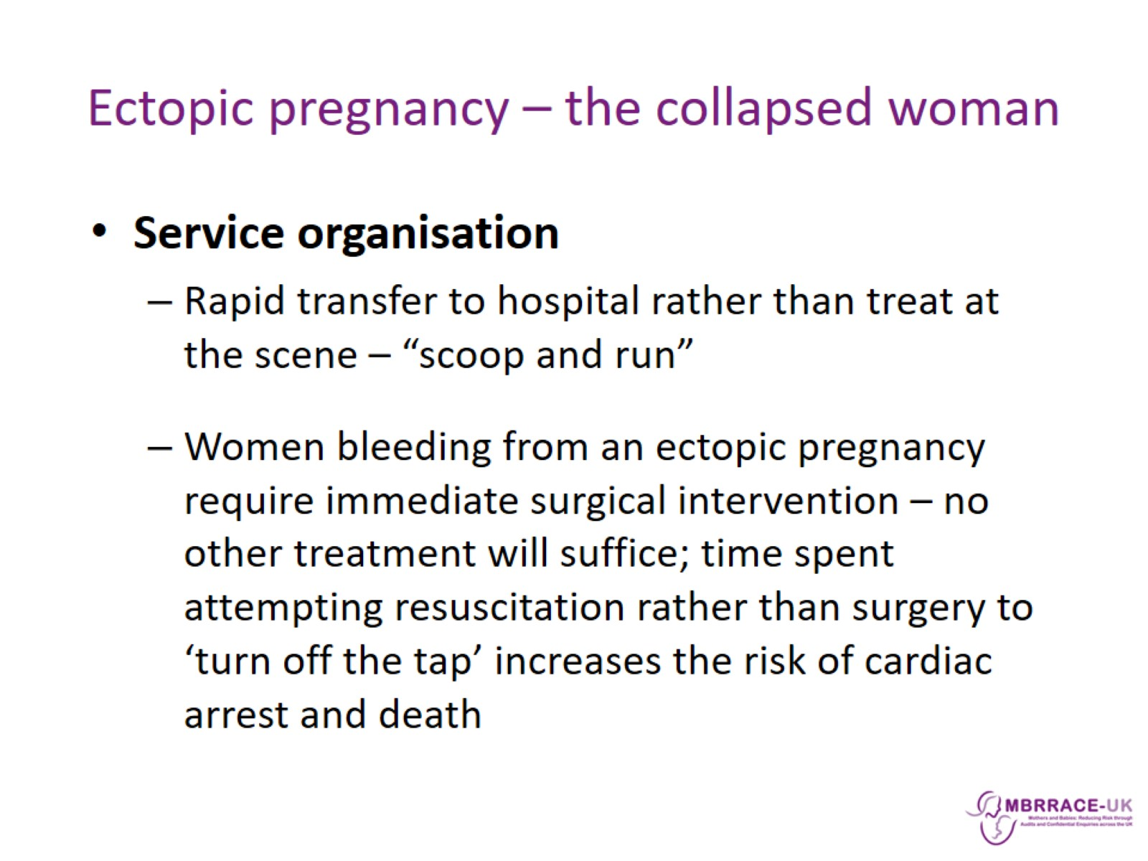
Ectopic pregnancy – the collapsed woman

Slide 15
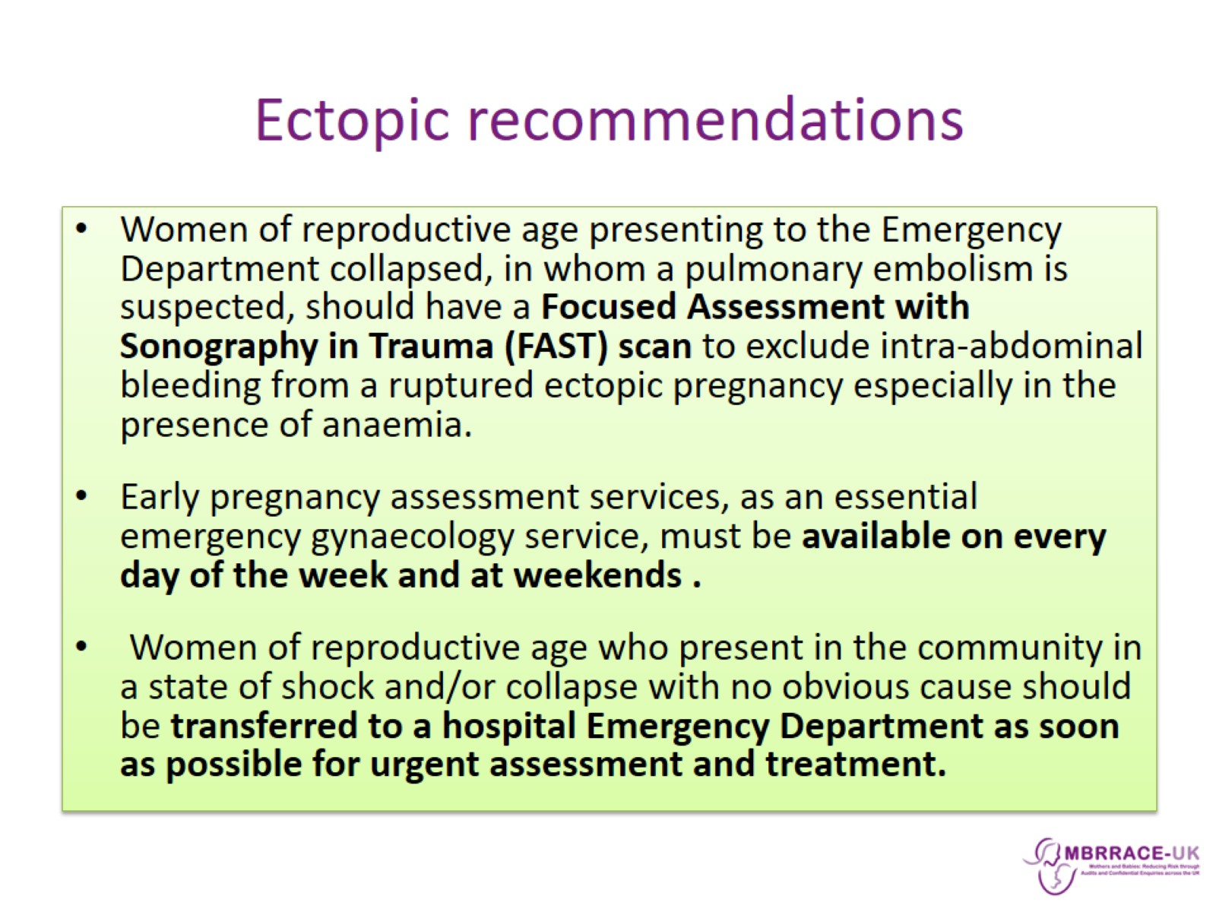
Ectopic recommendations

Slide 16
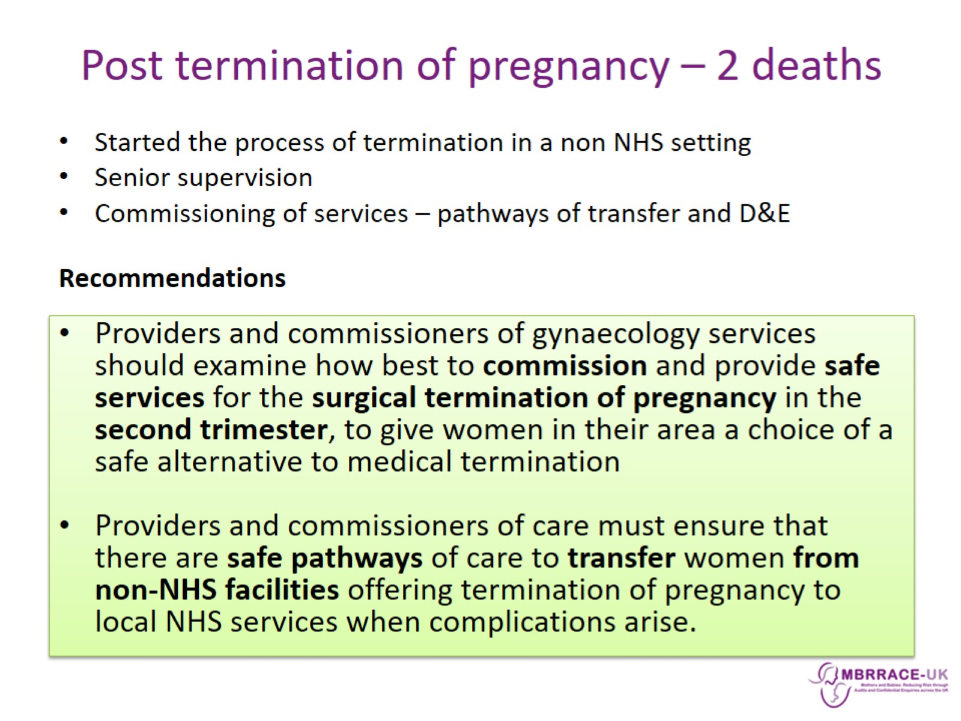
Post termination of pregnancy – 2 deaths

Slide 17
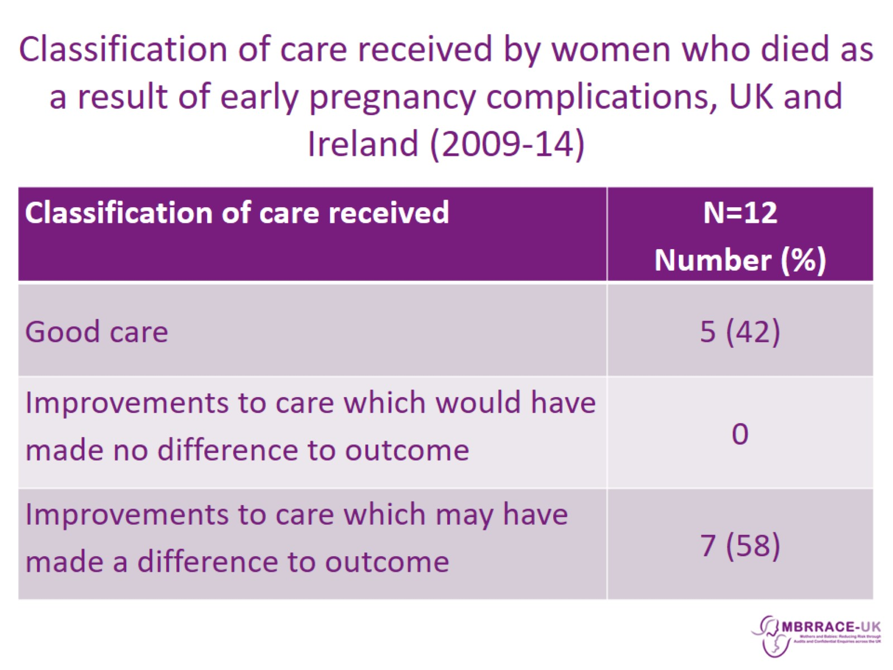
Classification of care received by women who died as a result of early pregnancy complications, UK and Ireland (2009-14)

Slide 18
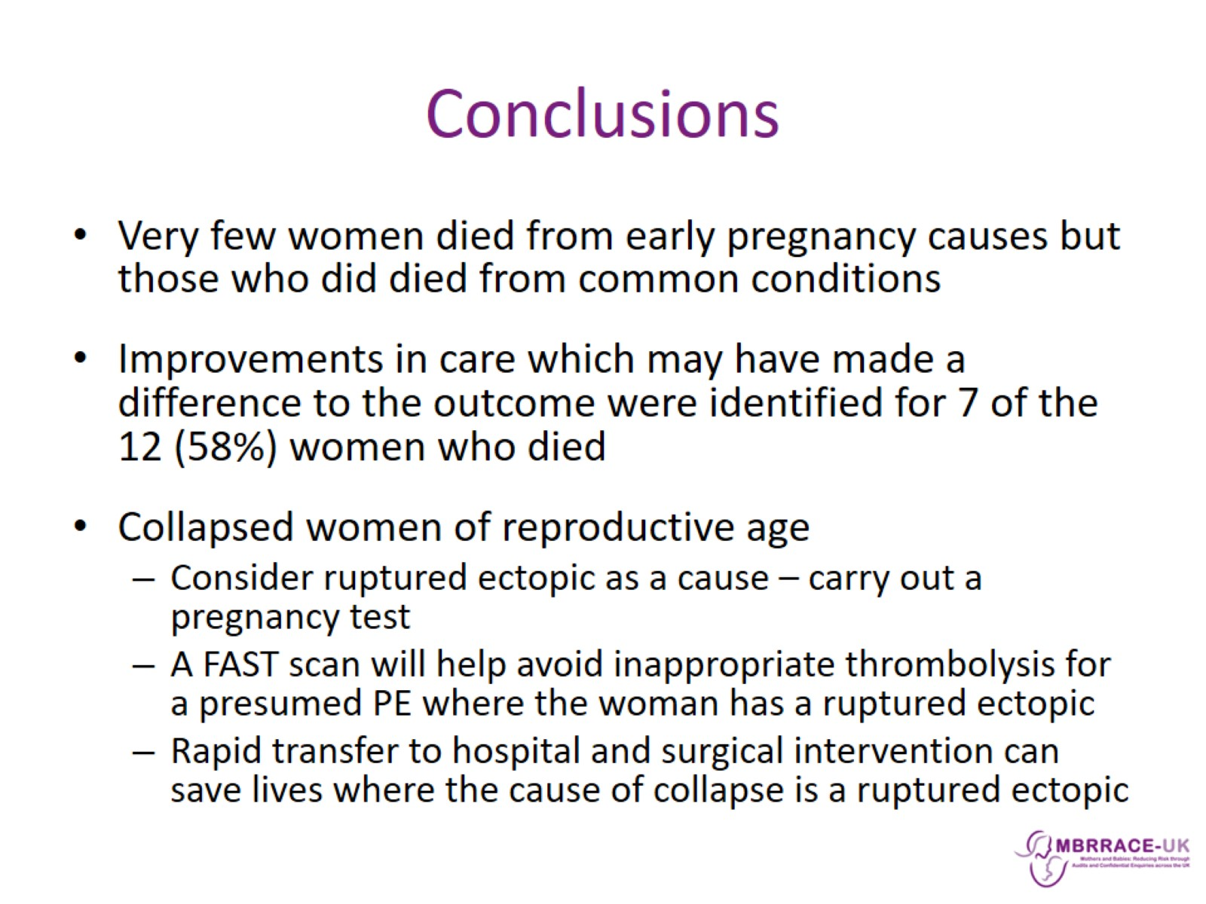
Conclusions

Slide 19
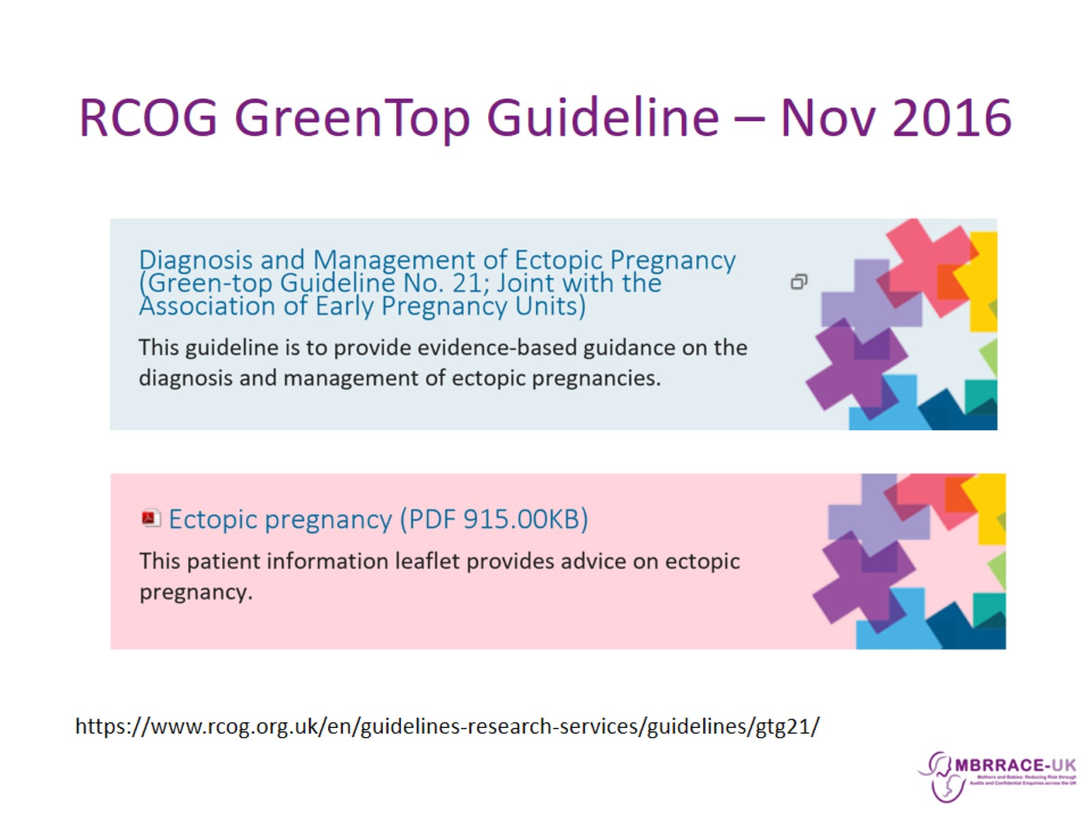
RCOG GreenTop Guideline – Nov 2016

