Slide 1
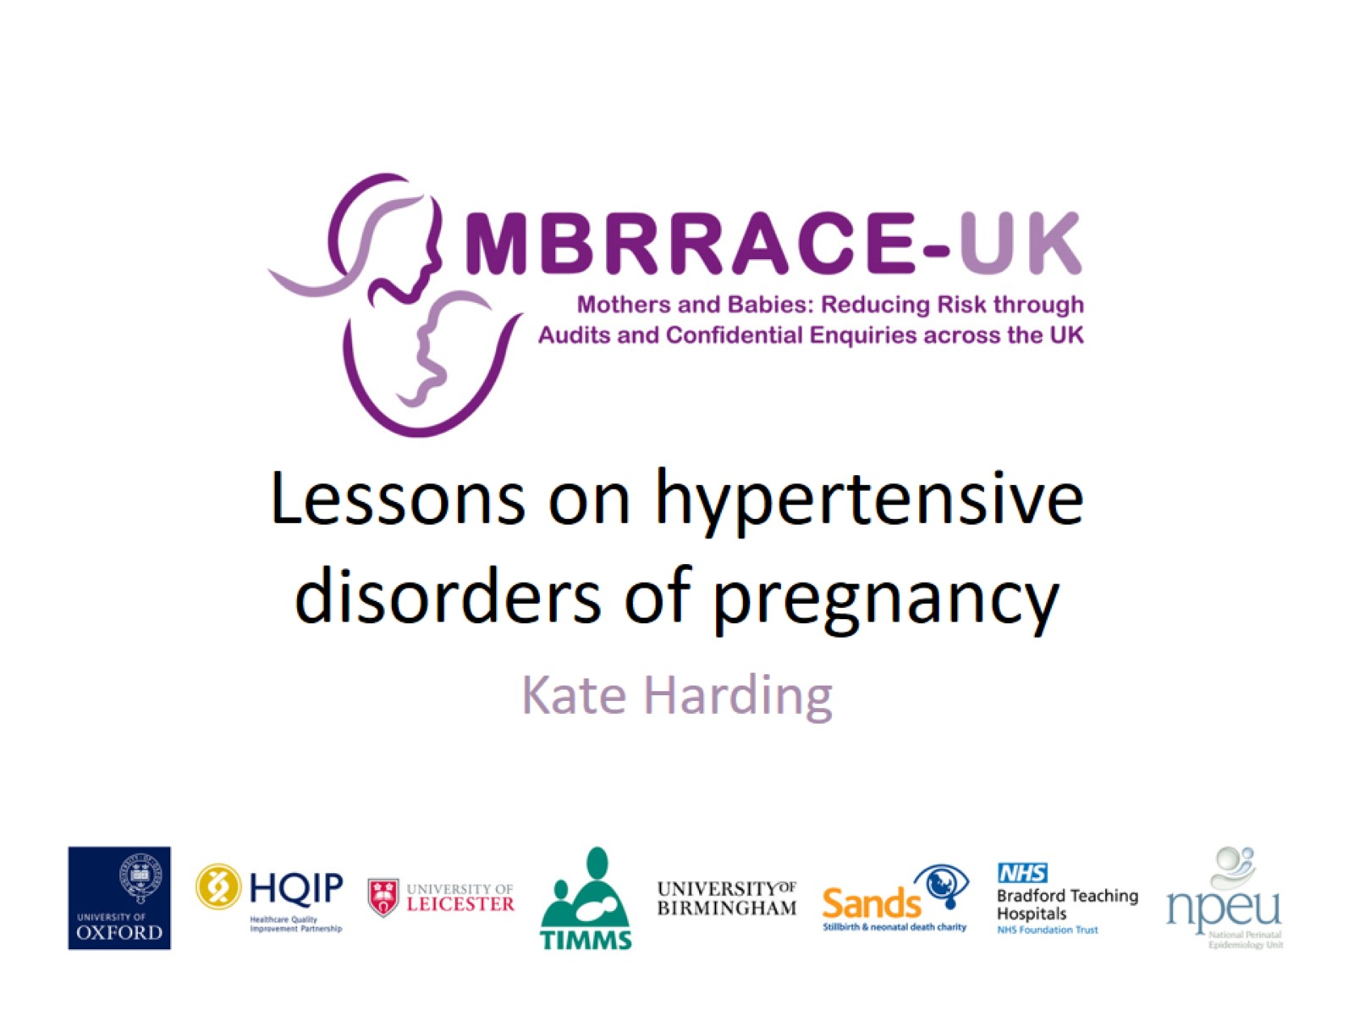
Lessons on hypertensive disorders of pregnancy

Slide 2
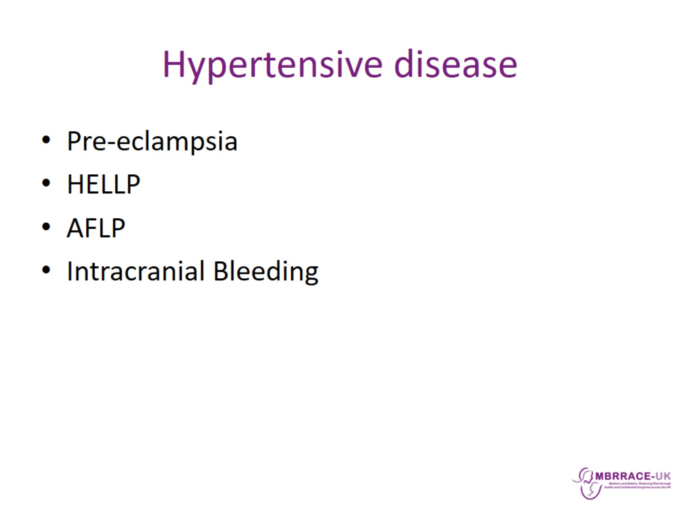
Hypertensive disease

Slide 3
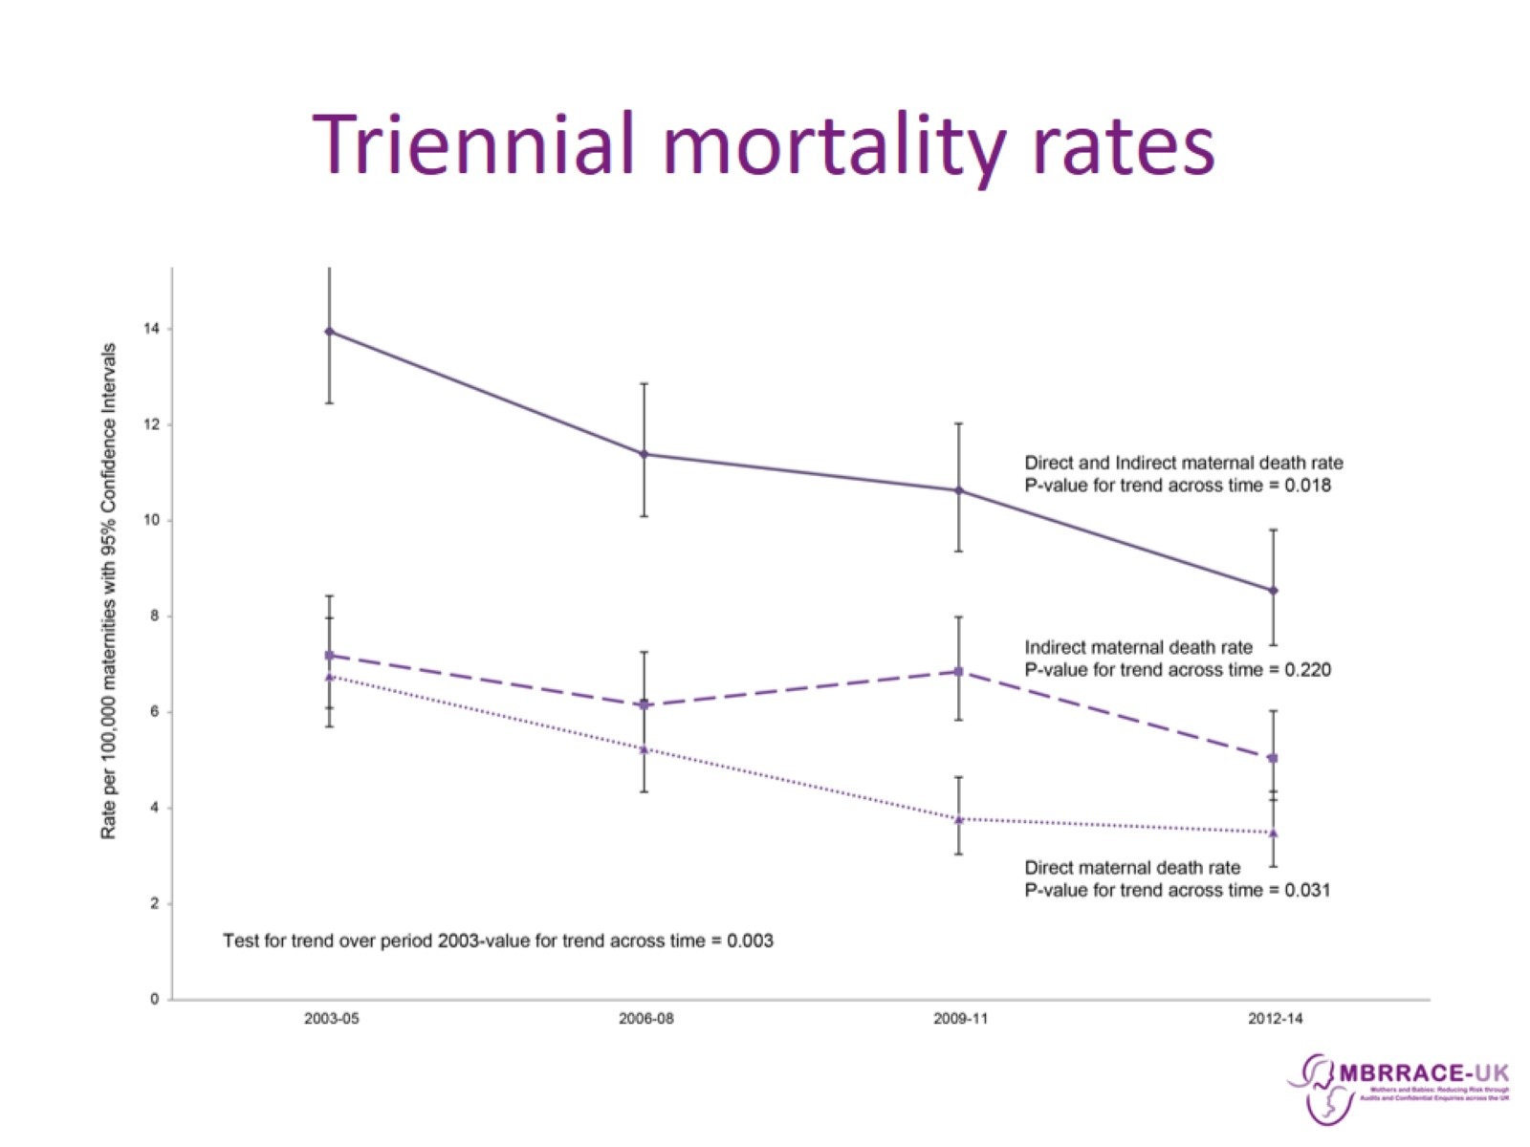
Triennial mortality rates

Slide 4
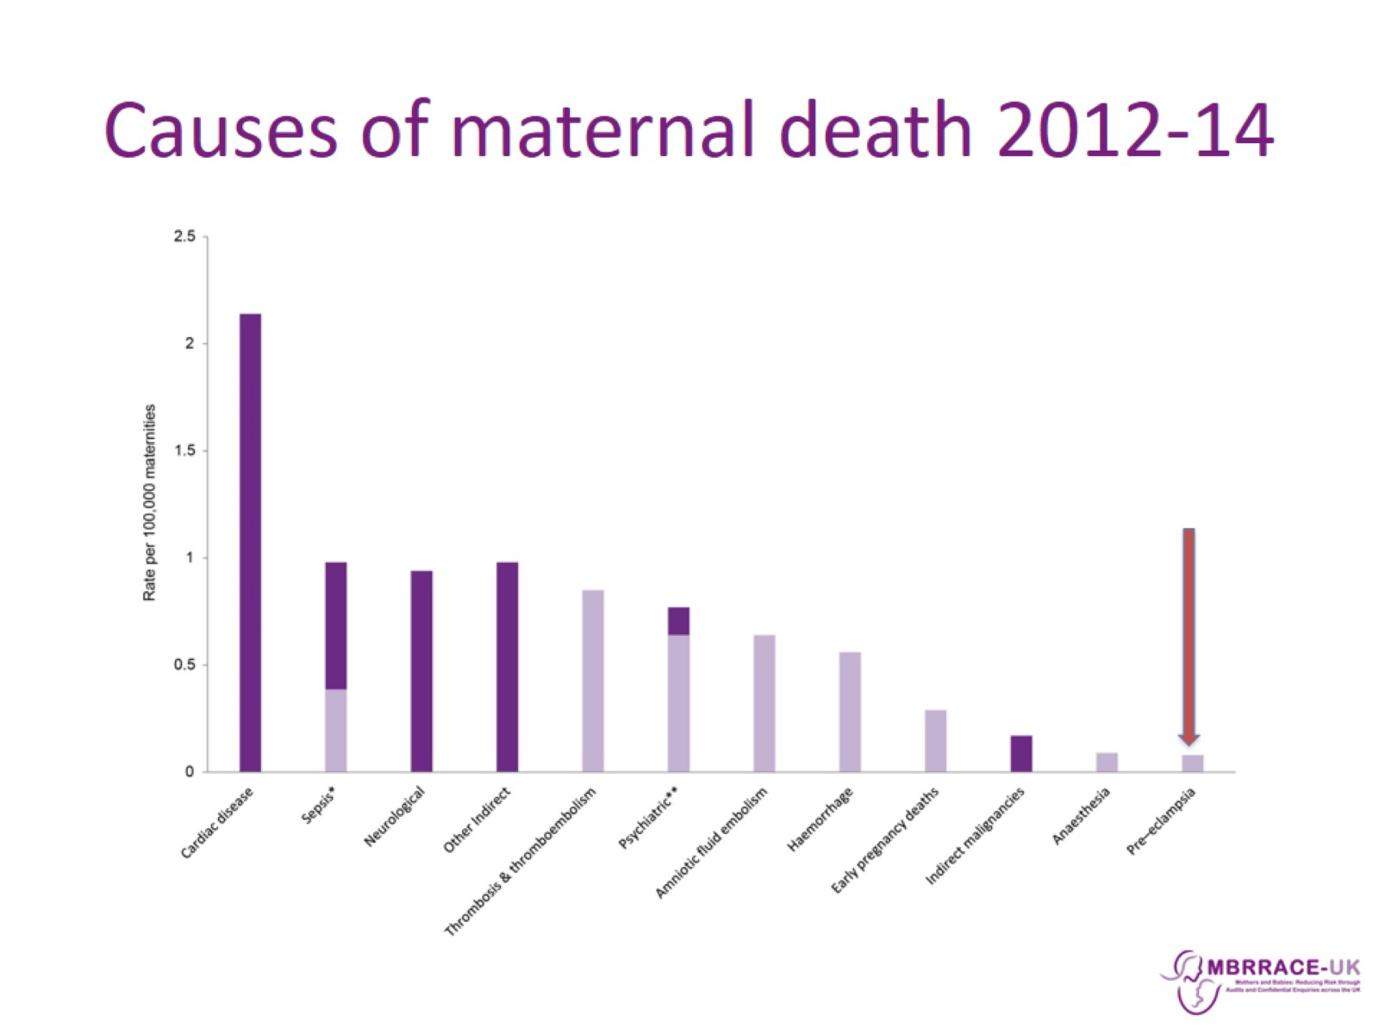
Causes of maternal death 2012-14

Slide 5
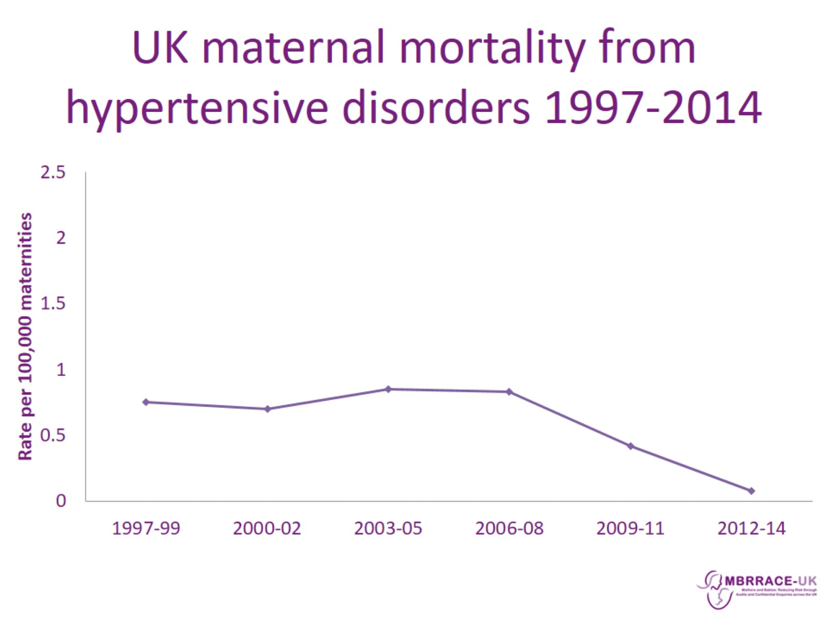
UK maternal mortality from hypertensive disorders 1997-2014

Slide 6
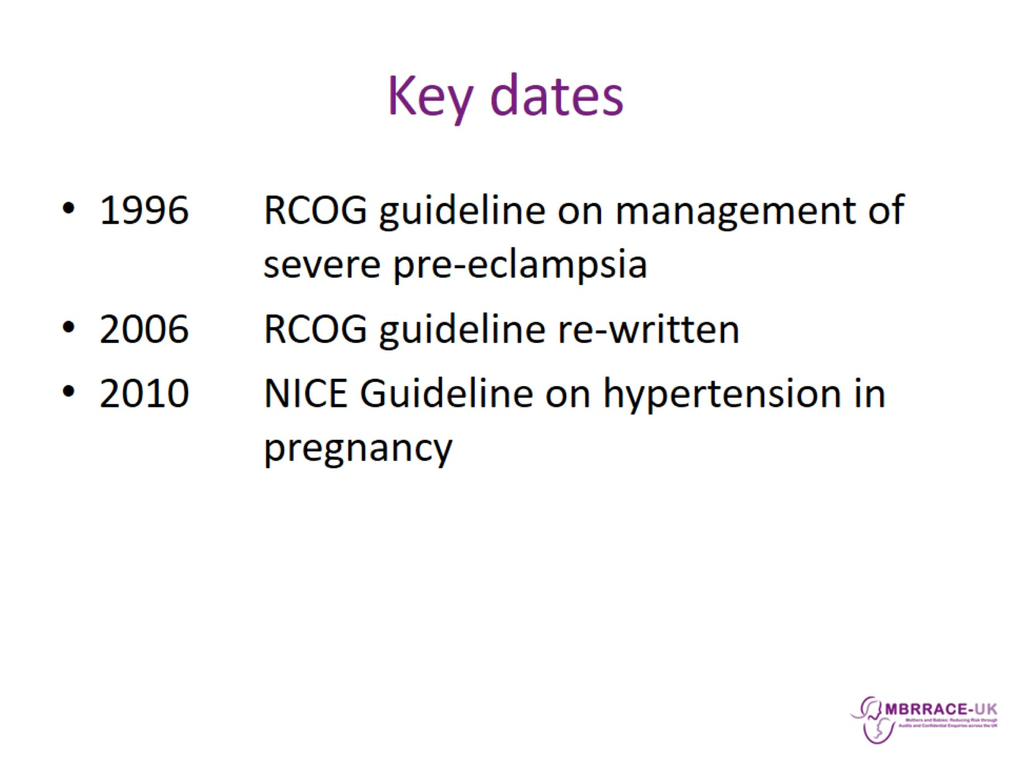
Key dates

Slide 7
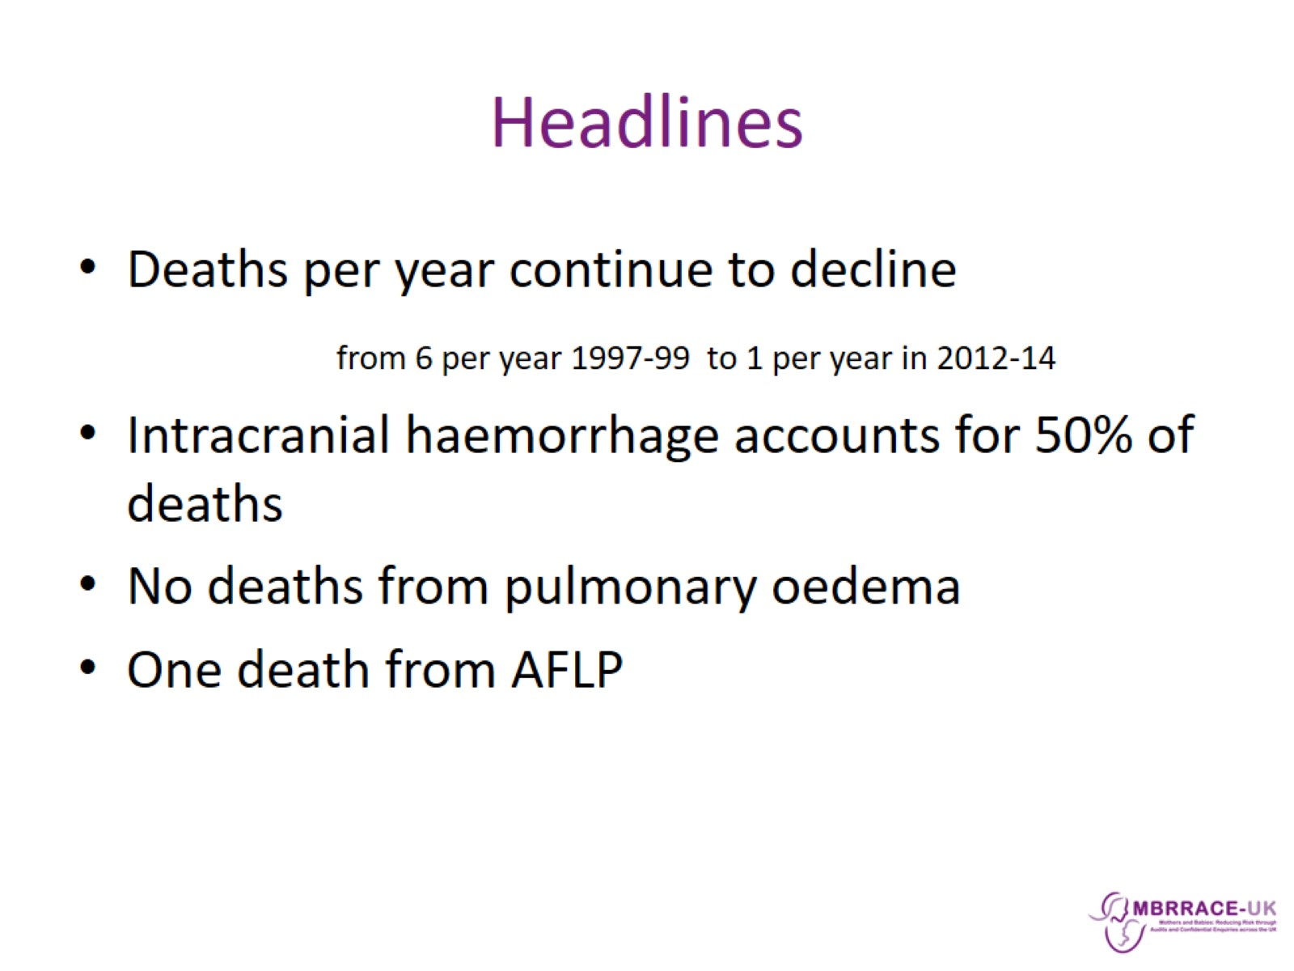
Headlines

Slide 8
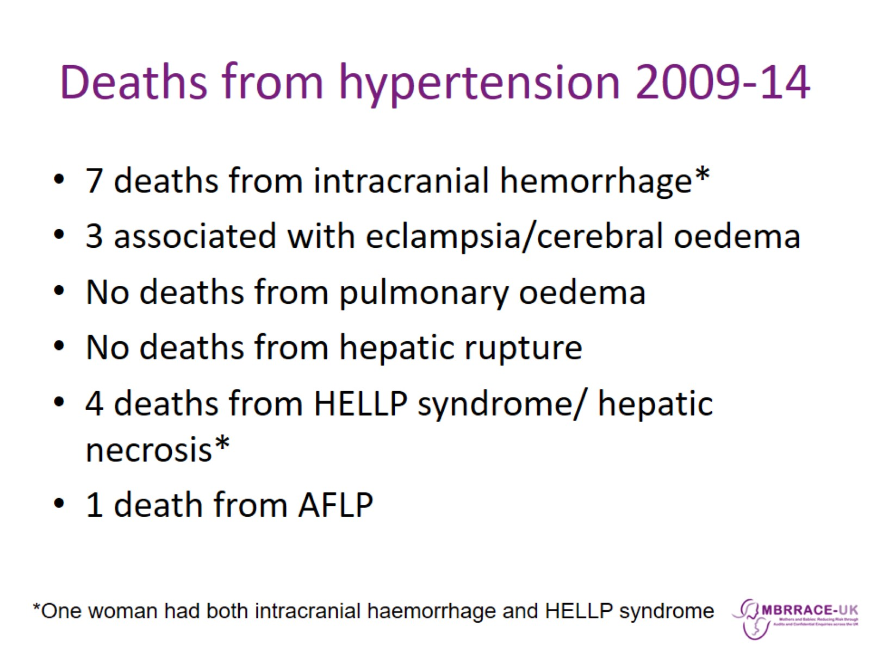
Deaths from hypertension 2009-14

Slide 9
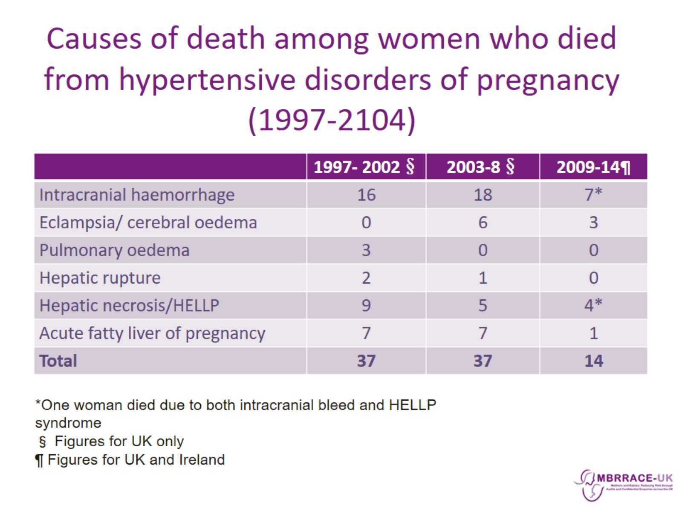
Causes of death among women who died from hypertensive disorders of pregnancy (1997-2104)

Slide 10
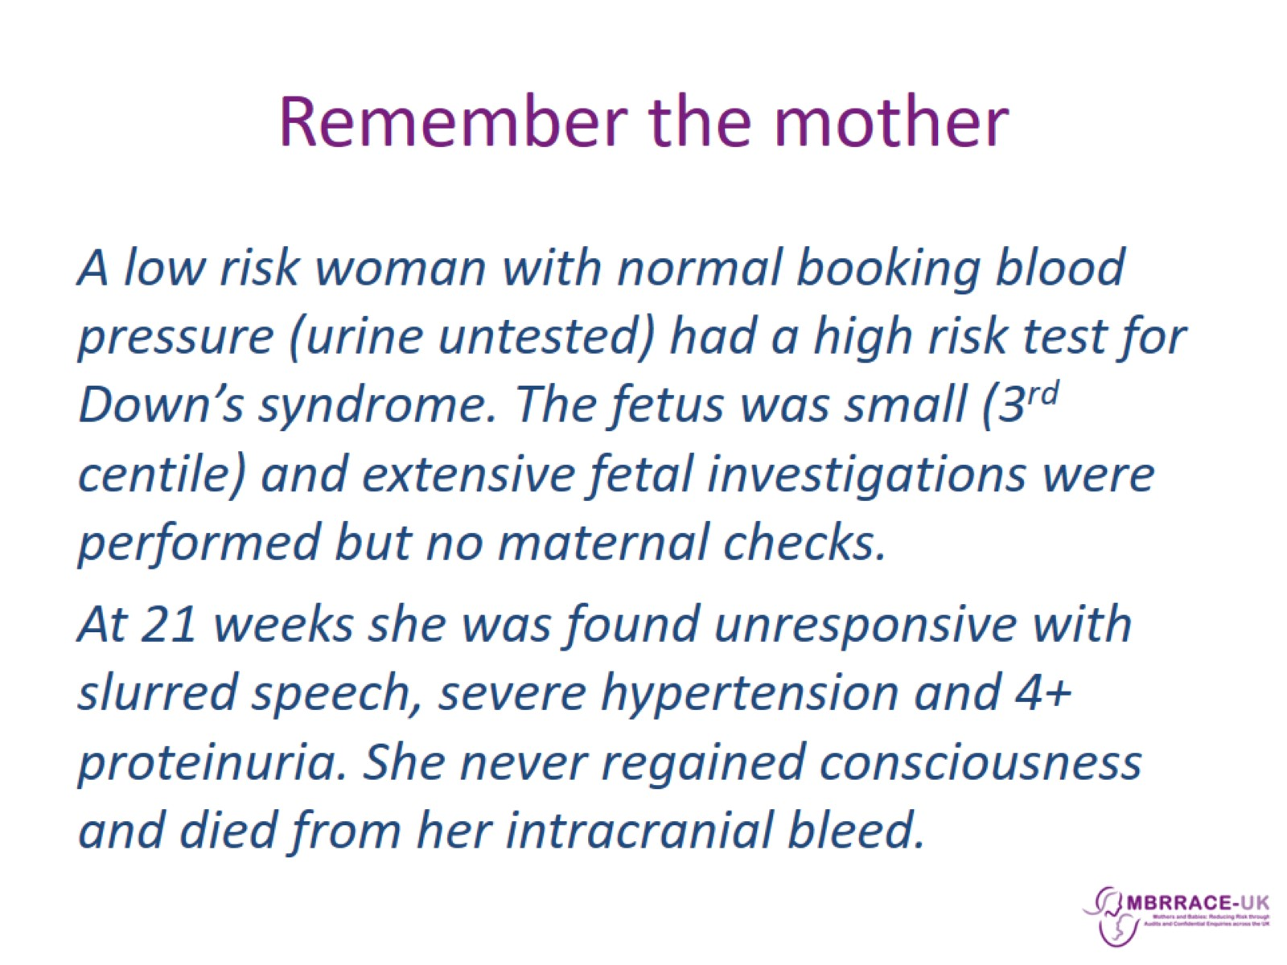
Remember the mother

Slide 11
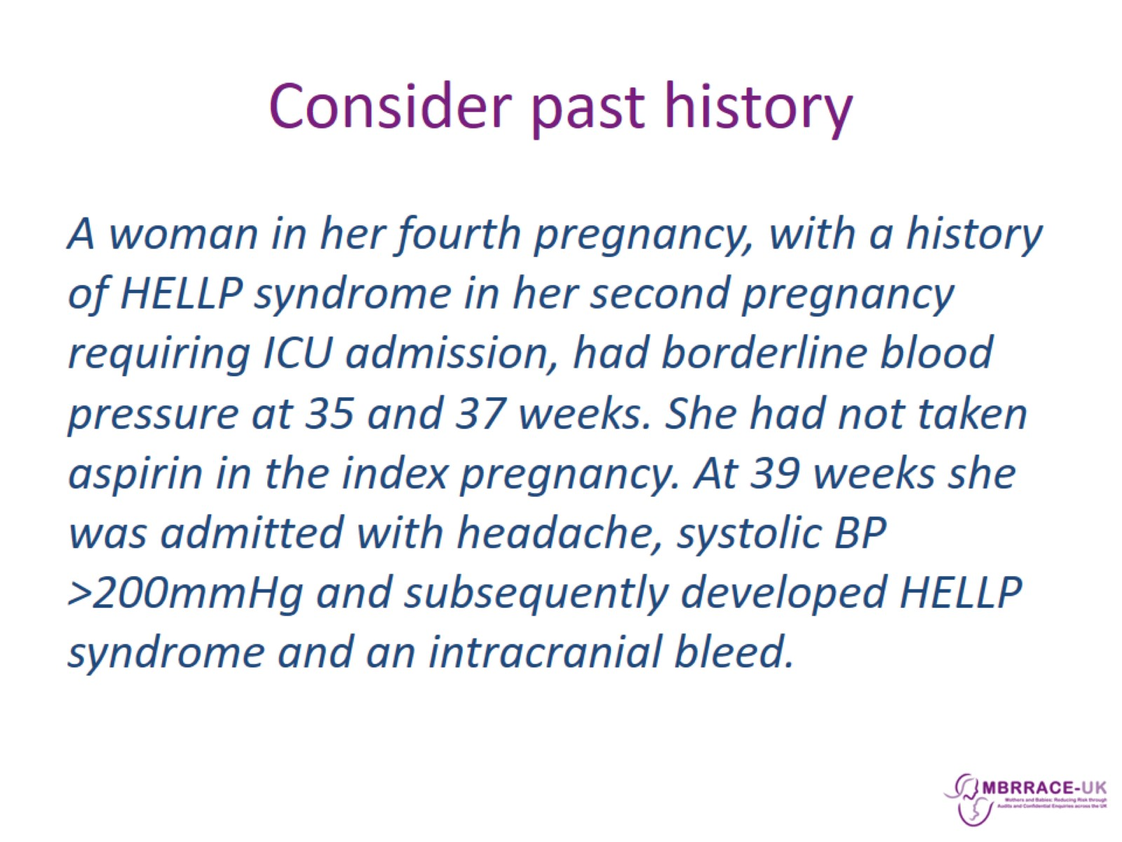
Consider past history

Slide 12
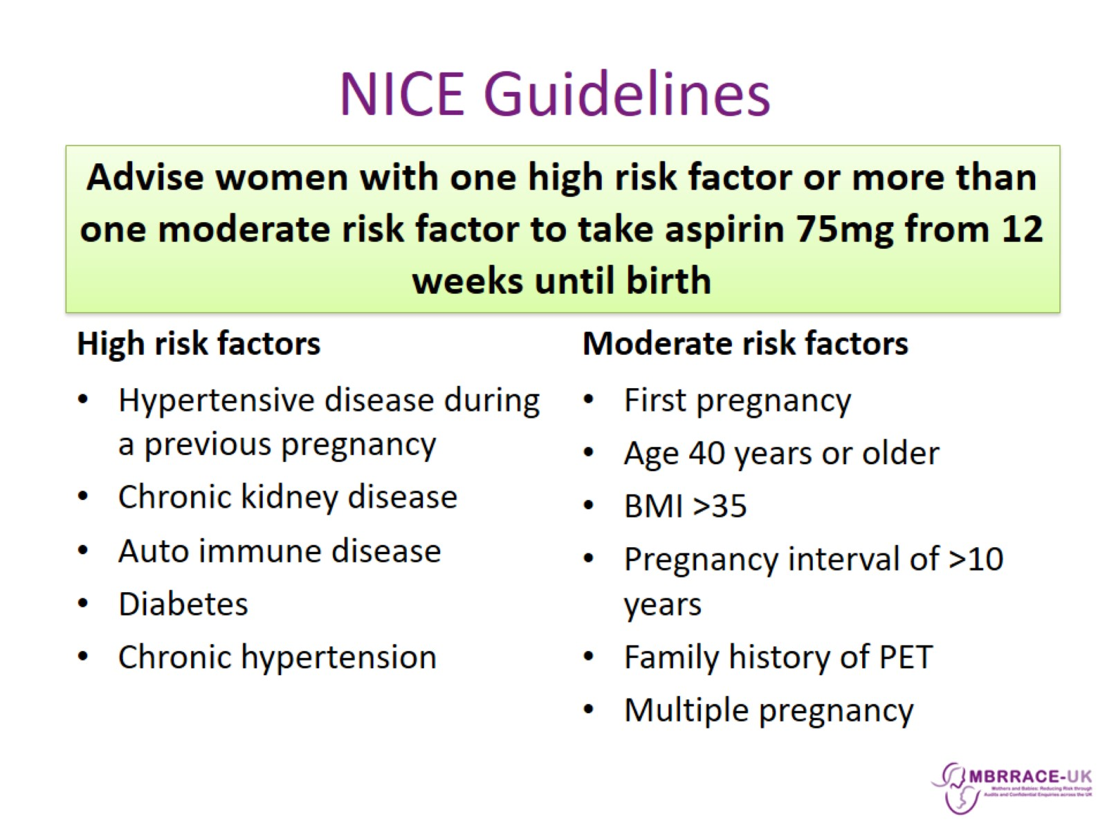
NICE Guidelines

Slide 13
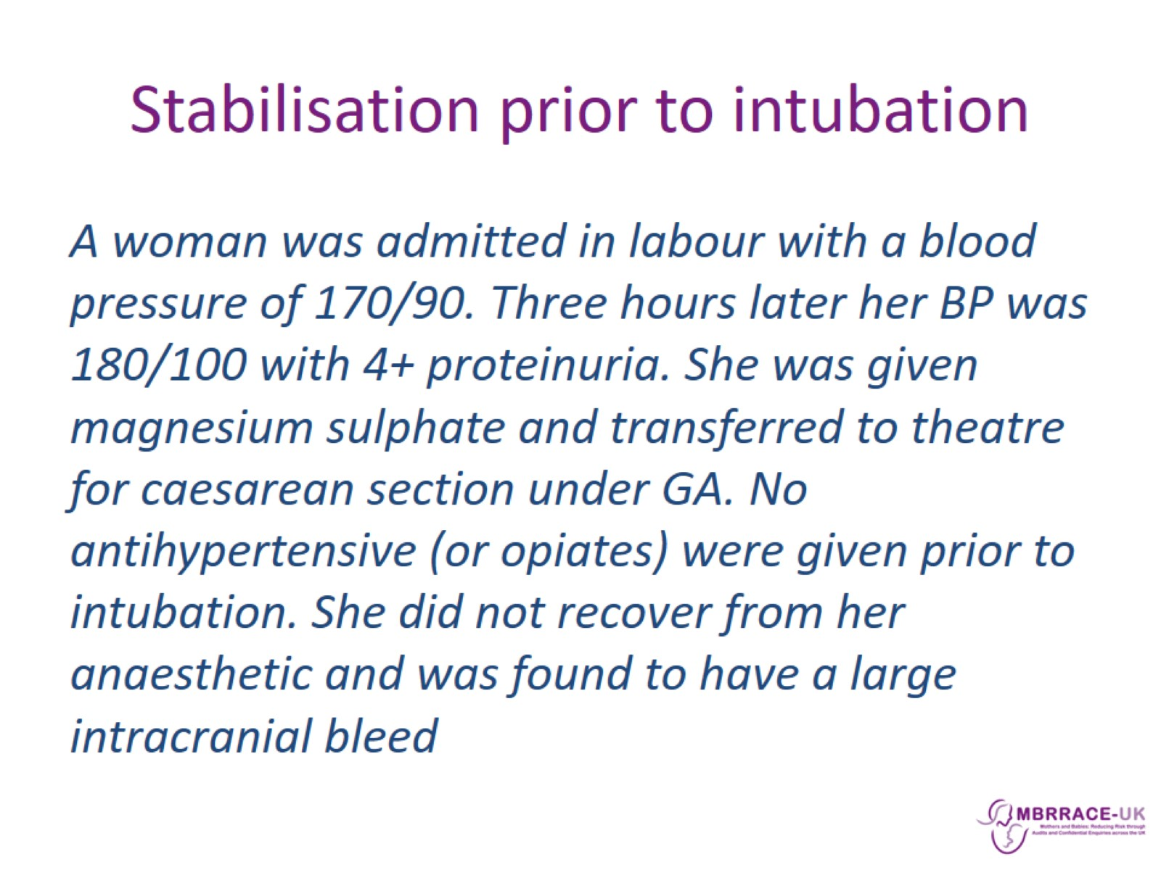
Stabilisation prior to intubation

Slide 14
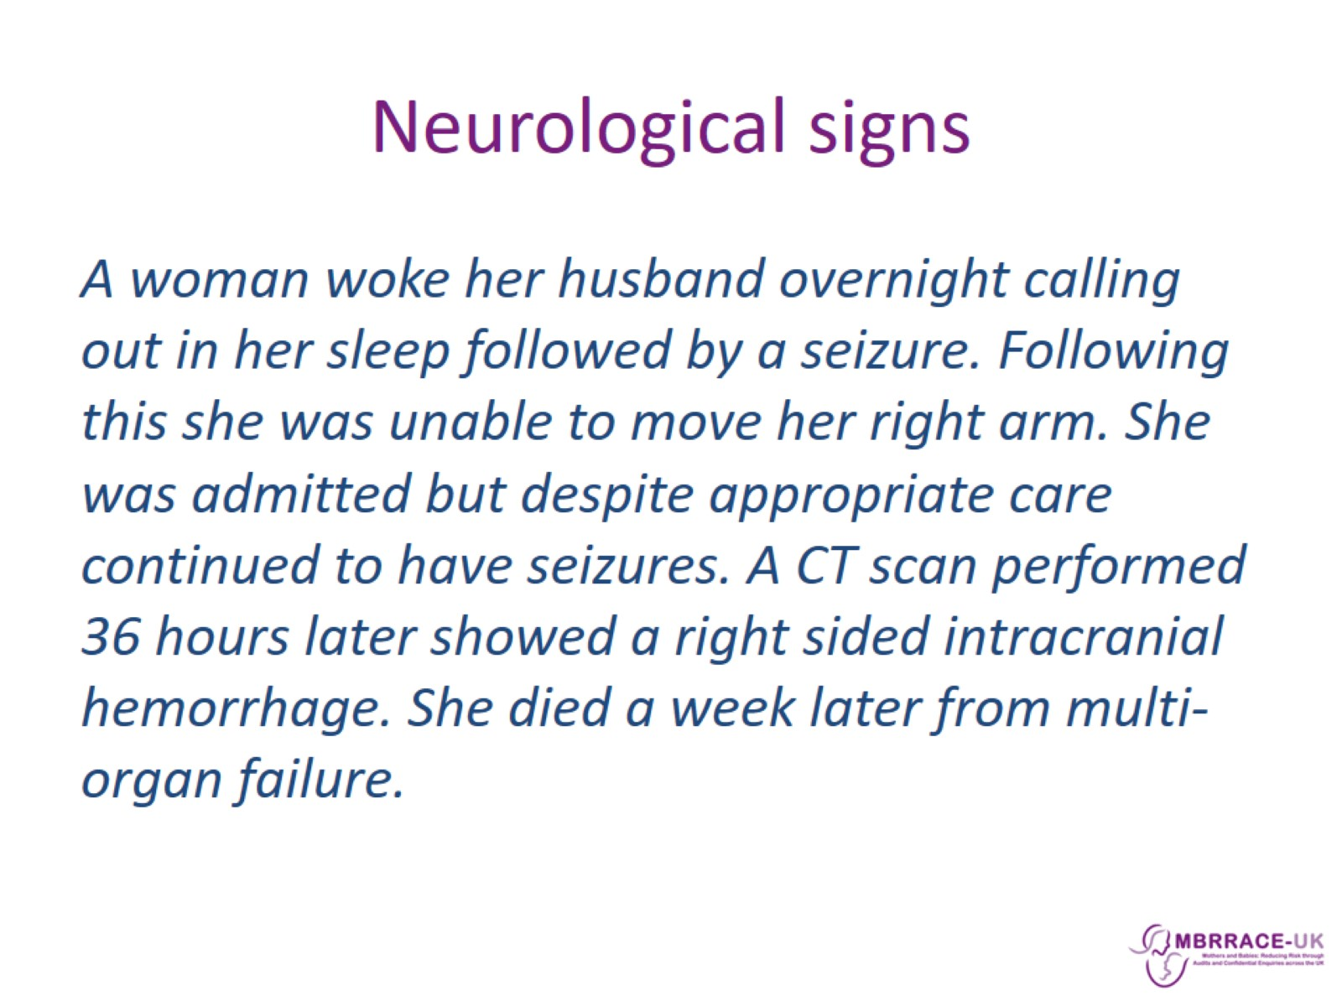
Neurological signs

Slide 15
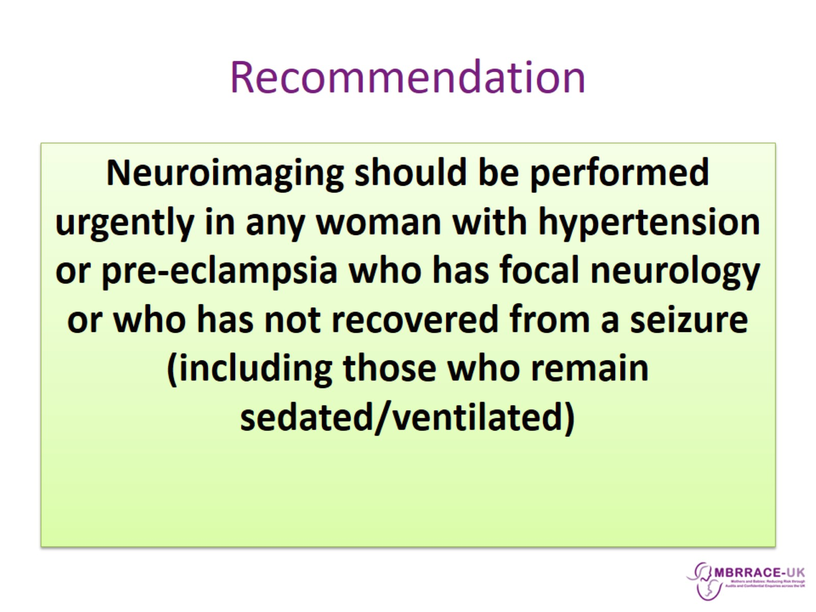
Recommendation

Slide 16
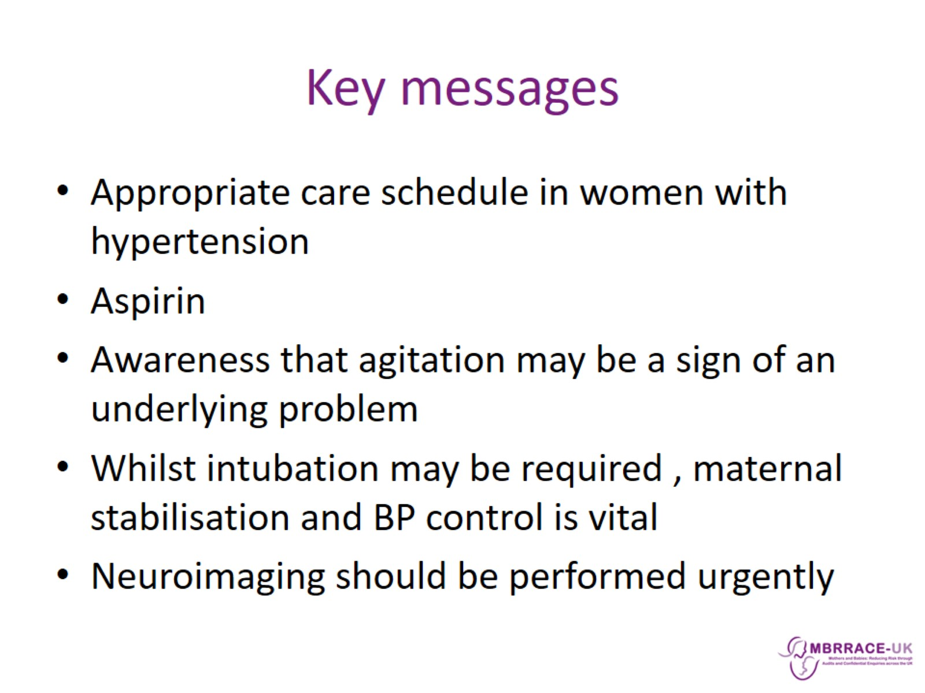
Key messages

