Slide 1
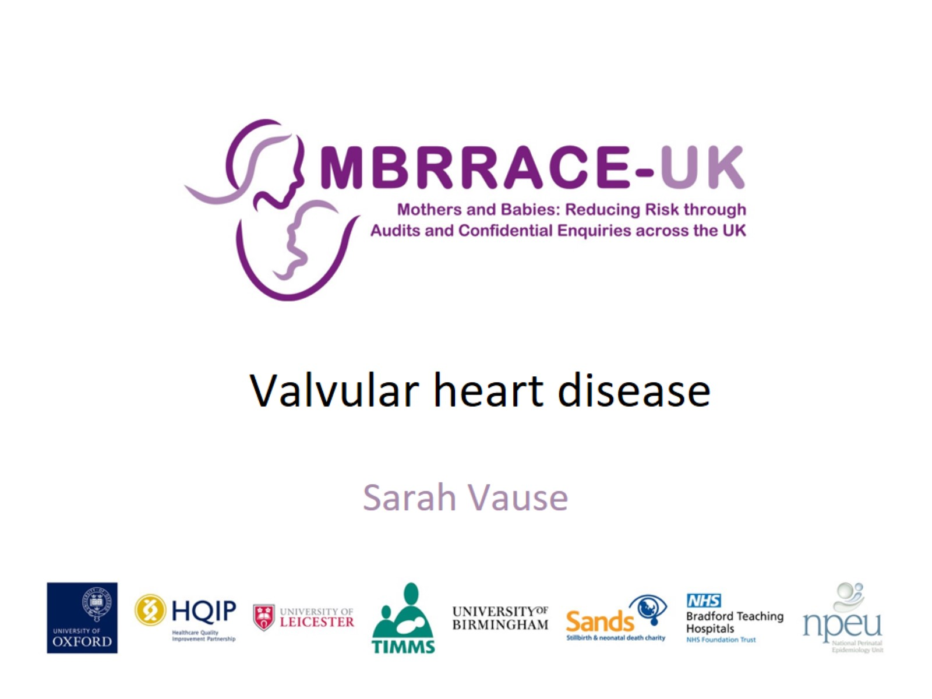
Valvular heart disease

Slide 2
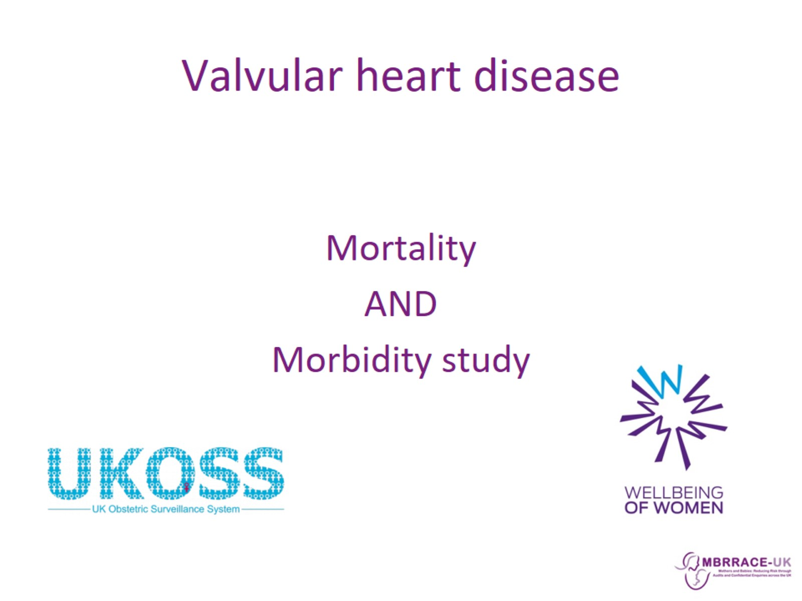
Valvular heart disease

Slide 3
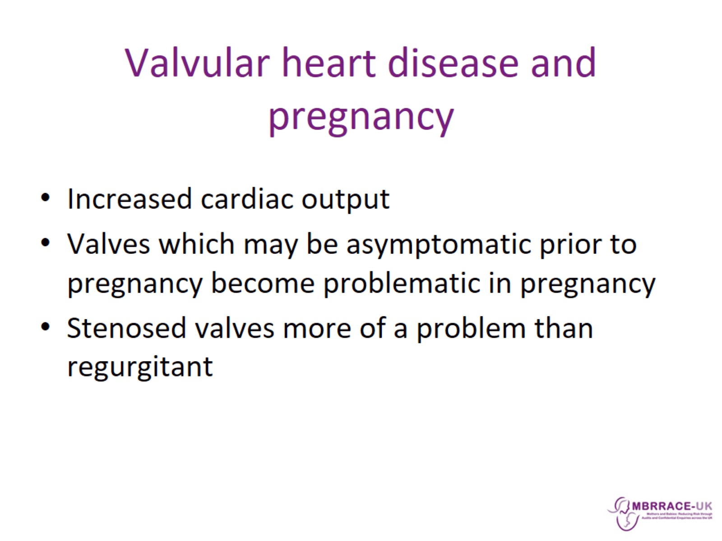
Valvular heart disease and pregnancy

Slide 4
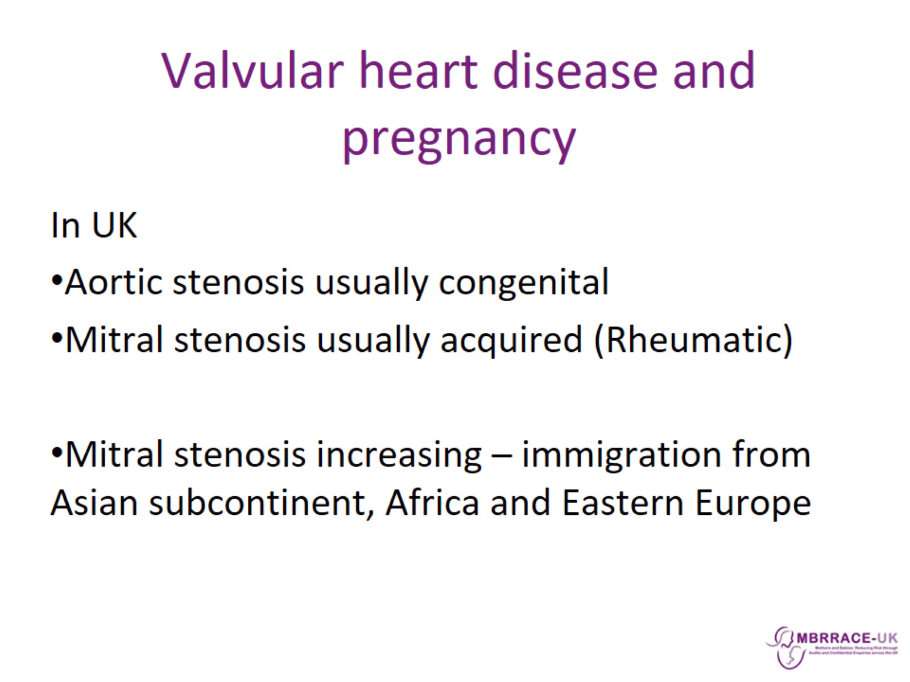
Valvular heart disease and pregnancy

Slide 5
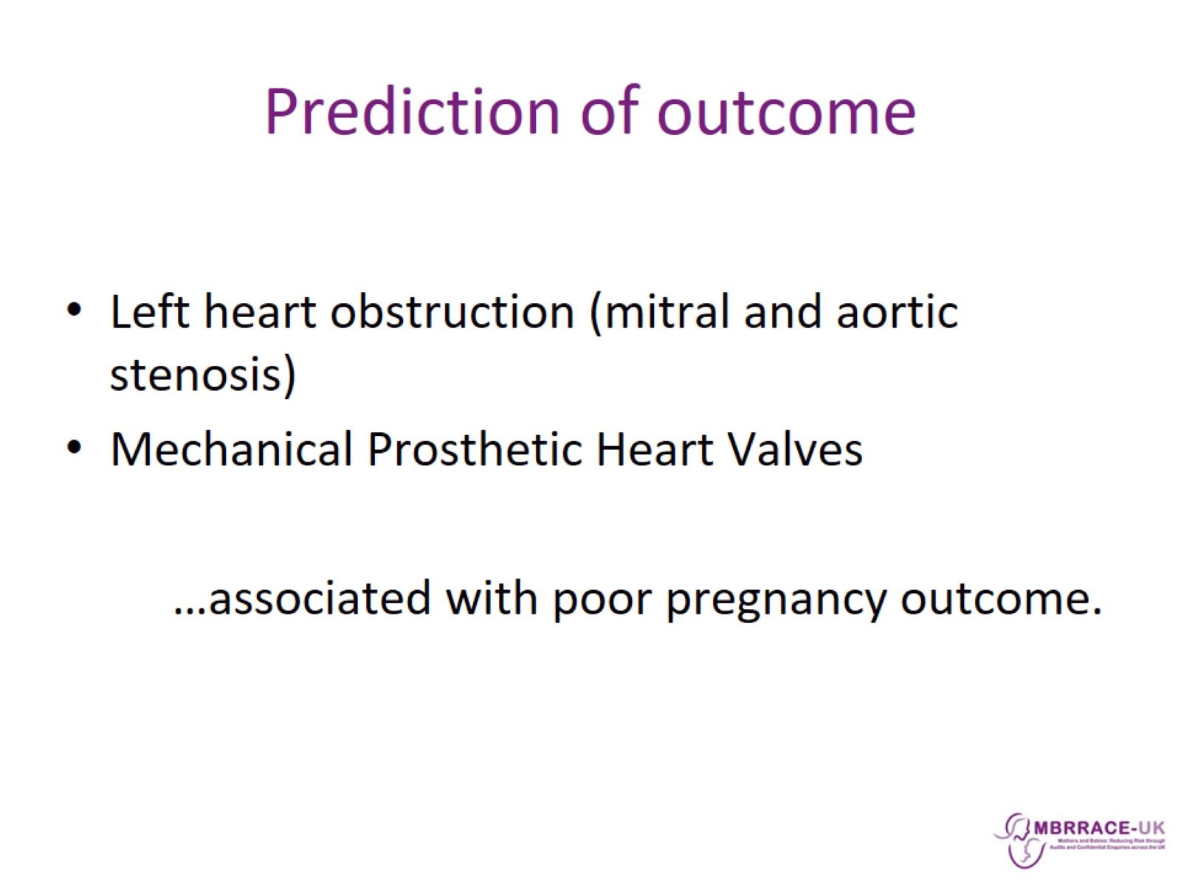
Prediction of outcome

Slide 6
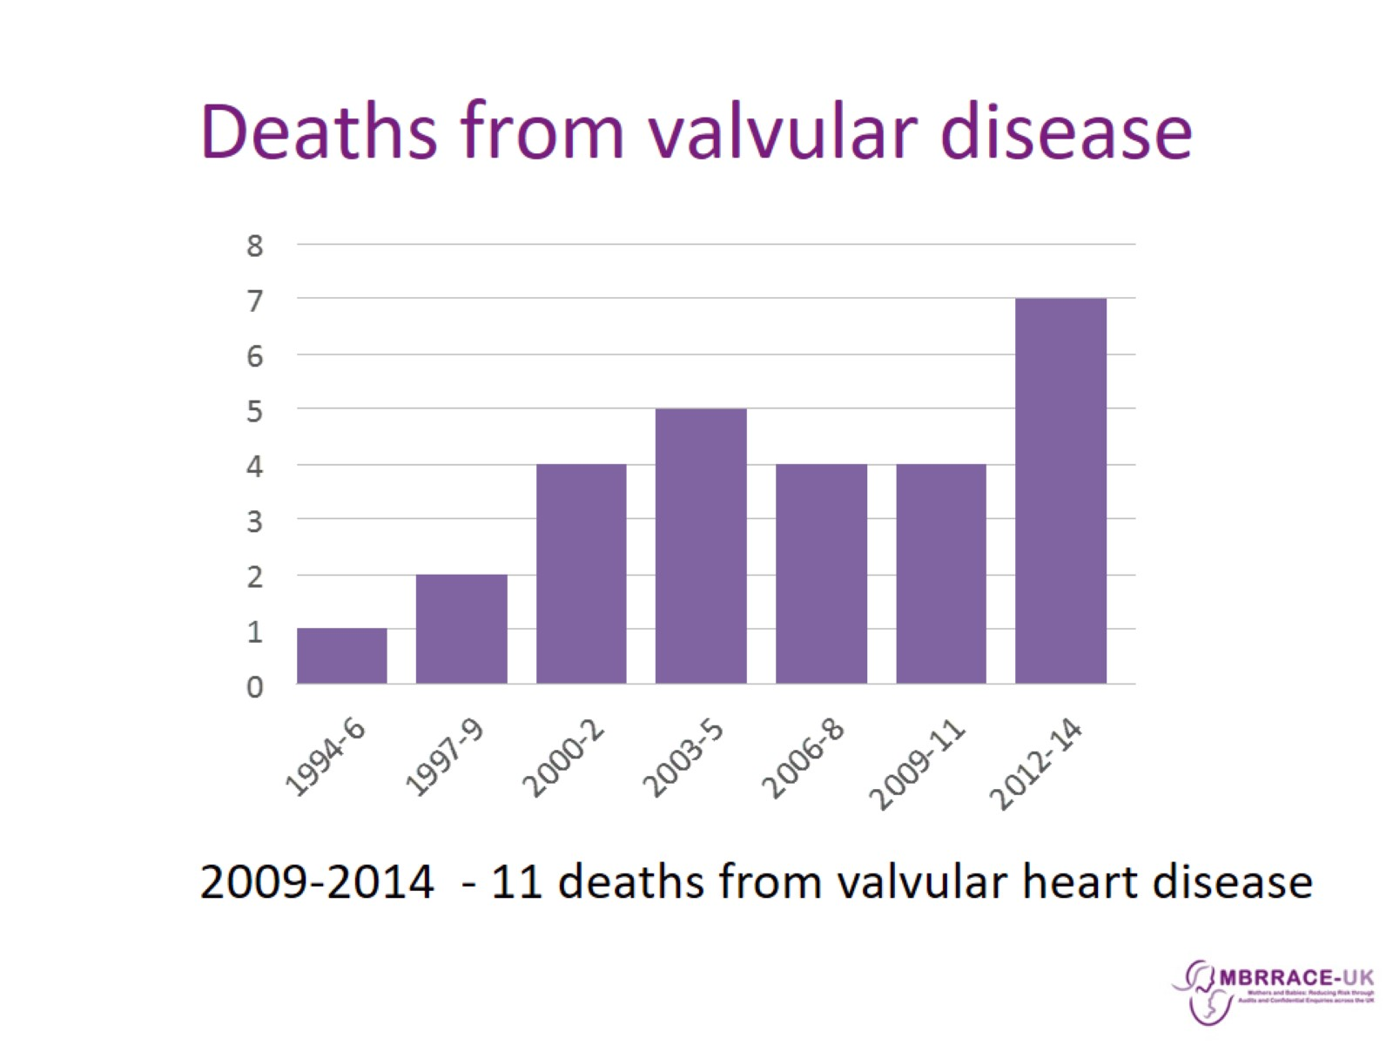
Deaths from valvular disease

Slide 7
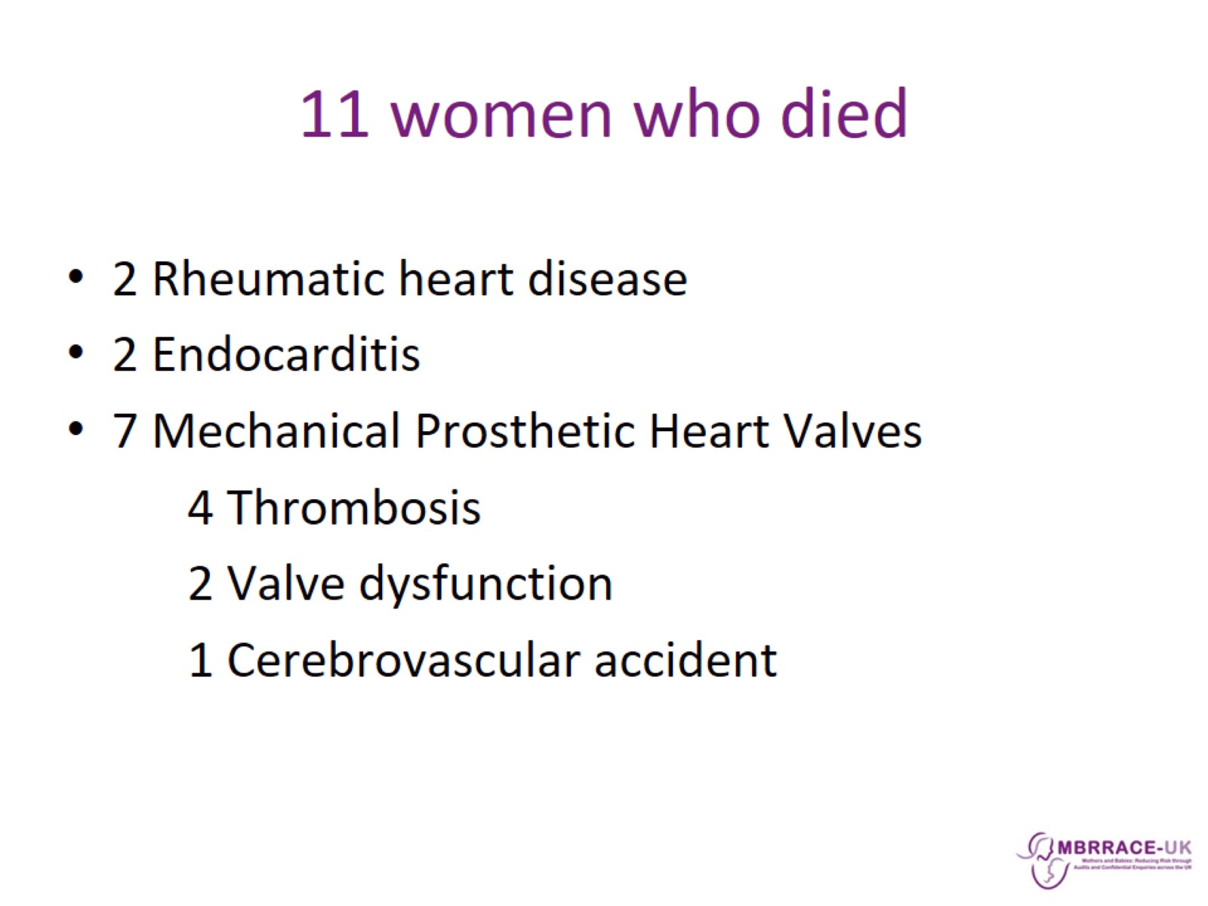
11 women who died

Slide 8
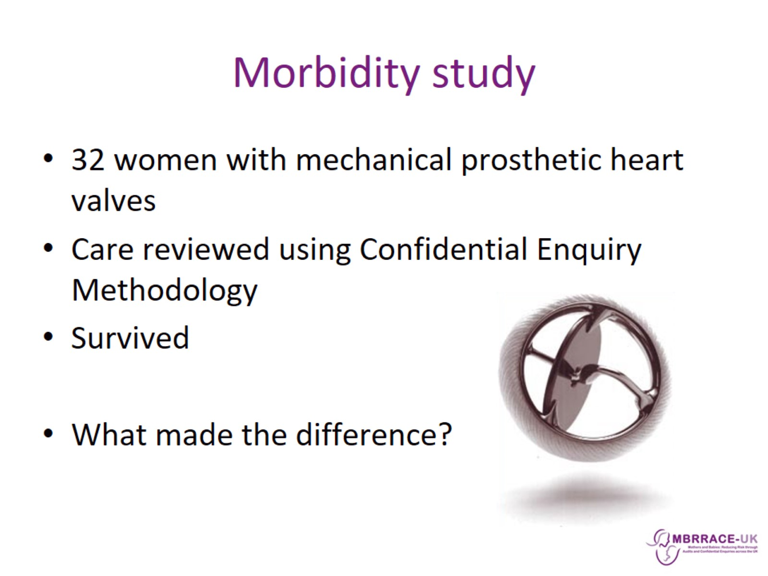
Morbidity study

Slide 9
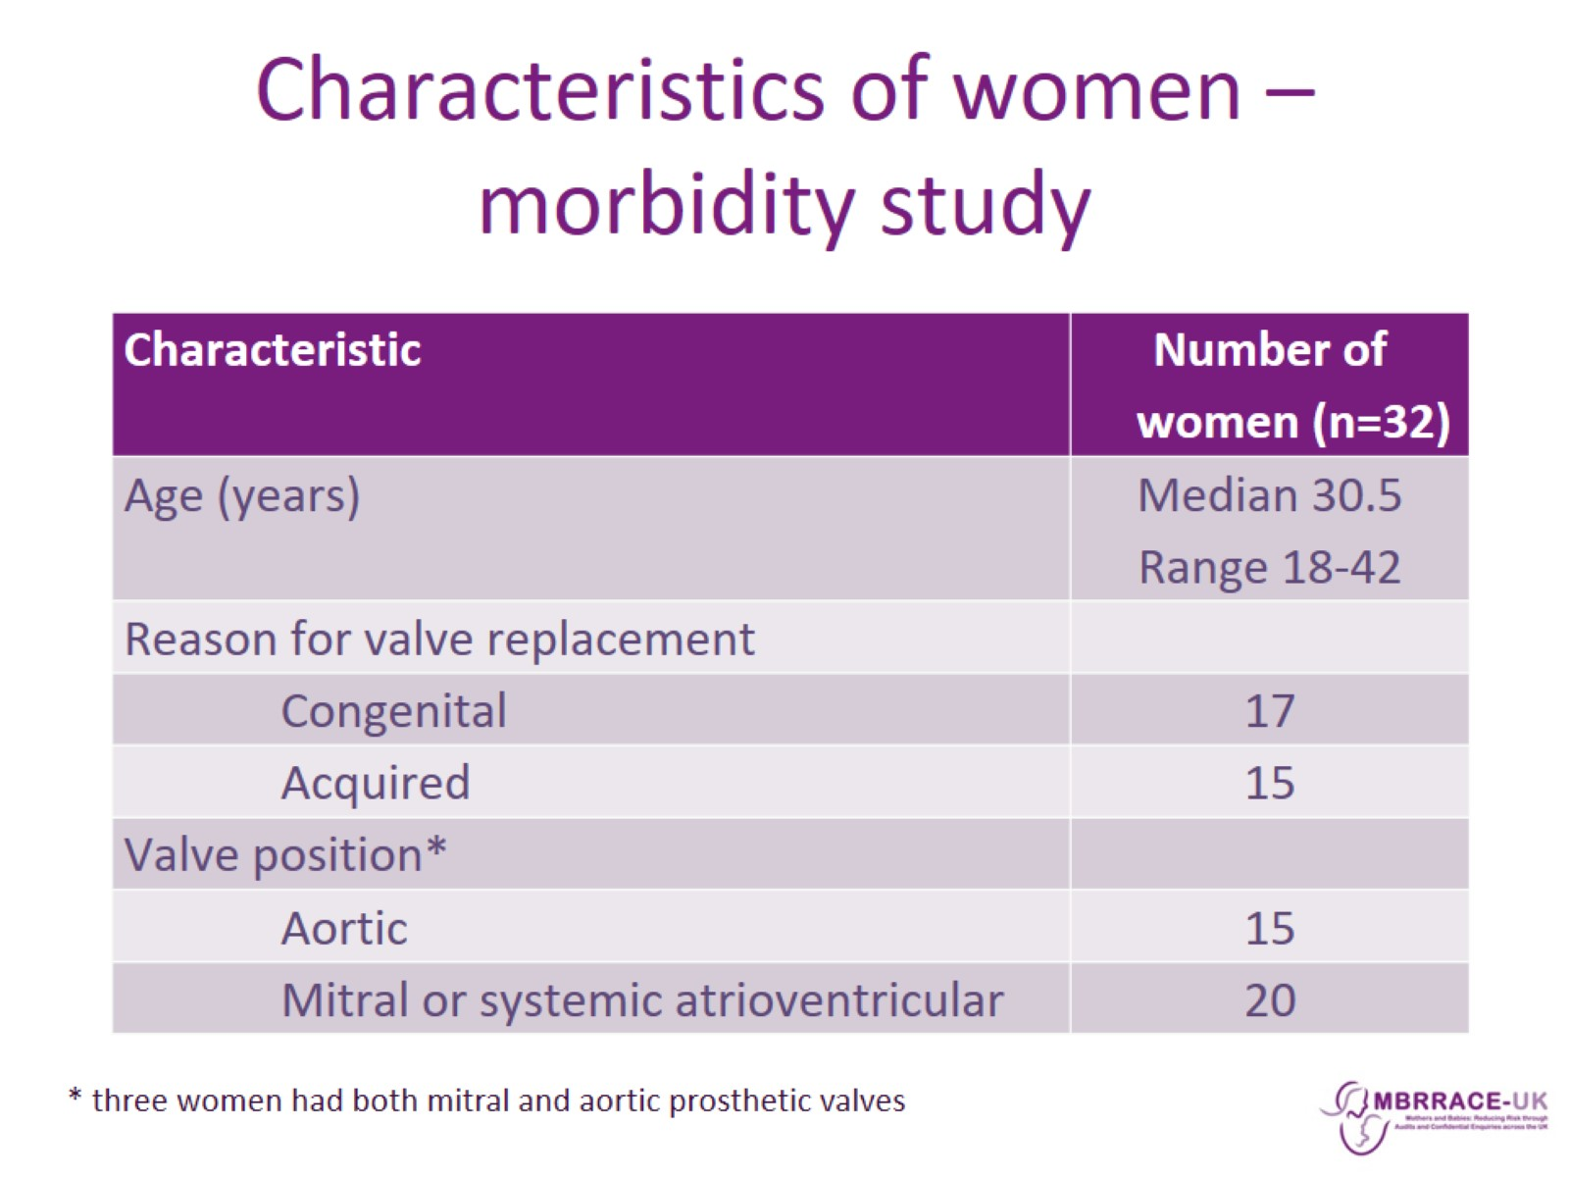
Characteristics of women – morbidity study

Slide 10
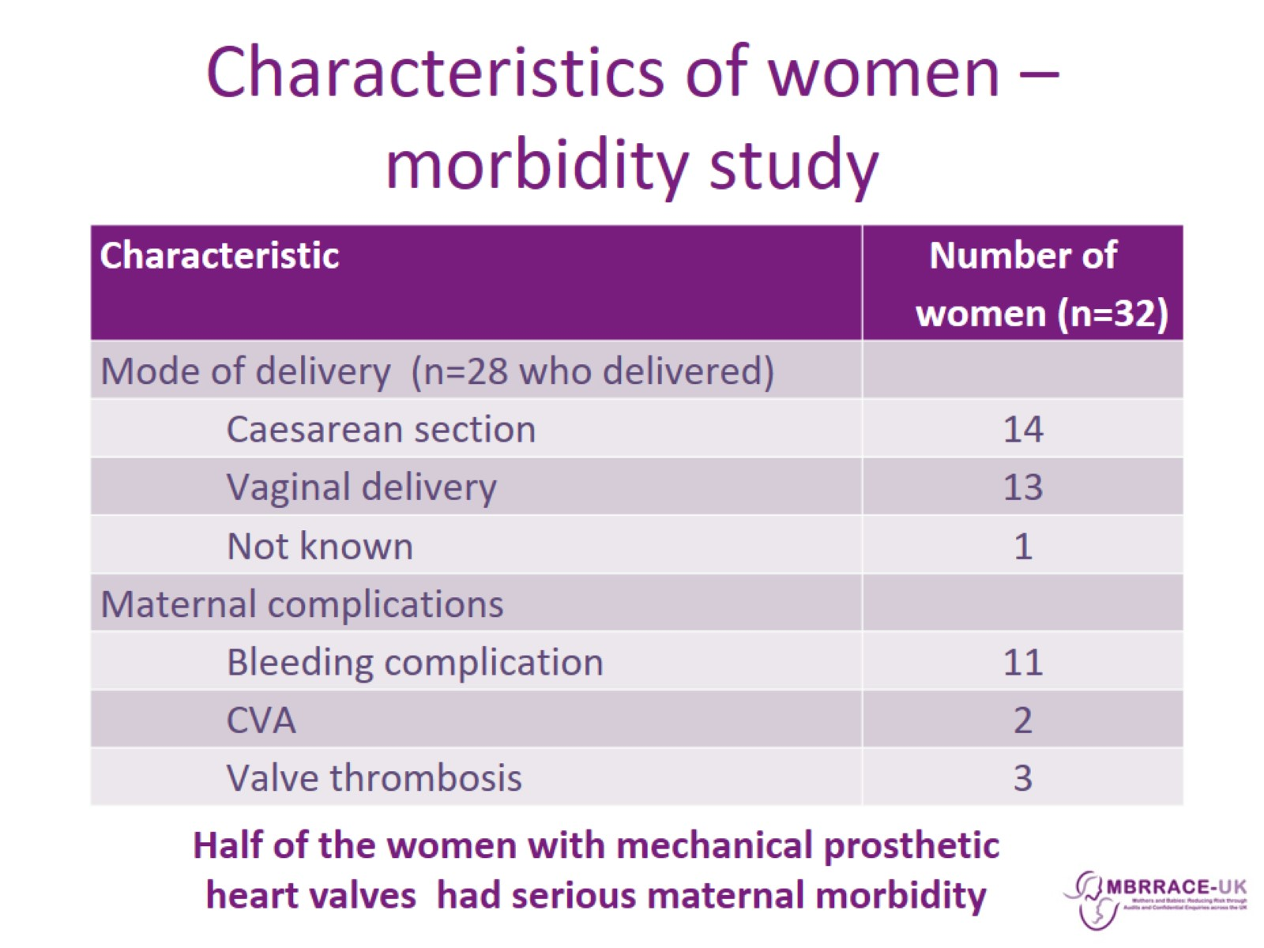
Characteristics of women – morbidity study

Slide 11
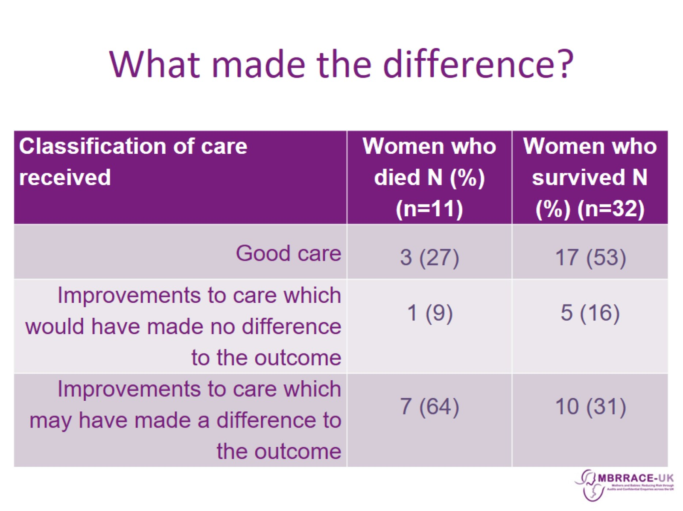
What made the difference?

Slide 12
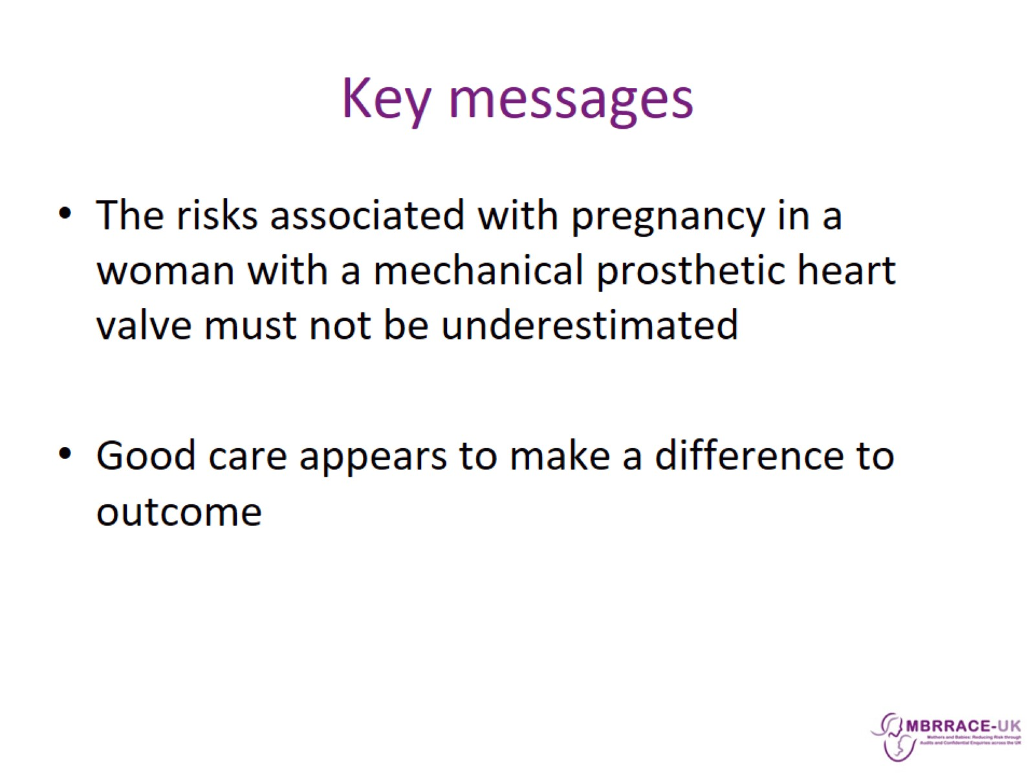
Key messages

Slide 13
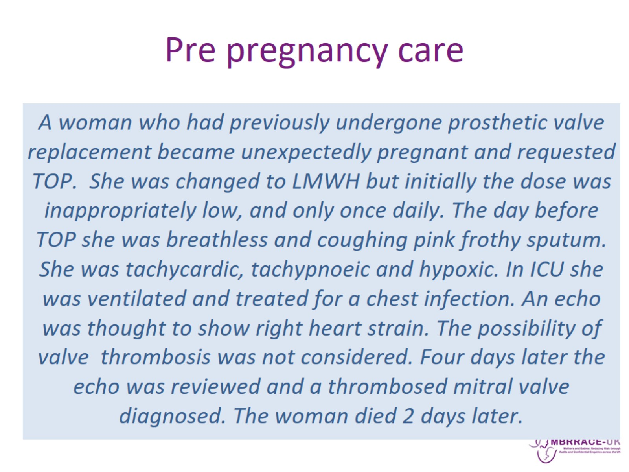
Pre pregnancy care

Slide 14
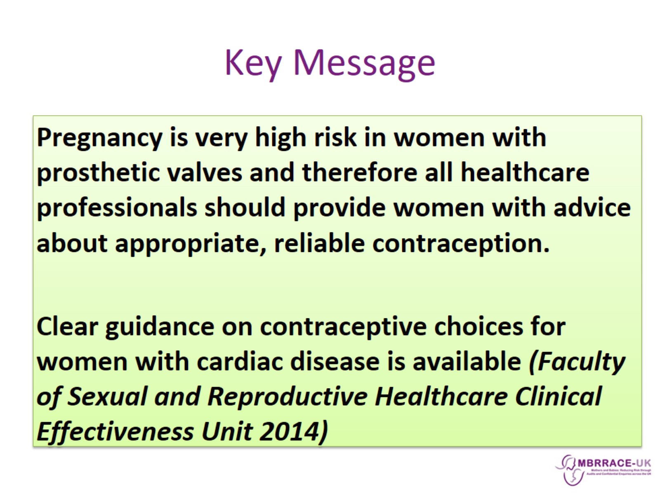
Key Message

Slide 15
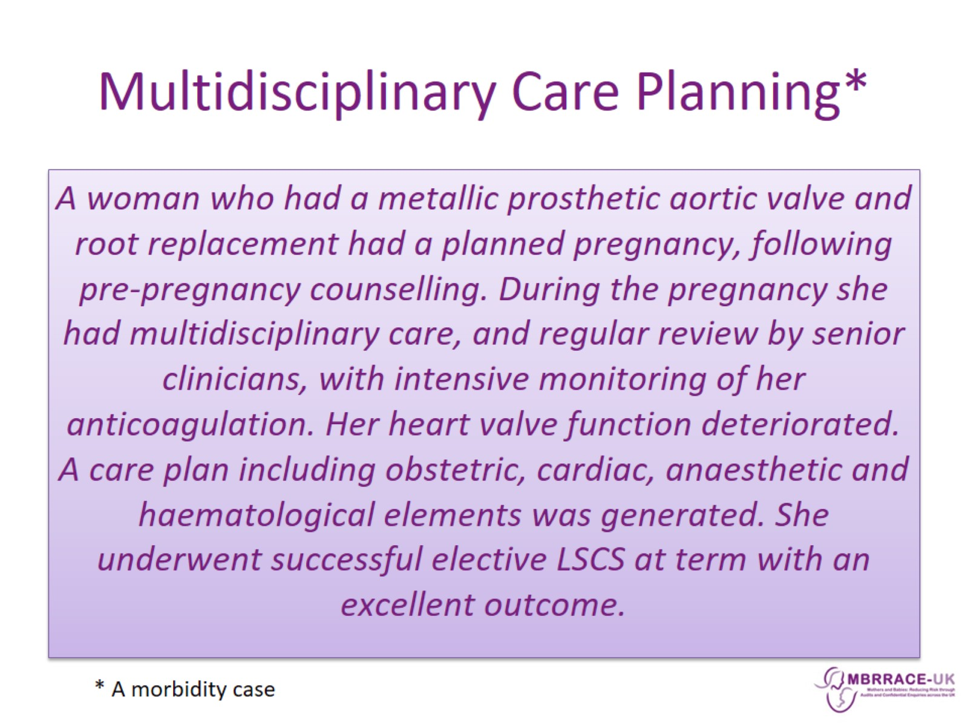
Multidisciplinary Care Planning*

Slide 16
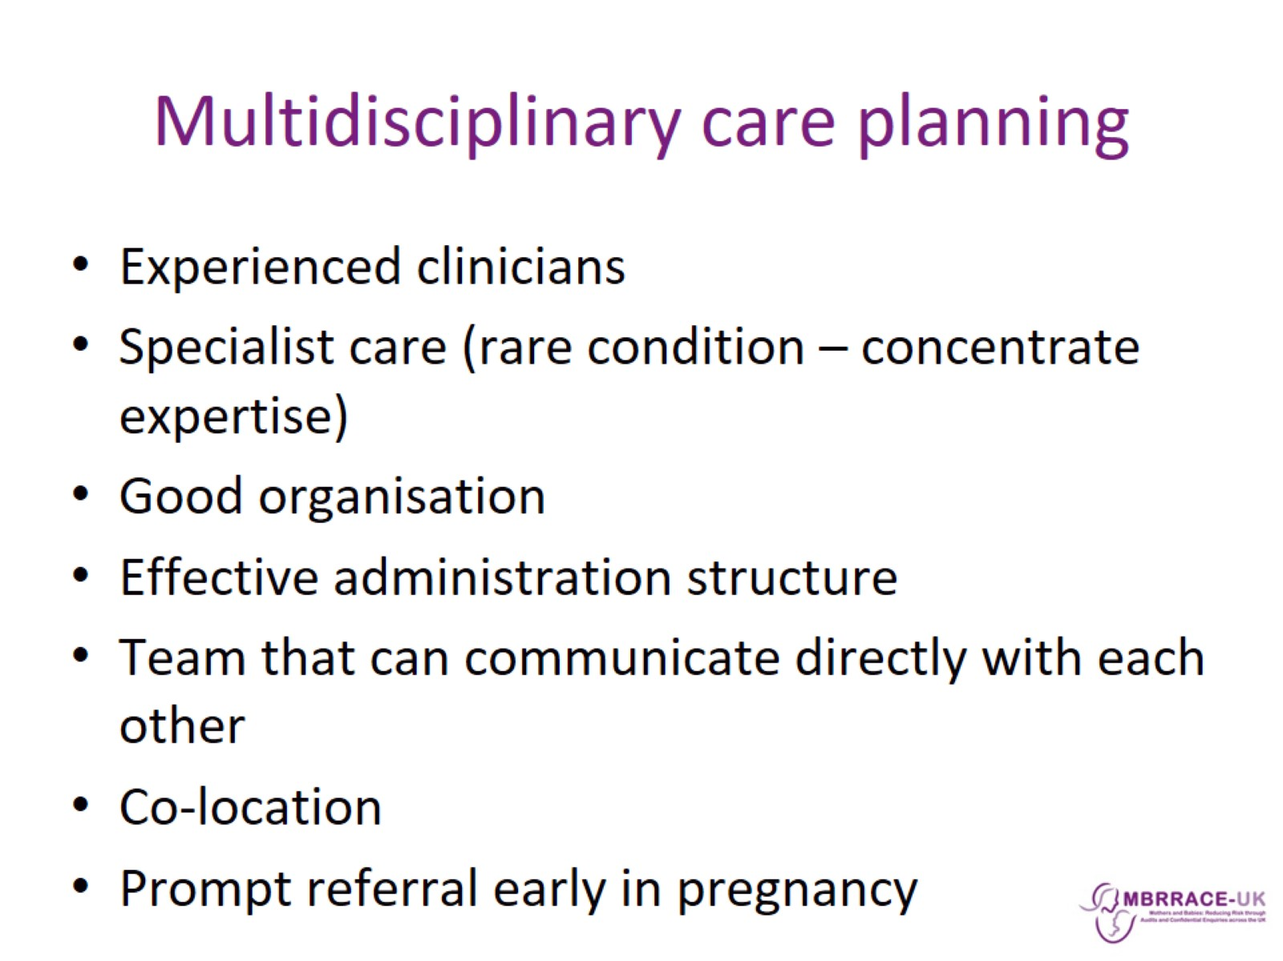
Multidisciplinary care planning

Slide 17
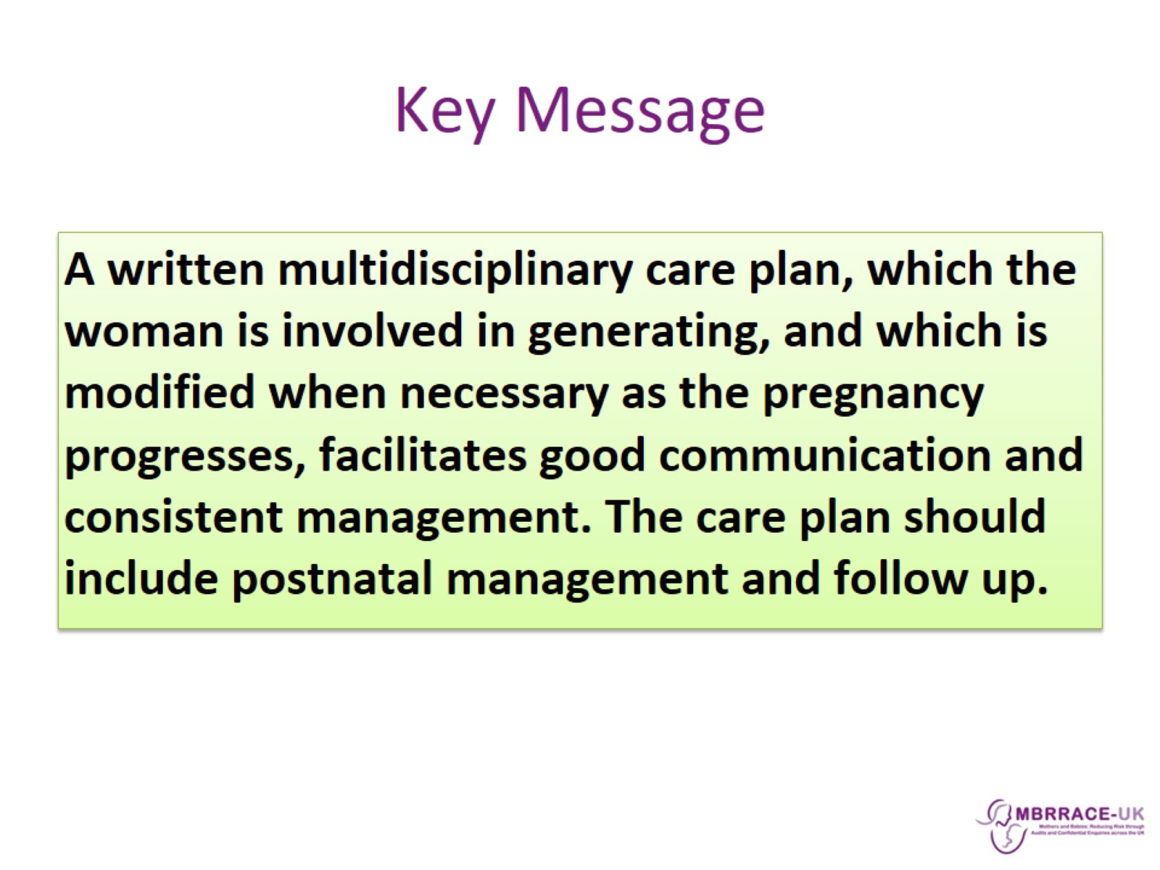
Key Message

Slide 18
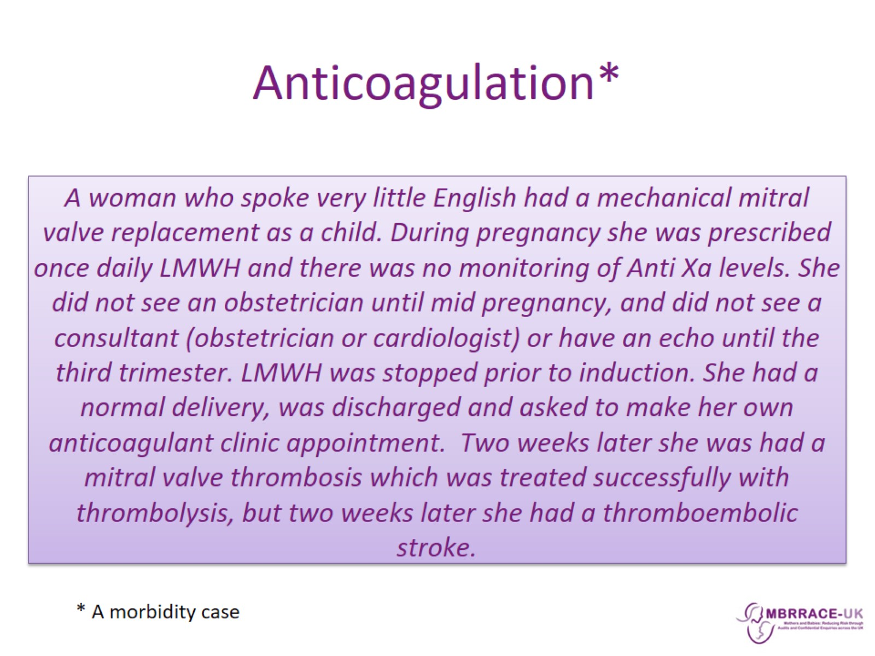
Anticoagulation*

Slide 19
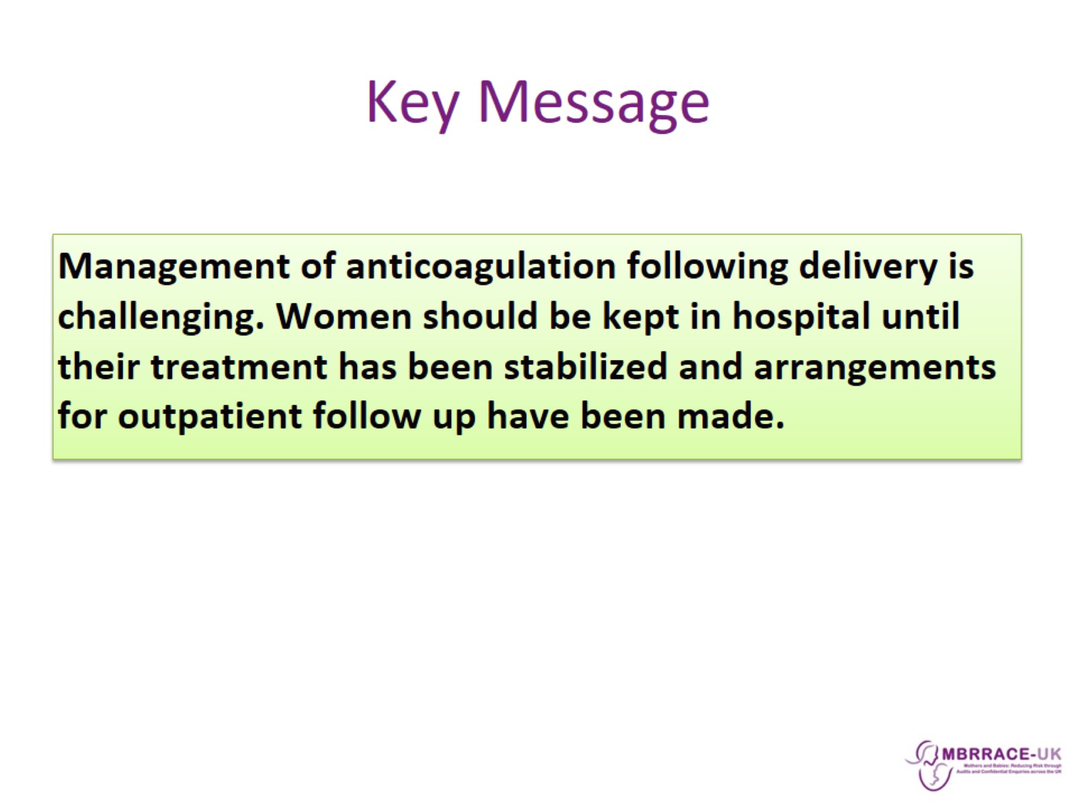
Key Message

Slide 20
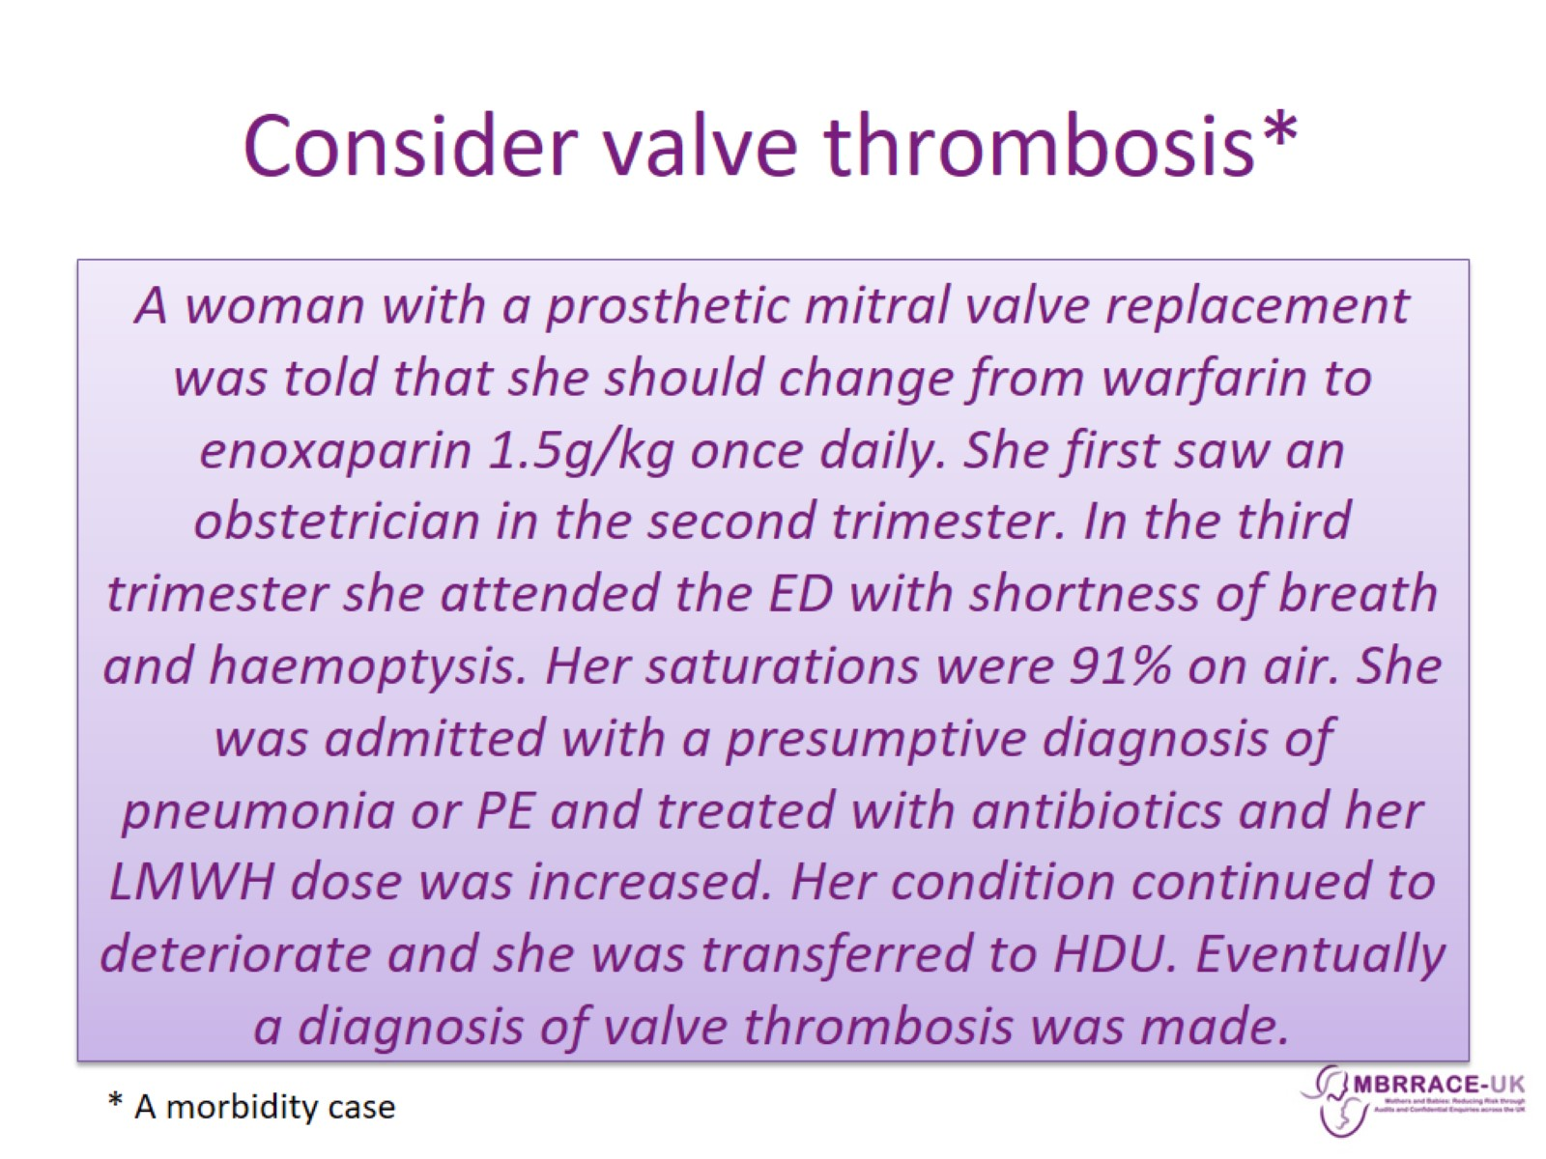
Consider valve thrombosis*

Slide 21
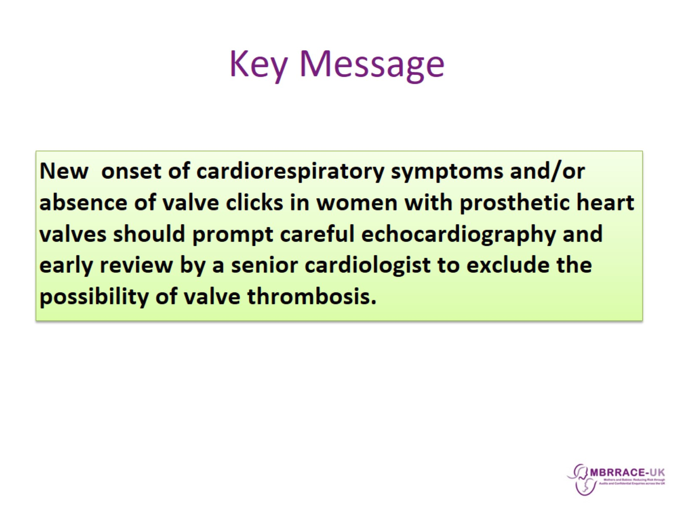
Key Message

Slide 22
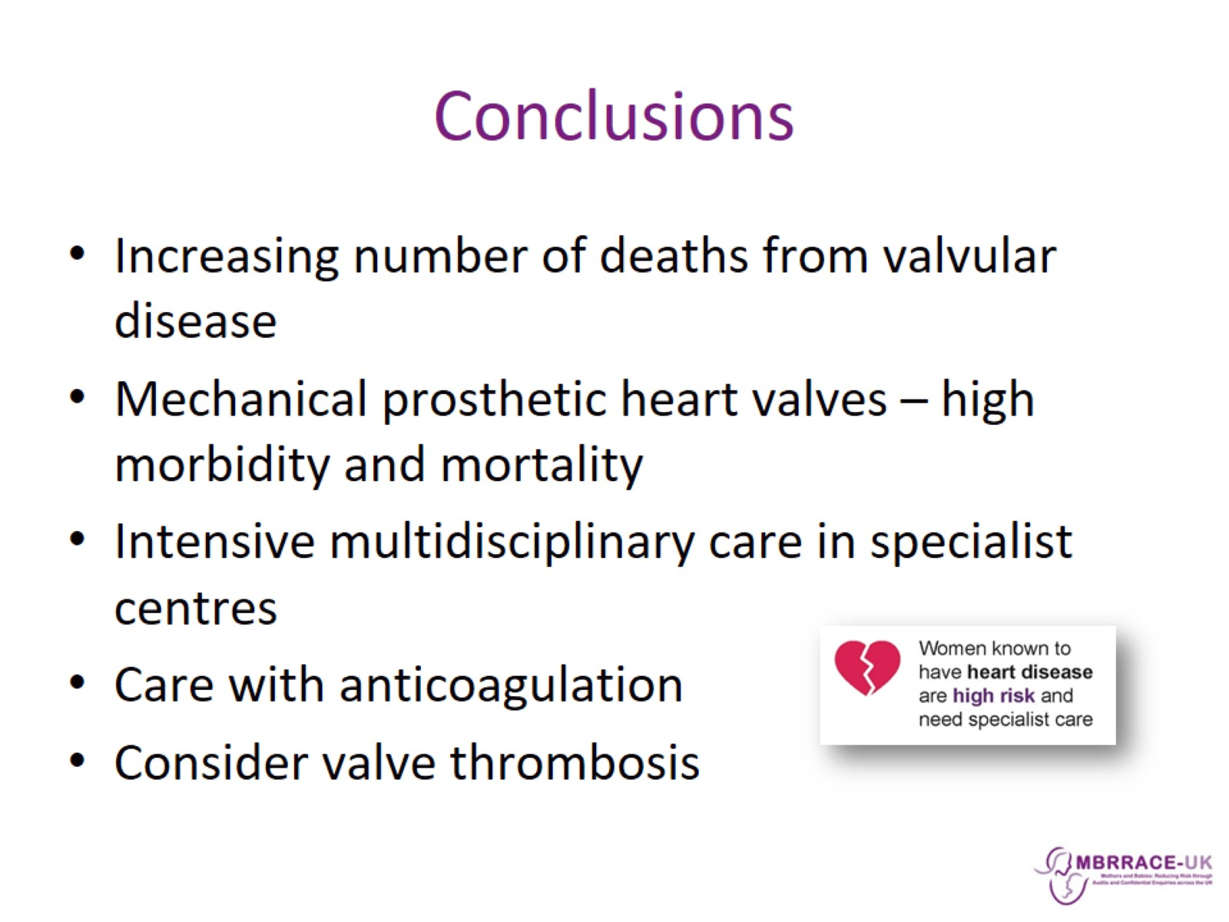
Conclusions

