Slide 1
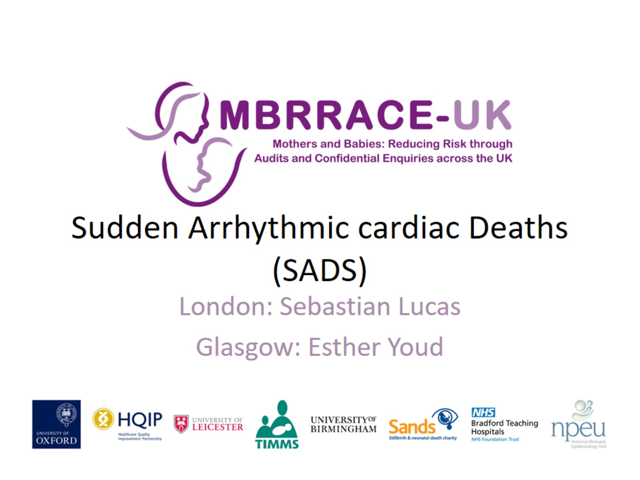
Sudden Arrhythmic cardiac Deaths (SADS)

Slide 2
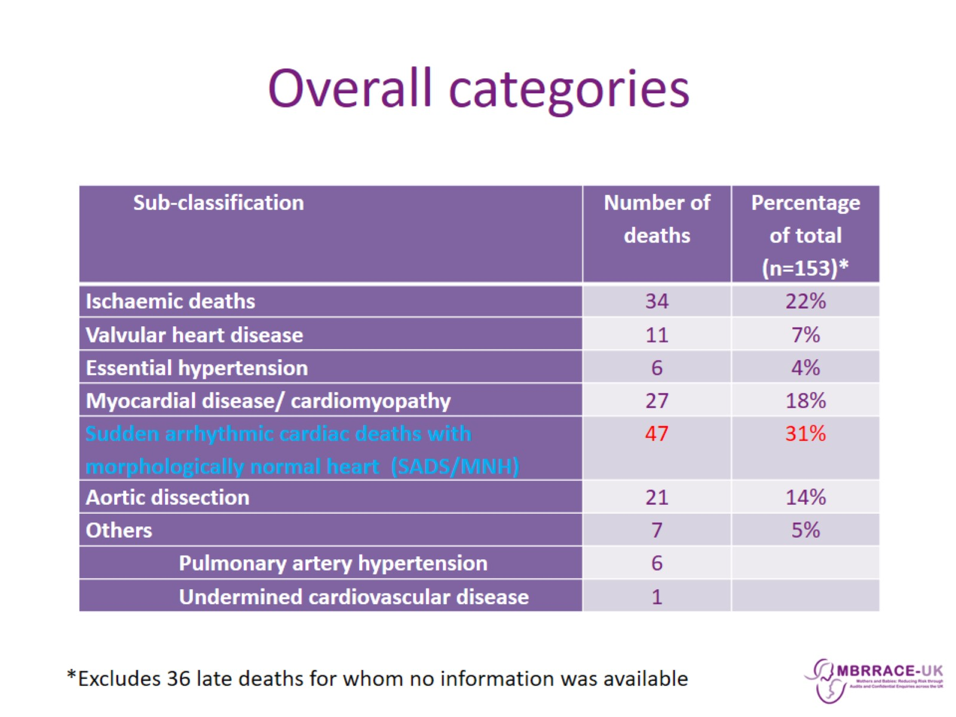
Overall categories

Slide 3
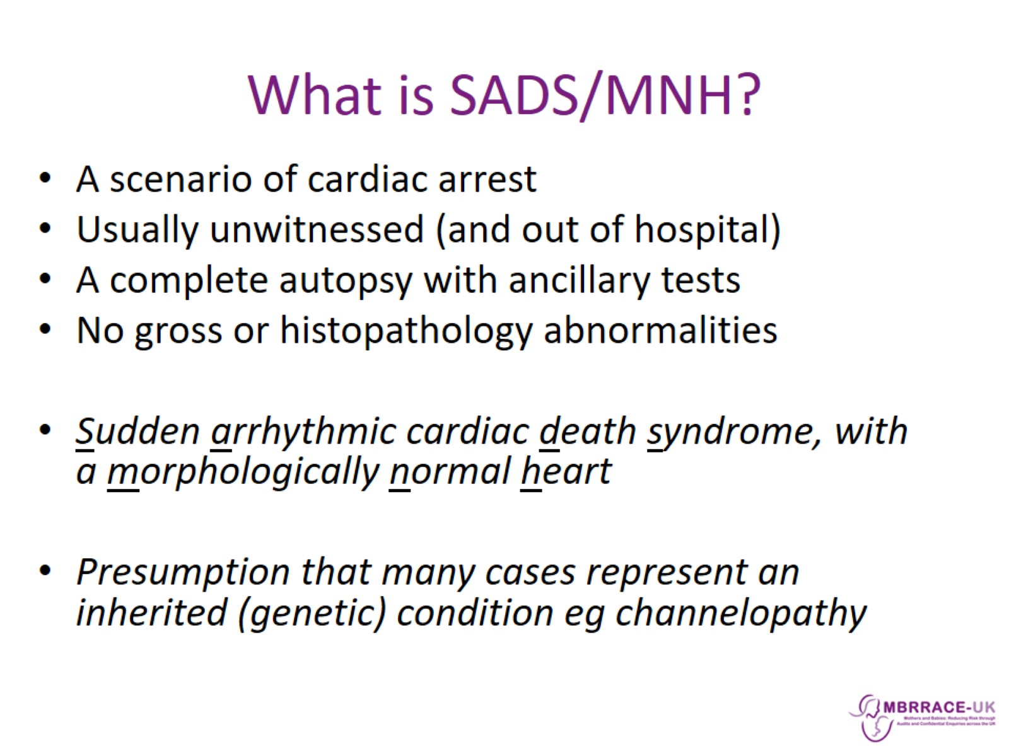
What is SADS/MNH?

Slide 4
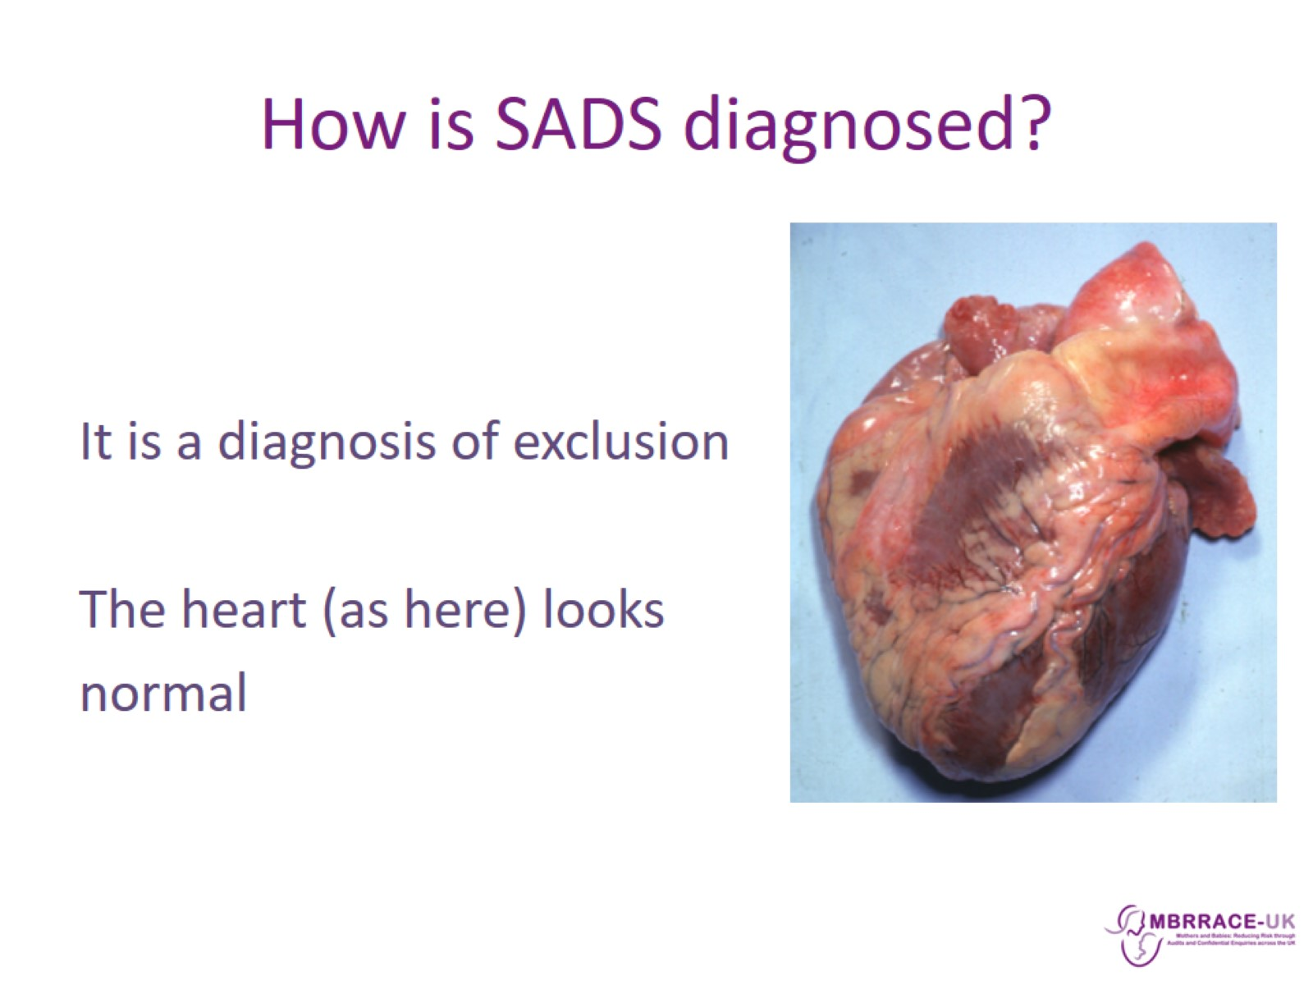
How is SADS diagnosed?

Slide 5
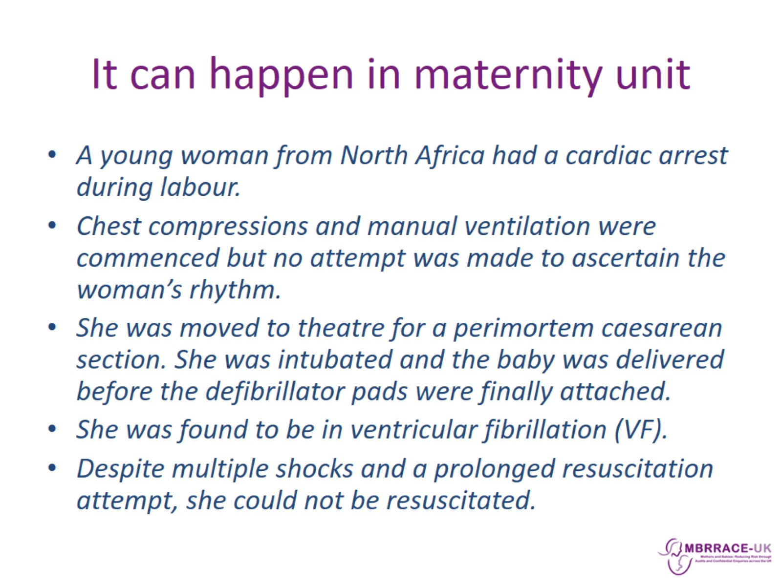
It can happen in maternity unit

Slide 6
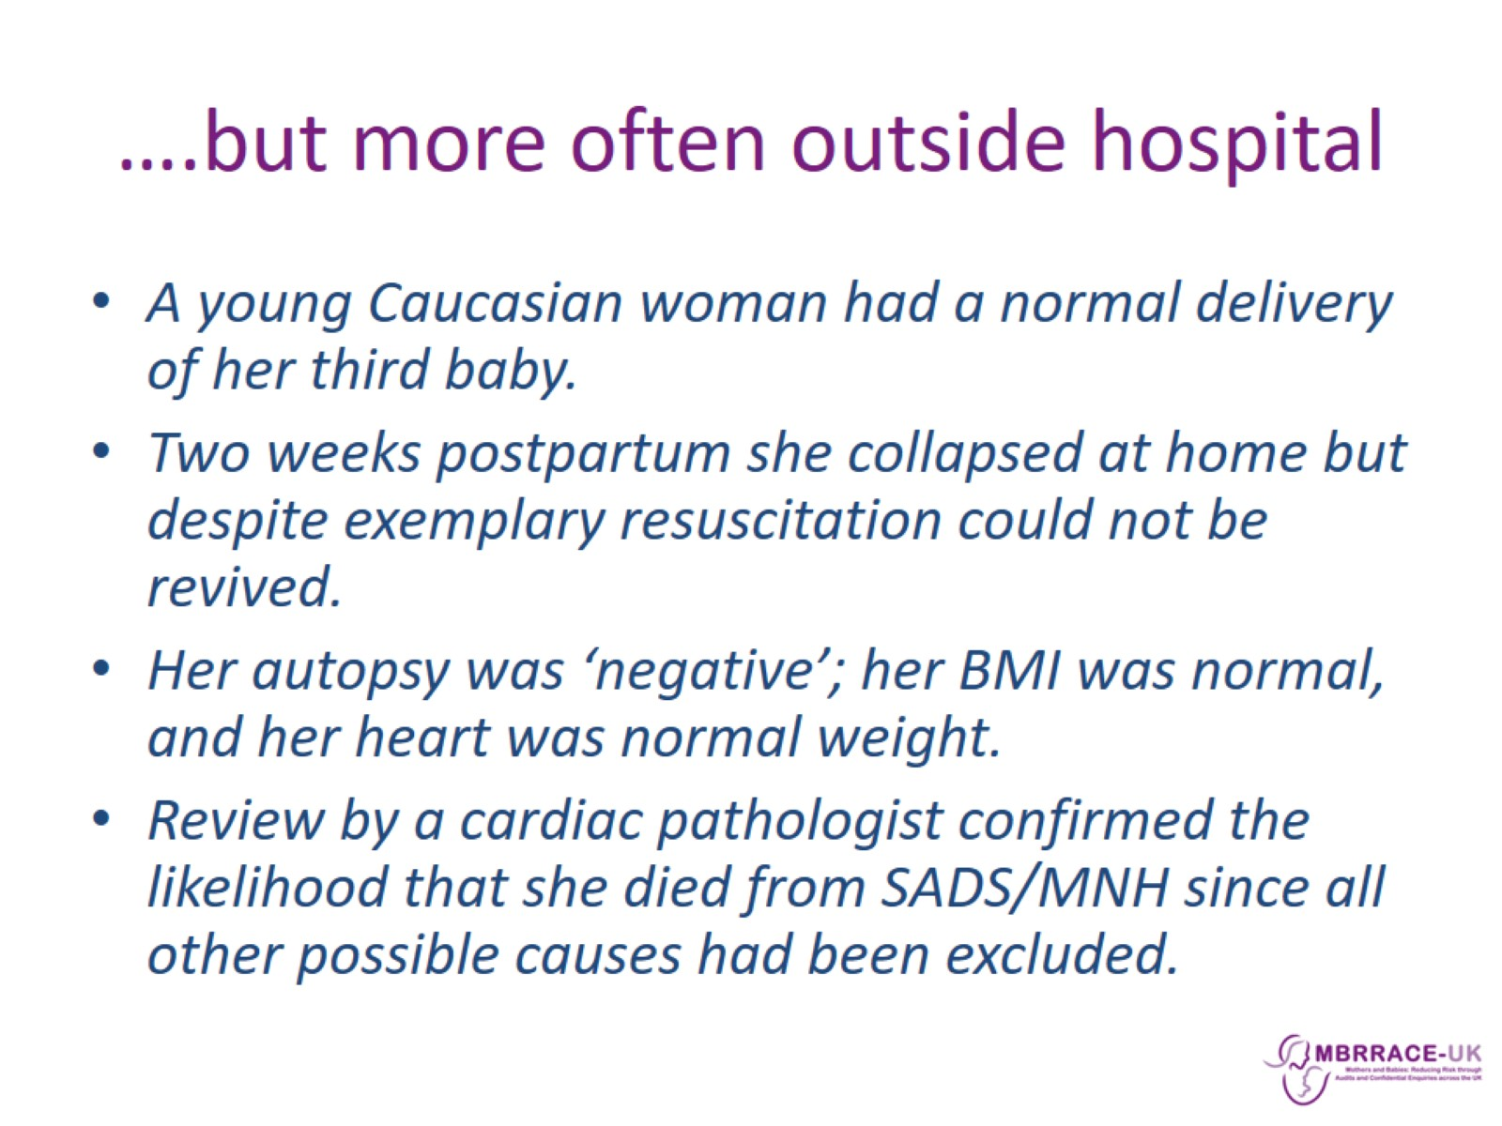
….but more often outside hospital

Slide 7
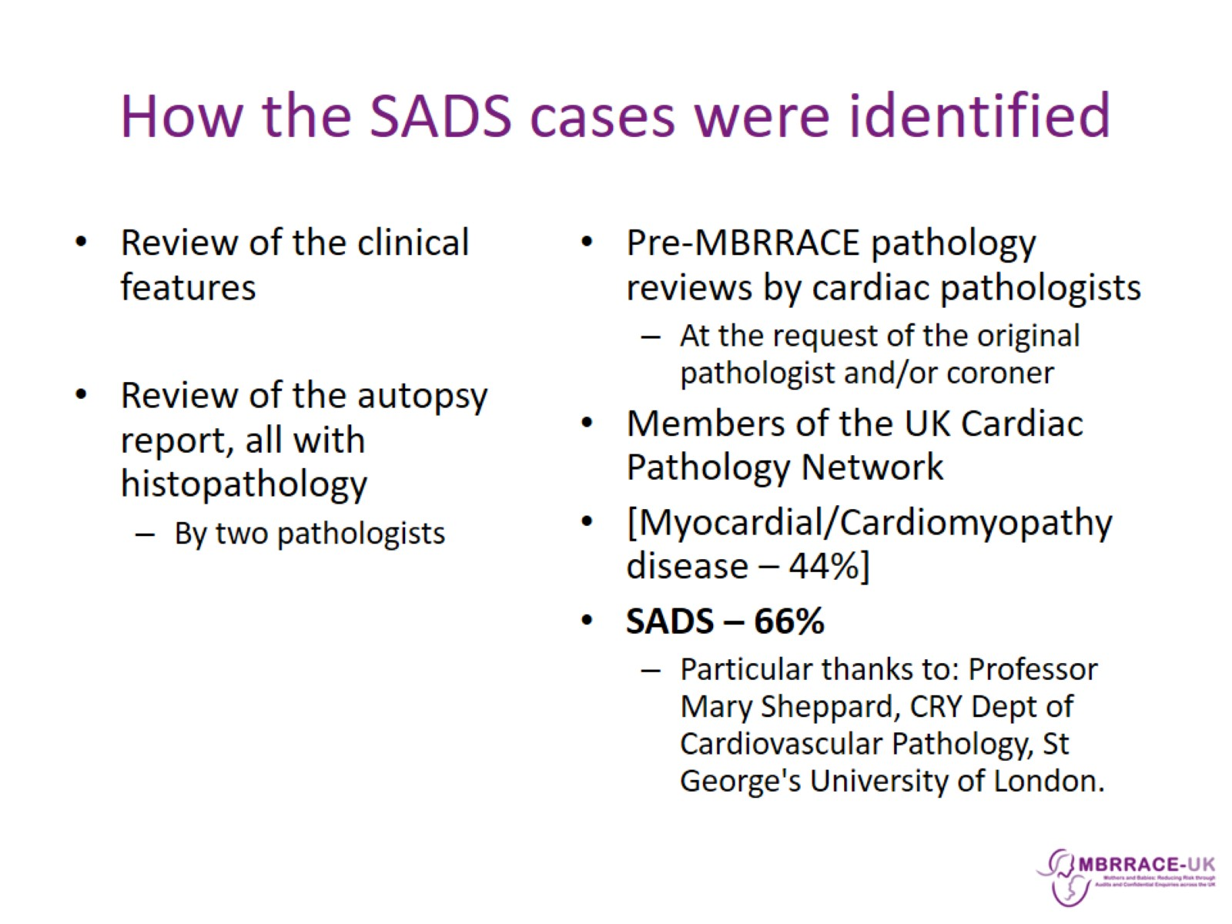
How the SADS cases were identified

Slide 8
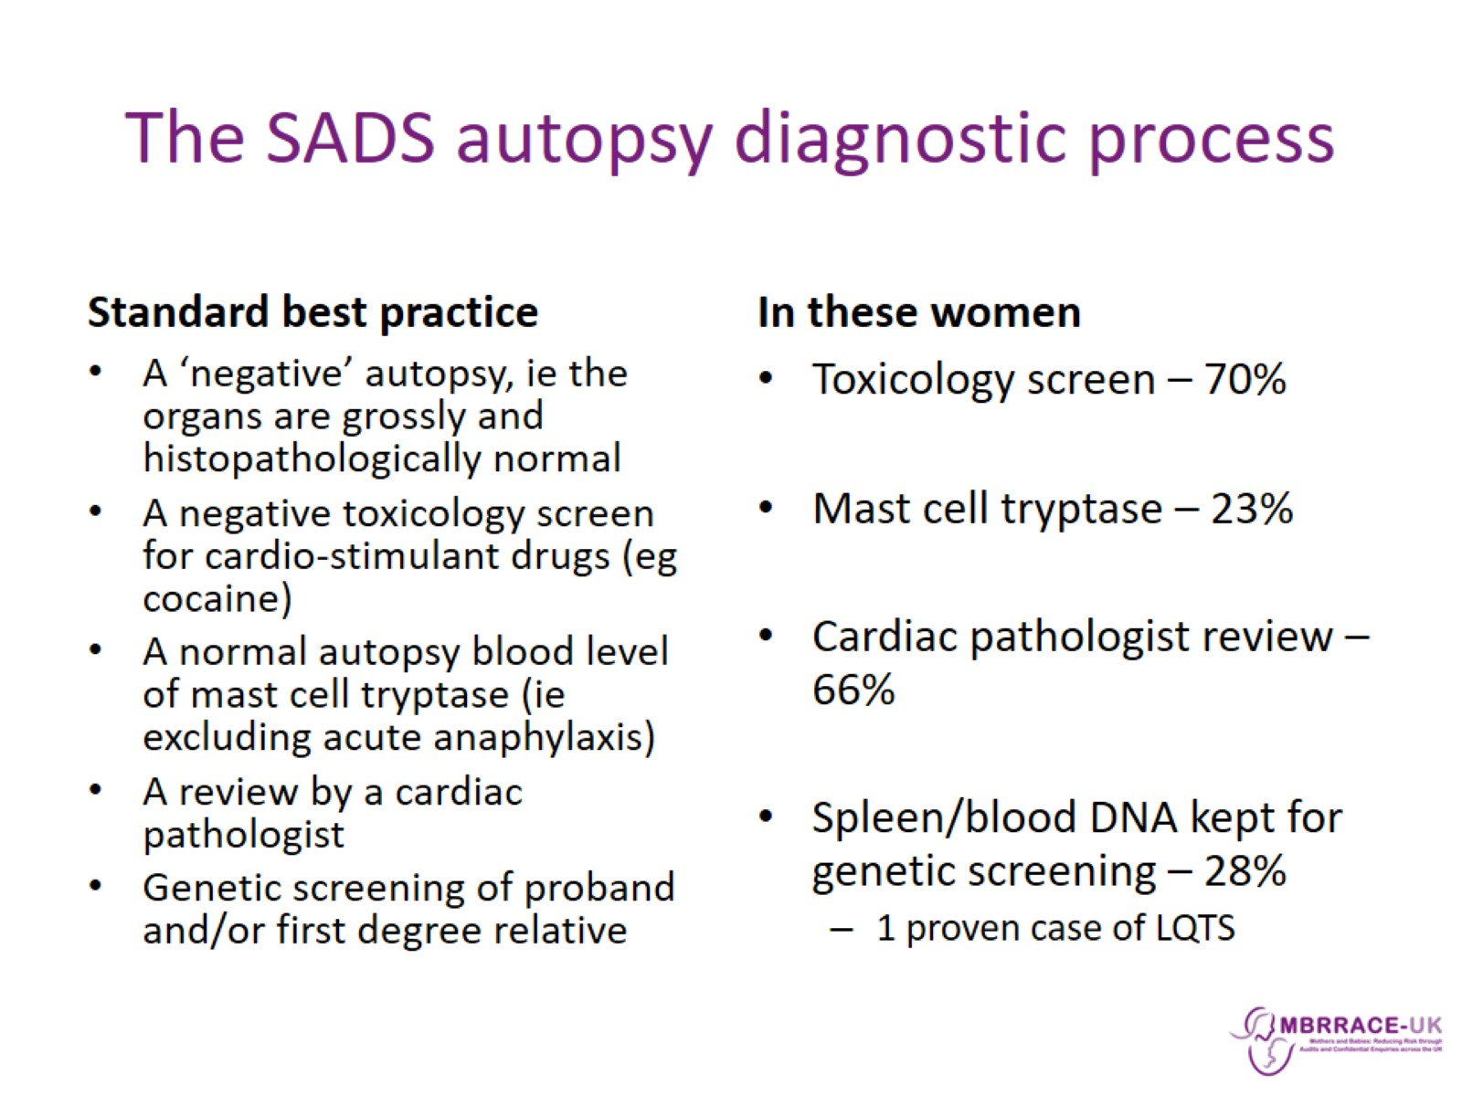
The SADS autopsy diagnostic process

Slide 9
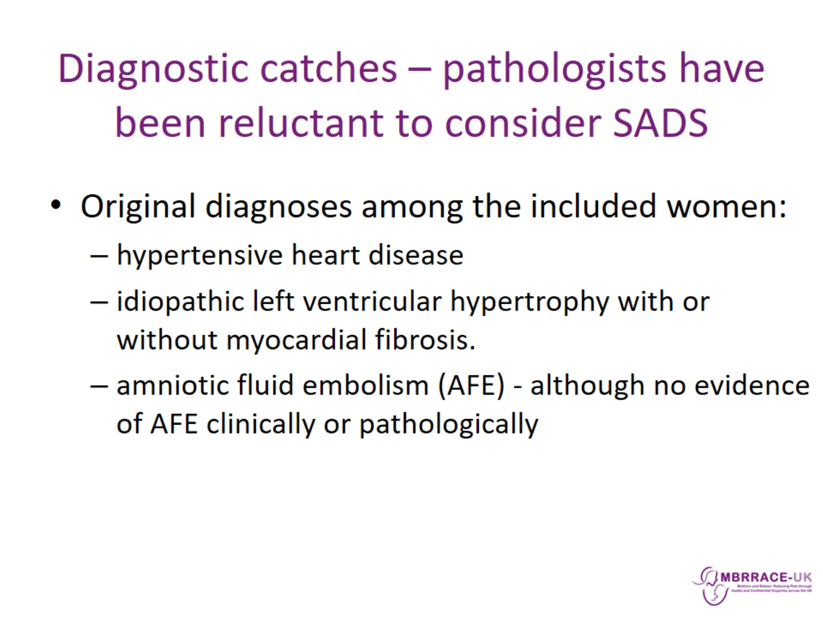
Diagnostic catches – pathologists have been reluctant to consider SADS

Slide 10
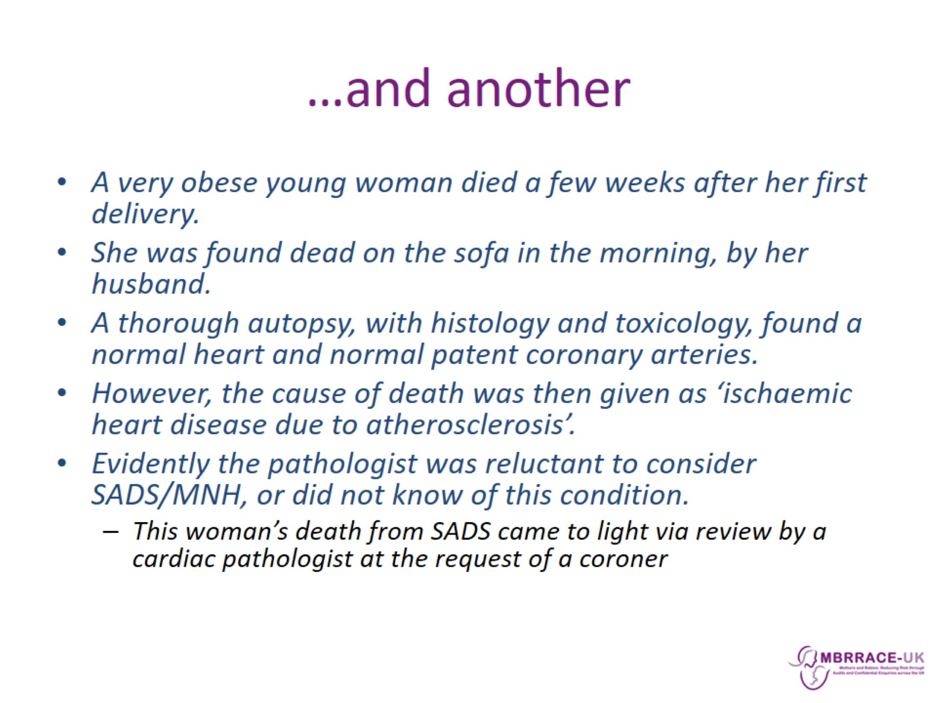
…and another

Slide 11
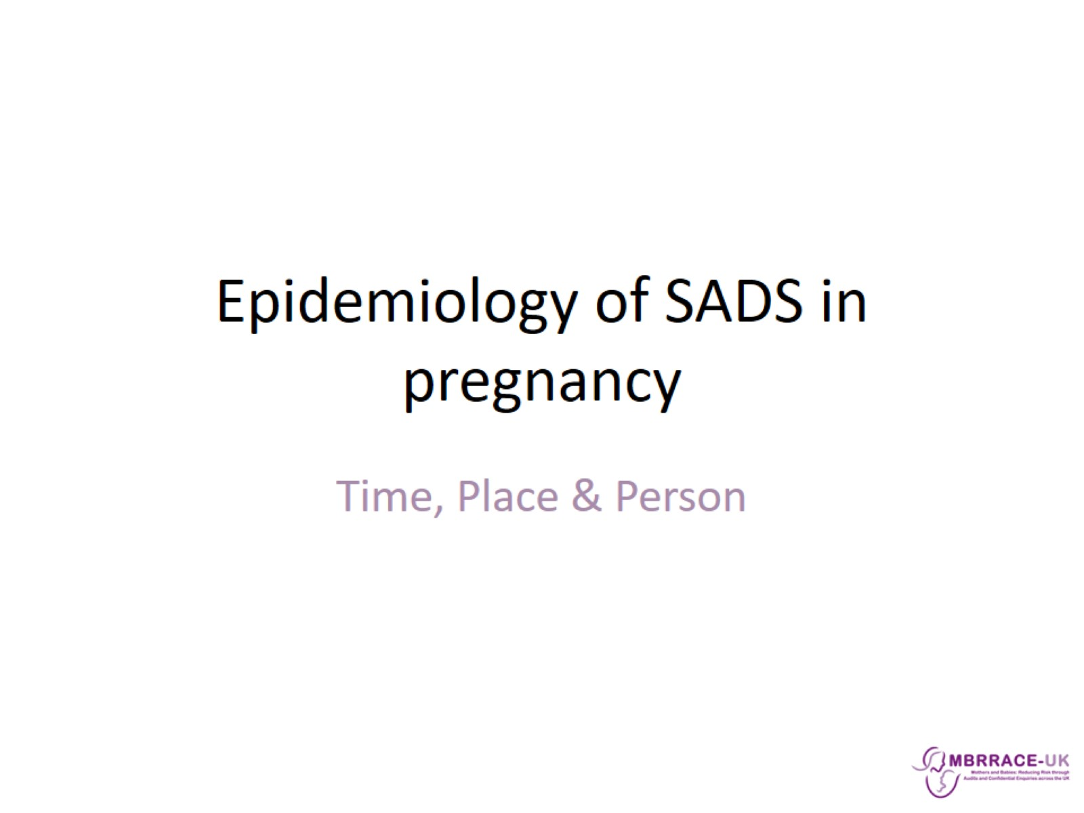
Epidemiology of SADS in pregnancy

Slide 12
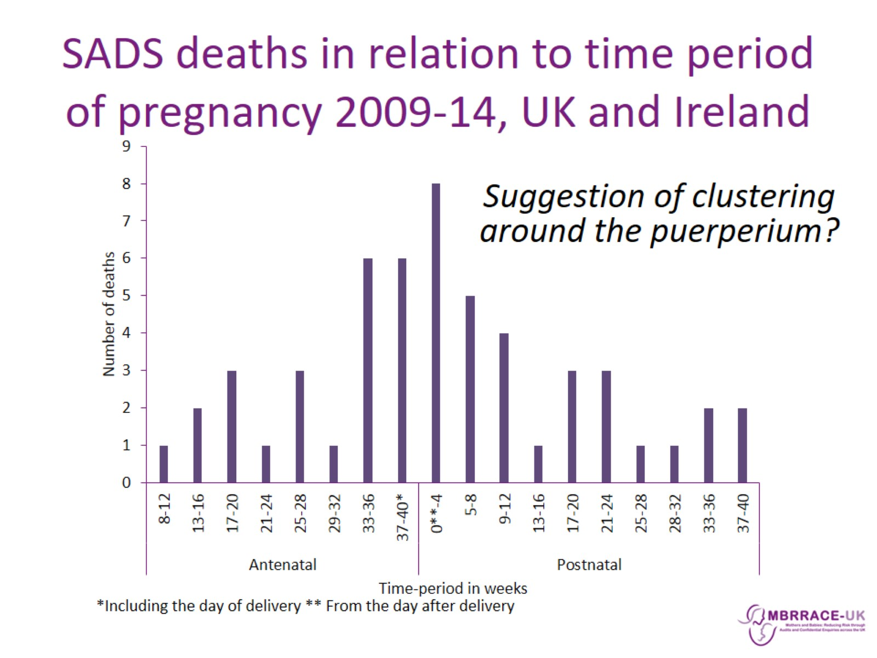
SADS deaths in relation to time period of pregnancy 2009-14, UK and Ireland

Slide 13
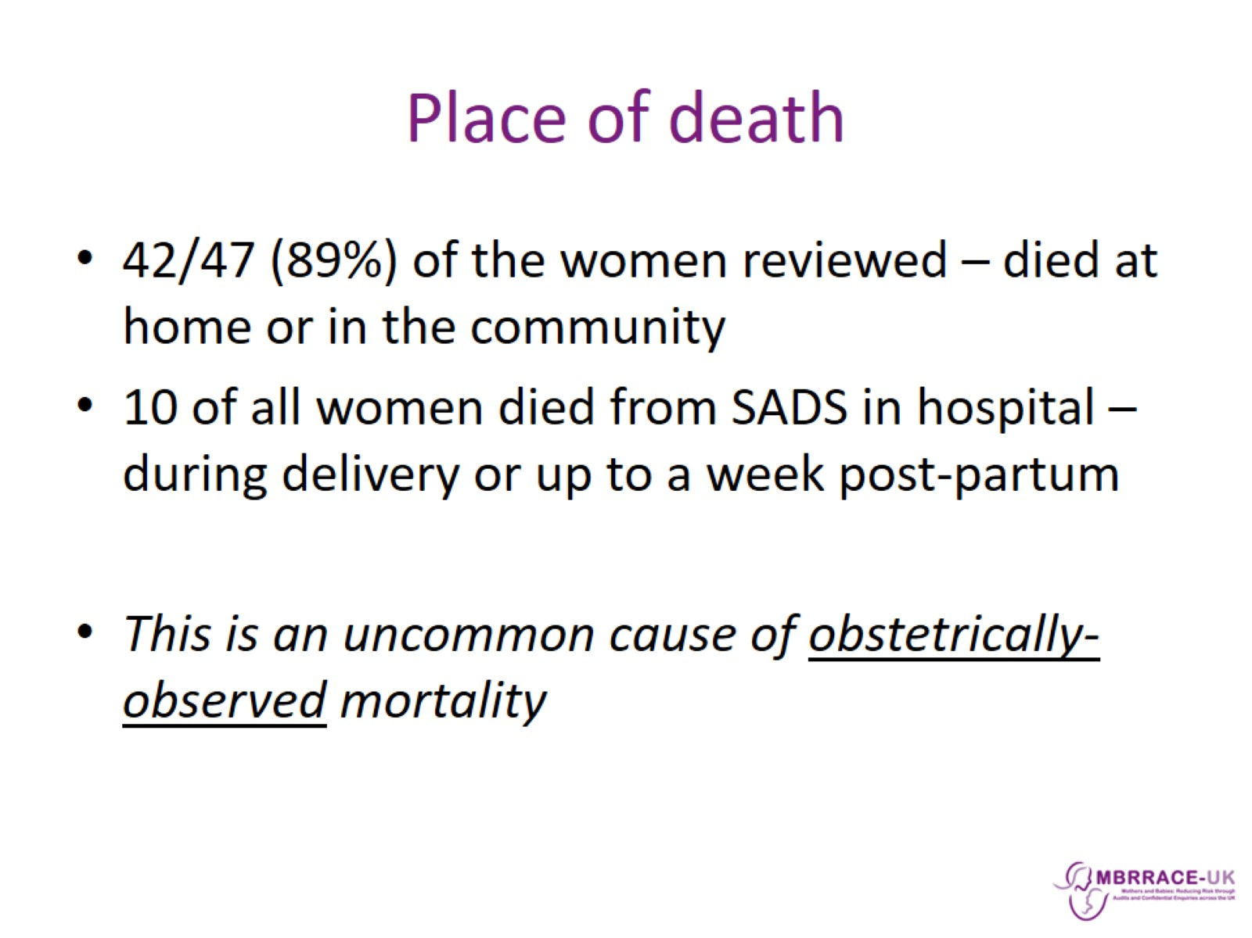
Place of death

Slide 14
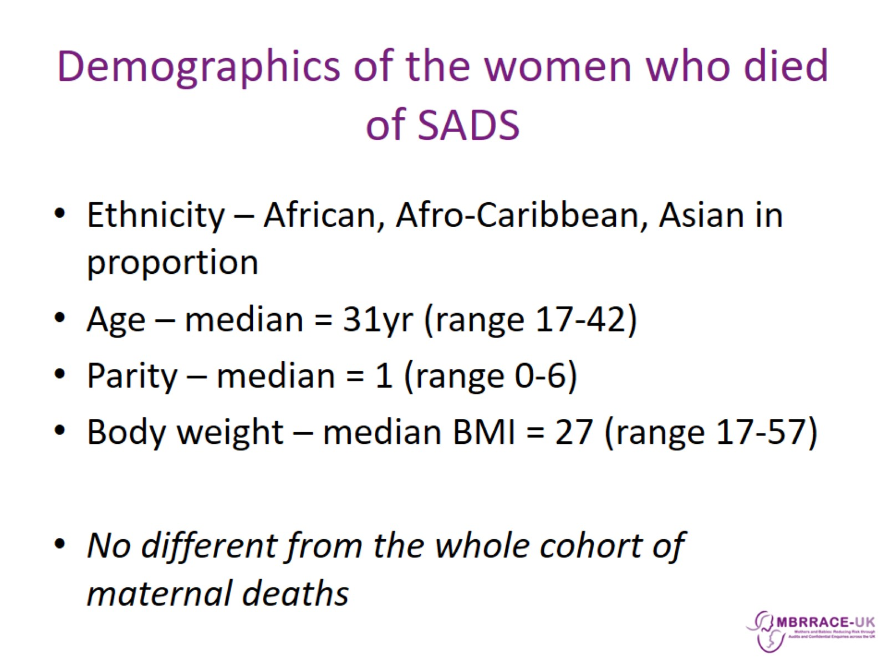
Demographics of the women who died of SADS

Slide 15
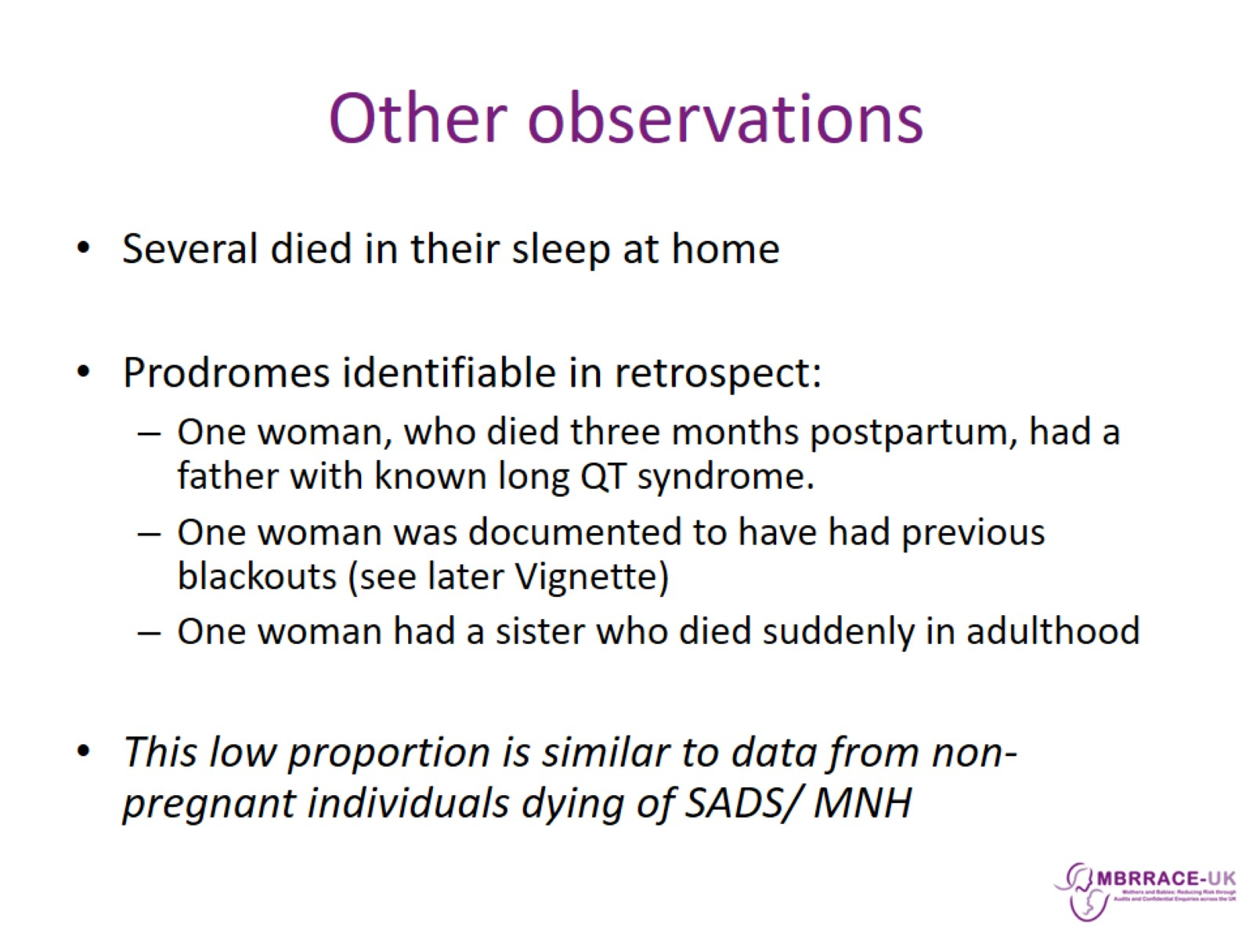
Other observations

Slide 16
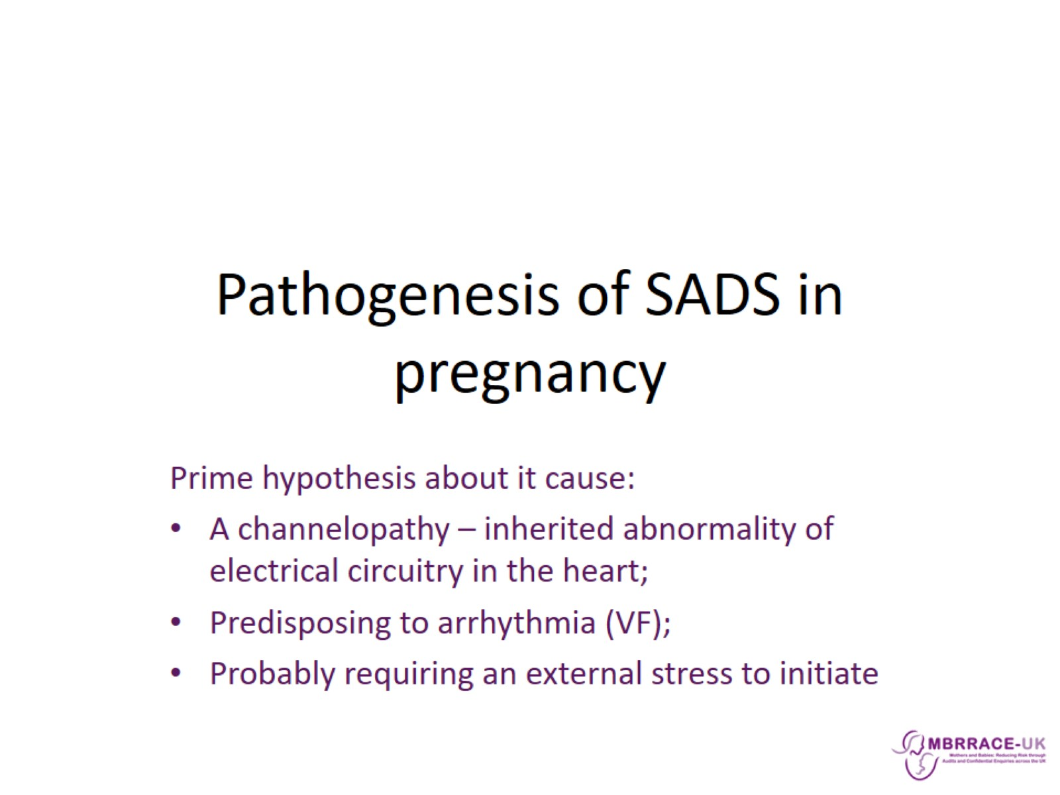
Pathogenesis of SADS in pregnancy

Slide 17
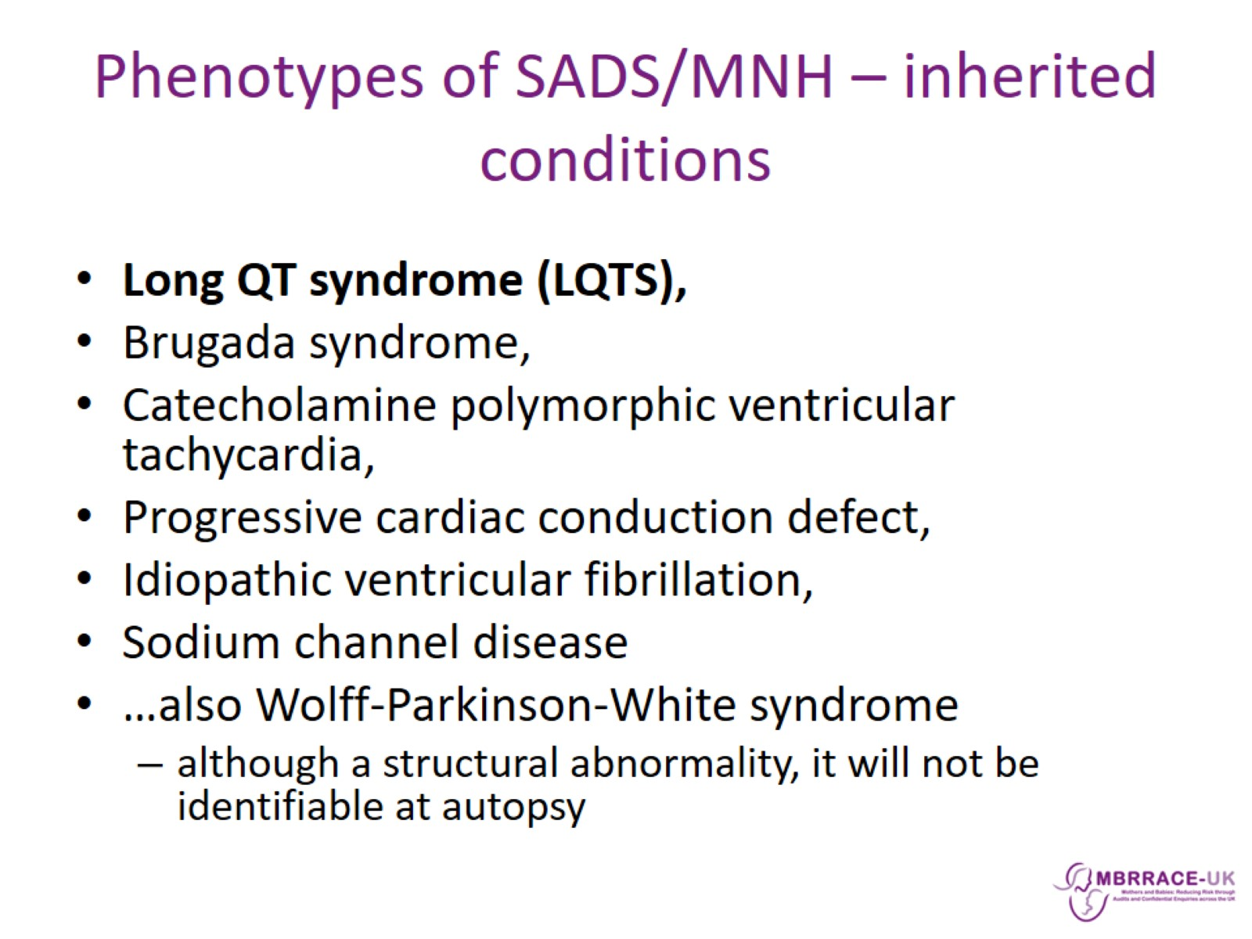
Phenotypes of SADS/MNH – inherited conditions

Slide 18
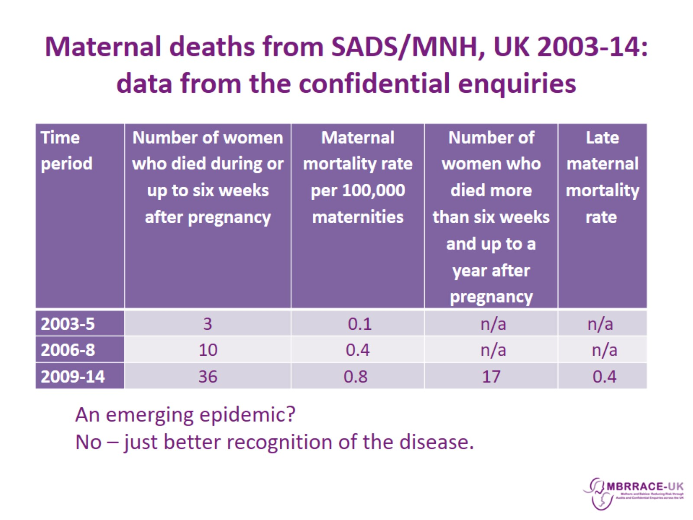
Maternal deaths from SADS/MNH, UK 2003-14: data from the confidential enquiries

Slide 19
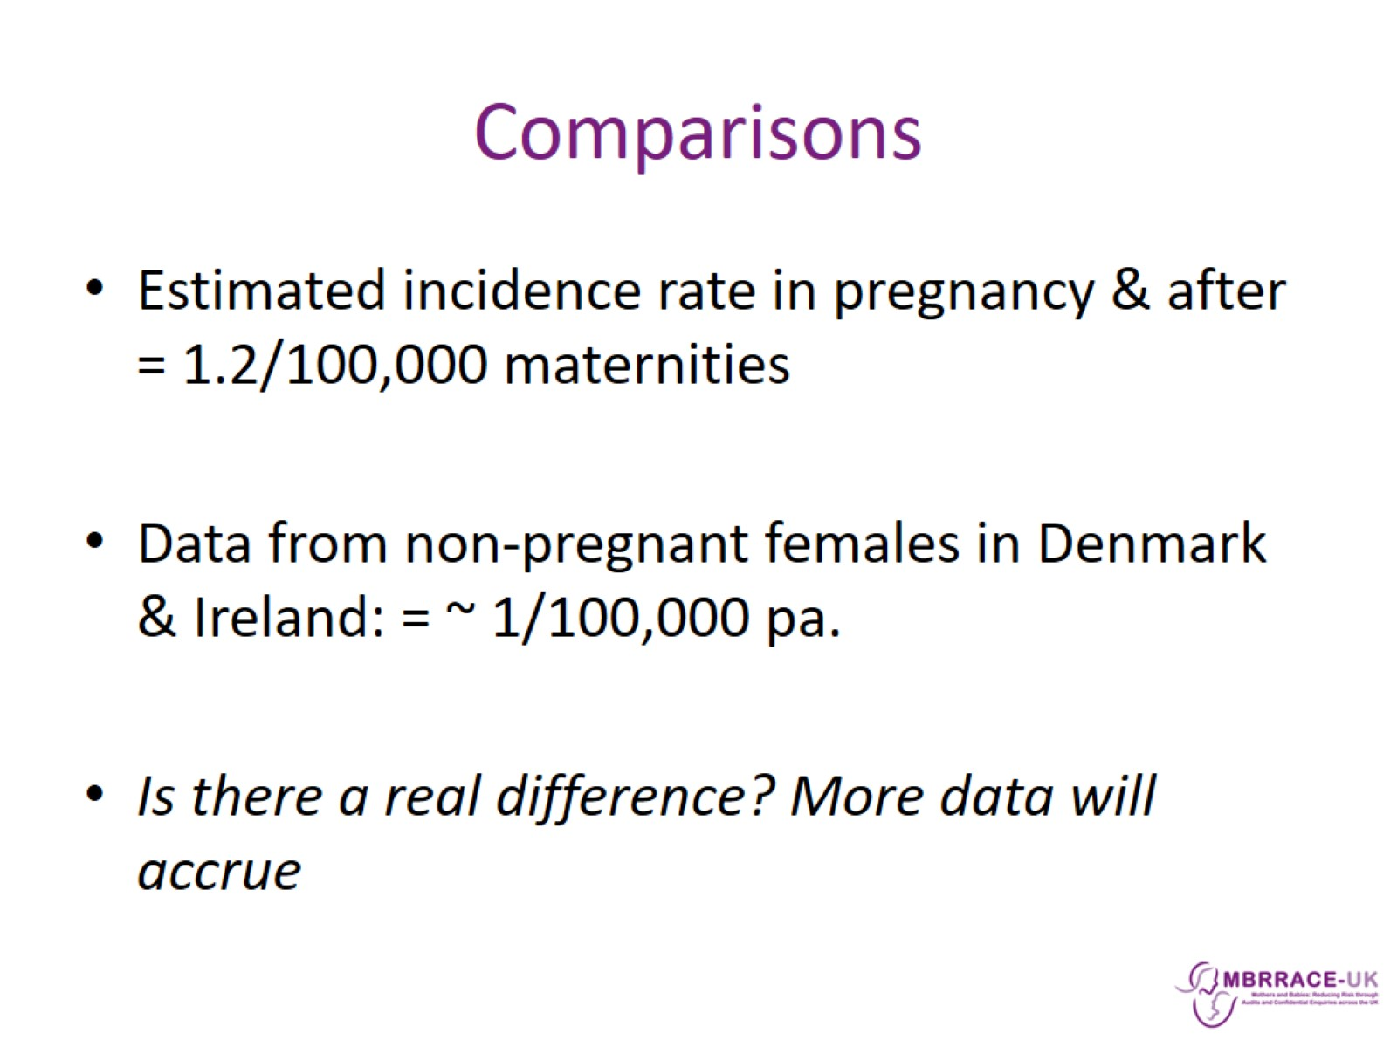
Comparisons

Slide 20
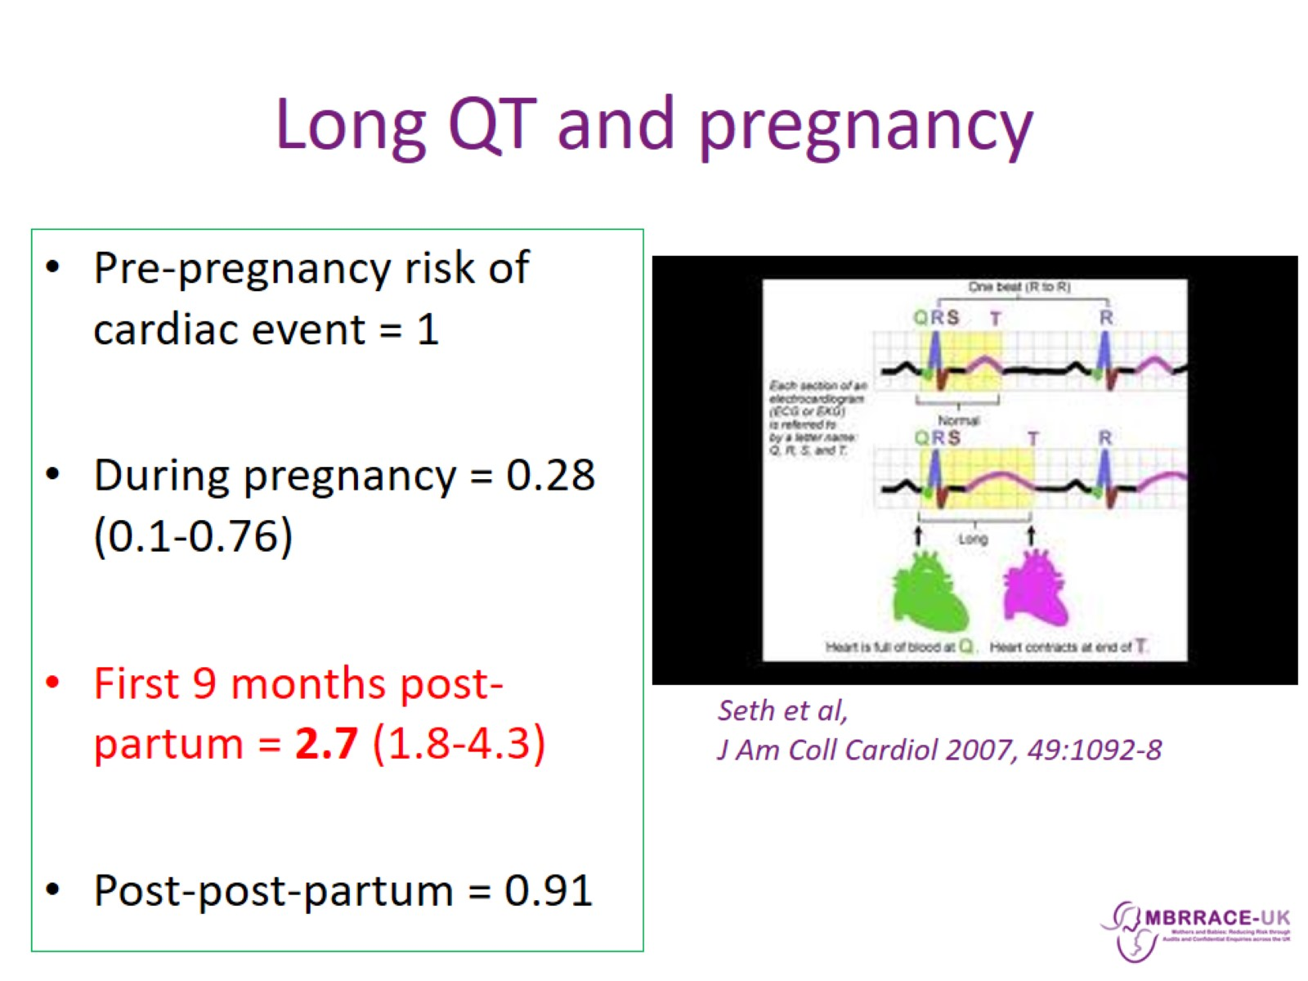
Long QT and pregnancy

Slide 21
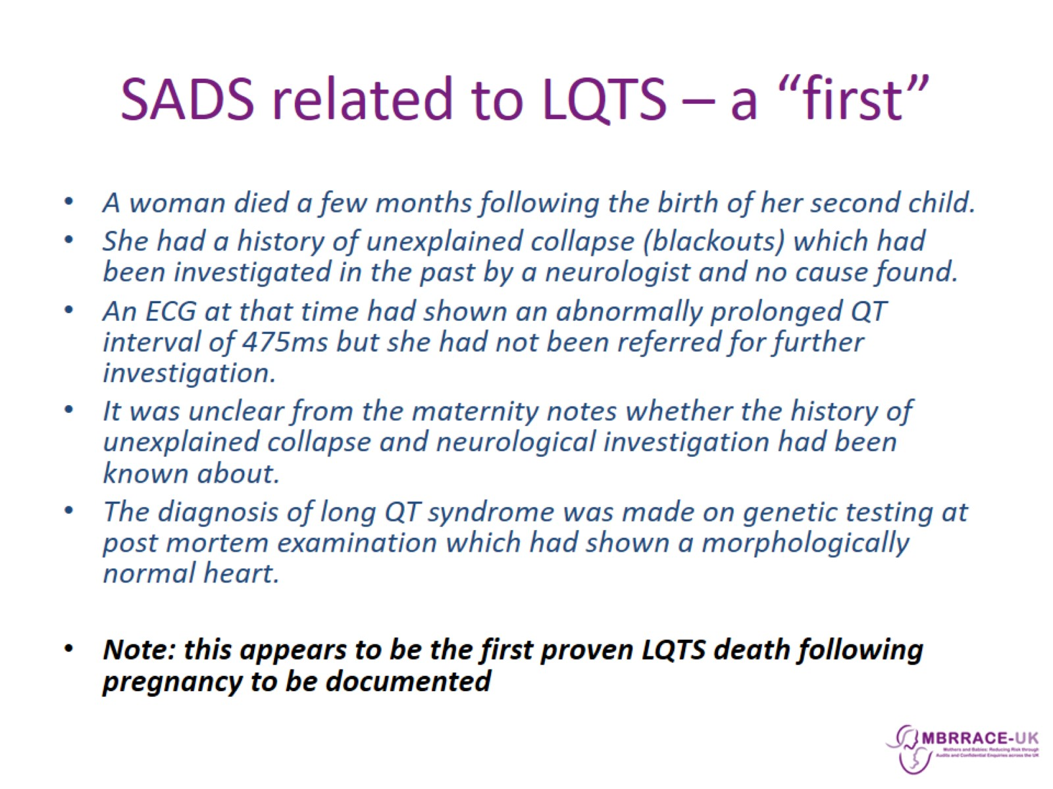
SADS related to LQTS – a “first”

Slide 22
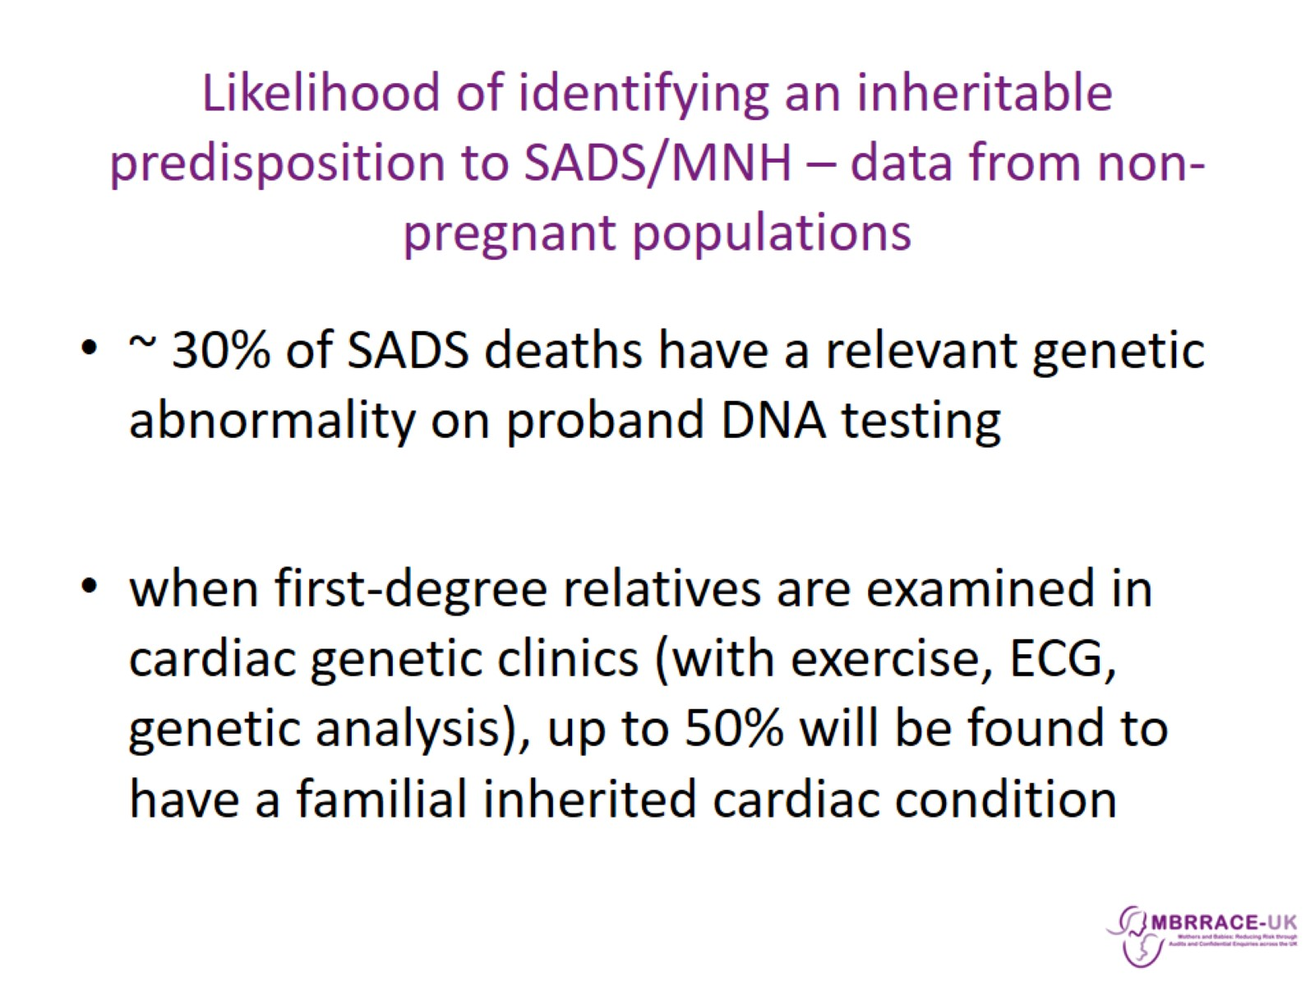
Likelihood of identifying an inheritable predisposition to SADS/MNH – data from non-pregnant populations

Slide 23
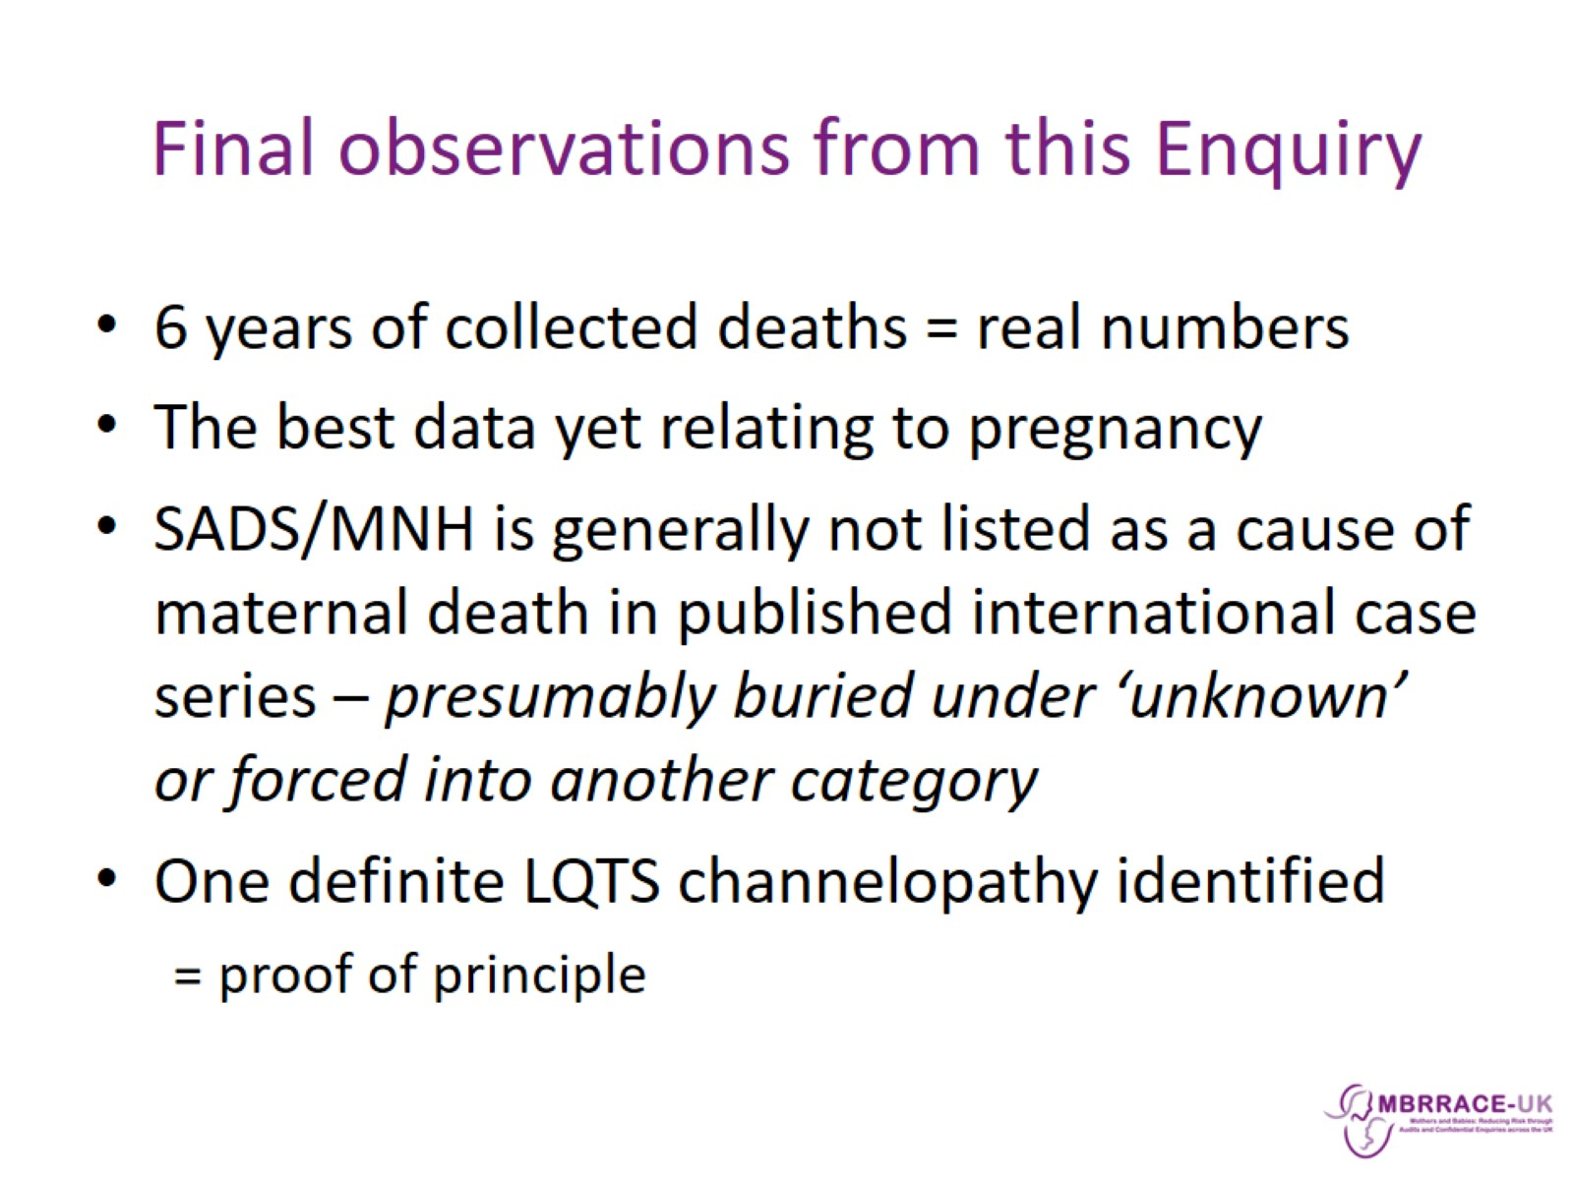
Final observations from this Enquiry

Slide 24
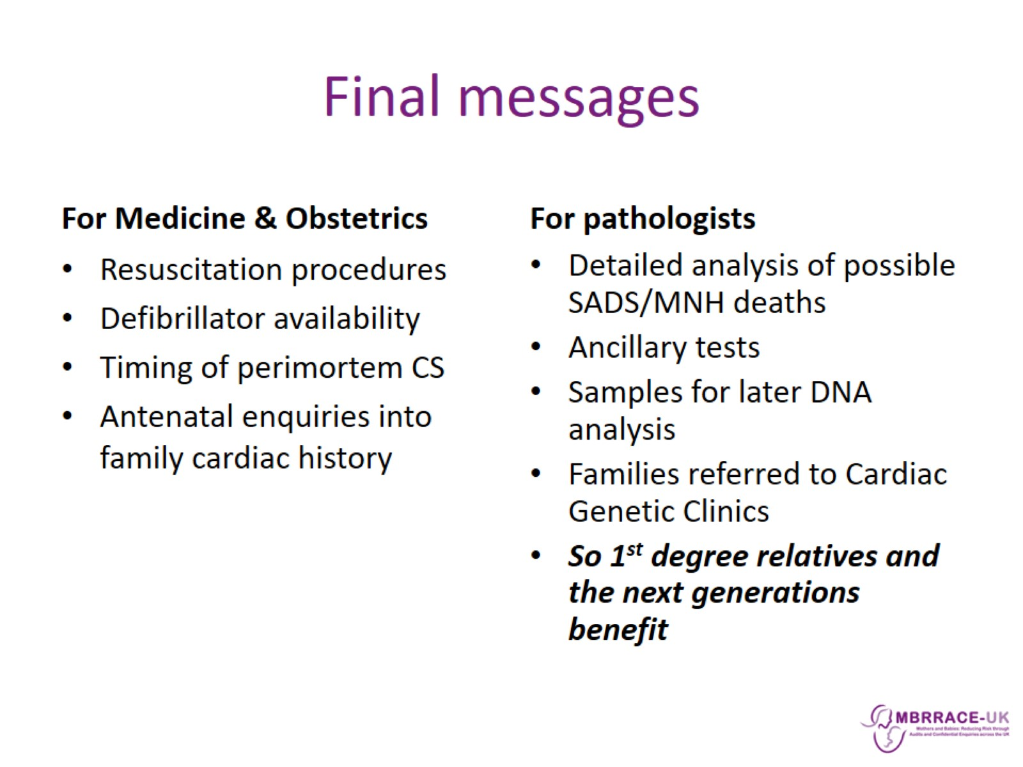
Final messages

