Slide 1
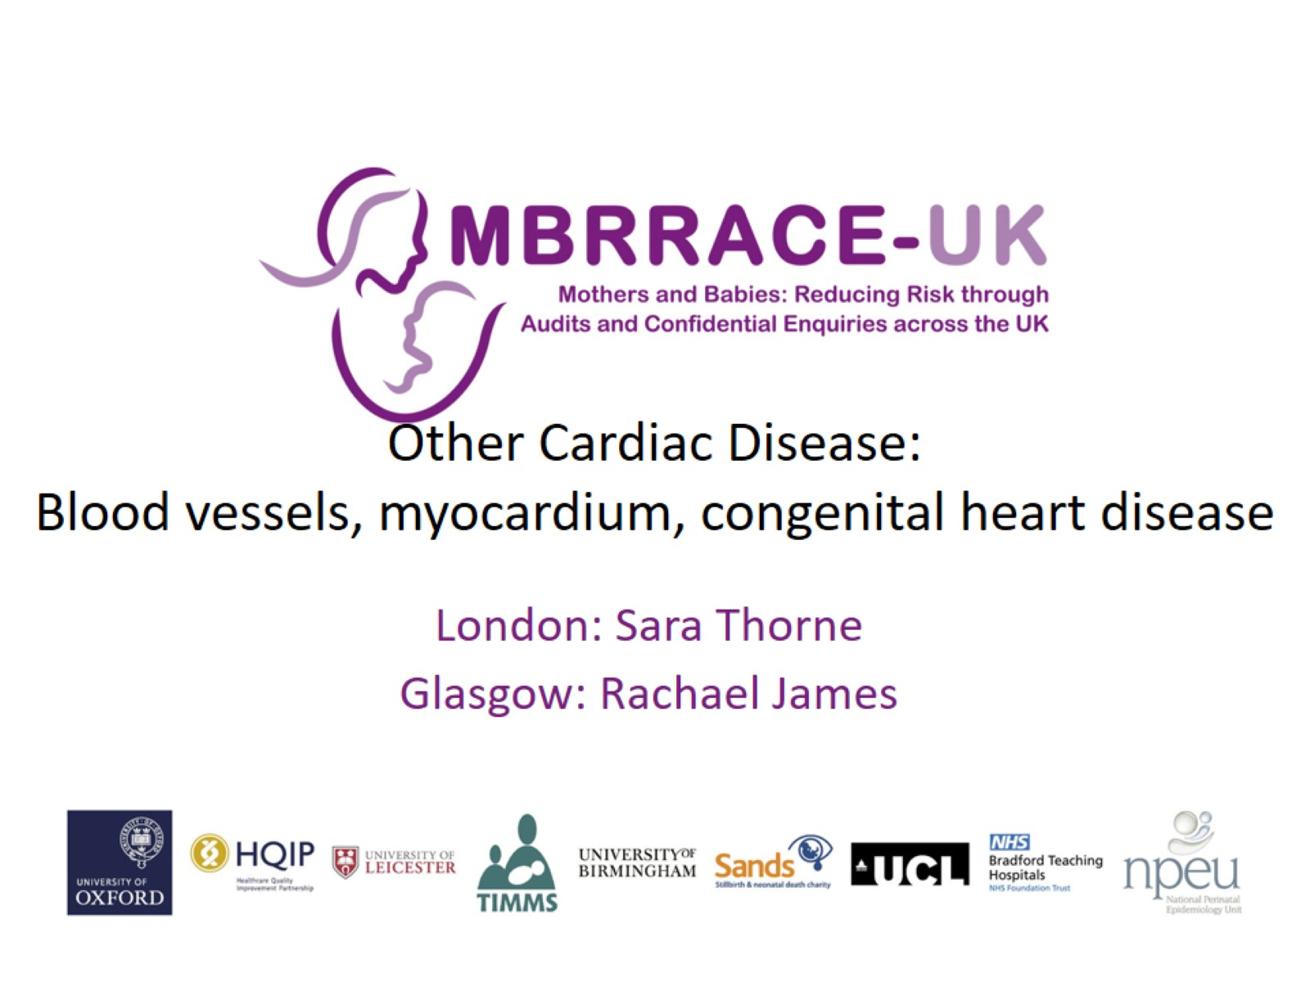
Other Cardiac Disease:
Blood vessels, myocardium, congenital heart disease

Slide 2
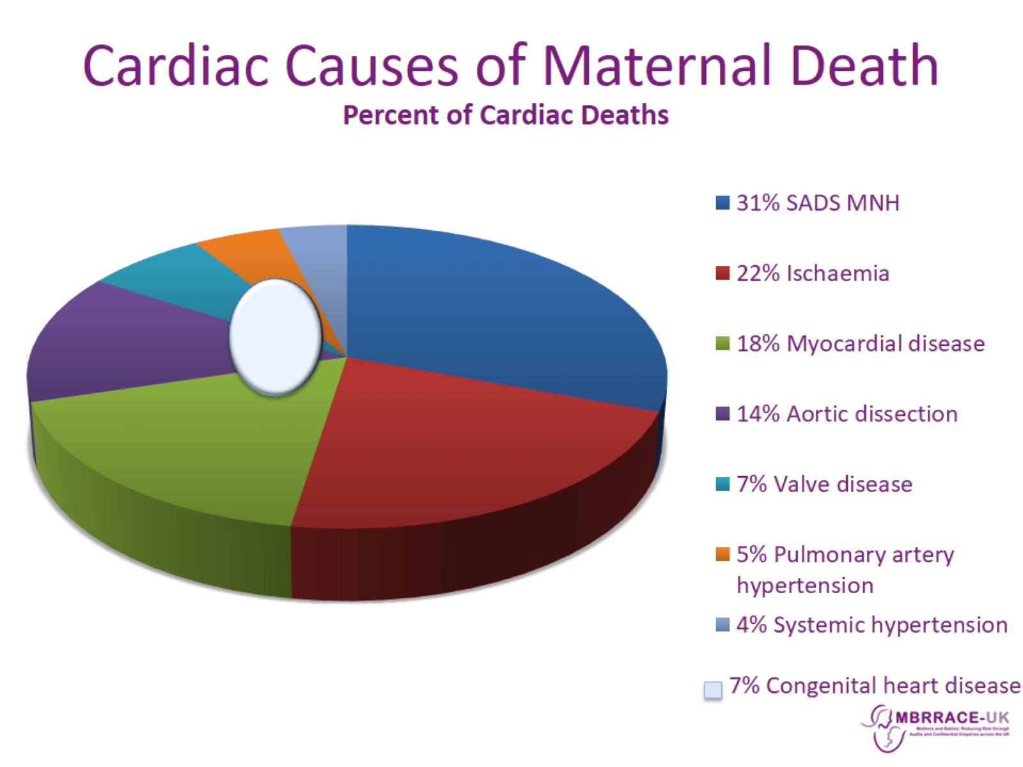
Cardiac Causes of Maternal Death

Slide 3
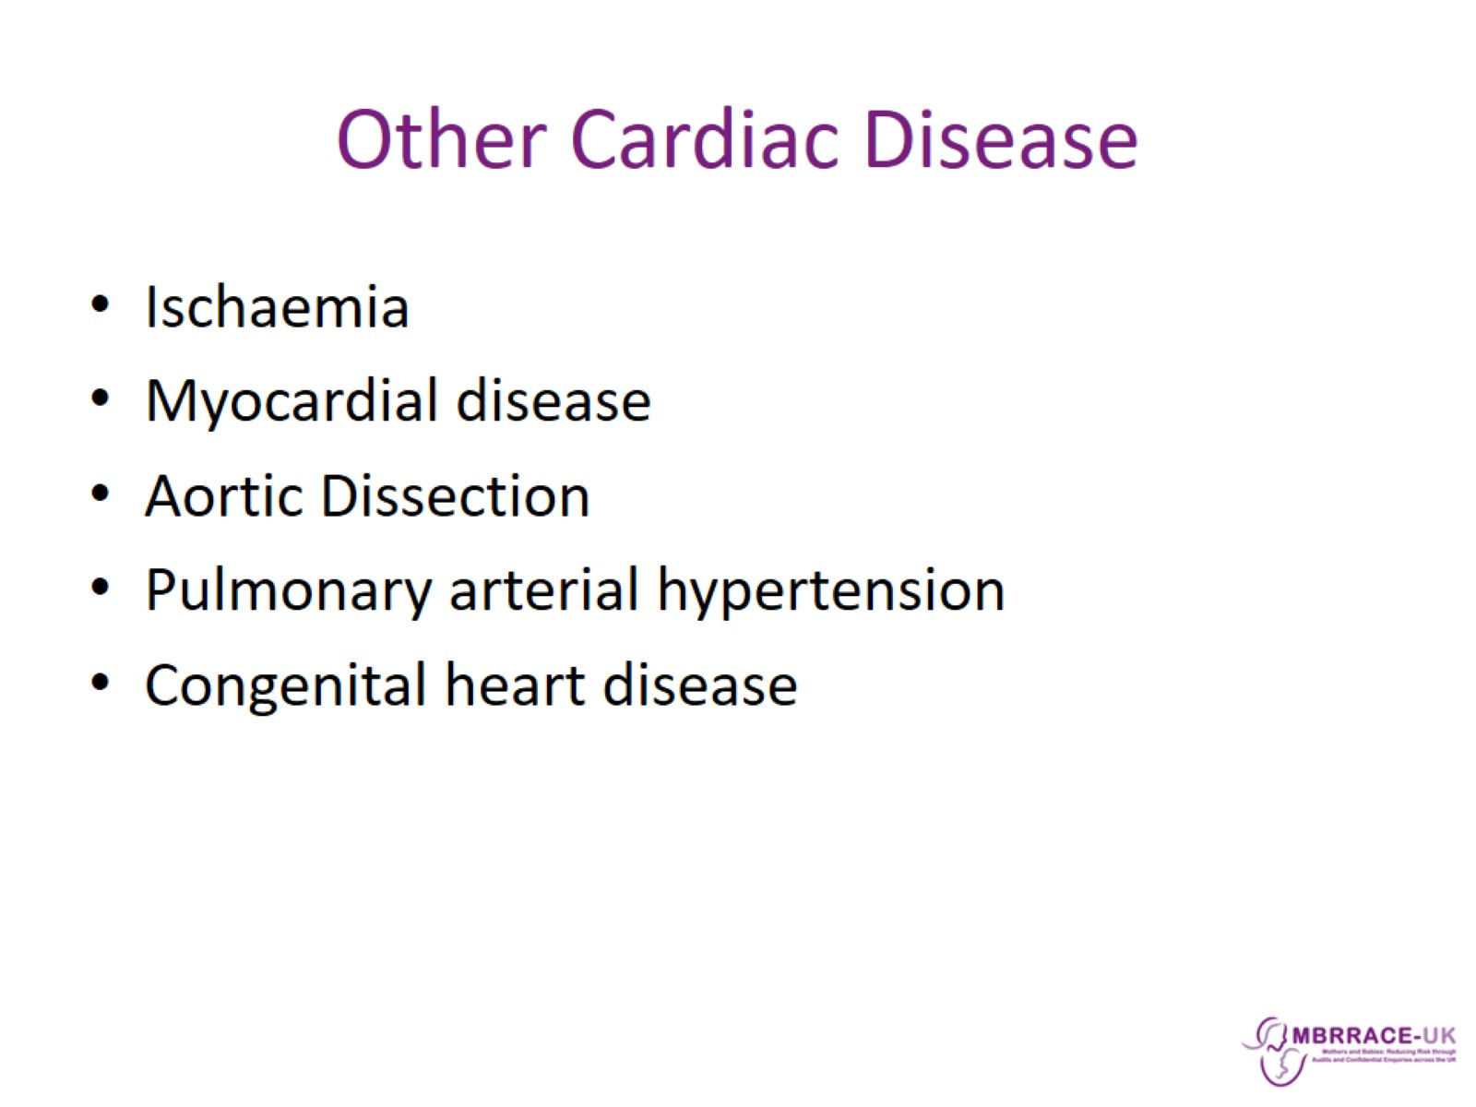
Other Cardiac Disease

Slide 4
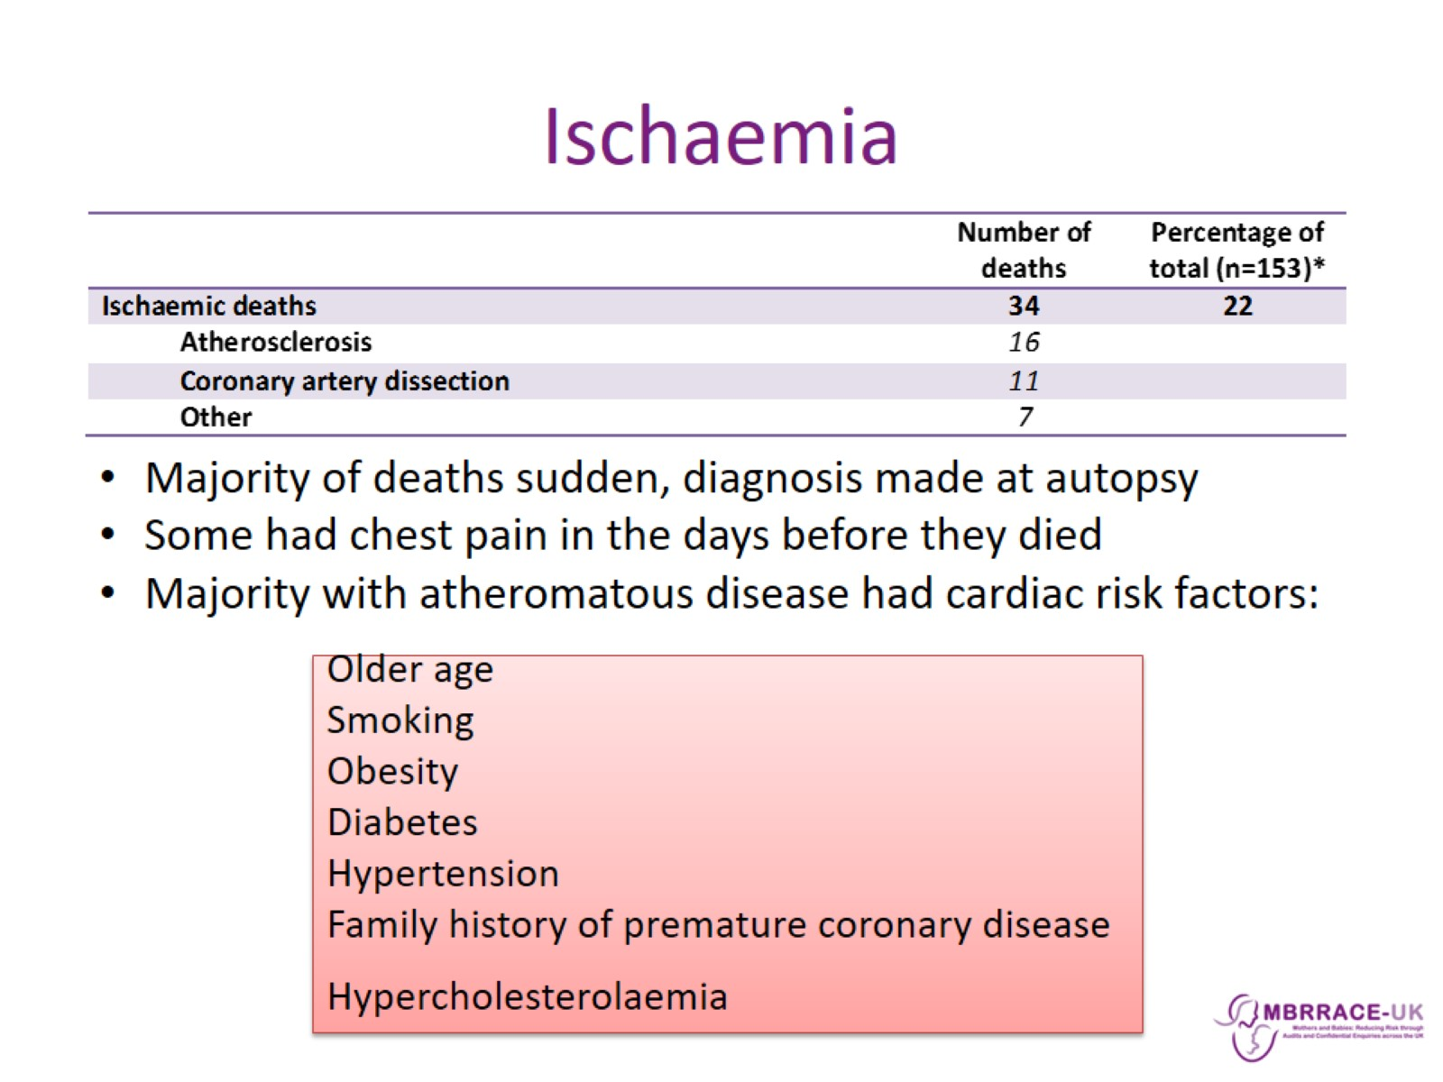
Ischaemia

Slide 5
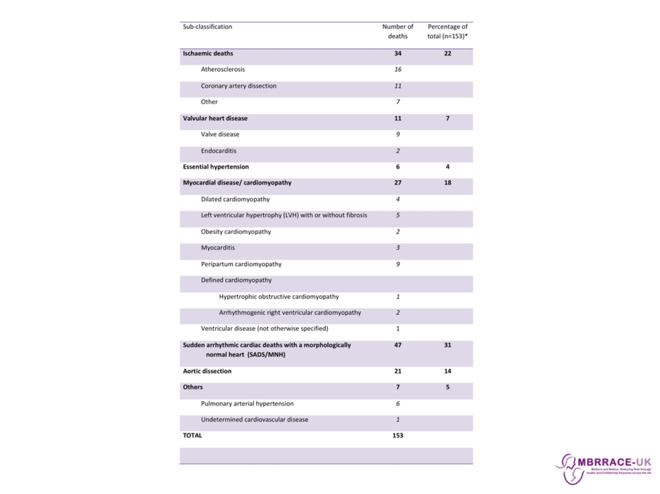

Slide 6
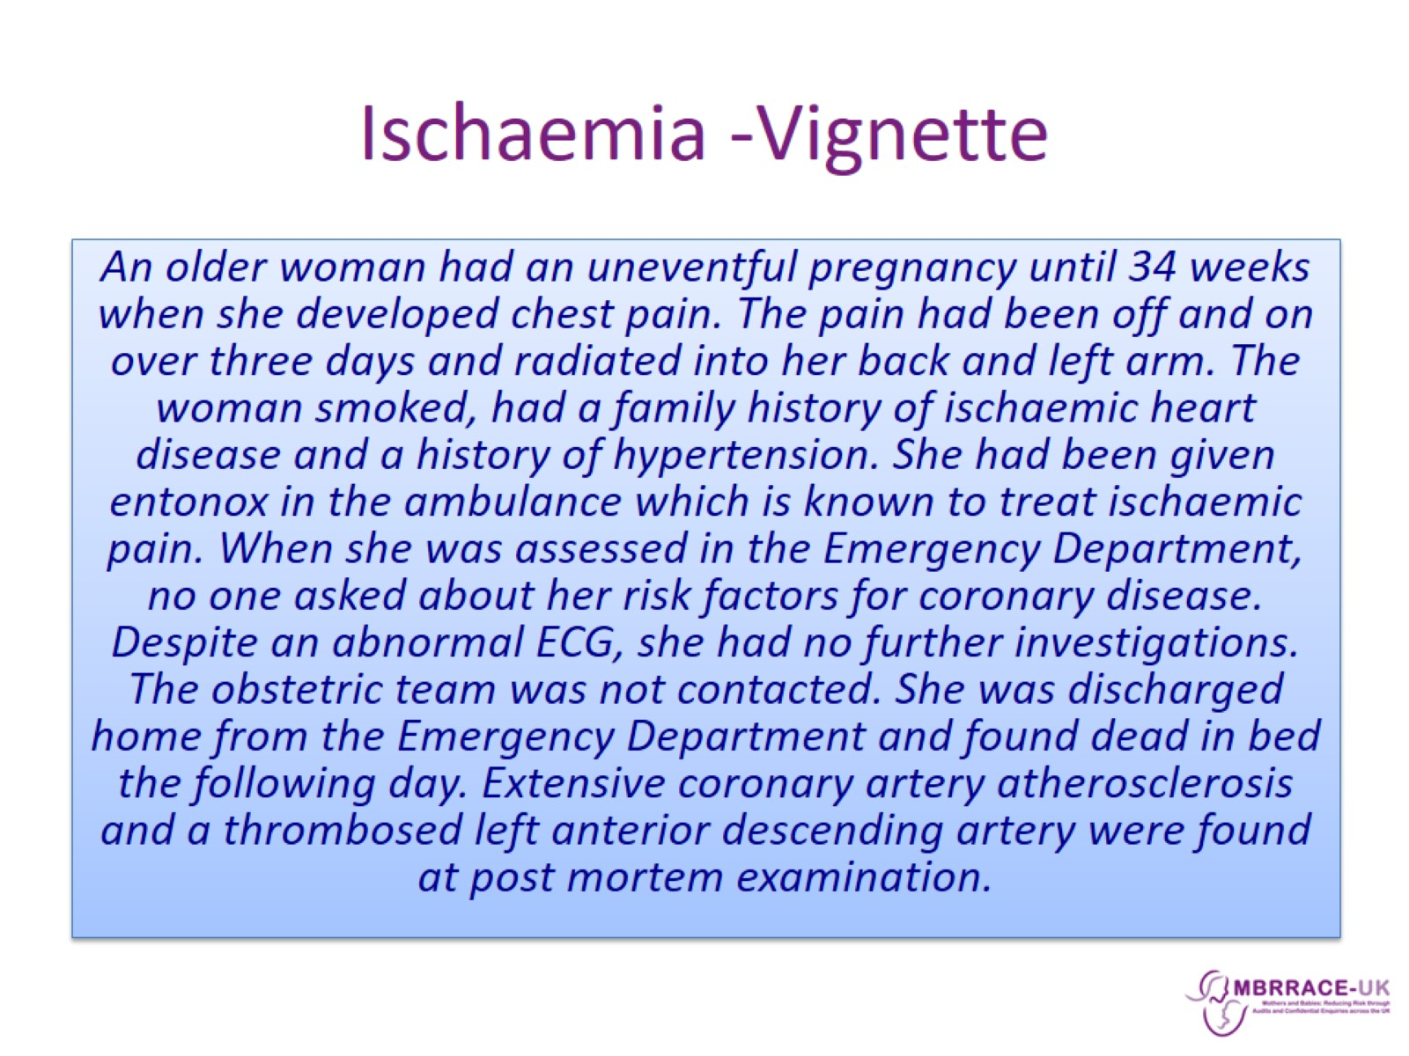
Ischaemia -Vignette

Slide 7
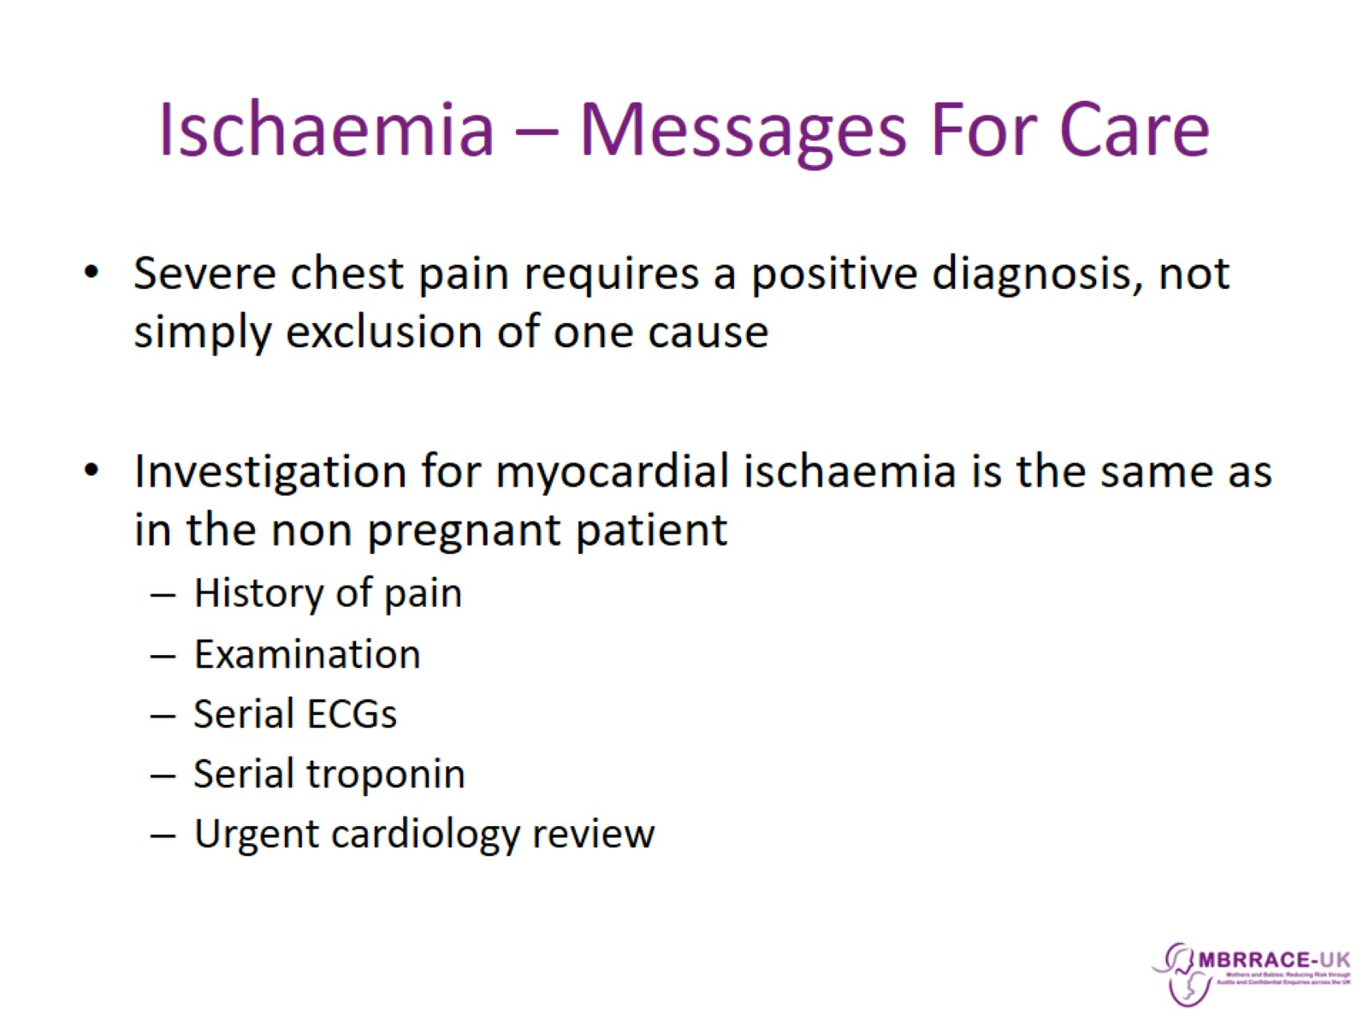
Ischaemia – Messages For Care

Slide 8
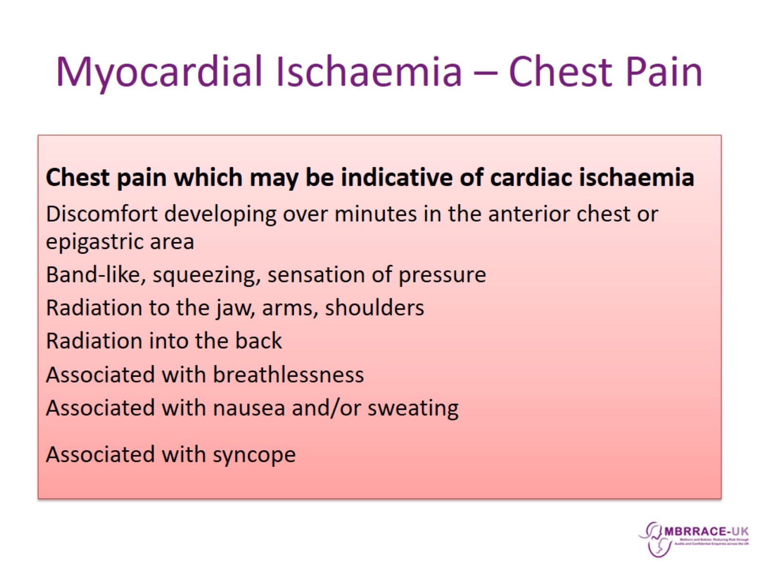
Myocardial Ischaemia – Chest Pain

Slide 9
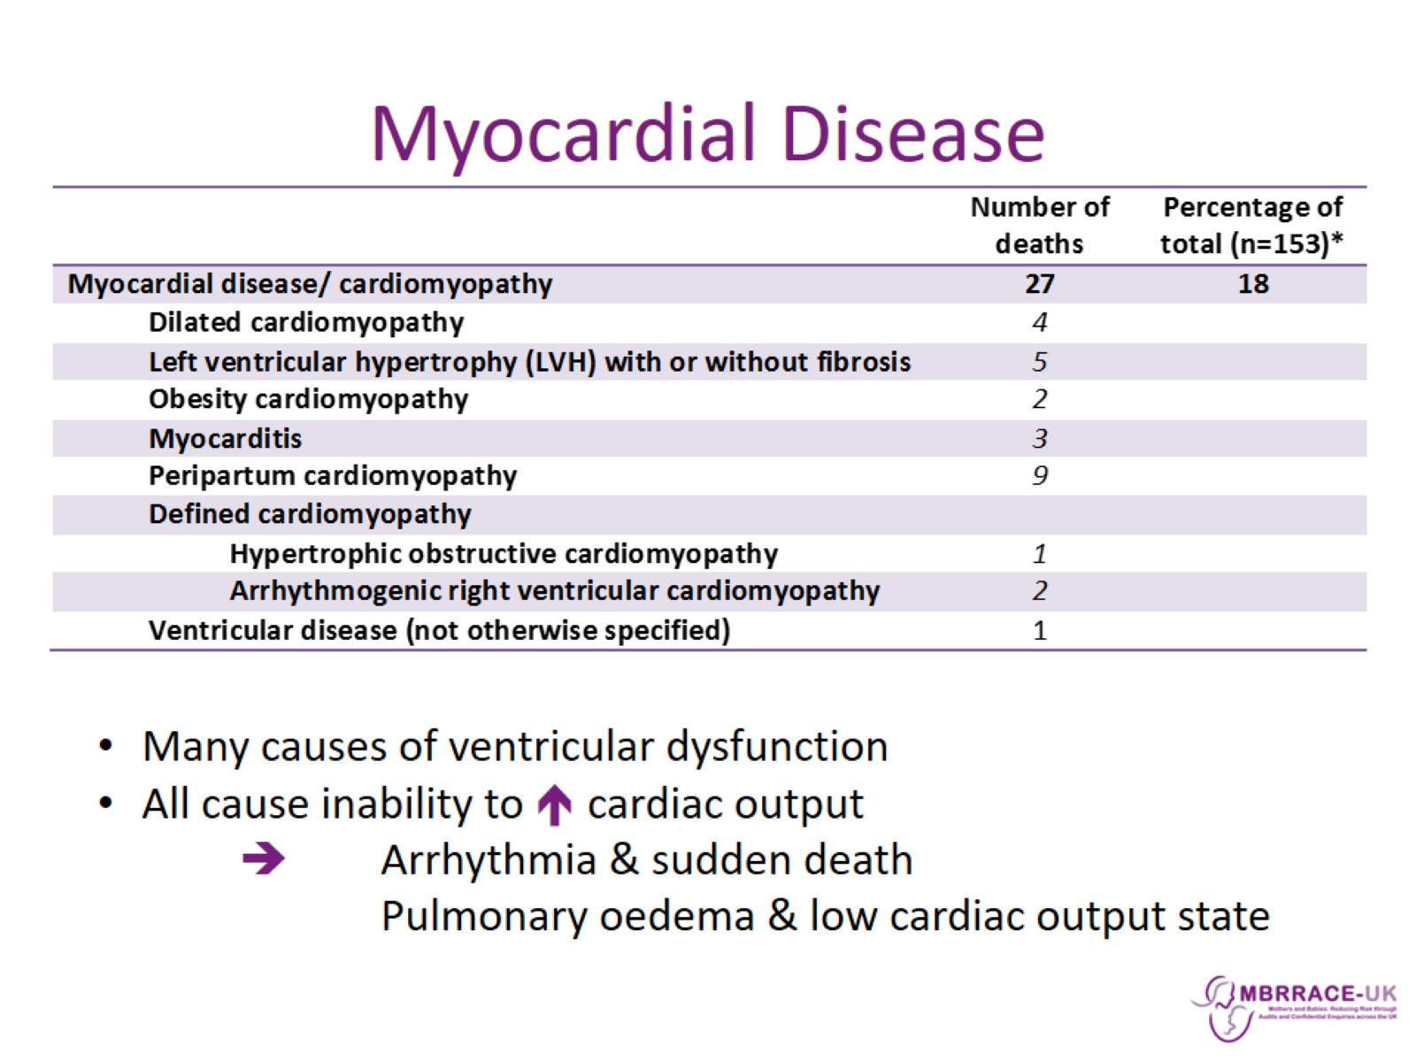
Myocardial Disease

Slide 10
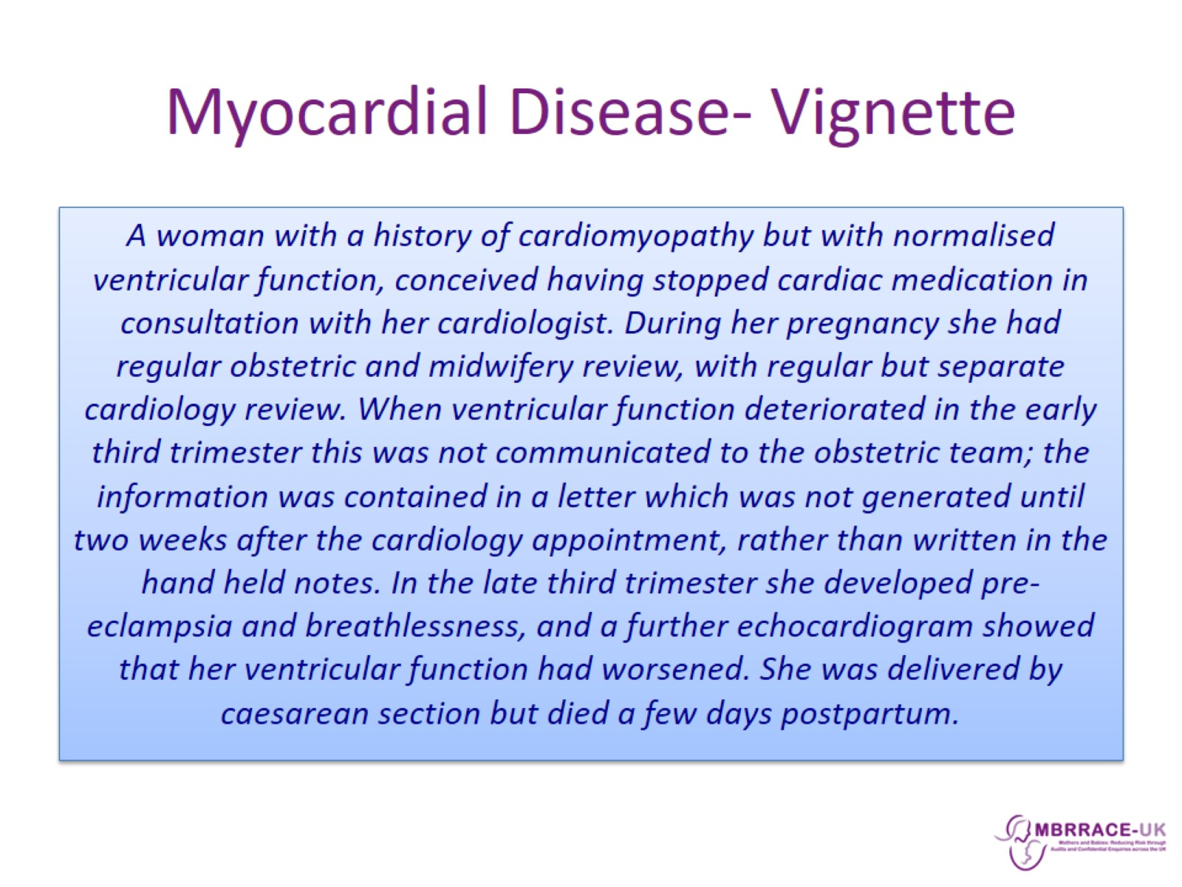
Myocardial Disease- Vignette

Slide 11
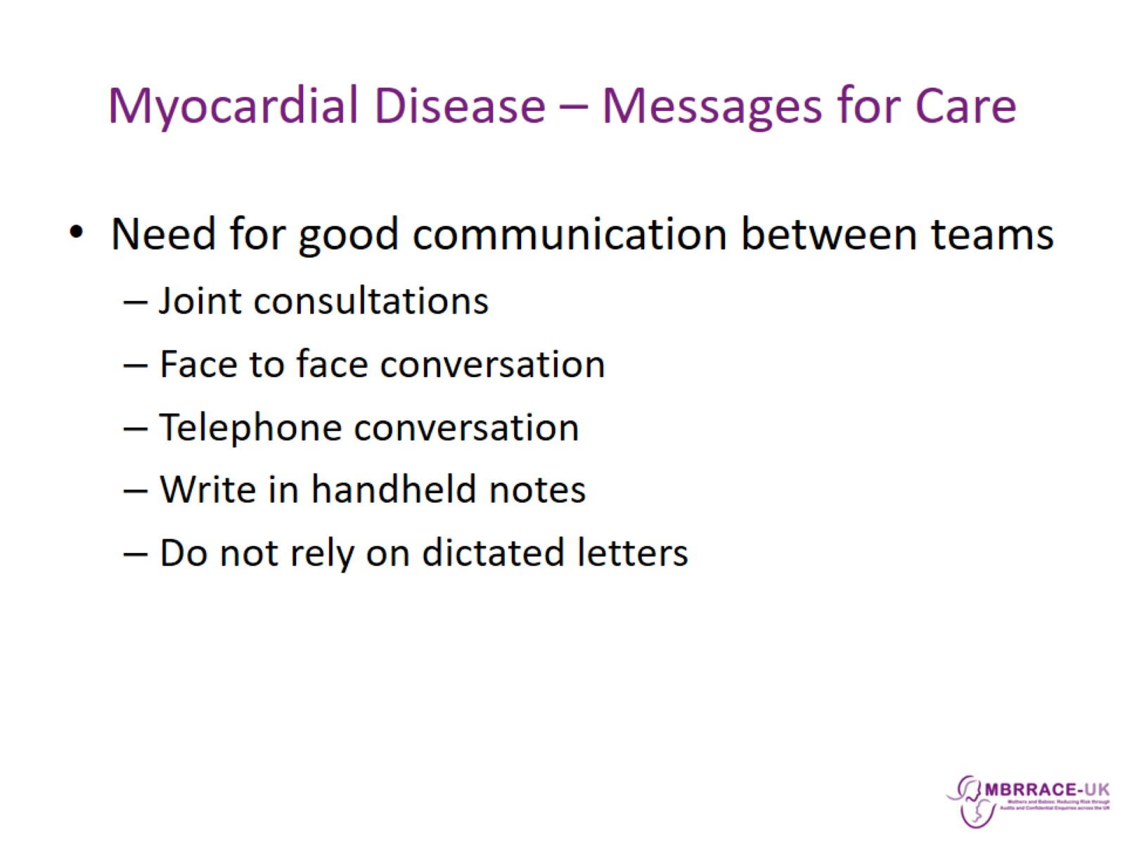
Myocardial Disease – Messages for Care

Slide 12
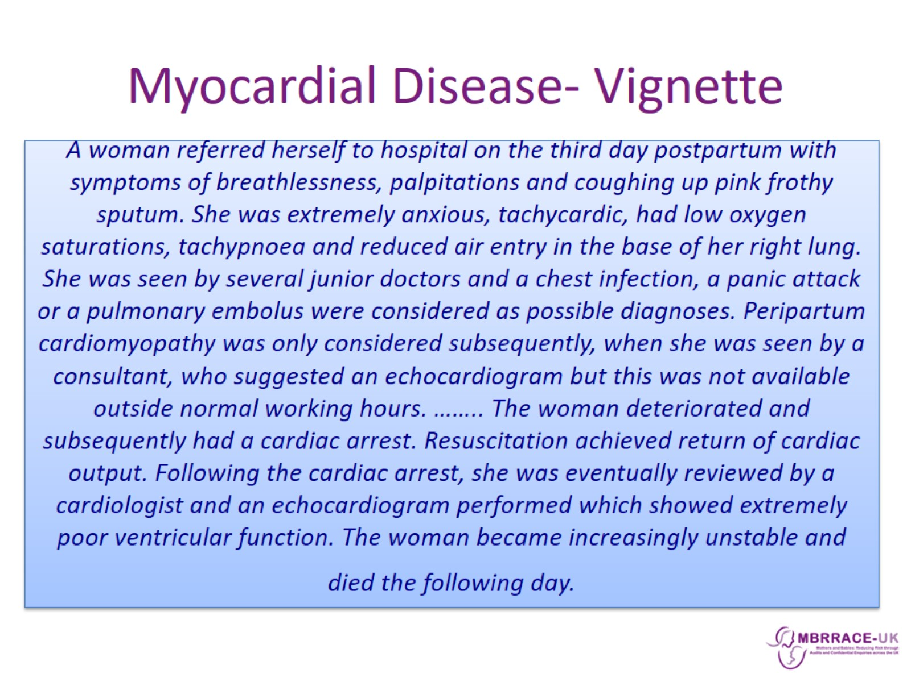
Myocardial Disease- Vignette

Slide 13
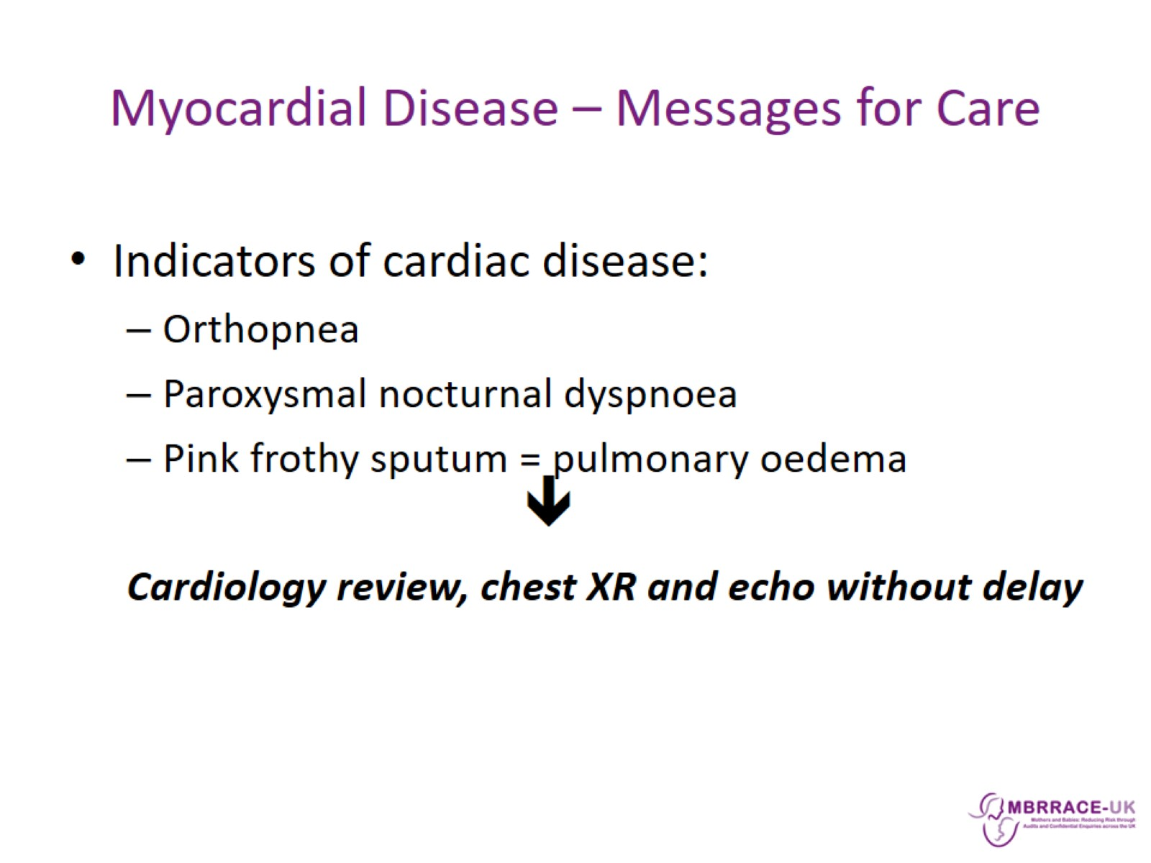
Myocardial Disease – Messages for Care

Slide 14
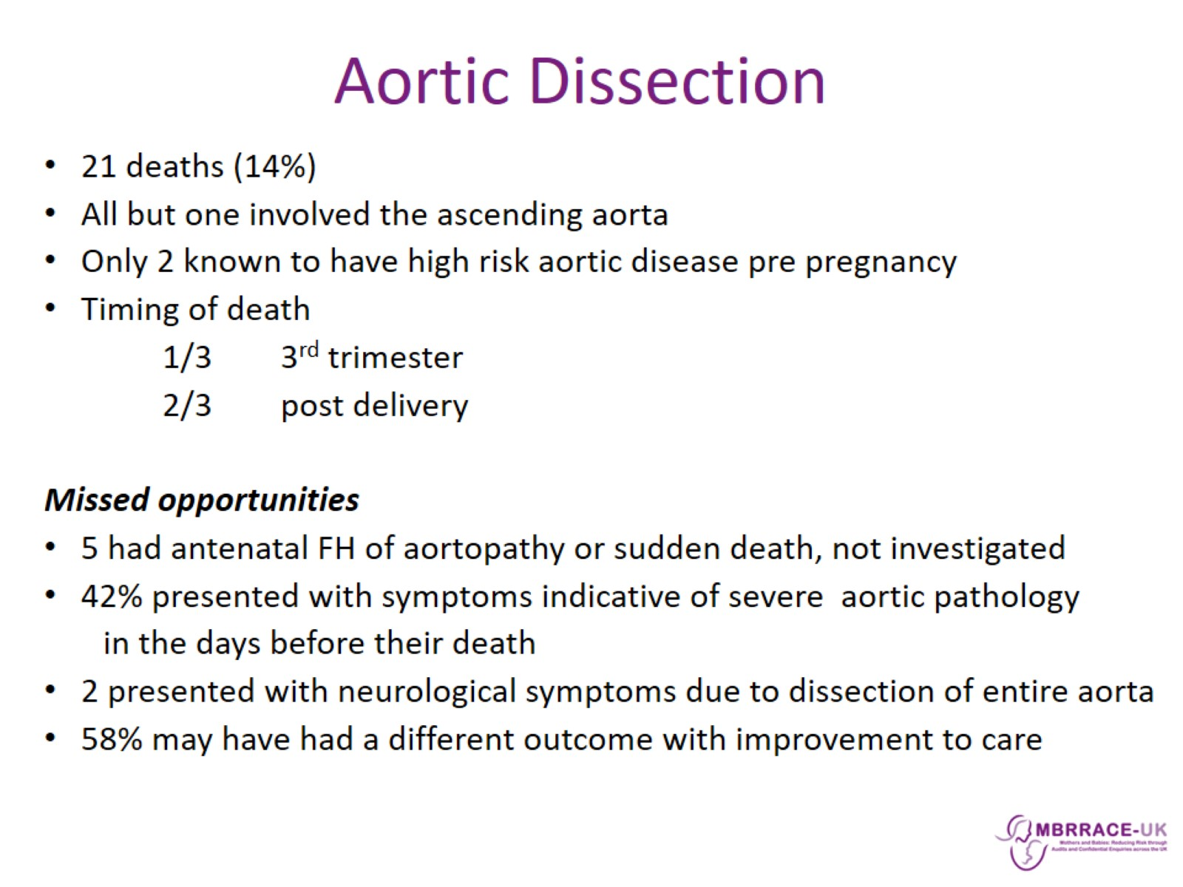
Aortic Dissection

Slide 15
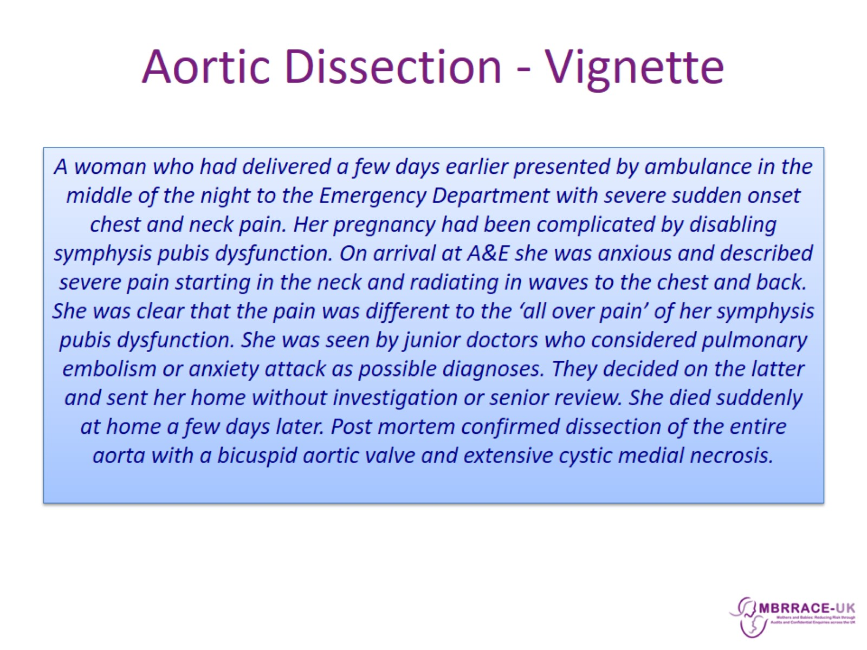
Aortic Dissection - Vignette

Slide 16
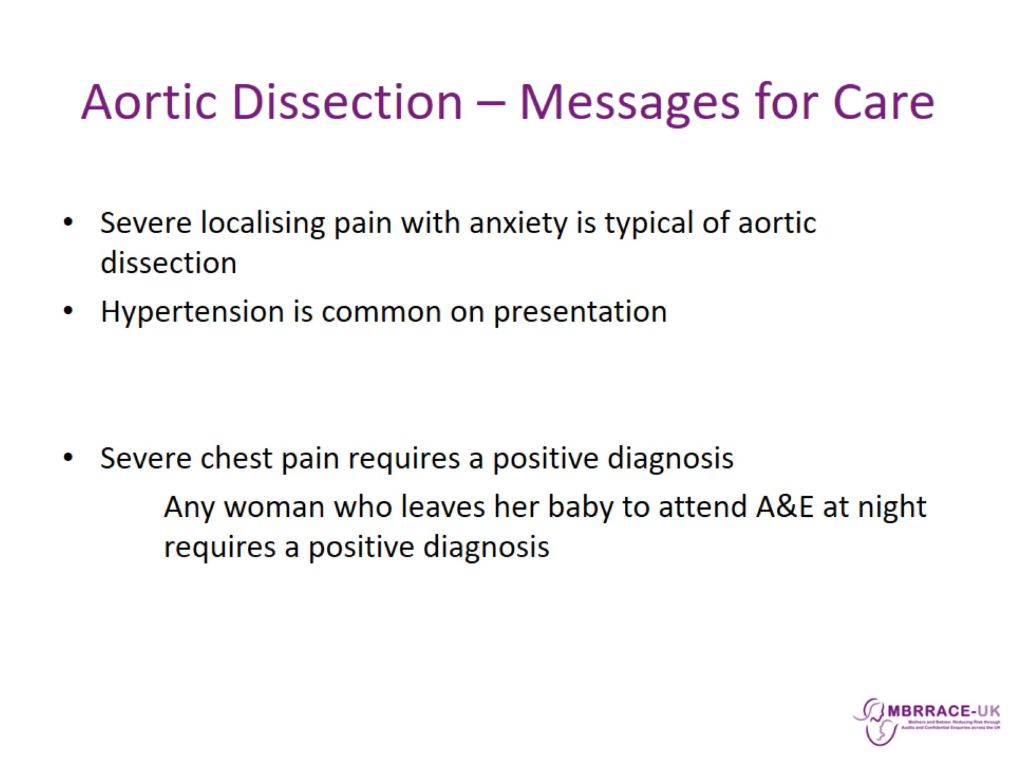
Aortic Dissection – Messages for Care

Slide 17
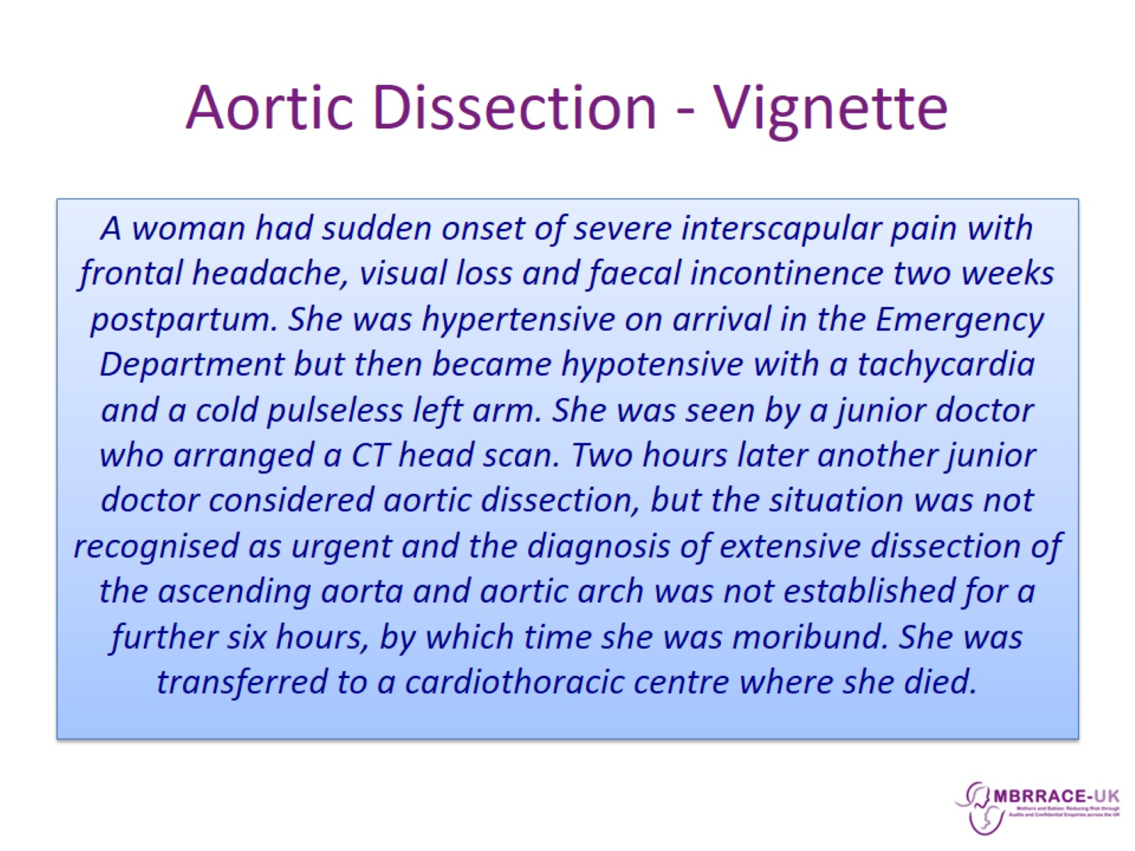
Aortic Dissection - Vignette

Slide 18
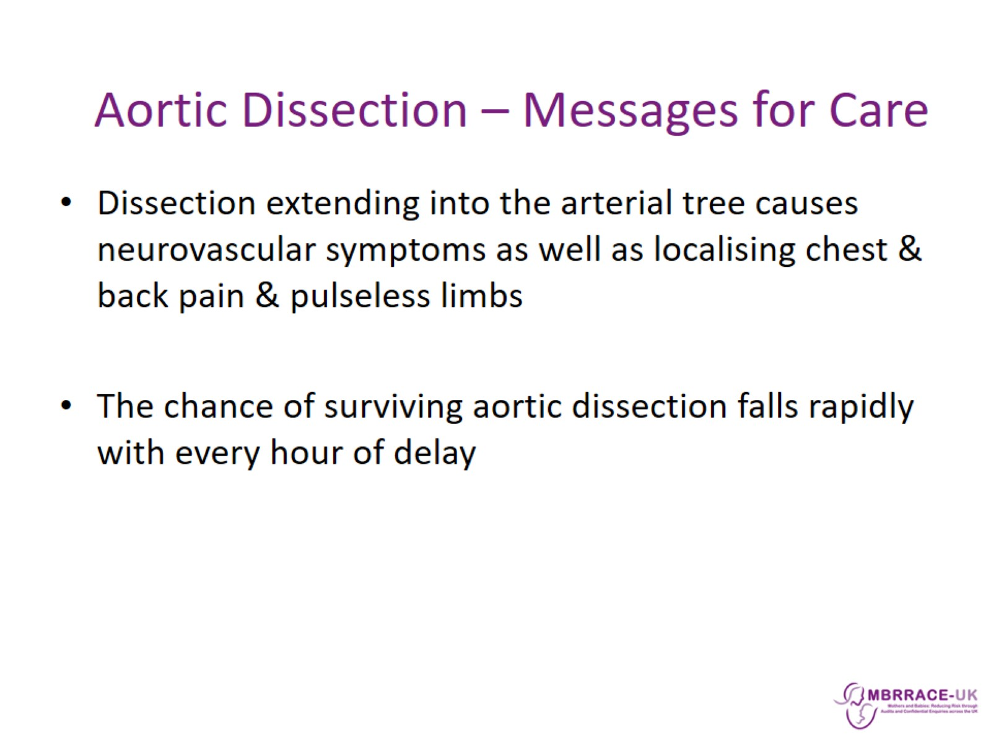

Slide 19
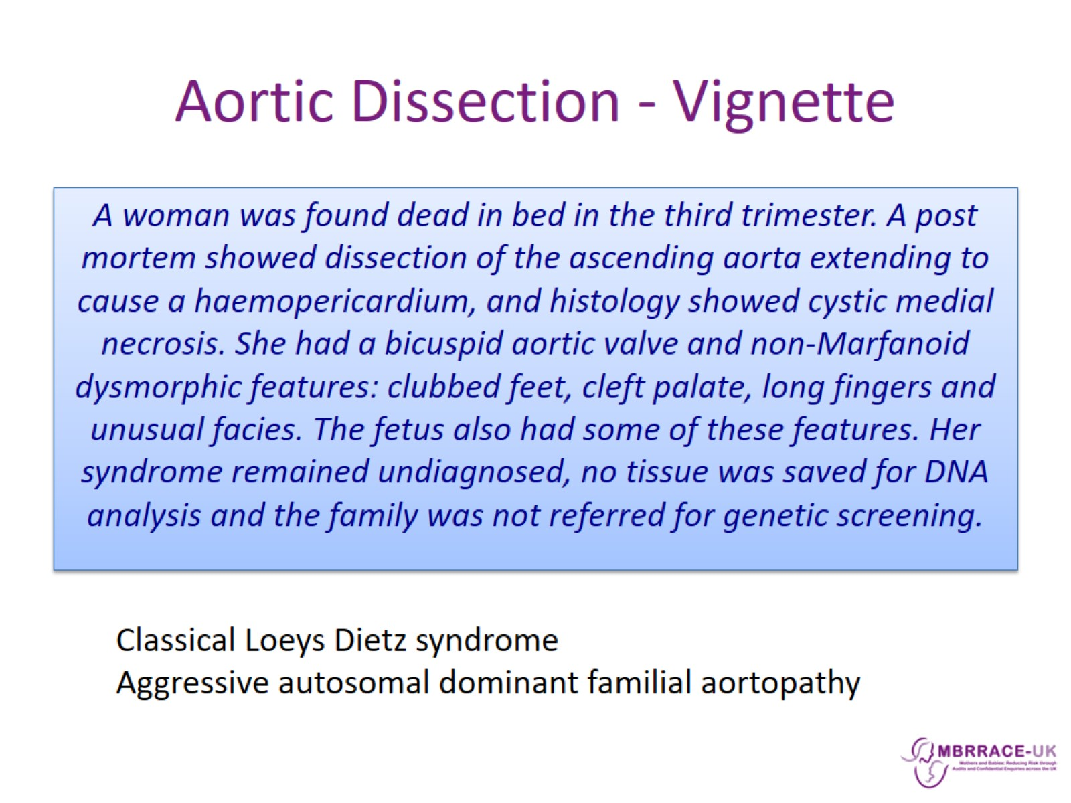
Aortic Dissection - Vignette

Slide 20
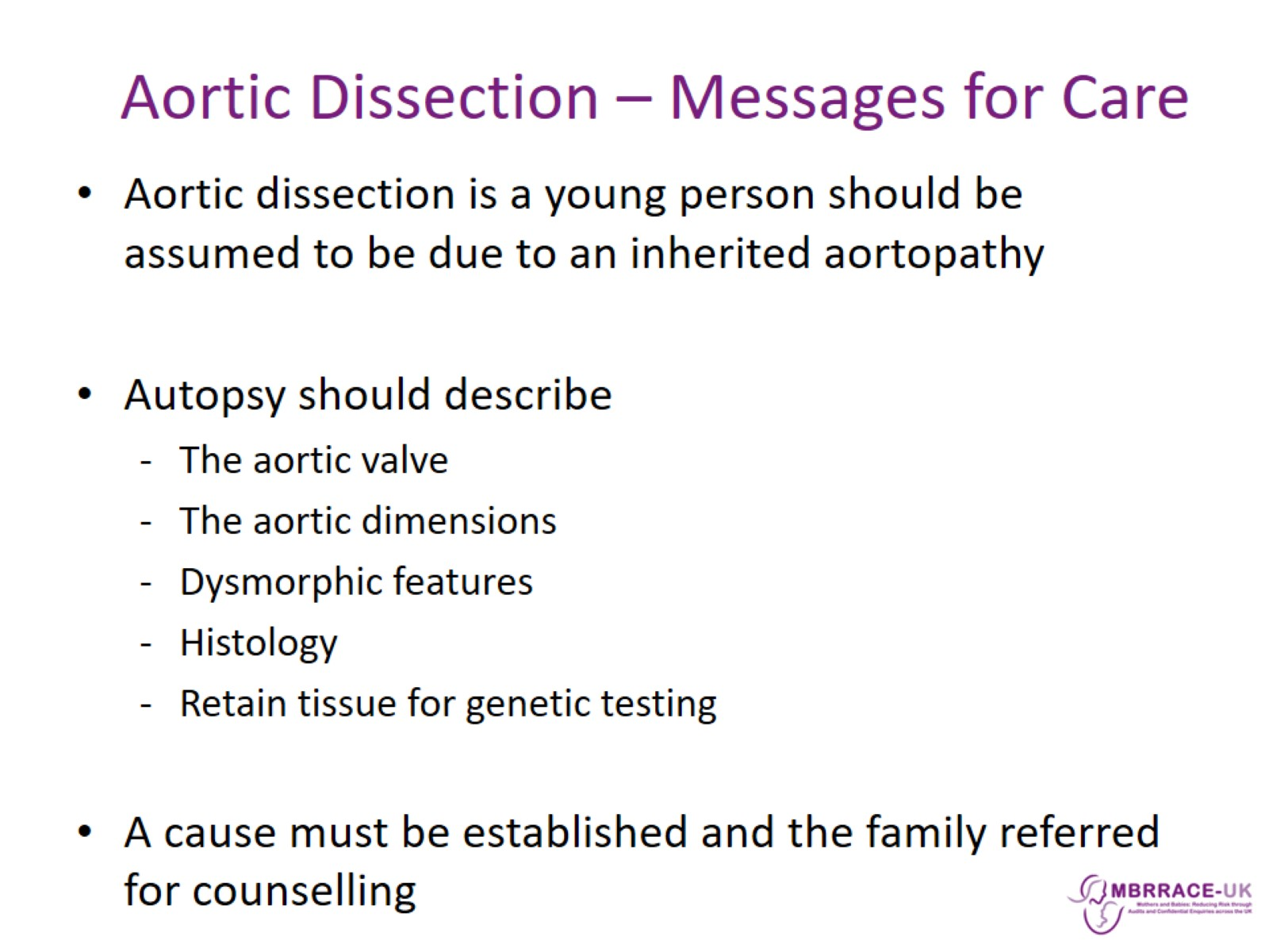

Slide 21
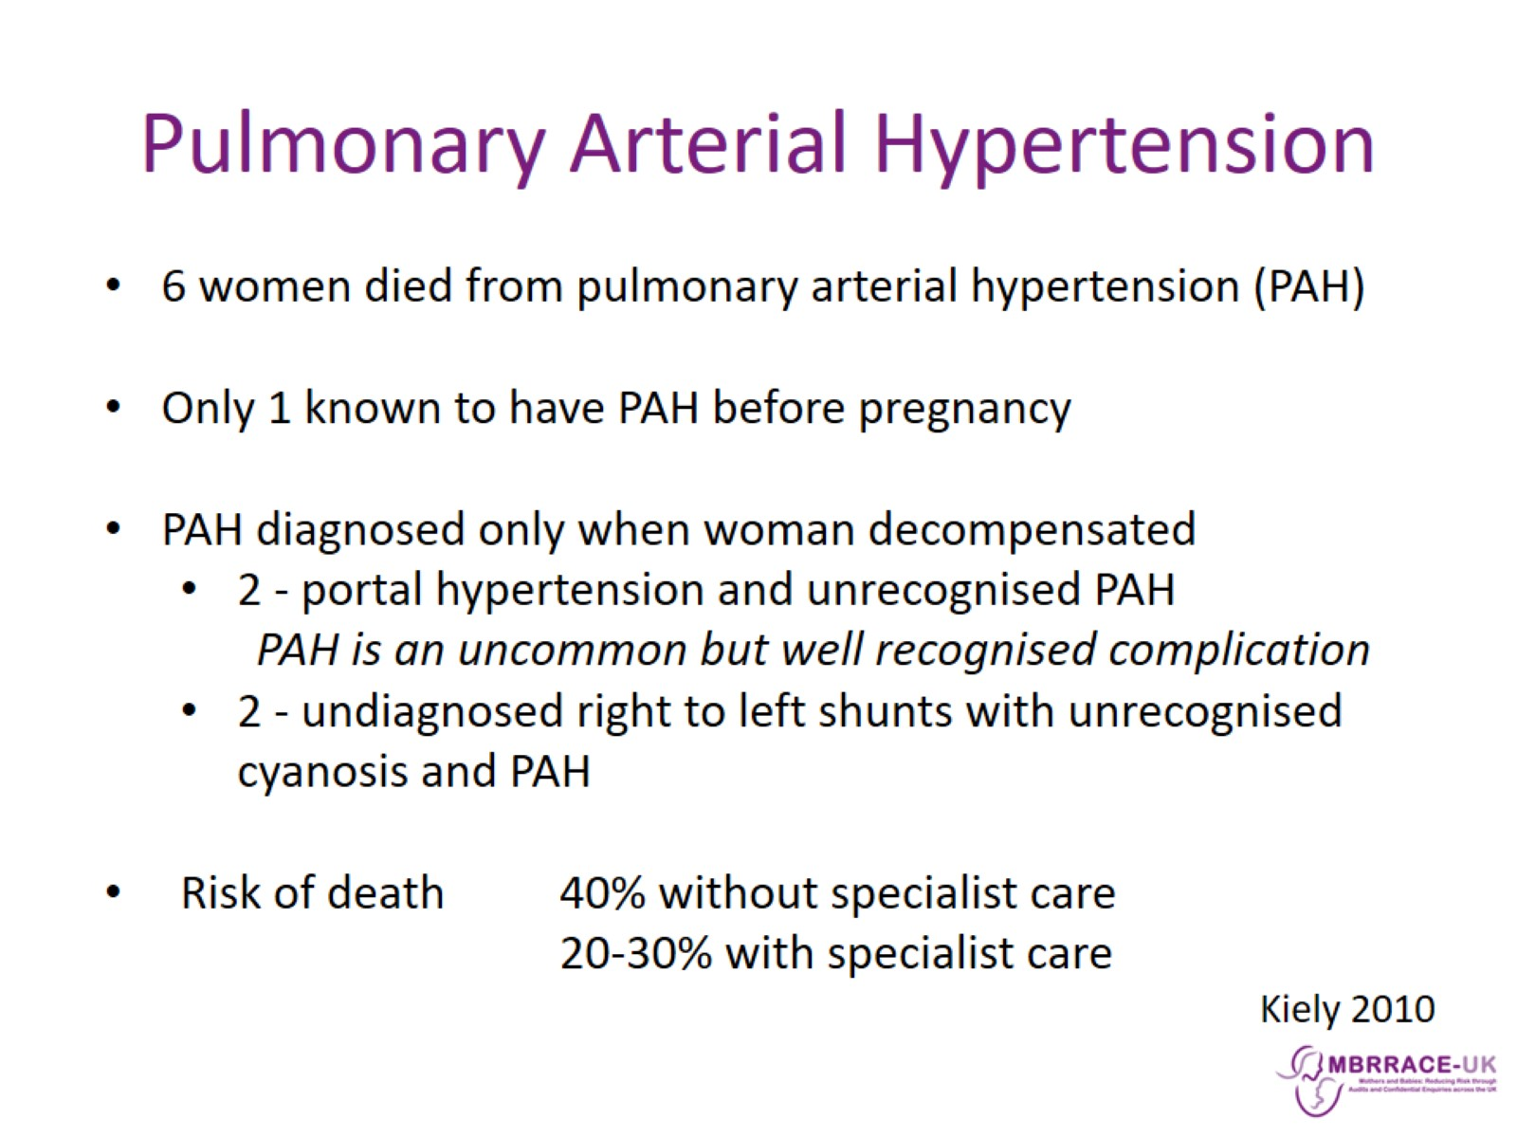
Pulmonary Arterial Hypertension

Slide 22
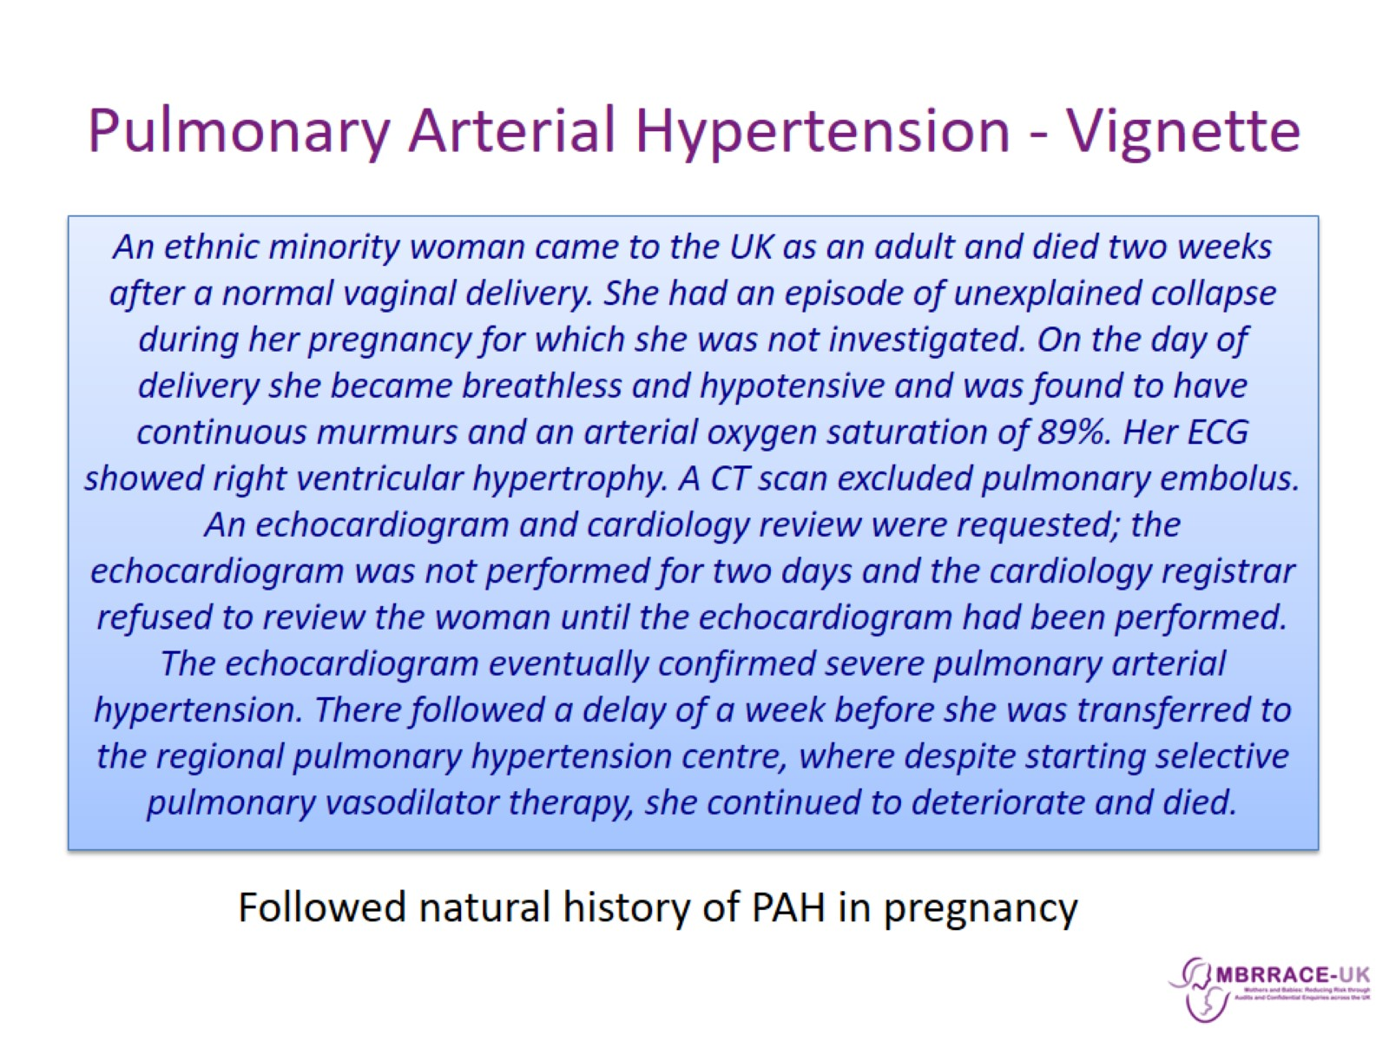
Pulmonary Arterial Hypertension - Vignette

Slide 23
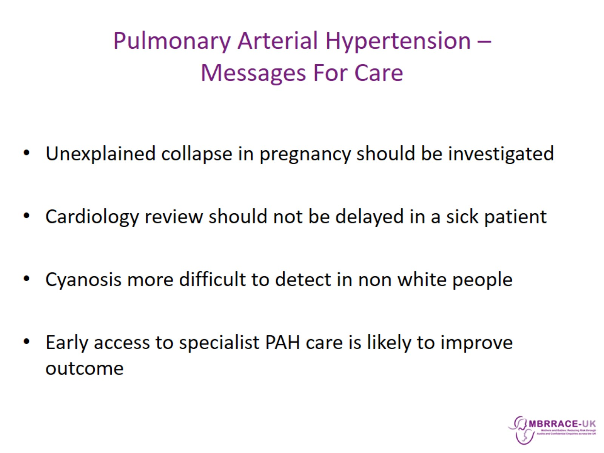
Pulmonary Arterial Hypertension –
Messages For Care

Slide 24
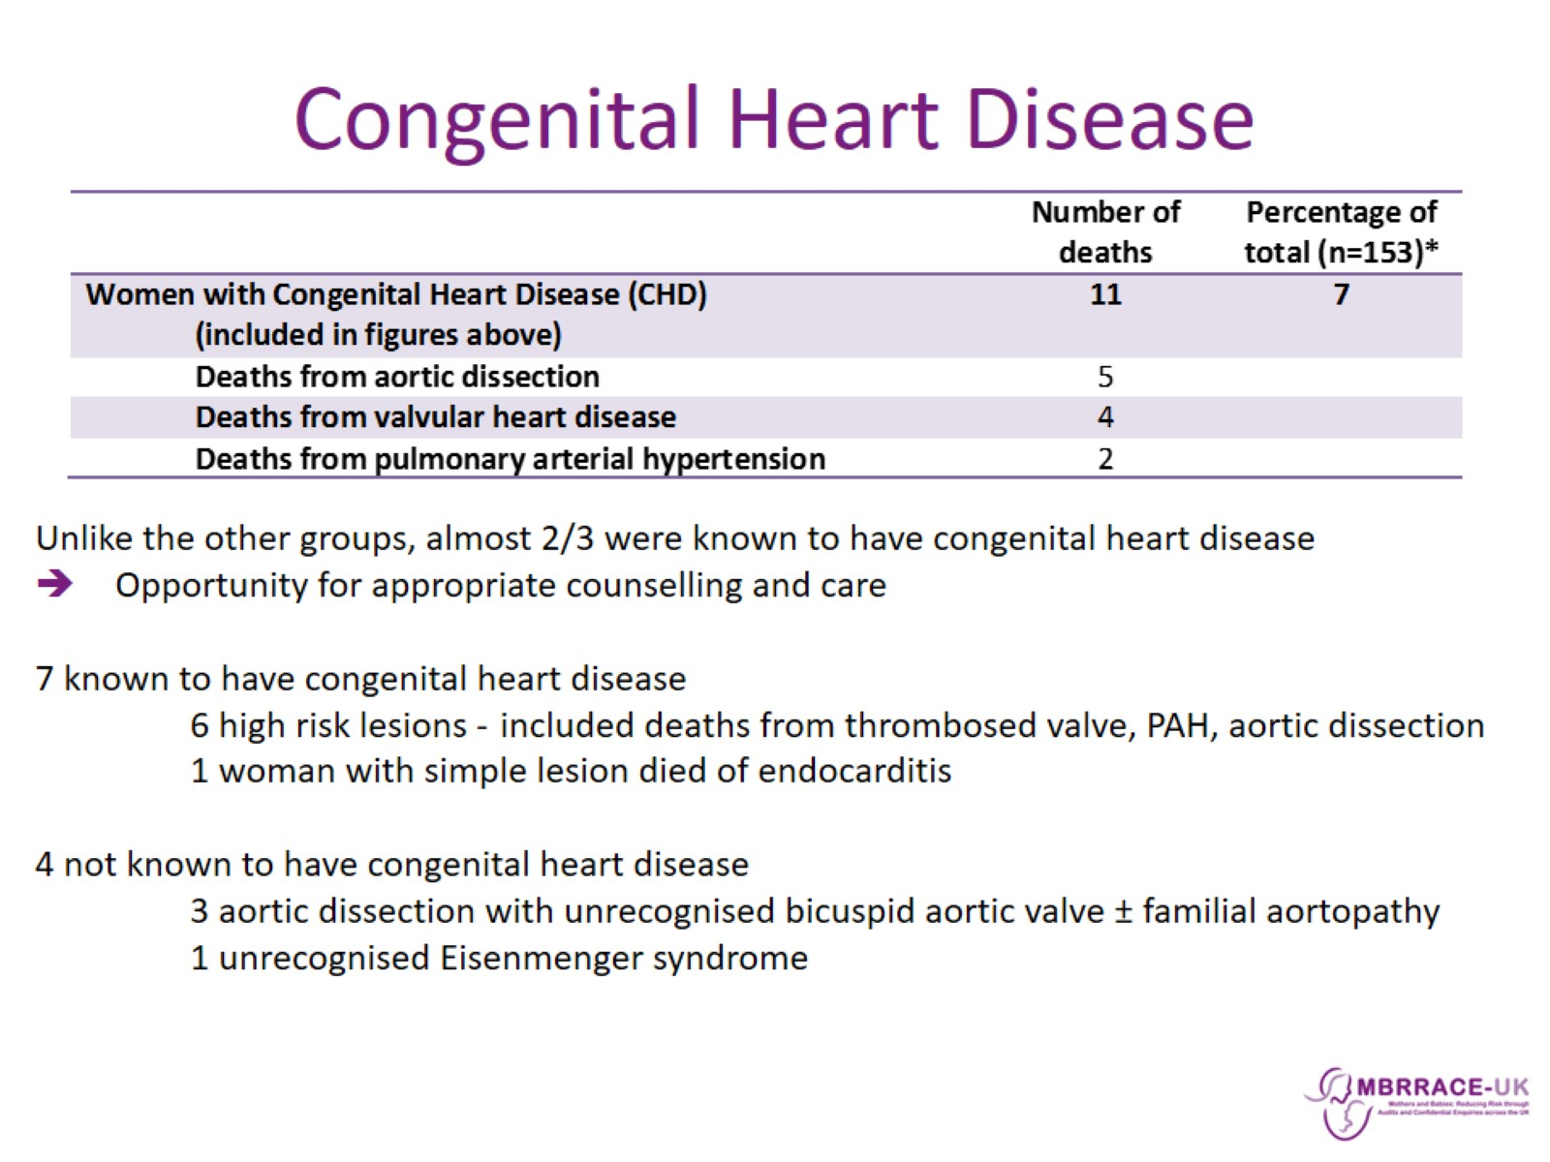
Congenital Heart Disease

Slide 25
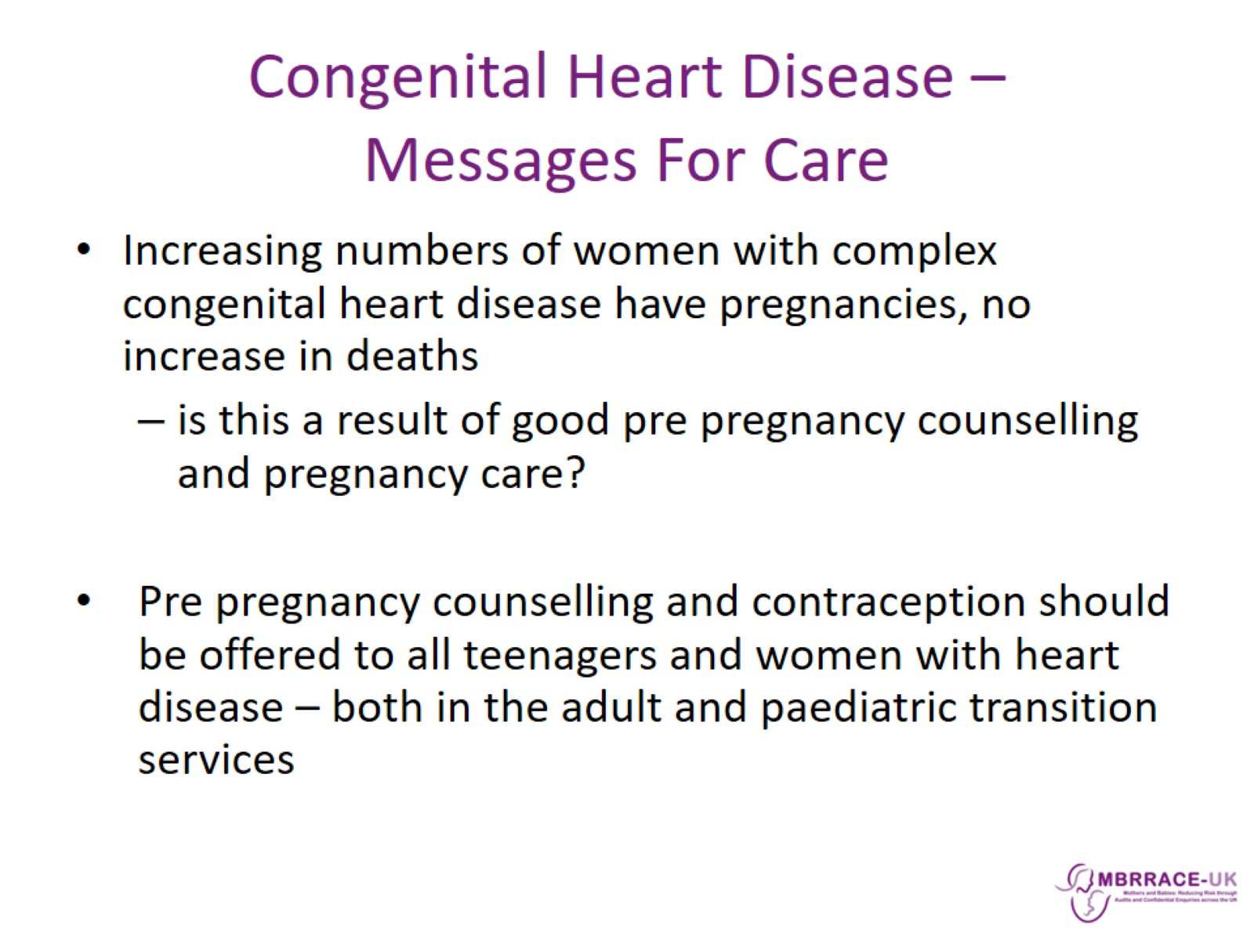
Congenital Heart Disease –
Messages For Care

