Slide 1


Slide 2


Slide 3
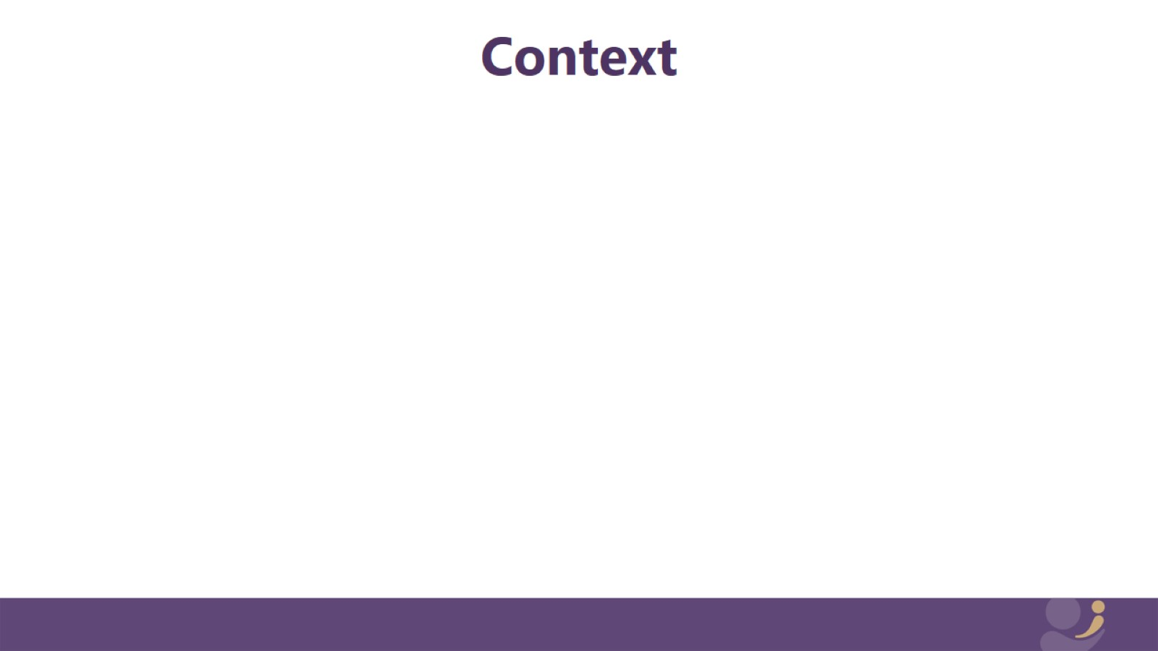
Context

Slide 4
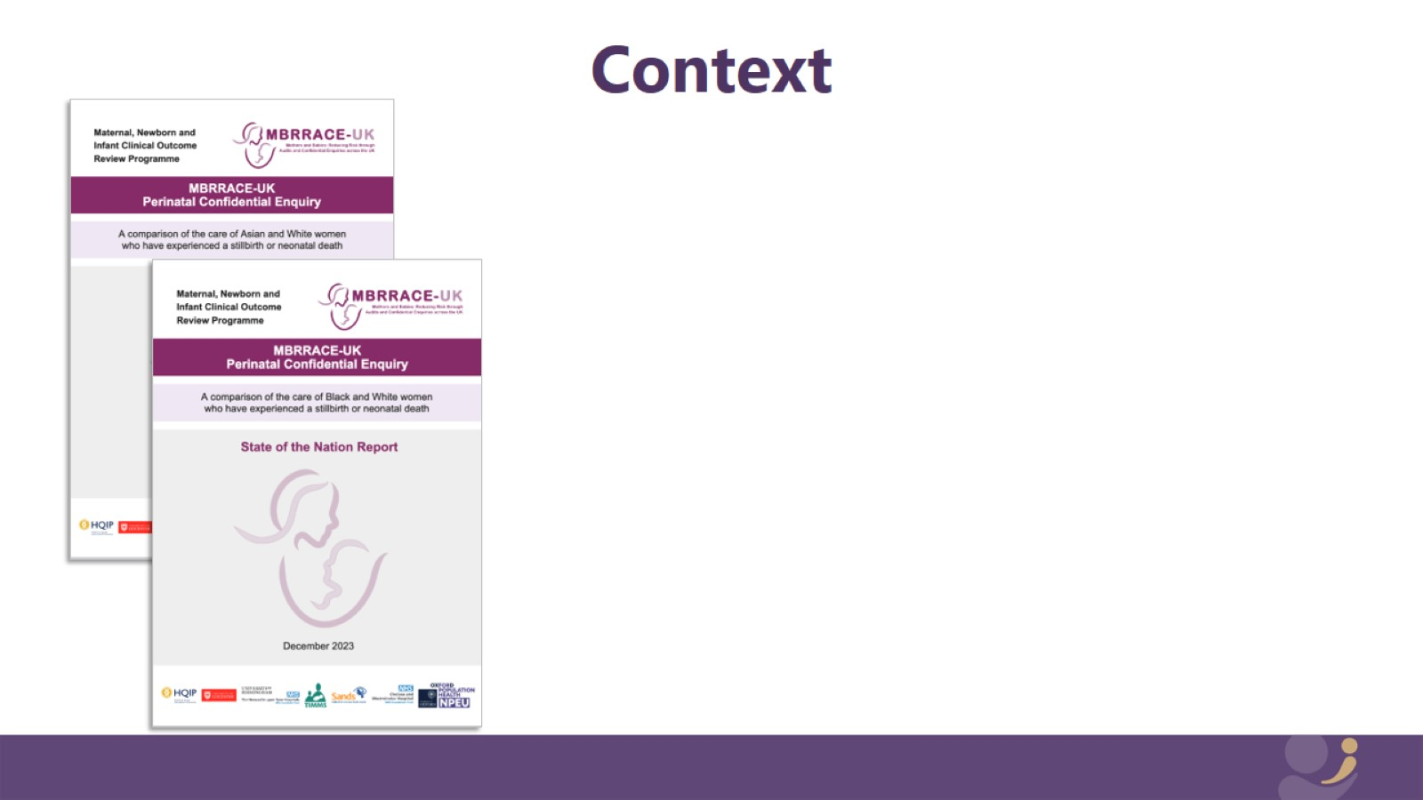
Context

Slide 5

Context

Slide 6
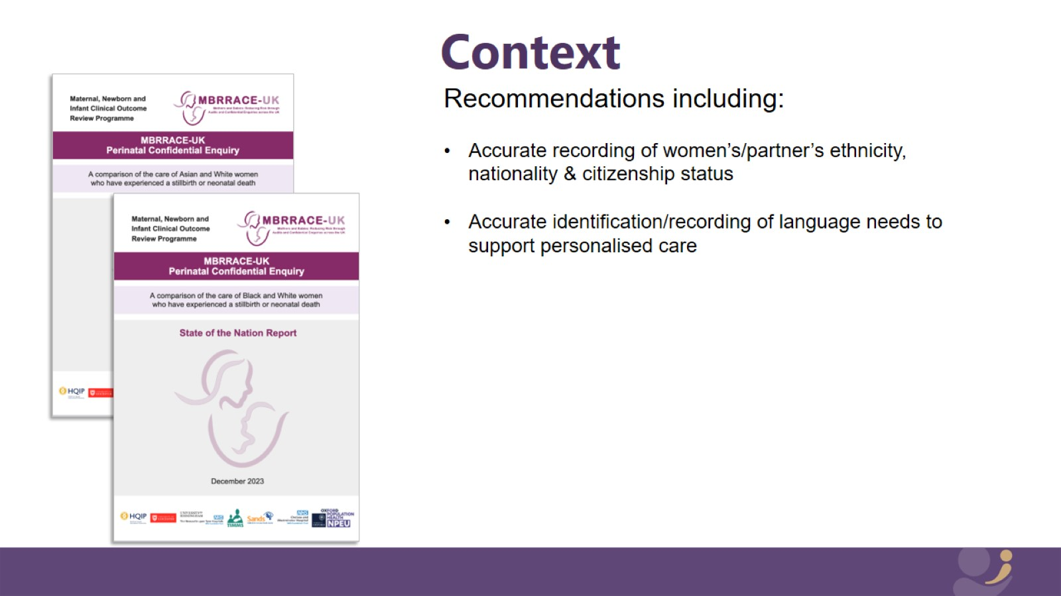
Context

Slide 7
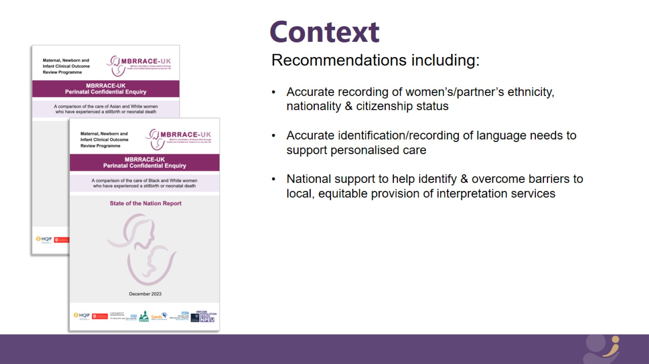
Context

Slide 8
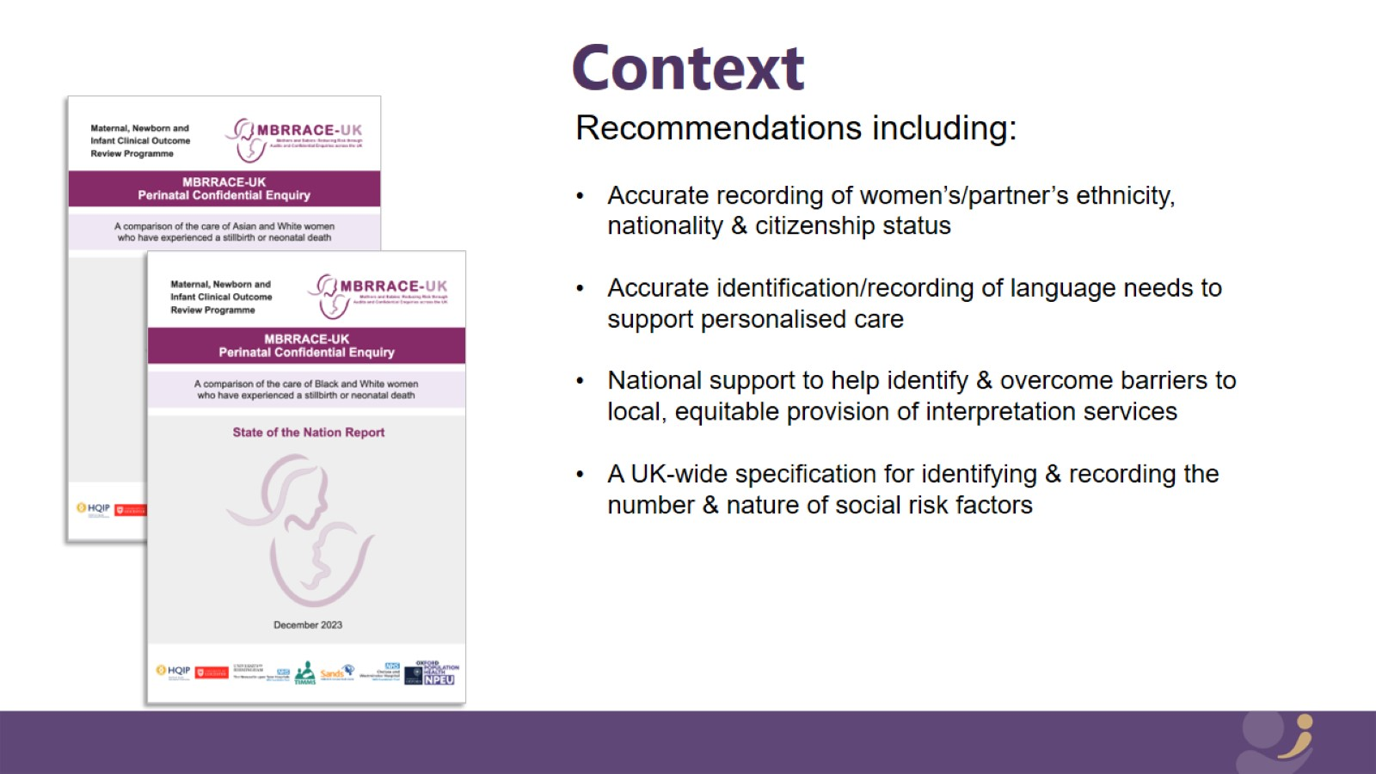
Context

Slide 9
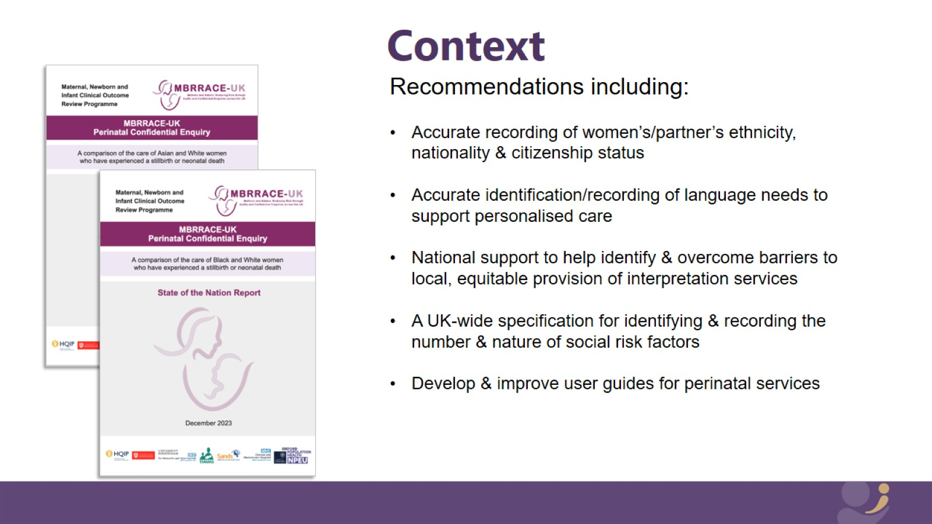
Context

Slide 10
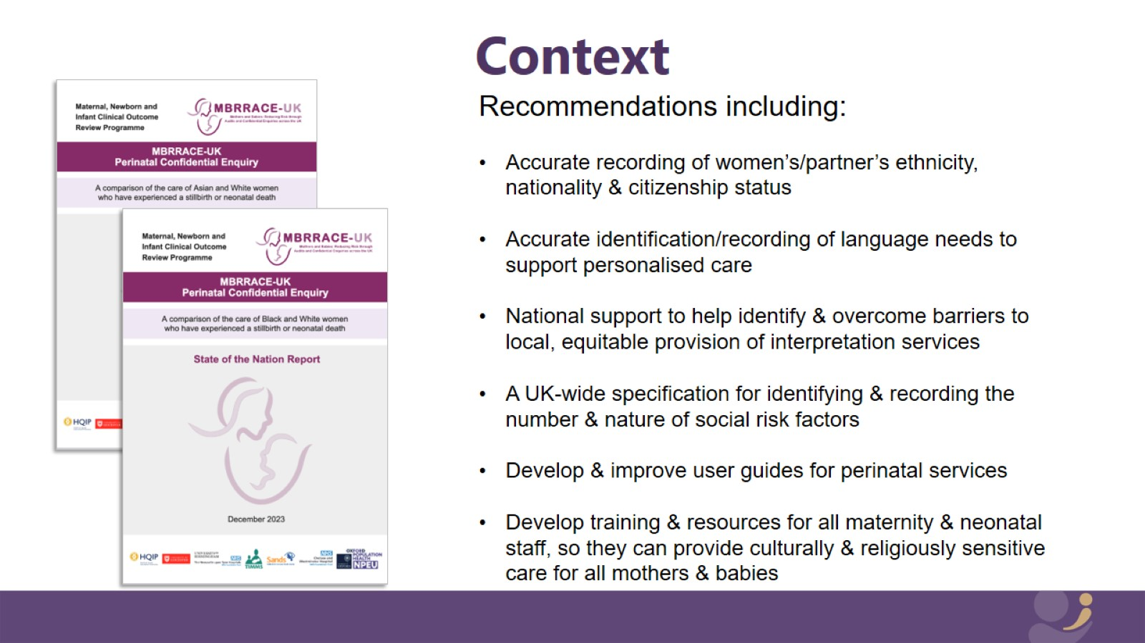
Context

Slide 11
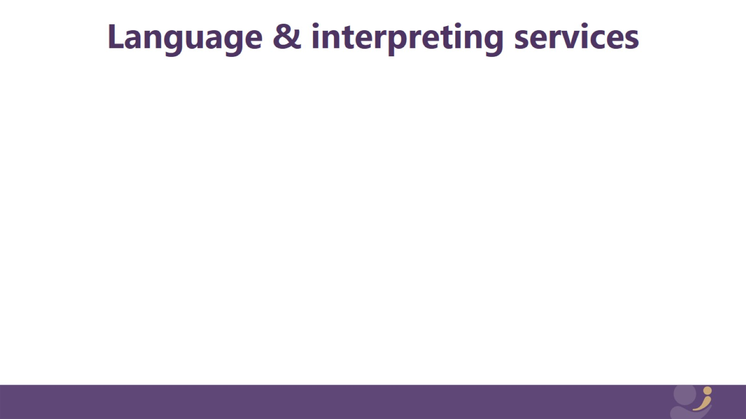
Language & interpreting services

Slide 12
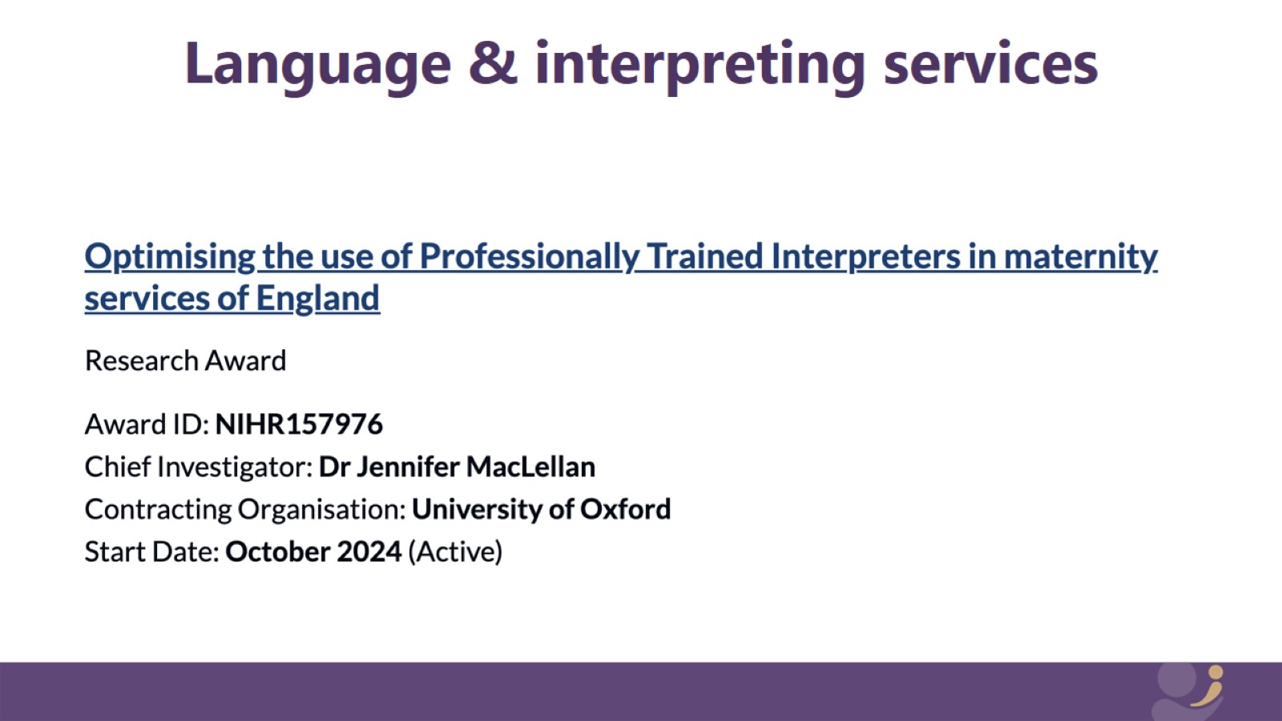
Language & interpreting services

Slide 13

Recommendation 1

Slide 14

Recommendation 2

Slide 15

Recommendation 3

Slide 16

Recommendation 4

Slide 17
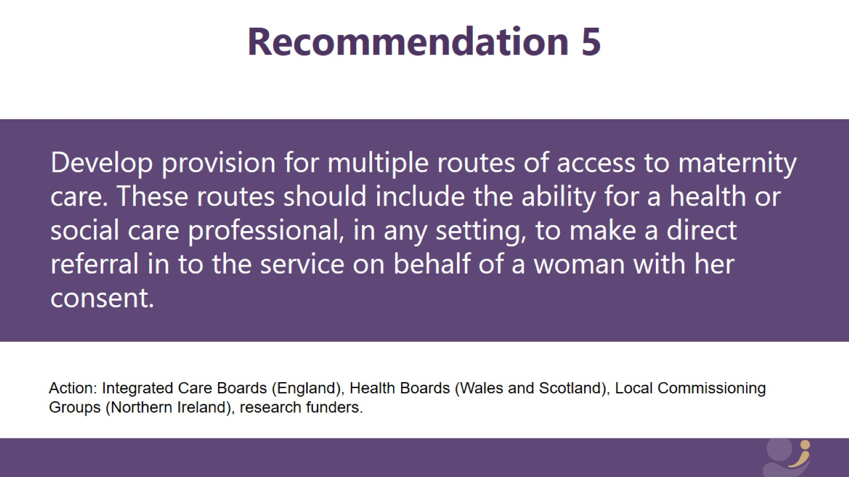
Recommendation 5

Slide 18


