Slide 1


Slide 2
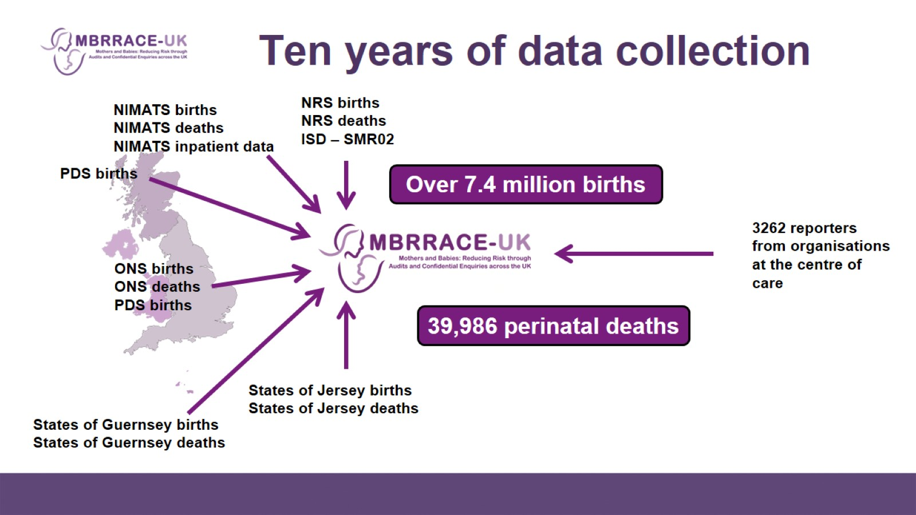
Ten years of data collection

Slide 3
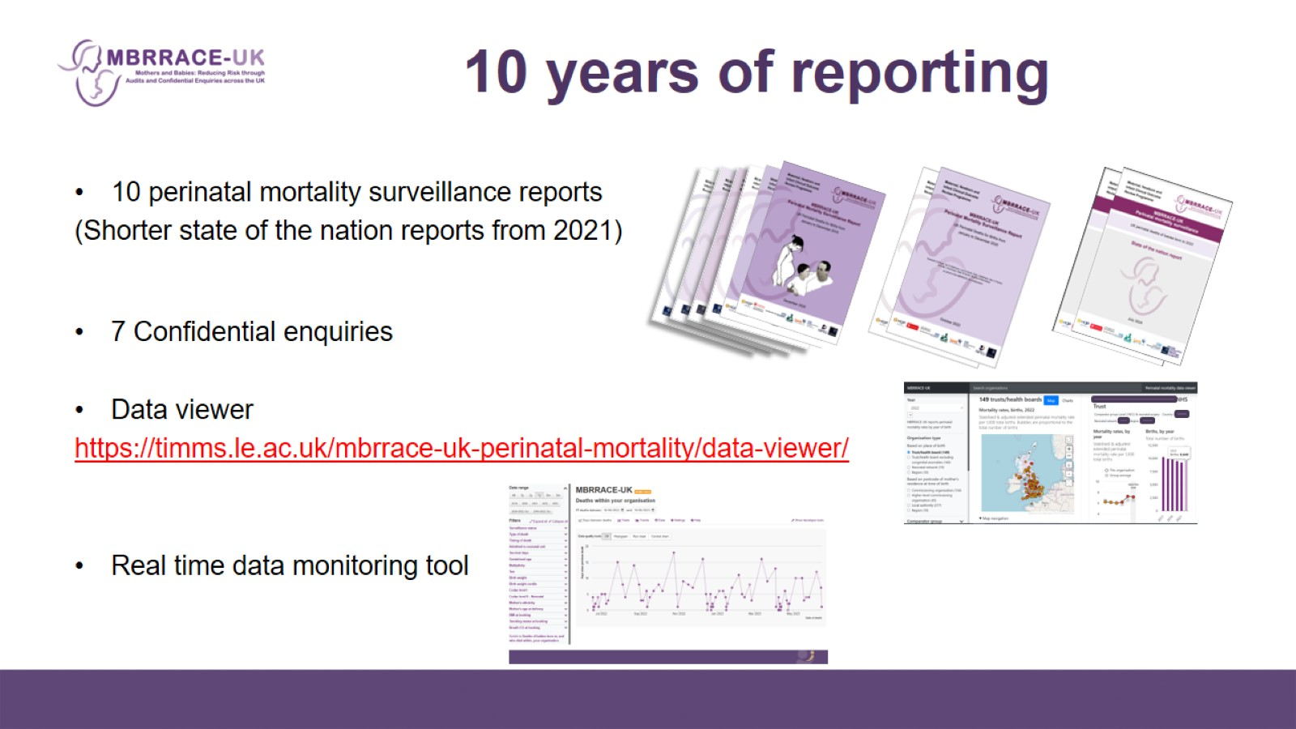
10 years of reporting

Slide 4
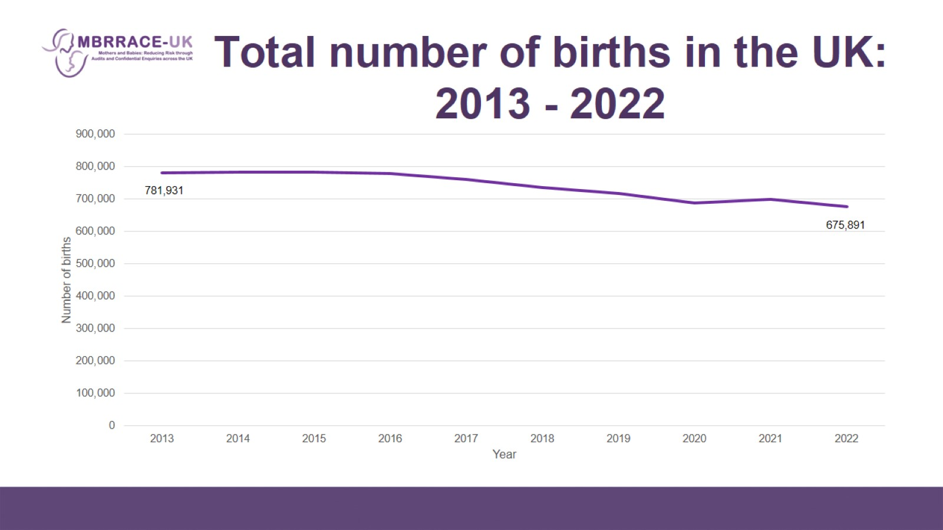
Total number of births in the UK: 2013 - 2022

Slide 5
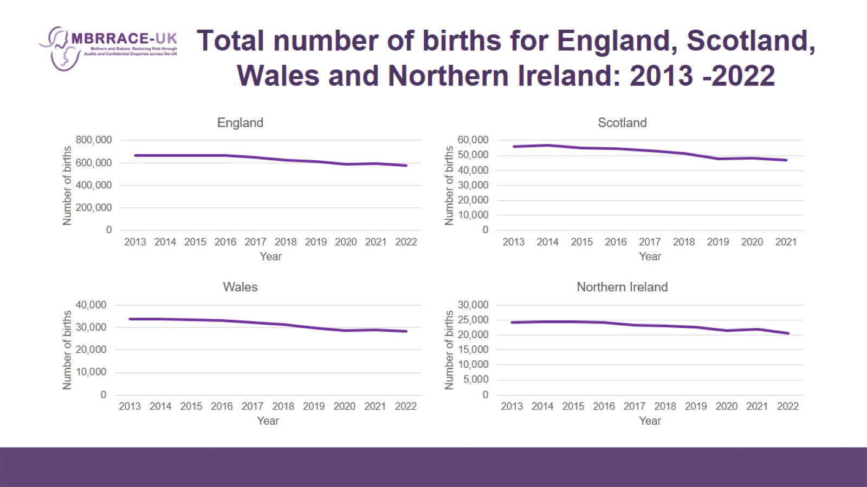
Total number of births for England, Scotland, Wales and Northern Ireland: 2013 -2022

Slide 6
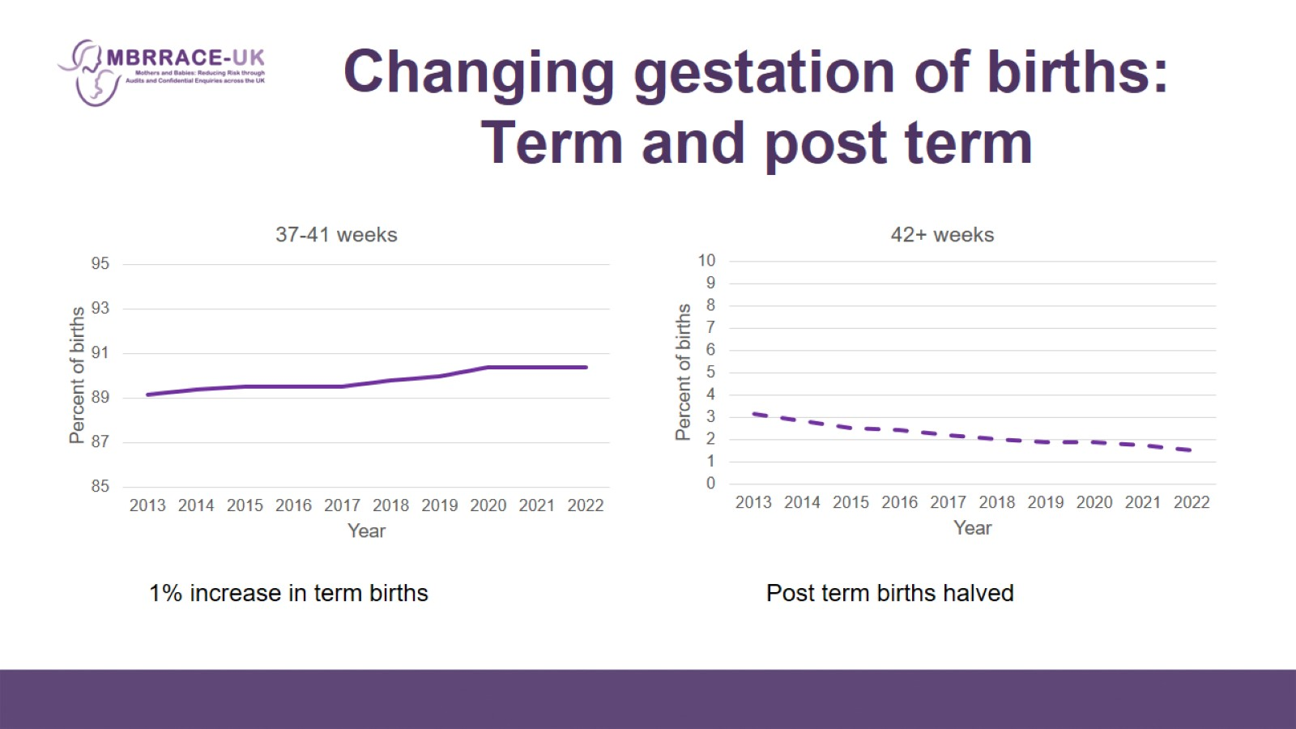
Changing gestation of births: Term and post term

Slide 7
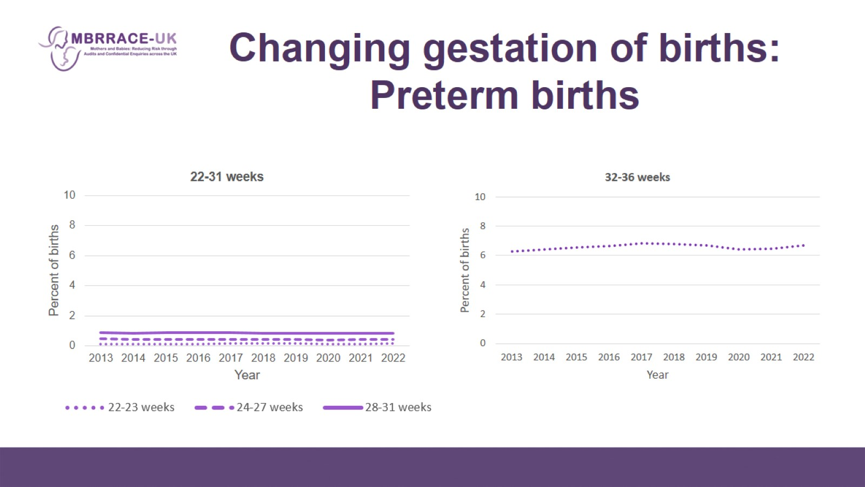
Changing gestation of births: Preterm births

Slide 8
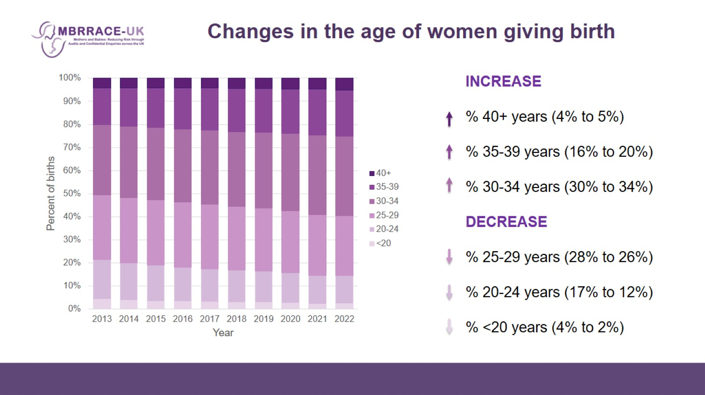
Changes in the age of women giving birth

Slide 9
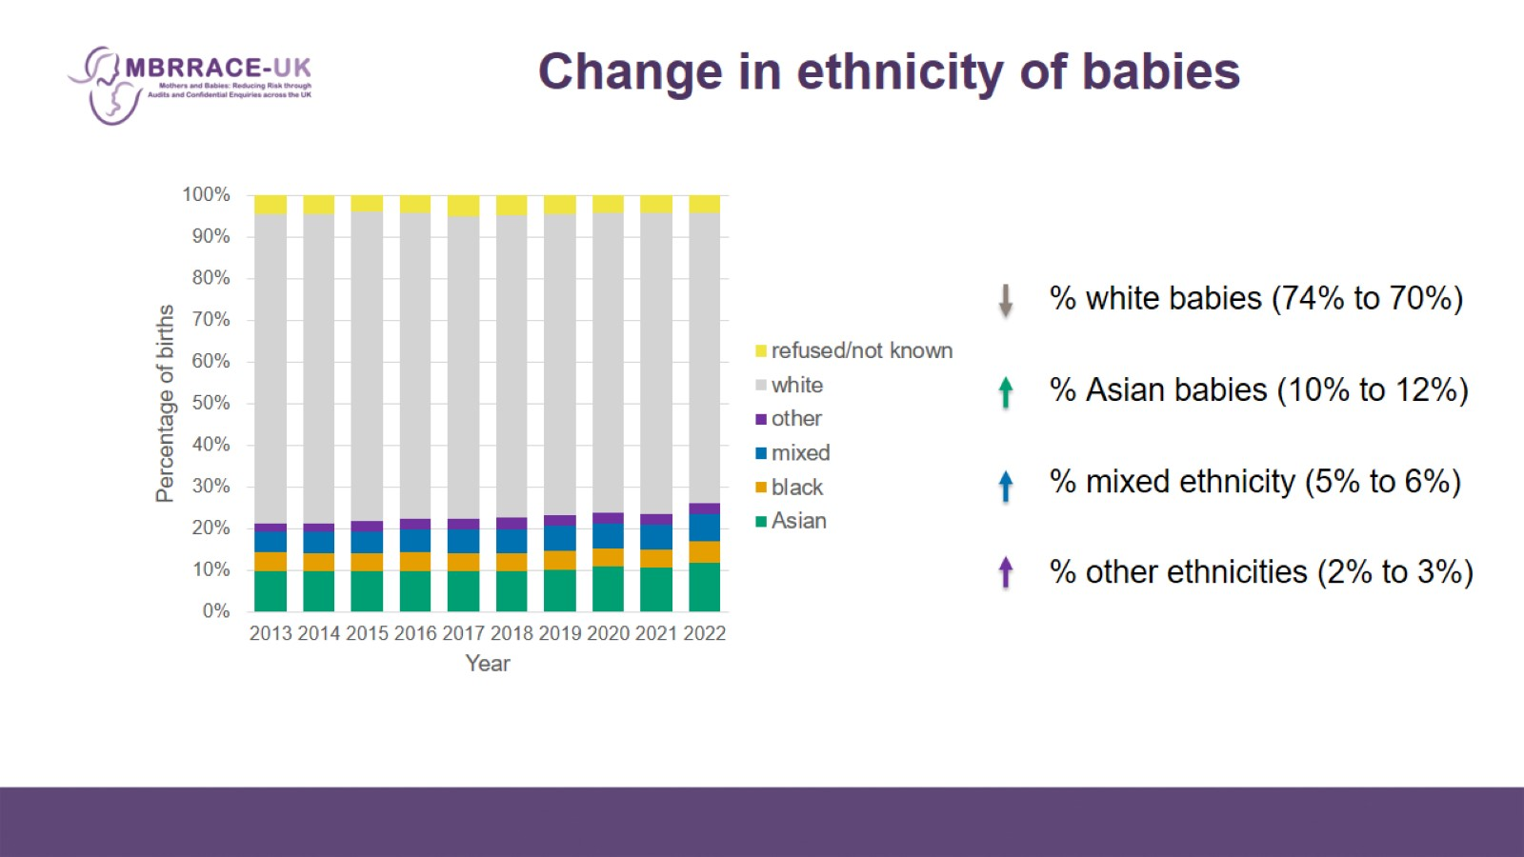
Change in ethnicity of babies

Slide 10
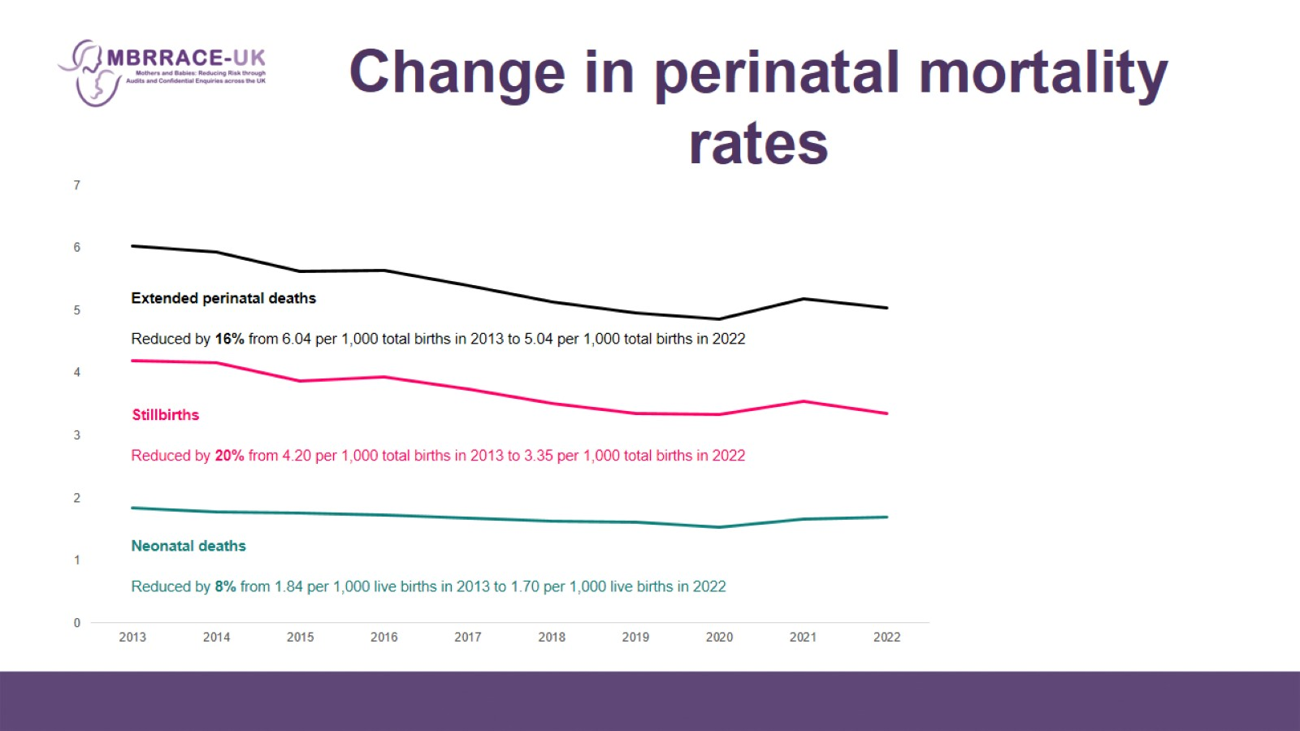
Change in perinatal mortality rates

Slide 11
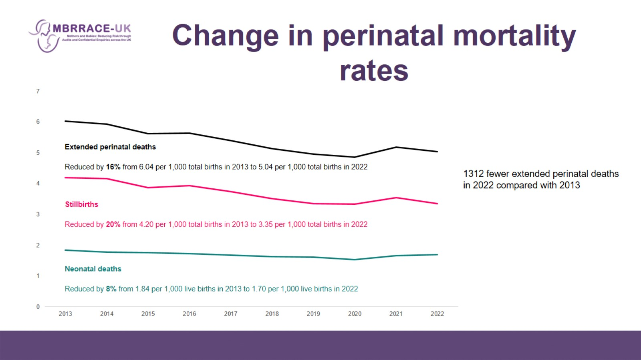
Change in perinatal mortality rates

Slide 12
Change in perinatal mortality rates

Slide 13
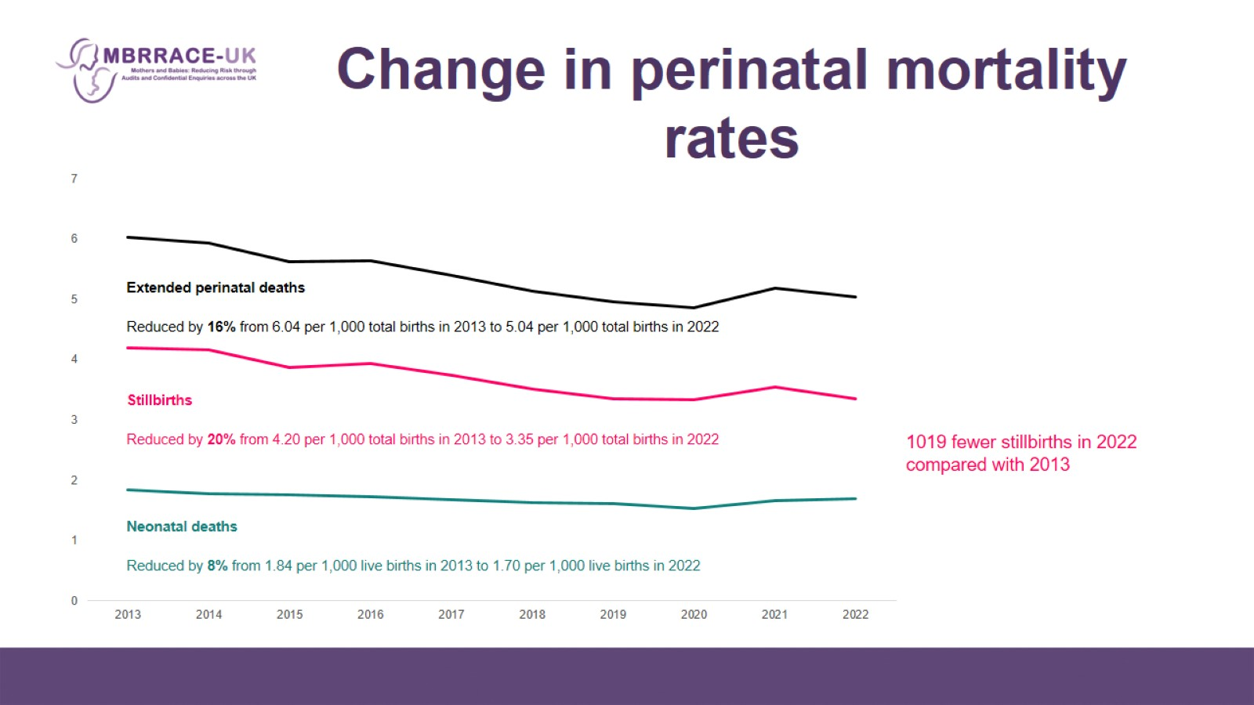
Change in perinatal mortality rates

Slide 14
Change in perinatal mortality rates

Slide 15
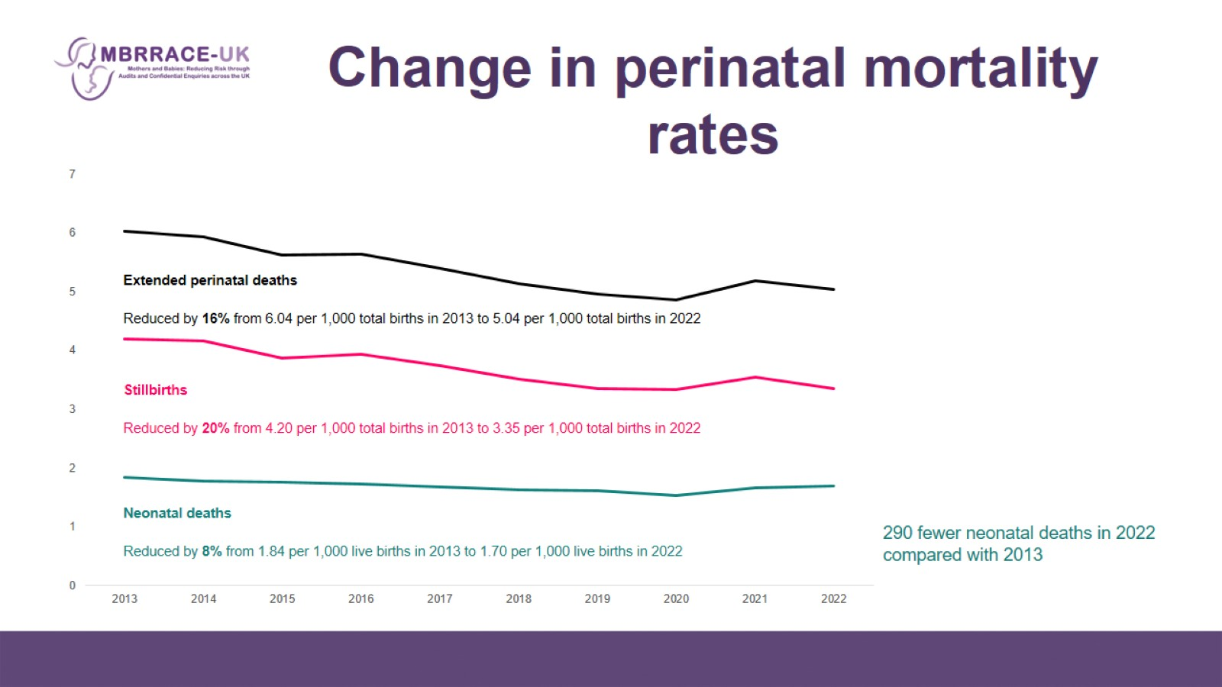
Change in perinatal mortality rates

Slide 16
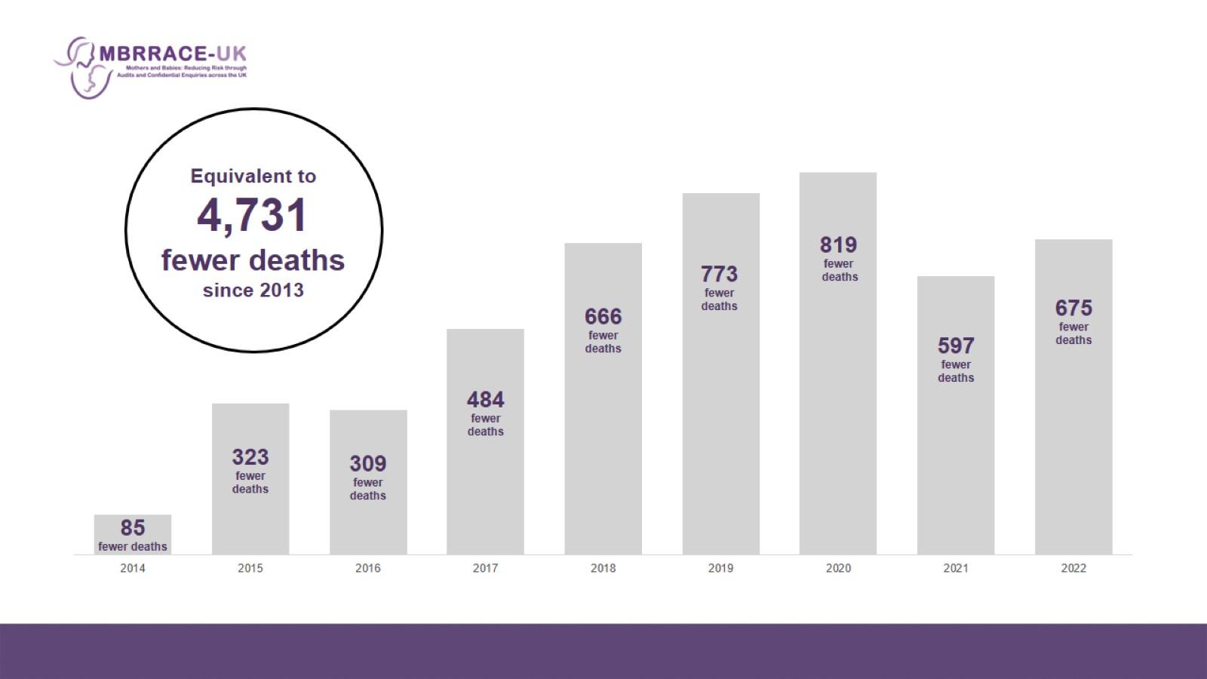
Equivalent to
4,731 fewer deaths since 2013

Slide 17
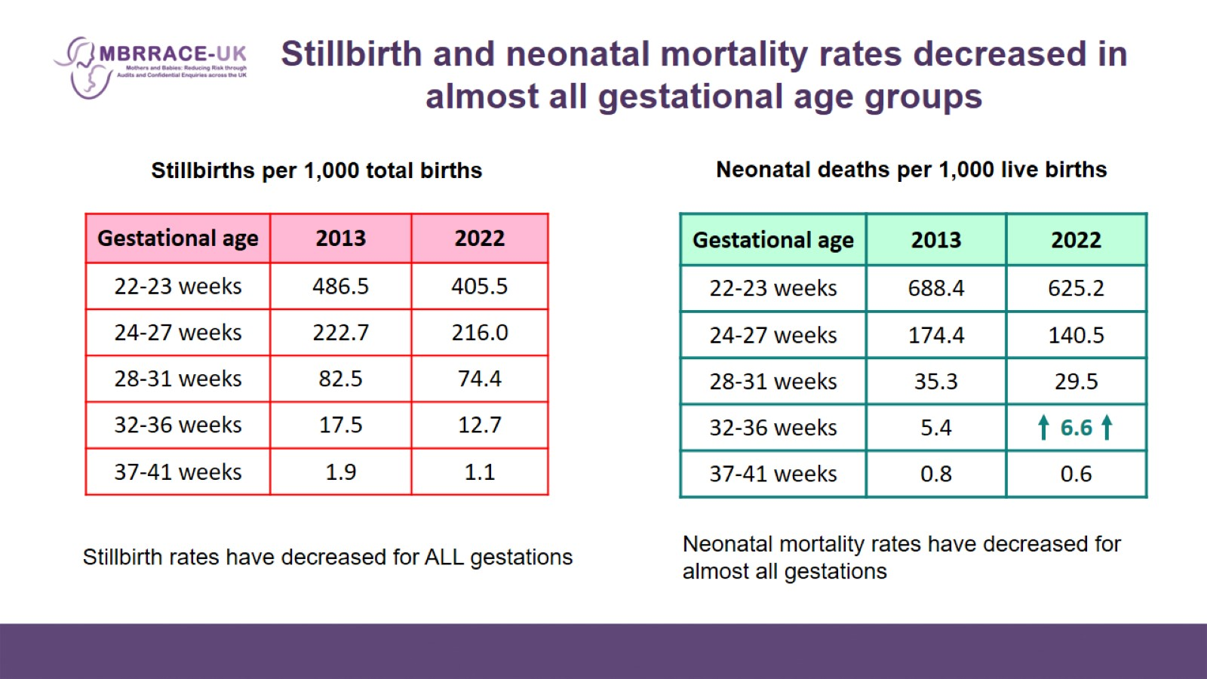
Stillbirth and neonatal mortality rates decreased in almost all gestational age groups

Slide 18
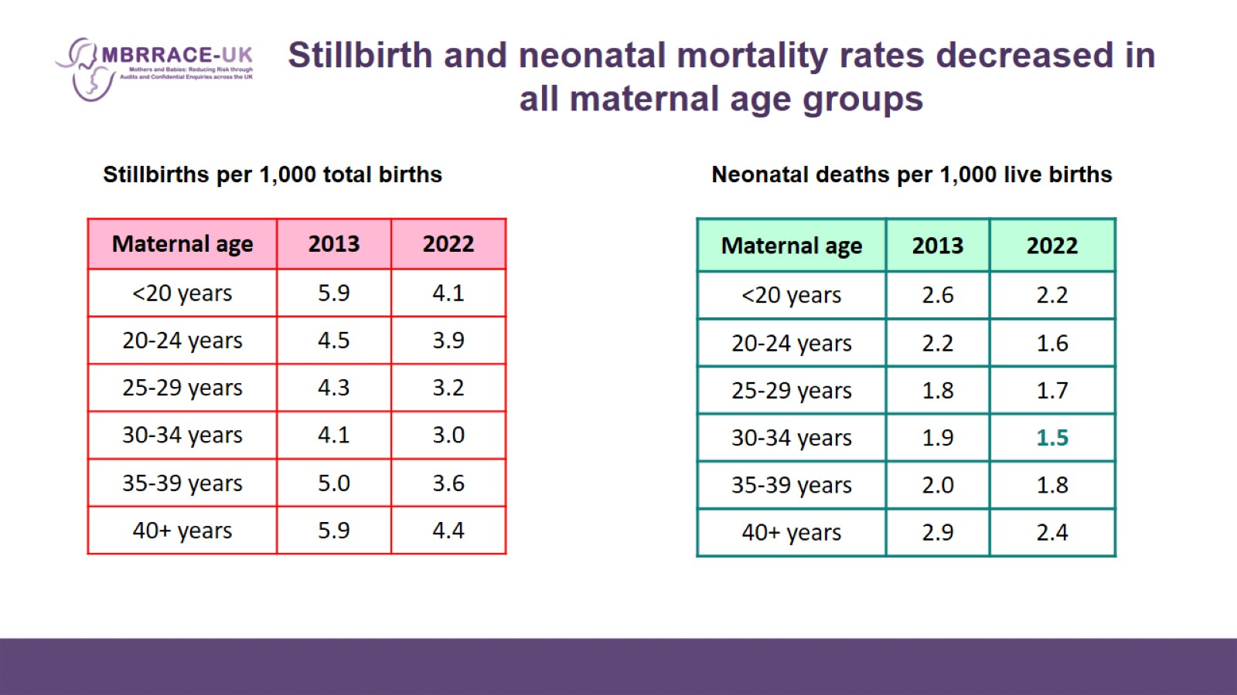
Stillbirth and neonatal mortality rates decreased in all maternal age groups

Slide 19
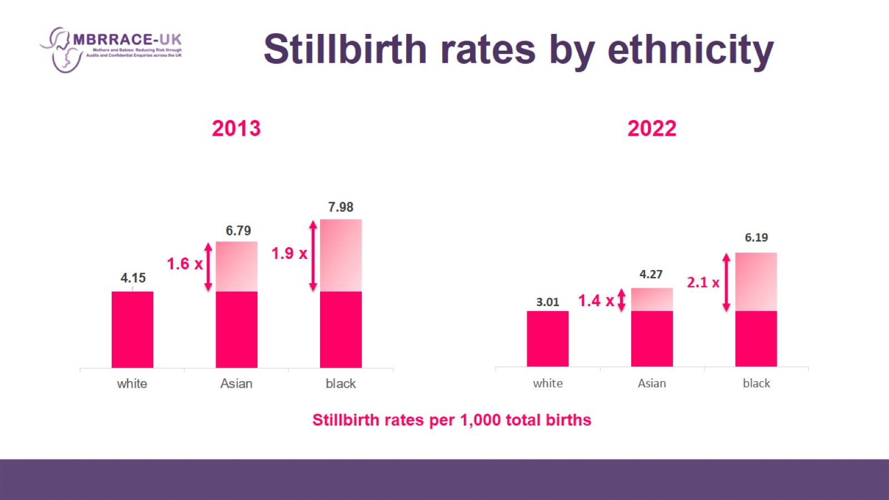
Stillbirth rates by ethnicity

Slide 20
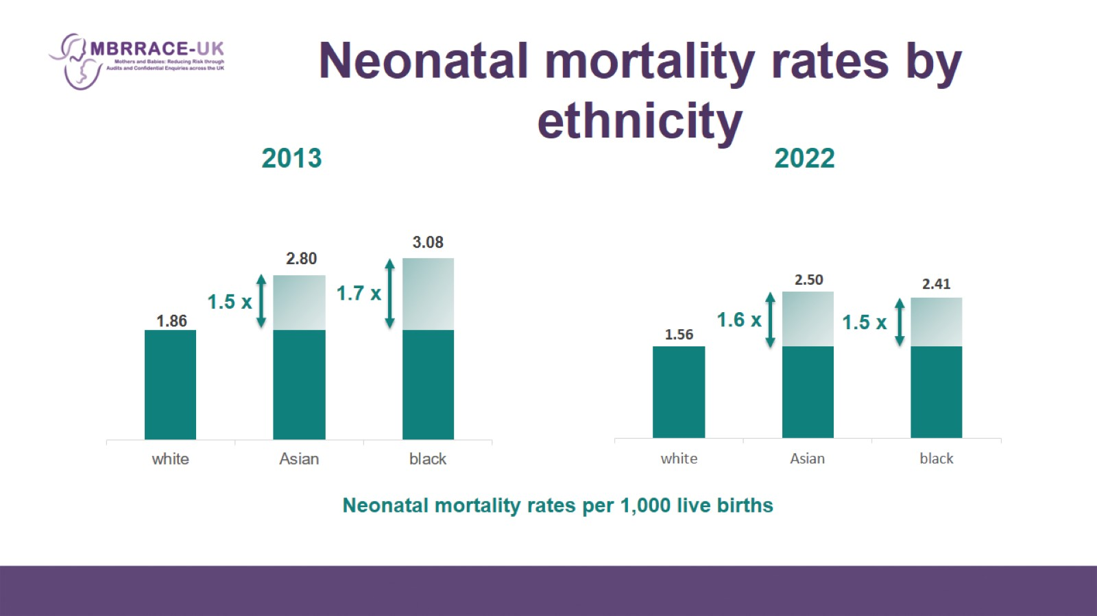
Neonatal mortality rates by ethnicity

Slide 21
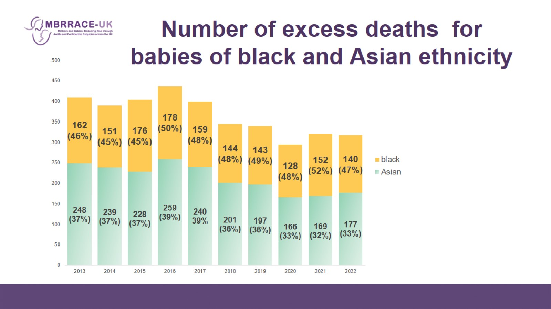
Number of excess deaths for babies of black and Asian ethnicity

Slide 22
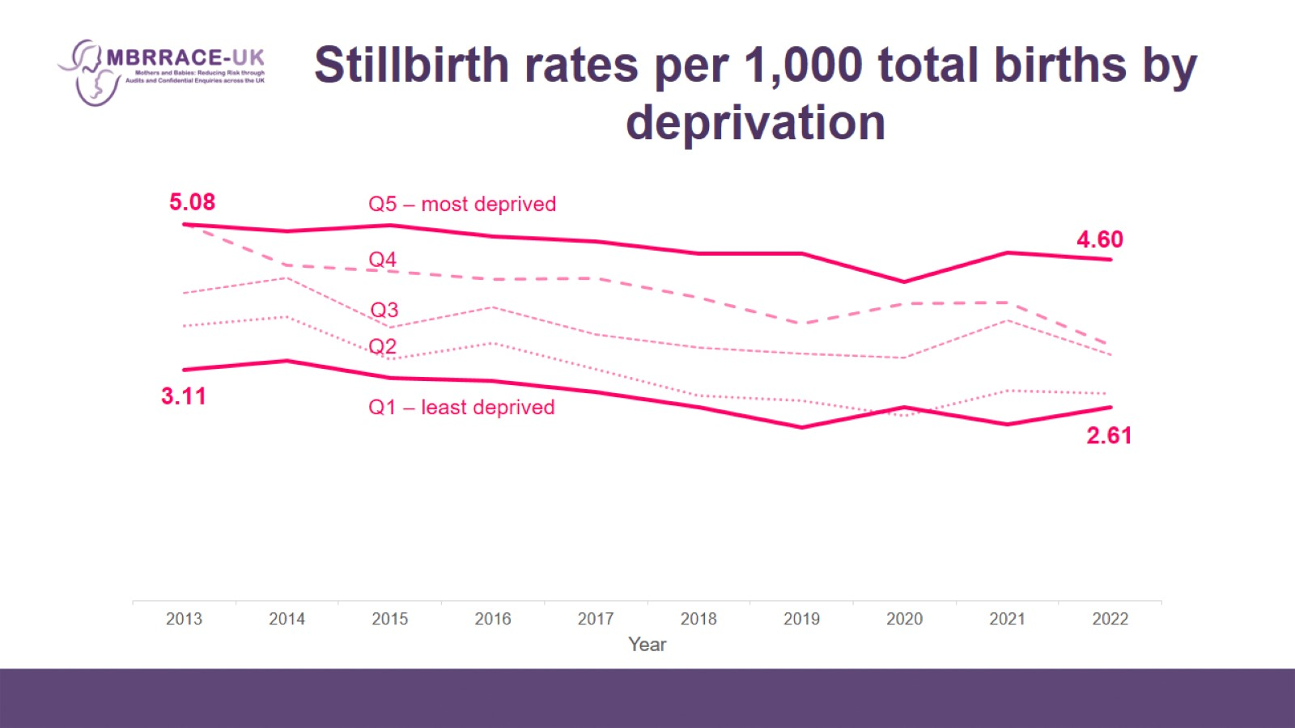
Stillbirth rates per 1,000 total births by deprivation

Slide 23
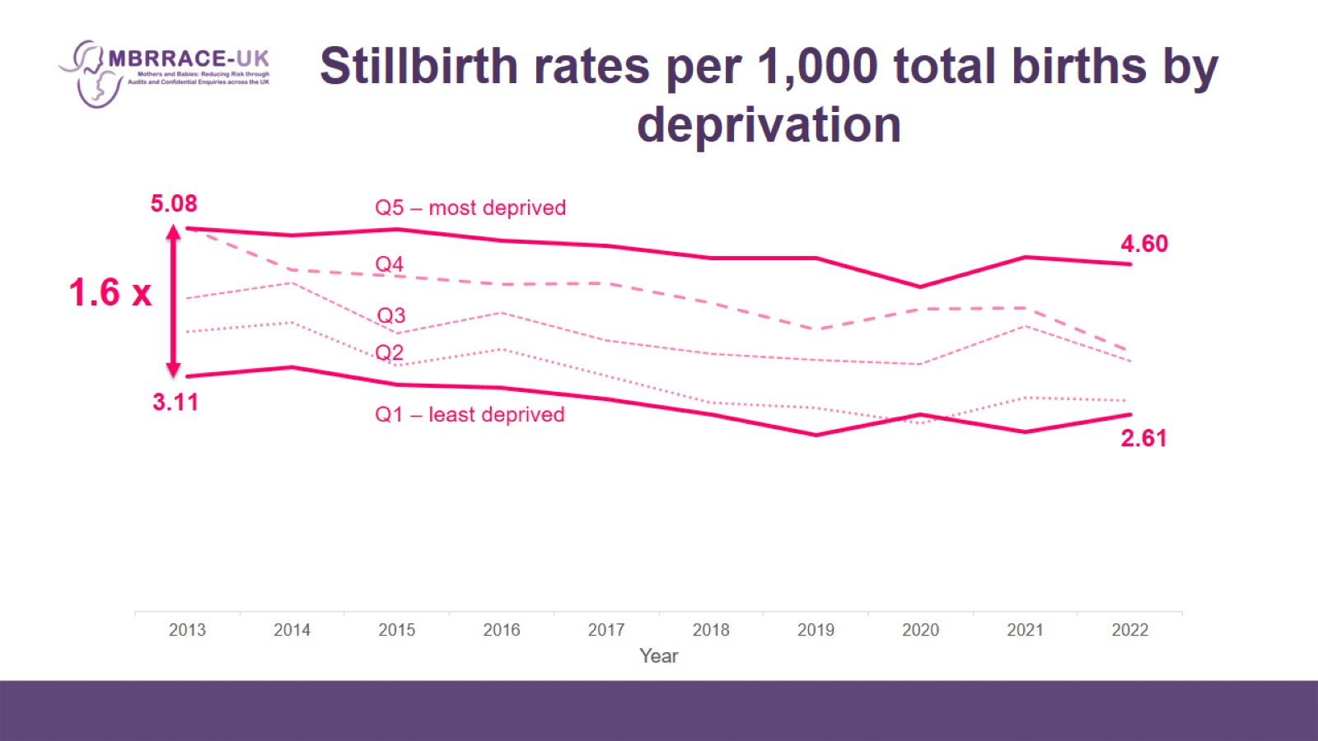
Stillbirth rates per 1,000 total births by deprivation

Slide 24
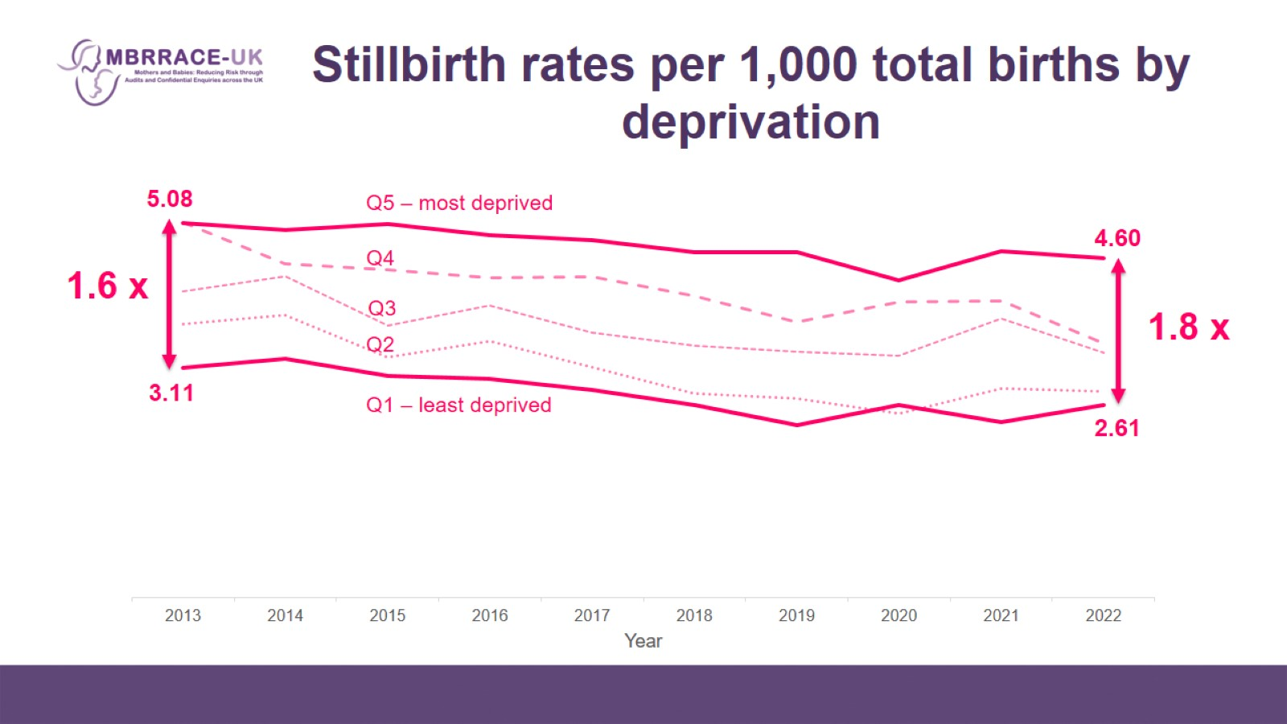
Stillbirth rates per 1,000 total births by deprivation

Slide 25
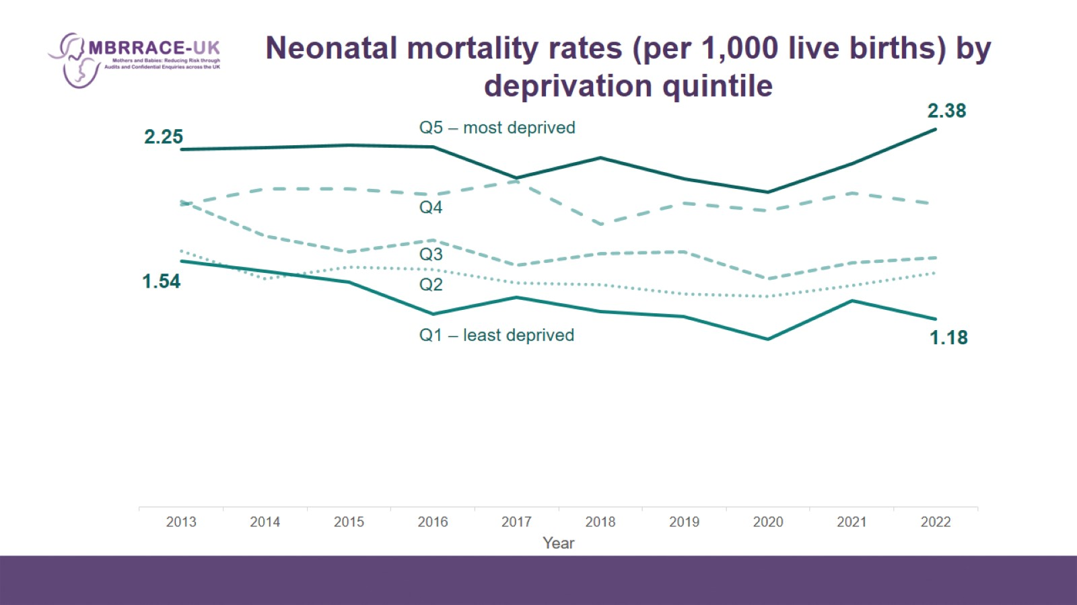
Neonatal mortality rates (per 1,000 live births) by deprivation quintile

Slide 26
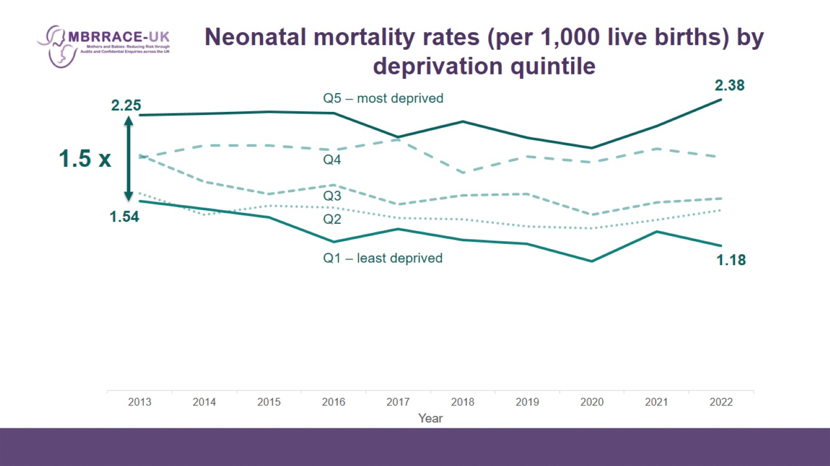
Neonatal mortality rates (per 1,000 live births) by deprivation quintile

Slide 27
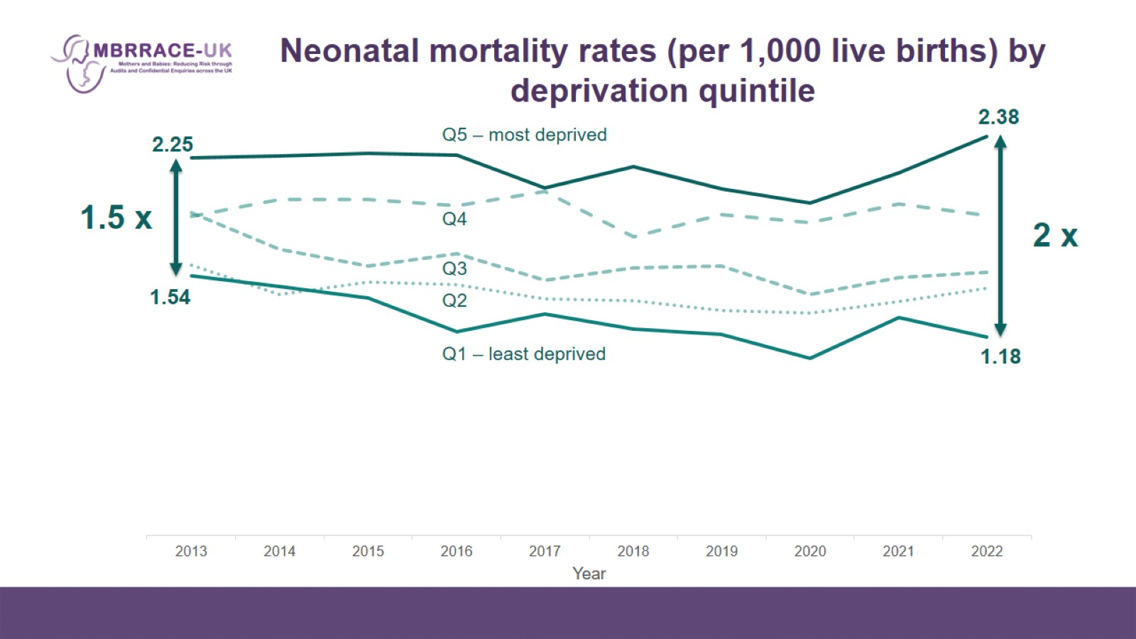
Neonatal mortality rates (per 1,000 live births) by deprivation quintile

Slide 28
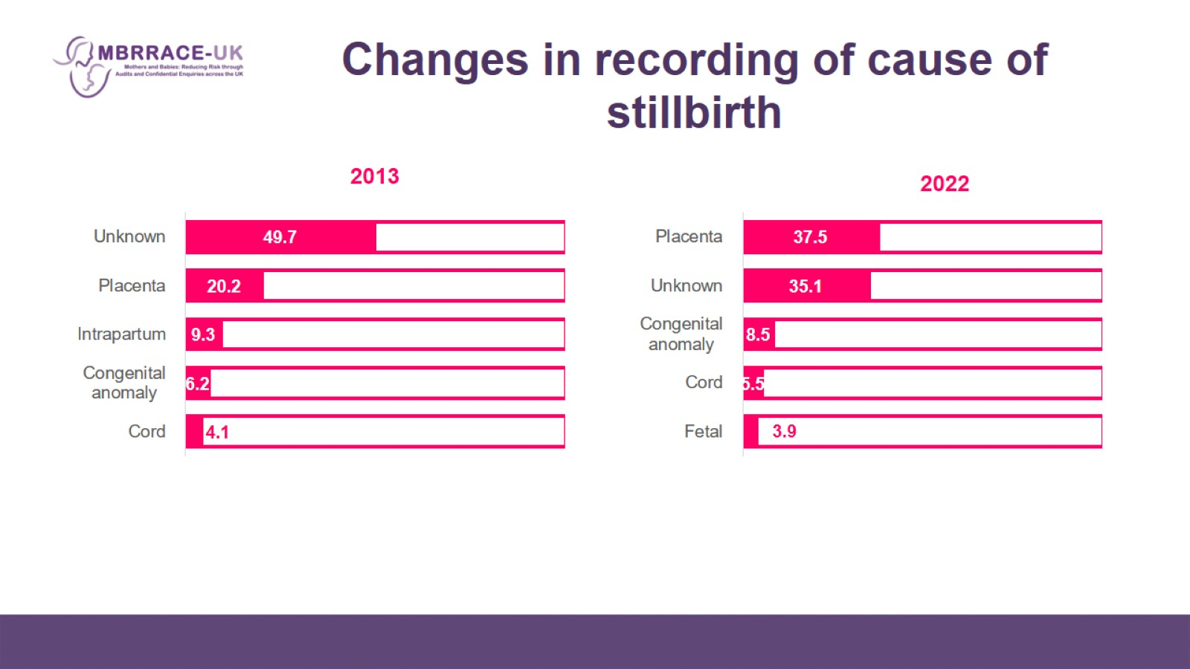
Changes in recording of cause of stillbirth

Slide 29
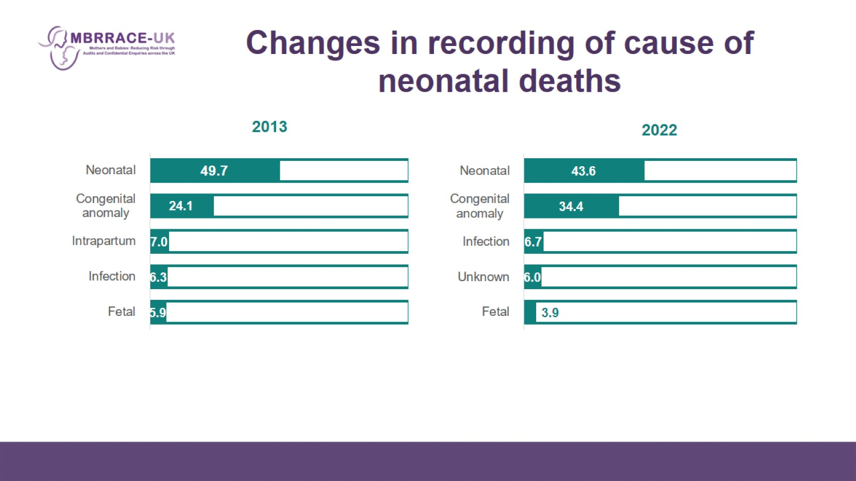
Changes in recording of cause of neonatal deaths

Slide 30
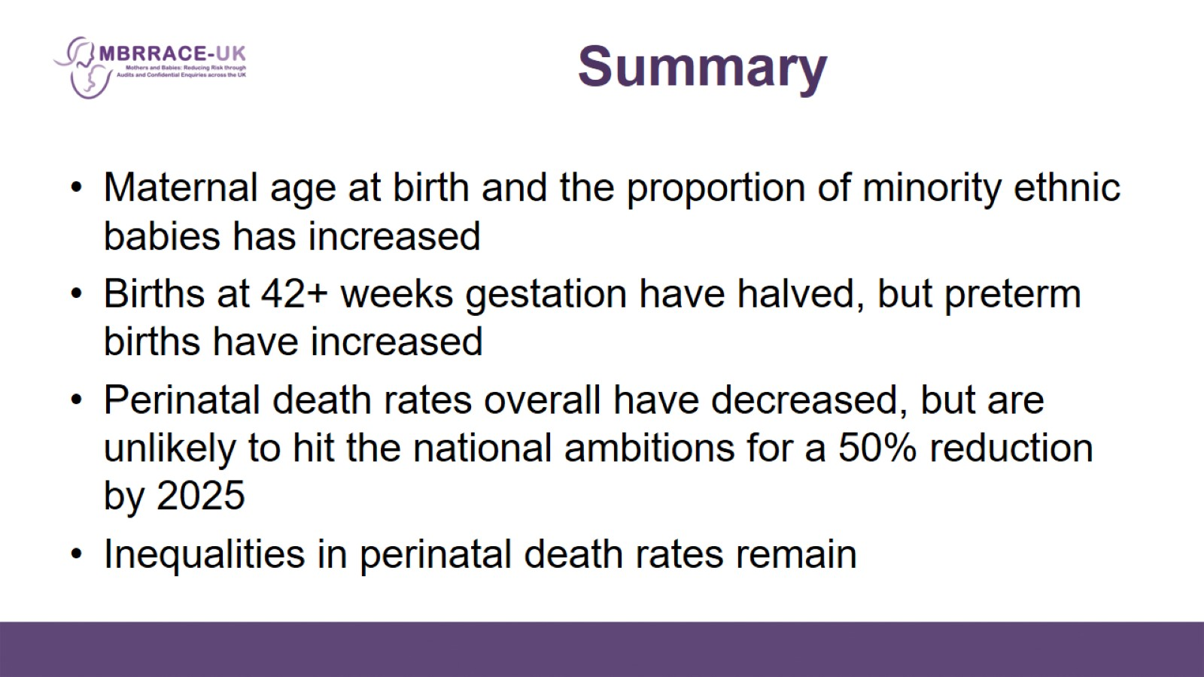
Summary

