Slide 1
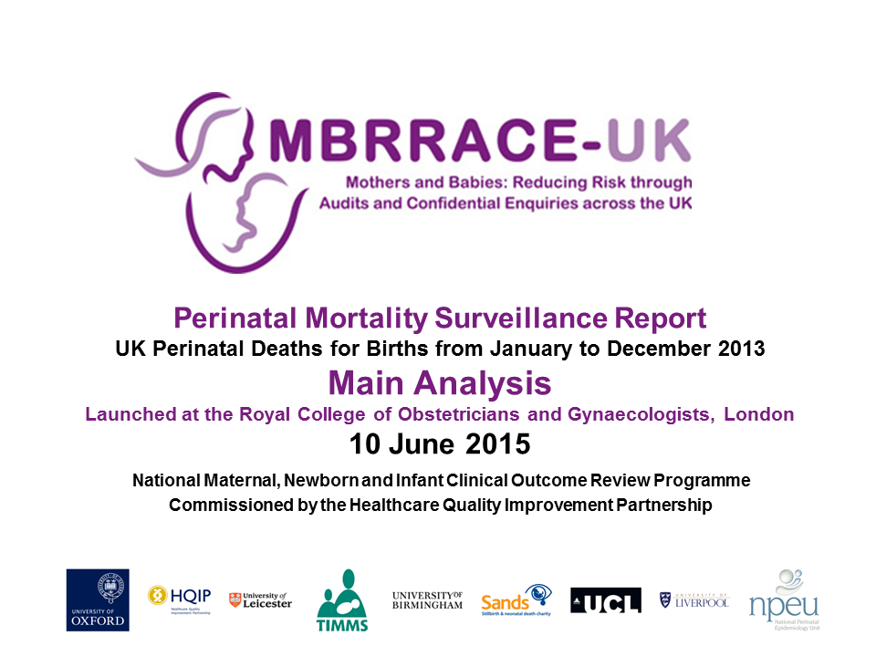

Slide 2
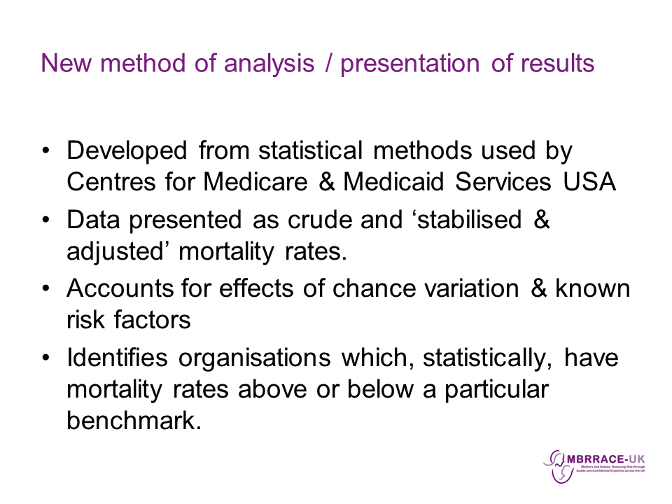

Slide 3
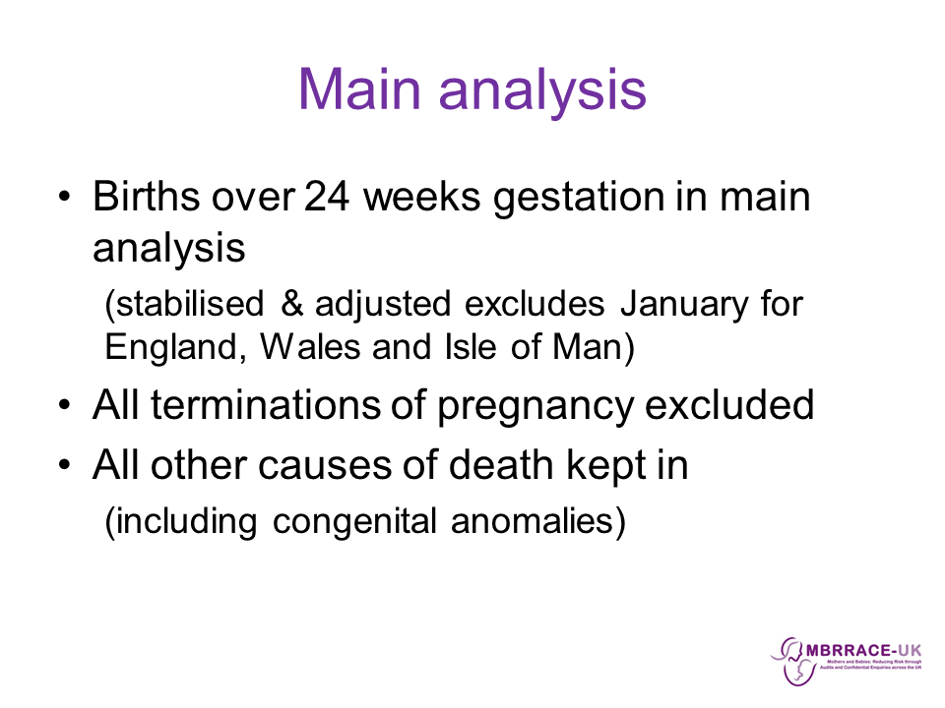

Slide 4
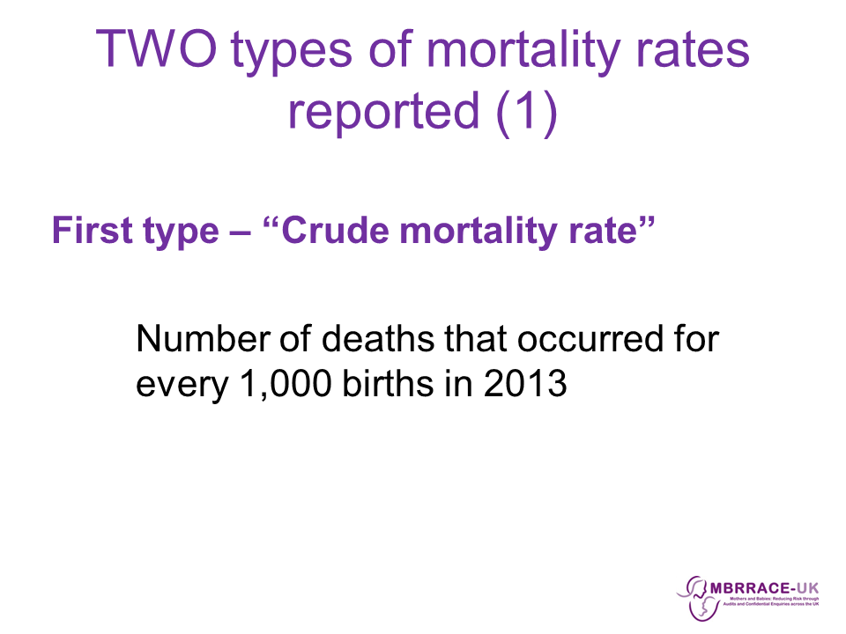

Slide 5

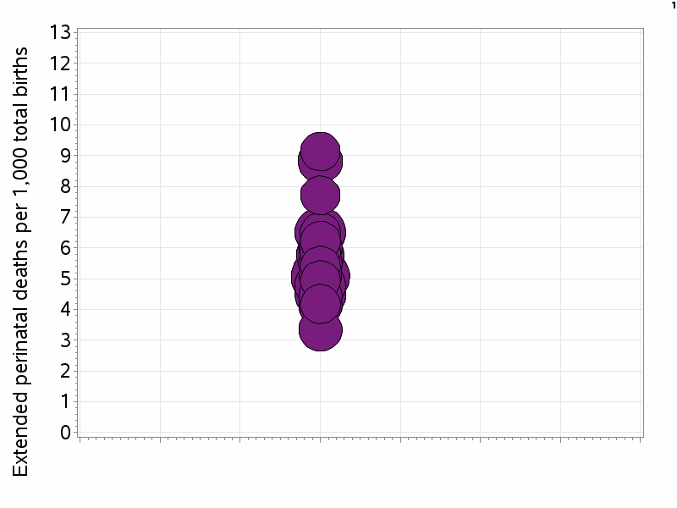
Crude mortality rates for ‘commissioning organisations’
0 to 13 deaths per 1,000 total births

Slide 6
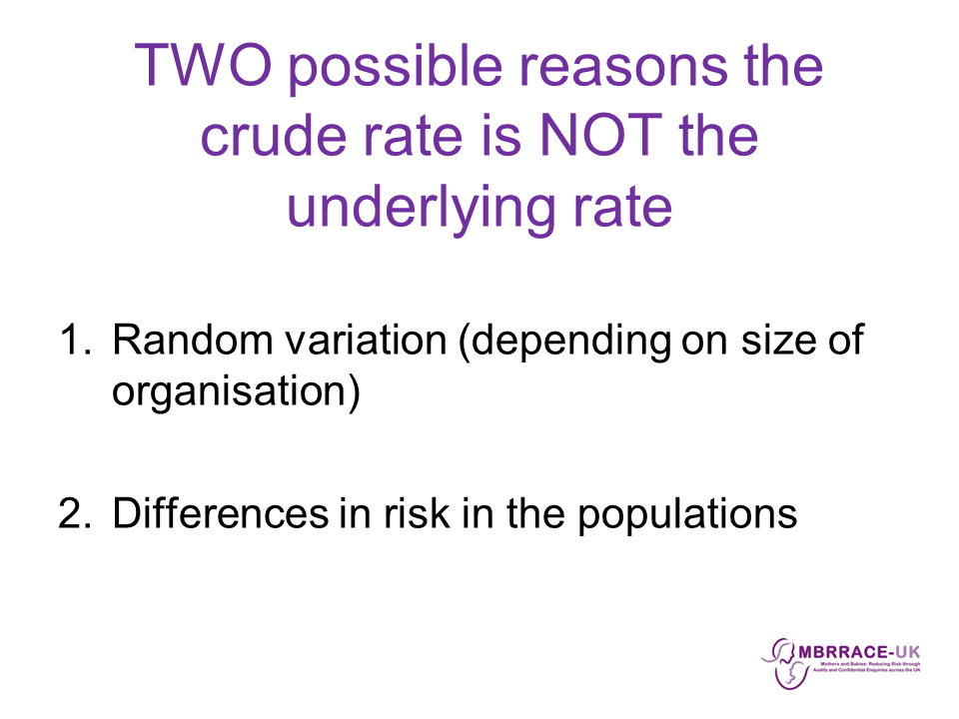

Slide 7

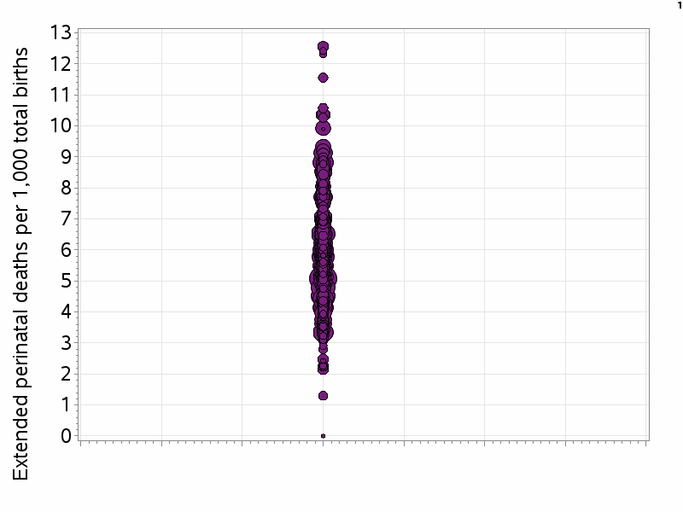
‘Crude’ mortality rates for commissioning organisations

Slide 8

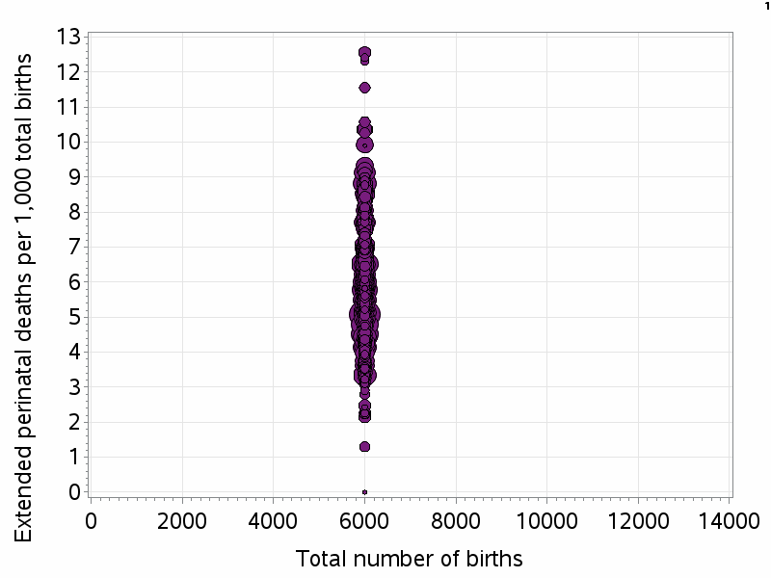
‘Crude’ mortality rates for commissioning organisations

Slide 9

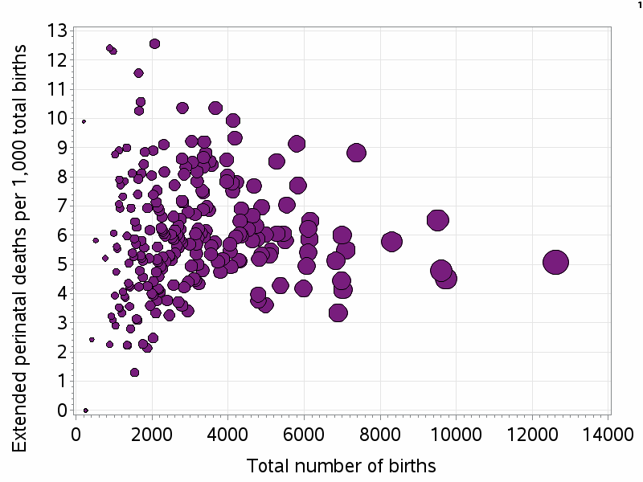
‘Crude’ mortality rates for commissioning organisations
Highest crude mortality rates
Lowest crude mortality rates

Slide 10
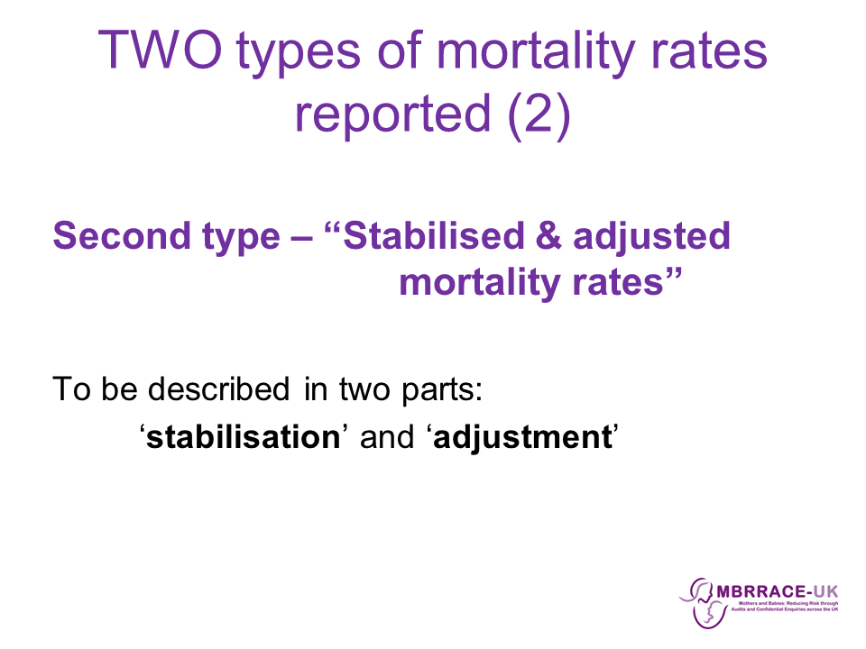

Slide 11
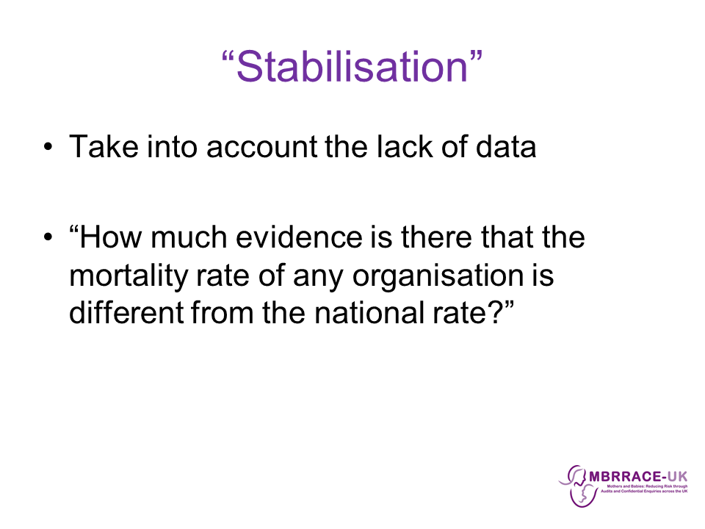

Slide 12

‘Stabilised’ mortality rates for commissioning organisations

Slide 13

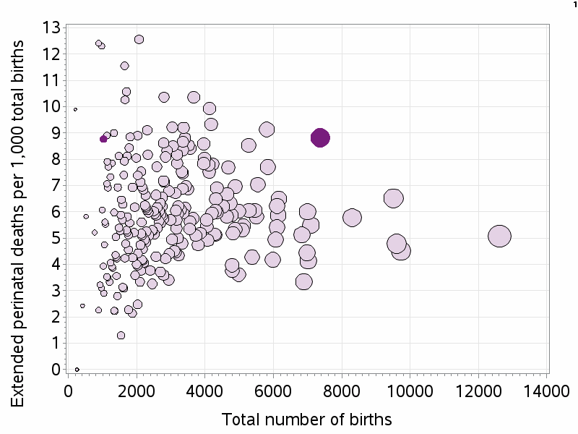
‘Stabilised’ mortality rates for commissioning organisations

Slide 14
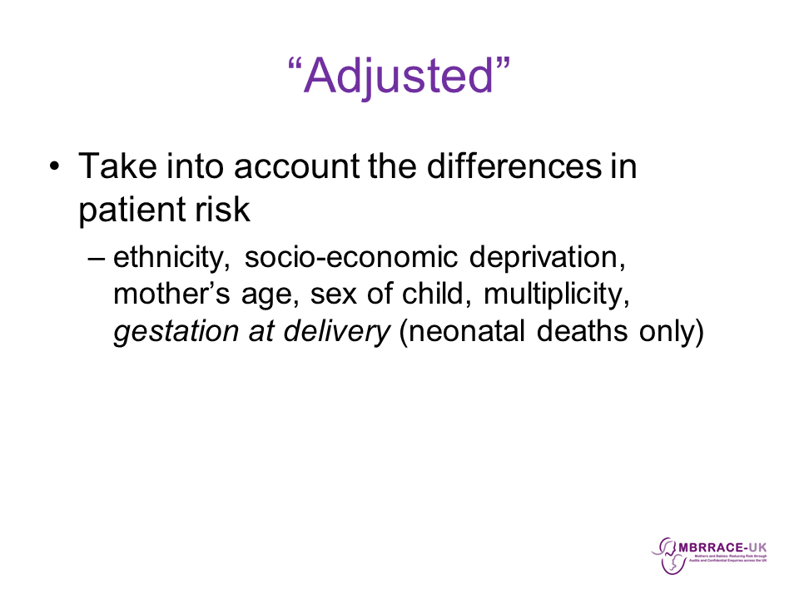

Slide 15

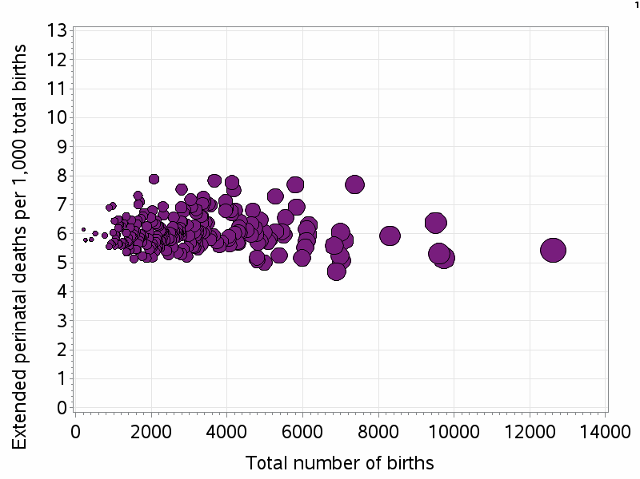
‘Stabilised & adjusted’ mortality rates for commissioning organisations

Slide 16

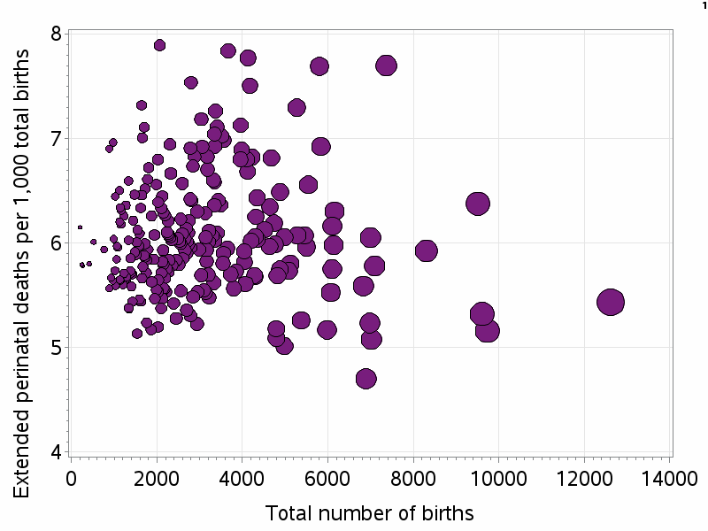
‘Stabilised & adjusted’ mortality rates for commissioning organisations

Slide 17
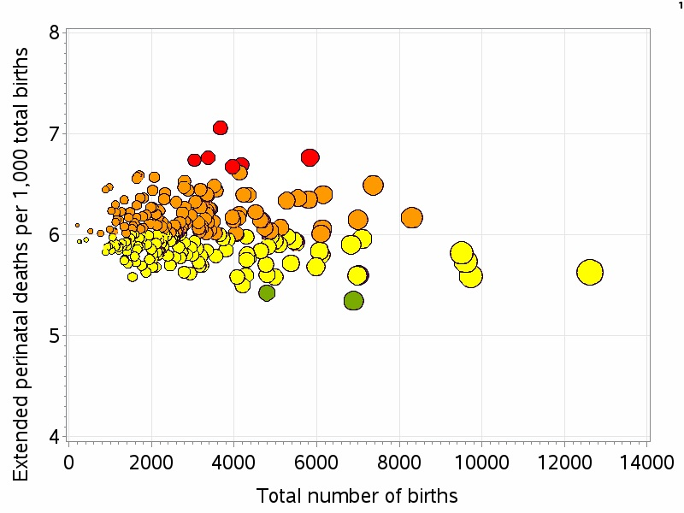
‘Stabilised & adjusted’ mortality rates for commissioning organisations

Slide 18
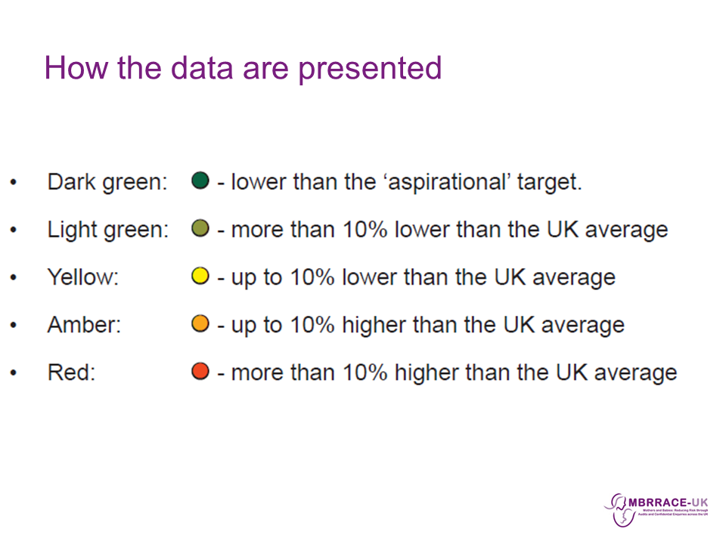

Slide 19
