Slide 1

Improving data quality
Dr Ian Gallimore

Slide 2
Overview
Data quality
Timing of reporting
Benchmarks
Incentives
Notes:
1) Data quality and completeness
Why might my Trust have missing data?
How can I avoid missing data?
2) Variations in how long it takes for a death to be reported to MBRRACE-UK
On a national basis
And then by Trust or Health Board
3) MBRRACE-UK benchmarks
By when should I have reported a death?
By when should the data be complete?
4) Incentives – what is in it for me to report early and report well?

Slide 3
1. Data quality
Key finding:
“There is a steady improvement in data quality overall, although there continues to be a problem with the completion of some maternal data especially carbon monoxide exposure monitoring (43.1% complete).”

Slide 4
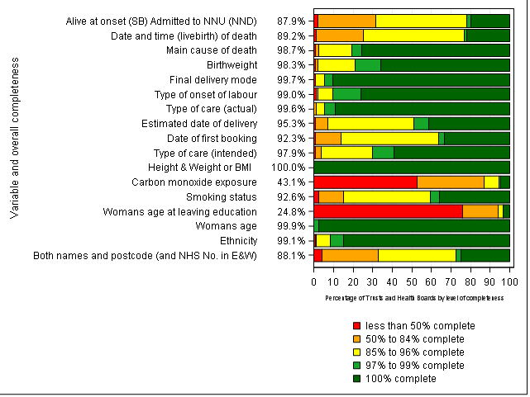
Data completeness
Notes:
CO exposure –improved from being missing in around ¾ of cases in 2014 to just over half in 2016, still work to do
In England CO testing is Element 1 of Saving Babies’ Lives Care Bundle (launched March 2016 so we hope to see big improvement for 2017)
Women’s age at leaving education
We know this is an issue for some Trusts due to the way they collect this information which has left them unable to answer the question
Adjustments have been made to reporting system to allow Trusts to report either age at leaving education or the mother’s highest level of qualification

Slide 5
Missing data
Why is data missing?
Baby born elsewhere:
  Born on delivery suite, died on NICU at same Trust/Health Board
  Born at another Trust/Health Board
      Reporters can view and edit all MBRRACE-UK cases reported by their Trust/Health Board
      The MBRRACE-UK case can be assigned to another Trust/Health Board for completion of the booking/antenatal/delivery information
      Receiving organisation has temporary ownership of case until it is returned to the assigning Trust/Health Board
      Requires good communication between maternity and neonatal teams
      e.g. transferred to hospice, discharged home
Notes:
Baby born elsewhere,
- on delivery suite, died on NICU
more likely to be an issue when baby born at another Trust
A few things in place to help deal with these situations

Slide 6

Missing data
Why is data missing?
Not known
  Un-booked or concealed pregnancy, unattended home delivery, overseas antenatal care, booked elsewhere etc.
  System will allow you to mark certain data fields as “not known”
  Case can also be assigned for completion of missing data (e.g. antenatal care received at another Trust/Health Board)

Slide 7
MBRRACE-UK recommendation
“All Trusts and Health Boards should endeavour to improve the quality and completeness of data reported to MBRRACE-UK and for routine inpatient, and birth and death registration purposes. Children’s hospitals should continue to develop and embed systems that allow for consistent liaison with birth hospitals to facilitate the collection of maternal information.”
  Difficulties where baby comes in from community via A&E; birth details sometimes not known and not appropriate to ask
  Ask us: we may be able to identify the place of birth from routine data sources, or can liaise with local Trusts/Health Boards
Notes:
Children’s hospitals – we know there can be an issue where baby comes in from community via A&E, birth details are not known and it is not appropriate to ask
Ask us: we may have routine data which can identify place of birth, or we can liaise with other local Trusts to try and identify where baby was born

Slide 8
2. Timing of reporting
Key finding:
“The timing of the reporting of deaths to MBRRACE-UK in 2016 shows a wide variation across the four countries of the UK.
Data entry was started within 6 months of a death for 95.1% of cases in Wales, 86.7% in England, 71.7% in Northern Ireland and 64.0% in Scotland.”

Slide 9
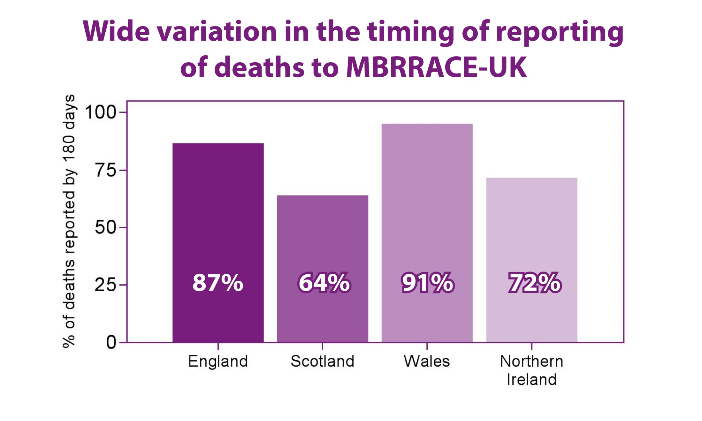
Notes:
Wide variation in the time it takes for a death to be reported to MBRRACE-UK, not just between units or between Trusts and Health Boards, but between countries.
Wales is the most timely reporter, with 91% of deaths being reported by 180 days
England very close behind
Scotland and Northern Ireland significantly slower to report deaths

Slide 10
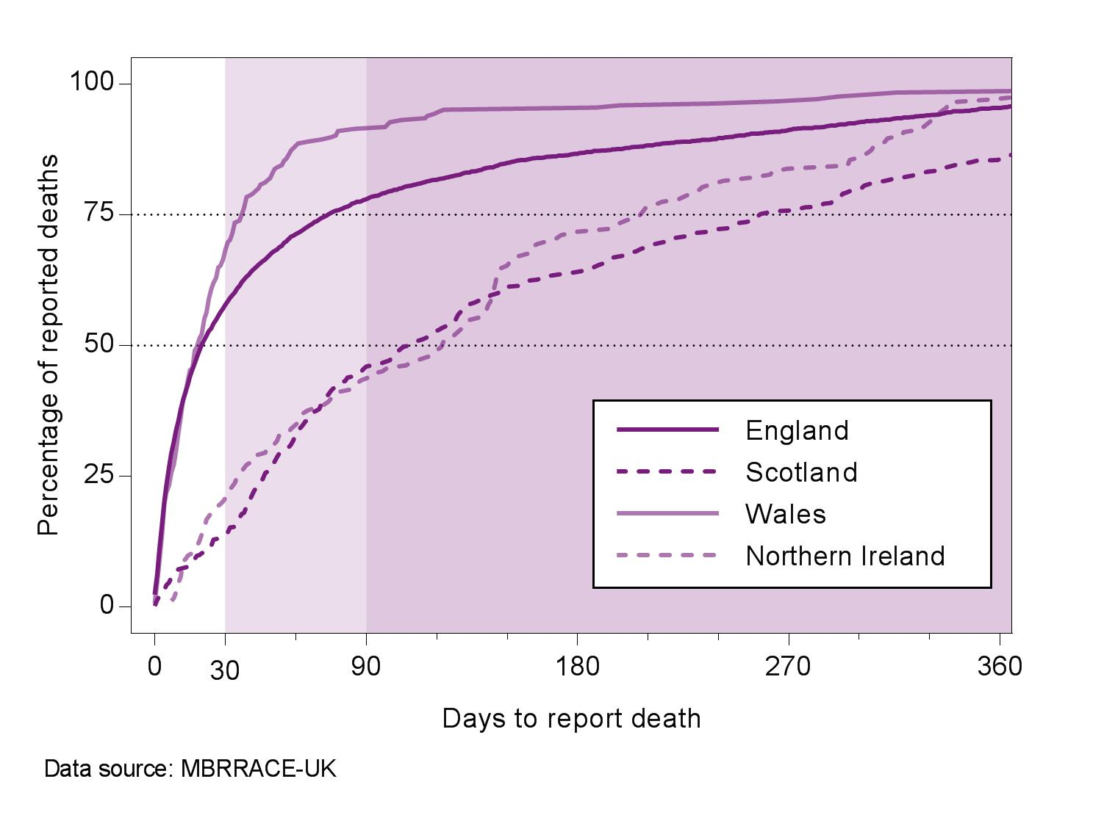
Timing of reporting across the UK
Notes:
For England and Wales data entry for half of their cases is started within 20 days of the occurrence of the death
In Scotland and Northern Ireland cases are started significantly later – takes over 100 days for 50% of deaths to be reported
This is not the time it takes to complete the case – just the gap between the death occurring and MBRRACE-UK being notified

Slide 11
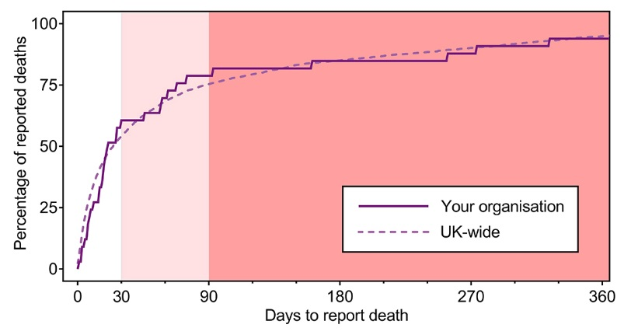
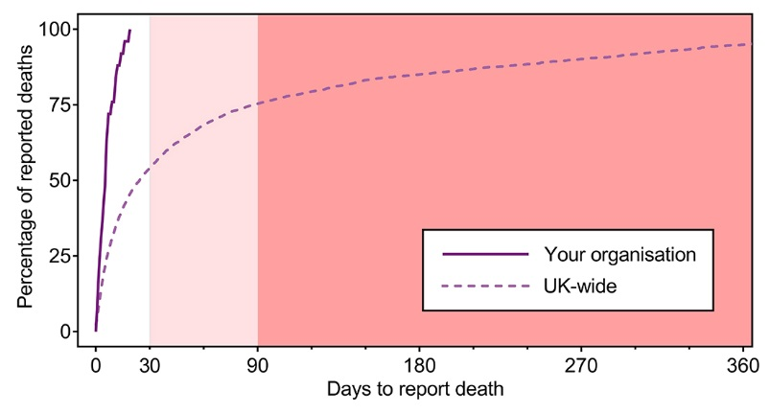
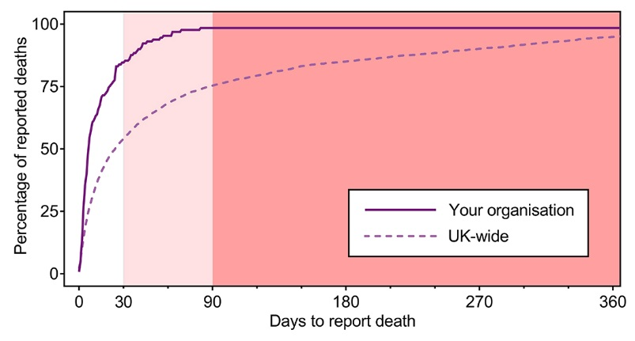
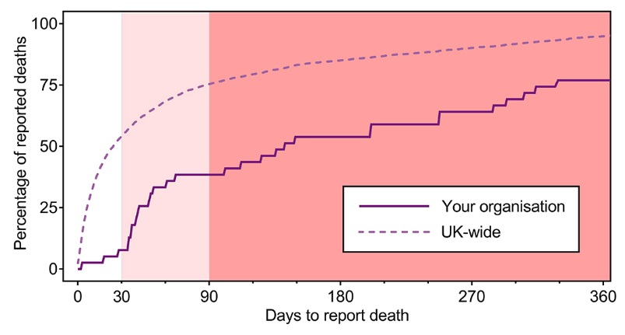
How does your organisation fare*?
1) Follows national average
2) Excellent reporting speed
3) Excellent, but missing case
4) Well below national average
*Information available in local Trust/Health Board reports
Notes:
For this year we have added a new chart to the individual reports available to each Trust and Health Board - how many days it took to report deaths to MBRRACE-UK compared with UK average
Trust 1) Reporting speed pretty much follows the UK average – just over ¾ of deaths are reported within 90 days
Trust 2) Excellent timeliness – 100% of deaths are reported to MBRRACE-UK within around 20 days.
Trust 3) Again, very good reporting speed, with almost all deaths reported within 90 days, but it takes over a year before they reach 100% because of a very small number of deaths reported very late (most likely identified by us from the routine data and then passed to the Trust as “missing” cases)
Trust 4) Very slow, with hardly any deaths being reported within 30 days, and well below the UK average

Slide 12

MBRRACE-UK recommendation
“In order to facilitate the close working between MBRRACE-UK and the Perinatal Mortality Review Tool (PMRT), within Trusts and Health Boards all stillbirths and neonatal deaths should be notified to MBRRACE-UK via the joint web-based system as soon as possible following the death.”

Slide 13
3. Benchmarks
MBRRACE-UK benchmarks:
  All deaths reported within 30 days
    Data does not have to be complete – report what you can at this stage
  Trusts/Health Boards should aim for complete data by 90 days
Notes:
Previously we haven’t been particularly explicit about how quickly deaths should be reported
We know that if you give people a deadline they tend to work towards it, which is why we see an increase in reporting activity in September as we get close to the closure of the database for that period.
However, some of these deaths occurred over a year previously

Slide 14
Benchmarks
Trusts should aim for complete data within 90 days
  May be some delays with PM results – enter a provisional cause of death if results are pending
  Data can be updated at a later date if new information becomes available
  Inform MBRRACE-UK if there is a significant delay in assigned cases being returned

Slide 15

4. Incentives for early reporting
Links with national Perinatal Mortality Review Tool
  List of MBRRACE-UK cases within PMRT
  PMRT reviews can be linked to MBRRACE-UK cases to ensure matching ID numbers
  Data sharing
    Currently limited
    Future releases of PMRT will expand data sharing to minimise double data entry
    Will be facilitated by a common notification page – which is coming soon

Slide 16
Incentives for early reporting
Reduced number of “missing” cases
  Created by MBRRACE-UK when a death registered by parents cannot be reliably matched to a death reported to MBRRACE-UK
    Death not reported; or
    Already reported but not matched with registered data (e.g. different surname, misspellings)
    Routine data not sufficient enough to confidently exclude (e.g. gestation uncertain)
Notes:
“Possibly unreported” cases

Slide 17
Incentives for early reporting
Reduced number of “missing” cases
  Created by MBRRACE-UK when registered death cannot be reliably matched to a death reported to MBRRACE-UK
    Death not reported
      Baby died outside maternity/NNU setting (e.g. hospice, A&E, home) – reporter(s) unaware of death
      Lack of resources – personnel, time
      Procedural
    Any death identified in routine data occurred at least 6 months earlier, up to 8-9 months in some cases
    To avoid duplicate entries use the outline case created by MBRRACE-UK
Notes:
Why has that death not been reported?
Unit not fully unaware of the death because the baby died in A&E, home, hospice etc – rare, usually some contact with maternity or NNU team
Resourcing issue
not enough staff to report the number of deaths
not enough protected time for available staff to report deaths in a timely fashion
Reporters have left Trust and have not been replaced
Procedural issue
No system in place to ensure that reporting to MBRRACE-UK is part of the process common to all perinatal deaths (some Trusts have this as part of their bereavement care checklist)
No system in place to track which deaths have been reported

Slide 18
Incentives for early reporting
Reduced number of “missing” cases
  Created by MBRRACE-UK when a death registered by parents cannot be reliably matched to a death reported to MBRRACE-UK
    Death not reported; or
    Already reported but not matched with registered data (e.g. different surname, misspellings)
    Routine data not sufficient enough to confidently exclude (e.g. gestation uncertain)
    Let us know if a death has already been reported, or does not meet MBRRACE-UK criteria

Slide 19
“Missing cases” list provided by MBRRACE-UK is there to help make sure cases don’t go unreported, but missing cases should be the exception, not the rule
If a case is identified as “missing” this death will have occurred 6-9 months earlier
Missing cases use more resources – notes need to be retrieved, reduced familiarity, mother may be pregnant again
Missing cases delay the reporting of other cases

Slide 20
Incentives for early reporting
Enhanced reports via the MBRRACE-UK reporting system
  Currently in development (schematic in development is on the next slide)
  Will allow access to more detailed and customisable reports specific to each Trust/Health Board

Slide 21
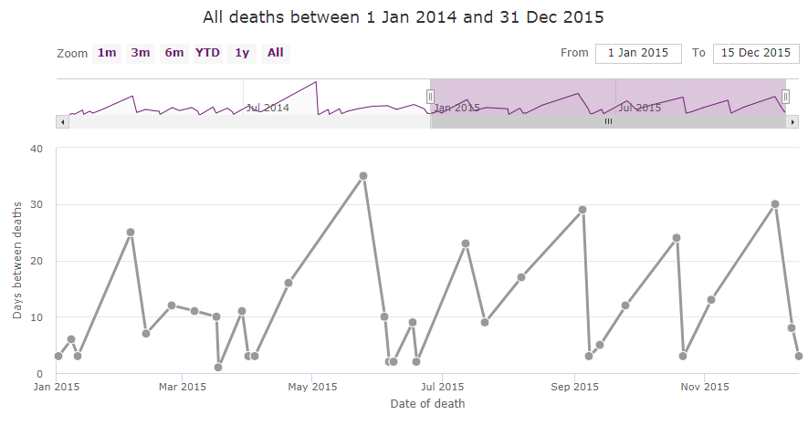
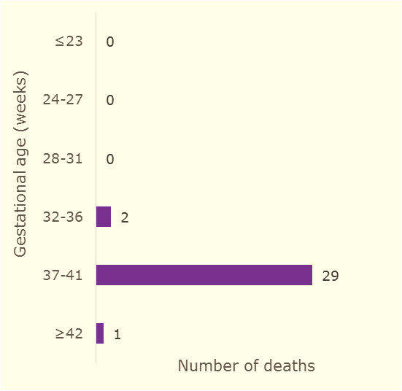
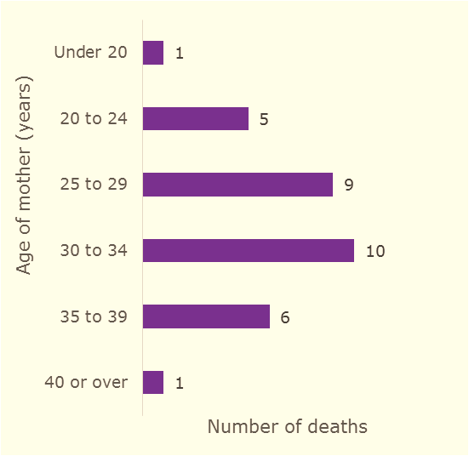
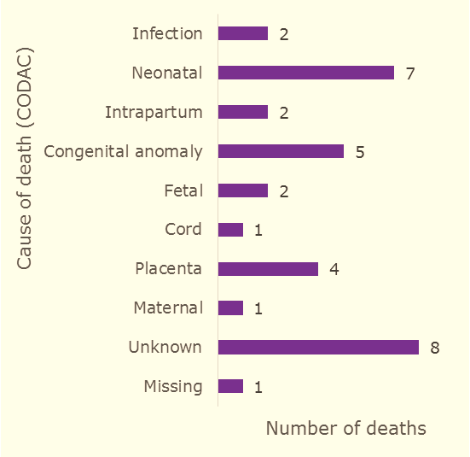
Filter
Deaths of babies born within your Trust
Clear
Type of death
Switch to Deaths at your Trust
Stillbirth (23)
Days between deaths
Neonatal death (9)
Gestational age
≤ 23 (0)
24-27 (0)
28-31 (0)
Singleton Neonatal death
Date of death: 13 September 2015
Born within: Trust A
Died at: Trust B
Days since previous death: 5
Gestational age (weeks): 35
Cause of death: Congenital anomaly
Report ID: 123456
32-36 (2)
37-41 (29)
≥ 42 (1)
Cause of death
Infection (2)
Neonatal (7)
Intrapartum (2)
Number of deaths
by gestational age
Number of deaths
by age of mother
Number of deaths
by cause of death
Congenital anomaly (5)
Fetal (2)
Cord (1)
Placenta (4)
Maternal (1)
Unknown (8)
Missing (1)

Slide 22
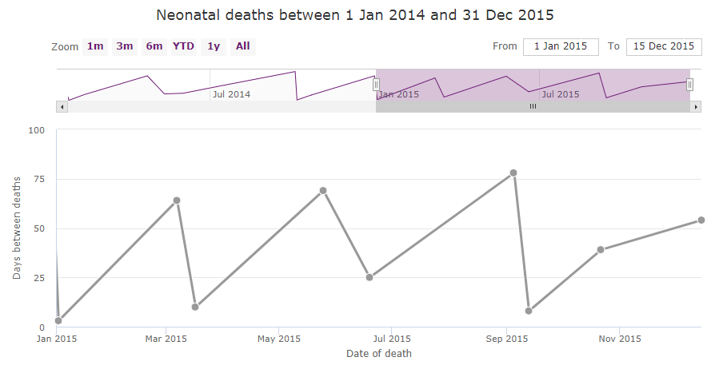
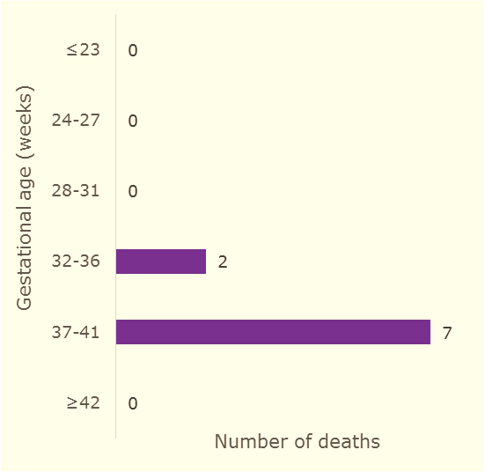
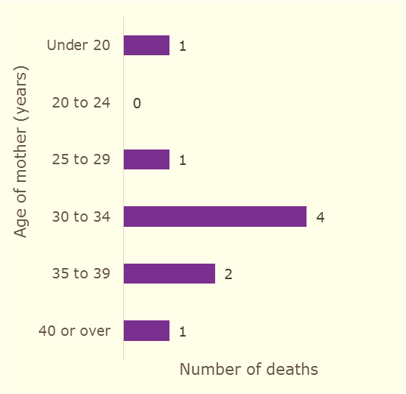
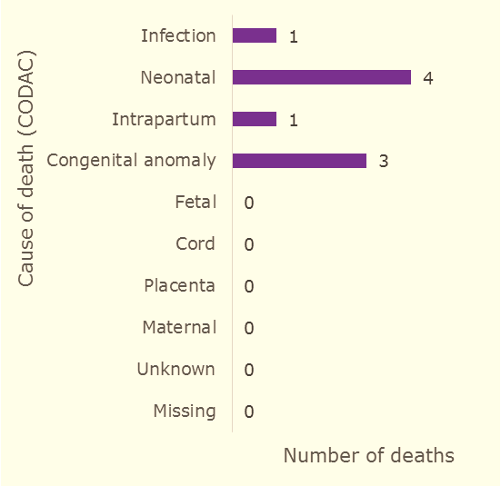
Filter
Deaths of babies born within your Trust
Clear
Type of death
Switch to Deaths at your Trust
Stillbirth (23)
Days between deaths
Neonatal death (9)
Gestational age
≤ 23 (0)
24-27 (0)
28-31 (0)
32-36 (2)
37-41 (7)
≥ 42 (0)
Cause of death
Infection (1)
Neonatal (4)
Intrapartum (1)
Number of deaths
by gestational age
Number of deaths
by age of mother
Number of deaths
by cause of death
Congenital anomaly (3)
Fetal (0)
Cord (0)
Placenta (0)
Maternal (0)
Unknown (0)
Missing (0)

Slide 23
MBRRACE-UK recommendation
“Trusts and Health Boards should ensure that the data provided to MBRRACE-UK is of the highest quality. This is of particular importance for those providing the most complex care to particularly high-risk mothers and babies as this will permit more appropriate sub-analyses and comparisons.”

Slide 24

Dependent on timely and accurate reporting

Slide 25

We want to help!
We want to make the reporting process as easy and efficient for you as we can

Slide 26
Contact us
If you have a question or a problem:
  Call us: 0116 252 5425
  Email us: mbrrace-uk@npeu.ox.ac.uk
  Use the “Contact us” option within the MBRRACE-UK system

Slide 27
In summary…
Report early to save time later
  Notify death within 30 days
  Complete data within 90 days
  Incorporate into local processes
  Must have adequate resourcing – staff and time
Quality is key – the better information you give us, the better information we can give you in return

Slide 28

Thank you
Calendar by Kid A, Help by Gregor Cresnar, Time by Orkhan Zizou Mursalov, from the Noun Project

