Slide 1






Parents’ experiences of losing a baby between 20 and 24 weeks of pregnancy
Lucy Smith, Department of Health Sciences, University of Leicester
Lisa Hinton, Health Experiences Research Group, Nuffield Department of Primary Care Health Sciences, University of Oxford

Slide 2
Why we did the research

Slide 3
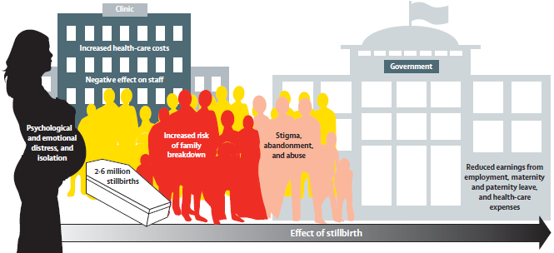
The effects of stillbirth affect mothers, their families, health services, society, and governments
Heazell et al. Lancet 2016
Notes:
Widespread themes of direct, indirect, and intangible costs are shown.

Slide 4
The effects of how we report stillbirths affect mothers, fathers, their families, health services, society, and governments
Heazell et al. Lancet 2016
Notes:
Widespread themes of direct, indirect, and intangible costs are shown.

Slide 5
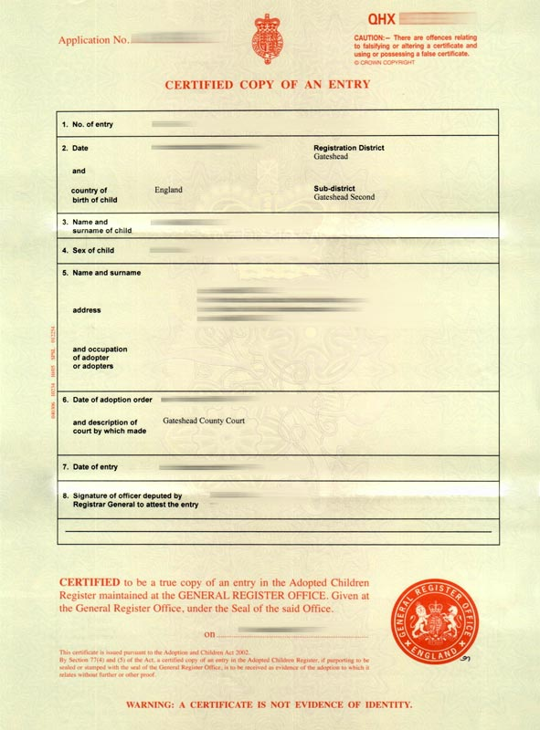

Registration of babies in the UK
  A baby that is born alive and dies shortly after birth at any gestation
  -> Official birth and death registration
  A baby that is born showing no signs of life from 24 weeks of gestation
  -> Official stillbirth registration
  BUT
  A baby born showing no signs of life before 24 weeks of gestation
  -> No official registration and referred to as a miscarriage
  -> These babies are not counted in any mortality statistics

Slide 6
Variation in registration of babies in the UK
There is wide variation between geographical areas as to whether a baby born at 22 or 23 weeks is reported as live born
  Ranging from 1 in 5 babies to 4 in 5 babies recorded as live born
May arise from differing views on viability and what it means to be born alive by clinical teams
In one hospital a woman may have their baby’s death registered as a neonatal death but in another hospital the same woman’s baby may have gone unregistered as a late miscarriage

Slide 7
Births at the limits of viability
Births before 24 weeks of gestations are extremely rare
  Little reliable information on the number of births before 22 weeks gestation
  MBRRACE-UK report all babies are born at 22⁺⁰-23⁺⁶ weeks gestation approx. 1 in 800 births
As survival is very poor births at 22 and 23 weeks they make up around 20% of baby deaths

Slide 8
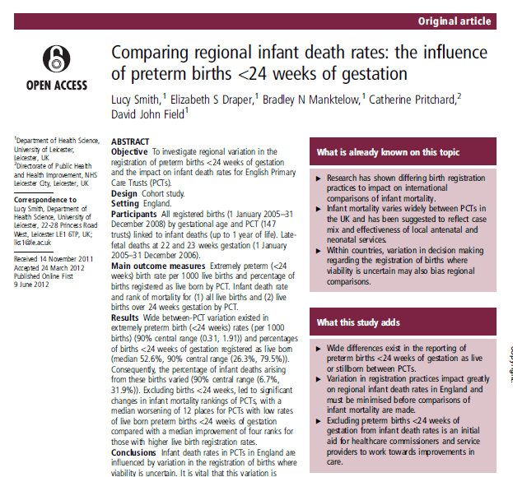
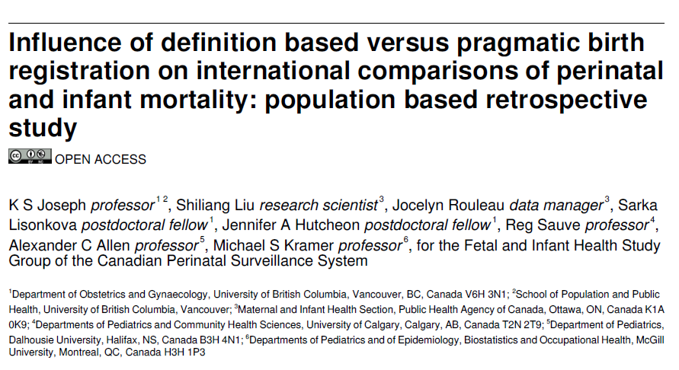
Impact on national and international comparisons
Variation leads to artefactual differences in mortality rates
Invalid comparisons nationally and internationally as not comparing “Like with like”
Inappropriate implementation of services

Slide 9
The importance of parents’ perspectives and experiences
Parents’ perspectives and experiences of loss at this gestation are often overlooked
Clinicians may make assumptions about parents’ preferences around birth and death registration based on anecdotal evidence
What are is the overall experience of care of parents losing a baby at this gestation?
How do legal gestational age limits for stillbirth registration impact on parents’ experiences of loss?
Are parents’ experiences similar to loss later or earlier in pregnancy?
Can we incorporate parents’ experiences into a resource to support parents, family and clinicians in the future

Slide 10
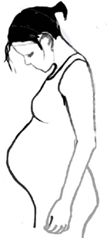
Before 24 weeks of pregnancy, parents whose baby is born alive and dies shortly after birth…
Official record
Parents received an official birth and death certificate following the death of their baby
Time to grieve
Parents are eligible for maternity leave and paternity leave
Financial aid
Parents receive free prescriptions, dental care, and maternity pay
Official investigation
A coroner’s investigation may help make sense of the death

Slide 11
Before 24 weeks of pregnancy, parents whose baby is born showing no signs of life…
Official record
Parents may receive an informal birth and death certificate from the hospital
Time to grieve
Parents have to get sick leave from work
Financial aid
Parents don’t receive any financial aid
Official investigation
There is no requirement for an investigation of the baby’s death

Slide 12
NIHR – Career Development Fellowship
To explore national and international variation in the management of babies at the limits of viability and identify good practice for mortality comparisons
To explore parents’ perspectives and experiences of baby loss at 20 to 24 weeks of pregnancy and produce a support resource for friends and families - module on the website www.healthtalk.org
To develop professional education training resources to reduce variation in practice and improve care and support for parents

Slide 13
How we did the research

Slide 14
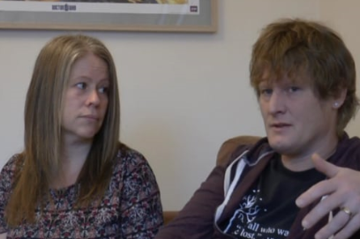
In-depth narrative interviews
We wanted to hear parents’ experiences of loss, in their own words
Interviews lasted around 2 hours exploring issues such as:
  Finding out something was wrong
  Experiences of birth
  What happens after loss?
  Coping with grief
  Impact on relationships
  Future pregnancies
  Life now and messages for others

Slide 15



Who participated?
We recruited parents through
  Support groups:
    The Miscarriage Association
    Sands (the Stillbirth and neonatal death charity)
  Clinicians at 4 UK hospitals
We travelled over 2000 miles around the UK, over 12 months to interview 38 parents in their own homes (28 mothers and 10 fathers)

Slide 16
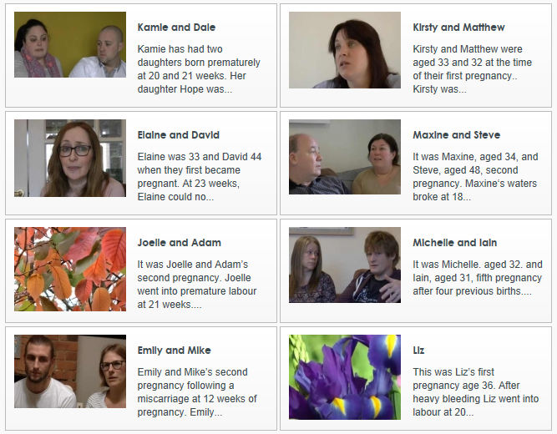
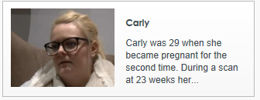
Parents biographies
We interviewed parents’ whose …
- baby died before labour begins
  Often confirmed at a routine scan or check-up
- baby was diagnosed with a severe congenital anomaly
  Detected through a routine scan
  Parents had to make a decision about continuation of the pregnancy
- baby was born following extremely preterm labour
  Some parents attended hospital with threatened preterm labour over a long period, and making decisions about induction of labour
  Others experienced very sudden onset of labour and birth

Slide 17



Time frame of loss
Maximum variation sample: Interviews between 6 weeks and 25 years after loss
1992
1997
2002
2007
2012
2017

Slide 18
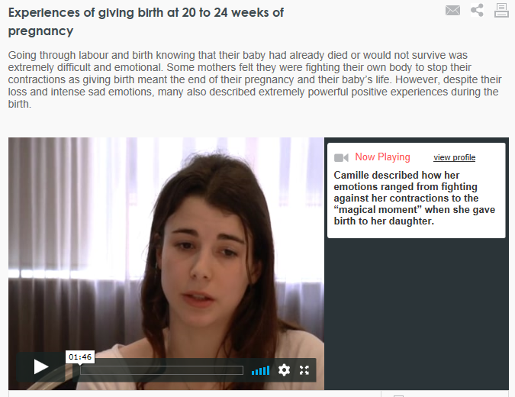
Health talk methodology
Narrative interviews, audio and video recorded (with consent)
  Transcribed
  Sent to parents for checking
  Thematic analysis to produce 22 summaries and 250 video and audio clips for a new module on www.healthtalk.org

Slide 19
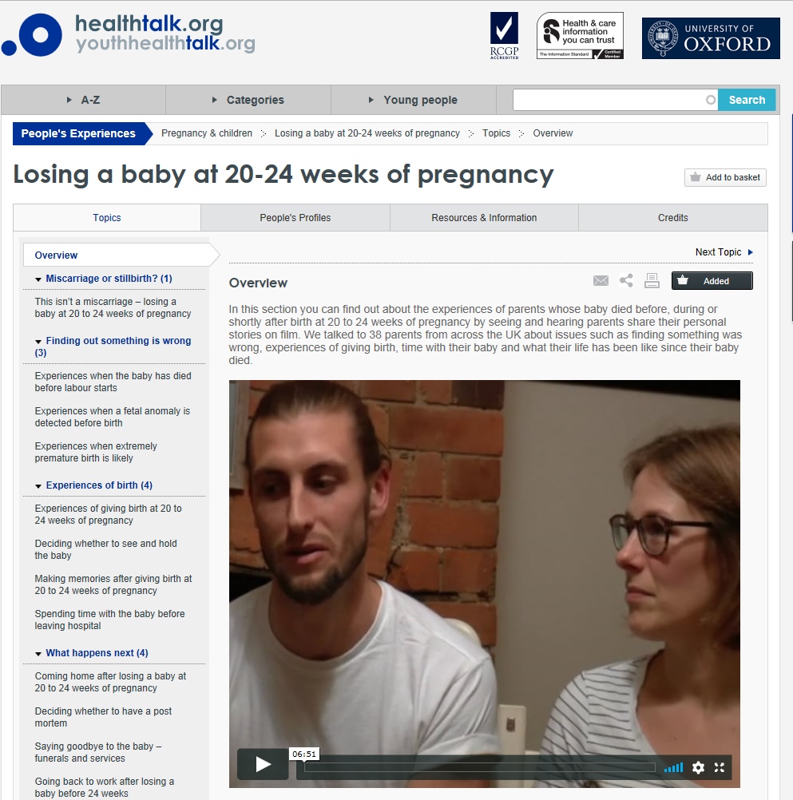

Slide 20
Parents’ voices

Slide 21
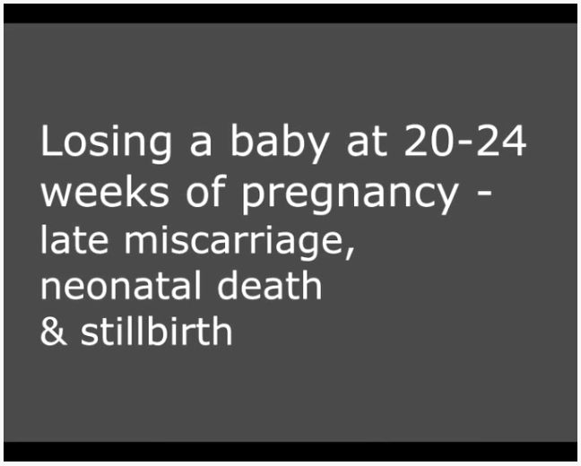
http://healthtalk.org/20-24

Slide 22
What did parents share with us?

Slide 23
What did parents share with us?
In their narratives of loss parents described journeys that incorporated:
- The stress of finding out something was wrong
- Experiences of giving birth, seeing their baby, spending time with their baby, making memories.
- Experiences of leaving hospital and going home
- Making decisions about funerals and whether to have a post mortem
- Experiences of taking leave and returning to work
- Impacts on relationships with their partner, family, friends and colleagues
- Making decisions about trying for another baby and stress of a subsequent pregnancy
- Life after loss, coping with grief, counselling and support groups
Examples of excellent care and areas for improvement

Slide 24

(i) Language matters: Terminology of loss
The legal definition of stillbirth led to difficulties around the terminology used when talking about baby loss
Parents were often told they were having a miscarriage or that there had been a fetal death
For these parents, terminology used when talking about baby loss led to shock and a lack of preparation for their experience
Parents experiences were different when midwives and doctors recognised they were having a baby

Slide 25
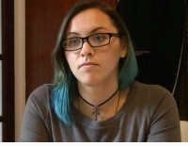
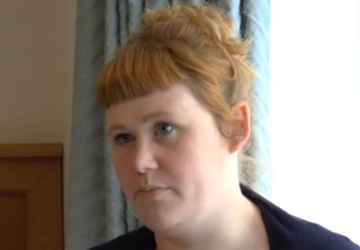
“And then labour happened. The fact that I had to go through the whole process of giving birth and everything. Because they kept saying to me, "Oh, it's a miscarriage. It's a miscarriage." But so in my head I was like 'it's not going to be like this, it's going to be like, like just blood or whatever'. But you know, I had to full on give birth.” Courtney
“It was nice that they were treating him as a baby, a child that we had lost, rather than a miscarriage and I think these are all the kind of things that made a massive difference to how we dealt with it afterwards.” Sarah

Slide 26
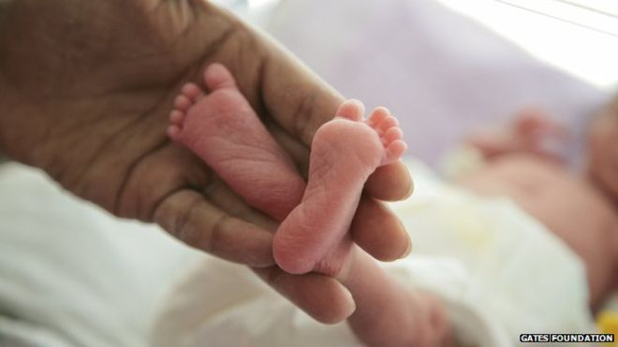
(ii) Impact of language on seeing the baby
Using the term miscarriage often meant the reality of seeing their baby was very different to what parents’ imagined
Parents reflected on the pain of labour and giving birth to a “formed, tiny, perfect” baby
Many held their baby in their arms, sung to them, washed and dressed them and had a funeral for them

Slide 27


“She was perfectly formed. Fingernails, and little things like that, as well. Just these tiny details that - to me, that wasn't a miscarriage. In no way, shape or form. Medically it was. But I don't, I don't think it was.”
Mike
“Grace was born at twenty three weeks. And to me, she looked like a baby. And it upset me for them to call her like a miscarriage… I hated the term miscarriage, it really upset me.”
Kelly

Slide 28
(iii) Language affects how others react
Terms such as miscarriage made it hard for friends, family and work colleagues to fully understand parents’ experiences.
Parents felt others thought they were overreacting to their loss because they didn’t comprehend what they had been through

Slide 29


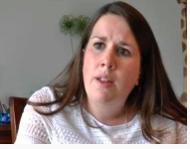
“And because there hadn't been a birth certificate or a death certificate, it's almost like it was minimised and wasn't that big of a deal. Not just for the people who were involved at the hospital, but for like families as well. They didn't really seem to grasp what had happened, or how horrific it had been.”
Matthew
David felt that calling the loss of his baby a miscarriage meant that a lot of people couldn’t “read between the lines and experience the pain”
Lindsay said it made her feel she “was making a mountain out of a molehill”

Slide 30
(iii) Impact of lack of registration
A lack of registration of the baby’s life meant there were no legal documents to show the baby’s existence
This is particularly important when opportunities to make mementoes are limited
It also reinforced the feeling that the health system and society more widely did not recognise the impact of their loss

Slide 31
(iv) Impact of legal cut-off – parental leave and benefits
Most of parents we spoke to were not entitled to parental leave and pay and so they had to take sick leave from work
Many spoke about feeling “huge pressure” to return to work
Having to visit their GP to extend their sick leave was stressful.
Differential experience for parents of live born babies. They had time to grieve and an opportunity to decide when to return to work

Slide 32

“It was really rubbing salt in the wound”
Sarah spoke about having to pay back costs for dental treatment that she was no longer exempt from
“So, when we lost, two weeks later I went back to work. Because it is a second trimester loss, again it isn't counted as a stillbirth. You don't get any rights. You don't get any help. So you do have to just go back to work. You're lucky if your company gives you bereavement time.”
Courtney
“He was born alive, so… he's given me this time off, as well to recover. So he has been kind to Mummy. And I think it's not fair. Because if he had been born dead, I wouldn't have had maternity leave. And it would have been a matter of three hours. Because he was born at quarter to ten.”
Asun

Slide 33
Improving recognition
Improving awareness of parents’ perspectives and experiences
Terminology and recognition impact on
  Experiences of giving birth
  Expectations of seeing the baby and spending time with them
  Reactions and support of friends and family
  Validation of life and parenthood
Registration differences
  Lead to inappropriate terminology
  Introduce inequalities around parental leave and pay

Slide 34
Panel discussion

Slide 35
Reducing the effects of variation in reporting baby loss on mothers, fathers, their families, health services, society, and governments

Slide 36
Improving parents’ experiences
From a parents’ perspective we hope the Healthtalk resource will:
  Offer comfort and emotional support for parents who have experienced loss
  Also provide practical information for those experiencing loss in the future
  Offer help to friends and family who are supporting parents
Combined with many other initiatives to improve care such as
  Department of Health and Social Care Pregnancy Loss Review
  Sands “Finding the Words” campaign
  Bereavement Care Pathway

Slide 37
Reducing variation in clinical practice
Improve awareness of parents’ perspectives and experiences
  Use the parents’ experiences as a training tool to highlight good practice and improve care
  Building on the Healthtalk resource, we will be developing a MDT training tool using parents’ experiences that can be delivered locally
Increase access to information
  Recommend the site to parents experiencing loss and their friends and family
Reduce variation in the registration of babies before 24 weeks
  Improving consistency in determining live birth

Slide 38

Definition of live birth
A live birth is the complete expulsion or extraction from its mother of a product of conception, irrespective of the duration of pregnancy, which, after such separation, breathes or shows any other evidence of life, such as beating of the heart, pulsation of the umbilical cord, or any definite movement of voluntary muscles, whether or not the umbilical cord has been cut or the placenta is attached.

Slide 39

Interpreting signs of life
Guidelines exist for intervention following live birth but not for determining whether a baby is “born alive”
Still much confusion and distress around what it means to be born alive
Beating of the heart
  A baby may have a detectable heartbeat at 19 weeks but should they be reported live born?
  If resuscitation is undertaken first and is unsuccessful, it may be unknown whether there was a heartbeat in the first five minutes
Pulsation of the cord
  Does all detectable pulsation count even following cardiac massage?
Breathing
  Respiration following unsuccessful resuscitation attempts?
Definite movements of voluntary muscles
Audible cry

Slide 40

Work towards guidelines for defining sign of life
Nuffield Council of Bioethics report on intervention in neonatal care –
  We therefore recommend that the RCOG and RCPCH, together with BAPM and the Royal College of Midwives (RCM), should consult widely and develop a definition of ‘born alive’ which encompasses the capacity of a baby to breathe either independently, or with the support of a ventilator. Consideration should be given to incorporating such a definition in statute.
Also confusion about what parents want and how that plays a role in determining signs of life
Move towards guidelines that offer support in a very difficult area

Slide 41
Reducing variation in clinical practice
Improve awareness of parents’ perspectives and experiences
  Use the parents’ experiences as a training tool to highlight good practice and improve care
Increase access to information
  Recommend the site to parents experiencing loss and their friends and family
Reduce variation in the registration of babies before 24 weeks
  Improving consistency in determining live birth
Ultimately reducing the effects of how we report baby loss on mothers, fathers, their families, health services, society, and governments

Slide 42
Thank you to all the parents and everyone who participated in www.healthtalk.org/20-24 …
Sophie Almond, Study administrator, University of Leicester
Natalie Armstrong, Professor of Healthcare Improvement Research, University of Leicester
Ruth Bender Attik, Charity representative, The Miscarriage Association
Adam Barnett, Head of technical operations, HealthTalk
Julia Clark, Midwife, University of Leicester
Jonathan Cusack, Consultant neonatologist, University Hospitals of Leicester
Joanne Dickens, Bereavement midwife, University Hospitals of Leicester
Elizabeth Draper, Professor of Perinatal Epidemiology, University of Leicester
Iain Every, Parent advisory group member
Michelle Every, Parent advisory group member
Carly Ewan, Parent advisory group member
David Field, Professor of Neonatal Medicine, University of Leicester
Jane Fisher, Charity representative, Antenatal Results and Choices (ARC)
Emily Gifford, Parent advisory group member
Mike Gifford, Parent advisory group member
Alex Heazell, Professor of Obstetrics, University of Manchester
Ross Jones, Charity representative, Sands
Jo Kidd, Head of Communnications, HealthTalk
Penelope McParland, Consultant obstetrician, University Hospitals of Leicester
Laura Price, Charity representative, Sands
Ruth Sanders, Research Delivery Project Manager, Oxford University
Kirsty Schemet, Parent advisory group member
Matthew Schemet, Parent advisory group member

