Slide 1

Clea Harmer
15th June 2018

Slide 2

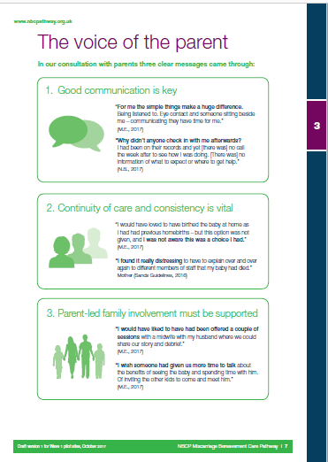
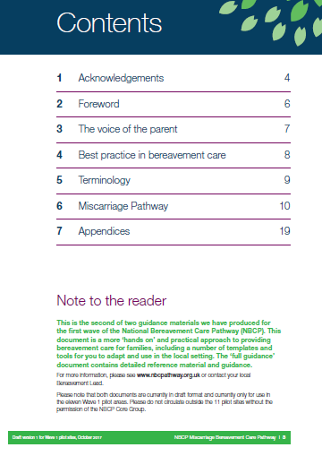
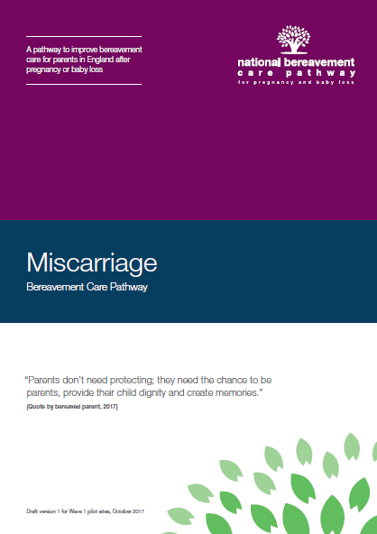
Contents
Parents and communication at the heart of the Pathway
Updates
Pilot sites
Evaluation
3. Challenges
4. Vision going forward

Slide 3
Vision and aim of
National Bereavement Care Pathway
To ensure that all bereaved parents are offered
equal, high quality, individualised, safe and sensitive care

Slide 4
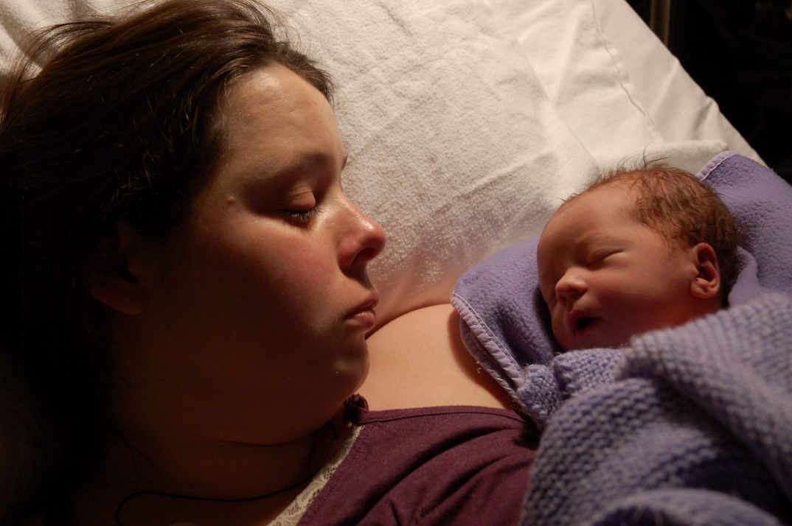
Parents at the heart of the NBCP
‘Hearing the parents voice’
Parents told us 3 things were important for excellent bereavement care:
Communication
Continuity and consistency in care
Parent-led family involvement

Slide 5
Communication: finding the right words is hard
Everyone needs to find the right words, healthcare professionals included.
Baseline evaluation of NBCP (April 2018) showed 52% felt ‘less than prepared’

Slide 6
Communication: finding the right words is hard
Baseline evaluation of NBCP (April 2018) showed 73% of
Midwives grades 3 to 5 felt ‘less than prepared’

Slide 7

Communication: finding the right words is hard
Notes:
https://www.youtube.com/watch?v=wPovVrRSRlY

Slide 8
Update on Wave 1: launched October 2017
We talk to Gynae a lot more now
Feedback from the 11 pilot sites
It has raised the profile of bereavement care and improved relationships with other departments
Some teams difficult to engage with, for example A&E when facing high demand
Sometimes difficult to engage senior staff, though often the reputational benefits resonated
Challenging to incorporate into existing roles – it requires a team of people to lead from different departments
High quality bereavement care doesn’t make money’ …
… but important to be seen to do the right thing
We have asked for each area to appoint a bereavement link
I was already at capacity

Slide 9

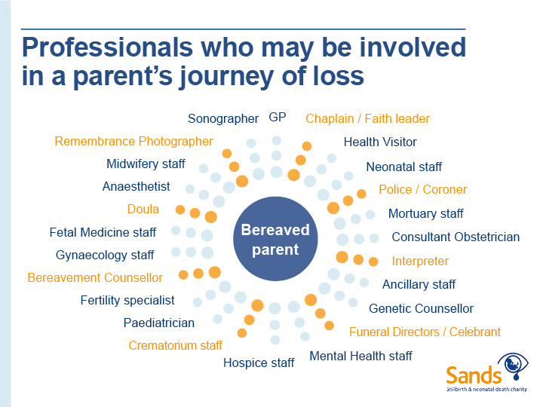
Partnership: Who do we need to engage with?
(not an exhaustive list!)
Pathologists
A&E staff
Cemetery staff

Slide 10
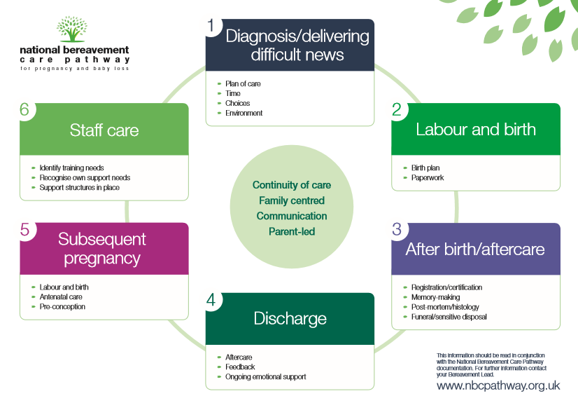

Slide 11
“For me the simple things make a huge difference.
Being listened to. Eye contact and someone sitting beside me –
communicating they have time for me.”
“I wish someone had given us more time to talk about the benefits of
seeing the baby and spending time with him. Of inviting the other kids to
come and meet him.”
“Parents don’t need protecting; they need the chance to be
parents, provide their child dignity and create memories.”
“I found it really distressing to have to explain over and over again to different
members of staff that my baby had died.”

Slide 12


Wave 1 baseline evaluation: key findings from healthcare professionals
Where in post, bereavement midwives/leads are making a significant and positive difference to bereavement care.
Bereavement care is inconsistent with parents experiencing miscarriage or TOPFA receiving less good care, as with parents in A&E or on Gynae Wards
Staff on lower grades feel less able to communicate, less able to discuss bad news, less supported to deliver good quality bereavement care

Slide 13
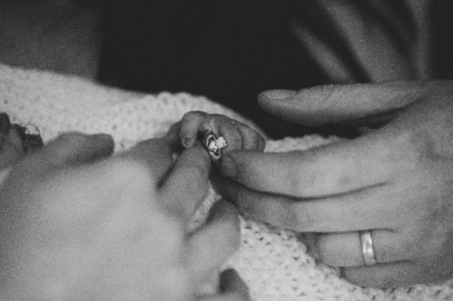
Further Updates
Wave 2: launched April 2018
Further 22 sites launched including those with leads who are Health Visitors, GPs, and from neonatal units
DHSC Funding
In April 2018 Minister for Health announced funding of national roll-out
APPG for Baby Loss
Continued support from APPG

Slide 14
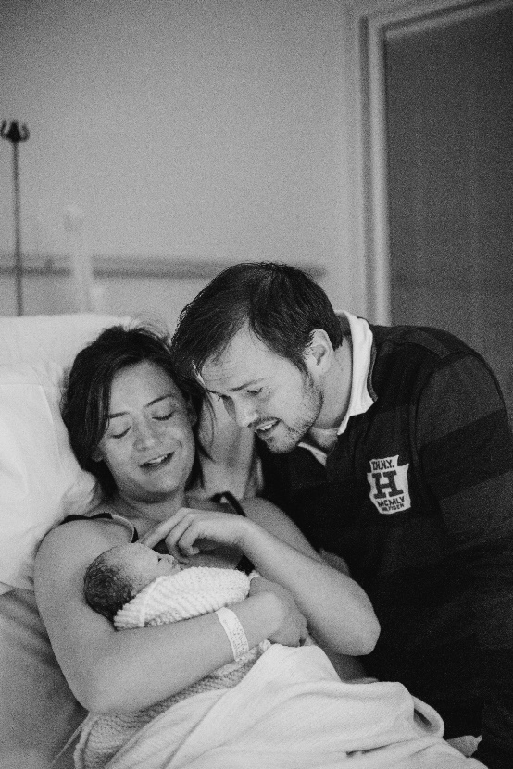
Scotland
Funding from Scottish Government for national roll-out in Scotland
Develop pathway for Scotland
Initial workshop on 25th June
Launch of pilot autumn 2018

Slide 15

Parent to parent – post mortem film
https://player.vimeo.com/video/272820256
https://sands-lothians.org.uk/post-mortem-animation/

Slide 16

Challenges
From current sites
Working across teams / engaging all departments
Senior management
Capacity/resources
Lack of bereavement care facilities

Slide 17
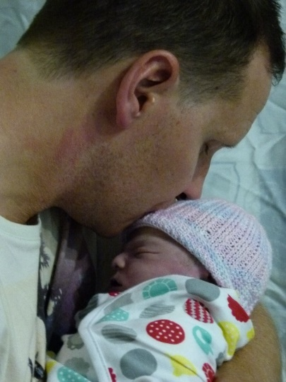
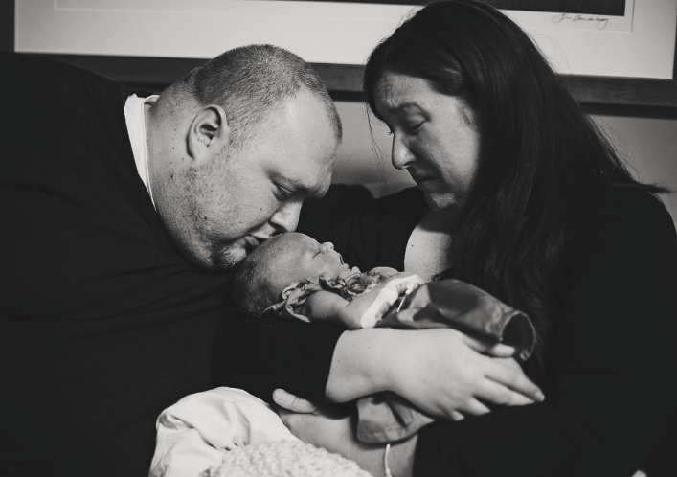
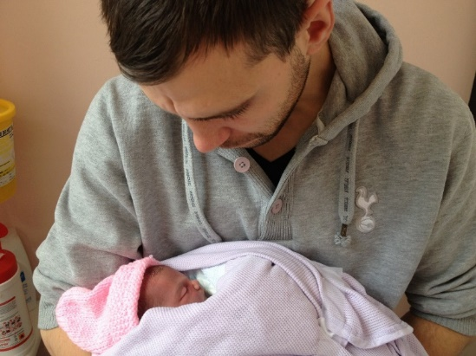
Challenges
Generally
Too many QI initiatives?
Embedding change (as with PMRT)
Pace that is needed

Slide 18

Vision going forward
National roll-out
Move from ‘nice to have’ to national quality improvement initiative
Remove postcode lottery
From autumn 2018
Use learning from Waves 1 and 2 to inform national roll-out as 3rd action research cycle
Use year to move from ‘driven’ model to
‘guided’ model

Slide 19

Vision going forward
Embedding the pathway - NBCP Standards
Outline requirements against which standards of bereavement care are assessed
Standards embedded in pathway, but also in other guidance and frameworks – building on work already undertaken with CQC and PMRT
All national guidance and frameworks supporting achievement of same core standards

Slide 20

Vision going forward
Training
Bereavement care training already exists – ensuring this is evidence-based and readily available
Bereavement Lead knows what needs to happen – needs support in making this happen
Multi-disciplinary working – putting the parent at the heart of the process - a paradigm shift?
Embedding and maintaining QI initiatives

Slide 21



Vision going forward
Global vision – keeping bereavement care on the agenda
Ensuring NBCP is linked to global work to improve bereavement care

Slide 22

Core Principles of Bereavement Care
Provide comprehensive, ongoing training in the care of bereaved women and families to the whole healthcare team.
Provide respectful maternity care to bereaved women, their families and their babies.
Make every effort to investigate and provide an explanation to women and families for the loss of their baby.
Offer appropriate information and postnatal care to address physical and psychological needs, including a point of contact for ongoing support.
Enable women and families to make Informed and supported decisions about birth options.
Acknowledge the breadth and depth of grief associated with stillbirth and offer appropriate emotional support.
Provide information for women and their families about future pregnancy planning.
Reduce stigma following bereavement by increasing awareness of stillbirth within communities.
D.Siassakos; ISA; University of Bristol; UCL

Slide 23














With thanks to all those involved
Advisory Group of stakeholders
Parents & families
All Party Parliamentary Group on Baby Loss (APPG)
Health and social care professionals
Royal colleges
Professionals bodies
Academics
Faith leaders
Third sector organisations
Project Board
Healthcare professionals across a range of professions
Training Sub-Group
Evaluation Sub-Group
Core Group
Parent Advisory Group
NBCP supported by
Notes:
Really important to work with everyone – so meets the needs of parents and reflects how HCPs work.
Have worked incrementally.
Really good engagement. 300+ on distribution list. 120 at the stakeholder events.
No point in drawing up an unachievable wish list

Slide 24

“What you are doing literally saves lives ….
…. even when a baby dies, good bereavement care saves parents’ lives”

