Slide 1

Anaesthesia

Slide 2
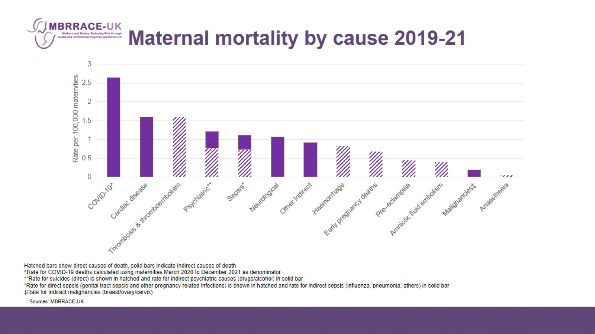
Maternal mortality by cause 2019-21

Slide 3
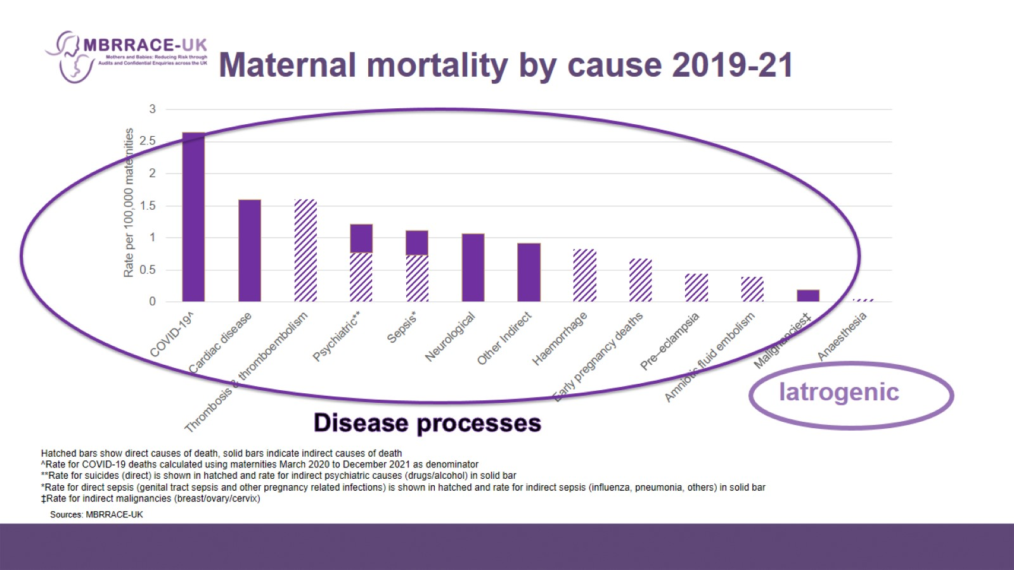
Maternal mortality by cause 2019-21

Slide 4
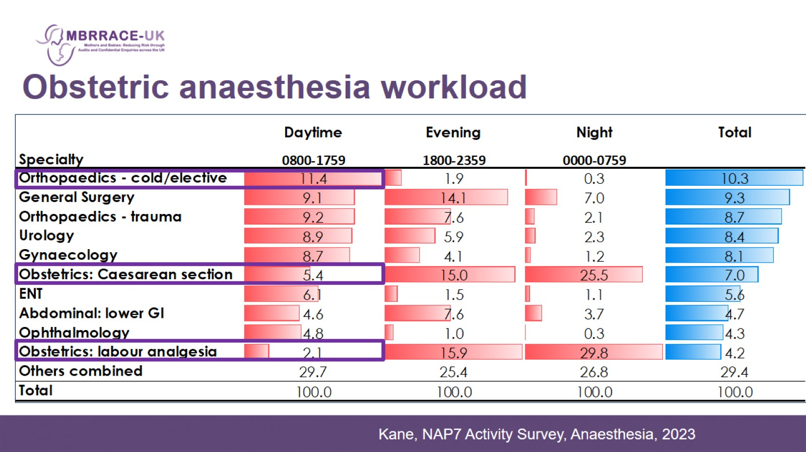

Slide 5
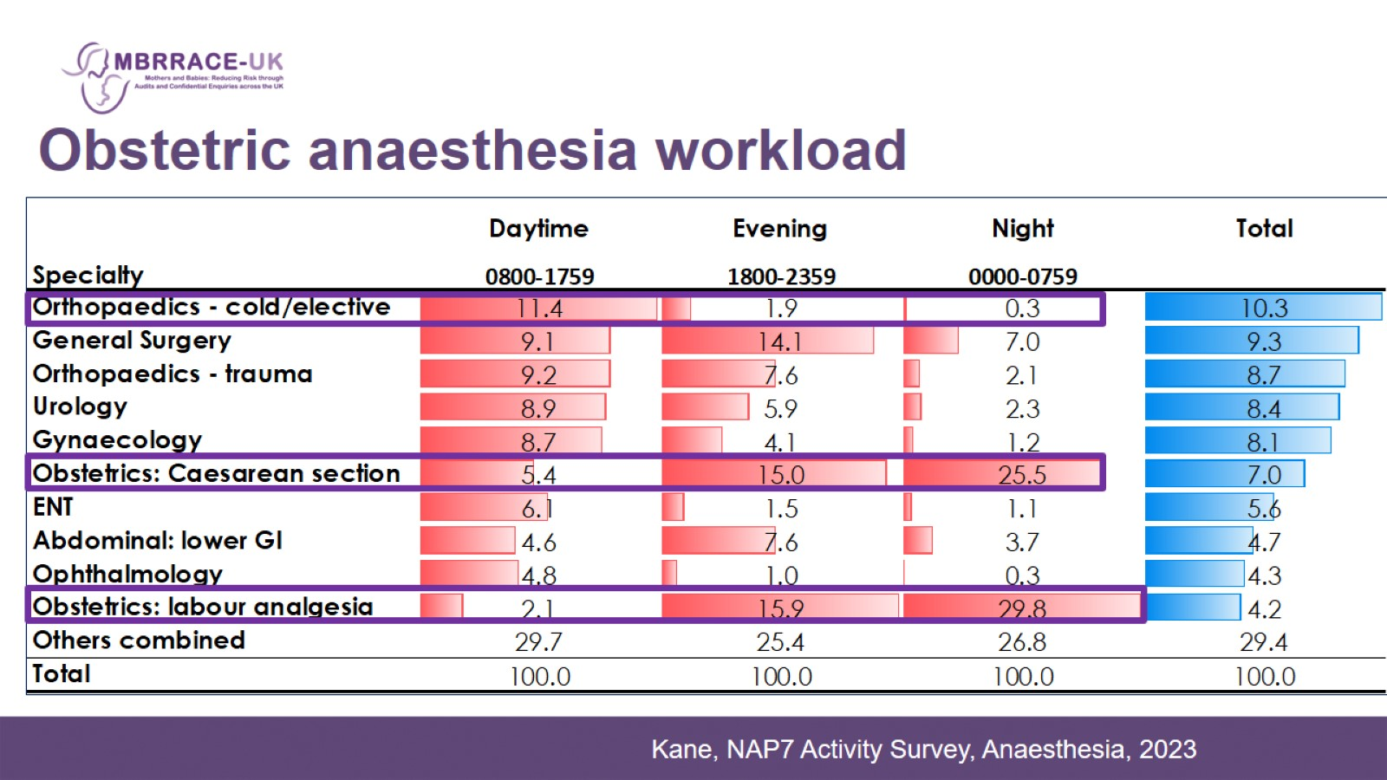

Slide 6
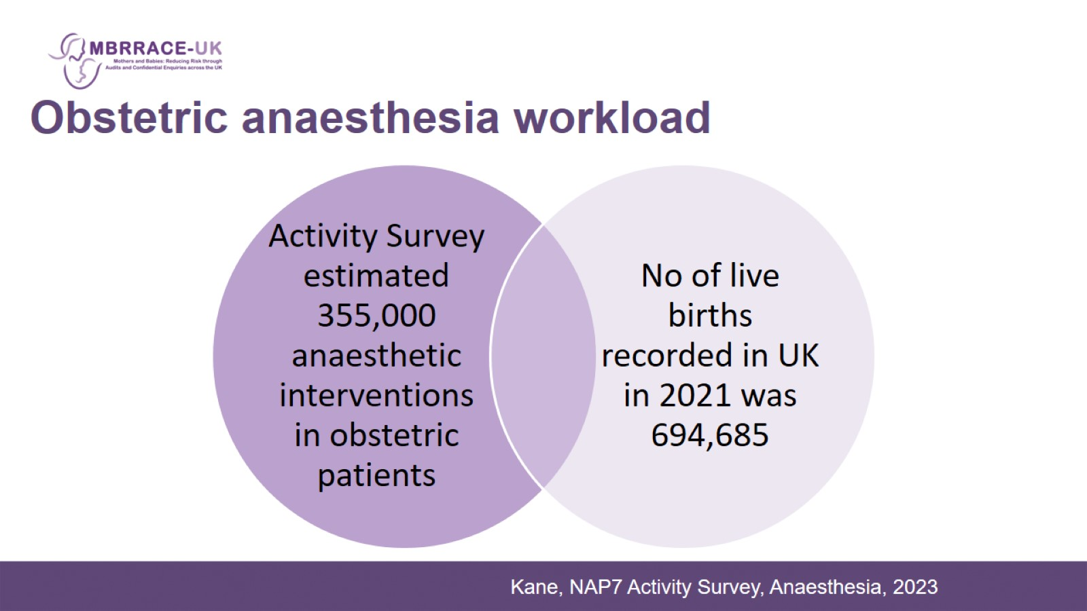

Slide 7
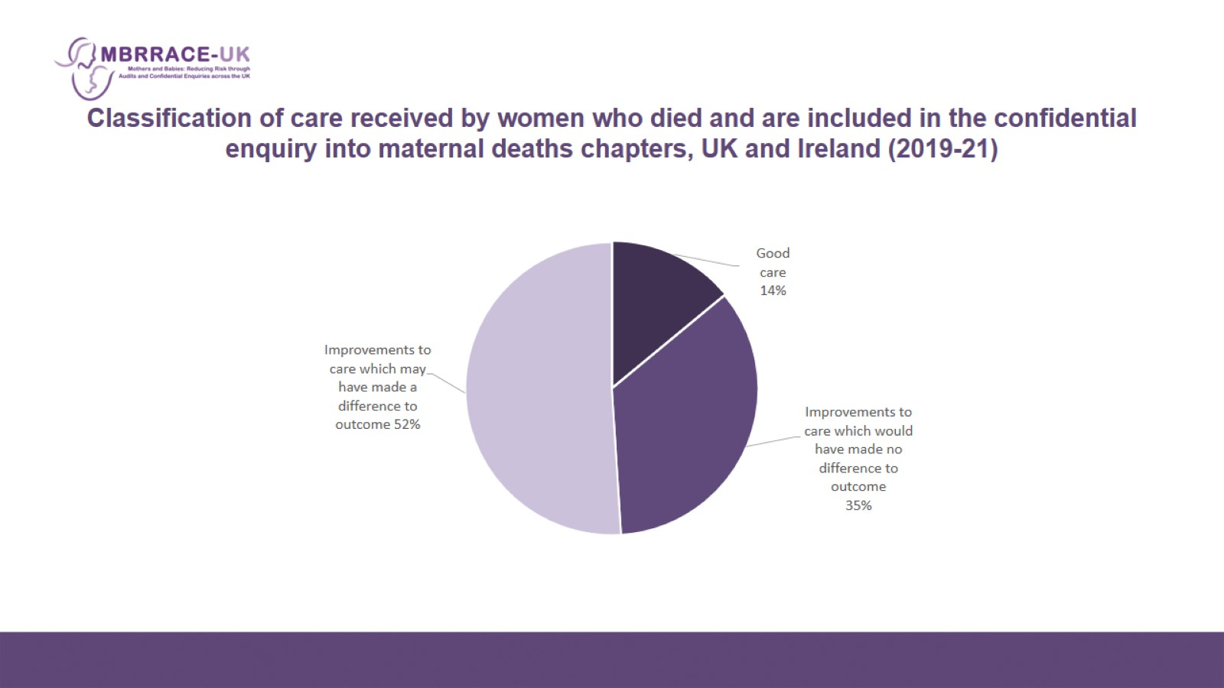
Classification of care received by women who died and are included in the confidential enquiry into maternal deaths chapters, UK and Ireland (2019-21)

Slide 8
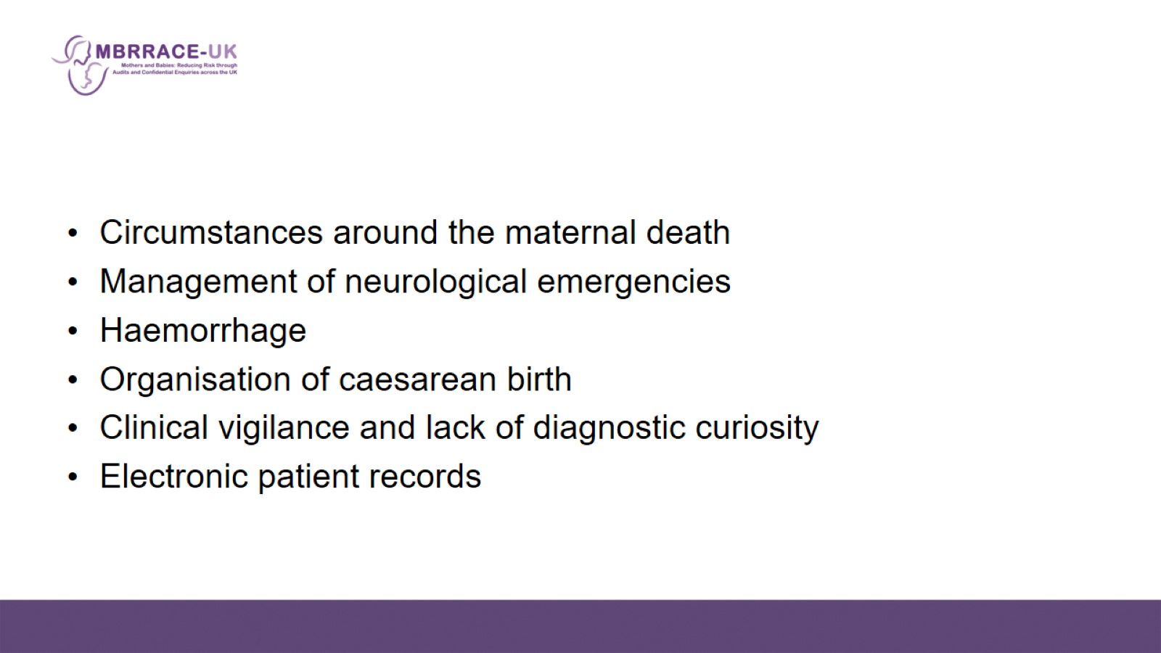

Slide 9
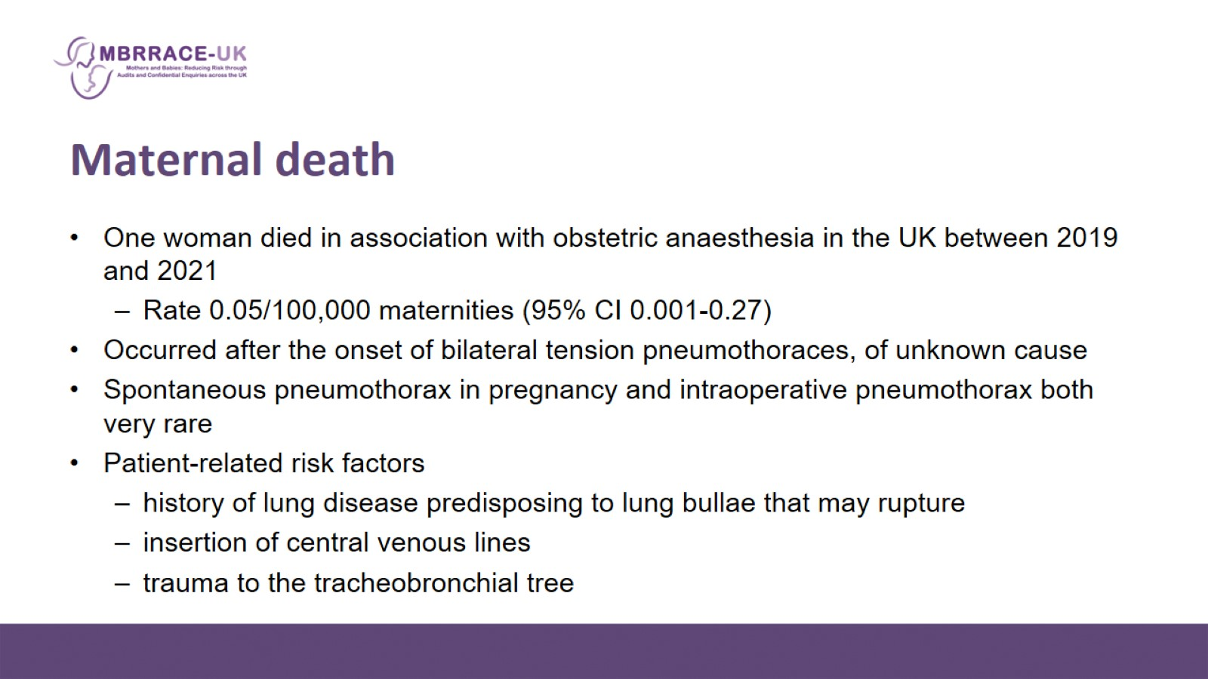
Maternal death

Slide 10
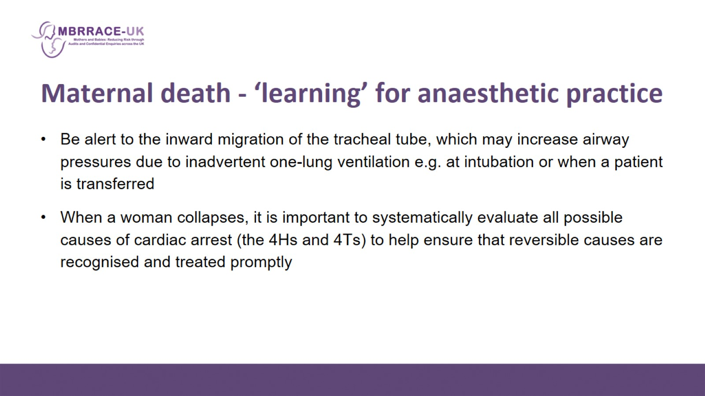
Maternal death - ‘learning’ for anaesthetic practice

Slide 11
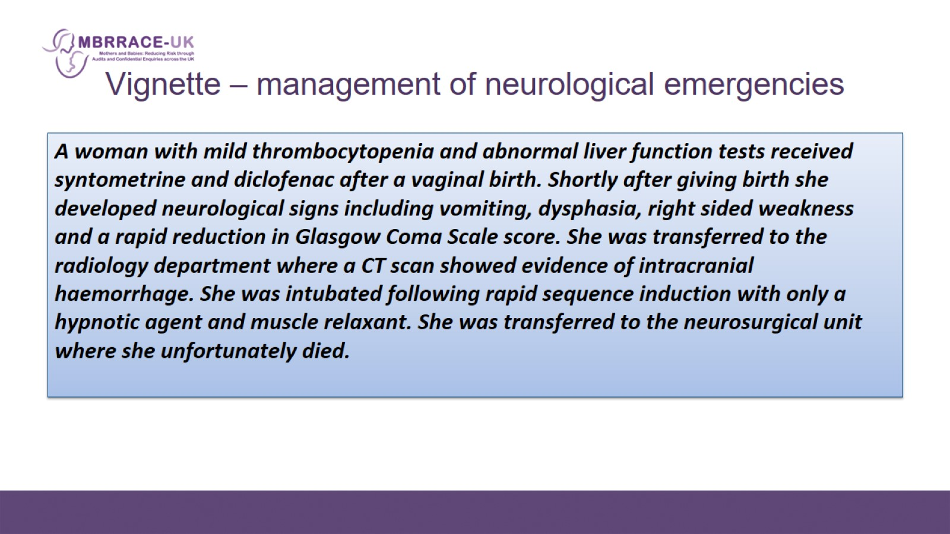
  Vignette – management of neurological emergencies

Slide 12
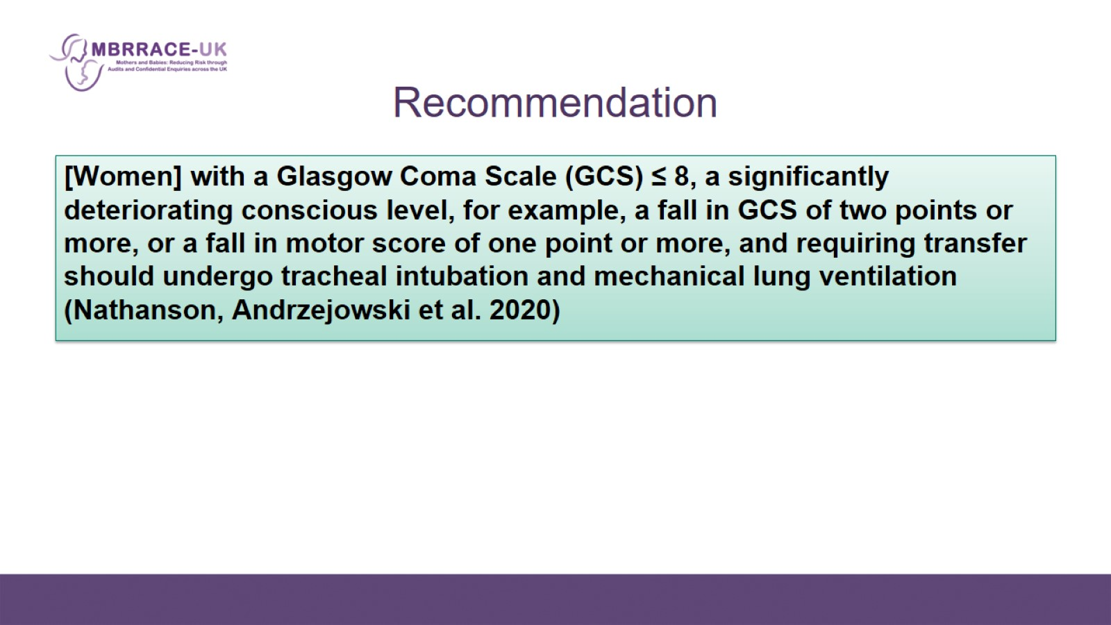
Recommendation

Slide 13
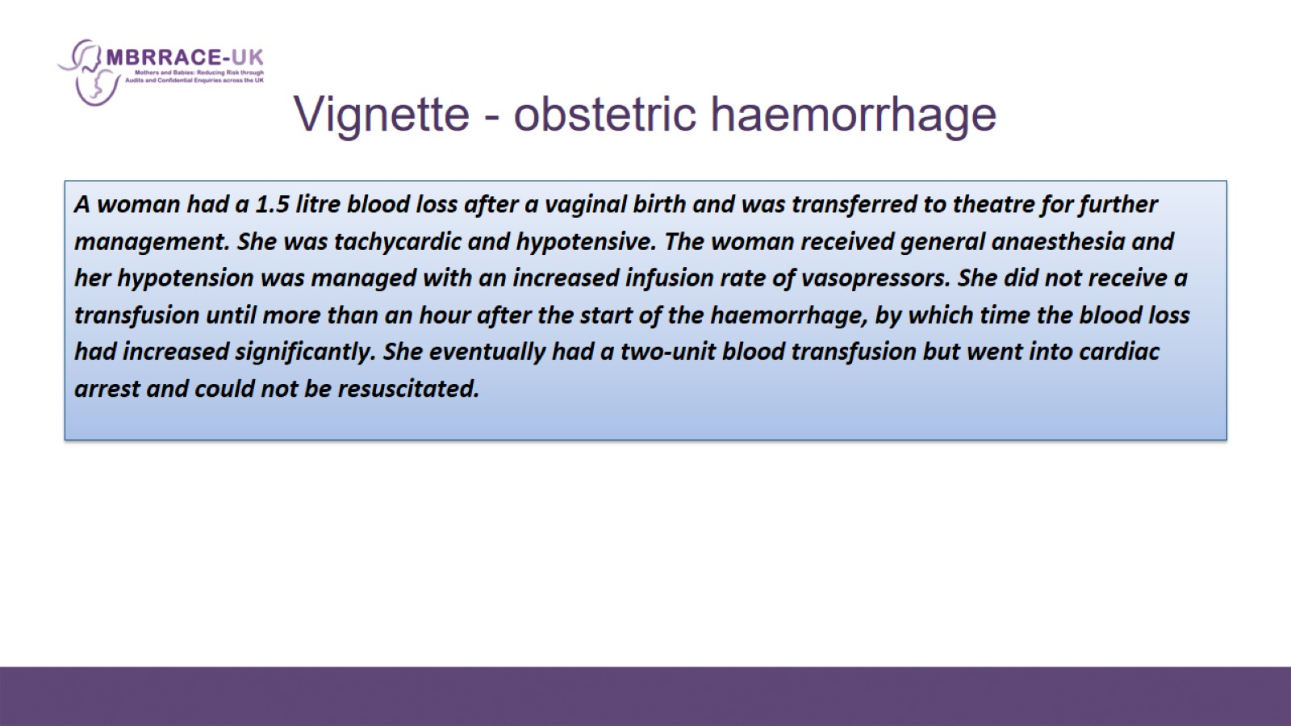
  Vignette - obstetric haemorrhage

Slide 14
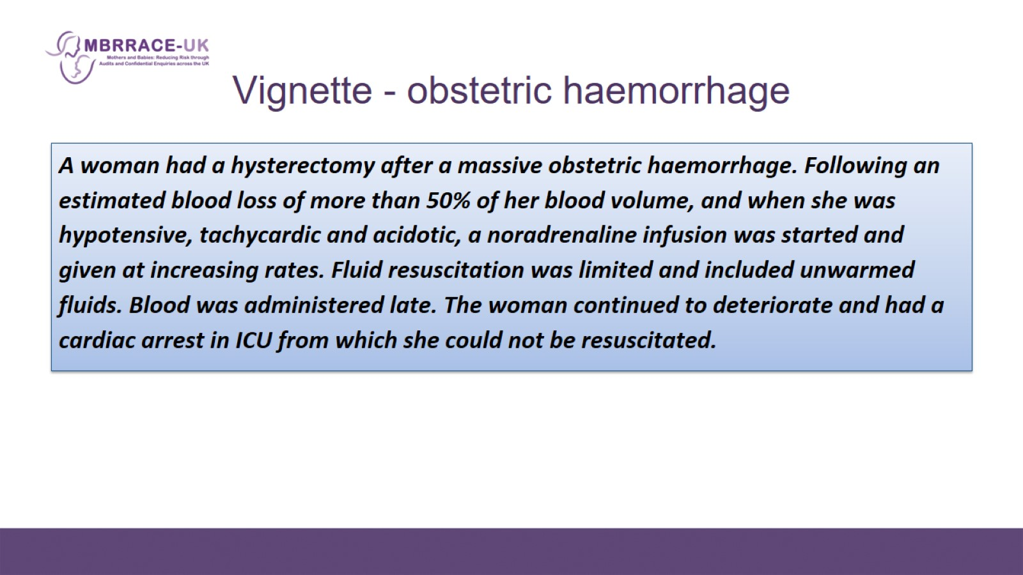
  Vignette - obstetric haemorrhage

Slide 15
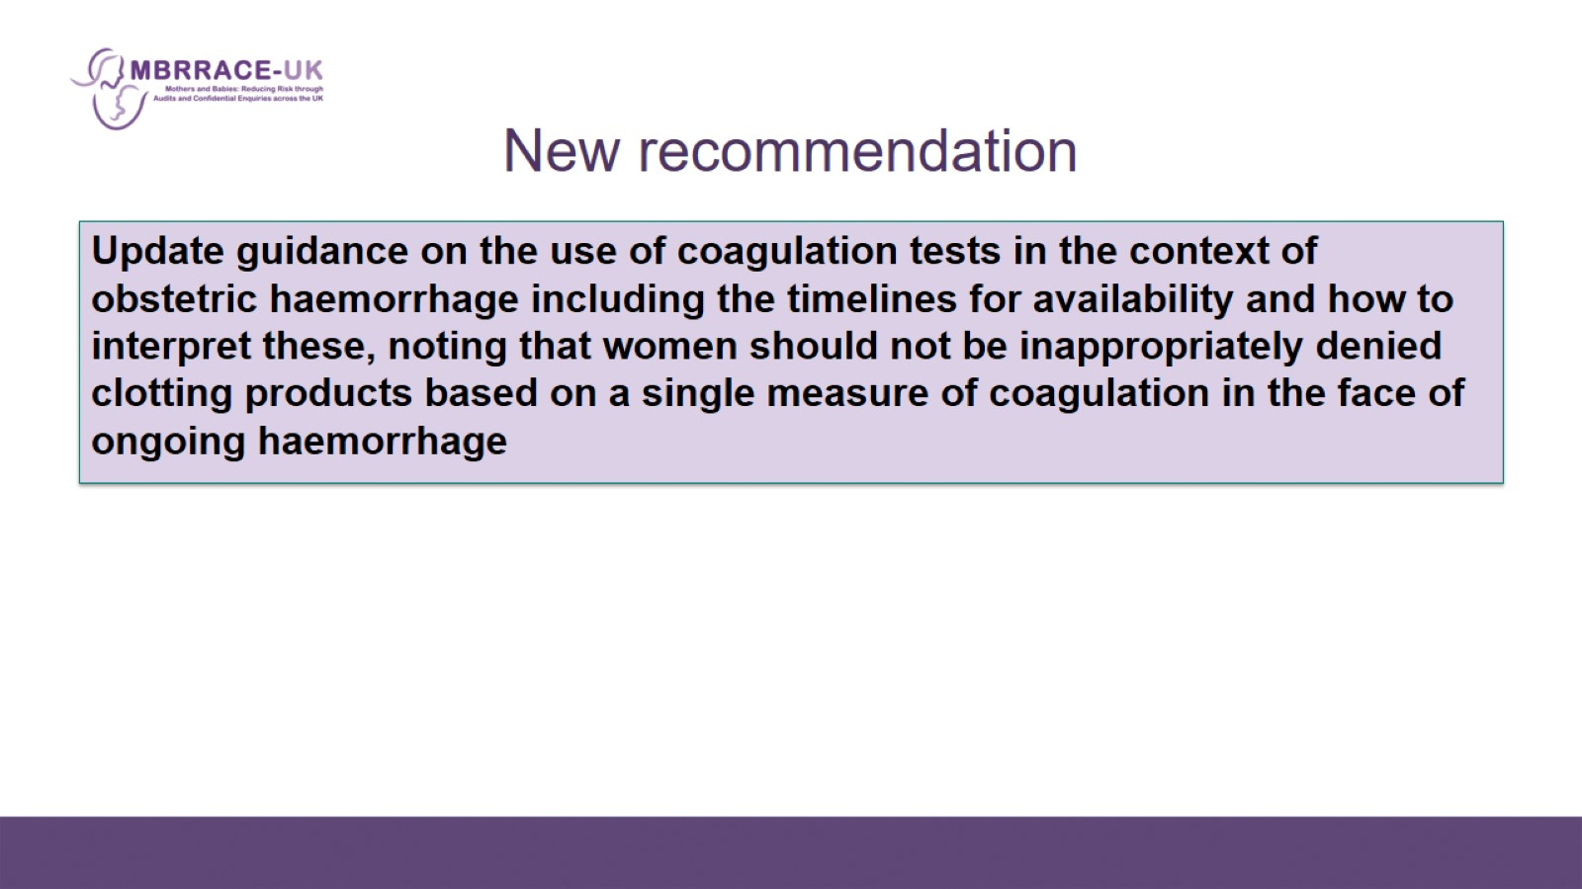
New recommendation

Slide 16
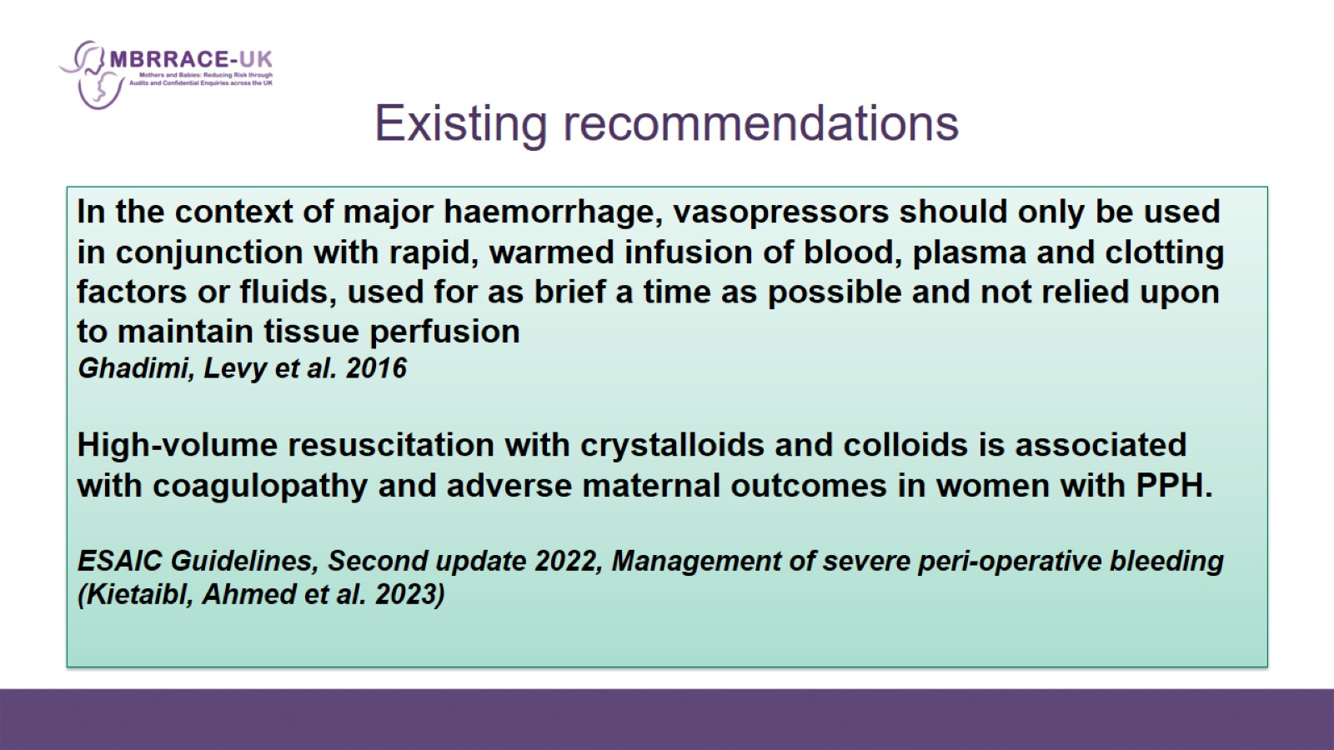
Existing recommendations

Slide 17
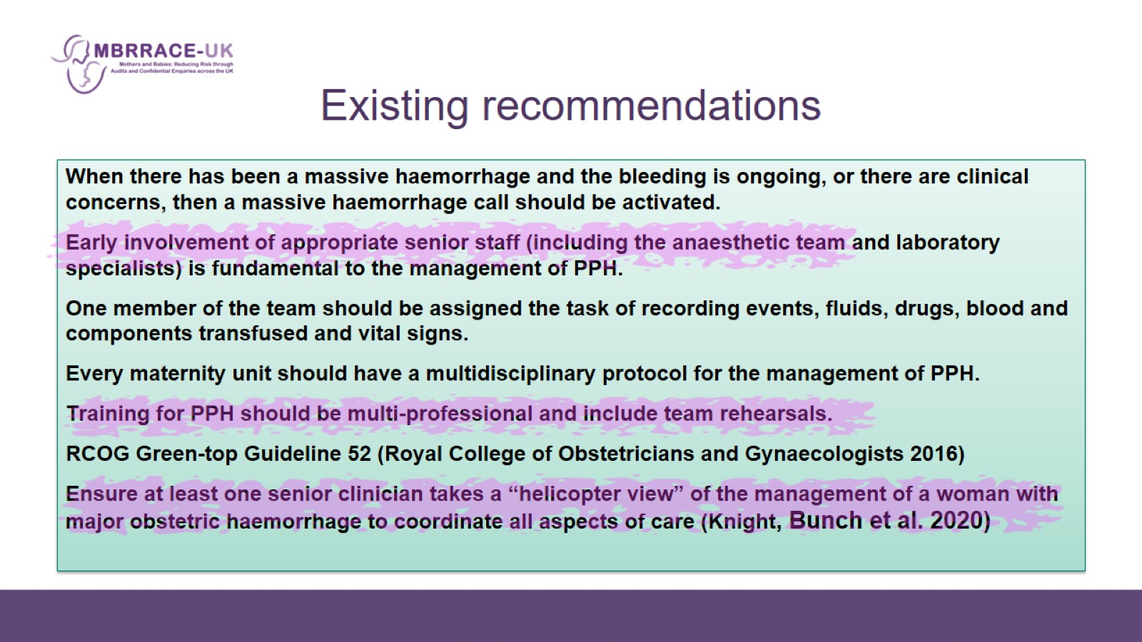
Existing recommendations

Slide 18


Slide 19
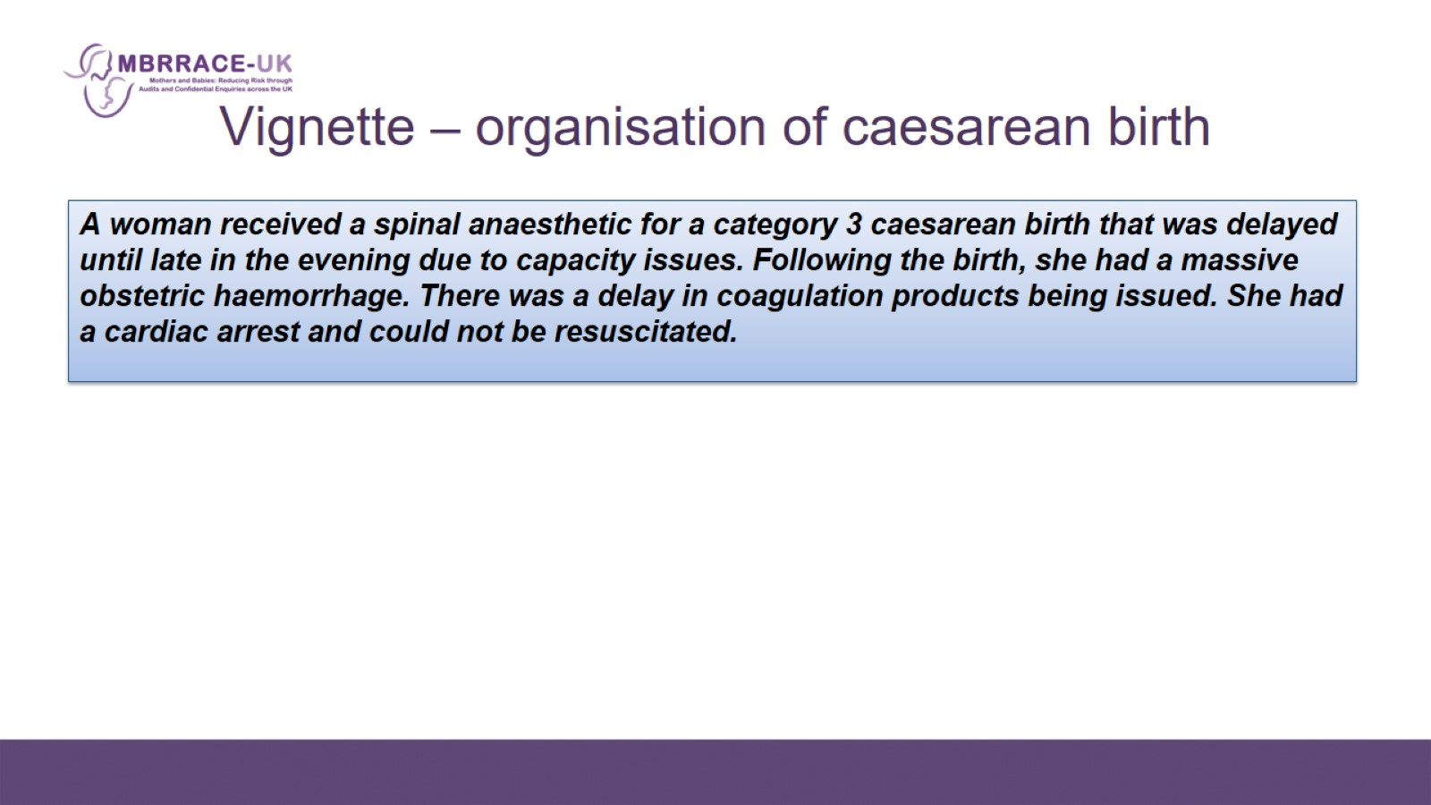
  Vignette – organisation of caesarean birth

Slide 20
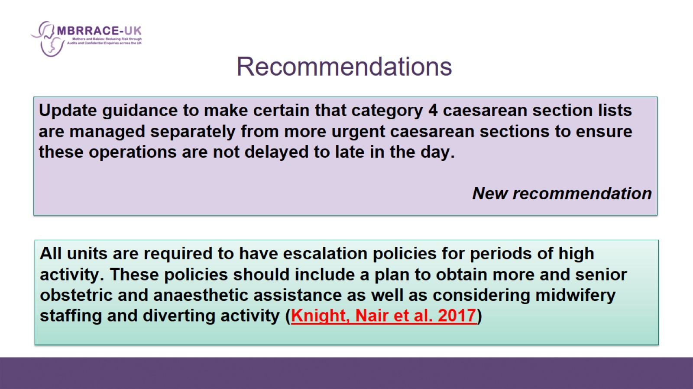
Recommendations

Slide 21
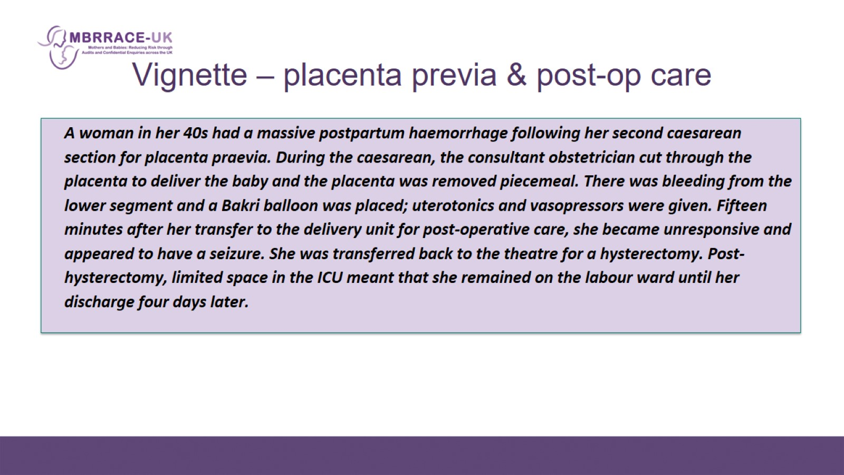
  Vignette – placenta previa & post-op care

Slide 22
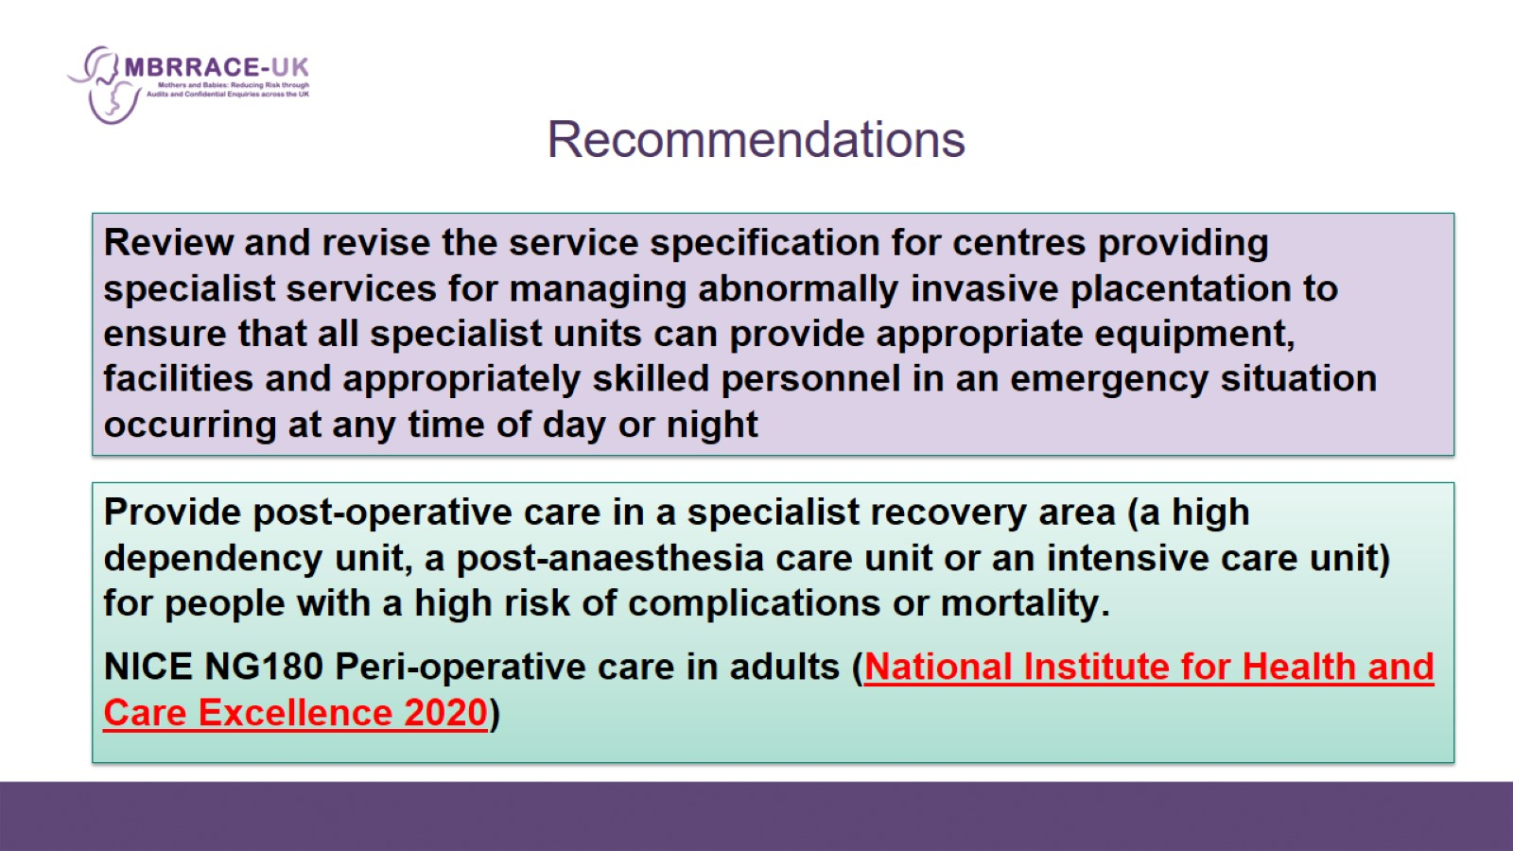
Recommendations

Slide 23
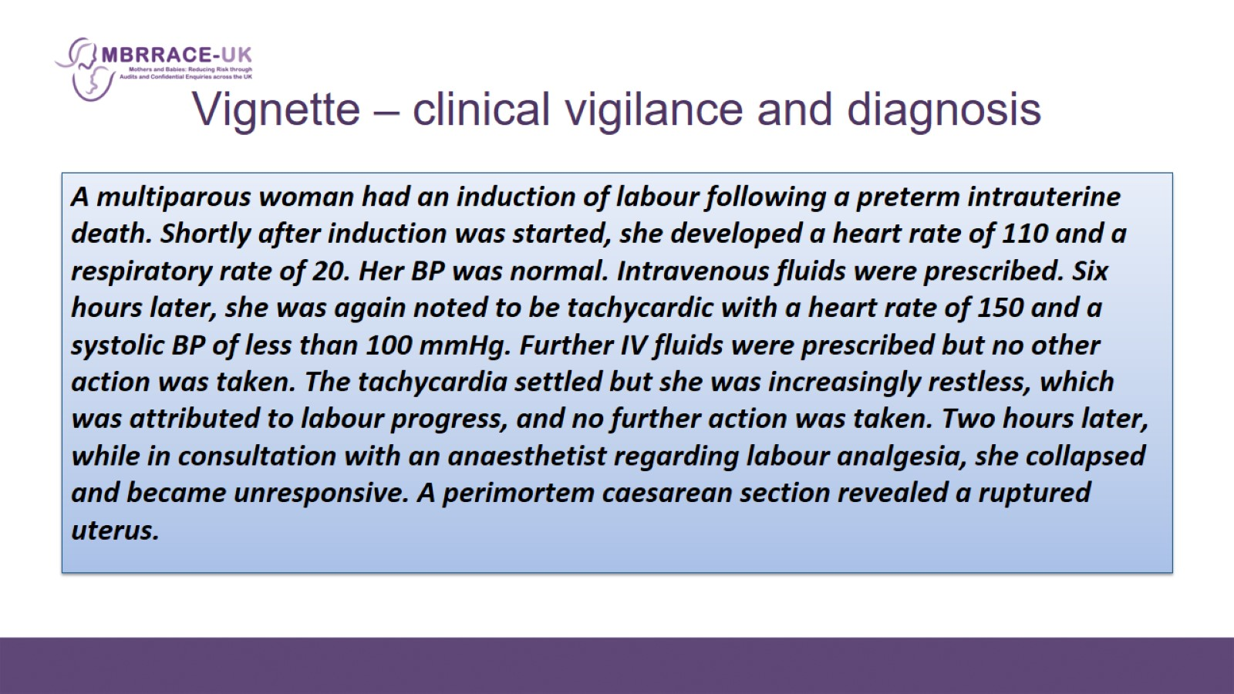

Slide 24
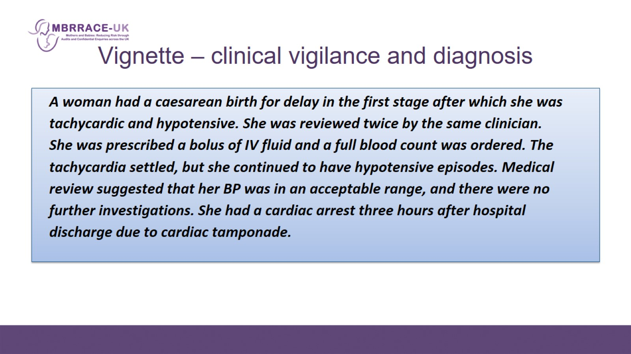
  Vignette – clinical vigilance and diagnosis

Slide 25
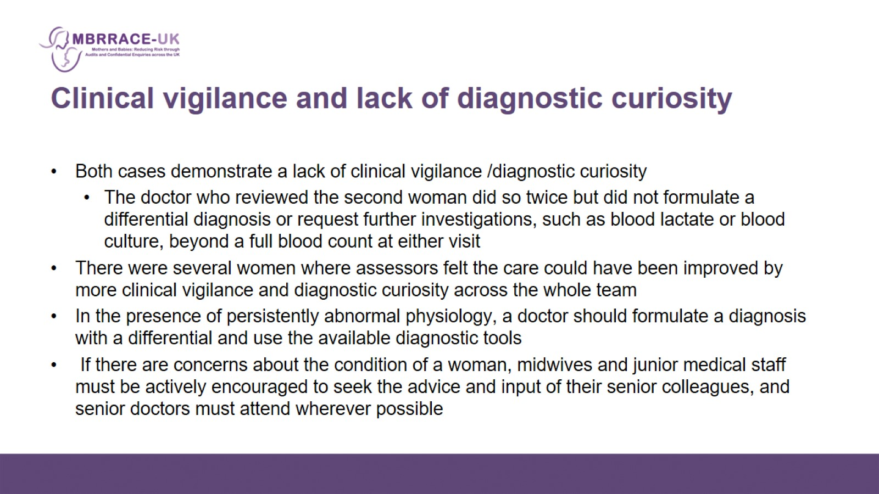
Clinical vigilance and lack of diagnostic curiosity

Slide 26
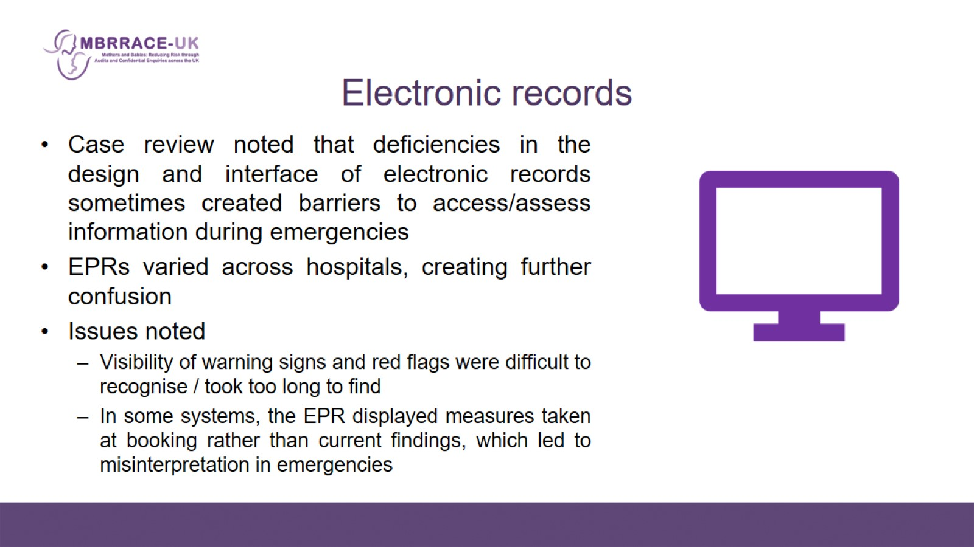
Electronic records

