Slide 1


Slide 2
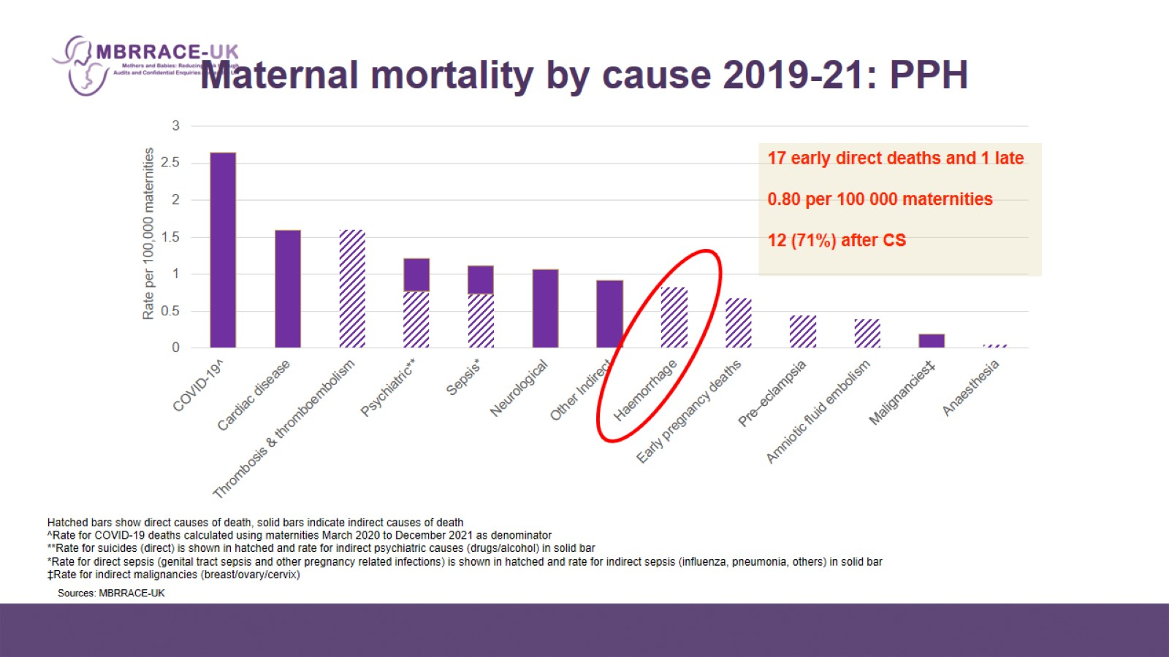
Maternal mortality by cause 2019-21: PPH

Slide 3
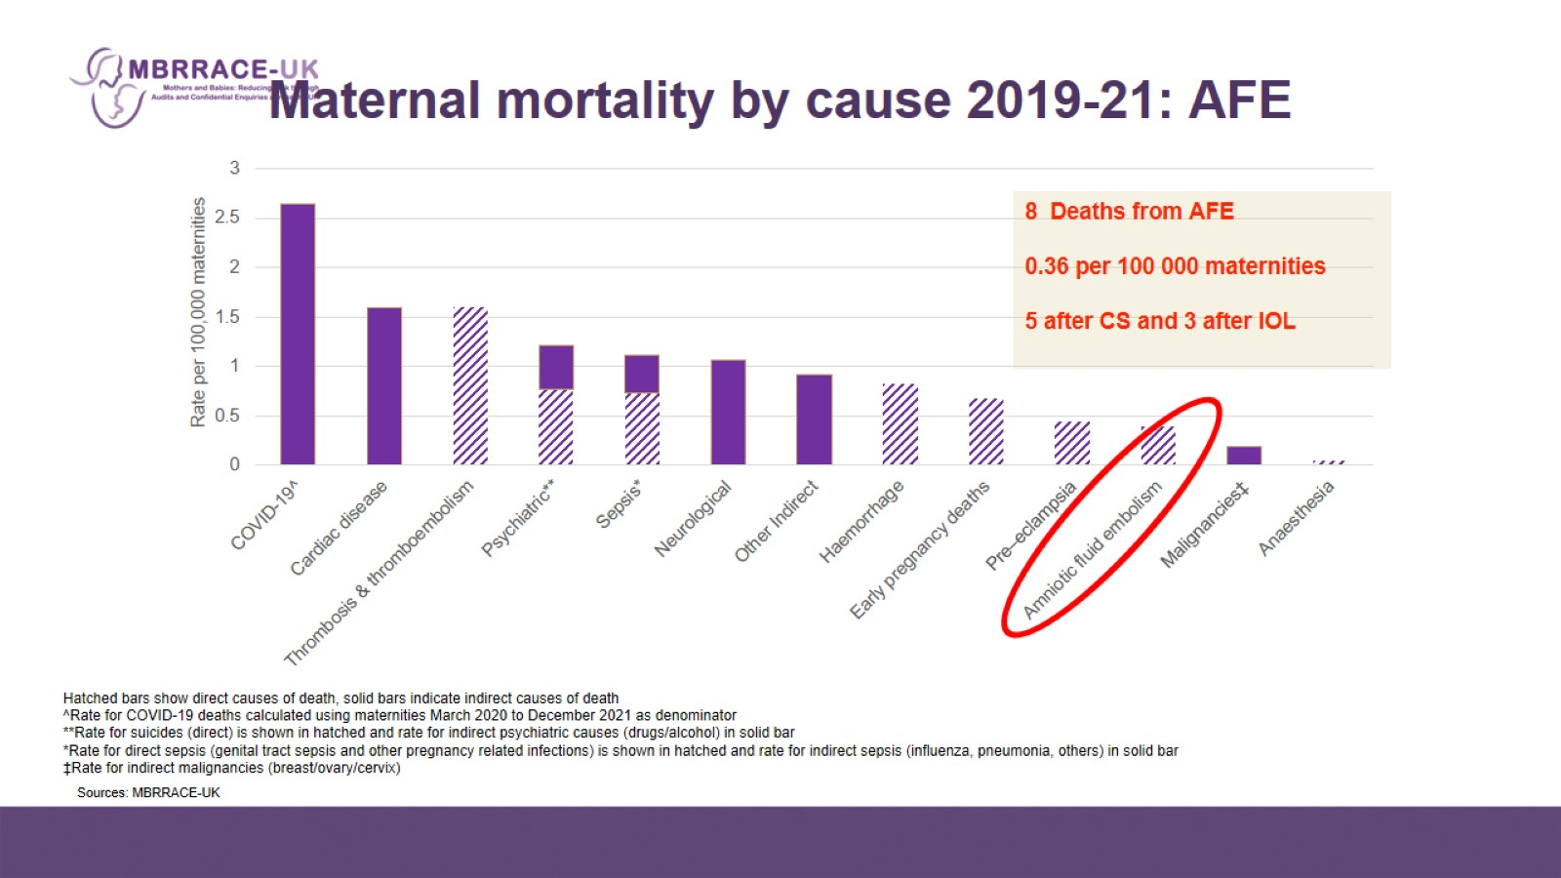
Maternal mortality by cause 2019-21: AFE

Slide 4
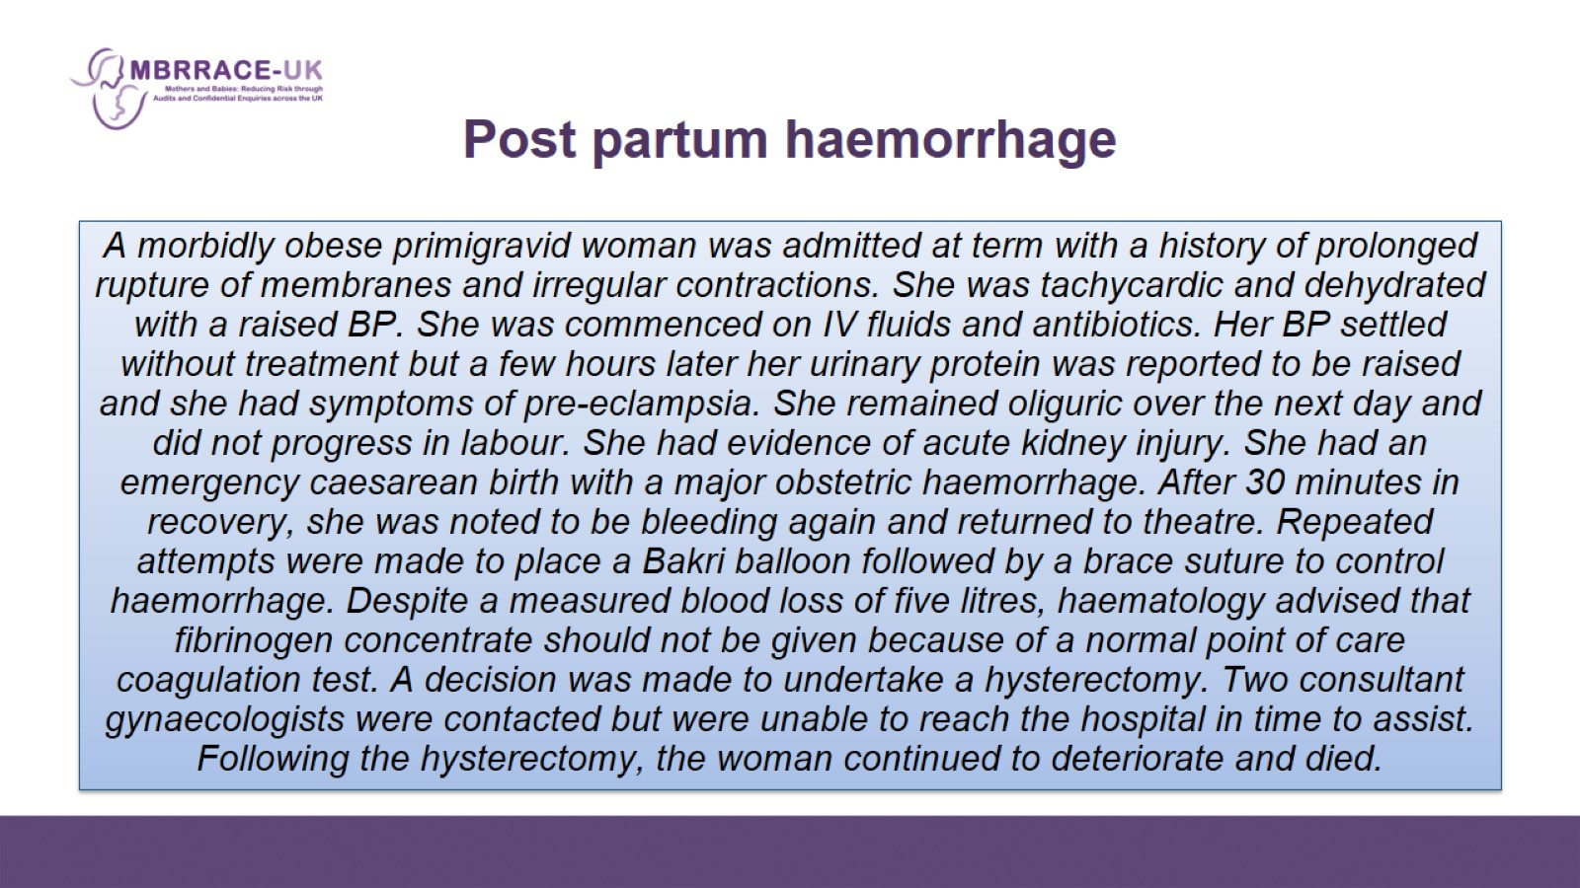
  Post partum haemorrhage

Slide 5
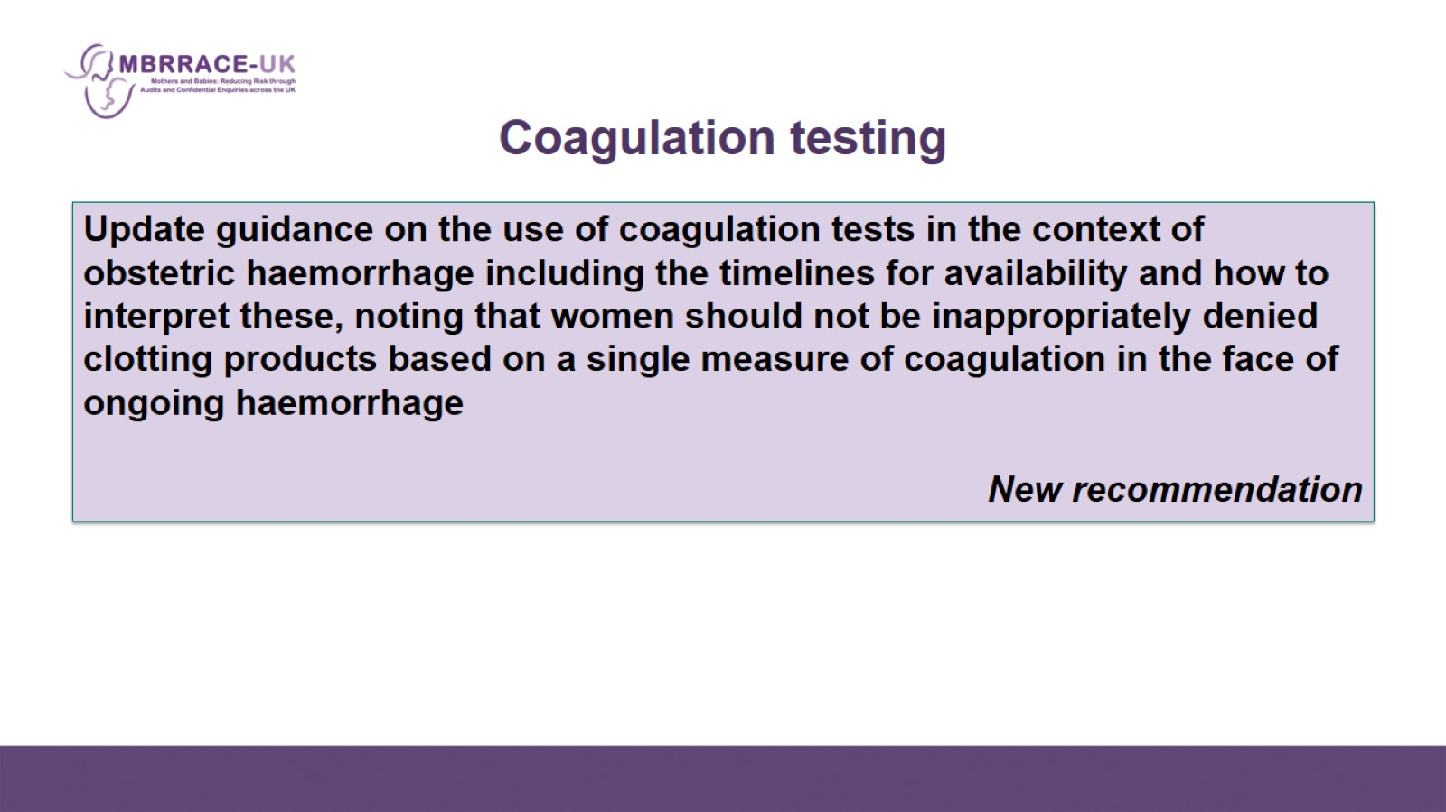
Coagulation testing

Slide 6
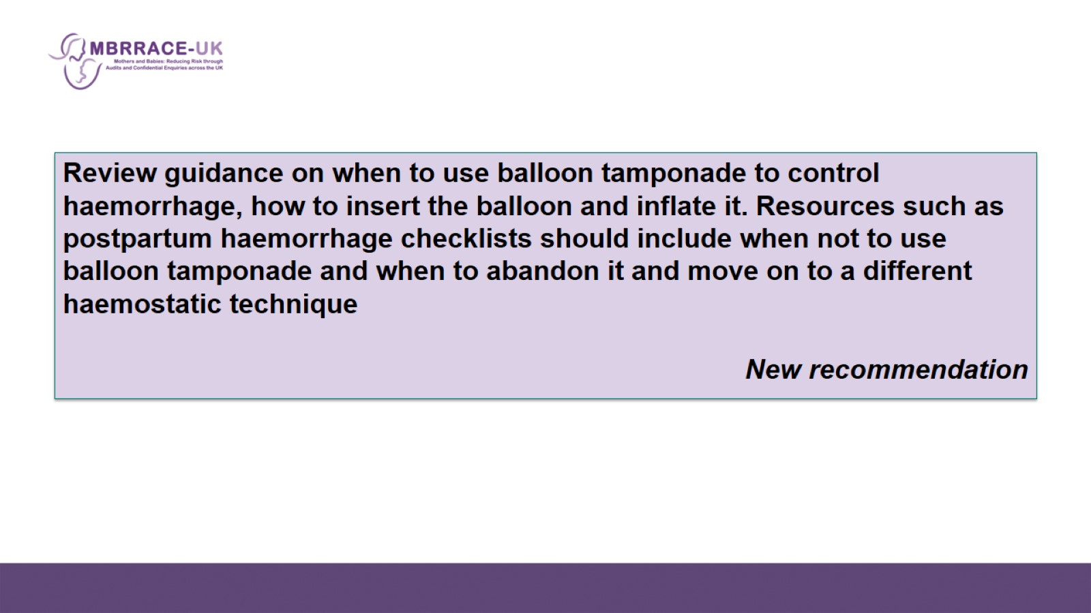

Slide 7
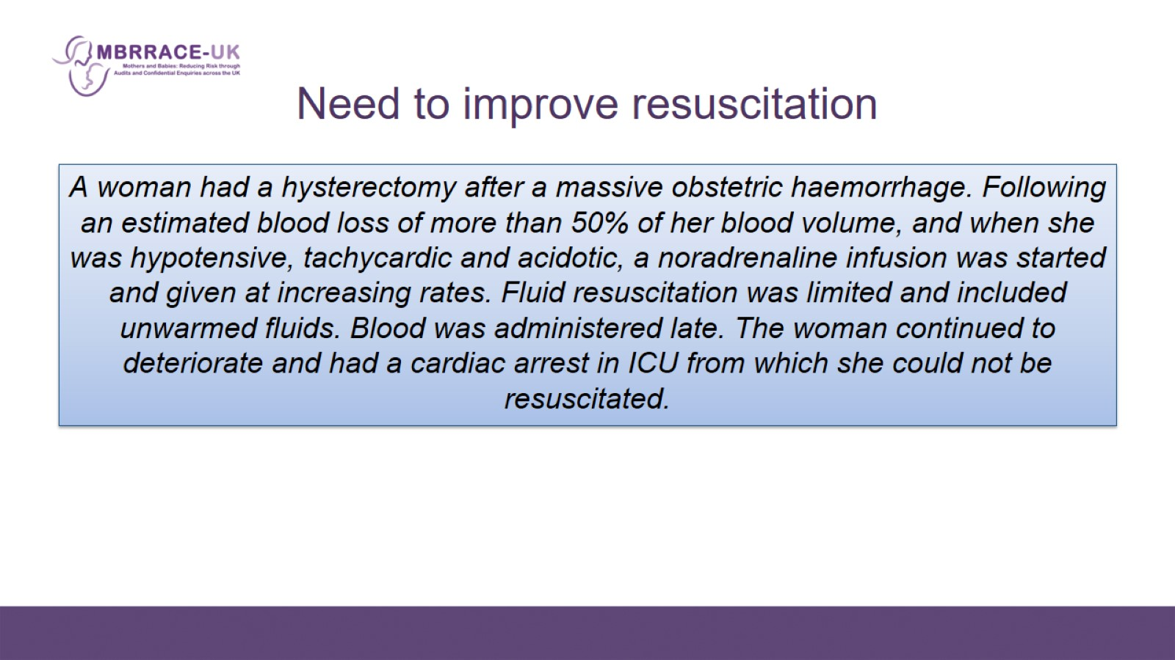
  Need to improve resuscitation

Slide 8
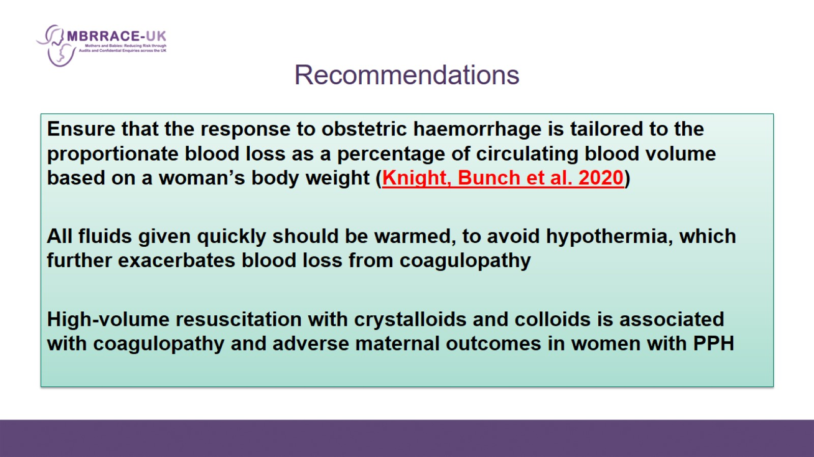
Recommendations

Slide 9
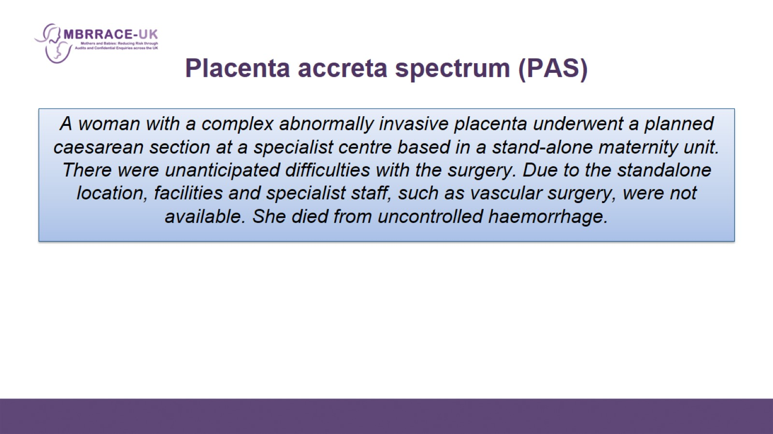
  Placenta accreta spectrum (PAS)

Slide 10
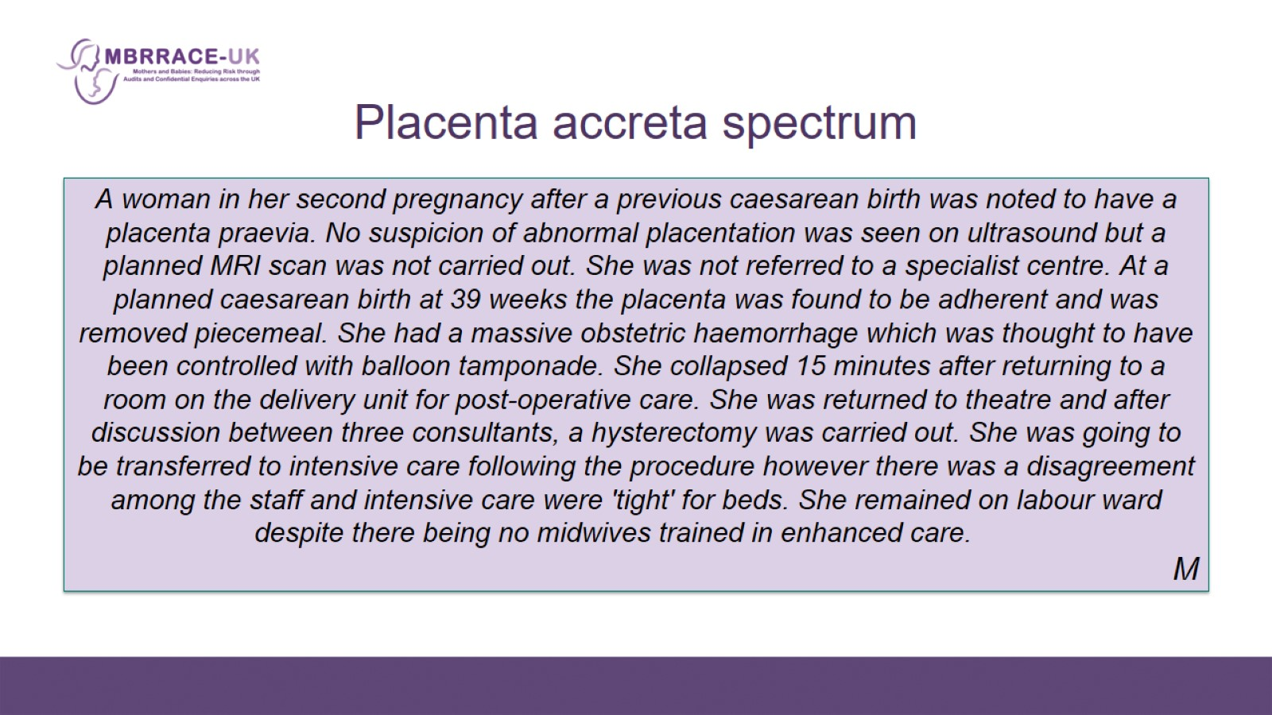
Placenta accreta spectrum

Slide 11
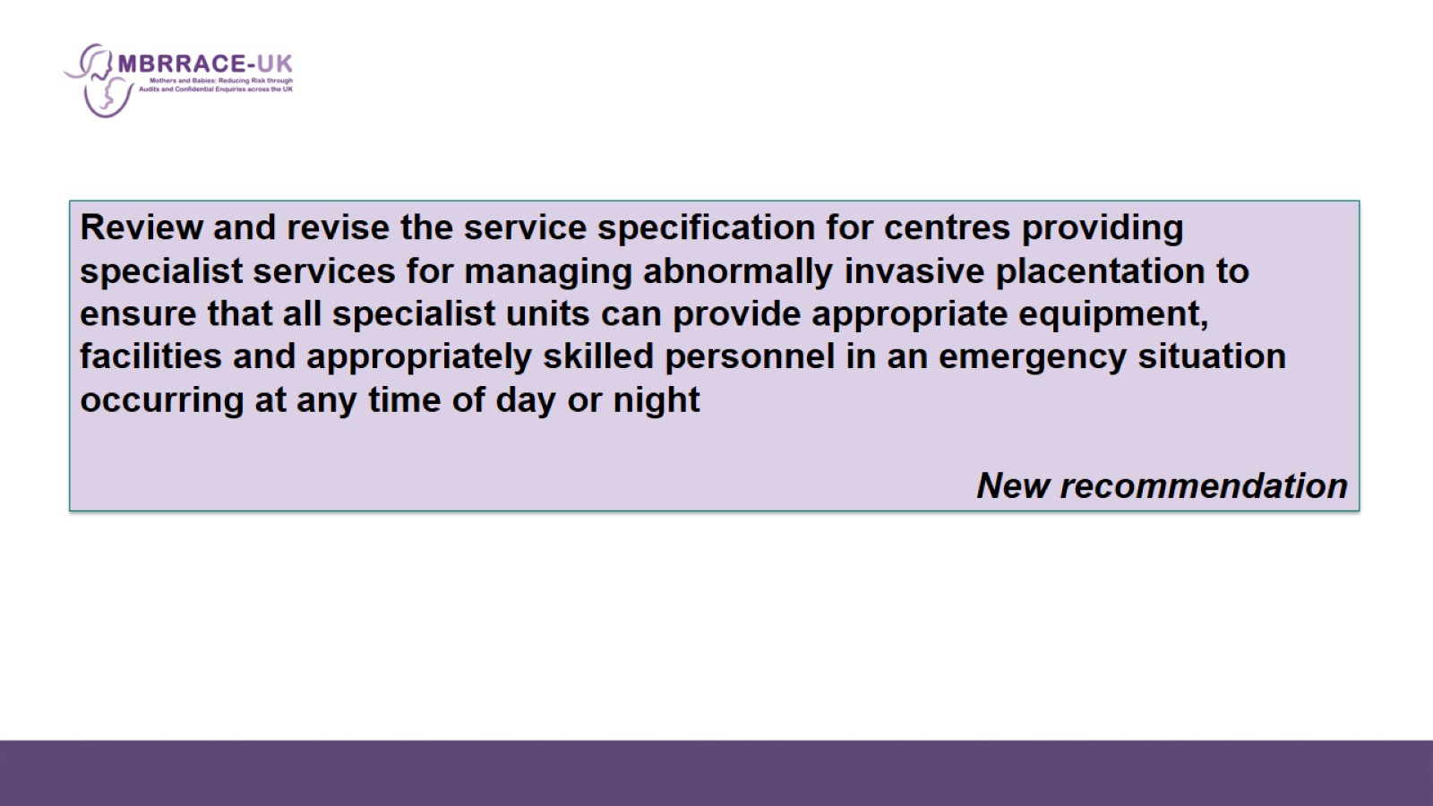

Slide 12

Managing workload

Slide 13
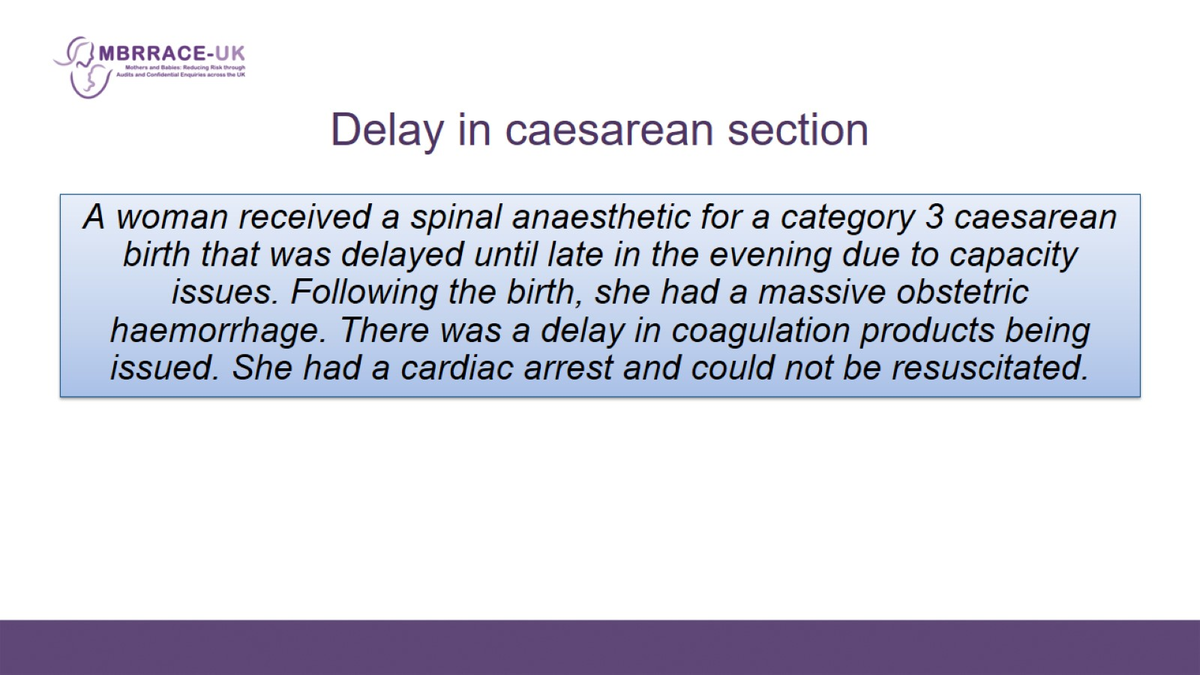
  Delay in caesarean section

Slide 14
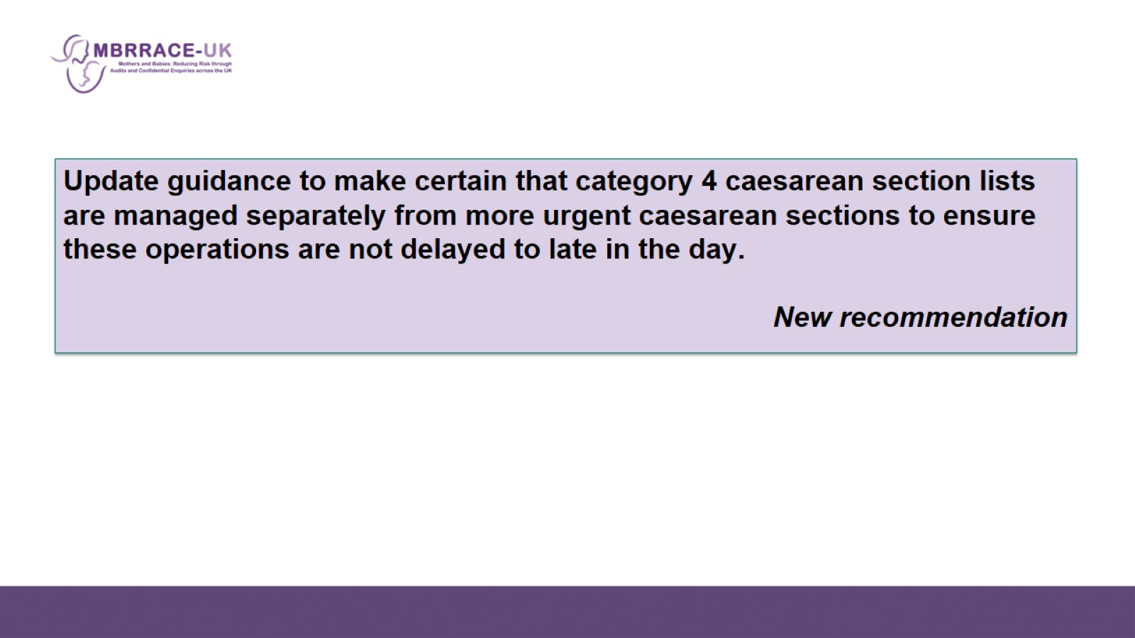

Slide 15
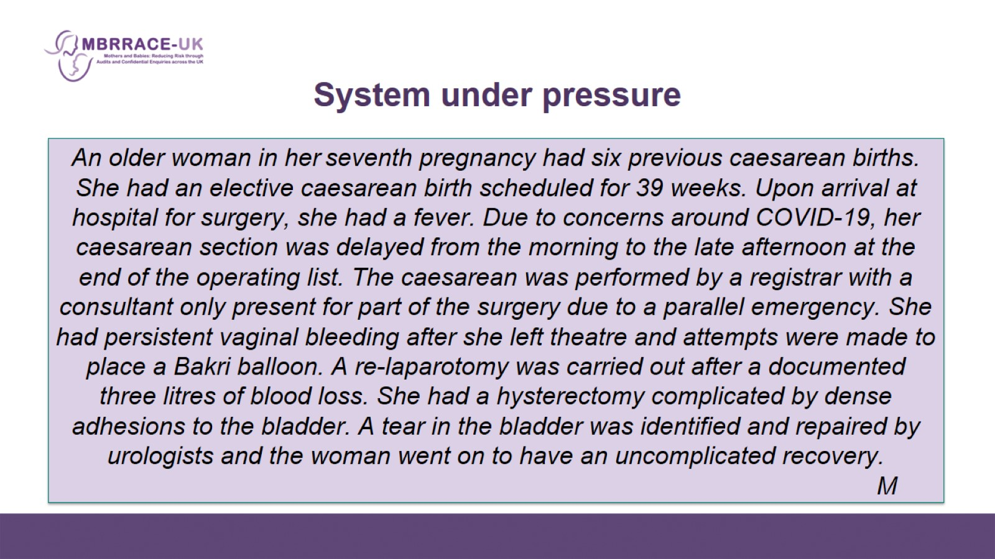
System under pressure

Slide 16
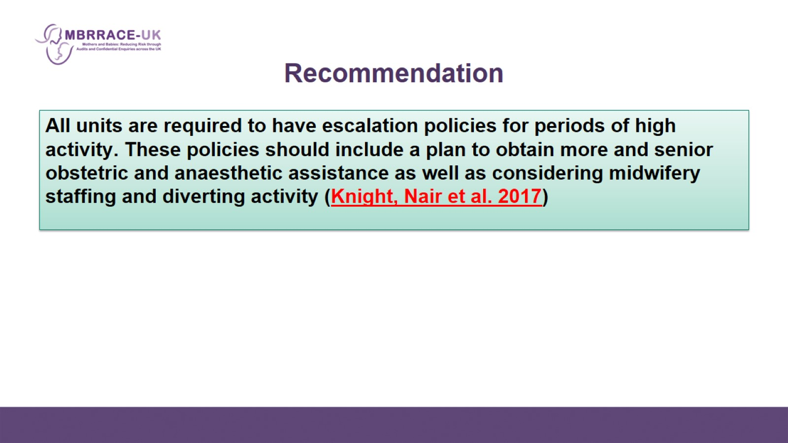
Recommendation

Slide 17
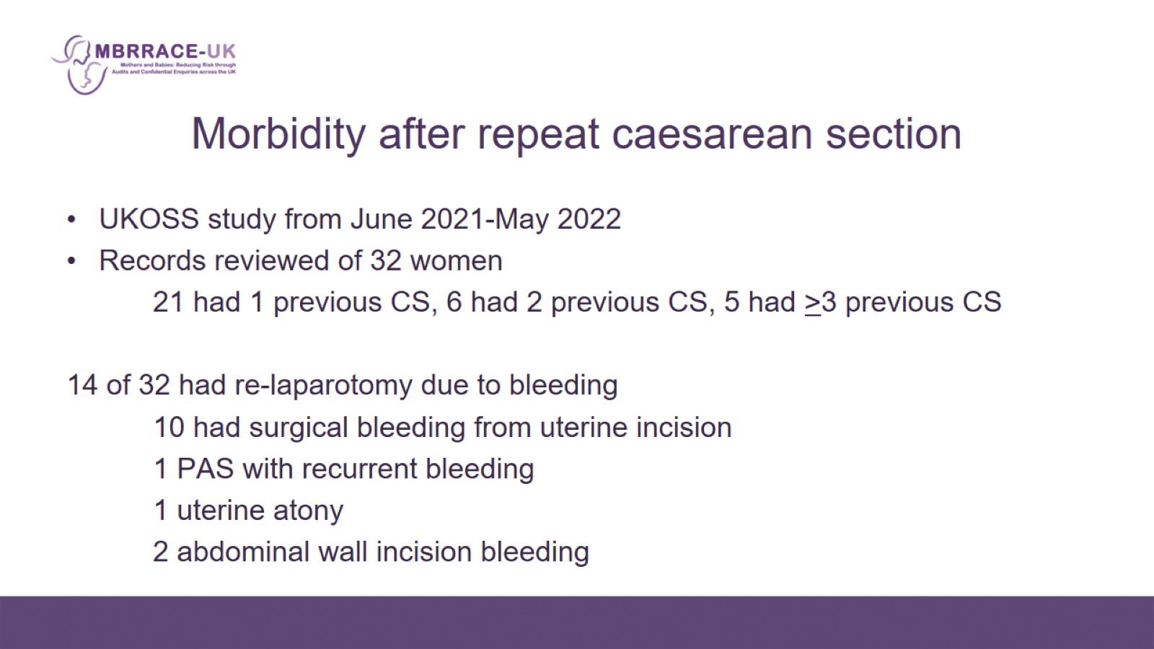
Morbidity after repeat caesarean section

Slide 18
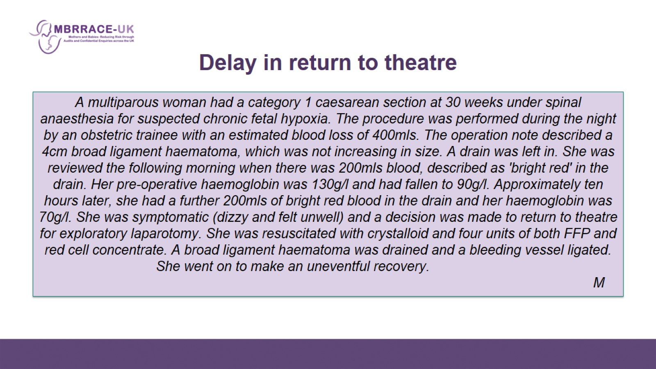
Delay in return to theatre

Slide 19
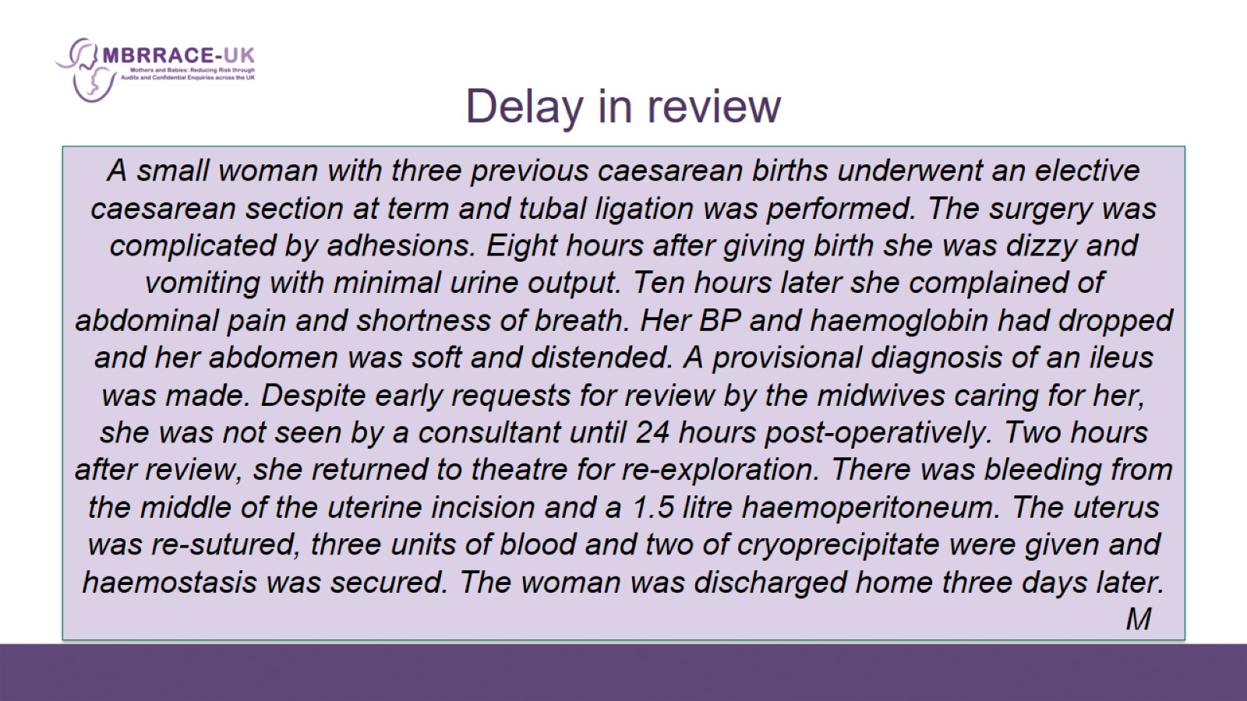
Delay in review

Slide 20
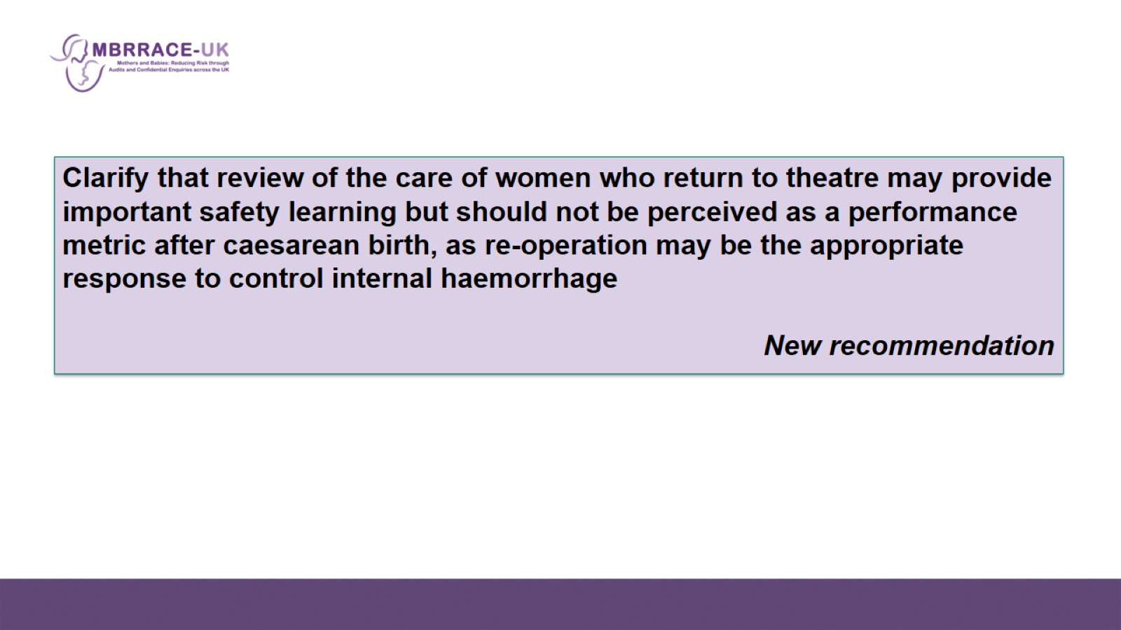

Slide 21
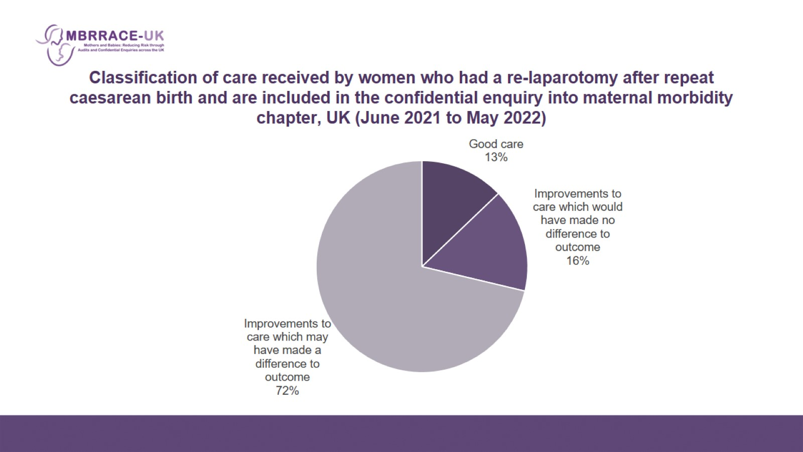
Classification of care received by women who had a re-laparotomy after repeat caesarean birth and are included in the confidential enquiry into maternal morbidity chapter, UK (June 2021 to May 2022)

Slide 22
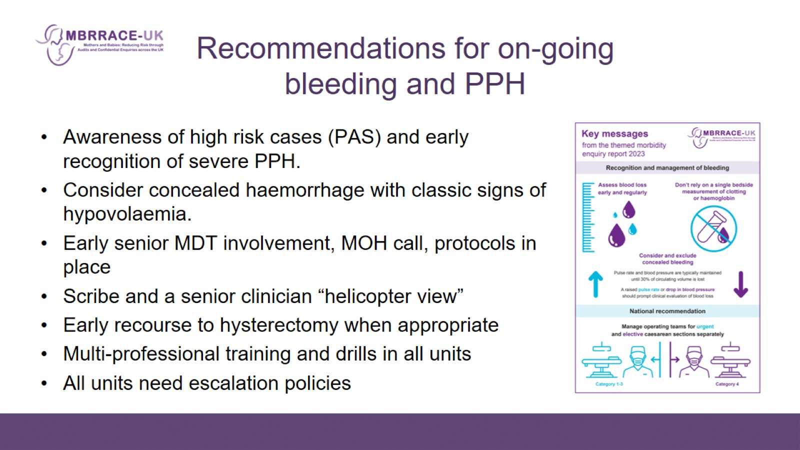
Recommendations for on-going bleeding and PPH

