Slide 1


Slide 2

Saving Lives, Improving Mothers’ Care

Slide 3
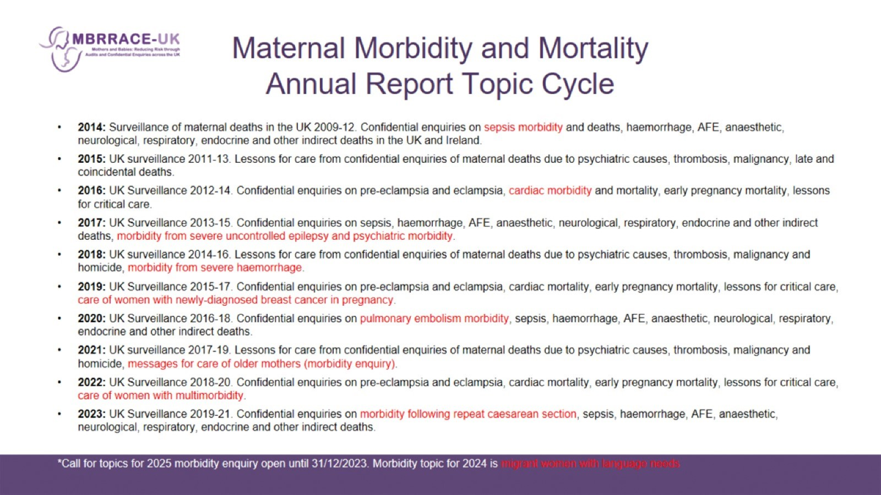
Maternal Morbidity and Mortality
Annual Report Topic Cycle

Slide 4

MBRRACE-UK: METHODS

Slide 5
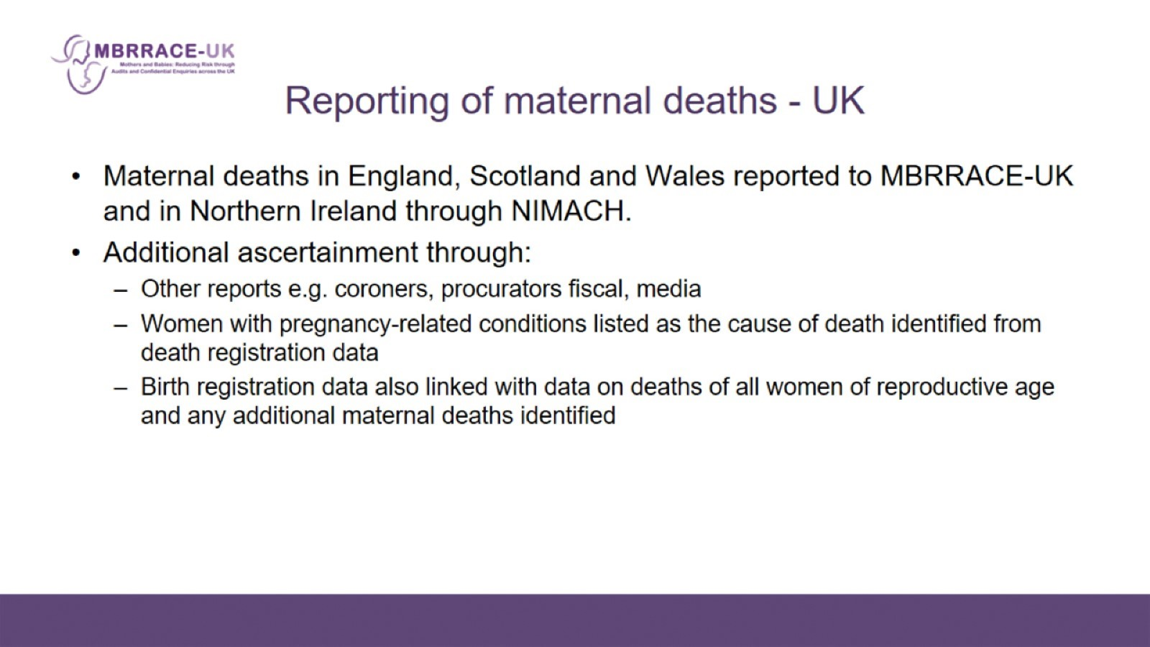
Reporting of maternal deaths - UK

Slide 6

MBRRACE–UK Methods

Slide 7
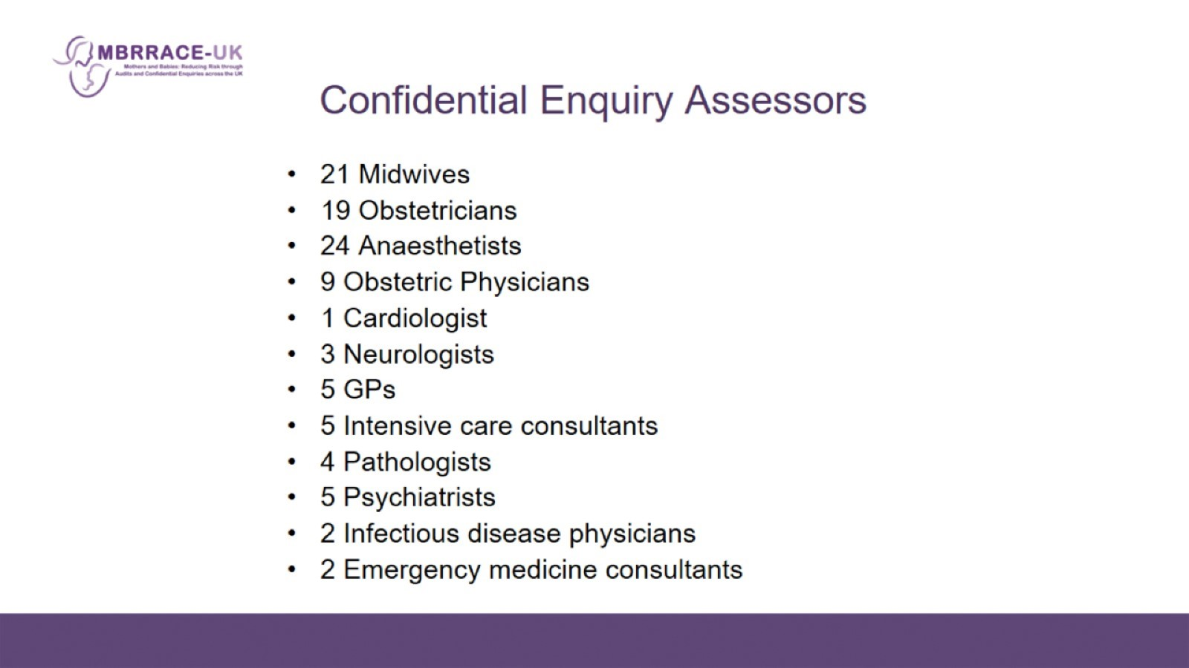
Confidential Enquiry Assessors

Slide 8
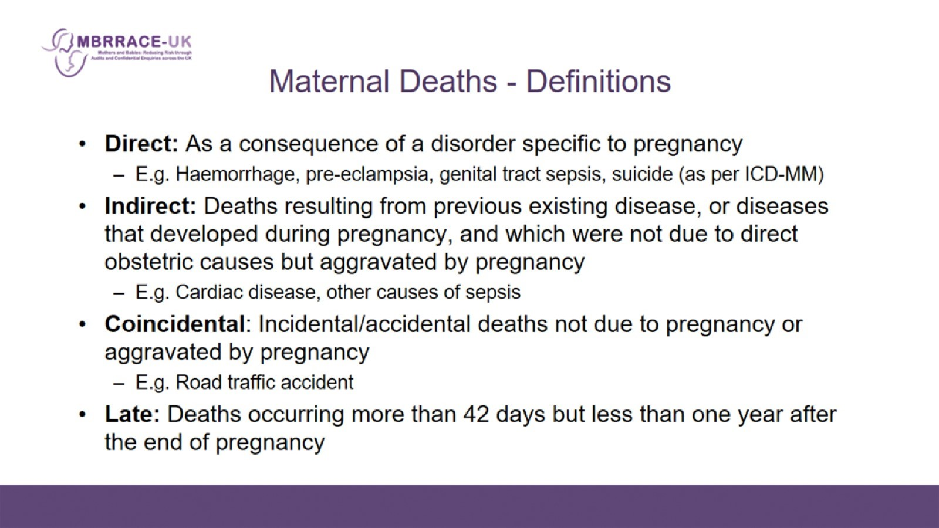
Maternal Deaths - Definitions

Slide 9
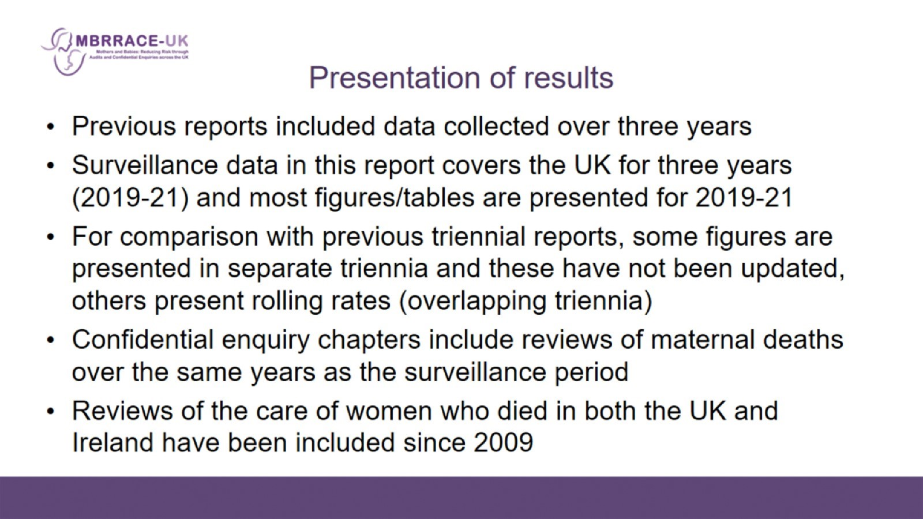
Presentation of results

Slide 10
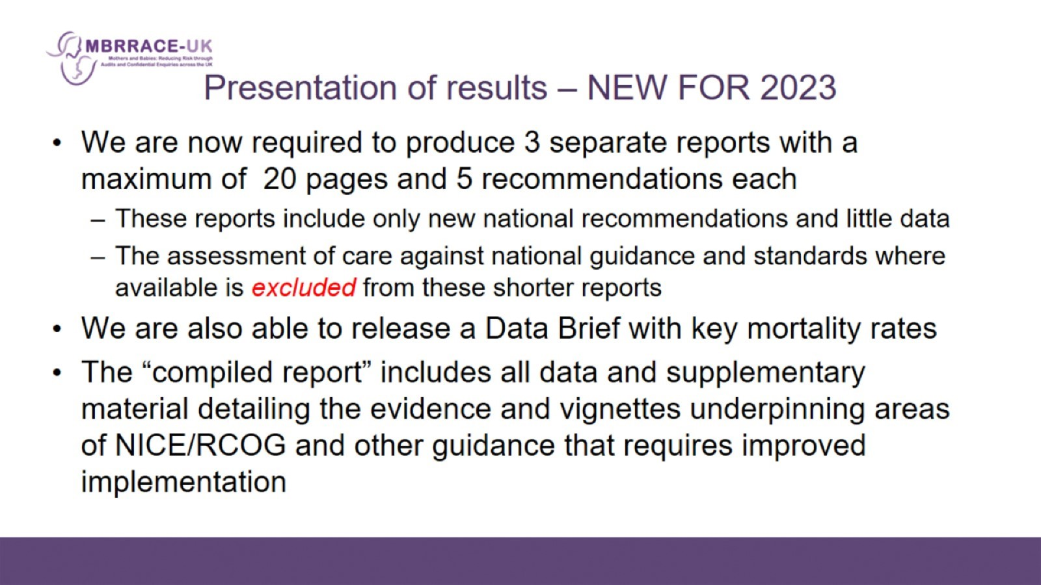
Presentation of results – NEW FOR 2023

Slide 11

MBRRACE-UK: RESULTS

Slide 12
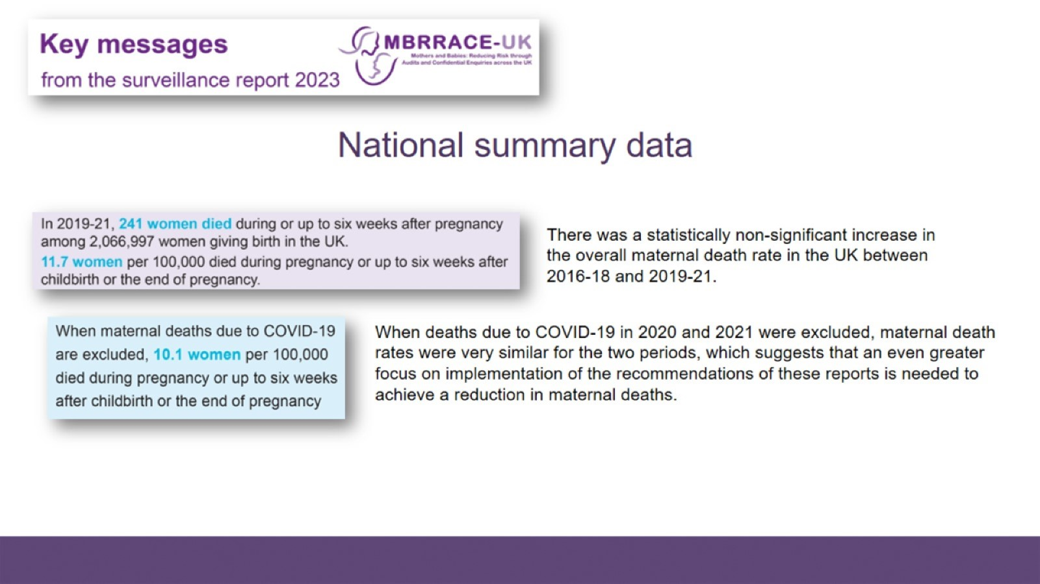
National summary data

Slide 13
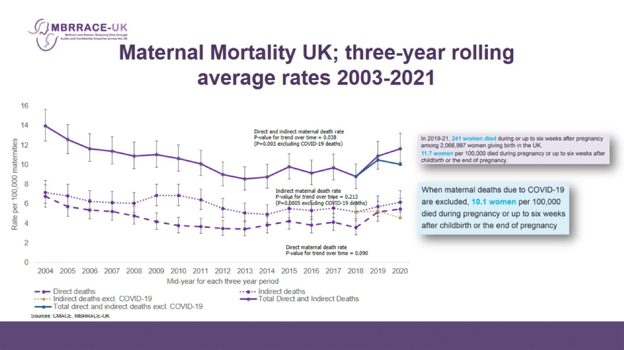
Maternal Mortality UK; three-year rolling average rates 2003-2021

Slide 14
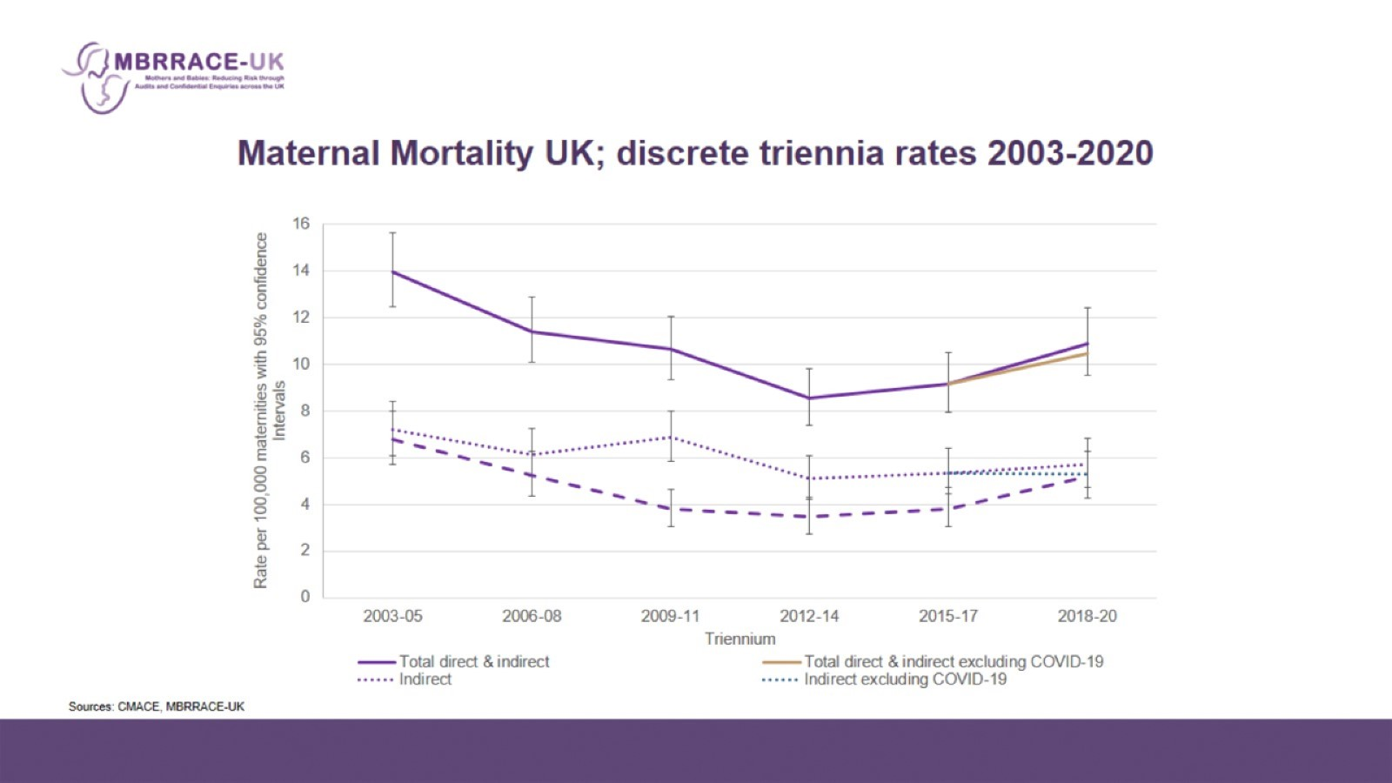
Maternal Mortality UK; discrete triennia rates 2003-2020

Slide 15
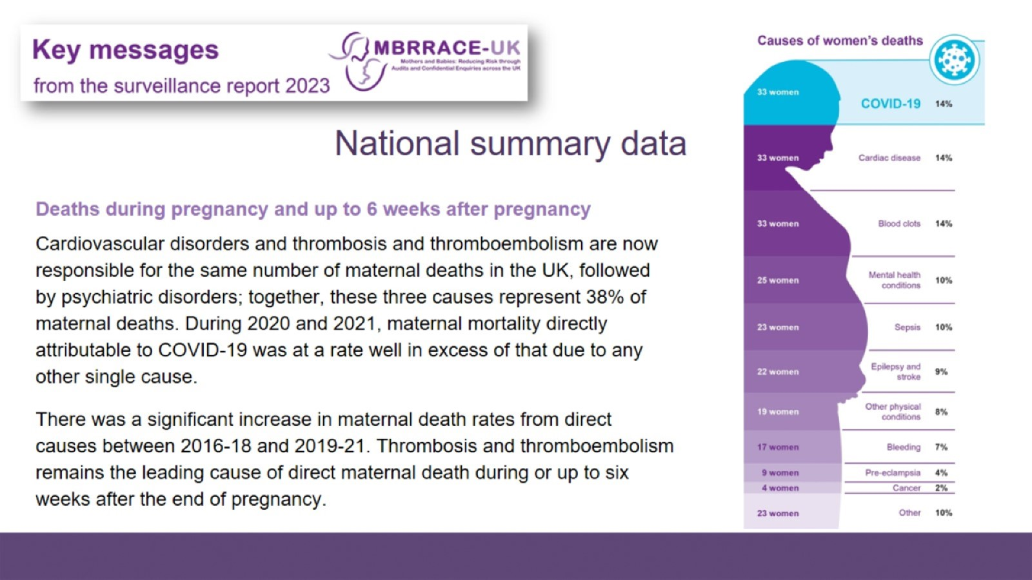
National summary data

Slide 16
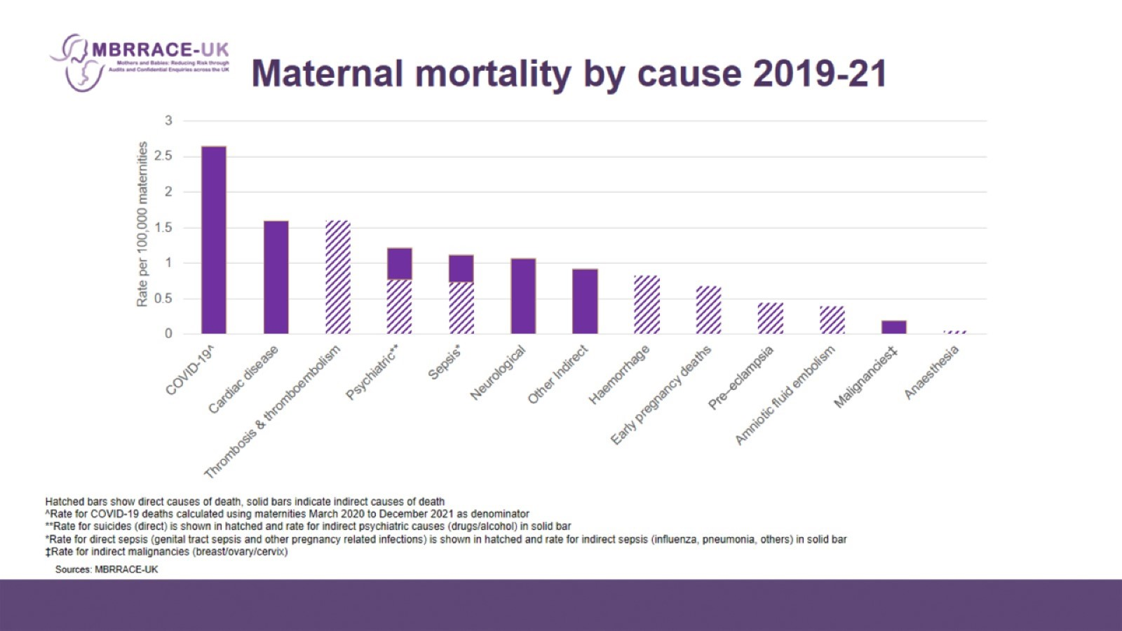
Maternal mortality by cause 2019-21

Slide 17
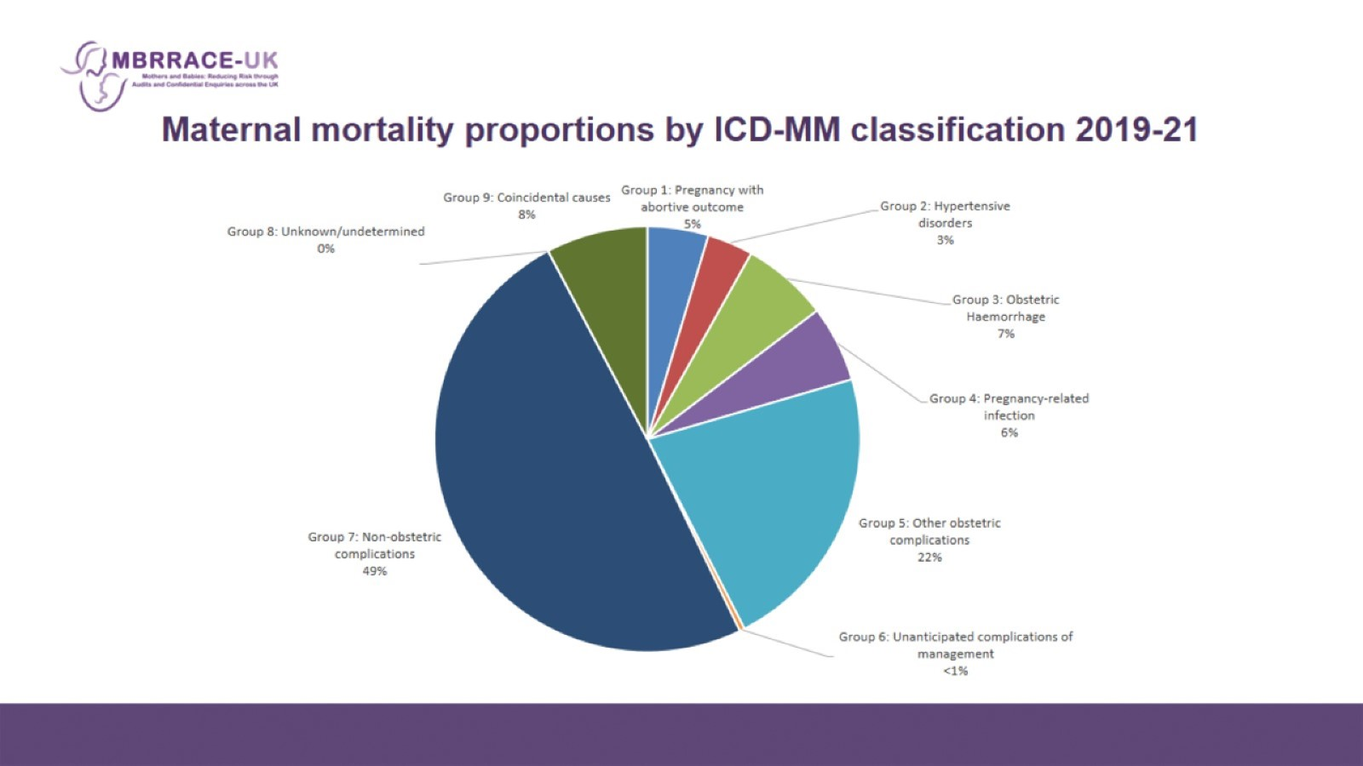
Maternal mortality proportions by ICD-MM classification 2019-21

Slide 18
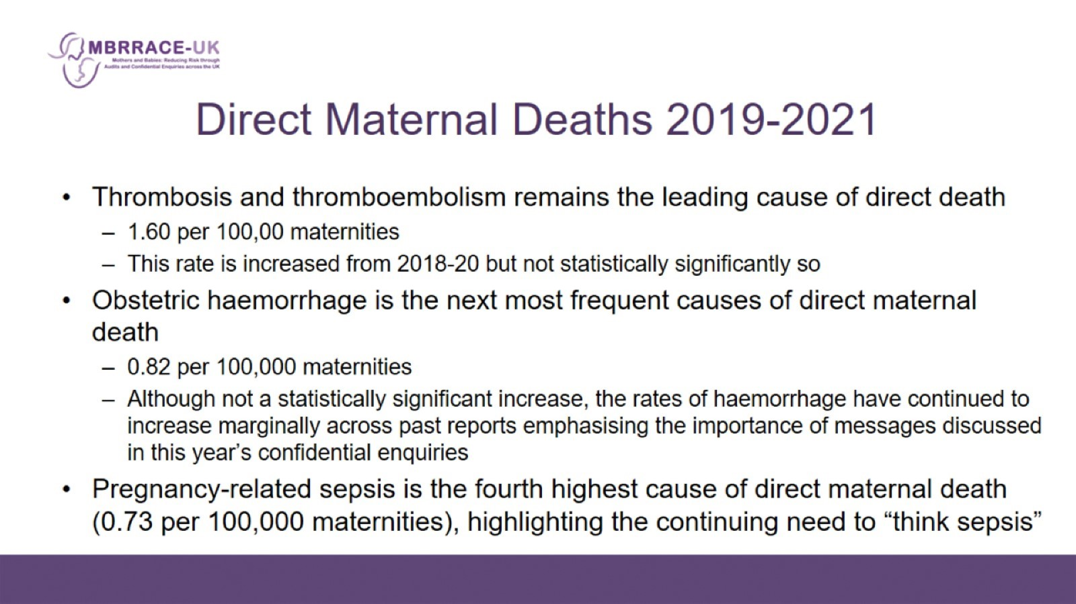
Direct Maternal Deaths 2019-2021

Slide 19
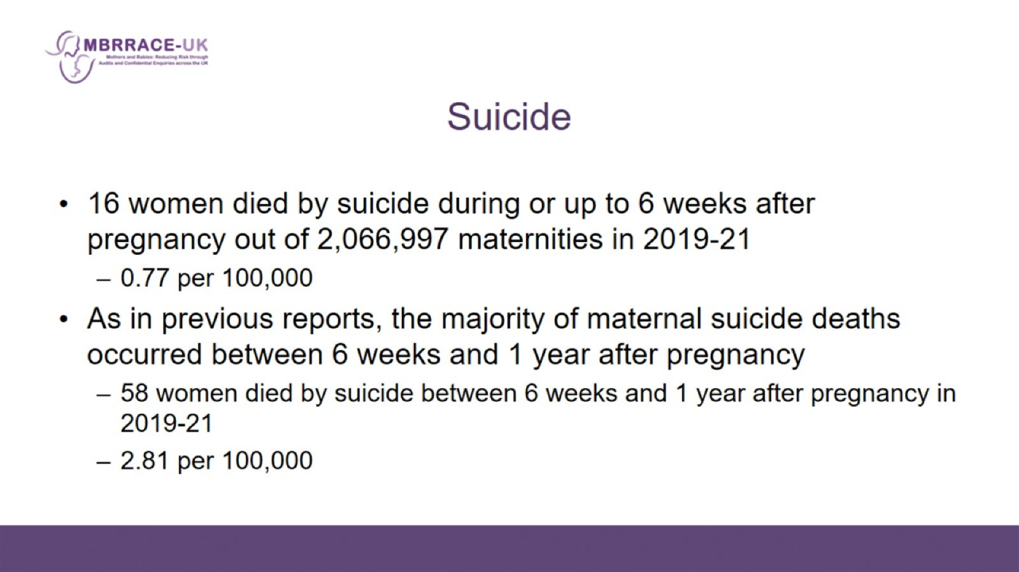
Suicide

Slide 20
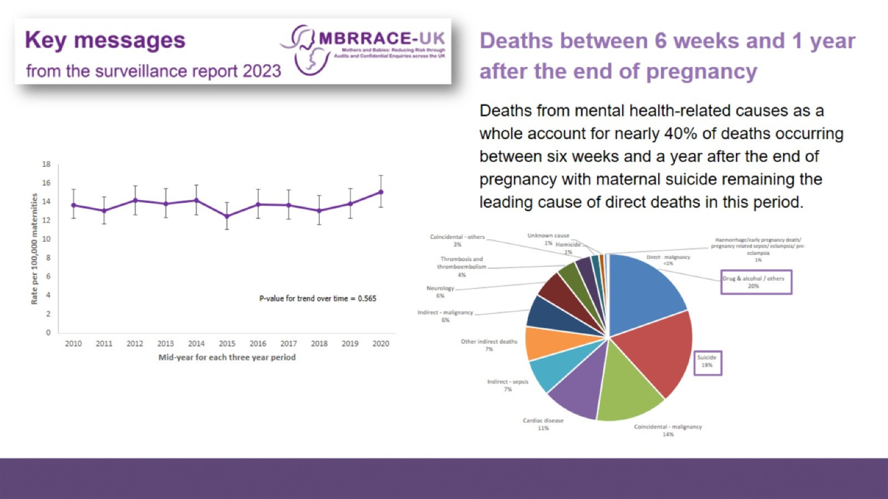

Slide 21
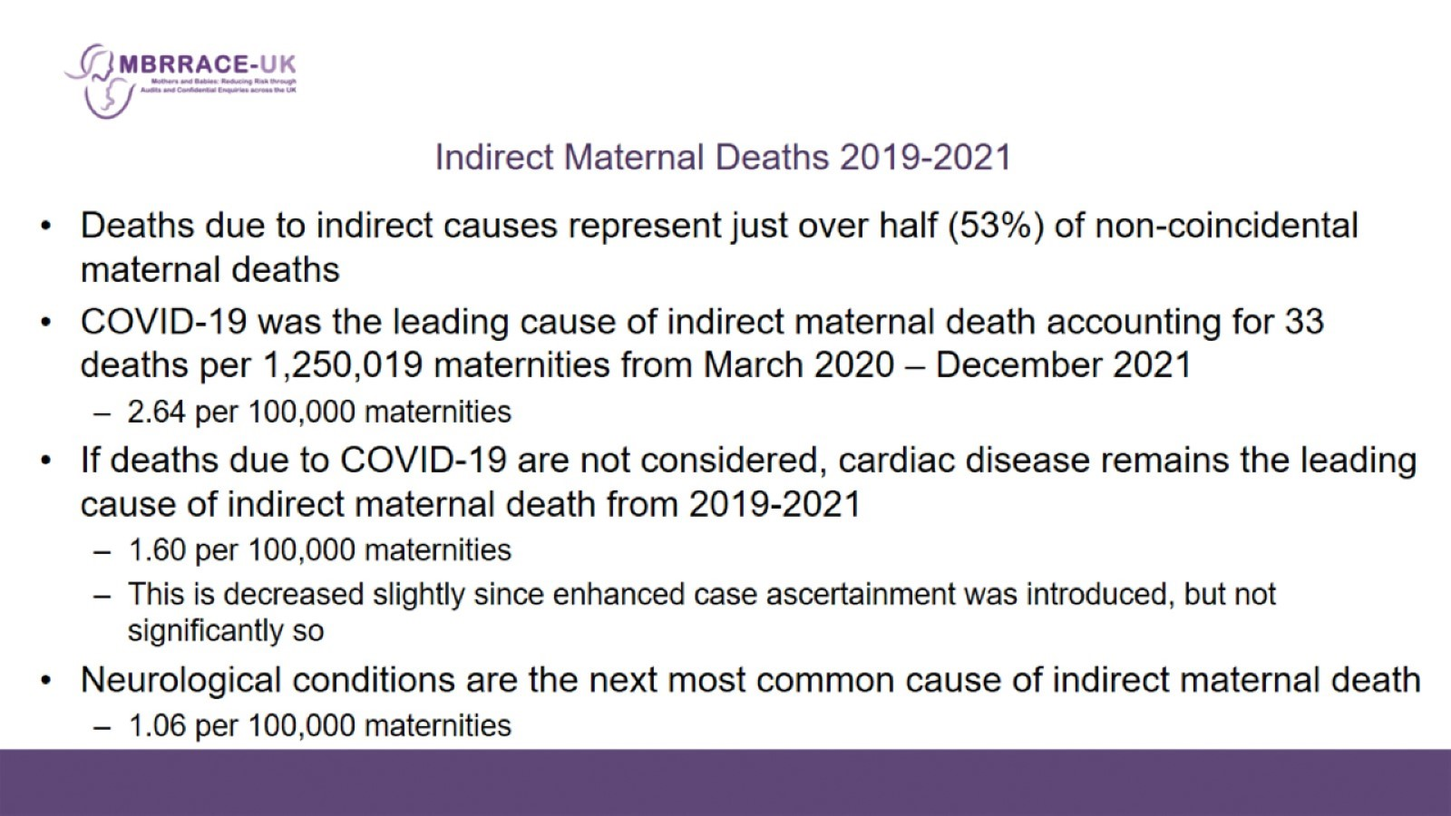
Indirect Maternal Deaths 2019-2021

Slide 22
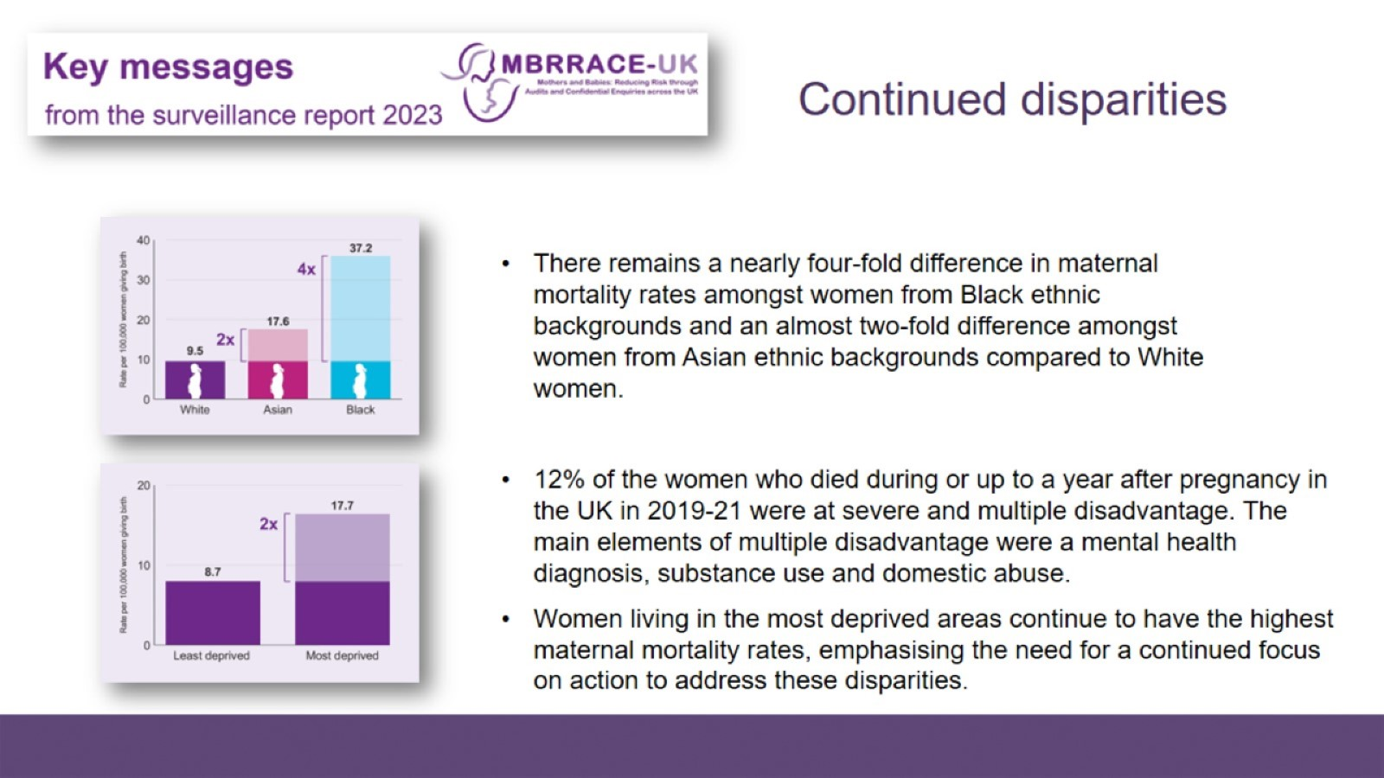

Slide 23
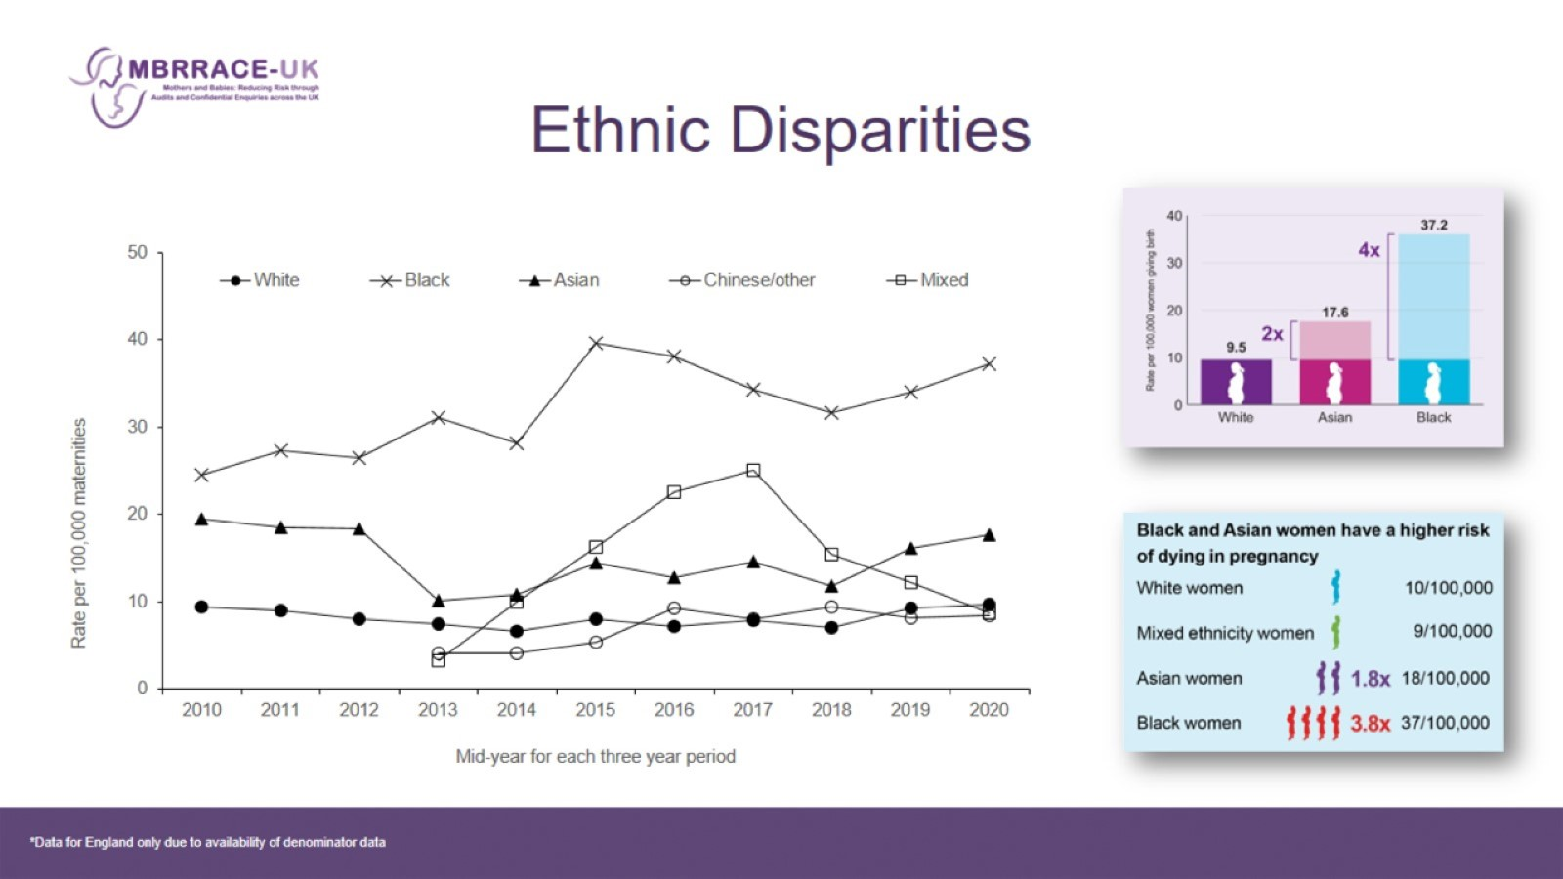
Ethnic Disparities

Slide 24
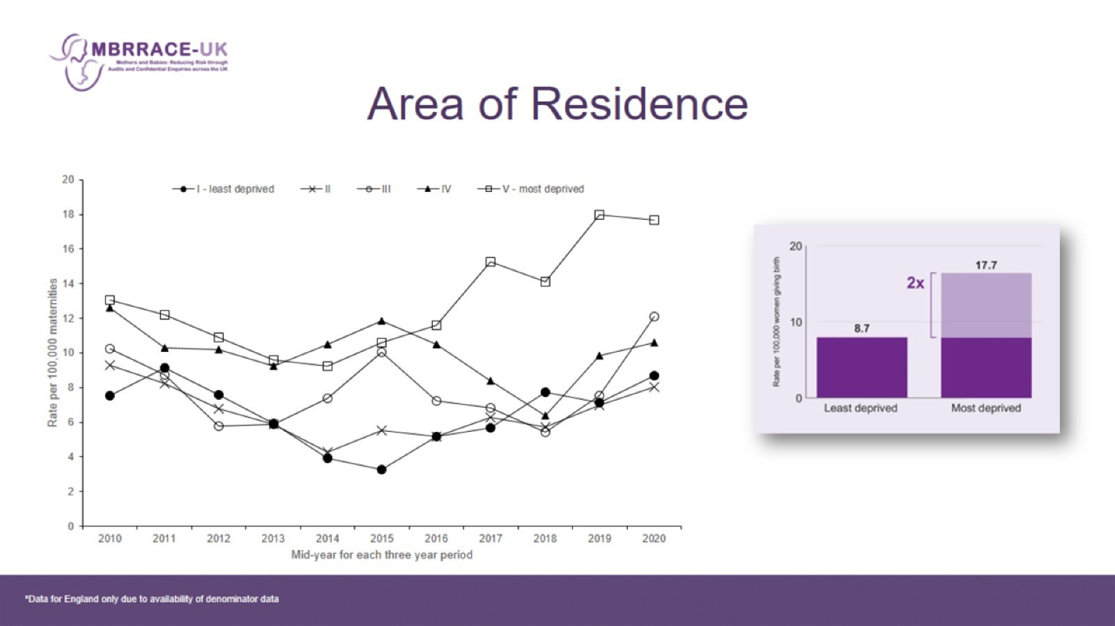
Area of Residence

Slide 25
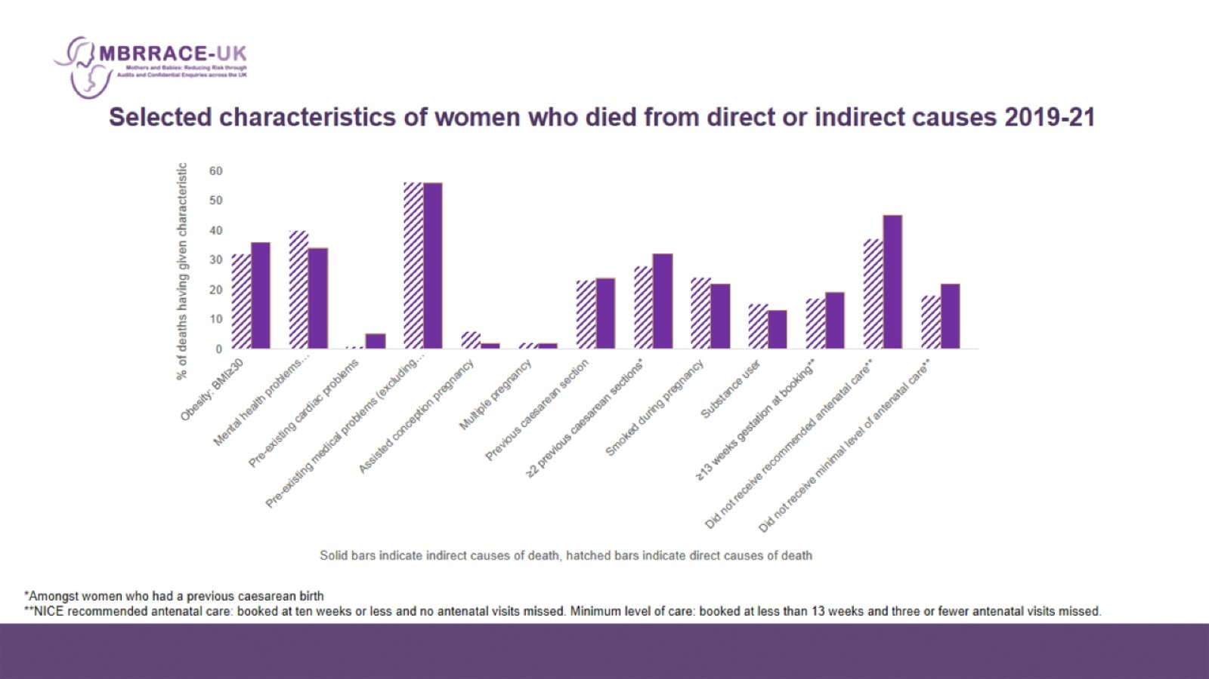
Selected characteristics of women who died from direct or indirect causes 2019-21

Slide 26
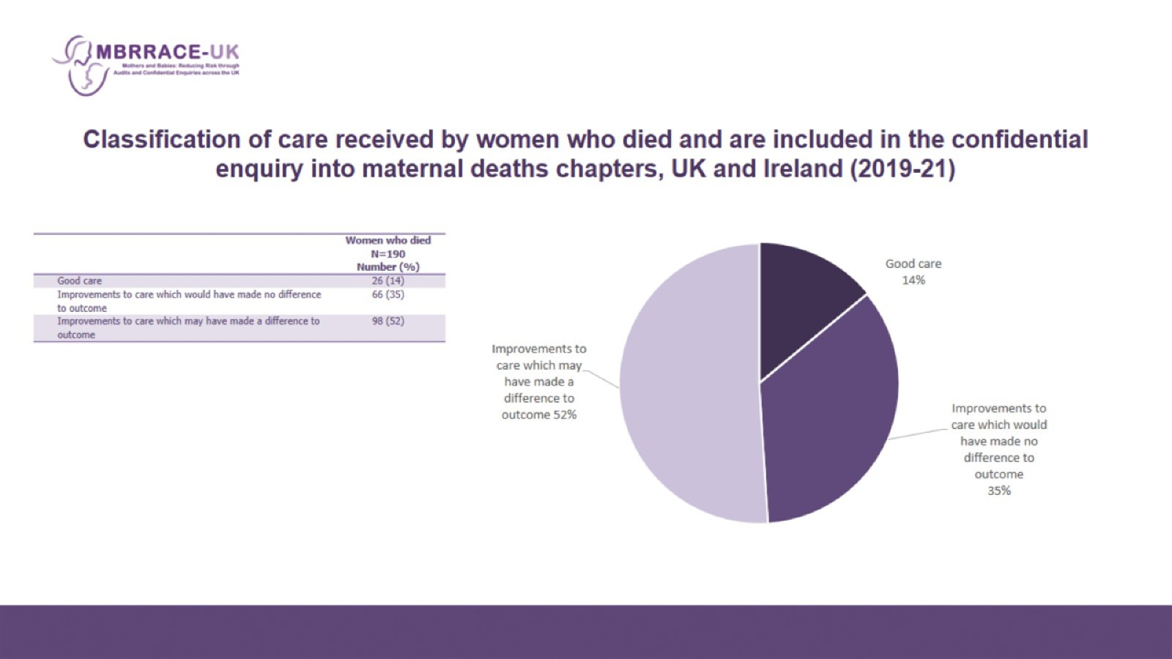
Classification of care received by women who died and are included in the confidential enquiry into maternal deaths chapters, UK and Ireland (2019-21)

Slide 27
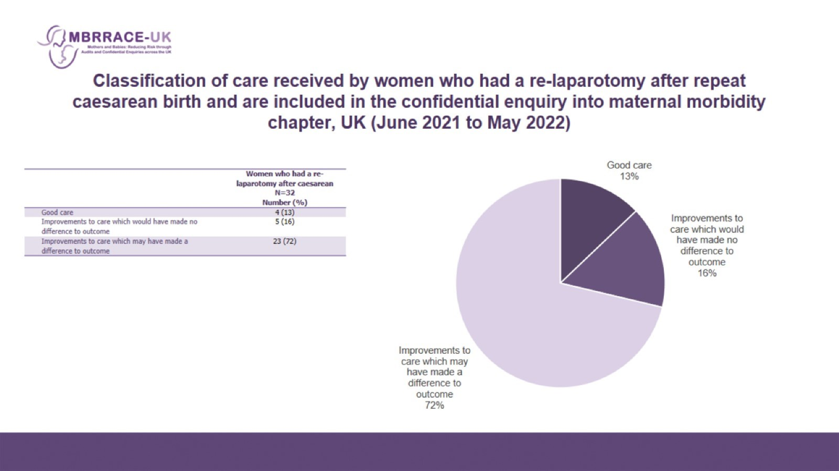
Classification of care received by women who had a re-laparotomy after repeat caesarean birth and are included in the confidential enquiry into maternal morbidity chapter, UK (June 2021 to May 2022)

Slide 28
