Slide 1

Recommendations

Slide 2
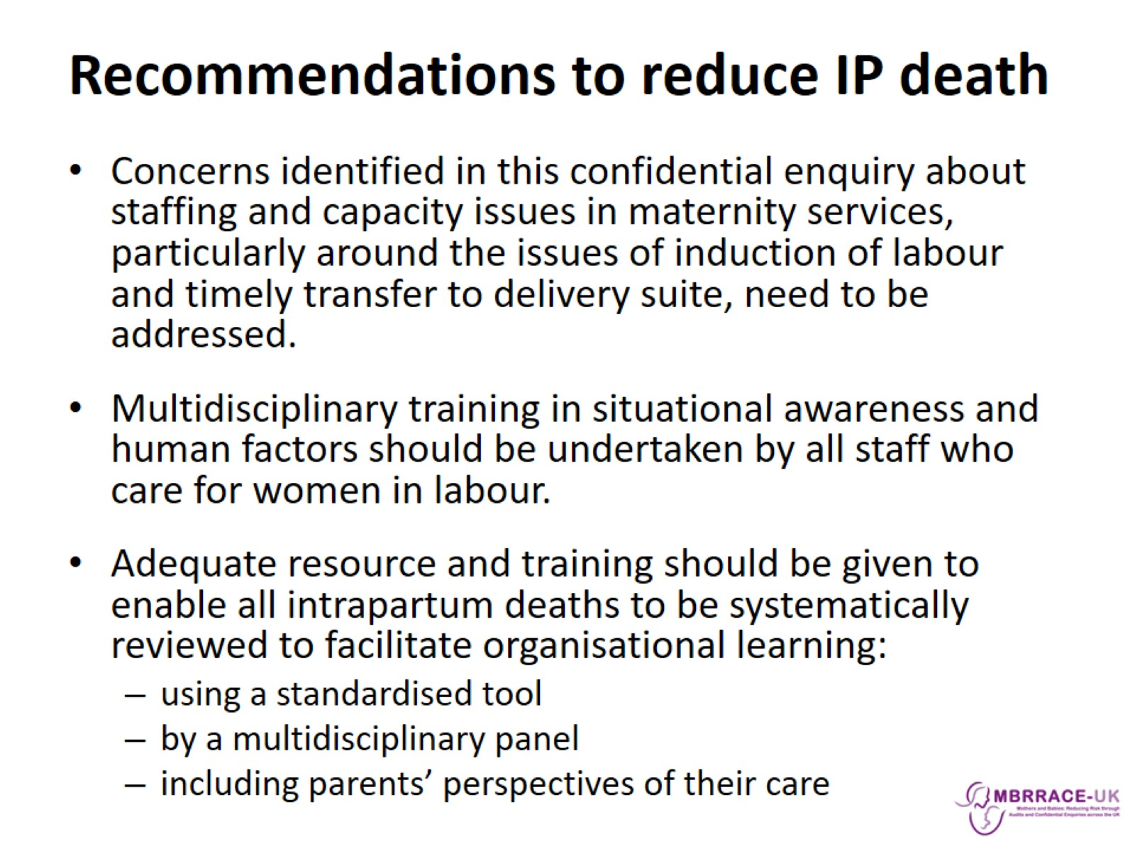
Recommendations to reduce IP death

Slide 3
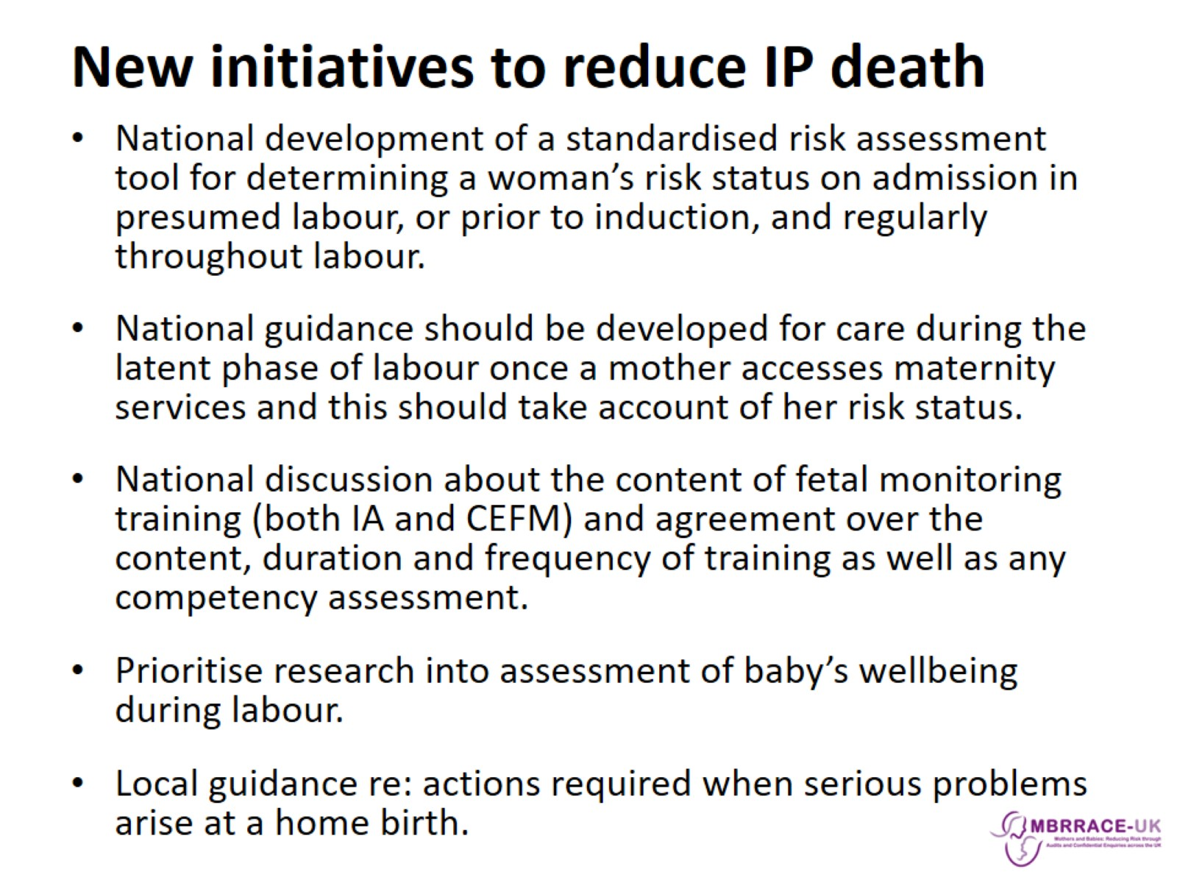
New initiatives to reduce IP death

Slide 4
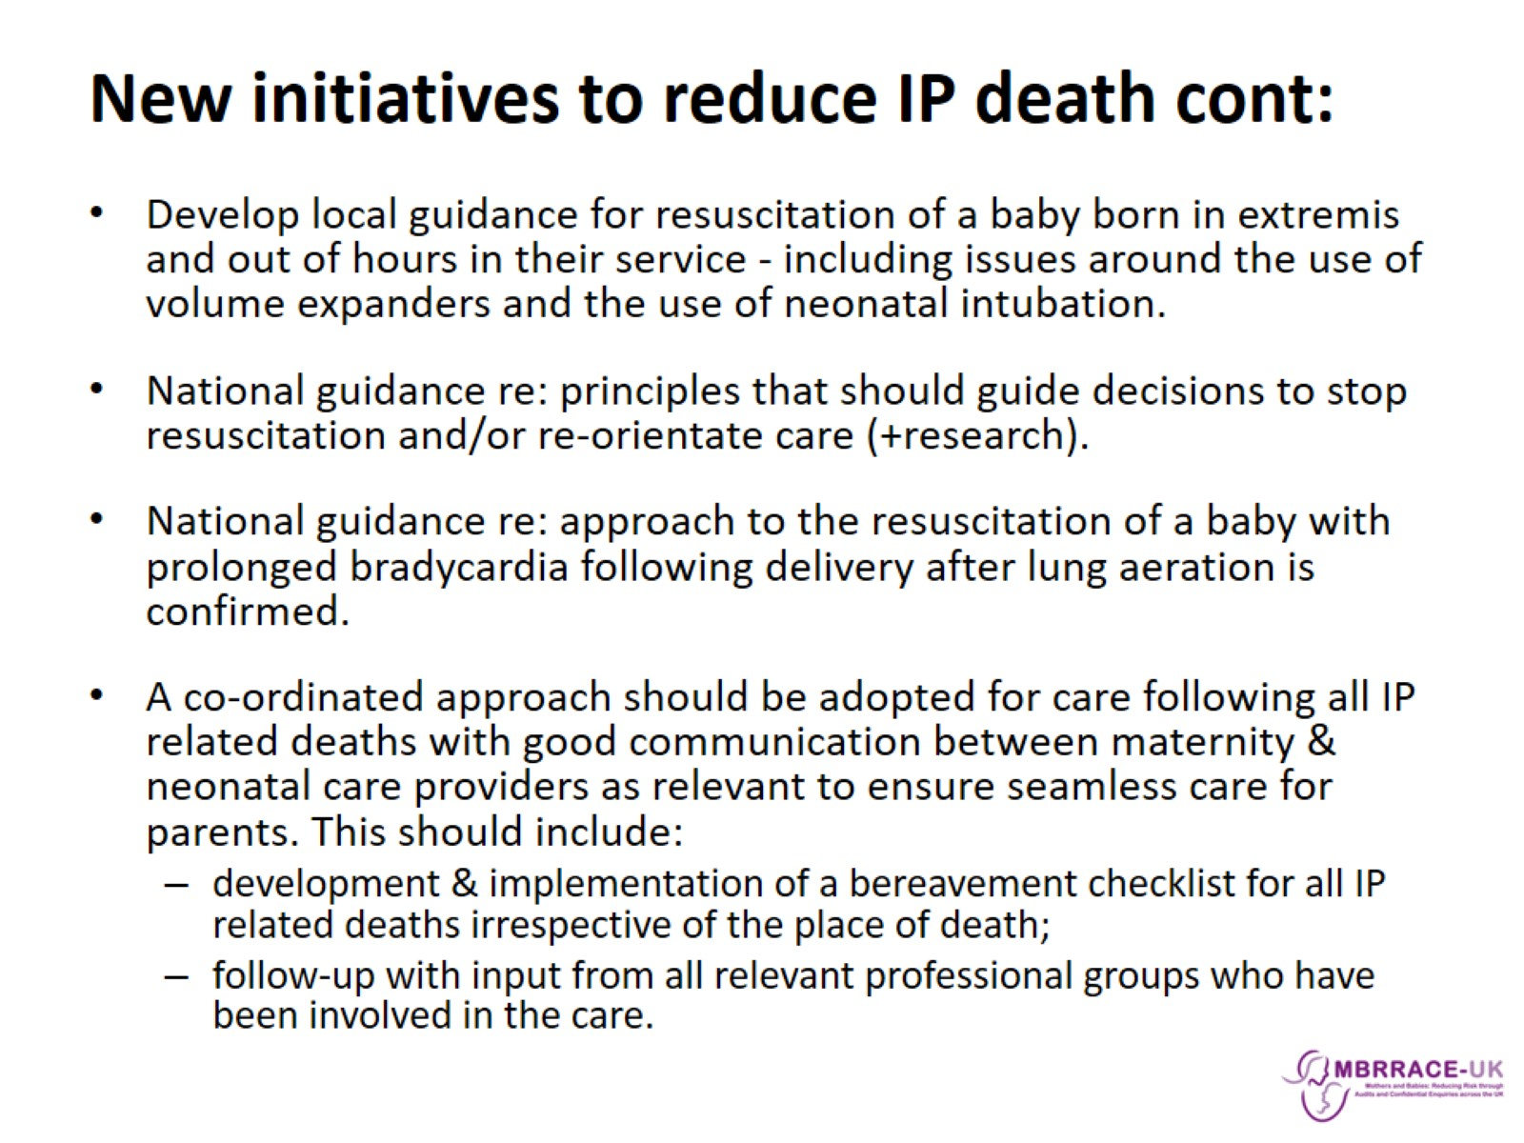
New initiatives to reduce IP death cont:

Slide 5
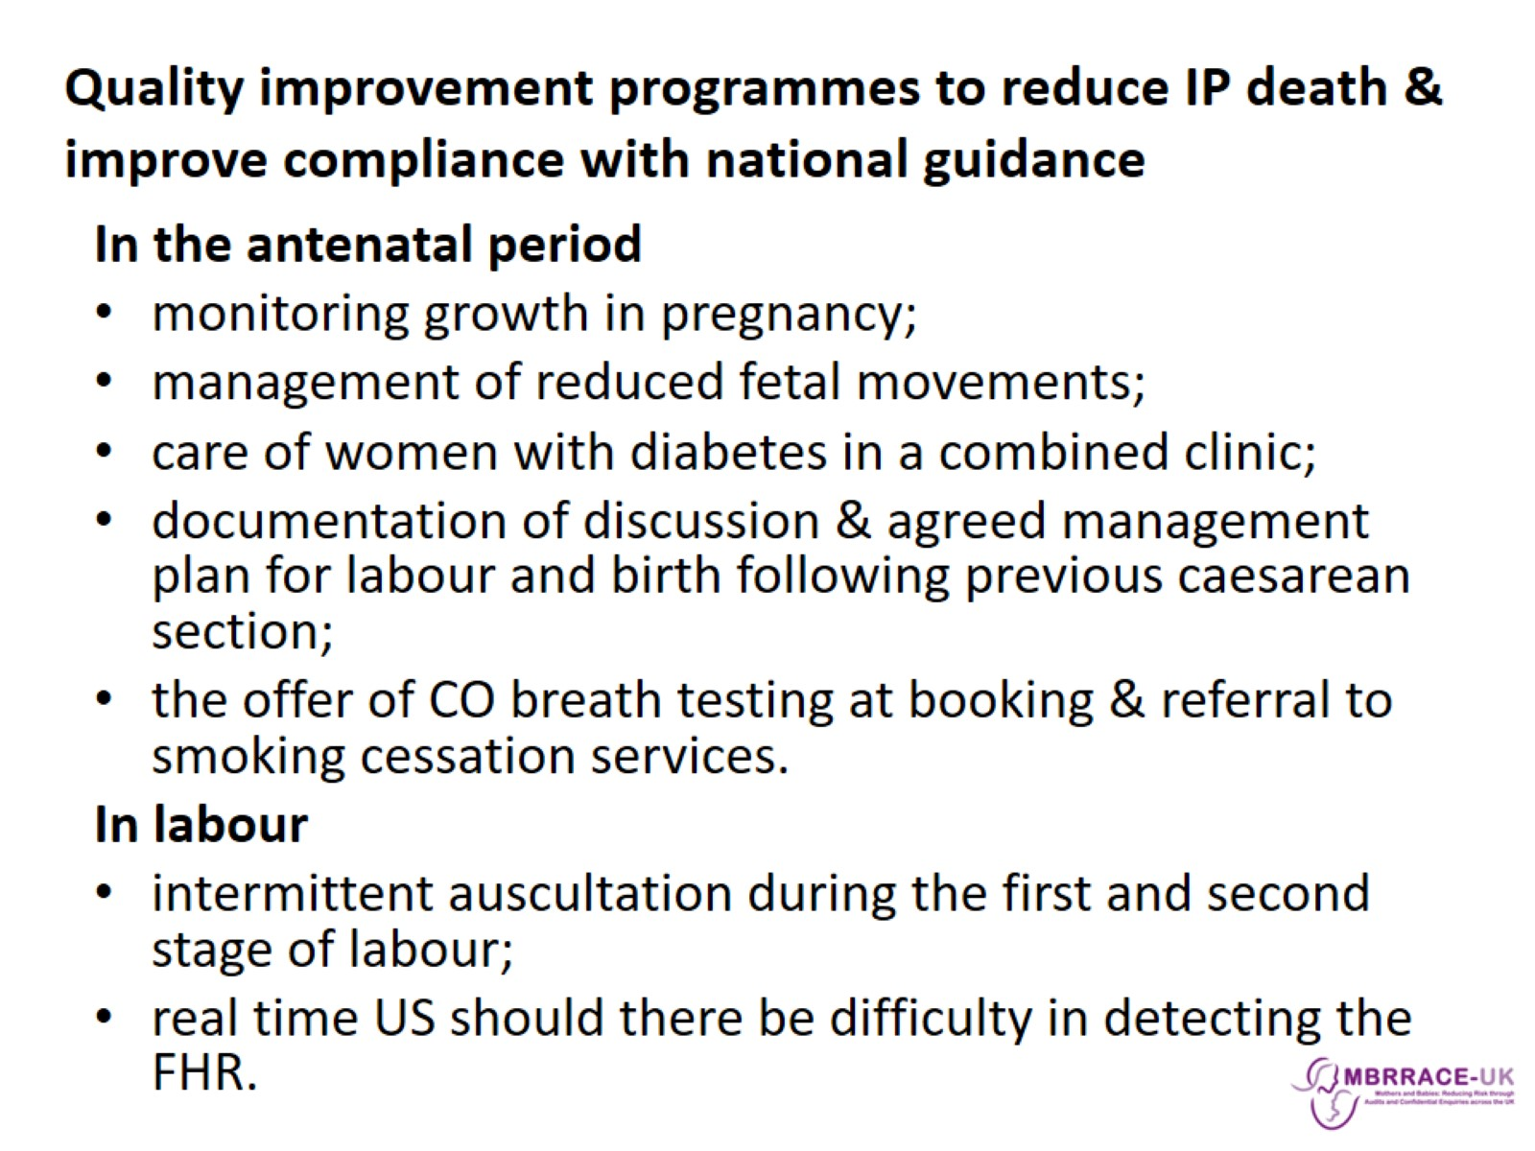
Quality improvement programmes to reduce IP death & improve compliance with national guidance

Slide 6
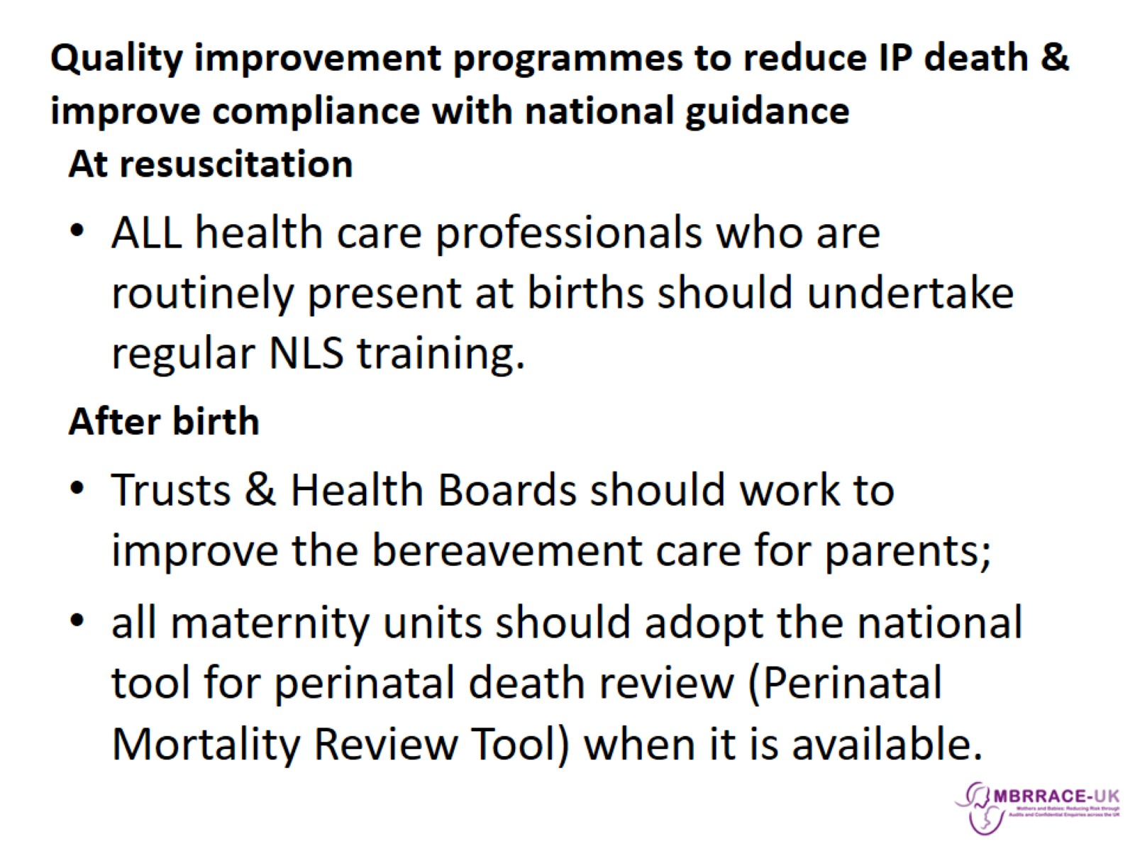
Quality improvement programmes to reduce IP death & improve compliance with national guidance

Slide 7
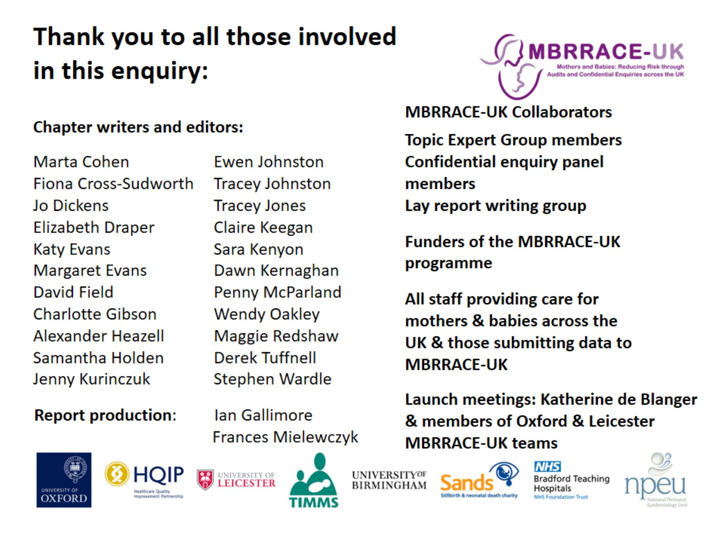

Slide 8

Perinatal Mortality Surveillance Report
UK Perinatal Deaths from January to December 2016

Slide 9

Thank you

