Slide 1
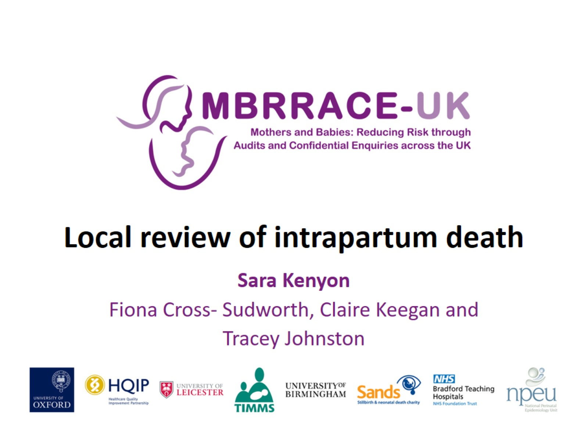
Local review of intrapartum death

Slide 2
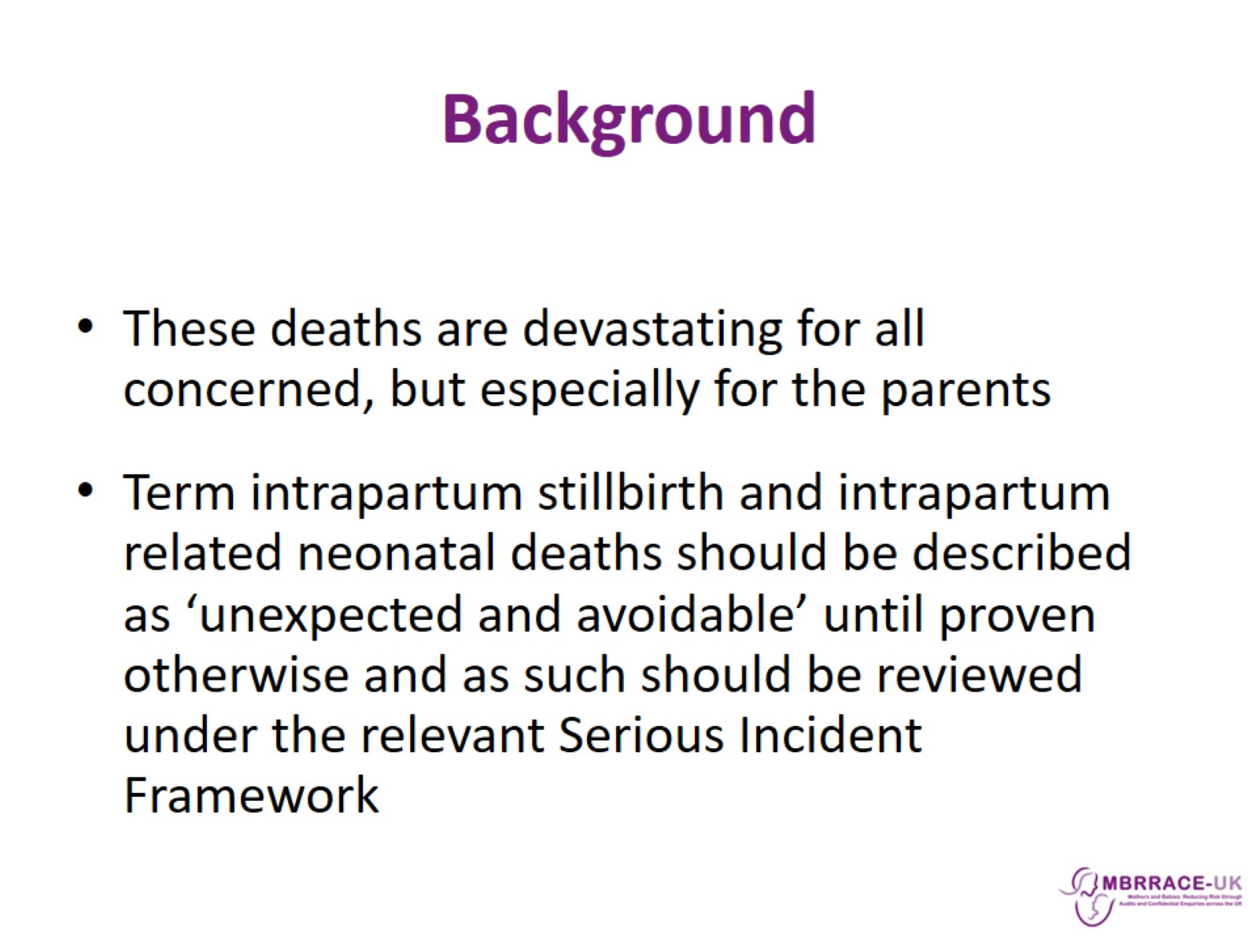
Background

Slide 3
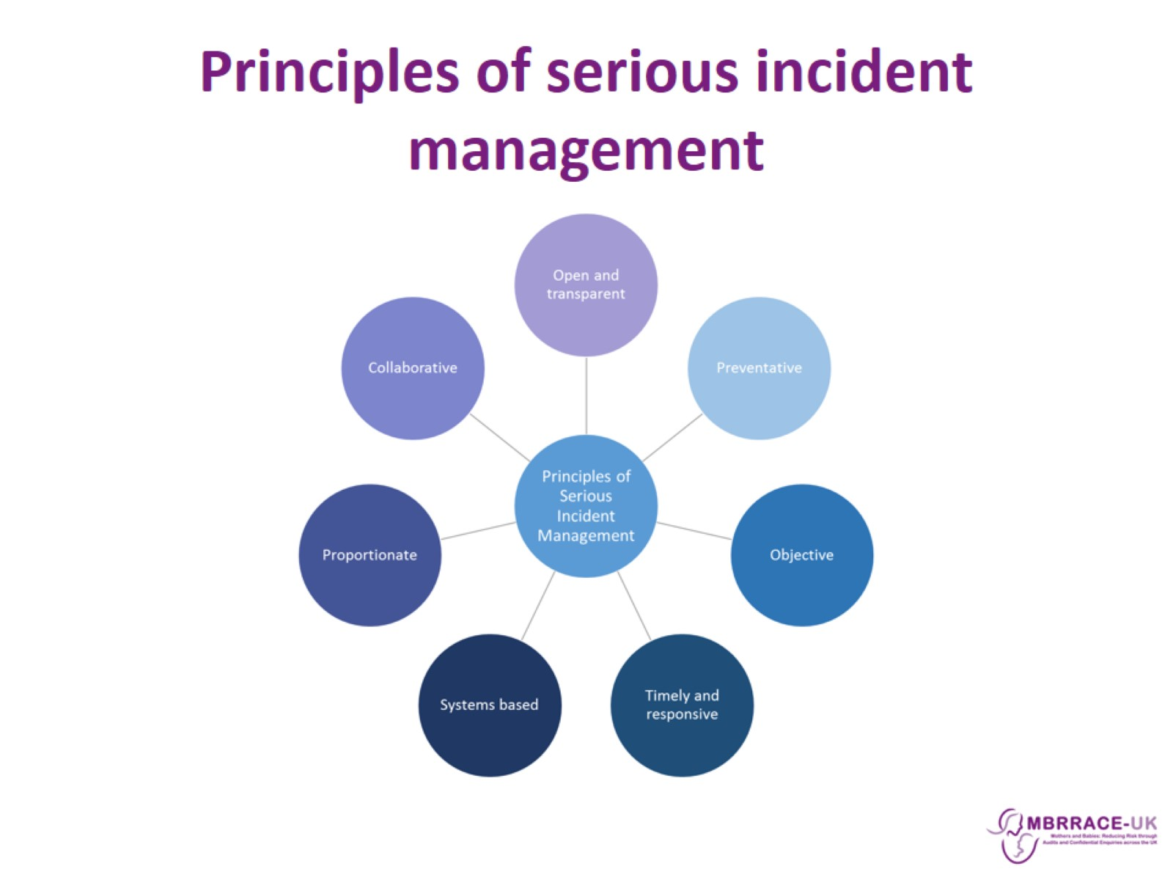
Principles of serious incident management

Slide 4
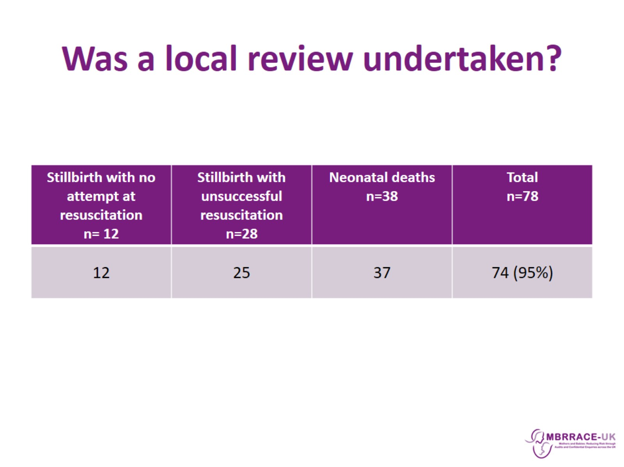
Was a local review undertaken?

Slide 5
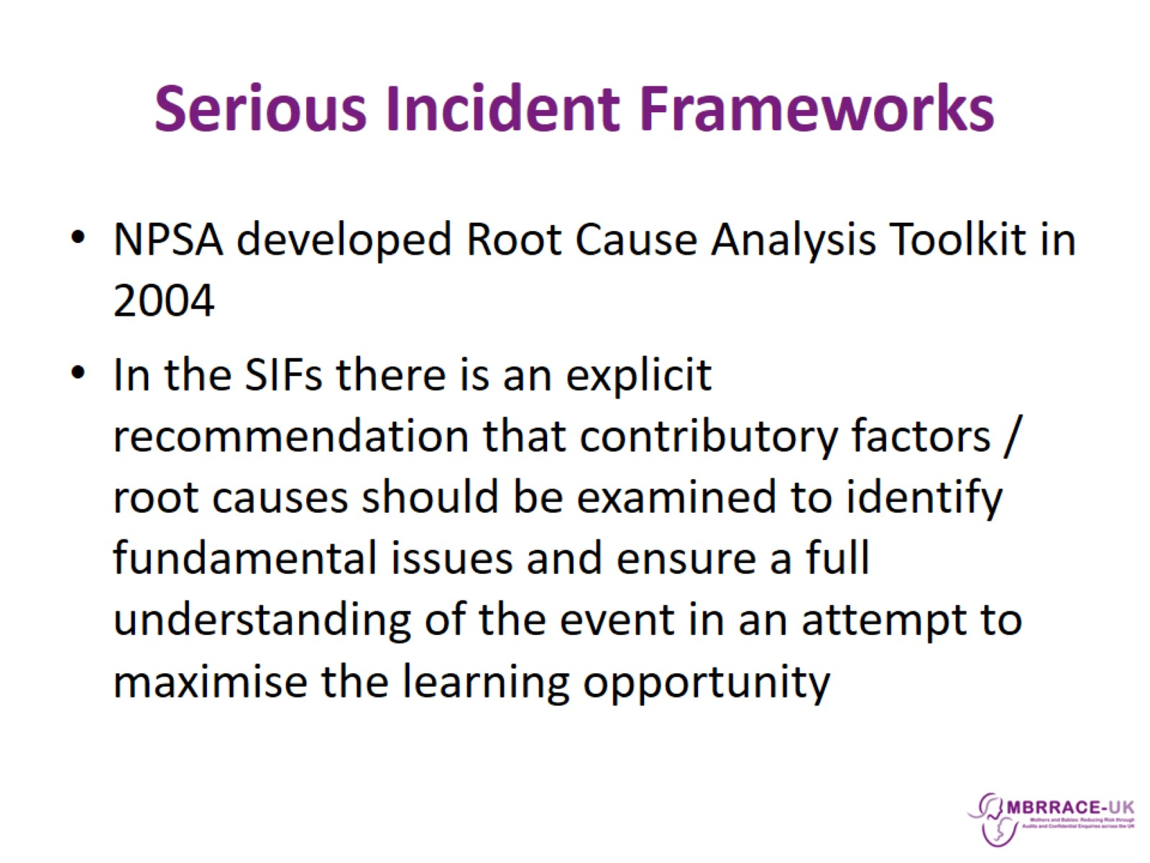
Serious Incident Frameworks

Slide 6
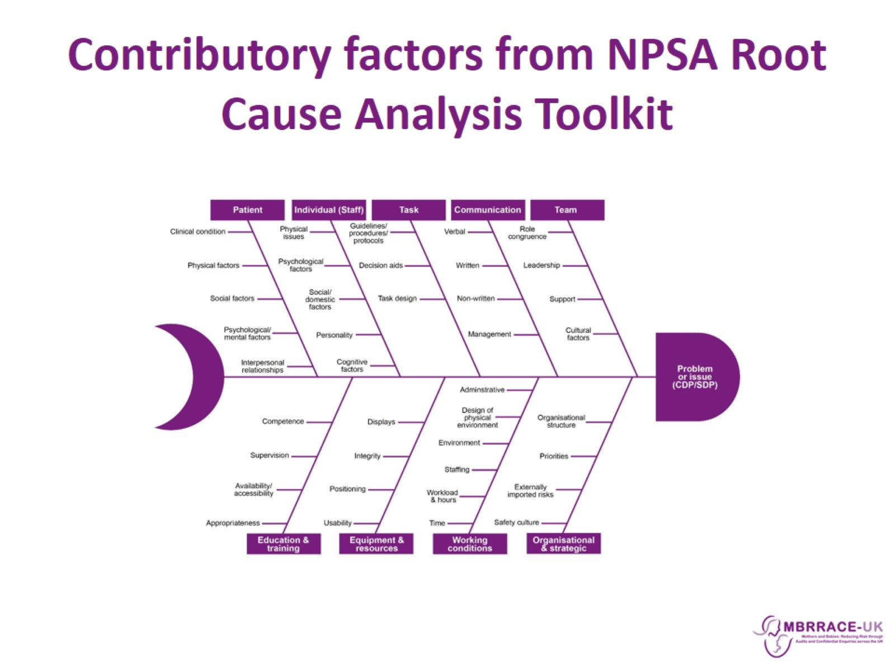
Contributory factors from NPSA Root Cause Analysis Toolkit

Slide 7
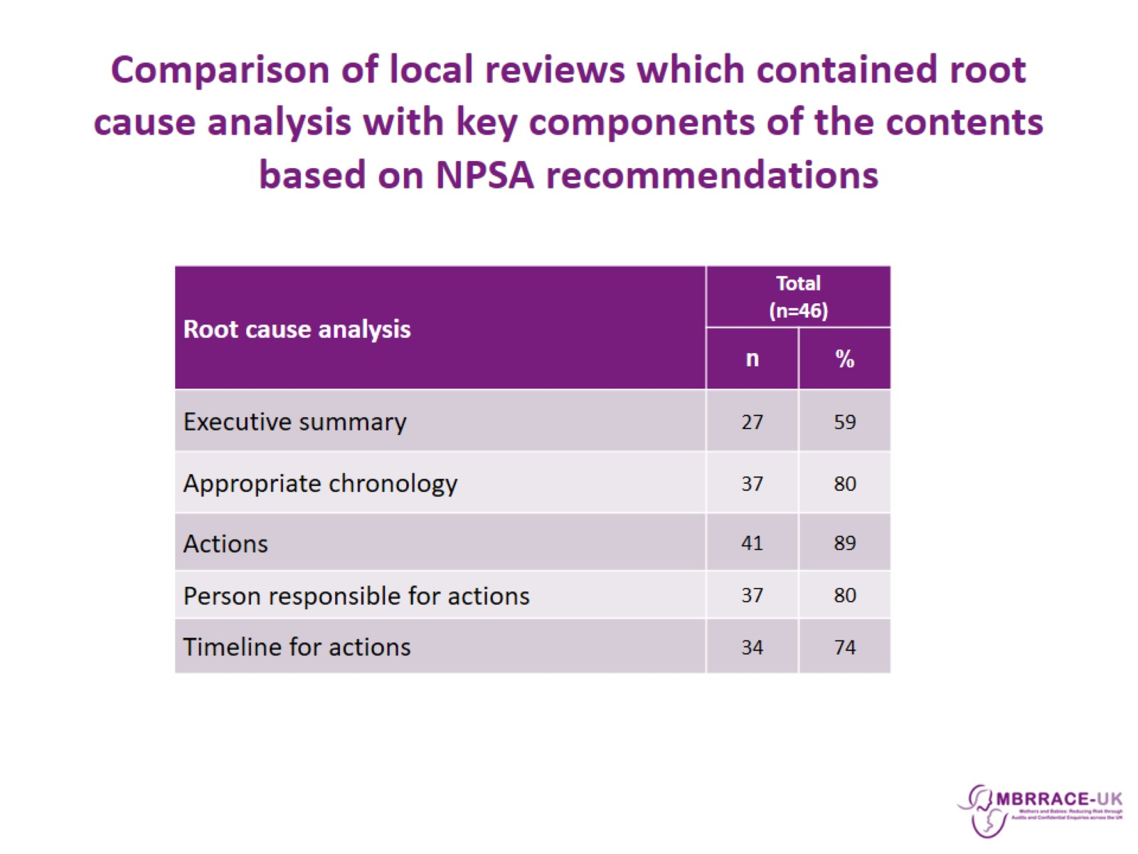
Comparison of local reviews which contained root cause analysis with key components of the contents based on NPSA recommendations

Slide 8
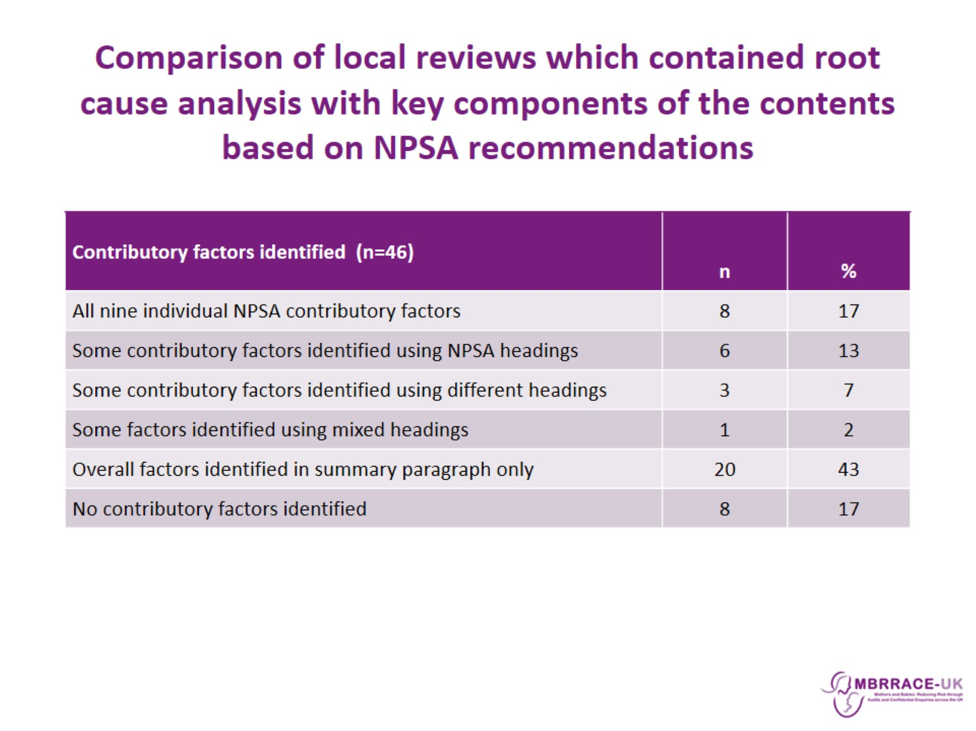
Comparison of local reviews which contained root cause analysis with key components of the contents based on NPSA recommendations

Slide 9
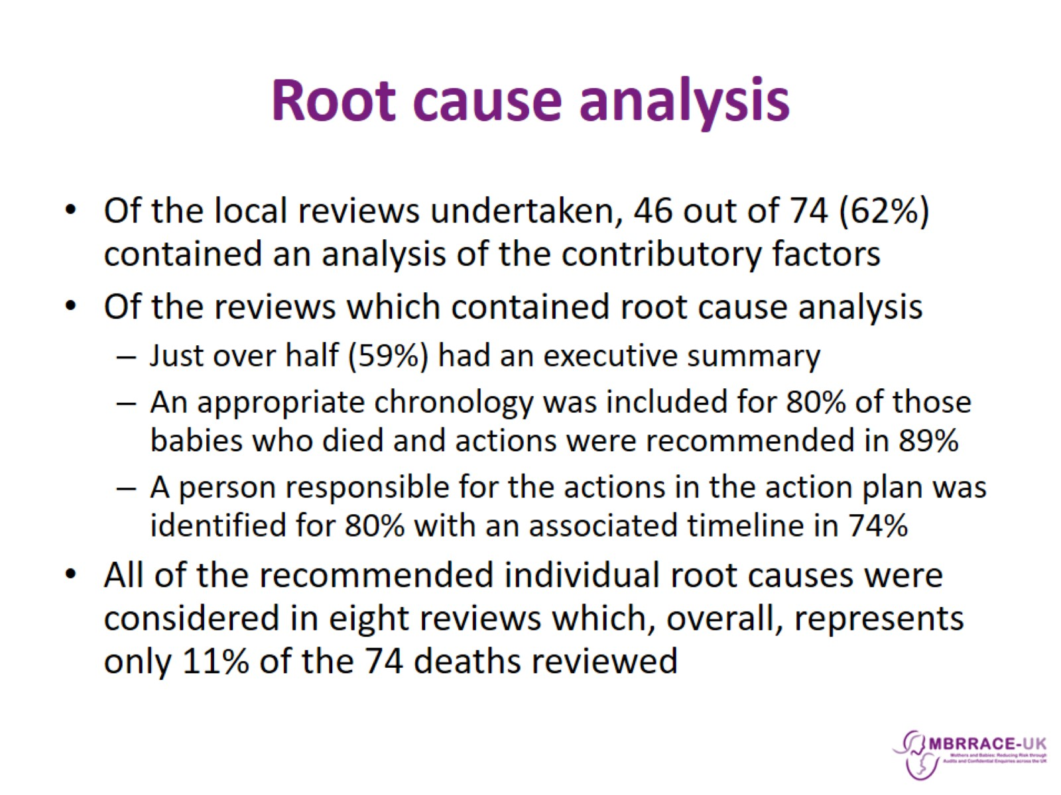
Root cause analysis

Slide 10
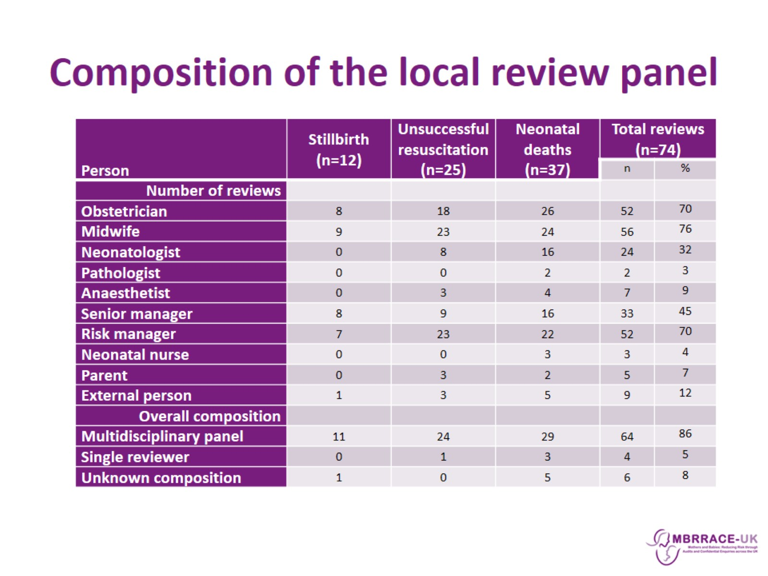
Composition of the local review panel

Slide 11
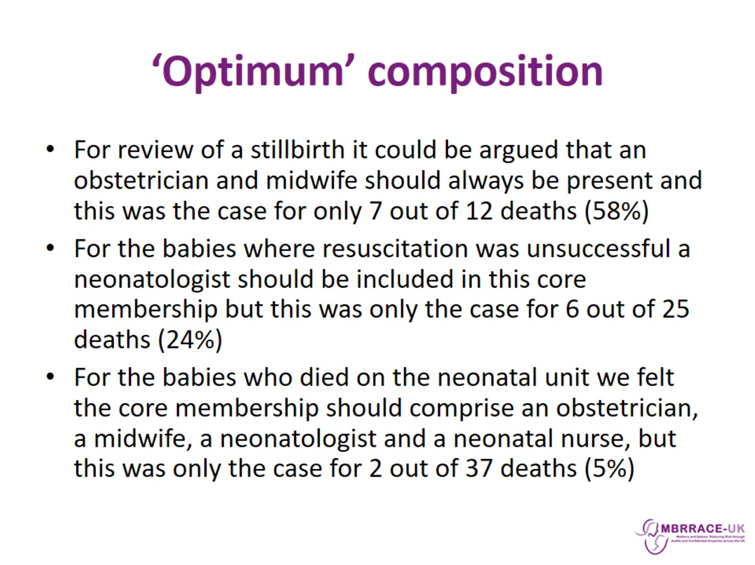
‘Optimum’ composition

Slide 12
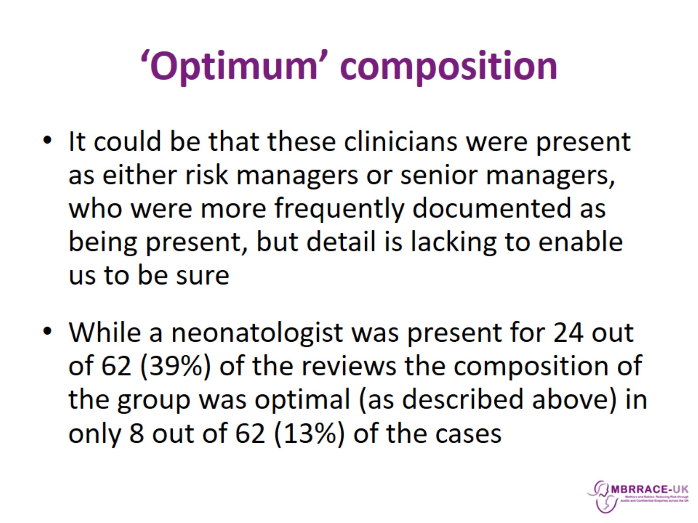
‘Optimum’ composition

Slide 13
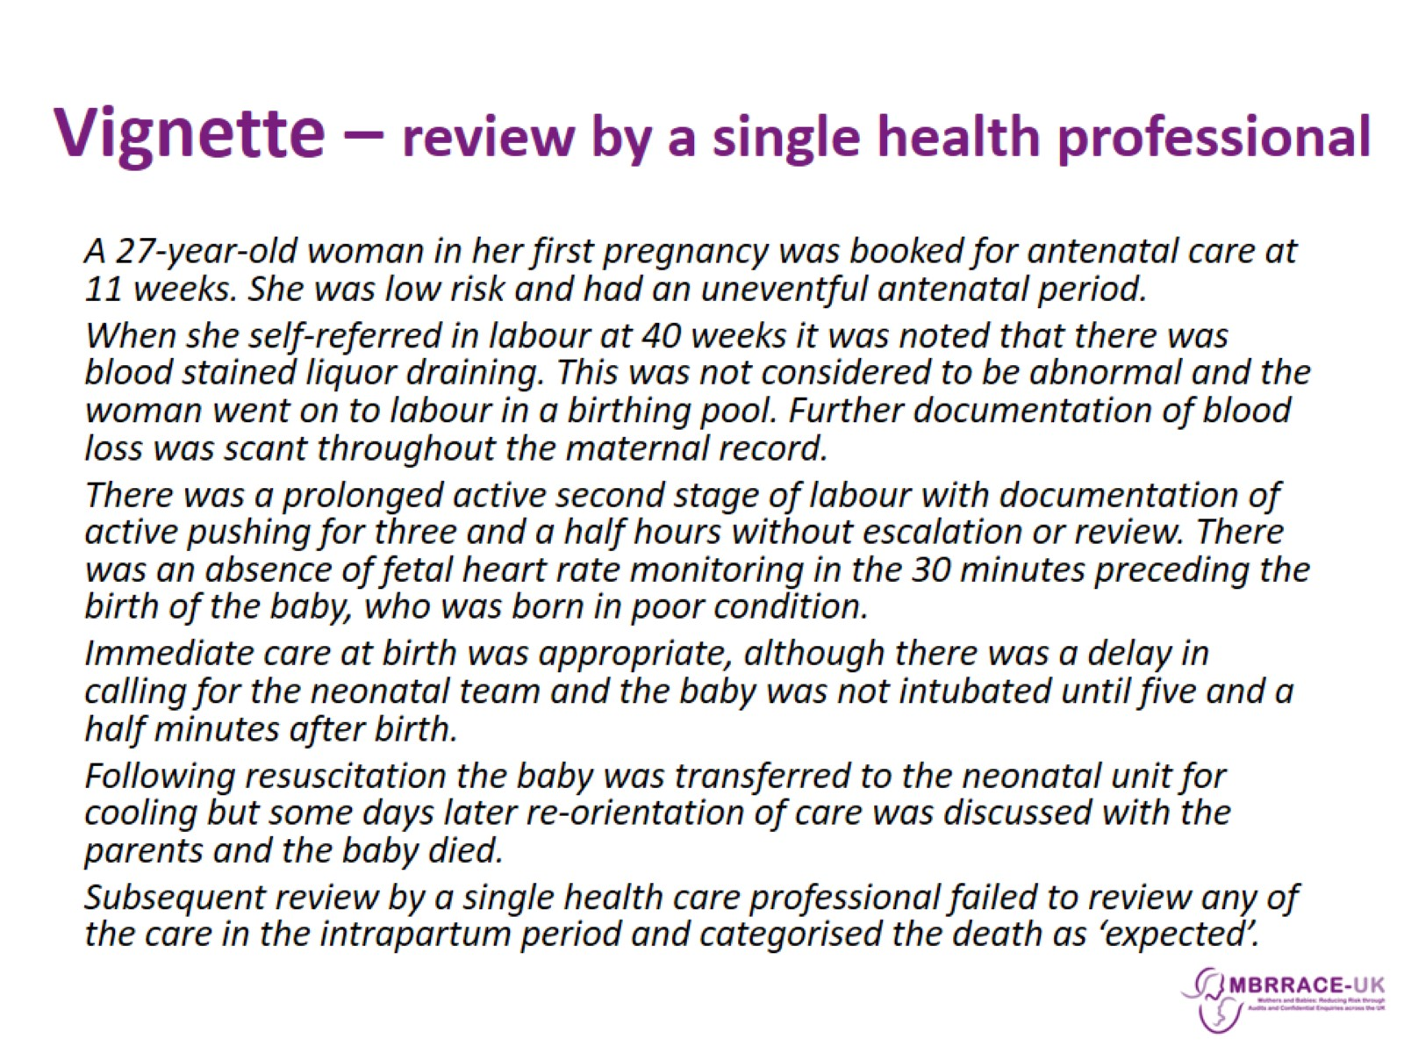
Vignette – review by a single health professional

Slide 14
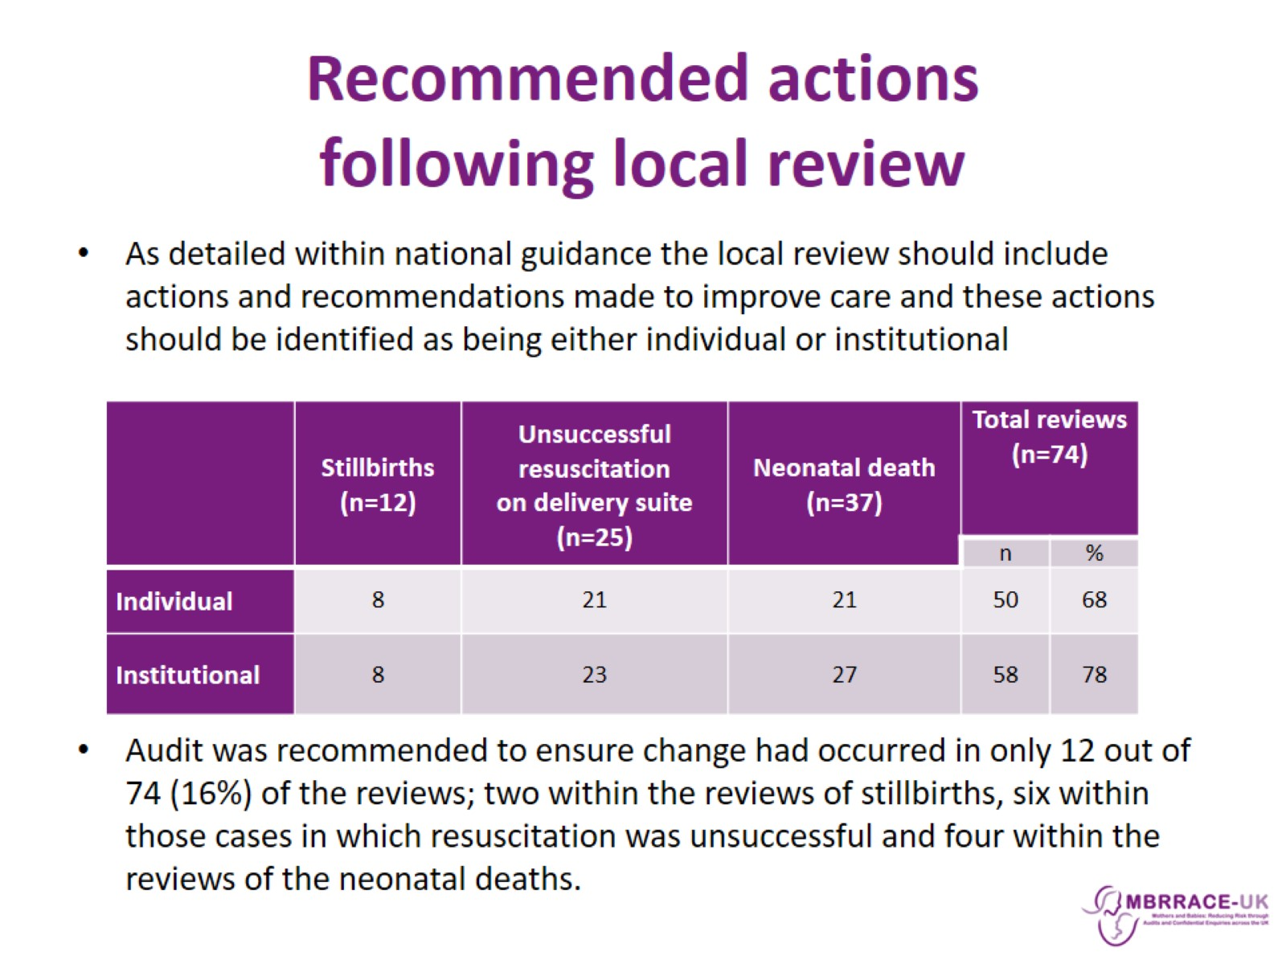
Recommended actions following local review

Slide 15
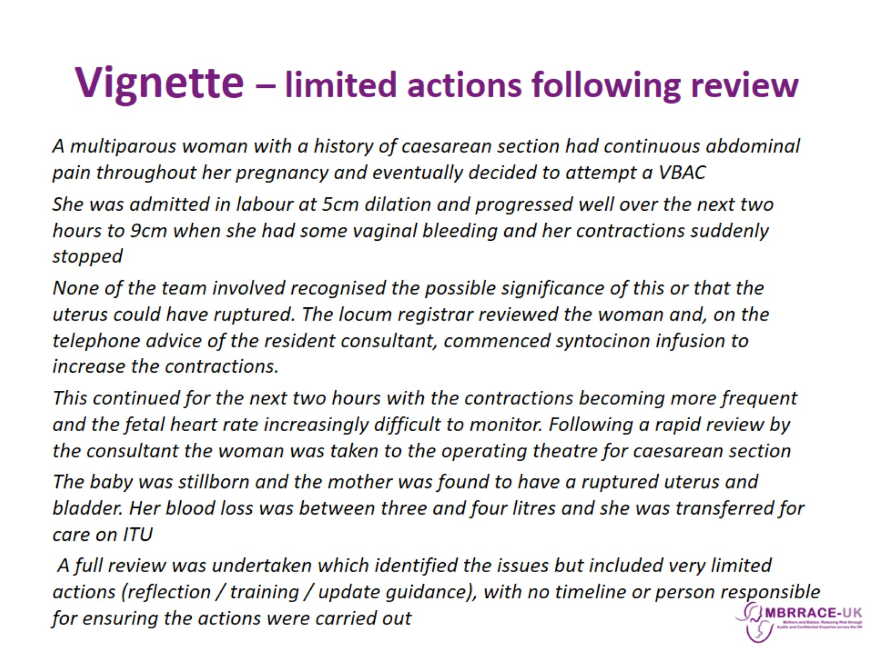
Vignette – limited actions following review

Slide 16
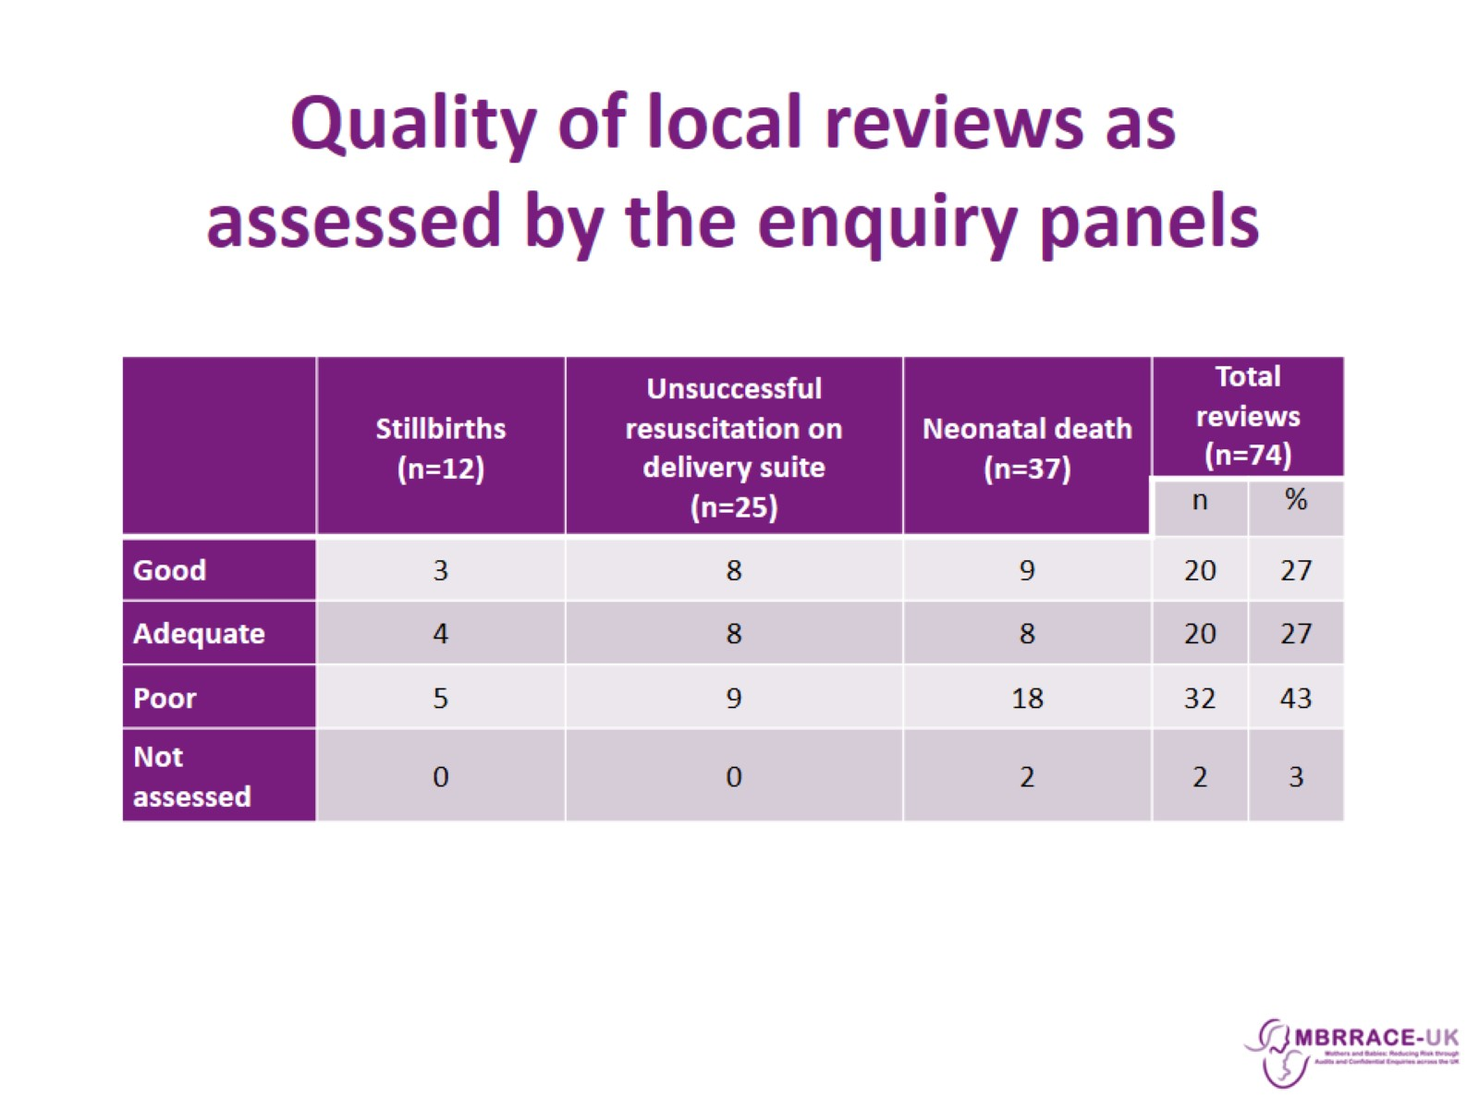
Quality of local reviews as assessed by the enquiry panels

Slide 17
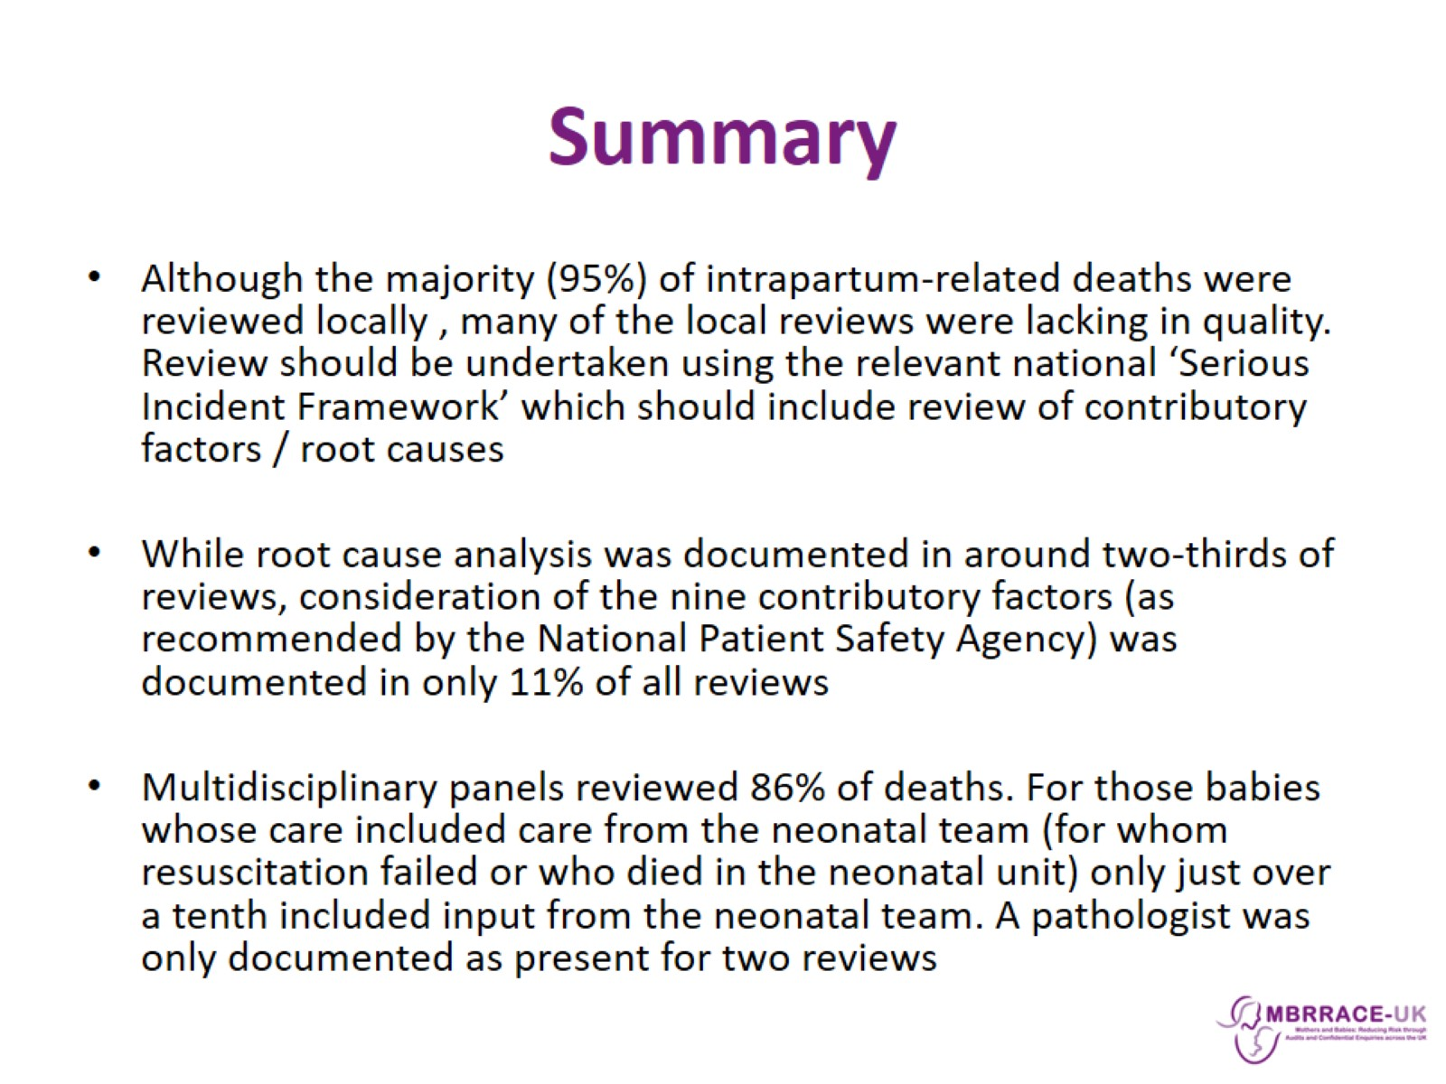
Summary

Slide 18
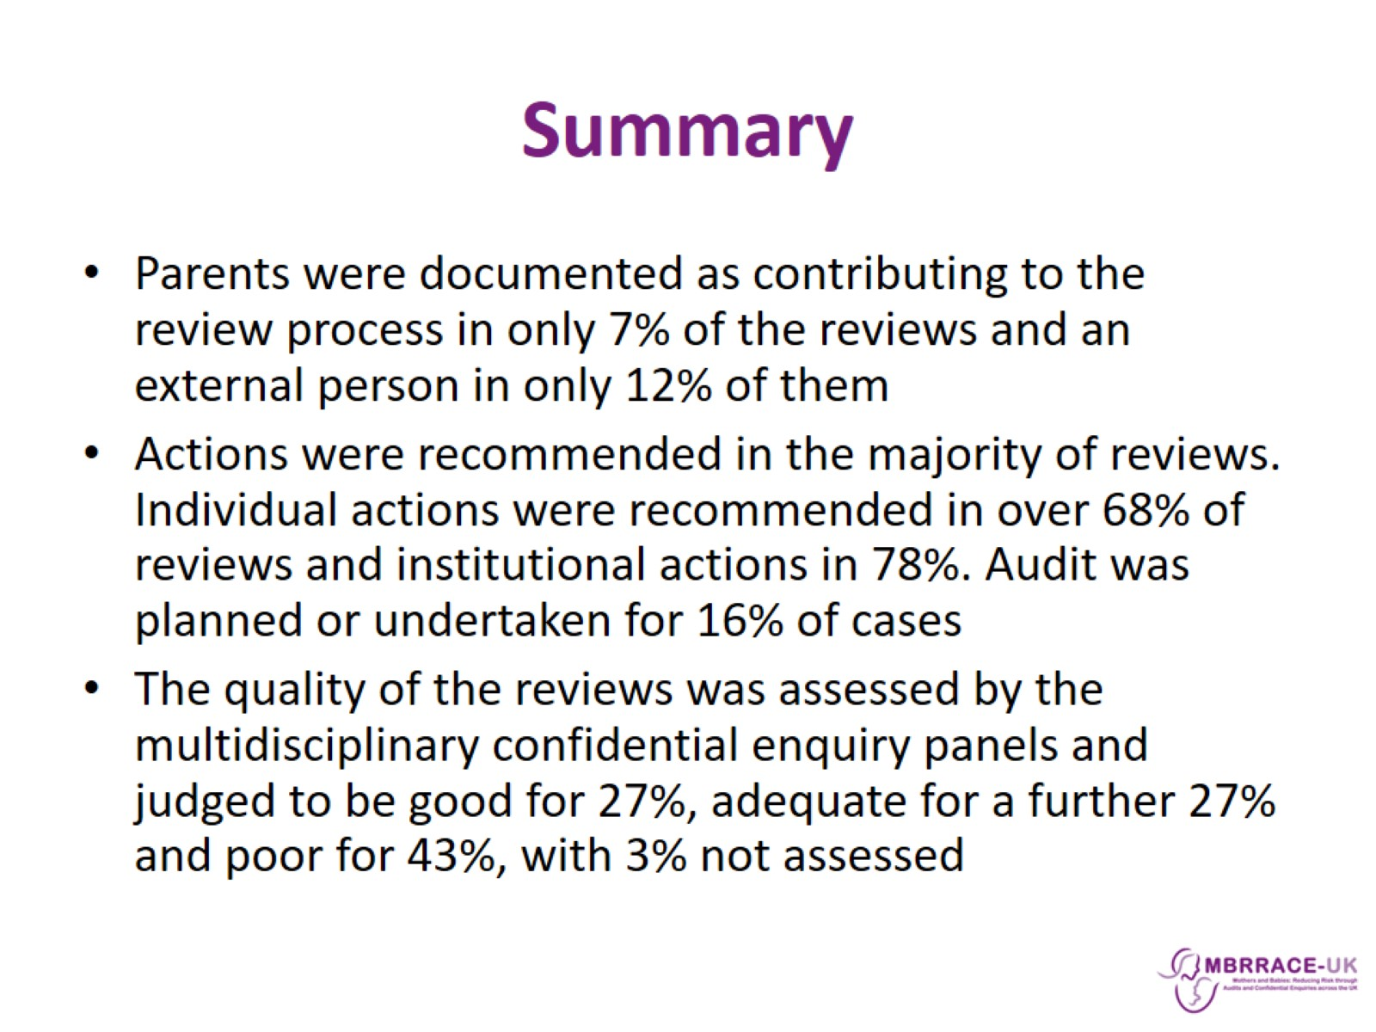
Summary

Slide 19
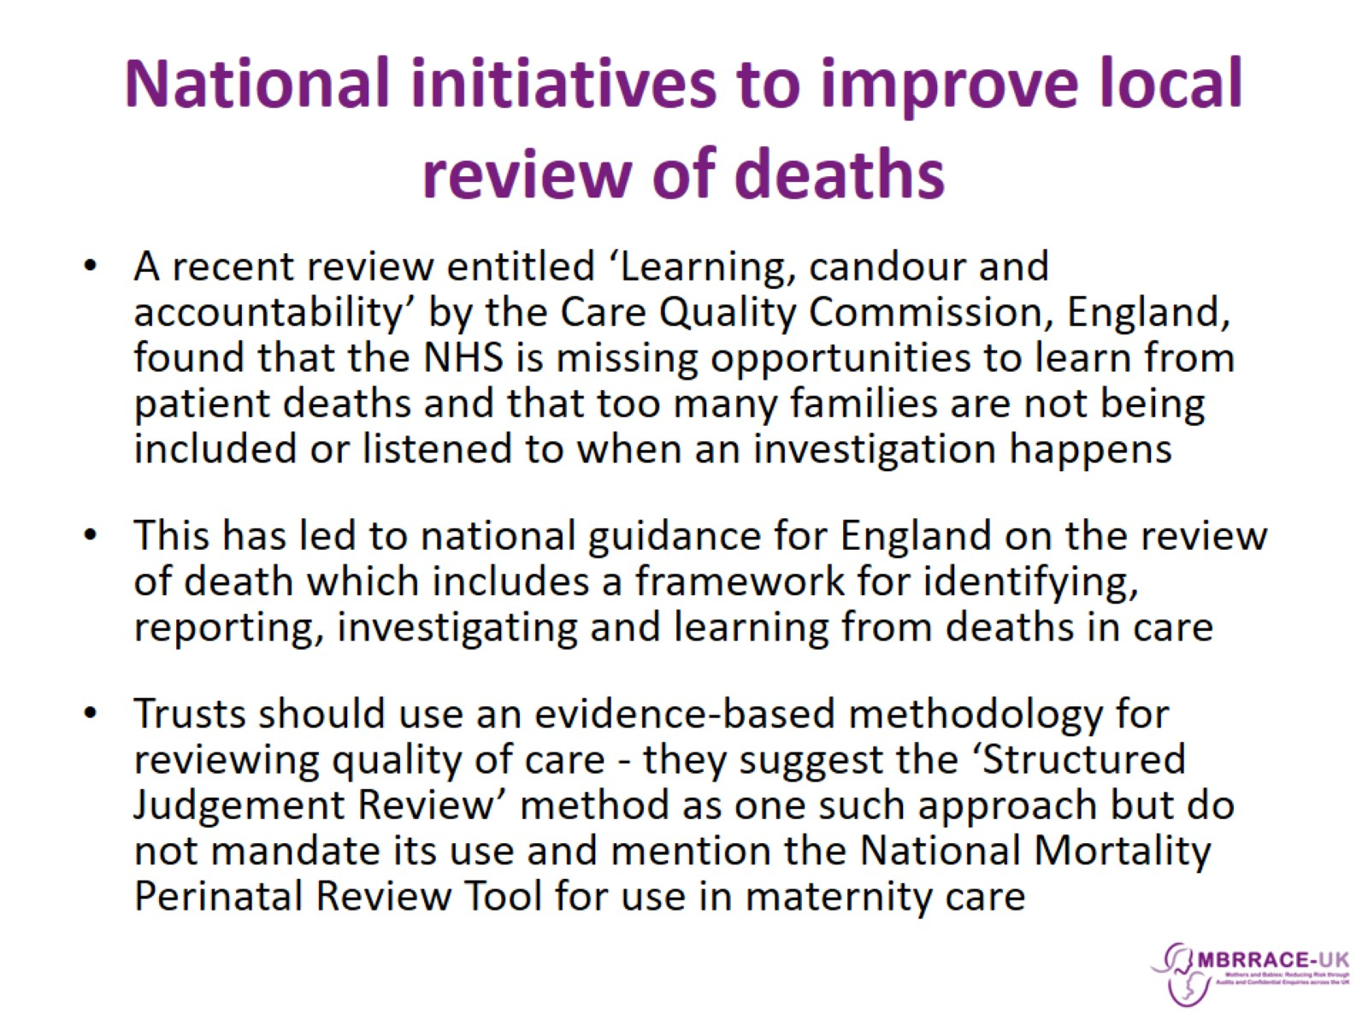
National initiatives to improve local review of deaths

