Slide 1

Monitoring in labour

Slide 2
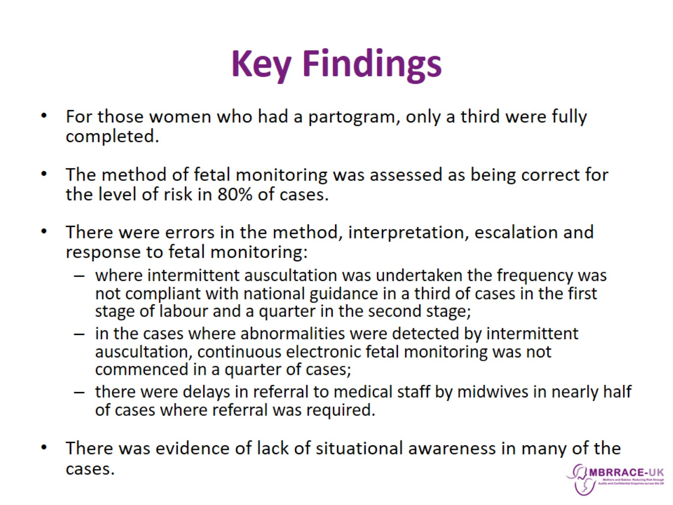
Key Findings

Slide 3
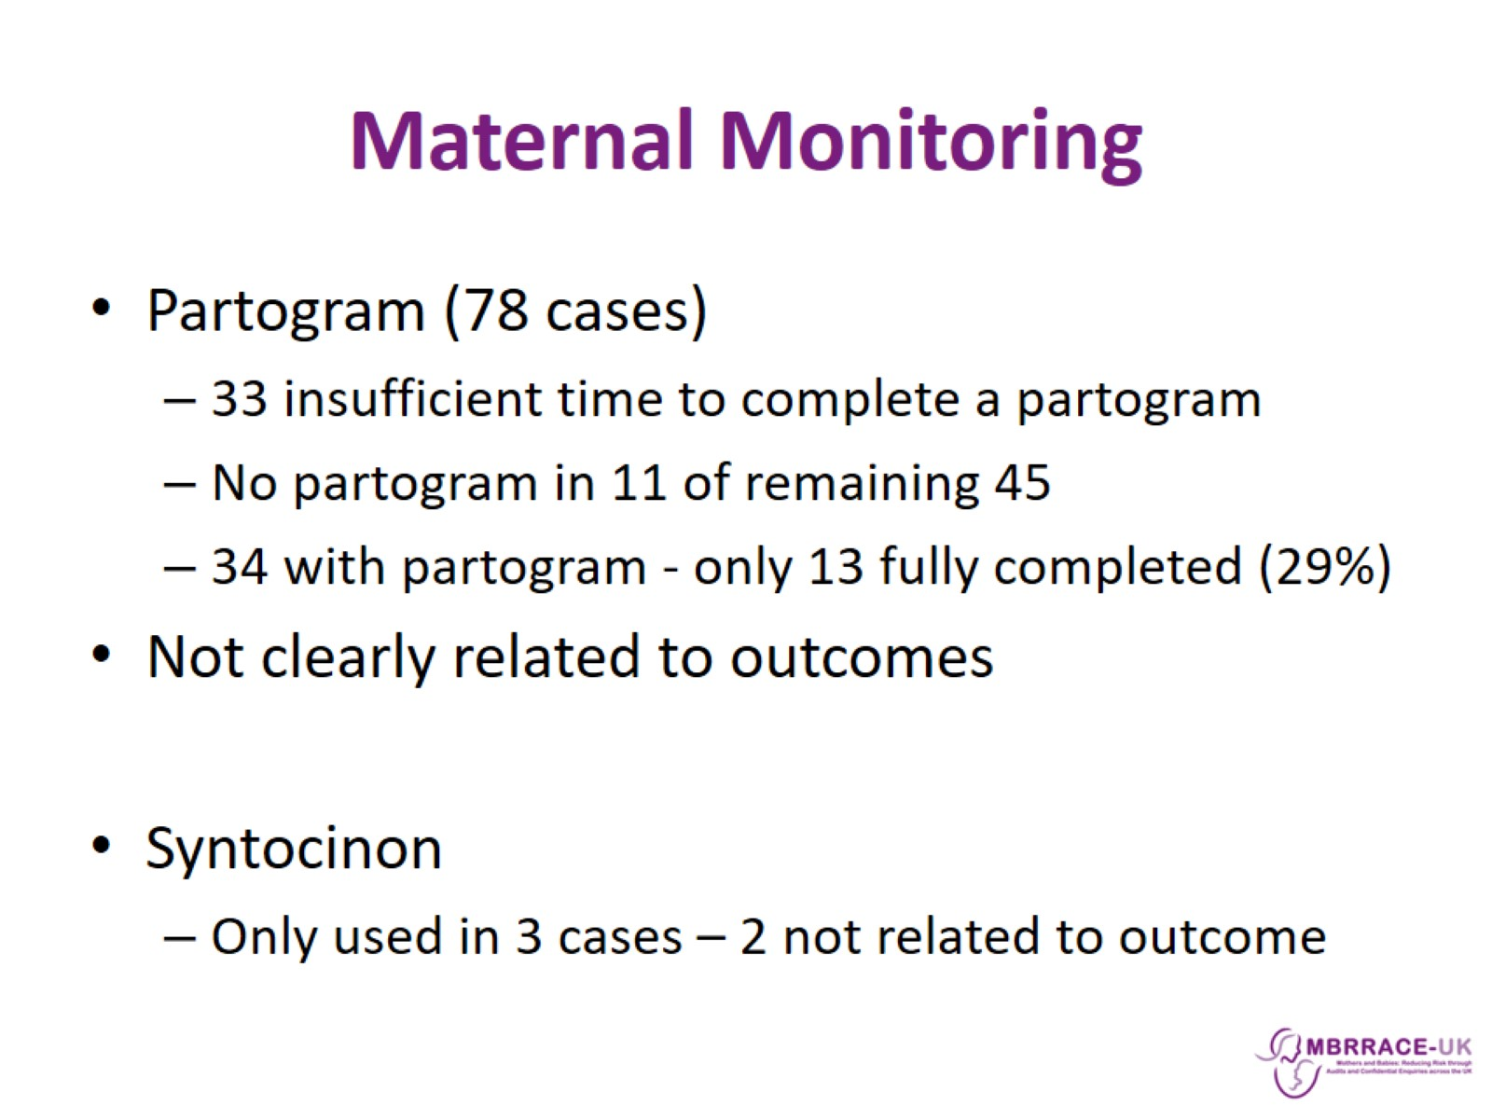
Maternal Monitoring

Slide 4
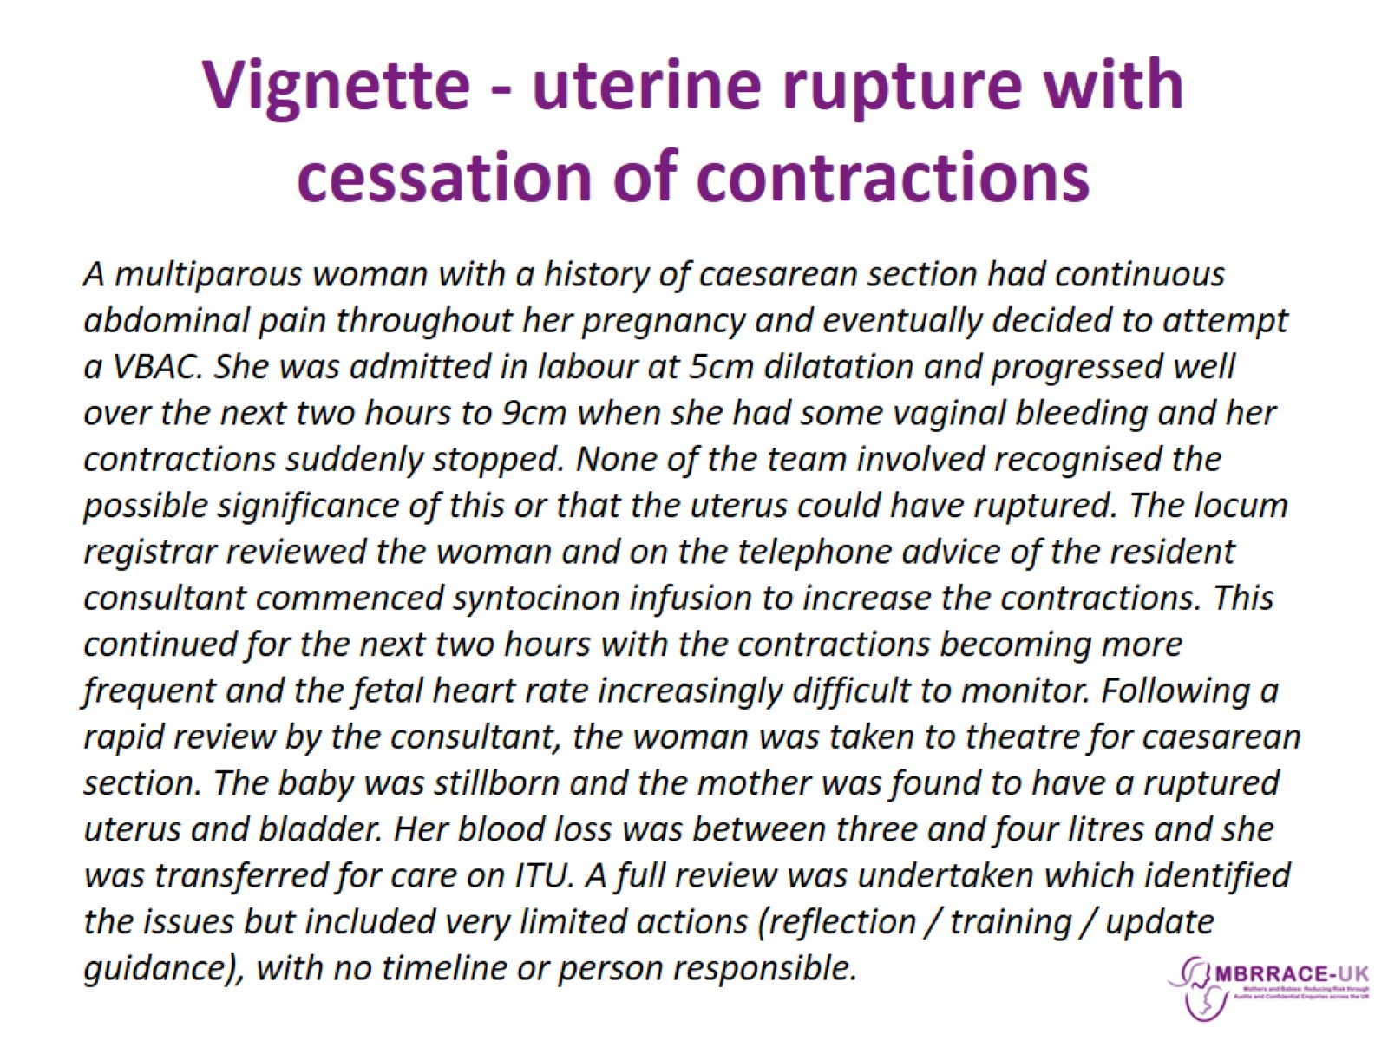
Vignette - uterine rupture with cessation of contractions

Slide 5
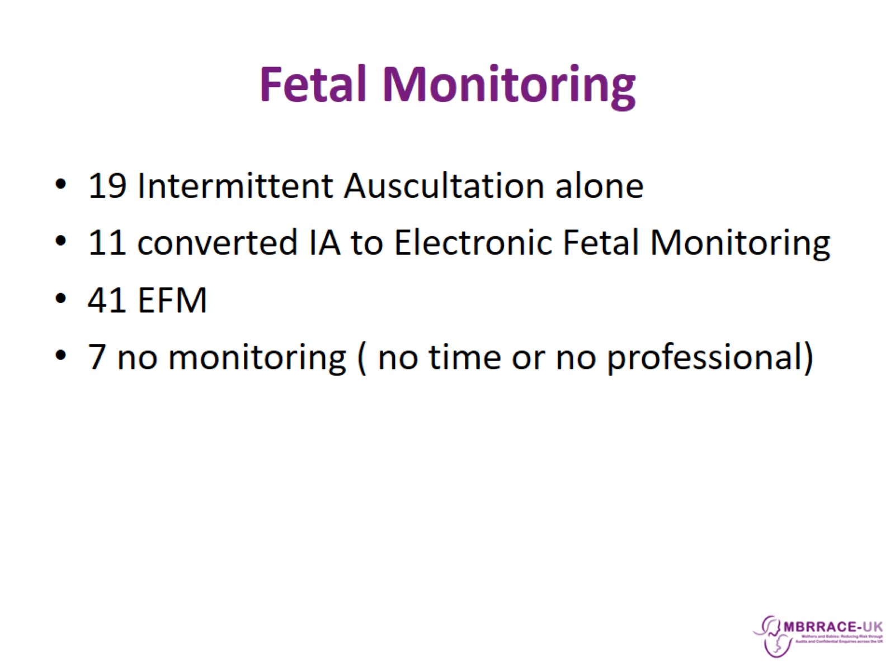
Fetal Monitoring

Slide 6
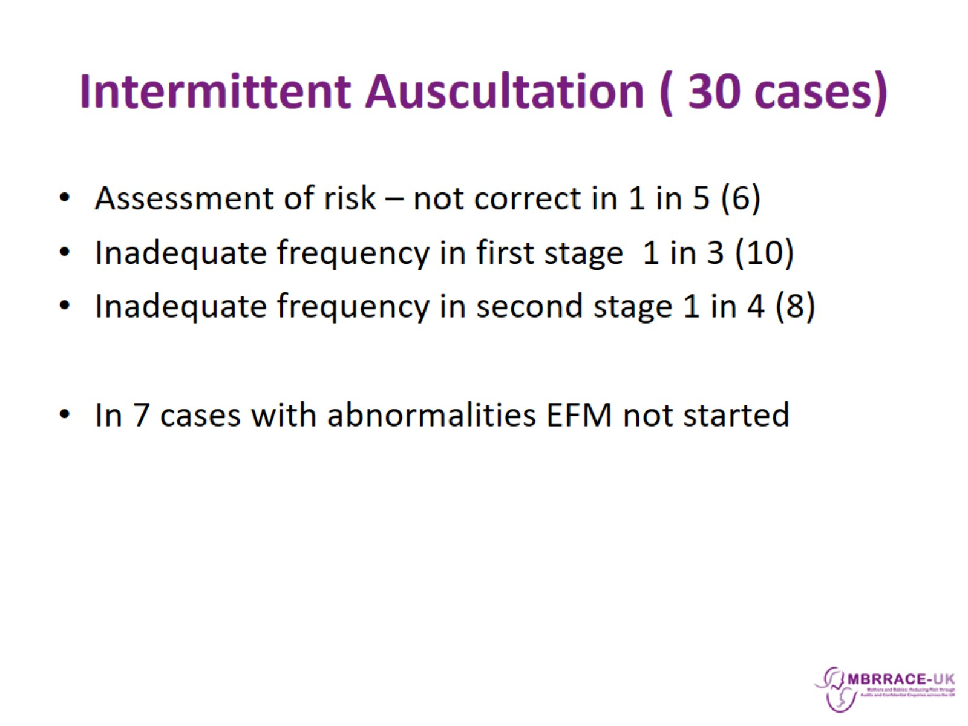
Intermittent Auscultation ( 30 cases)

Slide 7
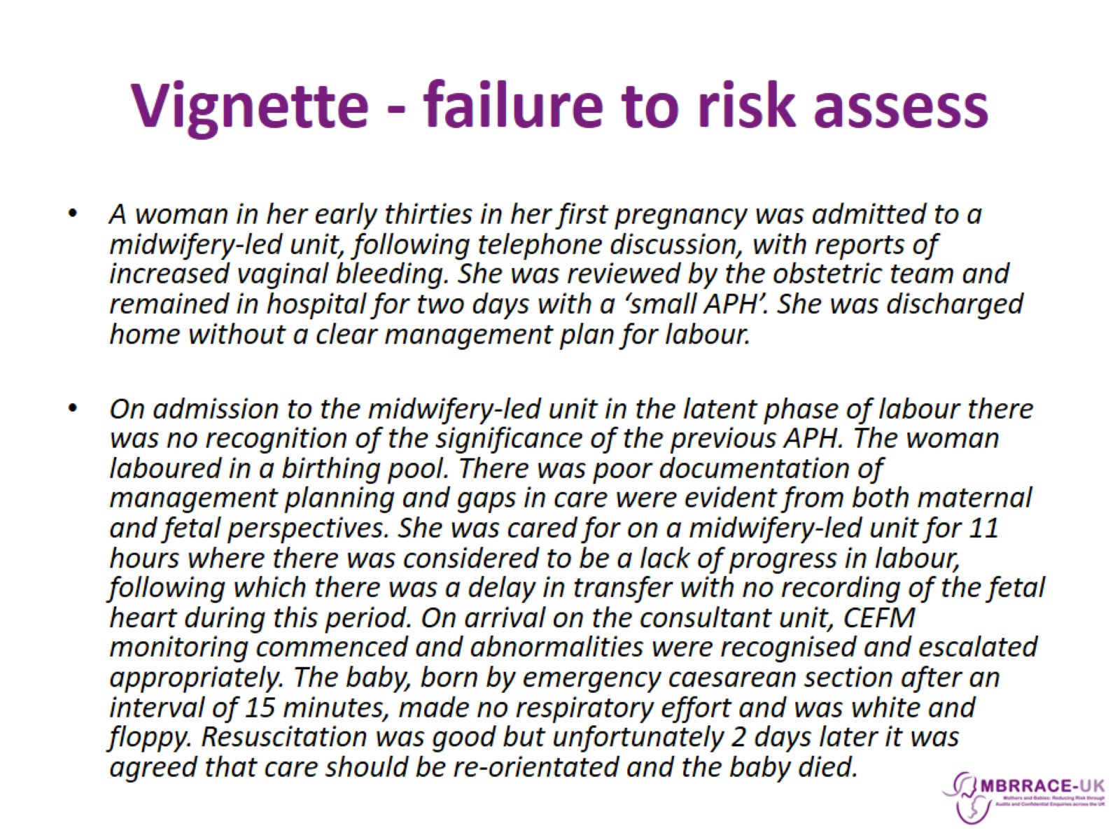
Vignette - failure to risk assess

Slide 8
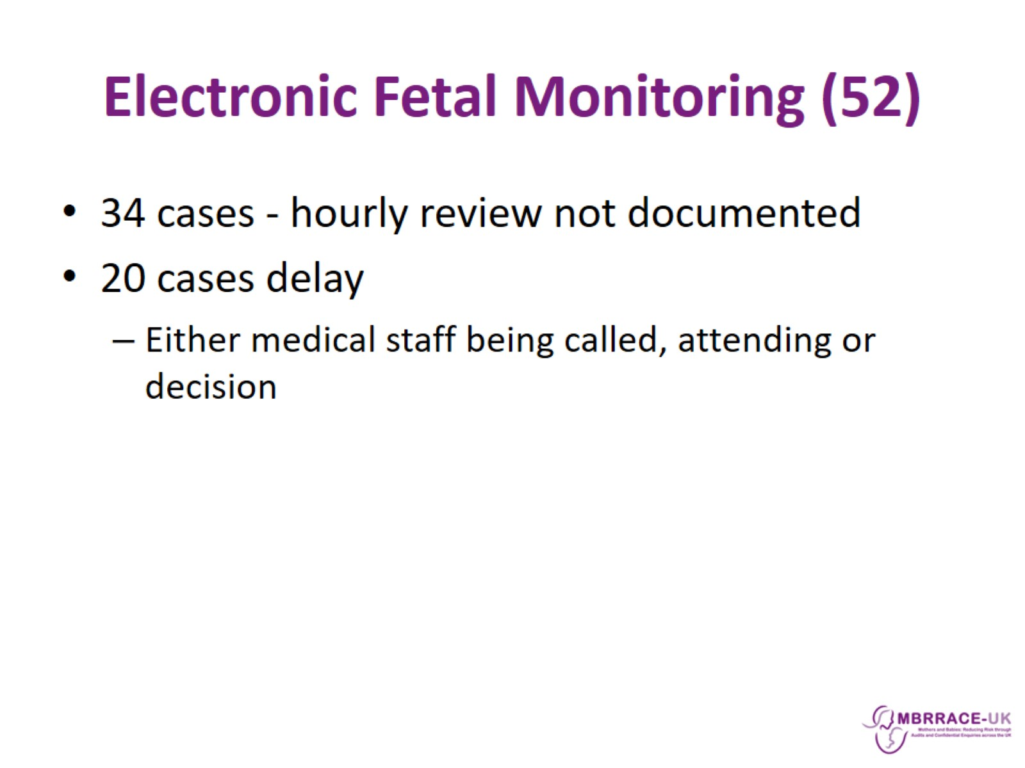
Electronic Fetal Monitoring (52)

Slide 9
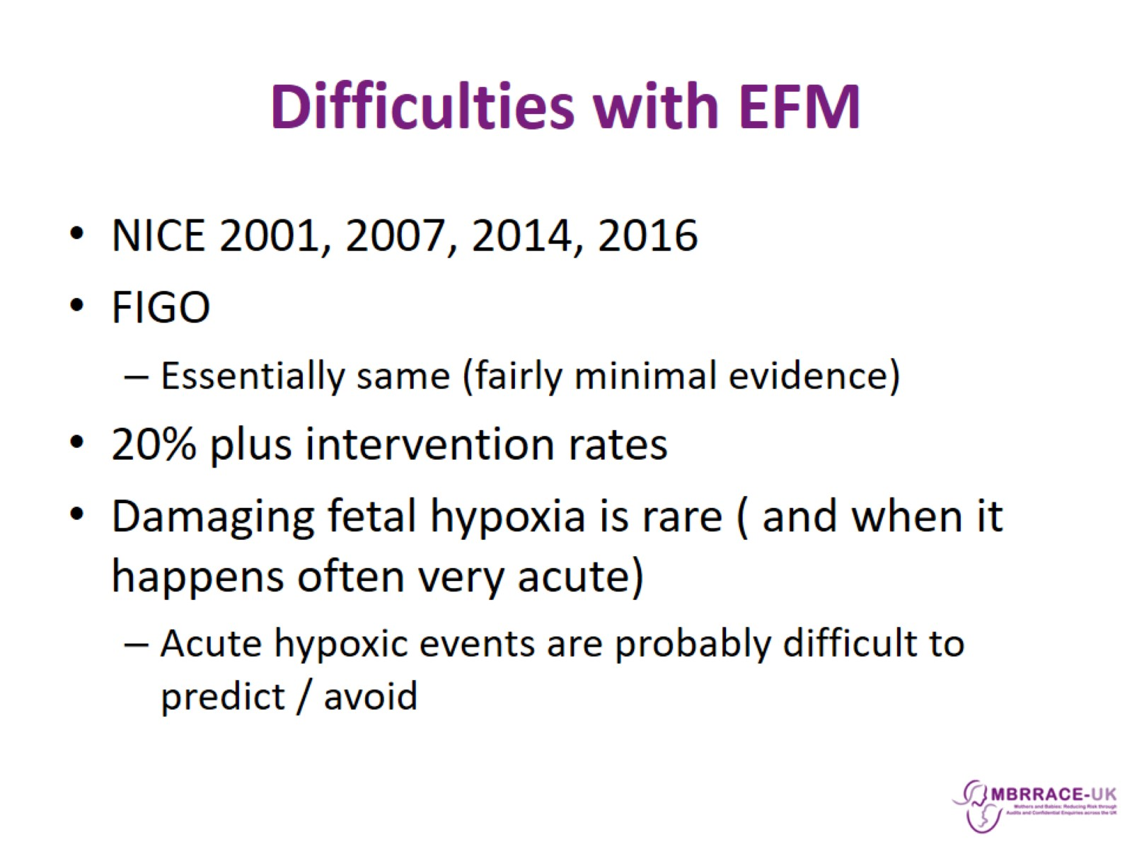
Difficulties with EFM

Slide 10
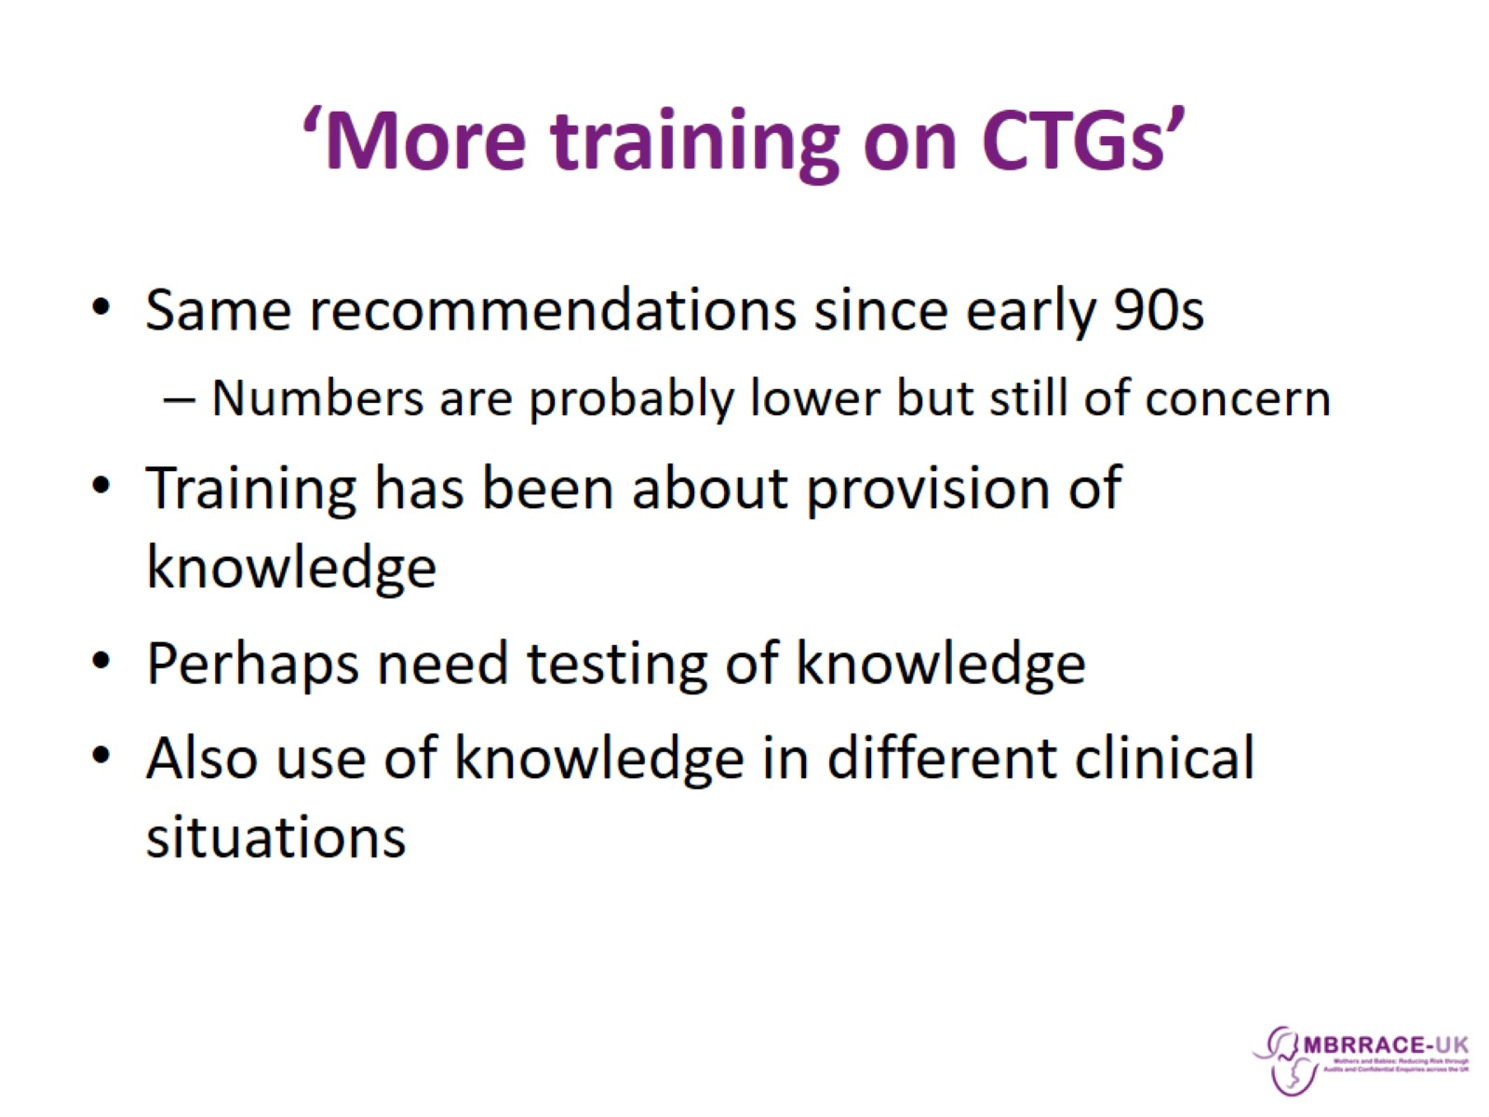
‘More training on CTGs’

Slide 11
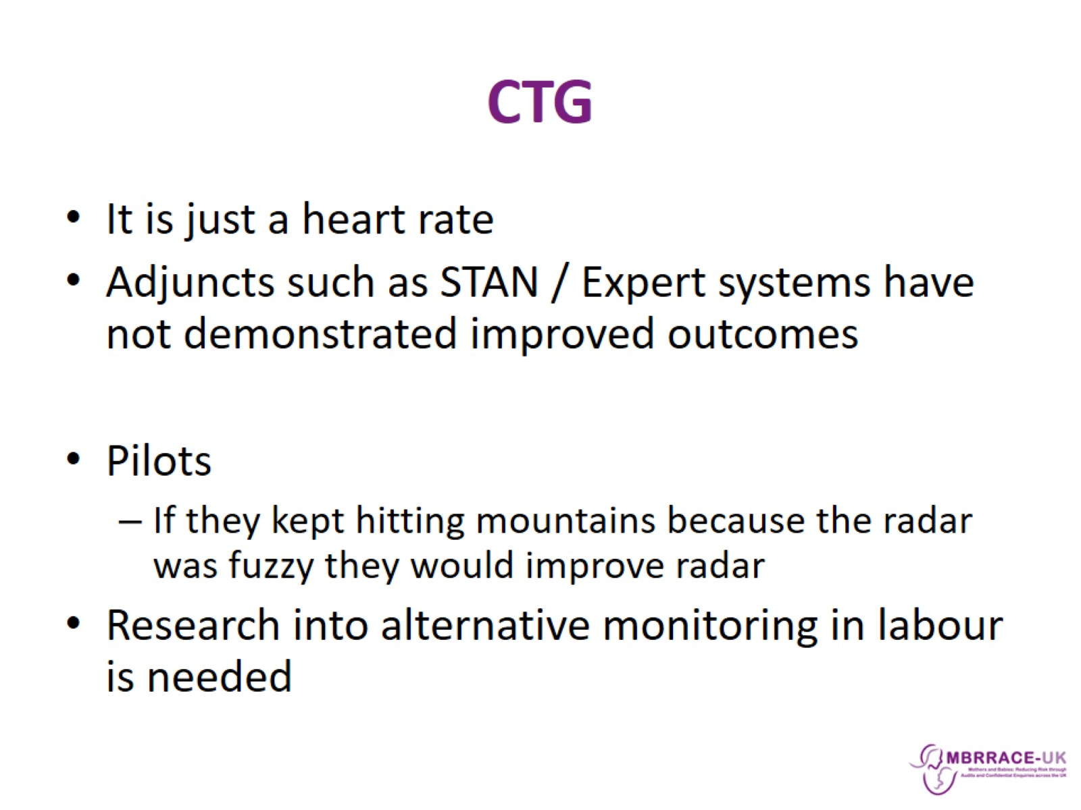
CTG

Slide 12
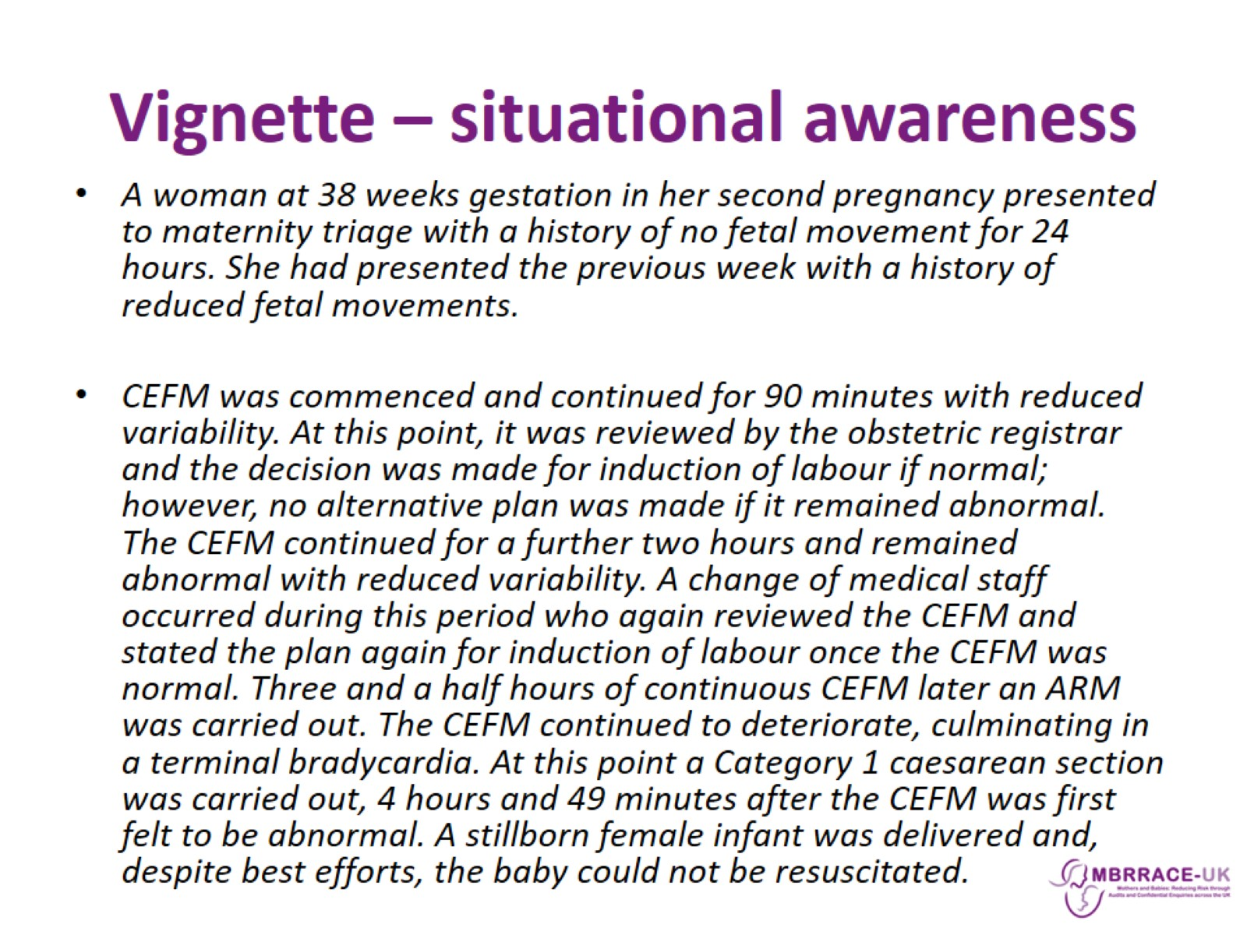
Vignette – situational awareness

Slide 13
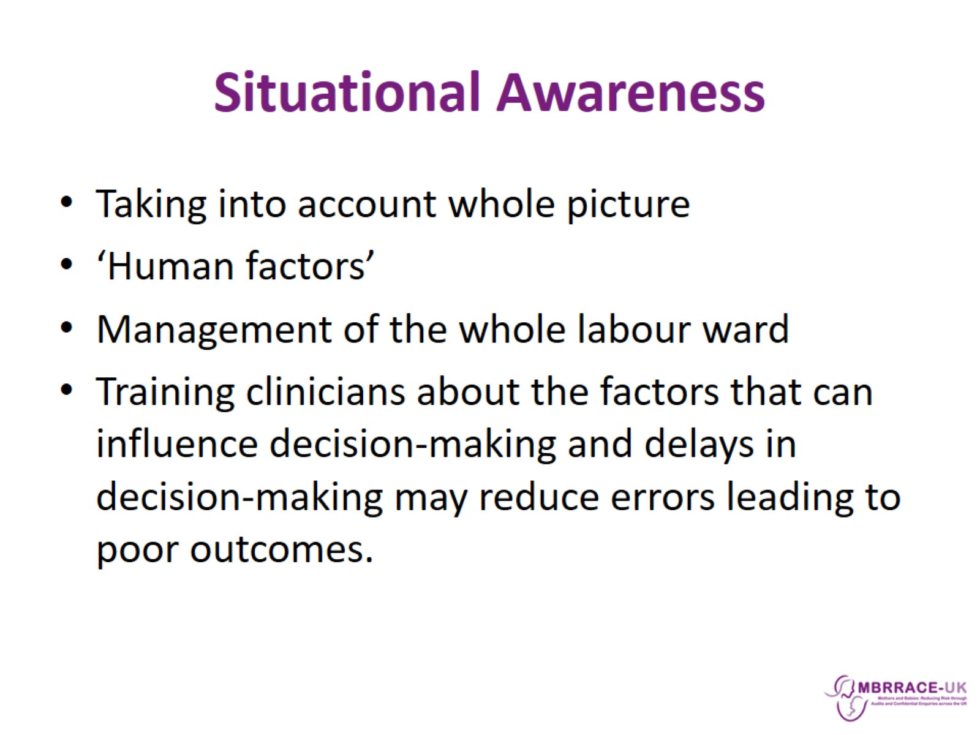
Situational Awareness

