Slide 1

Introduction to the 2017 Perinatal Confidential Enquiry

Slide 2
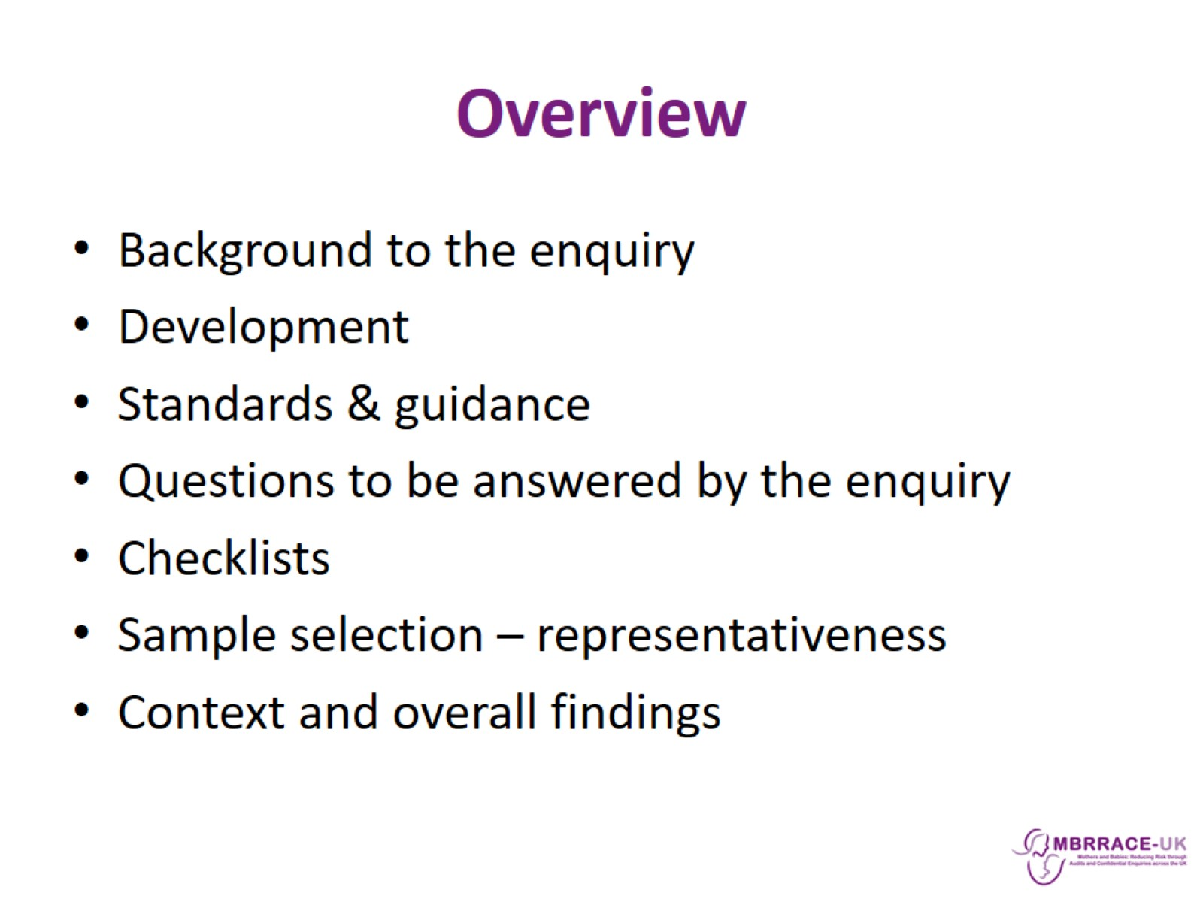
Overview

Slide 3


Slide 4
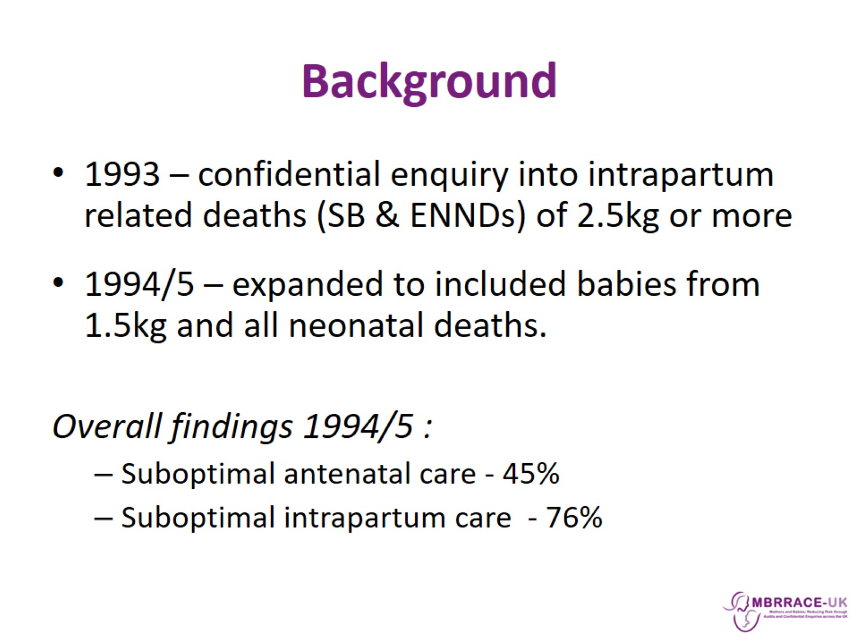
Background

Slide 5
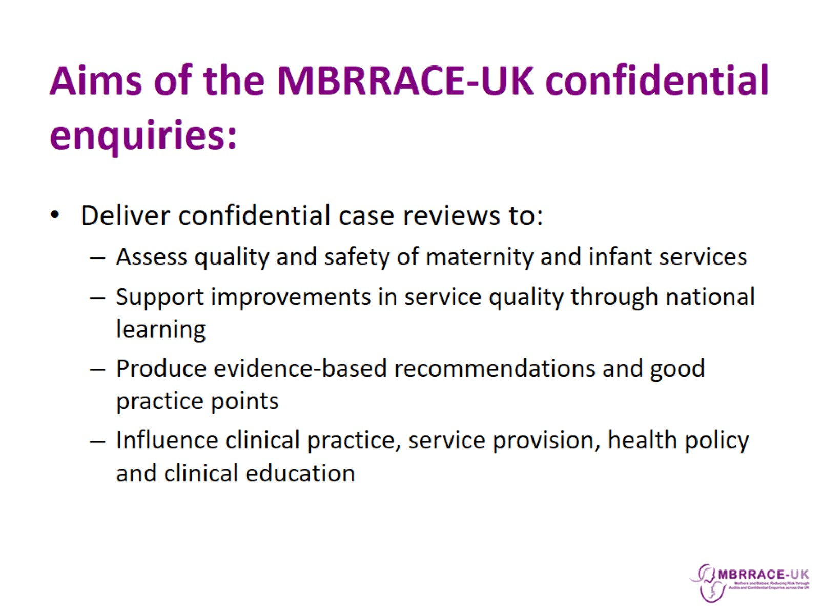
Aims of the MBRRACE-UK confidential enquiries:

Slide 6
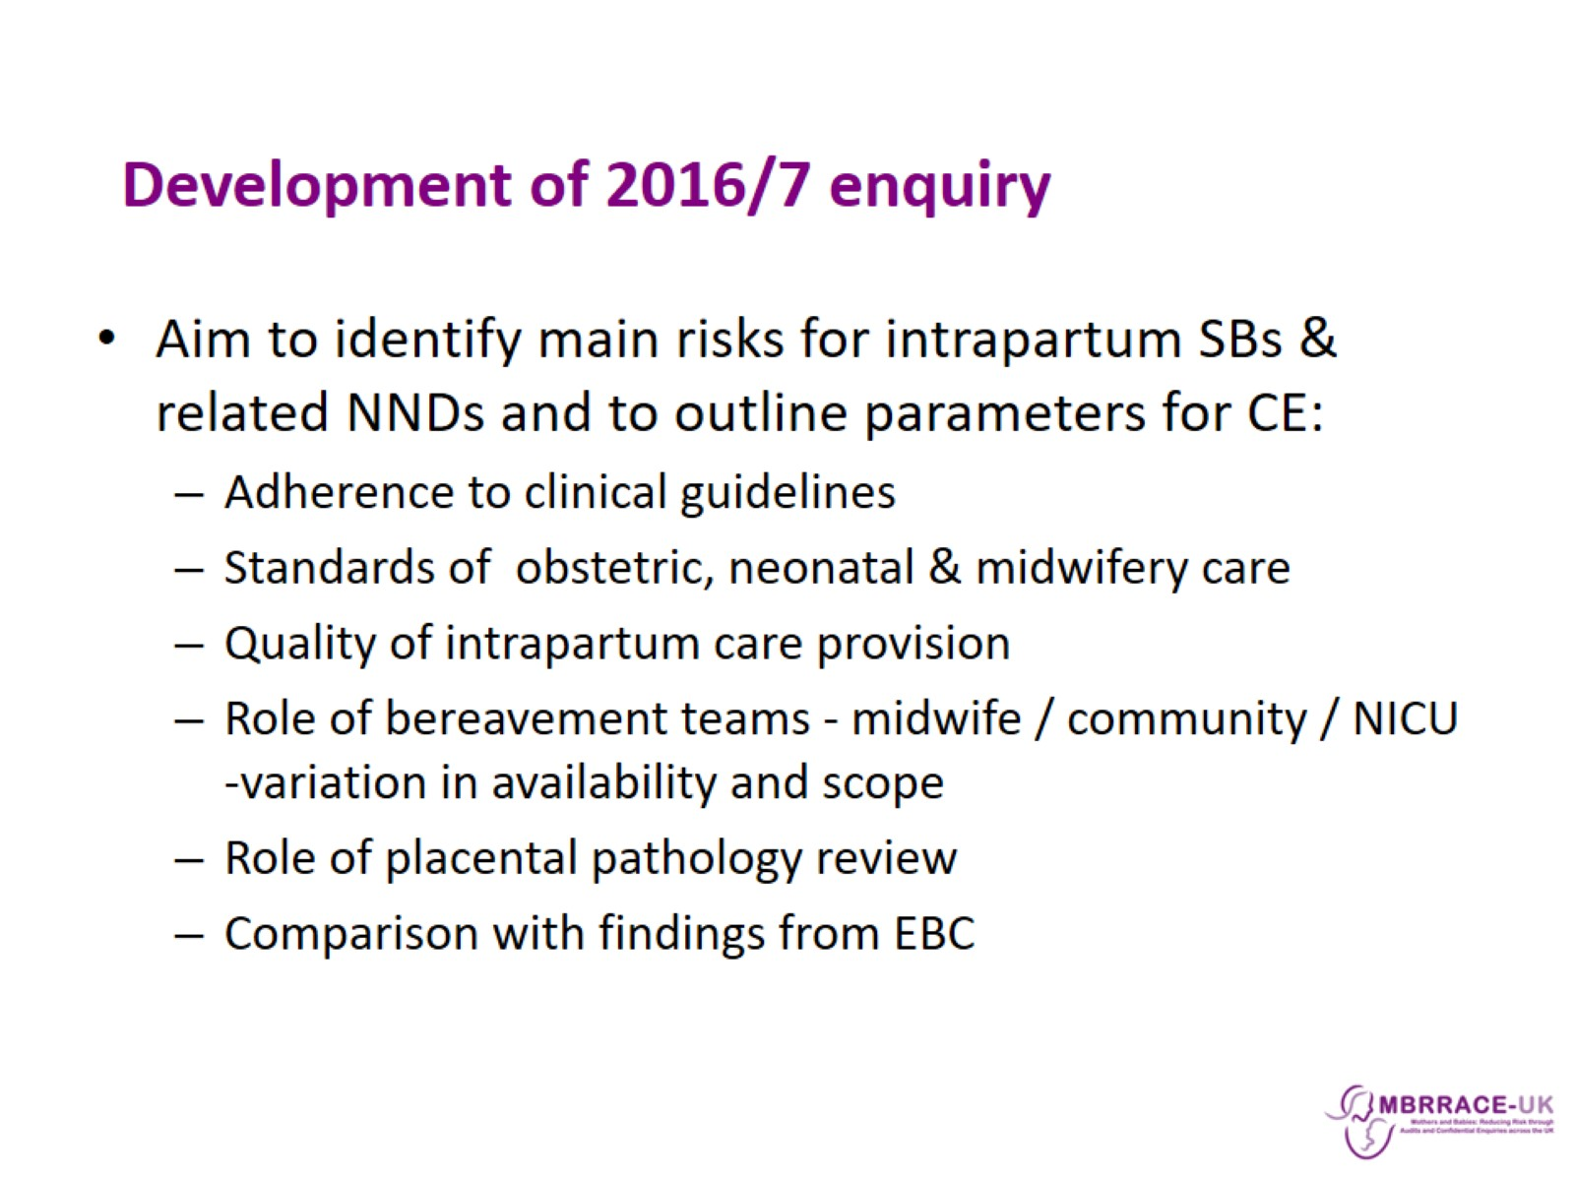
Development of 2016/7 enquiry

Slide 7

Topic Expert Group & Panel membership

Slide 8
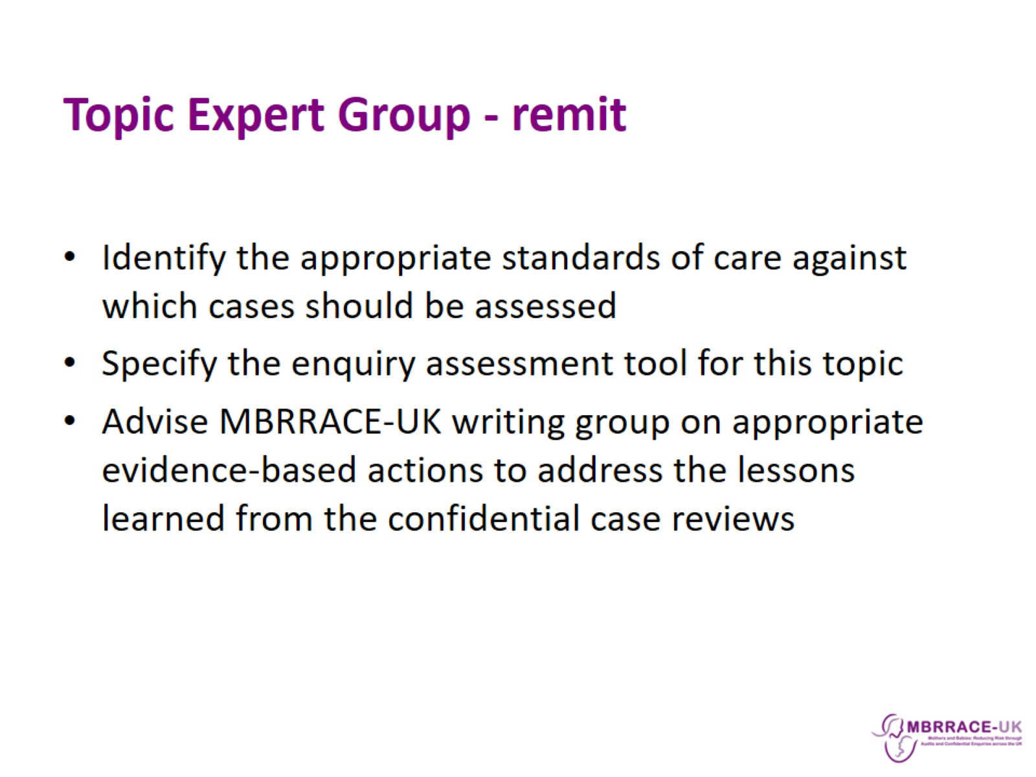
Topic Expert Group - remit

Slide 9
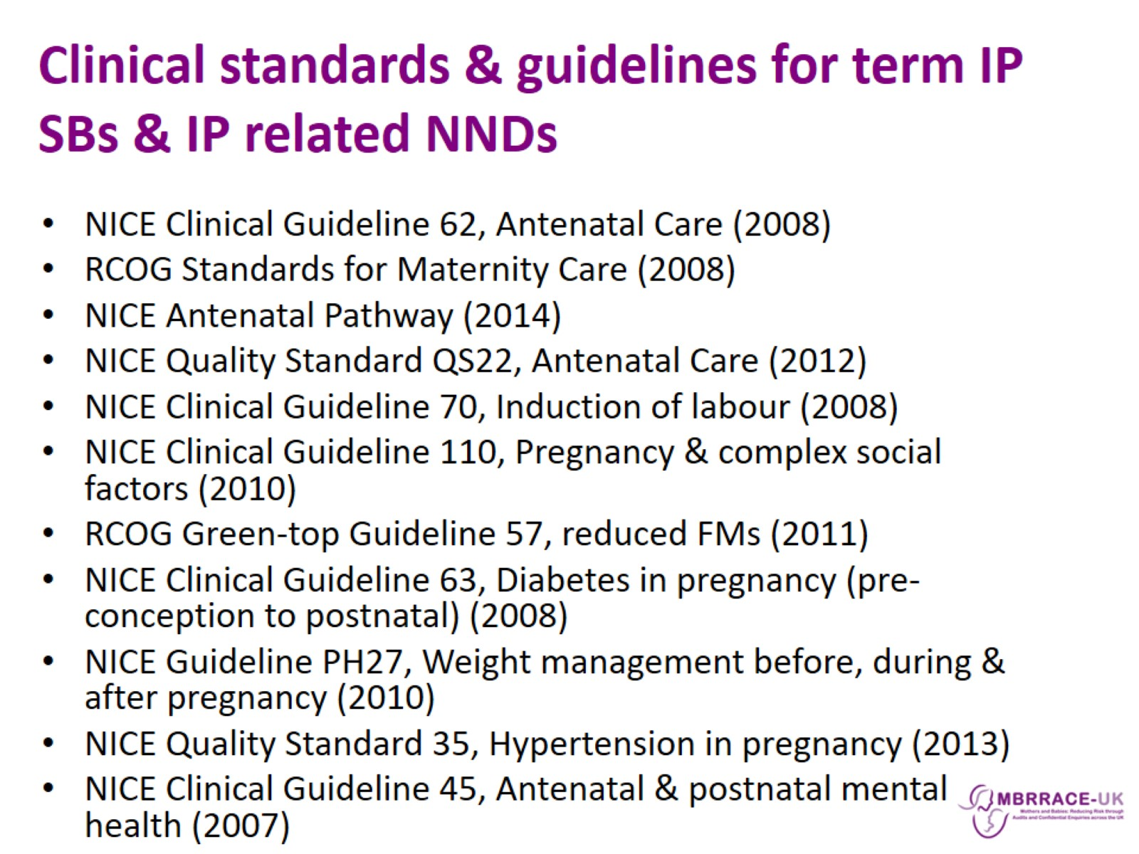
Clinical standards & guidelines for term IP SBs & IP related NNDs

Slide 10
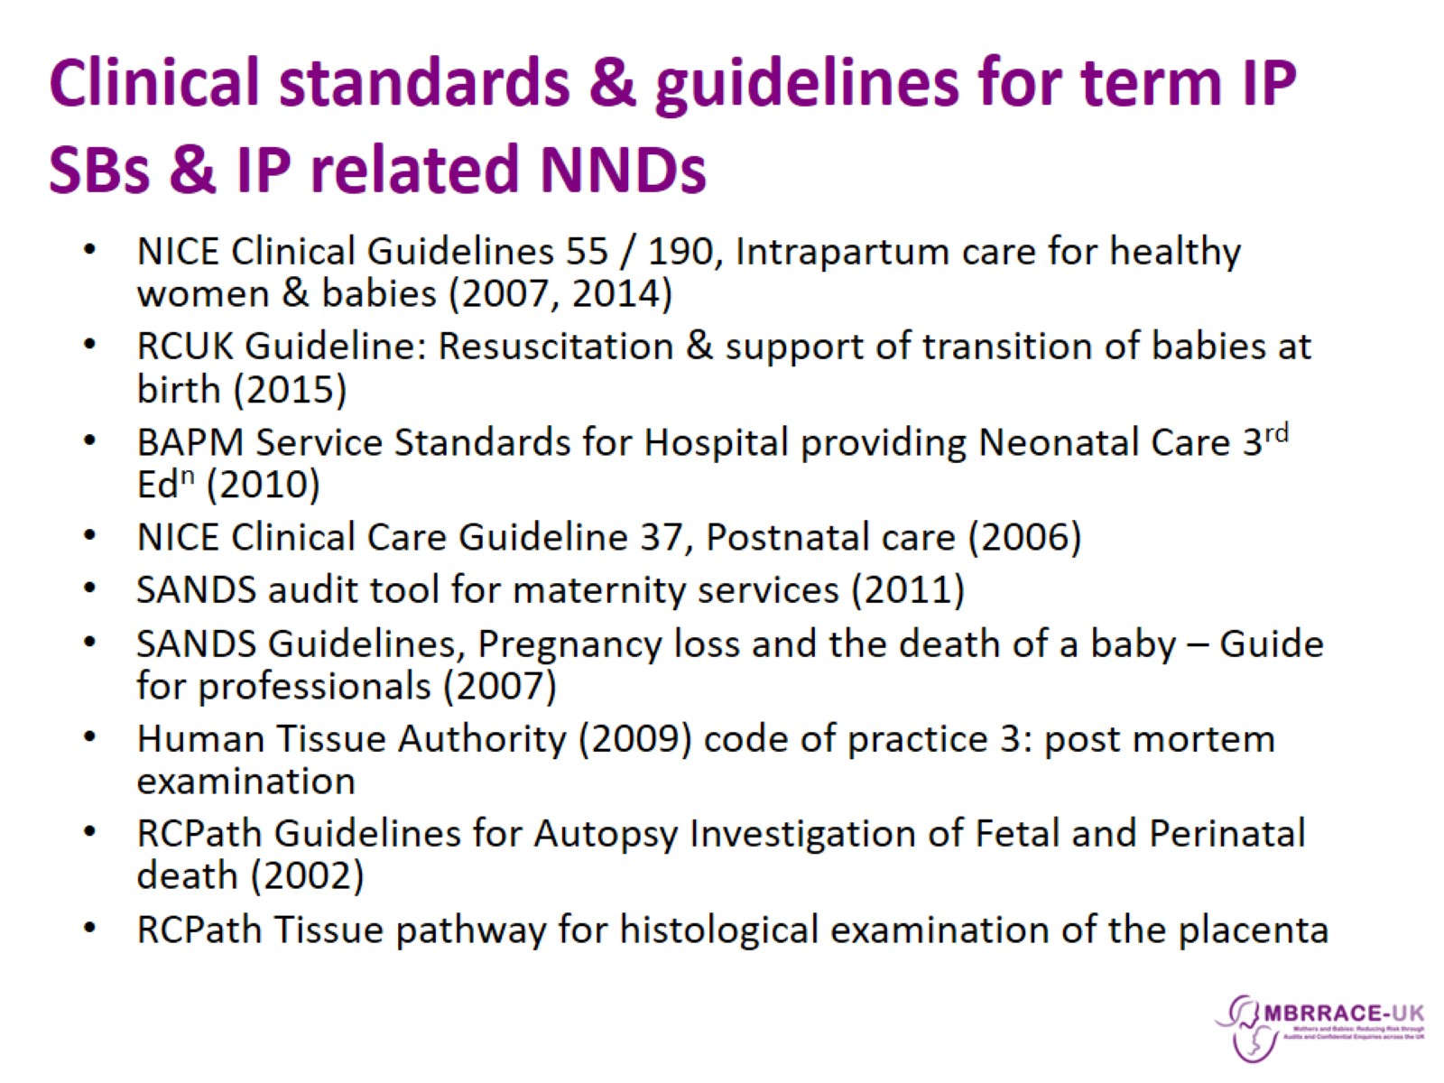
Clinical standards & guidelines for term IP SBs & IP related NNDs

Slide 11
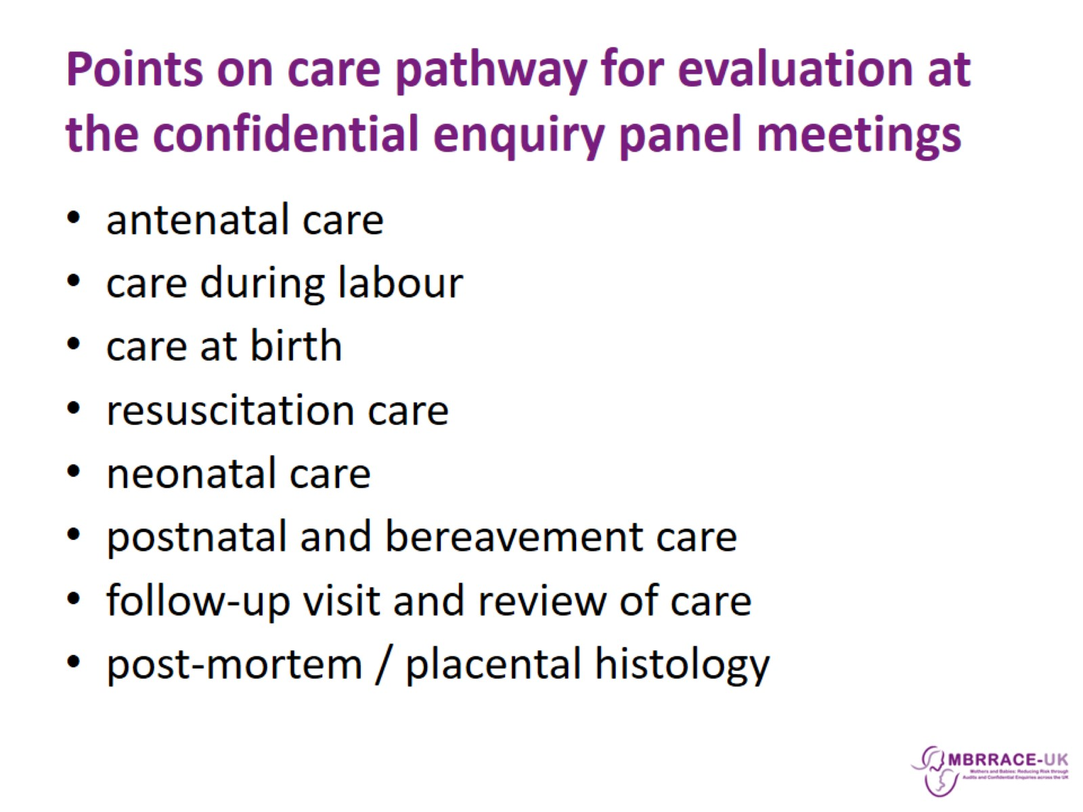
Points on care pathway for evaluation at the confidential enquiry panel meetings

Slide 12
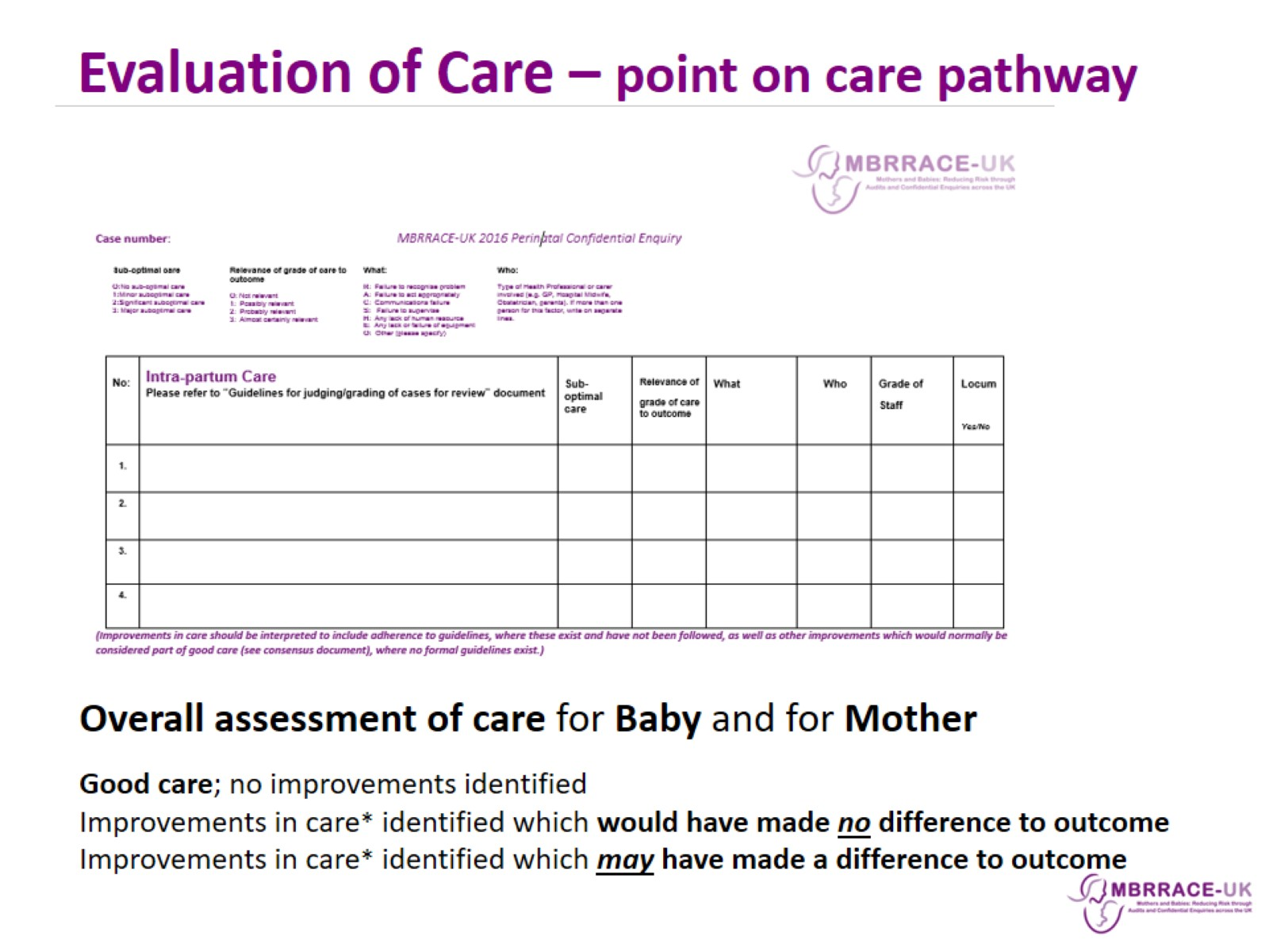

Slide 13
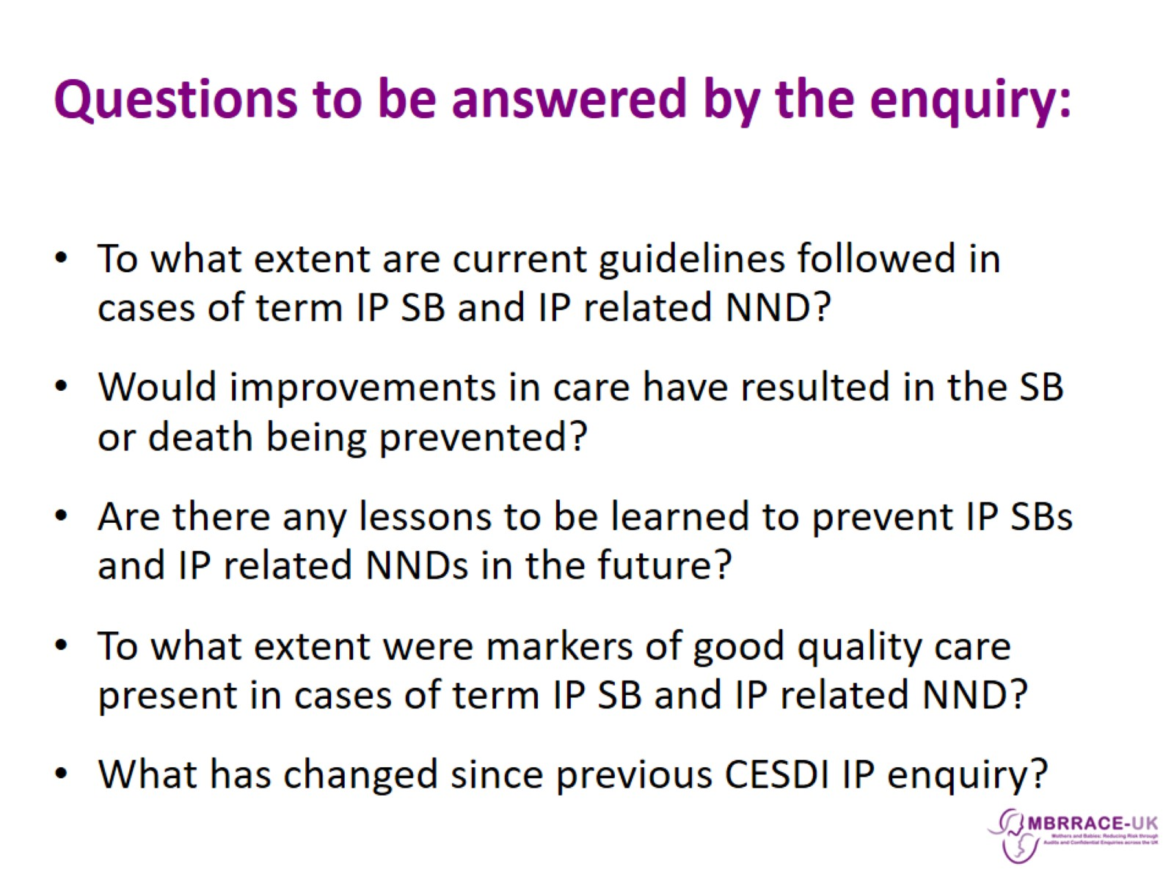
Questions to be answered by the enquiry:

Slide 14
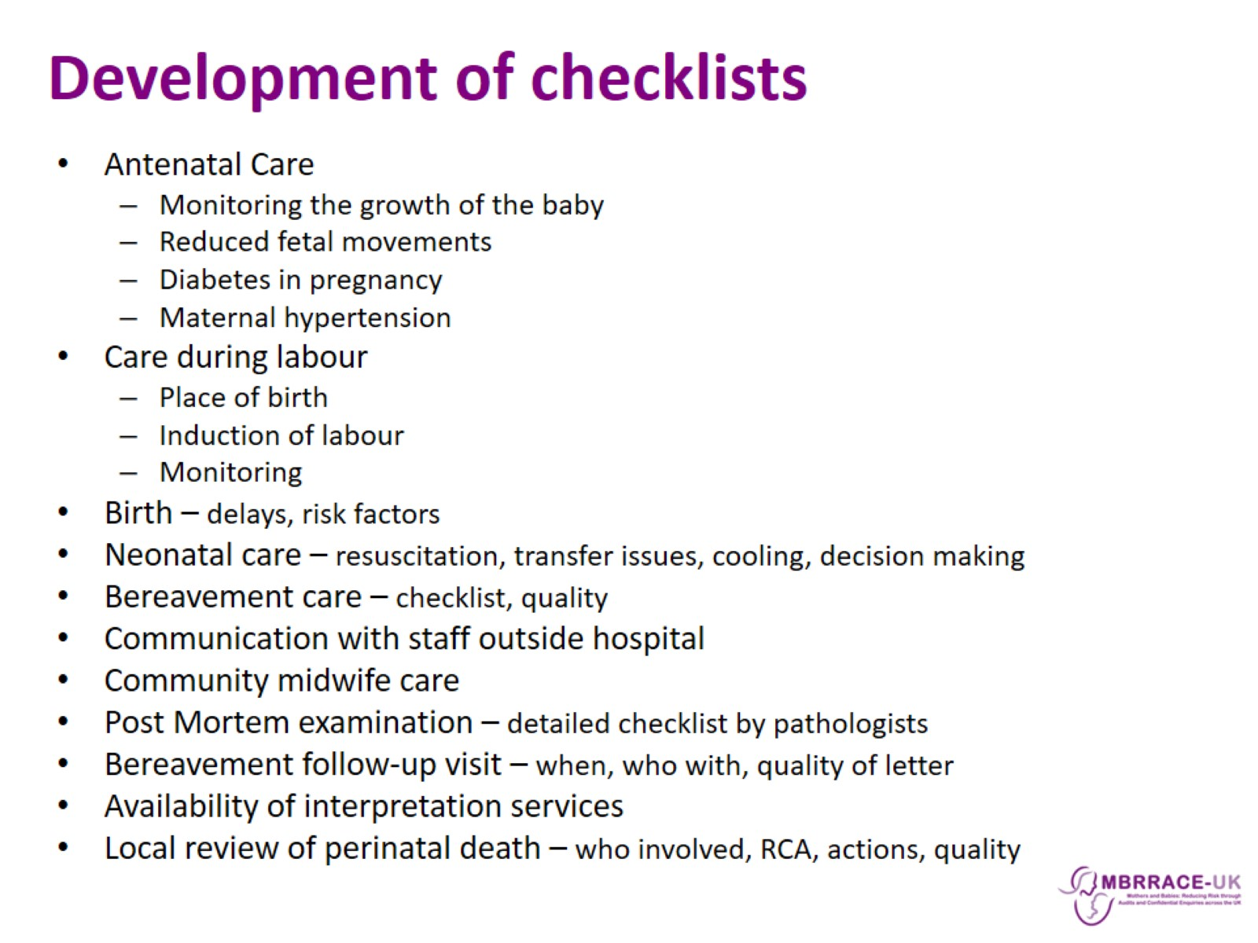
Development of checklists

Slide 15
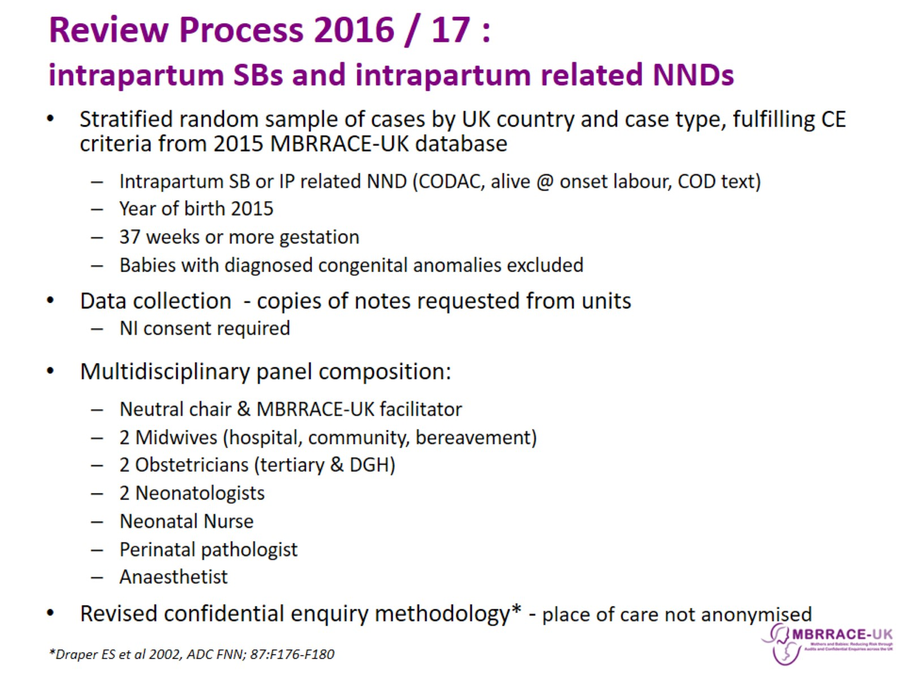
Review Process 2016 / 17 : intrapartum SBs and intrapartum related NNDs

Slide 16

Panel meetings

Slide 17
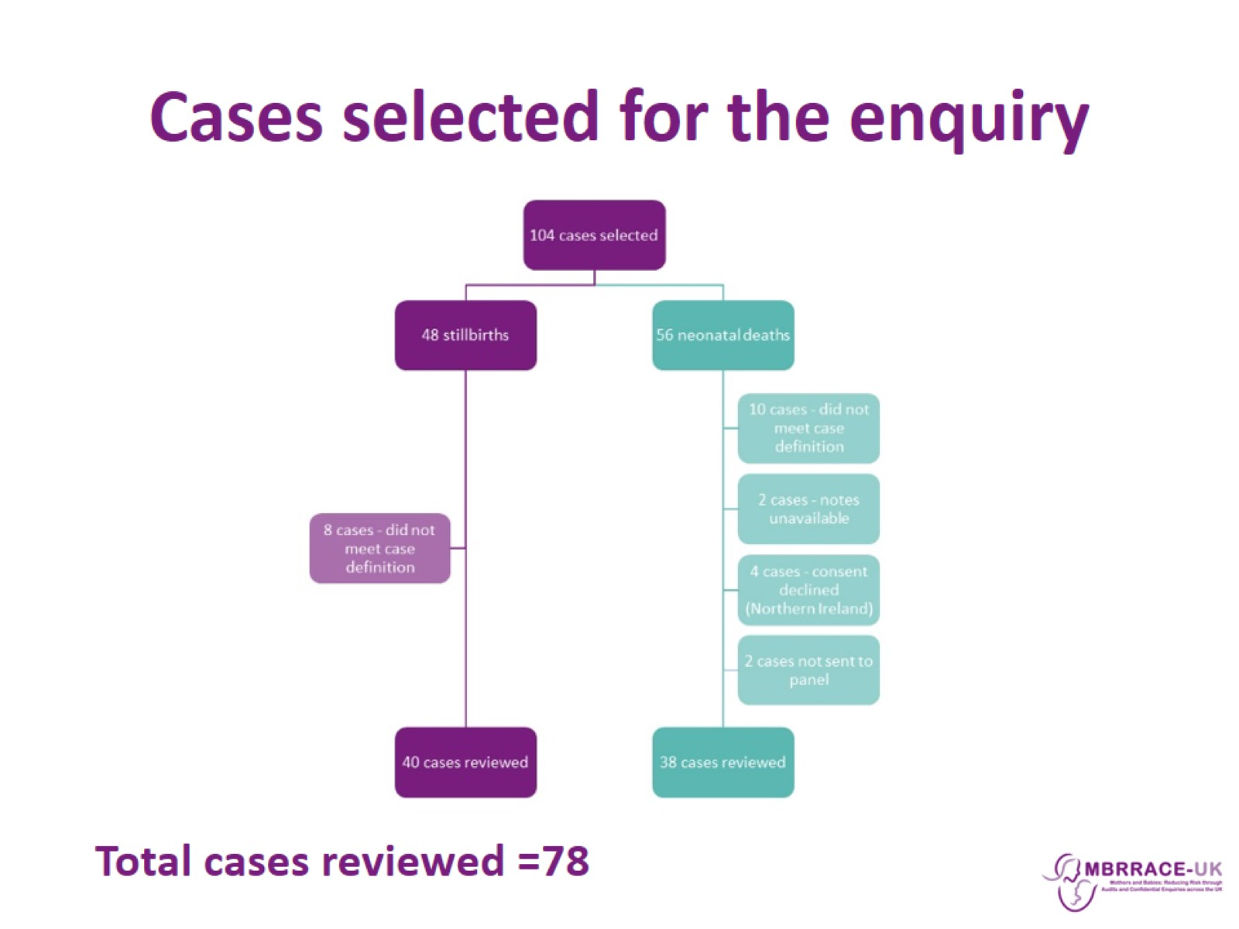
Cases selected for the enquiry

Slide 18
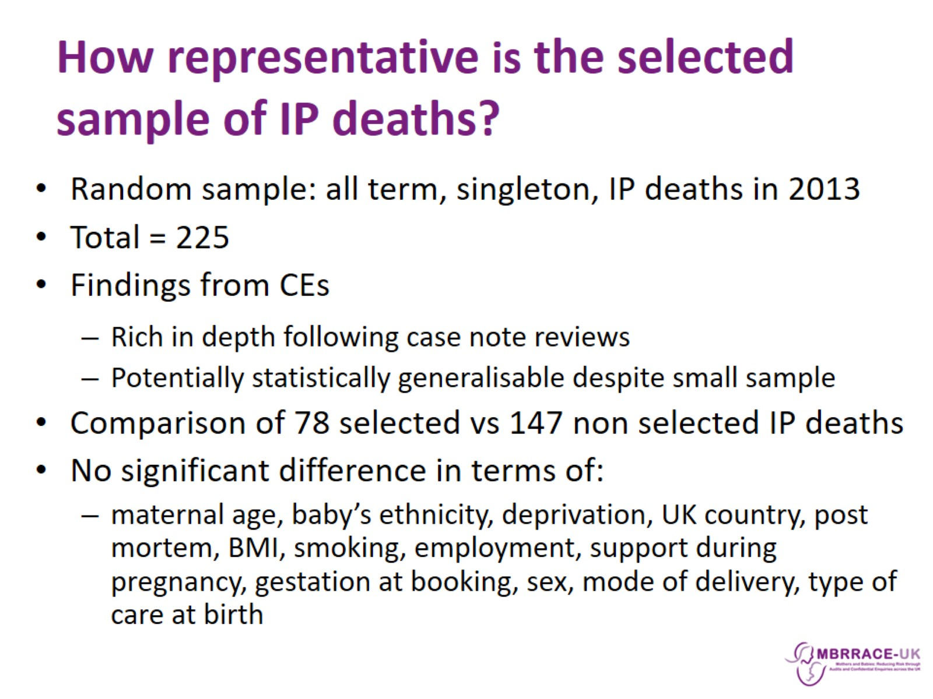
How representative is the selected sample of IP deaths?

Slide 19
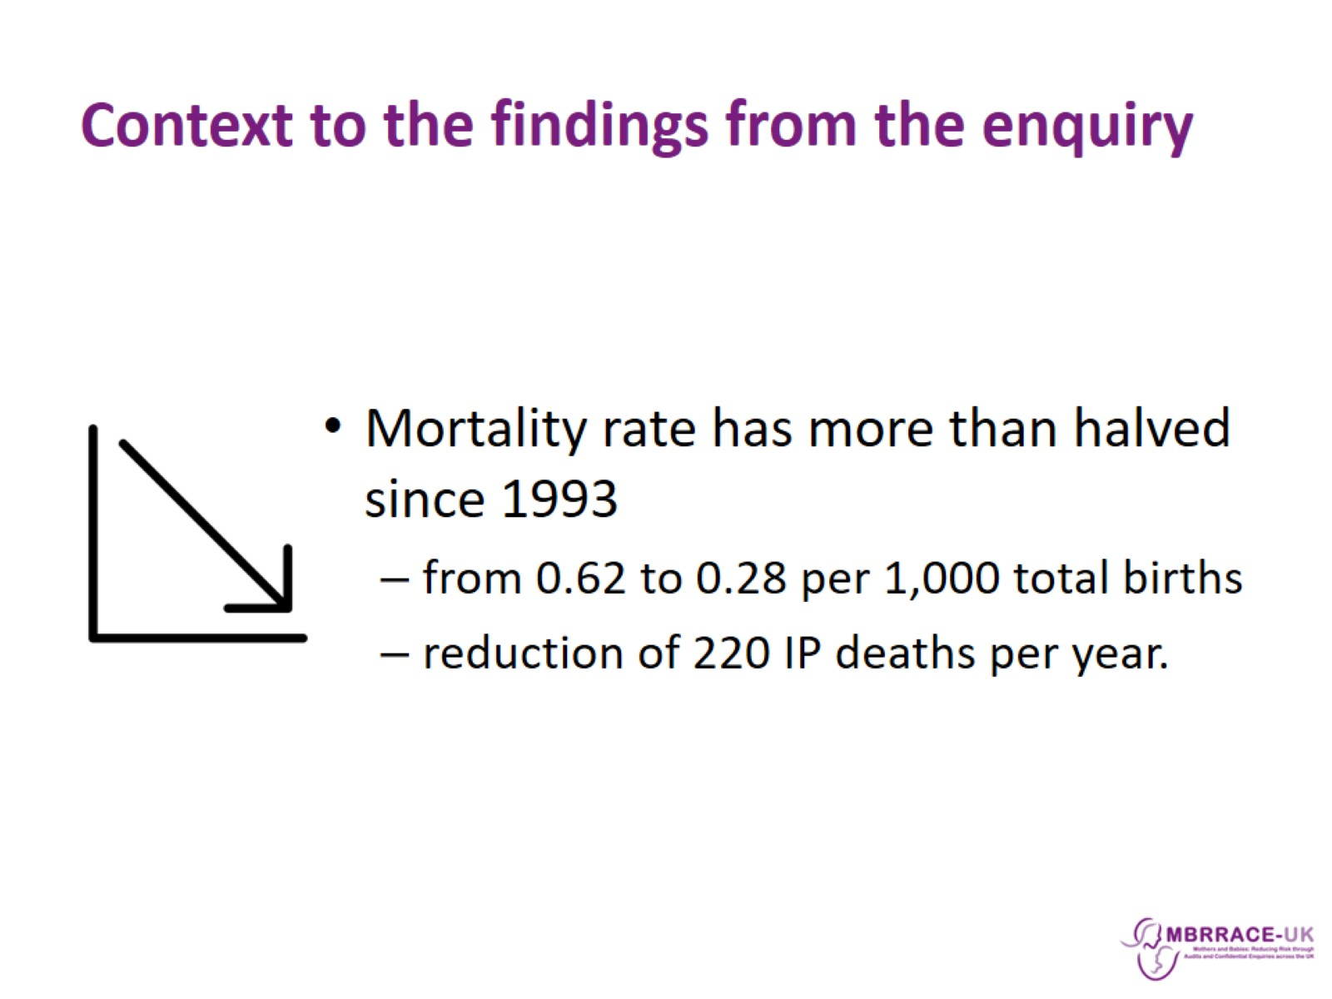
Context to the findings from the enquiry

Slide 20
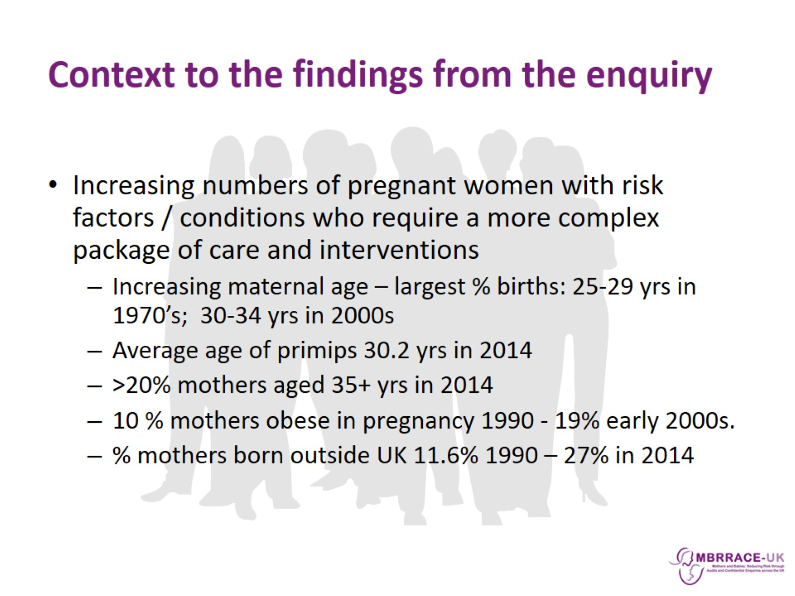
Context to the findings from the enquiry

Slide 21

Context to the findings from the enquiry

Slide 22

Key findings from confidential review panels

Slide 23
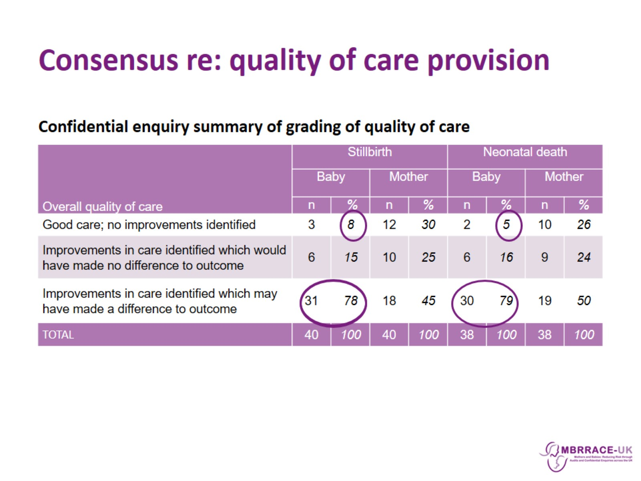
Consensus re: quality of care provision

Slide 24
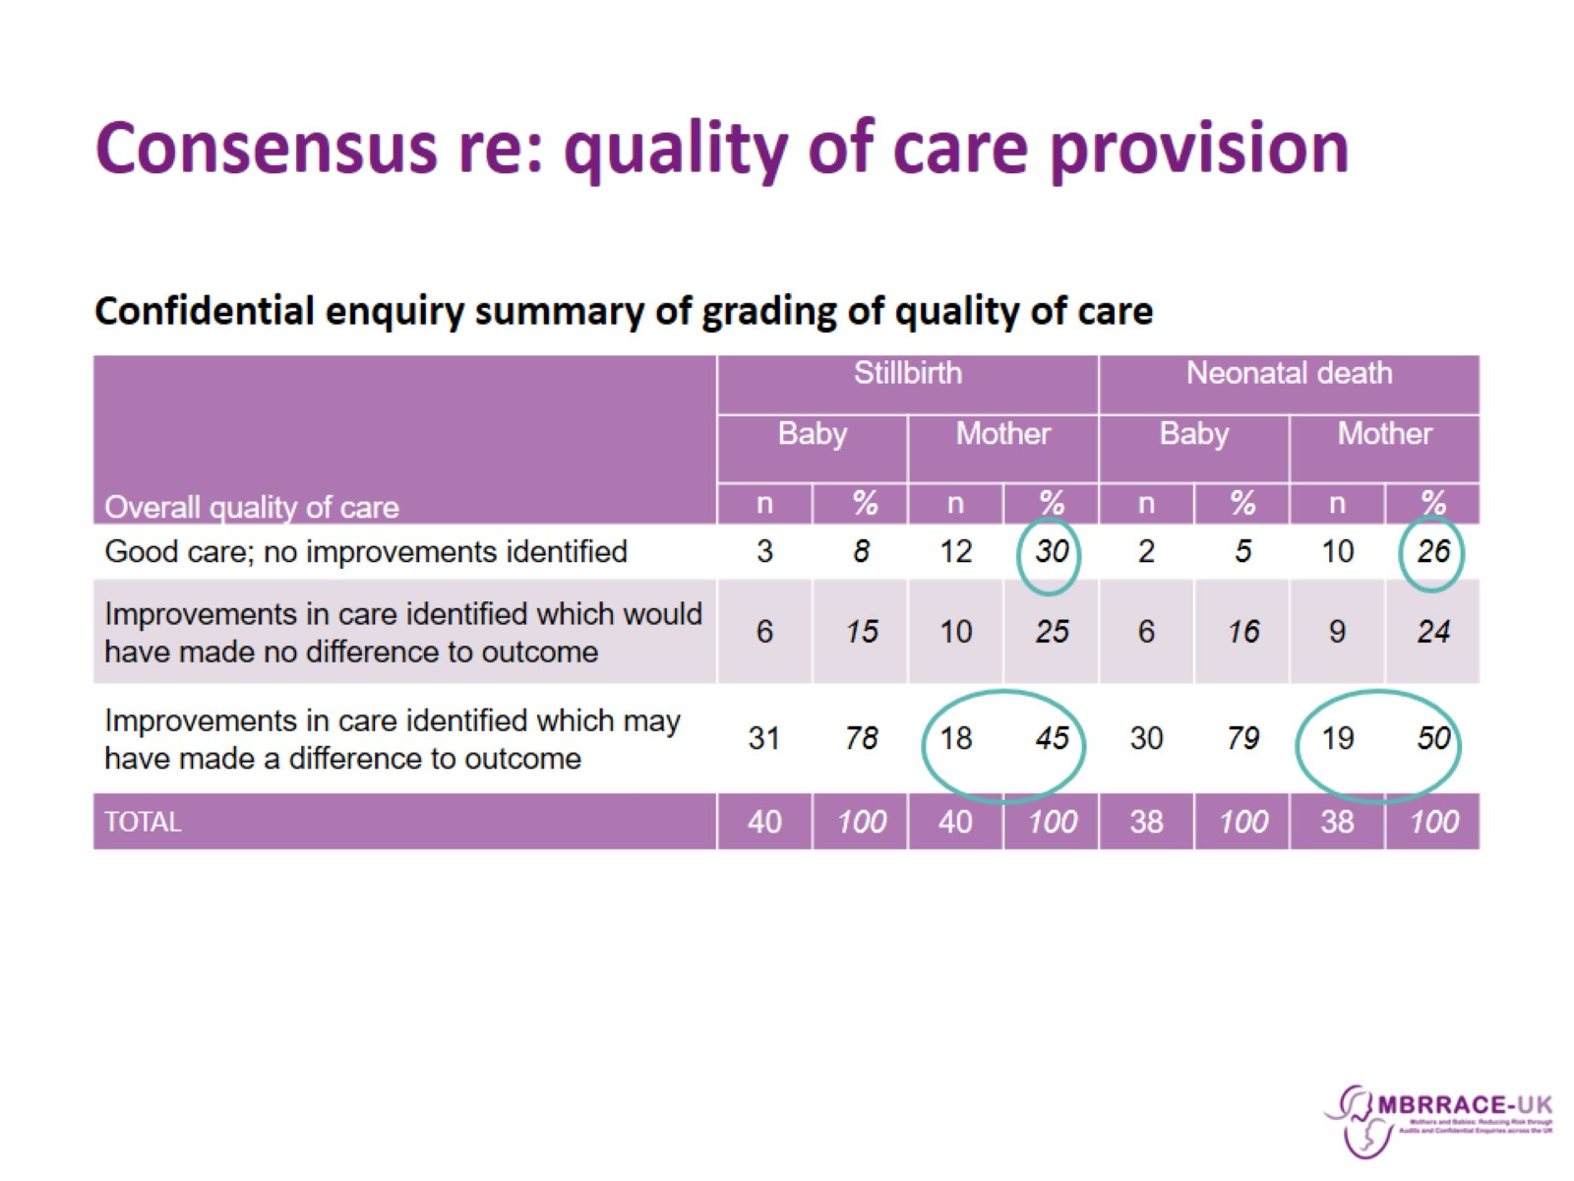
Consensus re: quality of care provision

Slide 25
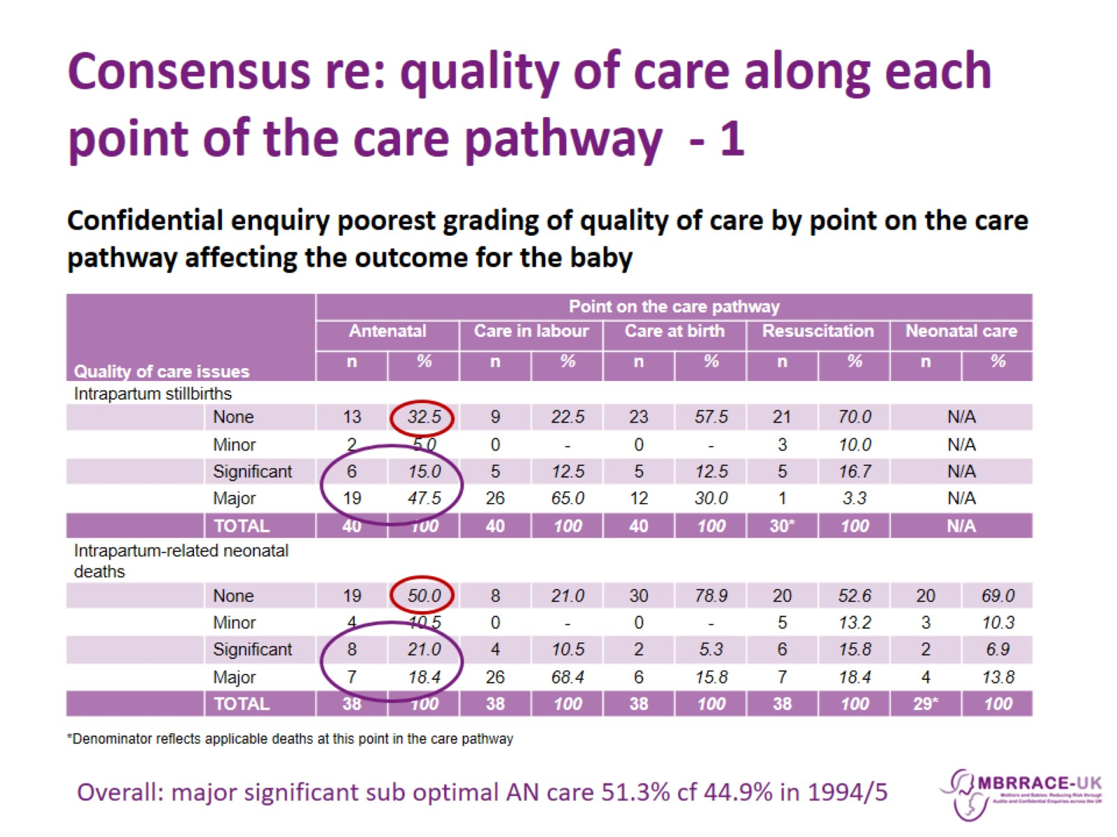
Consensus re: quality of care along each point of the care pathway - 1

Slide 26
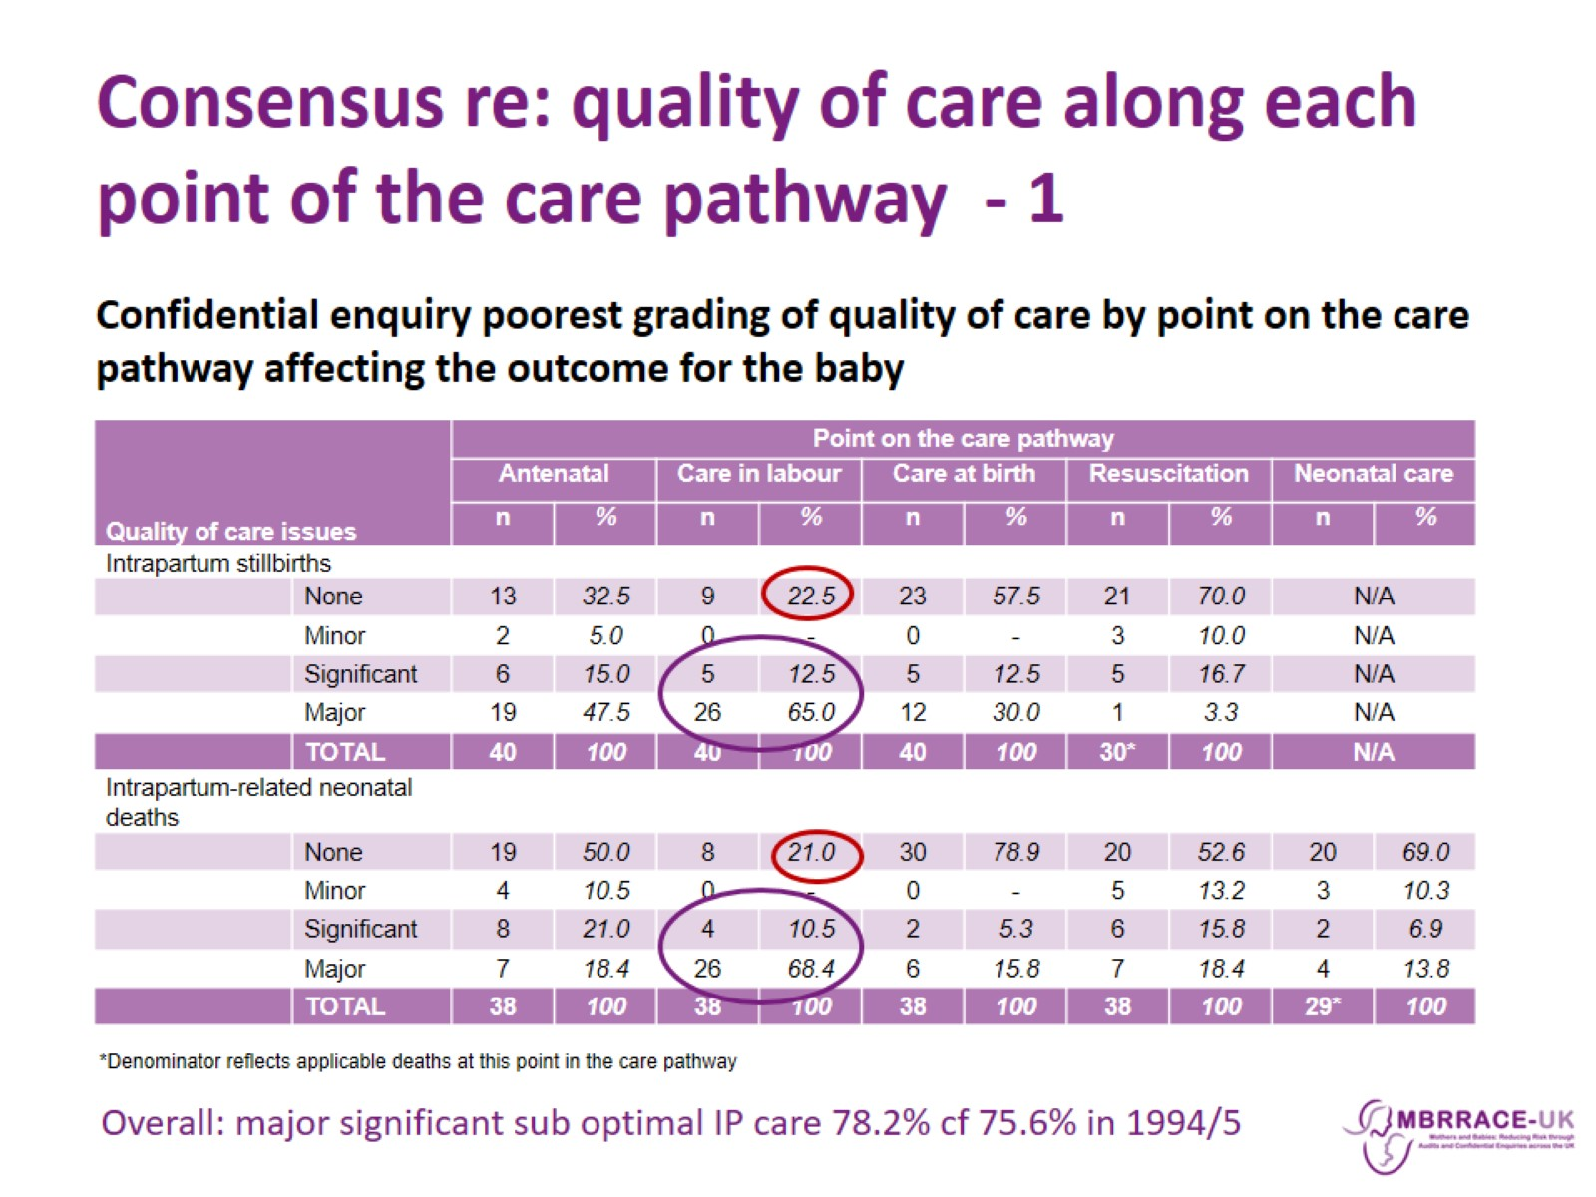
Consensus re: quality of care along each point of the care pathway - 1

Slide 27
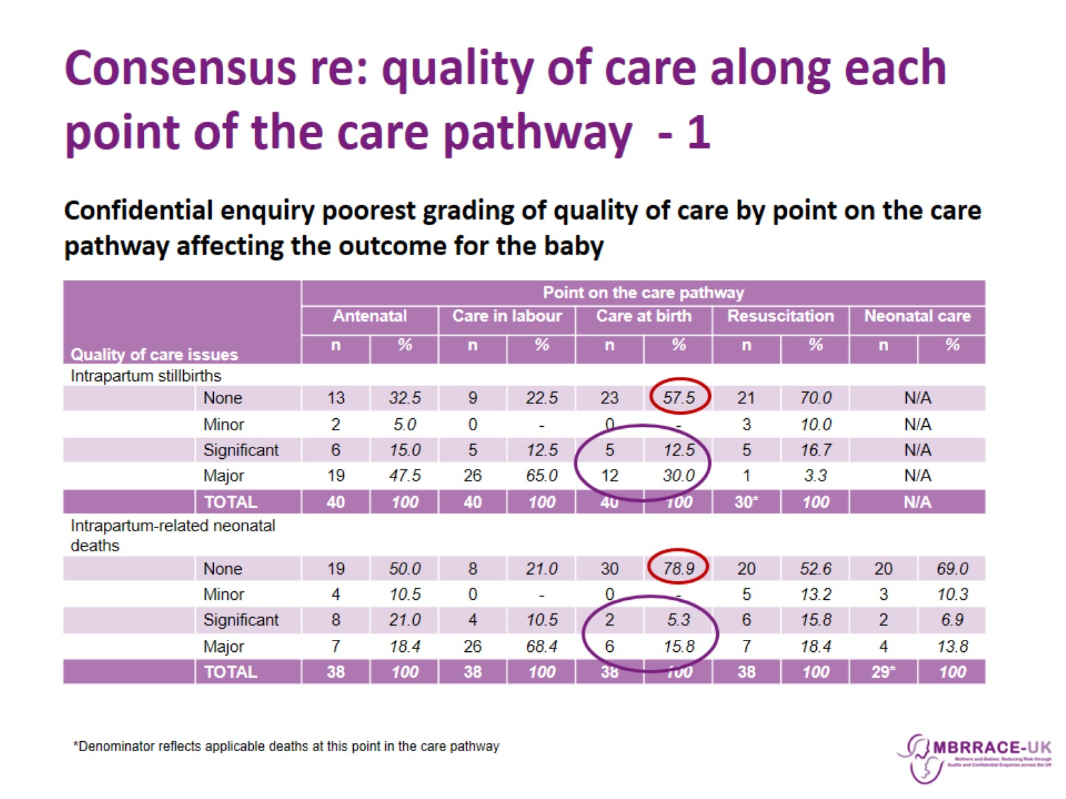
Consensus re: quality of care along each point of the care pathway - 1

Slide 28
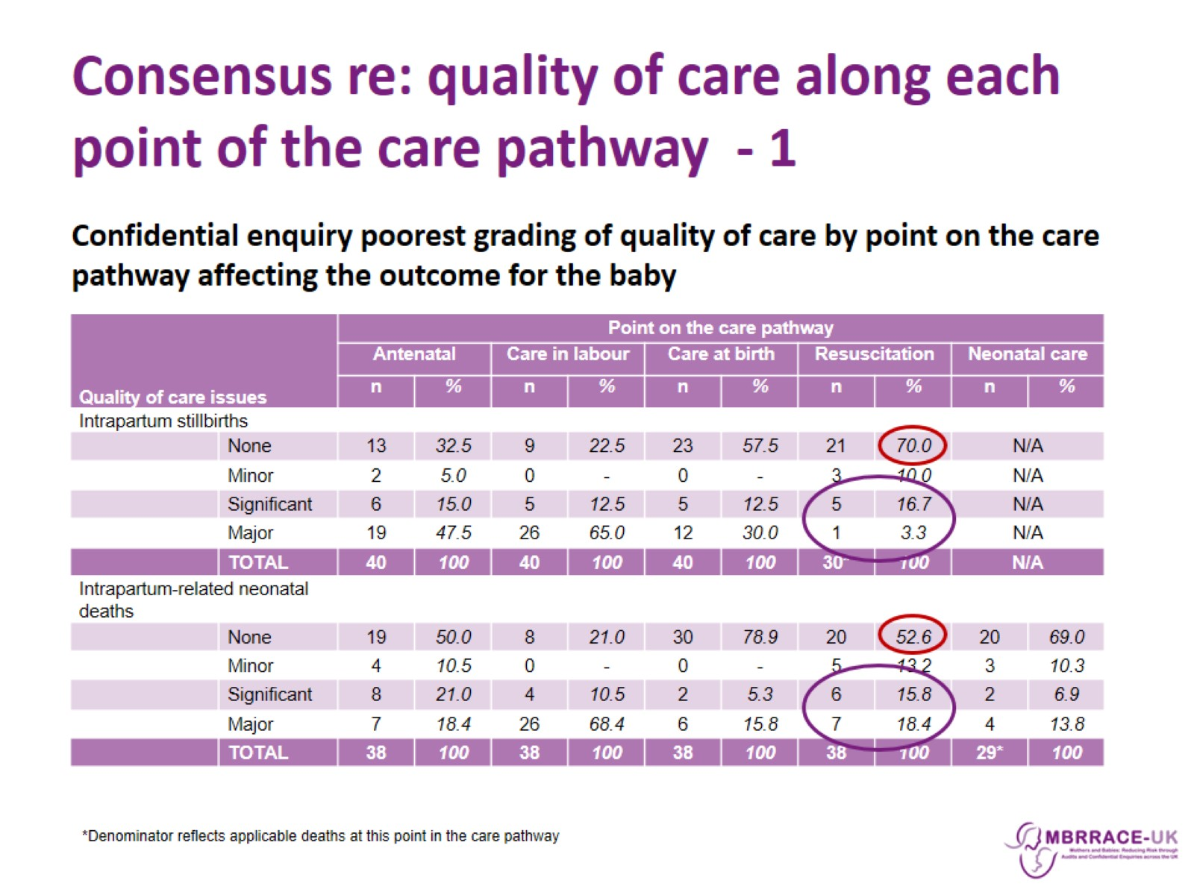
Consensus re: quality of care along each point of the care pathway - 1

Slide 29
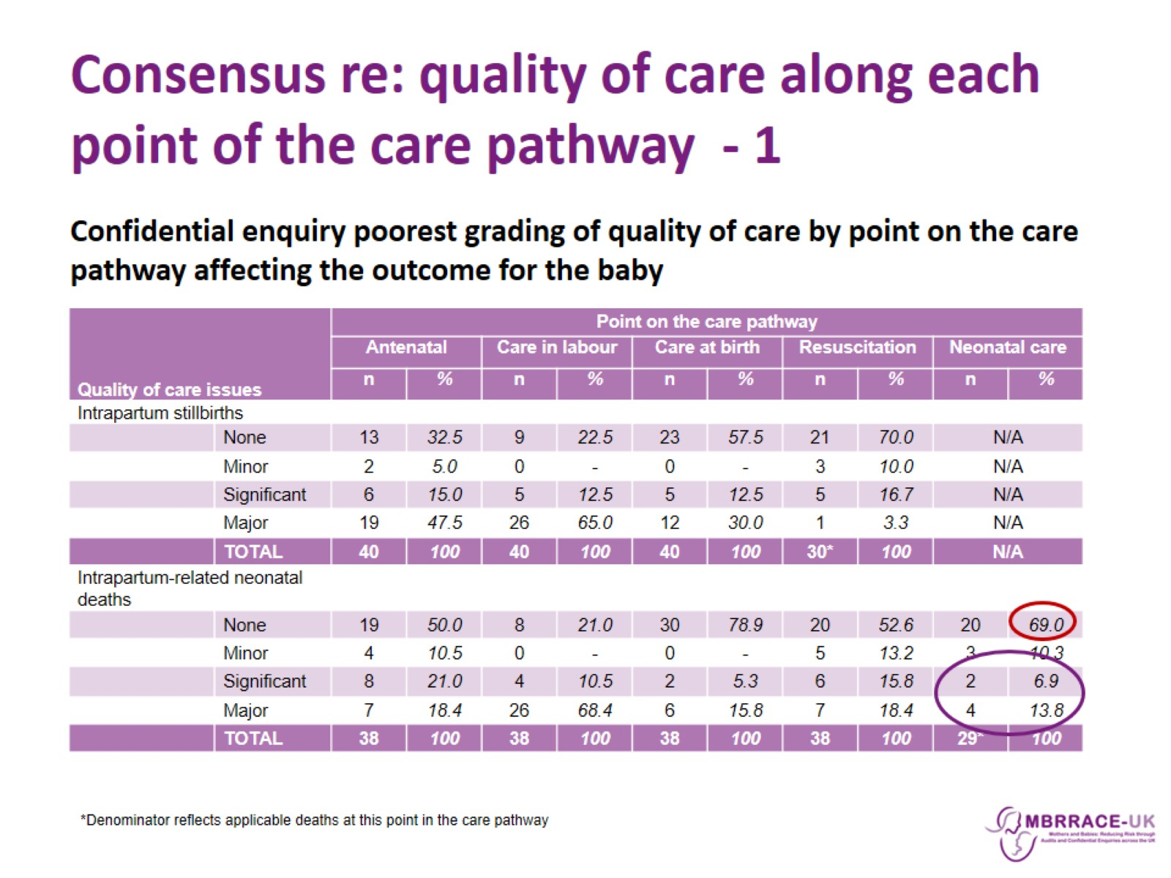
Consensus re: quality of care along each point of the care pathway - 1

Slide 30
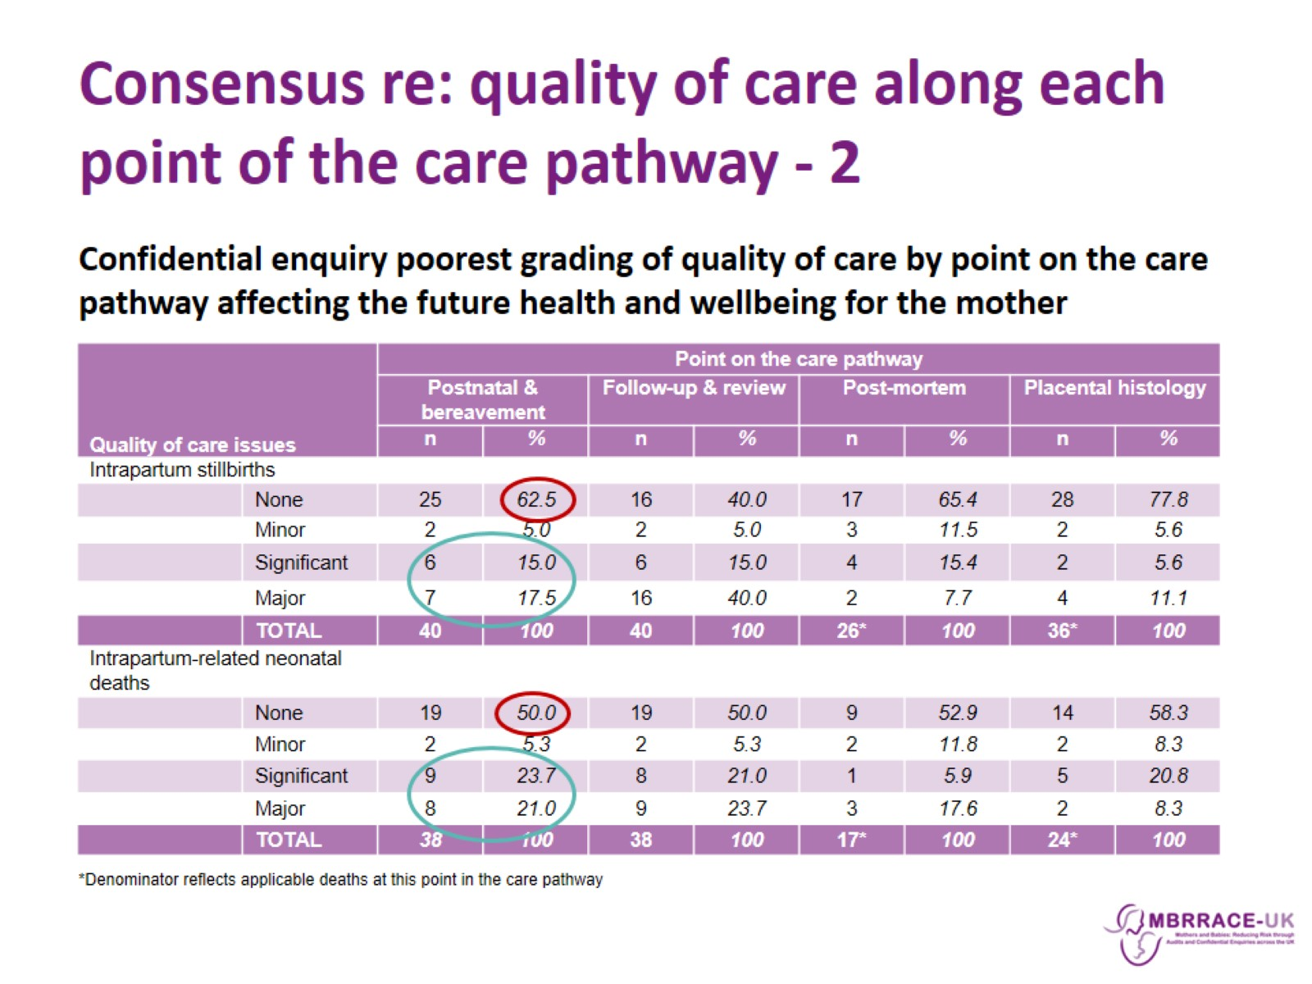
Consensus re: quality of care along each point of the care pathway - 2

Slide 31
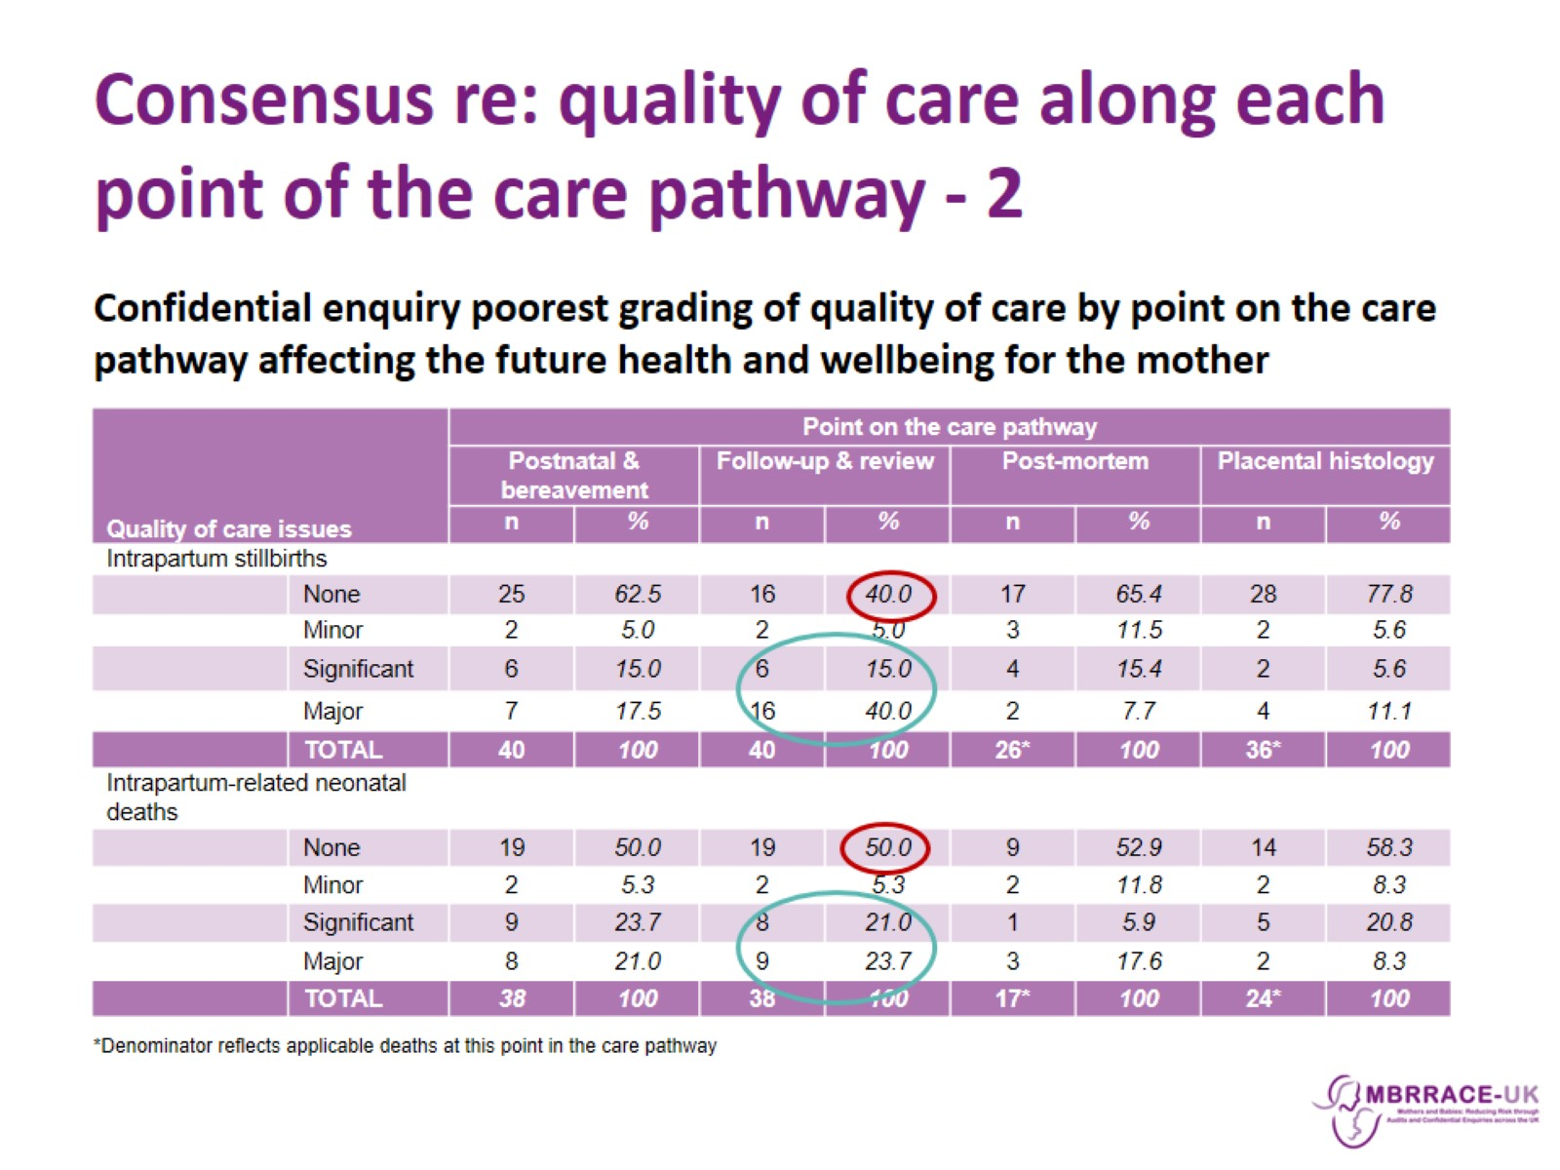
Consensus re: quality of care along each point of the care pathway - 2

Slide 32
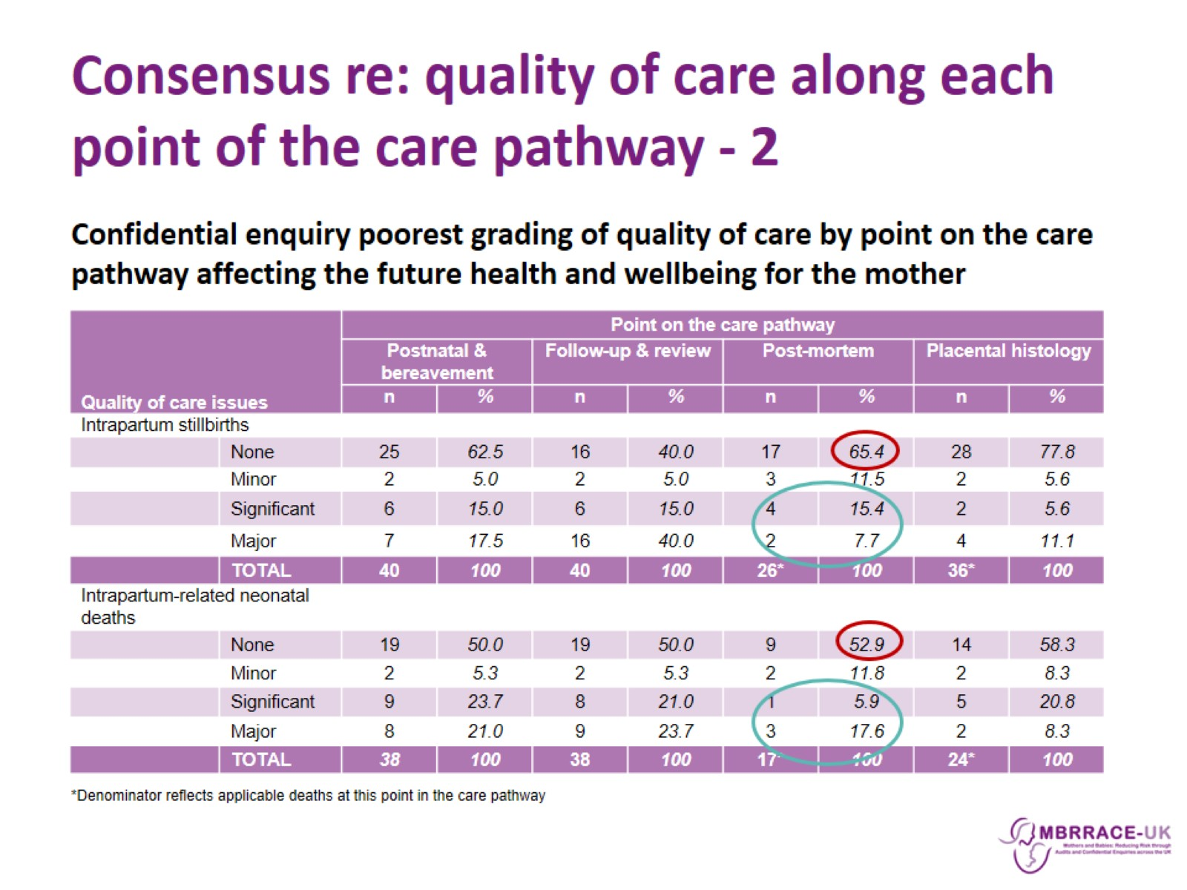
Consensus re: quality of care along each point of the care pathway - 2

Slide 33
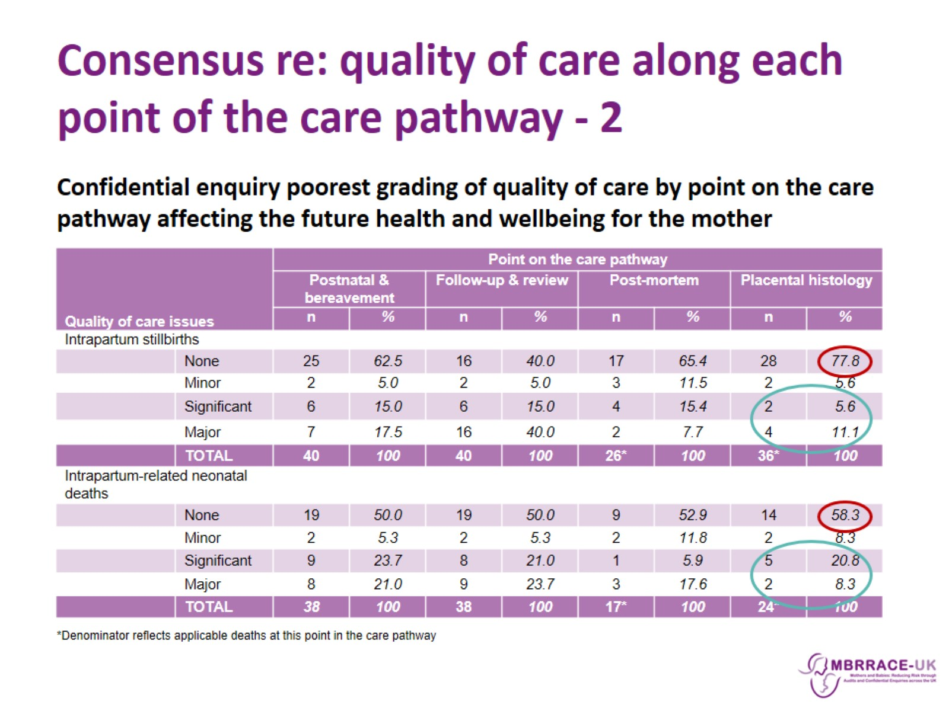
Consensus re: quality of care along each point of the care pathway - 2

