Slide 1

Confidential Enquiry
Congenital Diaphragmatic Hernia

Slide 2
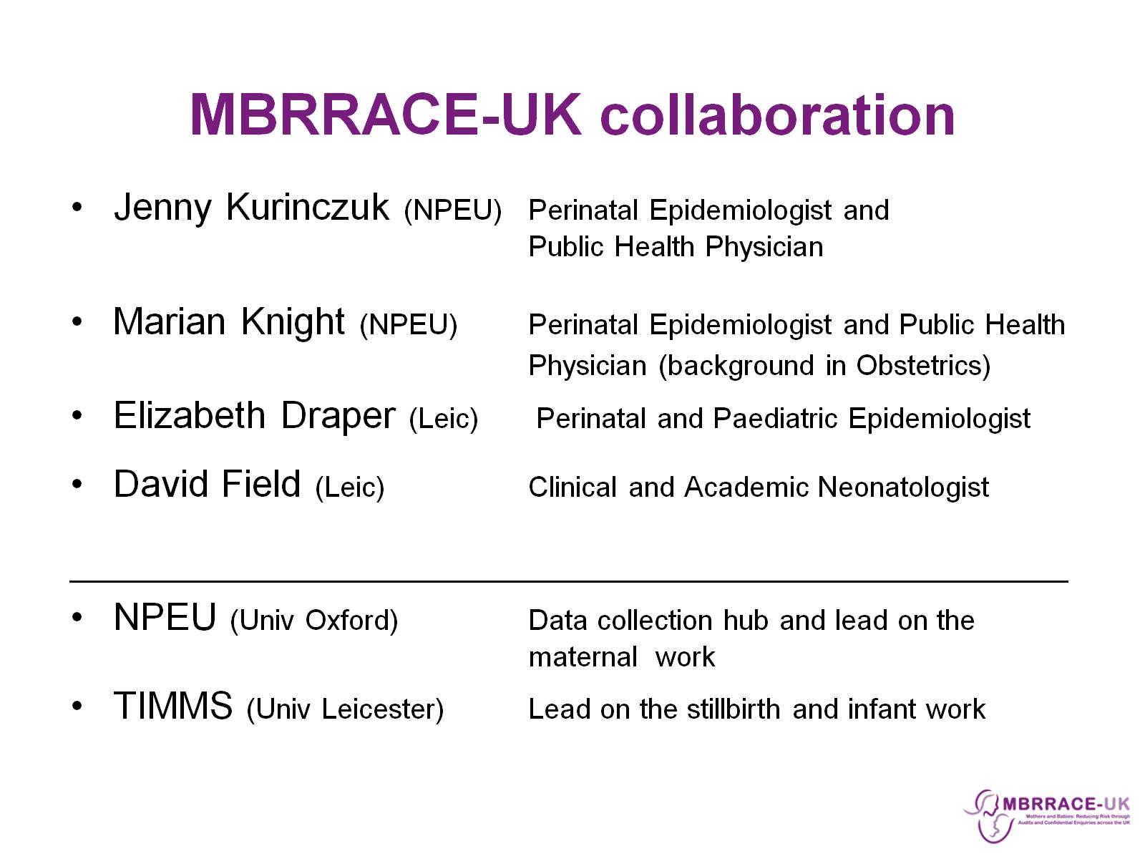
MBRRACE-UK collaboration

Slide 3
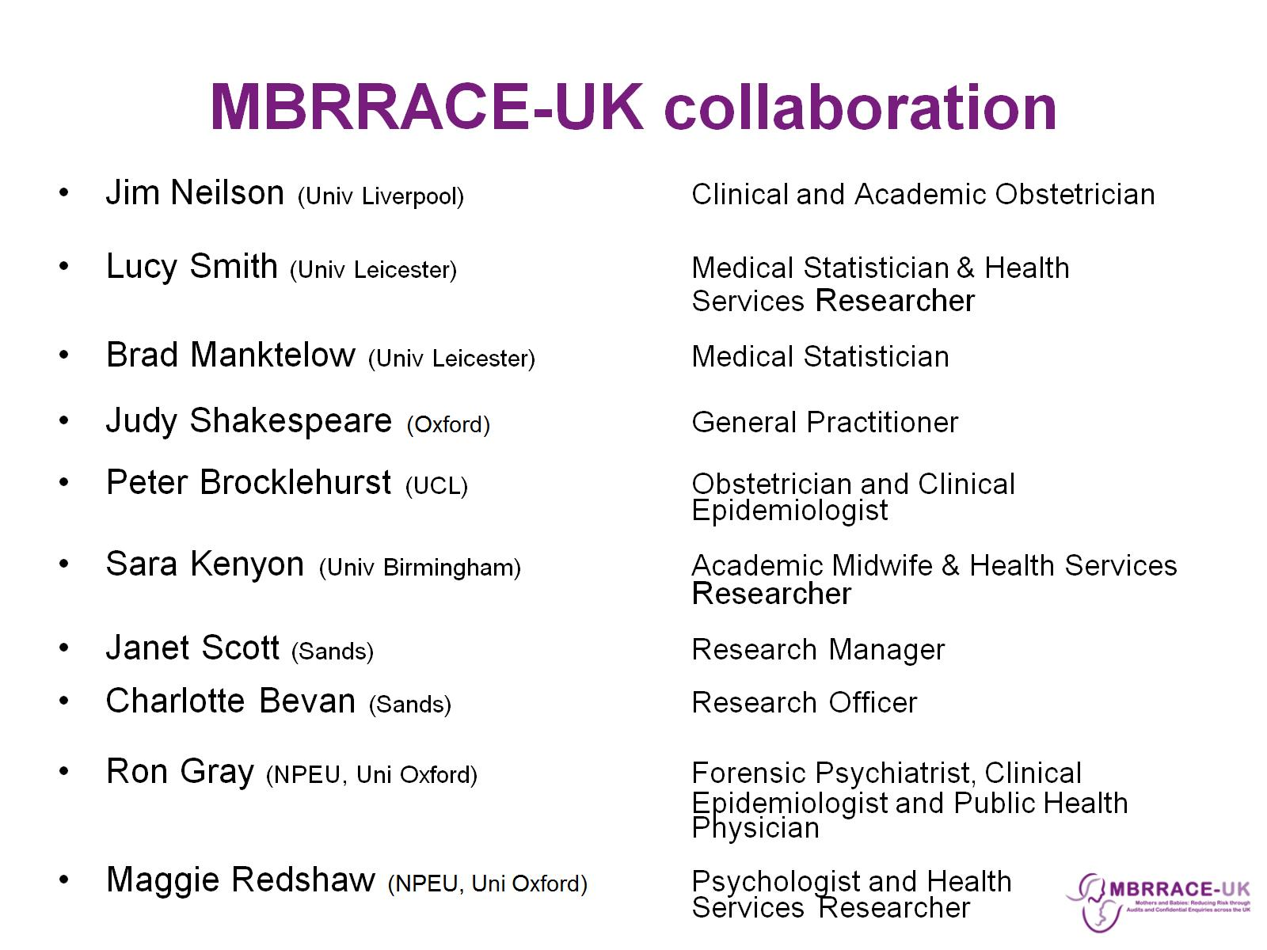
MBRRACE-UK collaboration

Slide 4
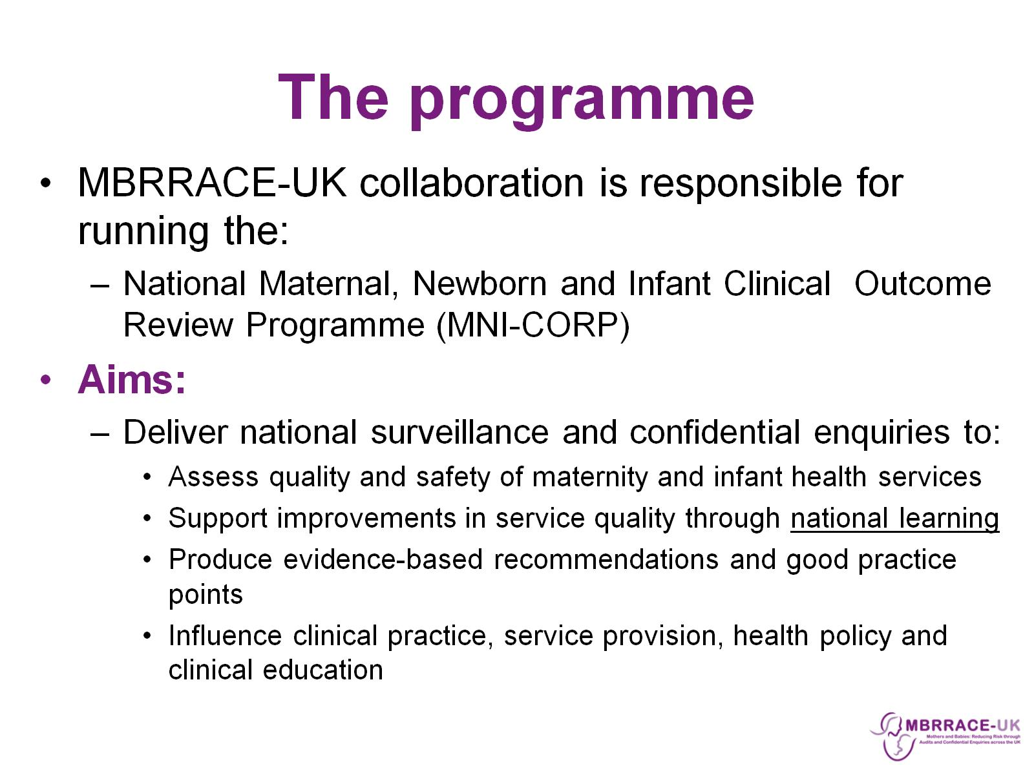
The programme

Slide 5
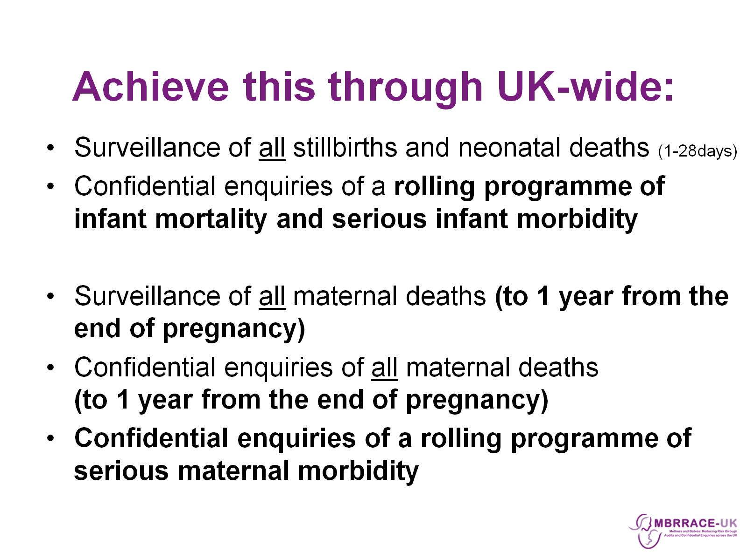
Achieve this through UK-wide:

Slide 6
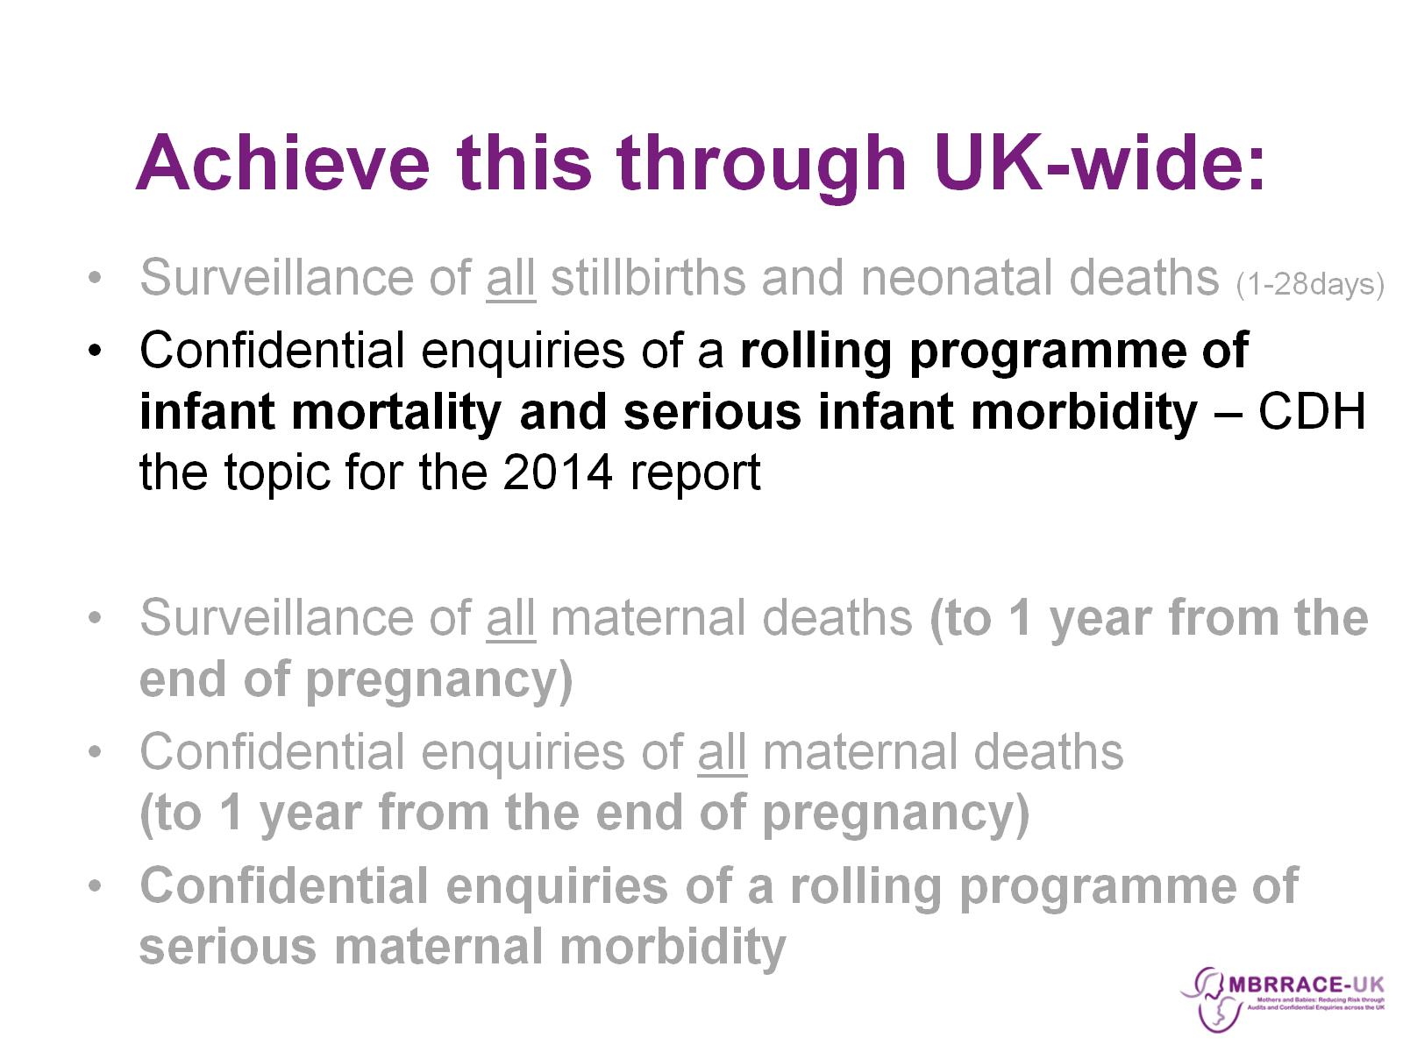
Achieve this through UK-wide:

Slide 7
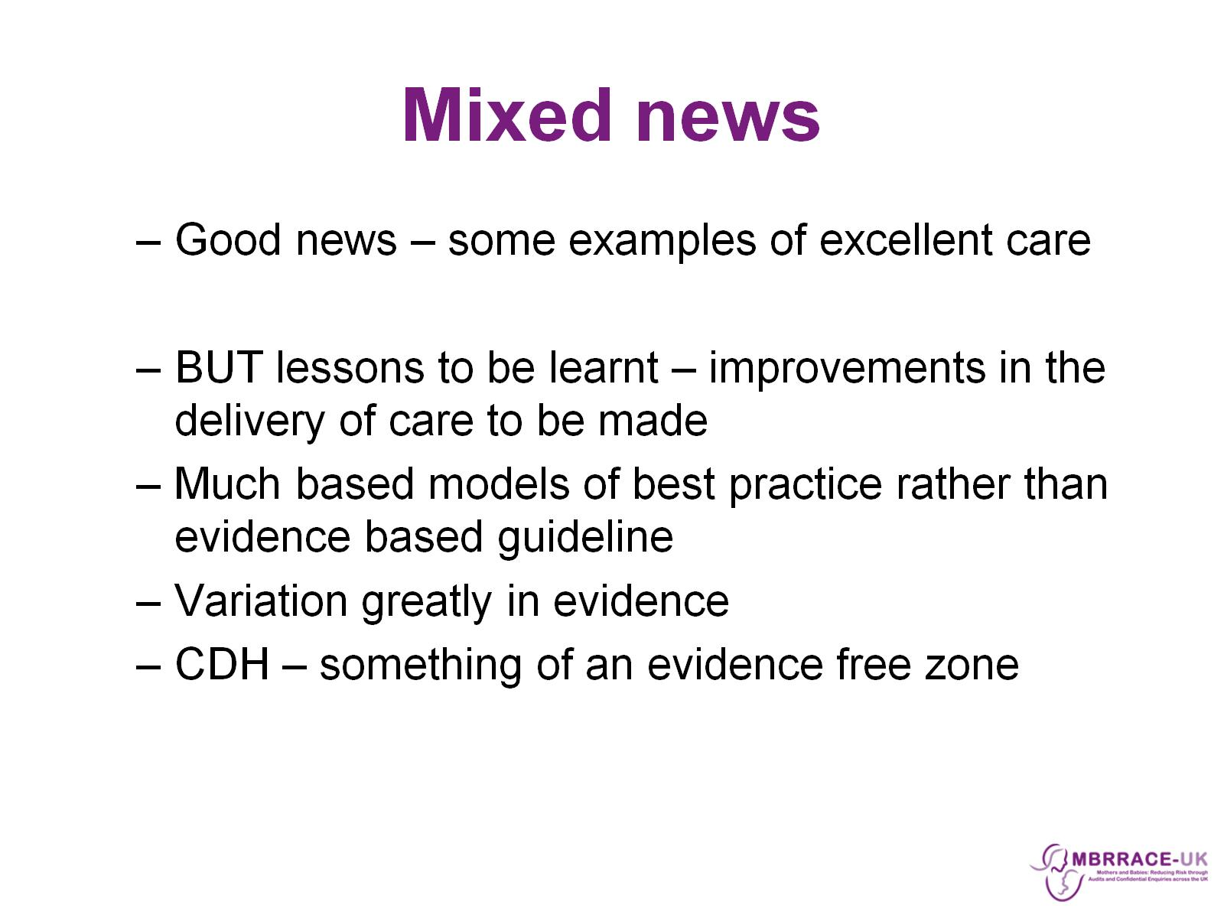
Mixed news

Slide 8
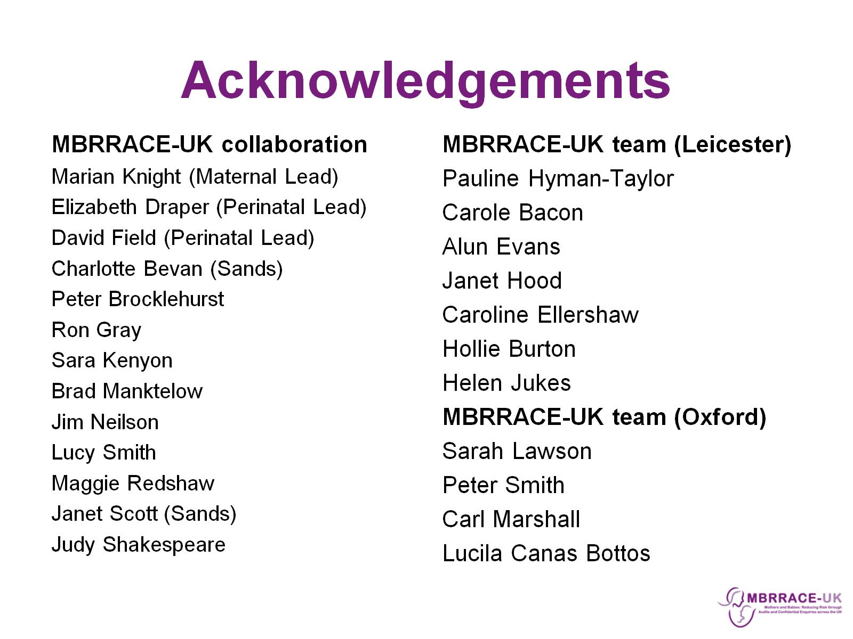
Acknowledgements

Slide 9
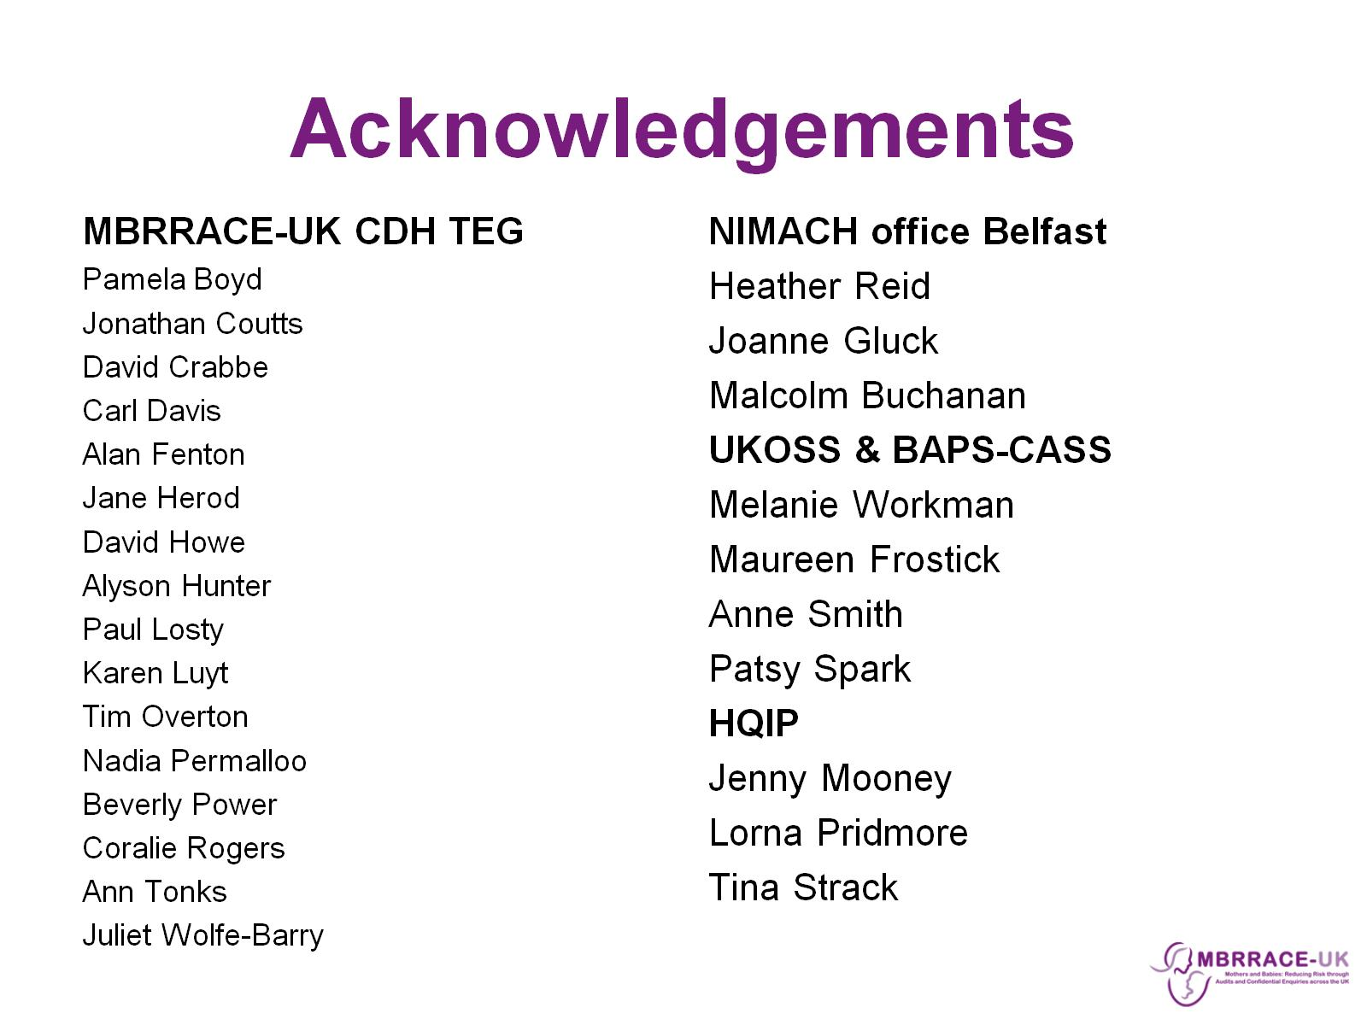
Acknowledgements

Slide 10
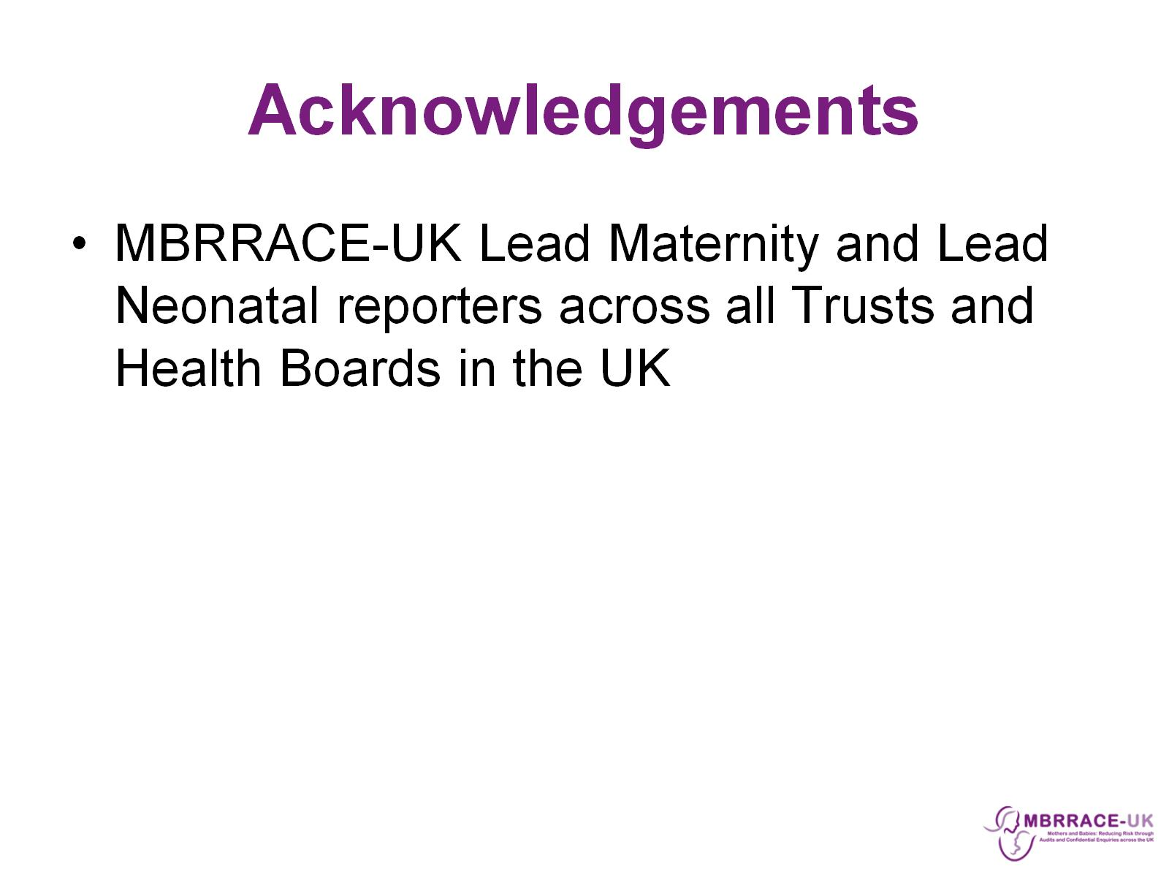
Acknowledgements

Slide 11
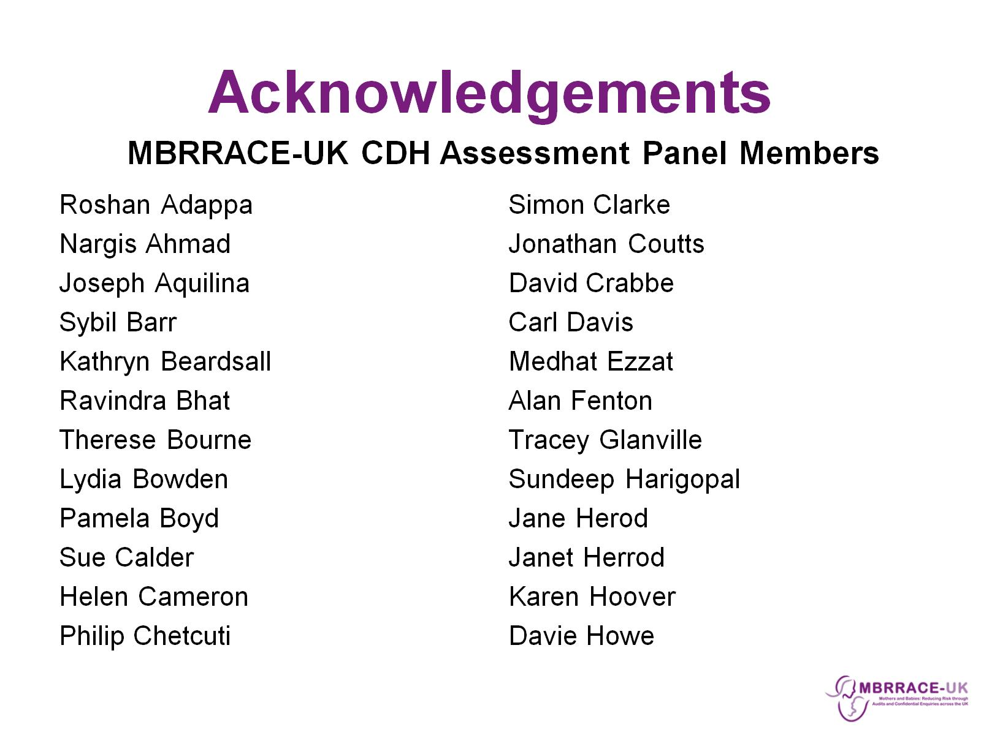
Acknowledgements

Slide 12
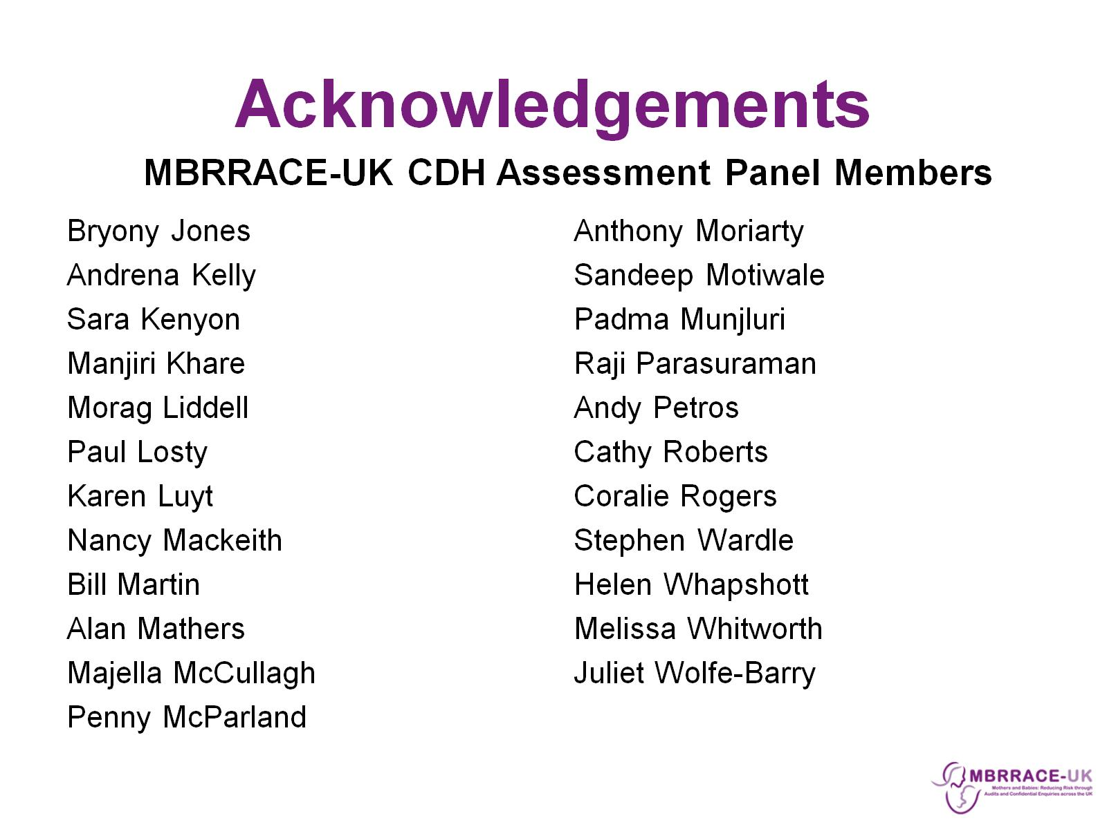
Acknowledgements

Slide 13
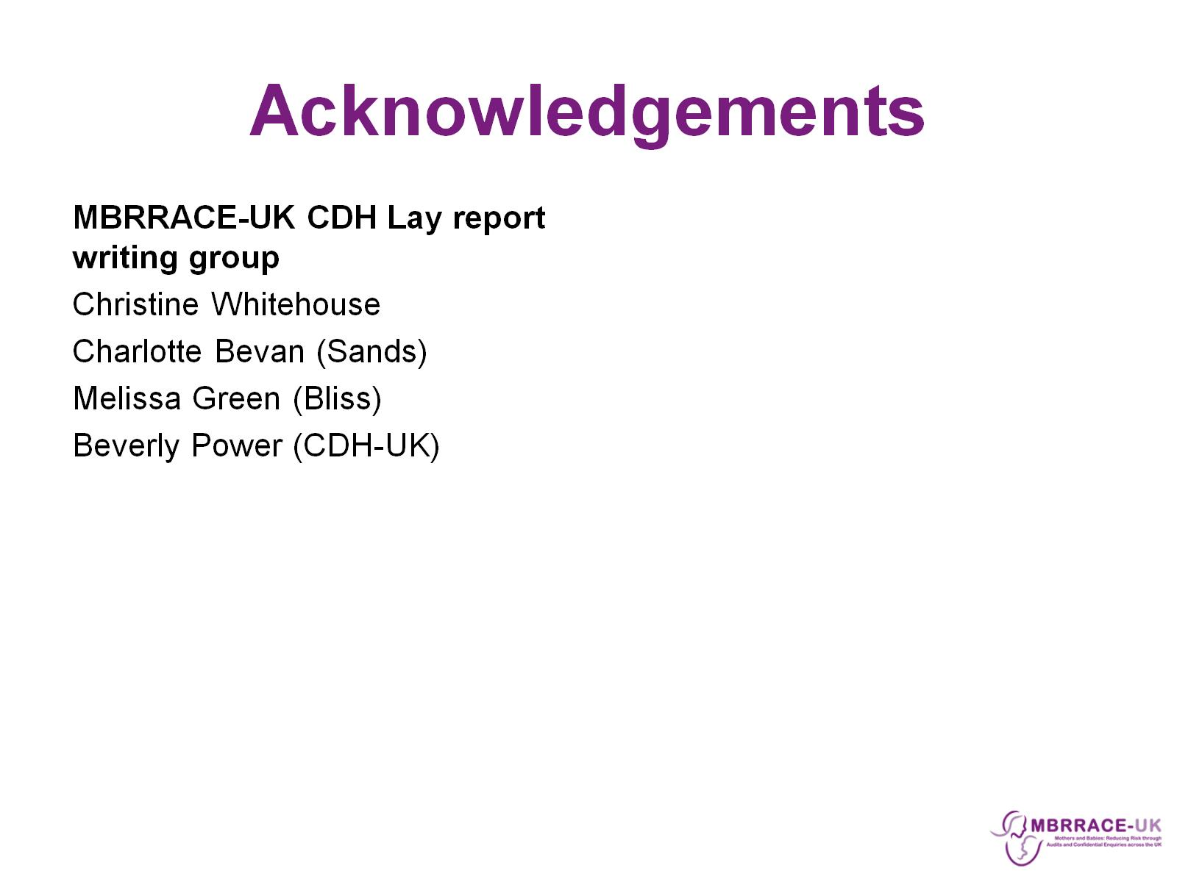
Acknowledgements

Slide 14
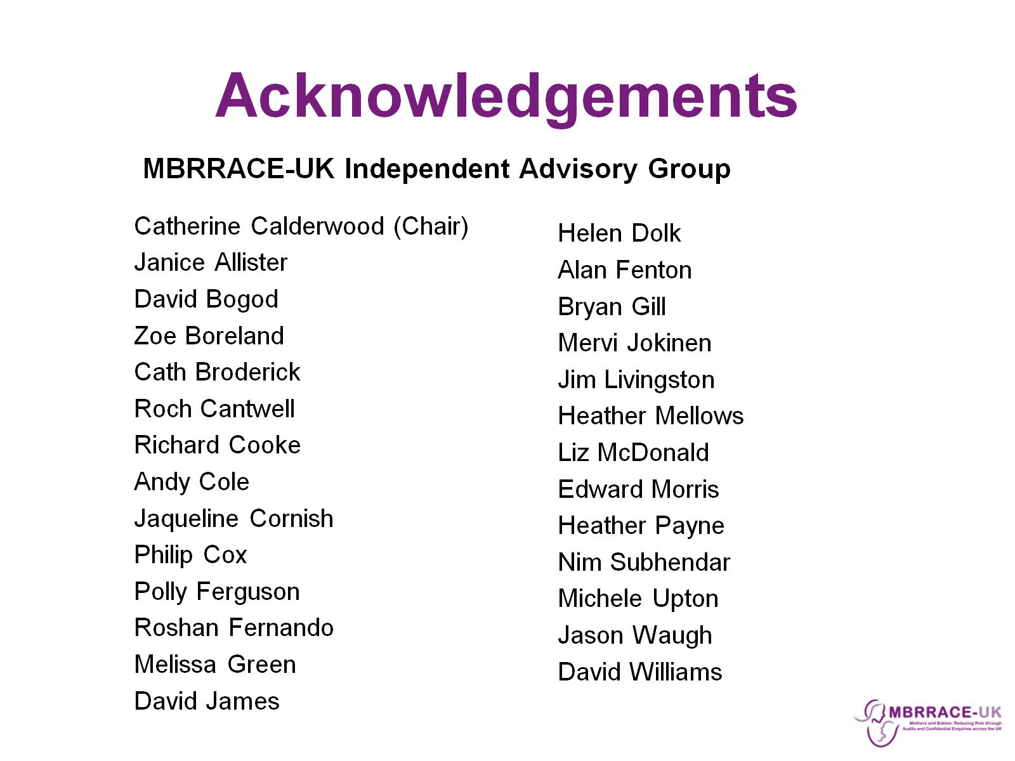
Acknowledgements

Slide 15
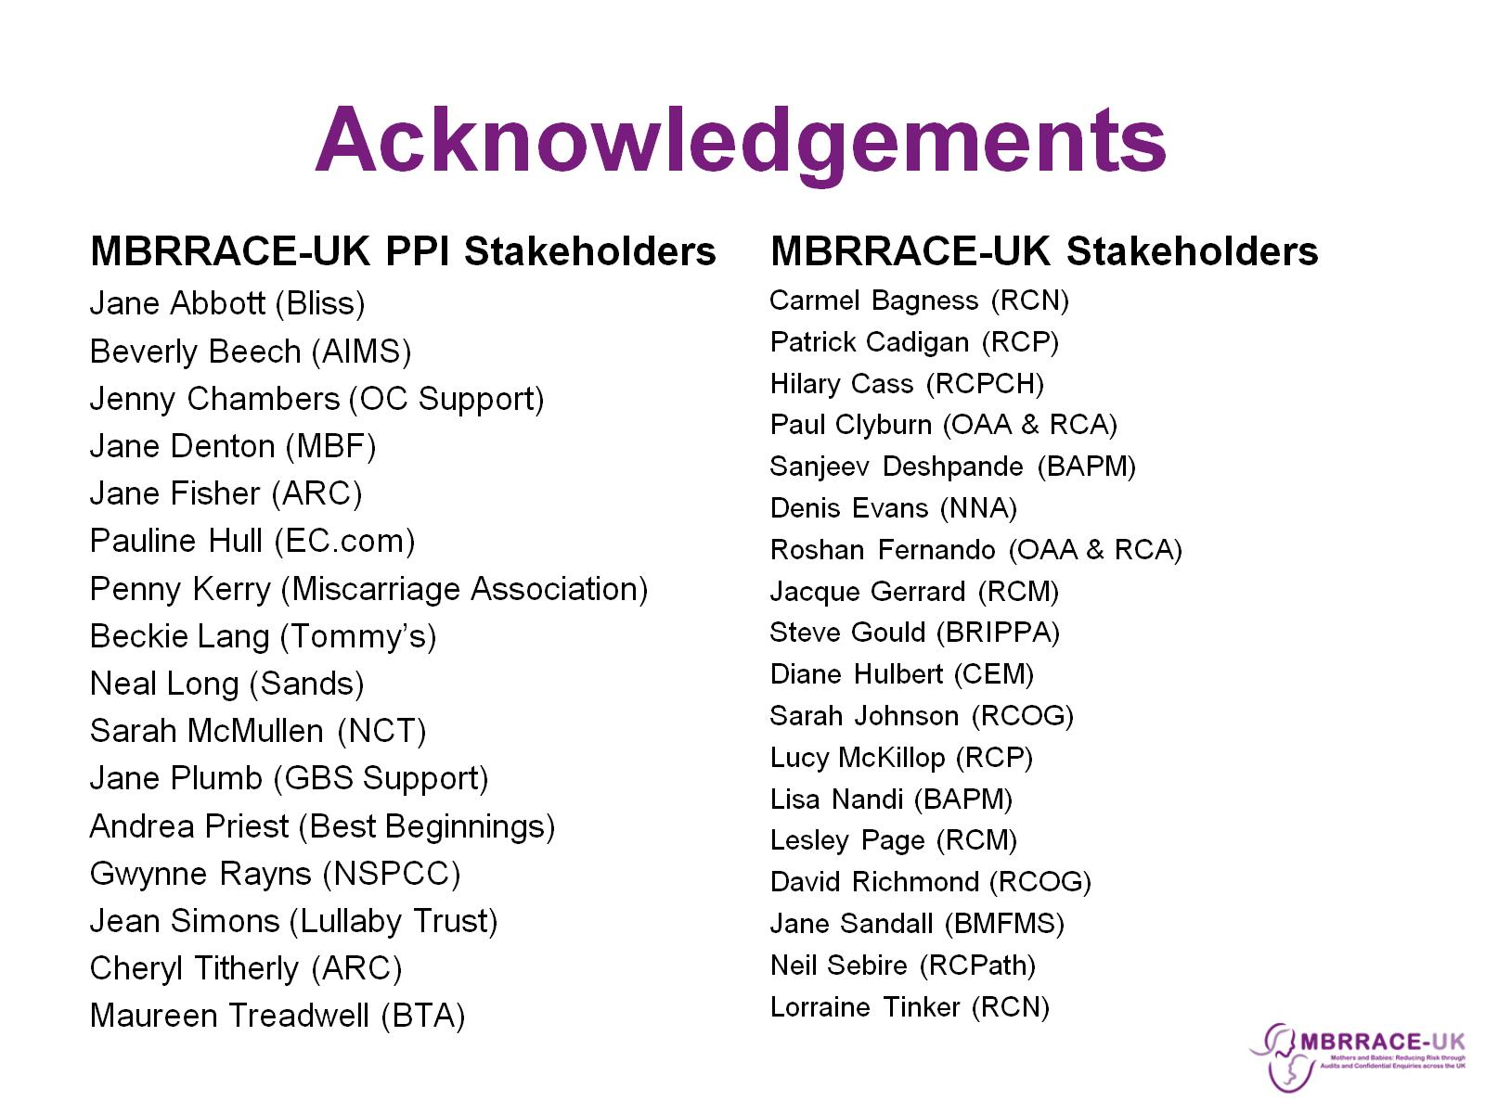
Acknowledgements

Slide 16

Funding

