Slide 1


Slide 2

Who We Are /
What We Do

Slide 3

Our Aim is to Refocus

Slide 4
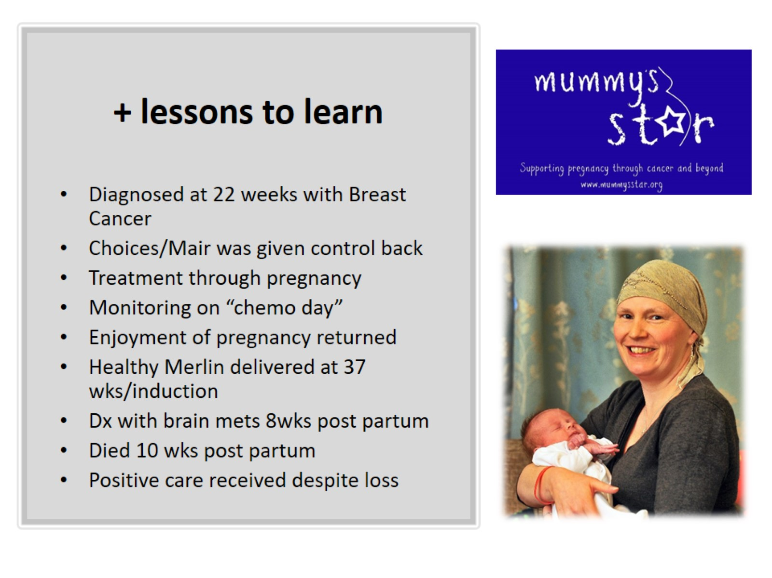
+ lessons to learn

Slide 5
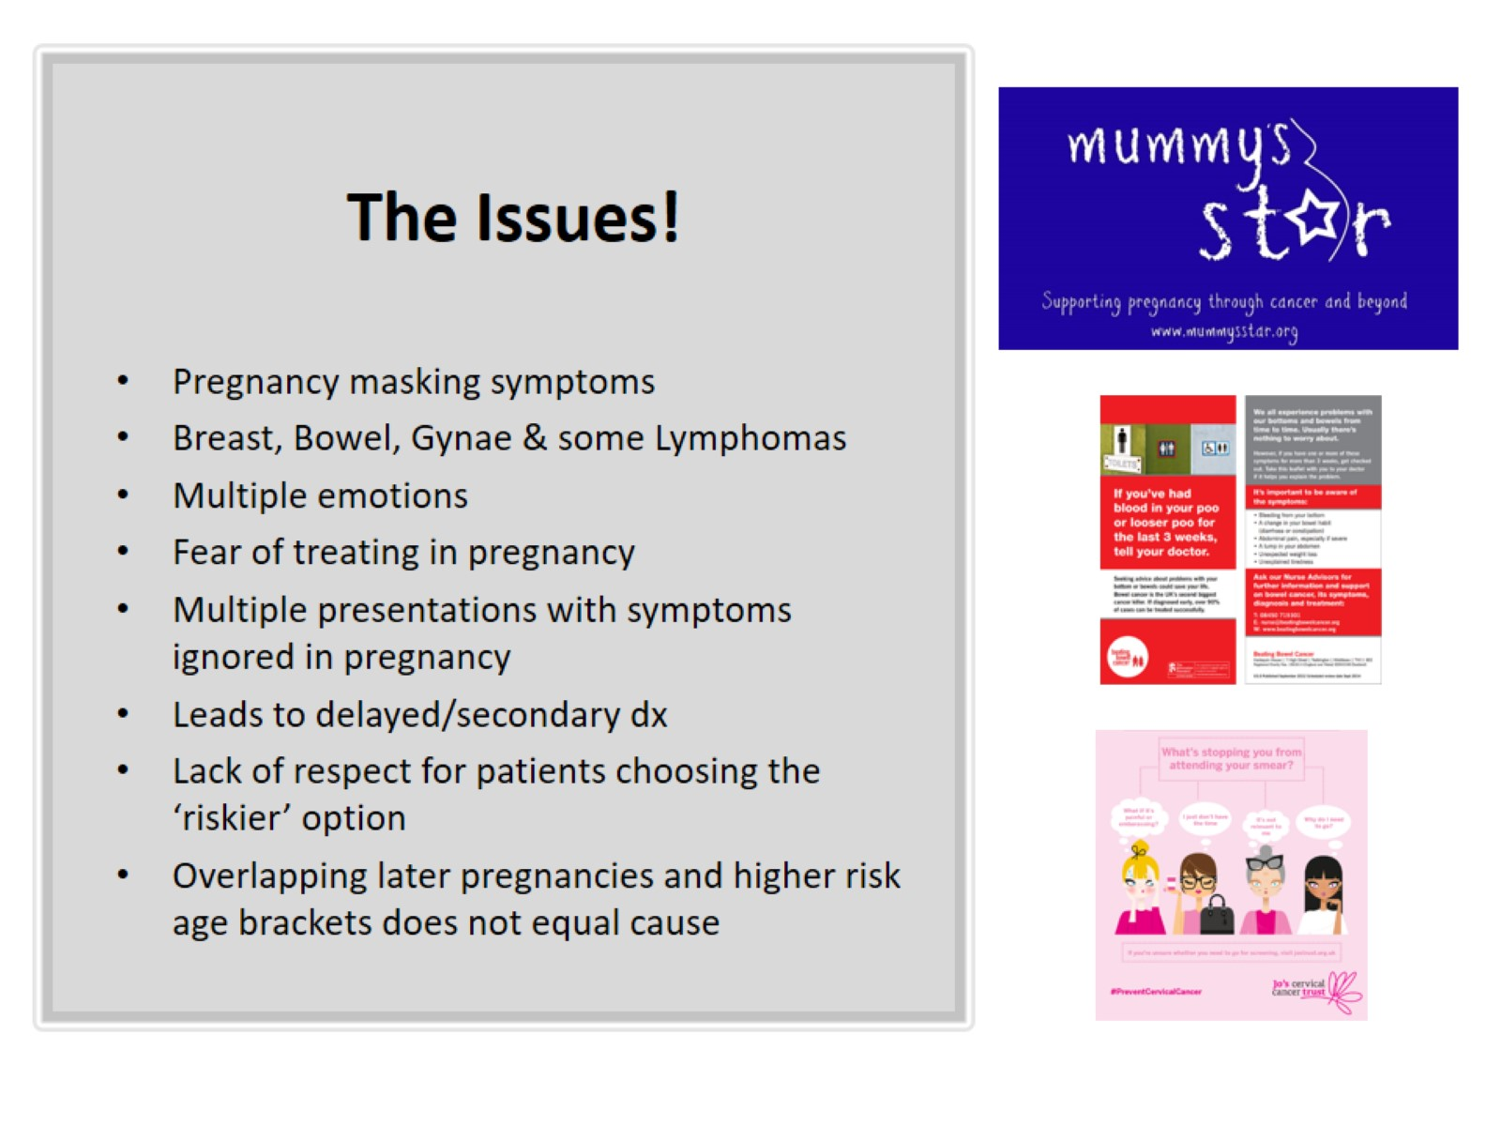
The Issues!

Slide 6
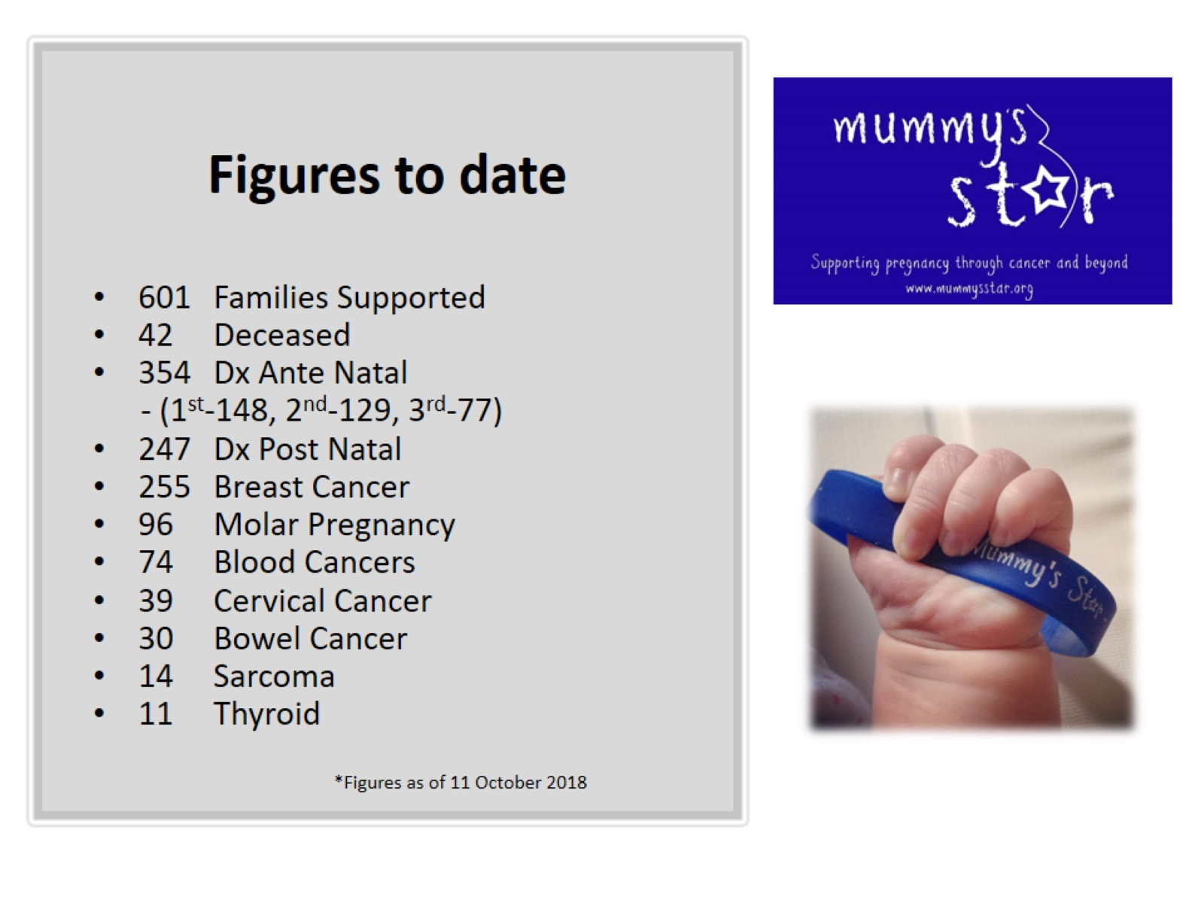
Figures to date

Slide 7

Further Info

