Slide 1

Taking messages forward from MBRRACE-UK

Slide 2
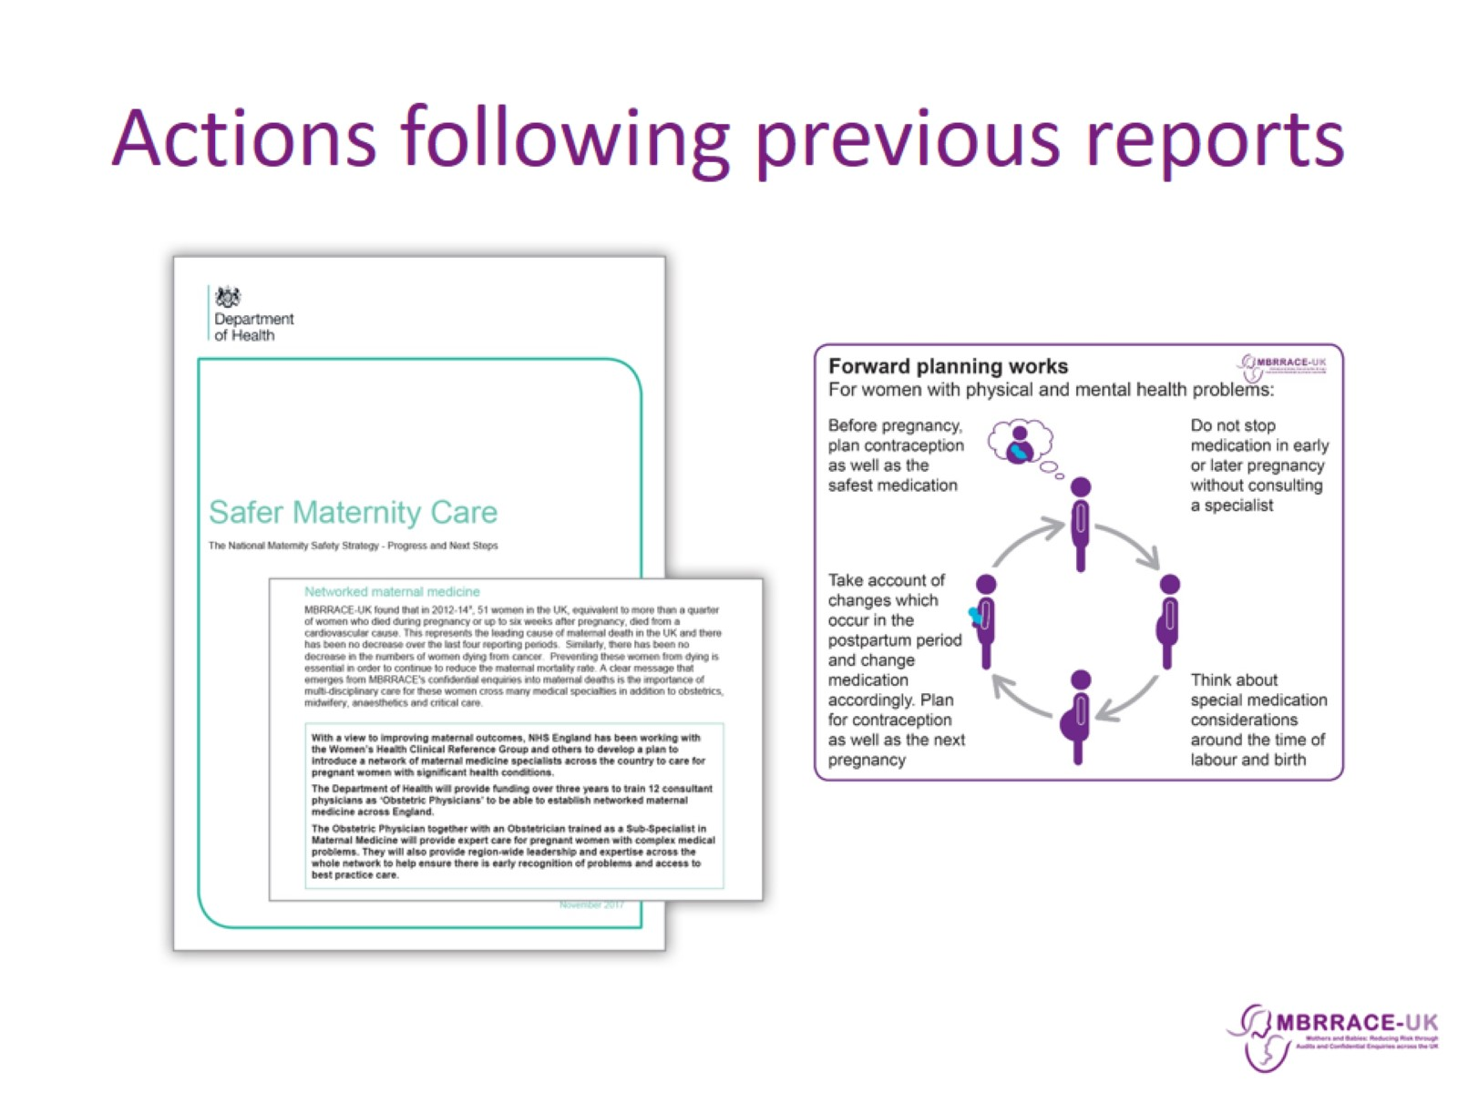
Actions following previous reports

Slide 3

Actions following previous reports

Slide 4
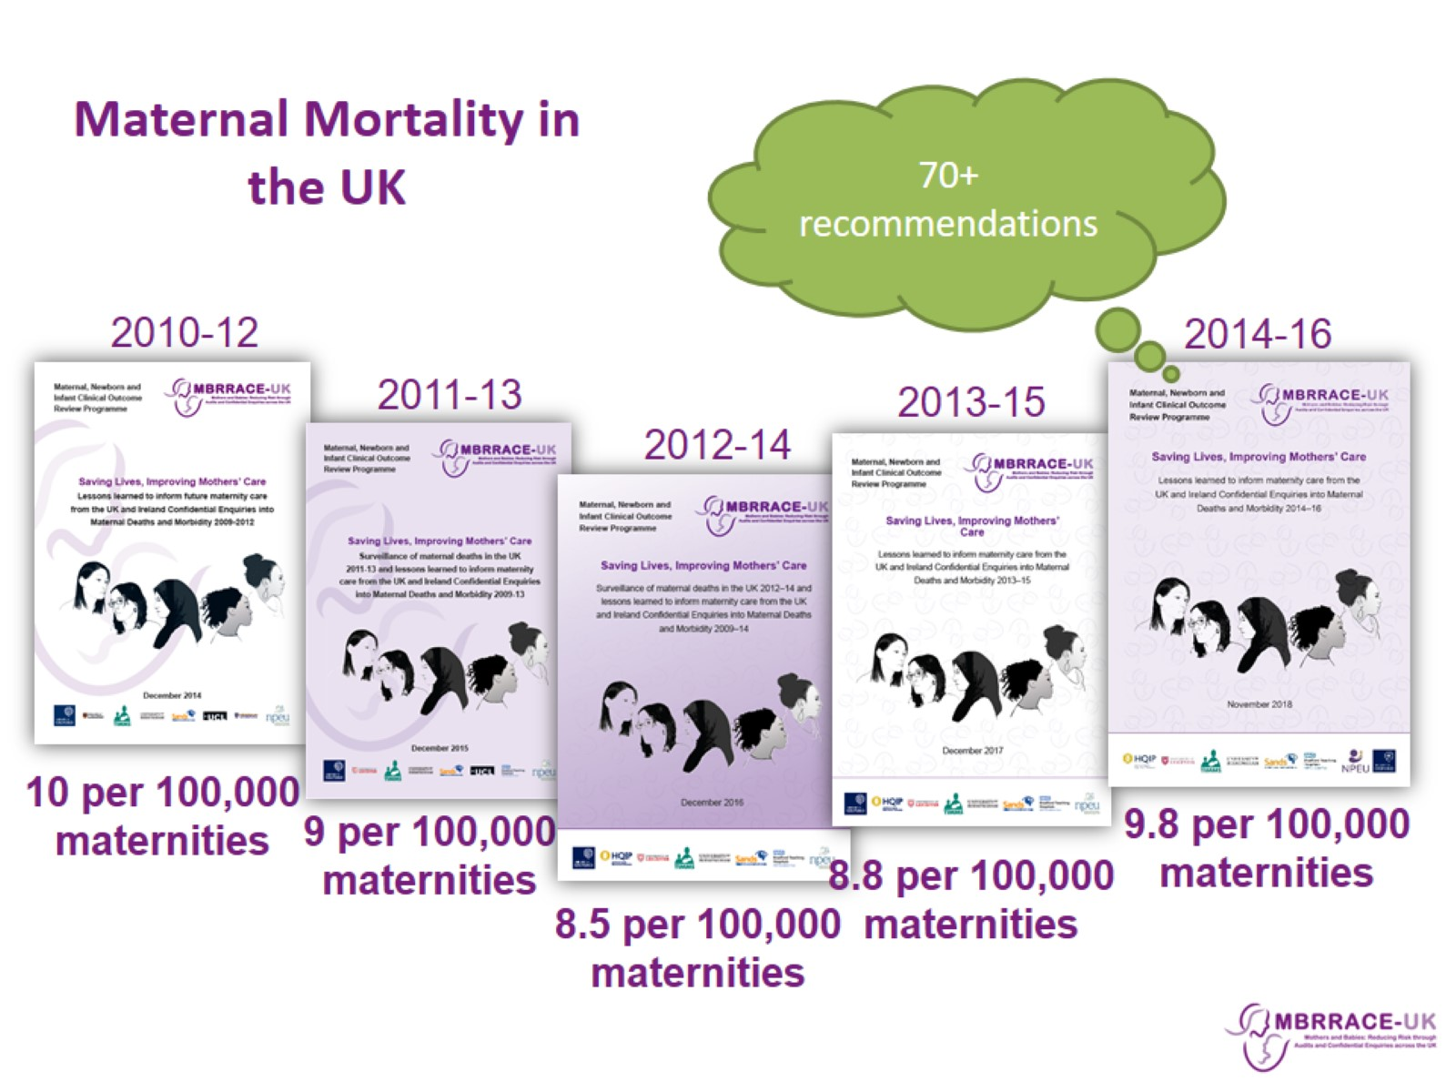
Maternal Mortality in the UK

Slide 5

Recurring themes in Confidential Enquiries

Slide 6
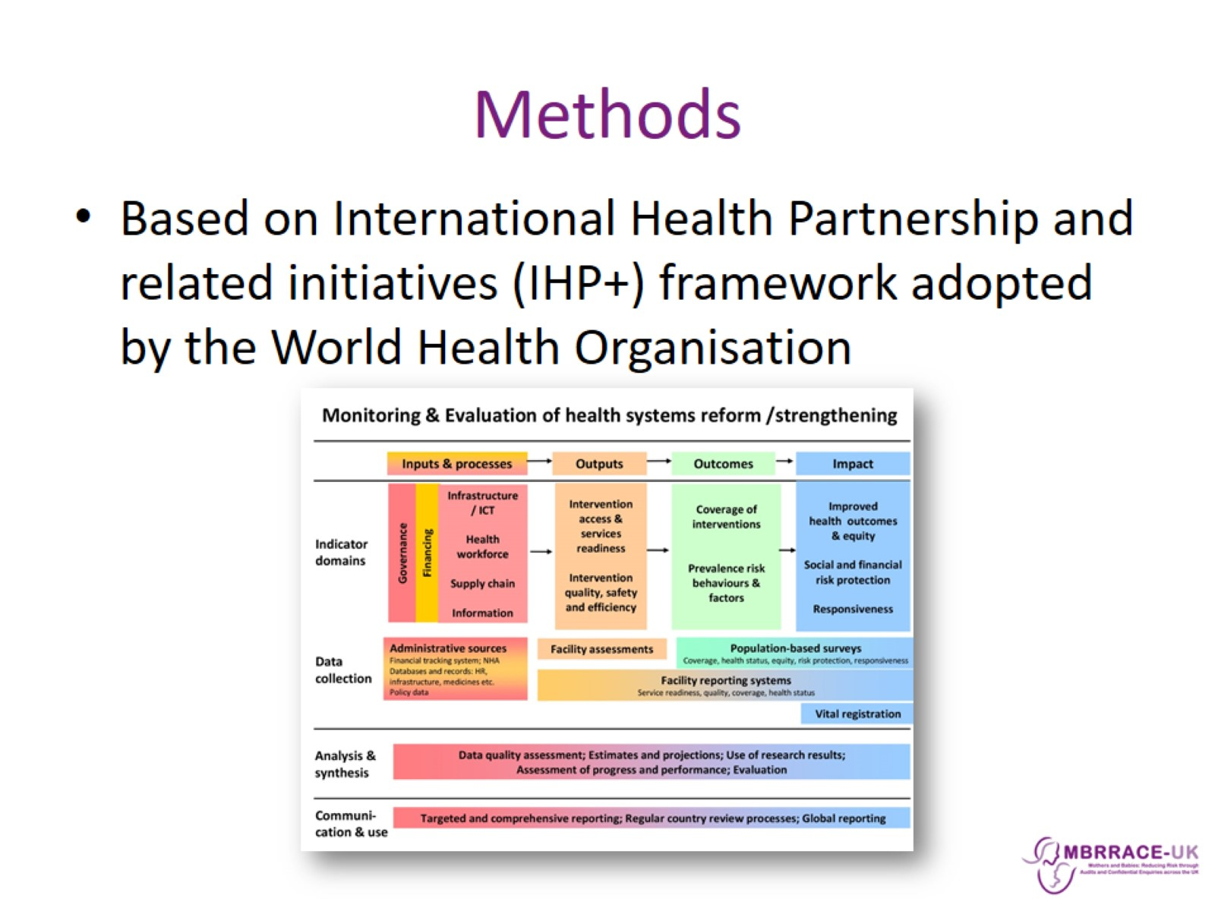
Methods

Slide 7
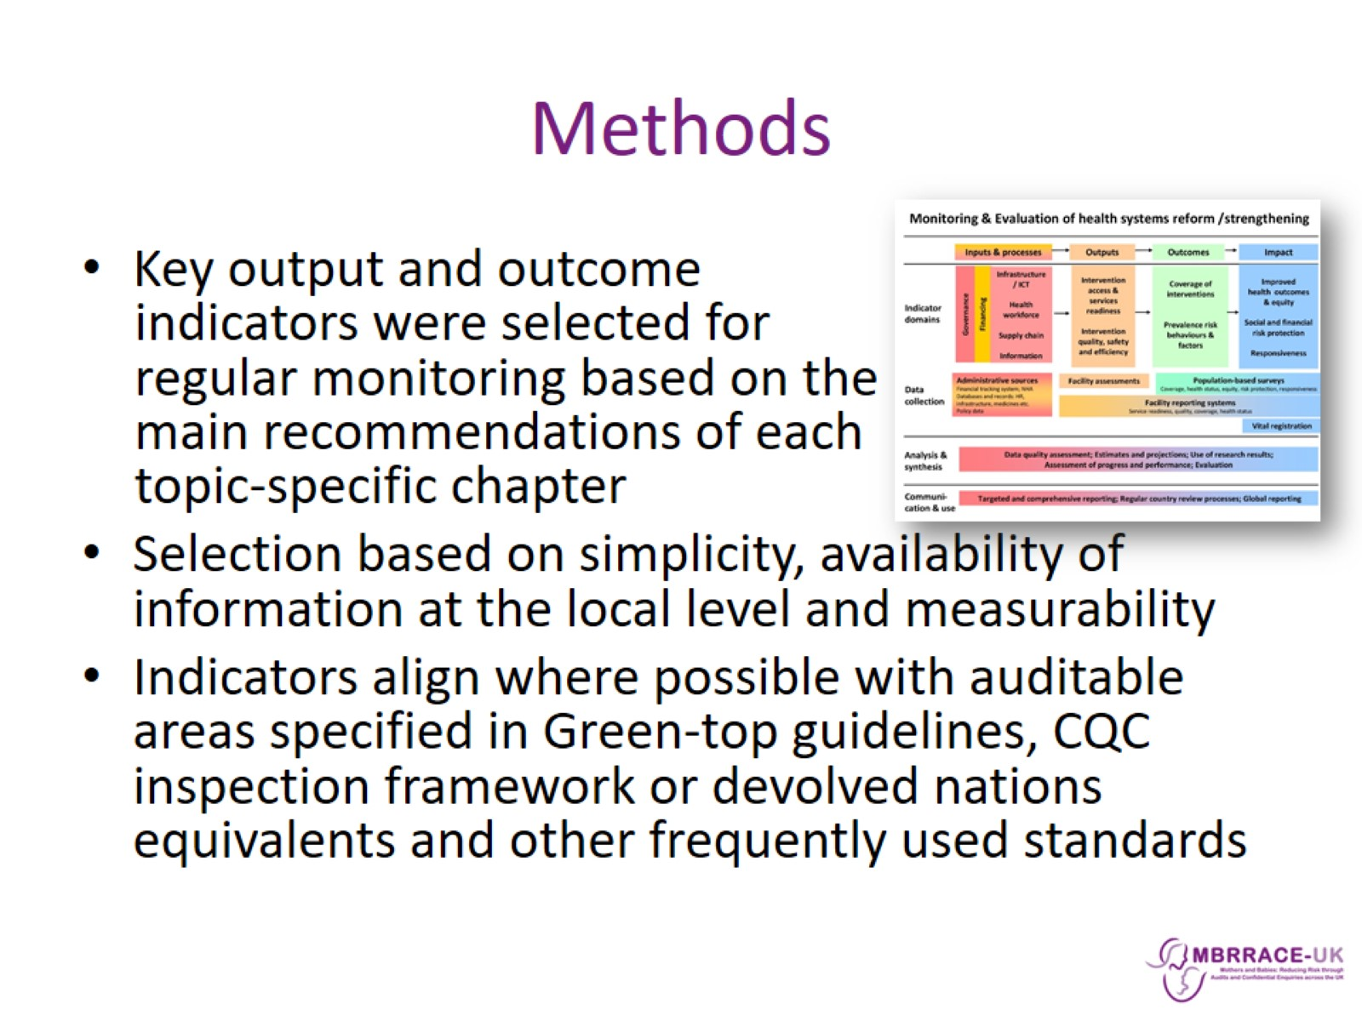
Methods

Slide 8
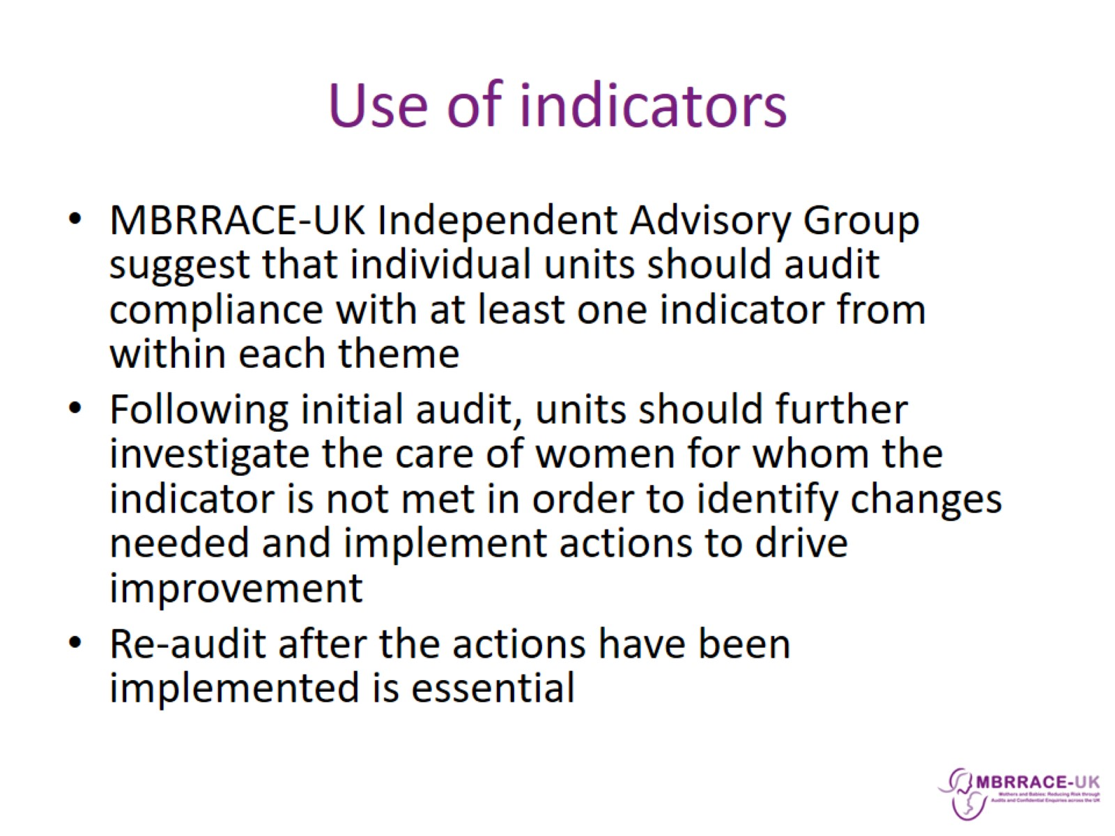
Use of indicators

Slide 9
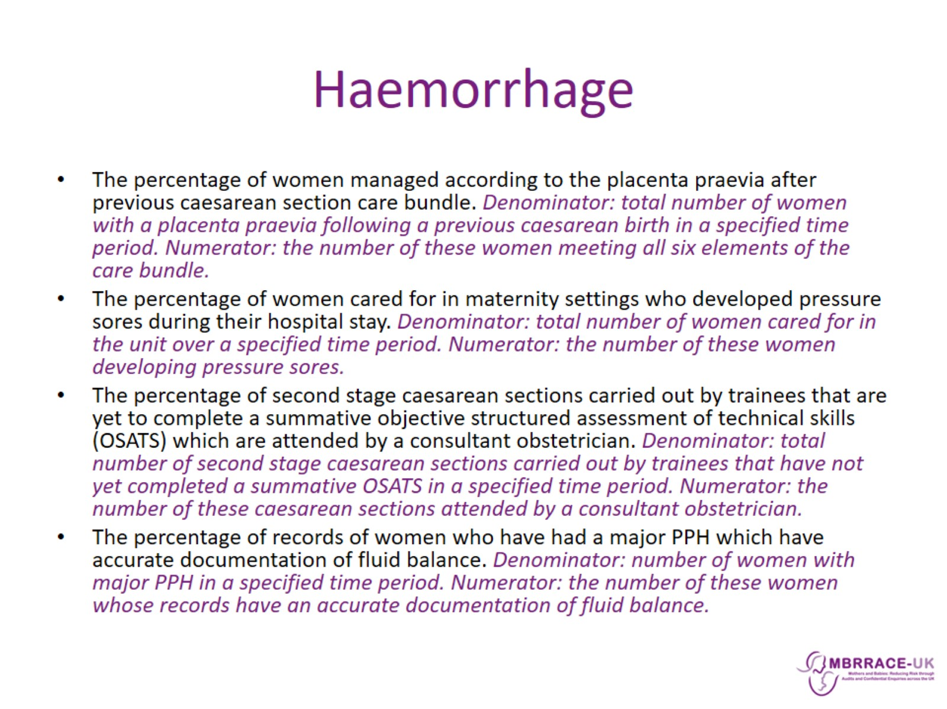
Haemorrhage

Slide 10
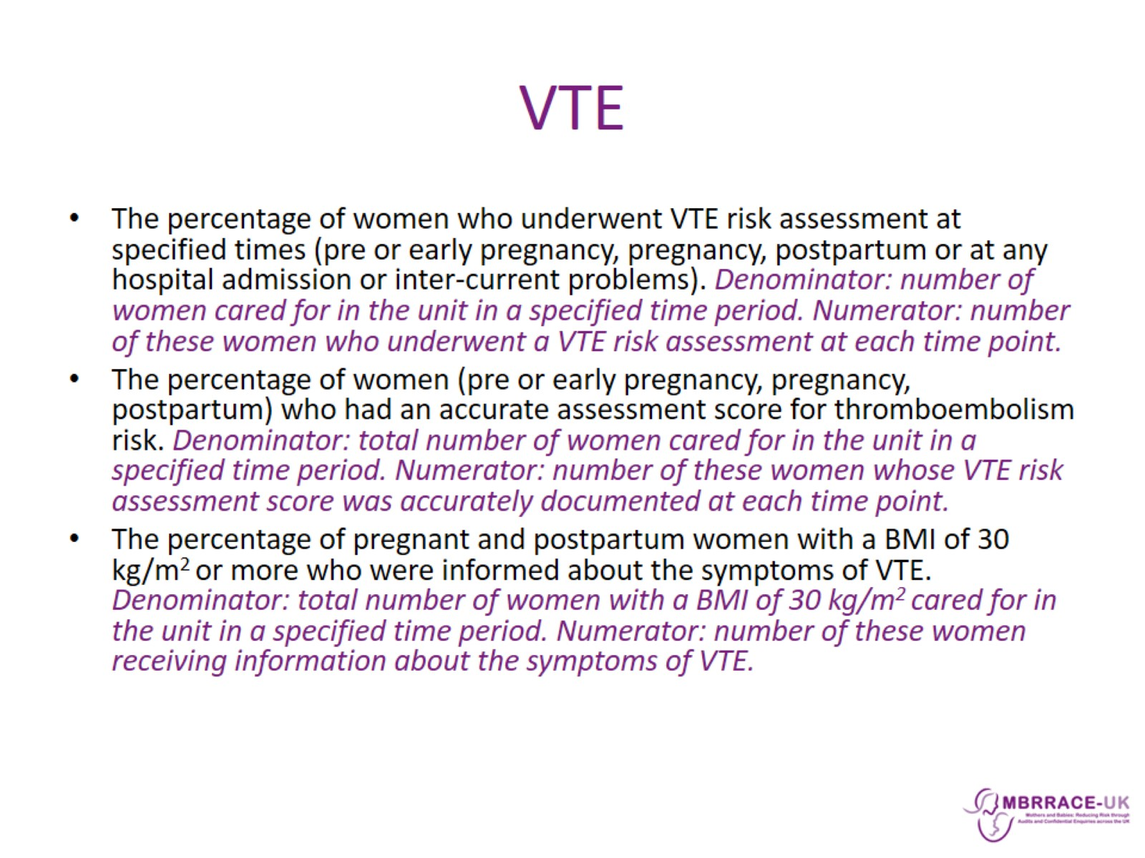
VTE

Slide 11
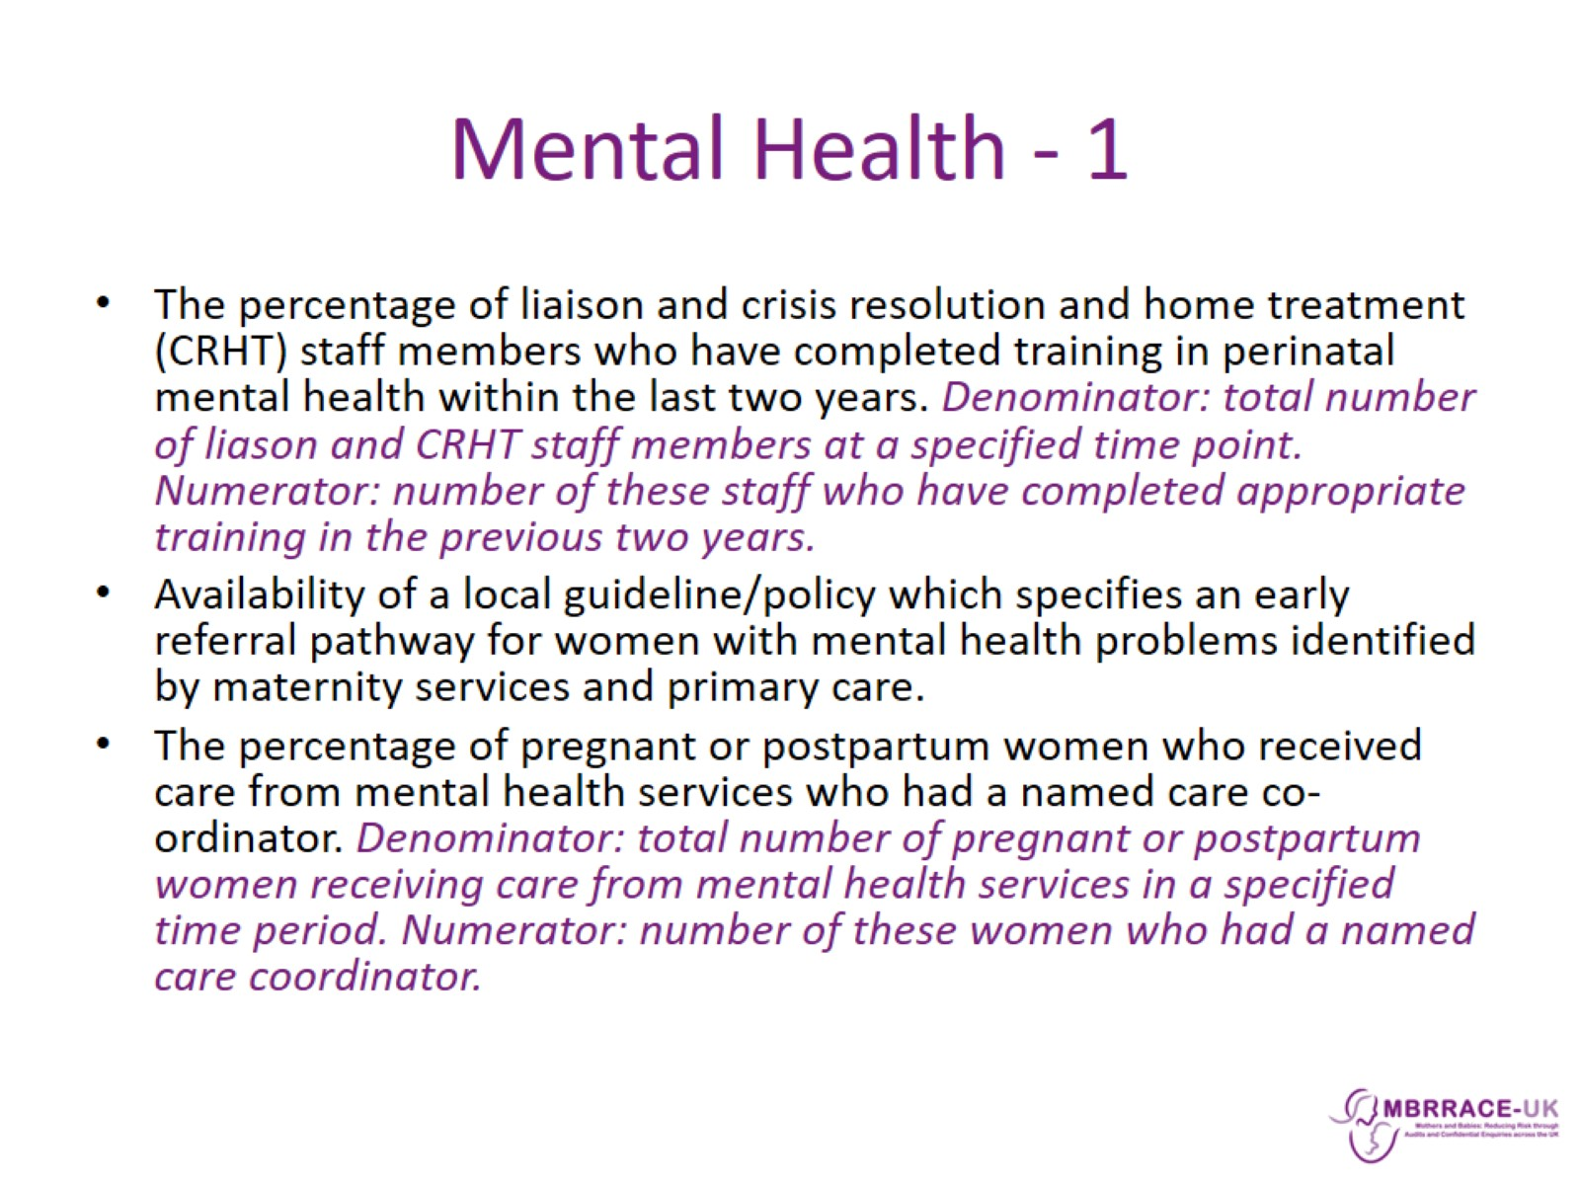
Mental Health - 1

Slide 12
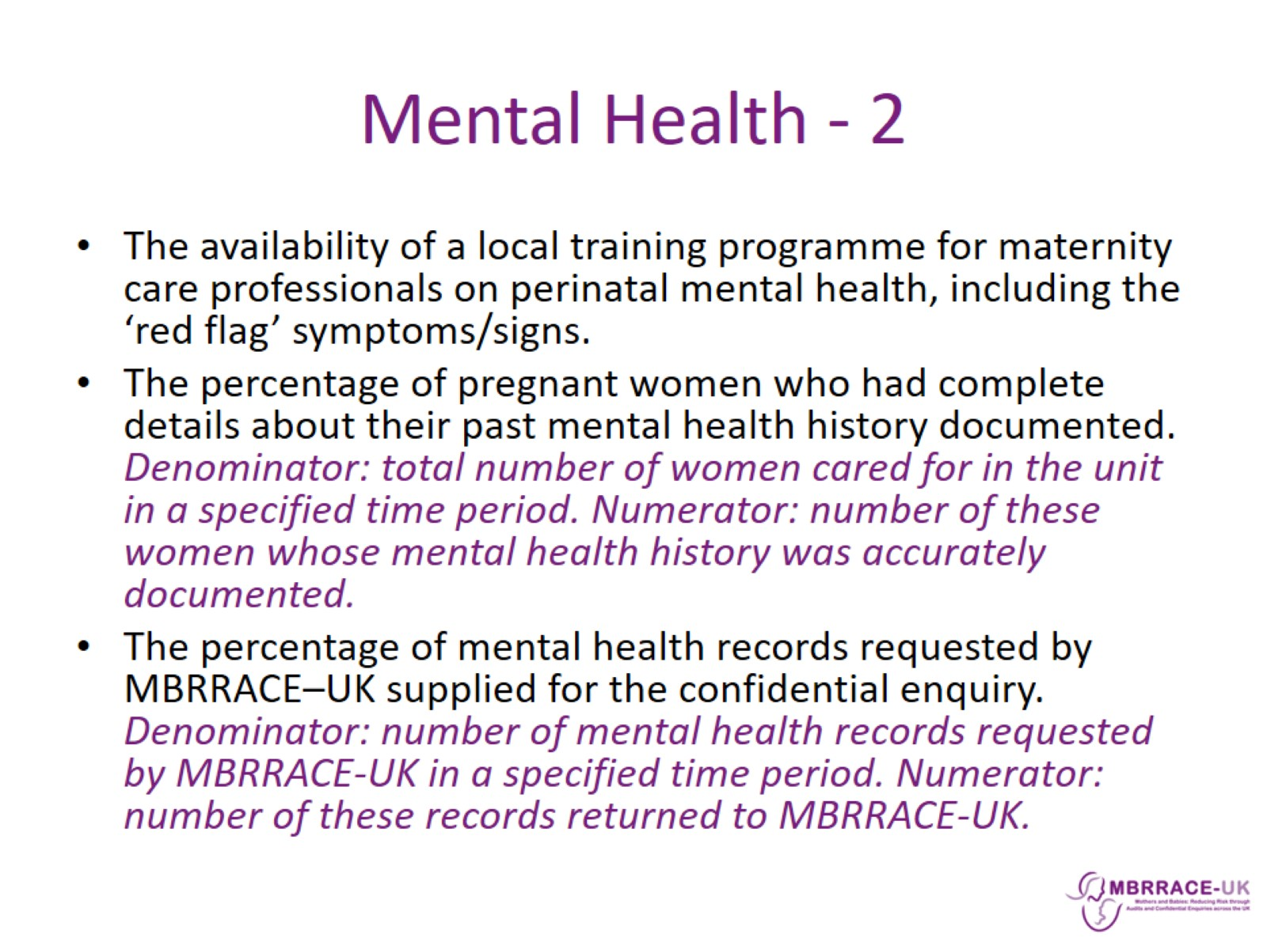
Mental Health - 2

Slide 13

Vulnerable Groups

Slide 14
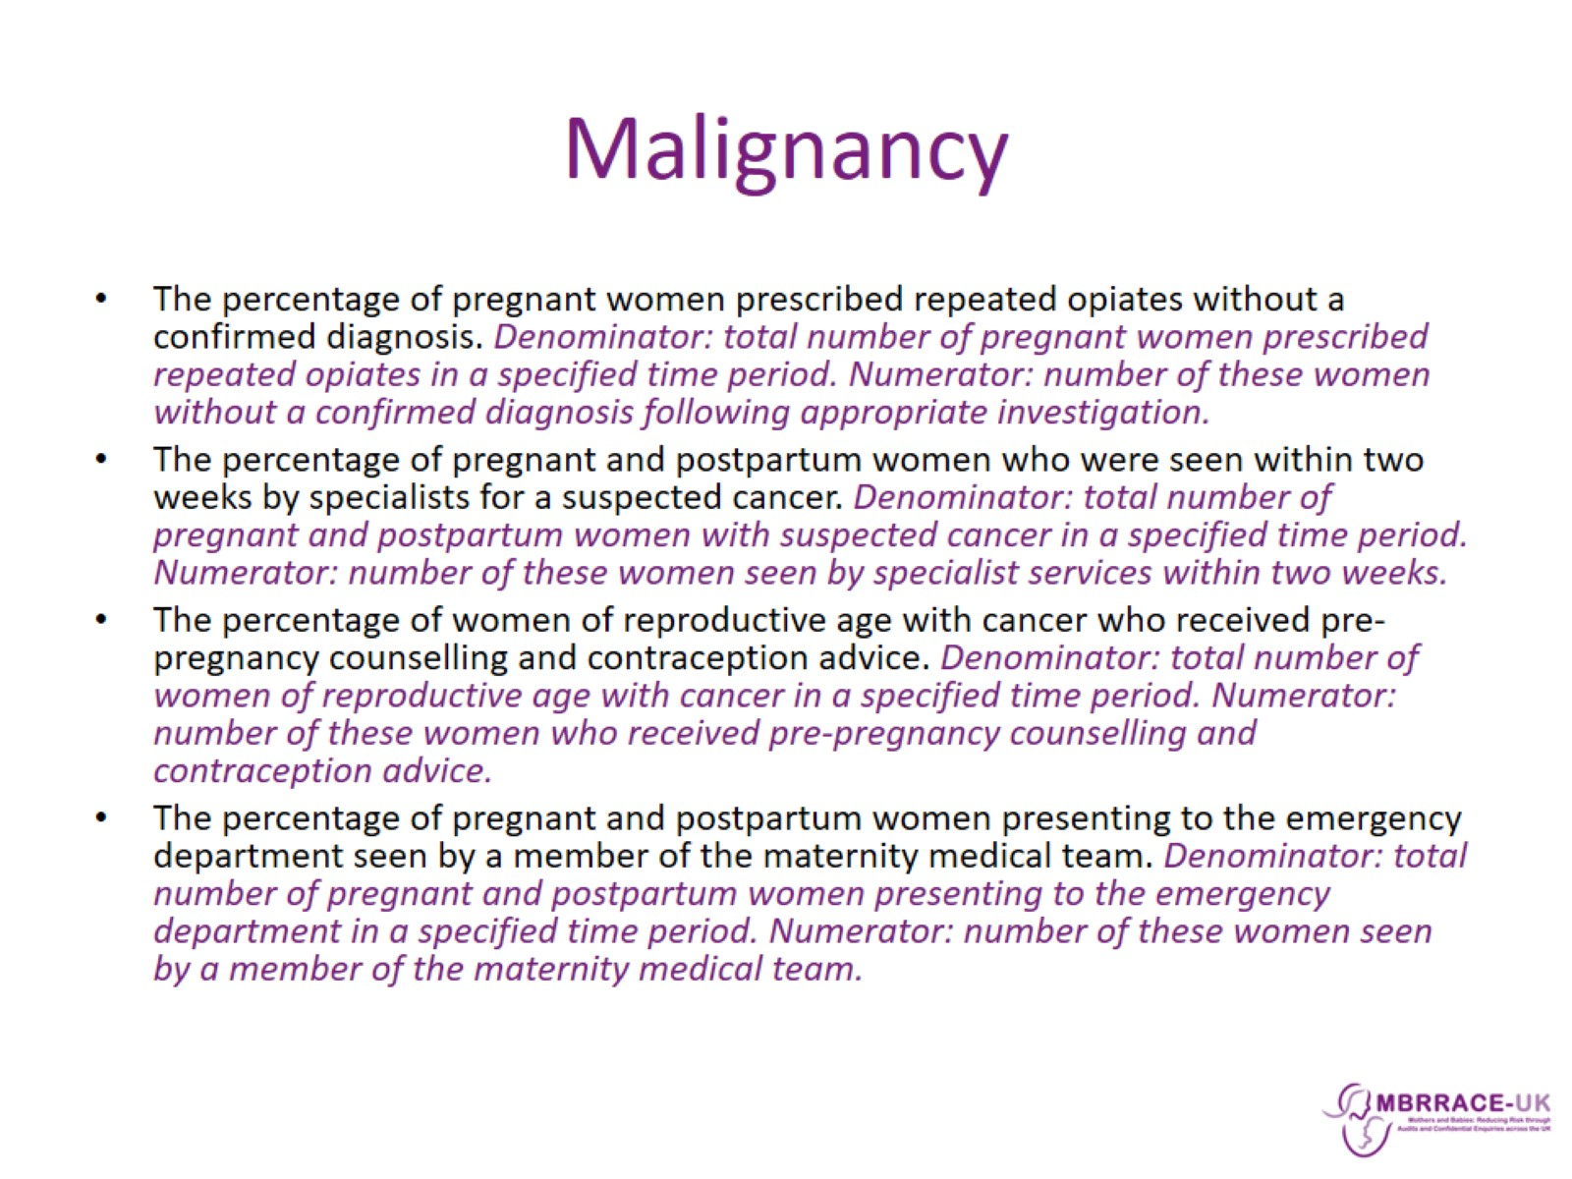
Malignancy

Slide 15

Recurring themes in Confidential Enquiries

